Slide 1
LONGITUDINAL DYNAMICS
Frank Tecker
based on the course by
Joël Le Duff
Many Thanks!
CAS on Advanced Level Accelerator Physics Course
Trondheim, 18-29 August 2013

Slide 2
Summary of the 2 lectures:
Acceleration methods
Accelerating structures
Phase Stability + Energy-Phase oscillations (Linac)
Circular accelerators: Cyclotron / Synchrotron
Dispersion Effects in Synchrotron
Longitudinal Phase Space Motion
Stationary Bucket
Injection Matching
Adiabatic Damping
Two more related lectures:
  Linear Accelerators I + II – Maurizio Vretanar
  RF Cavity Design - Erk Jensen

Slide 3
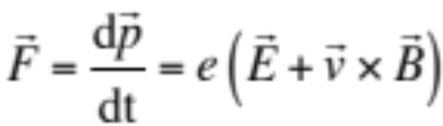

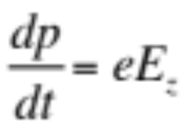
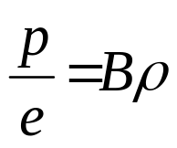
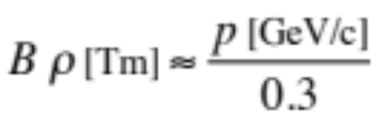
Main Characteristics of an Accelerator
Newton-Lorentz Force on a charged particle:
2nd term always perpendicular to motion => no acceleration
ACCELERATION is the main job of an accelerator.
It provides kinetic energy to charged particles, hence increasing their momentum.
In order to do so, it is necessary to have an electric field
preferably along the direction of the initial momentum (z).
BENDING is generated by a magnetic field perpendicular to the plane of the particle trajectory. The bending radius ρ obeys to the relation :
in practical units:
FOCUSING is a second way of using a magnetic field, in which the bending effect is used to bring the particles trajectory closer to the axis, hence to increase the beam density.

Slide 4
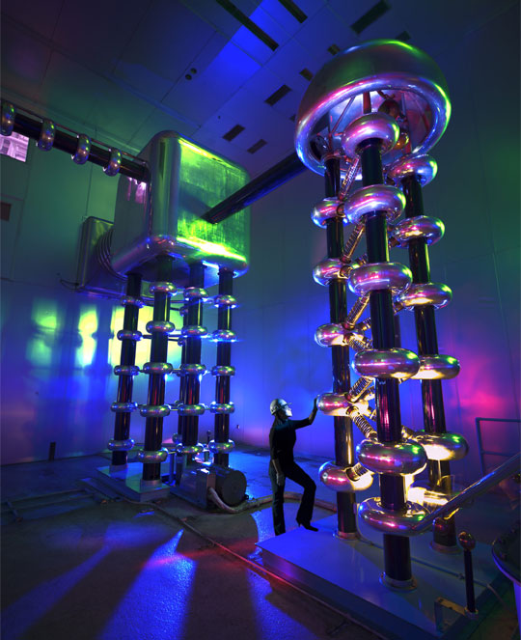
Electrostatic Acceleration
vacuum envelope
E
source
ΔV
Electrostatic Field:
Energy gain: W = e ΔV
Limitation: isolation problems
maximum high voltage (~ 10 MV)
used for first stage of acceleration: particle sources, electron guns
x-ray tubes
750 kV Cockroft-Walton generator
at Fermilab (Proton source)

Slide 5
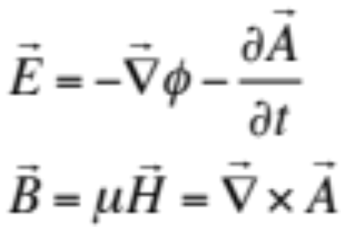
Methods of Acceleration: Induction
From Maxwell’s Equations:
The electric field is derived from a scalar potential φ and a vector potential A
The time variation of the magnetic field H generates an electric field E
Example: Betatron
The varying magnetic field is used to guide
particles on a circular trajectory as well as
for acceleration.
Limited by saturation in iron
vacuum pipe
beam
B_{f}
iron yoke
coil
E
beam
R
B
B_{f}

Slide 6
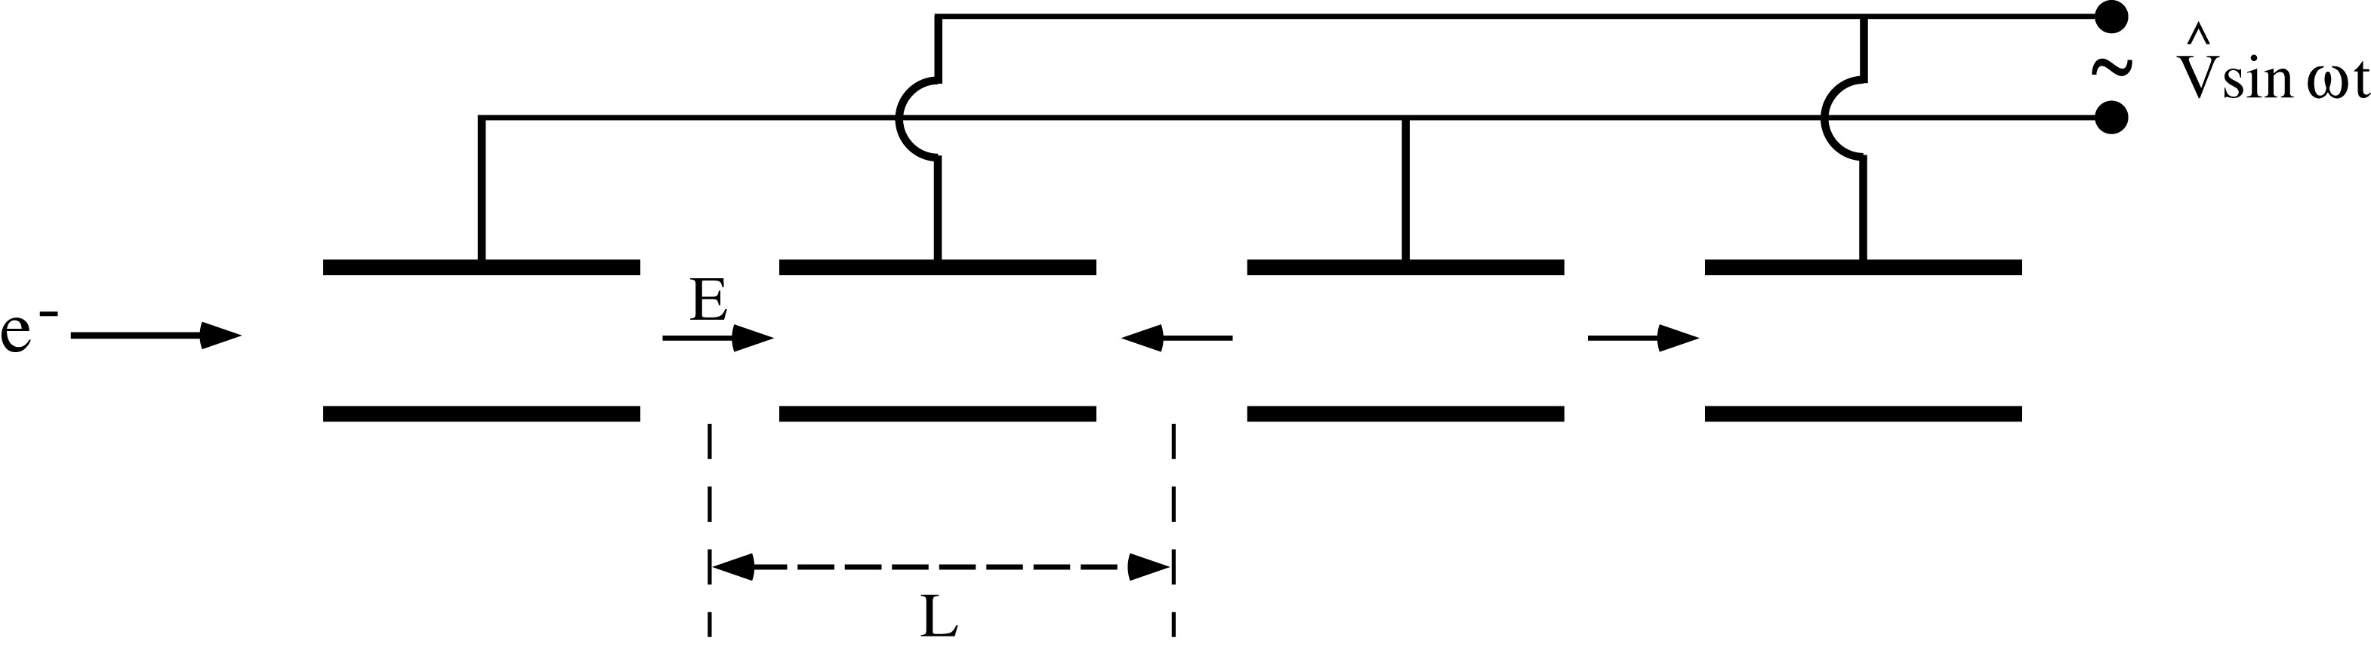
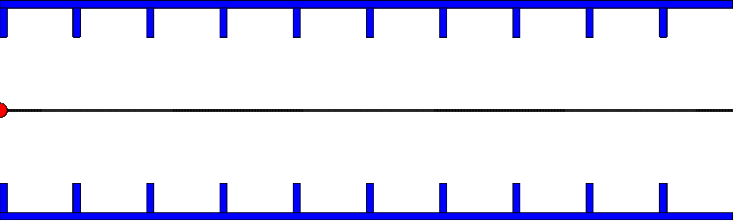
Radio-Frequency (RF) Acceleration
Electrostatic acceleration limited by isolation possibilities => use RF fields
Wideröe-type
structure
Cylindrical electrodes (drift tubes) separated by gaps and fed by a RF generator, as shown above, lead to an alternating electric field polarity
Synchronism condition L = v T/2
v = particle velocity
T = RF period
Similar for standing wave cavity as shown (with v≈c)
D.Schulte

Slide 7
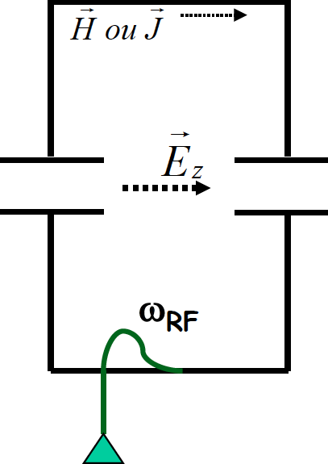
Resonant RF Cavities
Considering RF acceleration, it is obvious that when particles get high velocities the drift spaces get longer and one loses on the efficiency.
=> The solution consists of using a higher operating frequency.
The power lost by radiation, due to circulating currents on the electrodes, is proportional to the RF frequency.
=> The solution consists of enclosing the system in a cavity which resonant frequency matches the RF generator frequency.
The electromagnetic power is now constrained in the resonant volume
Each such cavity can be independently powered from the RF generator
Note however that joule losses will occur in the cavity walls (unless made of superconducting materials)

Slide 8
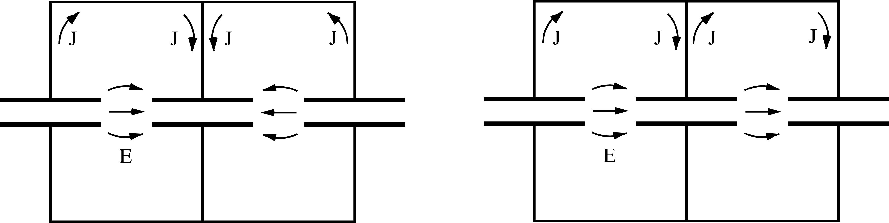
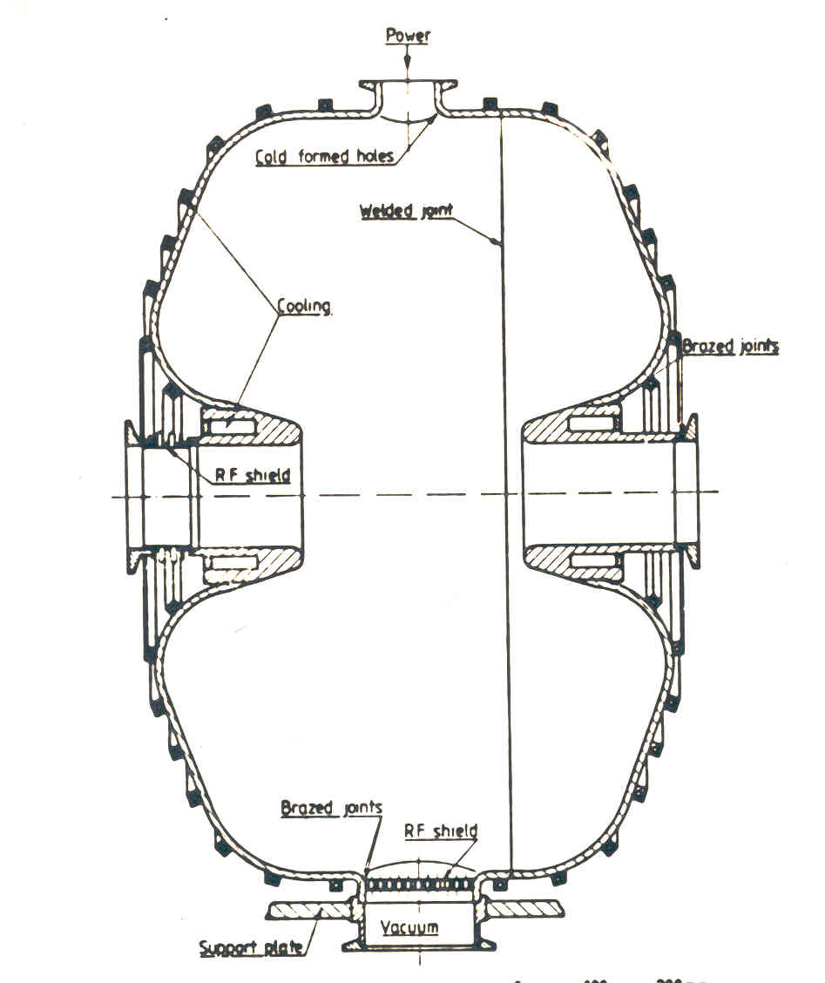
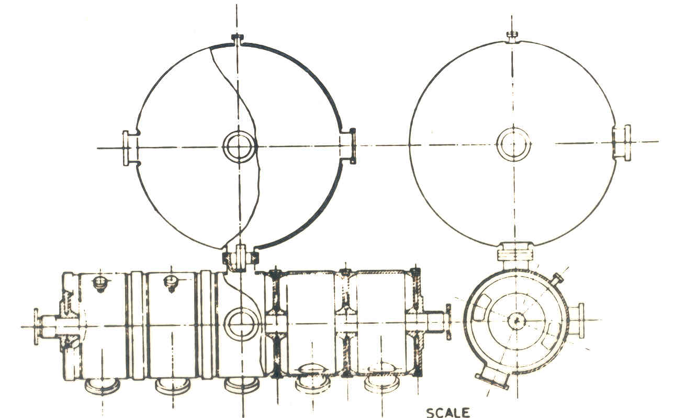
Some RF Cavity Examples
L = vT/2 (π mode) L = vT (2π mode)
Single Gap Multi-Gap

Slide 9
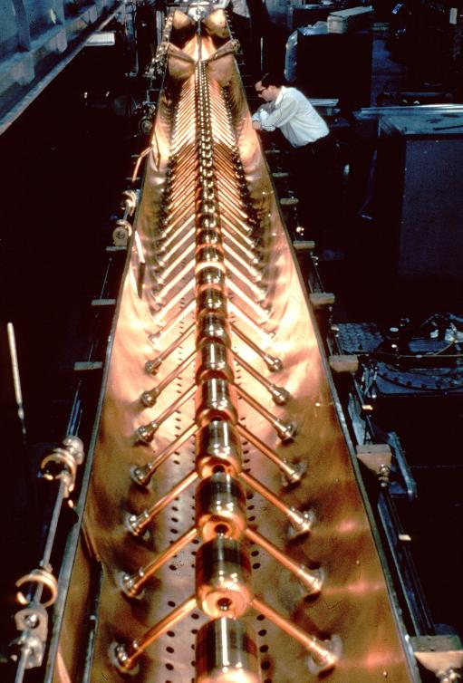

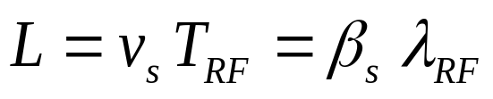
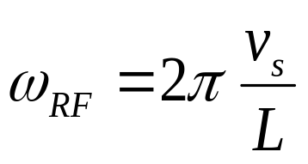
RF acceleration: Alvarez Structure
g
Used for protons, ions (50 – 200 MeV, f ~ 200 MHz)
L₁
L₂
L₃
L₄
L₅
RF generator
LINAC 1 (CERN)
Synchronism condition

Slide 10
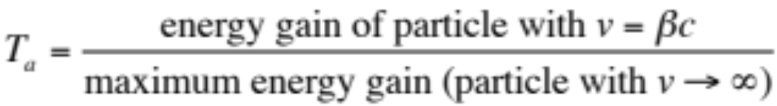
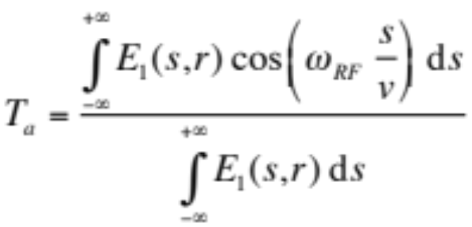

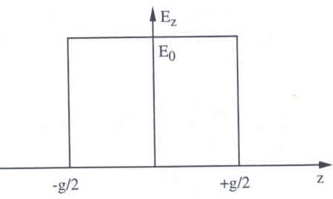
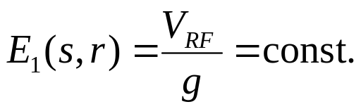
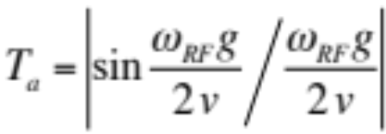
Transit time factor
The accelerating field varies during the passage of the particle
=> particle does not always see maximum field => effective acceleration smaller
Transit time factor defined as:
In the general case, the transit time factor is:
for
Simple model
uniform field:
0 < T_{a} < 1
T_{a} → 1 for g → 0, smaller ω_{RF}
Important for low velocities (ions)
follows:

Slide 11
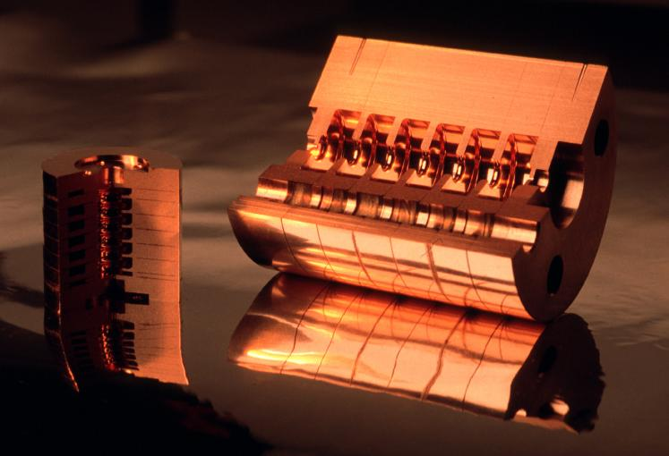
Disc loaded traveling wave structures
-When particles gets ultra-relativistic (v~c) the drift tubes become very long unless the operating frequency is increased. Late 40’s the development of radar led to high power transmitters (klystrons) at very high frequencies (3 GHz).
-Next came the idea of suppressing the drift tubes using traveling waves. However to get a continuous acceleration the phase velocity of the wave needs to be adjusted to the particle velocity.
CLIC Accelerating Structures (30 & 11 GHz)
solution: slow wave guide with irises ==> iris loaded structure

Slide 12
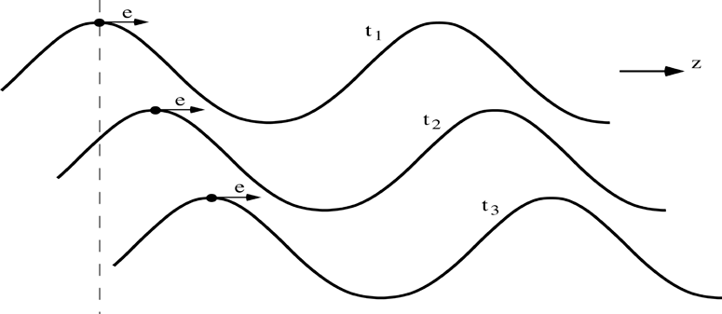
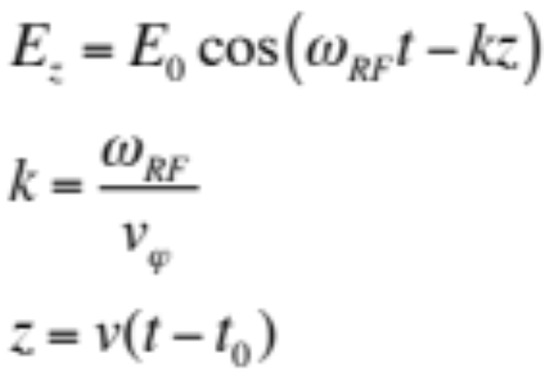
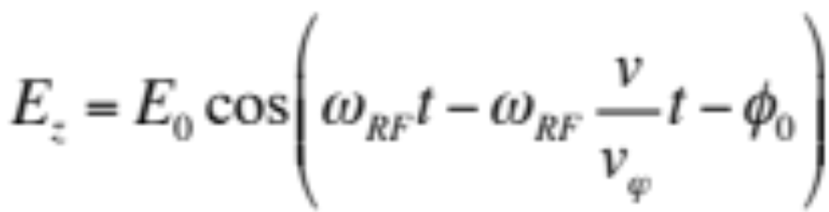

The Traveling Wave Case
wave number
v_{φ} = phase velocity
v = particle velocity
The particle travels along with the wave, and
k represents the wave propagation factor.
v = v_{φ} and
If synchronism satisfied:
where Φ₀ is the RF phase seen by the particle.

Slide 13
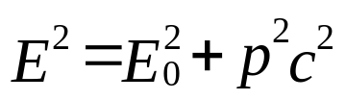


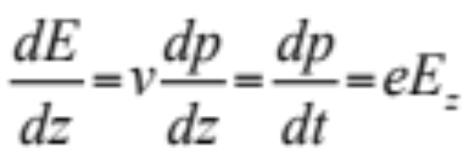

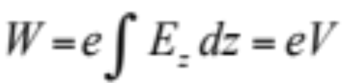
Energy Gain
In relativistic dynamics, total energy E and momentum p are linked by
W kinetic energy
Hence:
The rate of energy gain per unit length of acceleration (along z) is then:
and the kinetic energy gained from the field along the z path is:
where V is just a potential.

Slide 14
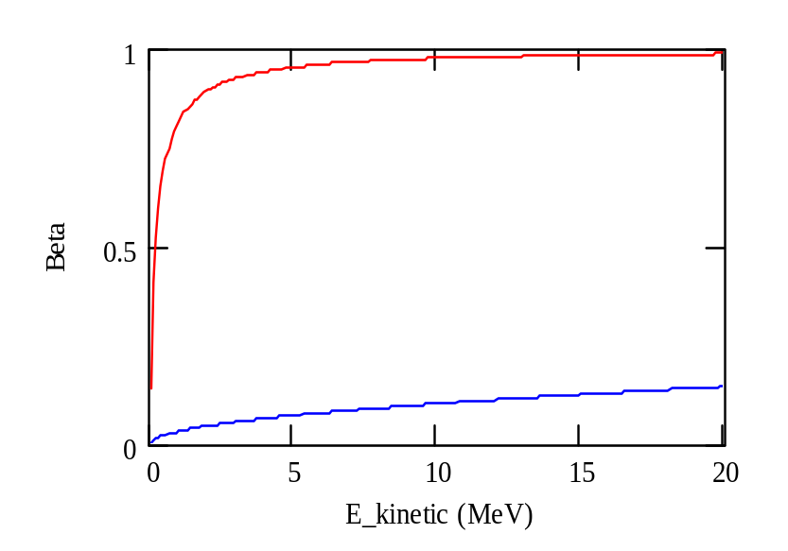
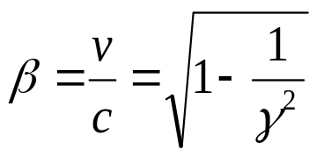
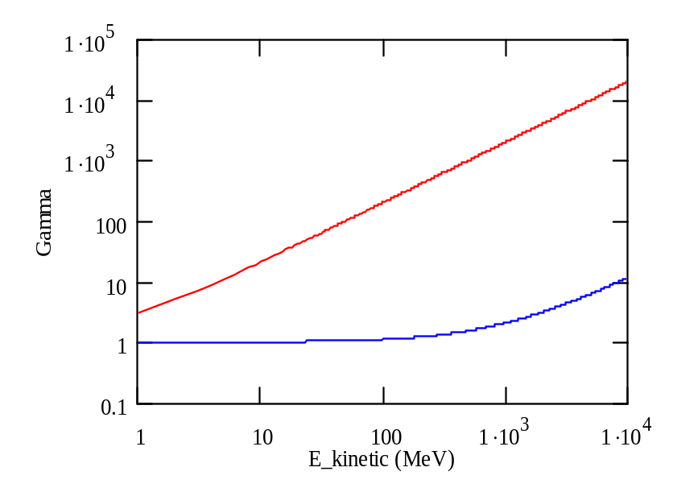
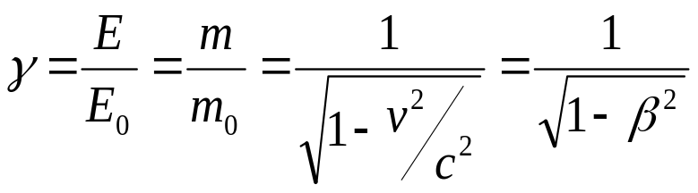
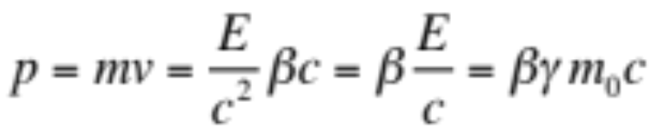
Velocity, Energy and Momentum
electrons
normalized velocity
normalized velocity
=> electrons almost reach the speed of light
very quickly (few MeV range)
protons
total energy
rest energy
total energy
rest energy
electrons
protons
Momentum

Slide 15
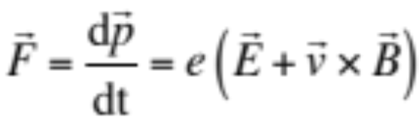
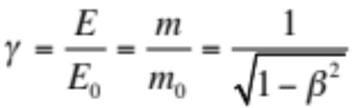
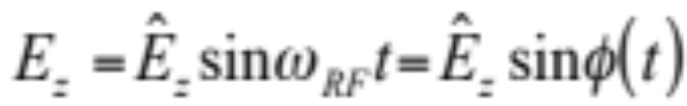
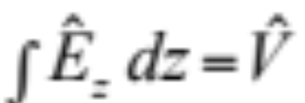
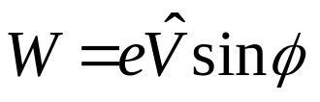
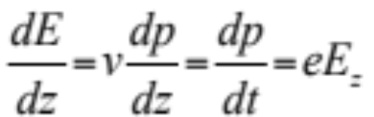

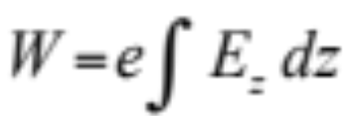
Summary: Relativity + Energy Gain
Newton-Lorentz Force
2nd term always perpendicular to motion => no acceleration
Relativistics Dynamics
RF Acceleration
(neglecting transit time factor)
The field will change during the passage of the particle through the cavity
=> effective energy gain is lower

Slide 16



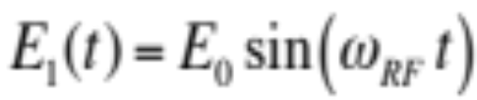
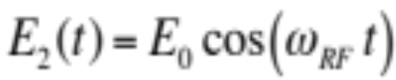
Common Phase Conventions
For circular accelerators, the origin of time is taken at the zero crossing of the RF voltage with positive slope
For linear accelerators, the origin of time is taken at the positive crest of the RF voltage
Time t= 0 chosen such that:
1
2
φ₁
φ₂
3. I will stick to convention 1 in the following to avoid confusion

Slide 17
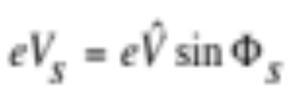
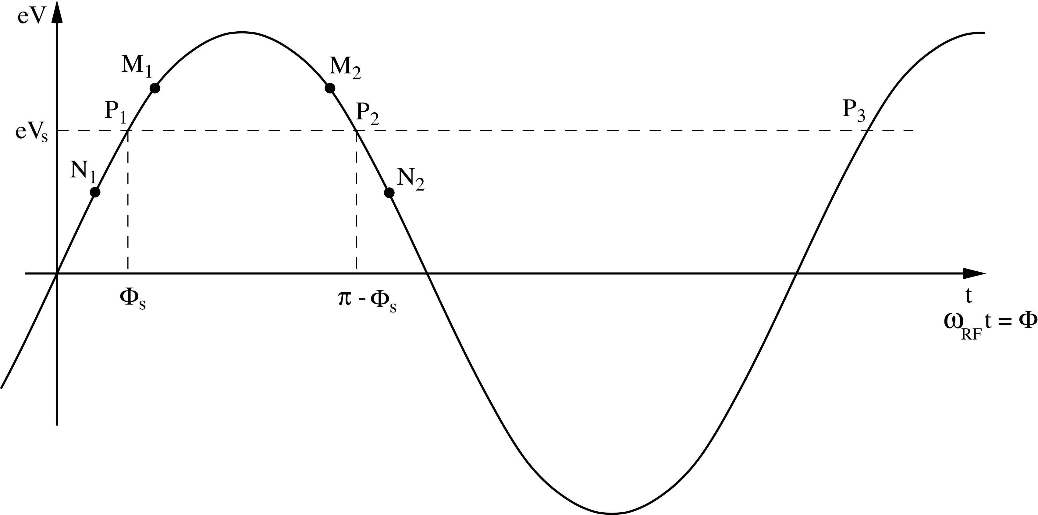
Principle of Phase Stability (Linac)
Let’s consider a succession of accelerating gaps, operating in the 2π mode, for which the synchronism condition is fulfilled for a phase Φs .
is the energy gain in one gap for the particle to reach the
next gap with the same RF phase: P₁ ,P₂, …… are fixed points.
For a 2π mode, the electric field is the same in all gaps at any given time.
If an energy increase is transferred into a velocity increase =>
M₁ & N₁ will move towards P₁ => stable
M₂ & N₂ will go away from P₂ => unstable
(Highly relativistic particles have no significant velocity change)

Slide 18
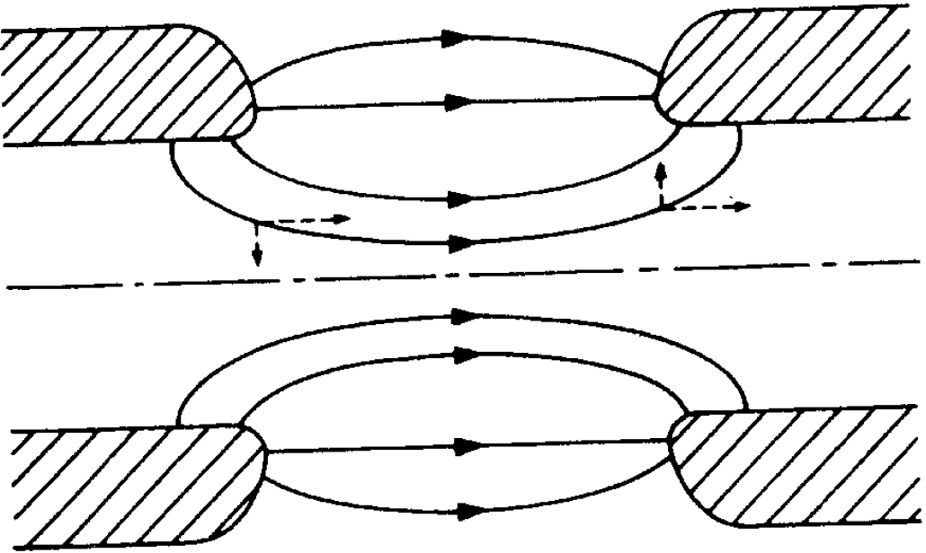
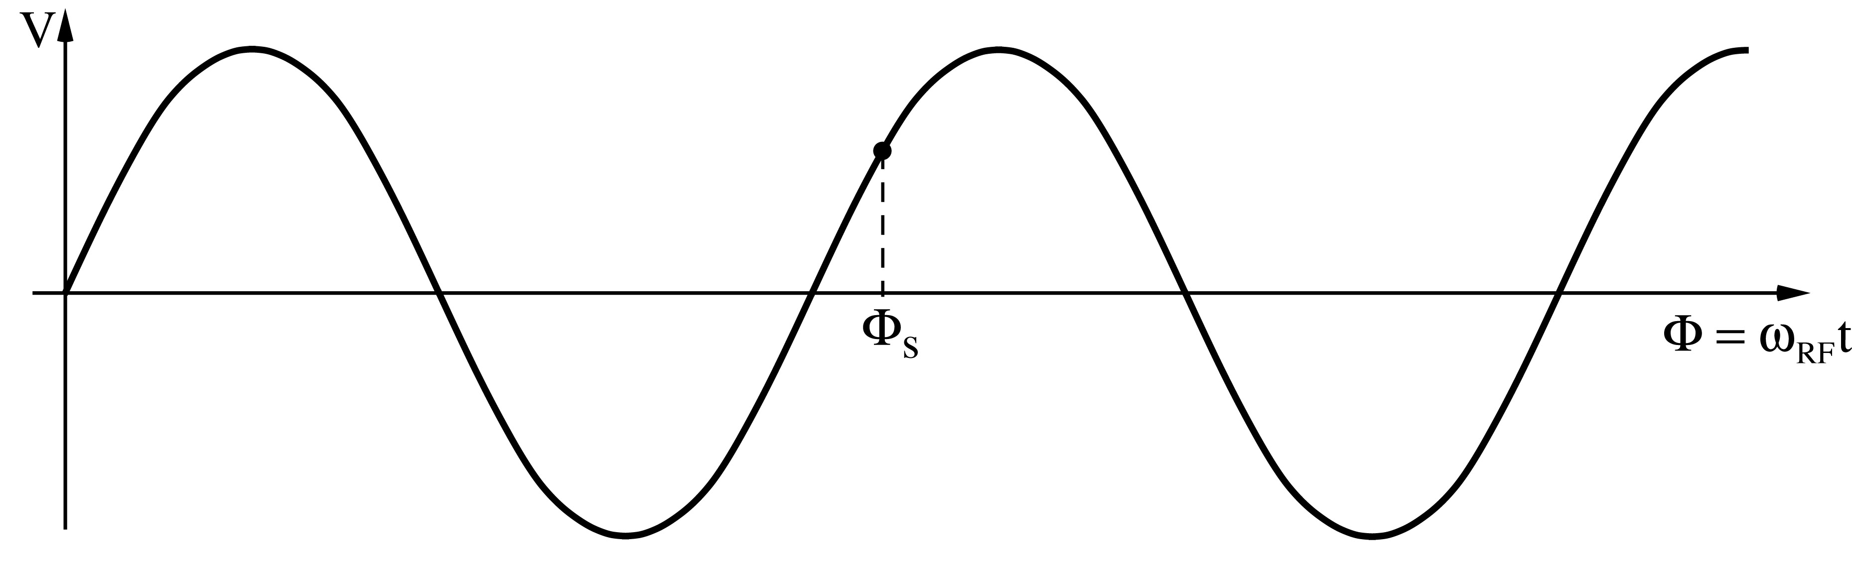
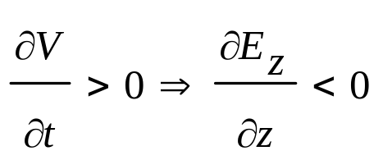
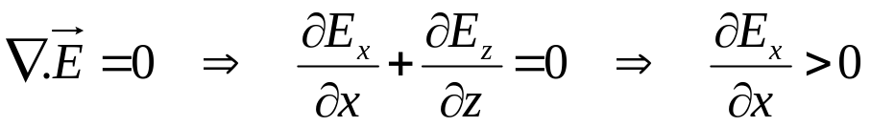
A Consequence of Phase Stability
Transverse focusing fields at the entrance and defocusing at the exit of the cavity.
Electrostatic case: Energy gain inside the cavity leads to focusing
RF case: Field increases during passage => transverse defocusing!
defocusing RF force
Longitudinal phase stability means :
The divergence of the field is zero according to Maxwell :
External focusing (solenoid, quadrupole) is then necessary

Slide 19
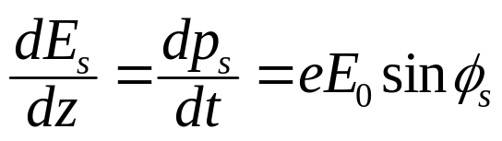


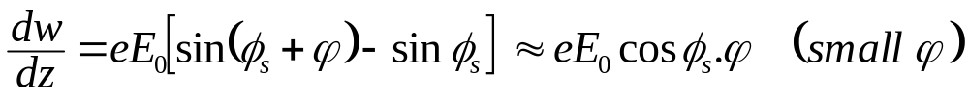
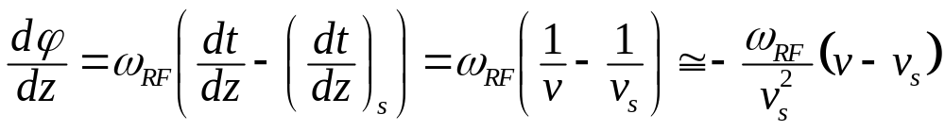

Energy-phase Oscillations (1)
- Rate of energy gain for the synchronous particle:
- Rate of energy gain for a non-synchronous particle, expressed in reduced variables, and :
- Rate of change of the phase with respect to the synchronous one:
Since:

Slide 20







Energy-phase Oscillations (2)
one gets:
Combining the two 1st order equations into a 2nd order equation gives:
with
Stable harmonic oscillations imply:
hence:
And since acceleration also means:
You finally get the result for the stable phase range:

Slide 21
Longitudinal phase space
The energy – phase oscillations can be drawn in phase space:
ΔΕ, Δp/p
ΔΕ, Δp/p
acceleration
move
forward
move
backward
deceleration
φ
φ
reference
The particle trajectory in the phase space (Δp/p, φ) describes its longitudinal motion.
Emittance: phase space area including all the particles
NB: if the emittance contour correspond to a possible orbit in phase space, its shape does not change with time (matched beam)

Slide 22


Circular accelerators: Cyclotron
Used for protons, ions
B = constant
ω_{RF} = constant
RF generator, ω_{RF}
Synchronism condition
B
g
Ion source
Cyclotron frequency
γ increases with the energy ⇒ no exact synchronism
if v << c ⇒ γ ≅ 1
Extraction electrode
Ions trajectory

Slide 23



Cyclotron / Synchrocyclotron
TRIUMF 520 MeV cyclotron Vancouver - Canada
Synchrocyclotron: Same as cyclotron, except a modulation of ω_{RF}
B = constant
  γ ω_{RF} = constant
ω_{RF} decreases with time
Allows to go beyond the
non-relativistic energies
The condition:

Slide 24


Circular accelerators: The Synchrotron
B
Constant orbit during acceleration
To keep particles on the closed orbit, B should increase with time
ω and ω_{RF} increase with energy
R
E
RF cavity
RF generator
h integer,
harmonic number:
number of RF cycles
per revolution
Synchronism condition

Slide 25

The Synchrotron
The synchrotron is a synchronous accelerator since there is a synchronous RF phase for which the energy gain fits the increase of the magnetic field at each turn. That implies the following operating conditions:
E
Energy gain per turn
Synchronous particle
RF synchronism
(h - harmonic number)
Constant orbit
Variable magnetic field
B
Bending
magnet
R=C/2π
injection
extraction
ρ
bending
radius
If v≈c, ω_{r} hence ω_{RF} remain constant (ultra-relativistic e⁻ )

Slide 26





The Synchrotron
Energy ramping is simply obtained by varying the B field (frequency follows v):
Since:
Stable phase φ_{s} changes during energy ramping
The number of stable synchronous particles is equal to the
harmonic number h. They are equally spaced along the circumference.
Each synchronous particle satisfies the relation p=eBρ.
They have the nominal energy and follow the nominal trajectory.

Slide 27








The Synchrotron
During the energy ramping, the RF frequency increases to follow the increase of the revolution frequency :
Hence: ( using )
Since the RF frequency must follow the variation of the B field with the law
This asymptotically tends towards when B becomes large compared to
which corresponds to

Slide 28




Dispersion Effects in a Synchrotron
If a particle is slightly shifted in momentum it will have a different orbit and the length is different.
The “momentum compaction factor” is defined as:
cavity
E
Circumference
2πR
E+δE
If the particle is shifted in momentum it will have also a different velocity.
As a result of both effects the revolution frequency changes:
p=particle momentum
R=synchrotron physical radius
f_{r}=revolution frequency

Slide 29












Dispersion Effects in a Synchrotron (2)
x
dθ
The elementary path difference from the two orbits is:
definition of dispersion D_{x}
leading to the total change in the circumference:
< >_{m} means that the average is considered over the bending magnet only
With ρ=∞ in straight sections we get:

Slide 30






Dispersion Effects in a Synchrotron (3)
definition of momentum compaction factor
η=0 at the transition energy

Slide 31
Phase Stability in a Synchrotron
From the definition of η it is clear that an increase in momentum gives
- below transition (η > 0) a higher revolution frequency
(increase in velocity dominates) while
- above transition (η < 0) a lower revolution frequency (v ≈ c and longer path)
where the momentum compaction (generally > 0) dominates.
Stable synchr. Particle for η < 0
above transition
η > 0

Slide 32

Crossing Transition
At transition, the velocity change and the path length change with momentum compensate each other. So the revolution frequency there is independent from the momentum deviation.
Crossing transition during acceleration makes the previous stable synchronous phase unstable. The RF system needs to make a rapid change of the RF phase, a ‘phase jump’.

Slide 33


Synchrotron oscillations
Simple case (no accel.): B = const., below transition
The phase of the synchronous particle must therefore be φ₀ = 0.
φ₁ - The particle is accelerated
- Below transition, an increase in energy means an increase in revolution frequency
- The particle arrives earlier – tends toward φ₀
φ₂
φ₀
φ₁
φ₂ - The particle is decelerated
- decrease in energy - decrease in revolution frequency
- The particle arrives later – tends toward φ₀

Slide 34



Synchrotron oscillations (2)
φ₂
φ₀
φ₁
Phase space picture

Slide 35


Synchrotron oscillations (3)
Case with acceleration B increasing
1
φ
2
φ_{s}
Phase space picture
stable region
unstable region
The symmetry of the case B = const. is lost
separatrix

Slide 36
Longitudinal Dynamics in Synchrotrons
It is also often called “synchrotron motion”.
The RF acceleration process clearly emphasizes two coupled variables, the energy gained by the particle and the RF phase experienced by the same particle. Since there is a well defined synchronous particle which has always the same phase φ_{s}, and the nominal energy E_{s}, it is sufficient to follow other particles with respect to that particle.
So let’s introduce the following reduced variables:
revolution frequency : Δf_{r} = f_{r} – f_{rs}
particle RF phase : Δφ = φ - φ_{s}
particle momentum : Δp = p - p_{s}
particle energy : ΔE = E – E_{s}
azimuth angle : Δθ = θ - θ_{s}

Slide 37





First Energy-Phase Equation
v
Δθ
particle ahead arrives earlier
=> smaller RF phase
θ_{s}
R
For a given particle with respect to the reference one:
Since:
and
one gets:

Slide 38




Second Energy-Phase Equation
The rate of energy gained by a particle is:
The rate of relative energy gain with respect to the reference particle is then:
Expanding the left-hand side to first order:
leads to the second energy-phase equation:

Slide 39


Equations of Longitudinal Motion
deriving and combining
This second order equation is non linear. Moreover the parameters within the bracket are in general slowly varying with time.
We will study some cases in the following…

Slide 40



Small Amplitude Oscillations
Let’s assume constant parameters R_{s}, p_{s}, ω_{s} and η:
with
Consider now small phase deviations from the reference particle:
(for small Δφ)
and the corresponding linearized motion reduces to a harmonic oscillation:
where Ω_{s} is the synchrotron angular frequency

Slide 41







Stability condition for ϕ_{s}
Stability is obtained when Ω_{s} is real and so Ω_{s}² positive:
cos (φ_{s})
V_{RF}
 < _{tr}
 > _{tr}
 > _{tr}
 < _{tr}
Stable in the region if
acceleration
deceleration

Slide 42




Large Amplitude Oscillations
For larger phase (or energy) deviations from the reference the second order differential equation is non-linear:
(Ω_{s} as previously defined)
Multiplying by and integrating gives an invariant of the motion:
which for small amplitudes reduces to:
(the variable is Δφ, and φ_{s} is constant)
Similar equations exist for the second variable : ΔE∝dφ/dt

Slide 43



Large Amplitude Oscillations (2)
When φ reaches π-φ_{s} the force goes to zero and beyond it becomes non restoring.
Hence π-φ_{s} is an extreme amplitude for a stable motion which in the
phase space( ) is shown as
closed trajectories.
Equation of the separatrix:
Second value φ_{m} where the separatrix crosses the horizontal axis:
Area within this separatrix is called “RF bucket”.

Slide 44






Energy Acceptance
From the equation of motion it is seen that reaches an extreme
when , hence corresponding to .
Introducing this value into the equation of the separatrix gives:
That translates into an acceptance in energy:
This “RF acceptance” depends strongly on φ_{s} and plays an important role for the capture at injection, and the stored beam lifetime.

Slide 45

RF Acceptance versus Synchronous Phase
The areas of stable motion (closed trajectories) are called “BUCKET”.
As the synchronous phase gets closer to 90º the buckets gets smaller.
The number of circulating buckets is equal to “h”.
The phase extension of the bucket is maximum for φ_{s} =180º (or 0°) which correspond to no acceleration . The RF acceptance increases with the RF voltage.

Slide 46





Stationnary Bucket - Separatrix
This is the case sinφ_{s}=0 (no acceleration) which means φ_{s}=0 or π . The equation of the separatrix for φ_{s}= π (above transition) becomes:
Replacing the phase derivative by the (canonical) variable W:
W
W_{bk}
and introducing the expression for Ω_{s} leads to the following equation for the separatrix:
φ
0
π
2π
with C=2πR_{s}

Slide 47






Stationnary Bucket (2)
Setting φ=π in the previous equation gives the height of the bucket:
This results in the maximum energy acceptance:
The area of the bucket is:
Since:
one gets:

Slide 48

Effect of a Mismatch
Injected bunch: short length and large energy spread
after 1/4 synchrotron period: longer bunch with a smaller energy spread.
W
W
φ
φ
For larger amplitudes, the angular phase space motion is slower
(1/8 period shown below) => can lead to filamentation and emittance growth
W.Pirkl
stationary bucket
accelerating bucket

Slide 49







Bunch Matching into a Stationnary Bucket
A particle trajectory inside the separatrix is described by the equation:
φ_{s}= π
W
The points where the trajectory crosses the axis are symmetric with respect to φ_{s}= π
W_{bk}
W_{b}
0
π
φ
π
2π
φ_{m}
2π-φ_{m}

Slide 50







Bunch Matching into a Stationnary Bucket (2)
Setting φ = π in the previous formula allows to calculate the bunch height:
or:
This formula shows that for a given bunch energy spread the proper matching of a shorter bunch (φ_{m} close to π, small)
will require a bigger RF acceptance, hence a higher voltage
For small oscillation amplitudes the equation of the ellipse reduces to:
Ellipse area is called longitudinal emittance

Slide 51

Capture of a Debunched Beam with Fast Turn-On

Slide 52

Capture of a Debunched Beam with Adiabatic Turn-On

Slide 53




Potential Energy Function
The longitudinal motion is produced by a force that can be derived from a scalar potential:
The sum of the potential energy and kinetic energy is constant and by analogy represents the total energy of a non-dissipative system.

Slide 54






Hamiltonian of Longitudinal Motion
Introducing a new convenient variable, W, leads to the 1st order equations:
The two variables φ,W are canonical since these equations of motion can be derived from a Hamiltonian H(φ,W,t):

Slide 55


Adiabatic Damping
Though there are many physical processes that can damp the longitudinal oscillation amplitudes, one is directly generated by the acceleration process itself. It will happen in the synchrotron, even ultra-relativistic, when ramping the energy but not in the ultra-relativistic electron linac which does not show any oscillation.
As a matter of fact, when E_{s} varies with time, one needs to be more careful in combining the two first order energy-phase equations in one second order equation:
The damping coefficient is proportional to the rate of energy variation and from the definition of Ω_{s} one has:

Slide 56






Adiabatic Damping (2)
So far it was assumed that parameters related to the acceleration process were constant. Let’s consider now that they vary slowly with respect to the period of longitudinal oscillation (adiabaticity).
For small amplitude oscillations the hamiltonian reduces to:
with
Under adiabatic conditions the Boltzman-Ehrenfest theorem states that the action integral remains constant:
(W, φ are canonical variables)
Since:
the action integral becomes:

Slide 57






Adiabatic Damping (3)
Previous integral over one period:
leads to:
From the quadratic form of the hamiltonian one gets the relation:
Finally under adiabatic conditions the long term evolution of the oscillation amplitudes is shown to be:

Slide 58
Bibliography
M. Conte, W.W. Mac Kay An Introduction to the Physics of particle Accelerators
        (World Scientific, 1991)
P. J. Bryant and K. Johnsen The Principles of Circular Accelerators and Storage Rings
        (Cambridge University Press, 1993)
D. A. Edwards, M. J. Syphers An Introduction to the Physics of High Energy Accelerators
        (J. Wiley & sons, Inc, 1993)
H. Wiedemann Particle Accelerator Physics
(Springer-Verlag, Berlin, 1993)
M. Reiser Theory and Design of Charged Particles Beams
        (J. Wiley & sons, 1994)
A. Chao, M. Tigner Handbook of Accelerator Physics and Engineering
        (World Scientific 1998)
K. Wille The Physics of Particle Accelerators: An Introduction
        (Oxford University Press, 2000)
E.J.N. Wilson An introduction to Particle Accelerators
        (Oxford University Press, 2001)
And CERN Accelerator Schools (CAS) Proceedings

