Slide 1
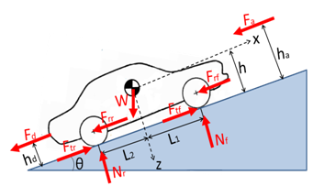

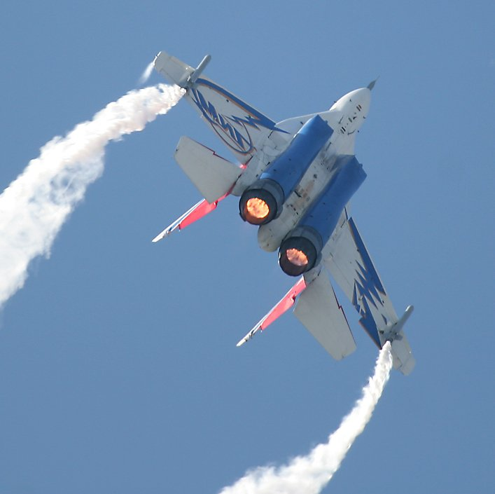

LONGITUDINAL
DYNAMICS
RECAP
Frank Tecker
CERN, BE-OP
Advanced Accelerator Physics Course
Warsaw, 27/9-9/10/2015

Slide 2
Summary of the 2 lectures:
Acceleration methods
Accelerating structures
Linac: Phase Stability + Energy-Phase oscillations
Circular accelerators: Cyclotron / Synchrotron
Dispersion Effects in Synchrotron
Stability and Longitudinal Phase Space Motion
Stationary Bucket
Injection Matching
Including selected topics from Introductory CAS lectures :
  Linacs – Alessandra Lombardi
  RF Systems - Erk Jensen
  Electron Beam Dynamics - Lenny Rivkin

Slide 3
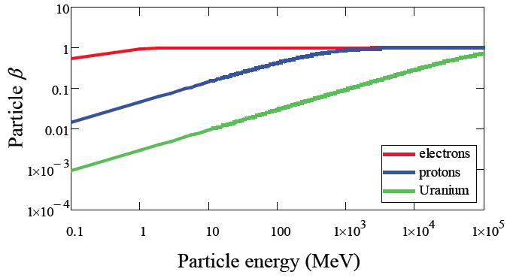
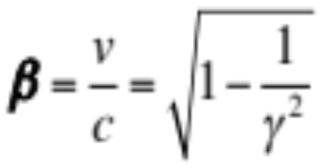
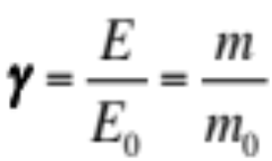
Particle types and acceleration
The accelerating system will depend upon the evolution of the particle velocity along the system
• electrons reach a constant velocity at relatively low energy
• heavy particles reach a constant velocity only at very high energy
-> we need different types of resonators,
optimized for different velocities
Particle rest mass:
electron 0.511 MeV
proton 938 MeV
²³⁹U ~220000 MeV
Relativistic
gamma factor:
E=E₀+W
particle kinetic energy W [MeV]

Slide 4
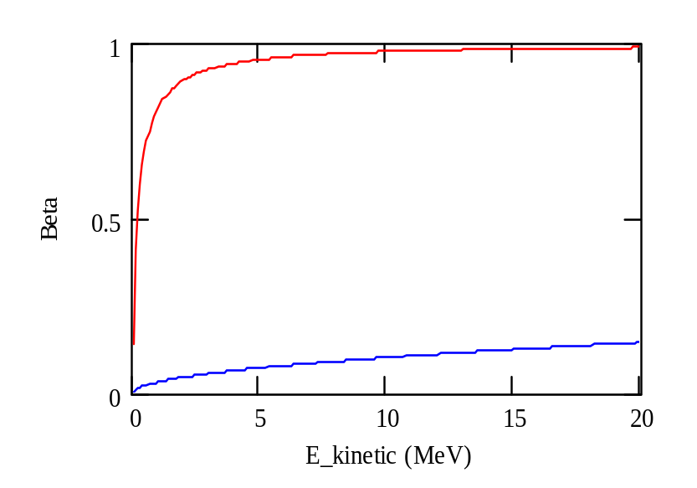

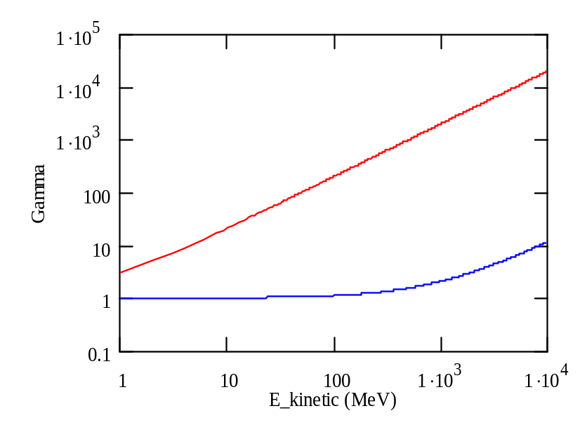
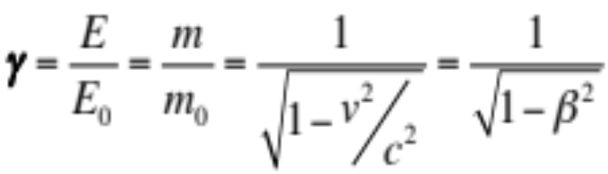
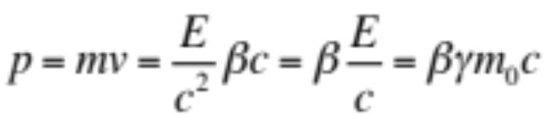
Velocity, Energy and Momentum
normalized velocity
electrons
normalized velocity
=> electrons almost reach the speed of light
very quickly (few MeV range)
protons
total energy
rest energy
total energy
rest energy
electrons
protons
Momentum

Slide 5

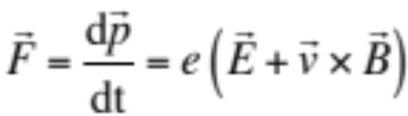
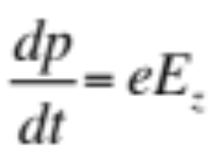
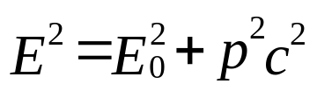


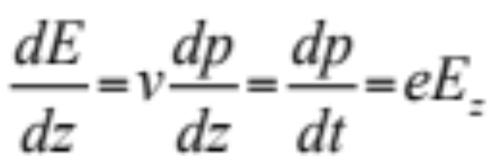

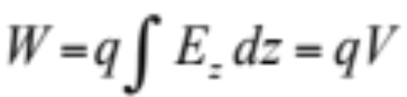
Acceleration + Energy Gain
May the force
be with you!
To accelerate, we need a force in the direction of motion!
Newton-Lorentz Force on a charged particle:
2nd term always perpendicular to motion => no acceleration
Hence, it is necessary to have an electric field E
(preferably) along the direction of the initial momentum (z),
which changes the momentum p of the particle.
In relativistic dynamics, total energy E and momentum p are linked by
The rate of energy gain per unit length of acceleration (along z) is then:
and the kinetic energy gained from the field along the z path is:
- V is a potential
- q the charge

Slide 6
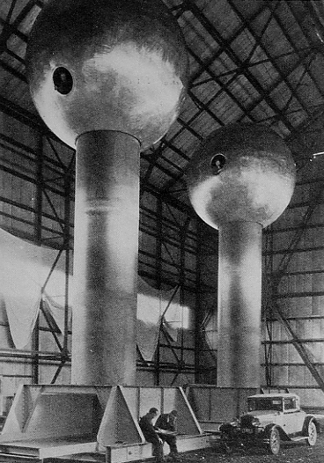
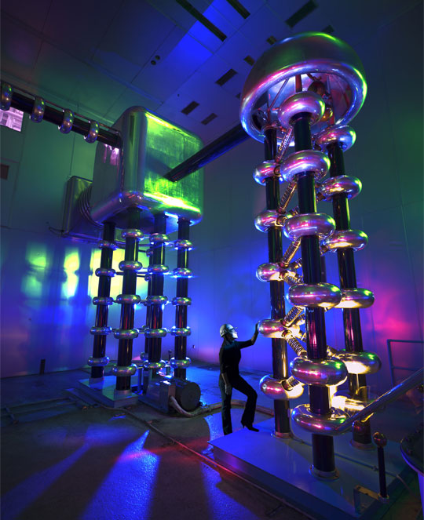
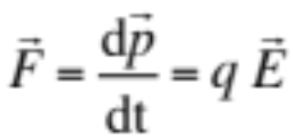
Electrostatic Acceleration
E
source
ΔV
vacuum envelope
Electrostatic Field:
Force:
Energy gain: W = q ΔV
used for first stage of acceleration: particle sources, electron guns,
x-ray tubes
Limitation: insulation problems
maximum high voltage (~ 10 MV)
750 kV Cockroft-Walton generator
at Fermilab (Proton source)
Van-de-Graaf generator at MIT

Slide 7
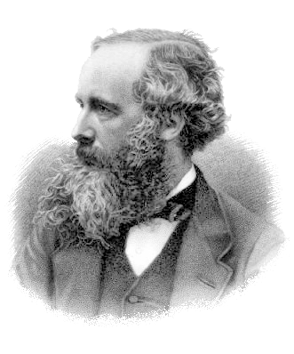
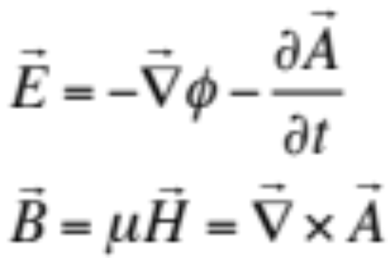
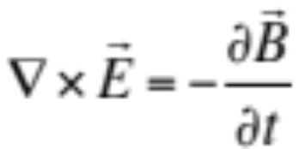
Methods of Acceleration: Time varying fields
The electrostatic field is limited by insulation,
the magnetic field does not accelerate.
From Maxwell’s Equations:
The electric field is derived from a scalar potential φ and a vector potential A
The time variation of the magnetic field H generates an electric field E
The solution: => time varying electric fields !
1) Induction
2) RF frequency fields
Consequence: We can only accelerate bunched beam!
or

Slide 8
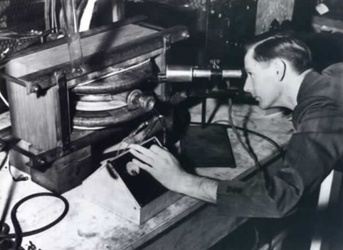
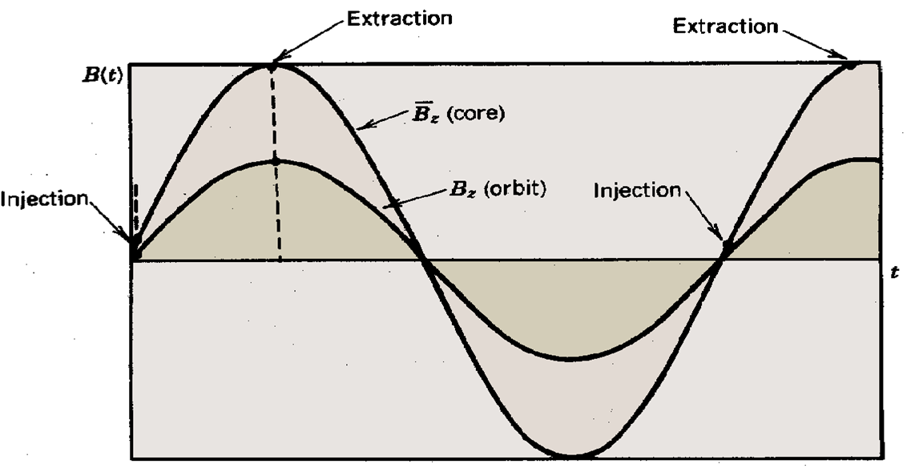
Acceleration by Induction: The Betatron
It is based on the principle of a transformer:
- primary side: large electromagnet - secondary side: electron beam.
The ramping magnetic field is used to guide particles on a circular trajectory as well as for acceleration.
Limited by saturation in iron (~300 MeV e-)
Used in industry and medicine, as they are
compact accelerators for electrons
side view
vacuum pipe
beam
B_{f}
iron yoke
coil
E
top
view
beam
R
time
B
Donald Kerst with the first betatron, invented at the University of Illinois in 1940
B_{f}

Slide 9
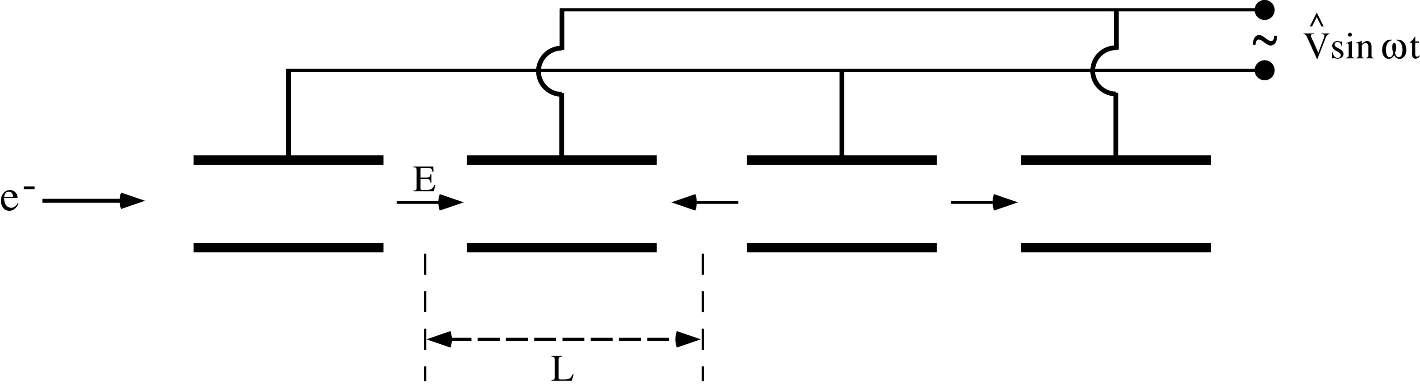
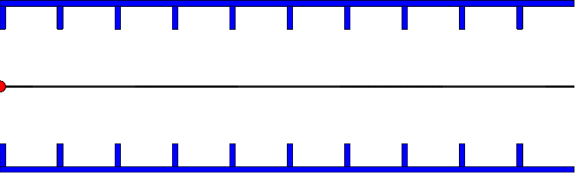
Radio-Frequency (RF) Acceleration
Electrostatic acceleration limited by isolation possibilities => use RF fields
Widerøe-type
structure
Animation: http://www.sciences.univ-nantes.fr/sites/genevieve_tulloue/Meca/Charges/linac.html
Cylindrical electrodes (drift tubes) separated by gaps and fed by a RF generator, as shown above, lead to an alternating electric field polarity
Synchronism condition L = v T/2
v = particle velocity
T = RF period
Similar for standing wave cavity as shown (with v≈c)
D.Schulte

Slide 10
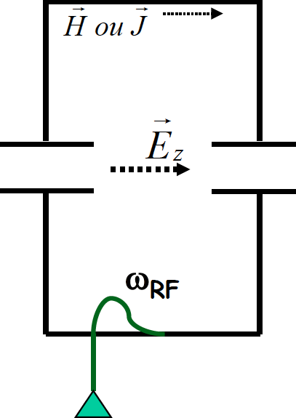
Resonant RF Cavities
Considering RF acceleration, it is obvious that when particles get high velocities the drift spaces get longer and one looses on the efficiency.
=> The solution consists of using a higher operating frequency.
The power lost by radiation, due to circulating currents on the electrodes, is proportional to the RF frequency.
=> The solution consists of enclosing the system in a cavity which resonant frequency matches the RF generator frequency.
The electromagnetic power is now constrained in the resonant volume
Each such cavity can be independently powered from the RF generator
Note however that joule losses will occur in the cavity walls (unless made of superconducting materials)

Slide 11
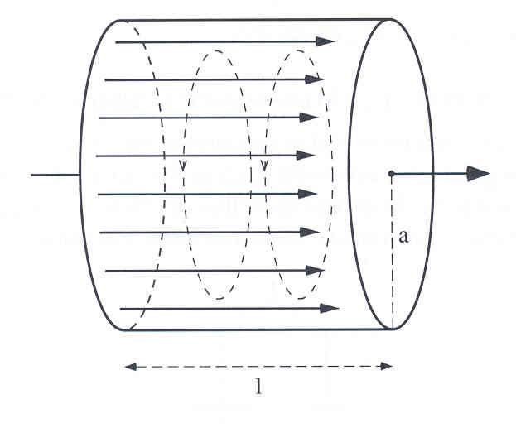
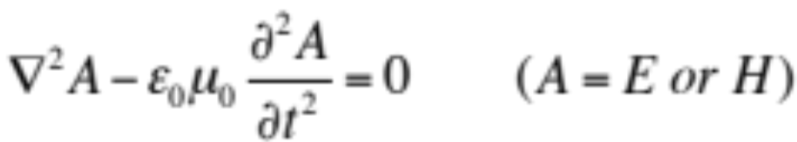
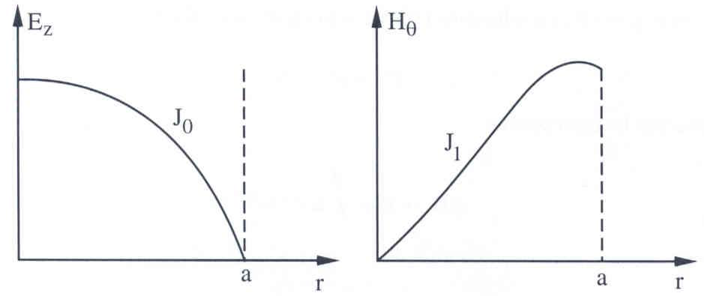
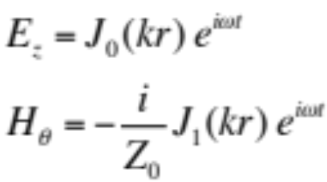
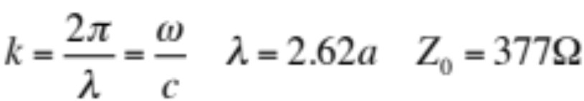
The Pill Box Cavity
From Maxwell’s equations one can derive the wave equations:
Solutions for E and H are oscillating modes, at discrete frequencies, of types TM_{xyz} (transverse magnetic) or TE_{xyz} (transverse electric).
Indices linked to the number of field knots in polar co-ordinates φ, r and z.
For l<2a the most simple mode, TM₀₁₀, has the
lowest frequency, and has only two field components:
E_{z}
H_{θ}

Slide 12
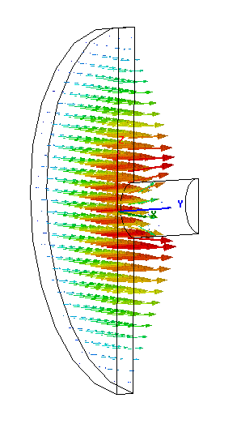
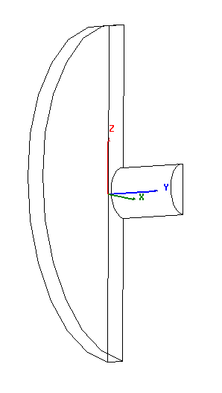
The Pill Box Cavity
One needs a hole for the beam pipe – circular waveguide below cutoff
TM₀₁₀-mode
(only 1/4 shown)
electric field
magnetic field

Slide 13
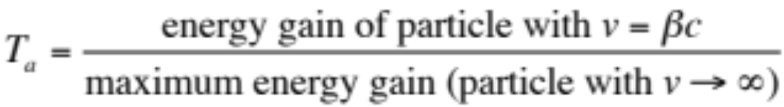
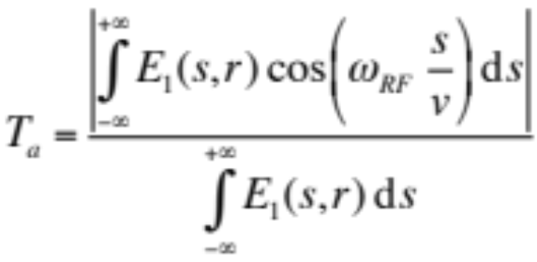

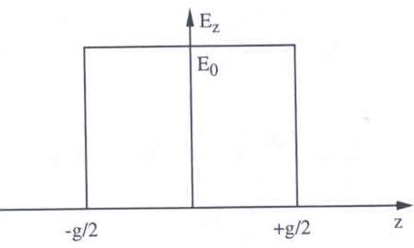
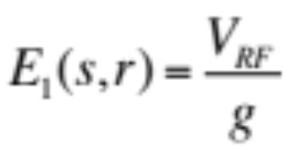

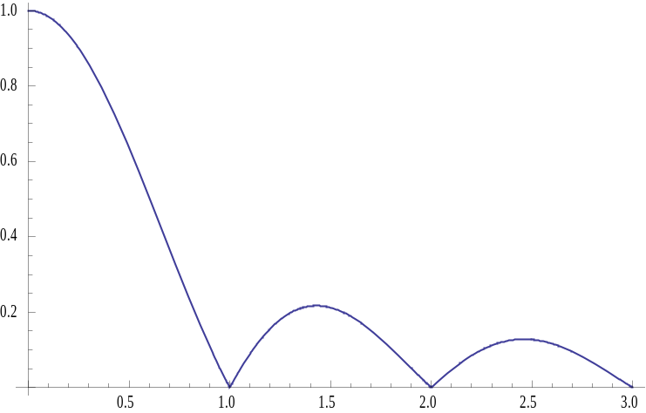
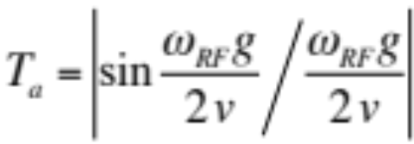
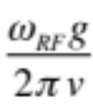
Transit time factor
The accelerating field varies during the passage of the particle
=> particle does not always see maximum field => effective acceleration smaller
Transit time factor defined as:
In the general case, the transit time factor is:
for
Simple model
uniform field:
Field rotates
by 360° during particle passage.
follows:
0 < T_{a} < 1, T_{a} → 1 for g → 0, smaller ω_{RF}
Important for low velocities (ions)

Slide 14
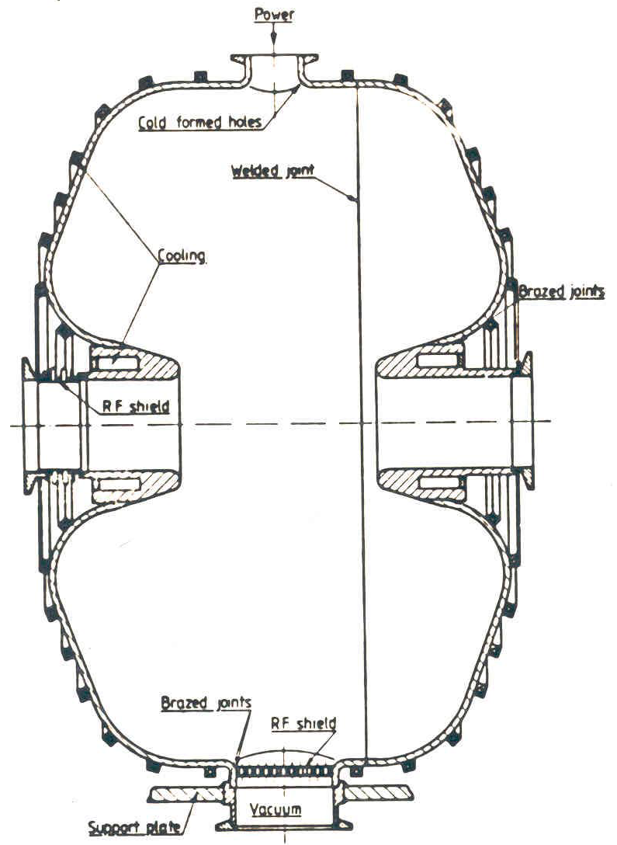
The Pill Box Cavity (2)
The design of a cavity can be sophisticated in order to improve its performances:
- A nose cone can be introduced in order to concentrate the electric field around the axis
- Round shaping of the corners allows a better distribution of the magnetic field on the surface and a reduction of the Joule losses.
It also prevents from multipactoring effects (e- emission and acceleration).
A good cavity efficiently transforms the RF power into accelerating voltage.
Simulation codes allow precise calculation of the properties.

Slide 15
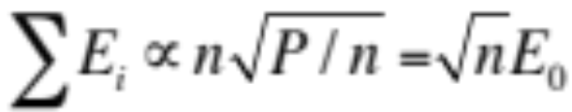
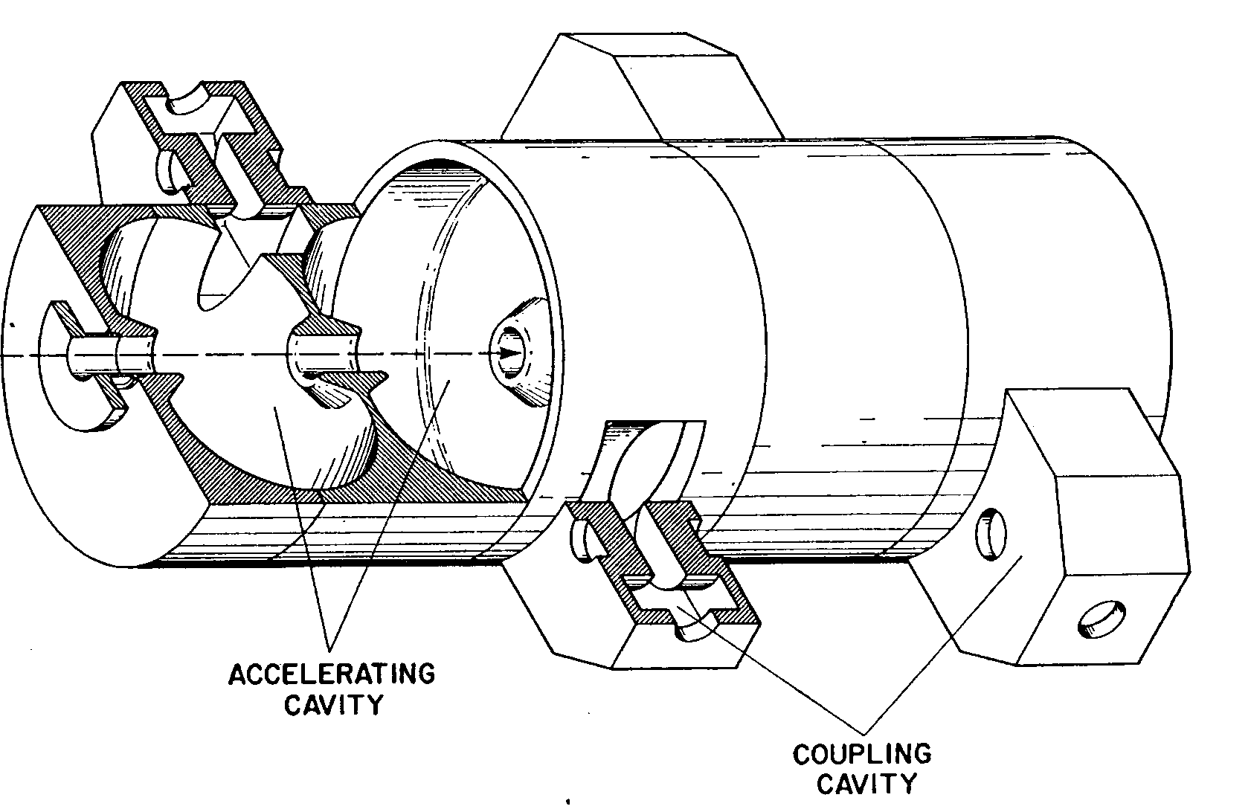
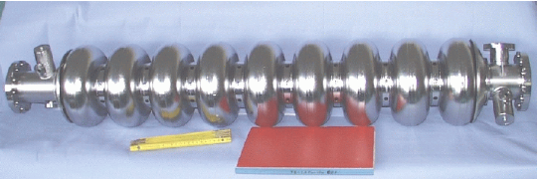
Multi-Cell Cavities
Acceleration of one cavity limited => distribute power P over several cells
Each cavity receives P/n
Since the field is proportional √P, you get
P/n
P/n
P/n
P/n
1
2
3
n
Instead of distributing the power from the amplifier, one might as well couple the cavities, such that the power automatically distributes, or have a cavity with many gaps (e.g. drift tube linac).

Slide 16
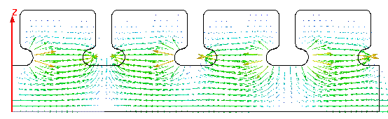
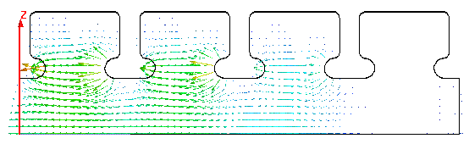
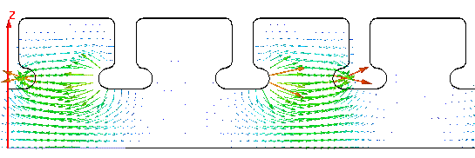
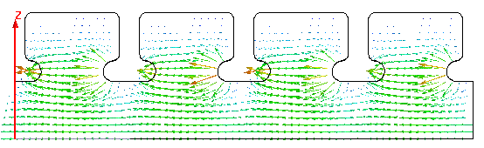
Multi-Cell Cavities - Modes
The phase relation between gaps is important!
Coupled harmonic oscillator
=> Modes, named after the phase difference between adjacent cells.
Relates to different synchronism conditions for the cell length L
π
2π/3
π/2
Mode | L
0 (2π) | βλ
π/2 | βλ/4
2π/3 | βλ/3
π | βλ/2
0

Slide 17
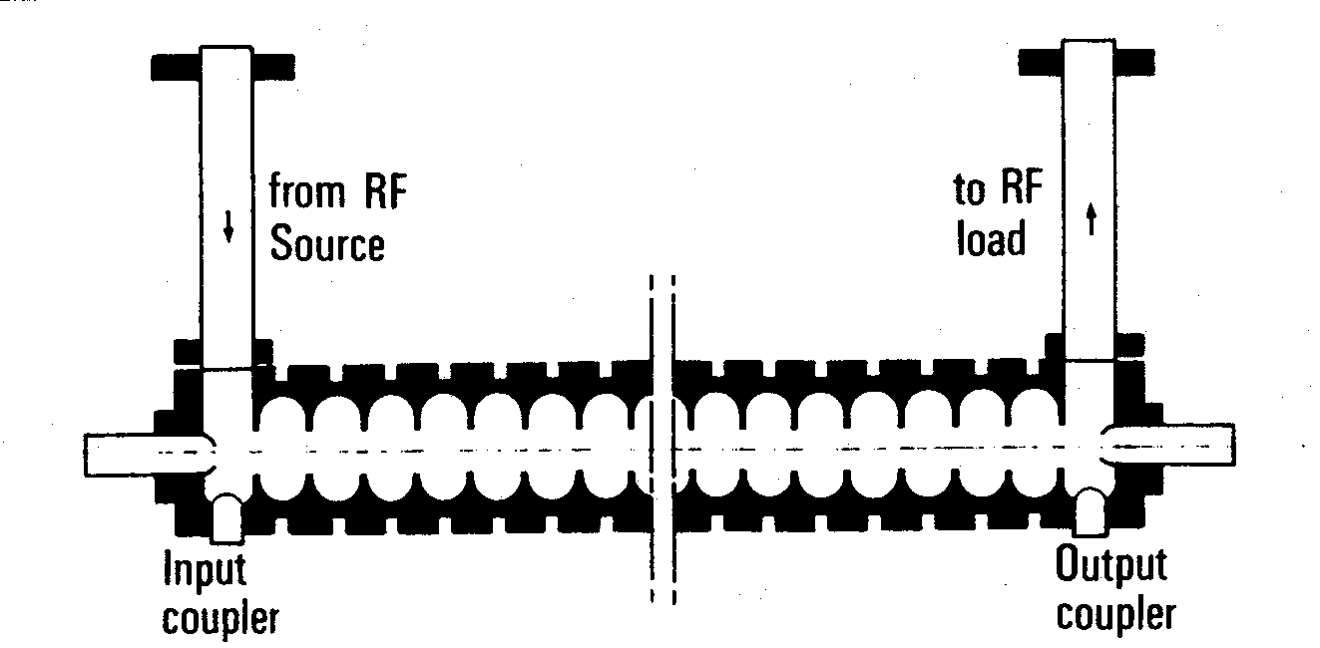
Disc-Loaded Traveling-Wave Structures
When particles gets ultra-relativistic (v~c) the drift tubes become very long unless the operating frequency is increased. Late 40’s the development of radar led to high power transmitters (klystrons) at very high frequencies (3 GHz).
Next came the idea of suppressing the drift tubes using traveling waves. However to get a continuous acceleration the phase velocity of the wave needs to be adjusted to the particle velocity.
solution: slow wave guide with irises ==> iris loaded structure

Slide 18
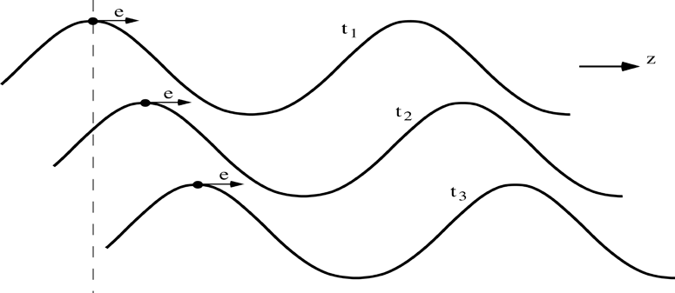
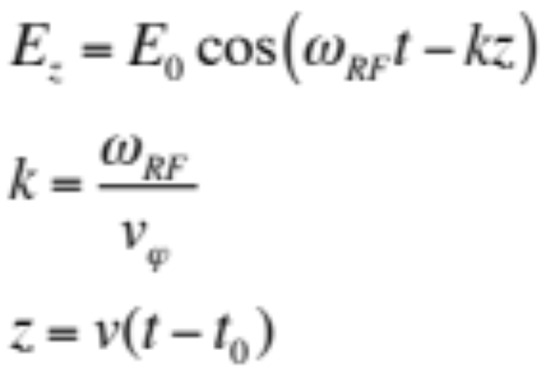


The Traveling Wave Case
wave number
v_{φ} = phase velocity
v = particle velocity
The particle travels along with the wave, and
k represents the wave propagation factor.
v = v_{φ} and
If synchronism satisfied:
where Φ₀ is the RF phase seen by the particle.

Slide 19




Important Parameters of Accelerating Cavities
- Average Electric Field E₀
Measure of the
potential acceleration
- Shunt Impedance R
depends on
- material
- cavity mode
- geometry
Relationship between electric
field E₀ and wall losses P_{d}
- Quality Factor Q
Attention: Different definitions are used!
Ratio of stored energy W_{s}
and dissipated power P_{d}
on the walls in one RF cycle
- function of the geometry and of the surface resistance of the material:
superconducting (niobium) : Q= 10¹⁰
normal conducting (copper) : Q=10⁴

Slide 20



Important Parameters of Accelerating Cavities (cont.)
- Fill Time t_{F}
- travelling wave cavities:
time needed for the electromagnetic energy to fill the cavity of length L
v_{g}: velocity at which the energy propagates through the cavity
- standing wave cavities:
time for the field to decrease by 1/e after the cavity has been filled
measure of how fast the stored energy is dissipated on the wall
Exponential decay of the
stored energy W_{s} due to losses

Slide 21





Common Phase Conventions
For circular accelerators, the origin of time is taken at the zero crossing of the RF voltage with positive slope
For linear accelerators, the origin of time is taken at the positive crest of the RF voltage
Time t= 0 chosen such that:
1
2
φ₁
φ₂
3. I will stick to convention 1 in the following to avoid confusion

Slide 22


Principle of Phase Stability (Linac)
Let’s consider a succession of accelerating gaps, operating in the 2π mode, for which the synchronism condition is fulfilled for a phase Φs .
is the energy gain in one gap for the particle to reach the
next gap with the same RF phase: P₁ ,P₂, …… are fixed points.
energy
gain
early
late
For a 2π mode, the electric field is the same in all gaps at any given time.
If an energy increase is transferred into a velocity increase =>
M₁ & N₁ will move towards P₁ => stable
M₂ & N₂ will go away from P₂ => unstable
(Highly relativistic particles have no significant velocity change)
Notes:
Edwin McMillan of UC Berkley, and the Russian V.I. Veksler independently discovered Phase stability in 1945.

Slide 23



A Consequence of Phase Stability
The divergence of the field is zero according to Maxwell :
Transverse fields
focusing at the entrance and
defocusing at the exit of the cavity.
Electrostatic case: Energy gain inside the cavity leads to focusing
RF case: Field increases during passage => transverse defocusing!
External focusing (solenoid, quadrupole) is then necessary

Slide 24






Energy-phase Oscillations (Small Amplitude) (1)
- Rate of energy gain for the synchronous particle:
- Rate of energy gain for a non-synchronous particle, expressed in reduced variables, and :
- Rate of change of the phase with respect to the synchronous one:
Leads finally to:

Slide 25










Energy-phase Oscillations (Small Amplitude) (2)
Combining the two 1st order equations into a 2nd order equation gives the equation of a harmonic oscillator:
with
Slower for higher energy!
Stable harmonic oscillations imply:
hence:
cos (φ_{s})
And since acceleration also means:
V_{RF}
synchronous
phase
You finally get the result for the stable phase range:
acceleration

Slide 26
Longitudinal phase space
The energy – phase oscillations can be drawn in phase space:
ΔΕ, Δp/p
ΔΕ, Δp/p
acceleration
move
forward
move
backward
deceleration
φ
φ
reference
The particle trajectory in the phase space (Δp/p, φ) describes its longitudinal motion.
Emittance: phase space area including all the particles
NB: if the emittance contour correspond to a possible orbit in phase space, its shape does not change with time (matched beam)

Slide 27



Longitudinal Dynamics - Electrons
At relativistic velocity phase oscillations stop – the bunch is frozen longitudinally.
=> Acceleration can be at the crest of the RF for maximum energy gain.
Electrons injected into a TW structure
designed for v=c:
at v=c remain at the injection phase.
at v<c will move from injection phase ϕ₀ to an asymptotic phase ϕ, which depends on gradient E₀ and β₀ at injection.
The beam can be injected with an offset in phase, to reach the crest of the wave at β=1
Capture condition, relating gradient E₀ and β₀ :
Example: λ=10cm → W_{in}=150 keV for E₀=8 MV/m.
In high current linacs, a bunching and pre-acceleration sections up to 4-10 MeV prepares the injection in the TW structure (that occurs already on the crest)

Slide 28



Bunching with a Pre-buncher
A long bunch coming from the gun enters
an RF cavity.
The reference particle is the one which has no velocity change. The others get accelerated or decelerated, so the bunch gets an energy and velocity modulation.
After a distance L bunch gets shorter: bunching effect.
This short bunch can now be captured more efficiently by a TW structure (v_{ϕ}=c).

Slide 29

Bunch compression
At ultra-relativistic energies (γ>> 1) the longitudinal motion is frozen.
For linear e+/e- colliders, you need very short bunches (few 100-50µm).
Solution: introduce energy/time correlation + a magnetic chicane.
Increases energy spread in the bunch => chromatic effects
=> compress at low energy before further acceleration to reduce relative ΔE/E
long.
phase
space
N.Walker

Slide 30


Longitudinal Wake Fields - Beamloading
Beam induces wake fields in cavities (in general when chamber profile changing)
⇒ decreasing RF field in cavities
(beam absorbs RF power when accelerated)
Particles within a bunch see a decreasing field
⇒ energy gain different within the single bunch
Locating bunch off-crest
at the best RF phase
minimises energy spread
Example: Energy gain
along the bunch
in the NLC linac (TW):
wakefield
RF
φ = 15.5º
Total

Slide 31



The Radio-Frequency Quadrupole - RFQ
Initial acceleration difficult for protons and ions at low energy
(space charge, low β ⇒ short cell dimensions, bunching needed)
RFQ = Electric quadrupole
focusing channel + bunching + acceleration
Alternating electric quadrupole field gives
transverse focusing like magnetic focusing channel.
Does not depend on velocity!
Ideal at low β!
+
−
−
+

Slide 32





The Radio-Frequency Quadrupole - RFQ
The vanes have a longitudinal modulation with period = βλ
→ this creates a longitudinal component of the electric field.
The modulation corresponds exactly to a series of RF gaps and can provide acceleration.
−
+
Opposite vanes (180º)
Adjacent vanes (90º)
RF Field excitation:
An empty cylindrical cavity can be excited on different modes.
Some of these modes have only transverse electric field (the TE modes), and one uses in particular the “quadrupole” mode, the TE₂₁₀.
B-field
E-field

Slide 33








RFQ Design + Longitudinal Phase Space
RFQ design: The modulation period can be slightly adjusted to change the phase of the beam inside the RFQ cells, and the amplitude of the modulation can be changed to change the accelerating gradient
→ start with some bunching cells, progressively bunch the beam (adiabatic bunching channel), and only in the last cells accelerate.
Longitudinal beam profile of a proton beam along the CERN RFQ2

Slide 34
Summary up to here…
Acceleration by electric fields, static fields limited
=> time-varying fields
Synchronous condition needs to be fulfilled for acceleration
Particles perform oscillation around synchronous phase
visualize oscillations in phase space
Electrons are quickly relativistic, speed does not change
use traveling wave structures for acceleration
Protons and ions
  RFQ for bunching and first acceleration
  need changing structure geometry

Slide 35











Summary: Relativity + Energy Gain
Newton-Lorentz Force
2nd term always perpendicular to motion => no acceleration
Relativistics Dynamics
RF Acceleration
(neglecting transit time factor)
The field will change during the passage of the particle through the cavity
=> effective energy gain is lower

Slide 36
Circular accelerators
Cyclotron
Synchrotron

Slide 37


Circular accelerators: Cyclotron
Used for protons, ions
B = constant
ω_{RF} = constant
RF generator, ω_{RF}
Synchronism condition
B
g
Ion source
Cyclotron frequency
γ increases with the energy ⇒ no exact synchronism
if v << c ⇒ γ ≅ 1
Extraction electrode
Cyclotron Animation
Ions trajectory
Animation: http://www.sciences.univ-nantes.fr/sites/genevieve_tulloue/Meca/Charges/cyclotron.html

Slide 38




Cyclotron / Synchrocyclotron
TRIUMF 520 MeV cyclotron Vancouver - Canada
CERN 600 MeV synchrocyclotron
Synchrocyclotron: Same as cyclotron, except a modulation of ω_{RF}
B = constant
  γ ω_{RF} = constant
ω_{RF} decreases with time
Allows to go beyond the
non-relativistic energies
The condition:

Slide 39


Circular accelerators: The Synchrotron
B
Constant orbit during acceleration
To keep particles on the closed orbit, B should increase with time
ω and ω_{RF} increase with energy
R
E
RF frequency can be
multiple of revolution frequency
RF cavity
RF generator
h integer,
harmonic number:
number of RF cycles
per revolution
Synchronism condition

Slide 40



Circular accelerators: The Synchrotron
EPA (CERN)
Electron Positron Accumulator
LEAR (CERN)
Low Energy Antiproton Ring
© CERN Geneva
© CERN Geneva
Examples of different proton and electron synchrotrons at CERN
+ LHC (of course!)
PS (CERN)
Proton Synchrotron
© CERN Geneva

Slide 41

The Synchrotron
The synchrotron is a synchronous accelerator since there is a synchronous RF phase for which the energy gain fits the increase of the magnetic field at each turn. That implies the following operating conditions:
E
Energy gain per turn
Synchronous particle
RF synchronism
(h - harmonic number)
Constant orbit
Variable magnetic field
B
Bending
magnet
R=C/2π
injection
extraction
ρ
bending
radius
If v≈c, ω_{r} hence ω_{RF} remain constant (ultra-relativistic e⁻ )

Slide 42





The Synchrotron – Energy ramping
Energy ramping by increasing the B field (frequency has to follow v):
Since:
Stable phase φ_{s} changes during energy ramping
The number of stable synchronous particles is equal to the
harmonic number h. They are equally spaced along the circumference.
Each synchronous particle satisfies the relation p=eBρ.
They have the nominal energy and follow the nominal trajectory.

Slide 43








The Synchrotron – Frequency change
During the energy ramping, the RF frequency increases to follow the increase of the revolution frequency :
Hence: ( using )
Since the RF frequency must follow the variation of the B field with the law
This asymptotically tends towards when B becomes large compared to
which corresponds to

Slide 44




Dispersion Effects in a Synchrotron
If a particle is slightly shifted in momentum it will have a different orbit and the orbit length is different.
The “momentum compaction factor” is defined as:
cavity
E
Circumference
2πR
E+δE
If the particle is shifted in momentum it will have also a different velocity.
As a result of both effects the revolution frequency changes:
p=particle momentum
R=synchrotron physical radius
f_{r}=revolution frequency

Slide 45












Momentum Compaction Factor
x
dθ
The elementary path difference from the two orbits is:
definition of dispersion D_{x}
leading to the total change in the circumference:
< >_{m} means that the average is considered over the bending magnet only
With ρ=∞ in straight sections we get:

Slide 46






Dispersion Effects – Revolution Frequency
There are two effects changing the revolution frequency:
the orbit length and the velocity of the particle
definition of momentum compaction factor
η=0 at the transition energy where both effects cancel

Slide 47
Phase Stability in a Synchrotron
From the definition of η it is clear that an increase in momentum gives
- below transition (η > 0) a higher revolution frequency
(increase in velocity dominates) while
- above transition (η < 0) a lower revolution frequency (v ≈ c and longer path)
where the momentum compaction (generally > 0) dominates.
energy
gain
Stable synchr. Particle for η < 0
above transition
η > 0
early
late

Slide 48

Crossing Transition
At transition, the velocity change and the path length change with momentum compensate each other. So the revolution frequency there is independent from the momentum deviation.
Crossing transition during acceleration makes the previous stable synchronous phase unstable. The RF system needs to make a rapid change of the RF phase, a ‘phase jump’.
In the PS: γ_{tr} is at ~6 GeV
In the SPS: γ_{tr}= 22.8, injection at γ=27.7
=> no transition crossing!
In the LHC: γ_{tr} is at ~55 GeV, also far below injection energy
Transition crossing not needed in leptons machines, why?

Slide 49


Dynamics: Synchrotron oscillations
Simple case (no accel.): B = const., below transition
The phase of the synchronous particle must therefore be φ₀ = 0.
φ₁ - The particle B is accelerated
- Below transition, an increase in energy means an increase in revolution frequency
- The particle arrives earlier – tends toward φ₀
B
φ₂
φ₀
φ₁
φ₂ - The particle is decelerated
- decrease in energy - decrease in revolution frequency
- The particle arrives later – tends toward φ₀

Slide 50
Longitudinal Phase Space Motion
Particle B performs a synchrotron oscillation around the synchronous particle A
Plotting this motion in longitudinal phase space gives:
ΔE
higher energy
early arrival
late arrival
Δt (or φ)
lower energy

Slide 51



Synchrotron oscillations – No acceleration
φ₂
φ₀
φ₁
Phase space picture
stable region
unstable region
separatrix

Slide 52


Synchrotron oscillations (with acceleration)
Case with acceleration B increasing
1
φ
2
φ_{s}
Phase space picture
stable region
unstable region
The symmetry of the case B = const. is lost
separatrix

Slide 53

Synchrotron motion in phase space
Remark:
Synchrotron frequency much smaller than betatron frequency.
The restoring force is non-linear.
speed of motion depends on position in
phase-space
(here shown for a stationary bucket)

Slide 54




Synchrotron motion in phase space
ΔE-φ phase space of a stationary bucket (when there is no acceleration)
Dynamics of a particle
Non-linear, conservative oscillator → e.g. pendulum
Particle inside the separatrix:
Particle at the
unstable fix-point
Bucket area: area enclosed by the separatrix
=> longitudinal Acceptance [eVs]
The area covered by particles
is the longitudinal emittance.
Particle outside the separatrix:

Slide 55

RF Acceptance versus Synchronous Phase
The areas of stable motion (closed trajectories) are called “BUCKET”.
As the synchronous phase gets closer to 90º the buckets gets smaller.
The number of circulating buckets is equal to “h”.
The phase extension of the bucket is maximum for φ_{s} =180º (or 0°) which correspond to no acceleration . The RF acceptance increases with the RF voltage.

Slide 56




Longitudinal Motion with Synchrotron Radiation
4
r
E
4
Synchrotron radiation energy-loss energy dependant:
During one period of synchrotron oscillation:
when the particle is in the upper half-plane, it loses more energy per turn, its energy gradually reduces
- when the particle is in the lower half-plane, it loses less energy per turn, but receives U₀ on the average, so its energy deviation gradually reduces
The phase space trajectory spirals towards the origin (limited by quantum excitations)
=> The synchrotron motion is damped toward an equilibrium bunch length and energy spread.
More details in Andy Wolski’s lecture
on ‘Low Emittance Machines’
U
=
π
e
(
)
0
3
m
c
2
3
ρ
0
ΔΕ

Slide 57
Longitudinal Dynamics in Synchrotrons
“Synchrotron Motion”
The RF acceleration process clearly emphasizes two coupled variables, the energy gained by the particle and the RF phase experienced by the same particle. Since there is a well defined synchronous particle which has always the same phase φ_{s}, and the nominal energy E_{s}, it is sufficient to follow other particles with respect to that particle.
So let’s introduce the following reduced variables:
revolution frequency : Δf_{r} = f_{r} – f_{rs}
particle RF phase : Δφ = φ - φ_{s}
particle momentum : Δp = p - p_{s}
particle energy : ΔE = E – E_{s}
azimuth angle : Δθ = θ - θ_{s}

Slide 58





First Energy-Phase Equation
v
Δθ
particle ahead arrives earlier
=> smaller RF phase
θ_{s}
R
For a given particle with respect to the reference one:
Since:
and
one gets the
1st order equation:

Slide 59



Second Energy-Phase Equation
The rate of energy gained by a particle is:
The rate of relative energy gain with respect to the reference particle leads to the second energy-phase equation:
deriving and
combining
This second order equation is non linear. Moreover the parameters within the bracket are in general slowly varying with time.
We will study some cases in the following…

Slide 60



Small Amplitude Oscillations
Let’s assume constant parameters R_{s}, p_{s}, ω_{s} and η:
with
Consider now small phase deviations from the reference particle:
(for small Δφ)
and the corresponding linearized motion reduces to a harmonic oscillation:
where Ω_{s} is the synchrotron angular frequency

Slide 61



Stability condition for ϕ_{s}
Stability is obtained when Ω_{s} is real and so Ω_{s}² positive:
cos (φ_{s})
V_{RF}
 < _{tr}
 > _{tr}
 > _{tr}
 < _{tr}
Stable in the region if
acceleration
deceleration

Slide 62




Large Amplitude Oscillations
For larger phase (or energy) deviations from the reference the second order differential equation is non-linear:
(Ω_{s} as previously defined)
Multiplying by and integrating gives an invariant of the motion:
which for small amplitudes reduces to:
(the variable is Δφ, and φ_{s} is constant)
Similar equations exist for the second variable : ΔE∝dφ/dt

Slide 63



Large Amplitude Oscillations (2)
When φ reaches π-φ_{s} the force goes to zero and beyond it becomes non restoring.
Hence π-φ_{s} is an extreme amplitude for a stable motion which in the
phase space( ) is shown as
closed trajectories.
Equation of the separatrix:
Second value φ_{m} where the separatrix crosses the horizontal axis:

Slide 64






Energy Acceptance
From the equation of motion it is seen that reaches an extreme
when , hence corresponding to .
Introducing this value into the equation of the separatrix gives:
That translates into an acceptance in energy:
This “RF acceptance” depends strongly on φ_{s} and plays an important role for the capture at injection, and the stored beam lifetime.
It’s largest for φ_{s}=0 and φ_{s}=π (no acceleration, depending on η).
Need a higher RF voltage for higher acceptance.

Slide 65
RF Acceptance versus Synchronous Phase
The areas of stable motion (closed trajectories) are called “BUCKET”.
As the synchronous phase gets closer to 90º the buckets gets smaller.
The number of circulating buckets is equal to “h”.
The phase extension of the bucket is maximum for φ_{s} =180º (or 0°) which correspond to no acceleration . The RF acceptance increases with the RF voltage.

Slide 66





Stationnary Bucket - Separatrix
This is the case sinφ_{s}=0 (no acceleration) which means φ_{s}=0 or π . The equation of the separatrix for φ_{s}= π (above transition) becomes:
Replacing the phase derivative by the (canonical) variable W:
W
W_{bk}
and introducing the expression for Ω_{s} leads to the following equation for the separatrix:
φ
0
π
2π
with C=2πR_{s}

Slide 67






Stationnary Bucket (2)
Setting φ=π in the previous equation gives the height of the bucket:
This results in the maximum energy acceptance:
The area of the bucket is:
Since:
one gets:

Slide 68


Bunch Transfer - Effect of a Mismatch
When you transfer the bunch from one RF system to another, the shape of the phase space and the bunch need to match.
Mismatch example: Injected bunch: short length and large energy spread
after 1/4 synchrotron period: longer bunch with a smaller energy spread.
W
W
φ
φ
For larger amplitudes, the angular phase space motion is slower
(1/8 period shown below) => can lead to filamentation and emittance growth
W
W
φ
φ
W.Pirkl
restoring force is
non-linear
stationary bucket
accelerating bucket

Slide 69




Effect of a Mismatch (2)
Evolution of an injected beam for the first 100 turns.
For a matched transfer, the emittance does not grow (left).
matched beam
mismatched beam – bunch length

Slide 70


Effect of a Mismatch (3)
Evolution of an injected beam for the first 100 turns.
For a mismatched transfer, the emittance increases (right).
matched beam
mismatched beam – phase error

Slide 71







Bunch Matching into a Stationnary Bucket
A particle trajectory inside the separatrix is described by the equation:
φ_{s}= π
W
The points where the trajectory crosses the axis are symmetric with respect to φ_{s}= π
W_{bk}
W_{b}
0
π
φ
π
2π
φ_{m}
2π-φ_{m}

Slide 72







Bunch Matching into a Stationnary Bucket (2)
Setting φ = π in the previous formula allows to calculate the bunch height:
or:
This formula shows that for a given bunch energy spread the proper matching of a shorter bunch (φ_{m} close to π, small)
will require a bigger RF acceptance, hence a higher voltage
For small oscillation amplitudes the equation of the ellipse reduces to:
Ellipse area gives the longitudinal emittance of

Slide 73

Bunch Rotation
Phase space motion can be used to make short bunches.
Start with a long bunch and extract or recapture when it’s short.
initial beam

Slide 74

Capture of a Debunched Beam with Fast Turn-On

Slide 75

Capture of a Debunched Beam with Adiabatic Turn-On

Slide 76




Potential Energy Function
The longitudinal motion is produced by a force that can be derived from a scalar potential:
The sum of the potential energy and kinetic energy is constant and by analogy represents the total energy of a non-dissipative system.

Slide 77






Hamiltonian of Longitudinal Motion
Introducing a new convenient variable, W, leads to the 1st order equations:
The two variables φ,W are canonical since these equations of motion can be derived from a Hamiltonian H(φ,W,t):

Slide 78
Summary
Cyclotrons/Synchrocylotrons for low energy
Synchrotrons for high energies
constant orbit, rising field and frequency
Particles with higher energy have a longer orbit (normally) but a higher velocity
  at low energies (below transition) velocity increase dominates
  at high energies (above transition) velocity almost constant
Particles perform oscillations around synchronous phase
  synchronous phase depending on acceleration
  below or above transition
bucket is the region in phase space for stable oscillations
matching the shape of the bunch to the bucket is important

Slide 79
Bibliography
M. Conte, W.W. Mac Kay An Introduction to the Physics of particle Accelerators
        (World Scientific, 1991)
P. J. Bryant and K. Johnsen The Principles of Circular Accelerators and Storage Rings
        (Cambridge University Press, 1993)
D. A. Edwards, M. J. Syphers An Introduction to the Physics of High Energy Accelerators
        (J. Wiley & sons, Inc, 1993)
H. Wiedemann Particle Accelerator Physics
(Springer-Verlag, Berlin, 1993)
M. Reiser Theory and Design of Charged Particles Beams
        (J. Wiley & sons, 1994)
A. Chao, M. Tigner Handbook of Accelerator Physics and Engineering
        (World Scientific 1998)
K. Wille The Physics of Particle Accelerators: An Introduction
        (Oxford University Press, 2000)
E.J.N. Wilson An introduction to Particle Accelerators
        (Oxford University Press, 2001)
And CERN Accelerator Schools (CAS) Proceedings
In particular: CERN-2014-009
Advanced Accelerator Physics - CAS

Slide 80
Acknowledgements
I would like to thank everyone for the material that I have used.
In particular (hope I don’t forget anyone):
- Joël Le Duff (from whom I inherited the course)
- Erk Jensen
- Alessandra Lombardi
- Maurizio Vretenar
- Rende Steerenberg
- Gerald Dugan
- Heiko Damerau
- Werner Pirkl
- Genevieve Tulloue
- Mike Syphers
- Daniel Schulte
- Roberto Corsini
- Roland Garoby

