Slide 1
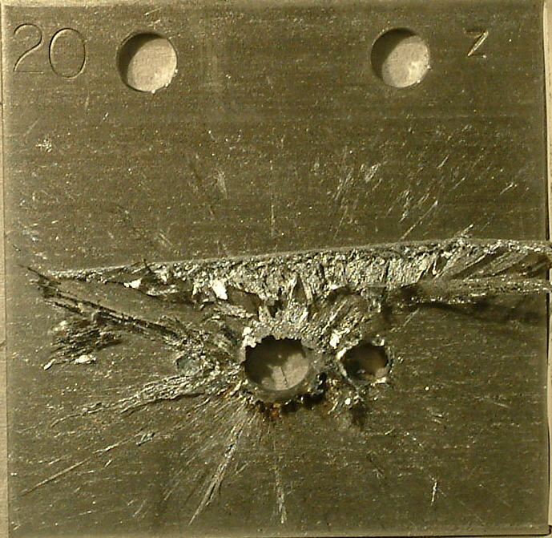

Machine Protection
Rüdiger Schmidt, CERN and ESS
CAS Accelerator School
October 2013 - Trondheim
Continuous an accidental beam losses
Protection of the accelerator from beam losses

Slide 2
Protection from Energy and Power
Risks come from Energy stored in a system (Joule), and Power when operating a system (Watt)
  “Very powerful accelerator” … the power flow needs to be controlled
An uncontrolled release of the energy, or an uncontrolled power flow can lead to unwanted consequences
  Damage of equipment and loss of time for operation
  For particle beams, activation of equipment
This is true for all systems, in particular for complex systems such as accelerators
  For the RF system, power converters, magnet system …
  For particle beams
This lecture on Machine Protection is focused on preventing damage caused by particle beams

Slide 3
Content
Different accelerator concepts: Examples for ESS and LHC
Hazards and Risks
Accidental beam losses and consequences
Accidental beam losses and probability
Machine Protection Systems
  For high energy proton synchrotrons (LHC)
  For high power accelerators (ESS)
Some principles for protection systems

Slide 4
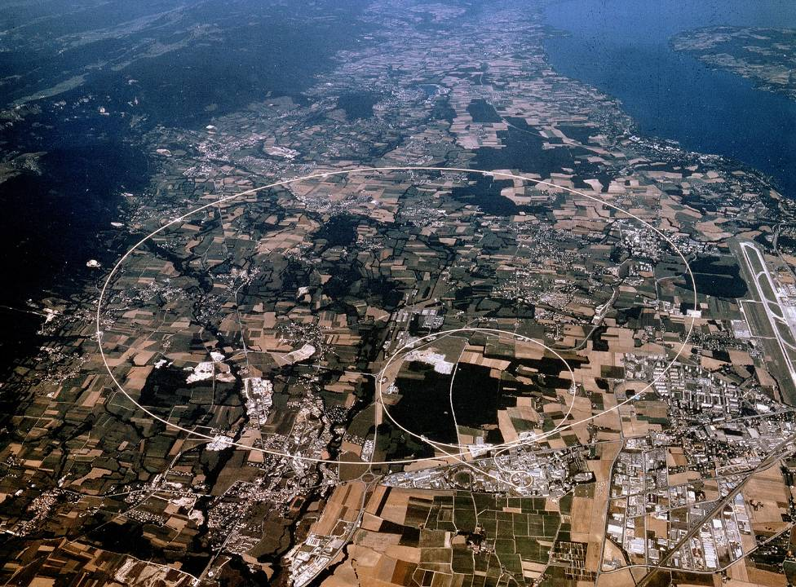


Proton collider LHC – 362 MJ stored in one beam
CERN
Switzerland
Lake Geneva
LHC Accelerator
(100 m down)
LHCb
CMS, TOTEM
ALICE
SPS Accelerator
ATLAS
LHC pp and ions
7 TeV/c – up to now 4 TeV/c
26.8 km circumference
Energy stored in one beam 362 MJ

Slide 5
Proton collider LHC – 362 MJ stored in one beam
If something goes wrong, the beam energy has to be safely deposited
CERN
Switzerland
Lake Geneva
LHC Accelerator
(100 m down)
LHCb
CMS, TOTEM
ALICE
SPS Accelerator
ATLAS
LHC pp and ions
7 TeV/c – up to now 4 TeV/c
26.8 km Circumference
Energy stored in one beam 362 MJ

Slide 6
ESS Lund / Sweden – 5 MW beam power
~ 500 m
352.21 MHz
704.42 MHz
2.4 m
4.0 m
3.6 m
32.4 m
58.5 m
113.9 m
227.9 m
Target
Source
LEBT
RFQ
MEBT
DTL
Spokes
Medium β
High β
HEBT & Upgrade
75 keV
3 MeV
78 MeV
200 MeV
628 MeV
2500 MeV
Low energy beam transport
RFQ
352.2 MHz
Medium energy beam transport
Drift tube linac with
4 tanks
Super-conducting cavities
High energy beam transport
Power of
5000 kW
Operating with protons
Operation with beam pulses at a frequency of 14 Hz
Pulse length of 2.86 ms
Average power of 5 MW
Peak power of 125 MW
As an example for a high intensity linear accelerator (similar to SNS and J-PARC)

Slide 7
ESS Lund / Sweden – 5 MW beam power
If something goes wrong, injection has to be stopped
~ 500 m
352.21 MHz
704.42 MHz
2.4 m
4.0 m
3.6 m
32.4 m
58.5 m
113.9 m
227.9 m
Target
Source
LEBT
RFQ
MEBT
DTL
Spokes
Medium β
High β
HEBT & Upgrade
75 keV
3 MeV
78 MeV
200 MeV
628 MeV
2500 MeV
Low energy beam transport
RFQ
352.2 MHz
Medium energy beam transport
Drift tube linac with
4 tanks
Super-conducting cavities
High energy beam transport
Power of
5000 kW
Operating with protons
Operation with beam pulses at a frequency of 14 Hz
Pulse length of 2.86 ms
Average power of 5 MW
Peak power of 125 MW
As an example for a high intensity linear accelerator (similar to SNS and J-PARC)

Slide 8
Energy stored in beam and magnet system
Factor
~200
Notes:
8

Slide 9
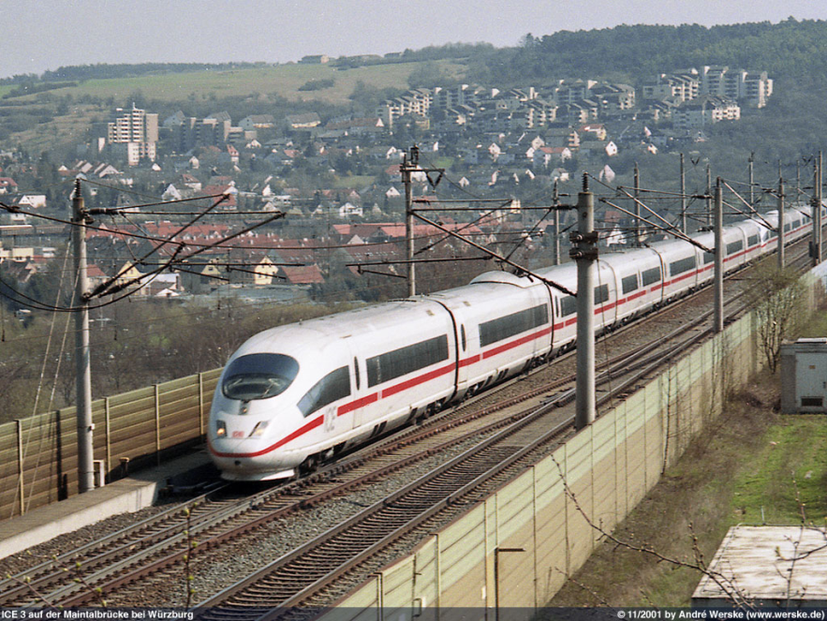
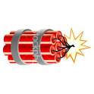


What does it mean ……… MJoule ?
The energy of an 200 m long fast train at 155 km/hour corresponds to the energy of 360 MJ stored in one LHC beam.
360 MJ: the energy stored in one LHC beam corresponds approximately to…
90 kg of TNT
8 litres of gasoline
15 kg of chocolate
It matters most how easy and fast the energy is released !!

Slide 10
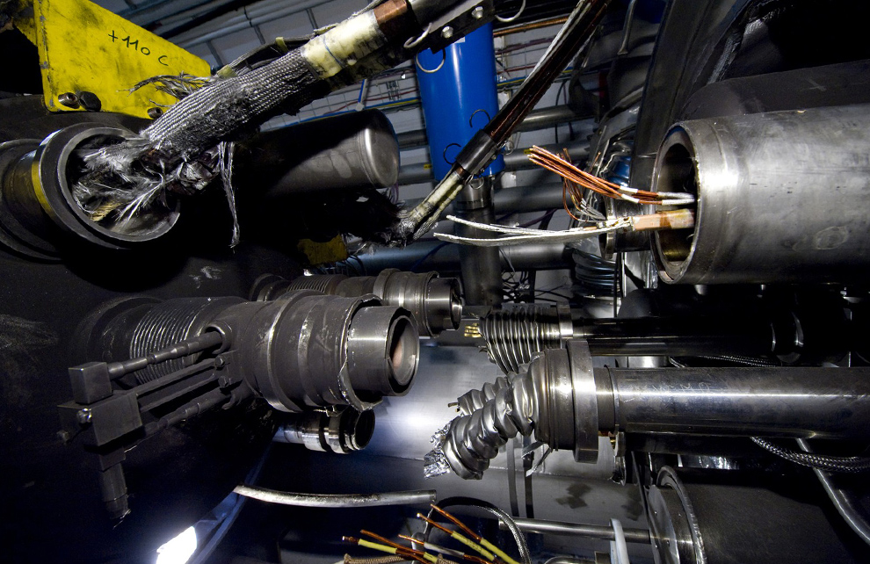
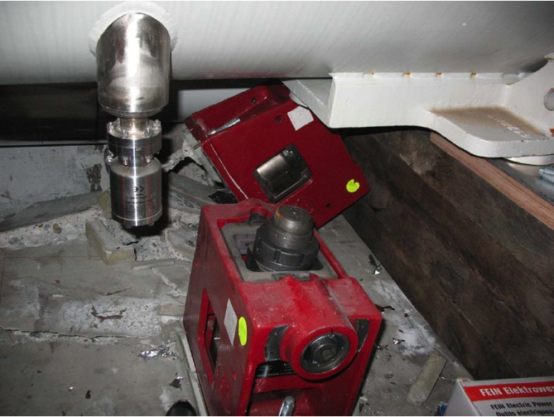
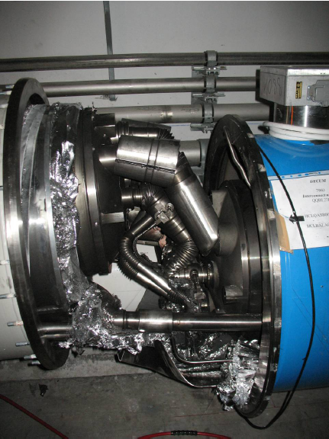
Consequences of a release of 600 MJ at LHC
The 2008 LHC accident happened during test runs without beam.
A magnet interconnect was defect and the circuit opened. An electrical arc provoked a He pressure wave damaging ~600 m of LHC, polluting the beam vacuum over more than 2 km.
Arcing in the interconnection
Magnet displacement
53 magnets had to be repaired
Over-pressure

Slide 11
Energy and Power density
Many accelerators operate with high beam intensity and/or energy
For synchrotrons and storage rings, the energy stored in the beam increased with time (from ISR to LHC)
For linear accelerators and fast cycling machines, the beam power increases
The emittance becomes smaller (down to a beam size of nanometer)
This is important today, and even more relevant for future projects, with increased beam power / energy density (W/mm² or J/mm² ) and increasingly complex machines
Even a small amount of energy can lead to some (limited) damage
Can be an issue for sensitive equipment

Slide 12
Hazards and Risks

Slide 13
Hazard and Risk for accelerators
Hazard: a situation that poses a level of threat to the accelerator. Hazards are dormant or potential, with only a theoretical risk of damage. Once a hazard becomes "active“: incident / accident. Consequences and possibility of an incident interact together to create RISK, can be quantified:
RISK = Consequences ∙ Probability
Related to accelerators
Consequences of an uncontrolled beam loss
Probability of an uncontrolled beam loss
The higher the RISK, the more Protection is required
Notes:
13

Slide 14
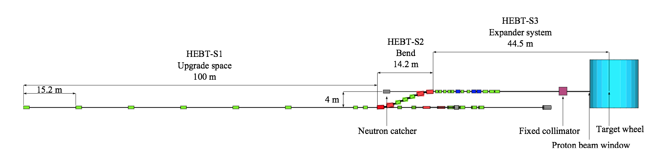
Example for ESS
~ 160 m following the sc cavities
HEBT-S2
5 MW Beam
Bending magnet in an accelerator deflecting the beam
Assume that the power supply for the bend in HEBT-S2 fails and the magnets stops deflecting the beam
  Probability: MTBF for power supply is 100000 hours = 15 years
The beam is not deflected and hits the vacuum chamber
  Consequences: what is expected to happen? Damage of magnet, vacuum pipe, possibly pollution of superconducting cavities

Slide 15
Example for LHC: SPS, transfer line and LHC
Beam is accelerated in SPS to 450 GeV (288 bunches, stored energy of 3 MJ)
Beam is transferred from SPS to LHC
Beam is accelerated in LHC to high energy (stored energy of 362 MJ)
IR8
Injection kicker
Fast extraction kicker
Transfer line 3 km
SPS
6911 m
450 GeV
3 MJ transfer to LHC
Injection kicker
LHC
IR2
Fast extraction kicker
1 km
Transfer line

Slide 16

Protection at injection
LHC vacuum chamber
LHC circulating beam
Transfer line vacuum chamber
Circulating beam in LHC

Slide 17
Protection at injection
LHC circulating beam
LHC injected beam
Beam from SPS
Injection Kicker
Beam injected from SPS and transfer line

Slide 18

Protection at injection
LHC circulating beam
Beam from SPS
Major damage to sc magnets, vacuum pipes, possibly LHCb / Alice experiments
Injection Kicker
Kicker failure (no kick)

Slide 19
Protection at injection
phase advance 90⁰
LHC circulating beam
Beam from SPS
Injection Kicker
Injection absorber
(TDI) ~7σ
Set of transfer line collimators (TCDI) ~5σ
Beam absorbers take beam in case of kicker misfiring
Transfer line collimators ensure that incoming beam trajectory is ok

Slide 20
Protection at injection
This type of kicker failure happened several times: protection worked
phase advance 90⁰
LHC circulating beam
LHC circulating beam
Circulating beam – kicked out
Injection Kicker
Injection absorber
(TDI) ~7σ
Set of transfer line collimators (TCDI) ~5σ
Beam absorbers take beam in case of kicker misfiring on circulating beam

Slide 21
(Accidental) beam loss and consequences

Slide 22
Beam losses and consequences
Charged particles moving through matter interact with the electrons of atoms in the material, exciting or ionizing the atoms => energy loss of traveling particle described by Bethe-Bloch formula.
If the particle energy is high enough, particle losses lead to particle cascades in materials, increasing the deposited energy
  the maximum energy deposition can be deep in the material at the maximum of the hadron / electromagnetic shower
The energy deposition leads to a temperature increase
  material can vaporise, melt, deform or lose its mechanical properties
  risk to damage sensitive equipment for less than one kJ, risk for damage of any structure for some MJ (depends on beam size)
  superconducting magnets could quench (beam loss of ~mJ to J)
  superconducting cavities performance degradation by some 10 J
  activation of material, risk for hand-on-maintenance

Slide 23
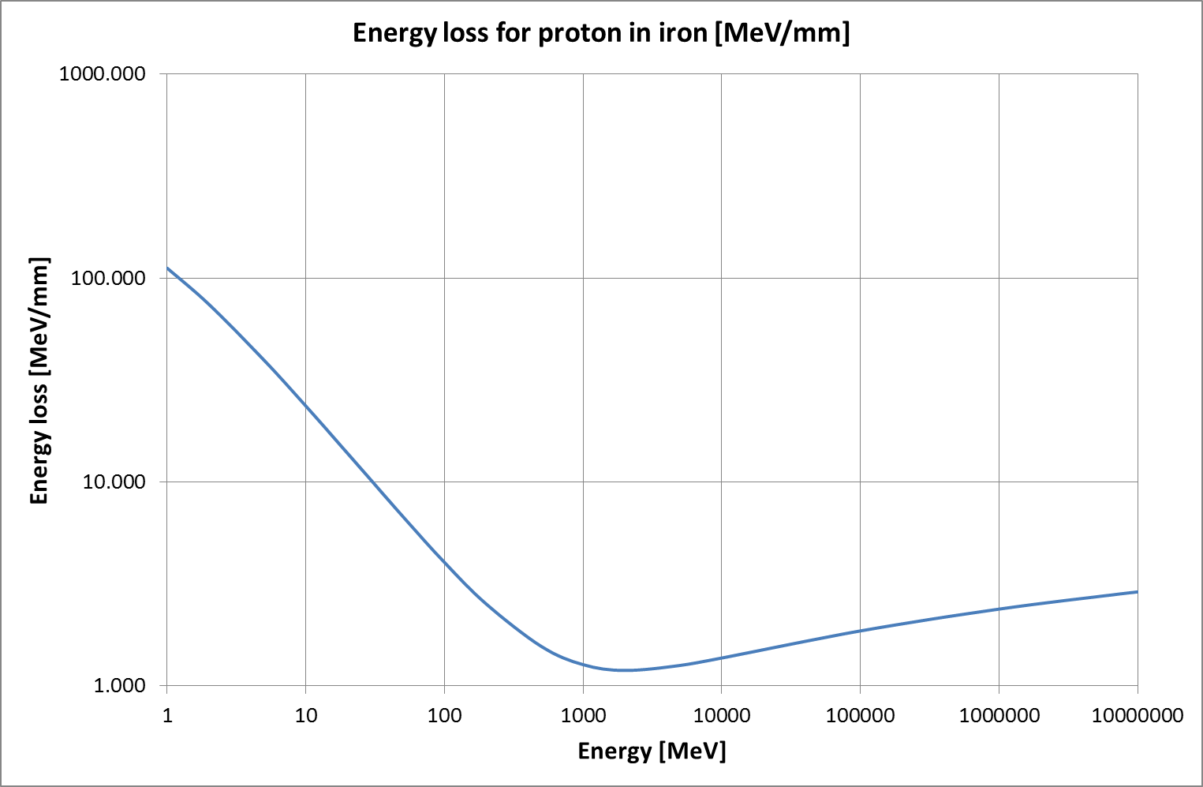
Energy loss: example for one proton in iron
(stainless steel, copper very similar)
From Bethe-Bloch formula.
Low energy few MeV, beam transport, RFQ for many machines
SNS - ESS 1 – 3 GeV
LHC 7 TeV

Slide 24
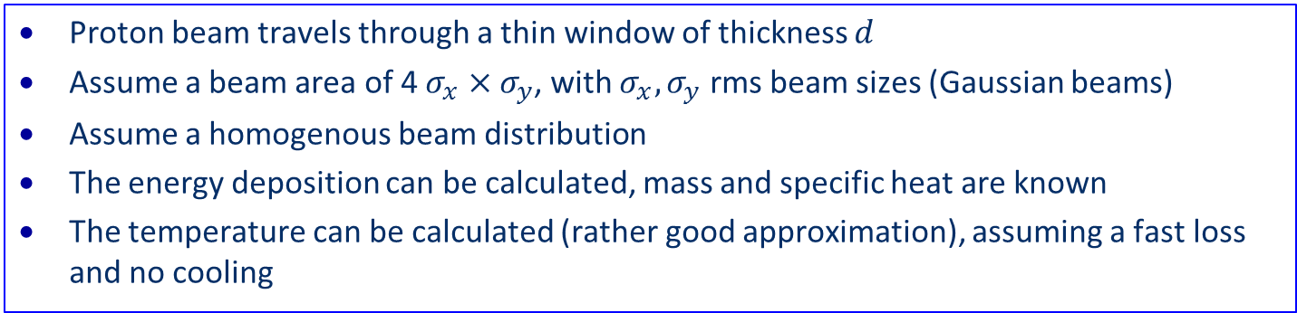
Beam losses and consequences
Proton beam travels through a thin window of thickness $d$
Assume a beam area of 4 $σ_{x}×σ_{y}$, with $σ_{x}, σ_{y}$ rms beam sizes (Gaussian beams)
Assume a homogenous beam distribution
The energy deposition can be calculated, mass and specific heat are known
The temperature can be calculated (rather good approximation), assuming a fast loss and no cooling

Slide 25
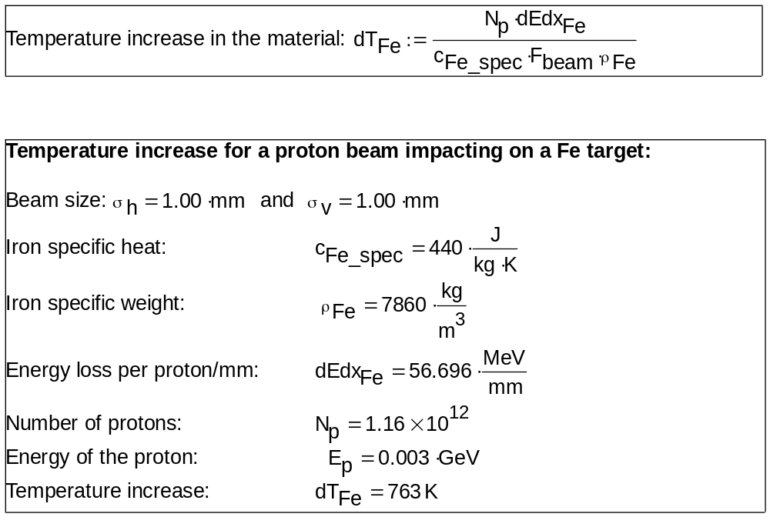
Heating of material with low energy protons
(3 MeV)

Slide 26
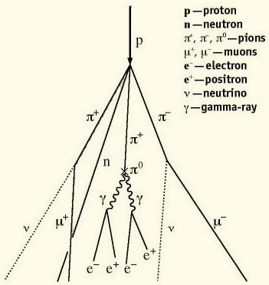
Heating of material with high energy protons
Nuclear inelastic interactions (hadronic shower)
  Creation of pions when going through matter
  Causes electromagnetic shower through decays of pions
  Exponential increase in number of created particles
  Final energy deposition to large fraction done by large number of electromagnetic particles
  Scales roughly with total energy of incident particle
  Energy deposition maximum deep in the material
  Energy deposition is a function of the particle type, its momentum and parameters of the material (atomic number, density, specific heat)
  No straightforward expression to calculate energy deposition
  Calculation by codes, such as FLUKA, GEANT or MARS
http://williamson-labs.com/ltoc/cbr-tech.htm

Slide 27
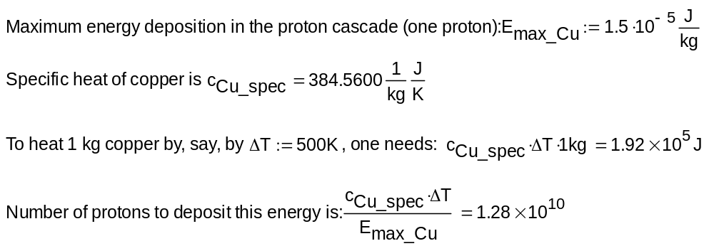
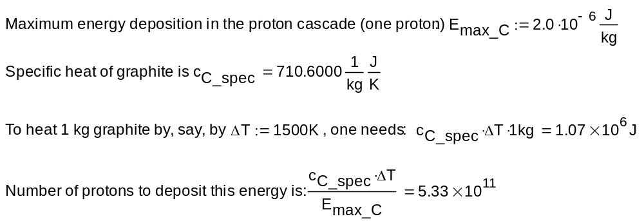
Damage of a pencil 7 TeV proton beam (LHC)
copper
Copper
graphite
graphite

Slide 28
Beam losses and consequences
Calculate the response of the material (deformation, melting, …) to beam impact (mechanical codes such as ANSYS, hydrodynamic codes such as BIG2 and others)
Beams at very low energy have limited power…. however, the energy deposition is very high, and can lead to (limited) damage in case of beam impact
  issue at the initial stage of an accelerator, after the source, low energy beam transport and RFQ
  limited impact (e.g. damaging the RFQ) might lead to long downtime, depending on spare situation
Beams at very high energy can have a tremendous damage potential
  for LHC, damage of metals for ~10¹⁰ protons
  one LHC bunch has about 1.5∙10¹¹ protons, in total up to 2808 bunches
  in case of catastrophic beam loss, possibly damage beyond repair

Slide 29
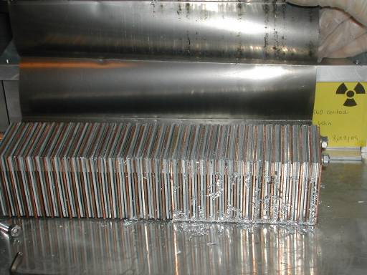
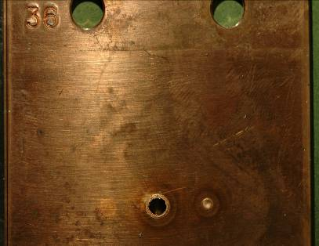
SPS experiment: Beam damage with 450 GeV protons
Controlled SPS experiment
8⋅10¹² protons clear damage
beam size σ_{x/y} = 1.1mm/0.6mm
above damage limit for copper
stainless steel no damage
2⋅10¹² protons
below damage limit for copper
25 cm
6 cm
0.1 % of the full LHC 7 TeV beams
factor of three below the energy in a bunch train injected into LHC
damage limit ~200 kJoule
A B D C
V.Kain et al
Notes:
29

Slide 30
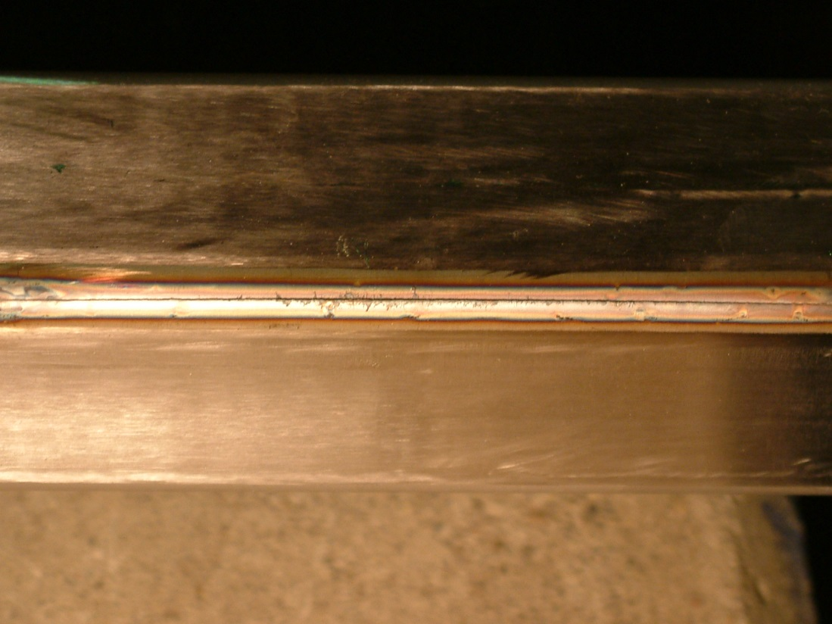
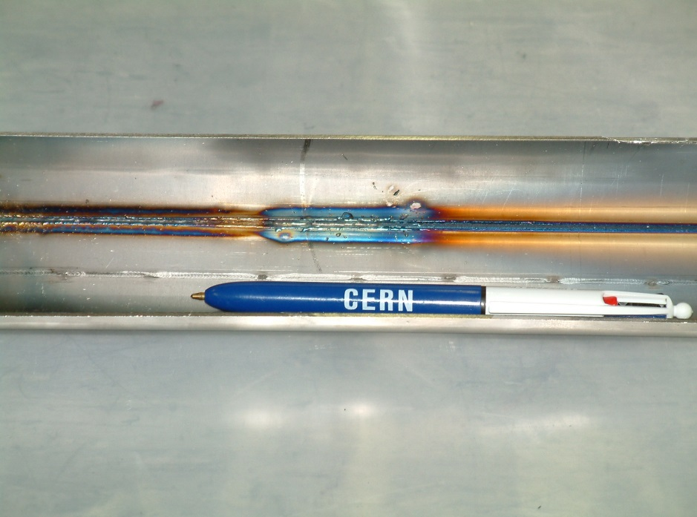
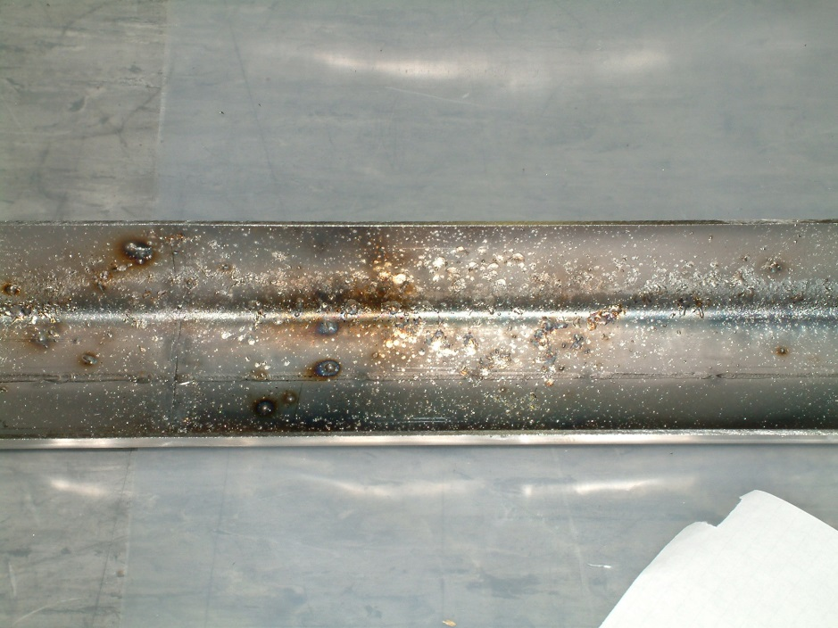
Vacuum chamber in SPS extraction line incident
450 GeV protons, 2 MJ beam in 2004
Failure of a septum magnet
Cut of 25 cm length, groove of 70 cm
Condensed drops of steel on other side of the vacuum chamber
Vacuum chamber and magnet needed to be replaced

Slide 31
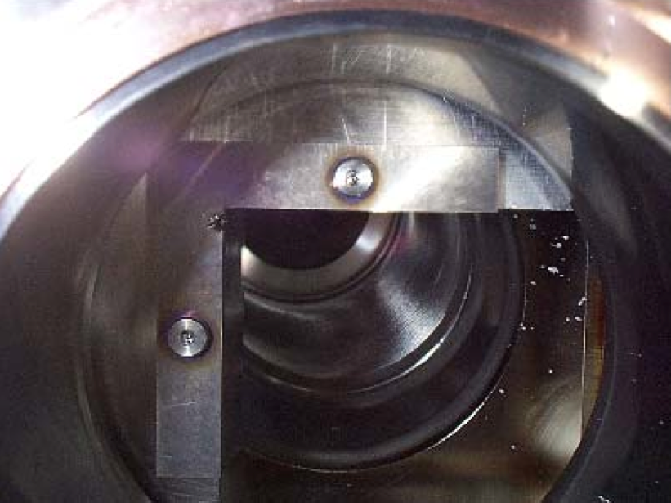
Collimator in Tevatron after an incident in 2003
A Roman pot (movable device) moved into the beam
Particle showers from the Roman pot quenched superconducting magnets
The beam moved by 0.005 mm/turn, and touched a collimator jaw surface after about 300 turns
The entire beam was lost, mostly on the collimator
Observation of HERA tungsten collimators: grooves on the surface when opening the vacuum chamber were observed. No impact on operation.

Slide 32
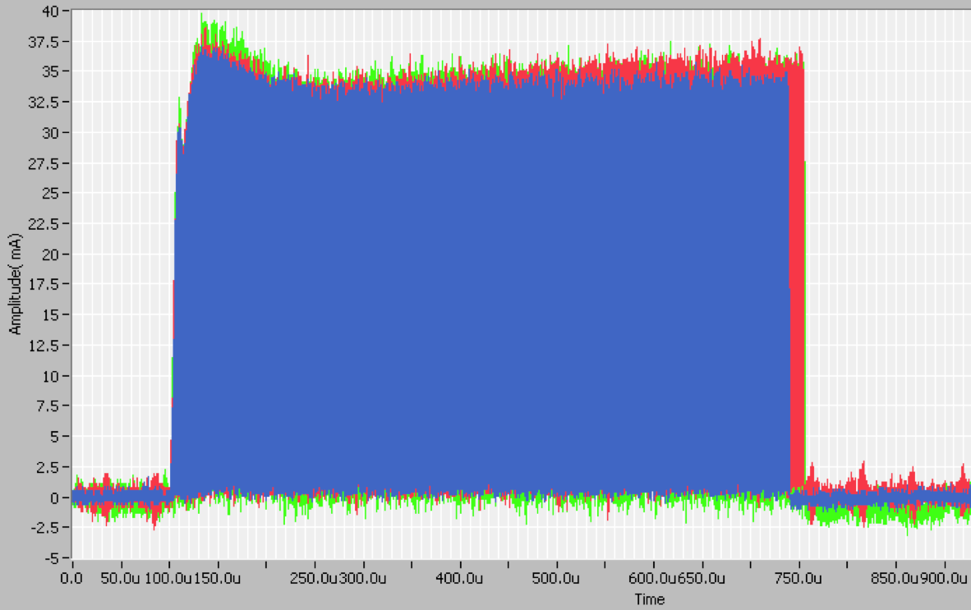
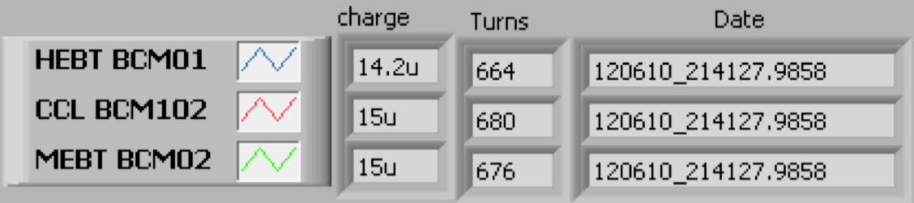
Beam losses in SNS linac
Beam Current Monitors (BCM) measure current pulse at different locations along the linac.
About 16 µsec of beam lost in the superconducting part of linac
680 µs of beam before sc linac
16 µs of beam lost in the sc linac
664 µs of beam after sc linac
Beam energy in 16 µs
End of DTL = 30 J
End of CCL = 66 J
End of SCL = 350 J
M.Plum / C.Peters

Slide 33
Beam loss with low energy deposition
Beam might hit surface of HV system (RFQ, kicker magnets, cavities)
Surfaces with HV, after beam loss performance degradation might appear (not possible to operate at the same voltage, increased probability of arcing, …)
SNS: errant beam losses led to a degradation of the performance of superconducting cavity
  Bam losses likely to be caused by problems in ion source, low energy beam transfer and normal conducting linac
  Cavity gradient needs to be lowered, conditioning after warm-up helps in most cases
  Energy of beam losses is about 100 J
  Damage mechanisms not fully understood, it is assumed that some beam hitting the cavity desorbs gas or particulates (=small particles) creating an environment for arcing

Slide 34
Accidental beam loss and probability

Slide 35
Beam losses mechanisms
In accelerators, particles are lost due to a variety of reasons: beam gas interaction, losses from collisions, losses of the beam halo, …
Continuous beam losses are inherent during the operation of accelerators
  Taken into account during the design of the accelerator
Accidental beam losses are due to a multitude of failures mechanisms
The number of possible failures leading to accidental beam losses is (nearly) infinite
Notes:
35

Slide 36
Beam losses, machine protection and collimation
Continuous beam losses: Collimation prevents too high beam losses around the accelerator (beam cleaning)
A collimation system is a (very complex) system with (massive) material blocks close to the beam
installed in an accelerator to capture halo particles
Such system is also called (beam) Cleaning System
Accidental beam losses: “Machine Protection” protects equipment from damage, activation and downtime
Machine protection includes a large variety of systems, including collimators (or beam absorbers) to capture mis-steered beam
Notes:
36

Slide 37
Regular and irregular operation
Regular operation
Many accelerator systems
Continuous beam losses
Collimators for beam cleaning
Collimators for halo scraping
Collimators to prevent ion-induced desorption
Failures during operation
Beam losses due to failures, timescale from nanoseconds to seconds
Machine protection systems
Collimators
Beam absorbers
Notes:
37

Slide 38
Continuous beam losses: Collimation
Continuous beam with a power of 1 MW and more (SNS, JPARC, PSI)
  A loss of 1% corresponds to 10 kW – not to be lost along the beam line to avoid activation of material, heating, quenching, …
  Assume a length of 200 m: 50 W/m, not acceptable
  Plans for accelerators of 5 MW (ESS), 10 MW and more
Limitation of beam losses is in order of 1 W/m to avoid activation and still allow hands-on maintenance
  Avoid beam losses – as far as possible
  Define the aperture by collimators
  Capture continuous particle losses with collimators at specific locations
LHC stored beam with an energy of 360 MJ
  Assume lifetime of 10 minutes corresponds to beam loss of 500 kW, not to be lost in superconducting magnets
  Reduce losses by four orders of magnitude
….but also: capture fast accidental beam losses

Slide 39
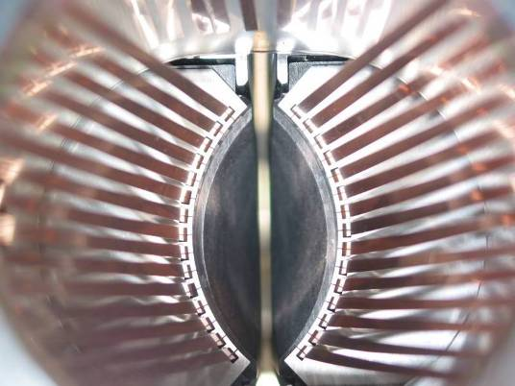
RF contacts for guiding image currents
2 mm
View of a two sided collimator
for LHC
about 100 collimators are installed in LHC
Beam spot
length about 120 cm
Ralph Assmann, CERN

Slide 40
Accidental beam losses: Machine Protection
Single-passage beam loss in the accelerator complex (ns - μs)
  transfer lines between accelerators or from an accelerator to a target station (target for secondary particle production, beam dump block)
  failures of kicker magnets (injection, extraction, special kicker magnets, for example for diagnostics)
  failures in linear accelerators, in particular due to RF systems
  too small beam size at a target station
Very fast beam loss (ms)
  e.g. multi turn beam losses in circular accelerators
  due to a large number of possible failures, mostly in the magnet powering system, with a typical time constant of ~1 ms to many seconds
Fast beam loss (some 10 ms to seconds)
Slow beam loss (many seconds)
Notes:
40

Slide 41
Classification of failures
Type of the failure
  hardware failure (power converter trip, magnet quench, AC distribution failure such as thunderstorm, object in vacuum chamber, vacuum leak, RF trip, kicker magnet misfires, .…)
  controls failure (wrong data, wrong magnet current function, trigger problem, timing system, feedback failure, ..)
  operational failure (chromaticity / tune / orbit wrong values, …)
  beam instability (due to too high beam / bunch current / e-clouds)
Parameters for the failure
  time constant for beam loss
  probability for the failure
  damage potential
defined as risk

Slide 42
Probability of a failure leading to beam loss
Experience from LHC (the most complex accelerator)
  When the beam are colliding, the optimum length of a store is in the order of 10-15 hours, then ended by operation
  Most fills (~70 %) are ended by failures, the machine protection systems dump the beams
  MTBF of about 6 h
Other large accelerators (SNS, plans for ESS, synchrotron light sources)
  MTBF between 20 h and up to several 100 h
    (…. more accurate numbers are appreciated)
At high power accelerators, most failures would lead to damage if not mitigated = > the machine protection system is an essential part of the accelerator

Slide 43
Machine Protection

Slide 44



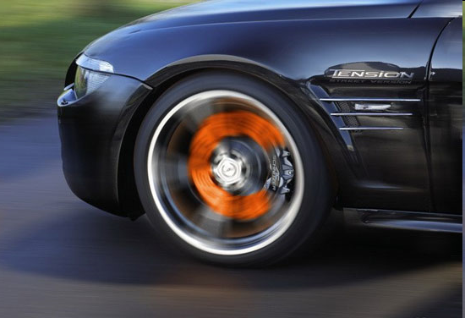
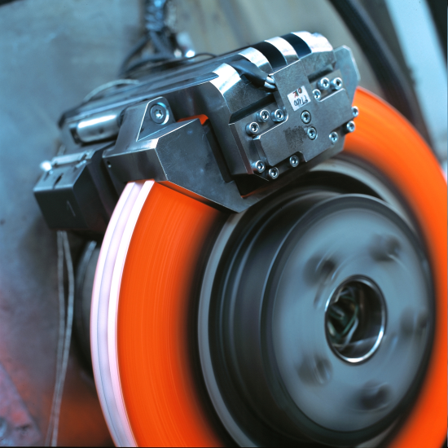
Example for Active Protection - Traffic
A monitor detects a dangerous situation
An action is triggered
The energy stored in the system is safely dissipated

Slide 45

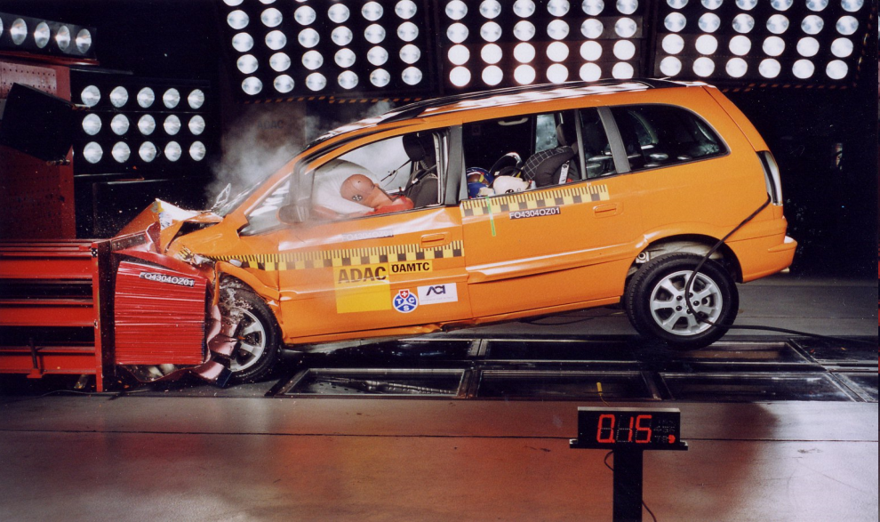
Example for Passive Protection
The monitor fails to detect a dangerous situation
The reaction time is too short
Active protection not possible – passive protection by bumper, air bag, safety belts

Slide 46
Strategy for protection and related systems
Avoid that a specific failure can happen
Detect failure at hardware level and stop beam operation
Detect initial consequences of failure with beam instrumentation ….before it is too late…
Stop beam operation
  inhibit injection
  extract beam into beam dump block
  stop beam by beam absorber / collimator
Elements in the protection systems
  equipment monitoring and beam monitoring
  beam dump (fast kicker magnet and absorber block)
  chopper to stop the beam in the low energy part
  collimators and beam absorbers
  beam interlock systems linking different systems

Slide 47
Beam instrumentation for machine protection
Beam Loss Monitors
  stop beam operation in case of too high beam losses
  monitor beam losses around the accelerator (full coverage?)
  could be fast and/or slow (LHC down to 40 μs)
Beam Position Monitors
  ensuring that the beam has the correct position
  in general, the beam should be centred in the aperture
Beam Current Transformers
  if the transmission between two locations of the accelerator is too low (=beam lost somewhere): stop beam operation
  if the beam lifetime is too short: dump beam
Beam Size Monitors
  if beam size is too small could be dangerous for windows, targets, …

Slide 48
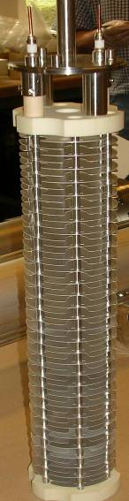
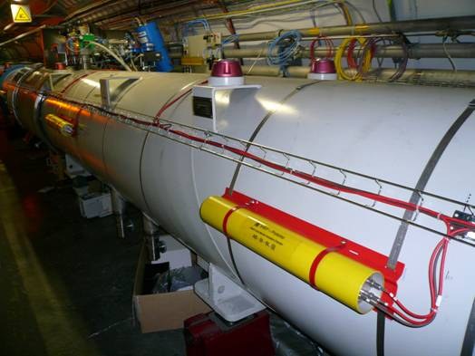
Beam Loss Monitors
Ionization chambers to detect beam losses:
  Reaction time ~ ½ turn (40 μs)
  Very large dynamic range (> 10⁶)
There are ~3600 chambers distributed over the ring to detect abnormal beam losses and if necessary trigger a beam abort !

Slide 49
Layout of beam dump system in IR6
LHC Layout
eight arcs (sectors)
eight long straight section (about 700 m long)
Beam dump blocks
IR5:CMS
Signal to kicker magnet
IR4: RF + Beam instrumentation
IR6: Beam dumping system
IR3: Moment Beam Clearing (warm)
IR7: Betatron Beam Cleaning (warm)
IR2: ALICE
IR8: LHC-B
Detection of beam losses with >3600 monitors around LHC
IR1: ATLAS
Injection
Injection
Beams from SPS
49

Slide 50
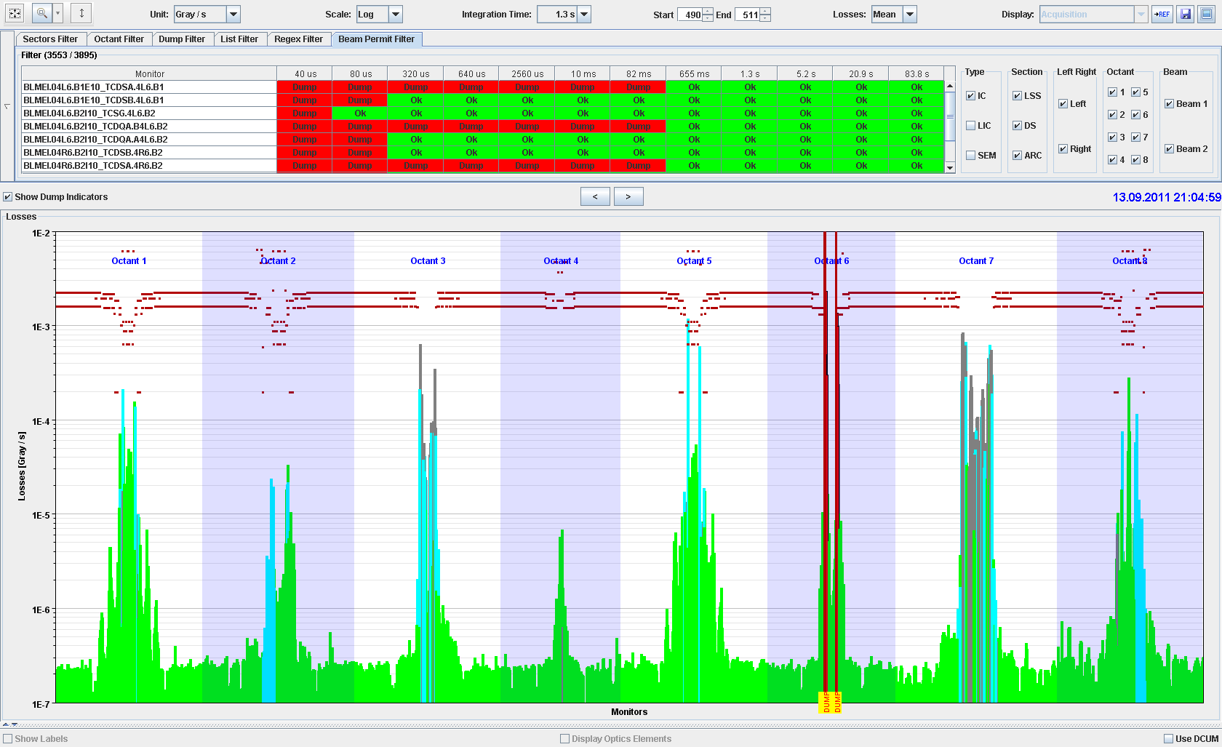
Continuous beam losses during collisions
ATLAS Experiment
ALICE Experiment
MomentumCleaning
RF and
BI
CMS Experiment
Beam
dump
Betatron Cleaning
LHC Experiment

Slide 51
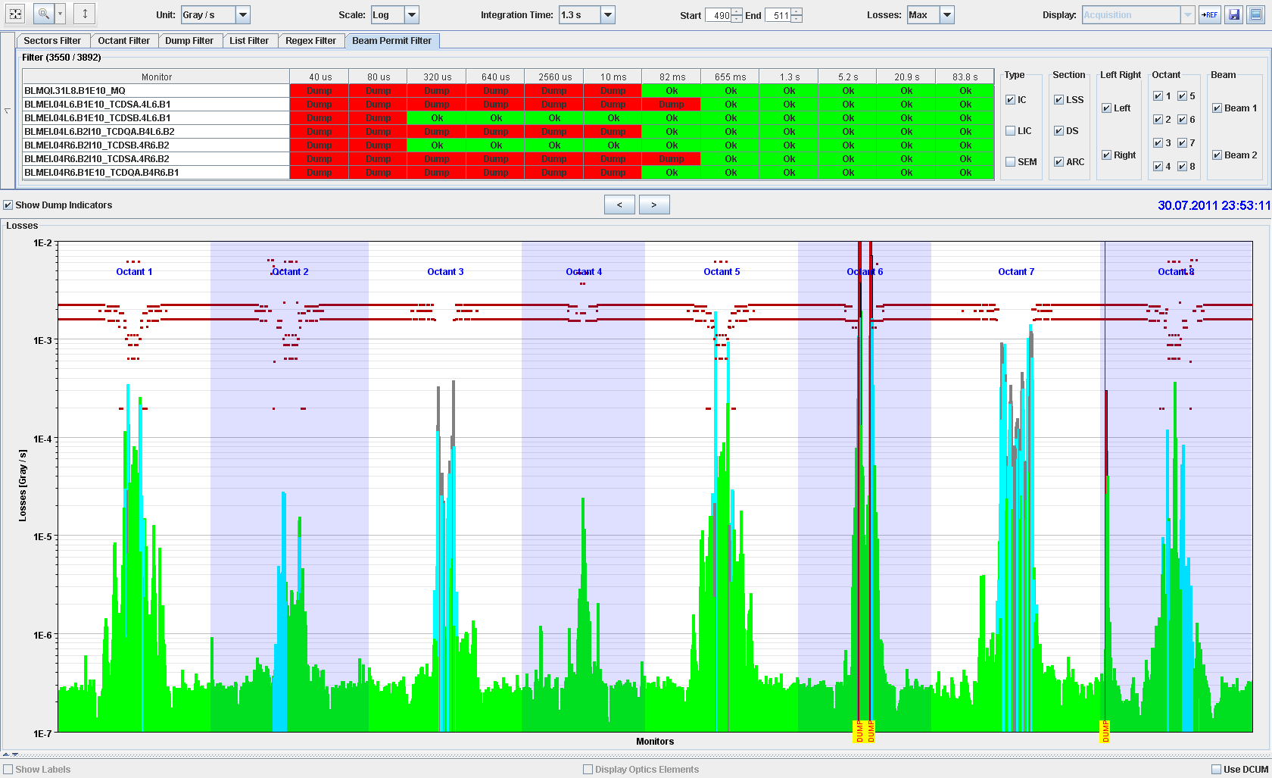
Accidental beam losses during collisions

Slide 52
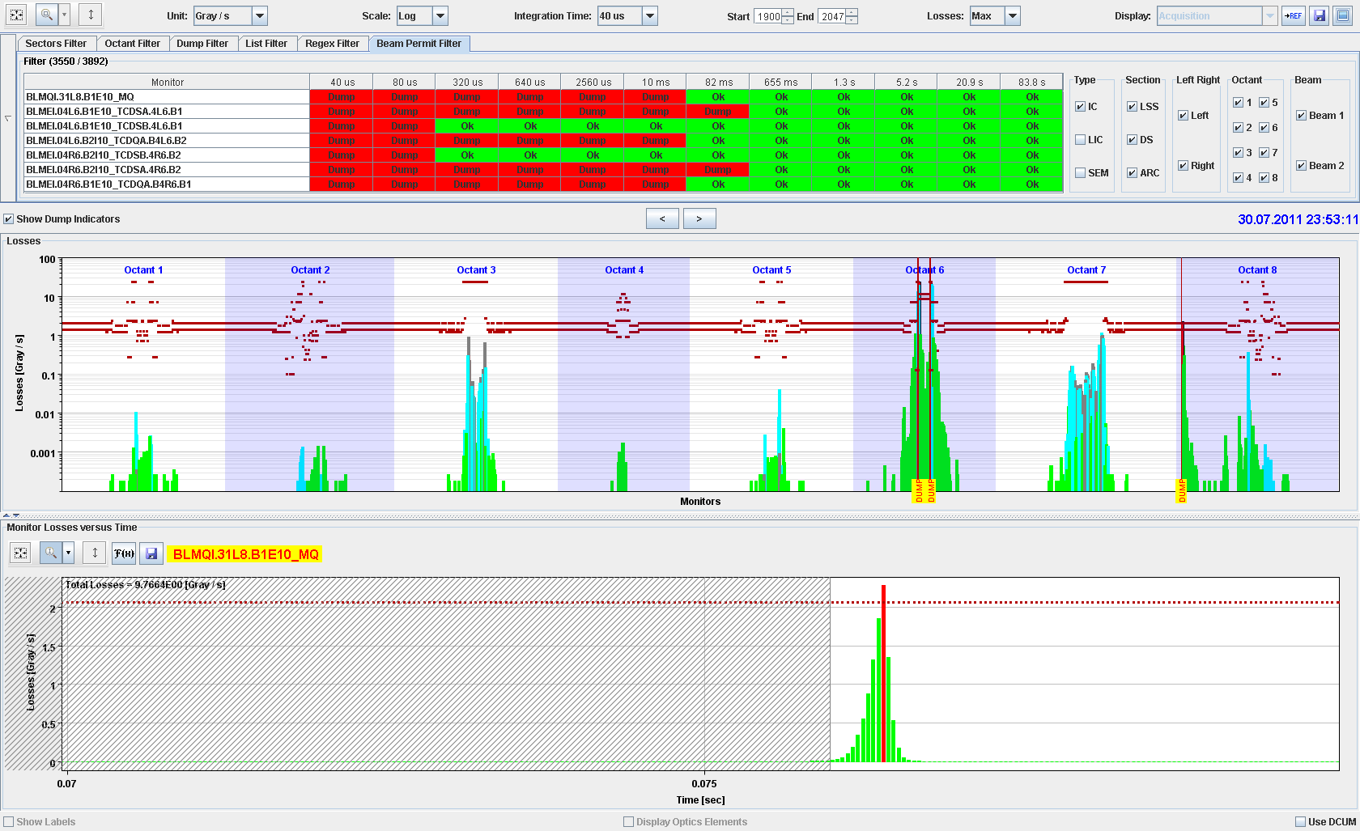
Accidental beam losses during collisions

Slide 53
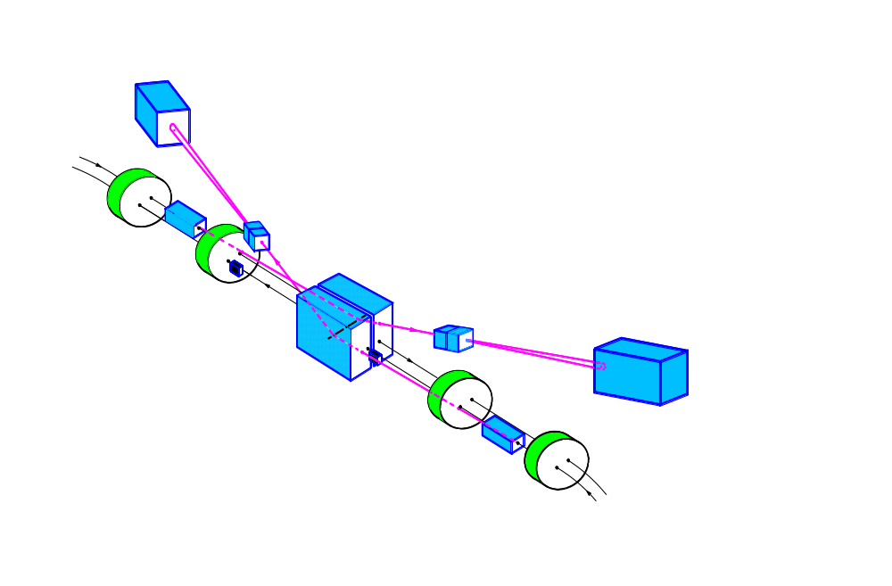
Layout of beam dump system in IR6
CERN
When it is time to get rid of the beams (also in case of emergency!), the beams are ‘kicked’ out of the ring by a system of kicker magnetsd send into a dump block !
Septum magnets deflect the extracted beam vertically
Ultra-high reliable system !!
Kicker magnets to paint (dilute) the beam
Beam dump block
15 fast ‘kicker’ magnets deflect the beam to the outside
about 700 m
about 500 m
The 3 μs gap in the beam gives the kicker time to reach full field.
quadrupoles
Beam 2
R.Schmidt HASCO 2013
53

Slide 54
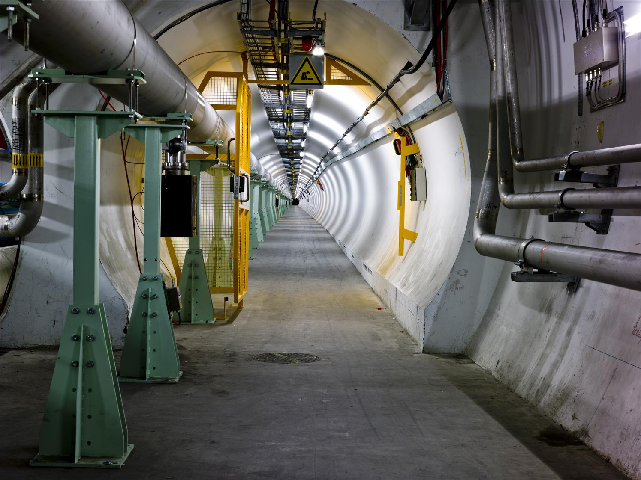
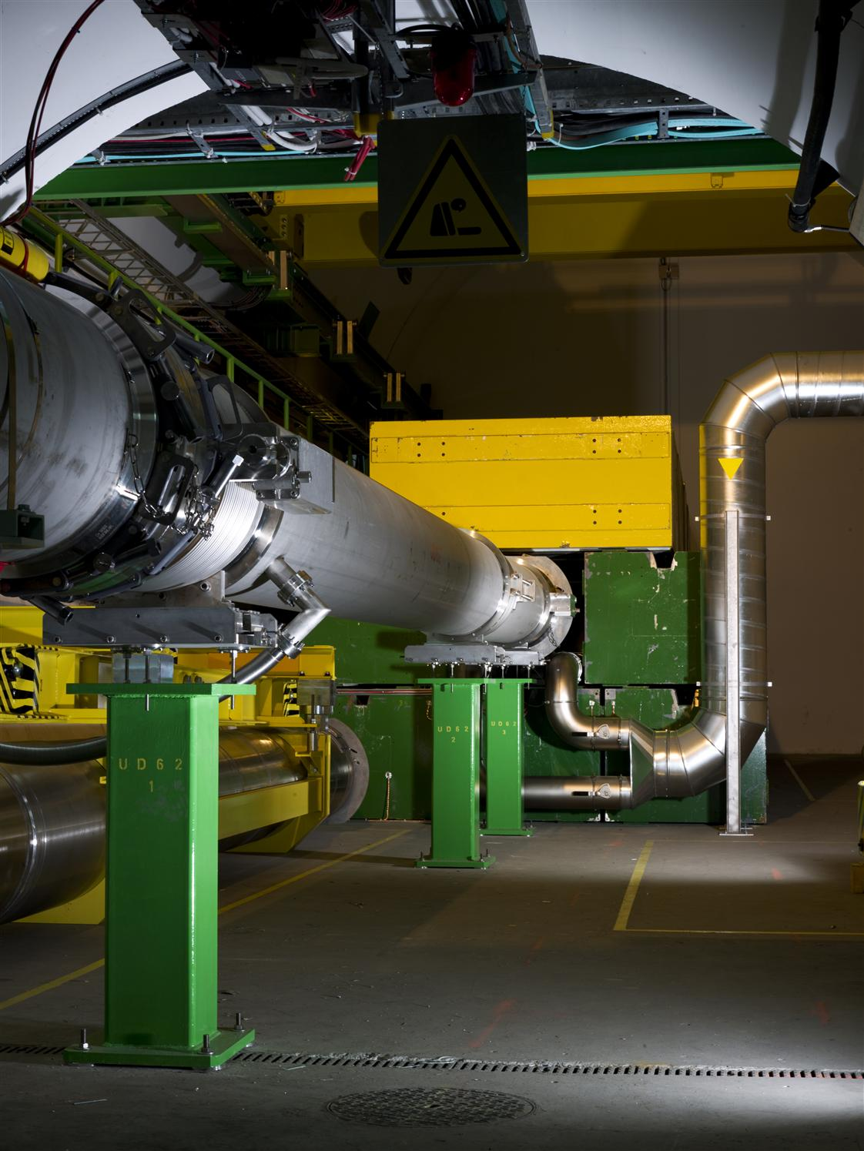
Beam dumping system line for LHC

Slide 55
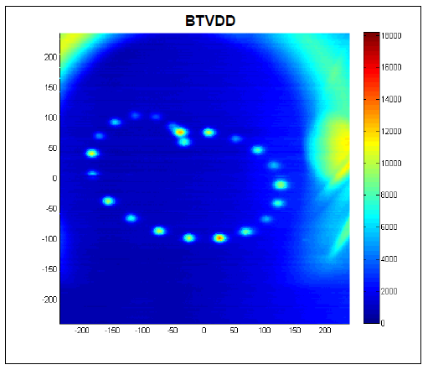
Beam dump
Screen in front of the beam dump block
Each light dot shows the passage of one proton bunch traversing the screen
Each proton bunch has a different trajectory, to better distribute the energy across a large volume
50 cm

Slide 56
High power accelerators …
Operate with beam power of 1 MW and more
SNS – 1 MW, PSI cyclotron – 1.3 MW, ESS – planned for 5 MW, FRIB (ions) – planned for 0.4 MW
ESS (4 % duty cycle): in case of an uncontrolled beam loss during 1 ms, the deposited energy is up to 130 kJ, for 1 s it is up to 5 MJ
It is required to inhibit the beam after detecting uncontrolled beam loss – how fast?
The delay between detection and “beam off” to be considered

Slide 57
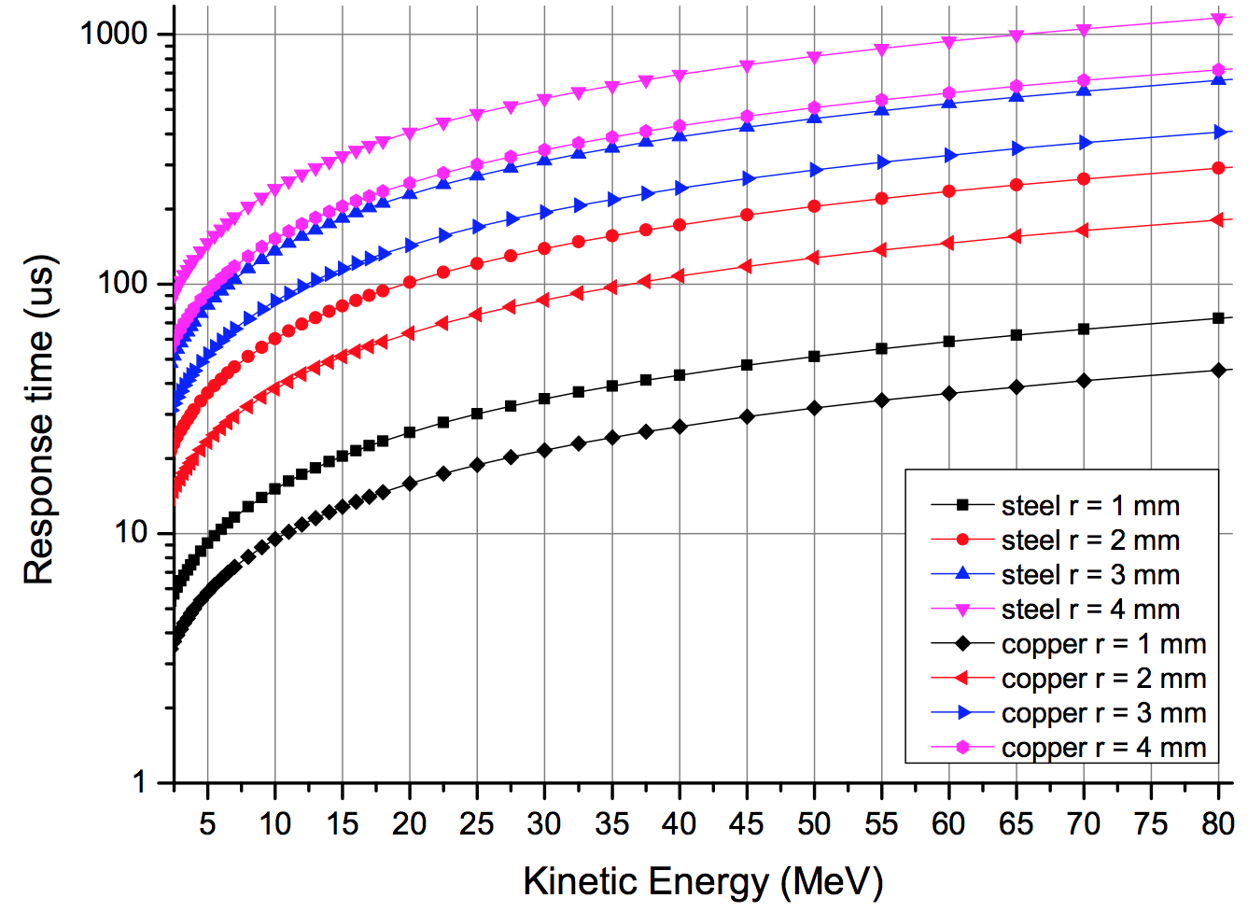

Example for ESS
Example:
After the DTL normal conducting linac, the proton energy is 78 MeV. In case of a beam size of 2 mm radius, melting would start after about 200 µs.
Inhibiting beam should be in about 10% of this time.
Time to melting point
L.Tchelidze
inhibit beam interlock signal
source
dT = dT_detect failure + dT_transmit signal + dT_inhibit source + dT_beam off

Slide 58
Some design principles for protection systems
Failsafe design
  detect internal faults
  possibility for remote testing, for example between two runs
  if the protection system does not work, better stop operation rather than damage equipment
Critical equipment should be redundant (possibly diverse)
Critical processes not by software (no operating system)
  no remote changes of most critical parameters
Demonstrate safety / availability / reliability
  use established methods to analyse critical systems and to predict failure rate
Managing interlocks
  disabling of interlocks is common practice (keep track !)
  LHC: masking of some interlocks possible for low intensity / low energy beams

Slide 59
Accelerators that require protection systems I
Hadron synchrotrons with large stored energy in the beam
  Colliders using protons / antiprotons (TEVATRON, HERA, LHC)
  Synchrotrons accelerating beams for fixed target experiments (SPS)
High power accelerators (e.g. spallation sources) with beam power of some 10 kW to above 1 MW
  Risk of damage and activation
  Spallation sources, up to (and above) 1 MW quasi-continuous beam power (SNS, ISIS, PSI cyclotron, JPARC, and in the future ESS, FRIB, MYRRHA and IFMIF)
Synchrotron light sources with high intensity beams and secondary photon beams
Energy recovery linacs
  Example of Daresbury prototype: one bunch train cannot damage equipment, but in case of beam loss next train must not leave the (injector) station
Notes:
59

Slide 60
Accelerators that require protection systems II
Linear colliders / accelerators with very high beam power densities due to small beam size
  High average power in linear accelerators: FLASH 90 kW, European XFEL 600 kW, JLab FEL 1.5 MW, ILC 11 MW
  One beam pulse can lead already to damage
  “any time interval large enough to allow a substantial change in the beam trajectory of component alignment (~fraction of a second), pilot beam must be used to prove the integrity” from NLC paper 1999
Medical accelerators: prevent too high dose to patient
  Low intensity, but techniques for protection are similar
Very short high current bunches: beam induces image currents that can damage the environment (bellows, beam instruments, cavities, …)
Notes:
60

Slide 61
For future high intensity machines
Machine protection should always start during the design phase of an accelerators
Particle tracking
  to establish loss distribution with realistic failure modes
  accurate aperture model required
Calculations of the particle shower (FLUKA, GEANT, …)
  energy deposition in materials
  activation of materials
  accurate 3-d description of accelerator components (and possibly the tunnel) required
Coupling between particle tracking and shower calculations
From the design, provide 3-d model of all components

Slide 62
Summary
Machine protection
is not equal to equipment protection
requires the understanding of many different type of failures that could lead to beam loss
requires comprehensive understanding of all aspects of the accelerator (accelerator physics, operation, equipment, instrumentation, functional safety)
touches many aspects of accelerator construction and operation
includes many systems
is becoming increasingly important for future projects, with increased beam power / energy density (W/mm² or J/mm² ) and increasingly complex machines

Slide 63
Acknowledgements to many colleagues from CERN and to the authors of the listed papers
R.F.Koontz, Multiple Beam Pulse of the SLAC Injector, PAC 1967
R.Bacher et al., The HERA Quench Protection System, a Status Report, EPAC 1996
C.Adolphsen et al., The Next Linear Collider Machine Protection System, PAC 1999
M.C.Ross et al., Single Pulse Damage in Copper, LINAC 2000
C.Sibley, Machine Protection Strategies for High Power Accelerators, PAC 2003
C.Sibley, The SNS Machine Protection System: Early Commissioning Results and Future Plans, PAC 2005
S.R.Buckley and R.J.Smith, Monitoring and Machine Protection Designs for the Daresbury Laboratory Energy Recovery Linac Prototype, EPAC 2006
L.Fröhlich et al., First Operation of the FLASH Machine Protection System with long Bunch Trains, LINAC 2006
L.Fröhlich et al., First Experience with the Machine Protection System of FLASH, FEL 2006
N.V.Mokhov et al., Beam Induced Damage to the TEVATRON Components and what has been done about it, HB2006
M.Werner and K.Wittenburg, Very fast Beam Losses at HERA, and what has been done about it, HB2006
S.Henderson, Status of the Spallation Neutron Source: Machine and Experiments, PAC 2007
H.Yoshikawa et al., Current Status of the Control System for J-PARC Accelerator Complex, ICALEPCS 2007
L.Froehlich, Machine Protection for FLASH and the European XFEL, DESY PhD Thesis 2009
A.C.Mezger, Control and protection aspects of the megawatt proton accelerator at PSI, HB2010
Y.Zhang, D.Stout, J.Wei, ANALYSIS OF BEAM DAMAGE TO FRIB DRIVER LINAC, SRF 2012

Slide 64
References
CERN and LHC
R.B.Appleby et. al., Beam-related machine protection for the CERN Large Hadron Collider experiments, Phys. Rev. ST Accel. Beams 13, 061002 (2010)
R.Schmidt et al., Protection of the CERN Large Hadron Collider, New Journal of Physics 8 (2006) 290
R.Schmidt, Machine Protection, CERN CAS 2008 Dourdan on Beam Diagnostics
N.Tahir et al., Simulations of the Full Impact of the LHC Beam on Solid Copper and Graphite Targets, IPAC 2010, Kyoto, Japan, 23 - 28 May 2010
Theses
Verena Kain, Machine Protection and Beam Quality during the LHC Injection Process, CERN-THESIS-2005-047
G.Guaglio, Reliability of the Beam Loss Monitors System for the Large Hadron Collider at CERN /, CERN-THESIS-2006-012 PCCF-T-0509
Benjamin Todd, A Beam Interlock System for CERN High Energy Accelerators, CERN-THESIS-2007-019
A. Gomez Alonso, Redundancy of the LHC machine protection systems in case of magnet failures / CERN-THESIS-2009-023
Sigrid Wagner, LHC Machine Protection System: Method for Balancing Machine Safety and Beam Availability /, CERN-THESIS-2010-215
Roderik Bruce, Beam loss mechanisms in relativistic heavy-ion colliders, CERN-THESIS-2010-030

Slide 65
References
L.Tchelidze, In how long the ESS beam pulse would start melting steel/copper accelerating components? ESS AD Technical Note, ESS/AD/0031, 2012
Conference reports in JACOW, keywords: machine protection, beam loss

