Slide 1


Multi-bunch Feedback Systems
Hermann Schmickler CAS 2013 - Trondheim
Slides and animations from Marco Lonza
Sincrotrone Trieste - Elettra

Slide 2
Outline
Introduction
Basics of feedback systems
Feedback system components
Digital signal processing
Integrated diagnostic tools
Conclusions

Slide 3
Ways to Control
open loop
(simple)
input
output
plant
(but) requires
precise knowledge of plant
plant
+
feed forward
anticipate, requires alternate means of influencing output
FF
feed back means influencing the system output by acting back on the input
plant
feedback
-
new system !
new properties ?
FB

Slide 4
“Hammer it flat”
Basic principle of any beam feedback: Counteract any longitudinal or transversal beam excursion.
Why worry about beam spectra, modes….?
→diagnostics: one wants to understand the beam dynamics
….sources of beam instabilities
→ cost for building a feedback system are in the required kick strength and the bandwidth of the actuator:
need to understand the requirements

Slide 5
Sources of instabilities
RF Cavity
Cavity High Order Modes (HOM)
High Q spurious resonances of the accelerating cavity excited by the bunched beam act back on the beam itself
Each bunch affects the following bunches through the wake fields excited in the cavity
The cavity HOM can couple with a beam oscillation mode having the same frequency and give rise to instability
E
Electron
Bunch
F
Resistive wall impedence
Interaction of the beam with the vacuum chamber (skin effect)
Particularly strong in low-gap chambers and in-vacuum insertion devices (undulators and wigglers)
e⁻
Interaction of the beam with other objects
Discontinuities in the vacuum chamber, small cavity-like structures, ...
Ex. BPMs, vacuum pumps, bellows, ...
e⁻
Ion instabilities
Gas molecules ionized by collision with the electron beam
Positive ions remains trapped in the negative electric potential
Produce electron-ion coherent oscillations
+
e⁻
+

Slide 6
Passive cures
Cavity High Order Modes (HOM)
Thorough design of the RF cavity
Mode dampers with antennas and resistive loads
Tuning of HOMs frequencies through plungers or changing the cavity temperature
Resistive wall impedance
Usage of low resistivity materials for the vacuum pipe
Optimization of vacuum chamber geometry
e⁻
Interaction of the beam with other objects
Proper design of the vacuum chamber and of the various installed objects
e⁻
Ion instabilities
Ion cleaning with a gap in the bunch train
+
e⁻
+
Landau damping by increasing the tune spread
Higher harmonic RF cavity (bunch lengthening)
Modulation of the RF
Octupole magnets (transverse)
Active Feedbacks

Slide 7

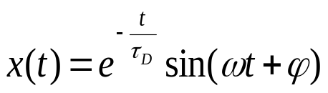
Equation of motion of one particle: harmonic oscillator analogy
“x” is the oscillation coordinate (transverse or longitudinal displacement)
Natural damping
Betatron/Synchrotron frequency:
tune (ν) x revolution frequency (ω₀)
If ω >> D, an approximated solution of the differential equation is a damped sinusoidal oscillation:
where τ_{D} = 1/D is the “damping time constant” (D is called “damping rate”)
Excited oscillations (ex. by quantum excitation) are damped by natural damping (ex. due to synchrotron radiation damping). The oscillation of individual particles is uncorrelated and shows up as an emittance growth

Slide 8


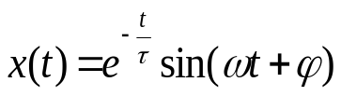
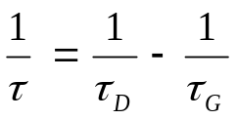
Coherent Bunch Oscillations
Coupling with other bunches through the interaction with surrounding metallic structures addd a “driving force” term F(t) to the equation of motion:
Under given conditions the oscillation of individual particles becomes correlated and the centroid of the bunch oscillates giving rise to coherent bunch (coupled bunch) oscillations
Each bunch oscillates according to the equation of motion:
where τ_{G} = 1/G is the “growth time constant” (G is called “growth rate”)
If D > G the oscillation amplitude decays exponentially
If D < G the oscillation amplitude grows exponentially
as:
where
Since G is proportional to the beam current, if the latter is lower than a given current threshold the beam remains stable, if higher a coupled bunch instability is excited

Slide 9

Feedback Damping Action
The feedback action adds a damping term D_{fb} to the equation of motion
Such that D-G+D_{fb} > 0
A multi-bunch feedback detects an instability by means of one or more Beam Position Monitors (BPM) and acts back on the beam by applying electromagnetic ‘kicks’ to the bunches
PROCESSING
DETECTOR
KICKER
In order to introduce damping, the feedback must provide a kick proportional to the derivative of the bunch oscillation
Since the oscillation is sinusoidal, the kick signal for each bunch can be generated by shifting by π/2 the oscillation signal of the same bunch when it passes through the kicker

Slide 11
BPM A
BPM B

Slide 12
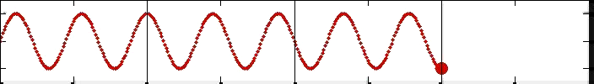
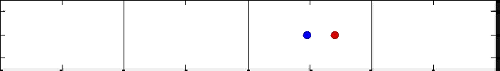
Multi-bunch modes
Typically, betatron tune frequencies (horizontal and vertical) are higher than the revolution frequency, while the synchrotron tune frequency (longitudinal) is lower than the revolution frequency
Ex.
Vertical
Tune = 2.25
Longitudinal
Tune = 0.5
0 1 2 3 4
Machine Turns
Although each bunch oscillates at the tune frequency, there can be different modes of oscillation, called multi-bunch modes depending on how each bunch oscillates with respect to the other bunches

Slide 13
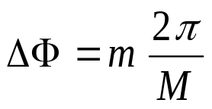

Multi-bunch modes
Let us consider M bunches equally spaced around the ring
Each multi-bunch mode is characterized by a bunch-to-bunch phase difference of:
m = multi-bunch mode number (0, 1, .., M-1)
Each multi-bunch mode is associated to a characteristic set of frequencies:
Where:
p is and integer number -∞ < p < ∞
ω₀ is the revolution frequency
Mω₀ = ω_{rf} is the RF frequency (bunch repetition frequency)
ν is the tune
Two sidebands at ±(m+ν)ω₀ for each multiple of the RF frequency

Slide 14
Multi-bunch modes
The spectrum is a repetition of frequency lines at multiples of the bunch repetition frequency with sidebands at ±νω₀: ω = pω_{rf} ± νω₀ -∞ < p < ∞ (ν = 0.25)
. . . . .
. . . . .
−3ω_{rf}
−2ω_{rf}
−ω_{rf}
0
ω_{rf}
2ω_{rf}
3ω_{rf}
Since the spectrum is periodic and each mode appears twice (upper and lower side band) in a ω_{rf} frequency span, we can limit the spectrum analysis to a 0-ω_{rf}/2 frequency range
The inverse statement is also true:
Since we ‘sample’ the continuous motion of the beam with only one pickup, any other frequency component above half the ‘sampling frequency’ (i.e the bunch frequency ω_{rf} ) is not accessible (Nyquist or Shannon Theorem)

Slide 15
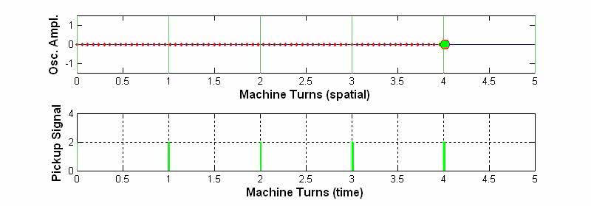
Multi-bunch modes: example1
Pickup position
Vertical plane. One single stable bunch
Every time the bunch passes through the pickup ( ) placed at coordinate 0, a pulse with constant amplitude is generated. If we think it as a Dirac impulse, the spectrum of the pickup signal is a repetition of frequency lines at multiple of the revolution frequency: pω₀ for -∞ < p < ∞
. . . . .
. . . . .
−3ω₀
−2ω₀
−ω₀
0
ω₀
2ω₀
3ω₀

Slide 16
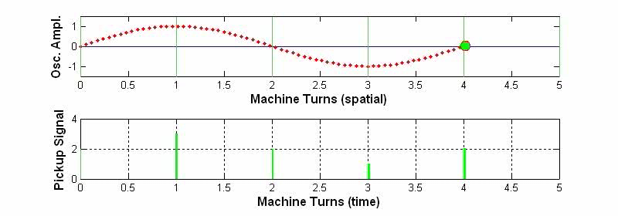
Multi-bunch modes: example2
One single unstable bunch oscillating at the tune frequency νω₀: for simplicity we consider a vertical tune ν < 1, ex. ν = 0.25. M = 1 → only mode #0 exists
Pickup
The pickup signal is a sequence of pulses modulated in amplitude with frequency νω₀
Two sidebands at ±νω₀ appear at each of the revolution harmonics
. . . . .
. . . . .
−3ω₀
−2ω₀
−ω₀
0
ω₀
2ω₀
3ω₀

Slide 17
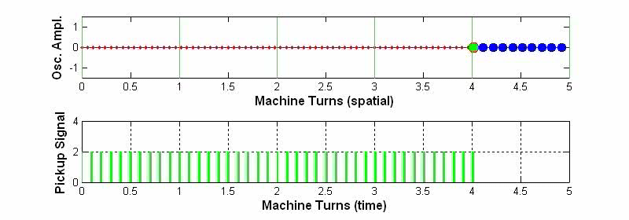
Multi-bunch modes: example3
Ten identical equally-spaced stable bunches filling all the ring buckets (M = 10)
Pickup
The spectrum is a repetition of frequency lines at multiples of the bunch repetition frequency: ω_{rf} = 10 ω₀ (RF frequency)
. . . . .
. . . . .
−3ω_{rf}
−2ω_{rf}
−ω_{rf}
0
ω_{rf}
2ω_{rf}
3ω_{rf}

Slide 18
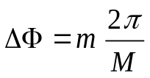
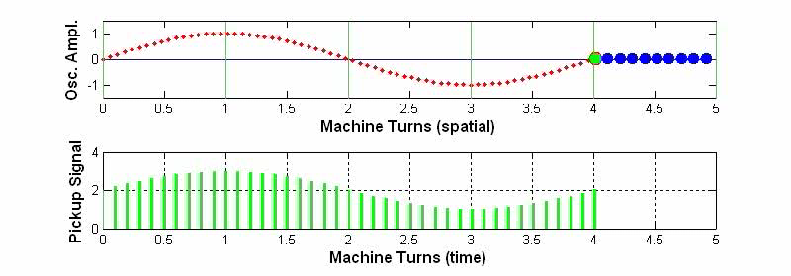
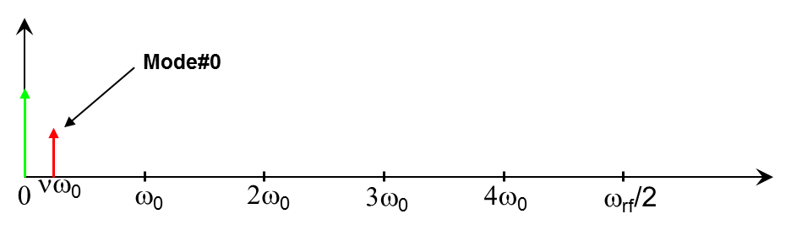
Multi-bunch modes: example4
Ten identical equally-spaced unstable bunches oscillating at the tune frequency νω₀ (ν = 0.25)
M = 10 → there are 10 possible modes of oscillation
Ex.: mode #0 (m = 0) ΔΦ=0 all bunches oscillate with the same phase
m = 0, 1, .., M-1
Pickup

Slide 19
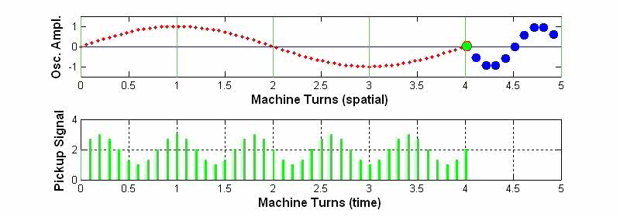
Multi-bunch modes: example5
Ex.: mode #1 (m = 1) ΔΦ = 2π/10 (ν = 0.25)
Pickup
ω = pω_{rf} ± (ν+1)ω₀ -∞ < p < ∞
Mode#1
0
ω₀
2ω₀
3ω₀
4ω₀
ω_{rf}/2

Slide 20
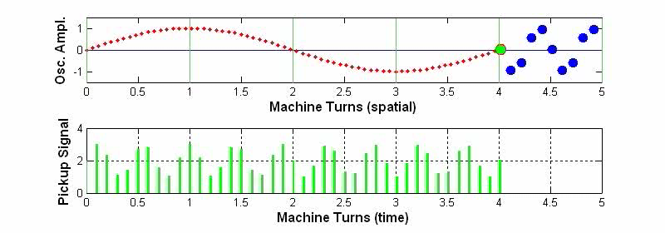
Multi-bunch modes: example6
Ex.: mode #2 (m = 2) ΔΦ = 4π/10 (ν = 0.25)
Pickup
ω = pω_{rf} ± (ν+2)ω₀ -∞ < p < ∞
Mode#2
0
ω₀
2ω₀
3ω₀
4ω₀
ω_{rf}/2

Slide 21
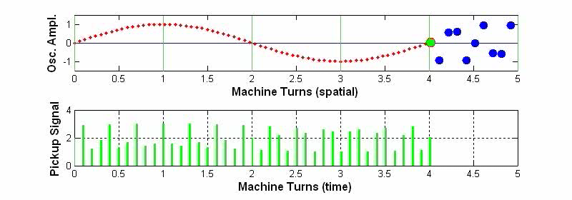
Multi-bunch modes: example7
Ex.: mode #3 (m = 3) ΔΦ = 6π/10 (ν = 0.25)
Pickup
ω = pω_{rf} ± (ν+3)ω₀ -∞ < p < ∞
Mode#3
0
ω₀
2ω₀
3ω₀
4ω₀
ω_{rf}/2

Slide 22
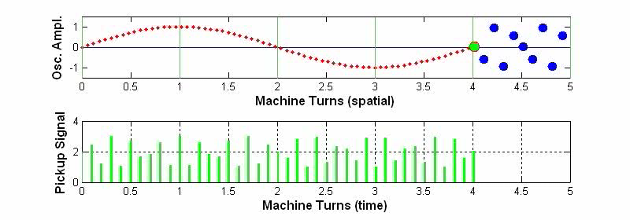
Multi-bunch modes: example8
Ex.: mode #4 (m = 4) ΔΦ = 8π/10 (ν = 0.25)
Pickup
ω = pω_{rf} ± (ν+4)ω₀ -∞ < p < ∞
Mode#4
0
ω₀
2ω₀
3ω₀
4ω₀
ω_{rf}/2

Slide 23
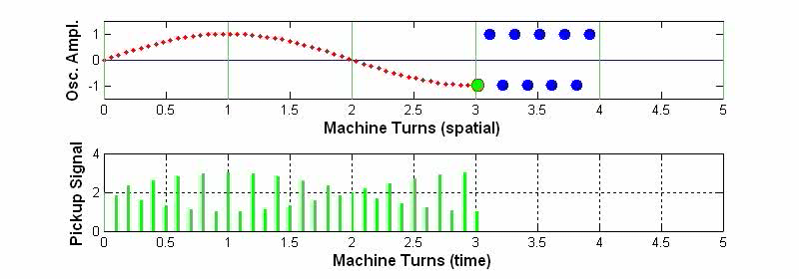
Multi-bunch modes: example9
Ex.: mode #5 (m = 5) ΔΦ = π (ν = 0.25)
Pickup
ω = pω_{rf} ± (ν+5)ω₀ -∞ < p < ∞
Mode#5
0
ω₀
2ω₀
3ω₀
4ω₀
ω_{rf}/2

Slide 24
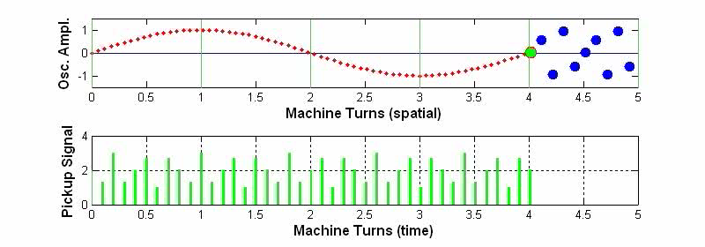
Multi-bunch modes: example10
Ex.: mode #6 (m = 6) ΔΦ = 12π/10 (ν = 0.25)
Pickup
ω = pω_{rf} ± (ν+6)ω₀ -∞ < p < ∞
Mode#6
0
ω₀
2ω₀
3ω₀
4ω₀
ω_{rf}/2

Slide 25

Multi-bunch modes: example11
Ex.: mode #7 (m = 7) ΔΦ = 14π/10 (ν = 0.25)
Pickup
ω = pω_{rf} ± (ν+7)ω₀ -∞ < p < ∞
Mode#7
0
ω₀
2ω₀
3ω₀
4ω₀
ω_{rf}/2

Slide 26
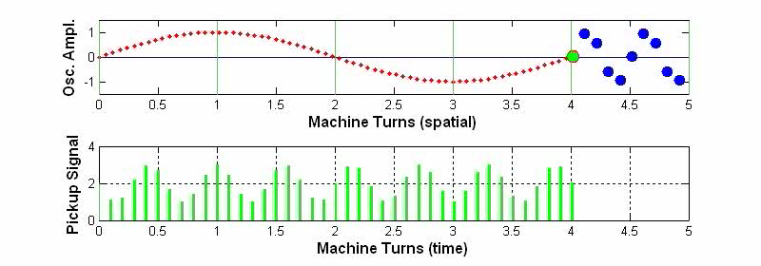
Multi-bunch modes: example12
Ex.: mode #8 (m = 8) ΔΦ = 16π/10 (ν = 0.25)
Pickup
ω = pω_{rf} ± (ν+8)ω₀ -∞ < p < ∞
Mode#8
0
ω₀
2ω₀
3ω₀
4ω₀
ω_{rf}/2

Slide 27
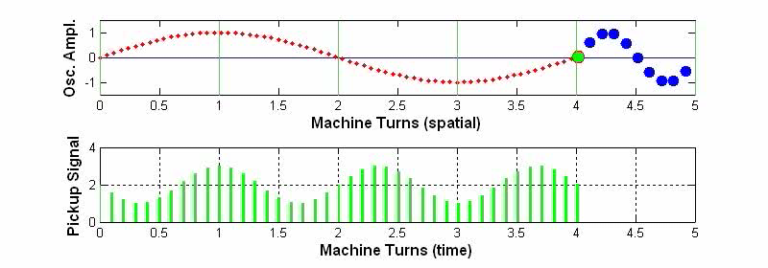
Multi-bunch modes: example13
Ex.: mode #9 (m = 9) ΔΦ = 18π/10 (ν = 0.25)
Pickup
ω = pω_{rf} ± (ν+9)ω₀ -∞ < p < ∞
Mode#9
0
ω₀
2ω₀
3ω₀
4ω₀
ω_{rf}/2

Slide 28
Multi-bunch modes: uneven filling and longitudinal modes
0
9
1
8
2
7
3
6
4
5
5
4
6
3
7
2
8
1
9
0
0
ω₀
2ω₀
3ω₀
4ω₀
ω_{rf}/2
6ω₀
7ω₀
8ω₀
9ω₀
ω_{rf}
If the bunches have not the same charge, i.e. the buckets are not equally filled (uneven filling), the spectrum has frequency components also at the revolution harmonics (multiples of ω₀). The amplitude of each revolution harmonic depends on the filling pattern of one machine turn
In case of longitudinal modes, we have a phase modulation of the stable beam signal. Components at ±νω₀, ± 2νω₀, ± 3νω₀, … can appear aside the revolution harmonics. Their amplitude depends on the depth of the phase modulation (Bessel series expansion)
νω₀
nω₀

Slide 29
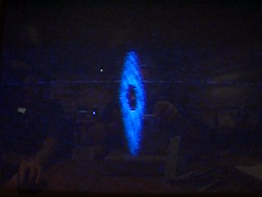


Multi-bunch modes: coupled-bunch instability
One multi-bunch mode can become unstable if one of its sidebands overlaps, for example, with the frequency response of a cavity high order mode (HOM). The HOM couples with the sideband giving rise to a coupled‑bunch instability, with consequent increase of the sideband amplitude
Response of a cavity HOM
nω₀
Effects of coupled-bunch instabilities:
increase of the transverse beam dimensions
increase of the effective emittance
beam loss and max current limitation
increase of lifetime due to decreased Touschek scattering (dilution of particles)
Synchrotron Radiation Monitor showing the transverse beam shape

Slide 30
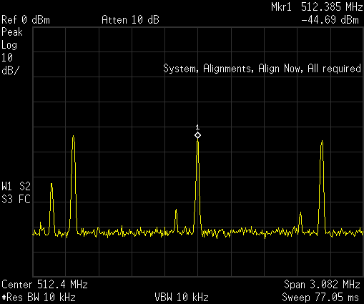
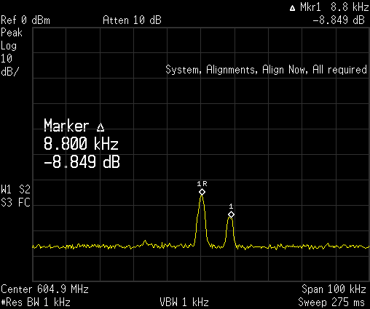
Real example of multi-bunch modes
ELETTRA Synchrotron: f_{rf}=499.654 Mhz, bunch spacing≈2ns, 432 bunches, f₀ = 1.15 MHz
ν_{hor}= 12.30(fractional tune frequency=345kHz), ν_{vert}=8.17(fractional tune frequency=200kHz) ν_{long} = 0.0076 (8.8 kHz)
Rev. harmonic
Spectral line at 512.185 MHz
Lower sideband of 2f_{rf}, 200 kHz apart from the 443rd revolution harmonic
→ vertical mode #413
Vertical mode
#413
200 kHz
Spectral line at 604.914 MHz
Upper sideband of f_{rf}, 8.8kHz apart from the 523rd revolution harmonic
→ longitudinal mode #91
Rev. harmonic
Long. mode
#91
8.8kHz

Slide 31
Feedback systems
A multi-bunch feedback system detects the instability using one or more Beam Position Monitors (BPM) and acts back on the beam to damp the oscillation through an electromagnetic actuator called kicker
DETECTOR
FEEDBACK
PROCESSING
POWER
AMPLIFIER
Kicker
BPM
BPM and detector measure the beam oscillations
The feedback processing unit generates the correction signal
The RF power amplifier amplifies the signal
The kicker generates the electromagnetic field

Slide 32
Mode-by-mode feedback
A mode-by-mode (frequency domain) feedback acts separately on each unstable mode
f₁
delay1
TRANSVERSE FEEDBACK
f₂
delay2
+
POWER
AMPLIFIER
f₃
delay3
.
.
.
Δ
BPM
Kicker
An analog electronics generates the position error signal from the BPM buttons
A number of processing channels working in parallel each dedicated to one of the controlled modes
The signals are band-pass filtered, phase shifted by an adjustable delay line to produce a negative feedback and recombined

Slide 33
Bunch-by-bunch feedback
A bunch-by-bunch (time domain) feedback individually steers each bunch by applying small electromagnetic kicks every time the bunch passes through the kicker: the result is a damped oscillation lasting several turns
The correction signal for a given bunch is generated based on the motion of the same bunch
Example of implementation using a time division scheme
Channel1
TRANSVERSE FEEDBACK
delay
POWER
AMPLIFIER
Channel2
Channel3
.
.
.
Δ
BPM
Kicker
Every bunch is measured and corrected at every machine turn but, due to the delay of the feedback chain, the correction kick corresponding to a given measurement is applied to the bunch one or more turns later
Damping the oscillation of each bunch is equivalent to damping all multi-bunch modes

Slide 34
Analog bunch-by-bunch feedback: one-BPM feedback
Transverse feedback
The correction signal applied to a given bunch must be proportional to the derivative of the bunch oscillation at the kicker, thus it must be a sampled sinusoid shifted π/2 with respect to the oscillation of the bunch when it passes through the kicker
The signal from a BPM with the appropriate betatron phase advance with respect to the kicker can be used to generate the correction signal
Detector
Delay
POWER
AMPLIFIER
Δ
BPM
Kicker
The detector down converts the high frequency (typically a multiple of the bunch frequency f_{rf}) BPM signal into base-band (range 0 - f_{rf}/2)
The delay line assures that the signal of a given bunch passing through the feedback chain arrives at the kicker when, after one machine turn, the same bunch passes through it

Slide 35
Analog bunch-by-bunch feedback: two-BPM feedback
Transverse feedback case
Delay
Detector
Att.
+
Delay
POWER
AMPLIFIER
Detector
Att.
Δ
Δ
BPM1
BPM2
Kicker
BPM2
The two BPMs can be placed in any ring position with respect to the kicker providing that they are separated by π/2 in betatron phase
Their signals are combined with variable attenuators in order to provide the required phase of the resulting signal
α₂
α₁
BPM1

Slide 36
Analog feedback: revolution harmonics suppression
Transverse feedback case
The revolution harmonics (frequency components at multiples of ω₀) are useless components that have to be eliminated in order not to saturate the RF amplifier
This operation is also called “stable beam rejection”
Delay
Detector
Att.
+
Notch
Filters
Delay
POWER
AMPLIFIER
Detector
Att.
Δ
Δ
BPM1
BPM2
Kicker
Similar feedback architectures have been used to built the transverse multi-bunch feedback system of a number of light sources: ex. ALS, BessyII, PLS, ANKA, …

Slide 37
Digital bunch-by-bunch feedback
Transverse and longitudinal case
Digital
Signal
Processing
Detector
Stable Beam Rejection
ADC
DAC
Modulator
Delay
RF POWER
AMPLIFIER
Combiner
BPM
Kicker
The combiner generates the X, Y or Σ signal from the BPM button signals
The detector (RF front-end) demodulates the position signal to base-band
”Stable beam components” are suppressed by the stable beam rejection module
The resulting signal is digitized, processed and re-converted to analog by the digital processor
The modulator translates the correction signal to the kicker working frequency (long. only)
The delay line adjusts the timing of the signal to match the bunch arrival time
The RF power amplifier supplies the power to the kicker

Slide 38
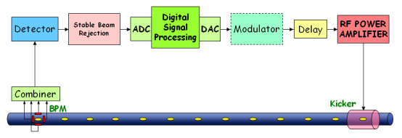
Digital vs. analog feedbacks
ADVANTAGES OF DIGITAL FEEDBACKS
reproducibility: all parameters (gains, delays, filter coefficients) are NOT subject to temperature/environment changes or aging
programmability: the implementation of processing functionalities is usually made using DSPs or FPGAs, which are programmable via software/firmware
performance: digital controllers feature superior processing capabilities with the possibility to implement sophisticated control algorithms not feasible in analog
additional features: possibility to combine basic control algorithms and additional useful features like signal conditioning, saturation control, down sampling, etc.
implementation of diagnostic tools, used for both feedback commissioning and machine physics studies
easier and more efficient integration of the feedback in the accelerator control system for data acquisition, feedback setup and tuning, automated operations, etc.
DISADVANTAGE OF DIGITAL FEEDBACKS
High delay due to ADC, digital processing and DAC

Slide 39
BPM and Combiner
The four signals from a standard four-button BPM can be opportunely combined to obtain the wide-band X, Y and Σ signals used respectively by the horizontal, vertical and longitudinal feedbacks
Any f_{rf}/2 portion of the beam spectrum contains the information of all potential multi-bunch modes and can be used to detect instabilities and measure their amplitude
Usually BPM and combiner work around a multiple of f_{rf}, where the amplitude of the overall frequency response of BPM and cables is maximum
Moreover, a higher f_{rf} harmonic is preferred for the longitudinal feedback because of the better sensitivity of the phase detection system
C
O
M
B
I
N
E
R
X=(A+D)-(B+C)
BPM
Y=(A+B)-(C+D)
. . .
A
B
f_{rf}
2f_{rf}
3f_{rf}
D
C
0
Σ =A+B+C+D
The SUM (Σ) signal contains only information of the phase (longitudinal position) of the bunches, since the sum of the four button signals has almost constant amplitude

Slide 40
Detector: transverse feedback
The detector (or RF front-end) translates the wide-band signal to base-band (0-f_{rf}/2 range): the operation is an amplitude demodulation
. . . . .
0
f_{rf}
2f_{rf}
3f_{rf}
Heterodyne technique: the “local oscillator” signal is derived from the RF by multiplying its frequency by an integer number corresponding to the chosen harmonic of f_{rf}
Band-pass
Filter
Low-pass
Filter
X or Y
Base-band
0-f_{rf}/2 range
X or Y
Wideband
f_{rf}
X3

Slide 41
Detector: longitudinal feedback
The detector generates the base-band longitudinal position (phase error) signal (0-f_{rf}/2 range) by processing the wide-band signal: the operation is a phase demodulation
The phase demodulation can be obtained with the same heterodyne technique but using a local oscillator signal in quadrature (shifted π/2) with respect to the bunches
Σ
Wideband
Band-pass
Filter
Low-pass
Filter
Phase error
Baseband
0-f_{rf}/2 range
f_{rf}
X3
π/2
Amplitude demodulation:
A(t) sin(3ω_{rf} t) . sin(3ω_{rf}t) ∝ A(t) ( cos(0) – cos(6ω_{rf}t ) ) ≈ A(t)
Phase demodulation:
sin( 3ω_{rf} t + ϕ(t) ) . cos(3ω_{rf}t) ∝ sin( 6ω_{rf} t + ϕ(t) ) + sin( ϕ(t) ) ≈ ϕ(t)
Low-pass filter
Low-pass filter
For small signals

Slide 42
Detector: time domain considerations
The base-band signal can be seen as a sequence of “pulses” each with amplitude proportional to the position error (X, Y or Φ) and to the charge of the corresponding bunch
By sampling this signal with an A/D converter synchronous to the bunch frequency, one can measure X, Y or Φ
Sampling Period = 1/f_{rf}
Amplitude
The multi-bunch-mode number M/2 is the one with higher frequency (≈f_{rf}/2): the pulses have almost the same amplitude but alternating signs
Bunch#1
Bunch#2
Bunch#3
Bunch#4
T₁
T₂
T₃
T₄
Time
The design of band-pass and low-pass filters is a compromise between maximum flatness of the top of the pulses and cross-talk between bunches due to overlap with adjacent pulses
Good flatness
Ideal case:
max flatness with min cross-talk
Amplitude
NO
Bad flatness
YES
Cross-Talk
Time

Slide 43
Rejection of stable beam signal
The turn-by-turn pulses of each bunch can have a constant offset (stable beam signal) due to:
  transverse case: off-centre beam or unbalanced BPM electrodes or cables
  longitudinal case: beam loading, i.e. different synchronous phase for each bunch
In the frequency domain, the stable beam signal carries non-zero revolution harmonics
These components have to be suppressed because don’t contain information about multi-bunch modes and can saturate ADC, DAC and amplifier
Examples of used techniques:
Balancing of BPM buttons: variable attenuators on the electrodes to equalize the amplitude of the signals (transverse feedback)
Att.
BPM
To the detector
Att.
From the detector
T_{rev} delay
Comb filter using delay lines and combiners: the frequency response is a series of notches at multiple of ω₀, DC included
-
. . .
0
ω_{o}
2ω_{o}
Digital DC rejection: the signal is sampled at f_{rf}, the turn-by-turn signal is integrated for each bunch, recombined with the other bunches, converted to analog and subtracted from the original signal
From the detector
-
Delay
DAC
FPGA
ADC

Slide 44
Digital processor
The A/D converter samples and digitizes the signal at the bunch repetition frequency: each sample corresponds to the position (X, Y or Φ) of a given bunch. Precise synchronization of the sampling clock with the bunch signal must be provided
The digital samples are then de-multiplexed into M channels (M is the number of bunches): in each channel the turn-by-turn samples of a given bunch are processed by a dedicated digital filter to calculate the correction samples
The basic processing consists in DC component suppression (if not completely done by the external stable beam rejection) and phase shift at the betatron/synchrotron frequency
After processing, the correction sample streams are recombined and eventually converted to analog by the D/A converter
D
e
m
u
x
Filter #1
M
u
x
Filter #2
Error signal
ADC
Filter #3
DAC
Correction signal
Filter #4
Clock
Filter #5
Clock
.
.
.

Slide 45
Digital processor implementation
ADC: existing multi-bunch feedback systems usually employ 8-bit ADCs at up to 500 Msample/s; some implementations use a number of ADCs with higher resolution (ex. 14 bits) and lower rate working in parallel. ADCs with enhanced resolution have some advantages:
  lower quantization noise (crucial for low-emittance machines)
  higher dynamic range (external stable beam rejection not necessary)
DAC: usually employed DACs convert samples at up to 500 Msample/s and 14-bit resolution
Digital Processing: the feedback processing can be performed by discrete digital electronics (obsolete technology), DSPs or FPGAs
Pros Cons
Easy programming Flexible | Difficult HW integration Latency Sequential program execution A number of DSPs are necessary
Fast (only one FPGA is necessary) Parallel processing Low latency | Trickier programming Less flexible
DSP
FPGA

Slide 46
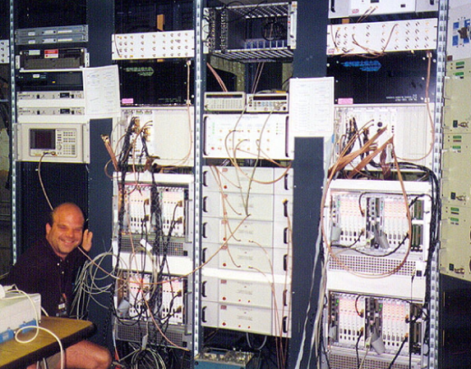
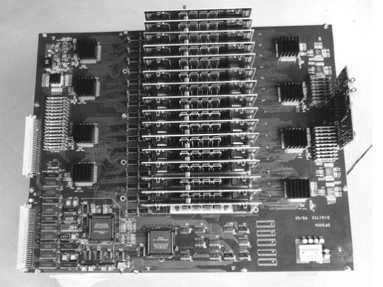
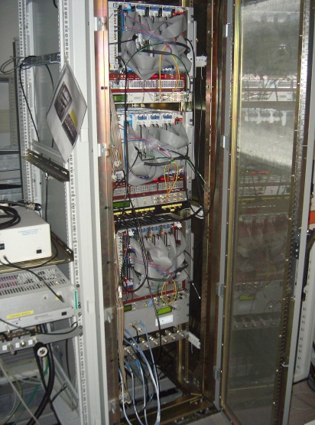
Examples of digital processors
PETRA transverse and longitudinal feedbacks: one ADC, a digital processing electronics made of discrete components (adders, multipliers, shift registers, …) implementing a FIR filter, and a DAC
ALS/PEP-II/DAΦNE longitudinal feedback (also adopted at SPEAR, Bessy II and PLS): A/D and D/A conversions performed by VXI boards, feedback processing made by DSP boards hosted in a number of VME crates
PEP-II transverse feedback: the digital part, made of two ADCs, a FPGA and a DAC, features a digital delay and integrated diagnostics tools, while the rest of the signal processing is made analogically
KEKB transverse and longitudinal feedbacks: the digital processing unit, made of discrete digital electronics and banks of memories, performs a two tap FIR filter featuring stable beam rejection, phase shift and delay
Elettra/SLS transverse and longitudinal feedbacks: the digital processing unit is made of a VME crate equipped with one ADC, one DAC and six commercial DSP boards (Elettra only) with four microprocessors each

Slide 47
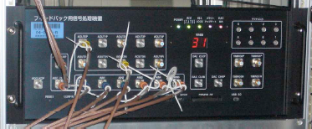
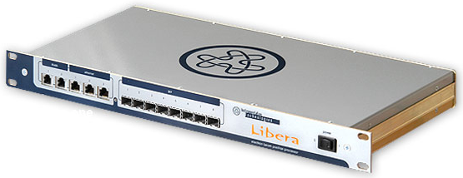
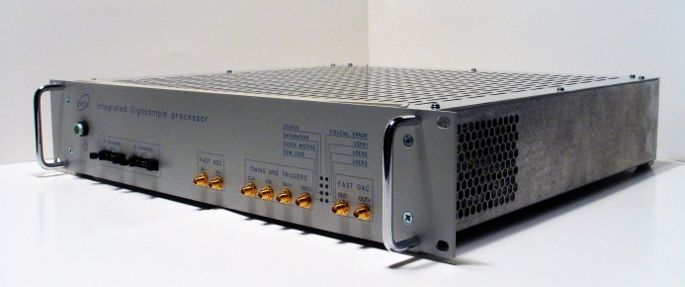
Examples of digital processors
CESR transverse and longitudinal feedbacks: they employ VME digital processing boards equipped with ADC, DAC, FIFOs and PLDs
HERA-p longitudinal feedback: it is made of a processing chain with two ADCs (for I and Q components), a FPGA and two DACs
SPring-8 transverse feedback (also adopted at TLS, KEK Photon Factory and Soleil): fast analog de-multiplexer that distributes analog samples to a number of slower ADC FPGA channels. The correction samples are converted to analog by one DAC
ESRF transverse/longitudinal and Diamond transverse feedbacks: commercial product ‘Libera Bunch by Bunch’ (by Instrumentation Technologies), which features four ADCs sampling the same analog signal opportunely delayed, one FPGA and one DAC
HLS tranverse feedback: the digital processor consists of two ADCs, one FPGA and two DACs
DAΦNE transverse and KEK-Photon-Factory longitudinal feedbacks: commercial product called ‘iGp’ (by Dimtel), featuring an ADC-FPGA-DAC chain

Slide 48
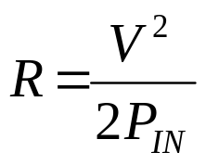
Amplifier and kicker
The kicker is the feedback actuator. It generates a transverse/longitudinal electromagnetic field that steers the bunches with small kicks as they pass through the kicker. The overall effect is damping of the betatron/synchrotron oscillations
The amplifier must provide the necessary RF power to the kicker by amplifying the signal from the DAC (or from the modulator in the case of longitudinal feedbacks)
A bandwidth of at least f_{rf}/2 is necessary: from ~DC (all kicks of the same sign) to ~f_{rf}/2 (kicks of alternating signs)
The bandwidth of amplifier-kicker must be sufficient to correct each bunch with the appropriate kick without affecting the neighbour bunches. The amplifier-kicker design has to maximize the kick strength while minimizing the cross-talk between corrections given to adjacent bunches
Shunt impedance, ratio between the squared voltage seen by the bunch and twice the power at the kicker input:
A
Important issue: the group delay of the amplifier must be as constant as possible, i.e. the phase response must be linear, otherwise the feedback efficiency is reduced for some modes and the feedback can even become positive
ϕ
Anti-damping
0
180°

Slide 49
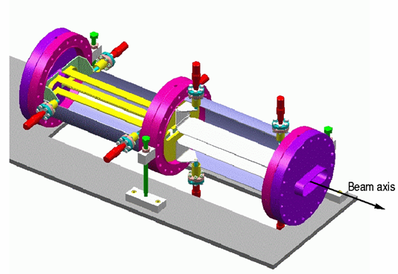
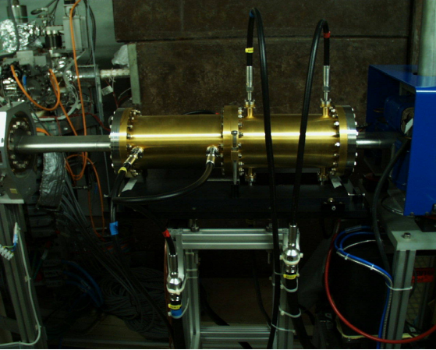
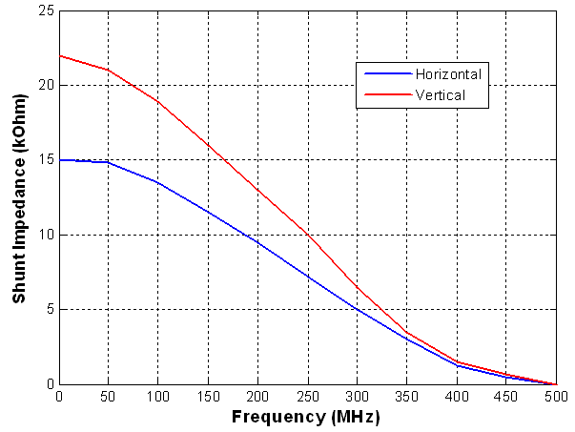
Kicker and Amplifier: transverse FB
For the transverse kicker a stripline geometry is usually employed
Amplifier and kicker work in the ~DC - ~f_{rf}/2 frequency range
Power
Amplifier
50Ω
load
Low-pass
filter
KICKER
D
AC
180°
Beam
Power
Amplifier
Low-pass
filter
50Ω
load
Shunt impedance of the ELETTRA/SLS transverse kickers
The ELETTRA/SLS transverse kicker (by Micha Dehler-PSI)

Slide 50
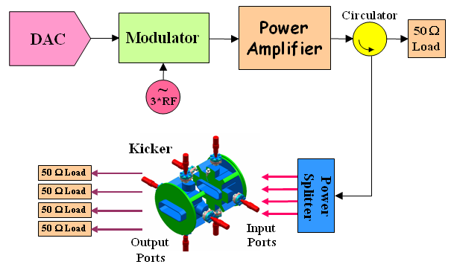
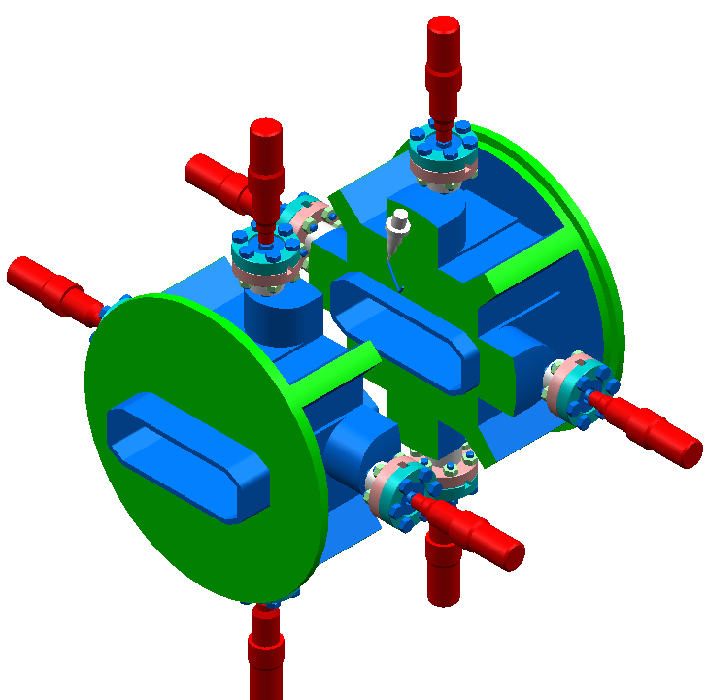
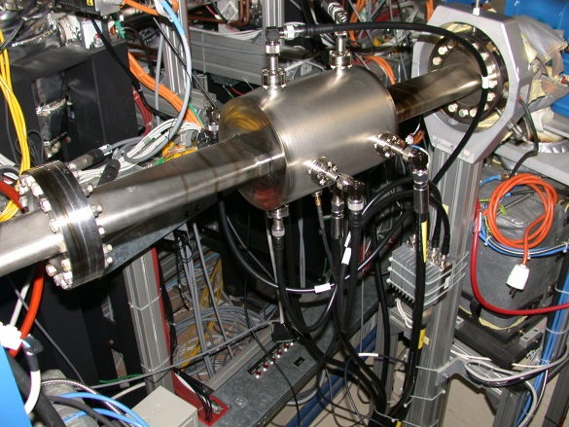
Kicker and Amplifier: longitudinal FB
A “cavity like” kicker is usually preferred
Higher shunt impedance and smaller size
The operating frequency range is typically f_{rf}/2 wide and placed on one side of a multiple of f_{rf}:
ex. from 3f_{rf} to 3f_{rf}+f_{rf}/2
A “pass-band” instead of “base-band” device
The base-band signal from the DAC must be modulated, i.e. translated in frequency
A SSB (Single Side Band) amplitude modulation or similar techniques (ex. QPSK) can be adopted
Kicker Shunt Impedance
The ELETTRA/SLS longitudinal kicker (by Micha Dehler-PSI)
0
f_{rf}
2f_{rf}
3f_{rf}

Slide 51

Control system integration
It is desirable that each component of the feedback system that needs to be configured and adjusted has a control system interface
Any operation must be possible from remote to facilitate the system commissioning and the optimization of its performance
An effective data acquisition channel has to provide fast transfer of large amounts of data for analysis of the feedback performance and beam dynamics studies
It is preferable to have a direct connection to a numerical computing environment and/or a script language (ex. Matlab, Octave, Scilab, Python, IGOR Pro, IDL, …) for quick development of measurement procedures using scripts as well as for data analysis and visualization
Control System

Slide 52
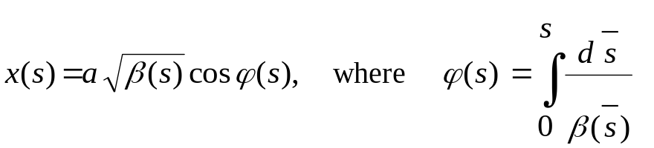
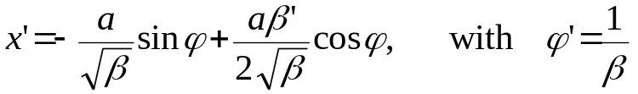
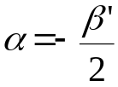
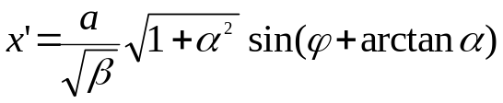
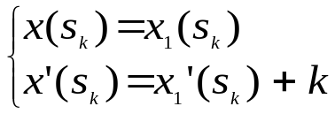


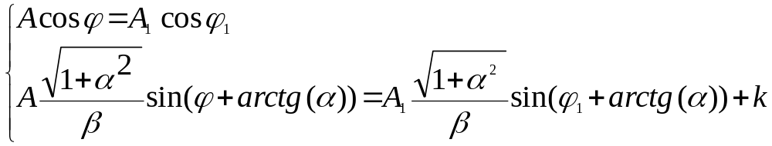
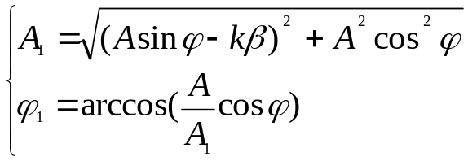
RF power requirements: transverse feedback
The transverse motion of a bunch of particles not subject to damping or excitation can be described as a pseudo-harmonic oscillation with amplitude proportional to the square root of the β-function
The derivative of the position, i.e. the angle of the trajectory is:
By introducing
we can write:
At the coordinate s_{k}, the electromagnetic field of the kicker deflects the particle bunch which varies its angle by k : as a consequence the bunch starts another oscillation
which must satisfy the following constraints:
By introducing
the two-equation two-unknown-variables system becomes:
The solution of the system gives amplitude and phase of the new oscillation:

Slide 53

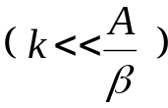
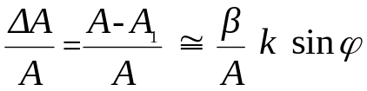
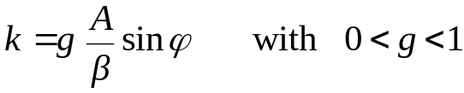
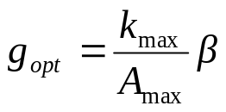
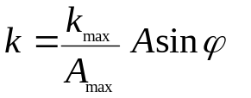
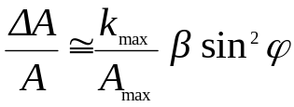



RF power requirements: transverse feedback
From
if the kick is small
then
In the linear feedback case, i.e. when the turn-by-turn kick signal is a sampled sinusoid proportional to the bunch oscillation amplitude, in order to maximize the damping rate the kick signal must be in-phase with sinϕ, that is in quadrature with the bunch oscillation
The optimal gain g_{opt} is determined by the maximum kick value k_{max} that the kicker is able to generate. The feedback gain must be set so that k_{max} is generated when the oscillation amplitude A at the kicker location is maximum:
Therefore
For small kicks
the relative amplitude decrease is monotonic and its average is:
The average relative decrease is therefore constant, which means that, in average, the amplitude decrease is exponential with time constant τ (damping time) given by:
where T₀ is the revolution period.
By referring to the oscillation at the BPM location:
A_{Bmax} is the max oscillation amplitude at the BPM

Slide 54









RF power requirements: transverse feedback
For relativistic particles, the change of the transverse momentum p of the bunch passing through the kicker can be expressed by:
where
is the kick voltage and
e = electron charge, c = light speed,
= fields in the kicker, L = length of the kicker, E_{B} = beam energy
can be derived from the definition of kicker shunt impedance:
The max deflection angle in the kicker is given by:
From the previous equations we can obtain the power required to damp the bunch oscillation with time constant τ:

Slide 55




RF power requirements
Max oscillation amplitude
Longitudinal
Transverse
Required damping time
The required RF power depends on:
  the strength of the instability
  the maximum oscillation amplitude
If we switch the feedback on when the oscillation is small, the required power is lower
Example:
Elettra Transverse feedback
R_{k} = 15 kΩ (average value)
E_{B}/e = 2GeV
T₀ = 864 ns
τ = 120 μs
β_{B} _{H,V} = 5.2, 8.9 m
β_{K} _{H,V} = 6.5, 7.5 m

Slide 56
Digital signal processing
D
e
m
u
x
Filter #1
M
u
x
Filter #2
Error signal
ADC
Filter #3
Compensation
Filter
DAC
Correction signal
Filter #4
Filter #5
.
.
.
M channel/filters each dedicated to one bunch: M is the number of bunches
To damp the bunch oscillations the turn-by-turn kick signal must be the derivative of the bunch position at the kicker: for a given oscillation frequency a π/2 phase shifted signal must be generated
In determining the real phase shift to perform in each channel, the phase advance between BPM and kicker must be taken into account as well as any additional delay due to the feedback latency (multiple of one machine revolution period)
The digital processing must also reject any residual constant offset (stable beam component) from the bunch signal to avoid DAC saturation
Digital filters can be implemented with FIR (Finite Impulse Response) or IIR (Infinite Impulse Response) structures. Various techniques are used in the design: ex. frequency domain design and model based design
A filter on the full-rate data stream can compensate for amplifier/kicker not-ideal behaviour

Slide 57




Digital filter design: 3-tap FIR filter
The minimum requirements are:
  DC rejection (coefficients sum = 0)
  Given amplitude response at the tune frequency
  Given phase response at the tune frequency
A 3-tap FIR filter can fulfil these requirements: the filter coefficients can be calculated analytically
Z transform of the FIR filter response
In order to have zero amplitude at DC, we must put a “zero” in z=1. Another zero in z=c is added to fulfill the phase requirements.
c can be calculated analytically:
Nominal working point
Example:
Tune ω /2π = 0.2
Amplitude response at tune |H(ω)| = 0.8
Phase response at tune α = 222°
H(z) = -0.63 + 0.49 z⁻¹ + 0.14 z⁻²
k is determined given the required amplitude response at tune |H(ω)|:

Slide 58

Digital filter design: 5-tap FIR filter
With more degrees of freedom additional features can be added to a FIR filter
Ex.: transverse feedback. The tune frequency of the accelerator can significantly change during machine operations. The filter response must guarantee the same feedback efficiency in a given frequency range by performing automatic compensation of phase changes.
In this example the feedback delay is four machine turns. When the tune frequency increases, the phase of the filter must increase as well, i.e. the phase response must have a positive slope around the working point.
The filter design can be made using the Matlab function invfreqz()
This function calculates the filter coefficients that best fit the required frequency response using the least squares method
The desired response is specified by defining amplitude and phase at three different frequencies: 0, f₁ and f₂
Nominal working point
0
f₁
f₂

Slide 59


Digital filter design: selective FIR filter
A filter often employed in longitudinal feedback systems is a selective FIR filter which impulse response (the filter coefficients) is a sampled sinusoid with frequency equal to the synchrotron tune
The filter amplitude response has a maximum at the tune frequency and linear phase
The more filter coefficients we use the more selective is the filter
Samples of the filter impulse response
(= filter coefficients)
Amplitude and phase response of the filter

Slide 60
Advanced filter design
More sophisticated techniques using longer FIR or IIR filters enable a variety of additional features exploiting the potentiality of digital signal processing:
  enlarge the working frequency range with no degradation of the amplitude response
  enhance filter selectivity to better reject unwanted frequency components (noise)
  minimize the amplitude response at frequencies that must not be fed back
  stabilize different tune frequencies simultaneously by designing a filter with two separate working points (for example when horizontal and vertical as well as dipole and quadrupole instabilities have to be addressed by the same feedback system)
  improve the robustness of the feedback under parametric changes of accelerator or feedback components (ex. optimal control, robust control, etc.)

Slide 61
Down sampling (longitudinal feedback)
The synchrotron frequency is usually much lower than the revolution frequency: one complete synchrotron oscillation is accomplished in many machine turns
In order to be able to properly filter the bunch signal down sampling is usually carried out
One out of D samples is used: D is the dawn sampling factor
The processing is performed over the down sampled digital signal and the filter design is done in the down sampled frequency domain (the original one enlarged by D)
The turn-by-turn correction signal is reconstructed by a hold buffer that keeps each calculated correction value for D turns
The reduced data rate allows for more time available to perform filter calculations and more complex filters can therefore be implemented
Bunch samples
Bunch correction samples
D = 4
Processing
Held samples
Selected samples

Slide 62
Integrated diagnostic tools
A feedback system can implement a number of diagnostic tools useful for commissioning and optimization of the feedback system as well as for machine physics studies:
ADC data recording: acquisition and recording, in parallel with the feedback operation, of a large number of samples for off-line data analysis
Modification of filter parameters on the fly with the required timing and even individually for each bunch: switching ON/OFF the feedback, generation of grow/damp transients, optimization of feedback performance, …
Injection of externally generated digital samples: for the excitation of single/multi bunches
Control system interface
Timing
Diagnostic controller
2
3
1
3
D
E
M
U
X
Filter #n
+
M
U
X
ADC
+
DAC
Filter #n+1
Filter #n+2
.
.
.

Slide 63

Diagnostic tools: excitation of individual bunches
The feedback loop is switched off for one or more selected bunches and the excitation is injected in place of the correction signal. Excitations can be:
    white (or pink) noise
    sinusoids
Diagnostic controller
D
E
M
U
X
Filter #n
+
M
U
X
ADC
+
DAC
Filter #n+1
Filter #n+2
.
.
.
In this example two bunches are vertically excited with pink noise in a range of frequencies centered around the tune, while the feedback is applied on the other bunches.
The spectrum of one excited bunch reveals a peak at the tune frequency
This technique is used to measure the betatron tune with almost no deterioration of the beam quality

Slide 64
Diagnostic tools: multi-bunch excitation
Interesting measurements can be performed by adding pre-defined signals in the output of the digital processor
By injecting a sinusoid at a given frequency, the corresponding beam multi-bunch mode can be excited to test the performance of the feedback in damping that mode
By injecting an appropriate signal and recording the ADC data with filter coefficients set to zero, the beam transfer function can be calculated
By injecting an appropriate signal and recording the ADC data with filter coefficients set to the nominal values, the closed loop transfer function can be determined
Diagnostic controller
D
E
M
U
X
Filter #n
+
M
U
X
ADC
+
DAC
Filter #n+1
Filter #n+2
.
.
.

Slide 65



Diagnostic tools: transient generation
Oscillation amplitude
A powerful diagnostic application is the generation of transients.
Transients can be generated by changing the filter coefficients accordingly to a predefined timing and by concurrently recording the oscillations of the bunches
t₀
t₁
t₂
t₃
Time
Start recording
Set filter1
Set filter2
Stop recording
Different types of transients can be generated, damping times and growth rates can be calculated by exponential fitting of the transients:
Constant multi-bunch oscillation → FB on: damping transient
FB on → FB off → FB on: grow/damp transient
Stable beam → positive FB on (anti-damping) → FB off: natural damping transient
. . . .
1
2
3
. . . .

Slide 66


Grow/damp transients: 3-D graphs
Grow/damp transients can be analyzed by means of 3-D graphs
Feedback on
Feedback on
Feedback off
Feedback off
Evolution of the bunches oscillation amplitude during a grow-damp transient
Evolution of coupled-bunch unstable modes during a grow-damp transient

Slide 67


Grow/damp transients: real movie
‘Movie’ sequence:
1. Feedback OFF
2. Feedback ON after 5.2 ms
‘Camera’ view slice is 50 turns long (about 43 μs)

Slide 68
Applications using diagnostic tools
Diagnostic tools are helpful to tune feedback systems as well as to study coupled-bunch modes and beam dynamics. Here are some examples of measurements and analysis:
Feedback damping times: can be used to characterize and optimize feedback performance
Resistive and reactive response: a feedback not perfectly tuned has a reactive behavior (induces a tune shift when switched on) that has to be minimized
Modal analysis: coupled-bunch mode complex eigenvalues, i.e. growth rates (real part) and oscillation frequency (imaginary part)
Accelerator impedance: analysis of complex eigenvalues and bunch synchronous phases can be used to evaluate the machine impedance
Stable modes : coupled-bunch modes below the instability threshold can be studied to predict their behavior at higher currents
Bunch train studies: analysis of different bunches in the train give information on the sources of coupled-bunch instabilities
Phase space analysis: phase evolution of unstable coupled-bunch modes for beam dynamics studies

Slide 69



Effects of a feedback: beam spectrum
Vertical modes
Revolution harmonics
FB OFF
FB ON
Spectrum analyzer connected to a stripline pickup: observation of vertical instabilities. The sidebands corresponding to vertical coupled-bunch modes disappear as soon as the transverse feedback is activated

Slide 70


Effects of a feedback: transverse and longitudinal profile
Synchrotron Radiation Monitor images taken at TLS
Images of one machine turn taken with a streak camera in ‘dual scan mode’ at TLS. The horizontal and vertical time spans are 500 and 1.4 ns respectively

Slide 71




Effects of a feedback: photon beam spectra
Effects on the synchrotron light: spectrum of photons produced by an undulator
The spectrum is noticeably improved when vertical instabilities are damped by the feedback
Feedback OFF
SuperESCA beamline at Elettra
Feedback ON
Pin-hole camera images at SLS/PSI (courtesy of Micha Dehler)

Slide 72

Conclusions
Feedback systems are indispensable tools to cure multi-bunch instabilities in storage rings
Technology advances in digital electronics allow implementing digital feedback systems using programmable devices
Digital signal processing theory widely used to design and implement filters as well as to analyze data acquired by the feedback
Feedback systems not only for closed loop control but also as powerful diagnostic tools for:
  optimization of feedback performance
  beam dynamics studies
Many potentialities of digital feedback systems still to be discovered and exploited

Slide 73
References and acknowledges
Marco Lonza (Elletra) for leaving his splendid slides
Herman Winick, “Synchrotron Radiation Sources”, World Scientific
Many papers about coupled-bunch instabilities and multi-bunch feedback systems (PETRA, KEK, SPring-8, DaΦne, ALS, PEP-II, SPEAR, ESRF, Elettra, SLS, CESR, HERA, HLS, DESY, PLS, BessyII, SRRC, …)
Special mention for the articles of the SLAC team (J.Fox, D.Teytelman, S.Prabhakar, etc.) about development of feedback systems and studies of coupled-bunch instabilities

