Slide 1

Beam Instrumentation & Beam Diagnostics
Today
CAS 2015 Hermann Schmickler (CERN)

Slide 2
Instrumentation---Diagnostics
Instrumentation: summary word for all the technologies needed to produce primary measurements of direct beam observables.
Diagnostics: making use of these instruments in order to:
- operate the accelerators (orbit control…)
- improve the performance of the accelerators
ex: avoid beam losses, high brillance/luminosity
- deduce further beam parameters or performance indicators of the machine by further data processing
ex: chromaticty measurements, betatron matching, bunch arrival time
- detect equipment faults

Slide 3
Instrumentation <-> Diagnostics
a BPM (yesterdays talk) delivers two values:
X,Y…the transverse position of the beam.
It delivers these values per machine turn/beam passage or per bunch passage in the BPM.
- Diagnostics usage:
Closed Orbit (=: CO)
- inspection/Correction
- automated real time feedback
- dispersion (CO for different momentum)
Turn by Turn data:
- machine optics (values of beta function, phase advances)
- tune, chromaticty
!!! The details of the diagnostics usage determine the specifications of the instruments. !!!

Slide 4
Outline
Optimization of Machine Performance
(“the good days”)
  Orbit correction, Beam threading
  CERN Linac2→ PS booster transfer line
Various Diagnostics (“the fun days”)
  Tune & chromaticity measurements
  Dynamic effects: tune and chromaticity control
  The story about LEP and the moon
Trying to make the machine work
(2 examples of “the bad days”)
  The beam gets lost, when changing the beta*
  The beam does not circulate!
That is what
gets reported
on in
conferences

Slide 5
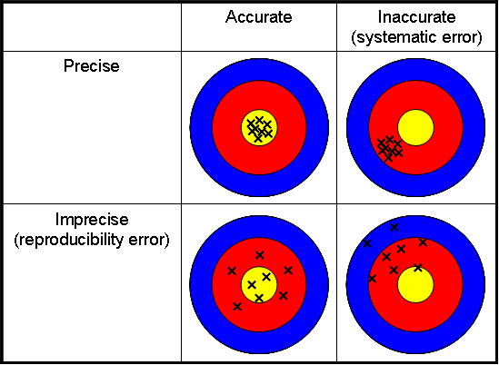
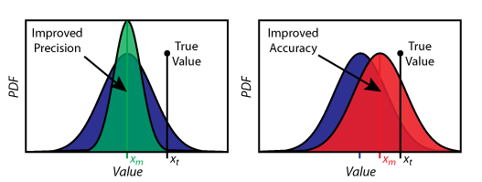
Accuracy, Precision, Resolution
Very often confused in day-to-day language
Accuracy:= also called trueness of measurement
Precision:= how well can I reproduce my measurements
Resolution:= smallest possible difference in successive measurements
Ex: BPM: Mechanical and electrical offsets, gain factors influence the accuracy, various noise sources or timing jitter influence the precision, ADC resolution can limit the resolution.

Slide 6
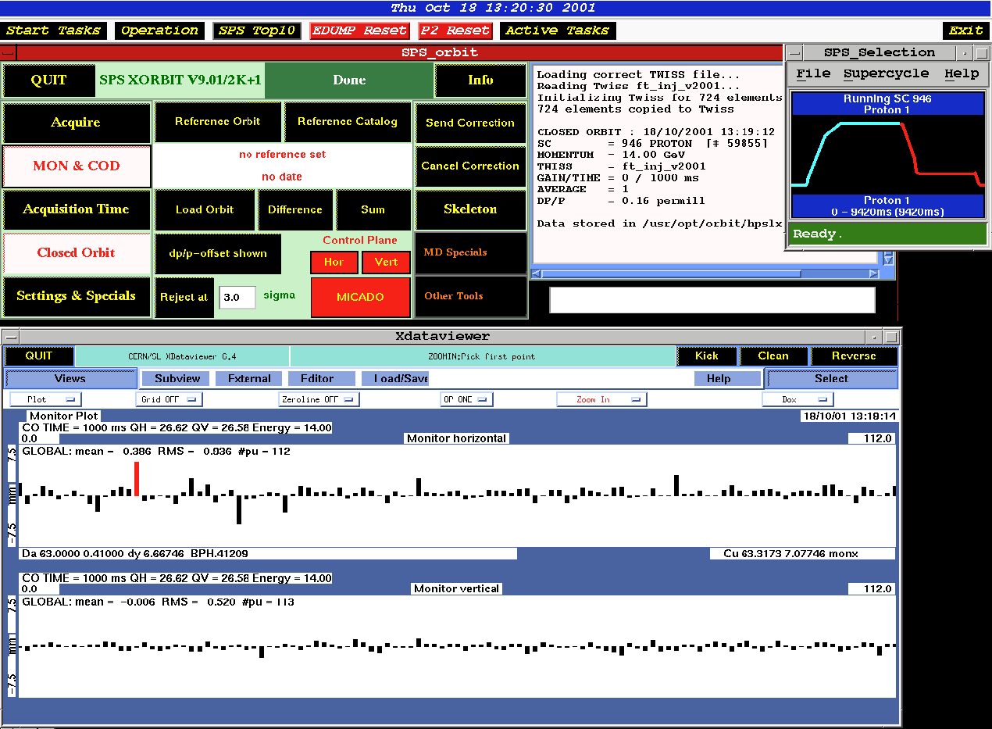
Orbit Acquisition
Horizontal
This orbit excursion
is too large!
Vertical

Slide 7
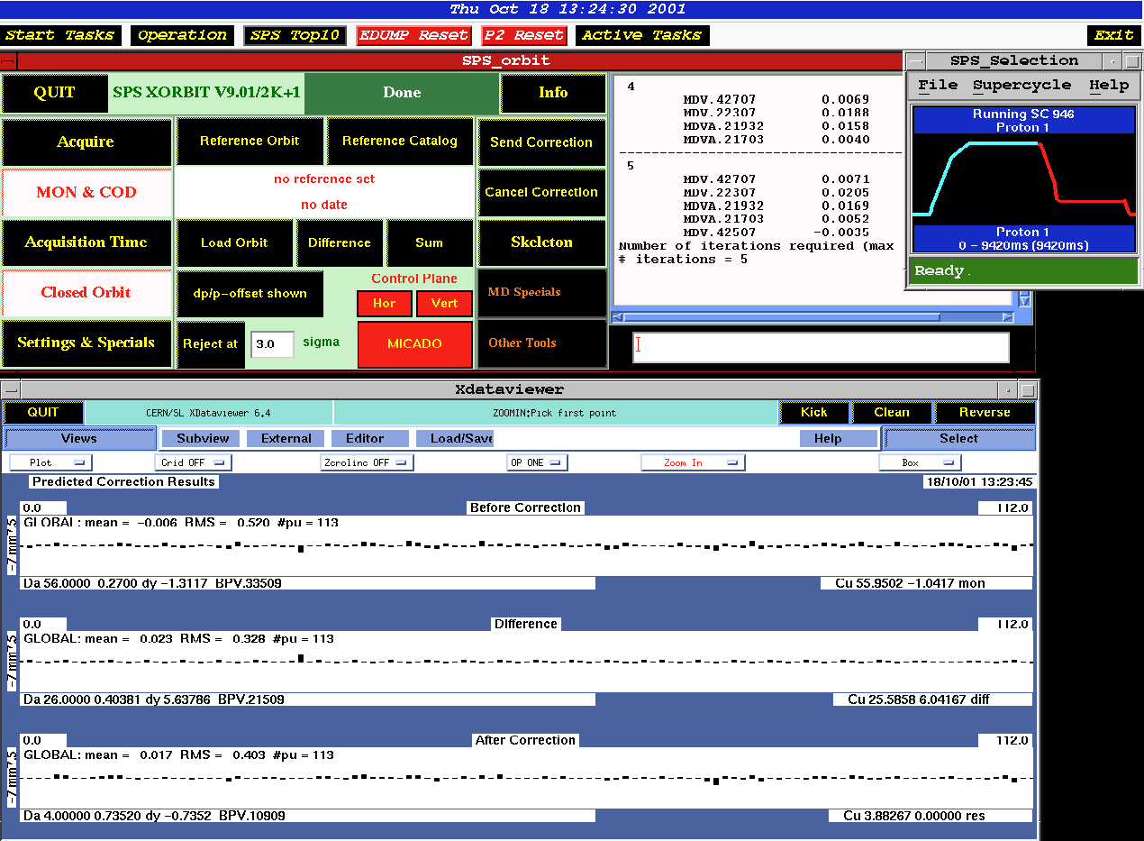
Orbit Correction (Operator Panel)

Slide 8
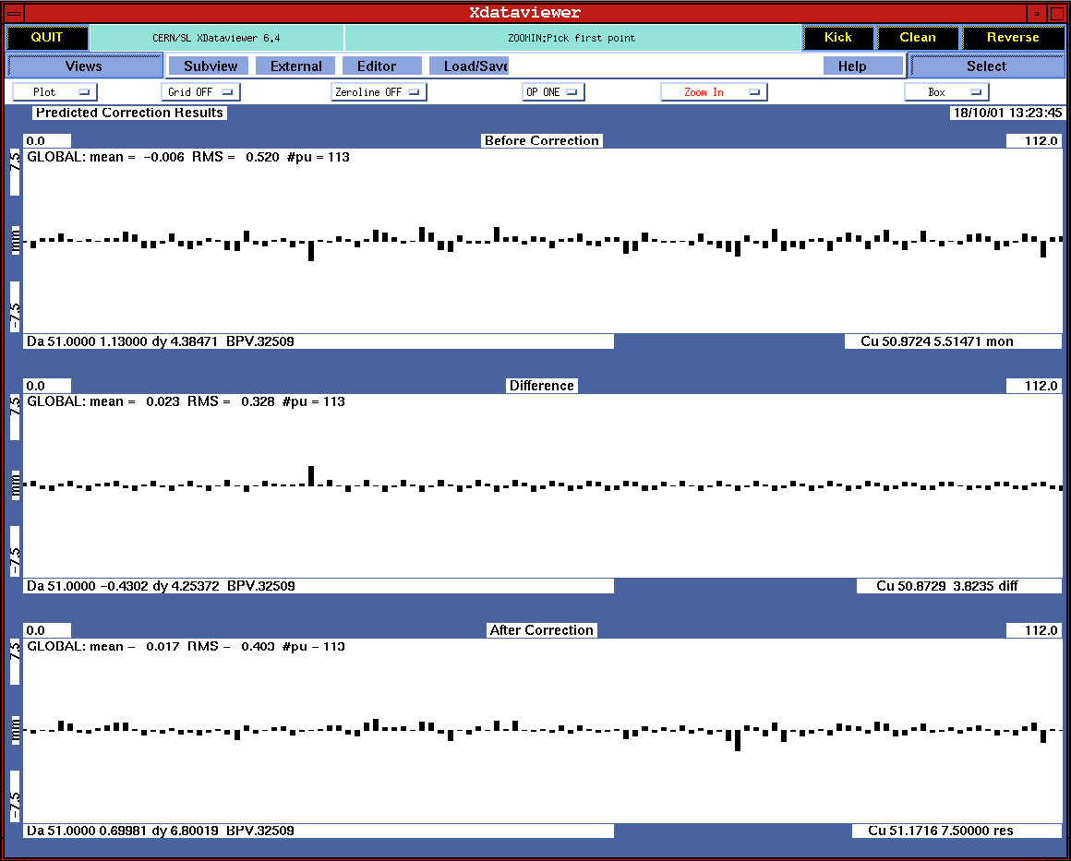
Orbit Correction (Detail)

Slide 9
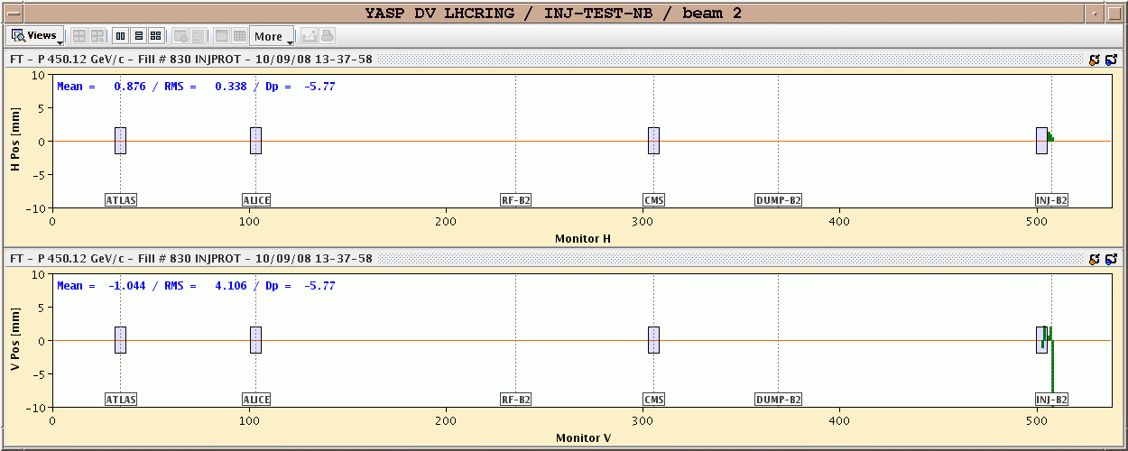
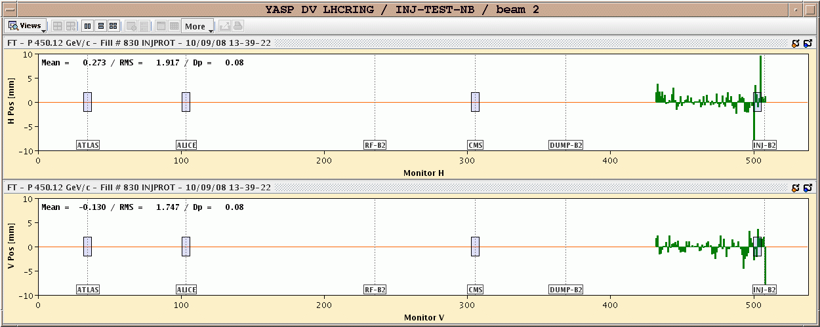
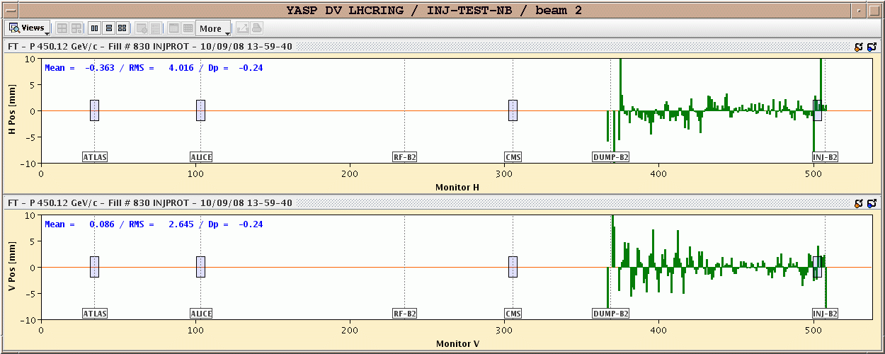
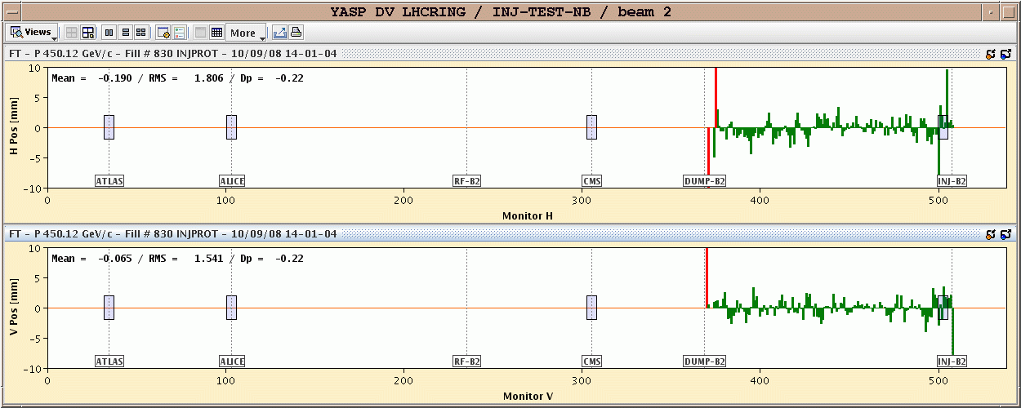
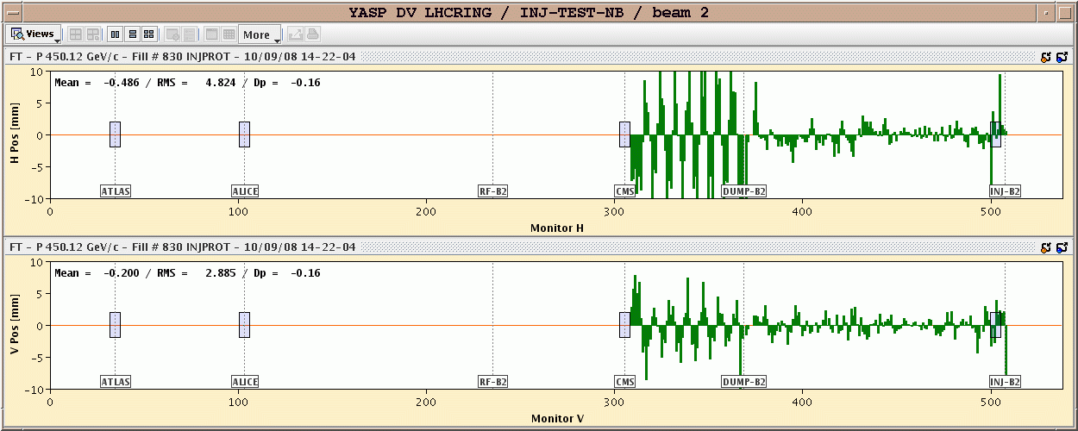
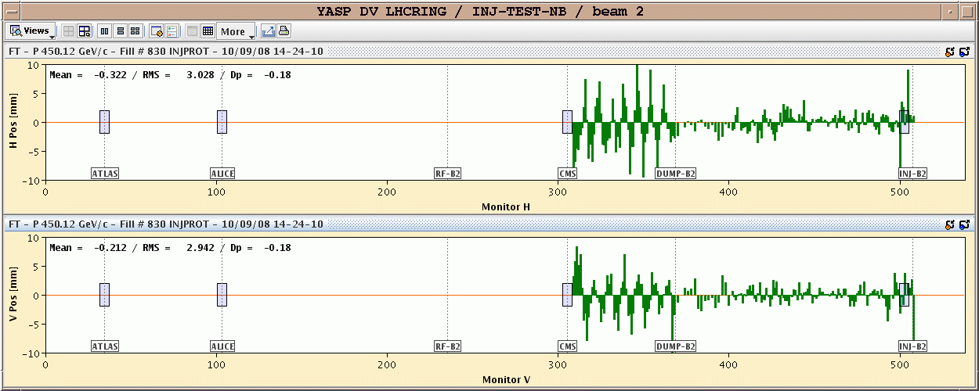
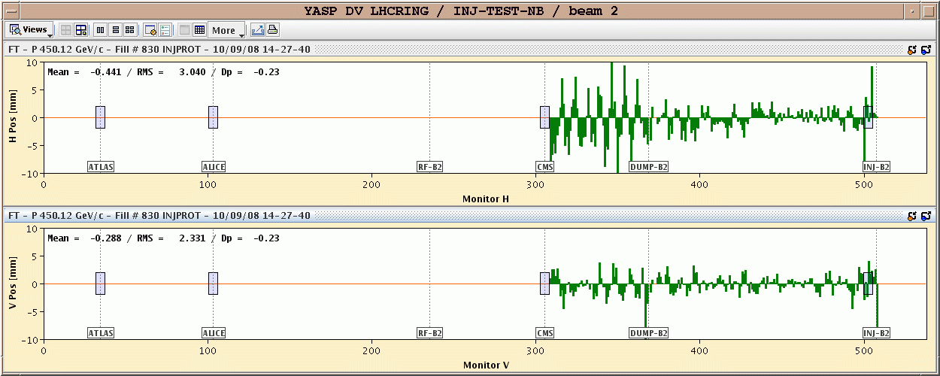
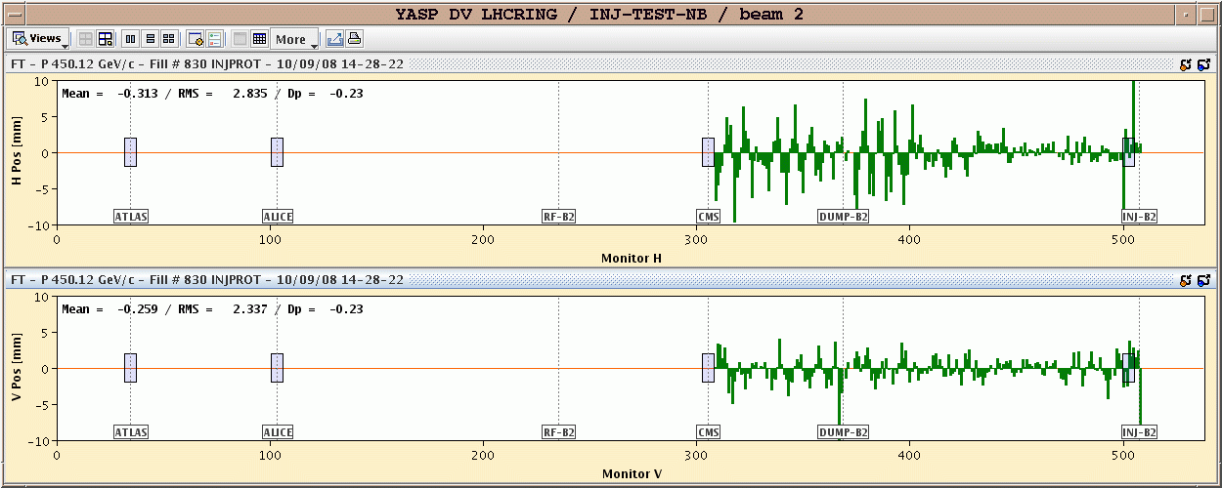
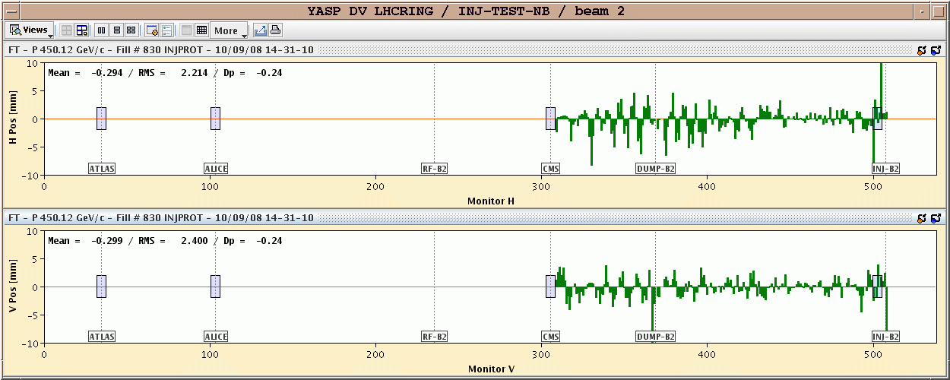
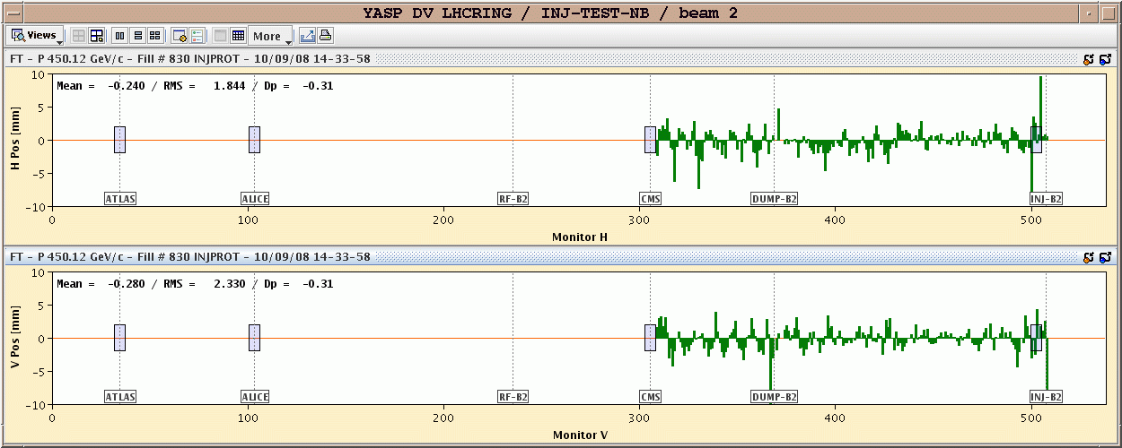
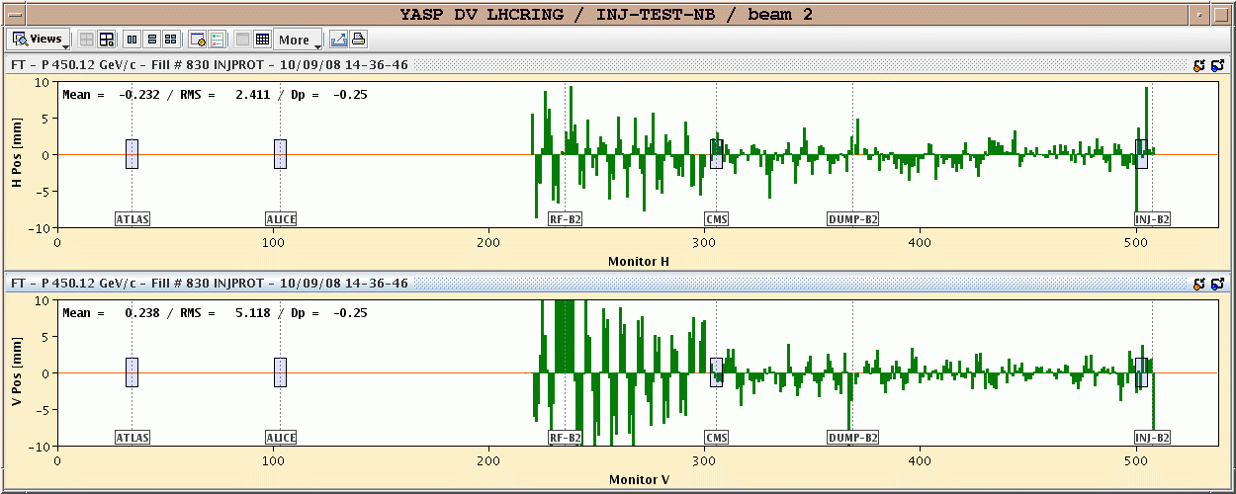
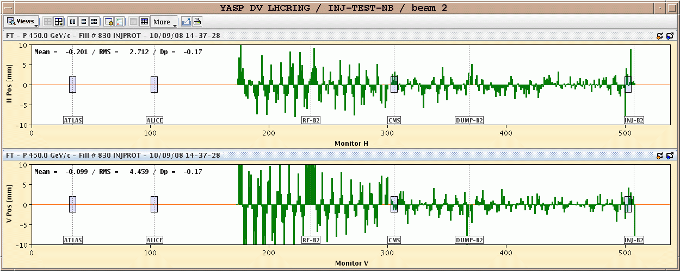
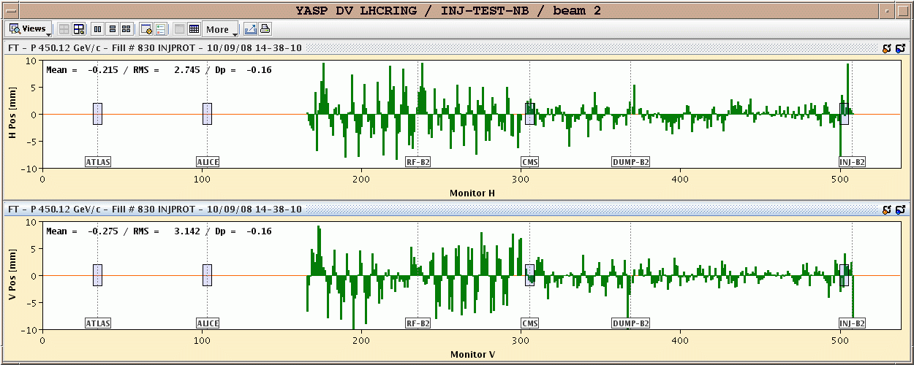
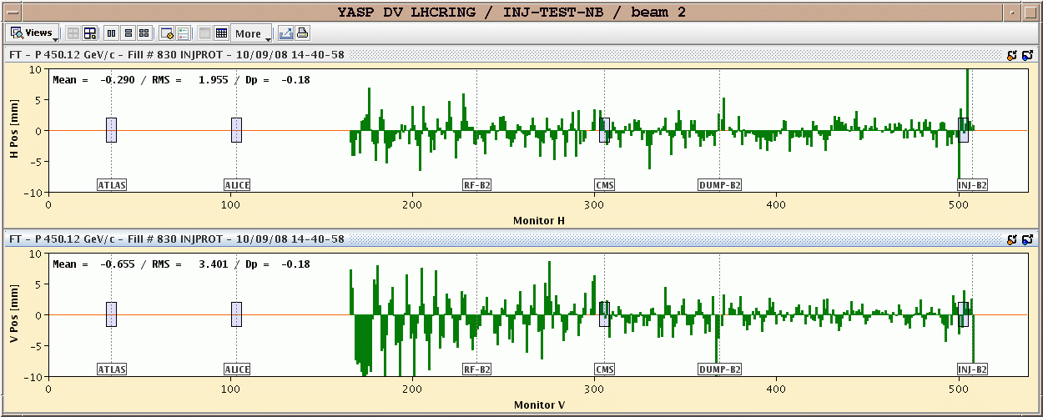
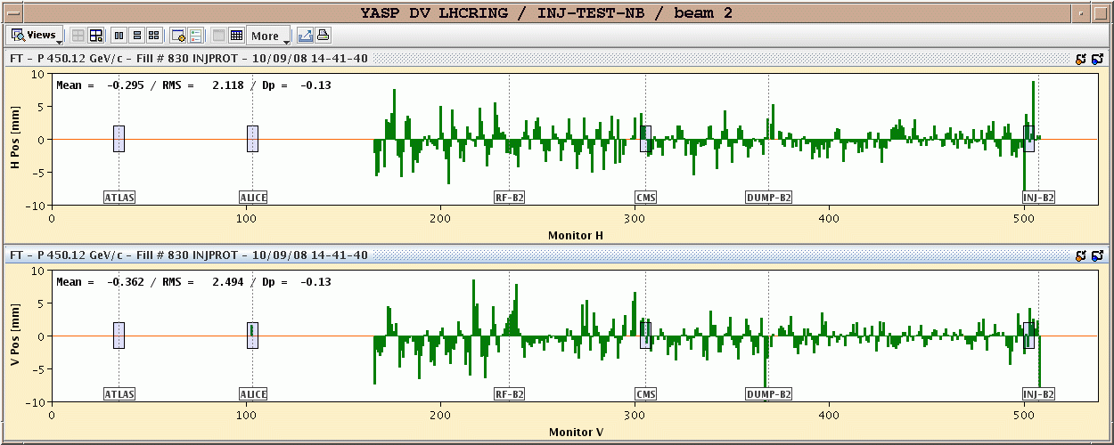
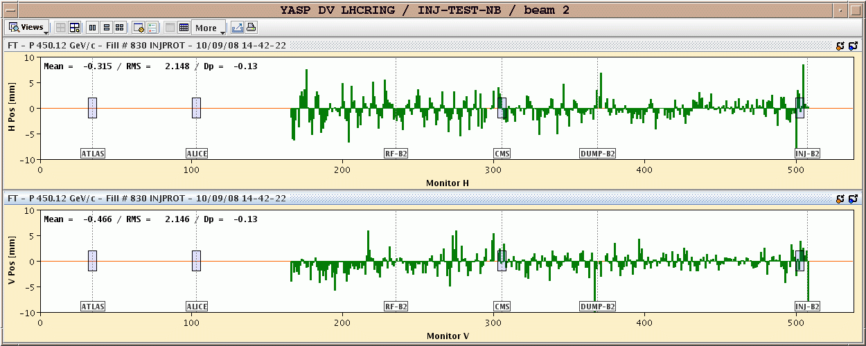
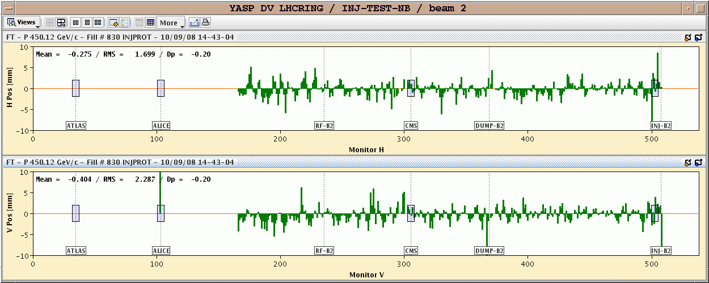
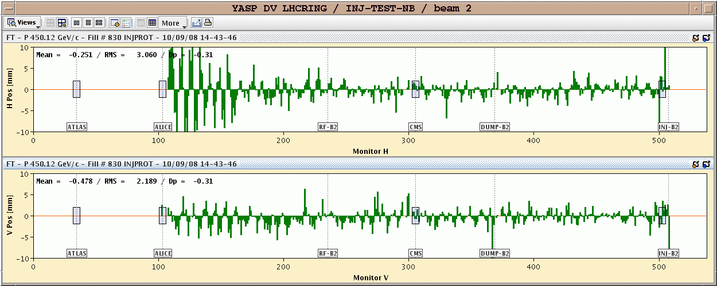
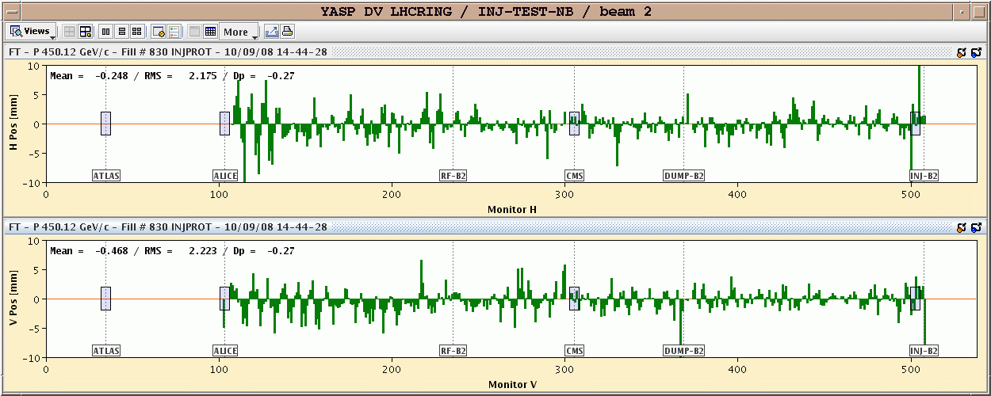
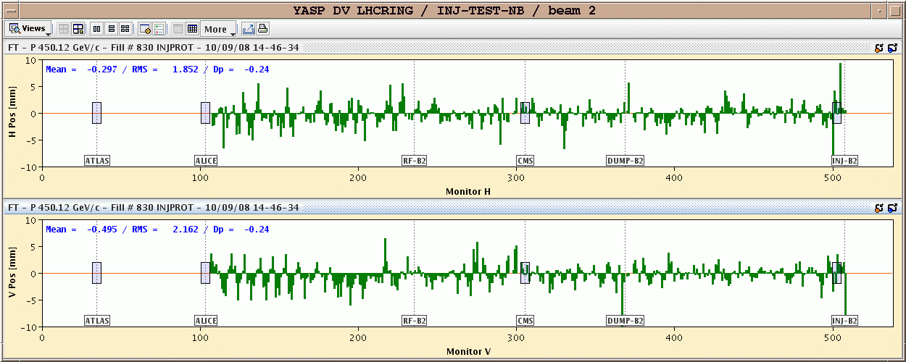
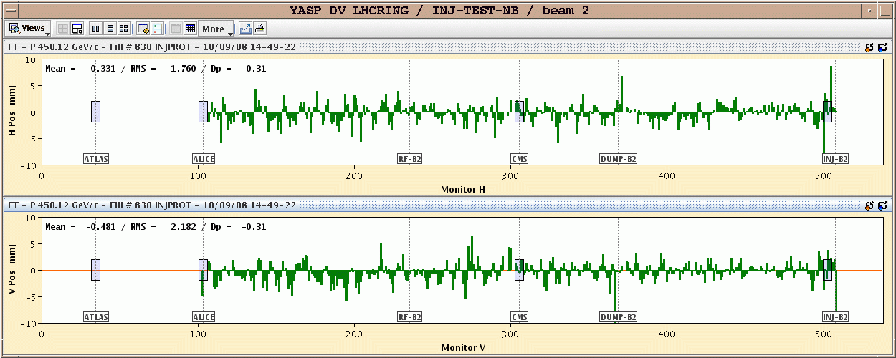
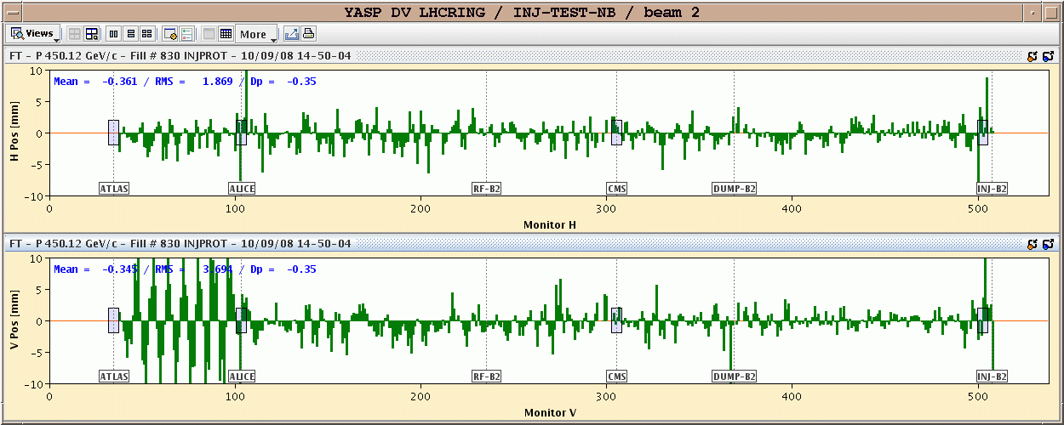
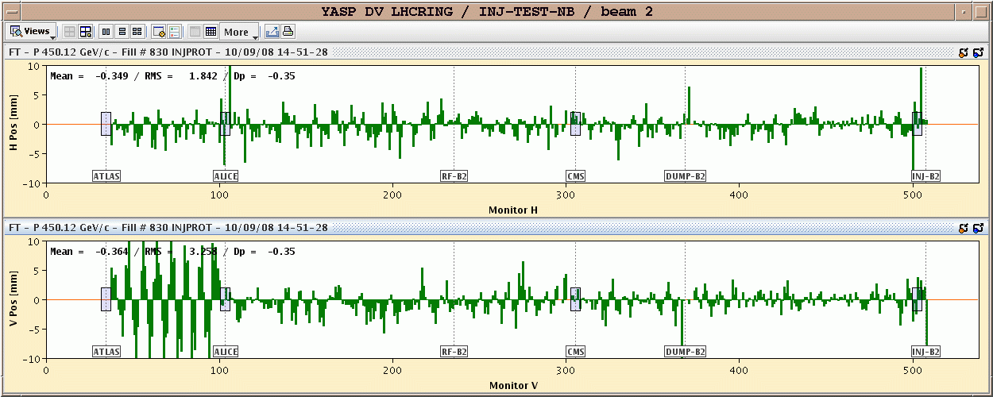
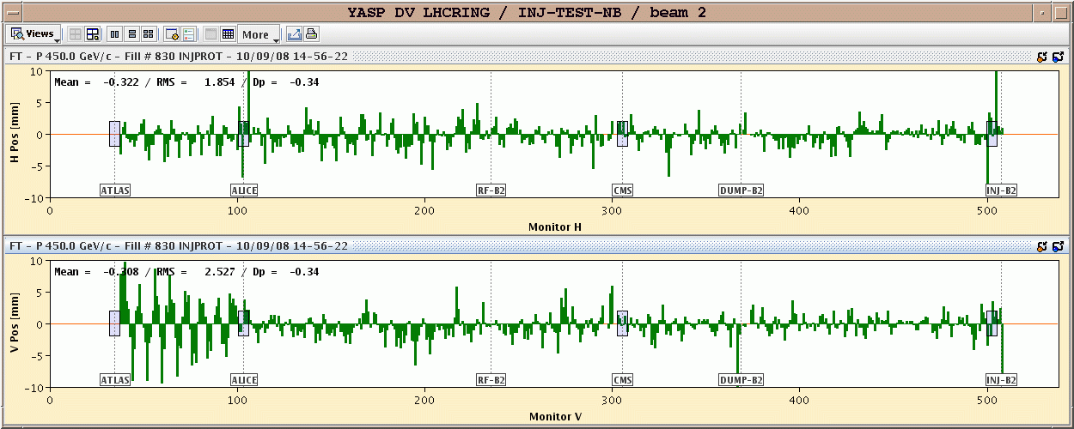
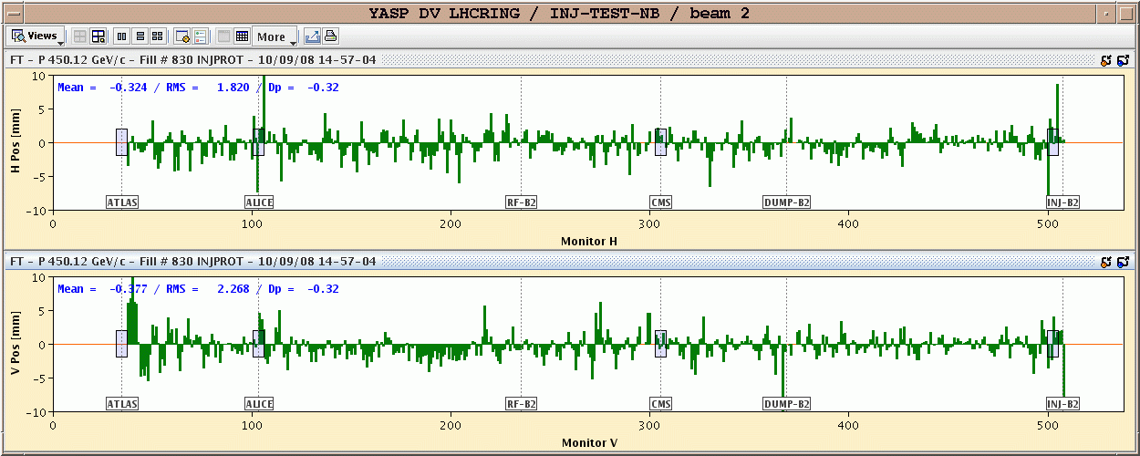
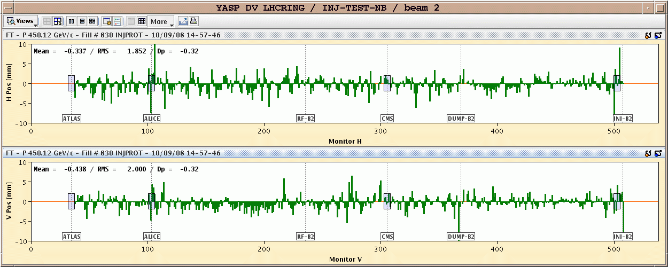
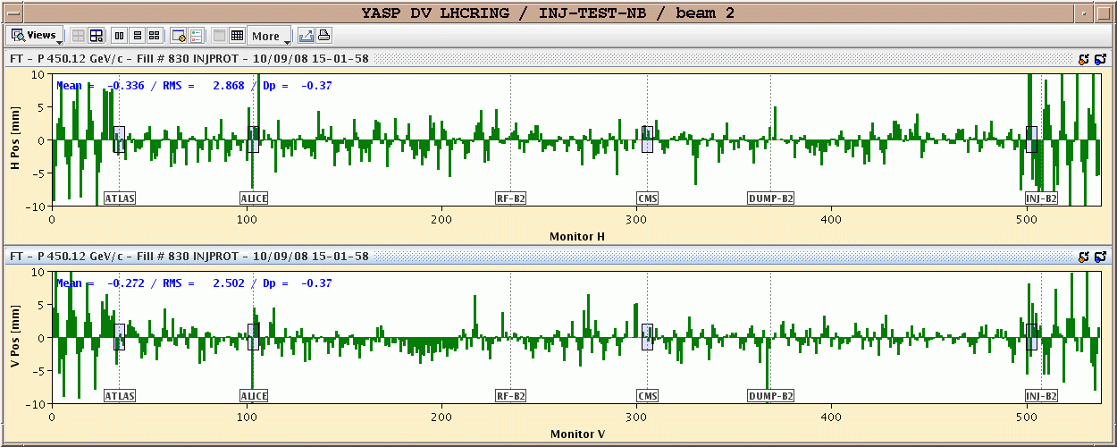
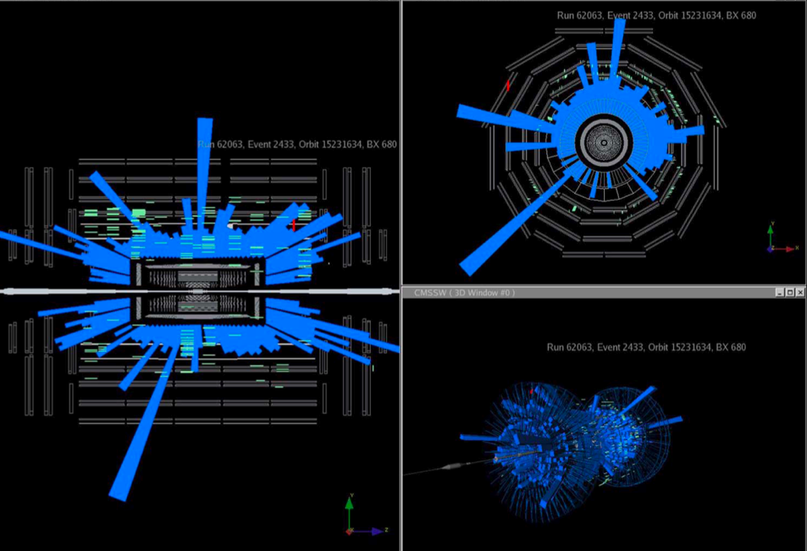
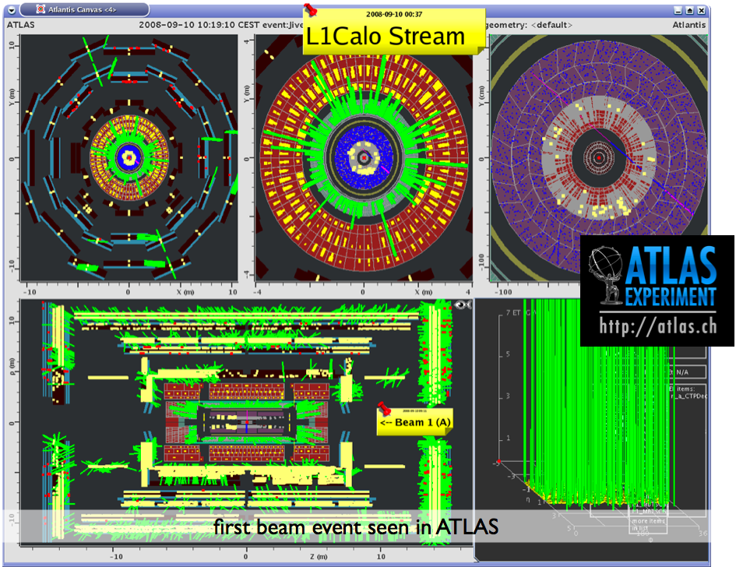
Beam Threading
Threading the beam round the LHC ring (very first commissioning)
  One beam at a time, one hour per beam.
  Collimators were used to intercept the beam (1 bunch, 2×10⁹ protons)
  Beam through 1 sector (1/8 ring)
    correct trajectory, open collimator and move on.
Beam 2 threading
BPM availability ~ 99%
Courtesy of CMS
Courtesy of ATLAS

Slide 10
Kind of boring: orbit corrections….but:
Beam physics data derived from BPM rawdata:
Examples:
orbit difference for different beam momenta→
dispersion
Orbit difference for different beam intensities →
Transverse impedance
Turn by turn trajectory on each BPM; beam forced on constant oscillation →
Beta function and phase advances
It follows a non trivial example of a BPM problem→

Slide 11
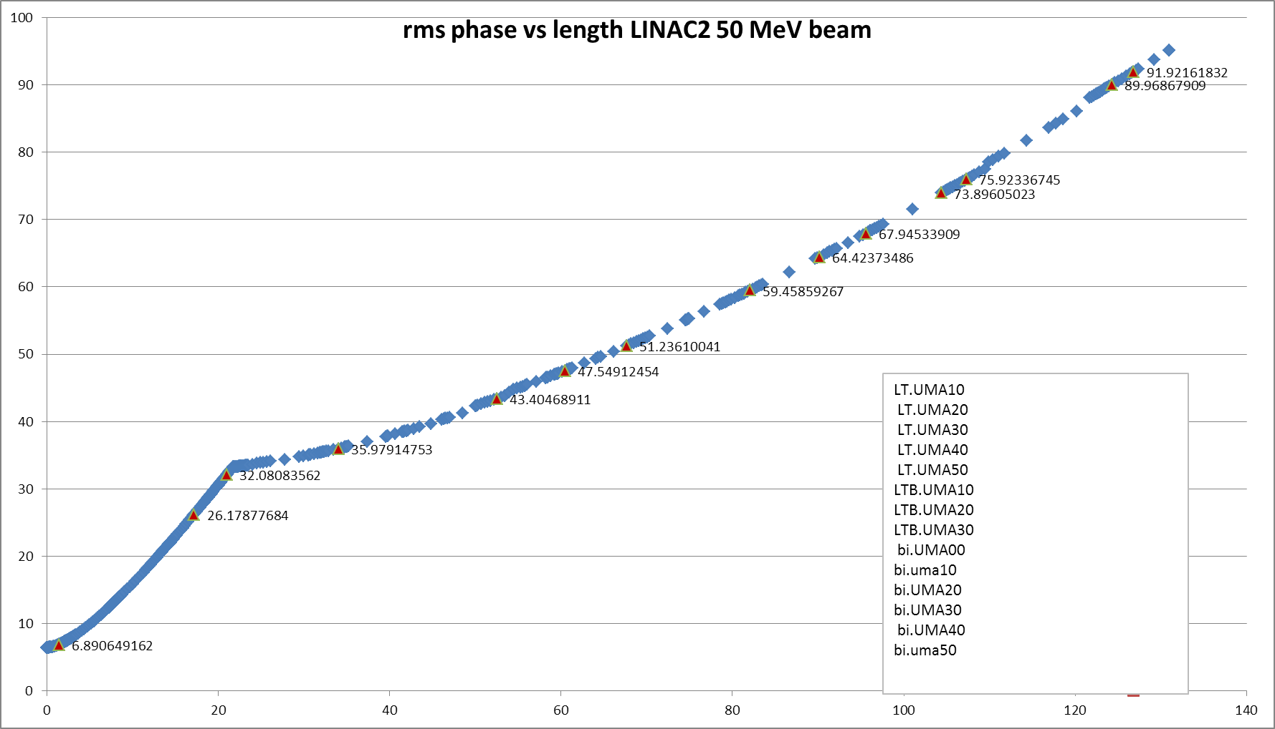
CERN transfer line Linac2 →PS booster work of Michele Bozzolan (CERN-BE-BI)
LT line
BI line
time
T=4.95ns, f= 202.5MHz
150mA, a few 10⁹ ppb
BI Line
Debuncher cavity
LTB Line
LT Line
Courtesy A. Lombardi

Slide 12
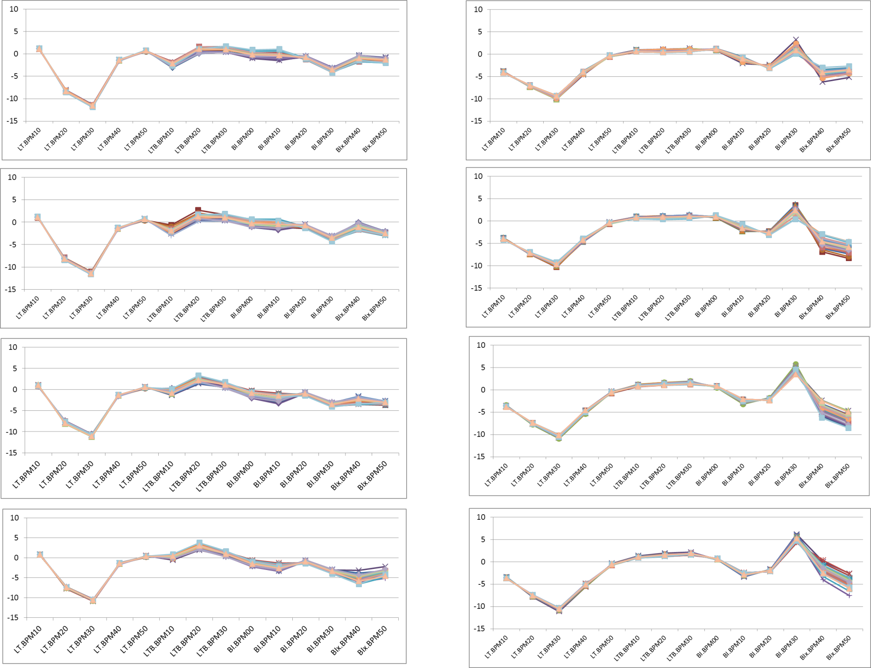
Beam Trajectories : 30 x LHCINDIV cycles
R1
R2
R3
R4
Beam position [mm]
Horizontal plane
Vertical plane

Slide 13
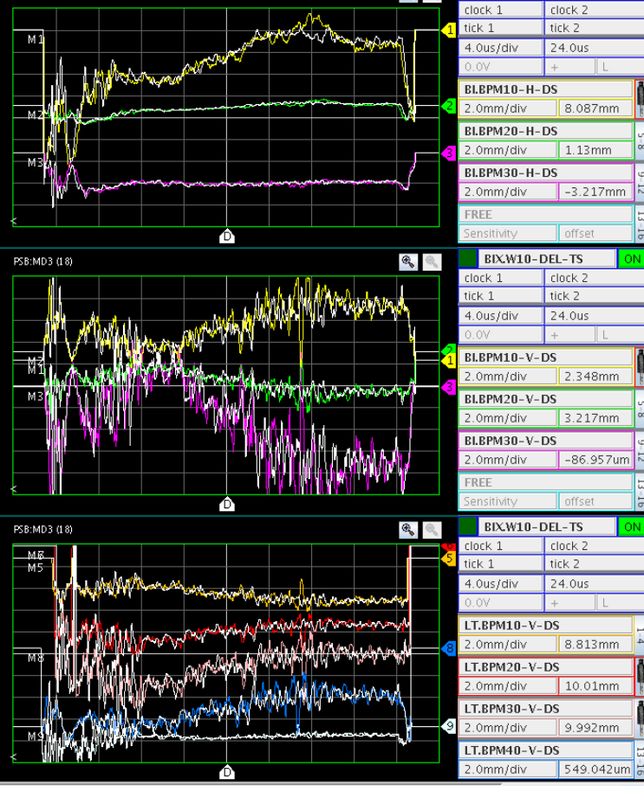
POSITION vs TIME (NOMINAL BEAM)
H PLANE BI LINE BEFORE DISTRIBUTOR
V PLANE BI LINE BEFORE DISTRIBUTOR
V PLANE LT LINE.

Slide 14
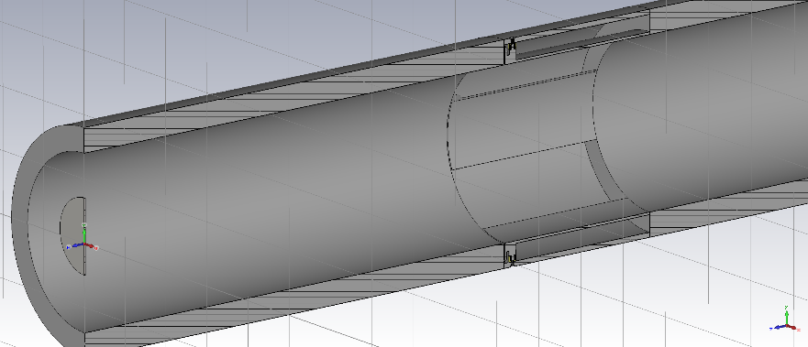
Can we trust the Shorted Stripline?
Simulation conditions:
E_{kin} = 50 MeV
F_{RF} = 202.5 MHz
I_{linac} = 150mA
10 Gaussian bunches, 5mm off-centered
Mesh cells: ~ 6.5 M
Variables = σ_{t} and beam size
140mm
60mm or
30mm
1.26ns
0.8ns
BI Line
0.493ns
0.094ns
LT Line
LTB Line
Courtesy A. Lombardi

Slide 15
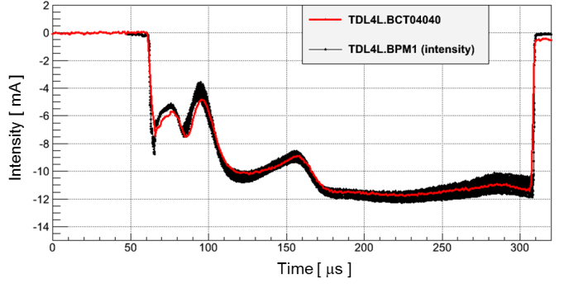
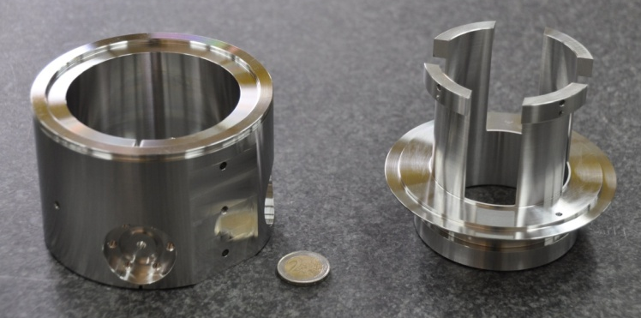
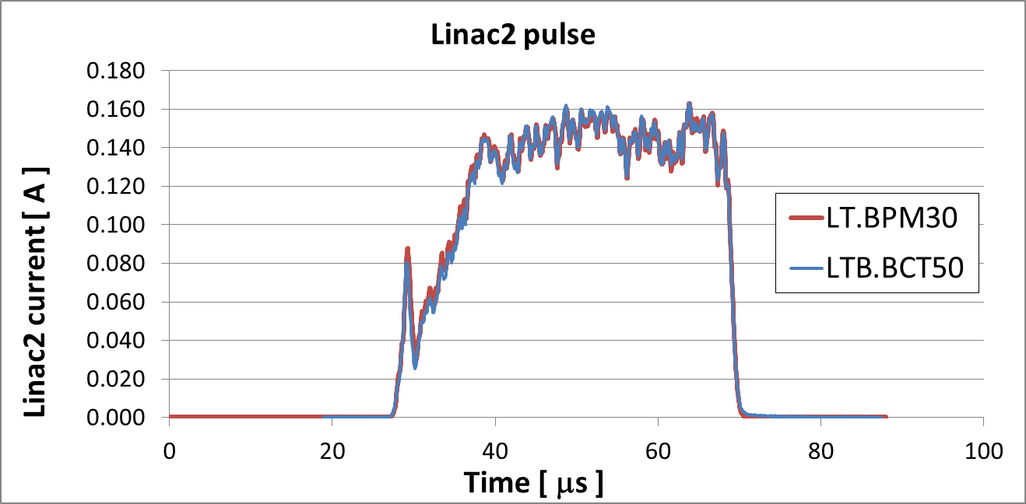
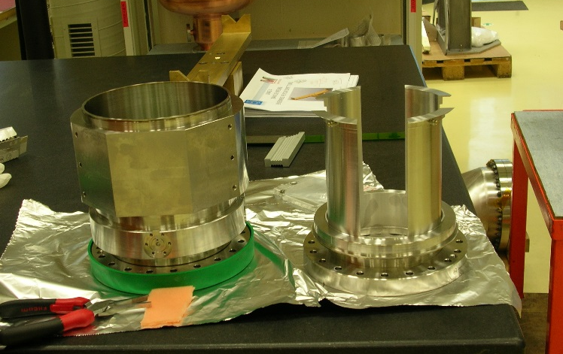
Can we trust the Shorted Stripline?
Comparison of sum signal with a current transformer
Beam aperture: 67mm, 3MeV H- beams
Beam aperture: 140mm, 50MeV p beams

Slide 16
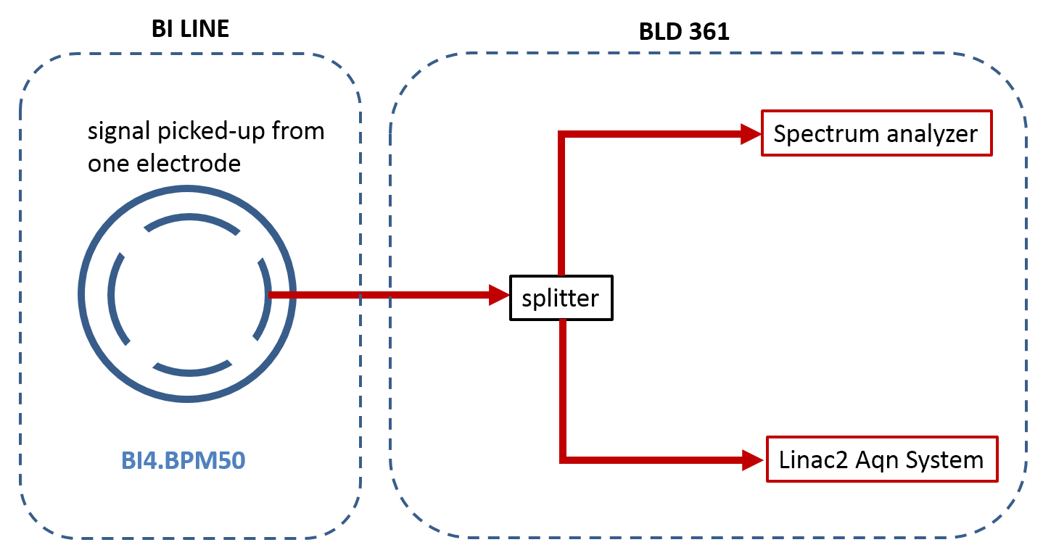
Can we trust the acq. chain ?
Algorithm
  Cross check I/Q demodulation with Hilbert transform and RMS processing
  Amplitude difference between algorithms is within a few per mille.
Down-mixing board
  Process data from fast digitizing oscilloscope: same results as with analogue board
  Cross check with a spectrum analyser

Slide 17
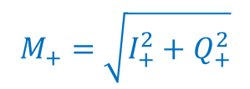

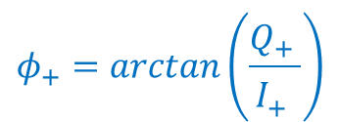
Acquisition system: Well known Down Converter and IQ sampler
BPM
202 MHz bunch freq
LO
177 MHz
F_{ADC}
4xF_{IF}
FESA
Calibration
Position
Options:
Intensity, ϕ, TOF
IF
25 MHz
ADC
25 MHz
Machine
BOR
Network
FESA Class: I/Q demodulation
M_{R}-M_{L}
M+
M-
ΔH =
S×Cal
M_{R}+M_{L}+M_{U}+M_{D}
I+ Q+
I+ Q+
ADC input signal
IF = 25MHz
I- Q-
I- Q-
ϕ = ϕ_{beam} - ϕ_{LO}
I ∝ M_{R}+M_{L}+M_{U}+M_{D}
TOF = ϕ_{PU2} - ϕ_{PU1}

Slide 18
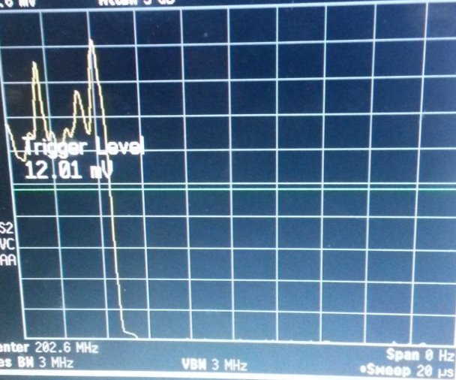
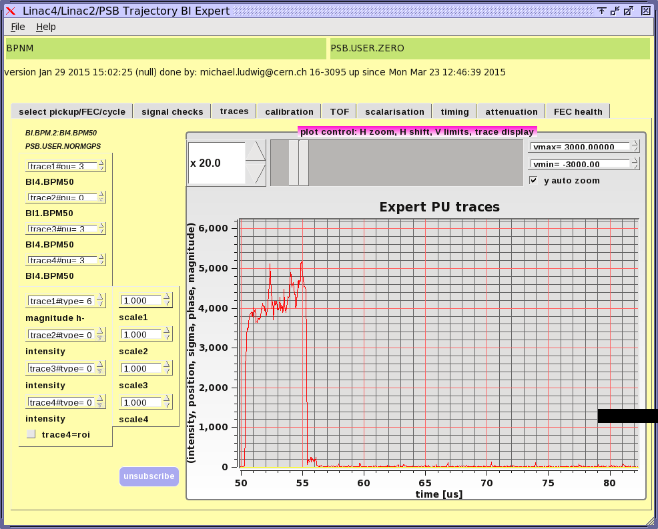
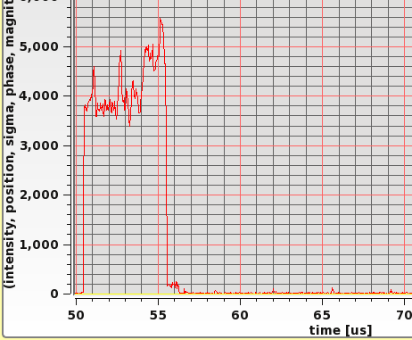
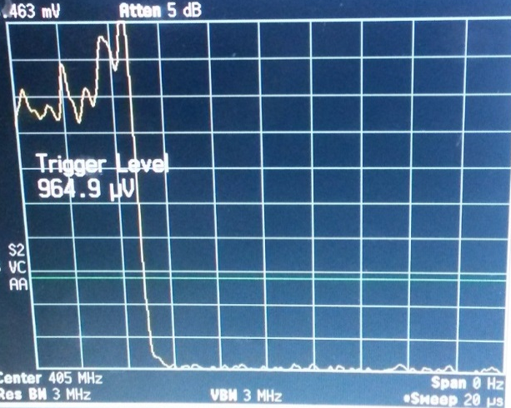
Can we trust the acq. Chain ?
Spectrum analyzer
Linear scale, span 0Hz, trigger
Linac2 aqn chain
202.5 MHz
1st harmonic
202.5 MHz
25.5 MHz
Sweep 20 μs
LO=178 MHz
BW: 10 MHz
BW: 3 MHz
2nd harmonic
405 MHz
405MHz
25.5 MHz
Sweep 20 μs
LO= 430.5 MHz
BW: 3MHz
BW: 10 MHz
Pick-up sensitivity is frequency-dependent:
74.4mm @ h1
56.2mm @ h2
Beam positions are the same
for both harmonics.

Slide 19
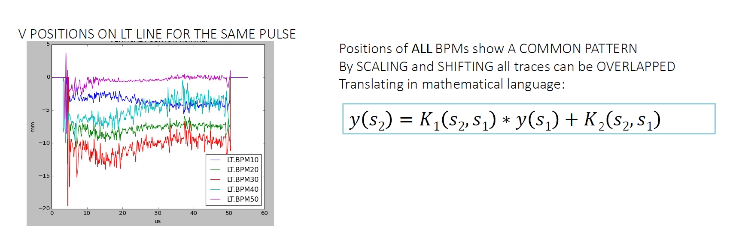

AFTER some painful time:

Slide 20

The explanation:
The Source (Linac2) delivers a strongly asymmetric beam along the cycle.
As the beam rotates in phase space, the measured positions (=centre of gravity of the charges) varies.
The effect is amplified at the end of line due to high betas and large phase advances.
Cures: additional optical elements at end of line, improvements on linac2 emittance.

Slide 21
Outline
Optimization of Machine Performance
(“the good days”)
  Orbit measurement & correction
  CERN Linac2 → PS booster transfer line
Diagnostics of transverse beam motion:
Important tools to stabilize performance at high levels
  Tune & chromaticity measurements
  Dynamic effects: orbit, tune and chromaticity control
  story of LEP and the moon
Trying to make the machine work
(2 examples from “the bad days”)
  The beam gets lost, when changing the beta*
  The beam does not circulate!

Slide 22
Measurement of Q (betatron tune)
QD
QF
QD
Characteristic Frequency
of the Magnet Lattice
Produced by the strength of the
Quadrupole magnets
QF
QF
SD
SF
SD
SF
SF
Q – the eigenfrequency of betatron oscillations in a circular machine
  One of the key parameters of machine operation
Many measurement methods available:
  different beam excitations
  different observations of resulting beam oscillation
  different data treatment

Slide 23
Principle of any Q-measurement
G(ω)
H(ω)
BTF:= H(ω)/G(ω)
Measurement of betatron tune Q:
Maximum of BTF
Observation of
Transverse beam
Oscillations
E.M. pickup
resonant BPM
others
Beam
Excitation Source for
Transverse beam
Oscillations
- stripline kickers
- pulsed magnets

Slide 24

Simple example: FFT analysis
G(ω) == flat
(i.e. excite all frequencies)
Made with random noise kicks
Measure beam position over many consecutives turns
apply FFT → H(ω)
BTF = H(ω)

Slide 25

Network Analysis
Excite beams with a sinusoidal carrier
Measure beam response
Sweep excitation frequency slowly through beam response

Slide 26


Time Resolved Measurements
To follow betatron tunes during machine transitions we need time resolved measurements. Simplest example:
  repeated FFT spectra as before (spectrograms)

Slide 27
Principle of PLL tune measurements
This PLL system looks to the 90 deg. point of the BTF
BPM
B sin(ωt+ϕ)
Beam
Phase detector
AB sin(2 ωt +ϕ)cos(ϕ)
Read VCO
Frequency=
tune!
At regular
Time intervals
VCO
Voltage controlled oscillator
A sin(ωt)
Frequency control:
ABcos(ϕ)
Lowpass

Slide 28
Illustration of PLL tune tracking
A
Single carrier PLL locks on 90⁰ point of BTF;
q
Φ
q

Slide 29

Example of PLL tune measurement
In this case continuous tune tracking was used whilst crossing the horizontal and vertical tunes with a power converter ramp.
Closest tune approach is a measure of coupling
qh
qv
qh -qv

Slide 30
Getting BPM resolutions in the nm-range for tune-diagnostics on hadron beams without emittance dilution
Aperture of BPM approx. 50 mm or more
Wide band electronics thermal noise limit: 10^-5 of aperture
Narrow band front-end gains factor 10…100
State of the art commercial BPM system reaches 5nm/sqrt(Hz),
i.e. LHC turn by turn measurement (11 kHz) about
sqrt(11000)* 5 nm = 0,5 um rms noise.
Different approach:
BBQ electronics: “Zoom in” getting high sensitivity for beam oscillations, but loosing absolute information of DC = closed orbit information.

Slide 31





Direct Diode Detection – M.Gasior (CERN BE-BI)
s_{d}(t)
Simulation parameters:
beam relative offset α = 0.1
betatron oscillation relative amplitude β = 0.05
simulated tune value q = 0.1
filter time constant τ = 10T (T – revolution period)
storage capacitor C_{f} = C_{pu} (PU electrode capacitance)
electrode 1
signal
electrode 2
signal
peak
detector
output
signal
detector signal
difference

Slide 32







Direct Diode Detection – The principle
signals on the detector outputs
detector signal difference
Simulation parameters:
α = 0, β = 0.01
q = 0.1, C_{f} = C_{pu}
τ = T
τ = 100 T
4 bunches
τ = 100 T

Slide 33




Results from the PS (AD cycle)
4 bunches, ≈ 4⋅10¹² p⁺/ bunch,1.4-26 GeV,
h=8 changed to h=20 in steps of 2
No explicit beam excitation
Q Kicker set to minimum

Slide 34
Chromaticity (Q’ or ξ)
Spread in the Machine Tune
due to Particle Energy Spread
Controlled by Sextupole magnets
Optics Analogy:
Achromatic incident light
[Spread in particle energy]
Focal length is
energy dependent
Lens
[Quadrupole]

Slide 35
Chromaticity - What observable to choose?
Tune Difference for different beam momenta | ⇔ | used at HERA, RHIC and Tevatron in combination with PLL tune tracking
Width of tune peak or damping time | ⇔ | model dependent, non-linear effects, Used extensively at DESY
Amplitude ratio of synchrotron sidebands | ⇔ | Difficult of exploit in hadron machines with low synchrotron tune, influence of lattice resonances?
Excitation of energy oscillations and PLL tune tracking | ⇔ | Operationally used at RHIC and Tevatron; prepared for LHC
Bunch spectrum variations during betatron oscillations | ⇔ | difficult to measure
Head-tail phase advance (same as above, but in time domain) | ⇔ | very good results but requires kick stimulus ⇒ emittance growth!

Slide 36


Q’ Measurement via RF-frequency modulation (momentum modulation)
Δ Q_{h}
Δ Q_{v}
Applied Frequency Shift Δ F (RF)
Amplitude & sign of chromaticity
calculated from continuous tune plot

Slide 37

Measurement Example during LEP β-squeeze
qh
qv

Slide 38

The story of LEP and the moon
Another story of what you can do, when you use instruments in a way, which is not foreseen:
The three plots show high accuracy measurements of the LEP beam energies (using resonant depolarization) → which follow the moon cycle
Graphs on this and following pages: J.Wenninger (CERN-BE-OP)

Slide 39

What is the cause?
→ orbit-lengthening due to elastic deformation of earth in the Geneva region (1mm in 27km!!!)
→ particles do not move exactly through middle of quadrupoles and get extra bending.

Slide 40


Must be visible in the BPMs

Slide 41

Crosscheck all around the machine:
We wanted to find a second independent method to prove the orbit lengthening:
Instead of keeping the RF frequency constant and observe the excursion in the arc, we wanted to to find at each moon phase the Rf-frequency (=beam energy), for which the beam goes on average through the centre of all quadrupoles.
→ Use chromaticity measurements!!!
At that frequency we pass through the center of all quadrupoles

Slide 42

X-arc and f-cent correlation

Slide 43
Luminosity & Beam-Beam Tune Shift
Number of
Bunches
Bunch
Intensity
Luminosity
Normalized emittance
Beam-beam tune shift
To maximize L and minimize the stored energy, increase N to the tune shift limit, choose a large number of bunches (M) and a small β*
Beam size
at the IP

Slide 44
Collider luminosity optimization
Knobs
Concept of golden orbit
Orbit
(mainly vertical)
Coupling, tunes,
chromaticity, …
Div. measurements
Dispersion,
chromaticity,
optics, orbit,
tunes, …
Correction algo-
rithms (MICADO,
DFS, beta match)
OPERATOR
Vertical beam
size
2D beam image,
beam lifetime
Fast luminosity
signals
Absolute lumi
in experiments
Reduce vertical
emittance...
Fast detection of
resonances, problems
Increase luminosity
Absolute (slow) pro-
duction reference
F a s t t u n i n g s i g n a l s

Slide 45
Main LEP instruments to provide online beam size signals, BEUV called BSRT in LHC….
BEUV Continuous 2D image of beam
Fast detection of beam resonances, problems, …
BEXE Sensitive, continuous display of vertical spot sizes.
Use for precision tuning of vertical emittance and
luminosity.
Used heavily for beam optimization!

Slide 46

Direct measurement of beam sizes in LEP:
Via synchrotron radiation emitted by beam …
1) BEUV
Near ultra-violet
range
Real time 2D
image of beam
Integrate 224 turns, all bunches. Absolute precision limited by diffraction, mirror deformation, …
“Determination of emittance below 0.25 nm difficult.”
R.Jung. “Precision emittance measurements in LEP with imaging telescopes, comparison with wire scanner and x-ray detector measurements.” CERN-SL-95-63 BI.

Slide 47

2) BEXE X-ray range
Accurate measure of vertical beam size
Vertical beam size down to 300 μm with 1% precision… (“TURN AVERAGE DISPLAY” for fast tuning)
R.Jones et al. “Real time
display of the vertical
beam sizes in LEP using
the BEXE X-ray detector
and fast VME based
computers”.
CERN-SL-99-056-BI.

Slide 48
Luminosity monitoring:
1) Luminosity monitors of the experiments
Absolute reference
Slow time response (~ minutes)
Large fluctuations
2) LEP luminosity monitors (16 Tungsten-Silicon calorimeters in IP’s)
E. Bravin et al. “Luminosity measurements at LEP”. CERN-SL-97-072-BI.
Luminosity per IP
Problems at high energy of LEP II:
Double background rate
Four times smaller Bhabba cross section
Not very much used
3) Luminosity estimate from beam lifetime
Fastest response. First year of operational use…

Slide 49

LEP lifetime well understood:
(E.g. H. Burckhardt, R.Kleiss. Beam Lifetimes in LEP. EPAC94)
Different regimes:
1) Without collision:
Compton scattering on thermal
photons, beam-gas scattering.
τ₀ = 32 h.
2) In collision:
Radiative Bhabha scattering or
beam-beam bremsstrahlung.

Slide 50
Formula for luminosity:
(in convenient units for LEP2 parameters)
Performance improved by increasing signal to noise ratio!
Data suggests 758.5
Measured with BCT

Slide 51

Luminosity from BCT / experiments:
Fill 6653, 101 GeV,
30-Oct-1999
RF trips cause low lifetime and
Spikes in BCT luminosity signal
Very good agreement… BCT signal less noisy and much faster!

Slide 52

LHC Routine Operation - Feedbacks
Opted for central global feedback system regrouping:
  Orbit, energy, tune (operational)
  Chromaticity, coupling (tested)
Initial requirements:
  Chromaticity expected to be most critical parameter for real-time control
    Large perturbations foreseen & tight tolerances required
  BUT
    Large losses during early ramps changed focus to tune followed by orbit feedback
  Orbit-Feedback is the largest and most complex LHC feedback:
    1088 BPMs → 2176+ readings @ 25 Hz from 68 front-ends
    530 correction dipole magnets/plane, distributed over ~50 front-ends
  Total >3500 devices involved
    more than half the LHC is controlled by beam based feedbacks!
Notes:
During the LHC design phase chromaticity was expected to be the parameter for which feedback was most required. This being due to the large swing in chromaticity expected at the start of the ramp, the so called snapback, where the b3filds of the dipoles is difficult to compensate.
In addition this was the hardest parameter for us to measure with high intensity physics beams. A lot of effort therefore went into finding chromaticity measurement and feedback strategies. However, losses observed during the early ramps due to poor tune control quickly changed the focus to tune feedback. It was therefore orbit and tune feedback that were made operational, and are now used for all ramps.
Although chromaticity control is still important, the remarkable reproducibility of the LHC combined with predictions from sophisticated magnetic modelling allows this parameter to be sufficiently controlled via feedforward alone.

Slide 53

Orbit Feedback in the LHC
Bandwidth of 0.1 Hz with BPM data supplied at 25Hz
Regularised SVD approach to calculate applied correction
Can maintain orbit stability to better than ~70μm globally & ~20μm in the arcs

Slide 54

Orbit Feedback in the LHC
Earth Tides dominating Orbit Stability during Physics

Slide 55

The LHC Tune System
Base Band Tune (BBQ) Measurement System
  Direct diode detection, heavy filtering & baseband acquisition using audio ADCs
  Shows extremely high sensitivity
  Most measurements possible with residual beam oscillations
    No need for PLL system with tune determination using FFT peak fitting

Slide 56


Tune Feedback in the LHC
Hor. spectrum with Tune-FB OFF
Hor spectrum with Tune-FB ON
With full pre-cycling the fill-to-fill stability is now typically 2-3×10⁻³
Variations frequently increase up to 0.02
  Due to partial or different magnet pre-cycles after e.g. access or sector trips
Tune-FB routinely used for physics ramps to compensate these effects
  Using peak fit on FFT with 0.1..0.3 Hz Bandwidth

Slide 57

Tune Feedback & Active Damping
BBQ noise-floor raised by 30 dB
  wide tune peak → reduces tune resolution from 10⁻⁴ → ~10⁻²
  Impacts reliable tune (and coupling) measurement & feedback
  Incompatible with chromaticity measurements using small Δp/p-modulation
Only solution found so far is to run damper with lower gain

Slide 58
Outline
Optimization of Machine Performance
(“the good days”)
  Orbit measurement & correction
  CERN Linac2 → PS booster transfer line
Diagnostics of transverse beam motion:
Important tools to stabilize performance at high levels
  Tune & chromaticity measurements
  Dynamic effects: orbit, tune and chromaticity control
  story of LEP and the moon
Trying to make the machine work
(2 examples from “the bad days”)
  The beam gets lost, when changing the beta*
  The beam does not circulate!

Slide 59

LEP Beams Lost During Beta Squeeze
From LEP logbook

Slide 60

…and the corresponding diagnostics

Slide 61

Explanation
Master-Slave Configuration for power converter; each converter can deliver full current, slave only needed to give double voltage for fast current changes.
controls
Master converter
Slave converter
U magnet = R* I magnet + L * d I magnet/dt

Slide 62

LEP – No Circulating Beam after at technical stop
Positrons
QL10.L1

Slide 63



Zoom on QL1
QL10.L1

Slide 64


& 10 metres to the right …
Unsociable sabotage: both bottles were empty!!
Notes:
Quand les journalistes ont reçu les nouvelles de l’incident des bouteilles de bières, ils ont téléphoné sans cesse pour avoir tous les détails ensanglantés. En effet notre section de media du CERN était très contente: ils m’ont même dit que le CERN a eu plus de publicité par trouver ces bouteilles que on aurait eu si on avait trouver les particules Higgs. Triste
L’incident avec les bouteilles de bière était un acte de sabotage très grave. On a eu de la chance de retrouver les bouteilles assez rapidement, mais cette fois on n'a pas pu trouver les saboteurs. Il y avait la police genevoise qui a fait une enquête très profonde et ils ont suggéré des mesures à suivre pour faciliter leur travaille si jamais, à l’avenir, il y aura un incident similaire. En plus avec le group vide on a pris des mesures pour éviter que les chambres à vide puissent être ouvert par n’emporte qui. En plus, on a acheté et inventé des outils pour faciliter la tache de retrouver un obstacle dans le système vide.

Slide 65
In these two lectures we got a first impression on how to build and use beam instrumentation to run and optimize accelerators
It should have become clear that there is “bread and butter” usage of instruments, but one can make real progress and innovation by using instruments in non-conventional ways. You should get many ideas during this school…

