Slide 1




Beam instabilities (II)
Giovanni Rumolo
in CERN Accelerator School, Advanced Level, Warsaw
Thursday 01.10.2013

Slide 2
Summary of the first part
What is a beam instability?
  A beam becomes unstable when a moment of its distribution exhibits an exponential growth (e.g. mean positions <x>, <y>, <z>, standard deviations σ_{x}, σ_{y}, σ_{z}, etc.) – resulting into beam loss or emittance growth!
Instabilities are caused by the electro-magnetic fields trailing behind charged particles moving at the speed of light
  Origin: discontinuities, lossy materials
  Described through wake functions and beam coupling impedances
Longitudinal plane
  Energy loss and potential well distortion
    Synchronous phase shift
    Bunch lengthening/shortening, synchrotron tune shift
  Instabilities
    Robinson instability (dipole mode)
    Coupled bunch instabilities
    Single bunch instabilities

Slide 3
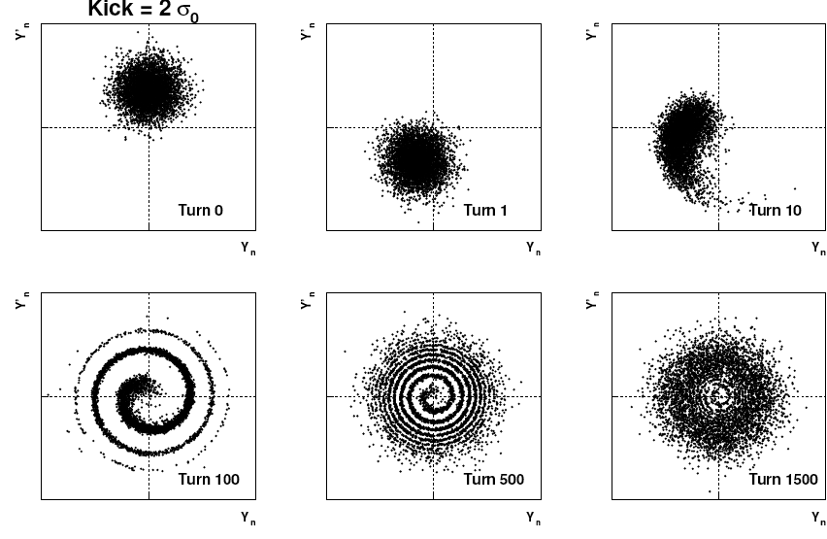
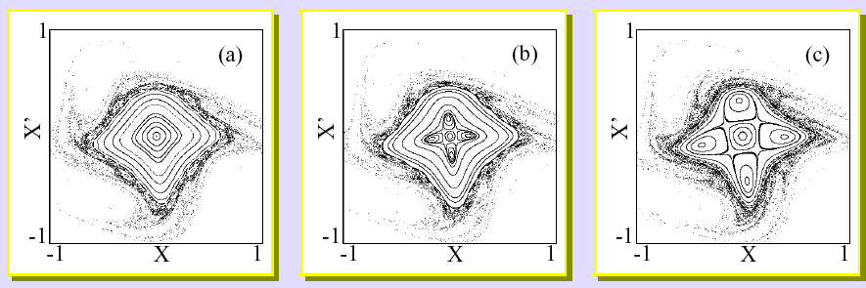
2. The transverse plane

Slide 4
Transverse wake function: definition
Source, q₁
Witness, q₂
2b
z
L
  In an axisymmetric structure (or simply with a top-bottom and left-right symmetry) a source particle traveling on axis cannot induce net transverse forces on a witness particle also following on axis
  At the zero-th order, there is no transverse effect
  We need to introduce a breaking of the symmetry to drive transverse effect, but at the first order there are two possibilities, i.e. offset the source or the witness
Notes:
This is like a Green function, we need to define which is the pulse response (in time domain), in which we are interested!

Slide 5
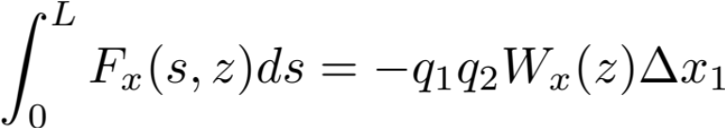
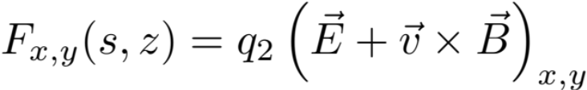
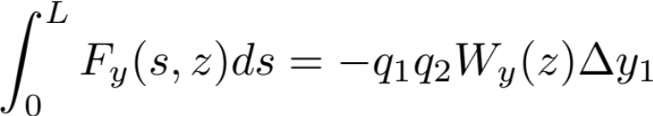
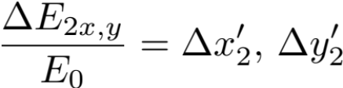

Transverse dipolar wake function: definition
Source, q₁
Witness, q₂
Δx₁ (or Δy₁)
2b
z
L
Notes:
This is like a Green function, we need to define which is the pulse response (in time domain), in which we are interested!

Slide 6
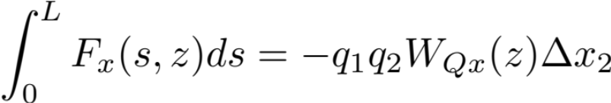

Transverse quadrupolar wake function: definition
Source, q₁
Witness, q₂
Δx₂ (or Δy₂)
2b
z
L
Notes:
This is like a Green function, we need to define which is the pulse response (in time domain), in which we are interested!

Slide 7
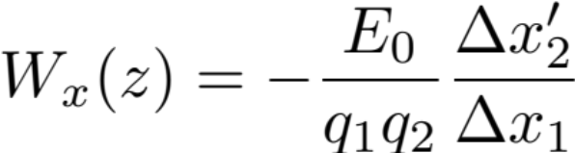
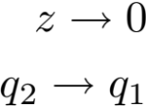



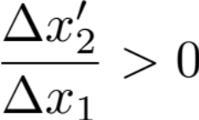
Transverse dipolar wake function
  The value of the transverse dipolar wake functions in 0, W_{x,y}(0), vanishes because source and witness particles are traveling parallel and they can only – mutually – interact through space charge, which is not included in this framework
  W_{x,y}(0⁻⁻)<0 since trailing particles are deflected toward the source particle (Δx₁ and Δx’₂ have the same sign)

Slide 8
Transverse dipolar wake function
  The value of the transverse dipolar wake functions in 0, W_{x,y}(0), vanishes because source and witness particles are traveling parallel and they can only – mutually – interact through space charge, which is not included in this framework
  W_{x,y}(0⁻⁻)<0 since trailing particles are deflected toward the source particle (Δx₁ and Δx’₂ have the same sign)
  W_{x,y}(z) has a discontinuous derivative in z=0 and it vanishes for all z>0 because of the ultra-relativistic approximation
W_{x,y}(z)
z

Slide 9
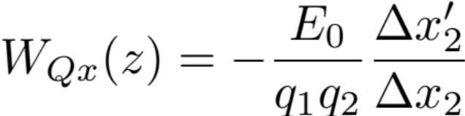


Transverse quadrupolar wake function
  The value of the transverse quadrupolar wake functions in 0, W_{Qx,y}(0), vanishes because source and witness particles are traveling parallel and they can only – mutually – interact through space charge, which is not included in this framework
  W_{Qx,y}(0⁻⁻) can be of either sign since trailing particles can be either attracted or deflected even more off axis (depends on geometry and boundary conditions)

Slide 10
Transverse quadrupolar wake function
  The value of the transverse quadrupolar wake functions in 0, W_{Qx,y}(0), vanishes because source and witness particles are traveling parallel and they can only – mutually – interact through space charge, which is not included in this framework
  W_{Qx,y}(0⁻⁻) can be of either sign since trailing particles can be either attracted or deflected even more off axis (depends on geometry and boundary conditions)
  W_{x,y}(z) has a discontinuous derivative in z=0 and it vanishes for all z>0 because of the ultra-relativistic approximation
W_{Qx,y}(z)
z

Slide 11
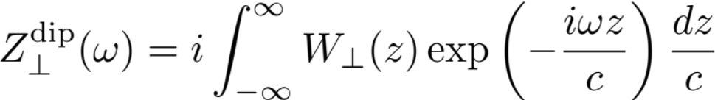
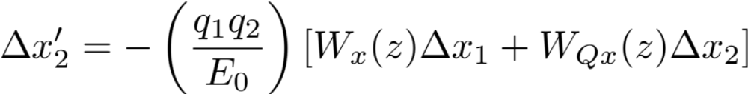
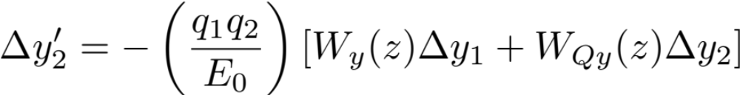
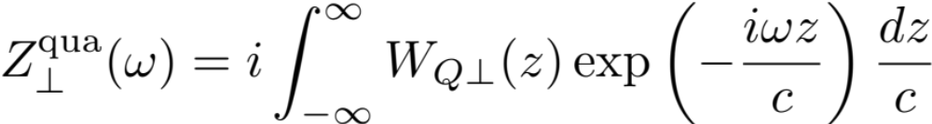
Transverse impedance
  The transverse wake function of an accelerator component is basically its Green function in time domain (i.e., its response to a pulse excitation)
    Very useful for macroparticle models and simulations, because it relates source perturbations to the associated kicks on trailing particles!
  We can also describe it as a transfer function in frequency domain
  This is the definition of transverse beam coupling impedance of the element under study
[Ω/m/s]
[Ω/m]
* linear terms retained, however coupling terms are neglected (usually small in symmetric structures)
** m⁻¹ refers then to a transverse offset and does not represent a normalization per unit length of the structure

Slide 12
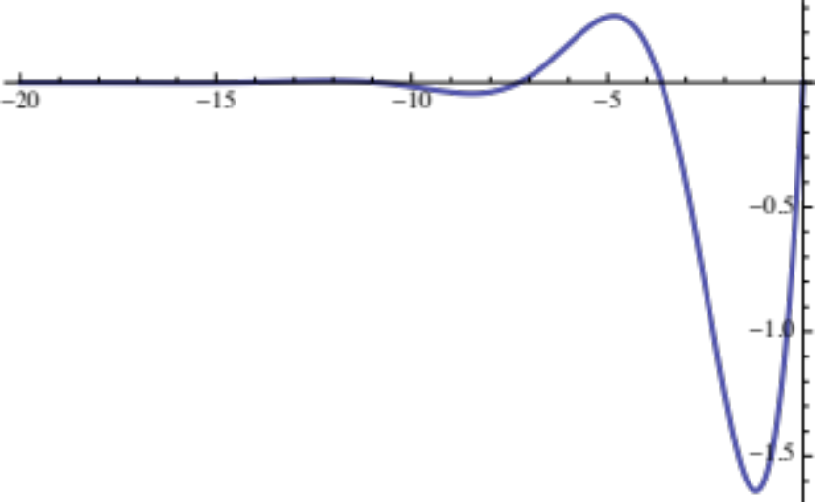
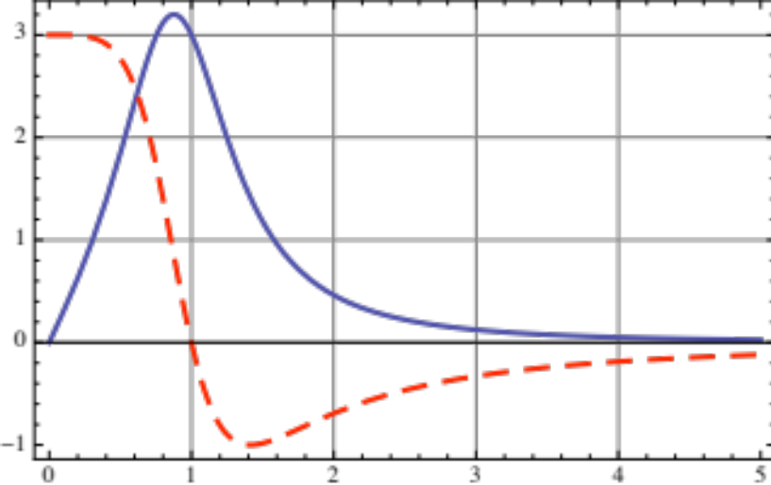
Transverse impedance: resonator
Re[Z_{x,y}]
Im[Z_{x,y}]
  Shape of wake function can be similar to that in longitudinal plane, determined by the oscillations of the trailing electromagnetic fields
  Contrary to longitudinal impedances, Re[Z_{x,y}] is an odd function of frequency, while Im[Z_{x,y}] is an even function

Slide 13
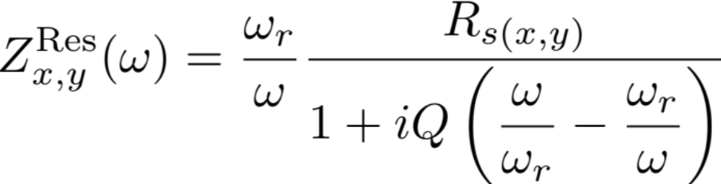
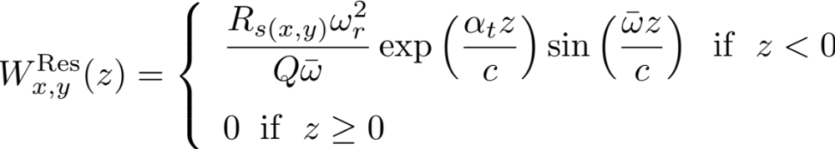
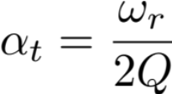
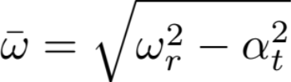
Transverse wake & impedance
Equations of the resonator

Slide 14
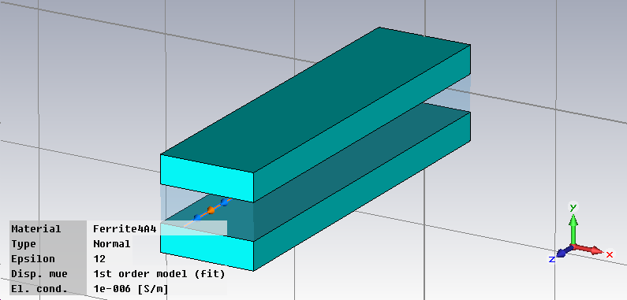
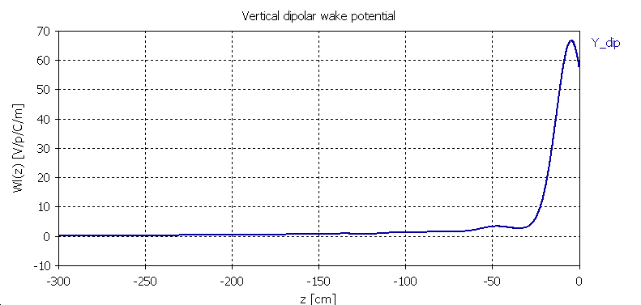
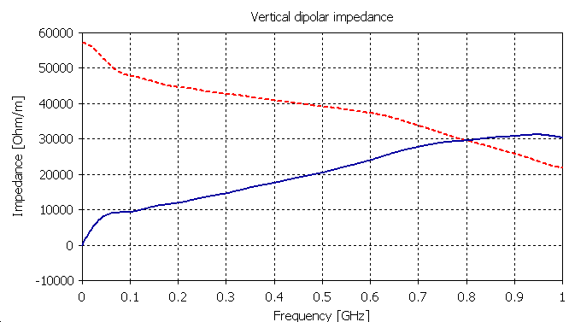
Transverse impedance: kicker
  An example: magnetic kickers are usually large contributors to the transverse impedance of a machine
  It is a broad band contribution
    No trapped modes
    Losses both in vacuum chamber and ferrite (kicker heating and outgassing)
Im[Z_{x,y}]
Re[Z_{x,y}]
Dipolar

Slide 15
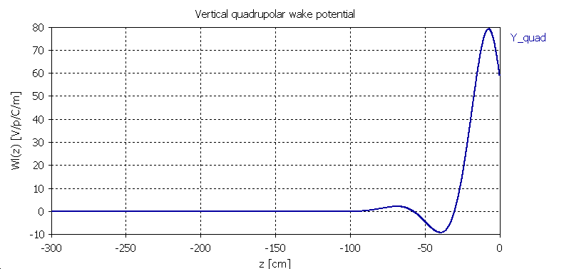
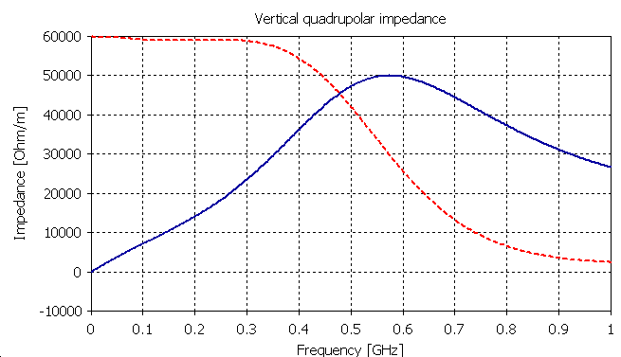
Transverse impedance: kicker
  An example: magnetic kickers are usually large contributors to the transverse impedance of a machine
  It is a broad band contribution
    No trapped modes
    Losses both in vacuum chamber and ferrite (kicker heating and outgassing)
Im[Z_{Qx,y}]
Re[Z_{Qx,y}]
Quadrupolar

Slide 16
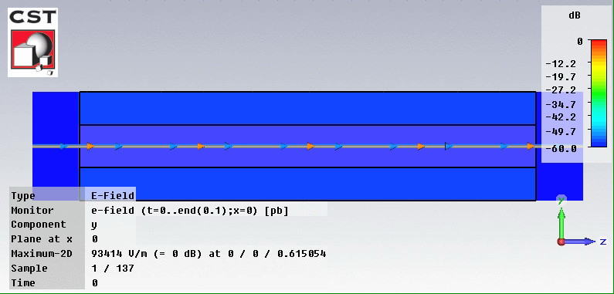
Transverse impedance: kicker
  Evolution of the electromagnetic fields (E_{y}) in the kicker while and after the beam has passed

Slide 17

Transverse impedance: kicker
  Evolution of the electromagnetic fields (H_{x}) in the kicker while and after the beam has passed

Slide 18
Transverse impedance: resistive wall
  The case of a conductive pipe with an arbitrary number of layers with specified EM properties can be solved semi-analytically
  Layers sometimes required for impedance, but also for other reasons (e.g. coating against electron cloud or for good vacuum)
b
L = 1 m

Slide 19
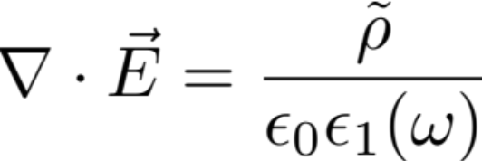

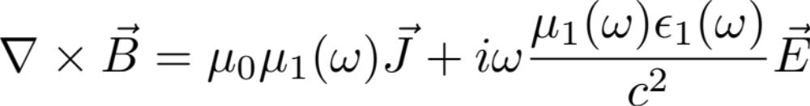


Transverse impedance: resistive wall
Source terms (displaced point charge traveling along s with speed v) in cylindrical coordinates and frequency domain:

Slide 20
Transverse impedance: resistive wall
Source terms (displaced point charge traveling along s with speed v) in cylindrical coordinates and frequency domain:
Expansion in longitudinal modes
Expansion in azimuthal modes

Slide 21
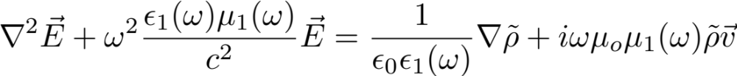
Transverse impedance: resistive wall
Maxwell’s equations combine into the wave equations:
We can seek solutions as expansions of longitudinal and azimuthal modes (for both E and B)

Slide 22
Transverse impedance: resistive wall
It can be demonstrated that he components of the force on the witness charge only depends on E_{s}

Slide 23
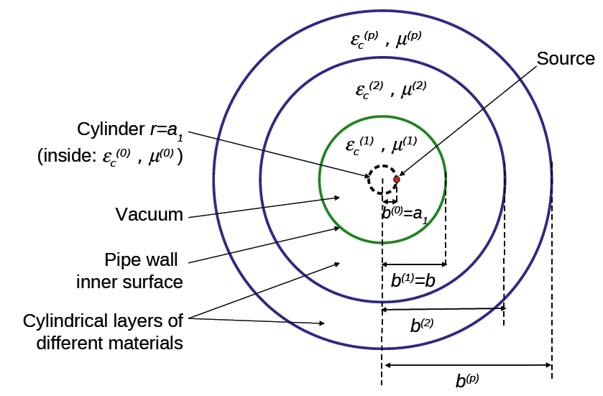
Transverse impedance: resistive wall
The equations for the coefficients of the azimuthal modes of E_{s} must be solved in all the media and the conservation of the tangential components of the fields is applied at the boundaries between different layers
➔ E.g. ImpedanceWake2D code (N. Mounet) can calculate impedances and then wakes by inverse Fourier transform. It can deal with both round and flat structures
r₁
=r₁

Slide 24
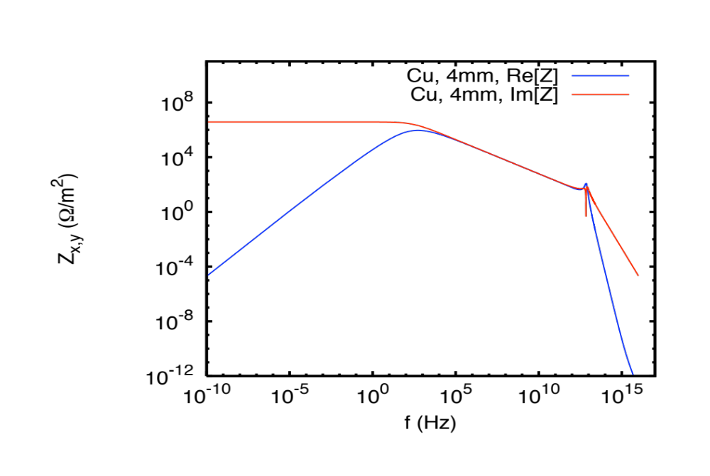
Transverse impedance: resistive wall
  An interesting example: a 1 m long Cu pipe with radius b=2 cm and thickness t = 4mm in vacuum
b
t

Slide 25
Transverse impedance: resistive wall
b
t
3 frequency regions of interest:
Below 0.1 kHz, impedance is basically purely imaginary, EM field is shielded by image charges → Indirect space charge

Slide 26
Transverse impedance: resistive wall
b
t
3 frequency regions of interest:
Between 10 kHz and 1 THz, the EM field is fully attenuated in the Cu layer and the impedance is like the one calculated assuming infinitely thick wall

Slide 27
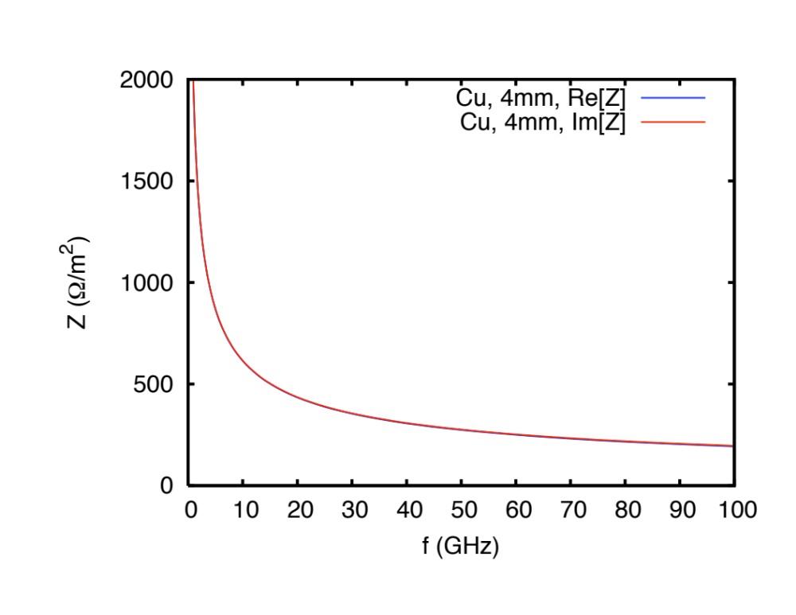
Transverse impedance: resistive wall
b
t
3 frequency regions of interest:
Between 10 kHz and 1 THz, the EM field is fully attenuated in the Cu layer and the impedance is like the one calculated assuming infinitely thick wall

Slide 28
Transverse impedance: resistive wall
b
t
3 frequency regions of interest:
Above 1 THz, there is a resonance (100 THz region). In this region also ac conductivity should be taken into account

Slide 29
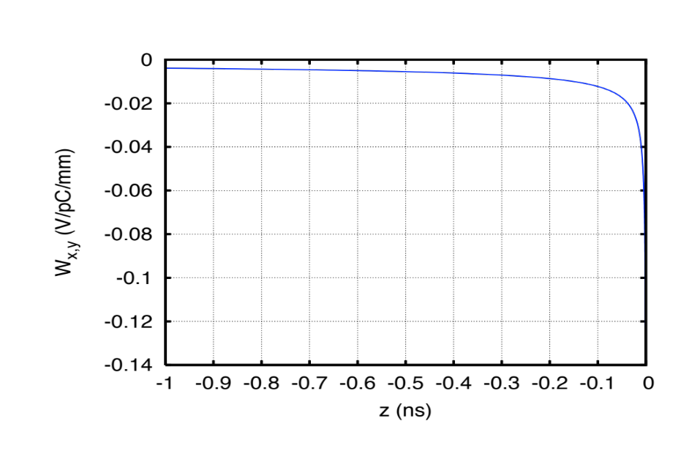
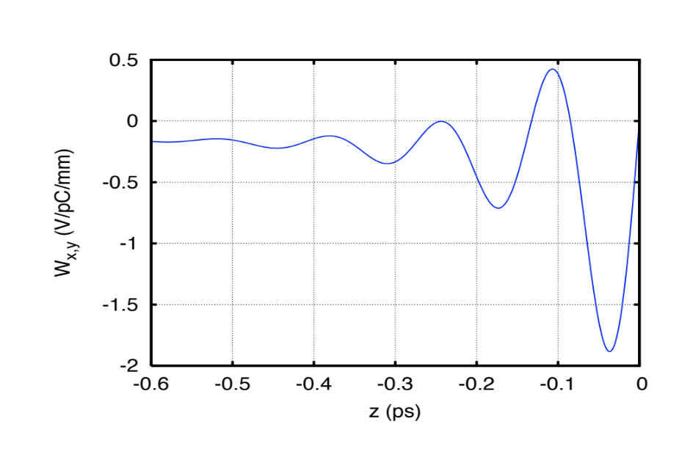
Transverse impedance: resistive wall
b
Correspondingly, in time domain, the wake exhibits different behaviours in short and long range
t
Medium-long range
Short range
In the range of tenths of ns up to fractions of ms (e.g. bunch length to several turns for the SPS) monotonically decaying wake
From behind the source to ~1ps the wake has an oscillatory behaviour, associated to the high frequency resonance

Slide 30
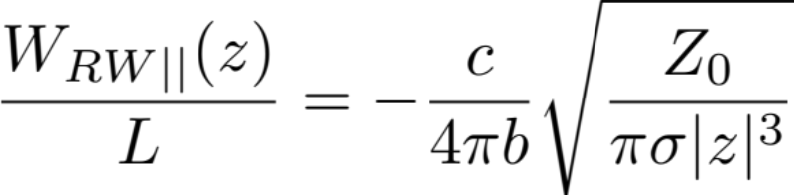
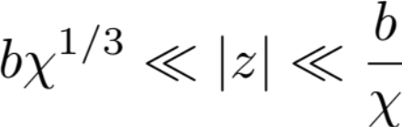
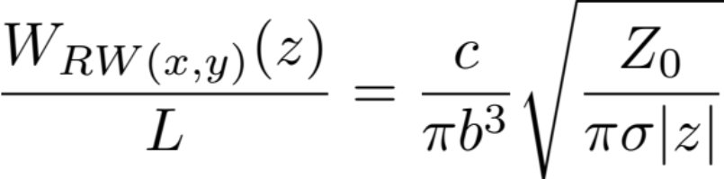
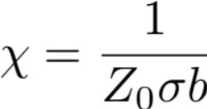
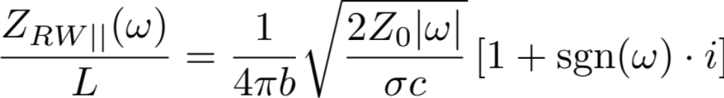
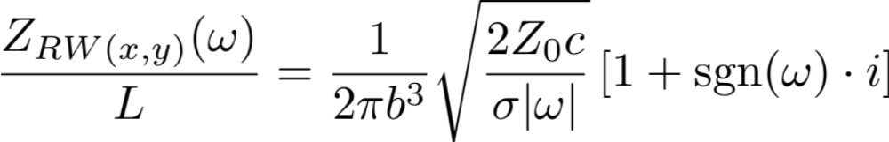
Transverse impedance: resistive wall (infinitely thick wall)
valid only in the range
b
with
valid in the corresponding range of frequencies

Slide 31
Transverse impedance: resistive wall (infinitely thick wall)
b
b
a

Slide 32
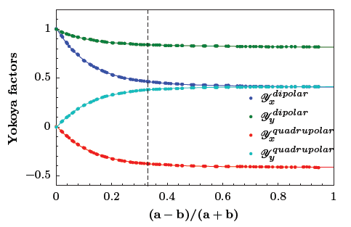
Transverse impedance: resistive wall (infinitely thick wall)
b
b
a
Y^{longitudinal} ≈ 1
Y_{y}^{dipolar}
Y_{x}^{dipolar}
Y_{y}^{quadrupolar}
Y_{x}^{quadrupolar}

Slide 33



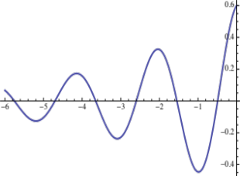
Single particle equations of the transverse motion in presence of dipolar wake fields
  The single particle in the witness slice λ(z)dz will feel the external focusing forces and that associated to the wake in s₀
  Space charge here neglected
  The wake contribution can extend to several turns
Bunch tail
Bunch head
External Focusing
Wake fields

Slide 34
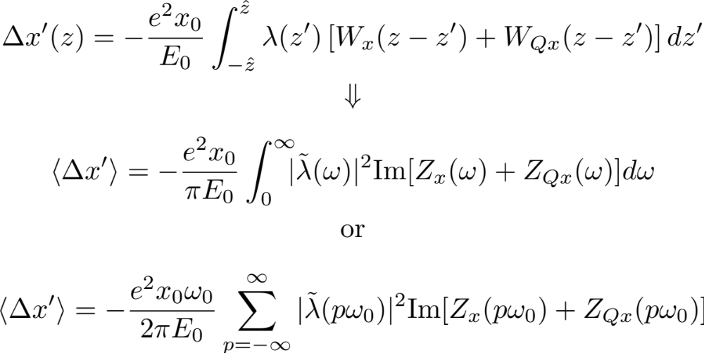
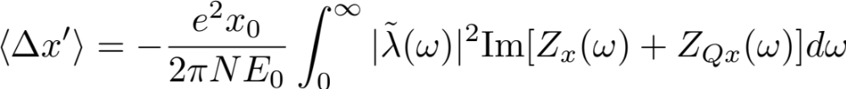
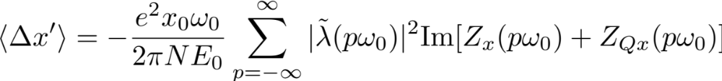
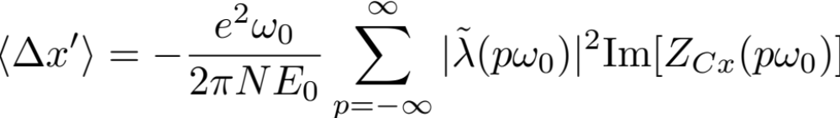
Beam deflection kick
Off-axis traversal of symmetric chamber
y
x
x₀
or
Traversal of asymmetric chamber
y
x

Slide 35
Beam deflection kick
Off-axis traversal of symmetric chamber
y
  The beam deflection kicks
    Are the transverse equivalent of the energy loss in the longitudinal plane
    Can be responsible for intensity dependent orbit variations
    Cause z-dependent orbits and can determine tilted equilibrium bunch distributions for long bunches
x
x₀
or
Traversal of asymmetric chamber
y
x

Slide 36
The Rigid Bunch Instability
  To illustrate the rigid bunch instability we will use some simplifications:
    The bunch is point-like and feels an external linear force (i.e. it would execute linear betatron oscillations in absence of the wake forces)
    Longitudinal motion is neglected
    Smooth approximation → constant focusing + distributed wake
  In a similar fashion as was done for the Robinson instability in the longitudinal plane we want to
    Calculate the betatron tune shift due to the wake
    Derive possible conditions for the excitation of an unstable motion

Slide 37
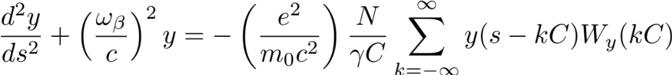
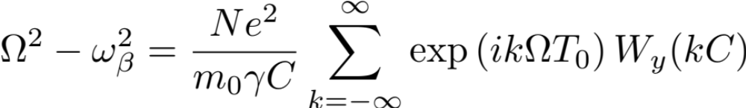
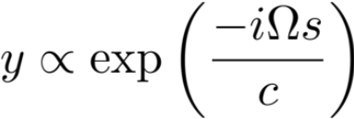

The Rigid Bunch Instability
  To illustrate the rigid bunch instability we will use some simplifications:
    The bunch is point-like and feels an external linear force (i.e. it would execute linear betatron oscillations in absence of the wake forces)
    Longitudinal motion is neglected
    Smooth approximation → constant focusing + distributed wake
Comes from the definition of Z_{y}

Slide 38




The Rigid Bunch Instability
  We assume a small deviation from the betatron tune
  Re(Ω - ω_{β}) → Betatron tune shift
  Im(Ω - ω_{β}) → Growth/damping rate, if it is positive there is an instability!

Slide 39

The Rigid Bunch Instability
  We assume the impedance to be peaked at a frequency ω_{r} close to hω₀ (e.g. RF cavity fundamental mode or HOM)
  Defining the tune ν_{y}=n_{y} + Δ_{βy} with -0.5<Δ_{βy}<0.5, we can easily express the only two leading terms left in the summation at the RHS of the equation for the growth rate
Re[Z_{y}]
Im[Z_{y}]
ω_{r} ≈ hω₀

Slide 40
The Rigid Bunch Instability
  We assume the impedance to be peaked at a frequency ω_{r} close to hω₀ (e.g. RF cavity fundamental mode or HOM)
  Defining the tune ν_{y}=n_{y} + Δ_{βy} with -0.5<Δ_{βy}<0.5, we can easily express the only two leading terms left in the summation at the RHS of the equation for the growth rate

Slide 41






The Rigid Bunch Instability
 | ω_{r} < hω₀ | ω_{r} > hω₀
Tune above integer (Δ_{βy}>0) | unstable | stable
Tune below integer (Δ_{βy}<0) | stable | unstable

Slide 42

The Rigid Bunch Instability
  We assume the impedance to be of resistive wall type, i.e. strongly peaked in the very low frequency range (→ 0)
  Using the same definitions for the tune as before, we can easily express the only two leading terms left in the summation at the RHS of the equation for the growth rate
Re [Z_{y}]

Slide 43




The Rigid Bunch Instability
  Using the same definitions for the tune as before, we can easily express the only two leading terms left in the summation at the RHS of the equation for the growth rate
Re [Z_{y}]
Always stable

Slide 44


The Rigid Bunch Instability
  Using the same definitions for the tune as before, we can easily express the only two leading terms left in the summation at the RHS of the equation for the growth rate
Re [Z_{y}]
Always unstable

Slide 45
The Rigid Bunch Instability
  Using the same definitions for the tune as before, we can easily express the only two leading terms left in the summation at the RHS of the equation for the growth rate
Re [Z_{y}]
This is the reason why most of the running machines are usually operated with a fractional part of the tunes below 0.5!
In practice, tunes above the half integer can be used, if the resistive wall instability is Landau damped (refer to W. Herr’s lectures!) or efficiently suppressed with a feedback system
Always unstable

Slide 46
The Strong Head Tail Instability
(aka Transverse Mode Coupling Instability)
  To illustrate TMCI we will need to make use of some simplifications:
    The bunch is represented through two particles carrying half the total bunch charge and placed in opposite phase in the longitudinal phase space
    They both feel external linear focusing in all three directions (i.e. linear betatron focusing + linear synchrotron focusing).
    Zero chromaticity (Q’_{x,y}=0)
    Constant transverse wake left behind by the leading particle
    Smooth approximation → constant focusing + distributed wake
  We will
    Calculate a stability condition (threshold) for the transverse motion
    Have a look at the excited oscillation modes of the centroid

Slide 47
The Strong Head Tail Instability
(aka Transverse Mode Coupling Instability)
  To illustrate TMCI we will need to make use of some simplifications:
    The bunch is represented through two particles carrying half the total bunch charge and placed in opposite phase in the longitudinal phase space
    They both feel external linear focusing in all three directions (i.e. linear betatron focusing + linear synchrotron focusing)
    Zero chromaticity (Q’_{x,y}=0)
    Constant transverse wake left behind by the leading particle
    Smooth approximation → constant focusing + distributed wake
δp/p₀
Particle 1 (+Ne/2)
Particle 2 (+Ne/2)
z
W_{y}
z
-W₀

Slide 48
The Strong Head Tail Instability
(aka Transverse Mode Coupling Instability)
  To illustrate TMCI we will need to make use of some simplifications:
    The bunch is represented through two particles carrying half the total bunch charge and placed in opposite phase in the longitudinal phase space
    They both feel external linear focusing in all three directions (i.e. linear betatron focusing + linear synchrotron focusing)
    Zero chromaticity (Q’_{x,y}=0)
    Constant transverse wake left behind by the leading particle
    Smooth approximation → constant focusing + distributed wake
δp/p₀
Particle 1 (+Ne/2)
Particle 2 (+Ne/2)
z
W_{y}
z
-W₀

Slide 49



The Strong Head Tail Instability
(aka Transverse Mode Coupling Instability)
  During the first half of the synchrotron motion, particle 1 is leading and executes free betatron oscillations, while particle 2 is trailing and feels the defocusing wake of particle 1

Slide 50



The Strong Head Tail Instability
(aka Transverse Mode Coupling Instability)
  During the first half of the synchrotron motion, particle 1 is leading and executes free betatron oscillations, while particle 2 is trailing and feels the defocusing wake of particle 1
  During the second half of the synchrotron period, the situation is reversed

Slide 51


The Strong Head Tail Instability
(aka Transverse Mode Coupling Instability)
  We solve with respect to the complex variables defined below during the first half of synchrotron period
  y₁(s) is a free betatron oscillation
  y₂(s) is the sum of a free betatron oscillation plus a driven oscillation with y₁(s) being its driving term
Free oscillation term
Driven oscillation term

Slide 52




The Strong Head Tail Instability
Transfer map
  Second term in RHS equation for y₂(s) negligible if ω_{s}<<ω_{β}
  We can now transform these equations into linear mapping across half synchrotron period

Slide 53



The Strong Head Tail Instability
Transfer map
  In the second half of synchrotron period, particles 1 and 2 exchange their roles
  We can therefore find the transfer matrix over the full synchrotron period for both particles
  We can analyze the eigenvalues of the two particle system

Slide 54


The Strong Head Tail Instability
Stability condition
  Since the product of the eigenvalues is 1, the only condition for stability is that they both be purely imaginary exponentials
  From the second equation for the eigenvalues, it is clear that this is true only when sin(φ/2)<1
  This translates into a condition on the beam/wake parameters

Slide 55

The Strong Head Tail Instability
Stability condition
  Proportional to p₀ → bunches with higher energy tend to be more stable
  Proportional to ω_{s} → the quicker is the longitudinal motion within the bunch, the more stable is the bunch
  Inversely proportional to β_{y} → the effect of the impedance is enhanced if the kick is given at a location with large beta function
  Inversely proportional to the wake per unit length along the ring, W₀/C → a large integrated wake (impedance) lowers the instability threshold

Slide 56





The Strong Head Tail Instability
Mode frequencies
The evolution of the eigenstates follows:
They shift with increasing intensity
Eigenfrequencies:
l = 0
Unstable region
l = -1

Slide 57
The Strong Head Tail Instability
Mode frequencies
The evolution of the eigenstates follows:
They shift with increasing intensity
Eigenfrequencies:
l = 0
Unstable region
l = -1
That’s the reason why this type of instability is called Transverse Mode Coupling Instability!

Slide 58


The Strong Head Tail Instability
Why TMCI?
  For a real bunch, modes exhibit a more complicated shift pattern
  The shift of the modes can be calculated via Vlasov equation or can be found through macroparticle simulations
Simplified calculation for a short bunch
Full calculation for a relatively long SPS bunch (red lines) + macroparticle simulation (white traces)

Slide 59

The Strong Head Tail Instability
Experimental observation
SPS MDs in 2013

Slide 60







The Strong Head Tail Instability
Experimental observation
SPS MDs in 2013

Slide 61
The Head Tail Instability
  To illustrate the head-tail instability we will need to make use of some simplifications:
    The bunch is represented through two particles carrying half the total bunch charge and placed in opposite phase in the longitudinal phase space
    They both feel external linear focusing in all three directions (i.e. linear betatron focusing + linear synchrotron focusing).
    Chromaticity is different from zero (Q’_{x,y}≠0)
    Constant transverse wake left behind by the leading particle
    Smooth approximation → constant focusing + distributed wake
  We can
    Show that this system is intrinsically unstable
    Calculate the growth time of the excited oscillation modes

Slide 62



The Head Tail Instability
Equations of motion
  As for the TMCI, during the first half of the synchrotron motion, particle 1 is leading and executes free betatron oscillations, while particle 2 is trailing and feels the defocusing wake of particle 1
  During the second half of the synchrotron period, the situation is reversed
Difference! → now the frequency of free oscillation is modulated by the momentum spread, δ(s)

Slide 63



The Head Tail Instability
Oscillation modes
  Similarly to the solution for the Strong Head Tail Instability, we obtain the transport map
Complex number!
Weak beam intensity:
+ mode is “in-phase” mode → the two particles oscillate in phase (ω_{β})
- mode is “out-phase” mode → the two particles oscillate in opposition of phase (ω_{β} ± ω_{s})

Slide 64

The Head Tail Instability
Growth/damping time
  Inversely proportional to p₀ → bunches with higher energy tend to be less affected by impedances
  Proportional to N → the more intense is the bunch, the more sensitive it is
  Proportional to bunch length → this depends on the chosen shape of the wake
  Proportional to ξ_{y} → higher chromaticity enhances the head-tail effect
  Inversely proportional to η → faster synchrotron motion stabilizes (lowest rise times close to transition crossing!)
  Proportional to the wake per unit length along the ring, W₀/C → a large integrated wake (impedance) gives a stronger effect

Slide 65
The Head Tail Instability
Growth/damping time
Mode 0 (+)
 | ξ_{y}>0 | ξ_{y}<0
Above transition (η>0) | damped | unstable
Below transition (η<0) | unstable | damped
Mode 1 (–)
 | ξ_{y}>0 | ξ_{y}<0
Above transition (η>0) | unstable | damped
Below transition (η<0) | damped | unstable

Slide 66

The Head Tail Instability
The head-tail instability is unavoidable in the two-particle model
  Either mode 0 or mode 1 is unstable
  Growth/damping times are in all cases identical
Fortunately, the situation is less dramatic in reality
  The number of modes increases with the number of particles we consider in the model (and becomes infinite in the limit of a continuous bunch)
  The instability conditions for mode 0 remain unchanged, but all the other modes become unstable with much longer rise times when mode 0 is stable
Mode 0
 | ξ_{y}>0 | ξ_{y}<0
Above transition (η>0) | damped | unstable
Below transition (η<0) | unstable | damped
All modes >0
 | ξ_{y}>0 | ξ_{y}<0
Above transition (η>0) | unstable | damped
Below transition (η<0) | damped | unstable

Slide 67
The Head Tail Instability
The head-tail instability is unavoidable in the two-particle model
  Either mode 0 or mode 1 is unstable
  Growth/damping times are in all cases identical
Fortunately, the situation is less dramatic in reality
  The number of modes increases with the number of particles we consider in the model (and becomes infinite in the limit of a continuous bunch)
  The instability conditions for mode 0 remain unchanged, but all the other modes become unstable with much longer rise times when mode 0 is stable
  Therefore, the bunch can be in practice stabilized by using the settings that make mode 0 stable (ξ<0 below transition and ξ>0 above transition) and relying on feedback or Landau damping (refer to W. Herr’s lectures) for the other modes
To be able to study these effects we would need to resort to a more detailed description of the bunch
  Vlasov equation (kinetic model)
  Macroparticle simulations

Slide 68

A glance into the head-tail modes
Different transverse head-tail modes correspond to different parts of the bunch oscillating with relative phase differences. E.g.
  Mode 0 is a rigid bunch mode
  Mode 1 has head and tail oscillating in counter-phase
  Mode 2 has head and tail oscillating in phase and the bunch center in opposition

Slide 69






A glance into the head-tail modes
(as seen at a wide-band BPM)
Q’=0
Q’≠0
⬅ l=0 ➔
⬅ l=1 ➔
⬅ l=2 ➔

Slide 70

A glance into the head-tail modes
(experimental observations)
The mode that gets first excited in the machine depends on
  The spectrum of the exciting impedance
  The chromaticity setting
Head-tail instabilities are a good diagnostics tool to identify and quantify the main impedance sources in a machine

Slide 71

Macroparticle simulation
We have simulated the evolution of a long PS bunch under the effect of a transverse resistive wall impedance lumped in one point of the ring
We have used parameters at injection (below transition!) and three different chromaticity values: ξ_{x,y}= ±0.15, -0.3
Re[Z_{x,y}]
PS ring:
Transverse → 1-turn map M with chromaticity
Longitudinal → kick from sinusoidal voltage
Im[Z_{x,y}]

Slide 72

Macroparticle simulation
We have simulated the evolution of a long PS bunch under the effect of a transverse resistive wall impedance lumped in one point of the ring
We have used parameters at injection (below transition!) a chromaticity values: ξ_{x,y}= 0.15

Slide 73

Macroparticle simulation
We have simulated the evolution of a long PS bunch under the effect of a transverse resistive wall impedance lumped in one point of the ring
We have used parameters at injection (below transition!) a chromaticity values: ξ_{x,y}= -0.15

Slide 74

Macroparticle simulation
We have simulated the evolution of a long PS bunch under the effect of a transverse resistive wall impedance lumped in one point of the ring
We have used parameters at injection (below transition!) a chromaticity values: ξ_{x,y}= -0.3

Slide 75
Conclusions
A particle beam can be driven unstable by its interaction with its own induced EM fields
  Longitudinal, transverse
  Multi-bunch, single bunch
Simplified models within the wake/impedance framework can be adopted to explain the mechanism of the instability
  Stability criteria involving beam/machine parameters
  Growth/damping times
More sophisticated tools are necessary to describe in deeper detail the beam instabilities (kinetic theory, macroparticle simulations)

Slide 76
Fortunately ….
In real life beam stability is eased by some mechanisms so far not included in our simplified linearized models
  Spreads and nonlinearities stabilize (Landau damping, refer to W. Herr’s lecture)
    Longitudinal: momentum spread, synchrotron frequency spread
    Transverse: chromaticity, betatron tune spreads (e.g from machine nonlinearities, enhanced with purposely higher order fields)
  Active feedback systems are routinely employed to control/suppress instabilities
    Coherent motion is detected (pick-up) and damped (kicker) before it can degrade the beam
    Sometimes bandwidth/power requirements can be very stringent
  Impedance localization and reduction techniques are applied to old accelerators as well as for the design of new accelerators to extend their performance reach!

Slide 77
Thank you for your attention
Many thanks to H. Bartosik, G. Iadarola, K. Li, N. Mounet, B. Salvant, R. Tomás, C. Zannini for material, discussions, suggestions, inspiration, review, help & support and to A. Chao for his book!

Slide 78



The Head Tail Instability
Equations of motion
  Let’s first write the solution without wake field assuming a linear synchrotron motion and particles in opposite phase (z₁=-z₂)
  It is already clear that head and tail of the bunch exhibit a phase difference given by the chromatic term
is the head-tail phase shift

Slide 79


The Head Tail Instability
Equations of motion
  The free oscillation is the correct solution for y₁(s) in the first half synchrotron period
  For y₂(s) we assume a similar type of solution, allowing for a slowly time varying coefficient
  Substituting into the equation of motion this yields

Slide 80

The Head Tail Instability
Transfer map
  For small head-tail shifts, we can expand the exponential in Taylor series and find an expression for y₂(s)
  We can write a transfer map over the first half of synchrotron period in the same form as was done for the study of the TMCI
  This time ϒ is a complex parameter!

