Slide 1




Beam instabilities (I)
Giovanni Rumolo
in CERN Accelerator School, Advanced Level, Warsaw
Wednesday 30.09.2015

Slide 2

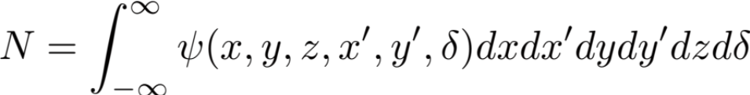
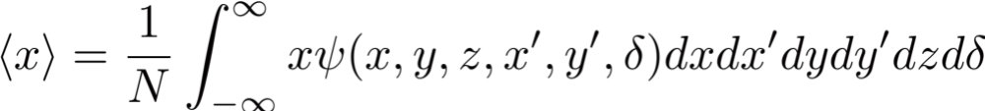

What is a beam instability?
What is a beam instability?
  A beam becomes unstable when a moment of its distribution exhibits an exponential growth (e.g. mean positions <x>, <y>, <z>, standard deviations σ_{x}, σ_{y}, σ_{z}, etc.) – resulting into beam loss or emittance growth!
y
z
x
2
And similar definitions for

Slide 3
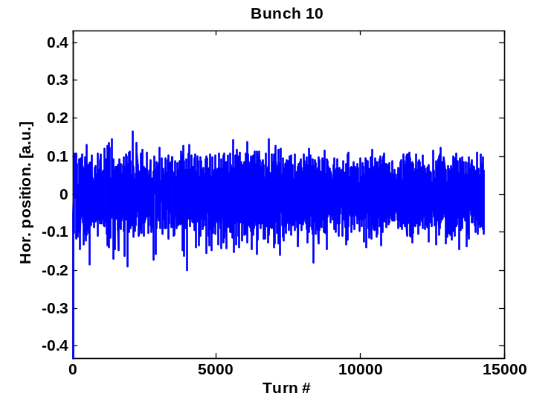
What is a beam instability?
What is a beam instability?
  A beam becomes unstable when a moment of its distribution exhibits an exponential growth (e.g. mean positions <x>, <y>, <z>, standard deviations σ_{x}, σ_{y}, σ_{z}, etc.) – resulting into beam loss or emittance growth!
Beam Position Monitor
y
Stable beam
z
x

Slide 4
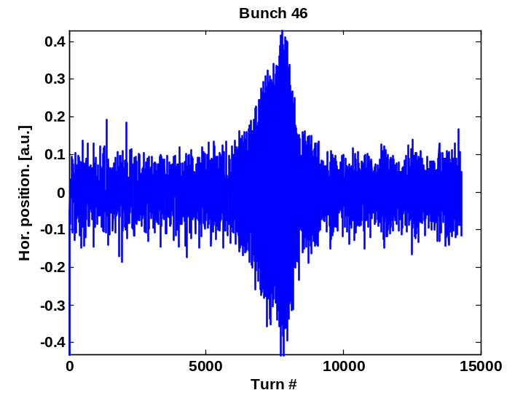
What is a beam instability?
What is a beam instability?
  A beam becomes unstable when a moment of its distribution exhibits an exponential growth (e.g. mean positions <x>, <y>, <z>, standard deviations σ_{x}, σ_{y}, σ_{z}, etc.) – resulting into beam loss or emittance growth!
Beam Position Monitor
y
Unstable beam
z
Beam Current Transformer
ΔI
x

Slide 5
What is a beam instability?
What is a beam instability?
  A beam becomes unstable when a moment of its distribution exhibits an exponential growth (e.g. mean positions <x>, <y>, <z>, standard deviations σ_{x}, σ_{y}, σ_{z}, etc.) – resulting into beam loss or emittance growth!
Beam Profile Monitor
Beam Position Monitor
Beam Profile Monitor
Unstable beam
Beam Current Transformer
ΔI

Slide 6
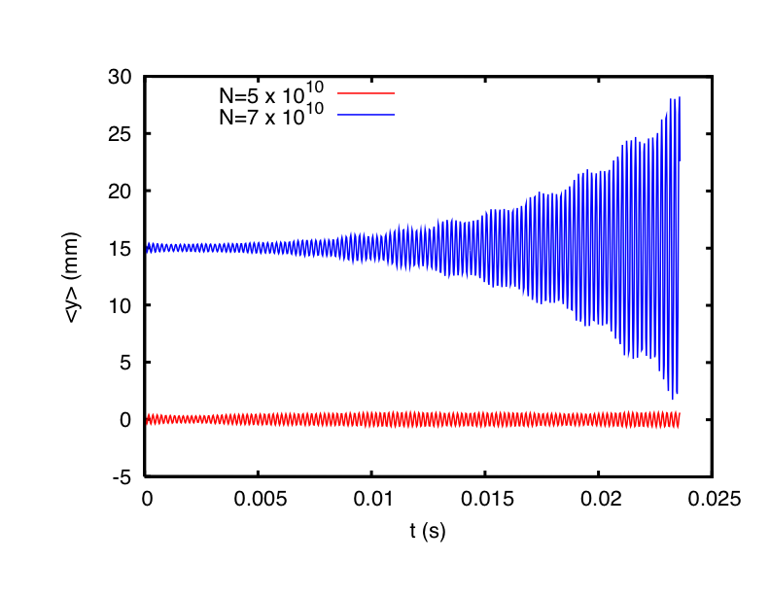
Why study beam instabilities?
What is a beam instability?
  A beam becomes unstable when a moment of its distribution exhibits an exponential growth (e.g. mean positions <x>, <y>, <z>, standard deviations σ_{x}, σ_{y}, σ_{z}, etc.) – resulting into beam loss or emittance growth!
Why study beam instabilities?
  The onset of a beam instability usually determines the maximum beam intensity that a machine can store/accelerate (performance limitation)
y
Typical situation
  A beam centroid instability appears when the intensity is raised above a certain threshold
  The threshold can be optimized by an accurate choice of the machine settings
z
x

Slide 7
Why study beam instabilities?
What is a beam instability?
  A beam becomes unstable when a moment of its distribution exhibits an exponential growth (e.g. mean positions <x>, <y>, <z>, standard deviations σ_{x}, σ_{y}, σ_{z}, etc.) – resulting into beam loss or emittance growth!
Why study beam instabilities?
  The onset of a beam instability usually determines the maximum beam intensity that a machine can store/accelerate (performance limitation)
  Understanding the type of instability limiting the performance, and its underlying mechanism, is essential because it:
    Allows identifying the source and possible measures to mitigate/suppress the effect
    Allows dimensioning an active feedback system to prevent the instability

Slide 8
Types of beam instabilities
Beam instabilities occur in both linear and circular machines
  Longitudinal plane (z,δ)
  Transverse plane (x,y,x’,y’)
Beam instabilities can affect the beam on different scales
  Cross-talk between bunches
    The unstable motion of subsequent bunches is coupled
    The instability is consequence of another mechanism that builds up along the bunch train
  Single bunch effect
  Coasting beam instabilities

Slide 9
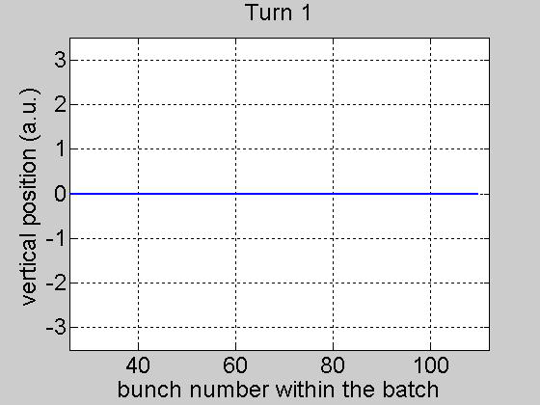
Example of multi-bunch instability
They can affect the beam on different scales
  Cross-talk between bunches
    The unstable motion of subsequent bunches is coupled
    The instability is consequence of another mechanism that builds up along the bunch train
  Single bunch effect

Slide 10
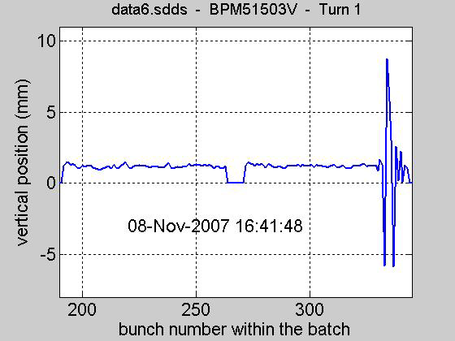
Example of multi-bunch instability
They can affect the beam on different scales
  Cross-talk between bunches
    The unstable motion of subsequent bunches is coupled
    The instability is consequence of another mechanism that builds up along the bunch train
  Single bunch effect

Slide 11
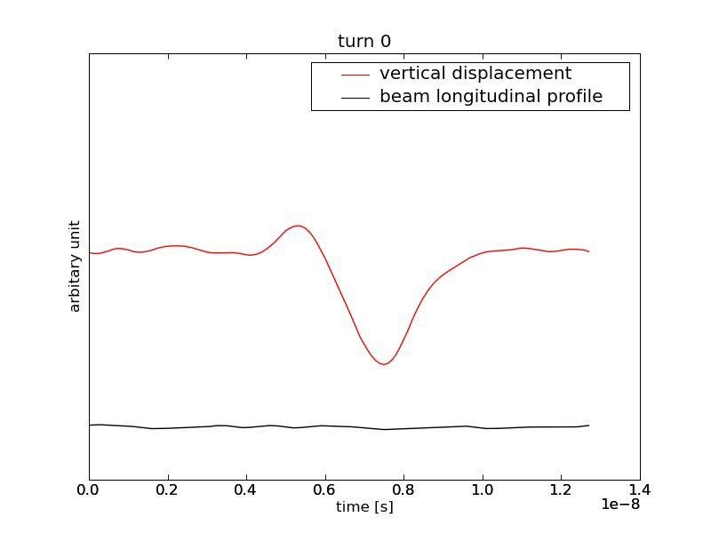
Example of single bunch instability
They can affect the beam on different scales
  Cross-talk between subsequent bunches
    The instability builds up along a bunch train
    The instability is consequence of another mechanism that builds up along the bunch train
  Single bunch effect

Slide 12
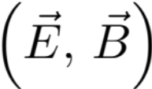
Instability loop
Multi-bunch beam
s
Equations of motion of the beam particles
Interaction with the external environment
Additional electromagnetic field acting on the beam, besides RF and external magnetic fields

Slide 13
Instability loop
Multi-bunch beam
s
Noise
Equations of motion of the beam particles
Interaction with the external environment
Additional electromagnetic field acting on the beam, besides RF and external magnetic fields

Slide 14
Instability loop
Multi-bunch beam
s
Noise
Equations of motion of the beam particles
Interaction with the external environment
Additional electromagnetic field acting on the beam, besides RF and external magnetic fields

Slide 15
Some examples of beam-environment interaction
Interaction of the beam with the external environment
Beam self-fields
  Set of Maxwell’s equations with
    The beam as the source term
    Boundary conditions given by the accelerator component in which the beam propagates
Fields from another beam
  Set of Maxwell’s equations with
    The other beam as the source term
    Boundary conditions given by the chamber in which the encounter between the beams takes place
The electron/ion cloud
  Electron/ion production and accumulation
  Poisson’s equation with
    The electron cloud as the source term
    Boundary conditions given by the chamber in which the electron cloud builds up
Additional electromagnetic field acting on the beam, besides RF and external magnetic fields

Slide 16
Electro-magnetic beam-environment interaction
Interaction of the beam with the external environment
Beam self-fields
  Set of Maxwell’s equations with
    The beam as the source term
    Boundary conditions given by the accelerator component in which the beam propagates
Need of a mathematical framework to describe the effects of the self-induced fields on the beam
Time domain: Wake fields
Frequency domain: Beam coupling impedances

Slide 17
Wake fields (general)
Source, q₁
Witness, q₂
2b
z
z
z
L
  While source and witness ( q_{i} δ(s-ct) ), distant by z<0, move in a perfectly conducting chamber, the witness does not feel any force (γ >> 1)
  When the source encounters a discontinuity (e.g., transition, device), it produces an electromagnetic field, which trails behind (wake field)
    The source loses energy
    The witness feels a net force all along an effective length of the structure, L

Slide 18
Wake fields (general)
Source, q₁
Witness, q₂
2b
z
L
  Not only geometric discontinuities cause electromagnetic fields trailing behind sources traveling at light speed.
  For example, a pipe with finite conductivity causes a delay in the induced currents, which also produces delayed electromagnetic fields
    No ringing, only slow decay
    The witness feels a net force all along an effective length of the structure, L
  In general, also electromagnetic boundary conditions other than PEC can be the origin of wake fields.
Notes:
This is like a Green function, we need to define which is the pulse response (in time domain), in which we are interested!

Slide 19
1. The longitudinal plane
δp/p₀
z

Slide 20
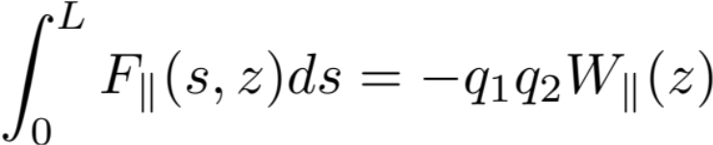

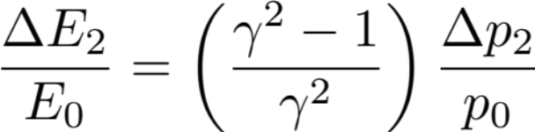

Longitudinal wake function: definition
Source, q₁
Witness, q₂
2b
z
L
Notes:
This is like a Green function, we need to define which is the pulse response (in time domain), in which we are interested!

Slide 21
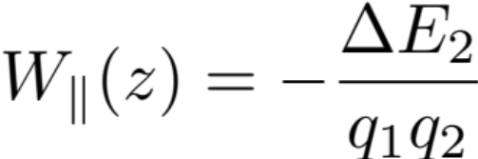
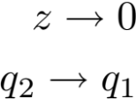
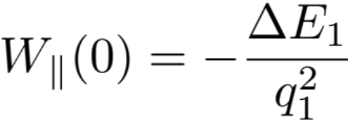
Longitudinal wake function: properties
  The value of the wake function in 0, W||(0), is related to the energy lost by the source particle in the creation of the wake
  W||(0)>0 since ΔE₁<0
  W||(z) is discontinuous in z=0 and it vanishes for all z>0 because of the ultra-relativistic approximation
W||(z)
z

Slide 22
The energy balance
What happens to the energy lost by the source?
  In the global energy balance, the energy lost by the source splits into
    Electromagnetic energy of the modes that remain trapped in the object
      Partly dissipated on lossy walls or into purposely designed inserts or HOM absorbers
      Partly transferred to following particles (or the same particle over successive turns), possibly feeding into an instability!
    Electromagnetic energy of modes that propagate down the beam chamber (above cut-off), which will be eventually lost on surrounding lossy materials

Slide 23
The energy balance
What happens to the energy lost by the source?
  In the global energy balance, the energy lost by the source splits into
    Electromagnetic energy of the modes that remain trapped in the object
      Partly dissipated on lossy walls or into purposely designed inserts or HOM absorbers
      Partly transferred to following particles (or the same particle over successive turns), possibly feeding into an instability!
    Electromagnetic energy of modes that propagate down the beam chamber (above cut-off), which will be eventually lost on surrounding lossy materials
  The energy loss is very important because
    It causes beam induced heating of the beam environment (damage, outgassing)
    It feeds into both longitudinal and transverse instabilities through the associated EM fields

Slide 24
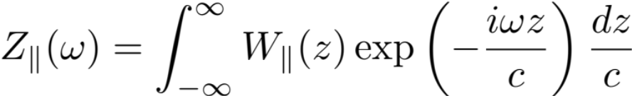
Longitudinal impedance
  The wake function of an accelerator component is basically its Green function in time domain (i.e., its response to a pulse excitation)
    Very useful for macroparticle models and simulations, because it can be used to describe the driving terms in the single particle equations of motion!
  We can also describe it as a transfer function in frequency domain
  This is the definition of longitudinal beam coupling impedance of the element under study
[Ω]
[Ω/s]

Slide 25
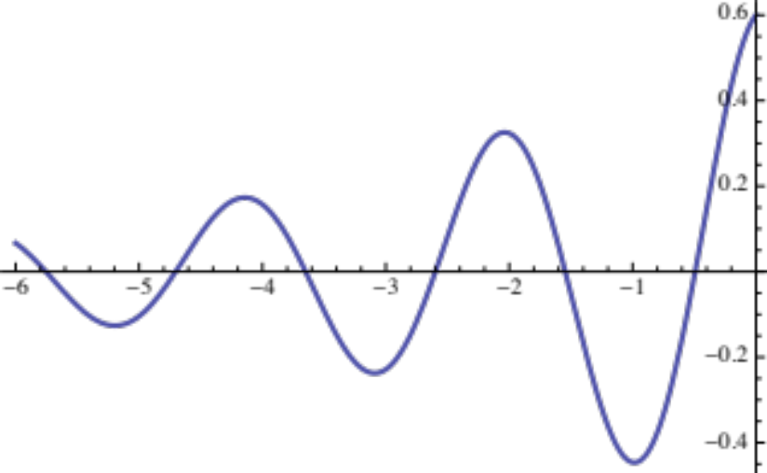
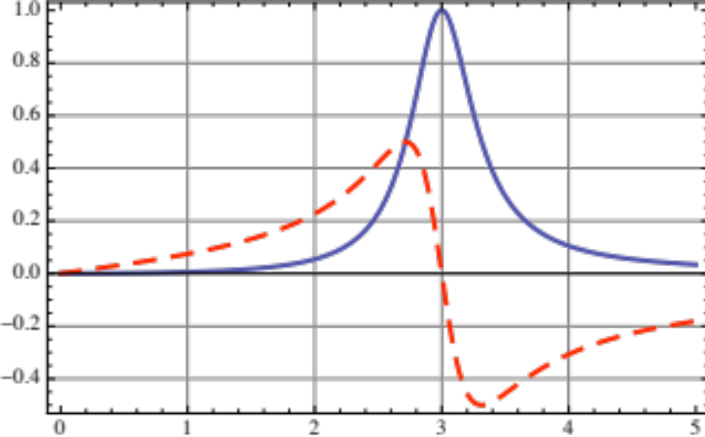
Longitudinal impedance: resonator
W||
Re[Z||]
Im[Z||]
ω_{r}
T=2π/ω_{r}
  The frequency ω_{r} is related to the oscillation of E_{z}, and therefore to the frequency of the mode excited in the object
  The decay time depends on how quickly the stored energy is dissipated (quantified by a quality factor Q)

Slide 26
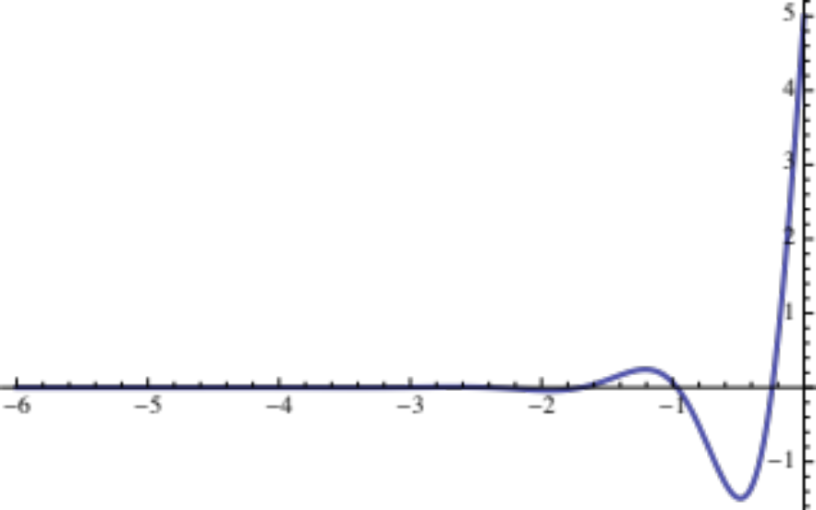
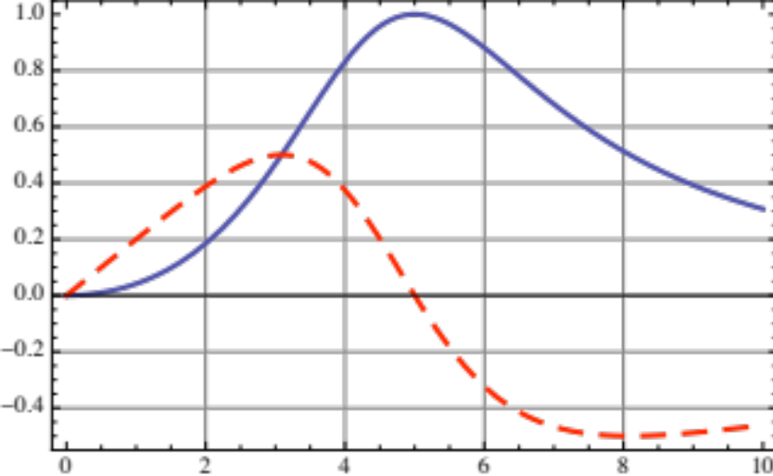
Longitudinal impedance: resonator
W||
Re[Z||]
Im[Z||]
  In general, the impedance will be composed of several of these resonator peaks
  Other contributors to the global impedance can also have different shapes, e.g. the resistive wall

Slide 27
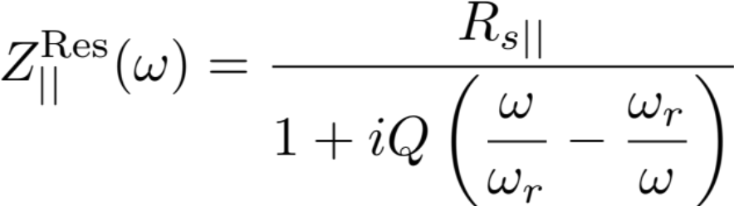
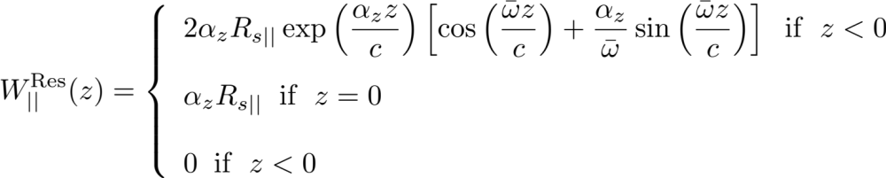

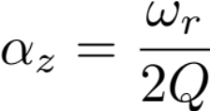

Longitudinal wake & impedance
Equations of the resonator

Slide 28
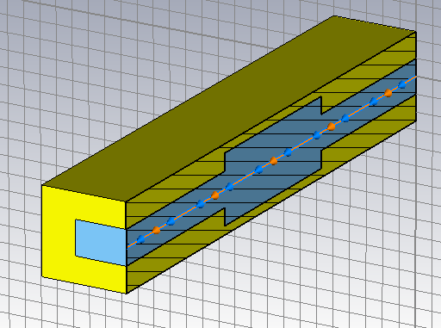
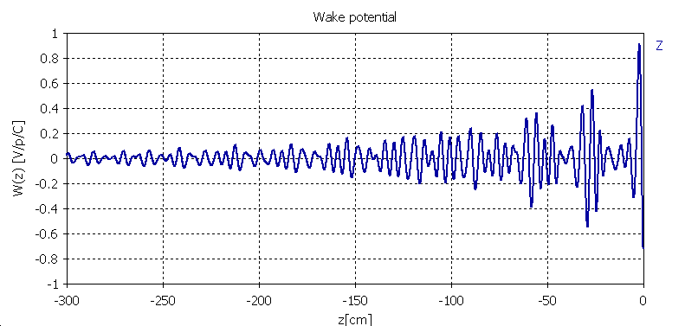
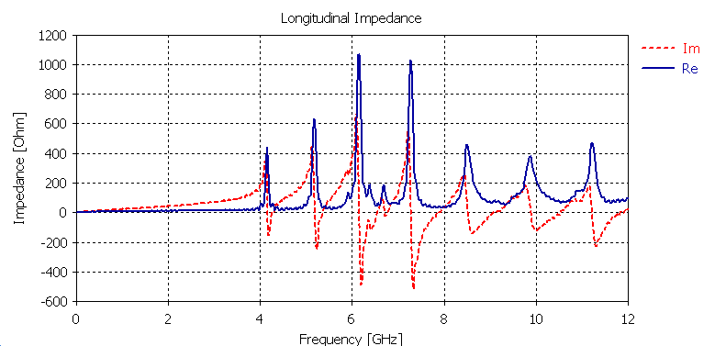
Longitudinal impedance: cavity
  A more complex example: a simple pill-box cavity with walls having finite conductivity
  Several modes can be excited
    Below the pipe cut-off frequency the width of the peaks is only determined by the finite conductivity of the walls
    Above, losses also come from propagation in the chamber
Re[Z||]
Im[Z||]
Note W||(0)<0, CST uses opposite convention!!

Slide 29
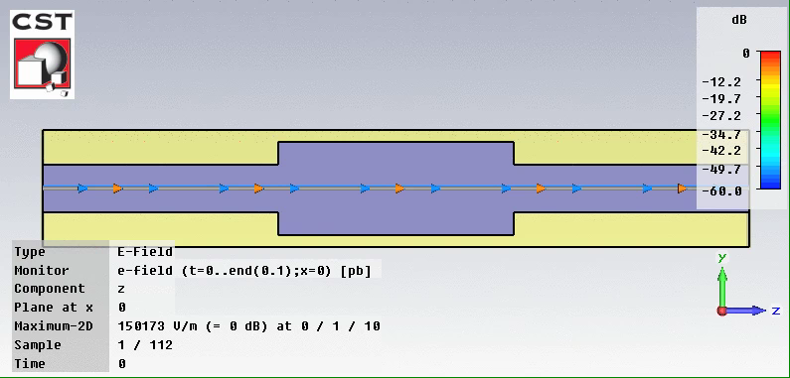
Longitudinal impedance: cavity
  Evolution of the electromagnetic fields (E_{z}) in the cavity while and after the beam has passed

Slide 30

Single bunch effects
W||
Im[Z||]
Re[Z||]

Slide 31
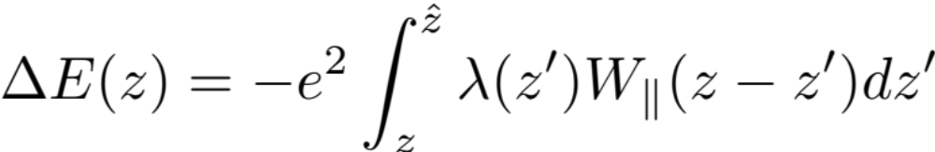
Single bunch effects
W||

Slide 32
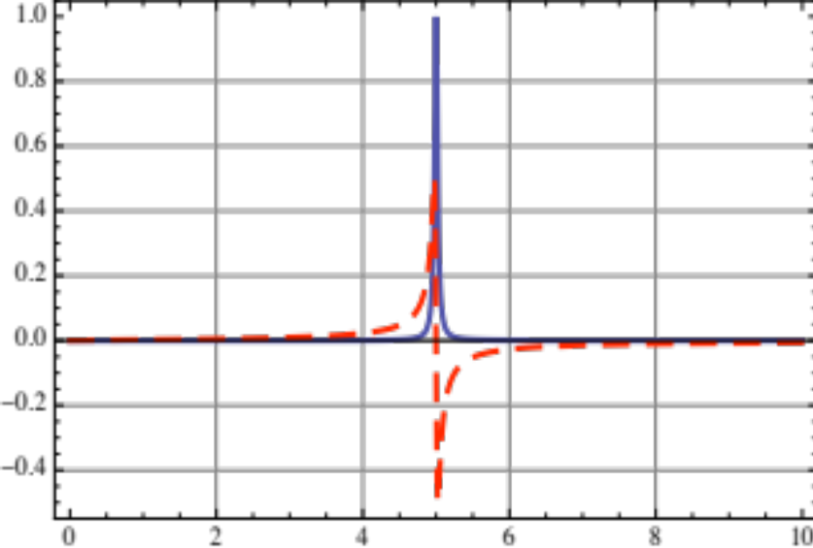
Multi bunch effects
Re[Z||]
Im[Z||]

Slide 33
Multi bunch effects
W||

Slide 34
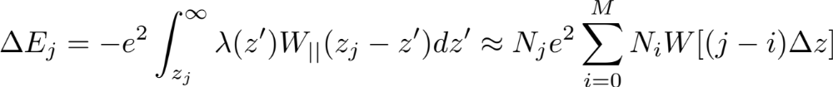
Multi bunch effects
Δz

Slide 35
Single bunch vs. Multi bunch
  A short-lived wake, decaying over the length of one bunch, can only cause intra-bunch (head-tail) coupling
  It can be therefore responsible for single bunch instabilities
Re[Z||]
W||
Im[Z||]

Slide 36
Single bunch vs. Multi bunch
  A long-lived wake field, decaying over the length of a bunch train or even more than a turn, causes bunch-to-bunch or multi-turn coupling
  It can be therefore responsible for multi-bunch or multi-turn instabilities
Re[Z||]
W||
Im[Z||]

Slide 37
Detailed calculations:
  Energy loss
  Robinson instability
Qualitative descriptions:
  Coupled bunch instabilities
  Single bunch modes
[1] “Physics of Collective Beam Instabilities in High Energy Accelerators”, A. W. Chao

Slide 38
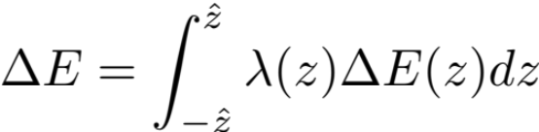


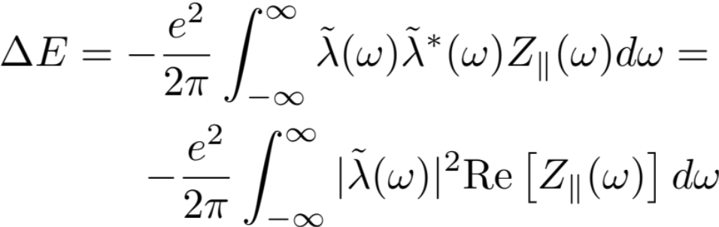

Energy loss of a bunch (single pass)
  The energy kick ΔE(z) on each particle e in the witness slice λ(z)dz is the integral of the contributions from the wakes left behind by all the preceding eλ(z’)dz slices (sources)
  The total energy loss ΔE of the bunch can then be obtained by integrating ΔE(z) λ(z) over the full bunch extension
Bunch tail
Bunch head

Slide 39
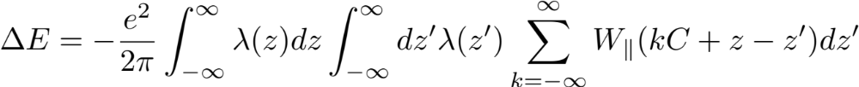
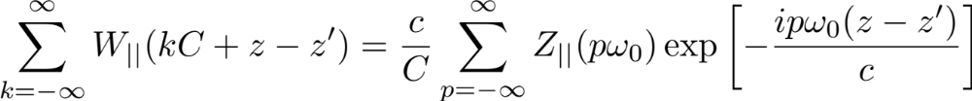
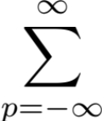


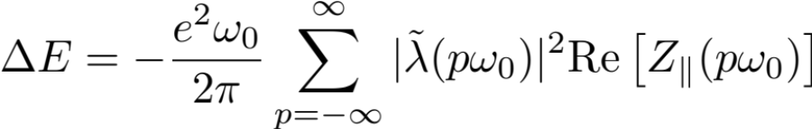
Energy loss of a bunch (multi-pass)
  The total energy loss ΔE of the bunch can still be obtained by integrating ΔE(z) over the full bunch extension
  ΔE(z) this time also includes contributions from all previous turns, spaced by multiples of the ring circumference C

Slide 40
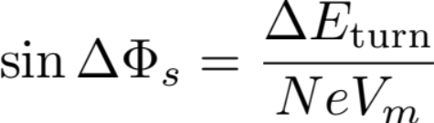
Energy loss per turn: stable phase shift
  The RF system has to compensate for the energy loss by imparting a net acceleration to the bunch
  Therefore, the bunch readjusts to a new equilibrium distribution in the bucket and moves to a synchronous angle ΔΦ_{s}
Below transition
Above transition

Slide 41
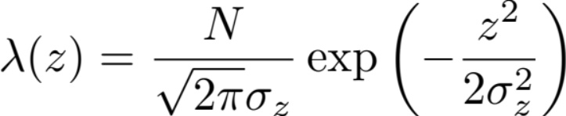
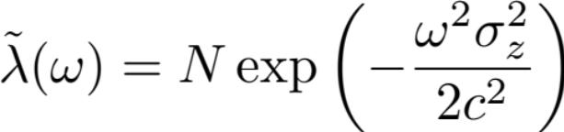
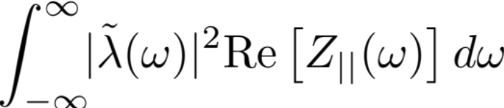
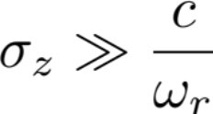
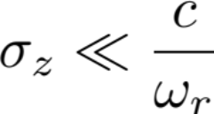
Example
Gaussian bunch and power loss with a broad-band resonator impedance
can be calculated with Z||(ω) = Z||^{Res}(ω) from previous slide in the two limiting cases
Need to expand Re[Z||(ω)] for small ω
Can assume |λ(ω)| constant over Re[Z||(ω)]

Slide 42
Single particle equations of the longitudinal motion in presence of wake fields
Bunch tail
  The single particle in the witness slice λ(z)dz will feel the force from the RF, from the bunch own space charge, and that associated to the wake
  The wake contribution can extend to several turns
Bunch head
External RF
Wake fields

Slide 43
The Robinson instability
  To illustrate the Robinson instability we will use some simplifications:
    The bunch is point-like and feels an external linear force (i.e. it would execute linear synchrotron oscillations in absence of the wake forces)
    The bunch additionally feels the effect of a multi-turn wake
δp/p₀
z
Unperturbed: the bunch executes synchrotron oscillations at ω_{s}

Slide 44
The Robinson instability
  To illustrate the Robinson instability we will use some simplifications:
    The bunch is point-like and feels an external linear force (i.e. it would execute linear synchrotron oscillations in absence of the wake forces)
    The bunch additionally feels the effect of a multi-turn wake
δp/p₀
z
The perturbation also changes the oscillation amplitude
Unstable motion
The perturbation changes ω_{s}

Slide 45
The Robinson instability
  To illustrate the Robinson instability we will use some simplifications:
    The bunch is point-like and feels an external linear force (i.e. it would execute linear synchrotron oscillations in absence of the wake forces)
    The bunch additionally feels the effect of a multi-turn wake
δp/p₀
z
The perturbation also changes the oscillation amplitude
Damped motion

Slide 46
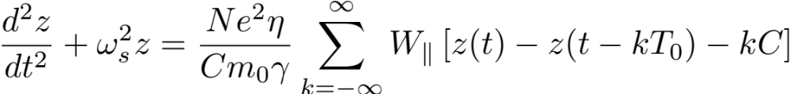
The Robinson instability
  To illustrate the Robinson instability we will use some simplifications:
    The bunch is point-like and feels an external linear force (i.e. it would execute linear synchrotron oscillations in absence of the wake forces)
    The bunch additionally feels the effect of a multi-turn wake
We assume that the wake can be linearized on the scale of a synchrotron oscillation

Slide 47

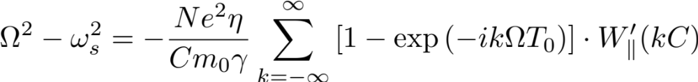
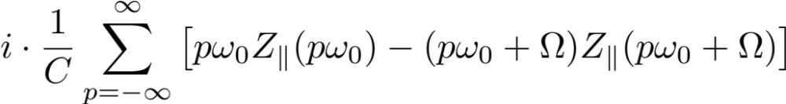
The Robinson instability
  The term Σ W||(kC) only contributes to a constant term in the solution of the equation of motion, i.e. the synchrotron oscillation will be executed around a certain z₀ and not around 0. This term represents the stable phase shift that compensates for the energy loss
  The dynamic term proportional to z(t)-z(t-kT₀) ≈kT₀dz/dt will introduce a “friction” term in the equation of the oscillator, which can lead to instability!

Slide 48

The Robinson instability
  We assume a small deviation from the synchrotron tune
  Re(Ω - ω_{s}) → Synchrotron tune shift
  Im(Ω - ω_{s}) → Growth/damping rate, only depends on the dynamic term, if it is positive there is an instability!
Complex frequency shift
x
x

Slide 49


The Robinson instability
  We assume the impedance to be peaked at a frequency ω_{r} close to hω₀ >> ω_{s} (e.g. RF cavity fundamental mode or HOM)
  Only two dominant terms are left in the summation at the RHS of the equation for the growth rate
  Stability requires that η and Δ[Re Z||(hω₀)] have different signs
Re[Z||]
Im[Z||]
ω_{r} ≈ hω₀
Stability criterion →

Slide 50
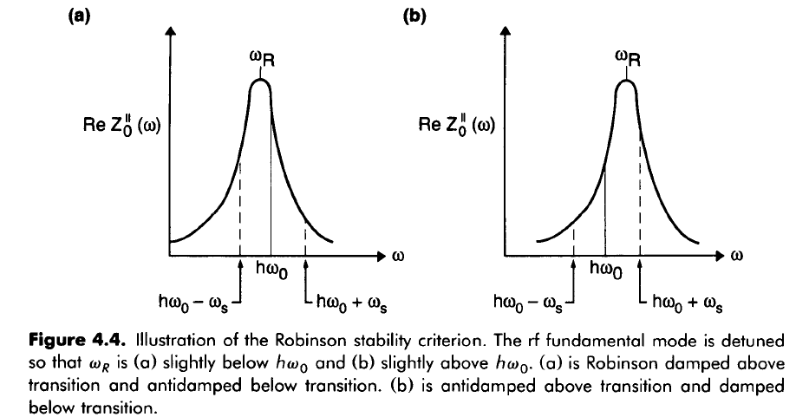




The Robinson instability
Stability criterion →
 | ω_{r} < hω₀ | ω_{r} > hω₀
Above transition (η>0) | stable | unstable
Below transition (η<0) | unstable | stable

Slide 51
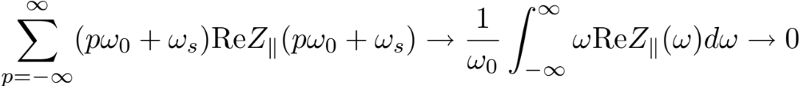
The Robinson instability
  Other types of impedances can also cause instabilities through the Robinson mechanism
  However, a smooth broad-band impedance with no narrow structures on the ω₀ scale cannot give rise to an instability
    Physically, this is clear, because the absence of structure on ω₀ scale in the spectrum implies that the wake has fully decayed in one turn time and the driving term in the equation of motion also vanishes

Slide 52
Other longitudinal instabilities
The Robinson instability occurs for a single bunch under the action of a multi-turn wake field
  It contains a term of coherent synchrotron tune shift
  It results into an unstable rigid bunch dipole oscillation
  It does not involve higher order moments of the bunch longitudinal phase space distribution
Other important collective effects can affect a bunch in a beam
  Potential well distortion (resulting in synchronous phase shift, bunch lengthening or shortening, synchrotron tune shift/spread)
  Coupled bunch instabilities
  High intensity single bunch instabilities (e.g. microwave instability)
  Coasting beam instabilities (e.g. negative mass instability)
To be able to study these effects we would need to resort to a more detailed description of the bunch(es)
  Vlasov equation (kinetic model)
  Macroparticle simulations

Slide 53
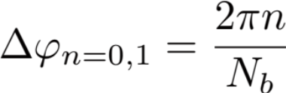
Coupled bunch modes
M bunches can exhibit M different modes of coupled rigid bunch oscillations in the longitudinal plane
Mode 0
z

Slide 54
Coupled bunch modes
M bunches can exhibit M different modes of coupled rigid bunch oscillations in the longitudinal plane
Mode 1
z

Slide 55
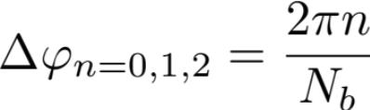
Coupled bunch modes
M bunches can exhibit M different modes of coupled rigid bunch oscillations in the longitudinal plane
Any rigid coupled bunch oscillation can be decomposed into a combination of these basic modes
Mode 0
z

Slide 56
Coupled bunch modes
M bunches can exhibit M different modes of coupled rigid bunch oscillations in the longitudinal plane
Any rigid coupled bunch oscillation can be decomposed into a combination of these basic modes
Mode 1
z

Slide 57
Coupled bunch modes
M bunches can exhibit M different modes of coupled rigid bunch oscillations in the longitudinal plane
Any rigid coupled bunch oscillation can be decomposed into a combination of these basic modes
This modes can become unstable under the effect of long range wake fields
Mode 2
z

Slide 58
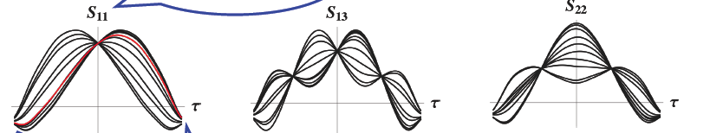
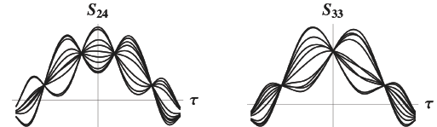
Single bunch modes
In a similar fashion, a single bunch exhibits a double infinity of natural modes of oscillation, with rather complicated phase space portraits.
Whatever perturbation on the bunch phase space distribution can be expanded as a series of these modes
Oscillation modes as observed at a wall current monitor

Slide 59

Single bunch modes
In a similar fashion, a single bunch exhibits a double infinity of natural modes of oscillation, with rather complicated phase space portraits.
Whatever perturbation on the bunch phase space distribution can be expanded as a series of these modes
One of these modes or a combination of them can become unstable under the effect of a short range wake field
In particular, the frequencies of these modes shift with intensity, and two of the modes can merge above a certain threshold, causing a microwave instability!

Slide 60

Macroparticle simulation
We have simulated the evolution of an SPS bunch under the effect of a longitudinal broad band impedance lumped in one point of the ring
SPS ring:
Transverse → 1-turn map M
Longitudinal → kick from sinusoidal voltage

Slide 61

Macroparticle simulation
We have simulated the evolution of an SPS bunch under the effect of a longitudinal broad band impedance lumped in one point of the ring
Two different intensity values have been simulated
  Low intensity → below instability threshold, but potential well distortion is visible in terms of stable phase shift and bunch lengthening
  High intensity → above microwave instability threshold

Slide 62

Macroparticle simulation
We have simulated the evolution of an SPS bunch under the effect of a longitudinal broad band impedance lumped in one point of the ring
Two different intensity values have been simulated
  Low intensity → below instability threshold, but potential well distortion is visible in terms of stable phase shift and bunch lengthening
  High intensity → above microwave instability threshold

Slide 63
Conclusions (part I)
Beam instability
  Manifests itself like an exponential coherent motion resulting in beam loss or emittance blow up
  Can be caused by self induced EM fields
  Can be described in the framework of wake fields/beam coupling impedances
Longitudinal effects
  Energy loss
  Dipole instability (Robinson), excitation of coupled bunch & single bunch modes
Tomorrow → transverse wake fields/beam coupling impedances and instabilities

