Slide 1
Beam Diagnostics Lecture 2
Measuring Complex Accelerator Parameters
Uli Raich
CERN AB-BI

Slide 2
Contents of lecture 2
Some examples of measurements done with the instruments explained during the last lecture
  Spectroscopy
  Trajectory and Orbit measurements
  Tune measurements
    Traditional method
    BBQ method
  Multi-turn extraction
  Transverse and longitudinal emittance measurements
  Longitudinal phase space tomography

Slide 3
Faraday Cup application
Testing the decelerating RFQ
Antiproton decelerator
Accelerate protons to 24 GeV and eject them onto a target
Produce antiprotons at 2 GeV
Collect the antiprotons and cool them
Decelerate them and cool them
Output energy: 100 MeV
In order to get even lower energies:
Pass them through a moderator
  High losses
  Large energy distribution
=> Build a decelerating RFQ

Slide 4
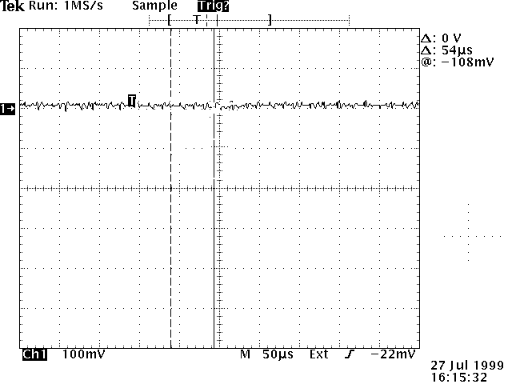
Waiting for Godot
Proton beam
RFQ
Testing the
decelerating RFQ
Spectrometer
magnet
FC
FC

Slide 5
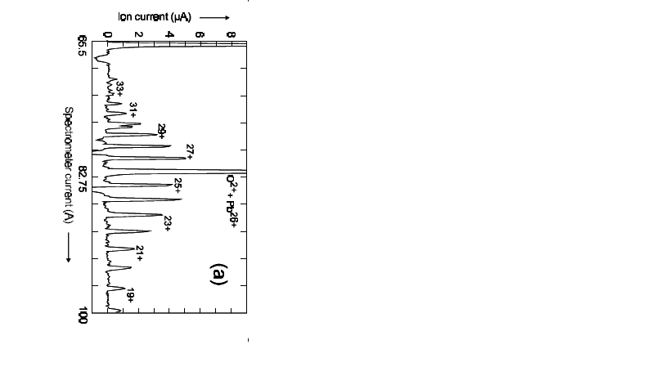
Setup for charge state measurement
Spectrometer
Magnet
Faraday
Cup
The spectrometer magnet is swept and the current passing the slit is measured
Ion
source
beam

Slide 6
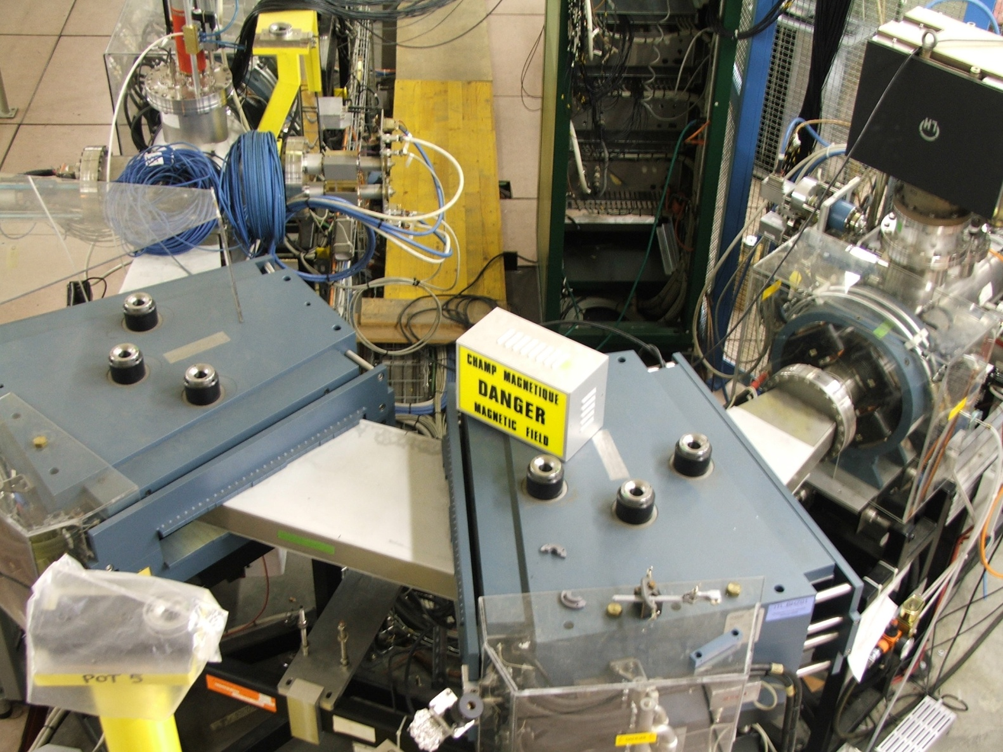
Measuring charge state distribution
Faraday Cup
Slit
Spectrometer
magnets

Slide 7
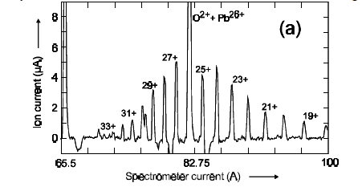
Charge state distribution measured with a Faraday Cup on a heavy ion source

Slide 8
Trajectory and Orbit measurements
Definitions:
Trajectory: The mean positions of the beam during 1 turn
Orbit: The mean positions over many turns for each of the
BPMs
The trajectories must be controlled at injection, ejection, transition
Closed orbits may change during acceleration or RF “gymnastics”

Slide 9
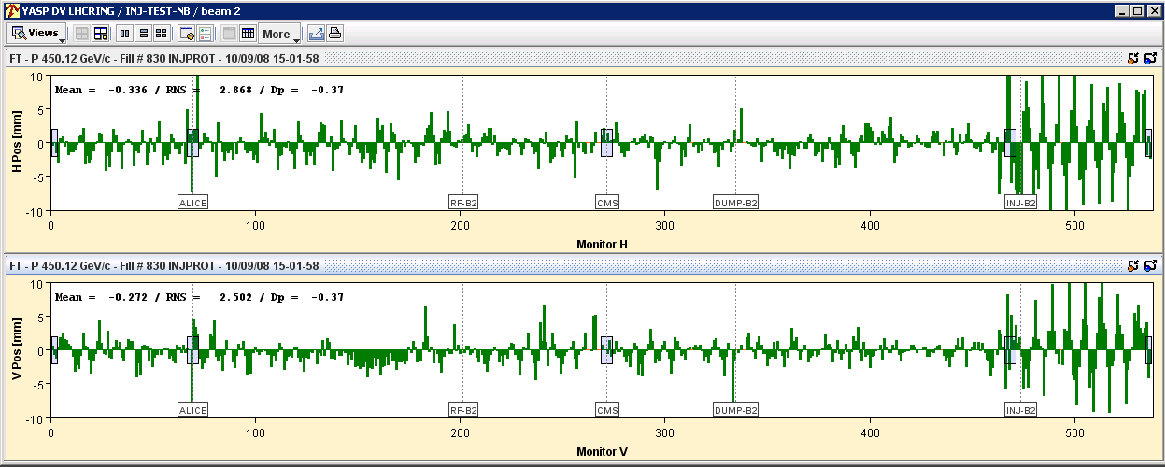
Trajectory Measurement at LHC
Knowing the optics one can deduce the orbit correction from the measurement

Slide 10
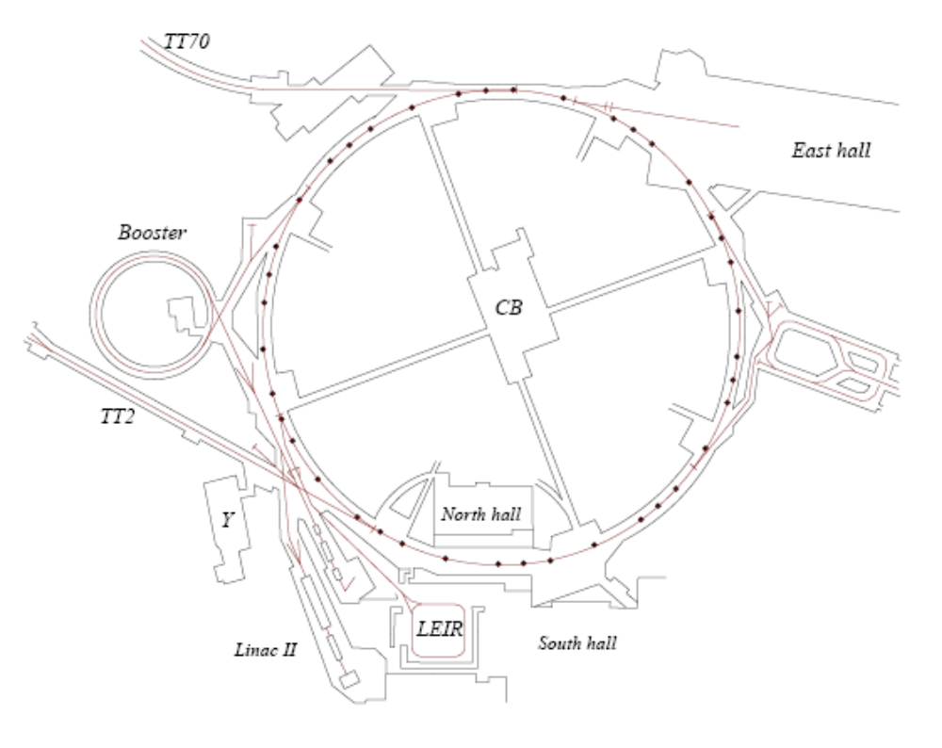
The PUs

Slide 11
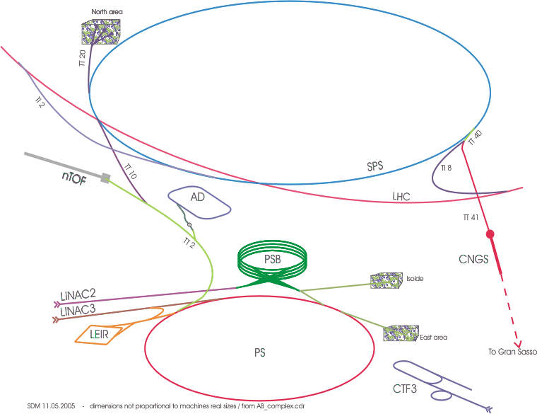
The PS, a universal machine
All beams pass through the PS
Different particle types
Different beam characteristics
Concept of a super cycle

Slide 12
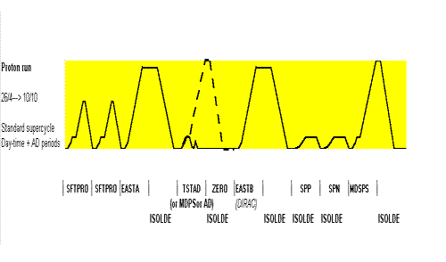
The super cycle

Slide 13
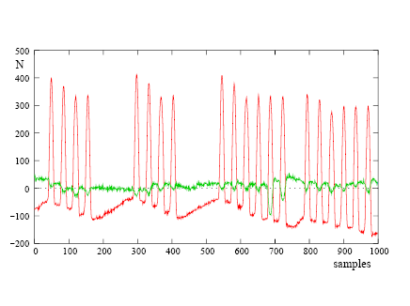
Position Measurements
Red: The sum signal
Green: The difference signal
Procedure:
Produce integration gates and
Baseline signals
Baseline correct both signals
Integrate sum and difference signals
and store results in memory
Take external timing events into account e.g. harmonic number change, γ-transition etc.

Slide 14
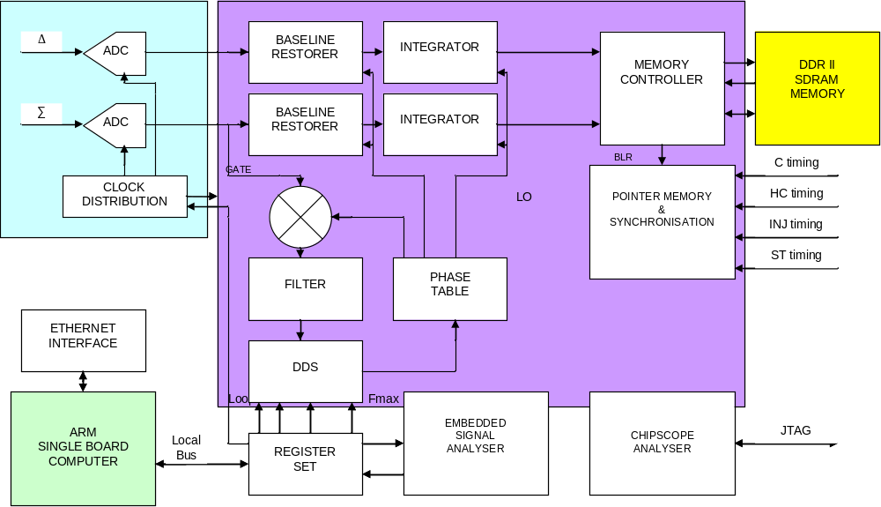
Trajectory readout electronics

Slide 15
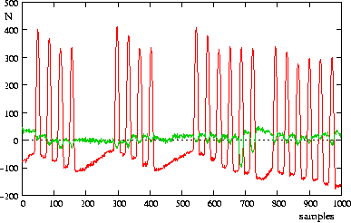
Trajectory measurements in circular machines
Needs integration gate
Can be rather tricky
Distance between bunches
changes with acceleration
Number of bunches
may change
Raw data from pick-ups
double batch injection

Slide 16
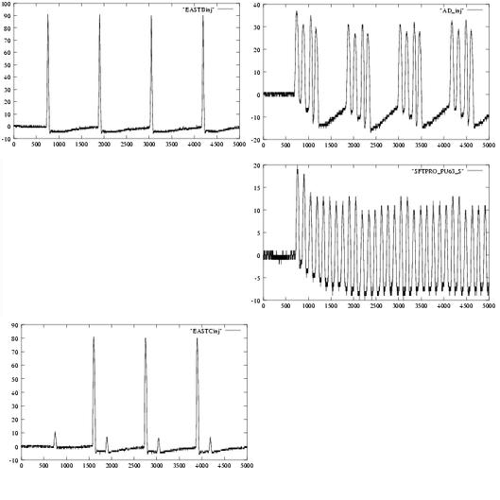
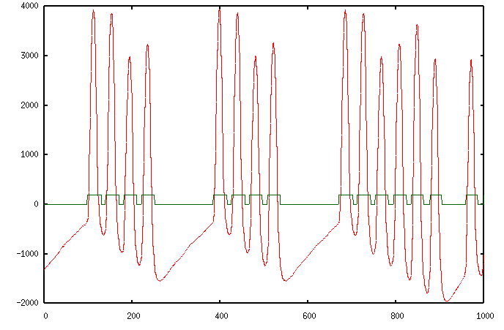
Beams in the PS

Slide 17
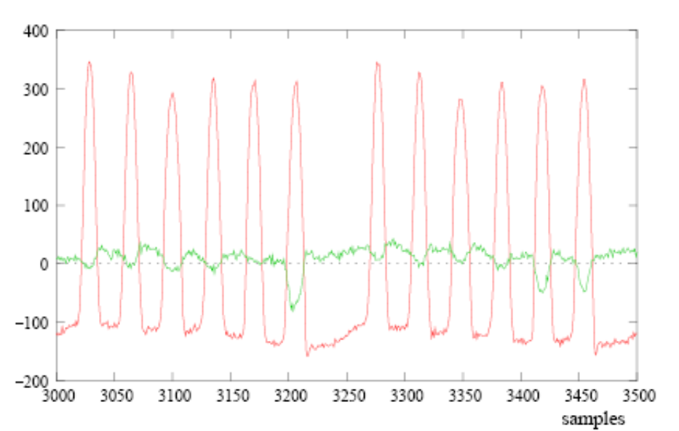
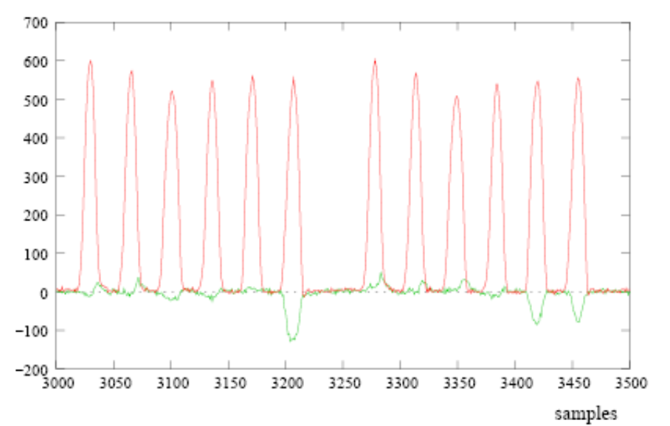
Baseline restoration
Low pass filter the signal to get an estimate of the base line
Add this to the original signal

Slide 18
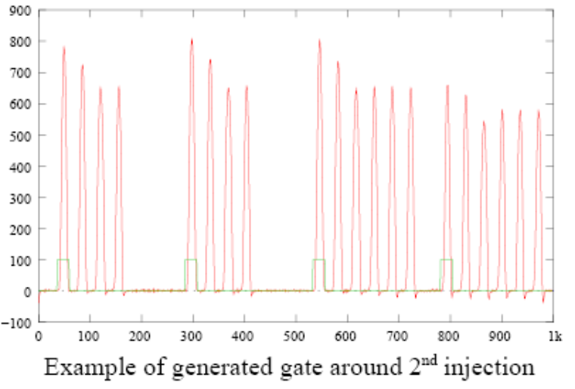
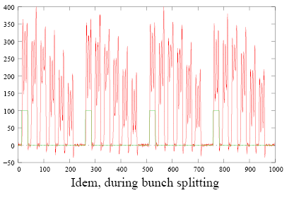
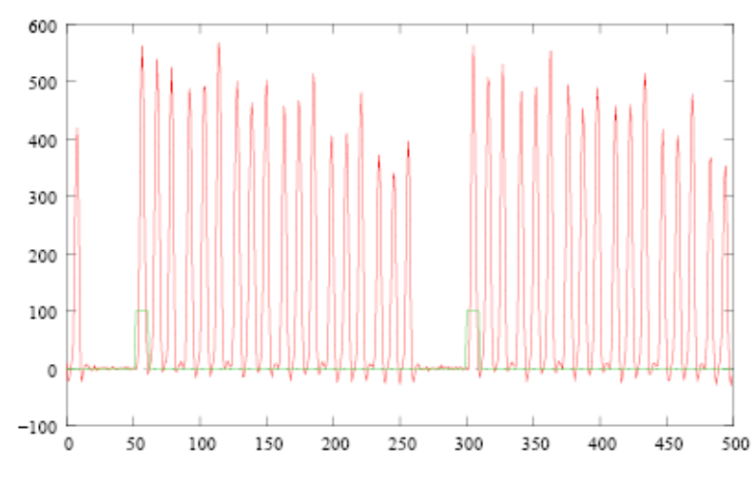
RF Gymnastics

Slide 19
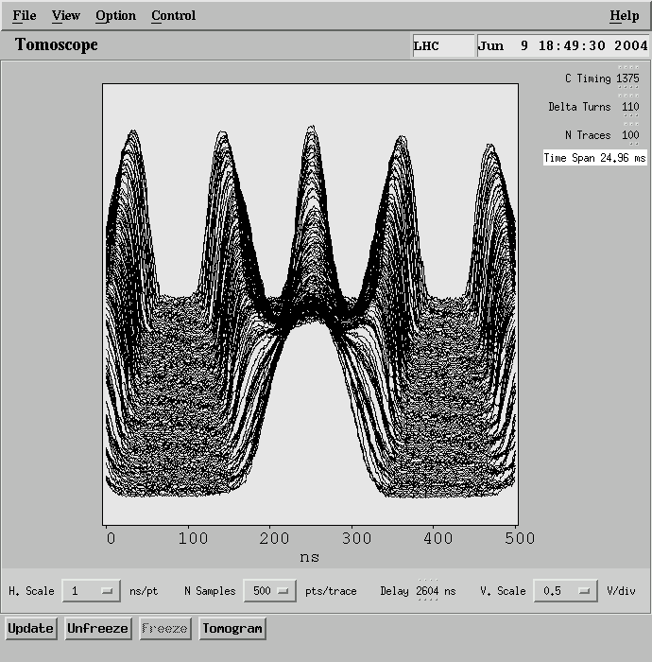
Changing bunch frequency
Bunch splitting or recombination
One RF frequency is gradually
decreased while the other one
is increased
Batch compression
For all these cases the gate generator must be synchronized

Slide 20
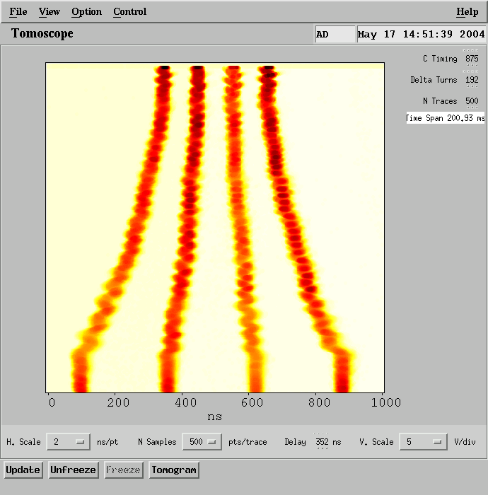
Batch compression

Slide 21
Tune measurements
When the beam is displaced (e.g. at injection or with a deliberate kick, it starts to oscillate around its nominal orbit (betatron oscillations)
Measure the trajectory
Fit a sine curve to it
Follow it during one revolution
kicker

Slide 22
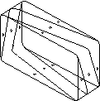
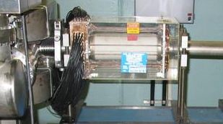
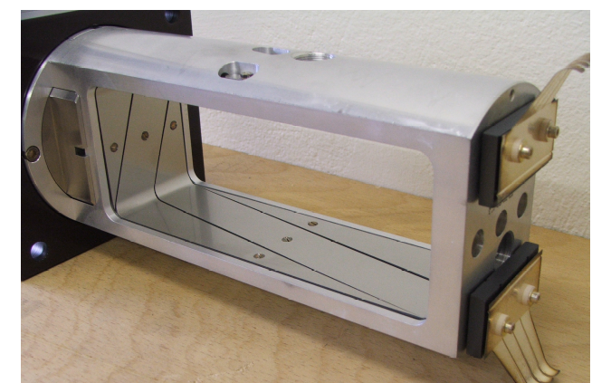
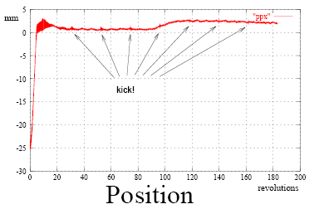
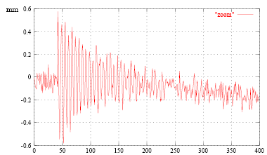
The Sensors
Shoebox pick-up
with linear cut
The kicker

Slide 23
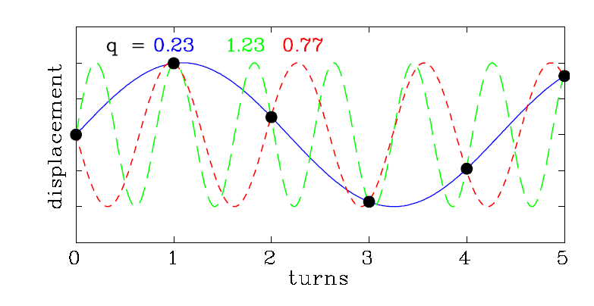
Tune measurements with a single PU
Design by P. Forck

Slide 24
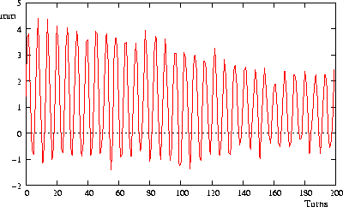
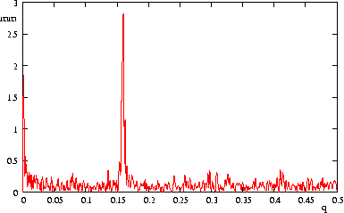
Kicker + 1 pick-up
Measures only non-integral part of Q
Measure a beam position at each revolution
Fourier transform of pick-up signal

Slide 25
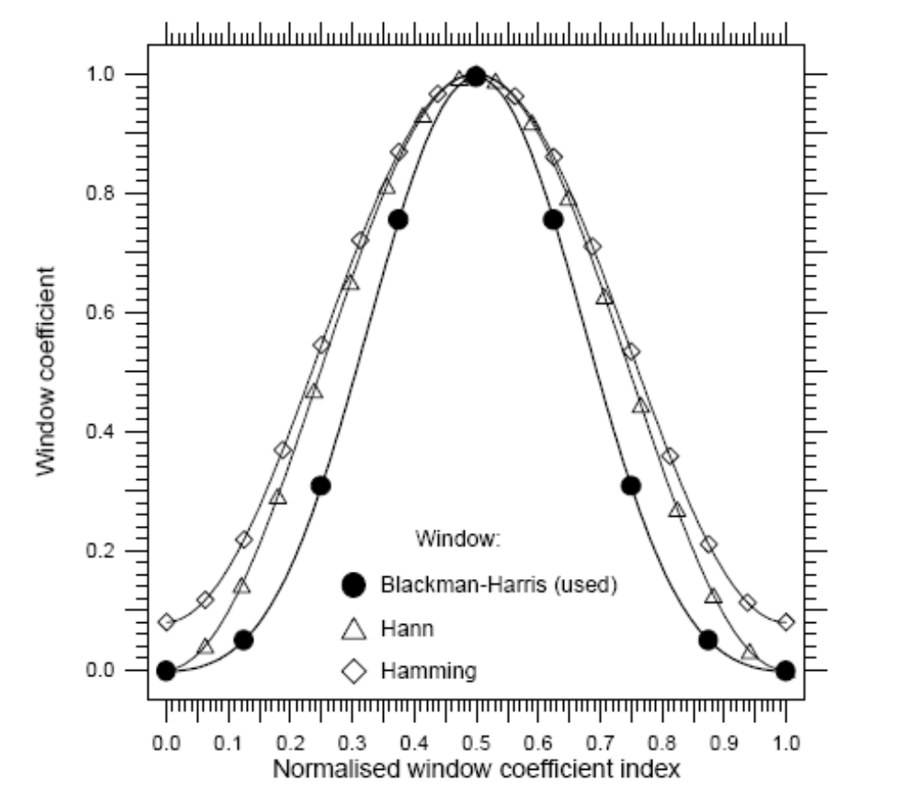
Windowing
The Discrete Fourier assumes one cycle of a repetitive signal.
Blackman-Harris Window is used
Each sample is multiplied with a coefficient
Coefficients are pre-calculated and stored in a table

Slide 26
Periodic extension of the signal and Windowing
discontinuity

Slide 27
Peak search algorithm
Power value is bigger than its predecessor
Power value is bigger than its successor
Power value is biggest in the whole spectrum
The power value is at least 3 times bigger than the arithmetic mean of all power bins.

Slide 28
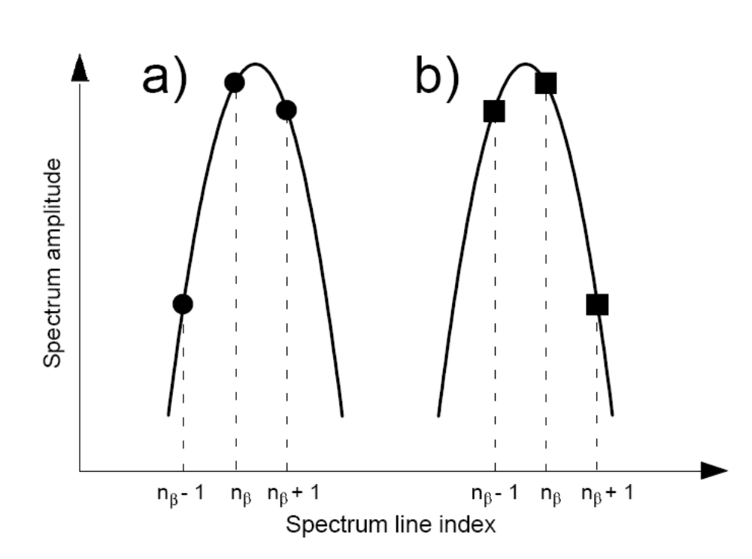
Q interpolation
Betatron signal is not a pure
Harmonic but includes rev. freq
Harmonics, noise …
The windowing process is not
Perfect
Coherent betatron signal is
Damped in the time domain

Slide 29
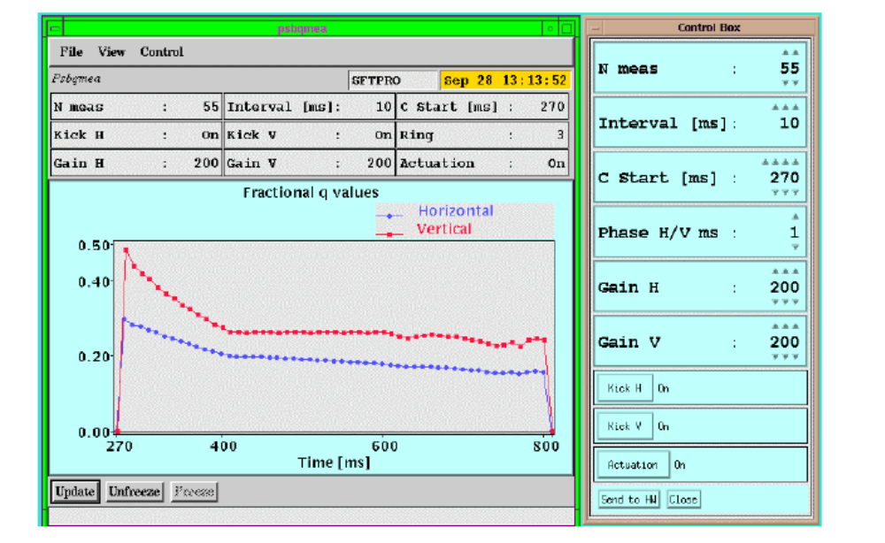
Q-Measurement Results

Slide 30
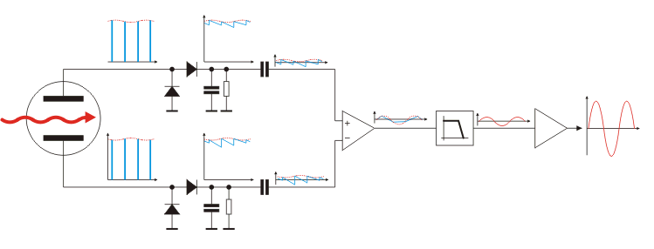
Direct Diode Detection Base Band Q measurement
Diode Detectors convert spikes to saw-tooth waveform
Signal is connected to differential amplifier to cut out DC level
Filter eliminates most of the revolution frequency content
Output amplifier brings the signal level to amplitudes suitable for long distance transmission
Curtesy M. Gasior

Slide 31
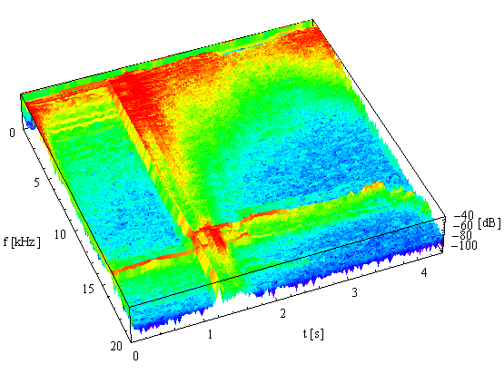
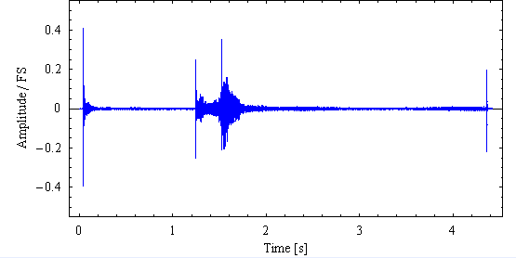

BBQ Results from CERN SPS
Results from Sampling
After Fourier Transform

Slide 32
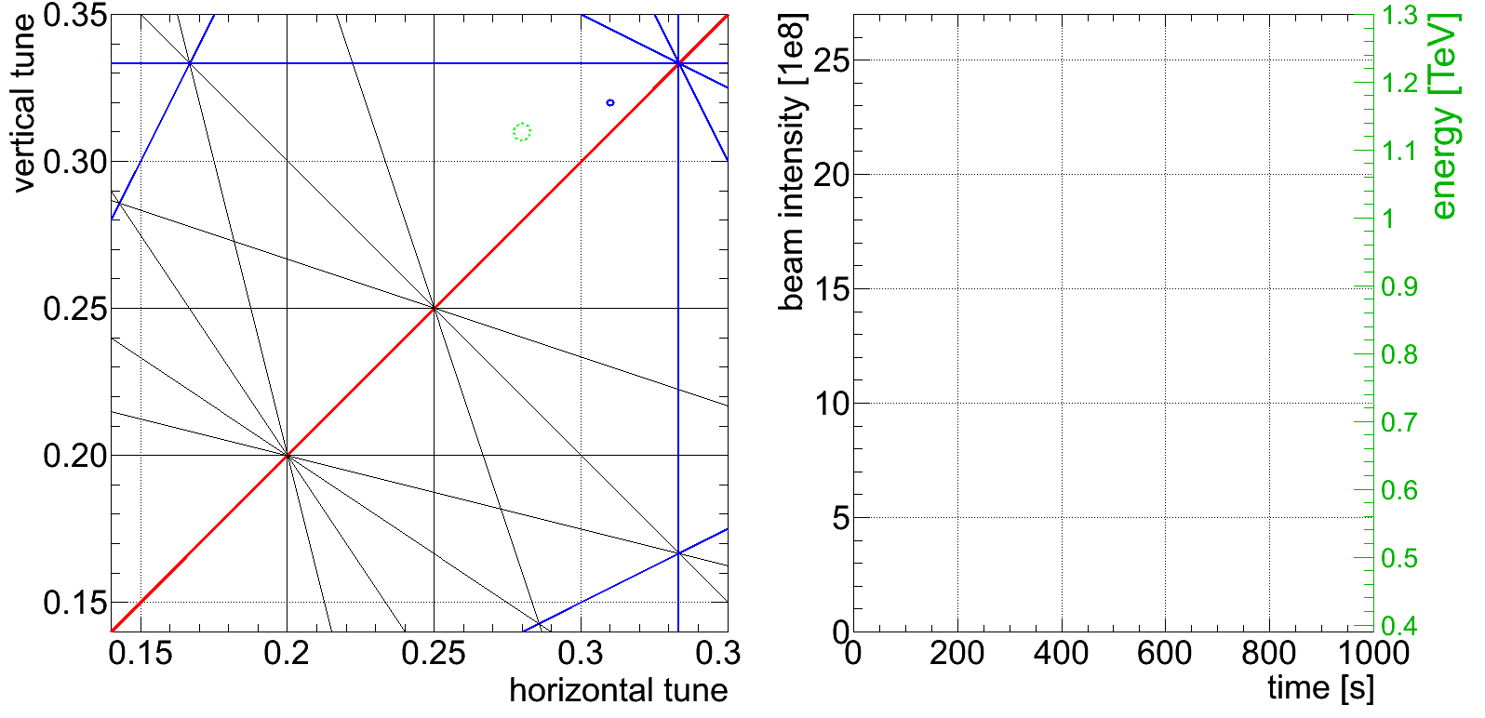
Tune feedback at the LHC

Slide 33
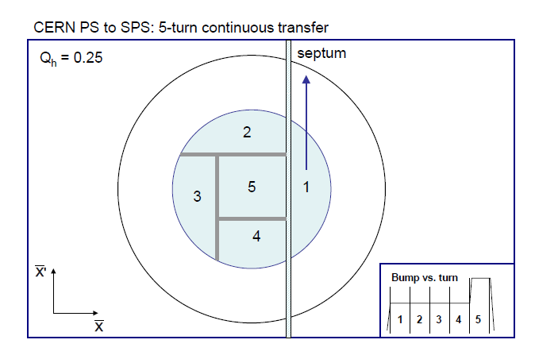
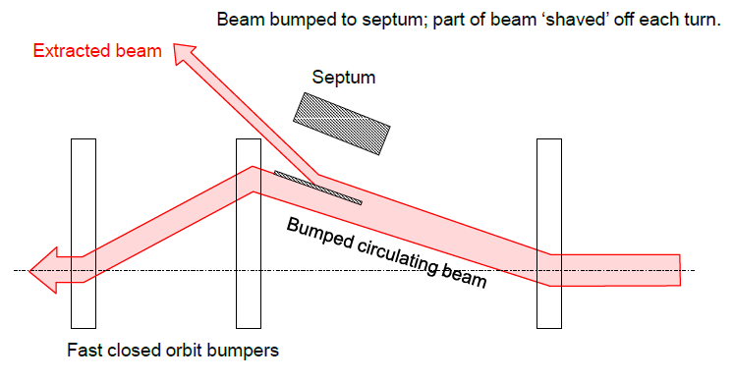
Multi-Turn Extraction
Losses on the
septum blade

Slide 34
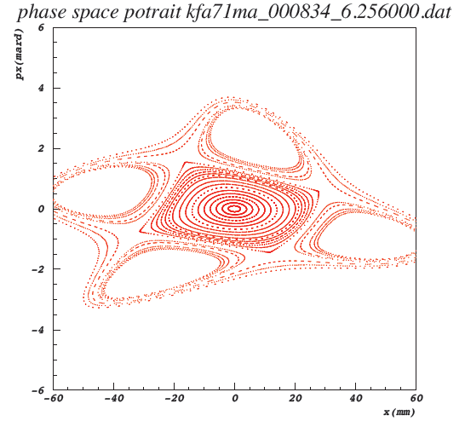
Islands in transverse phase space
Create stable island
in phase space through
excitation with hexapoles and
octopoles and capture
the beam in them
Can this be measured?
Poor man‘s phase space
meter using 2 BPMs at
90° phase advance

Slide 35
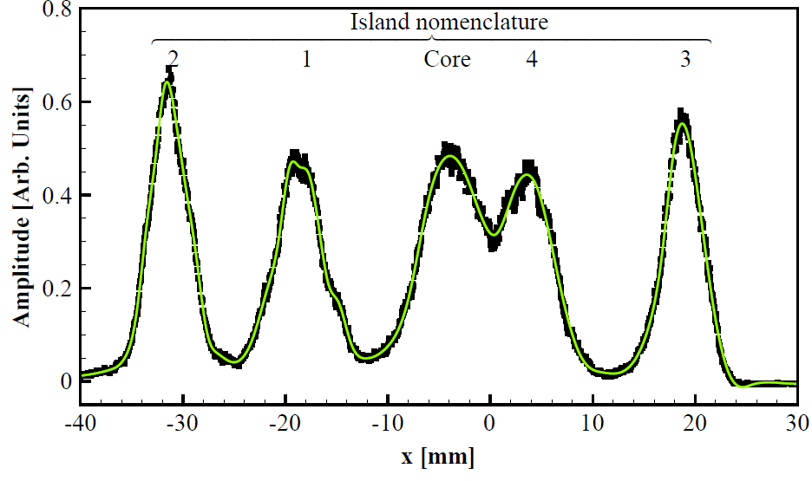
Profile of Islands

Slide 36
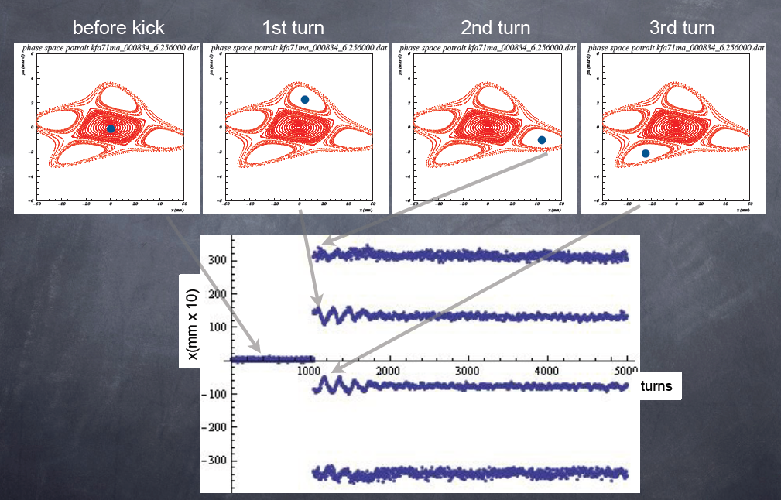
Stable Islands in Phase Space

Slide 37
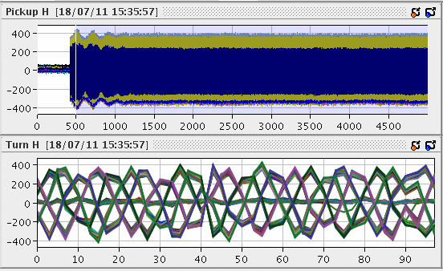
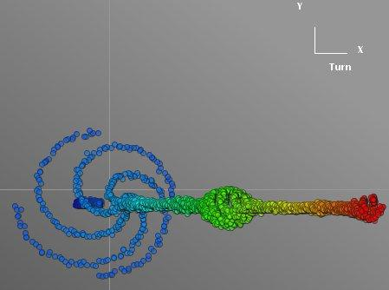
Projection in Phase Space

Slide 38
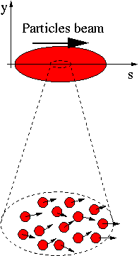
Emittance measurements
A beam is made of many many particles,
each one of these particles is moving with
a given velocity. Most of the velocity
vector of a single particle is parallel to the
direction of the beam as a whole (s).
There is however a smaller component of
the particles velocity which is
perpendicular to it (x or y).
Design by E. Bravin

Slide 39
Emittance measurements
x’
If for each beam particle we plot its position and its transverse angle we get a particle distribution who’s boundary is an usually ellipse.
The projection onto the x axis is the beam size
Beam size
x

Slide 40
The slit method
If we place a slit into the beam we cut out a small vertical slice of phase space
Converting the angles into position through a drift space allows to reconstruct the angular distribution at the position defined by the slit
x’
x
slit

Slide 41
Transforming angular distribution to profile
Influence of a drift space
x’
x’
When moving through a drift space the angles don’t change (horizontal move in phase space)
When moving through a quadrupole the position does not change but the angle does (vertical move in phase space)
x
x
slit
slit
Influence of a quadrupole
x’
x
slit

Slide 42
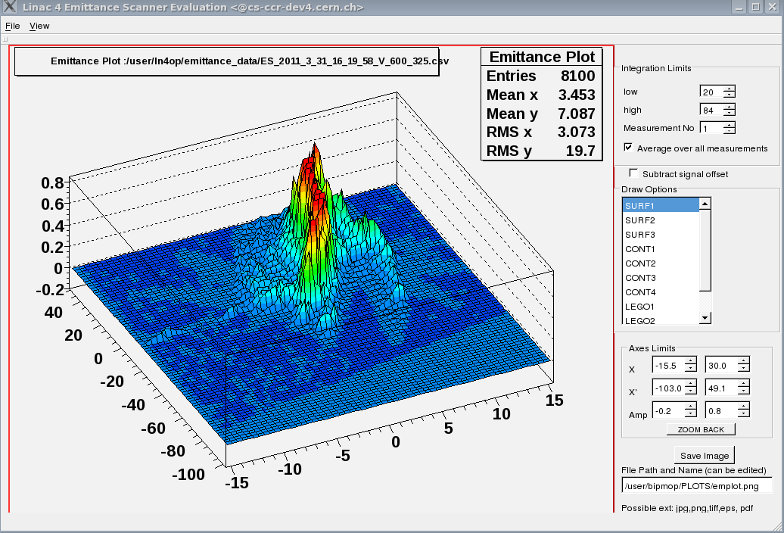
The Slit Method

Slide 43
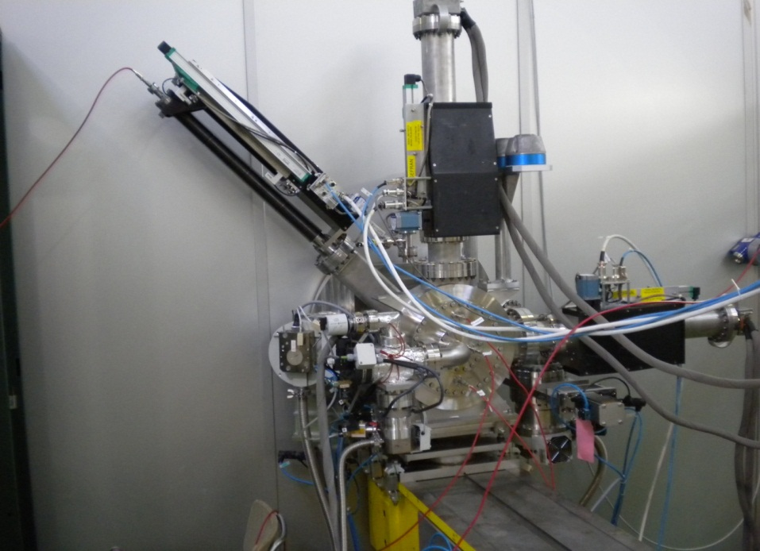
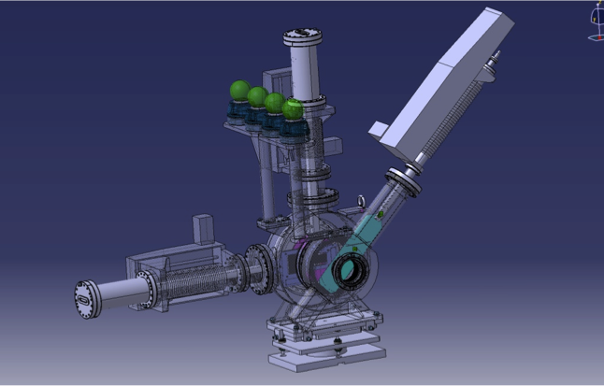
Phase Space Scanner

Slide 44
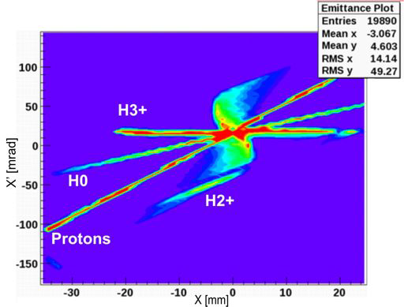

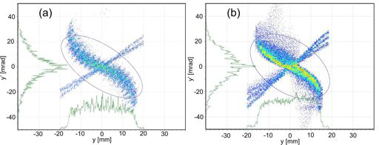
Emittance plot Solenoid
0
The solenoid splits
the trajectories according to
particle type.
The source produces
protons
H⁰
H₂⁺
H₃⁺

Slide 45
Moving slit emittance measurement
Position resolution given by slit size and displacement
Angle resolution depends on resolution of profile measurement device and drift distance
High position resolution → many slit positions → slow
Shot to shot differences result in measurement errors

Slide 46
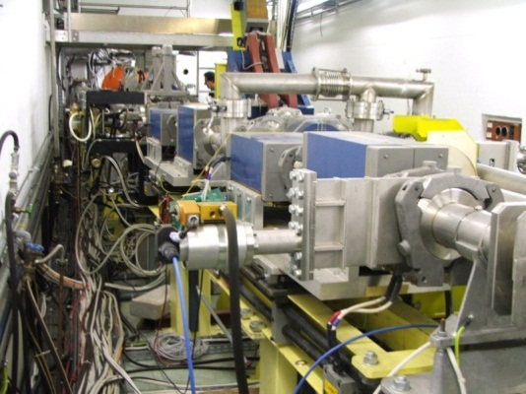
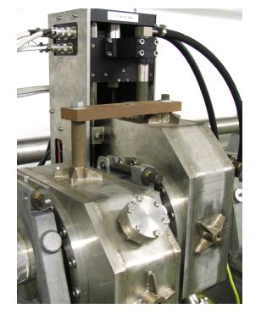

Transformation in Phase Space
Kicker
Kicker
Quadrupole
Quadrupole
X’
X’
X’
X’
X’
SEMGrid
X
X
X
X
X
at slit
first drift space
first quadrupole
second drift space
Second quadrupol

Slide 47

Result of single pulse emittance measurement

Slide 48
Transverse Emittance measurement
Spectrometer produces image
of slit on second slit
second slit selects energy slice
first kicker sweep phase space
over all energies
buncher rotates energy slice in
phase space
at second spectrometer the
phase distribution is
transformed into an
energy distribution analyzed by
the second spectrometer
second kicker corrects for first
kick
Kicker
Transformer
SEMGrid
Buncher
Kicker
Spectrometer magnet
E
E
E
E
φ
φ
φ
φ
at slit
first drift space
buncher
second drift space

Slide 49
Single Shot Emittance Measurement
Advantage:
  Full scan takes 20 μs
  Shot by shot comparison possible
Disadvantage:
  Very costly
  Needs dedicated measurement line
  Needs a fast sampling ADC + memory for each wire
Cheaper alternative:
  Multi-slit or pepperpot measurement

Slide 50
Multi-slit measurement
Needs high resolution profile detector
Must make sure
that profiles
dont overlap
beam
Scintillator + TV + frame grabber
often used as profile detector
Very old idea, was used with photographic plates

Slide 51


Pepperpot
Uses small holes instead of slits
Measures horizontal and vertical emittance in a single shot
Photo P. Forck

Slide 52

Computed Tomography (CT)
Principle of Tomography:
Take many 2-dimensional Images at
different angles
Reconstruct a 3-dimensional picture
using mathematical techniques
(Algebraic Reconstruction Technique,
ART)

Slide 53




The reconstruction
Produce many projections of the object to be reconstructed
Back project and overlay the “projection rays”
Project the back-projected object and calculate the difference
Iteratively back-project the differences to re-construct the original object

Slide 54


Some CT resuluts

Slide 55

Computed Tomography and Accelerators
RF voltage
Restoring force for non-synchronous particle
Longitudinal phase space
Projection onto Φ axis corresponds to bunch profile

Slide 56


Reconstructed Longitudinal Phase Space

Slide 57


Bunch Splitting

