Slide 1
Beam Diagnostics
Lecture 1
Ulrich Raich
CERN BE - BI
(Beam Instrumentation)

Slide 2
Overview
First hour:
  Introduction
  Overview of measurement instruments
    Faraday Cup
    Beam Current Transformer
    Beam Position Monitor
    Fluorescence screens
    Profile Detectors
      SEMGrids
      Wire Scanners
    Beam Loss Monitors
Second hour
  Some depicted examples of beam parameter measurements

Slide 3
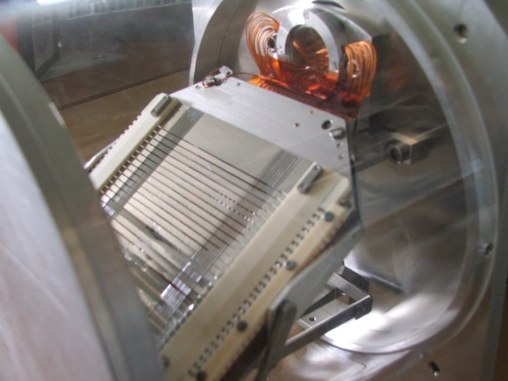
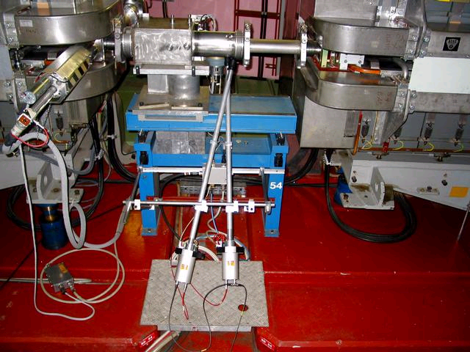
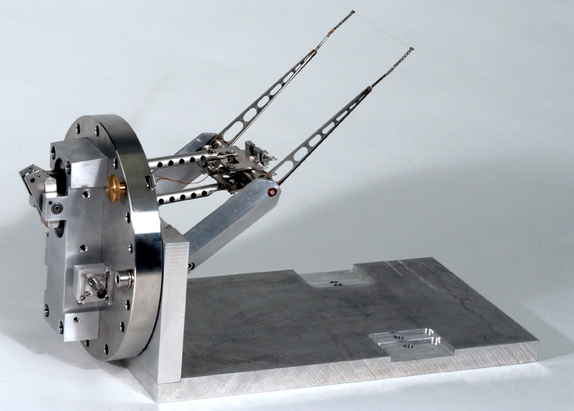
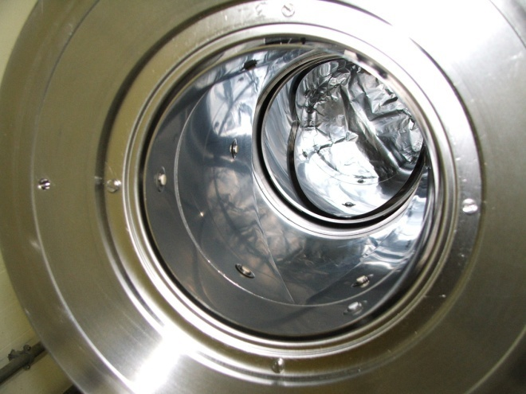
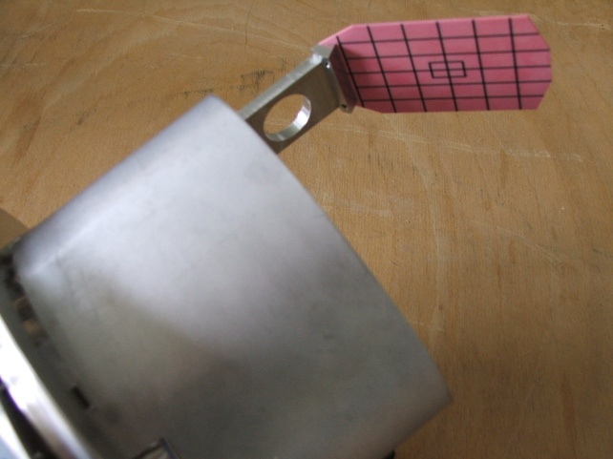
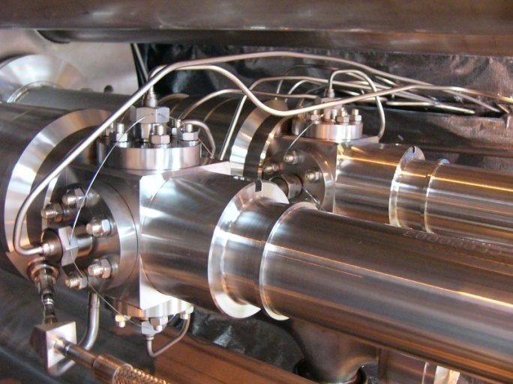
Introduction
An accelerator can never be better than the instruments measuring its performance!

Slide 4
Different uses of beam diagnostics
Regular crude checks of accelerator performance
  Beam Intensity
  Radiation levels
Standard regular measurements
  Emittance measurement
  Trajectories
  Tune
Sophisticated measurements e.g. during machine development sessions
  May require offline evaluation
  May be less comfortable

Slide 5
Diagnostic devices and quantity measured
Instrument | Physical Effect | Measured Quantity | Effect on beam
Faraday Cup | Charge collection | Intensity | Destructive
Current Transformer | Magnetic field | Intensity | Non destructive
Wall current monitor | Image Current | Intensity Longitudinal beam shape | Non destructive
Pick-up | Electric/magnetic field | Position | Non destructive
Secondary emission monitor | Secondary electron emission | Transverse size/shape, emittance | Disturbing, can be destructive at low energies
Wire Scanner | Secondary particle creation | Transverse size/shape | Slightly disturbing
Scintillator screen | Atomic excitation with light emission | Transverse size/shape (position) | Destructive
Residual Gas monitor | Ionization | Transverse size/shape | Non destructive

Slide 6

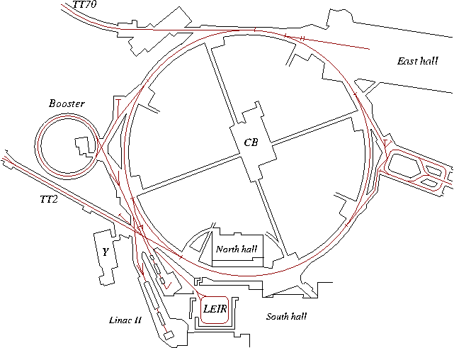
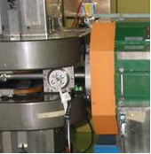
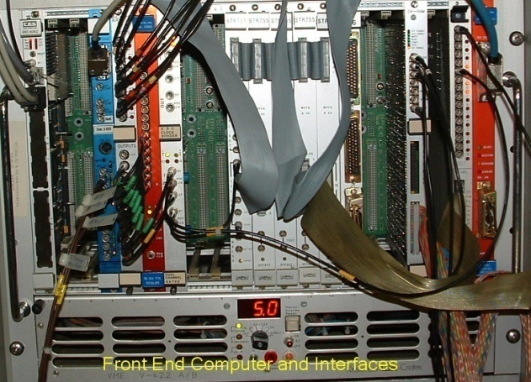
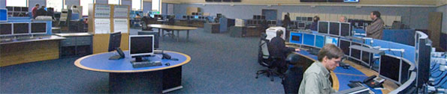
A beam parameter measurement

Slide 7
Required Competence in a beam diagnostics group
Some beam physics in order to understand the beam parameters to be measured and to distinguish beam effects from sensor effects
Detector physics to understand the interaction of the beam with the sensor
Mechanics
Analogue signal treatment
  Low noise amplifiers
  High frequency analogue electronics
Digital signal processing
Digital electronics for data readout
Front-end and Application Software

Slide 8
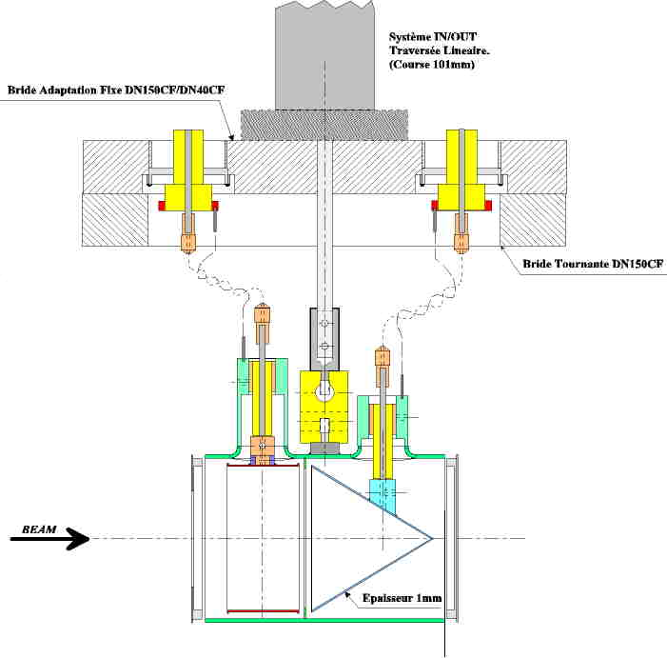
Layout of a Faraday Cup
Electrode: 1 mm stainless steel
Only low energy particles can be measured
Very low intensities (down to 1 pA) can be measured
Creation of secondary electrons of low energy (below 20 eV)
Repelling electrode with some 100 V polarisation voltage pushes secondary electrons back onto the electrode

Slide 9
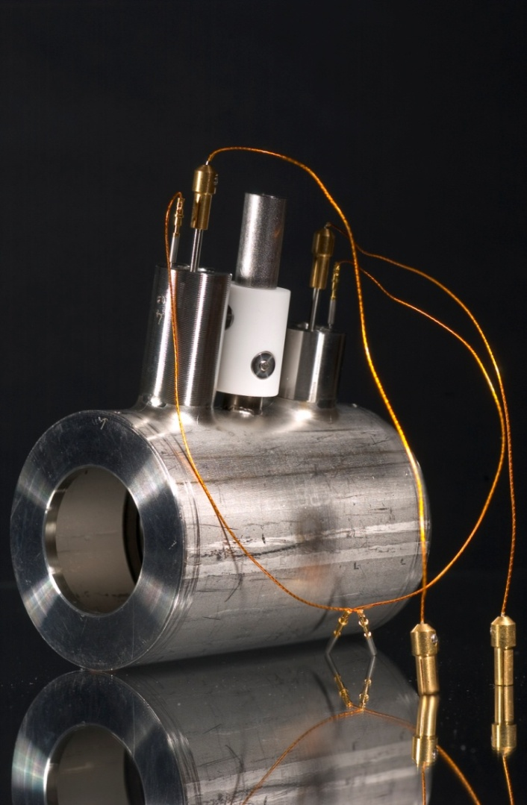
Faraday Cup

Slide 10
Electro-static Field in Faraday Cup
In order to keep secondary electrons within the cup a repelling voltage is applied to the polarization electrode
Since the electrons have energies of less than 20 eV some 100V repelling voltage is sufficient

Slide 11
Energy of secondary emission electrons
With increasing repelling voltage the electrons do not escape the Faraday Cup any more and the current measured stays stable.
At 40V and above no decrease in the Cup current is observed any more

Slide 12
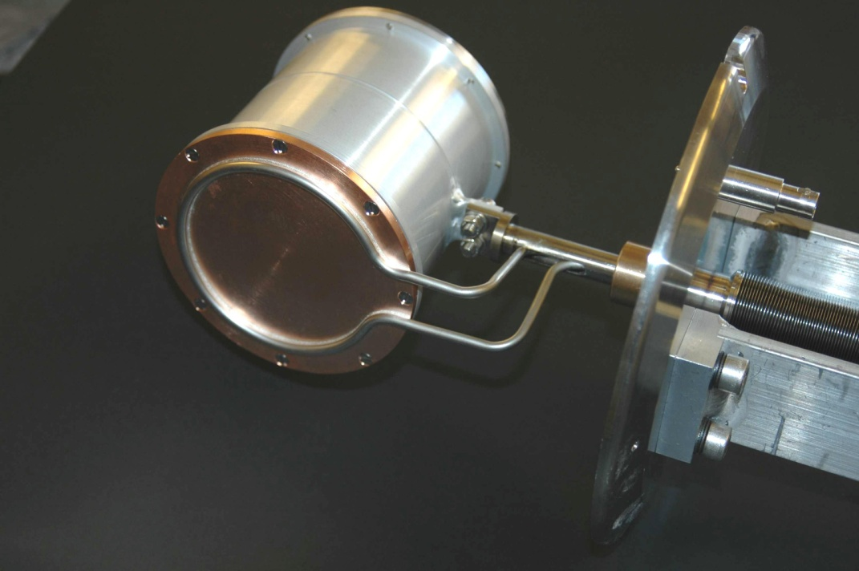
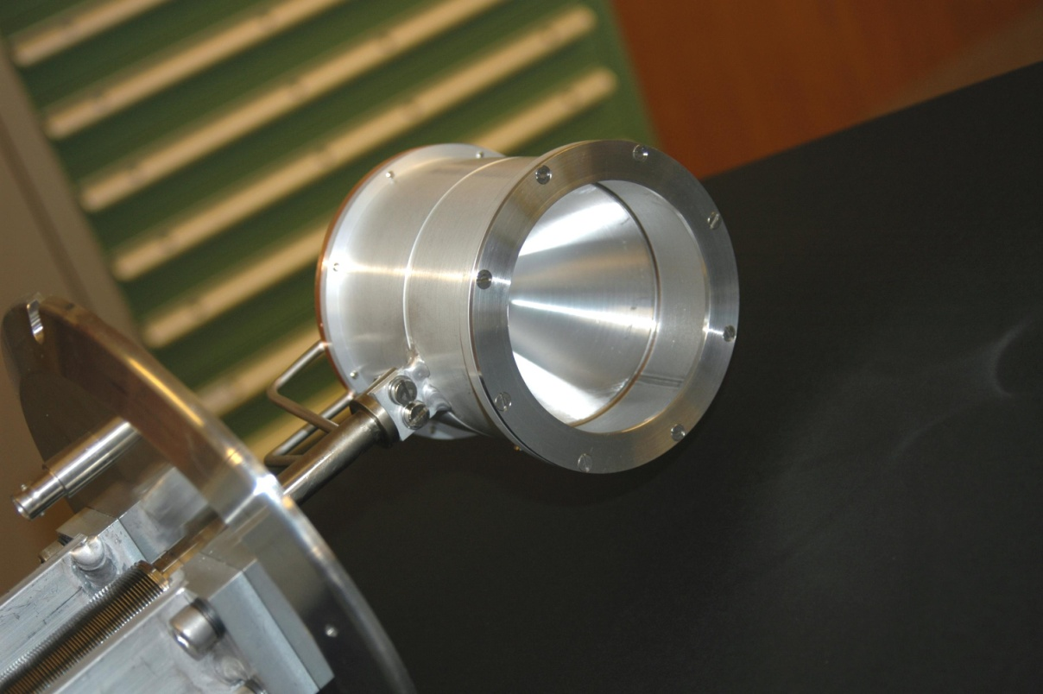
Faraday Cup with water cooling
For higher intensities
water cooling may be needed

Slide 13
Current Transformers
Magnetic field
Fields are very low
Capture magnetic field lines with cores of high
relative permeability
(CoFe based amorphous alloy Vitrovac: μ_{r}= 10⁵)
r_{i}
r_{o}
Beam current

Slide 14
The ideal transformer
The AC transformer
The active AC transformer
R_{F}
L_{s}
R_{L}
R_{L}
A
C_{S}
C_{S}
R
Inductance L of the winding
Transformer output signal
Beam signal

Slide 15
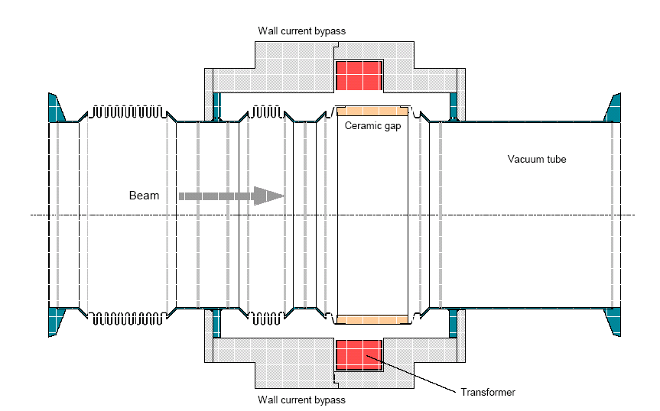
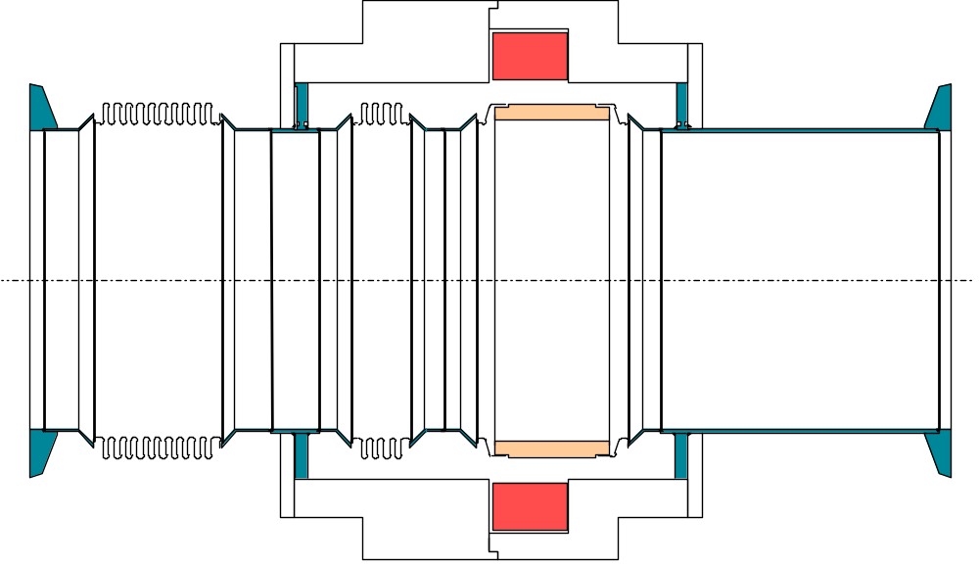
Principle of a fast current transformer
500MHz Bandwidth
Low droop (< 0.2%/μs)
Image
Current
Ceramic Gap
BEAM
80nm Ti Coating
20Ω to improve
impedance
Calibration winding
Diagram by H. Jakob

Slide 16
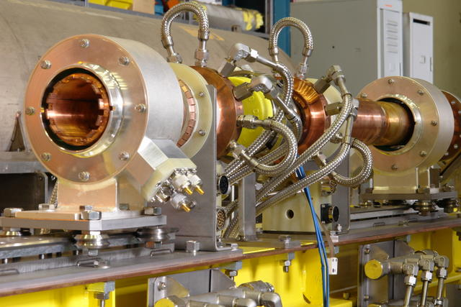
Fast current transformers for the LHC

Slide 17
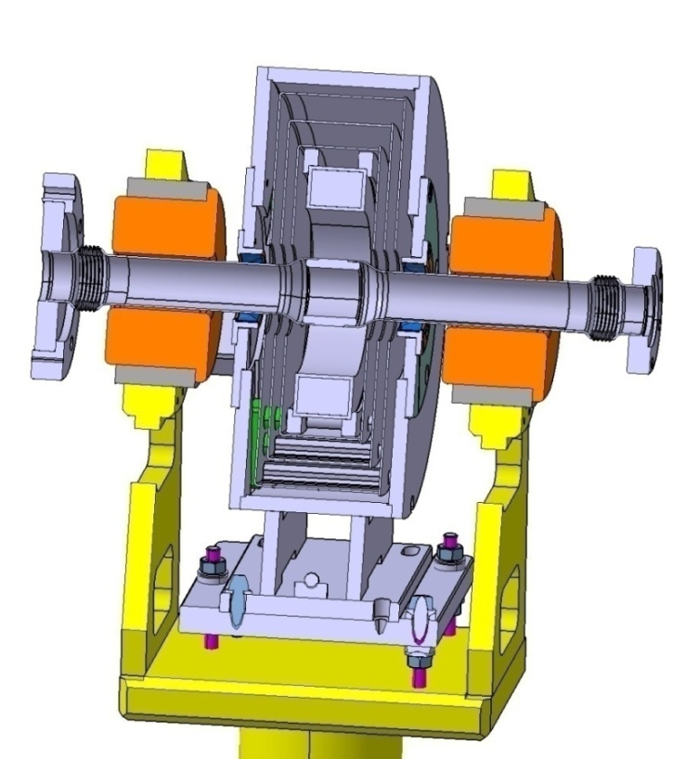
Magnetic shielding
Shield should extend along the vacuum chamber
length > diameter of opening
Shield should be symmetrical to the beam axis
Air gaps must be avoided especially along the beam axis
Shield should have highest μ possible but should not saturate
monitor
Permalloy (μ3)
Soft iron (μ1)
Transformer steel (μ2)

Slide 18
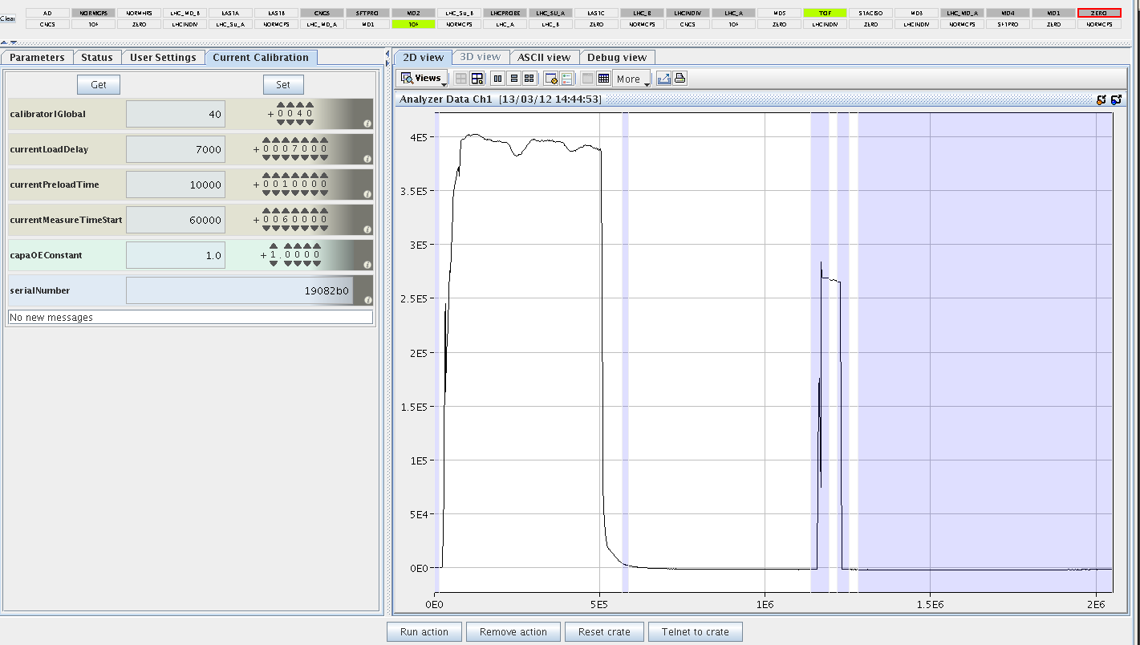
Calibration of AC current transformers
The transformer is calibrated with a very precise current source
The calibration signal is injected into a separate calibration winding
A calibration procedure executed before the running period
A calibration pulse before the beam pulse measured with the beam signal

Slide 19
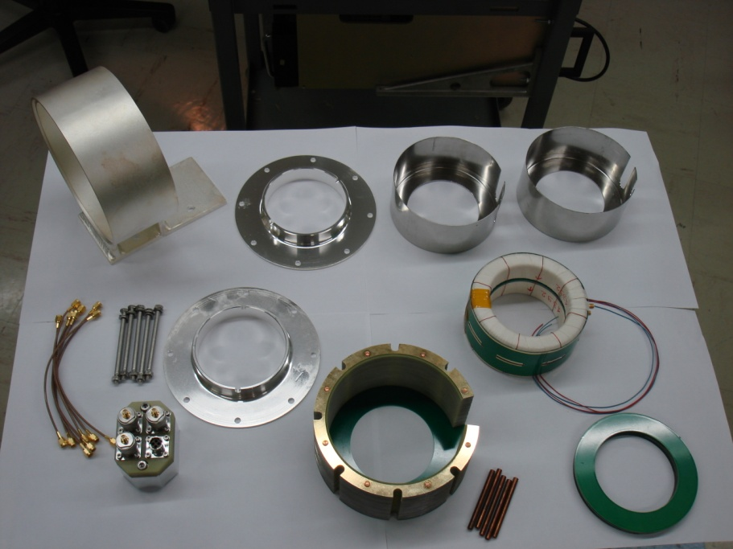
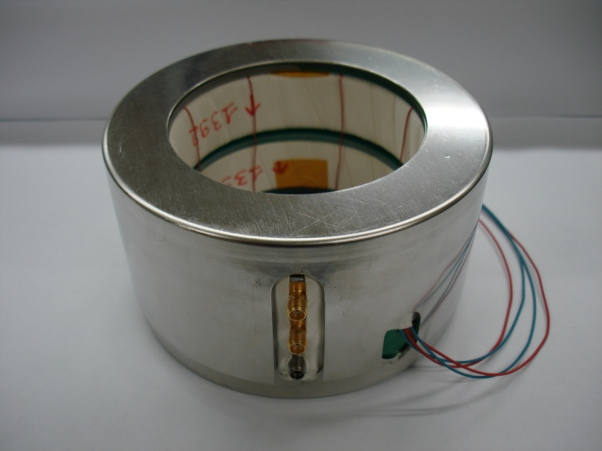
Current transformer and electronics

Slide 20
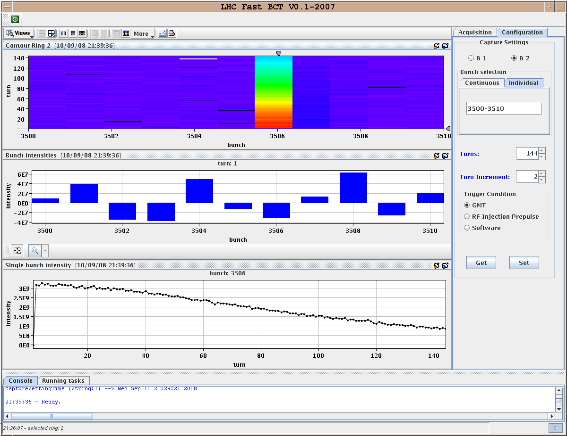
Display of transformer readings
First result from
LHC FBCT
Measurement of
bunch intensity
Diminishing intensity
due to debunching
Beam losses will
trigger machine
protection system

Slide 21
The DC current transformer
AC current transformer can be extended to very long droop times but not to DC
Measuring DC currents is needed in storage rings
Must provide a modulation frequency
Takes advantage of non/linear magnetisation curve
B
H

Slide 22
Principle of DCCT
V_{a}-V_{b}
Synchronous
detector
V_{a}
V_{b}
modulator
Power supply
beam
Compensation
current I_{feedback}=-I_{beam}
R
V=RI_{beam}

Slide 23
Modulation of a DCCT without beam
B
B=f(t)
H
Modulation current has only odd harmonic frequencies since the signal is symmetric
1
2
3
4
5

Slide 24
Modulation of a DCCT with beam
B=f(t)
B
H
Sum signal becomes non-zero
Even harmonics appear
1
1
2
3
4
5

Slide 25
Modulation current difference signal with beam
Difference signal has 2ω_{m}
ω_{m} typically 200 Hz – 10 kHz
Use low pass filter with
ω_{c}<< ω_{m}
Provide a 3rd core, normal AC transformer to extend to higher frequencies

Slide 26
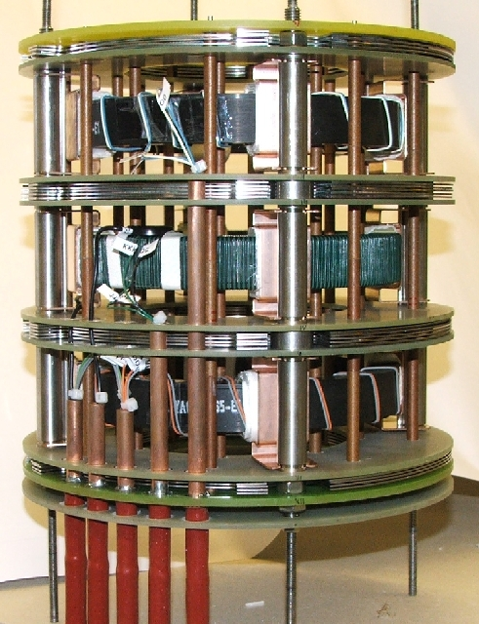
Photo of DCCT internals

Slide 27
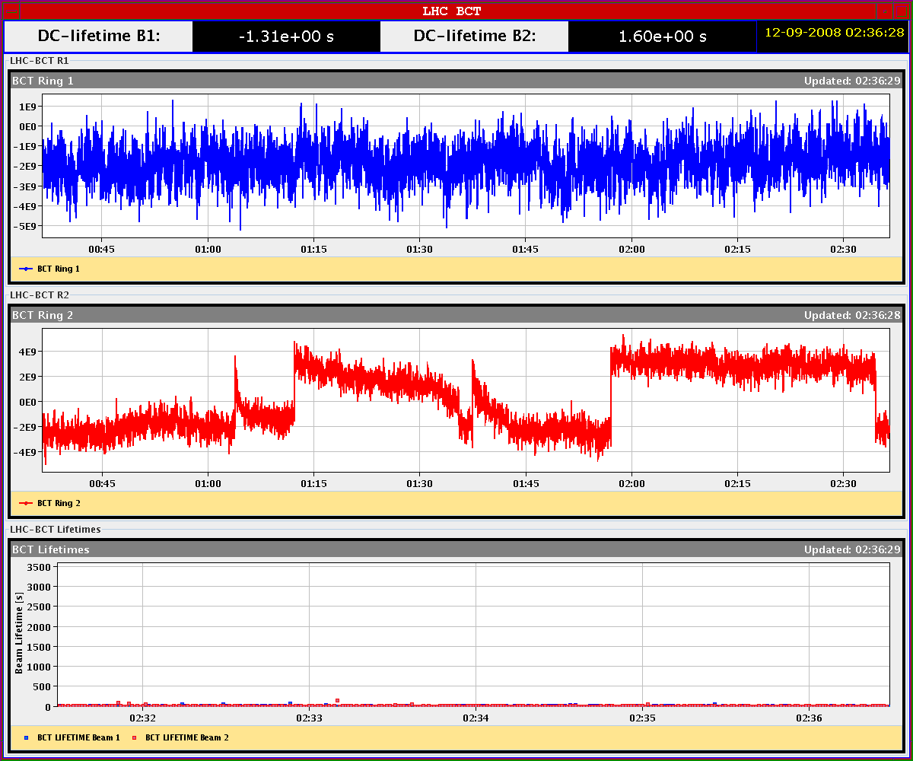
Results from DCCT
Injections into LHC
Beam 2
DCCT sees first
circulating beam

Slide 28
Measuring Beam Position – The Principle
Slide by R. Jones
-
+
-
+
-
-
+
-
+
-
+
-
-
+
-
+
-
+
-
-
+
-
+
-
+
-
-
+
-
+
-
+
-
-
+
-
+
-
+
-
+
-
+
+
+
-
-
+
+
-
+
-
+
+
+
-
-
+
+
-
+
-
+
+
+
-
-
+
-
+
-
-
+
-
+
-
+
-
-
+
-
+
-
+
-
-
+
-
+
+
+
+
+
+
+
+
+
+
+
+
+
+
+
+
+
+
+
+
+
+
+
+
+
+
+
+
+
+
+
+
+
+
+
+
+
+
+
+
+
+
+
+
+
+
+
+
+
+
+
+
+
+
+
+
+
+
+
+
+
+
+
+
+
+
+
+
+
+
+
+
+
+
+
+
+
+

Slide 29
Wall Current Monitor – The Principle
V
-
+
-
+
-
-
+
-
+
-
+
-
-
+
-
+
-
+
-
+
-
-
+
-
+
-
+
-
-
+
+
+
-
-
+
+
-
Ceramic Insert
-
+
-
+
+
+
-
-
+
+
-
+
-
-
+
-
+
-
+
-
-
+
-
+
+
+
+
+
+
+
+
+
+
+
+
+
+
+
+
+
+
+
+
+
+
+
+
+
+
+
+
+
+
+
+
+
+
+
+
+
+
+
+
+
+
+
+
+
+
+
+
+
+
+
+
+
+
+
+
+
+
+
+
+
+
+
+
+
+
+
+
+
+
+
+
+
+
+
+
+
+

Slide 30
Wall Current Monitor – Beam Response
V
R
Response
C
I_{B}
0
0
Frequency
L
I_{B}

Slide 31
Electrostatic Monitor – The Principle
V
-
+
-
+
-
-
+
-
+
-
+
-
-
+
-
+
-
+
-
+
-
-
+
-
+
-
+
-
+
-
+
-
+
-
-
-
+
+
-
-
+
+
-
-
-
-
+
-
+
-
+
-
-
+
-
+
-
+
-
-
+
-
-
-
-
-
+
-
+
+
-
+
-
-
+
-
+
-
+
-
+
-
+
+
+
+
-
+
-
-
+
-
+
+
+
+
+
+
+
+
+
+
+
+
+
+
+
+
+
+
+
+
+
+
+
+
+
+
+
+
+
+
+
+
+
+
+
+
+
+
+
+
+
+
+
+
+
+
+
+
+
+
+
+
+
+
+
+
+
+
+
+
+
+
+
+
+
+
+
+
+
+
+
+
+
+
+
+
+
+

Slide 32
Electrostatic Monitor – Beam Response
C
Response (V)
V_{B}
0
V
0
Frequency (Hz)
R

Slide 33
Position measurements
w
U
d
U
d
If the beam is much smaller than w, all field lines are captured and
U is a linear function with replacement
else: Linear cut (projection to measurement plane must be linear)

Slide 34
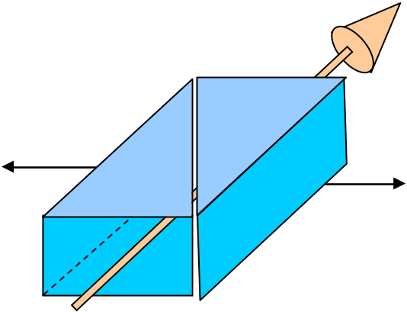
Shoebox pick-up
U_{L}
U_{R}
Linear cut through a shoebox

Slide 35
Doubly cut shoebox
Can measure horizontal and vertical position at once
Has 4 electrodes
b
a
c
d

Slide 36
Simulatenous horizontal and vertical measurement
horizontal
vertical
b
b
a
a
c
c
d
d

Slide 37
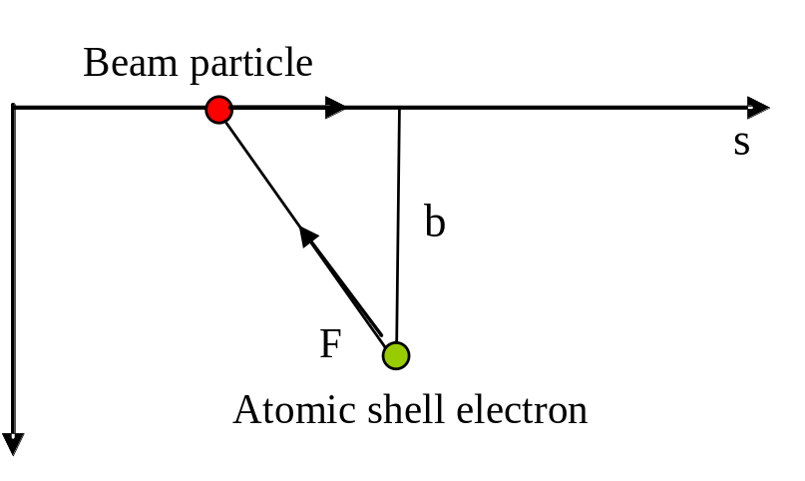
Interaction of particles with matter
Coulomb interaction
Average force in s-direction=0
Average force in transverse direction <> 0
Mostly large impact parameter => low energy of ejected electron
Electron mostly ejected transversely to the particle motion

Slide 38
Bethe Bloch formula
with the following constants:
NA: Avogadro’s number
m_{e} and r_{e}: electron rest mass and classical electron radius
c: speed of light
the following target material properties:
ρ: material density
A_{T} and Z_{T}: the atomic mass and nuclear charge
and the particle properties:
Z_{p}: particle charge
β: the particles velocity and
Dependance on

Slide 39
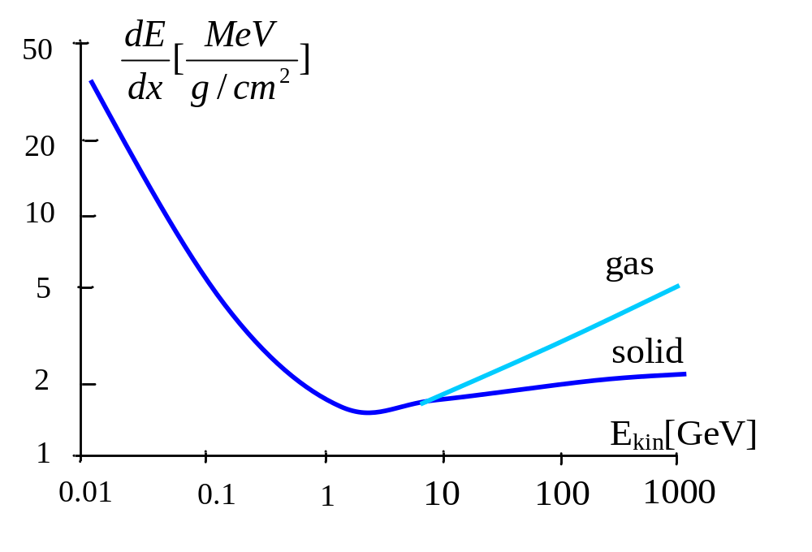
High energy loss a low energies
Heavy ions at low energy are stopped within a few micro-meters
All energy is deposited in a very small volume

Slide 40
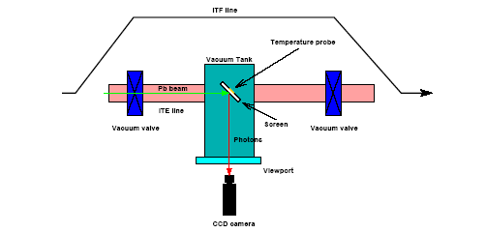
Scintillating Screens
Method already applied in cosmic ray experiments
Very simple
Very convincing
Needed:
Scintillating Material
TV camera
In/out mechanism
Problems:
Radiation resistance of TV camera
Heating of screen (absorption of
beam energy)
Evacuation of electric charges

Slide 41
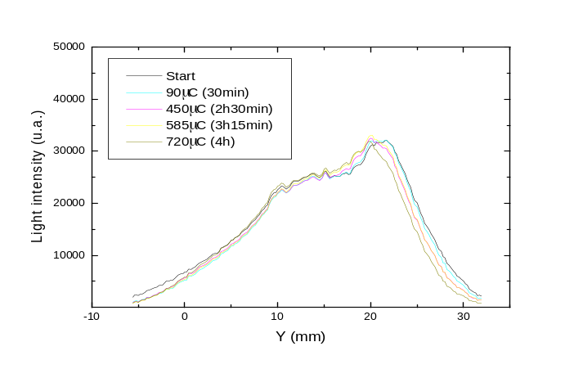
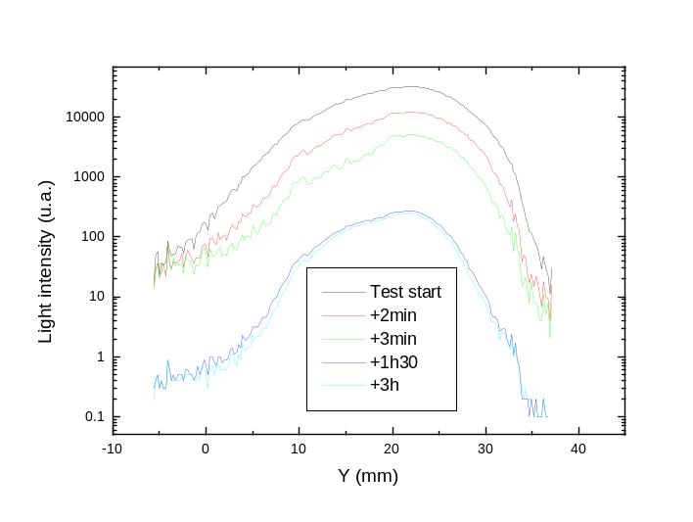
Test for resistance against heat-shock
Material | ρ g/cm³ | c_{p} at 20ºC J/gK | k at 100ºC W/mK | T_{max} ºC | R at 400 ºC Ω.cm
Al₂O₃ | 3.9 | 0.9 | 30 | 1600 | 10¹²
ZrO₂ | 6 | 0.4 | 2 | 1200 | 10³
BN | 2 | 1.6 | 35 | 2400 | 10¹⁴
Better for electrical conductivity (>400ºC)
Better for thermal properties
(higher conductivity, higher heat capacity)

Slide 42
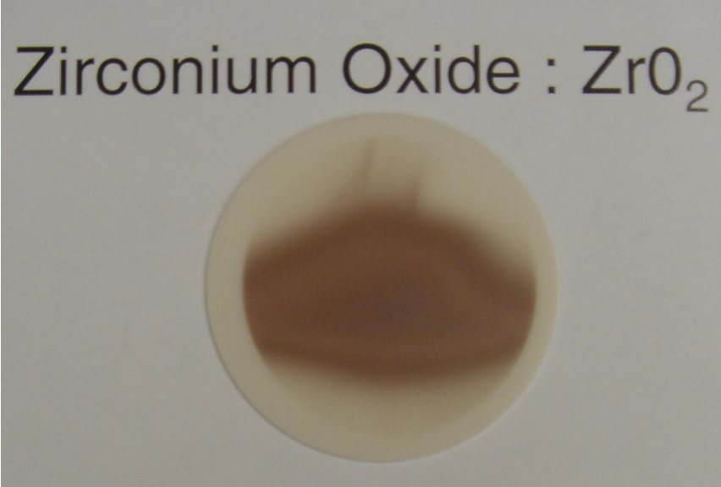
Degradation of screen
Degradation clearly visible
However sensitivity stays essentially
the same

Slide 43

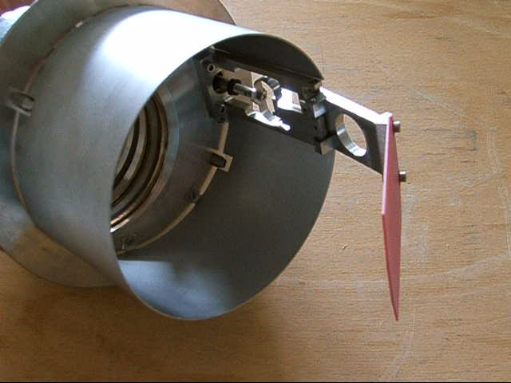
Screen mechanism
Screen with graticule

Slide 44
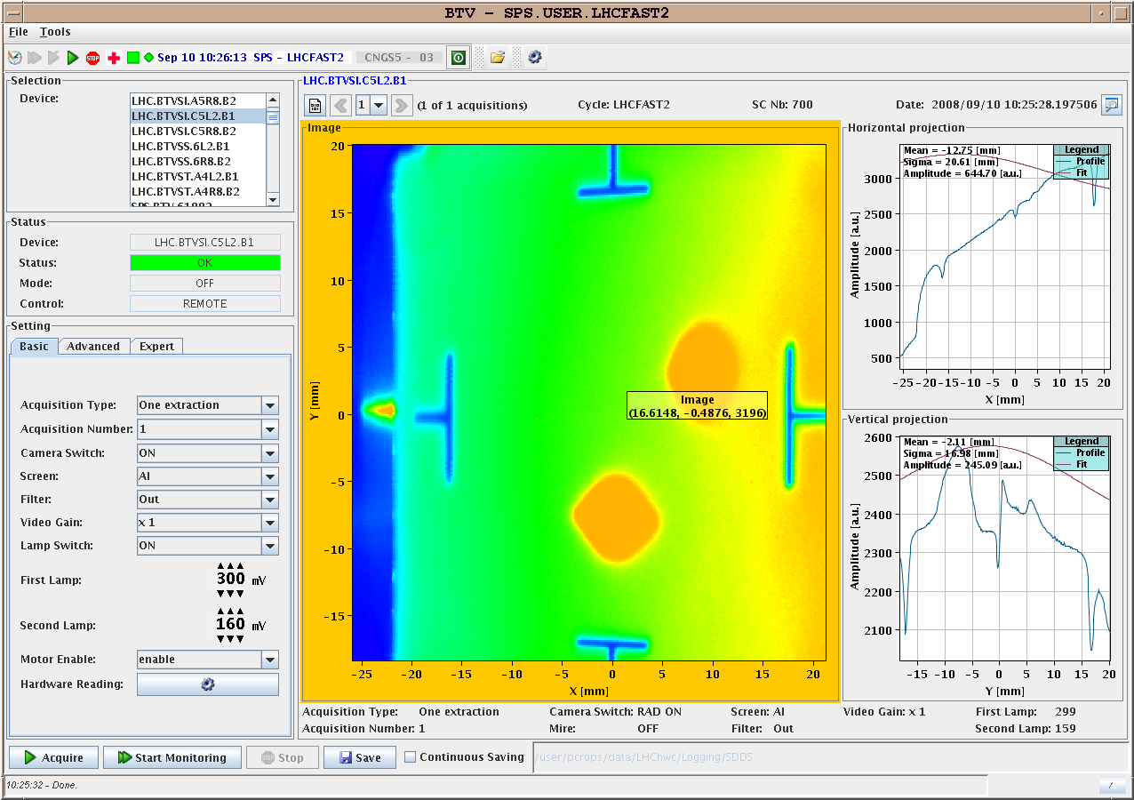
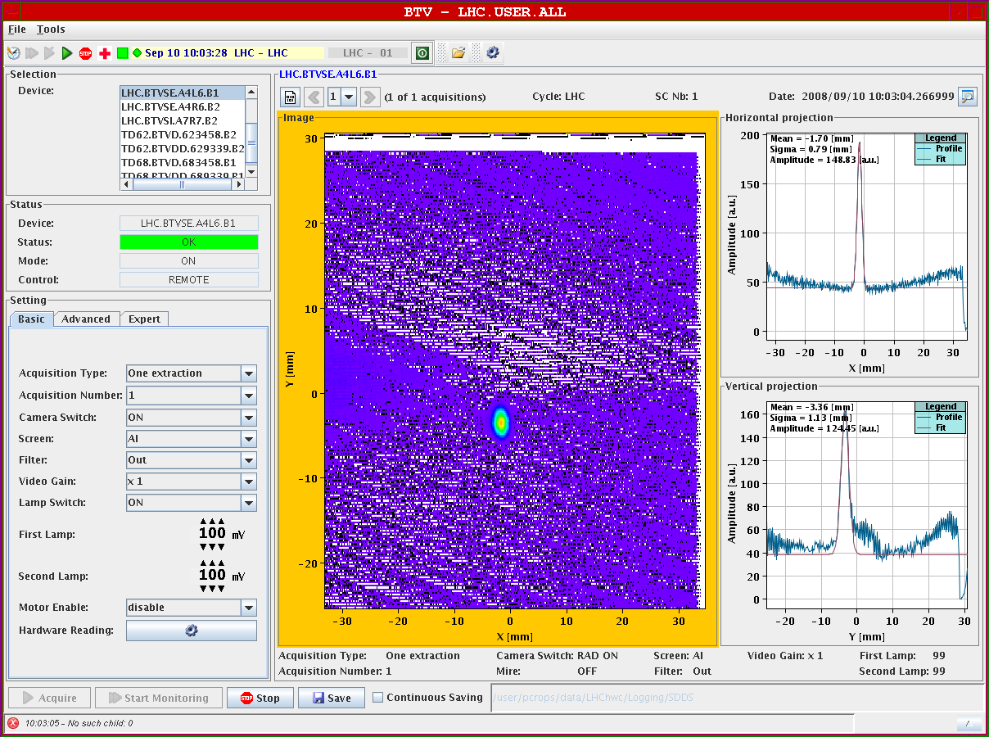
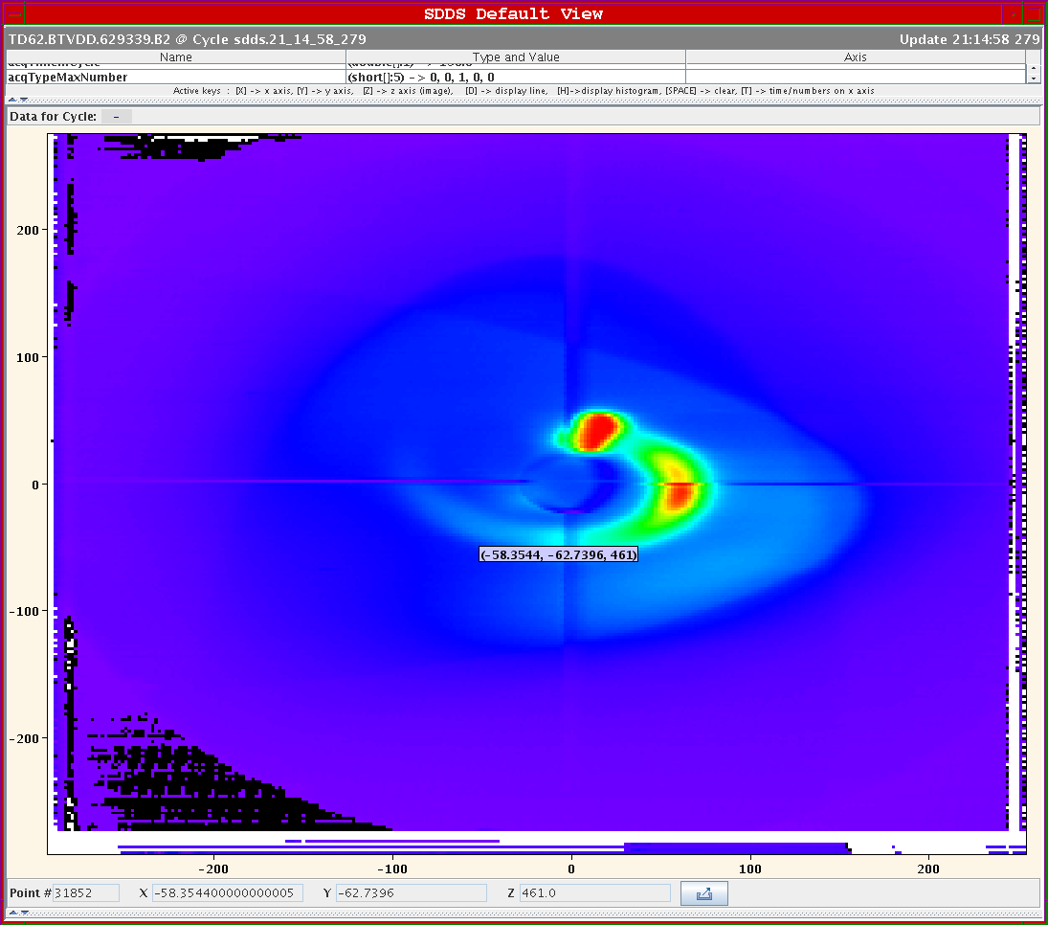
Results from TV Frame grabber
First full turn
as seen by the BTV
10/9/2008
Uncaptured beam sweeps through he dump line
For further evaluation the video signal is digitized, read-out and treated by program

Slide 45
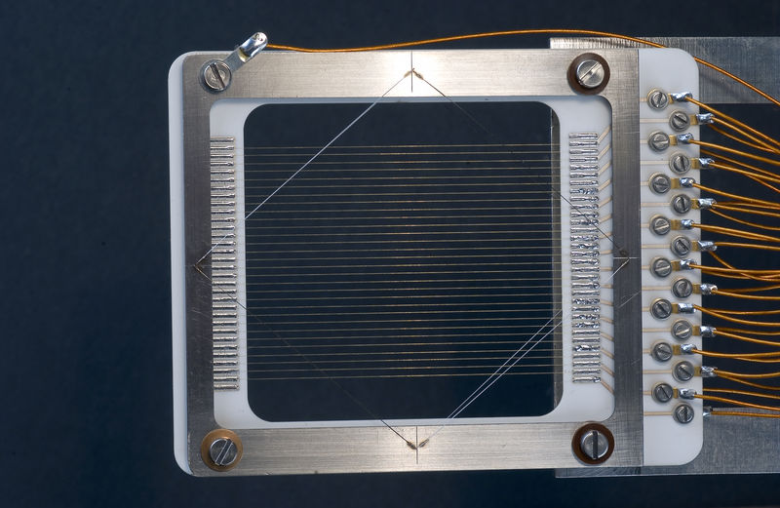
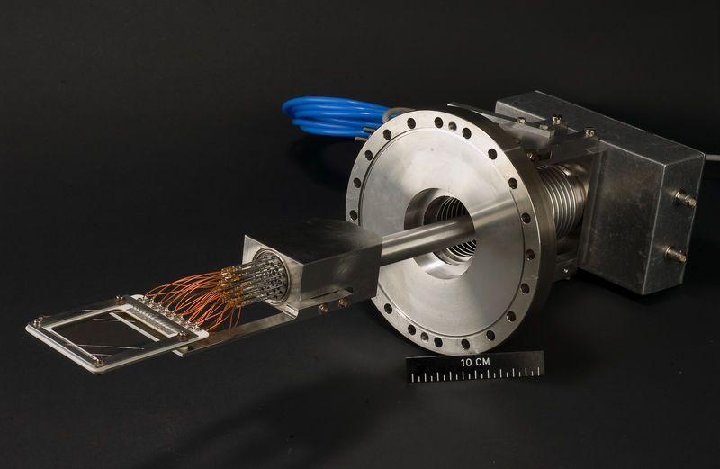
Profile measurements
Secondary emission grids (SEMgrids)
When the beam passes
secondary electrons are
ejected from the wires
The current flowing back
onto the wiress is
measured
Electrons are taken away
by polarization voltage
One amplifier/ADC chain
channel per wire

Slide 46
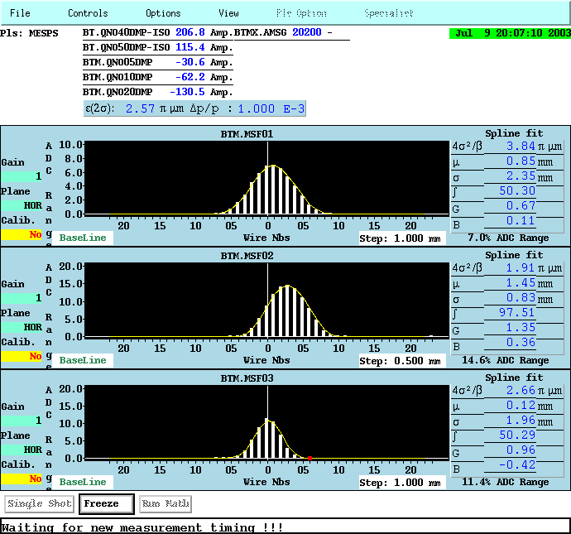
Profiles from SEMgrids
Charge density
projected to x or y axis is
measured
One amplifier/ADC per wire
Large dynamic range
Resolution is given by wire
distance
Used only in transfer lines

Slide 47

Wire Scanners
A thin wire is quickly moved across the beam
Secondary particle shower is detected outside the vacuum chamber
on a scintillator/photo-multiplier assembly
Position and photo-multiplier signal are recorded simultaneously

Slide 48
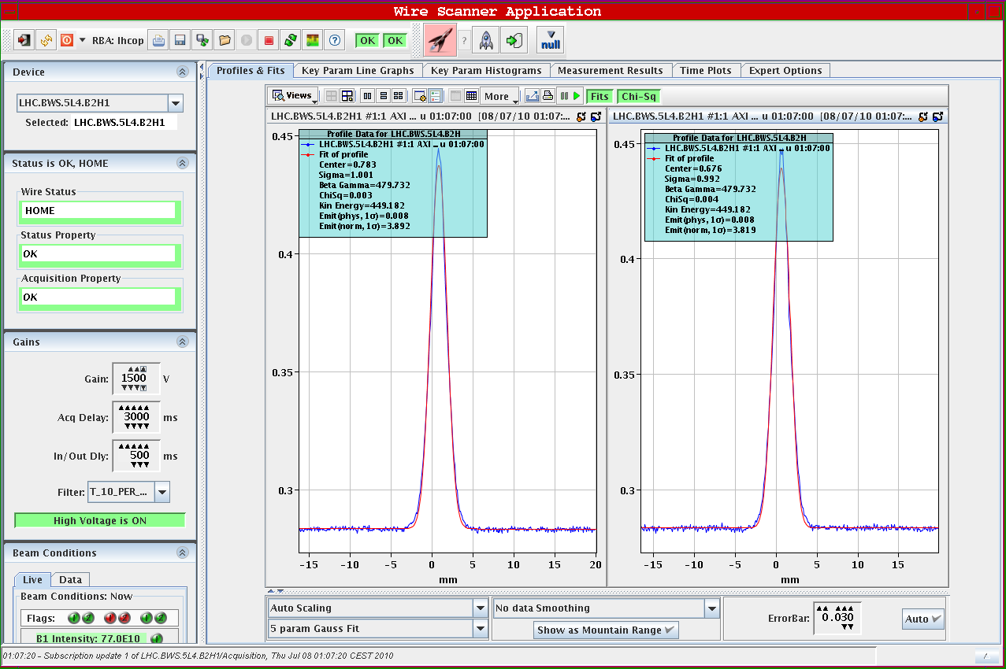
Wire scanner profile
High speed needed
because of heating.
Adiabatic damping
Current increase due to
particle speed increase
Wire speeds of up to
20m/s
=> 200g acceleration

Slide 49
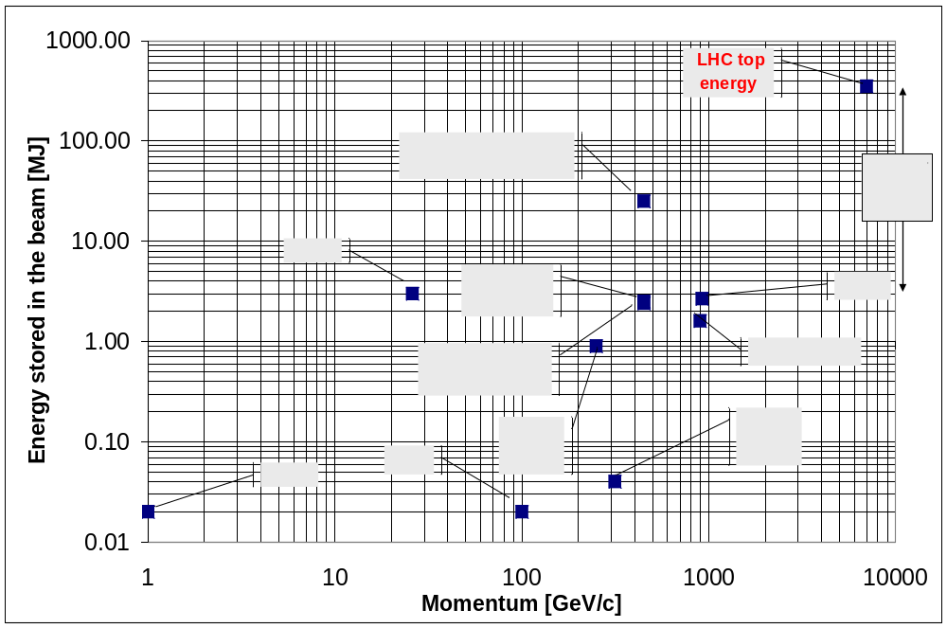
Stored Beam Energies
(Based on graph from R. Schmidt)
Quench Levels | Units | Tevatron | RHIC | HERA | LHC
Instant loss (0.01 - 10 ms) | [J/cm³] | 4.5 10⁻⁰³ | 1.8 10⁻⁰² | 2.1 10⁻⁰³ - 6.6 10⁻⁰³ | 8.7 10⁻⁰⁴
Steady loss (> 100 s) | [W/cm³] | 7.5 10⁻⁰² | 7.5 10⁻⁰² |  | 5.3 10⁻⁰³
Notes:
LHC extrapolation
Energy in beam 7 times Tevatron
Intensity of beam 30 times Tevatron
Number of LHC of moving elements in the LHC about 200
Energy stored in both beams: 0.7 GJoule
heat up from cryogenic temperature and melt
0.1 m3 of Copper

Slide 50
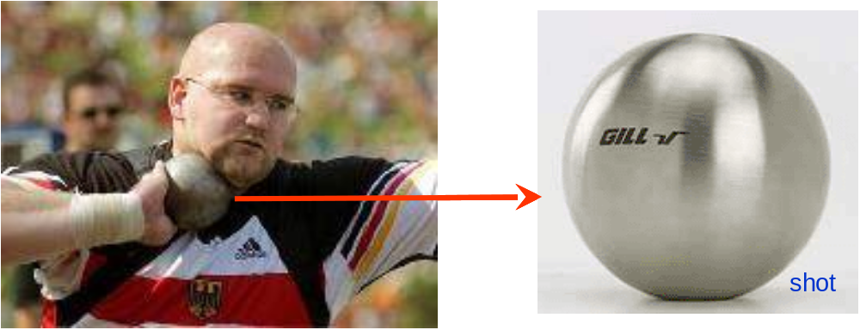

Beam power in the LHC
The Linac beam (160 mA, 200μs, 50 MeV, 1Hz) is enough to burn a hole into
the vacuum chamber
What about the LHC beam: 2808 bunches of 15*10¹¹ particles at 7 TeV?
1 bunch corresponds to a 5 kg bullet at 800 km/h

Slide 51
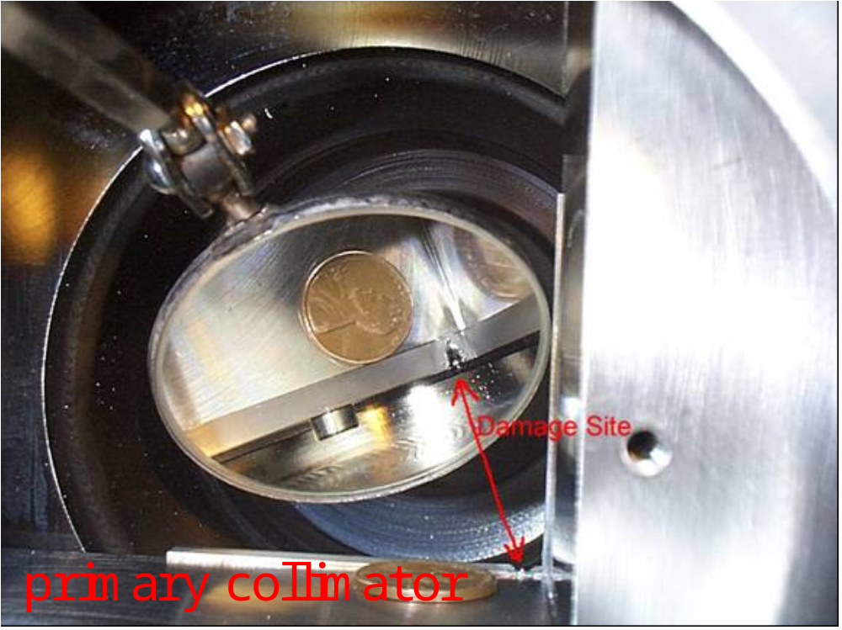
Beam Dammage
Fermi Lab‘sTevatron has 200 times less beam power than LHC!

Slide 52
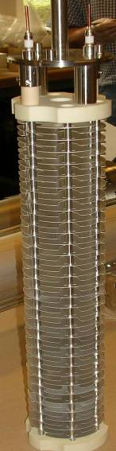
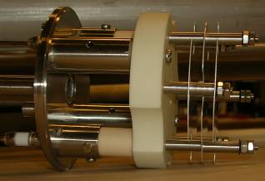
Beam Loss Monitor Types
Design criteria: Signal speed and robustness
Dynamic range (> 10⁹) limited by leakage current through insulator ceramics (lower) and saturation due to space charge (upper limit).
Secondary Emission Monitor (SEM):
  Length 10 cm
  P < 10⁻⁷ bar
  ~ 30000 times smaller gain
Ionization chamber:
  N₂ gas filling at 100 mbar over-pressure
  Length 50 cm
  Sensitive volume 1.5 l
  Ion collection time 85 μs
Both monitors:
  Parallel electrodes (Al, SEM: Ti) separated by 0.5 cm
  Low pass filter at the HV input
  Voltage 1.5 kV
Notes:
Chamber design considerations: Signal speed and robustness against ageing (and loss of chamber gas)
BLMB: Planned to use standard ACEM detectors (or photo-multipliers), and acquisition systems of LHC BCT. Not part of baseline scenario, for refined beam observation.

Slide 53
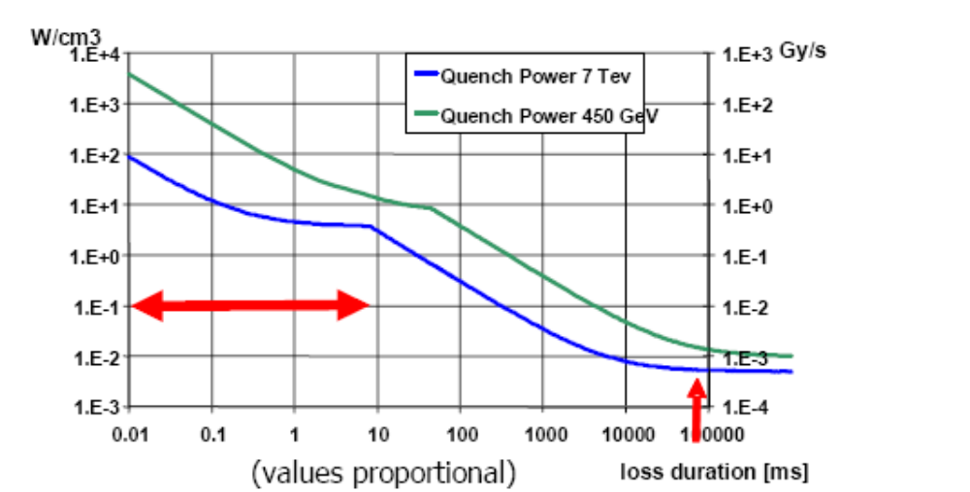
Quench levels

Slide 54
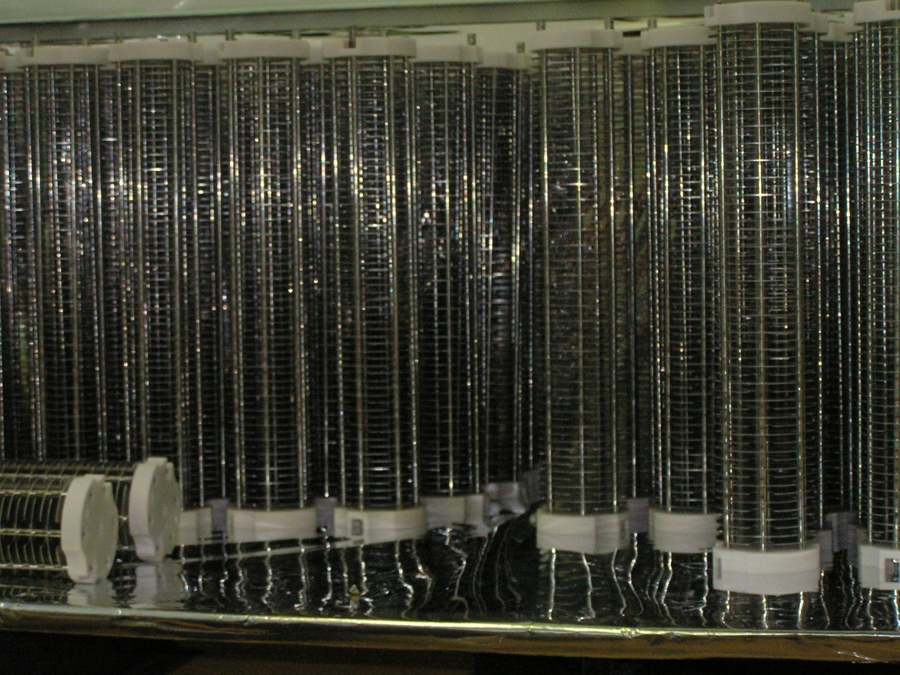
Industrial production of chambers
Beam loss must be
measured all around
the ring
=> 4000 sensors!

Slide 55
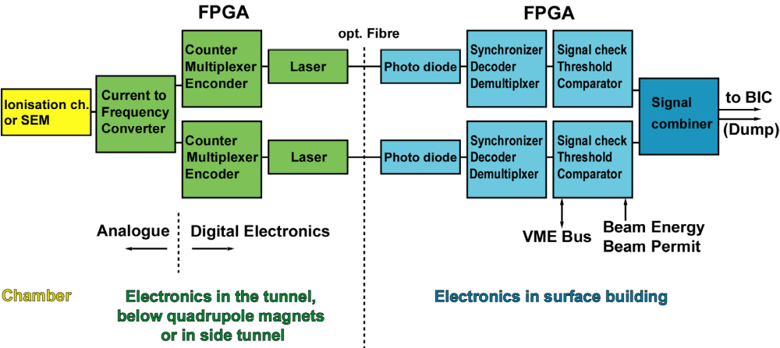
System layout

Slide 56
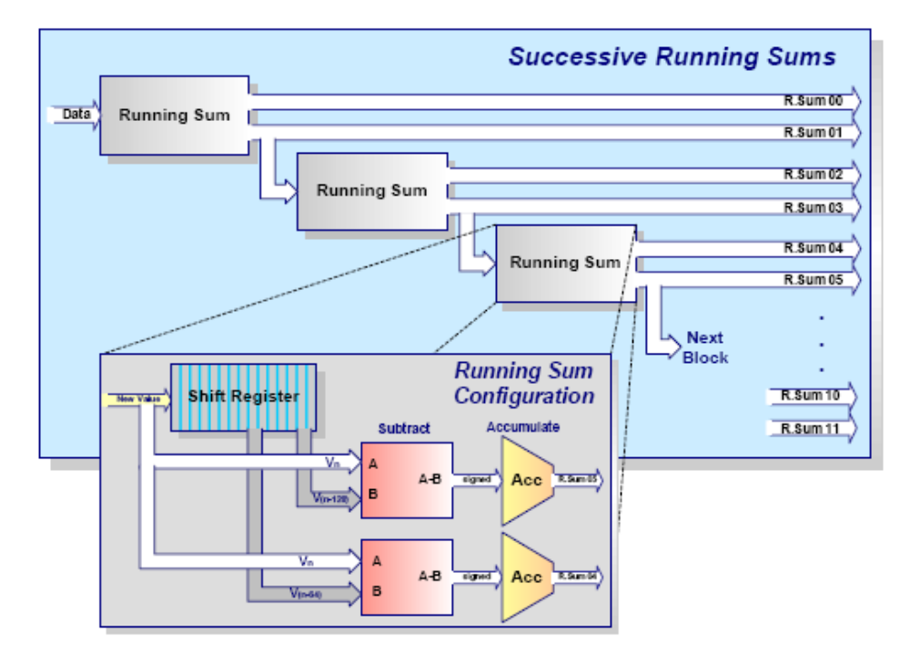
Successive running sums

