Slide 1
Overview of Future Accelerators
Ken Peach
John Adams Institute for Accelerator Science
&
Particle Therapy Cancer Research Institute (Oxford Martin School)
University of Oxford
CERN Accelerator School
Chios, Greece
September 29th 2011

Slide 2
Outline
Accelerators – why?
Accelerators
  in Science
    Particle & Nuclear Physics
    Physical and Life Sciences
  in Industry
  in Medicine
Summary

Slide 3
Why?

Slide 4
Why do we need accelerators?
4 reasons:
  As super-microscopes: λ=h/p
  To create very high energies
  To build nano-scale structures
  As a source of radiation
Science
  (particle & nuclear physics, physical, life and environmental sciences)
Society
  (industry and medicine)

Slide 5
Accelerators for particle physics
What is needed, and why
2 routes to new knowledge about the
fundamental structure of the matter
High Energy Frontier
New phenomena
(new particles)
created when the
“usable” energy > mc² [×2]
High Precision Frontier
Known phenomena studied
with high precision may show
inconsistencies with theory

Slide 6
What to accelerate
We can accelerate stable particles
  “Stable” means “with a lifetime long enough to capture and accelerate them
    in practice, > ~μ−second
Hadrons
  p, d, t, α, … nuclei (up to Pb) & antiprotons
    Hadrons contain “partons” (quarks, gluons…)
Leptons
  e±, μ±
    Leptons are “point-like”
      (at our present energy scales)

Slide 7
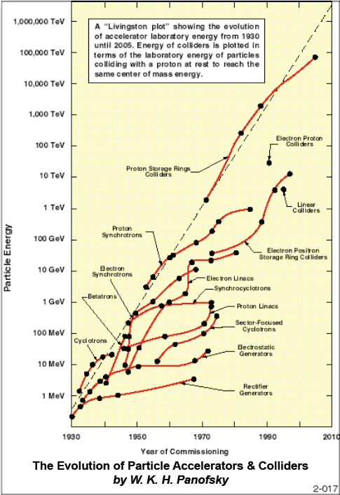
Livingston plot

Slide 8
Energy and luminosity
Energy must be sufficient
  Above the threshold
Luminosity must be sufficient
  enough events in a “reasonable” time
    a few years
      “lifetime” of a graduate student
s
E
N_{ev} = L × s × t
t ~ 10⁷ s/year
s ~ pb (10⁻³⁶ cm²)
For 1000 events in 1 year requires
L ~ 10³² cm²s⁻¹
For fixed target (esp. neutrino experiments) the equivalent parameter is
Beam Power or Protons on Target (POT)

Slide 9
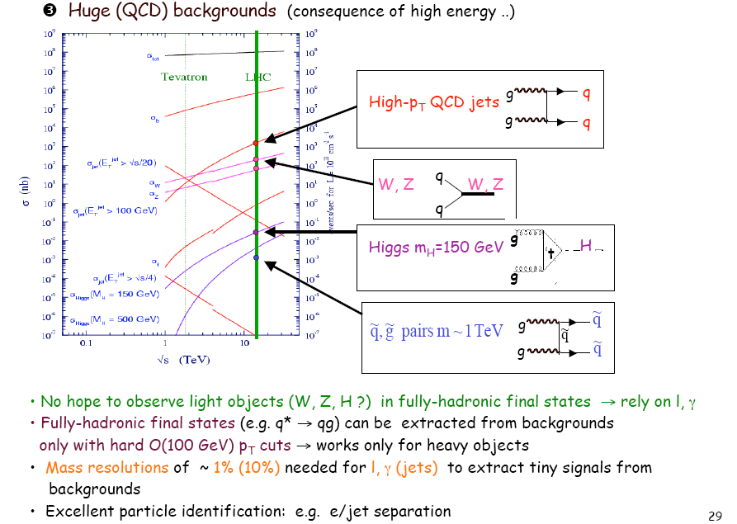
An example – the LHC
Needs high Energy & high Luminosity
Gianotti, LP05

Slide 10
Future Accelerators for Particle Physics
Large Hadron Collider
Linear (e⁺e⁻) Collider
Muon Collider
Neutrino Factory
EURISOL and Beta Beams
“Factories” (φ, τ, c, b)

Slide 11
Large Hadron Collider

Slide 12
The Large Hadron Collider
The two main goals are:
  Find the Higgs
    If it exists!!!
  Find the new physics
    If it exists!!!
We know ~ the energy scales
  M_{H} <250GeV ; E_{NP} < 1TeV
pp collisions at high energy
  Collision energy ~10% of total energy
    Need a total collision energy >10TeV
  Can calculate the cross-sections
    Need a luminosity > 10³³cm²/s
The Large Hadron Collider (LHC) @ CERN
  E ~ 14TeV ; L ~ 10³⁴cm²/s
?????????

Slide 13

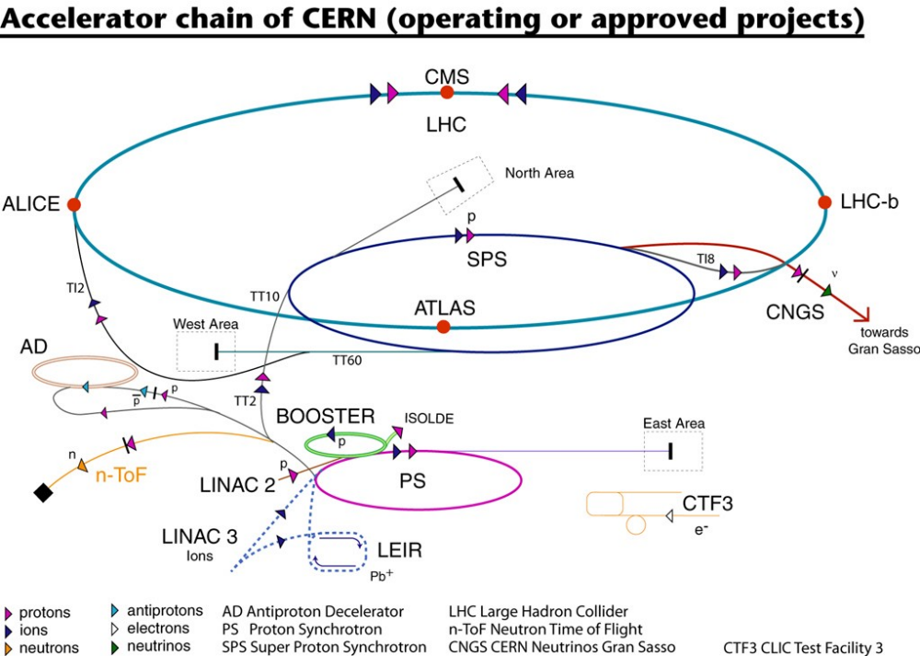
The CERN Accelerator Complex
Complex

Slide 14
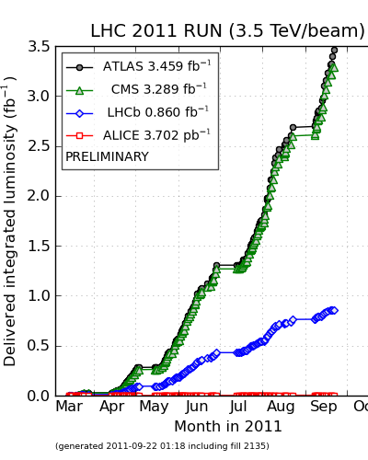
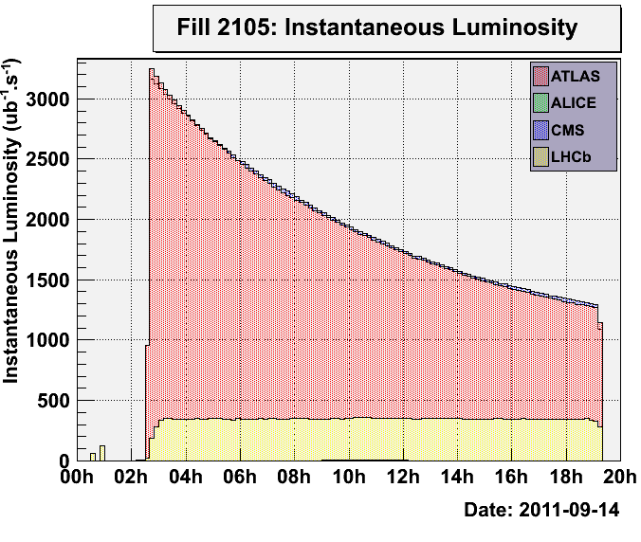
Integrated Luminosity

Slide 15
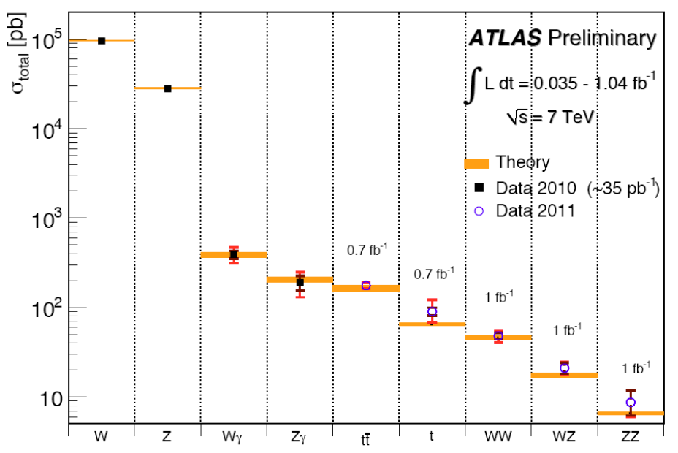
Do we know what we are doing?

Slide 16
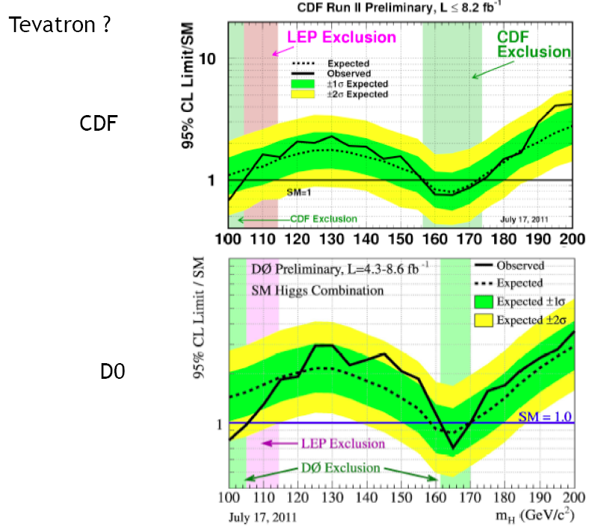
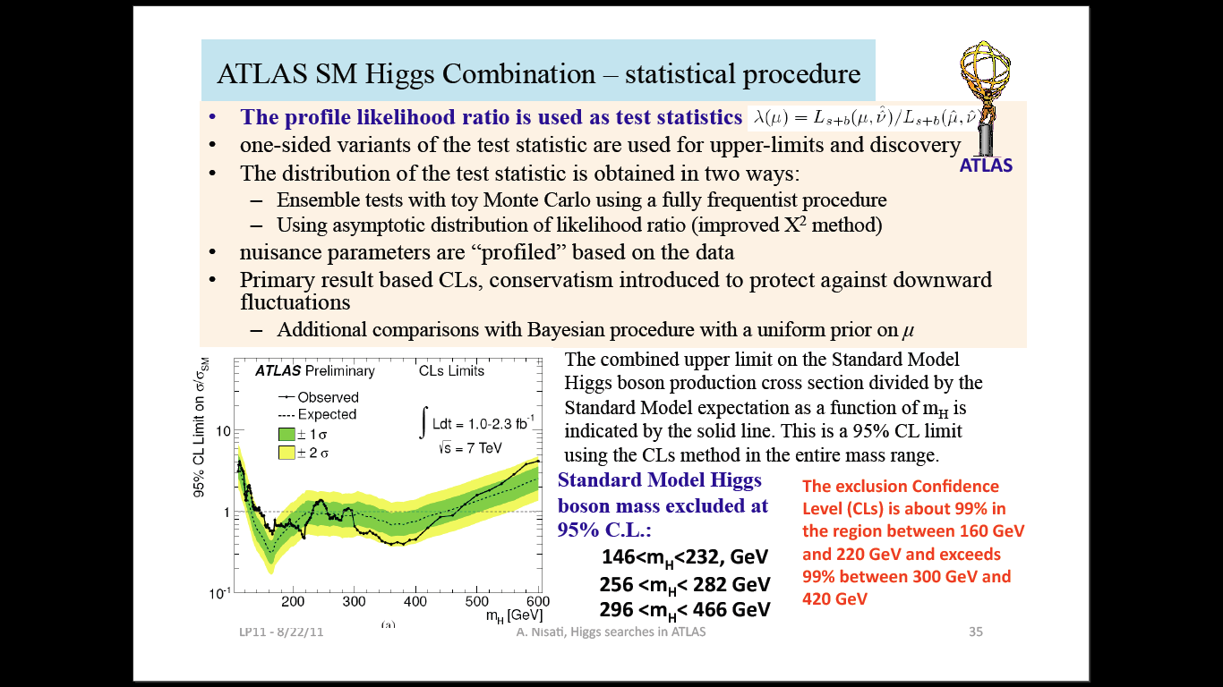
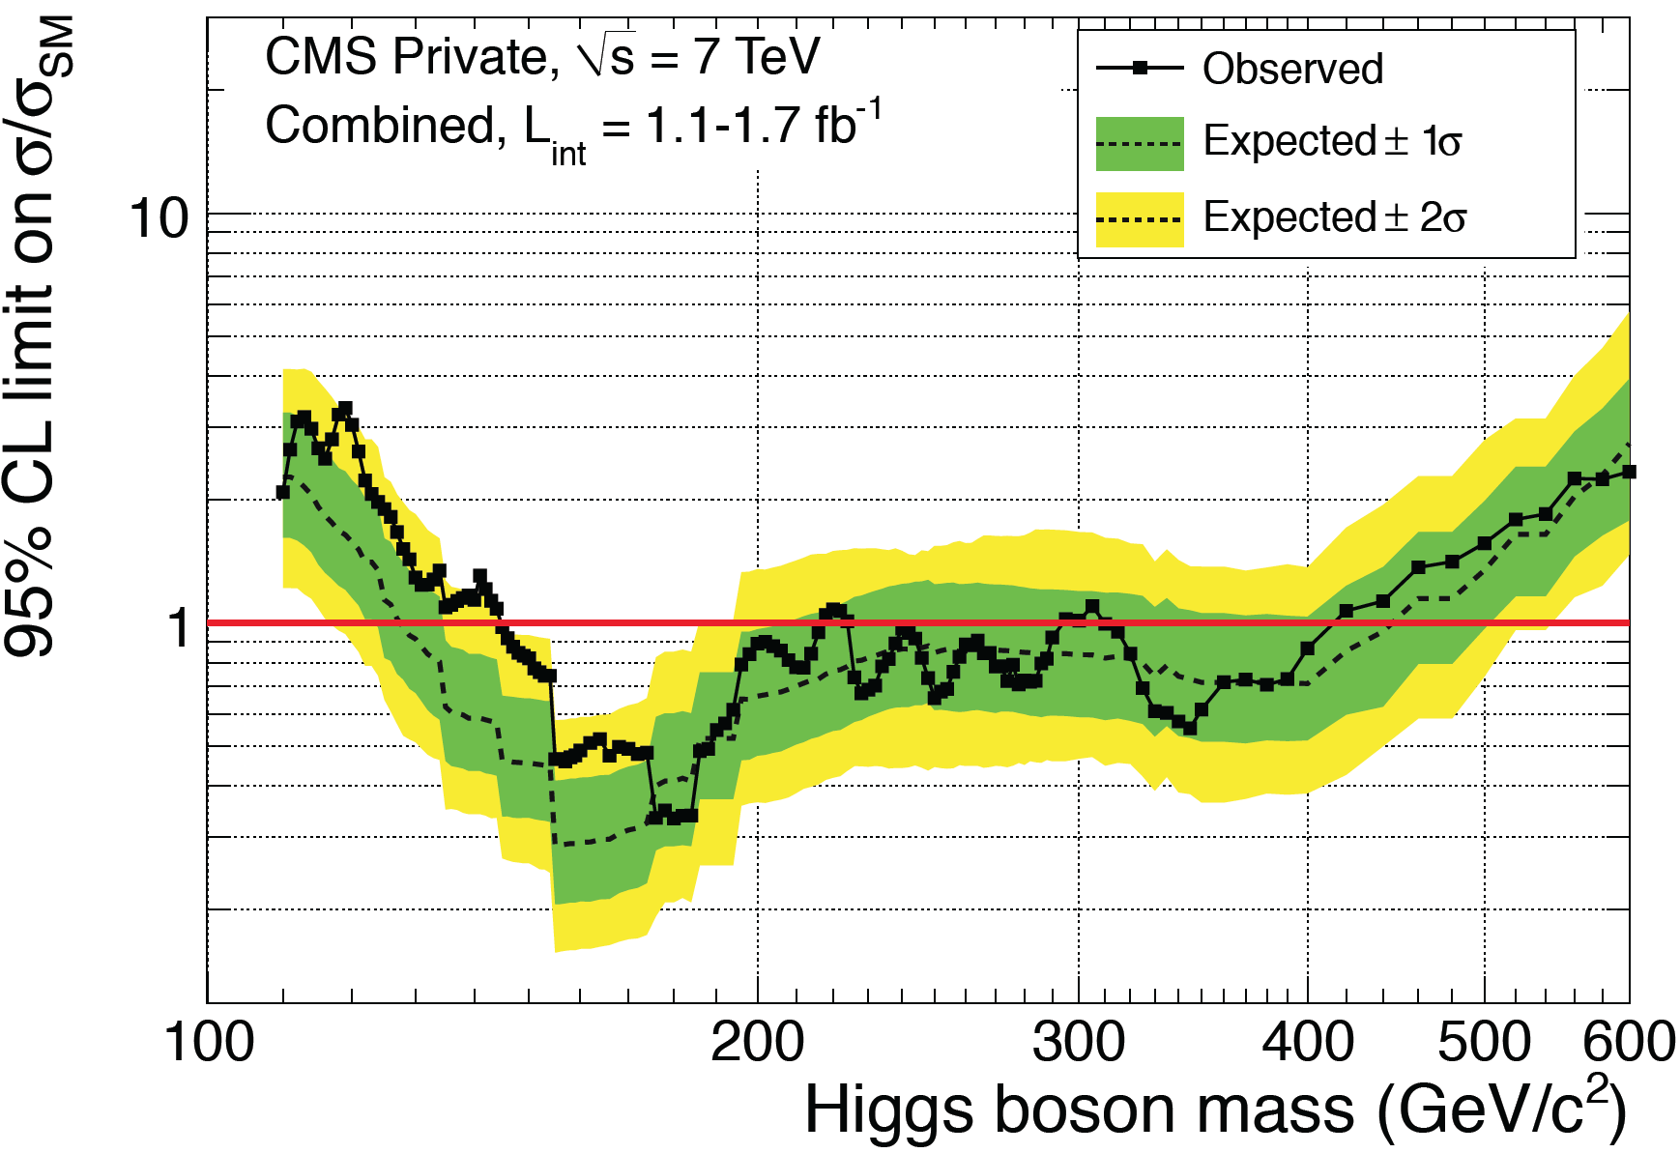
Where is Higgs?
What we know now
What we knew

Slide 17
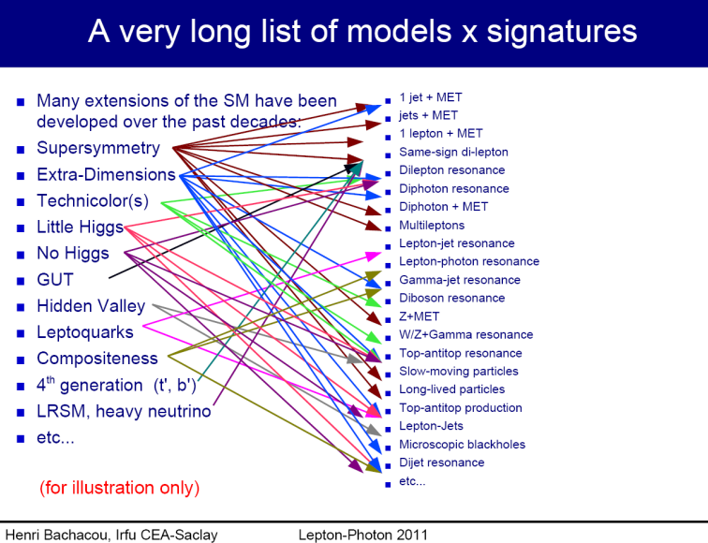
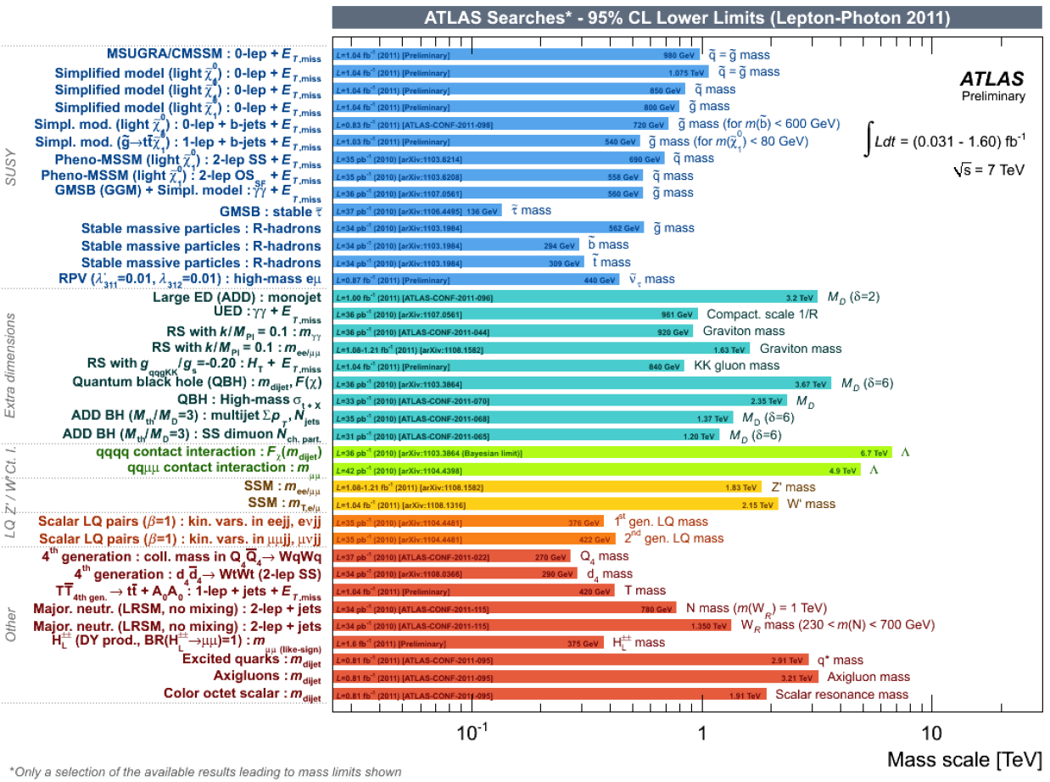
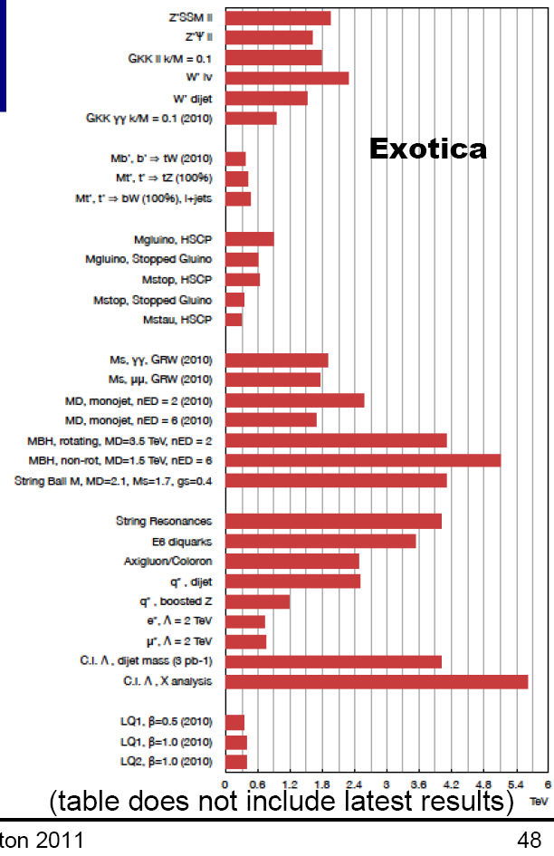
… and anything else?
Caution:
  new physics may different!
CMS

Slide 18
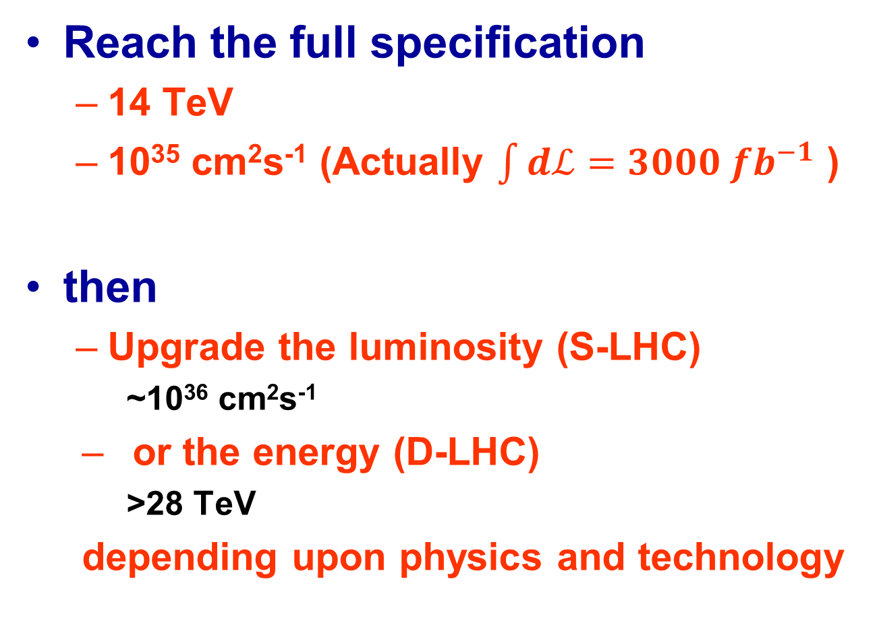
What Next?
Reach the full specification
  14 TeV
  10³⁵ cm²s⁻¹ (Actually $\int{dℒ=3000 {fb}^{−1}}$ )
then
  Upgrade the luminosity (S-LHC)
    ~10³⁶ cm²s⁻¹
  or the energy (D-LHC)
    >28 TeV
  depending upon physics and technology

Slide 19
Linear e⁺e⁻ Collider

Slide 20
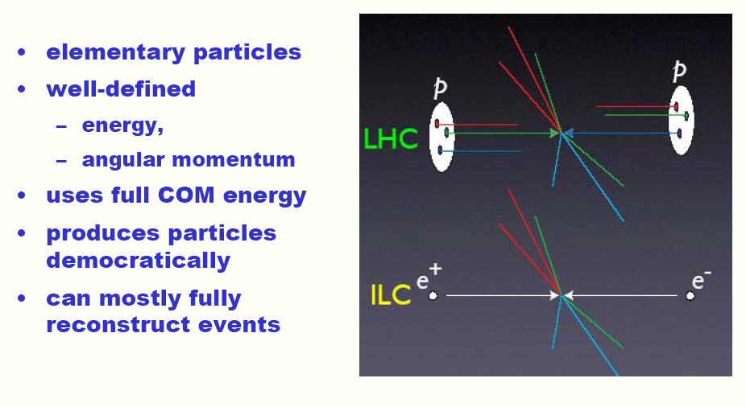
Why an e+e- collider?
After Barry Barish

Slide 21
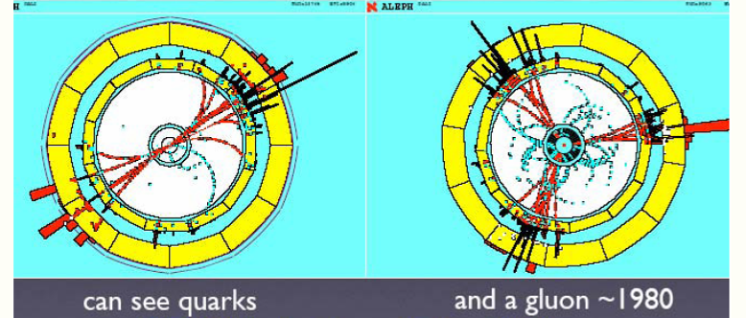
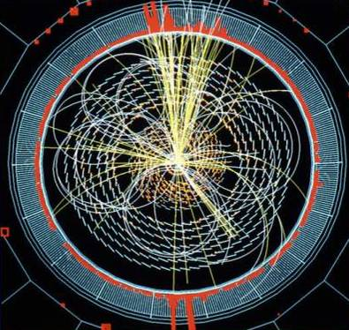
Why an e+e- collider?
← LEP
LHC →
After Barry Barish

Slide 22
Why a linear e+e- collider?
Synchrotron
Radiation!
or rather
the lack of it in a linear machine

Slide 23
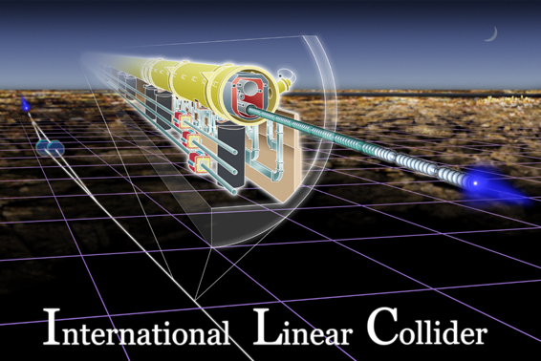
Key ILC Properties
Precision “true” CMS energy
Tuneable “true” CMS energy
Low backgrounds
After Blair

Slide 24
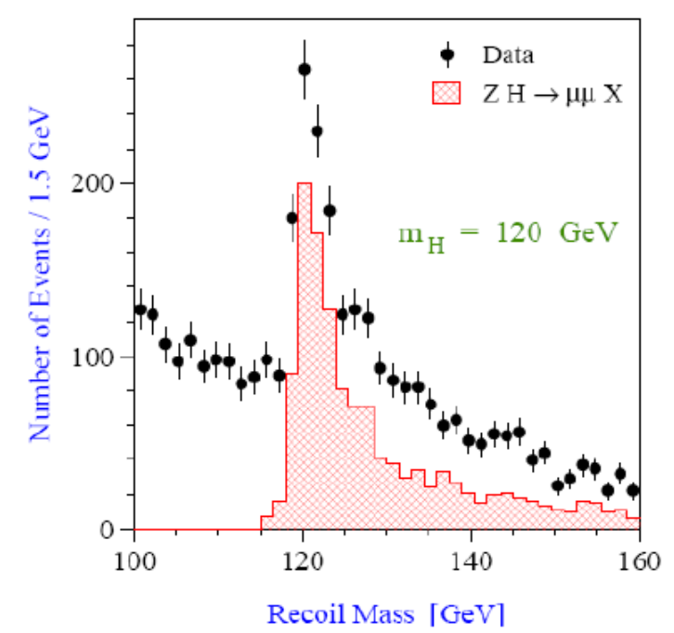
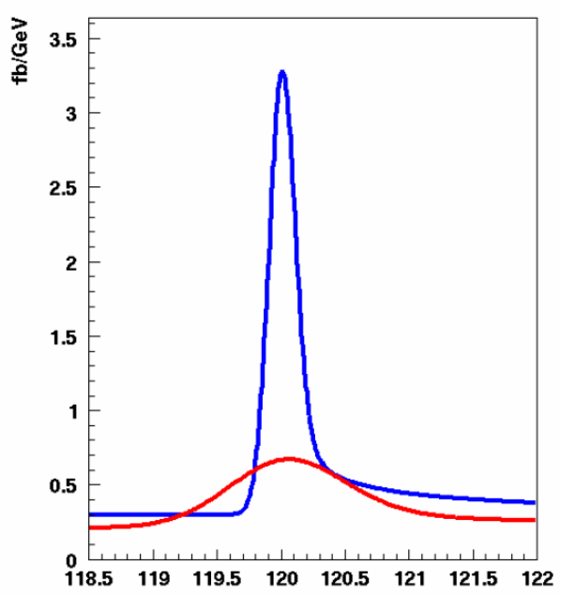
Invisible Higgs?
μ⁺
hº
Zº
μ⁻
Measure recoil against Z⁰
√s=230 GeV
120 GeV Higgs:
Advantages of
running at lower than
top threshold:
√s=350 GeV
Bambade et al.
After Blair

Slide 25
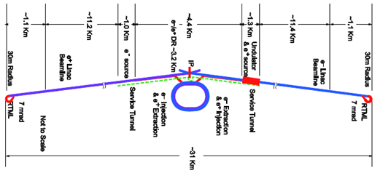
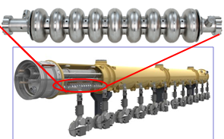
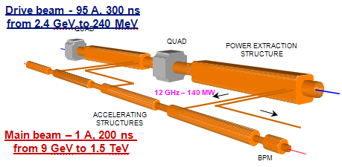
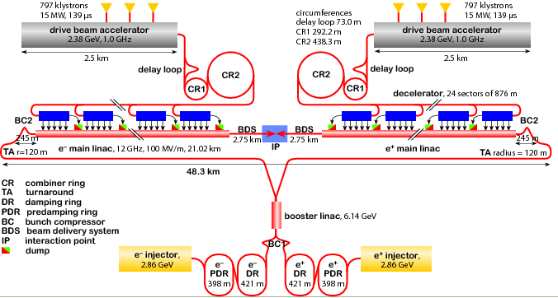
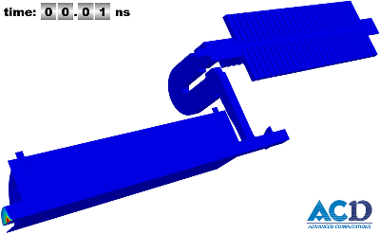
Linear Collider layouts http://www.linearcollider.org/cms http://clic-study.web.cern.ch/CLIC-Study/
ILC 0.5 TeV – 30 km
ILC 1 TeV – 50 km
CLIC 3 TeV: 48 km
CLIC 0.5 TeV: 13 km
Delahaye, ICHEP10

Slide 26
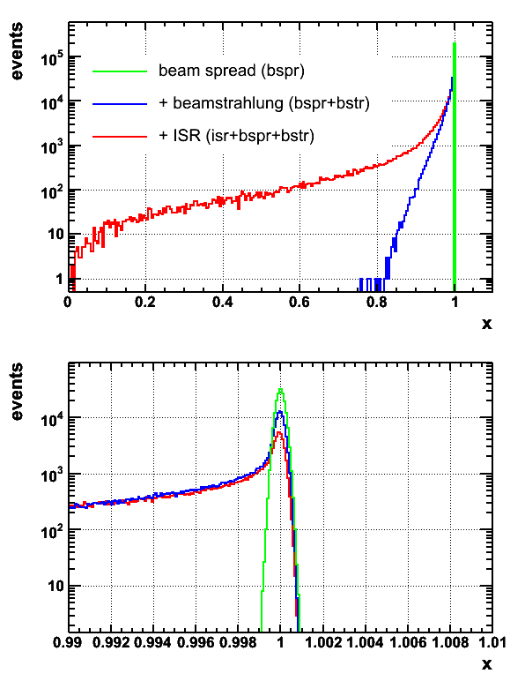
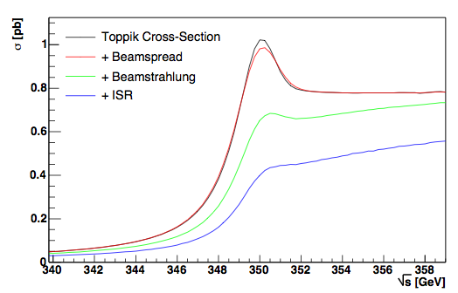
Energy spectrum; impacts physics output
Need for:
  Energy measurement accuracy 10⁻⁴
  Stability and ease of operation
  Minimal impact on physics data taking
After Blair

Slide 27
Linear Collider main parameters
Delahaye, ICHEP10
Technology | ILC | CLIC
Centre-of-mass energy (GeV) | 500 | 500 | 3000
Total (Peak 1%) luminosity (10³⁴⁾ | 2.0(1.5) | 2.3(1.4) | 5.9(2.0)
Total site length (km) | 31 | 13.0 | 48.3
Loaded accel. gradient (MV/m) | 31.5 | 80 | 100
Main linac RF frequency (GHz) | 1.3 (Super Cond.) | 12 (Normal Conducting)
Beam power/beam (MW) | 20 | 4.9 | 14
Bunch charge (10⁹ e+/-) | 20 | 6.8 | 3.72
Bunch separation (ns) | 176 | 0.5
Beam pulse duration (ns) | 1000 | 177 | 156
Repetition rate (Hz) | 5 | 50
Hor./vert. norm. emitt (10⁻⁶/10⁻⁹) | 10/40 | 4.8/25 | 0.66/20
Hor./vert. IP beam size (nm) | 640/5.7 | 202 / 2.3 | 40 / 1
Hadronic events/crossing at IP | 0.12 | 0.19 | 2.7
Coherent pairs at IP | 10 | 100 | 3.8 10⁸
Wall plug to beam transfer eff | 9.4% | 7.5% | 6.8%
Total power consumption (MW) | 216 | 129.4 | 415

Slide 28
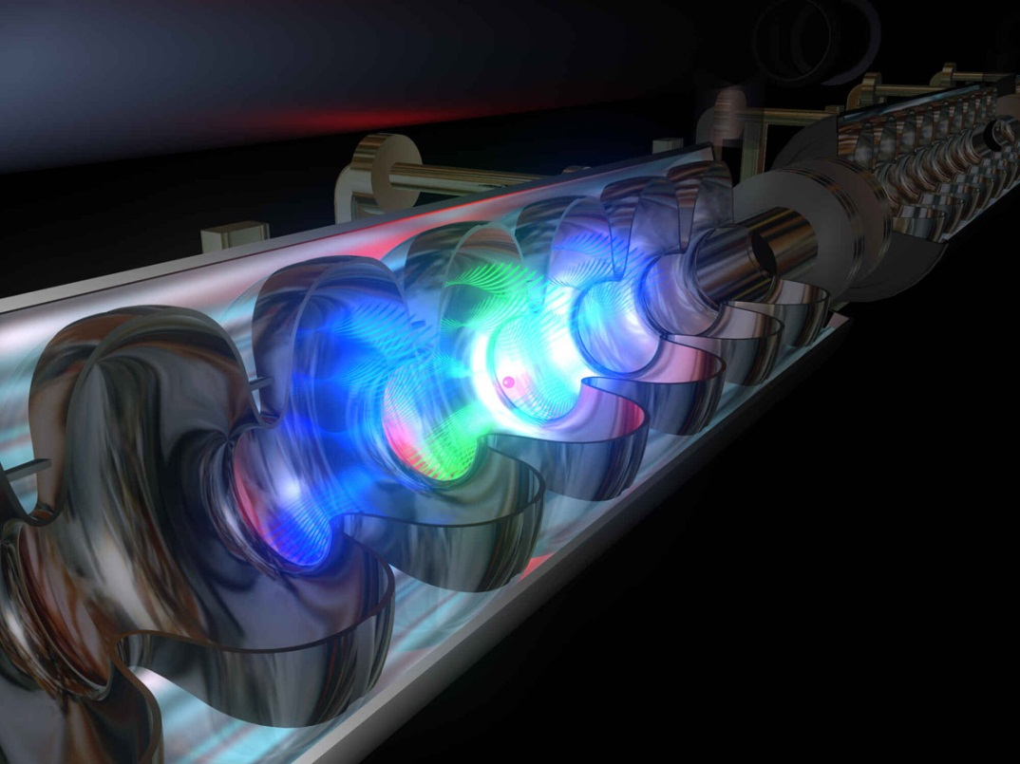
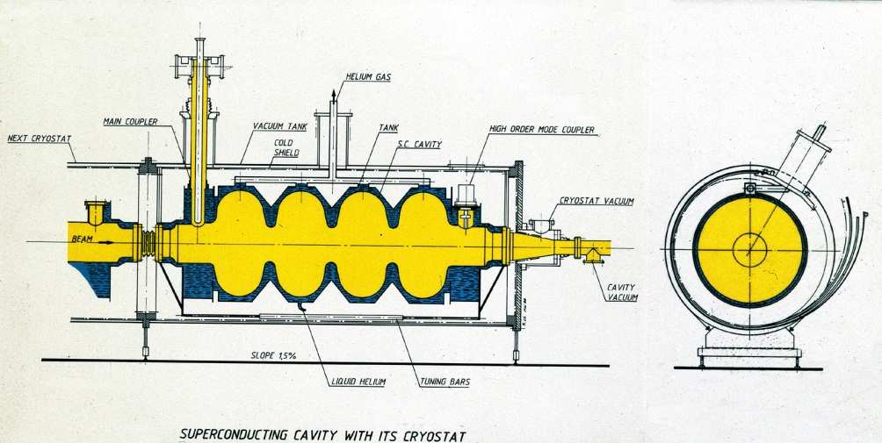
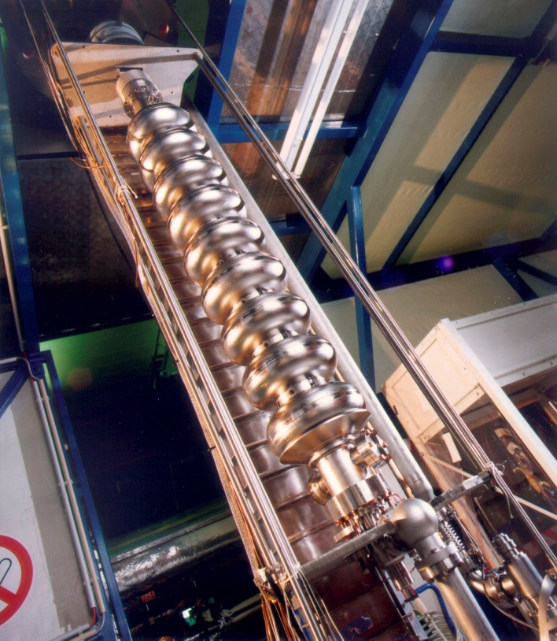
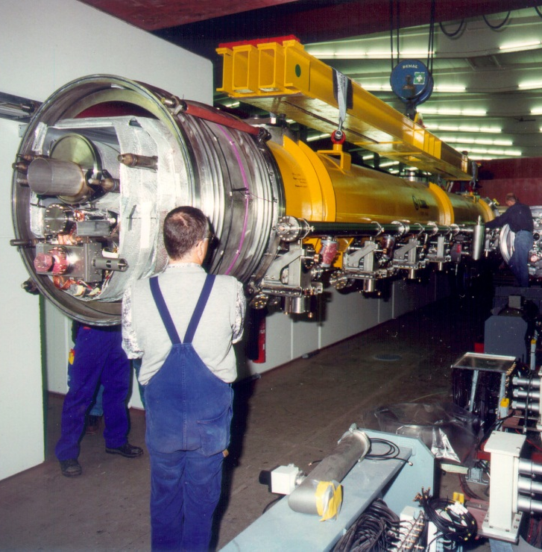
The heart of the ILC

Slide 29

CLIC
Compact
LInear
Collider

Slide 30
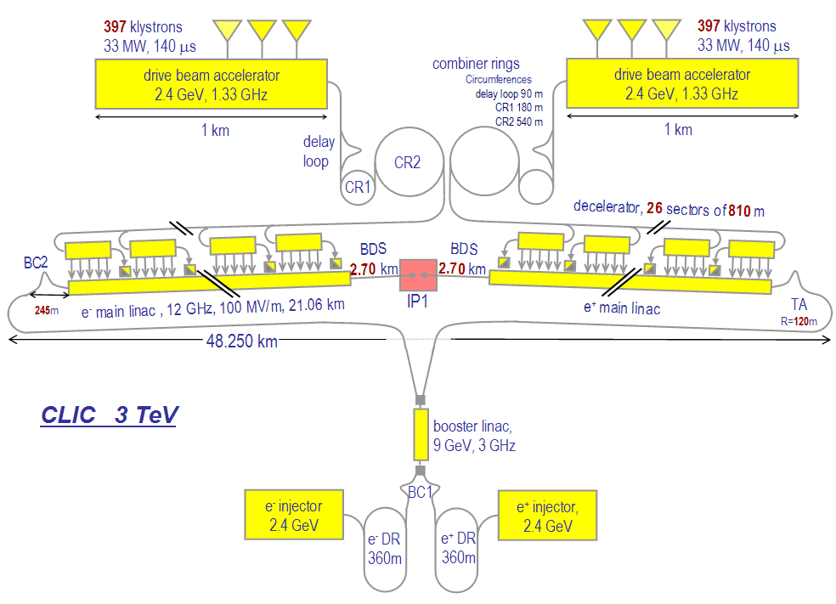
CLIC – overall layout
Drive Beam Generation Complex
Main Beam Generation Complex

Slide 31
Decision point for the LC
2½ key facts are needed
  Is there a light (<200 GeV/c²) Higgs?
  Is there New Physics (below 1 TeV)?
    If yes, what is the energy range?
Note:
  It does not matter much from the point of view of defining the decision point what the answers to these questions are – only that we know them!
  The 1st question may be answered by end 2012
  The 2nd question may be answered by end 2011
    The ½ question may not be clear for some time
  We need to define criteria for making a “fact”
    Is 3σ enough for evidence?
    Is 98% enough to exclude?
  Do we need the answers to both to proceed?
    (KJP) yes (politically)
Reach of LC wrt HE-LHC or HL-LHC?

Slide 32
The High Luminosity Frontier

Slide 33
When is luminosity more important than energy?
Suppose we know a particle exists
  What are its properties?
    Charge is easy
    Mass – depends upon the precision
    Spin & parity – need statistics
    Decay modes and dynamics
      Common decay modes – spin-parity analysis
      Rare decay modes – new physics!
      Needs large statistics
      High luminosity
?

Slide 34
“Factories”
Several particle factories built
  “b-factories” (KEKB and PEPII)
    High statistics studies of B_{d} decays
  “(tau-)charm factories” BEPC
    High statistics studies of J/ψ, ψ’ & τ decays
  “Phi-factory” (Frascati)
    High statistics studies of φ decays
      (Actually, φ→K₁K₂, which is the real interest)
      (Also, e⁺e⁻→π⁺π⁻ & other final states below 3 GeV for (g-2)_{μ} corrections)
Future? Neutrino Factory?

Slide 35
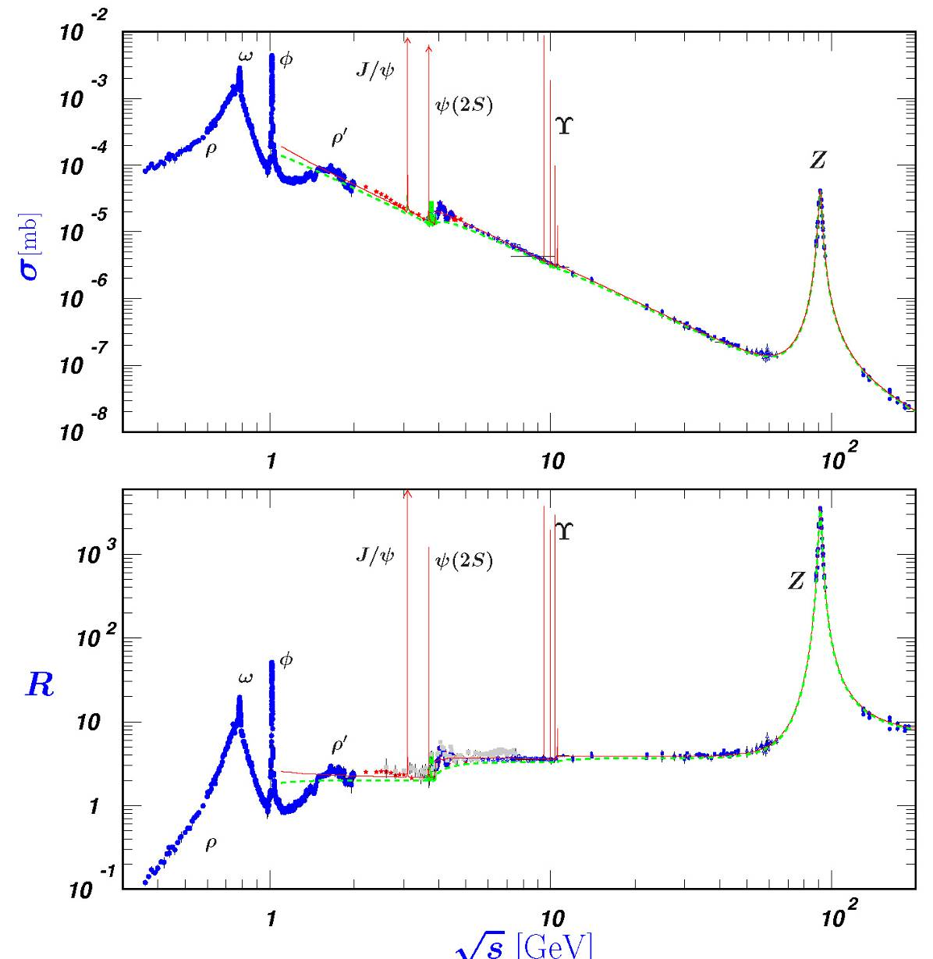
R = σ(e⁺e⁻→hadrons)/σ(e⁺e⁻→μ⁺μ⁻)
Large cross-sections in e⁺e⁻ when a “new quark” is discovered …
  s (φ)
    → KK
  c (J/ψ,ψ’, ψ(2S))
    → DD
  b (Υ…Υ(4S),Υ(5S))
    ‾BB
with low continuum backgrounds

Slide 36
Charm factories
Originally SPEAR @ SLAC in Palo Alto
Then BEPC @ IHEP in Beijing
Then CLEO-c @ Cornell
Then BEPC-II @ IHEP in Beijing
  Not discussed – impact of physics on the design between the φ-factory and the (symmetric) Υ-factory (CLEO-I & CLEO-II)

Slide 37
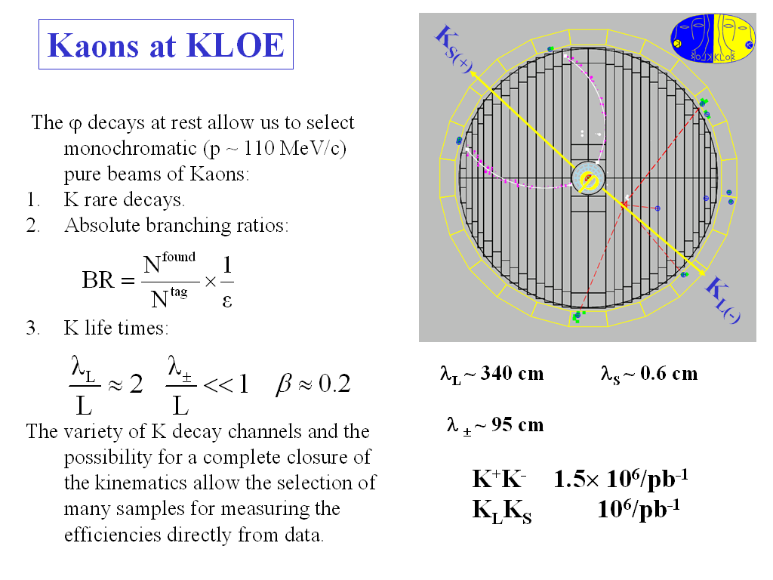
Example: φ→K_{S}K_{L}

Slide 38
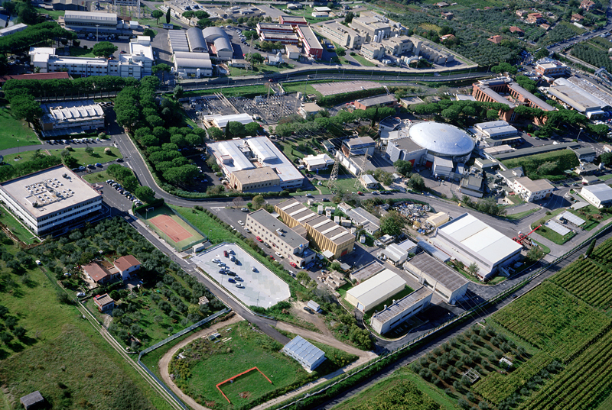

LNF-INFN
Frascati

Slide 39
Why a φ factory?
p⁺
p⁻
K_{S}
f
K_{L}
p⁻
p⁺
Observing the K_{S} decay (left) produces a pure K_{L} beam (right)
  Study (rare) K_{L} physics
Observing the K_{L} decay (right) produces a pure K_{S} beam (right)
  Study (rare) K_{S} physics
Observing the K_{S} decay (left) and a K_{L} decay (right)
  Study (EPR) quantum interference

Slide 40
Why a B factory?
e⁺
q⁻ℓ⁻
B
υ(4S)
‾B
e⁻
‾q,ℓ⁺
Exactly as in the Kaon system
  … but cτ(K) = 2.68cm (S) and 15.34m (L)
  and cτ(b) = 0.44μm (t~1.64ps)
    impossible to measure the flight path and separate the two sides …
  Beam spot size >> decay length
    Can measure ‾τ+τ but not ‾τ−τ, which contains the CP-violation information

Slide 41
Why an asymmetric B factory?
p⁻
‾B
p⁺
υ(4S)
B
p⁺
p⁻
Say e⁺=3 GeV, e⁻=9 GeV; ➔ √s=10.4 GeV

Slide 42
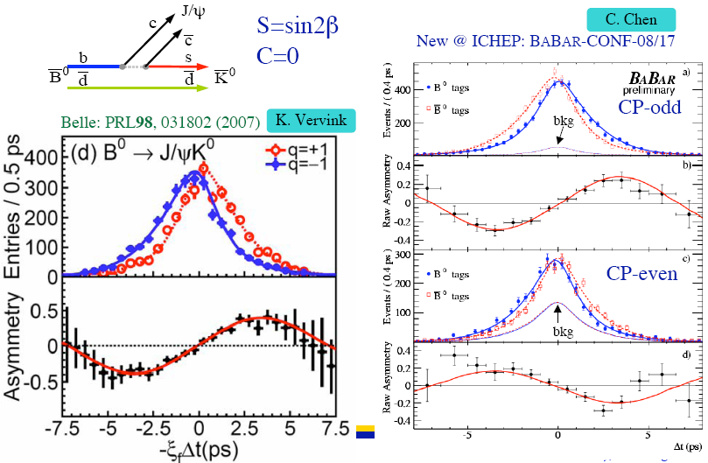
“Golden Channel” - ‾B⁰B⁰→K_{S}J/Ψ

Slide 43
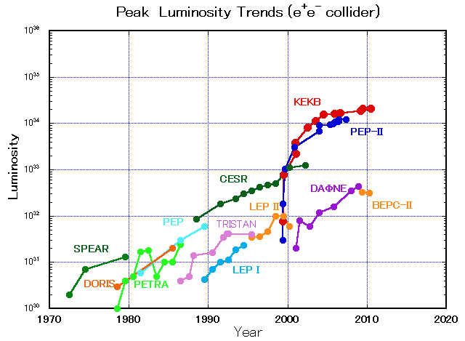
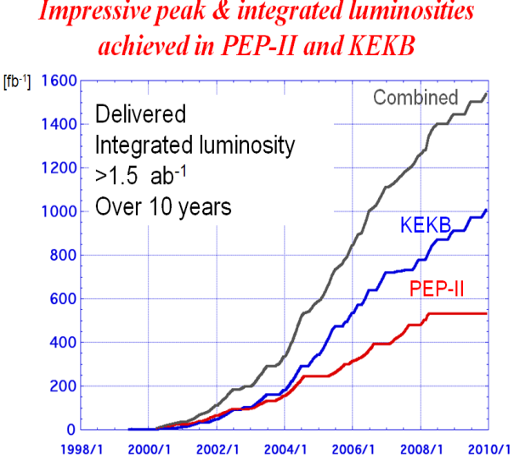
B Factories (PEPII&KEKB) to SuperB and
SuperKEKB @ high luminosity frontier
10³⁶
40 times higher luminosity
Next generation
B-factories
KEKB
Delahaye, ICHEP10

Slide 44
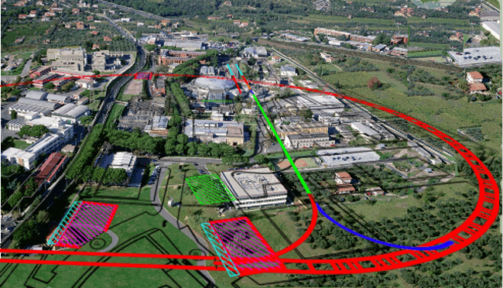
The SuperB Factory

Slide 45
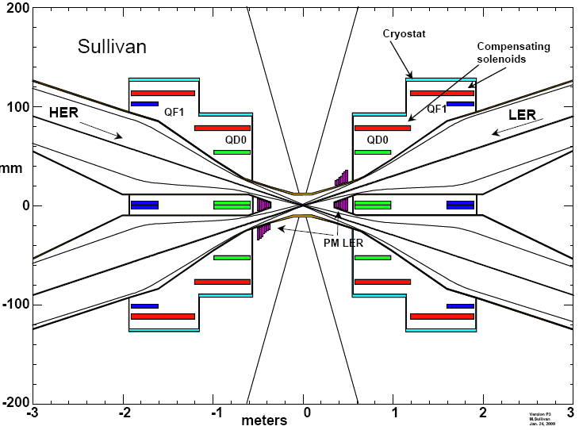
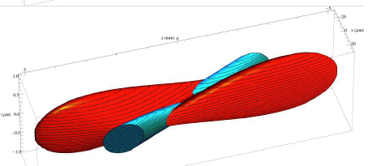
The SuperB factory

Slide 46
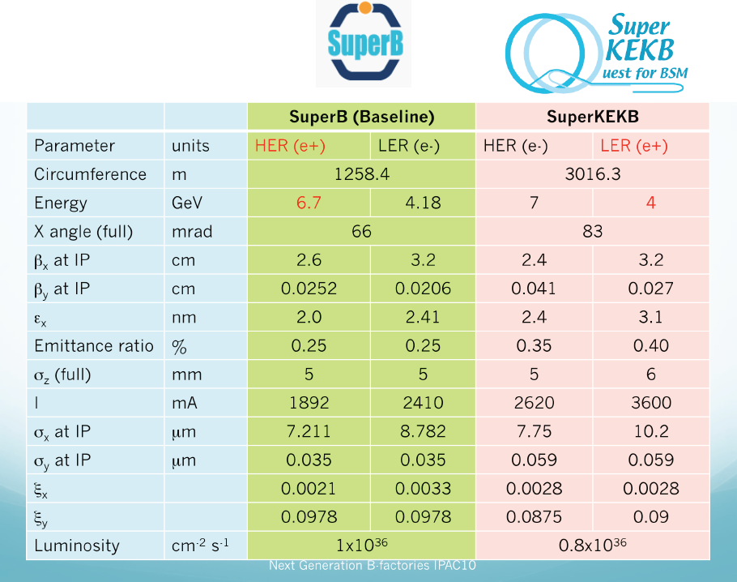
Major parameters
B Factories
Delahaye, ICHEP10

Slide 47
Precision Summary
Precision Frontier machine require
  Very high luminosity
    Peak and integrated
  Highly tuned beams
    Energy, spot size, [purity]
  High reliability
    Down time costs integrated luminosity
  Limited flexibility
    Modest changes in energy
  Low machine backgrounds
    Otherise background limits luminosity

Slide 48
Neutrino Beams & Factories
(see also seminar by Ken Long)

Slide 49
Neutrino Physics
1950’s and early 60’s
  Nature (and existence) of the neutrino
    (Reines & Cowan, Lederman, Schwartz and Steinberger)
Late 1960s, 1970s, 1980s
  Structure of the nucleon
    F₂, xF₃ etc
  Structure of the weak current
    Neutral currents, sin₂θ_{w} etc
Now, and future
  Nature of the neutrino
    Neutrino Mass and Neutrino Oscillations
    Standard Model assumption of massless neutrinos is wrong!
      Note: difficult to add neutrino mass to SM a la Higgs
      Lack of Charge → additional mass-like (Majorana) terms
New
facilities
allow
old
physics
to be
done
much
better

Slide 50
What to Measure?
Neutrinos
ν_{e} disappearance
ν_{e} → ν_{μ} appearance
ν_{e} → ν_{τ} appearance
ν_{μ} disappearance
ν_{μ} → ν_{e} appearance
ν_{μ} → ν_{τ} appearance
… and the corresponding antineutrino interactions
Note: the beam requirements for these experiments are:
high intensity known flux
known spectrum known composition (preferably no background)

Slide 51
Conventional Neutrino Beams
Decay
Region
Beam
Dump
Proton Beam
Horn
Detector
Target
Main components
  Proton Beam
    Energy, Intensity, frequency
  Target
  Horn (focussing)
  Decay Region
  Beam Dump
  Detector
Note
For any (class of) experiment
N_{ev} ∝ P × M (× E_{n})
Beam Target Neutrino Power Mass Energy

Slide 52
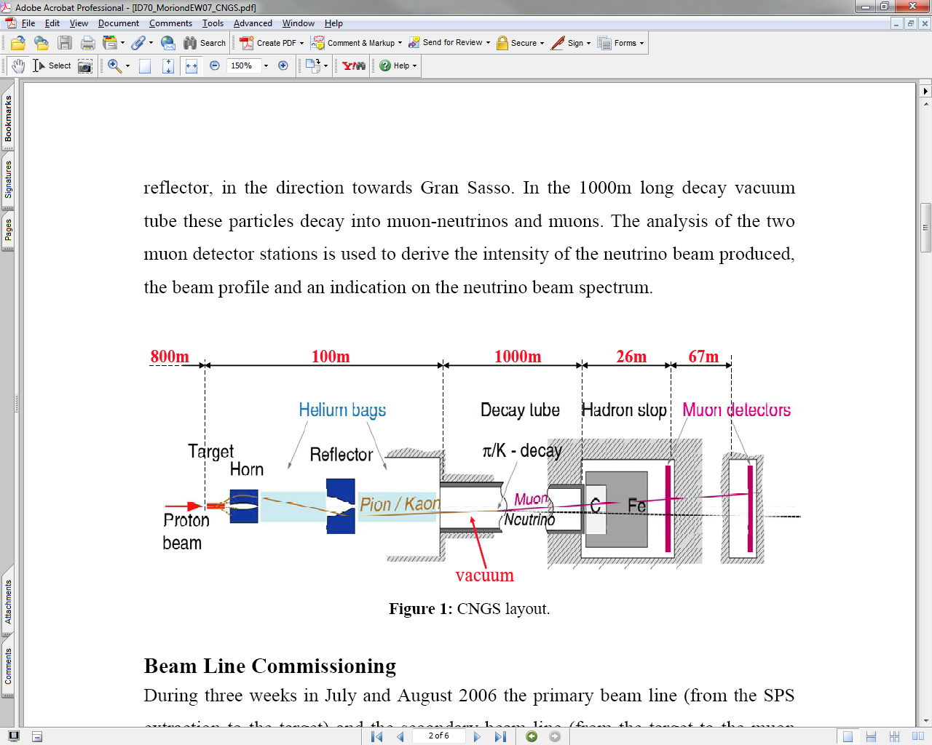
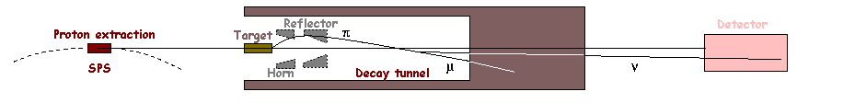
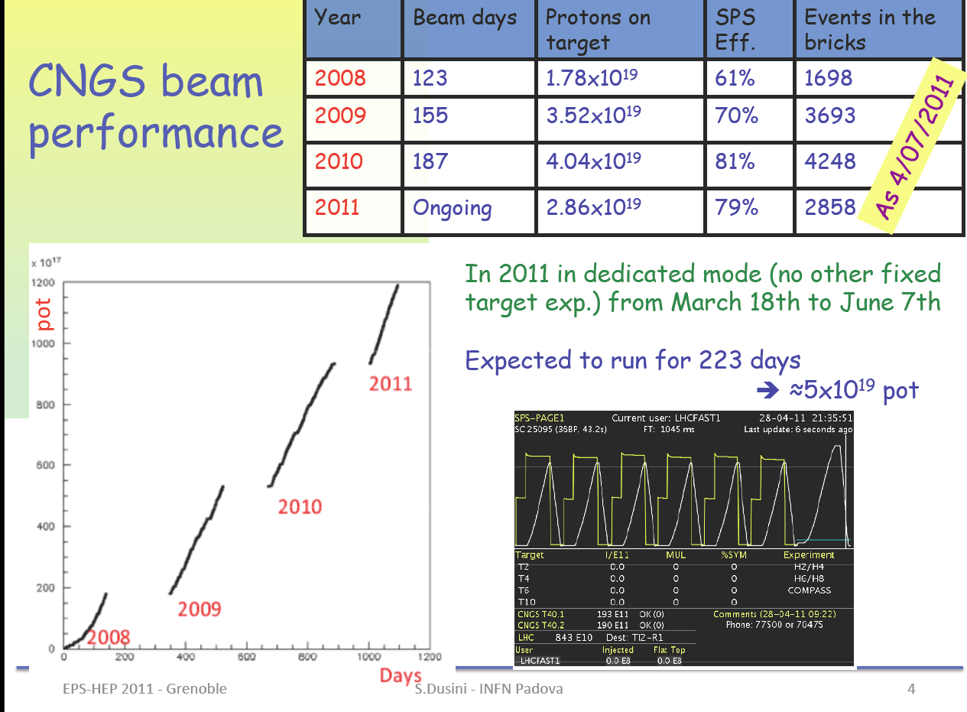
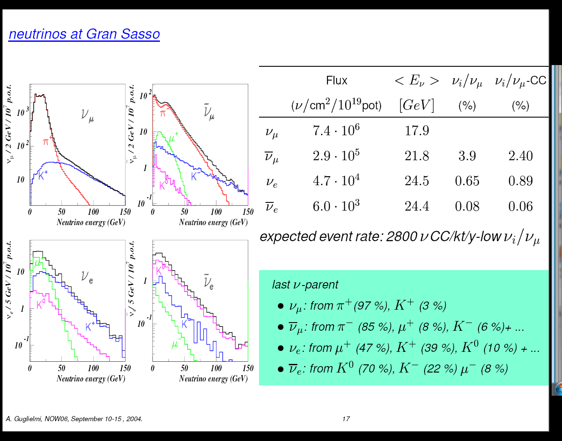
Example of a Neutrino Beam
CERN Neutrinos to Gran Sasso at CERN SPS
450 GeV
Why Change?

Slide 53
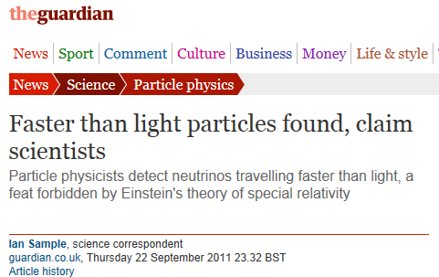
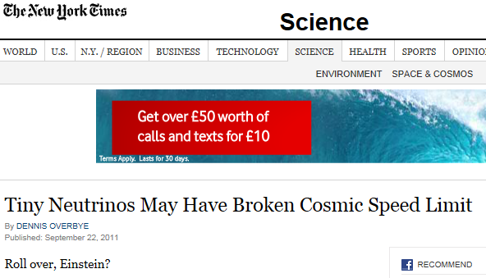
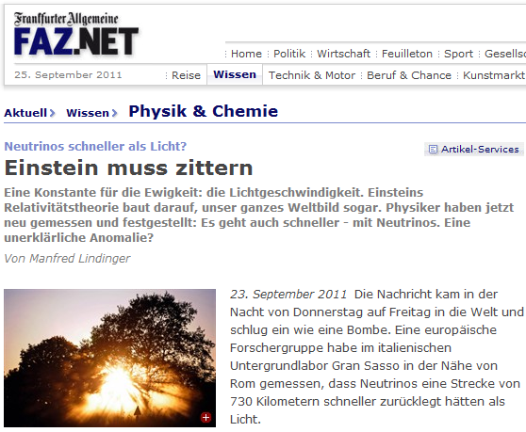

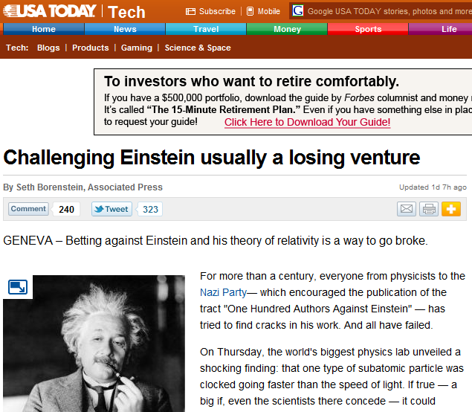
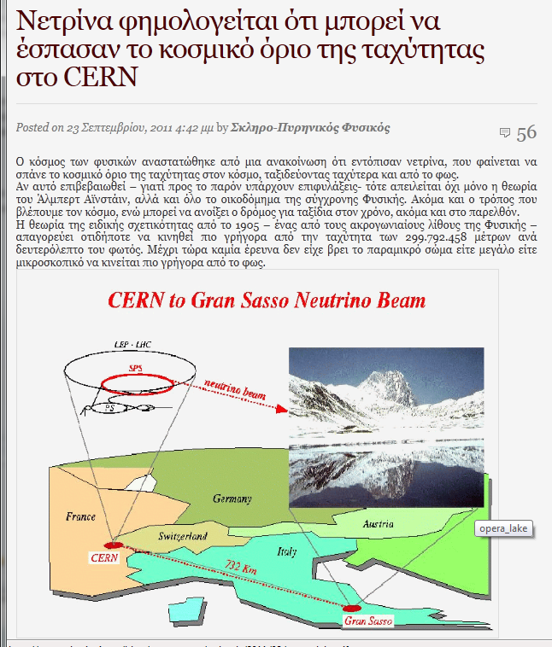


Another neutrino mystery

Slide 54





What was the fuss about?
This anomaly corresponds to a relative difference of the muon neutrino velocity with respect to the speed of light
$\frac{(v−c)}{c}=(2.48±0.28 \left(stat\right)±0.30 \left(syst\right)) ×{10}^{−5}$.

Slide 55
Is it true?
(sadly) probably not
  The experiment may not be “wrong”
  but may be less exciting than proving
    “Einstein was wrong”
  and might nevertheless be
    “interesting physics”
“Good science” means
  Observing
  Reporting
  Speculating
  Experimenting
  Repeating
  Explaining

Slide 56

The “Off Axis” trick
P_{n,T}
_{GeV/c}
0.03
1
2
3
4
5
P_{n,L}
GeV/c
-0.03
Short baselines (~100m) have large acceptances (~10mr)
Long baselines (>100km) have small acceptances (~10mr)
  Similar spectrum
Long baselines Off Axis
  Different spectrum
D. Beavis et al., “Long Baseline Neutrino Oscillation Experiment, E889, Physics Design Report,” BNL-52459, (1995)

Slide 57







T2K & Noνa
295km
<En>~0.7GeV
Kamioka
Tokaimura
ν
0.54Mton Kamiokande
4MW 50GeV Protons
Ash River

Slide 58

Very Long Baseline Neutrino Oscillations

Slide 59

Accelerating muons – (g-2)_{μ}

Slide 60

μ→e conversion
(Yoshi Kuno)
Br(μ⁻ + Al → e⁻ + Al) < 10⁻¹⁶
Br(μ⁻ + Ti → e⁻ + Ti) < 10⁻¹⁸

Slide 61
Muon Collider
See Ken Long’s seminar

Slide 62
Nuclear Physics

Slide 63


Accelerated heavy ions
Studies of nuclear properties
  New superheavy (> uranium) elements
  Nuclear structure
  Two techniques
Isotope separation “in-flight”

Slide 64

EURISOL

Slide 65

FAIR (Darmstadt)

Slide 66
Other science applications

Slide 67


ISIS - Neutron Beams
600 Experiments/year
1200 Users/year
235 UK Groups

Slide 68

Neutron Facilities
Demand for growth in capability and capacity
Declining number available
world-wide

Slide 69



The Spallation Sources

Slide 70



The China Spallation Neutron Source

Slide 71



The Diamond Synchrotron

Slide 72

Progress in light sources!
After Bartolini

Slide 73



Examples of use of Synchrotron Radiation
CCLRC/SRD annual report

Slide 74

The X-ray Free Electron Laser
See talk by Sven Reiche

Slide 75

The X-ray Free Electron Laser

Slide 76
Laser-Plasma accelerators

Slide 77

Plasma accelerators driven by TW lasers
Tajima & Dawson Phys Rev. Lett. 43 267 (1979)
Hooker, Oxford

Slide 78


Nonlinear plasma waves
  Plasma frequency decreases with intensity.
  Wavefronts of plasma wave become curved.
  At very high intensities reach the “blow-out” or “bubble” regime.
Pukhov et al. Appl. Phys. Lett. 74 355 (2002)
Hooker, Oxford

Slide 79

Generation of quasi-monoenergetic beams
  Three milestone results
    (Nature at end of 2004)
    Karl Krushelnick (Imperial College, UK)
    Victor Malka (LOA, France)
    Wim Leemans (Lawrence Berkeley, USA)
  1st evidence
  quasi-monoenergetic electron beams
Hooker, Oxford

Slide 80




Generation of quasi-monoenergetic beams
S. D. Mangles et al.
Nature 431 02939 (2004)
C. G. R. Geddes et al.
Nature 431 02900 (2004)
J Faure et al.
Nature 431 02963 (2004)
Hooker, Oxford

Slide 81
Generation of quasi-monoenergetic beams
  Typical output parameters:
    Output energy: 100 - 170 MeV
    Energy spread: 2.5 - 8%
    Bunch charge: 20 - 500 pC
    Normalized emittance: 1-2 π mm mrad
Hooker, Oxford

Slide 82


Laser-Driven FELs

Slide 83

Laser Driven Plasma Ion Acceleration
After Borghesi/QUB

Slide 84

Typical results (Vulcan)
After Borghesi/QUB

Slide 85



New mechanism - Radiation Pressure Acceleration (RPA)
Z⁺
e-
In ultrathin foils the laser push on electrons may lead to the detachment of a portion of the foil (light sail)
Acceleration by Radiation Pressure:
Cyclical re-acceleration of ions
Narrow-band spectrum (whole-foil acceleration)
Energy transfer more efficient as ions approach relativistic regime
Issues : Stability of acceleration
Electron heating:
Competition with TNSA
Target disassembly
Dominant mechanism at I~ 10²³ W/cm²
GeV acceleration in a single laser cycle!!
W ~ I²
T.Esirkepov et al, PRL, 92, 175004 (2004)

Slide 86


Radiation Pressure Acceleration
B. Qiao et al, Phys Rev Lett,102,145002 (2009)
Circularly polarized pulses
suppress hot electron production
suppress TNSA
limit target disassembly
+ ultra-thin target @ 10²¹-10²² W/cm²
promising for 0.1-1GeV acceleration

Slide 87


electron driven plasma acceleration
85 cm!
Energy doubled!
Blumenfeld et al, SLAC-PUB-12363

Slide 88
Prospects for laser-plasma accelerators
Laser-plasma accelerators: enormous progress:
  Electrons
    Demonstration of quasi-mononergetic beams
    Increase of output energy to 1 GeV
    Demonstration of controlled injection
  Protons & ions
    Similar dramatic progress
  Many groups, many plans
Beam-driven plasma accelerators
  “Energy doubling” @SLAC (electrons)
  Protons-excited plasmas
  FACET @ SLAC, something @ CERN

Slide 89
Industrial accelerators

Slide 90
Industrial uses
Cyclotrons for radio-isotope production
Ion implantation (electrostatic, linear)
Sterilisation
Fusion reactors
(coming?) security applications
ADSR?

Slide 91
Industrial Accelerators
Direct Voltage
  Van de Graaf, Cockcroft Walton …
    Protons, ions to a few MeV (~5)
Linacs
  Electron beam
    Up to 16 MeV
  Ion beam
    Up to ~70 MeV
Rings
  Cyclotrons
    Ions up to ~70+ MeV
  Betatrons
    Electrons up to a few 10s of MeV
  Synchrotrons
    Up to several GeV

Slide 92

Ion Implantation
Semiconductors
  Precision composition
Metals
  hardening
Glass
  Hardening
  Modified optics
    Note: All digital electronics depends upon ion implantation

Slide 93

Electron Beam Materials Processing
Usually low energy
  Few hundred keV
  Precision engineering
  (cutting, welding)

Slide 94

Electron Beam Irradiators
Low energy (<300 keV)
    Curing, laminating
  up to 1 MeV
    Also polymerisation
Medium energy (<5 MeV)
  Polimerisation
  Sterilisation (medical)
High Energy (~10 MeV)
  Food irradiation
  Waste water treatment
  Gemstone colour enhancement

Slide 95
Medical – cancer therapy

Slide 96
Radiotherapy – photons and protons
Charged particle therapy uses protons to destroy cancer cells
Conventional radiotherapy uses x-rays to destroy cancer cells
  But higher energy than the x-rays used for radiography
Dose
Dose
The Bragg Peak
Linac
Linac
Linac
Proton
Linac
Linac
Linac
Linac
Linac
Linac
Linac
Linac
Proton
Ken Peach (PTCRi, Oxford) Physics, Accelerators and Cancer Nottingham, 18th November 2010 96

Slide 97



X-rays compared with protons
X-rays
protons
Ken Peach (PTCRi, Oxford) Physics, Accelerators and Cancer Nottingham, 18th November 2010 97

Slide 98

Photons, Protons and Carbon
Ken Peach (PTCRi, Oxford) Physics, Accelerators and Cancer Nottingham, 18th November 2010 98

Slide 99

Linacs with on-Board Imaging
MV Beam
kV imager
kV X-ray tube
Remote
couch
control
MV EPID
Liz Macauley/ORHT
Ken Peach (PTCRi, Oxford) Physics, Accelerators and Cancer Nottingham, 18th November 2010 99

Slide 100

Inside …
Image courtesy of the Stanford Linear Accelerator Center
Ken Peach (PTCRi, Oxford) Physics, Accelerators and Cancer Nottingham, 18th November 2010 100

Slide 101


The Clatterbridge Centre for Oncology
Established 1989
  Douglas 62 MeV cyclotron
  First hospital based proton therapy
  >1700 patients with ocular melanoma
  First example of 3D computer treatment planning in UK;
    eye gaze direction used to obtain best approach angle to eye.
After Bleddyn Jones
Courtesy Clatterbridge
Ken Peach (PTCRi, Oxford) Physics, Accelerators and Cancer Nottingham, 18th November 2010 101

Slide 102



The IBA solution
University of Florida Proton Therapy Institute
IBA
Ken Peach (PTCRi, Oxford) Physics, Accelerators and Cancer Nottingham, 18th November 2010 102

Slide 103

What the patient sees

Slide 104
non-scaling FFAGs
Fixed Field Alternating Gradient
  See Ken Long
    EMMA – Electron Model with Many Applications
      “Proof of Principle”
      Relativistic – fixed frequency
Does a linear EMMA-like machine work
  For protons?
    Relativistic – yes
    Non-relativistic - no
      Too dense a lattice

Slide 105


EMMA & PAMELA
PAMELARING

Slide 106
From EMMA to PAMELA
F
D
D
F
F
The EMMA lattice
Doublet structure
  Focus and Defocus
Dense lattice
  Little space between magnets
Lots of RF Acceleration
  Almost every other cell
The PAMELA lattice
Triplet structure
  Focus, Defocus, Focus
Less Dense lattice
  Long straight sections
Less of RF Acceleration
  Larger cavities
  Lower frequencies
Larger radius

Slide 107

PAMELA Layout
Carbon ring
~12m
Proton ring
Carbon source & injection
Proton source & injection
Extraction
Transfer line

Slide 108





Working Point and Tunes
Working point
  High k (38)
    minimize orbit excursion
Machine tune variation (cell tune variation*12): [decapole]
  ν_{x} within 0.0476
  ν_{y} within 0.0528
  Well within an integer!
Beam sensitivity
  Amplification factor 5.8 (h)
  9.5 (v)
      (A = orbit distortion [mm] / 1σ alignment error [mm])
horizontal
vertical
Proton Ring
Notes:
108

Slide 109


Magnetic Lattice

Slide 110


Magnet Requirements
Non-scaling, non-linear FFAG
  Multipoles up to decapole
Challenges
  Maximum field (4.25T)
  Length restriction (314 mm)
  Required bore (>250 mm)
Magnet options
  n/c Iron cored magnets
  Superferric coils
  S/C cos(θ) magnets
  S/C Double-helix coils
Choose: Double-helix coils
Notes:
110

Slide 111






Double-Helix Principle
Current density:
Helix 1
Helix 2
Double-Helix
+
Double-helix coil:
Smart way of creating a cosine-theta magnet
Main advantage for PAMELA: No coil end problem
Notes:
111

Slide 112
Conclusion
Accelerators have an exciting future
  in particle physics
    LHC, LC, CLIC, NF, factories …
  in other sciences
    Light sources, FELs, spallation sources…
  in society
    Industry
    Medical accelerators (isotopes, hadron-therapy…)
And they are fun too!

