Slide 1



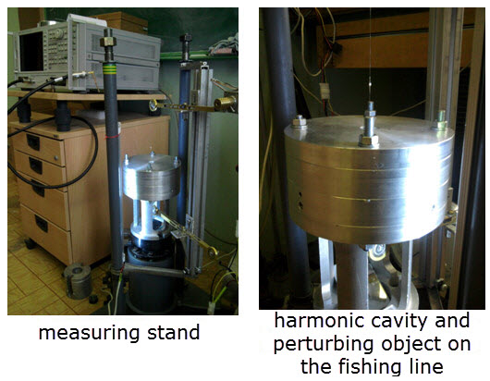
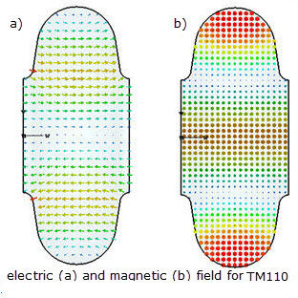
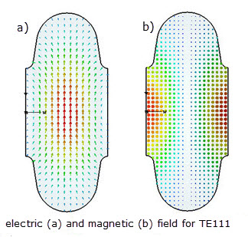



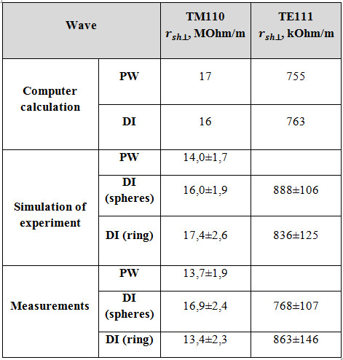
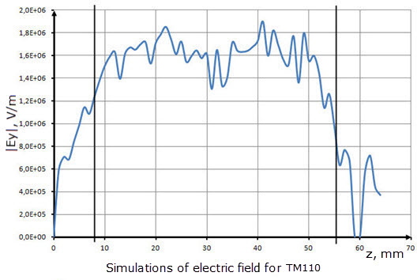
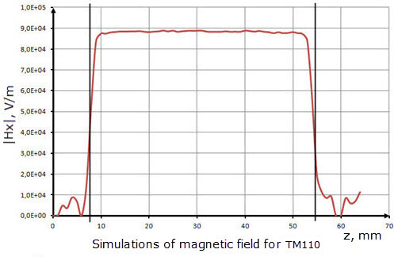
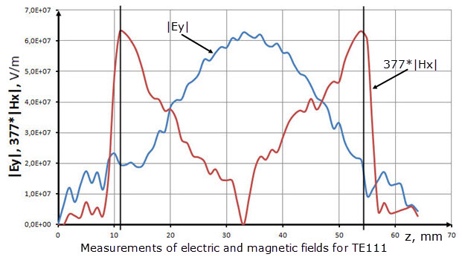
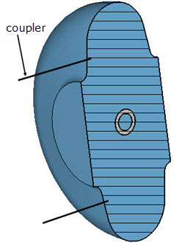
EXPERIMENTAL ANALYSIS OF DIPOLE MODES IN ELLIPTICAL CAVITY
A. Orlov, Ya. Shashkov, N. Sobenin, M. Lalayan
National Research Nuclear University MEPhI, Moscow, Russia
The experimental measurements of transverse shunt impedance for higher order modes TM110 and TE111 for S-band elliptical cavity were carried out. The experiments with perturbing objects such as dielectric and metallic spheres and with ring probe were performed.
There are two methods for defining the transverse shunt impedance : Panofsky- Wenzel’s method (1) and direct integration method (2)
k_{z} - longitudinal wave number, E_{z} – longitudinal component of the electric field, P_{los} – power loss in the structure, r – transverse coordinate offset in the plane of the dipole polarization of the wave relative to the central axis, l – length of the structure, c-speed of light, µ₀-magnetic constant, Ey-transverse axial component of the electric field, Hx – transverse axial component of the magnetic field.
Results

