Slide 1
Linac design for FELs
Stephen V. Milton
Synchrotron Radiation and Free-Electron Lasers
Erice, Italy 6 – 15 April 2011

Slide 2
Intro

Slide 3
Outline
Some initial comments
Goals of this design
Basics such as
  Discussion about constraints
  Technology considerations
FEL Refresher
Linac Refresher
Primary Design Considerations
Other Design Considerations

Slide 4
What is this course about?
It’s about the thought process for designing a linac and linac system
This will lead to a basic “point design”, a starting point, for the scientists and engineers to begin the preliminary design of the overall system.

Slide 5
As importantly, what this course is not
It is not a course on how to design the details of a linac or the various items that make up a linac
A course on linac optics
A course on collective effects
A course on how to engineer various components
Etc.

Slide 6
What I Will Touch Upon
What are the initial goals that we would like to achieve with the linac
Some basics on FELs
Some basics on linacs and linac systems
The point design
  Coming up with the initial concept of what you want to design
  Proceeding through this design
  Refining and iterating the design
Ancillary Items
  Buildings
  Power and water needs
  Cabling
  Basics layout of infrastructure
  Etc.

Slide 7
A few notes
This is not (yet) a real design although it might look like a design for some other machine that you might have seen or know about.
As always, designs take on the personality of the designer, i.e. there is no 1 perfect design. As such, these are my thoughts, and the compromises I have chosen to make reflect what I think might be best and these might not coincide with other’s opinions. But, the point is to move forward with confidence…and with an open mind to new and useful ideas.
I am certain there are some mistakes in what I will show today, but that’s the way designs start. You just have to be both willing to expose possibly some of your weaknesses and also be willing to accept constructive criticism and then modify your design to make it even better.
I might need more time than what is allocated. Then again, I might need less.

Slide 8
A Relevant Quote
When opening a University textbook, the undergraduate gets the impression that the subject concerned is a closed chapter. He is not likely to find openings for the discussion and understanding of problems still extant in the field. And yet, problems awaiting solution exist in every field
Antonino Zichichi

Slide 9
Some Goals of this design

Slide 10
What should we build?
The first question to ask is
  Why are we building this?
    It’s usually to provide a new light source for a broad user community.
    It’s not necessarily because it is fun (although it is) or that we are trying to develop a broad range of new linac technologies.

Slide 11
What should we build?
What does the user community want?
  Below are my opinions
  Up to 1100 eV photons at the fundamental wavelength (1.1 nm)
    This is above highest Ni L-edge (and just above Cu L-edge) and allows one to readily explore all the important ferromagnetic materials
    We will also assume that the FEL will be able to generate a significant amount of photons at the 5th harmonic, i.e. 5500 eV (0.23 nm)
  > 10 kHz operations
    Is this even possible?
      Not a pulse train delivering 10 kpps, but true 10 kHz operation
      Can it be done without SCRF?
        Let’s try anyway.
  Multiple beam lines
    Rate at individual beamlines programmable
    Requires fast switching system

Slide 12
What should we build?
What does the user community want?
  Variable Autonomous Polarization
    Use APPLE-type Undulators
  Variable Autonomous Wavelength Control
  Ultrashort pulses
    10s of fsec or better
  Shot-to-shot Stability
    Energy per pulse
    Wavelength
  Narrow, single-spike spectrum
  (Note: The above two bullets might imply the need to seed)

Slide 13
What should we build?
Some other considerations
  We might not be able to simultaneously satisfy all user desires.
  In fact we might never be able to satisfy some, but that’s OK.
  It is probably is a good idea to design beamlines that are tailored for a specific wavelength range or set of optical properties rather than making all general purpose.
    One could then move the experiment to the most appropriate station.
    This can simplify the machine design and make for a source that has overall superior properties.
  Seeding could be difficult at these wavelengths and repetition rates.
    I will not concern myself with seeding at this time.
  The real “new” goal is to achieve the high repetition rate with room temperature rf systems. That will be the primary focus of this design exercise.

Slide 14
What the Design Will Be
I will go through the thought process of generating an initial rough design for a linac system that will be used to drive a single pass VUV to soft x-ray FEL
  Up to 1.1 keV photons at the fundamental
  10 kHz operation if possible
  Room temperature (i.e. not superconducting)
  Compact and efficient (i.e. hopefully low cost)
The design will draw upon other designs whenever possible, but will at the same time be unique.

Slide 15
Some basics before proceeding

Slide 16
Some Additional Possible Constraints
Money
  This amount available might be based upon the initial estimate.
  It could be based on what the system will bear.
  It might be based on what the sponsor has decided they will provide.
  Contingency
    Even with the best effort you should always (if possible) consider some sensible amount of contingency
Real Estate
  This could be defined by existing property boundaries.
  It could be driven by costs
    Many times the property is provided as an in-kind contribution
  One must also be aware of the soil/geology conditions
Existing Infrastructure
  Power availability
  Water availability

Slide 17
What to do
Keep focus on the initial primary goals
  Ignore some of these other possible constraints for the time begin, but keep them in the back of your mind.
  You might find that your initial design meets all the essential constraints without need to compromise.
  If not then compromise…or start all over if there is a real problem.
Some of this designs goals will be
  Keep the overall system short, compact
  Try to keep the costs under control
    I won’t do a cost estimate, but will, when I think of it, point out where costs can be controlled.

Slide 18
Some Technology Considerations
Obviously driven by the above constraints
SC vs. Room Temperature RF accelerator (Big decision 1)
  The typical choice for high pulse per second count is SC
    The European XFEL
    The Berkeley Next Light Source
    i.e. common wisdom would say to design using a SC rf system
  So we will choose a room temperature design just to be sporty
    It is also considered to be the cheaper solution
      Again, people will argue that point as well

Slide 19
Some Technology Considerations
Type of Injector System to Use
  Two primary types
    Photocathode injector based systems
    Thermionic cathode injector based systems
  Need to consider
    Emittance achievable
      This has a direct impact on the final energy required
    Repetition rate
    Reliability
  We’ll leave this decision for little later
Undulator Technologies
  This also has a direct impact on the energy required
  Again this decision will be left for a little later.

Slide 20
FEL refresher

Slide 21
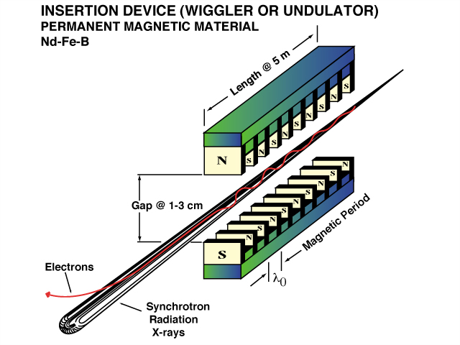
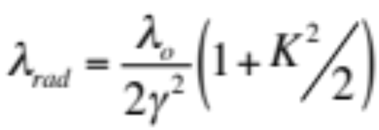
Undulator Magnets: Resonant Condition
“Resonance” occurs when the light wavefront “slips” ahead of the electron by one optical period in the time that it took the electron to traverse the distance of one undulator period
Where γ is the normalized electron beam total energy and
K = 0.934 λ_{rad} [cm] B_{max} [T]
Is the normalized undulator field strength parameter

Slide 22

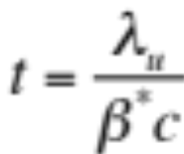
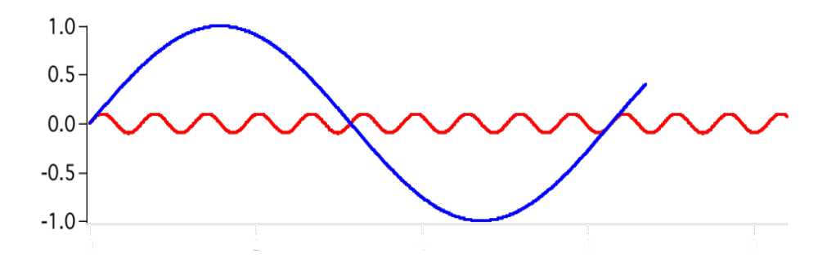


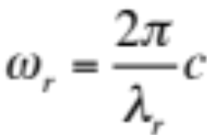



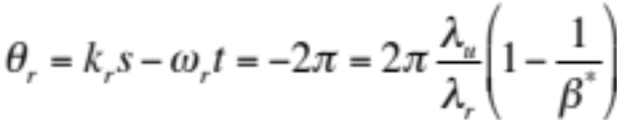


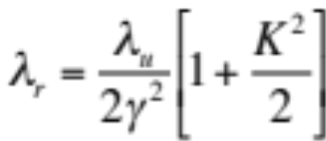
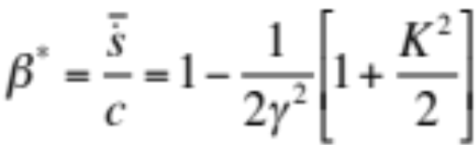
Simple Calculation of the “Resonant Wavelength”
To be resonant the light should out race the electron by one optical wavelength (2π in phase) after the electron has traveled one full cycle, i.e.
Using
Gives the resonant wavelength

Slide 23
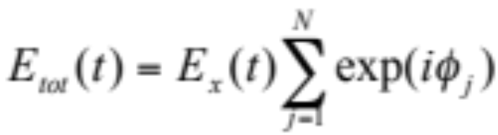
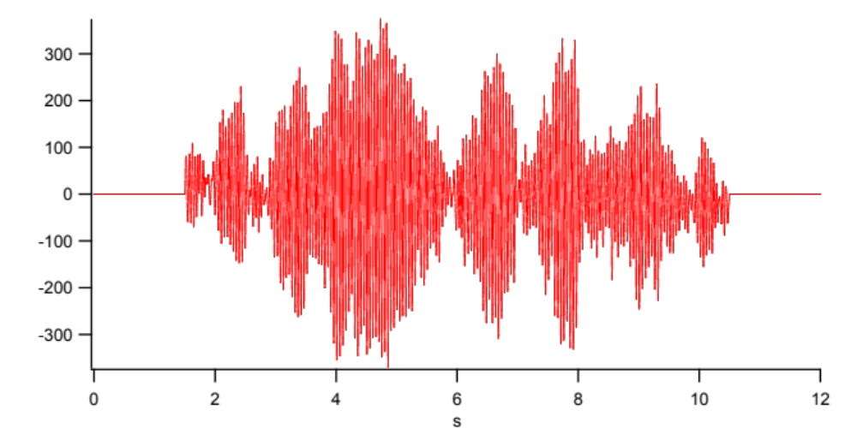
Multiple Electrons
Coherent sum of
radiation from N electrons
The light consists of several coherent regions, also referred to as spikes, randomly distributed over the pulse length of the electron beam.

Slide 24
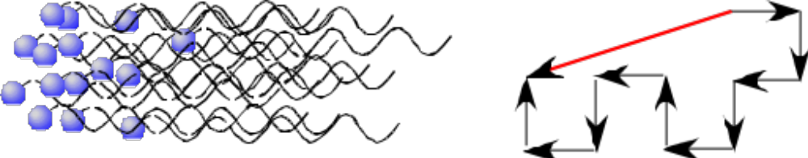
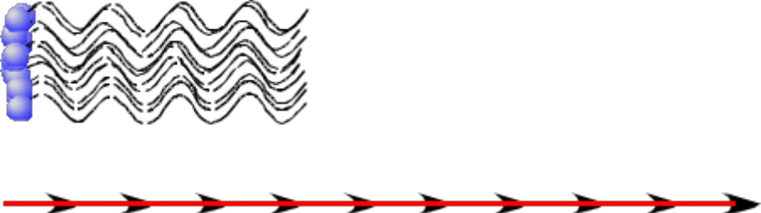
Multiple Electrons
If the electrons are independently radiating then the phase of their electric fields are random with respect to one another. The electric field then scale as the square root of the number of electrons and the power linearly with the number of electrons.
Incoherent Emission
If the electrons are in lock synch and radiate coherently then the electric field grows linear with the number of electrons
As power goes as the square of the field, if N is very large one can get an enormous gain in power emitted.
This is the essence of the Free-electron laser.
Coherent Emission

Slide 25
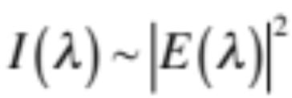
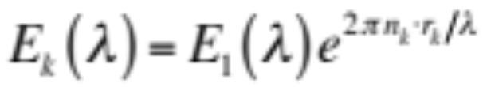
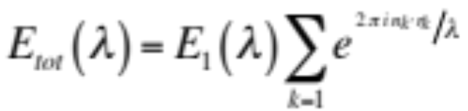
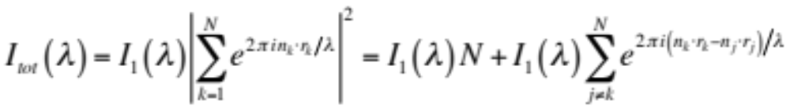
Coherent Radiation
Nodvick and Saxon, Phys. Rev. 96 (1954) 180.
x
Intensity of radiation
z
Electron Bunch
y
r_{k}
n_{k}
O
Detector
R
The component of the electric field from an electron seen by the detector at wavelength λ is
The total field of all electrons is
And the total intensity is
The 1st is the incoherent term and the 2nd is the coherent

Slide 26
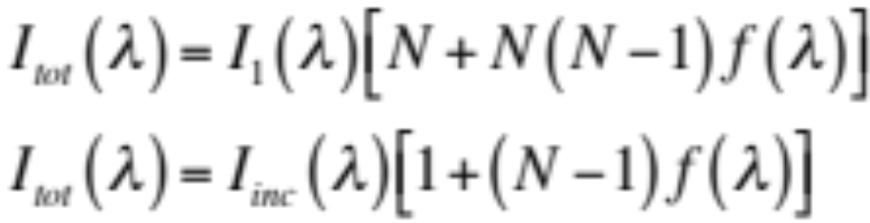
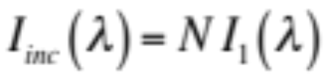
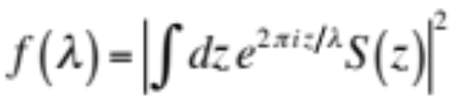
Coherent Radiation
Replace the sum with an integral and assume a normalized distribution symmetric about r = 0
Where
is the total incoherent intensity emitted by the bunch of N particles
and
is the form factor for the normalized bunch distribution S (z). Here we have assumed that the detector is located at a distance much larger than the length of the electron bunch.

Slide 27
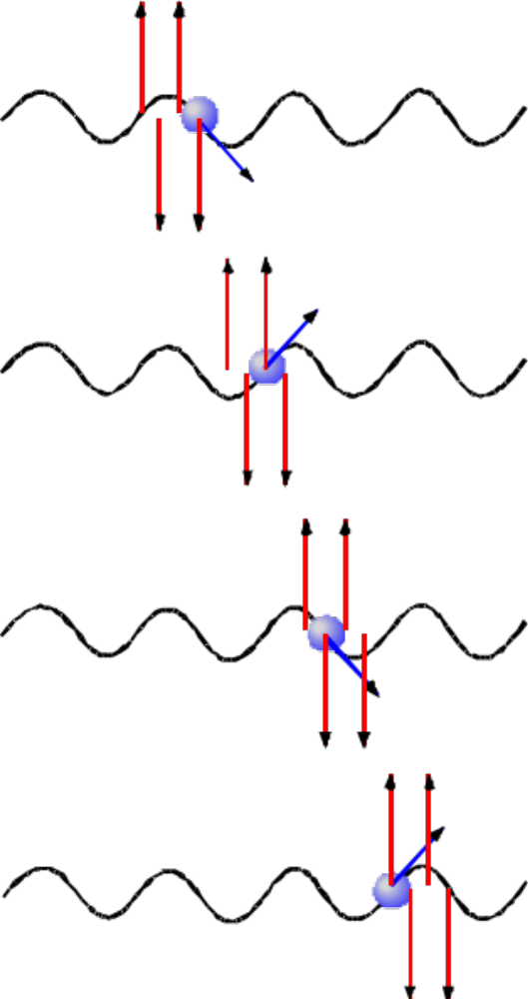
Interaction Between the Electron and EM Field
If the electron oscillates in phase with a co-propagating EM field of the correct frequency it can pick up or lose a net amount of momentum. Whether it picks up momentum or loses some is depended on the phase relationship.
In an assemble of electrons this process can create microbunching within the macroscopic electron bunch.

Slide 28

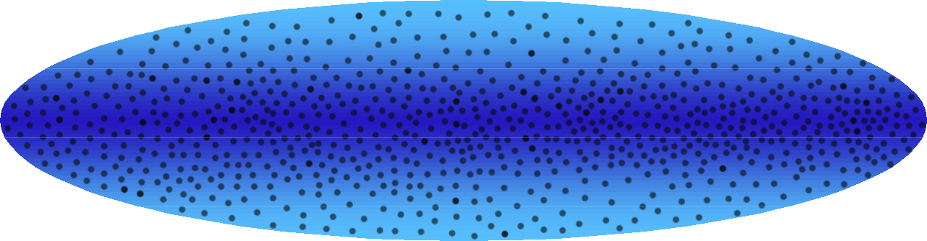
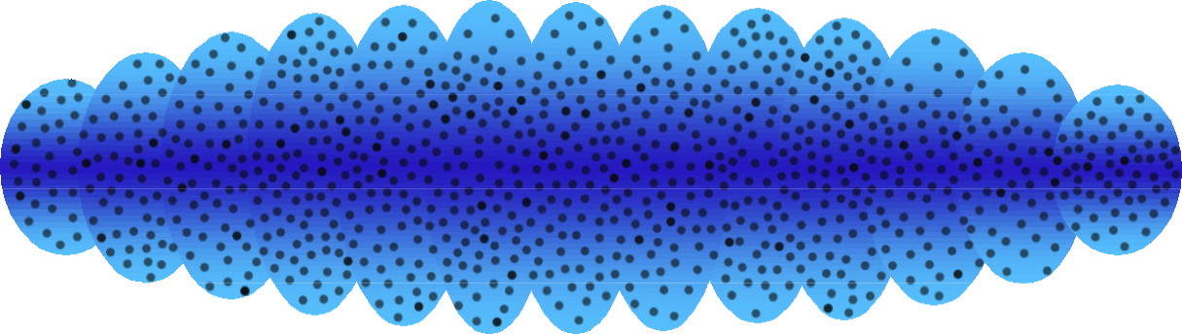
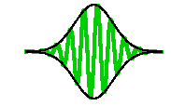
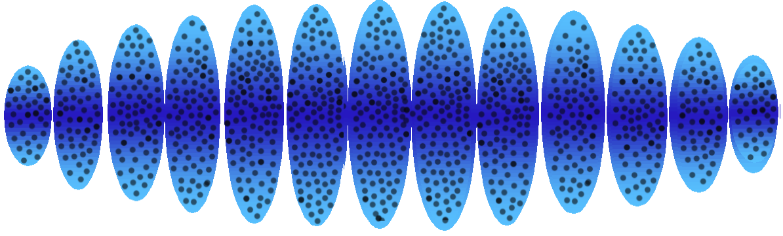
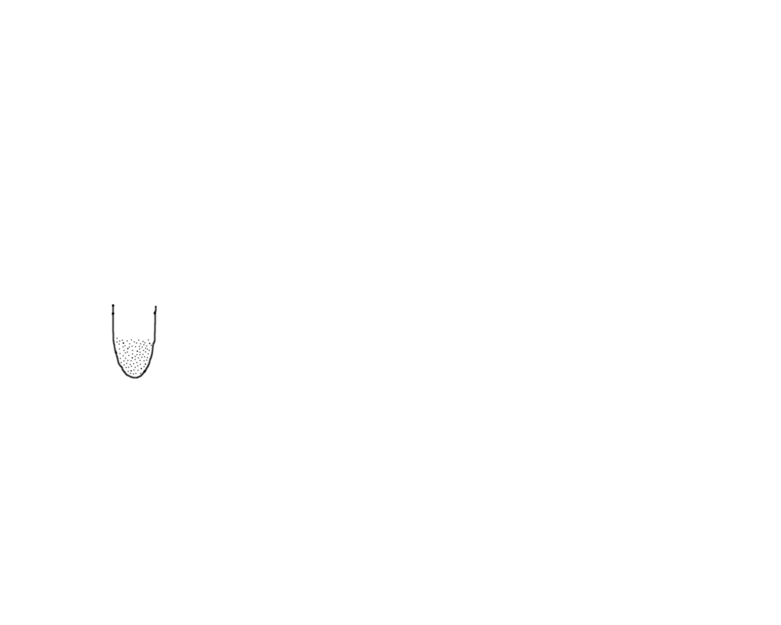
e-Beam Microbunching
P~ N_{e}
P~N_{e} •N_{lc}
P - Radiation Power
N_{e} - Number of particles in the bunch
E_{u} + E_{R} ⇒potential wells
N_{lc} - Number of particles in coherence volume

Slide 29
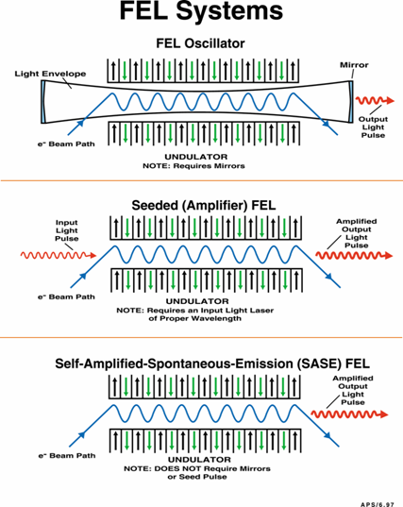
FEL Types: Oscillator, Seeded FEL, SASE

Slide 30
Beam Properties Required for Efficient FEL Action
Good overlap of the electron beam with the optical beam
Electron beam emittance better than the optical beam mode “emittance”
Electron beam energy spread less than the width of the driving optical “rf bucket”

Slide 31
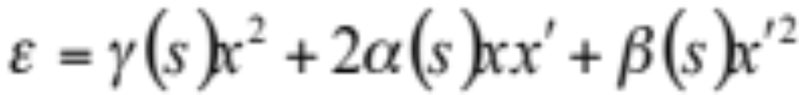

Emittance
Phase space
Projection on to the “transverse velocity” coordinate
x’
x’
N
x
N
The Phase Space of an ensemble of particles occupies an area of
x
Projection on to the “space” coordinate

Slide 32
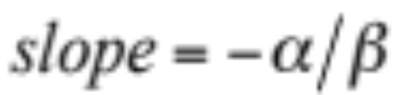
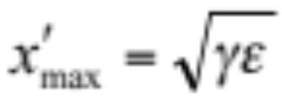
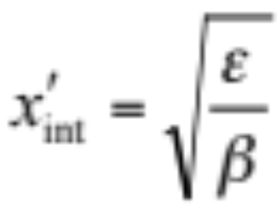
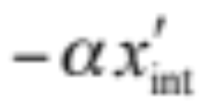
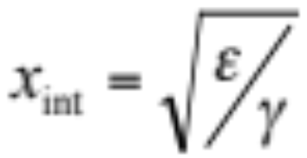
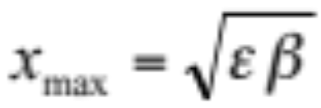
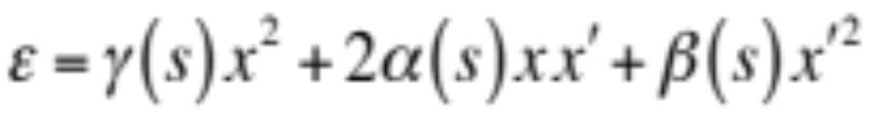
Emittance
x’
x

Slide 33
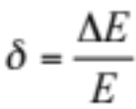

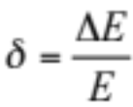
Energy Spread Effects
Small Energy Spread Beam
Favorable conditions to allow exchange of energy between the electron beam and the optical field
Large Energy Spread Beam
Unfavorable conditions. No net exchange of energy between the electron beam and the optical field

Slide 34
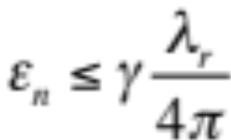
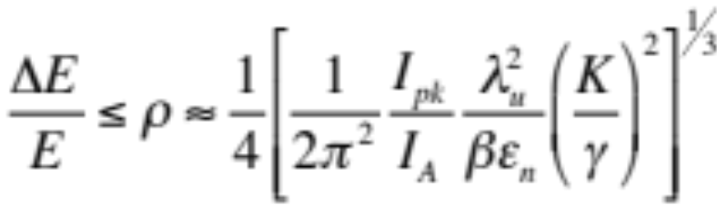
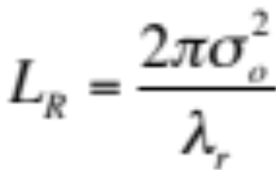

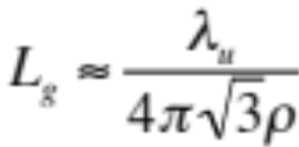
Required Conditions
Want the beam emittance to be less than the optical mode
Phase space size.
The Pierce parameter, ρ, should be
large and the beam energy spread
should be smaller than ρ.
The optical intensity should grow fast
enough to counter diffraction loss.
Want a Minimum gain length so want ρ to be as large a possible. i.e Want large I_{pk} and a small beam emittance.

Slide 35
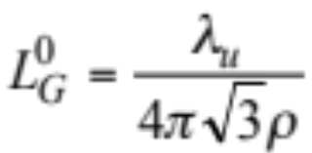
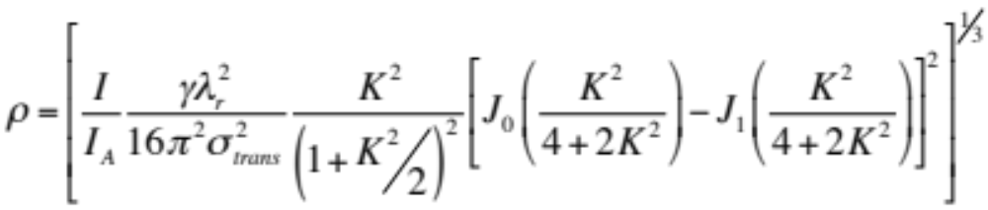
More Accurately and for a Planar Undulator
Gain Length
ρ is typically of the order 0.001 for visible and shorter wavelengths; therefore, the gain length is of the order of 100 undulator periods

Slide 36
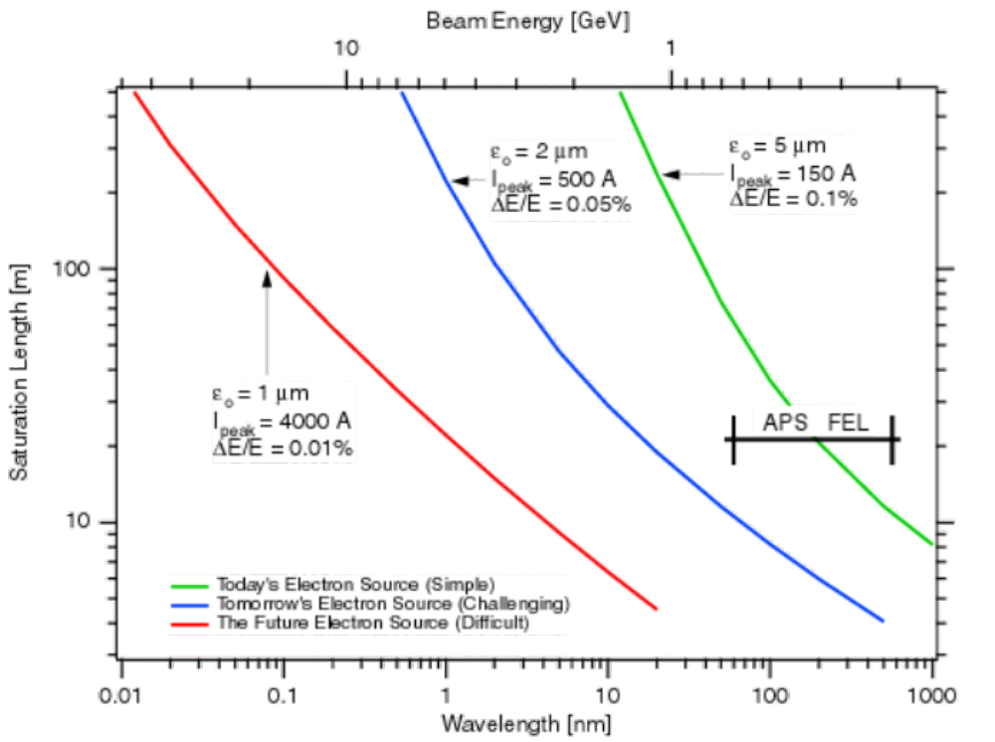
Beam Requirements
An old slide circa 1998.
Difficult has now been achieved.

Slide 37
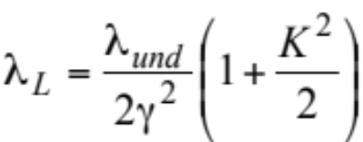
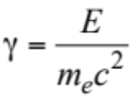
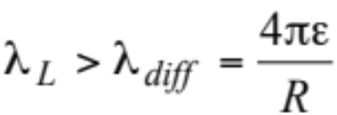
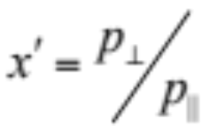

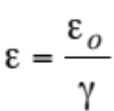


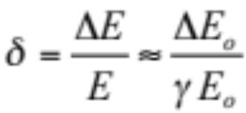
Digressing About Emittance, Energy Spread, and Undulators
Undulator Resonant Condition:
Diffraction Limit Requirement:
Linac Emittance Scaling:
Relevant Energy Spread:
The geometric emittance and the energy spread scale inversely with the energy so as you go higher in energy the relevant beam properties should improve, but since the undulator resonance scales inversely with the square of the energy the “equivalent” undulator needed to achieve a certain wavelength gets longer.

Slide 38
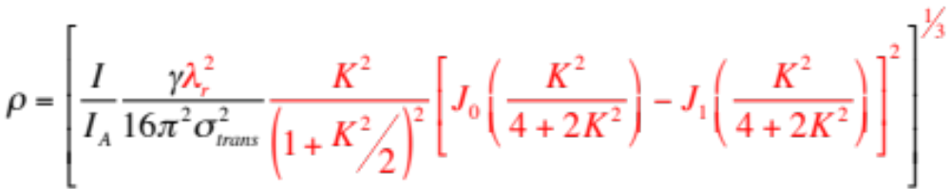

Choosing and Undulator
Want K large
Want λ_{ο} small to keep γ small
But there are practical limits.
K = 0.934 λ_{o} [cm] B_{max} [T]
It becomes difficult to achieve the high fields required when λ_{ο} becomes small.

Slide 39

Courtesy T. Shintake

Slide 40

The Spring-8 XFEL Undulator Parameters
Courtesy T. Shintake

Slide 41


Slide 42


Slide 43
Now we are getting somewhere with the design
Linac Energy
  We want a linac energy that is stable over the range 1.3 GeV to 2.5 GeV with a nominal working point energy of 2.3 GeV.
Emittance
  We will need a normalized emittance that is very good
  i.e. ε_{o} < 1 mm-mrad. Assume 0.8 mm-mrad slice emittance.
We will need an undulator with short period and relatively high K value.
  18 mm period, K roughly 1.8.
    K is 1.75 to achieve with 2.3 GeV a photon energy of 1.1 keV.

Slide 44

Bunch length and energy spread
Let’s start by putting the cart before the horse
Assume an initial longitudinal phase space
  FWHM Bunch length = 0.7 psec
  Energy Spread: σ_{ΔE/E} = 125 keV
  The longitudinal emittance is thus ε_{L} = 87.5 keV-psec
  This must be conserved.

Slide 45
Bunch length and energy spread
Keeping the longitudinal emittance constant what is the optimal ratio of the bunch length to the energy spread.
  I will show you how you can make this change in a minute.
As simple spreadsheet calculation of the FEL performance helps here.
  I have used the equations from M. Xie, “Design Optimization for X-ray Free Electron Laser Driven by SLAC Linac”, Particle Accelerator Conference, 1995.

Slide 46
Bunch length and energy spread
The optimum occurs when
  Bunch length = 28 fs
  Energy spread = 3.13 MeV
That’s a very short bunch with a very large energy spread!
One will need to compress the beam a lot!
  We’ll do our best.

Slide 47
Linac refresher

Slide 48


Primary References

Slide 49

Example of the Basic Linac “Cell”

Slide 50

Alternate Example from SCSS CDR

Slide 51

Waveguide Review

Slide 52



Waveguide Review
Copied from Wille
Disk loaded waveguide (Accelerating Structure). Quoting from Wille, “ Loss-free propagation can only occur if the wavelength is an integer multiple of the iris separation d, namely”

Slide 53

Waveguide Review
Copied from Wille

Slide 54

Waveguide Review
Copied from Wille
The most important modes
p = 2
p = 3
This is arguably the most commonly used.
p = 4

Slide 55

Waveguide Review
Copied from Wille
Copied from Wille

Slide 56

Waveguide Review
Copied from Wille

Slide 57

RF Power Generation: The Modulator

Slide 58

RF Power Generation: The Klystron
Copied from Wille

Slide 59

RF Power Generation: LLRF Control
From SCSS CDR

Slide 60
Design considerations

Slide 61
The Basics of a Linac to Drive and FEL
Need
  Low emittance injector
    The lower the emittance, the lower the final beam energy (See Joho Plot)
  High-gradient, high repetition rate accelerator
    Keeps things compact
  Short period, high efficiency undulator
    Short wavelengths at low energies
  Beam manipulation, monitoring, and controls
    To tailor and monitor the beam properties

Slide 62
The Cartoons
You’ve all seen them, but how do you get there from here?
SLAC LCLS Example
Courtesy P. Emma
RF Gun
rf
gun
Linac-X
L0a&b
Inj Vault
Linac-1
Linac-2
Linac-3
SLAC linac
21-1b
21-1d
X
21-3b
24-6d
25-1a
30-8c
undulator
BC-1
BC-2
DL-1
LTU
E-Dump
SLAC linac tunnel
research yard

Slide 63
Starting with a Vision
Use a robust and simple injector system
  I will choose to follow the work at Spring-8
  Pulsed DC Thermionic injector system
Want to minimize the overall length within reason but at the same time be able to operate at high repetition rates
  Implies high shunt impedance, high gradient structures requiring low input power

Slide 64




Starting with a Vision: Choosing the Frequency
Shunt impedance and voltage
  The effective voltage generated across a cavity operating on resonance and being supplied with an average power of is
  Where is the cavity shunt impedance
  Two notes:
    I have neglected for simplicity the transit time factor
    Sometime you find a factor of 2 in the sqrt
      Be careful
Copied from Wille

Slide 65

Starting with a Vision: Choosing the Frequency
Scaling Laws
  Using concepts from Wangler’s book
    Hold fixed the accelerating field E_{o} and the total energy gain ΔW so that the total structure length is fixed.
    Scale all other dimensions as f ⁻¹
  The surface resistance
    Note: there is still resistance in the superconducting case due to normal-conducting electrons at any finite temperature. (Imperfections have been neglected).

Slide 66


Starting with a Vision: Choosing the Frequency
Scaling Laws
  RF Power Dissipation
    Higher frequency gives reduced power for normal conducting, but higher power for super conducting.
  Q scales as

Slide 67

Starting with a Vision: Choosing the Frequency
Scaling Laws
  And the effective impedance per unit length scales as
    Higher frequency gives higher shunt impedance for normal conducting, but lower for super conducting.

Slide 68


Starting with a Vision: Choosing the Frequency
Scaling Laws
  And finally the which is proportional to the energy gain achievable for a given stored energy is
    Which is as expected as this figure of merit is geometry dependent and independent of surface properties.

Slide 69

The Injector: Choosing a system
Rule: If you don’t have good beam here you never will
Requirements
  Low emittance
  High peak current
  Low energy spread
What I call “The Injector”
  The electron source or “gun”
  Initial 6-D phase space manipulation completed
  Initial primary acceleration complete
    i.e. Out of the space charge regime
Required for the FEL to function

Slide 70
The Injector: Choosing the source
Choices
  RF-based or DC (pulsed) based
  Photocathode-based or Thermionic-based (Examples)
    RF Photocathode
      LCLS, FLASH, FERMI
    DC Photocathode
      Jefferson Laboratory
    RF Thermionic
      Advanced Photon Source
    DC (pulsed) thermionic
      SCSS/XFEL

Slide 71

The Injector: Choosing the source
DC-based
  Stable (or is it?)
    Will require pulsed operation for the beam to reach high enough energy off the cathode to avoid space charge issues.
    Provides nice constant field for the duration of the beam emission and so simplifies the initial beam dynamics

Slide 72

The Basic Thermionic Electron Gun
Copied from Wille

Slide 73
The Injector: Choosing the source
RF-based
  First: Room temperature of Superconducting?
    There are no operational SC guns out there that would meet the specifications for the FEL I have in mind at the moment…but they are coming.
    Also, SC is just yet another complication.
  Basic idea
    Create lots of charge in a short pulse and accelerate it quickly before the space charge, or for that matter the changing rf fields, do damage.
    Fix (unwind) and space charge growth issue quickly.
    Accelerate completely out of the space charge regime.
    Typically requires pulsed operation to achieve the high cathode fields without breakdown.
      Can obtain very high cathode gradients (10s to 100s of MV/m at the cathode.) and thus quickly mitigate the issue of space charge emittance growth.

Slide 74
The Injector: Choosing the source
Thermionic RF-based source
  Simple, but…
  For a number of reasons it is probably not capable of achieving the low emittance performance required.
  I won’t discuss this option and further.

Slide 75
The Injector: Choosing the source
RF Photocathode Version
  Requires Laser
    Complication
modelocked laser
harmonic
crystal
beam
expander
aperture
injector
solenoid
lens
cathode
electron beam
RF coupling
RF signal
klystron
circulator
Courtesy of D. Nguyen

Slide 76
Generic Laser System Layout for Photocathode Systems
Vacuum cell
Zoom
Beam shaper
UV converter
Virtual Cathode
Transport tube
Table in the tunnel
Steering system
Photocathode
Active Steering Stabilization
Courtesy of D. Nguyen

Slide 77

RF Photocathode Drive Laser
This was the original design for the drive laser of the LCLS. The figure is from the LCLS CDR.

Slide 78
The Injector: Choosing the source
Cathode Materials for RF Photocathode guns
  Copper is chosen in many due to its resistance to the very high on axis fields at the cathode
    Very low quantum efficiency
    Due to the low QE the drive laser power becomes very high for high repetition rates
  Some choose high QE cathodes such as Cs₂Te or GaAs or K₂CsSb
    One needs to operate at lower on-axis fields
    These are very susceptible to poor vacuum and can suffer short lifetimes before needing to be refreshed.
    It’s yet another complication.

Slide 79

Effect of the Solenoid (as promised)
The beam wants to diverge for 2 reasons
  Space charge
    The electron bunch coming off the cathode is very dense and wants to expand violently due to the electrostatic force
  Divergent RF Fields within the RF gun
    Anytime the electric field varies longitudinally there is a radial field
The solenoid focuses the low energy beam radially
  Beam enters the end radial field of the solenoid and gets a transverse kick
  This new transverse motion crosses the longitudinal field and rotates inward or outward depending on the solenoid polarization
  The particle is then closer in (assuming focusing) when passing through the end radial field at the opposite end of the solenoid and since it is further in the kick is less.
  The result is a net transverse focusing

Slide 80
Digression on the Effect of Space Charge Compensation
r
r’
b
Slug of Charge
Accelerate, Drift and space charge
b
c
c
z
a,d
r
a
d
Focus with Solenoid
r’
r’
Starting phase space
r’
a,d
r
a,d
c,b
r
c
a,d
r
c,b
Drift and space charge
b
First Studied by B. Carlsen

Slide 81


Basic Emittance: Thermionic Cathode
Electrons are emitted off a hot surface provided the temperature of the surface is hot enough such that the free-electrons in the metal have sufficient energy to overcome the work function Φ of the metal. The probability of emission is
r_{c}
Cathode at Temperature = T
x’
(Richardson-Dushman Equation)
Phase space
r is the reflection coefficient at the metal surface interface and A is an empirical constant
x
By computing the rms size of the resultant phase space one can calculate the rms normalized basic emittance from the thermionic cathode.

Slide 82


Basic Emittance: Photo Cathode (Simplified)
Electrons are ejected off the cathode when the photon energy is greater than the work function W of the cathode material. The excess energy is roughly
hν
r_{c}
Work function W
hν is the incoming photon energy
x’
Phase space
x
Assuming an isotropic emission and an outgoing electron energy of E_{e} and then computing the rms size of the resultant phase space one can calculate the rms normalized basic emittance from the photo cathode.

Slide 83


Basic Emittance: Some numbers
Typical for a “red” metal such as copper
UV light such as the 3rd harmonic from a Ti:Sapphire system
Rest energy for electrons
The clear cathode of choice if one can use it.

Slide 84





Beyond Simple Basic Emittance
Take for example the photocathode
This is the effective work function that has been lowered by the electric field on the cathode surface
E_{c} is the electric field on the cathode surface
Now a more complicated expression for the thermal emittance
E
This treatment gives a lower value for the thermal emittance than the simple expression given earlier and is also more correct.

Slide 85

My System of Choice: DC (Pulsed) Thermionic
Courtesy T. Shintake

Slide 86

The SCSS DC Thermionic Gun

Slide 87

The Gun HV Tank
From: Togawa et al. PHYSICAL REVIEW SPECIAL TOPICS - ACCELERATORS AND BEAMS 10, 020703 (2007)

Slide 88


Need a different Modulator
But there are some problems.
  The modulator used is the same as that used for the klystron and is very high power. These were mass produced (roughly 70 in total) and so were readily availble.
  The energy per pulse into the dummy load is 200 Joules
    25 kV * 5 kA *1.6 usec
  At 10 kHz this would be a power dissipated into the 1.9 kOhm load of 2 MW!!
Would need to redesign the modulator.
  Drop current
  Shorten pulse length

Slide 89
Need a different Modulator
Lower current
  Current out of the gun
    1 A at 500 kV.
    This equates to an instantaneous power of 500 kW
    The cathode to ground effective resistance is 500 kOhm (V/I)
    Assume a dummy load of 500 kOhm for parallel resistance of 250 kOhm
    The required current is then 2 A in the secondary
      That’s as opposed to the 260 A and so is a 130 fold reduction in power
Shorter pulse length
  For a single bunch that must be captured with a 1 nsec buncher system one only needs 1 nsec
    Assume 160 nsec due to various things like stray capacitance and impedance
      That’s as opposed to 1.6 usec or a 10 fold reduction in power
Power required if one uses a purpose-built modulator to operate at 10 kHz
  2 MW/260/10 = 770 W
  Much better

Slide 90


Basically Copy the SCSS Injector
From Shintake et al. PHYSICAL REVIEW SPECIAL TOPICS - ACCELERATORS AND BEAMS 12, 070701 (2009)
Measured performance at the beam dump
  0.3 nC
  300 A peak, 0.7 psec FWHM, 125 keV energy spread
  0.7 mm-mrad normalized slice emittance

Slide 91

How it Works

Slide 92
Final Comments About the Injector
There are still some problems to think through
  Sub Harmonic Buncher, Booster, and S-band systems
    These will still need to be designed to handle 10 kHz operations
    I will not tackle this here.
    Consider it a “homework problem”
    I will certainly continue to think about it, but for now will assume that the problem is tractable.
Where’s the Laser Heater?
  It appears to not be needed for the thermionic source.
  My guess is the drive laser for the photocathode source together with the very high space charge at the cathode for these sources creates micro density modulations that drive longitudinal space charge instabilities etc. etc.
  No laser heater simplifies things yet again.

Slide 93
The Accelerator Frequency Choice
What’s available out there (sort of)
  S-band (2856 MHz), C-band (5712 MHz) and X-band (11.424 GHz)
X-band
  Although the technology is not widely available…yet…there are many laboratories interested and there is a lot of research and testing that has been done.
  It provides the highest shunt impedance (based on scaling laws) and so will make for the shortest linac
  Choose X-band and see where it leads.
  Note: Others are thinking about this as well. I certainly am not the first.

Slide 94

X-Band: What’s “Available”
SLAC is the most advanced in this technology
  Have produced 80 MW klystrons capable of operation at roughly 100 Hz
  Have produced structures capable of supporting near 80 MV/m
  But that is not exactly what I need.
Courtesy S. Tantawi

Slide 95


Scaling to High Frequencies
What I really need
  First note: the voltage across a cavity is proportional to the square root of the power, i.e. the voltage does not drop so rapidly as does the power.
  Assume I can build a 1.3 MW X-Band klystron that operates at 10 kHz
    If I compare this to the 80 MW at 100 Hz that’s a little more than 60% of what was proven 10 years ago, i.e. it should be possible.
  Run this into a SLED (I will describe this later) to boost the power up to 4 MW and split this between two 0.6 m X-band TW cavities.
  For P_{rf} = 2 MW, l = 0.6 m and r_{s} = 10⁸ Ohms/m one gets 11 MV per cavity, i.e. 18 MV/m, i.e. pretty darn good. (at 1 MW it is 13 MV/m)
  I need the special purpose modulator (a challenge but not impossible) and an X-band structure with high shunt impedance (probably straight forward).

Slide 96
Discussion of Impact by X-band Choice
The Iris Size in Small
  At low energy will the beam fit comfortable
  The wakefields will be large, can one control them?
Power feed
  1 klystron/1 structure, 1 klystron/2 structures, 1 klystron/4 structures
  The trade off is in cost and space
    The cost increases for rf power as the number of structures per klystron decreases, but the overall length decreases. One needs to weight these against each other.
    More klystrons also means tighter packing of components such as the klystrons and modulators and could mean increasing the width and height of the klystron gallery.
Et cetera
  For every decision comes many other opportunities to make yet more decisions.

Slide 97


What is a SLED?
Send and power to and store energy in high Q resonant cavities.
Used that stored energy, together with the klystron power to greatly increase the peak power sent to the accelerator thereby increasing the available accelerating potential.
Factors of 3 in peak power are typical and readily achieved.
These are an integral part of this design.

Slide 98

Rough Estimate of Length
306 m

Slide 99


Slide 100


Slide 101


Slide 102


Slide 103


Slide 104
Rough Estimate of Total Power Needed for RF
Klystron Power
  Output = 1.3 MW, Duration = 1.4 usec, Rep rate = 10 kHz
  Assume 60% efficient
  Average power required from modulator
    1.3 MW/0.6 * 1.4 usec * 10 kHz = 35 kW
      Note: 26 kW of that goes to the accelerating structures
Modulator Power
  Assume 90% efficiency
  Average power for the modular = 35 kW/0.9 = 39 kW
Using 1 klystron per 4 cavities
  Requires 79 power stations to reach 2.5 GeV
  79 * 0.039 MW = 3.1 MW
Injector
  No more than 0.1 MW
Total power needed to generate the beam and RF ~ 3.2 MW

Slide 105
Other Major Power Needs
Water Plant
  Need to cool various system and supply all the water needs
  Roughly 1 MW for a system this size
Basic building power and HVAC needs
  Roughly 0.8 MW for a system this size
Magnet Systems
  Roughly 1 MW for a system this size
Total approximate power required for the facility
  4 to 5 MW which is really not all that bad for the repetition rate
Spoiler
  In some areas ordinances are in place requiring that you have installed enough power to power all installed equipment at 100%. Then the number jumps up significantly.

Slide 106
Wakefield control
The problem
  For the same reason that we like the x-band structures, high shunt impedance, they also present a problem, emittance growth due to the strong wakefields.

Slide 107
Wakefield Impact on Emittance
Beam enters the accelerating structure off center
The head of the bunch drives wakefields and these interact with the tail of the bunch
Left uncontrolled the head and tail of the bunch have different phase space distribution and the projected emittance is larger
Moral of the story: Ensure the structures are straight and that the beam goes through the center of the structure. This is particularly true at low energy when the beam is not as stiff

Slide 108

Wakefields Control
Build the structures straight and true
Courtesy T. Shintake

Slide 109
Wakefield Control
Align and position them perfectly
  Fiducialize accurately all components
  Place 4 accelerating structures on a V-block support/girder
  Install all other equipment on the girder with the aid of a coordinate measurement machine (1 to 2 micron accuracy)
  Install girder in tunnel on precision CAM mover system (1 to 2 micron accuracy)
  Use beam position monitor on one end and beam finder wire on the other end to precisely position the girder with respect to the beam
  This is what was done for the LCLS undulator system

Slide 110


Wakefield Control: Use of V-Block

Slide 111

Wakefield Control: CAM Movers like LCLS
Horizontal Slides
Manual Adjustments
Segment
Vacuum Chamber Support
Girder
Cam Movers
Manual
Adjustments
Fixed Supports

Slide 112

Wakefield control: LCLS Example
BFW Ø10mm x 25mm long
BFW Ø18mm x 19mm long
Bellows Ø10mm x 76mm long
BLM 5mm x 12.5mm x 25mm long
RFBPM Ø10mm x 75mm long
Beam Guide Vacuum Chamber 5mm x 12.5mm x 3467mm long
Quad Spool Ø8mm x 158mm long

Slide 113
Compressing the Electron Bunch
ΔΕ/Ε
ΔΕ/Ε
ΔΕ/Ε
Over-compression
Under-compression
2σ_{t0}
t
t
t
2σ_{t}
V = V₀sin(ωτ)
Δz = R₅₆ΔΕ/Ε
RF Accelerating
Voltage
Path Length-Energy
Dependent Beamline
Drawings from P. Emma SLAC/LCLS

Slide 114

Bunch Compression
Where does one place the bunch compressor chicane?
  Would like to compress the bunch as soon as possible to mitigate the rf curvature effects
  Need to also mitigate space charge
  As was seen before one can and should compress a lot for the best FEL performance (for this case).
Decide to use two compressors
  Compress a bit to start early on
  Then compress as much as one can in the final bunch compressor

Slide 115
1st Bunch Compressor
Compress by a factor of 4 to start
  This was chosen because the beam coming out of the injectors is 0.7 ps FWHM long. That is 2.9 degrees which is long enough to see the curvature of the RF
  2.9/4 = 0.7 degrees at x-band
  For space charge reasons would like to wait until the energy is 2 times what is it was at the injector, i.e. > 90 MeV
How much do you chirp the beam?
  Energy spread of the beam at the injector was 125 keV
  Conserving phase space I want 500 keV to compress
  by a factor of 4
δ

Slide 116


1st Bunch Compressor
Need to both get the beam up to energy and put the required chirp on the beam.
To be safe with space charge place BC1 at 200 MeV
  This also buys tuning flexibility
This implies using 20 x-band sections or 5 girders prior to the BC1 chicane.

Slide 117


What Does the BC Look Like?
θ
L
L
δ
δ₁
In our current case
s₁

Slide 118



Rough Estimate of θ and R₅₆
Δθ
l
d
θ
L
L
If L = 1.5 m R₅₆ = -31.5 mm
These are very reasonable numbers

Slide 119
A 2nd Bunch Compressor
Bunch as much as possible
  Higher peak currents.
    Better FEL performance
  Less problems with rf curvature
  Less problems with wakefields
How much do we dare compress?
  Current bunch length after BC1
    175 fsec FWHM
  For optimal FEL performance need to compress to 28 fsec FWHM
    i.e. compress by a another factor of 6.25
    Is this possible or desirable?

Slide 120



A 2nd Bunch Compressor
Phase to run at
  Apply an additional correlated energy spread of
    500 keV * 6.25/87.5 fsec = 3.13 MeV/87.5 fsec = 83 keV/fsec
    For to exist
    i.e.
    That’s a lot of potential to give up just to put a chirp on the beam.
    It’s just very short to start with so applying a chorp is difficult
  Compromise
    Do you buy additional RF?
    This must be balanced with the cost of the additional undulators and accelerator length including all additional infrastructure.
    Looking at the L_{g} vs τ
    X2 compression shortens L_{g} by 24%
    X3 by 32%
    X6 by 38%
    i.e. a factor of 2 to 3 is probably worth it but beyond that probably not.

Slide 121

A 2nd Bunch Compressor
Where should it be placed?
  Place it at as low an energy as possible
    This helps mitigate wake field effects, rf curvature effects and reduces the integrated strength of the BC dipoles.
The Choice
  Compress by a factor of 2
    For space charge reasons the BC2 should be installed at an energy above 212 MeV, but will occur automatically as the gradient is not sufficient to apply that amount of chirp in such a short distance.
    The minimum number of sections/girders needed is

Slide 122



A 2nd Bunch Compressor
The Choice (Continued)
  Use 3 times the number of structures needed only chirp the beam
    15 girders at 31 MeV per girder is 465 MeV so target 700 MeV as the energy for the second bunch compressor
    From before
OK, but now what?? Need to still design the BC2

Slide 123


A 2nd Bunch Compressor
Assume we use the identical bunch compressor as BC1 but allow L to vary.
  This minimizes redesign of many thing and so simplifies our task
  Make the following assumption
    Dipole strengths at BC1 vs BC2
      BC2 strength is 3 times BC1
        Change power supply current but assure not saturated
  Energy difference
    150 MeV vs 700 MeV = factor of 4.7
  Implies
    θ chicane = 0.1 rad *3/4.7 = 0.064 rad (3.7º)
    Again all perfectly reasonable.
Remember the cave man engineer

Slide 124

Focusing the Beam Along the Linac
One needs to control and focus the beam along the length of the linac.
  A quadrupoles

Slide 125



Beam Focusing
Periodically need to focus the electron beam
  Quadrupole: A magnetic element similar to an optical lens, but…
  Whereas a lens can be made to radially, a quadrupole focuses in on pland and defocuses in the other
  A properly contrived “lattice” of quadrupoles can be made to, on average, focus simultaneously in both directions
S
N
N
S
Bρ is referred to as the beam rigidity and is proportional to the momentum (~300 MeV = 1 Tm for electrons)

Slide 126




Beam Focusing
Use Standard FODO Lattice
1 Period
L = 6 m
L = 6 m

Slide 127


Beam Focusing
1 Period
L = 6 m
L = 6 m

Slide 128

Propagation of Phase Space in Free Space
x’
x’
x’
x
x
x

Slide 129




Emittance & Matching
3-screen region
L m
L m
Obtain the Twiss parameters
Calculate mismatch:
Correct quadrupole strengths
Repeat until δ_{m} ~ 1

Slide 130

Bunch Compressor Region Layout

Slide 131

Exhaustion Sets In With Plenty More to Do

Slide 132

What Have We Got?
Key Features (Unique Features) of This Design
  Very High Repetition Rate
  Normal conducting, i.e. not superconducting
  Use of a Pulsed DC Gun
  No Laser Heater
  Use of X-Band Accelerator
  Relatively Compact, all things considered
    Could be argued…and should
Overall Length
  Just a bit over 300 m
Capability
  10 kHz operation
    Ability to service MANY beamlines
      If one had 100 beamlines and all were operating and being provided equal time each would have 100 Hz operation and near full autonomous tuning
  1.1+ keV fundamental operation with a 2.3 GeV beam
From J. Corlett LBNL and NGL CDR

Slide 133

Where I Was a Week Ago
Moral of the Story
  Things evolve constantly

Slide 134
But There is Still Lots More to Think About
Ancillary Systems
  Buildings and Infrastructure
    Floor
    Radiation Enclosure
    Power System
      Primary Site Feed
      Secondary distribution to main switch boxes
      Local panel distribution
      Distribution dictated by overall design, safety requirements and operational needs
    Waters Systems
      Primary Site Feed
      Secondary Distribution
      Tertiary local distribution and control
      Distribution dictated by overall design, safety requirements and operational needs

Slide 135
And Still More
Other major systems
  Diagnostics
  BPMs
    Striplines
    Buttons
    Cavities
  Screens
    YAG
    Chromox
    OTR
  Wire scanners
  Charge monitors
  RF Deflecting cavities
  Spectrometer
  Bunch Arrival Monitor
  EO sampling system
  CSR monitor
  Coherent signal bunch length monitor

Slide 136
And Still More…To Name Just a Few
Controls
  Basic
  Some additional features required
    Single shot time stamping
Magnets
  Desired strength and properties
    Voltage and current ranges desired
    Water or air cooled
    Solid or laminated
    Strive for commonality
  Quadrupoles
  Dipoles
  Correctors
  Sextupoles?
Power Supplies
  Unipolar
  Bipolar
  Resolution
  Vacuum system
    Pressure requirements
    Ion pumps
    Pump out ports
    Diagnostics
      Ion gauge
      RGAs
    Vacuum pipe
      Size
        Effects wakefield
        Effects Pumping conductivity
      Material
        304L
        316L, 316LN
        Aluminum?
          Resistive wall issues needs checking
      Flanges
  Timing and Synchronization
  Support structures

Slide 137
Summary
What was that all about?
  The goal really was to walk you through a design example
    The choice of the design was purposely chosen to be a little unique just to show that there is still plenty out there to do…be creative.
  A initial point design of a 10 kHz, normal conducting somewhat compact machine capable of providing many beamlines with photons on the fundamental of 1.1+ keV.
As a reminder
…And yet, problems awaiting solution exist in every field.
Antonino Zichichi

