Slide 1
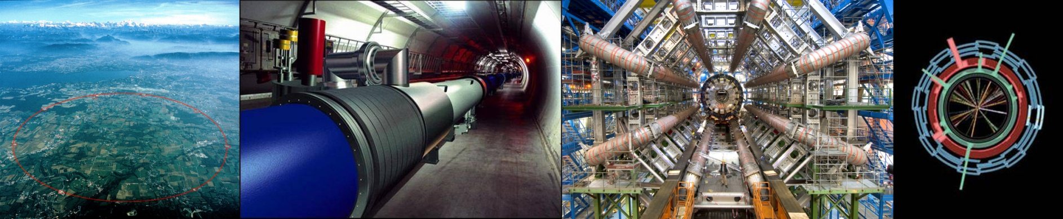
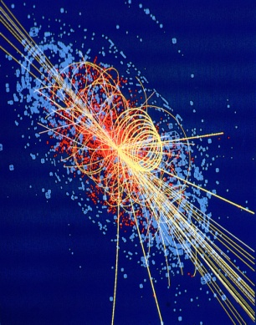
Introduction to
Beam Instrumentation
CAS 2013
Trondheim, Norway
18th – 29th August, 2013
Dr. Rhodri Jones
Head of the CERN Beam Instrumentation Group

Slide 2
Introduction
What do we mean by beam instrumentation?
  The “eyes” of the machine operators
    i.e. the instruments that observe beam behaviour
    An accelerator can never be better than the instruments measuring its performance!
What does work in beam instrumentation entail?
  Design, construction & operation of instruments to observe particle beams
  R&D to find new or improve existing techniques to fulfill new requirements
  A combination of the following disciplines
    Applied & Accelerator Physics; Mechanical, Electronic & Software Engineering
  A fascinating field of work!
What beam parameters do we measure?
  Beam Position
    Horizontal and vertical throughout the accelerator
  Beam Intensity (& lifetime measurement for a storage ring/collider)
    Bunch-by-bunch charge and total circulating current
  Beam Loss
    Especially important for superconducting machines
  Beam profiles
    Transverse and longitudinal distribution
  Collision rate / Luminosity (for colliders)
    Measure of how well the beams are overlapped at the collision point

Slide 3
More Measurements
Machine Tune
QF
QD
Characteristic Frequency
of the Magnetic Lattice
Given by the strength of the
Quadrupole magnets
QF
QD
QF
SD
SF
SD
SF
SF
Machine Chromaticity
Spread in the Machine Tune due to Particle Energy Spread
Controlled by Sextupole magnets
Optics Analogy:
Lens
[Quadrupole]
Focal length is
energy dependent
Achromatic incident light
[Spread in particle energy]

Slide 4
The Typical Instruments
Beam Position
  electrostatic or electromagnetic pick-ups and related electronics
Beam Intensity
  beam current transformers
Beam Profile
  secondary emission grids and screens
  wire scanners
  synchrotron light monitors
  ionisation and luminescence monitors
  femtosecond diagnostics for ultra short bunches
Beam Loss
  ionisation chambers or pin diodes
Machine Tune and Chromaticity
  in diagnostics section of tomorrow
Luminosity
  in diagnostics section of tomorrow

Slide 5
Measuring Beam Position – The Principle
-
+
-
+
-
-
+
-
+
-
+
-
-
+
-
+
-
+
-
-
+
-
+
-
+
-
-
+
-
+
-
+
-
-
+
-
+
-
+
-
+
-
+
+
+
-
-
+
+
-
+
-
+
+
+
-
-
+
+
-
+
-
+
+
+
-
-
+
-
+
-
-
+
-
+
-
+
-
-
+
-
+
-
+
-
-
+
-
+
+
+
+
+
+
+
+
+
+
+
+
+
+
+
+
+
+
+
+
+
+
+
+
+
+
+
+
+
+
+
+
+
+
+
+
+
+
+
+
+
+
+
+
+
+
+
+
+
+
+
+
+
+
+
+
+
+
+
+
+
+
+
+
+
+
+
+
+
+
+
+
+
+
+
+
+
+

Slide 6
Wall Current Monitor – The Principle
V
-
+
-
+
-
-
+
-
+
-
+
-
-
+
-
+
-
+
-
+
-
-
+
-
+
-
+
-
-
+
+
+
-
-
+
+
-
Ceramic Insert
-
+
-
+
+
+
-
-
+
+
-
+
-
-
+
-
+
-
+
-
-
+
-
+
+
+
+
+
+
+
+
+
+
+
+
+
+
+
+
+
+
+
+
+
+
+
+
+
+
+
+
+
+
+
+
+
+
+
+
+
+
+
+
+
+
+
+
+
+
+
+
+
+
+
+
+
+
+
+
+
+
+
+
+
+
+
+
+
+
+
+
+
+
+
+
+
+
+
+
+
+
+
+
+
+
+
+
+
+
+
+
+
+
+
+
+
+
+
+
+
+
+
+
+
+
+
+
+
+
+
+
+
+
+
+
+
+
+
+
+
+
+
+
+
+
+
+
+
+
+
+
+
+
+
+
+
+
+
+
+
+
+
+
+
+
+
+
+
+
+
+
+
+
+
+
+
+
+

Slide 7
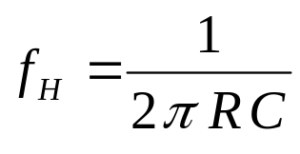
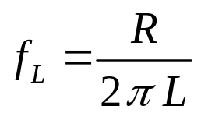
Wall Current Monitor – Beam Response
V
R
Response
C
I_{B}
0
0
Frequency
L
I_{B}

Slide 8
Electrostatic Monitor – The Principle
V
-
+
-
+
-
-
+
-
+
-
+
-
-
+
-
+
-
+
-
+
-
-
+
-
+
-
+
-
+
-
+
-
+
-
-
-
+
+
-
-
+
+
-
-
-
-
+
-
+
-
+
-
-
+
-
+
-
+
-
-
+
-
-
-
-
-
+
-
+
+
-
+
-
-
+
-
+
-
+
-
+
-
+
+
+
+
-
+
-
-
+
-
+
+
+
+
+
+
+
+
+
+
+
+
+
+
+
+
+
+
+
+
+
+
+
+
+
+
+
+
+
+
+
+
+
+
+
+
+
+
+
+
+
+
+
+
+
+
+
+
+
+
+
+
+
+
+
+
+
+
+
+
+
+
+
+
+
+
+
+
+
+
+
+
+
+
+
+
+
+

Slide 9
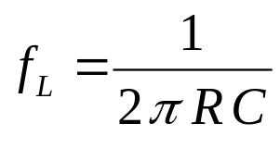
Electrostatic Monitor – Beam Response
C
Response (V)
V_{B}
0
0
Frequency (Hz)
R
V
+
+
+
+
+
+
+
+
+
+
+
+
+
+
+
+
+
+
+
+
+
+
+
+
+
+
+
+
+
+
+
+
+
+
+
+
+
+
+
+
+
+
+
+
+
+
+
+
+
+
+
+
+
+
+
+
+
+
+
+
+
+
+
+
+
+
+
+
+
+
+
+
+
+
+
+
+

Slide 10
Electrostatic Monitor – The Principle
V
-
+
-
+
-
-
+
-
+
-
+
-
-
+
-
+
-
+
-
+
-
-
+
-
+
-
+
-
+
-
+
-
-
+
-
+
+
-
-
-
-
+
-
+
-
-
-
-
+
+
-
+
-
-
+
-
+
-
-
-
-
-
-
-
-
-
+
-
+
+
-
+
+
-
+
-
-
+
-
+
-
+
-
+
-
+
+
+
+
-
+
-
-
+
-
+
+
+
+
+
+
+
+
+
+
+
+
+
+
+
+
+
+
+
+
+
+
+
+
+
+
+
+
+
+
+
+
+
+
+
+
+
+
+
+
+
+
+
+
+
+
+
+
+
+
+
+
+
+
+
+
+
+
+
+
+
+
+
+
+
+
+
+
+
+
+
+
+
+
+
+
+
+
+
+
-
+
+
-
+
+
-
-
-
-
+
-
-
+
-
-
+
+
+
-
-
+
-
+
+
-
-
-
+
-
+
-
-
-
-
-
-
+
-
+
+
+
+
-
+
-
-
+

Slide 11
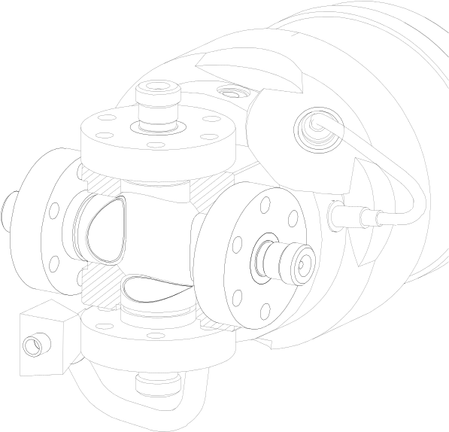
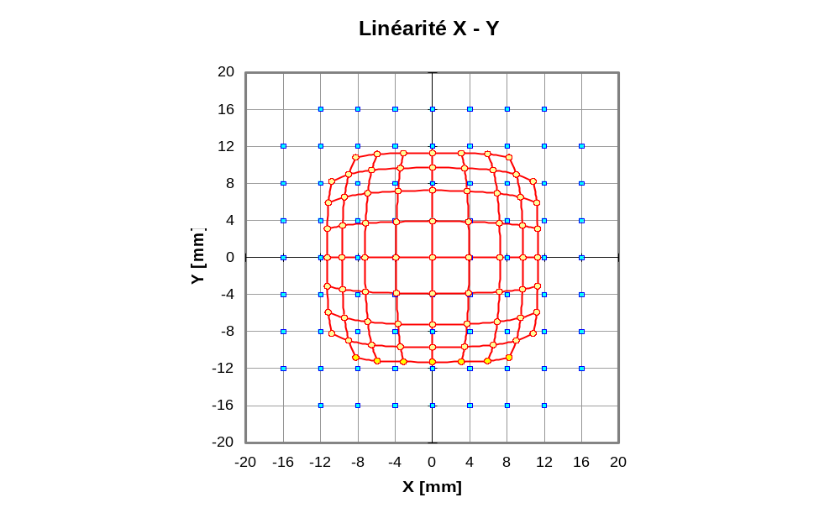
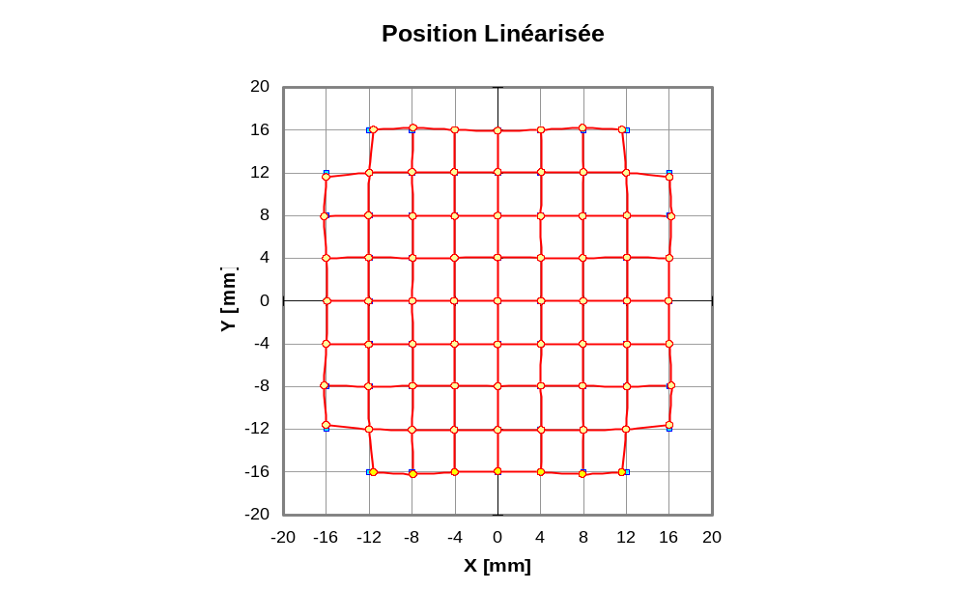
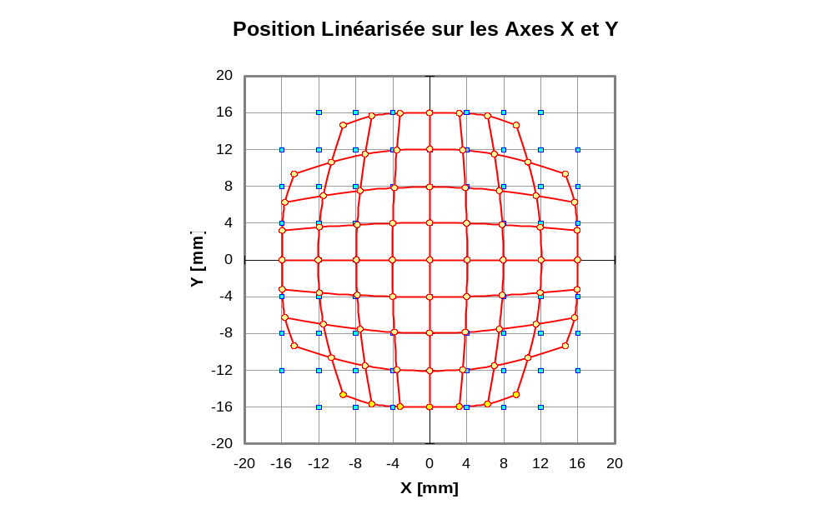
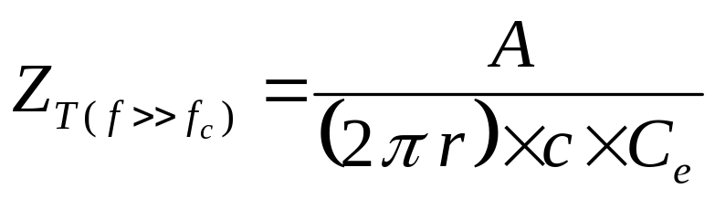
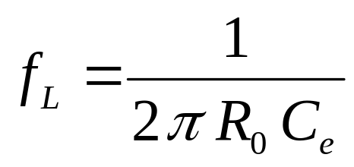
Electrostatic Pick-up – Button
Area A
Low cost ⇒ most popular
Non-linear
  requires correction algorithm
  when beam is off-centre
r
For Button with Capacitance C_{e} & Characteristic Impedance R₀
Transfer Impedance:
Lower Corner Frequency:

Slide 12
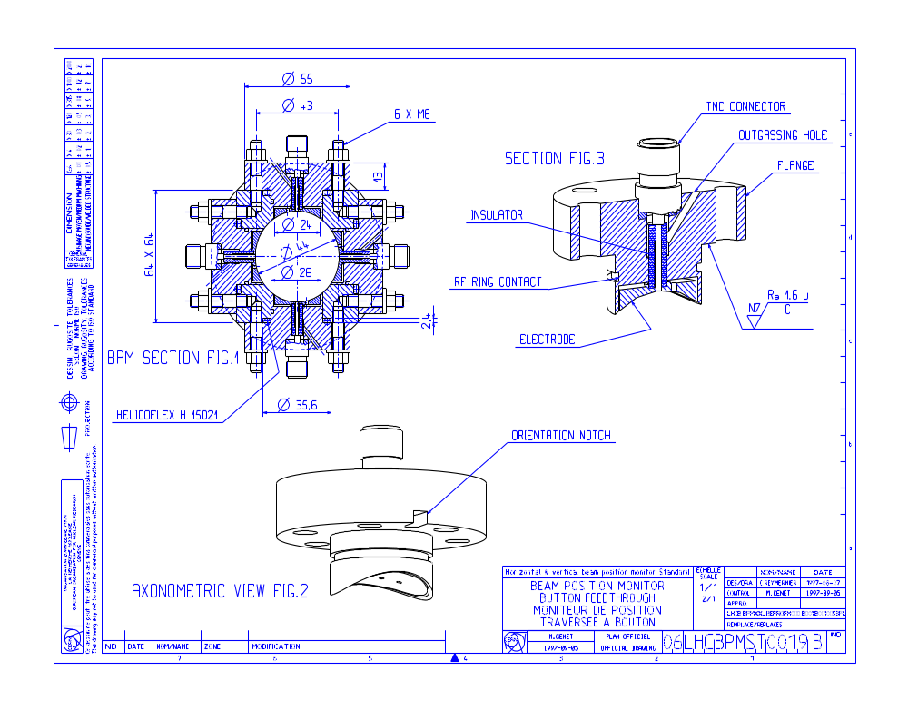
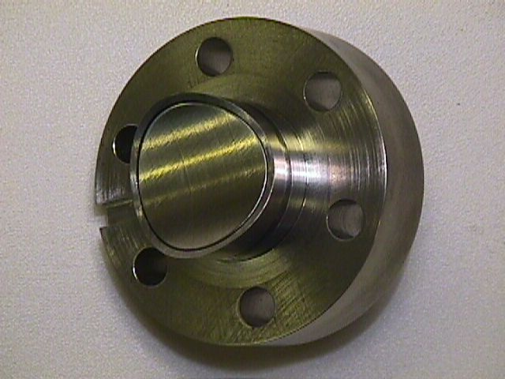


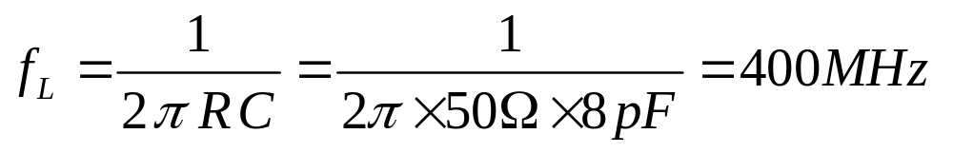
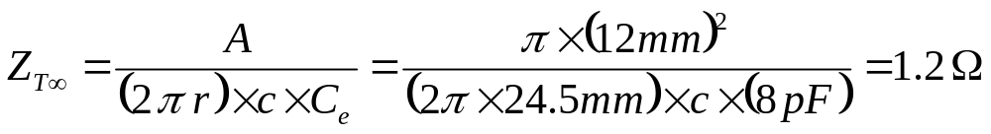
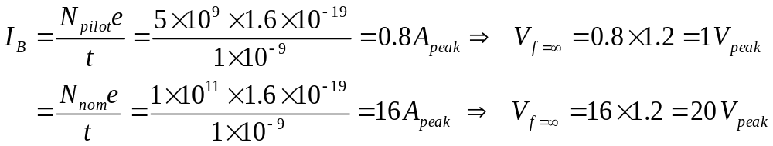
A Real Example – The LHC Button
Response (V)
0
Frequency (Hz)
0

Slide 13
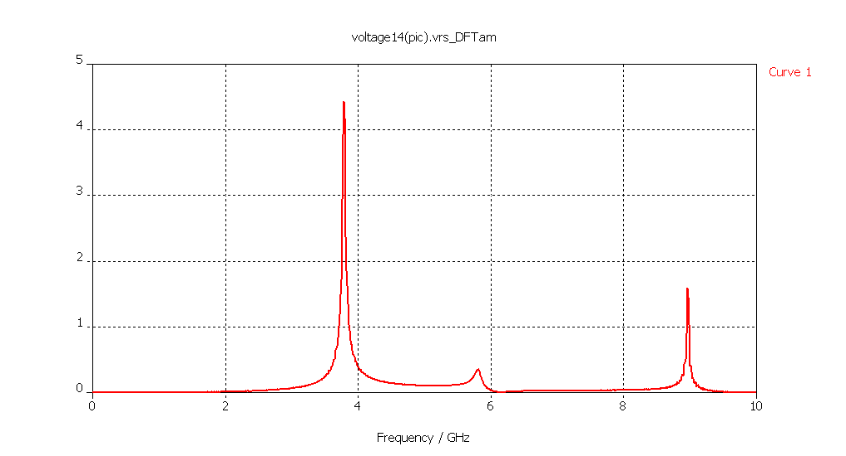
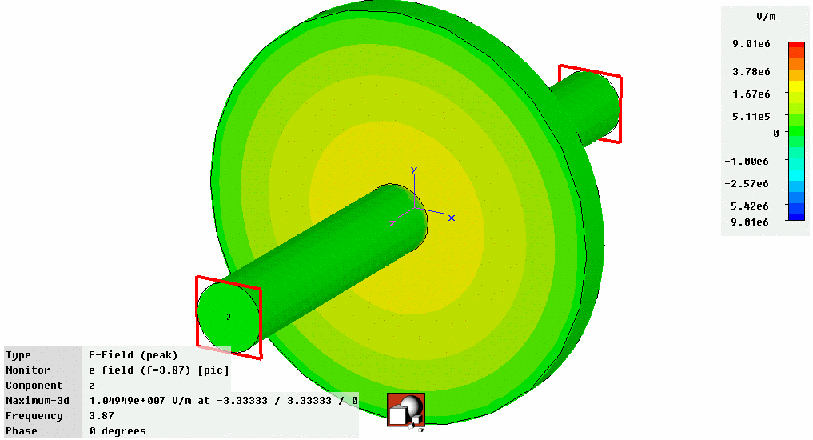
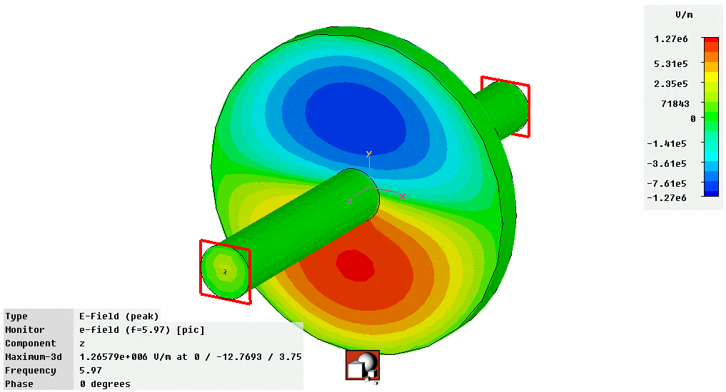
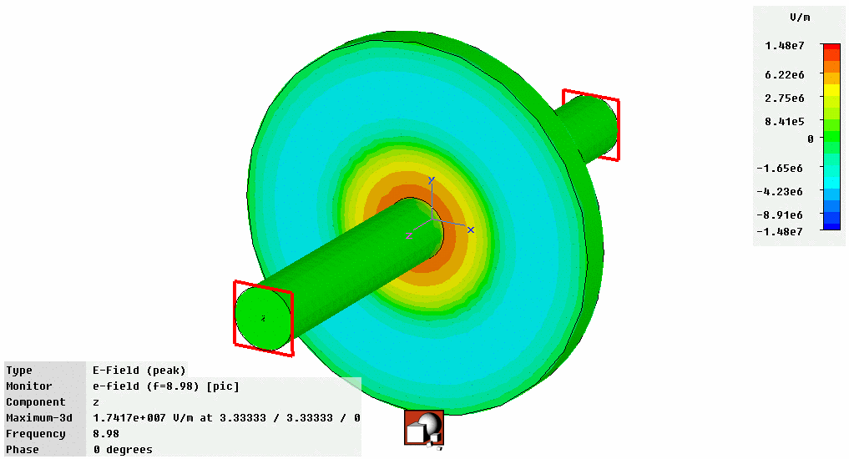
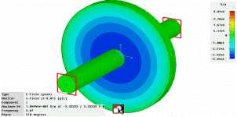
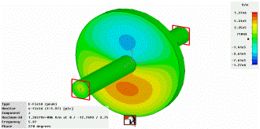
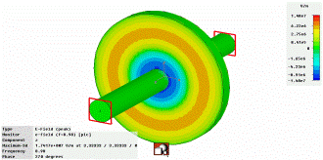
Improving the Precision for
Next Generation Accelerators
Standard BPMs give intensity signals which need to be subtracted to obtain a difference which is then proportional to position
  Difficult to do electronically without some of the intensity information leaking through
    When looking for small differences this leakage can dominate the measurement
    Typically 40-80dB (100 to 10000 in V) rejection ⇒ tens micron resolution for typical apertures
Solution – cavity BPMs allowing sub micron resolution
  Design the detector to collect only the difference signal
    Dipole Mode TM₁₁ proportional to position & shifted in frequency with respect to monopole mode
Frequency Domain
TM₀₁
TM₀₁
U / V
TM₀₂
TM₀₂
TM₁₁
TM₁₁
f / GHz
Courtesy of D. Lipka,
DESY, Hamburg
U~Q
U~Qr
U~Q

Slide 14
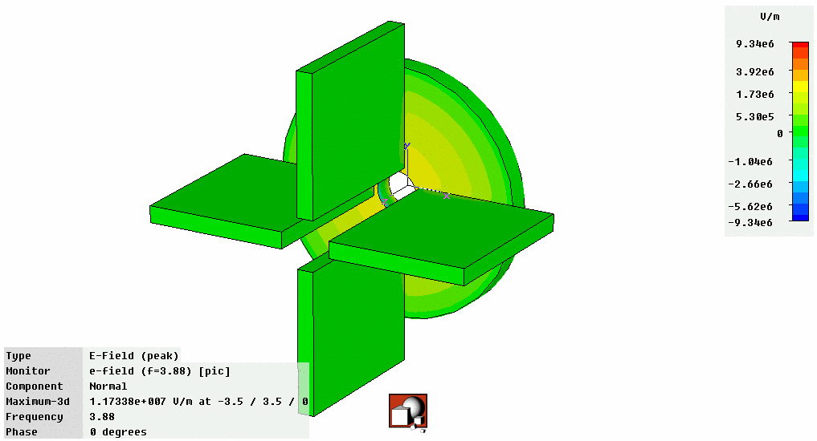
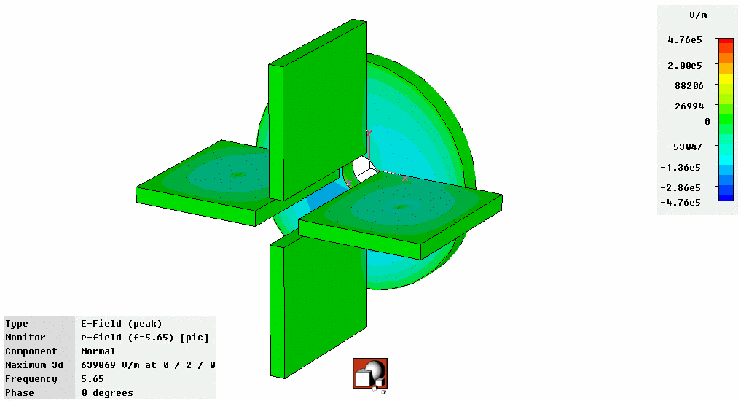
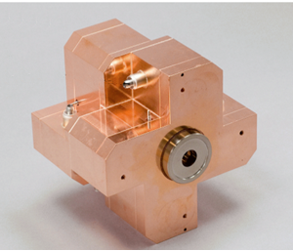
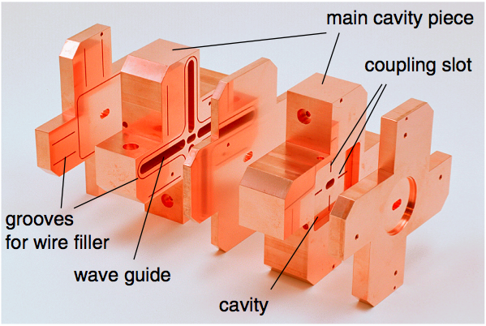
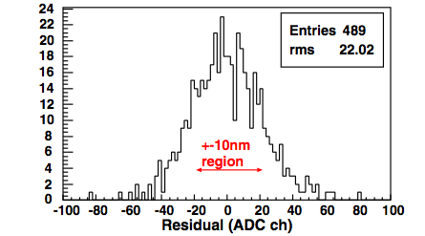
Today’s State of the Art BPMs
Obtain signal using waveguides that only couple to dipole mode
  Further suppression of monopole mode
Prototype BPM for ILC Final Focus
  Required resolution of 2nm (yes nano!) in a 6×12mm diameter beam pipe
  Achieved World Record (so far!) resolution of 8.7nm at ATF2 (KEK, Japan)
Monopole Mode
Dipole Mode
Courtesy of D. Lipka,
DESY, Hamburg
Courtesy of D. Lipka & Y. Honda

Slide 15
Criteria for Electronics Choice - so called “Processor Electronics”
Accuracy
  mechanical and electromagnetic errors
  electronic components
Resolution
Stability over time
Sensitivity and Dynamic Range
Acquisition Time
  measurement time
  repetition time
Linearity
  aperture & intensity
Radiation tolerance

Slide 16
Processing System Families
Automatic
Gain Control
on Σ
D I G I T I Z E R
Multiplexed
Heterodyne
Synchronous
Detection
POS = (A-B)
no turn by turn
Hybrid
Δ / Σ
Heterodyne
Homodyne
Detection
POS = Δ / Σ
Electrodes
A, B
Direct
Digitisation
POS = Δ / Σ
Individual
Treatment
Logarithmic
Amplifiers
Differential
Amplifier
POS = [log(A/B)]
= [log(A)-log(B)]
Legend:
/ Single channel
Wide Band
Narrow band
turn by turn
Passive
Normalisation
Amplitude
to Time
Limiter,
Δt to Ampl.
POS = [A/B]
Amplitude
to Phase
.
Limiter,
φ to Ampl.
POS = [ATN(A/B)]
Normaliser
Processor
Active
Circuitry

Slide 17
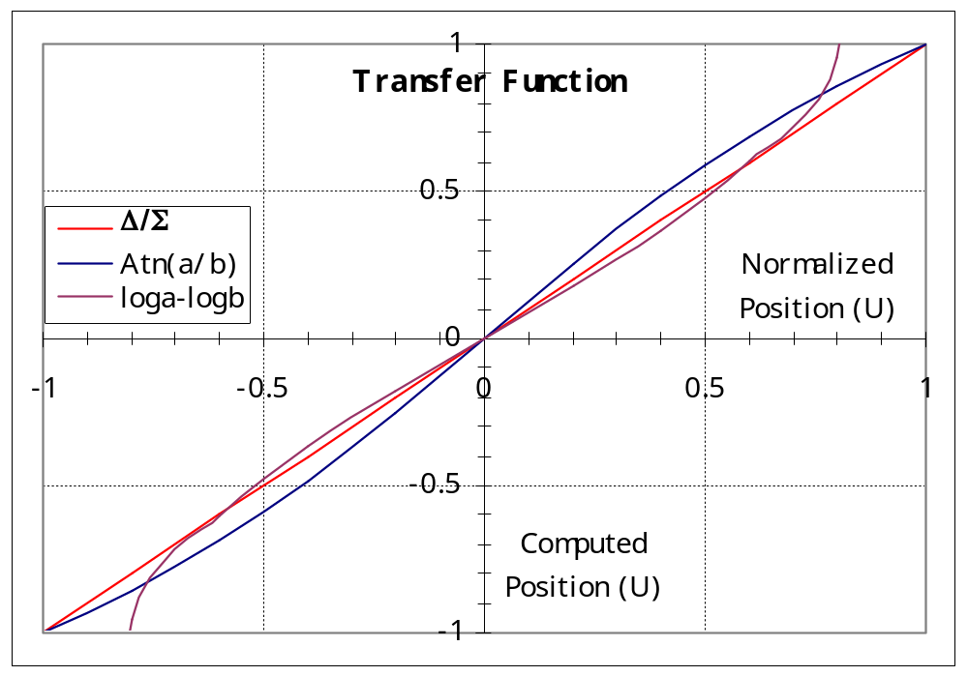
Linearity Comparison

Slide 18
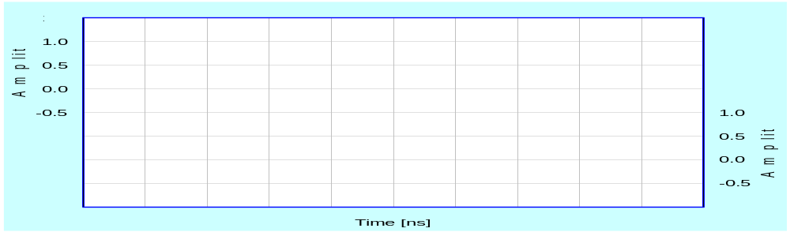
Amplitude to Time Normalisation
A
B
B + 1.5ns
1.5ns
A
Beam
Splitter
Delay lines
Combiner
B
Pick-up

Slide 19
Amplitude to Time Normalisation
A + (B + 1.5ns)
A
B
Δt depends on position
B + (A + 1.5ns)
A
B

Slide 20
BPM Acquisition Electronics
Amplitude to Time Normaliser
Advantages
Fast normalisation (< 25ns)
  bunch to bunch measurement
Signal dynamic independent of the number of bunches
  Input dynamic range ~45 dB
  No need for gain selection
Reduced number of channels
  normalisation at the front-end
~10 dB compression of the position dynamic due to the recombination of signals
Independent of external timing
Time encoding allows fibre optic transmission to be used
Limitations
Currently reserved for beams with empty RF buckets between bunches e.g.
  LHC 400MHz RF but 25ns spacing
  1 bunch every 10 buckets filled
Tight time adjustment required
No Intensity information
Propagation delay stability and switching time uncertainty are the limiting performance factors

Slide 21
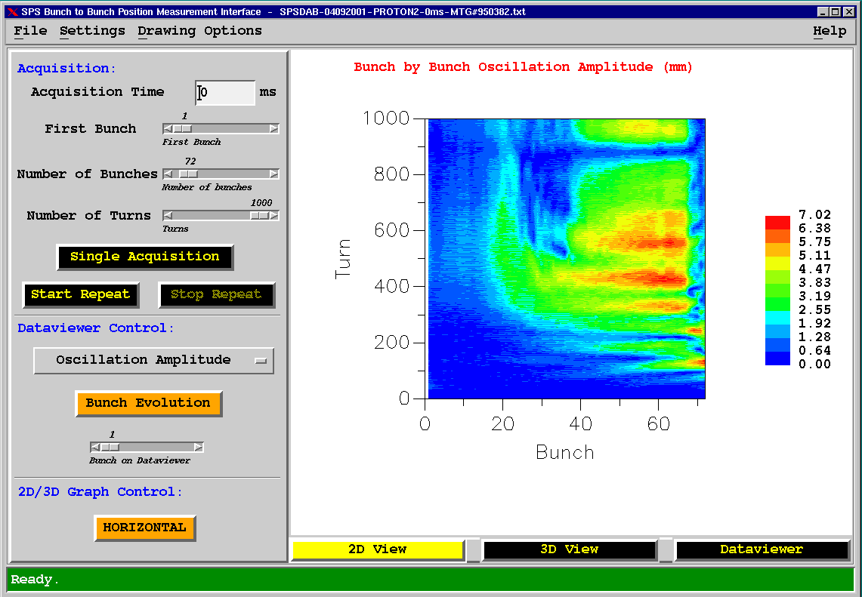
What one can do with such a System
Used in the CERN-SPS for electron cloud & instability studies

Slide 22
The Typical Instruments
Beam Position
  electrostatic or electromagnetic pick-ups and related electronics
Beam Intensity
  beam current transformers
Beam Profile
  secondary emission grids and screens
  wire scanners
  synchrotron light monitors
  ionisation and luminescence monitors
  Femtosecond diagnostics for ultra short bunches
Beam Loss
  ionisation chambers or pin diodes
Machine Tunes and Chromacitities
  in diagnostics section of tomorrow
Luminosity
  in diagnostics section of tomorrow

Slide 23
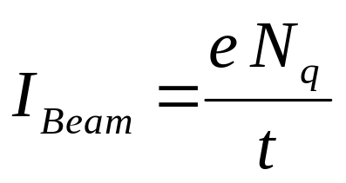
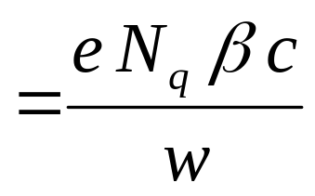
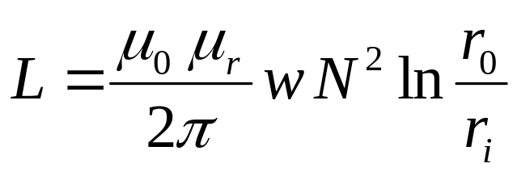
Current Transformers
Magnetic field
Fields are very low
Capture magnetic field lines with cores of high
relative permeability
(CoFe based amorphous alloy Vitrovac: μ_{r}= 10⁵)
r_{i}
r_{o}
N Turn winding
w
Beam current
Transformer Inductance

Slide 24
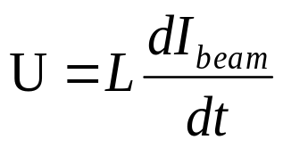
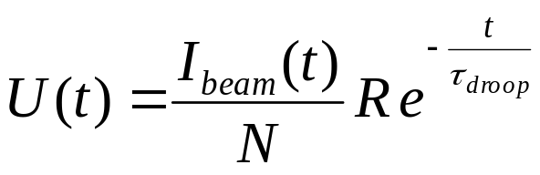
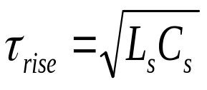
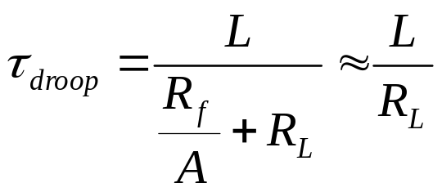
The Active AC transformer
Winding of N turns and Inductance L
R_{F}
R_{L}
A
L
C_{S}
R
Beam signal
Transformer output signal
I_{B}
U
t
t

Slide 25
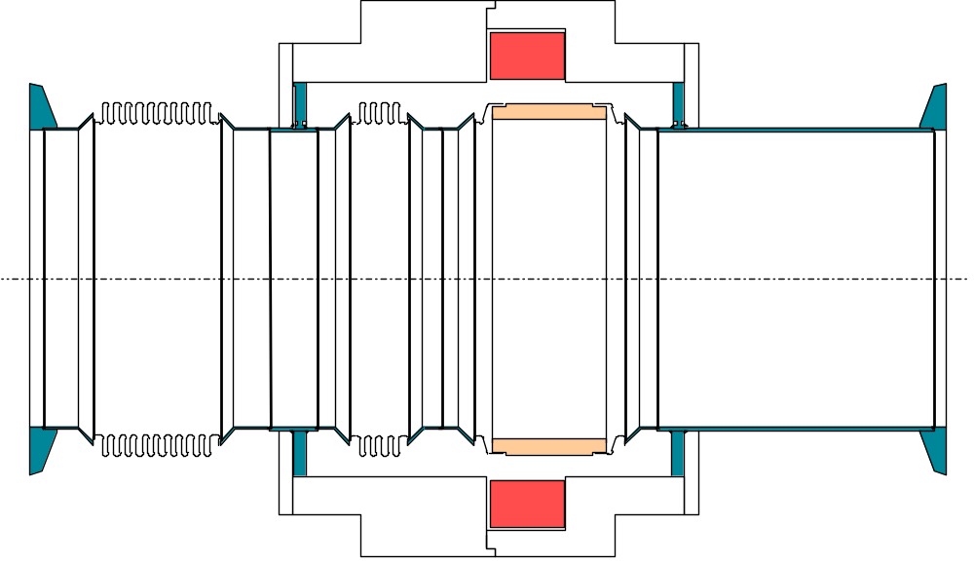
Fast Beam Current Transformer
Image
Current
1:40 Passive
Transformer
Ceramic Gap
BEAM
80nm Ti Coating
20Ω to improve
impedance
Calibration winding
500MHz Bandwidth
Low droop (< 0.2%/μs)

Slide 26
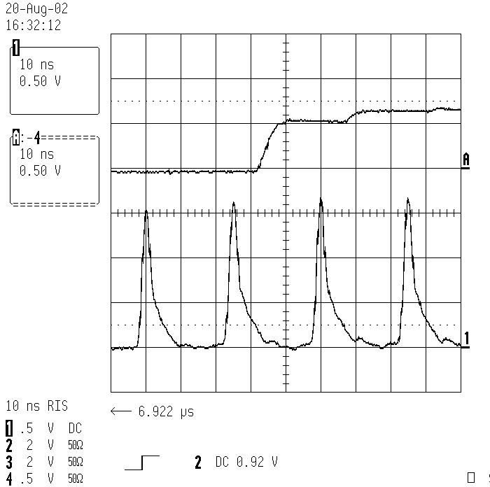
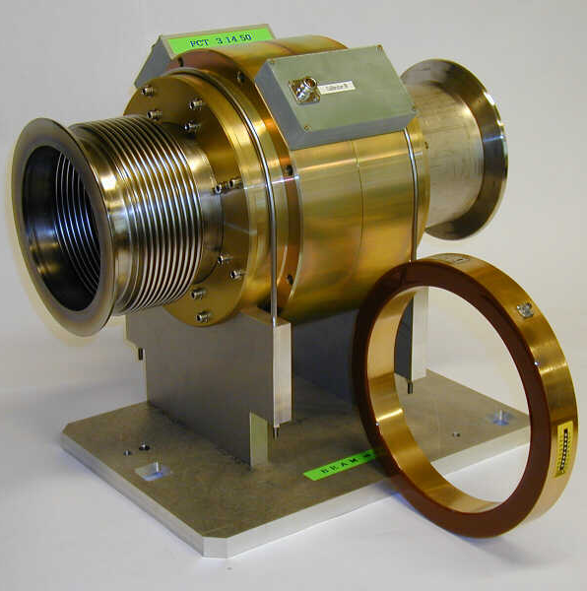
Acquisition Electronics
Integrator Output
25ns
FBCT Signal after 200m of Cable
Data taken on LHC type beams at the CERN-SPS

Slide 27
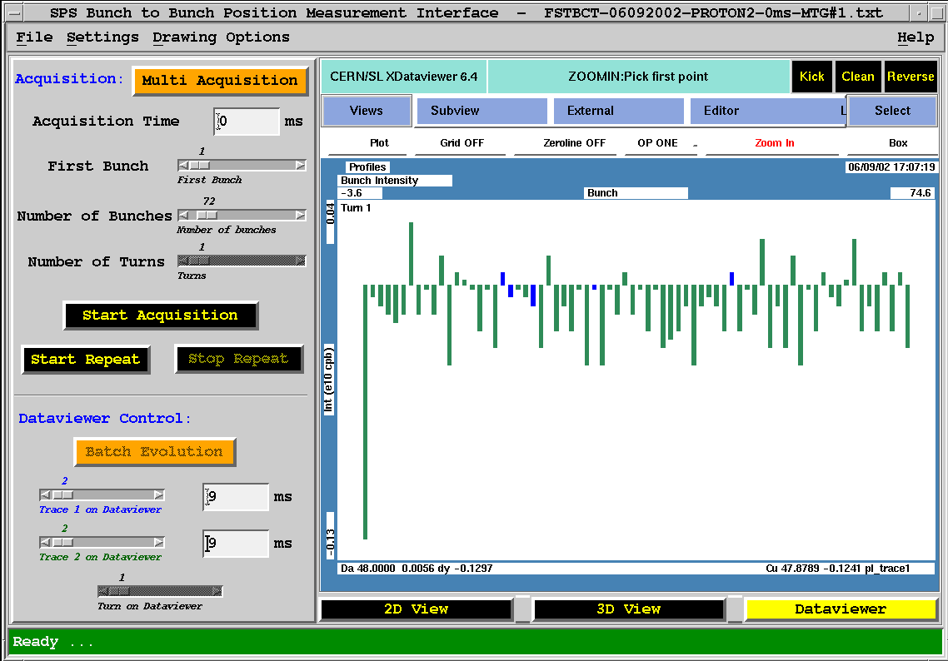
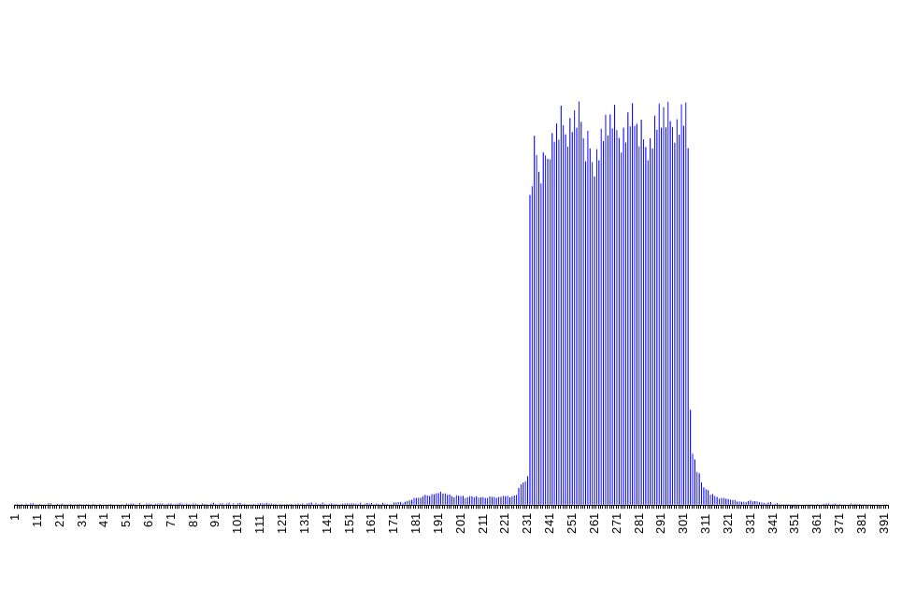
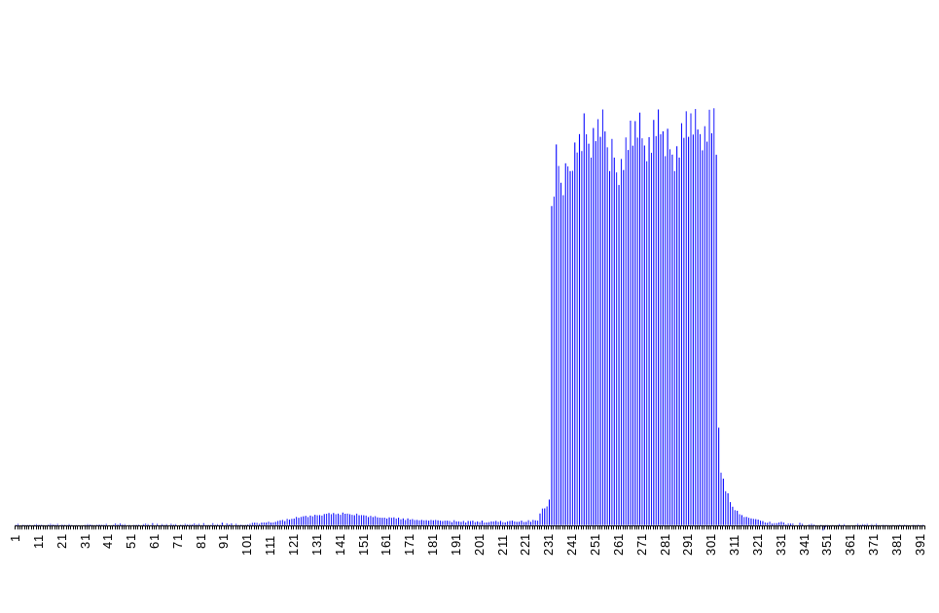
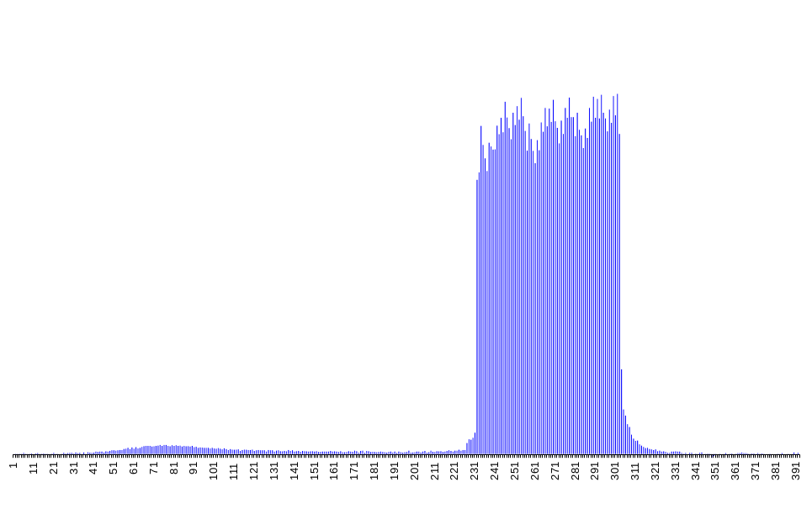
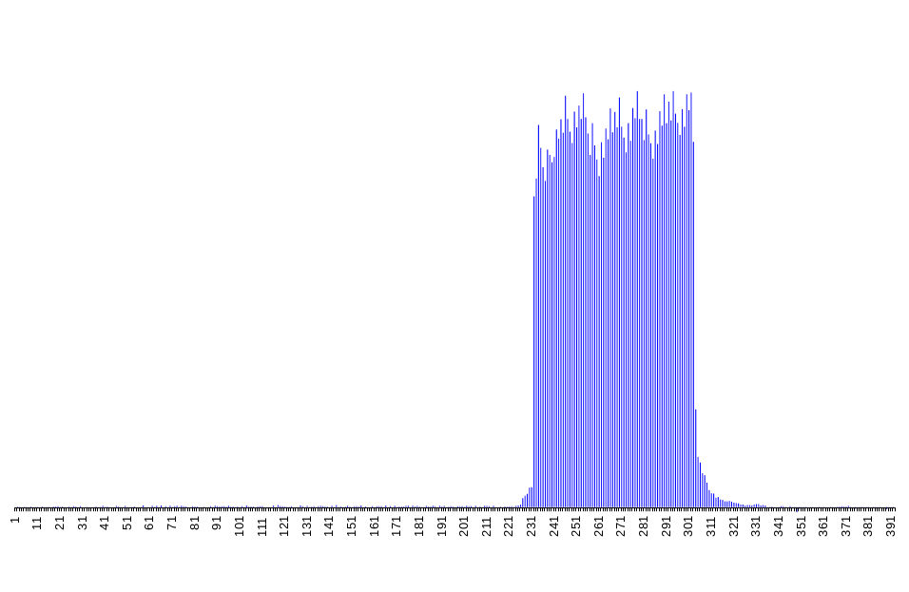
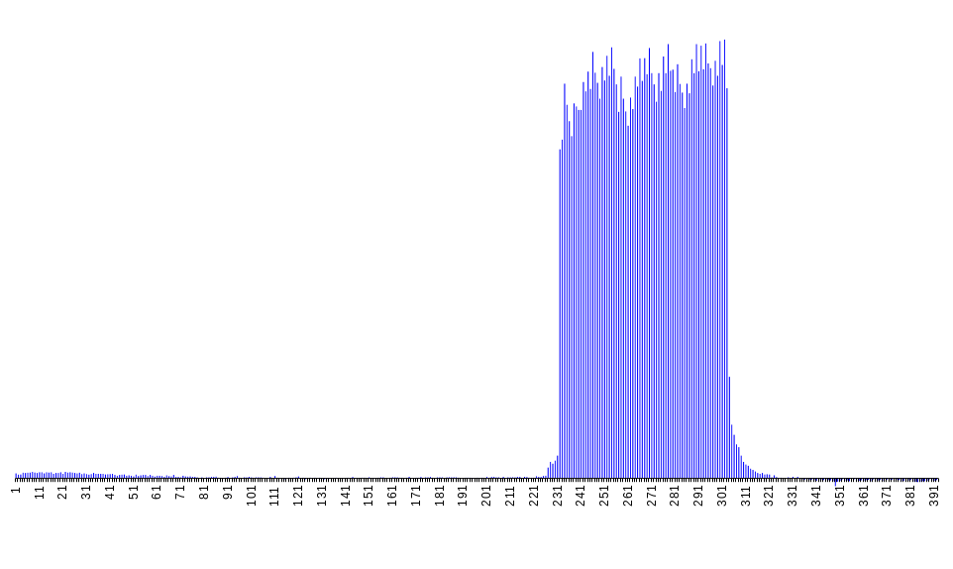
What one can do with such a System
Bad RF Capture of a single LHC Batch in the SPS (72 bunches)

Slide 28
The DC transformer
AC transformers can be extended to very low frequency but not to DC ( no dI/dt ! )
DC measurement is required in storage rings
To do this:
  Take advantage of non-linear magnetisation curve
  Use 2 identical cores modulated with opposite polarities
B
I

Slide 29
DCCT Principle – Case 1: no beam
Hysteresis loop
of modulator cores
B
I
Modulation Current - Core 1
Modulation Current - Core 2
I_{M}
t

Slide 30
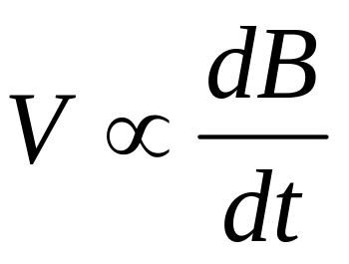
DCCT Principle – Case 1: no beam
B
I
dB/dt - Core 1 (V1)
dB/dt - Core 2 (V2)
Output voltage = V₁ – V₂
V
t

Slide 31
DCCT Principle – Case 2: with beam
B
Beam Current I_{B}
Output signal is at TWICE
the modulation frequency
I
dB/dt - Core 1 (V1)
dB/dt - Core 2 (V2)
Output voltage = V₁ – V₂
I_{B}
V
t

Slide 32
Zero Flux DCCT Schematic
V_{a} - V_{b}
Synchronous
detector
V_{a}
V_{b}
Modulator
Power supply
Beam
R
V = R × I_{beam}
Compensation current I_{feedback} = - I_{beam}

Slide 33
The Typical Instruments
Beam Position
  electrostatic or electromagnetic pick-ups and related electronics
Beam Intensity
  beam current transformers
Beam Profile
  secondary emission grids and screens
  wire scanners
  synchrotron light monitors
  ionisation and luminescence monitors
  femtosecond diagnostics for ultra short bunches
Beam Loss
  ionisation chambers or pin diodes
Machine Tunes and Chromacitities
  in diagnostics section of tomorrow
Luminosity
  in diagnostics section of tomorrow

Slide 34
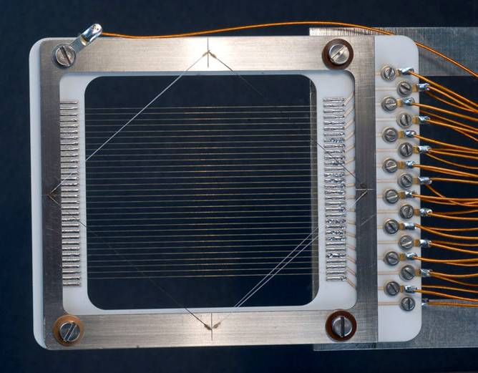
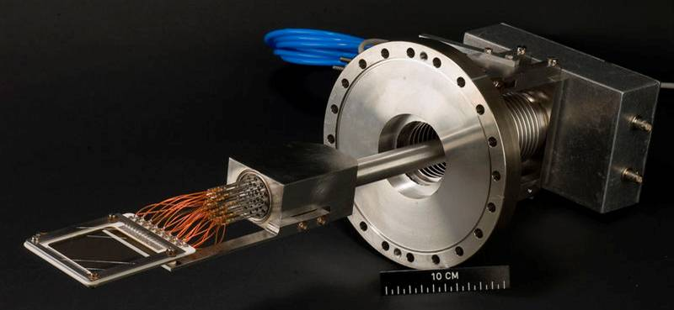
Secondary Emission (SEM) Grids
When the beam passes through secondary electrons are ejected from the wires
The liberated electrons are removed using a polarisation voltage
The current flowing back onto the wires is measured
One amplifier/ADC chain is used for each wire

Slide 35

Profiles from SEM grids
Charge density measured from each wire gives a projection of the beam profile in either horizontal or vertical plane
Resolution is given by distance between wires
Used only in low energy linacs and transfer lines as heating is too great for circulating beams

Slide 36



Wire Scanners
A thin wire is moved across the beam
  has to move fast to avoid excessive heating of the wire and/or beam loss
Detection
  Secondary particle shower detected outside the vacuum chamber using a scintillator/photo-multiplier assembly
  Secondary emission current detected as for SEM grids
Correlating wire position with detected signal gives the beam profile
+
+
+
+
+
+
+
+
+
+
+
+
+
+
+
+
+
+
+
+
+
+
+
+
+
+
+
+
+
+
+
+
+
+
+
+
+
+
+
+
+
+
+
+
+
+
+
+
+
+
+
+
+
+
+
+
+
+
+
+
+
+
+
+
+
+
+
+
+
+
+
+
+
+
+
+
+

Slide 37

Beam Profile Monitoring using Screens
Optical Transition Radiation
  Radiation emitted when a charged particle beam goes through the interface of 2 media with different dielectric constants
  surface phenomenon allows the use of very thin screens (~10μm)
OTR Screen
Beam
Exit window
Intensifier -
CCD
Mirror
Lens

Slide 38


Beam Profile Monitoring using Screens
Screen Types
  Luminescence Screens
    destructive (thick) but work during setting-up with low intensities
  Optical Transition Radiation (OTR) screens
    much less destructive (thin) but require higher intensity

Slide 39

Beam Profile Monitoring using Screens
Usual configuration
  Combine several screens in one housing e.g.
    Al₂O₃ luminescent screen for setting-up with low intensity
    Thin (~10um) Ti OTR screen for high intensity measurements
    Carbon OTR screen for very high intensity operation
Advantages compared to SEM grids
  allows analogue camera or CCD acquisition
  gives two dimensional information
  high resolution: ~ 400 x 300 = 120’000 pixels for a standard CCD
  more economical
    Simpler mechanics & readout electronics
  time resolution depends on choice of image capture device
    From CCD in video mode at 50Hz to Streak camera in the GHz range

Slide 40


Luminescence Profile Monitor
N₂-fluorescent gas
equally distributed
Vacuum gauge
Blackened walls
Valve
150mm flange
Ion beam
Viewport
Lens, Image-Intensifier
and CCD Camera
N₂ excited state
Photon
emitted
Beam
e⁻
N₂ ground state

Slide 41


Luminescence Profile Monitor
Beam size shrinks as
beam is accelerated
Time
2D
Side view
Fast extraction
Injection
Slow extraction
3D
Image
Beam Size
CERN-SPS Measurements
Profile Collected every 20ms
Local Pressure at ~5×10⁻⁷ Torr
Beam Size
Time

Slide 42

The Synchrotron Light Monitor
Beam
Synchrotron Light from
Bending Magnet
or Undulator

Slide 43


The Synchrotron Light Monitor

Slide 44

Measuring Ultra Short Bunches
Next Generation FELs & Linear Colliders
  Use ultra short bunches to increase brightness or improve luminosity
How do we measure such short bunches?
  Transverse deflecting cavity
p⁺ @ LHC | 250ps
H⁻ @ SNS | 100ps
e⁻ @ ILC | 500fs
e⁻ @ CLIC | 130fs
e⁻ @ XFEL | 80fs
e⁻ @ LCLS | <75fs
Destructive Measurement

Slide 45


Electro-Optic Sampling – Non Destructive
Limited to >250fs by laser bandwidth
Spectral Decoding
Limited to >30fs by sampling laser pulse
Temporal decoding

Slide 46
The Typical Instruments
Beam Position
  electrostatic or electromagnetic pick-ups and related electronics
Beam Intensity
  beam current transformers
Beam Profile
  secondary emission grids and screens
  wire scanners
  synchrotron light monitors
  ionisation and luminescence monitors
  femtosecond diagnostics for ultra short bunches
Beam Loss
  ionisation chambers or pin diodes
Machine Tunes and Chromacitities
  in diagnostics section of tomorrow
Luminosity
  in diagnostics section of tomorrow

Slide 47
Beam Loss Detectors
Role of a BLM system:
  Protect the machine from damage
  Dump the beam to avoid magnet quenches (for SC magnets)
  Diagnostic tool to improve the performance of the accelerator
Common types of monitor
  Long ionisation chamber (charge detection)
    Up to several km of gas filled hollow coaxial cables
    Position sensitivity achieved by comparing direct & reflected pulse
      e.g. SLAC – 8m position resolution (30ns) over 3.5km cable length
    Dynamic range of up to 10⁴
  Fibre optic monitors
    Similar layout with electrical signals replaced by light produced through Cerenkov effect

Slide 48




Beam Loss Detectors
Common types of monitor (cont)
  Short ionisation chamber (charge detection)
    Typically gas filled with many metallic electrodes and kV bias
    Speed limited by ion collection time - tens of microseconds
    Dynamic range of up to 10⁸
i_{in}(t) + I_{ref}
i_{in}(t)
LHC

Slide 49



Beam Loss Detectors
Common types of monitor (cont)
  PIN photodiode (count detection)
    Detect MIP crossing photodiodes
    Count rate proportional to beam loss
    Speed limited by integration time
    Dynamic range of up to 10⁹
HERA-p
Comparator

Slide 50



Beam Loss Detectors – New Materials
Diamond Detectors
  Fast & sensitive
  Used in LHC to distinguish bunch by bunch losses
  Investigations now ongoing to see if they can work in cryogenic conditions
Courtesy of E. Griesmayer

Slide 51

BLM Threshold Level Estimation

Slide 52
Summary
This was an overview of the common types of instruments that can be found in most accelerators
  Only a small subset of those currently in use or being developed with many exotic instruments tailored for specific accelerator needs existing
Tomorrow you will see how to use these instruments to run and optimise accelerators
  Introduction to Accelerator Beam Diagnostics (H. Schmickler)
Join the afternoon course:
Beam Instrumentation & Diagnostics
  For an in-depth analysis of all these instruments and on their application in various accelerators

