Slide 1
RF Cavity Design
Erk Jensen
CERN BE/RF
CERN Accelerator School
Accelerator Physics (Advanced level)
Trondheim 2013

Slide 2
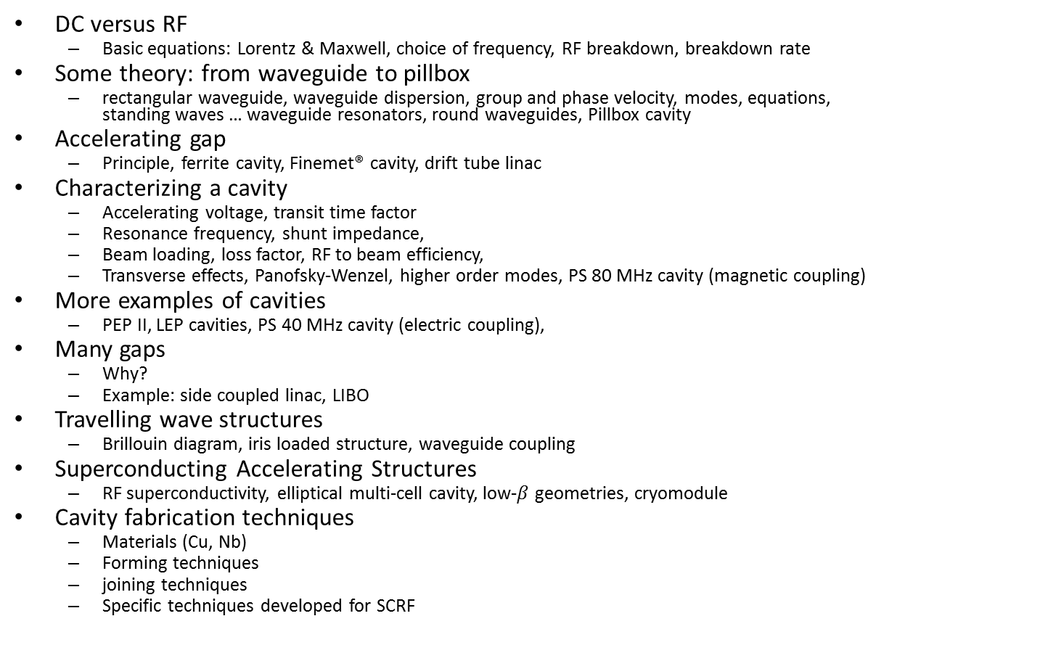
Overview
DC versus RF
  Basic equations: Lorentz & Maxwell, choice of frequency, RF breakdown, breakdown rate
Some theory: from waveguide to pillbox
  rectangular waveguide, waveguide dispersion, group and phase velocity, modes, equations,
  standing waves … waveguide resonators, round waveguides, Pillbox cavity
Accelerating gap
  Principle, ferrite cavity, Finemet® cavity, drift tube linac
Characterizing a cavity
  Accelerating voltage, transit time factor
  Resonance frequency, shunt impedance,
  Beam loading, loss factor, RF to beam efficiency,
  Transverse effects, Panofsky-Wenzel, higher order modes, PS 80 MHz cavity (magnetic coupling)
More examples of cavities
  PEP II, LEP cavities, PS 40 MHz cavity (electric coupling),
Many gaps
  Why?
  Example: side coupled linac, LIBO
Travelling wave structures
  Brillouin diagram, iris loaded structure, waveguide coupling
Superconducting Accelerating Structures
  RF superconductivity, elliptical multi-cell cavity, low-$β$ geometries, cryomodule
Cavity fabrication techniques
  Materials (Cu, Nb)
  Forming techniques
  joining techniques
  Specific techniques developed for SCRF

Slide 3
DC versus RF

Slide 4
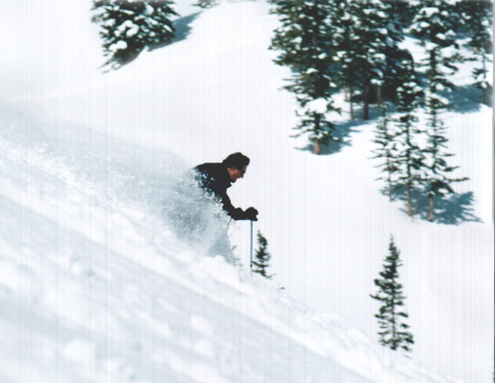
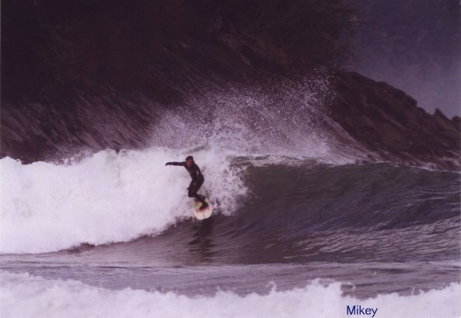
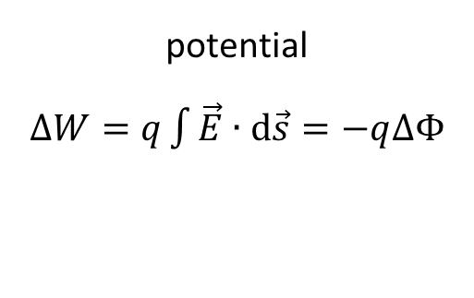
DC versus RF
DC accelerator
potential
$∆W=q\int{\vec{E}∙d\vec{s}}=−q∆Φ$
RF accelerator

Slide 5
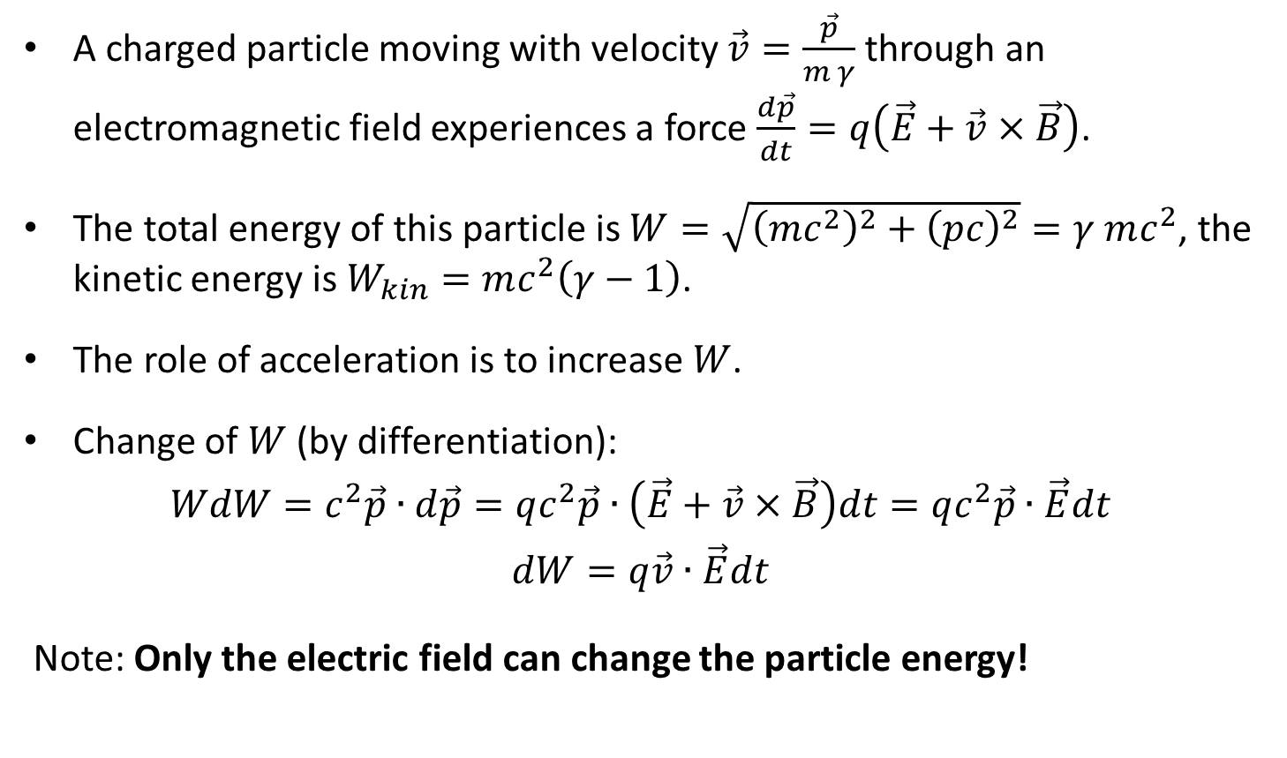
Lorentz force
A charged particle moving with velocity $\vec{v}=\frac{\vec{p}}{m γ}$ through an electromagnetic field experiences a force $\frac{d\vec{p}}{dt}=q\left(\vec{E}+\vec{v}×\vec{B}\right)$.
The total energy of this particle is $W=\sqrt{{\left(mc^{2}\right)}^{2}+{\left(pc\right)}^{2}}=γ mc^{2}$, the kinetic energy is $W_{kin}=mc^{2}\left(γ−1\right)$.
The role of acceleration is to increase $W$.
Change of $W$ (by differentiation):
$$WdW=c^{2}\vec{p}∙d\vec{p}=qc^{2}\vec{p}∙\left(\vec{E}+\vec{v}×\vec{B}\right)dt=qc^{2}\vec{p}∙\vec{E}dt$$
$$dW=q\vec{v}∙\vec{E}dt$$
Note: Only the electric field can change the particle energy!

Slide 6
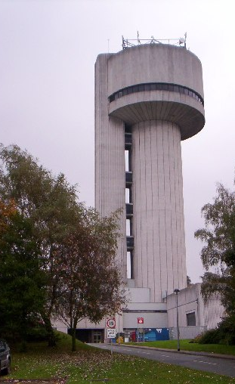
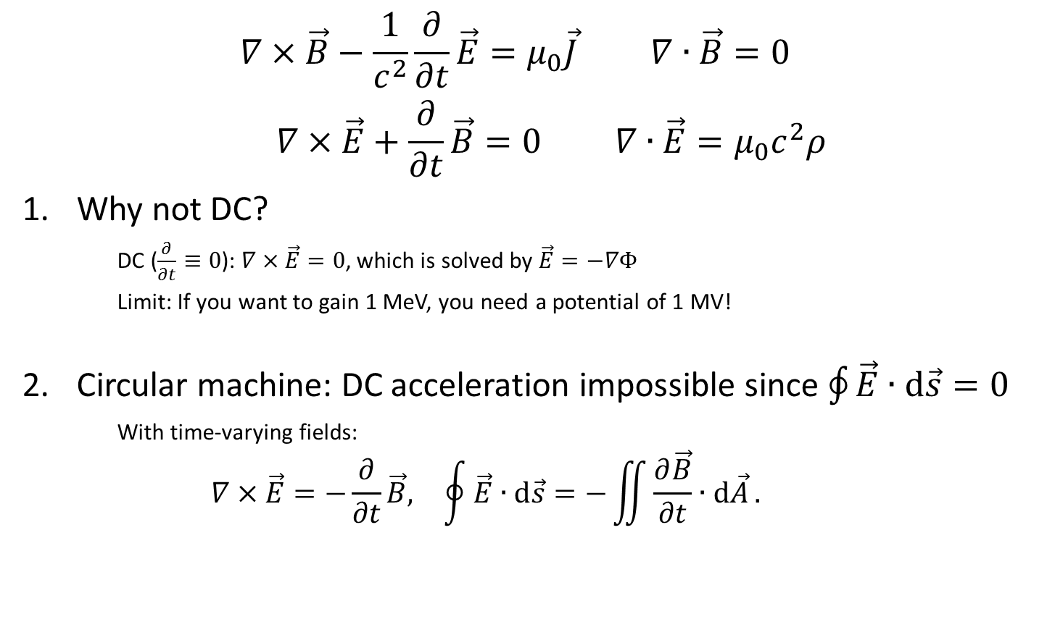
Maxwell’s equations (in vacuum)
$$\begin{matrix}∇×\vec{B}−\frac{1}{c^{2}}\frac{∂}{∂t}\vec{E}=μ_{0}\vec{J} & ∇∙\vec{B}=0 \\ ∇×\vec{E}+\frac{∂}{∂t}\vec{B}=0 & ∇∙\vec{E}=μ_{0}c^{2}ρ\end{matrix}$$
Why not DC?
    DC ($\frac{∂}{∂t}≡0$): $∇×\vec{E}=0$, which is solved by $\vec{E}=−∇Φ$
    Limit: If you want to gain 1 MeV, you need a potential of 1 MV!
Circular machine: DC acceleration impossible since $\oint{\vec{E}∙\text{d}\vec{s}=0}$
    With time-varying fields:
    $$\begin{matrix}∇×\vec{E}=−\frac{∂}{∂t}\vec{B}, & \oint{\vec{E}∙\text{d}\vec{s}=−\iint{\frac{∂\vec{B}}{∂t}∙\text{d}\vec{A}}}.\end{matrix}$$
World’s highest energy Van-de-Graaff Generator on Daresbury Lab campus

Slide 7
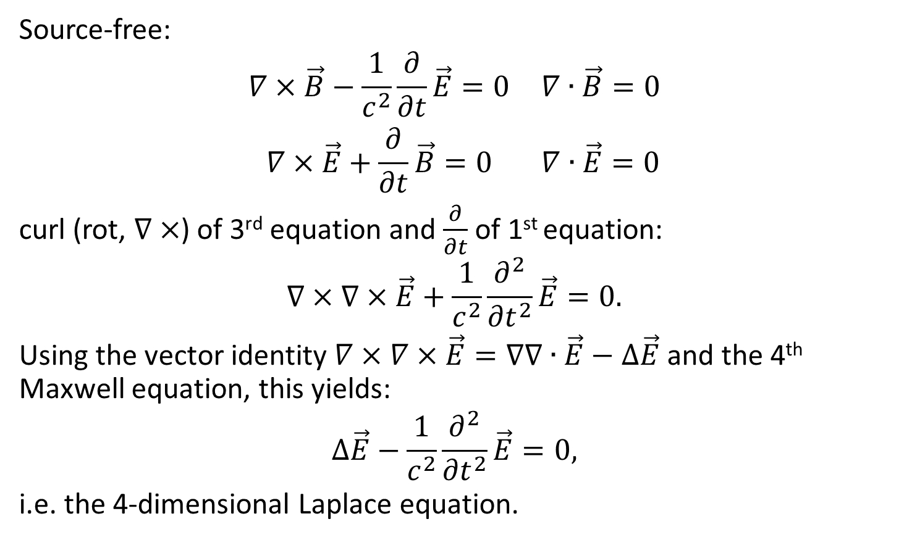
Maxwell’s equations in vacuum (contd.)
Source-free:
$$\begin{matrix}∇×\vec{B}−\frac{1}{c^{2}}\frac{∂}{∂t}\vec{E}=0 & ∇∙\vec{B}=0 \\ ∇×\vec{E}+\frac{∂}{∂t}\vec{B}=0 & ∇∙\vec{E}=0\end{matrix}$$
curl (rot, $∇×$) of 3rd equation and $\frac{∂}{∂t}$ of 1st equation:
$$∇×∇×\vec{E}+\frac{1}{c^{2}}\frac{∂^{2}}{{∂t}^{2}}\vec{E}=0.$$
Using the vector identity $∇×∇×\vec{E}=∇∇∙\vec{E}−∆\vec{E}$ and the 4th Maxwell equation, this yields:
$$∆\vec{E}−\frac{1}{c^{2}}\frac{∂^{2}}{{∂t}^{2}}\vec{E}=0,$$
i.e. the 4-dimensional Laplace equation.

Slide 8
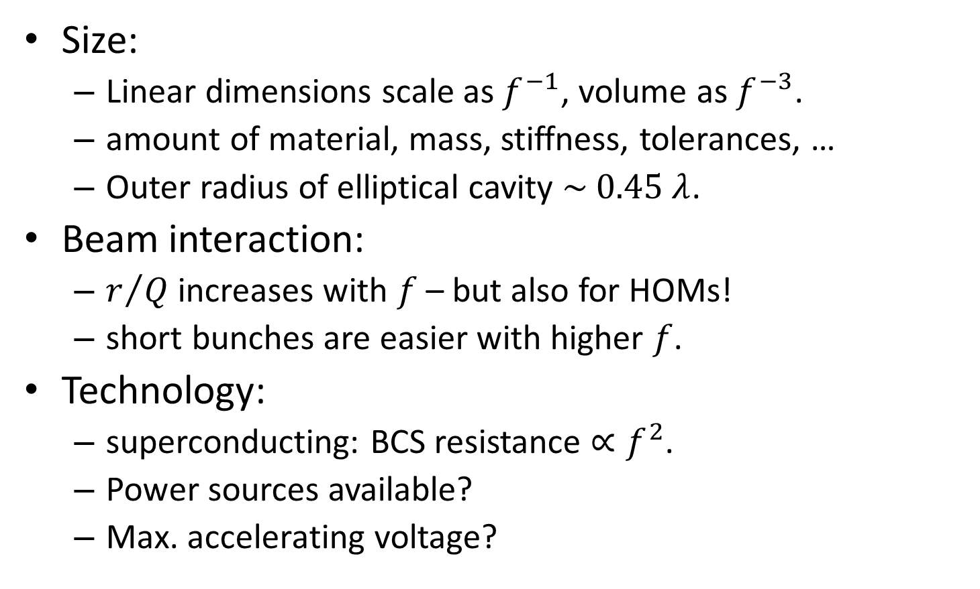
Choice of frequency
Size:
  Linear dimensions scale as $f^{−1}$, volume as $f^{−3}$.
  amount of material, mass, stiffness, tolerances, …
  Outer radius of elliptical cavity $\sim 0.45 λ$.
Beam interaction:
  $r/Q$ increases with $f$ – but also for HOMs!
  short bunches are easier with higher $f$.
Technology:
  superconducting: BCS resistance $∝f^{2}$.
  Power sources available?
  Max. accelerating voltage?

Slide 9
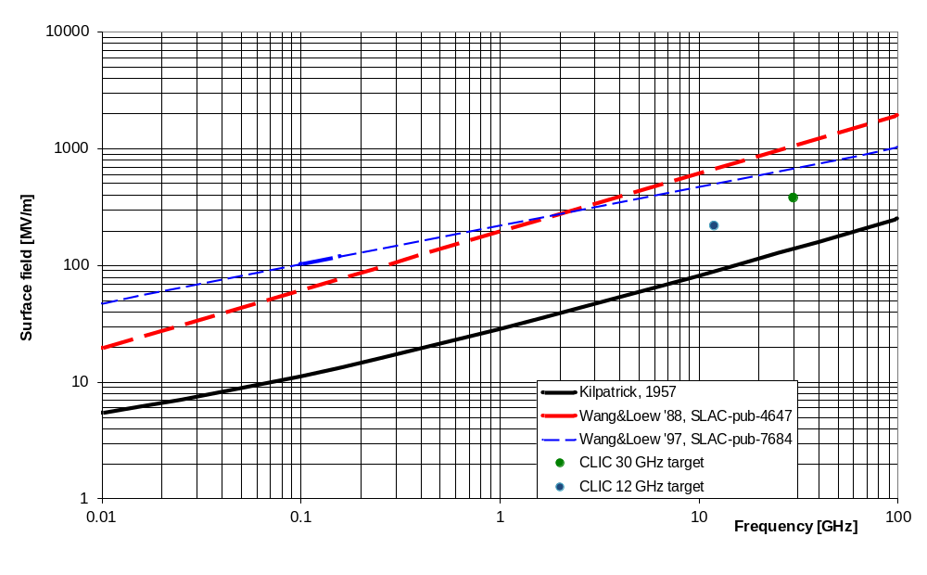
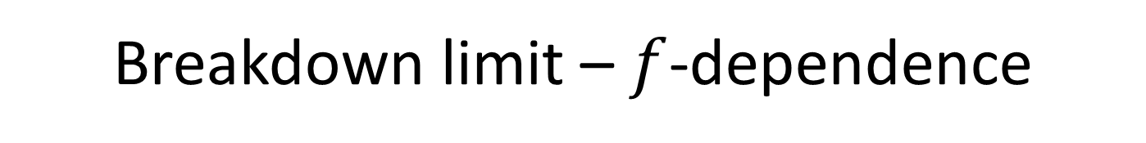
Breakdown limit – $f$-dependence
surface field, in vacuum, Cu surface, room temperature
Note: More recent experimental data show much less $f$-dependence!
E.g.: http://prl.aps.org/abstract/PRL/v90/i22/e224801

Slide 10
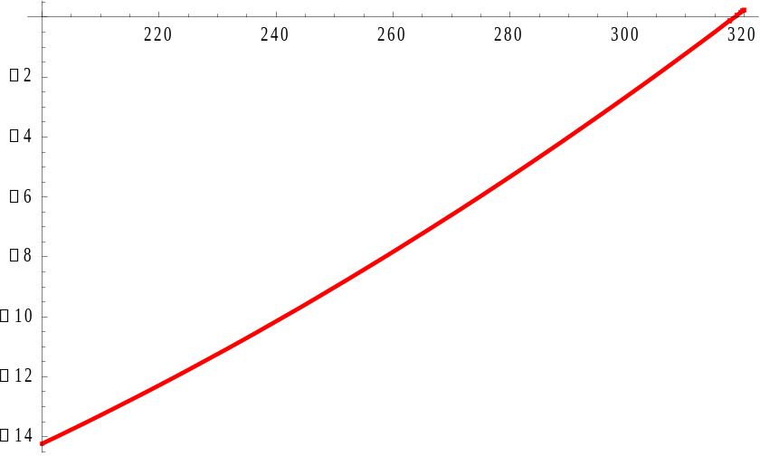
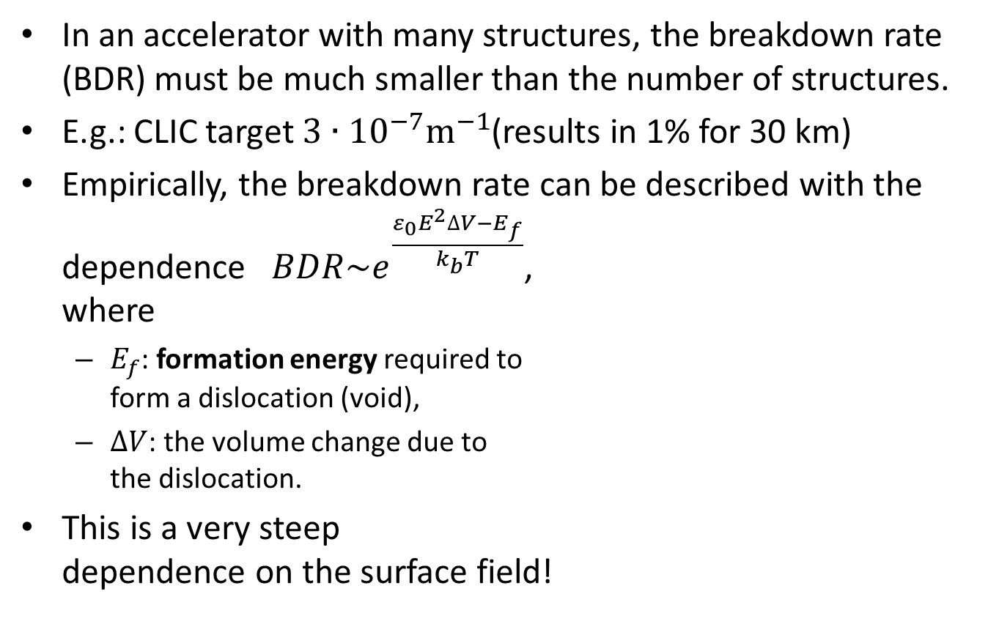



Breakdown rate!
In an accelerator with many structures, the breakdown rate (BDR) must be much smaller than the number of structures.
E.g.: CLIC target $3∙{10}^{−7}{\text{m}}^{−1}$(results in 1% for 30 km)
Empirically, the breakdown rate can be described with the dependence $BDR\sim e^{\frac{ε_{0}E^{2}∆V−E_{f}}{k_{b}T}}$,
where
  $E_{f}$: formation energy required to
  form a dislocation (void),
  $∆V$: the volume change due to
  the dislocation.
This is a very steep
dependence on the surface field!
$$E \left[\text{MV}\text{/}\text{m}\right]$$
Parameters:
$E_{f}=1.4 e\text{V},$
$∆V=0.25 {\text{μm}}^{3}$
$T=300 \text{K}$
$$log\left(BDR\right)$$

Slide 11
From waveguide to pillbox

Slide 12
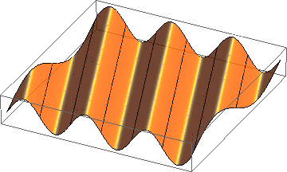
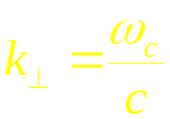
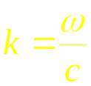
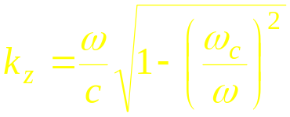
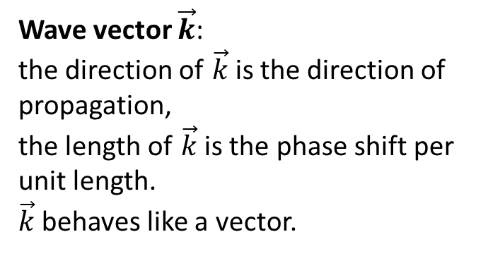
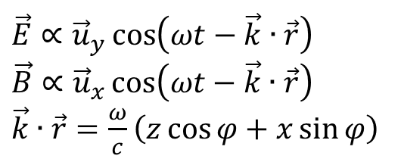
Homogeneous plane wave
$\vec{E}∝{\vec{u}}_{y}\cos\left(ωt−\vec{k}∙\vec{r}\right)$
$\vec{B}∝{\vec{u}}_{x}\cos\left(ωt−\vec{k}∙\vec{r}\right)$
$\vec{k}∙\vec{r}=\frac{ω}{c}\left(z\cos{φ}+x\sin{φ}\right)$
Wave vector $\vec{k}$:
the direction of $\vec{k}$is the direction of propagation,
the length of $\vec{k}$ is the phase shift per unit length.
$\vec{k}$ behaves like a vector.
x
E_{y}
φ
z

Slide 13
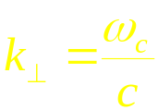
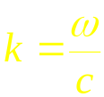
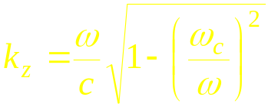
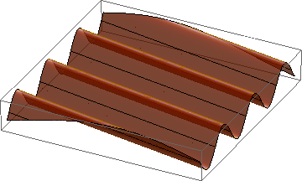
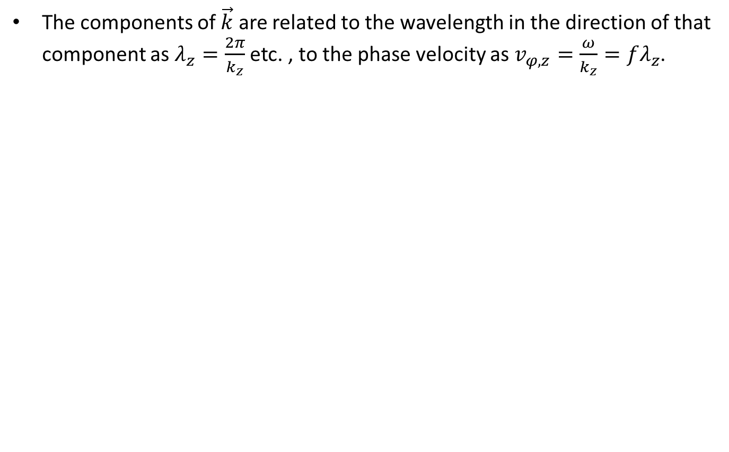
Wave length, phase velocity
The components of $\vec{k}$ are related to the wavelength in the direction of that component as $λ_{z}=\frac{2π}{k_{z}}$ etc. , to the phase velocity as $v_{φ,z}=\frac{ω}{k_{z}}=fλ_{z}$.
E_{y}
x
z

Slide 14
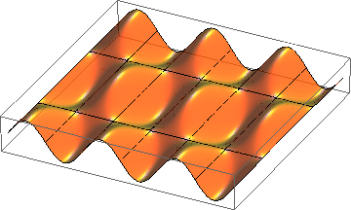
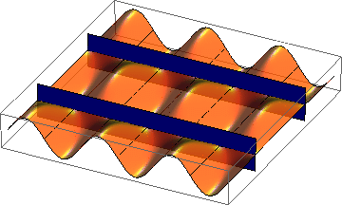
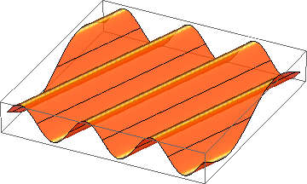
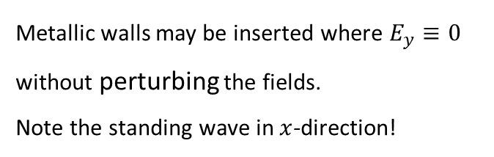
Superposition of 2 homogeneous plane waves
E_{y}
x
z
=
+
Metallic walls may be inserted where $E_{y}≡0$
without perturbing the fields.
Note the standing wave in $x$-direction!
This way one gets a hollow rectangular waveguide

Slide 15
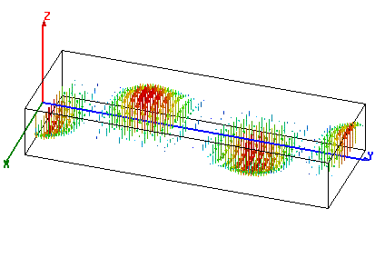
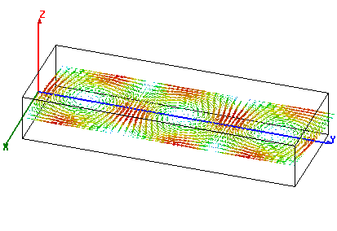
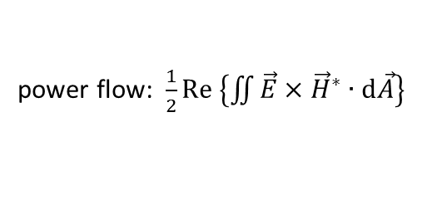
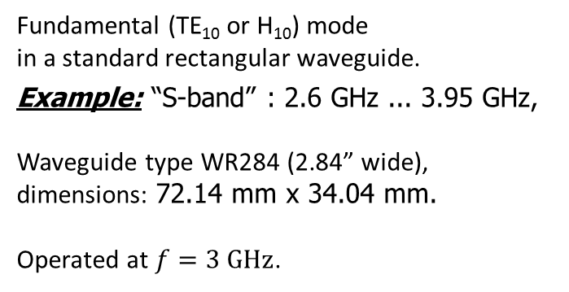
Rectangular waveguide
Fundamental (TE₁₀ or H₁₀) mode
in a standard rectangular waveguide.
Example: “S-band” : 2.6 GHz ... 3.95 GHz,
Waveguide type WR284 (2.84” wide), dimensions: 72.14 mm x 34.04 mm.
Operated at $f=3 \text{GHz}$.
power flow
electric field
power flow: $\frac{1}{2}\text{Re} \left\{\iint{\vec{E}}×{\vec{H}}^{∗}∙\text{d}\vec{A}\right\}$
magnetic field
power flow

Slide 16
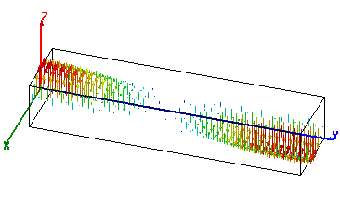
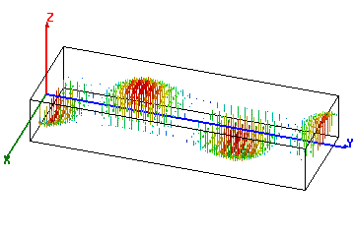

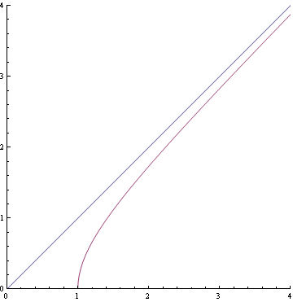


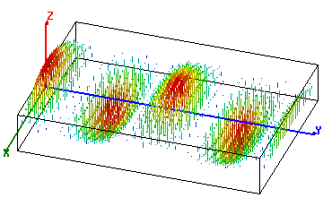


Waveguide dispersion
f = 3 GHz
What happens with different waveguide dimensions (different width a)?
1:
a = 52 mm,
f/f_{c} = 1.04
2:
a = 72.14 mm,
f/f_{c} = 1.44
3
2
3:
a = 144.3 mm,
f/f_{c} = 2.88
1
cutoff

Slide 17







Phase velocity
The phase velocity is the speed with which the crest or a zero-crossing travels in z-direction.
Note on the three animations on the right that, at constant f, it is .
Note that at , !
With , !
f = 3 GHz
1:
a = 52 mm,
f/f_{c} = 1.04
2:
a = 72.14 mm,
f/f_{c} = 1.44
3
2
3:
a = 144.3 mm,
f/f_{c} = 2.88
1
cutoff

Slide 18
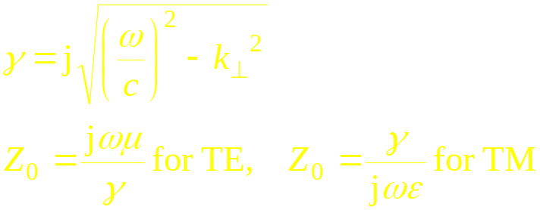
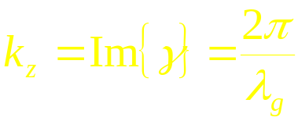
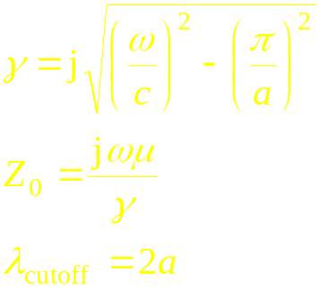
Summary waveguide dispersion and phase velocity:
In a general cylindrical waveguide:
e.g.: TE₁₀-wave in rectangular waveguide:
In a hollow waveguide: phase velocity > c, group velocity < c

Slide 19
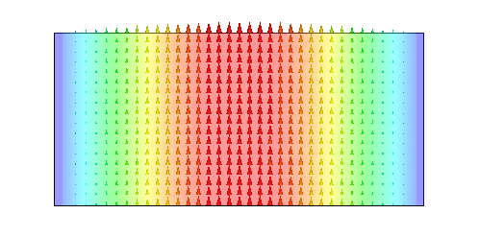
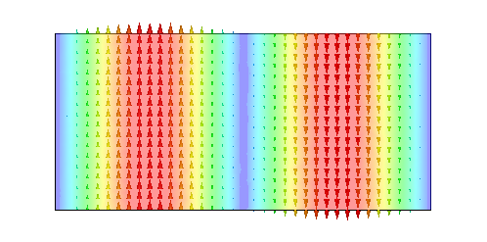
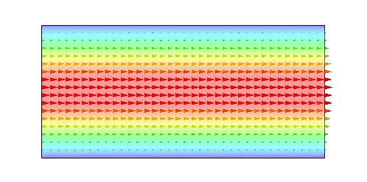
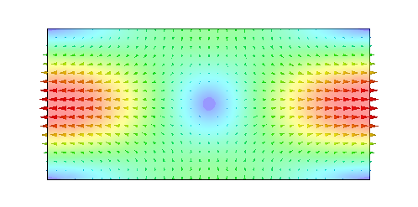
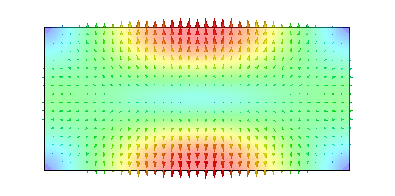
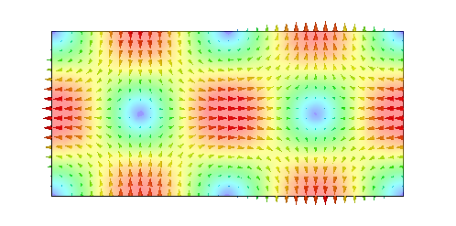
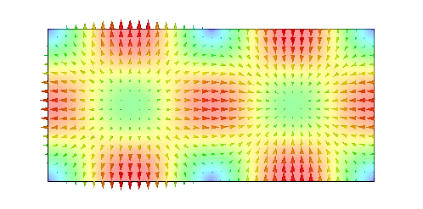
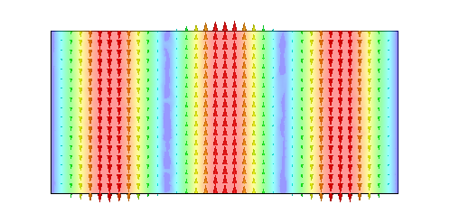
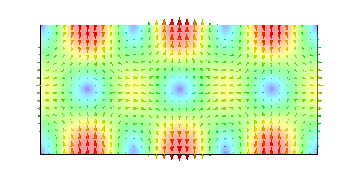
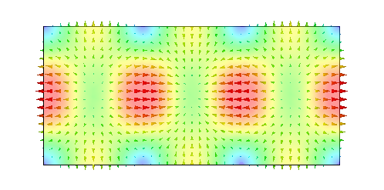
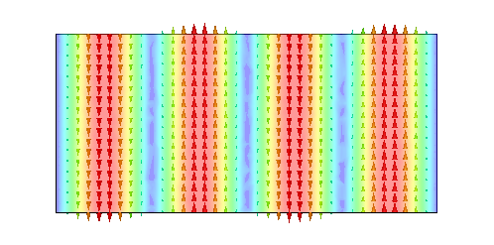









Rectangular waveguide modes
TE₁₀
TE₂₀
TE₀₁
TE₁₁
TM₁₁
TE₂₁
TM₂₁
TE₃₀
TE₃₁
TM₃₁
TE₄₀
TE₀₂
TE₁₂
TM₁₂
TE₄₁
TM₄₁
TE₂₂
TM₂₂
TE₅₀
TE₃₂
plotted: E-field

Slide 20





Radial waves
Also radial waves may be interpreted as superposition of plane waves.
The superposition of an outward and an inward radial wave can result in the field of a round hollow waveguide.

Slide 21









Round waveguide
f/f_{c} = 1.44
TE₁₁ – fundamental
TM₀₁ – axial field
TE₀₁ – low loss

Slide 22









Circular waveguide modes
TE₁₁
TE₁₁
TM₀₁
TE₂₁
TE₂₁
TE₃₁
TE₃₁
TE₀₁
TM₁₁
plotted: E-field

Slide 23


General waveguide equations:
Transverse wave equation (membrane equation): $∆T+{\left(\frac{ω_{c}}{c}\right)}^{2}T=0$.
 | TE (or H-) modes | TM (or E-) modes
Boundary condition: | $$\vec{n}∙∇T=0$$ | $$T=0$$
longitudinal wave equations (transmission line equations): | $$\frac{dU\left(z\right)}{dz}+γZ_{0}I\left(z\right)=0 \\ \frac{dI\left(z\right)}{dz}+\frac{γ}{Z_{0}}U\left(z\right)=0$$
Propagation constant: | $$γ=j\frac{ω}{c}\sqrt{1−{\left(\frac{ω_{c}}{ω}\right)}^{2}}$$
Characteristic impedance: | $$Z_{0}=\frac{jωμ}{γ}$$ | $$Z_{0}=\frac{γ}{jωε}$$
Ortho-normal eigenvectors: | $$\vec{e}={\vec{u}}_{z}×∇T$$ | $$\vec{e}=−∇T$$
Transverse fields: | $$\vec{E}=U\left(z\right)\vec{ e} \\ \vec{H}=I\left(z\right){ \vec{u}}_{z}×\vec{e}$$
Longitudinal fields: | $$H_{z}={\left(\frac{ω_{c}}{ω}\right)}^{2}\frac{T U\left(z\right)}{jωμ}$$ | $$E_{z}={\left(\frac{ω_{c}}{ω}\right)}^{2}\frac{T I\left(z\right)}{jωε}$$

Slide 24








Special cases: rectangular and round waveguide
Rectangular waveguide: transverse eigenfunctions
Round waveguide: transverse eigenfunctions
where in both cases $ε_{i}=\left\{\begin{matrix}1 & if & i=0 \\ 2 & if & i≠0\end{matrix}\right.$
TE (H-) modes: | $$T_{mn}^{(H)}=\frac{1}{π}\sqrt{\frac{a b ε_{m}ε_{n}}{{\left(mb\right)}^{2}+{\left(na\right)}^{2}}}\cos\left(\frac{mπ}{a}x\right)\cos\left(\frac{nπ}{b}y\right)$$
TM (E-) modes: | $$T_{mn}^{(E)}=\frac{2}{π}\sqrt{\frac{a b}{{\left(mb\right)}^{2}+{\left(na\right)}^{2}}}\sin\left(\frac{mπ}{a}x\right)\sin\left(\frac{nπ}{b}y\right)$$
$$b$$
$$a$$
$$\frac{ω_{c}}{c}=\sqrt{{\left(\frac{mπ}{a}\right)}^{2}+{\left(\frac{nπ}{b}\right)}^{2}}$$
TE (H-) modes: | $$T_{mn}^{(H)}=\sqrt{\frac{ε_{m}}{π\left(χ_{mn}^{′2}−m^{2}\right)}}\frac{J_{m}\left(χ_{mn}^{′}\frac{ρ}{a}\right)}{J_{m}\left(χ_{mn}^{′}\right)} \left\{\begin{matrix}\cos\left(mφ\right) \\ \sin\left(mφ\right)\end{matrix}\right\}$$
TM (E-) modes: | $$T_{mn}^{(E)}=\sqrt{\frac{ε_{m}}{π}} \frac{J_{m}\left(χ_{mn}\frac{ρ}{a}\right)}{J_{m−1}\left(χ_{mn}\right)} \left\{\begin{matrix}\sin\left(mφ\right) \\ \cos\left(mφ\right)\end{matrix}\right\}$$
$$∅=2a$$
$$\frac{ω_{c}}{c}=\frac{χ_{mn}}{a}$$

Slide 25


Waveguide perturbed by notches
“notches”
Signal flow chart
Reflections from notches lead to a superimposed standing wave pattern.
“Trapped mode”

Slide 26




Short-circuited waveguide
TM₀₁₀ (no axial dependence)
TM₀₁₁
TM₀₁₂

Slide 27







Single WG mode between two shorts
short
circuit
$$a$$
$$e^{−jk_{z}ℓ}$$
short
circuit
$$−1$$
Signal flow chart
$$−1$$
$$e^{−jk_{z}ℓ}$$
$$−ae^{−jk_{z}ℓ}$$
Eigenvalue equation for field amplitude $a$:
$$a=e^{−jk_{z}2ℓ}a$$
Non-vanishing solutions exist for $2k_{z}ℓ=2πm$:
With $k_{z}=\frac{ω}{c}\sqrt{1−{\left(\frac{ω_{c}}{ω}\right)}^{2}}$, this becomes $f_{0}^{2}=f_{c}^{2}+{\left(c\frac{m}{2𝓁}\right)}^{2}$.

Slide 28


Simple pillbox
(only 1/2 shown)
TM₀₁₀-mode
electric field (purely axial)
magnetic field (purely azimuthal)

Slide 29








Pillbox cavity field (w/o beam tube)
h
Ø 2a
The only non-vanishing field components :

Slide 30


Pillbox with beam pipe
TM₀₁₀-mode
(only 1/4 shown)
One needs a hole for the beam pipe – circular waveguide below cutoff
electric field
magnetic field

Slide 31


A more practical pillbox cavity
TM₀₁₀-mode
(only 1/4 shown)
Round of sharp edges (to reduce field enhancement!)
electric field
magnetic field

Slide 32
Accelerating gap

Slide 33

Accelerating gap
We want a voltage across the gap!
It cannot be DC, since we want the beam tube on ground potential.
Use $\int{\vec{E}∙d\vec{s}}=−\iint{\frac{d\vec{B}}{dt}∙d\vec{A}}$
The “shield” imposes a
  upper limit of the voltage pulse duration or – equivalently –
  a lower limit to the usable frequency.
The limit can be extended with a material which acts as “open circuit”!
Materials typically used:
  ferrites (depending on f-range)
  magnetic alloys (MA) like Metglas®, Finemet®, Vitrovac®…
resonantly driven with RF (ferrite loaded cavities) – or with pulses (induction cell)
gap voltage

Slide 34

Ferrite cavity
CERN
PS Booster, ‘98
0.6 – 1.8 MHz
< 10 kV gap
NiZn ferrites

Slide 35



Finemet® Cavity
Finemet® is a magnetic alloy exhibiting
wideband frequency response and large
magnetic field saturation level; it allows
building wide-band cavities.
Compared to ferrite cavities, no bias is
needed!
Example: the CERN PSB 5-gap system:
Single Finemet® ring on its cooling plate
frequency response: (0.6 … 4) MHz
5 gap prototype
… installed in PSB ring 4

Slide 36

Gap of PS cavity (prototype)

Slide 37



Drift Tube Linac (DTL) – how it works
For slow particles !
E.g. protons @ few MeV
The drift tube lengths
can easily be adapted.
electric field

Slide 38


Drift tube linac – practical implementations

Slide 39
Characterizing a cavity

Slide 40



Acceleration voltage & R-upon-Q
I define $V_{acc}=\int{E_{z} e^{j\frac{ω}{βc}z}dz}$. The exponential factor accounts for the variation of the field while particles with velocity $βc$ are traversing the gap (see next page).
With this definition, $V_{acc}$ is generally complex – this becomes important with more than one gap. For the time being we are only interested in $\left|V_{acc}\right|$.
Attention, different definitions are used!
The square of the acceleration voltage is proportional to the stored energy .
The proportionality constant defines the quantity called R-upon-Q:
$$\frac{R}{Q}=\frac{{\left|V_{acc}\right|}^{2}}{2ω_{0}W}$$
Attention, also here different definitions are used!

Slide 41



Transit time factor
The transit time factor is the ratio of the acceleration voltage to the (non-physical) voltage a particle with infinite velocity would see.
The transit time factor of an ideal pillbox cavity (no axial field dependence) of height (gap length) h is:
Field rotates by 360° during particle passage.
h/λ

Slide 42


Shunt impedance
The square of the acceleration voltage is proportional to the power loss .
The proportionality constant defines the quantity “shunt impedance”
Attention, also here different definitions are used!
Traditionally, the shunt impedance is the quantity to optimize in order to minimize the power required for a given gap voltage.

Slide 43



Cavity resonator - equivalent circuit
Simplification: single mode
I_{G}
I_{B}
V_{acc}
P
Generator
Z
Beam
C
L
R
L=R/(Qω₀)
: coupling factor
C=Q/(Rω₀)
Cavity
R: Shunt impedance
: R-upon-Q

Slide 44

Resonance

Slide 45
Reentrant cavity
Nose cones increase transit time factor, round outer shape minimizes losses.
Example: KEK photon factory 500 MHz - R probably as good as it gets -
this cavity optimized
pillbox
R/Q: 111 Ω 107.5 Ω
Q: 44270 41630
R: 4.9 MΩ 4.47 MΩ
nose cone

Slide 46




Loss factor
Impedance seen by the beam
I_{B}
V (induced)
Beam
Energy deposited by a single charge q:
R/β
C
L
R
L=R/(Qω₀)
C=Q/(Rω₀)
Cavity
Voltage induced by a single charge q:
1
0
-
1
0
5
1
0
1
5
2
0
t f₀

Slide 47




Summary: relations V_{gap}, W, P_{loss}
R-upon-Q
gap voltage
V_{gap}
Shunt impedance
Energy stored inside the cavity
Power lost in the cavity walls
W
P_{loss}
Q factor

Slide 48



Beam loading – RF to beam efficiency
The beam current “loads” the generator, in the equivalent circuit this appears as a resistance in parallel to the shunt impedance.
If the generator is matched to the unloaded cavity, beam loading will cause the accelerating voltage to decrease.
The power absorbed by the beam is , the power loss .
For high efficiency, beam loading shall be high.
The RF to beam efficiency is .

Slide 49

Beam Loading – allows efficiency
choice for CLIC main beam
full beam loading – optimum efficiency
eta
acceleration

Slide 50









Characterizing cavities
Resonance frequency
Transit time factor
  field varies while particle is traversing the gap
Shunt impedance
  gap voltage – power relation
Q factor
R/Q
  independent of losses – only geometry!
loss factor
Circuit definition
Linac definition

Slide 51






Example Pillbox:

Slide 52


Pillbox: dipole mode
TM₁₁₀-mode
(only 1/4 shown)
electric field
magnetic field

Slide 53

Panofsky-Wenzel theorem
For particles moving virtually at v=c, the integrated transverse force (kick) can be determined from the transverse variation of the integrated longitudinal force!
Pure TE modes: No net transverse force !
Transverse modes are characterized by
the transverse impedance in ω-domain
the transverse loss factor (kick factor) in t-domain !
W.K.H. Panofsky, W.A. Wenzel: “Some Considerations Concerning the Transverse Deflection of Charged Particles in Radio-Frequency Fields”, RSI 27, 1957]

Slide 54



CERN/PS 80 MHz cavity (for LHC)
inductive (loop) coupling,
low self-inductance

Slide 55


Higher order modes
Example shown:
80 MHz cavity PS for LHC.
Color-coded:

Slide 56
Higher order modes
external dampers
R₁, Q₁,ω₁
R₂, Q₂,ω₂
R₃, Q₃,ω₃
...
...
n₁
n₂
n₃
I_{B}

Slide 57

Higher order modes (measured spectrum)
without dampers
with dampers

Slide 58
More examples of cavities

Slide 59

PS 19 MHz cavity (prototype, photo: 1966)

Slide 60



Examples of cavities
PEP II cavity
476 MHz, single cell,
1 MV gap with 150 kW,
strong HOM damping,
LEP normal-conducting Cu RF cavities,
350 MHz. 5 cell standing wave + spherical cavity for energy storage, 3 MV

Slide 61




CERN/PS 40 MHz cavity (for LHC)
example for capacitive coupling
coupling C
cavity

Slide 62
RF power sources

Slide 63






RF Power sources
> 200 MHz: Klystrons
Thales TH1801, Multi-Beam Klystron (MBK), 1.3 GHz,
117 kV. Achieved:
48 dB gain, 10 MW peak, 150 kW average, η = 65 %
Output
Cavity
Input
Cavity
Gun
48 dB:
Magnet
Collector
< 1000 MHz: grid tubes
Window
Intermediate
cavities
electrons bunching
pictures from http://www.thales-electrondevices.com
Tetrode IOT UHF Diacrode®

Slide 64

RF power sources

Slide 65

Example of a tetrode amplifier (80 MHz, CERN/PS)
400 kW, with fast RF feedback
18 Ω coaxial output (towards cavity)
22 kV DC anode voltage feed-through with λ/4 stub
tetrode cooling water feed-throughs
coaxial input matching circuit

Slide 66
Many gaps

Slide 67



What do you gain with many gaps?
The R/Q of a single gap cavity is limited to some 100 Ω.
Now consider to distribute the available power to n identical cavities: each will receive P/n, thus produce an accelerating voltage of .
The total accelerating voltage thus increased, equivalent to a total equivalent shunt impedance of .
P/n
P/n
P/n
P/n
1
2
3
n

Slide 68

Standing wave multicell cavity
Instead of distributing the power from the amplifier, one might as well couple the cavities, such that the power automatically distributes, or have a cavity with many gaps (e.g. drift tube linac).
Coupled cavity accelerating structure (side coupled)
The phase relation between gaps is important!

Slide 69


Example of Side Coupled Structure
LIBO (= Linac Booster)
A 3 GHz Side Coupled Structure to accelerate protons out of cyclotrons from 62 MeV to 200 MeV
Medical application:
treatment of tumours (proton therapy)
Prototype of Module 1 built at CERN (2000)
Collaboration CERN/INFN/TERA Foundation

Slide 70

LIBO prototype
This Picture made it to the title page of CERN Courier vol. 41 No. 1 (Jan./Feb. 2001)

Slide 71
Travelling Wave Structures

Slide 72




Brillouin diagram
Travelling wave structure
π
ω L/c
2π/3
2π
speed of light line,
ω = β /c
π
synchronous
π/2
π/2
0
0
π/2
β L
π

Slide 73

Iris loaded waveguide
11.4 GHz structure (NLC)
1 cm
30 GHz structure

Slide 74

Disc loaded structure with strong HOM damping
“choke mode cavity”
Dimensions in mm

Slide 75

Power coupling with waveguides
Input coupler
shown: Re {Poynting vector} (power density)
Output coupler
Travelling wave structure
(CTF3 drive beam, 3 GHz)
¼ geometry shown

Slide 76

3 GHz Accelerating structure (CTF3)

Slide 77




Examples (CLIC structures @ 11.4, 12 and 30 GHz)
“HDS” – novel fabrication technique
“T18” reached 105 MV/m!

Slide 78
Superconducting Accelerating Structures

Slide 79



RF Superconductivity
Best described by BCS (Bardeen-
Cooper-Schrieffer) Theory
$R_{BCS}∝\frac{ω^{2}}{T}\exp\left(−1.76 \frac{T_{c}}{T}\right)$
Surface resistance $R=R_{BCS}+R_{res}$.
$R$ is not zero - $Q_{0}$ is finite.
Good values are some ${10}^{10}$.
Typical performance plot of a SC cavity:
From prst-ab.aps.org/abstract/PRSTAB/v3/i9/e092001

Slide 80




Elliptical multi-cell cavities
At $1.3 GHz$:
$R_{0}=103.3 mm$,
$2L=115.3 mm$.
The elliptical shape was found as
optimum compromise between
  maximum gradient ($E_{acc}/E_{surf}$)
  suppression of multipactor
  mode purity
  machinability
Operated in $π$-mode, i.e. cell length
is exactly ${βλ}/2$.
It has become de facto standard,
used for ions and leptons! E.g.:
  ILC/X-FEL: 1.3 GHz, 9-cell cavity
  SNS (805 MHz)
  SPL/ESS (704 MHz)
  LHC (400 MHz^{*)})
D. Proch: SRF 1993 *)
*): accelconf.web.cern.ch/accelconf/SRF93/papers/srf93g01.pdf‎

Slide 81




LHC SC RF, 4 cavity module, 400 MHz
installed in LHC IP4, 2 MV/cavity
LHC spare module stored in CERN’s SM18

Slide 82










Small $β$ superconducting cavities (example RIA, Argonne)
split ring cavity
$β=0.2$ “lollipop” cavity
$β=0.06$ QWR
¼-wave-resonator
$$β=0.021$$
fork cavity
$$β=0.03$$
fork cavity
$β=0.4$ spoke cavity
Some pictures from Shepard et al.: “Superconducting accelerating structures for a multi-beam driver linac for RIA”, Linac 2000, Monterey.

Slide 83





SC Cavity Cryomodule examples
HIE-Isolde (radioactive isotopes post-accelerator), 101 MHz, 5-cavity CM
SPL/ESS 704 MHz CM (partial view)
Bi-phase helium tube
Helium Tank
¼ wave cavity
Bellows
CEA’s tuner
Bulk Niobium 5Cells cavity
Magnetic shielding
Hom Coupler
Inter-cavity support
Double walled tube
RF Power Coupler
ILC/X-FEL 1.3 GHz, 8 cavity CM

Slide 84








SPL Cryomodule assembly sequence
Rossana Bonomi (CERN)
1- String of dressed cavities from clean room
2- Mounting of magnetic shields
3- Mounting of tuners and inter-cavity supports
4- Mounting of cryogenic distribution
5- Mounting of coupler cooling line
6- Mounting of thermal shield
Design by CNRS-IPNO
(courtesy of S.Rousselot)
7- Insertion in vacuum vessel
8- Closing vacuum vessel

Slide 85





HL-LHC Crab Cavity test CM
He vessel manufacturing
crab cavity
2-cavity string
He vessel
Cryomodule
Presently under study!
thermal shield
magnetic shield
T. Jones, S. Pattalwar

Slide 86
Cavity Fabrication techniques

Slide 87
Materials
Selection criteria
  Electrical conductivity
  Secondary emission yield
  mechanical stiffness/hardness
  thermal conductivity, thermal expansion
  machining & joining techniques
  vacuum tight, low outgassing rate
  creep resistance,
  magnetic permeability
  radiation hardness
  fatigue stress
  …
Important: specify what you need and what you can measure/control at reception!

Slide 88
OFE copper
Most room temperature cavities are made from copper (SLAC, CERN LEP, etc., B-factories) – (but still with plenty of exceptions, aluminium PEP).
Solid OFE*) copper was used in LEP injector linac and the NC linear collider studies (NLC, JLC, CLIC). It is used for NC linacs today (Linac4, CLIC & CTF, linac based light sources and medical linacs).
Copper becomes soft after annealing (or brazing). It is hardened by deformation (forging).
The copper for the LEP storage cavities and for CERN’s S-Band waveguides contain 0.1% silver (Cu-OFS), which increases the creep resistance by a factor 5.
“official names”: copper OFE Grade 1 (ASTM B224-98 oxygen free electronic, ISO 431 Cu-OFE, UNS C10100)
*) also called OFHC – oxygen free high conductivity

Slide 89



Galvanic Cu plating of stainless steel
In the surface-chemistry lab: the cavity itself was used as container
Anodes made from Pt coated Ti, adapted to the inner shape of the cavity.
Inside surface of the electroplated cavity

Slide 90


Niobium
Magnets use NbTi or Nb₃Sn, SC Cavities use mainly Nb!
Pure Nb has a high critical magnetic field ($H_{c}=200 mT$)
Nb has a high transition temperature ($T_{c}=9.3 K$).
It is chemically inert (surface covered by oxide layer)
It can be machined and deep-drawn
It is available as bulk and sheet material in any size, fabricated by forging and rolling
Large grain sizes (often favoured) obtained by e-beam melting
Instead of bulk or sheet Nb, Nb can also be coated (e.g. by sputtering) on Cu – CERN has built the LEP, LHC and HIE-Isolde cavities with this technique. Advantages: thermal stability, material cost, optimisation of $R_{BCS}$ possible; disadvantages: difficult technology to master, lower $Q_{0}$.
Nb ingot after EBM at Heraeus (D)

Slide 91

Dielectrics
Aluminium oxide, AL₂O₃, aka Alumina, is
often used in vacuum/RF windows and
vacuum feed-throughs.
Isostatically pressed AL₂O₃ is used for
leak-tightness (LEP power couplers, e.g.).
To reduce multipactor, it is often coated
with titanium or titanium nitride (TiN).
Other window materials: Sapphire, BeO,
quartz, diamond …)
Silicon carbide (SiC), C-loaded AlN have been effectively used as RF absorbers inside vacuum.
Different ferrites are used as absorbers and to use their variable magnetic permeability.
Coax transition through alumina window with traces of breakdown

Slide 92

Metal forming
Typical surface finish for classical machining operations

Slide 93


Turning
Classical industrial technique; cheap and accurate, gives excellent surface finish. Applies to a wide range of cavity dimensions (frequencies).
NB.:
Cutting fluids should be oil-free and sulphur free.
High-speed machining with diamond tools can be made with alcohol or even dry.
Diamond-turned Cu disks with 30-GHz cavities. Precise control of surface finish down to N1.
Part of the PS 40 MHz cavity after raw machining

Slide 94


5-axis milling
Direct 5-axis milling of cooling water circuit groove in PEPII cavity.

Slide 95



EDM (Electric discharge machining)
Machines el. conductors (metals, alloys, carbides, graphite etc.) by creating sparks with temperatures of 8,000 to 12,000 °C. The part and the electrode are immersed in a dielectric liquid, usually water or mineral oil. There are two types of EDM, die sinking and wire cutting.
die sinking
wire cutting
wire cutting of the iris slots of SICA (slotted iris – constant aperture) disks for CERN’s CTF3 drive beam accelerator

Slide 96















Fabrication of Nb sheets at
Nb ingot
Forging
Cutting
Pressing
Milling
Annealing
1st EB melting
Rolling
Levering
2nd, 3rd … EB melting
Polishing
Chemical polishing
Separate from base plate
Inspections: (ICP-AES, Gas analysis, RRR, grain size, hardness tensile stress …)
Rolling

Slide 97
Other forming techniques
Forging, pressing, deep drawing, …
Spinning, planing, rolling, …
lapping, polishing, electropolishing, …
Electroforming, hydroforming, explosion forming
Powder metal techniques, 3-D printing
Sputtering
…

Slide 98





Joining techniques
TIG welding
EB welding
Microstructure of the EB welding area
grain size (50 ÷ 2000) μm
double joint:
inner for vacuum,
out for mechanical stability

Slide 99



Advances in SCRF Technology
Preparing for EP (inserting cathode)
Photos: Rongli Geng
Clean room assembly (JLAB)
C. Antoine: CAS SC 2013

Slide 100
Thank you very much!

