Slide 1
Instabilities in High Energy Colliders II
Oliver Boine-Frankenheim,
TU Darmstadt and GSI, Darmstadt
Contents:
Part 1: Collective forces on beam particles: Wakefields, Impedances and electron clouds
Part 2: Modes of oscillation in bunches, Instabilities and thresholds
Part 3: Landau damping and instability cures

Slide 2
Introduction
Electromagnetic (EM) interaction of the beam with its surroundings can be described by impedances or wake fields. For rough estimates also the interaction with electron cloud can be described by wake functions (see Part 1).
Impedances/Wakefields cause complex coherent tune shifts and (above some threshold intensity) unstable coherent beam oscillations (Part 2).
Cures: Impedance reduction, Landau damping and tune spread (Part 3), feedback systems,..
Focus on high energy beams in rings and transverse instabilities in this lecture.

Slide 3
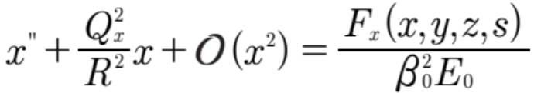


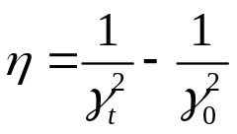
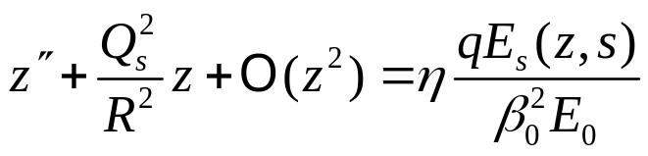
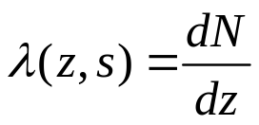

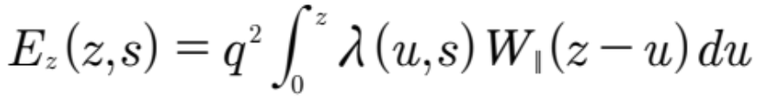

(Reduced) 3D beam physics model
(horizontal betatron oscillations)
Nonlinear terms:
Landau damping
(Energy)
$$R: ring radius$$
(synchrotron oscillations)
(frequency slip factor)
3D beam density:
Line density:
Collective forces:
(Wakes and impedances)
(longitudinal electric field)

Slide 4

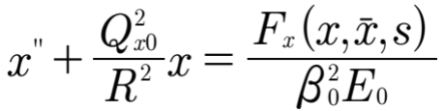

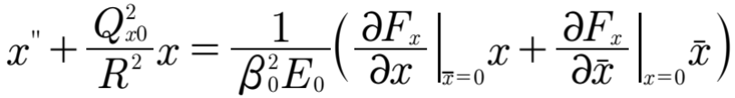


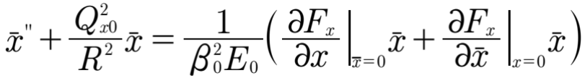
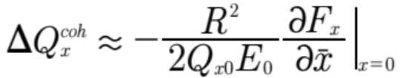
Transverse tune shifts (2D or coasting beam)
Betatron oscillations with beam induced forces:
y
(only horizontal)
x
s
Assuming small offsets:
Incoherent tune shift:
Beam offset oscillations (coherent):
Coherent tune shift:

Slide 5

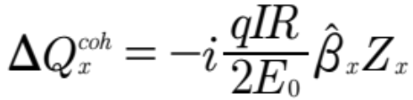
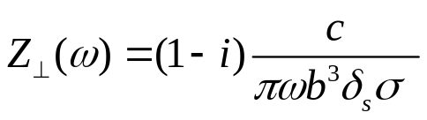
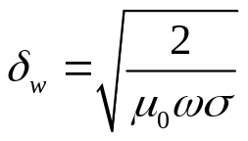
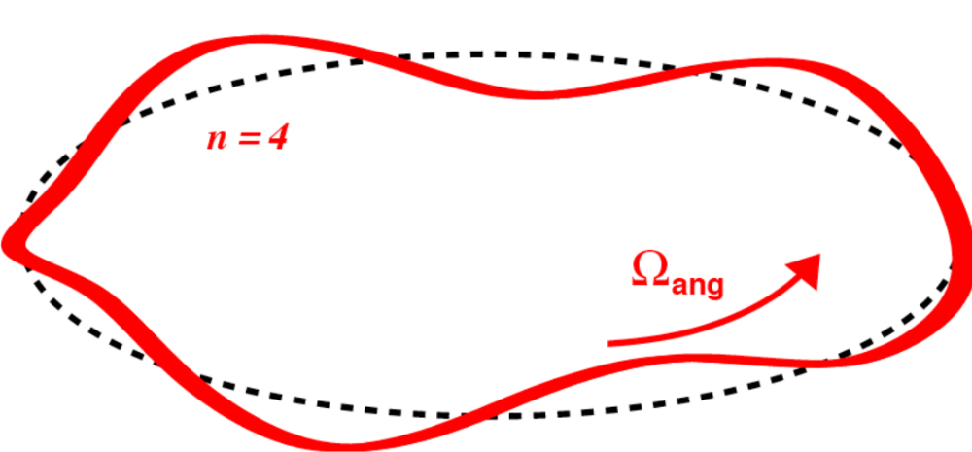
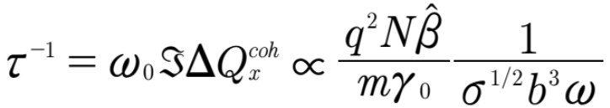







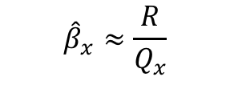


Instability growth rate (coasting beams)
(from Part 1)
$${\hat{β}}_{x}≈\frac{R}{Q_{x}}$$
($β−$function)
$$⇒$$
(Thick wall) resistive wall impedance:
Offset oscillations:
$$\overline{x}\left(θ_{0},t\right)=\hat{x}e^{±iω_{0}Qt}$$
(skin depth)
$$\overline{x}\left(θ,t\right)=\hat{x}e^{i(nθ−ωt)}$$
Instability growth rate:
$$\overline{x}\left(t\right)=\hat{x}e^{t/τ}$$
$$n=4$$
Betatron sideband :
$$ω=\left(n−Q\right)ω_{0}$$
$ω_{0}$: revolution frequency

Slide 6
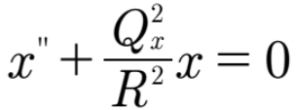
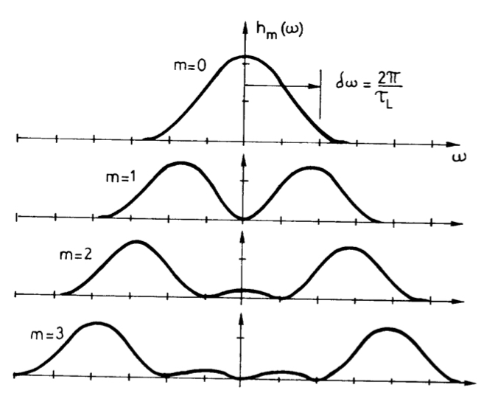
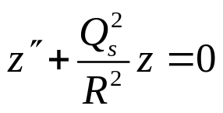











Bunched beams: Transverse head-tail modes
betatron
sidelines
Power spectrum
of head-tail modes
$${\left|Δ\left(ω\right)\right|}^{2}$$
$$k=0$$
Sacherer (1974)
(betatron oscillations)
$$ω$$
$$k=1$$
$$k=2$$
(synchrotron oscillations)
$$k=3$$
head-tail oscillations
$$p_{0}(t)$$
k=0:
$$\overline{x}=Ae^{iω_{0}Q_{x}t}$$
‚rigid‘ mode
Signal:
k=1:
$Δ\left(t\right)=λ\left(t\right)\overline{x}(t)$
$$p_{1}(t)$$
$$×e^{iω_{0}Q_{0}t}$$
Stable (for single bunches) !

Slide 7
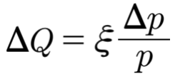
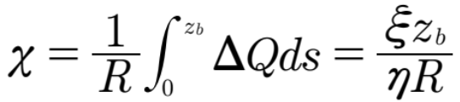





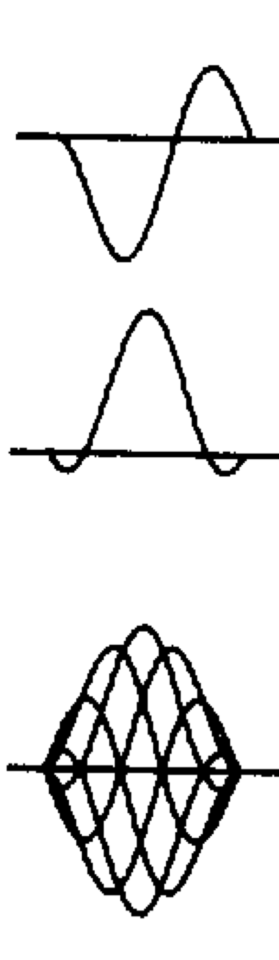
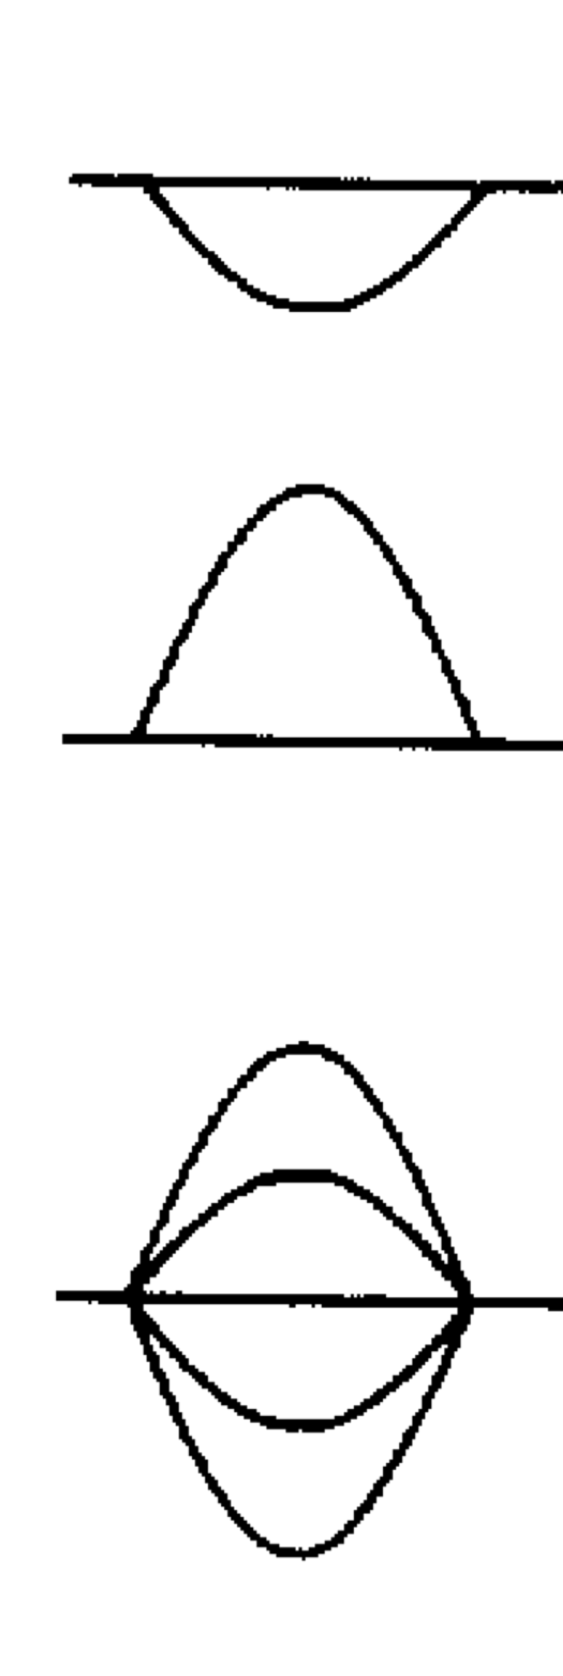

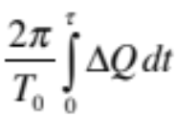
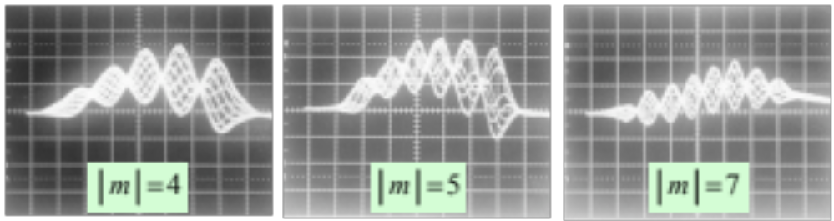
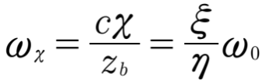
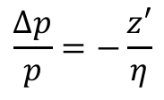


Head-tail modes: Chromatic phase shift
$$\frac{Δp}{p}=−\frac{z′}{η}$$
(Chromatic tune shift)
(head-tail phase shift)
$z_{b}:$bunch length
Traveling wave pattern !
bunch tail
bunch head
z
(betatron phase shift)
Sacherer (1974)
Unstable head-tail oscillations in the CERN PS
Spectrum:
${\left|Δ\left(ω\right)\right|}^{2}→$ ${\left|Δ\left(ω−ω_{χ}\right)\right|}^{2}$
Unstable !

Slide 8

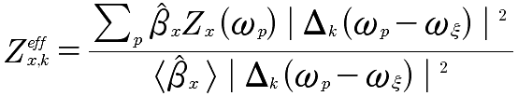
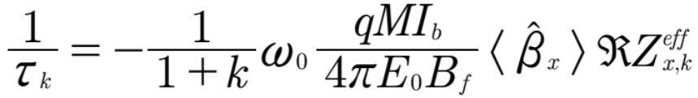








Transverse coupled-bunch instabilities
Example: Coupled „rigid“ bunch mode
Coasting beam:
$${\left|Δ\left(ω\right)\right|}^{2}$$
(chromatic frequency shift)
$$k=0$$
$$ω_{p}=\left(n−Q\right)ω_{0}$$
$$ω$$
Effective impedance:
$$k=1$$
$$k=2$$
$$k=3$$
Growth rate for mode k:
$M:$Number of bunches
Sacherer (1974)

Slide 9
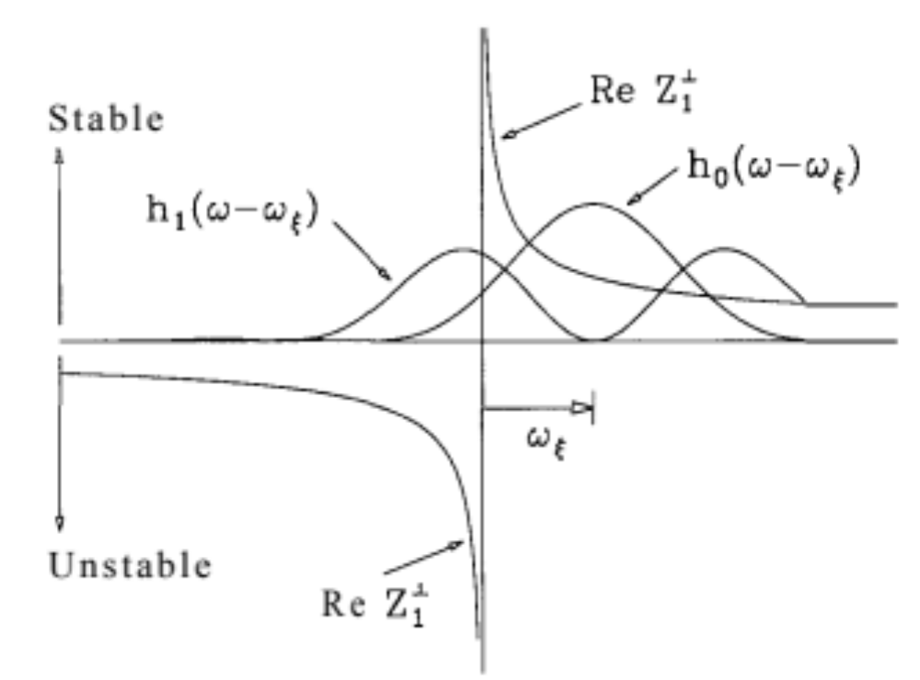





Transverse coupled-bunch instabilities II
for a smooth impedance and
rigid (k=0) oscillations:
$$ω_{p}$$
$${\left|Δ\left(ω−ω_{χ}\right)\right|}_{0}^{2}$$
$${\left|Δ\left(ω−ω_{χ}\right)\right|}_{1}^{2}$$
if only one sideband matters:
(form factor)
Positive/negative chromaticity above/below transition shifts all modes
towards the positive frequency side. Mode k = 0 becomes stable, but
mode k = 1 may be unstable because it samples more negative Z than
positive. No head-tail instability for compensated chromaticity.
Sacherer (1974)

Slide 10

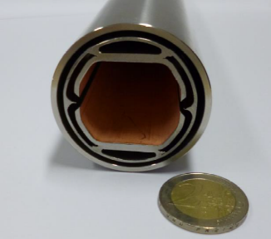
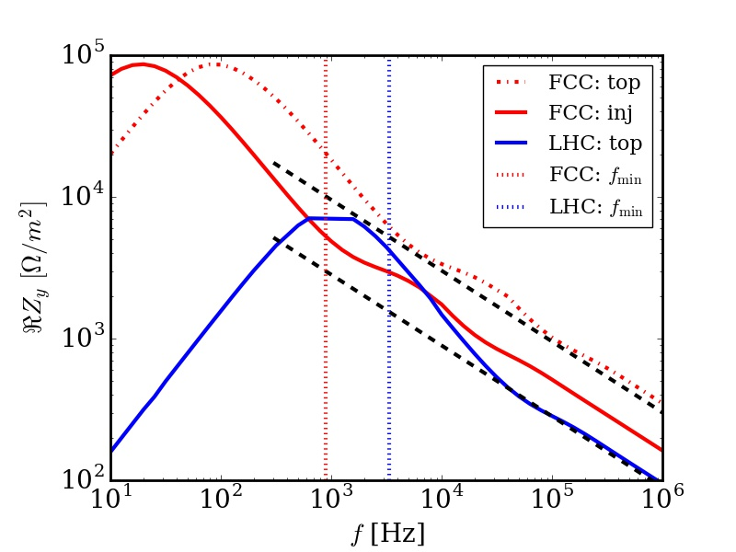

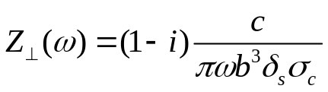
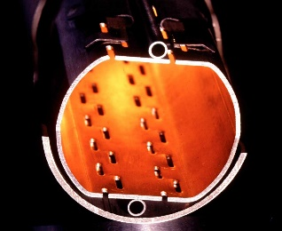

Resistive wall instability:
Growth rates for LHC and FCC-hh
FCC
Growth rate:
$$ω_{min}=\left(n−Q_{y}\right)ω_{0}$$
growth time at 3.3 TeV:
approx. 200 turns
at 50 TeV:
approx. 800 turns
LHC at 7 TeV:
approx. 2000 turns
b=0.02 m
b=0.014 m
LHC
kHz
few kHz
(Thick) resistive wall impedance
Damping by feedback or Landau damping -> Instability thresholds (Part 3)

Slide 11
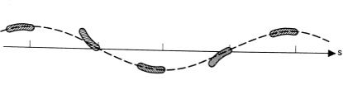
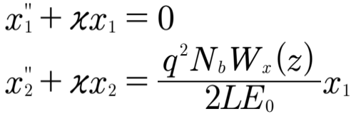
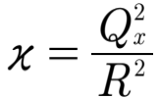
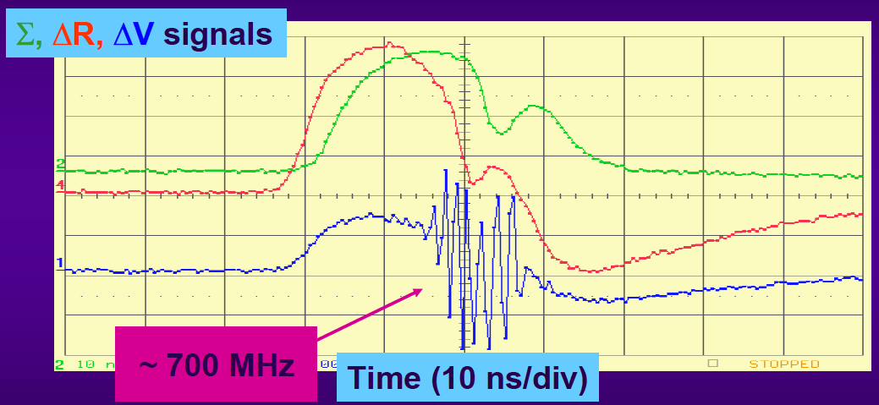

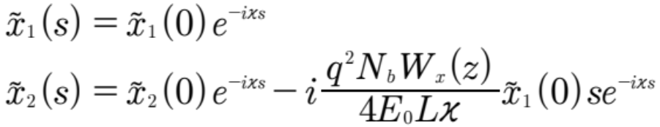






Two-particle model: Single bunch break up
$$\frac{N_{b}}{2}$$
Assume that you have corrected chromaticity
and a (working) feedback system for the „rigid“
coupled bunch instability (or you have a linac).
$$\frac{N_{b}}{2}$$
$W_{x}$(z)
Head
$$x_{2}$$
Tail
$$x_{1}$$
Linac
$$z$$
Two-particle coupled betatron oscillations:
Observation in the CERN PS near transition
New coordinates:
Solution:
Linear growth !
R. Cappi et al. (2000)

Slide 12
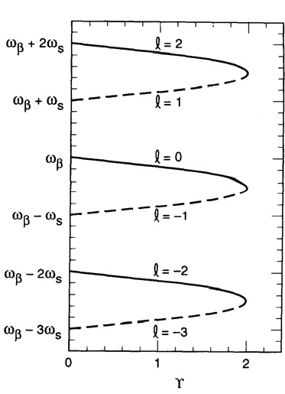

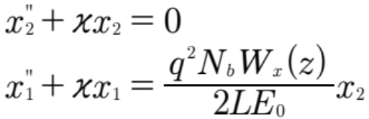
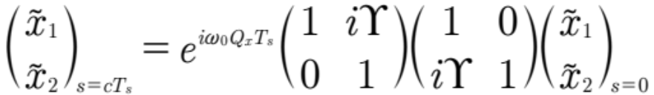
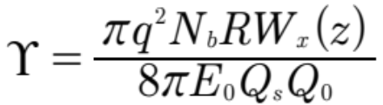








Two-particle model: Strong head-tail instability
Synchrotron oscillations suppress beam breakup !
Mode coupling !
Change of position in z every:
$$Q_{1}$$
Instability threshold !
$$Υ=2$$
$$k=0$$
rigid
$$Q_{0}$$
$$Q_{−1}$$
$$k=−1$$
A. Chao (p. 181): It is straightforward to show that ….
(low intensity)
$$Υ$$
$$Q_{k}=Q_{0}+kQ_{s}$$
A. Chao

Slide 13
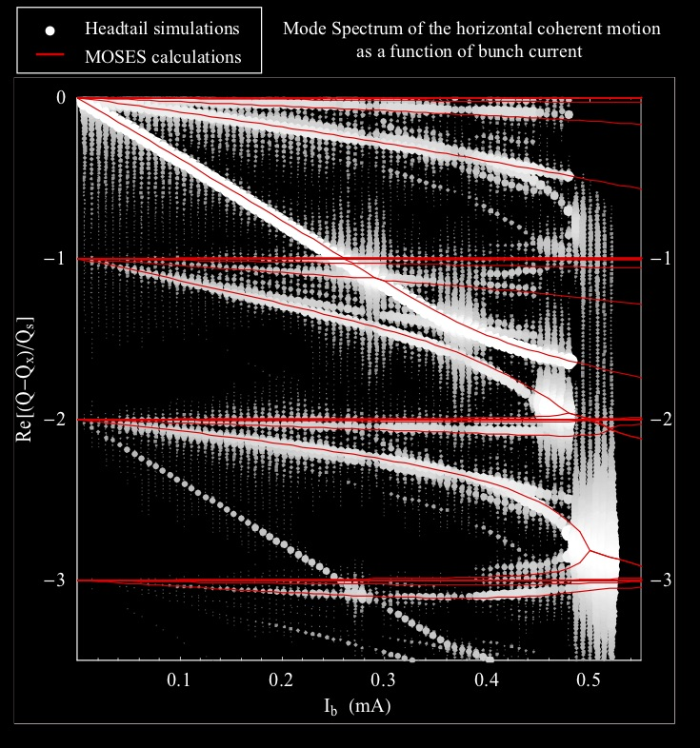
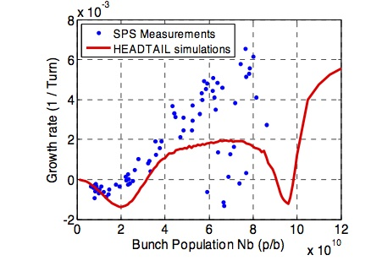
More general:
Transverse Mode Coupling Instabilities (TMCI)
Experiments / Simulations
B. Salvant et. al. 2008

Slide 14
Contents:
Part 1: Collective forces on beam particles: Wakefields, Impedances and electron clouds
Part 2: Modes of oscillation in bunches, instabilities and thresholds
Part 3: Landau damping and instability cures

Slide 15

Landau damping (LD)
Very simple picture (in beams):
-> instability thresholds
Remark: In this short lecture only nonlinearities will
be discussed as a source of the tune spread.
( rms tune spread due
to octupoles, beam-beam.....)
Detailed LD analysis requires: Vlasov equation + Poisson equation
LD of plasma waves:
LD of transverse beam oscillations:
D. Möhl , F. Ruggiero et al.
reversible (see beam/plasma echoes)
still a very active field of research !
Lev Davidovich Landau, On the vibration of the electronic plasma, JETP (1946)
Cédric Villani, Fields medal for (nonlinear) Landau damping, 2010

Slide 16
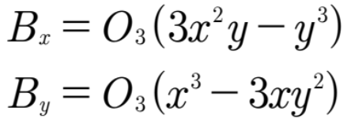
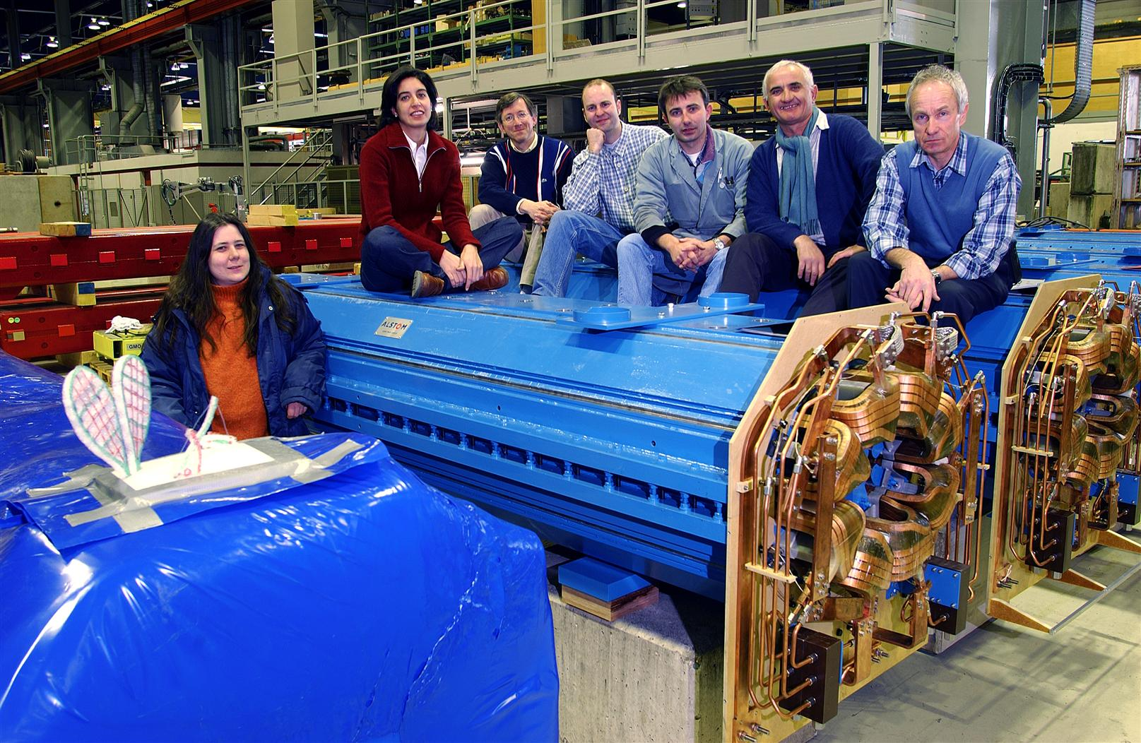
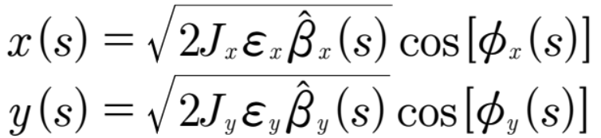

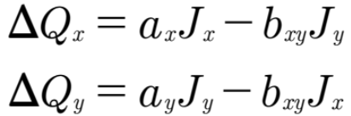



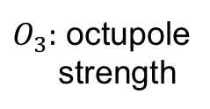
(Nonlinear) tune shifts from octupoles
Magnet field:
LHC: 168 dedicated octupoles
for Landau damping
$O_{3}:$ octupole
strength
Betatron oscillations (incoherent):
$ε_{x,y}:$rms emittances
$J_{x,y}:$normalized amplitudes
Tune shifts (integrated):
Beam distribution:
rms tune spread:

Slide 17
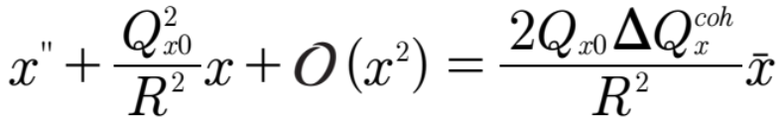







Dispersion relation
Driven (nonlinear) betatron oscillations:
Used from previous slides:
(bare tunes)
(octupoles)
(impedances)
$ℜΩ:$ real coherent shift
Ansatz:
$ℑΩ:$ growth or damping rate
Remark [1]: 1D beam response
2D dispersion relation [2]:
Solve for $Ω$
[1] H. G. Hereward, CERN 65-20 (1965)
[2] J. S. Berg, F. Ruggiero, CERN SL-AP-96-71 (1996)

Slide 18











Application to LHC: Stability diagram
Tune distribution
Stability curve
$$ℑΔQ_{coh}≈0.1$$
$$ℑΔQ_{coh}/{10}^{−3}$$
$$δQ_{oct}≈0.1$$
$$τ^{−1}≈δQ_{inc}$$
$$ℜΔQ_{coh}/{10}^{−3}$$
Numerical damping rate:$τ^{−1}≪ΔQ_{oct}$

Slide 19









Landau damping at very high energies
The good news:
$$\frac{1}{τ}∝\frac{1}{E_{0}}$$
(instability growth rate)
The OK news:
$$δQ_{oct}≈{\left(ω_{0}τ\right)}^{−1}∝\frac{L}{E_{0}}$$
(tune spread required for LD)
The bad news:
$$δQ_{oct}≈N_{oct}L_{m}\frac{ε}{E_{0}^{2}}$$
(tune spread provided by octupoles)
$$E_{0}=γ_{0}mc^{2}$$
$$⇒N_{oct}L_{m}∝E_{0}^{2}$$
$L:$circumference
$L_{m}:$length of magnet
From LHC to FCC-hh: 7² x 168 octupoles
$N_{oct}:$# of magnets
$ε:$normalized emittance

Slide 20



Landau damping by electron lenses
dc e-beam
Similar to the beam-beam force !
Bunch
Matched transverse beam radii.
Electron lenses
Gaussian electron
beam provides a
nonlinear tune shift.
Tune shift induced by a
counter-propagating electron beam:
V. Shiltsev et al., PRL (2017)
Example: One e-lens (l=2 m, I_{e}=1 A) in LHC would
provide a tune spread similar to the 168 octupoles.

Slide 21
Summary and Conclusions: Parts 2+3
Some aspects of transverse beam instabilities with a focus on hadrons and rings were covered.
Landau damping due to the nonlinear tune shifts was discussed.
Besides studies of “passive” Landau damping, active feedback systems are a very active field of R&D and might be able to cure most instabilities in the future.
The study of the interplay of impedances, electron clouds, beam-beam, ... becomes even more relevant as the machines are operated close to the intensity limits.
Computer simulations (particle tracking, Vlasov solvers) are essentials tools to study such more complex scenarios.

Slide 22
Backup

Slide 23
Two-particle model: application to e-cloud

