Slide 1
Instabilities in High Energy Colliders I
Oliver Boine-Frankenheim,
TU Darmstadt and GSI, Darmstadt
Contents:
Part 1: Collective forces on beam particles: Wakefields, Impedances and electron clouds
Part 2: Modes of oscillation in bunches, Instabilities and thresholds
Part 3: Landau damping and instability cures

Slide 2
Introduction
Beam instabilities (as covered in this presentation) are driven by the electromagnetic interaction with the accelerator environment (-> wakefields/impedances) and by electron clouds.
Above a certain intensity threshold the beam’s oscillation amplitude increases
exponentially and the beam is either lost at the wall (transverse instabilities) or
from the rf bucket (longitudinal) and/or the emittance increases.
Presently, heat loads and instabilities are one of the main beam quality and intensity limitation in particle accelerators for high intensity and brightness !
Finding “cures” for instabilities is one of the major challenges in beam physics and accelerator technology for future machines.
High energy beams: Beam instabilities are a ‘current effect’. However, synchrotron radiation, photoelectrons or other high energy effects affect instability thresholds.

Slide 3
Some Literature (used for this lecture)
Books on beam instabilites:
A. Chao, Physics of collective beam instabilities in high energy accelerators (1993)
B. Zotter, S. Kheifets, Impedances and Wakes in High Energy Particle Accelerators(1998)
K.Y. Ng, Physics of intensity dependent beam instabilities (2006)
….
Overview articles and lectures:
B. Zotter, F. Sacherer, Transverse instabilities of relativistic particle beams (1976)
E. Metral et al., Beam instabilities in hadron synchrotrons, Trans. Nucl. Sci. IEEE (2016)
…..

Slide 4



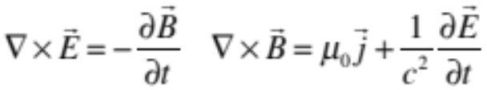
Electromagnetic forces acting on bunches
beam pipe
Incoherent space charge:
e⁻
(in the rest system of the beam)
-> beam intensity and emittance limits
Bunch
Wake fields and impedances:
Image current
(lab system)
-> heat loads and instabilities
Electron clouds:
created wall emission and other mechanisms.
-> heat loads, emittance growth and instabilities
Beam-beam interaction:
Can cause coherent instabilities.
In this lecture: Focus on instabilities driven by
wake fields and electron clouds.
Beyond this lecture: Interplay of different mechanisms.

Slide 5
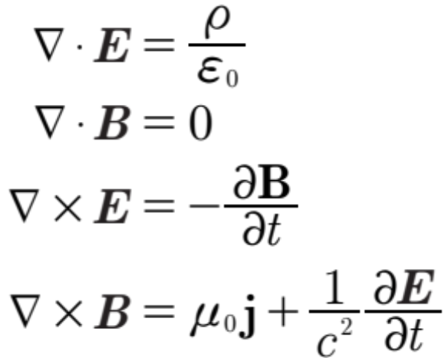
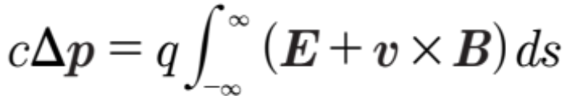


Maxwell‘s equations and Lorentz force
(resistive) beam pipe section
Bunch
$$v=c$$
+ boundary conditions at the walls
Impulse approximation
Rigid bunch approximation
The EM force continuously acting on a test charge is lumped in a single kick after the passage through the structure.
The beam traverses the structure rigidly.

Slide 6
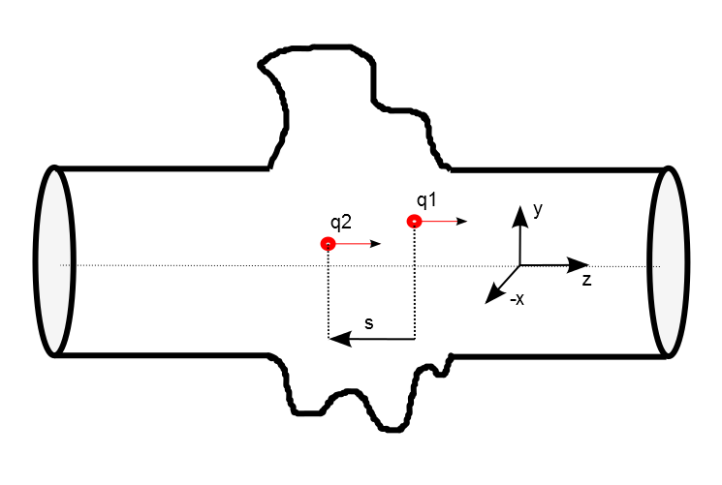


Wake fields
T. Weiland and R. Wanzenberg, “Wake Fields and Impedances,” in CERN Accelerator School (CAS), 1993. 20, 28, 99
L. Palumbo, V. G. Vaccaro, and M. Zobov, “Wake Fields and Impedance,” in Cern Accelerator School, 1994. 20
s
z
Longitudinal:
Transverse:

Slide 7

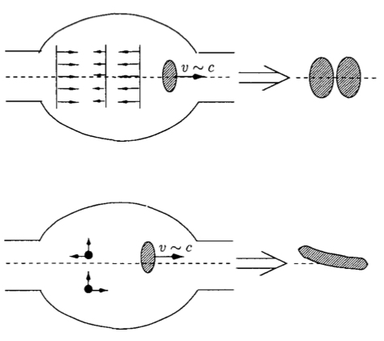




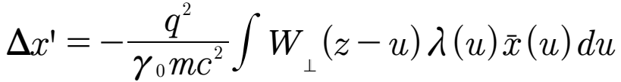

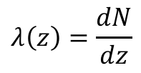
Wake functions
Longitudinal:
For a test particle in a bunch:
(Voltage kick or Wake potential)
Line density:
$$λ\left(z\right)=\frac{dN}{dz}$$
Transverse:
Ng (2006)
For a test particle in a bunch:
(horizontal kick)
$\overline{x}=⟨x⟩$: local bunch offset

Slide 8
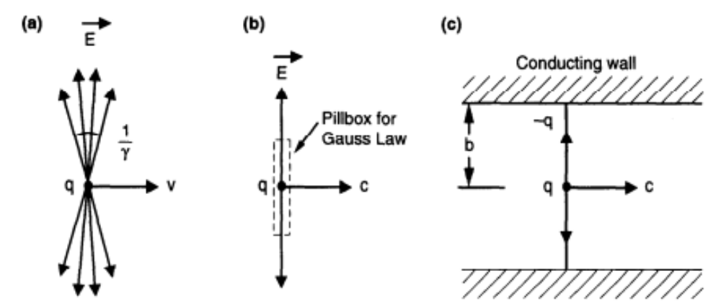

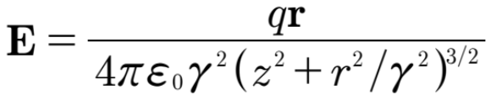
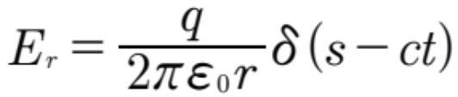
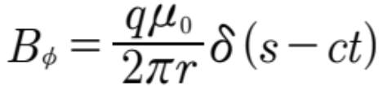

Reminder: Charged particle in free space
A.Chao (1993)
pancaked field
Image charges/currents
follow the particle
ake
Electric field:
Remark:
No wake (without bends)

Slide 9
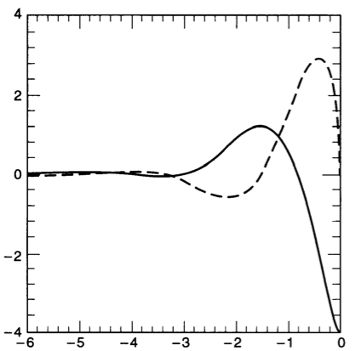
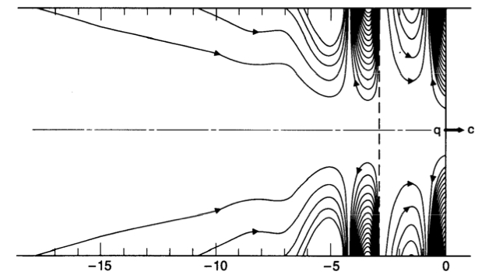



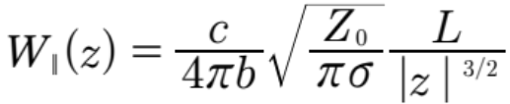

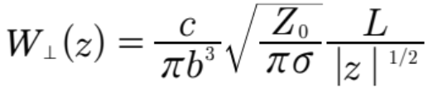


Wake field in a resistive beam pipe
Longitudinal wake field
Finite conductivity:
$$σ$$
A.Chao (1993)
K. Bane (1991)
z
z
Longitudinal:
Energy loss of a bunch:
Transverse:
$λ$: line density

Slide 10
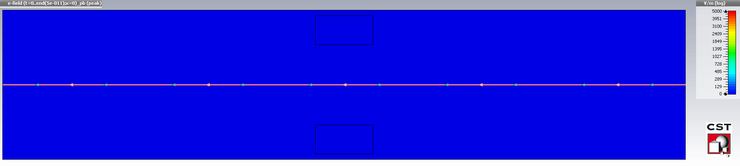
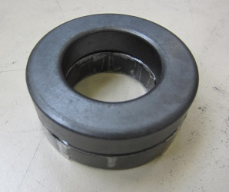
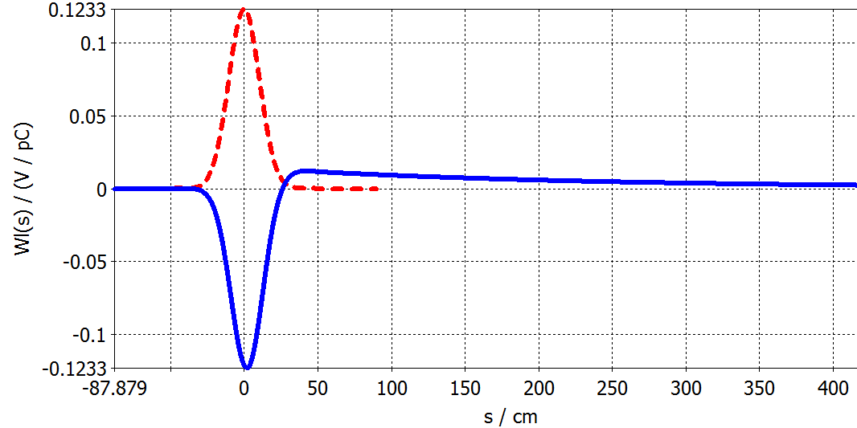
Wake potential: Numerical example
Magnitude of the electric field, logarithmic color scale
10 cm
Longitudinal cut
CST Particle Studio®
Uwe
Beam line density (a.u.)
Wake potential
(convolution of wake function with line density)
Dispersively lossy ferrite material

Slide 11



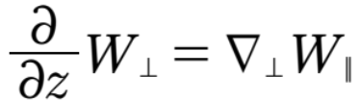



Panofsky-Wenzel Theorem (PWT)
Boundaries do not matter !
Transverse:
For $β=1:$
Wake functions:
+ Impulse approximation
For $β=1:$
+ Rigid bunch approximation
PWT connects transverse and longitudinal wakes.

Slide 12
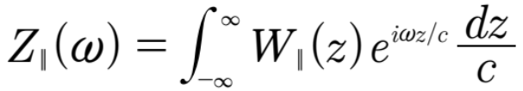
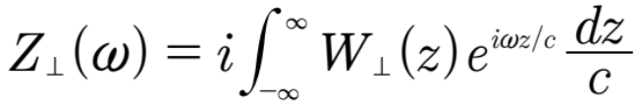


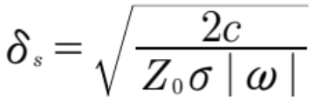




Impedances
Fourier transforms of the wake functions:
$[Ω$]
Impedances:
Bench measurements (with wires)
Frequency-domain (FD) EM simulations
Beam stability: Perturbation theory
Wake functions:
Time-domain (TD) EM simulations
Beam stability: Simulations in TD
$[Ω/m$]
PWT:
Example: cylindrical (thick) beam pipe
$b:$pipe radius
(skin depth)
Other properties:
PWT:

Slide 13

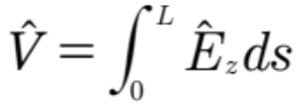









Impedances and current/offset modulations
beam particle
current modulation:
$$I\left(z,t\right)=\hat{I}e^{i(ωt−kz)}$$
induced voltage:
$${\hat{E}}_{z}$$
Transverse impedance (divided by length):
beam pipe
Offset oscillations
B_{y}
image currents
Deflecting dipolar
force:
beam

Slide 14


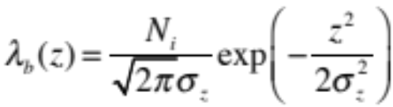
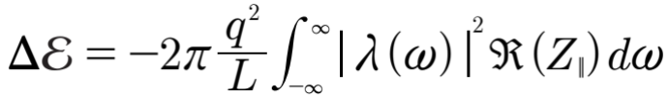
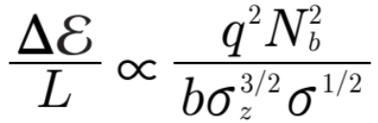
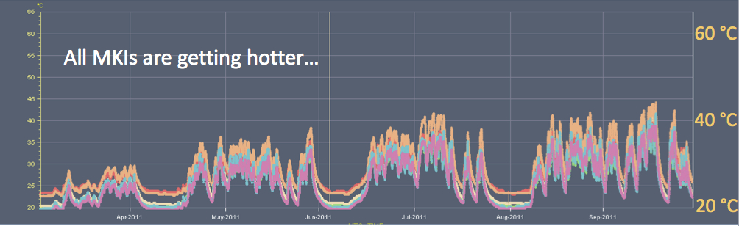


Longitudinal impedance: Heat load
Energy loss of a bunch (per length):
(line
density)
beam pipe
Bad conductor
From impedance (see e.g. A. Chao):
Example: resistive wall
Temperature in LHC injection kicker (ferrite loaded). One
needs to wait until it cools down to reinject (B. Salvant, 2012)
Heat load:
$l_{bb}:$bunch spacing

Slide 15
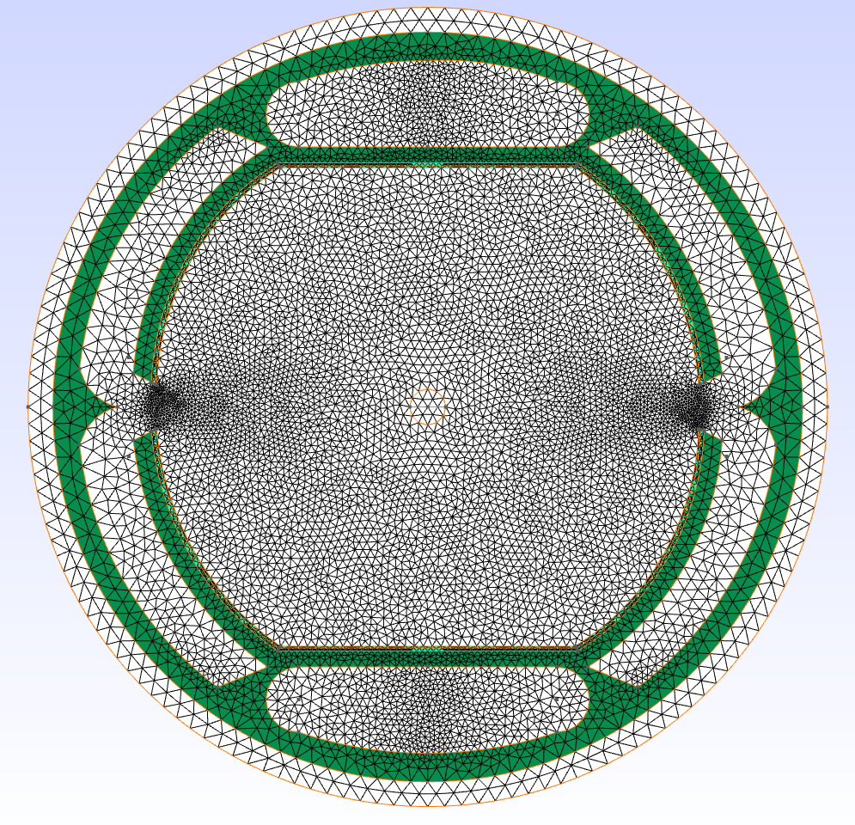
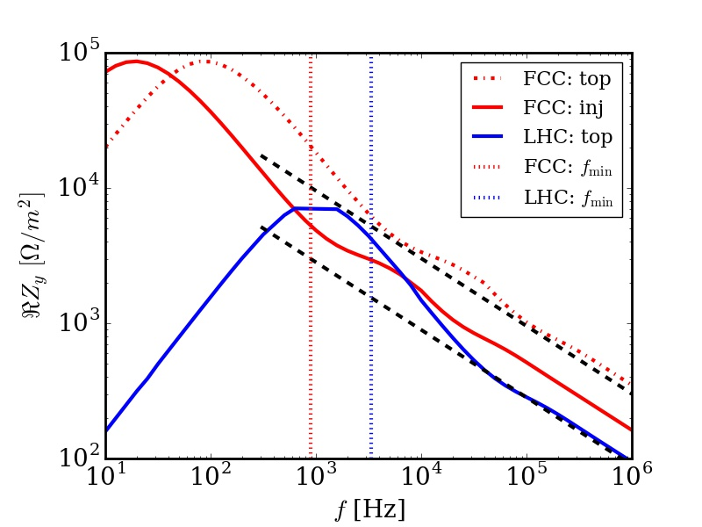
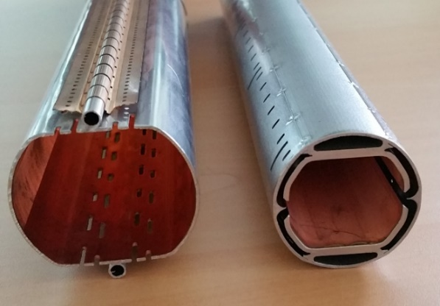
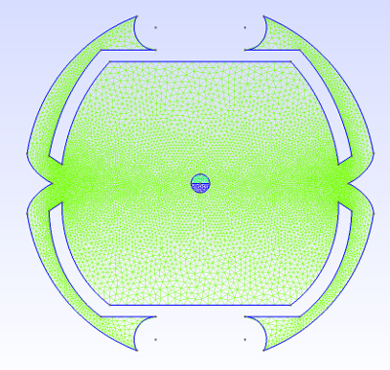
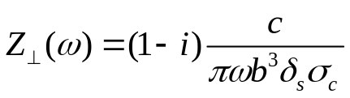


Transverse impedances:
LHC and FCC-hh beam pipes
Obtained with an impedance solver in the FD (U. Niedermayer, D. Astapovych)
LHC
FCC
b=0.02 m
b=0.014 m
$$f_{min}^{FCC}$$
$$f_{min}^{LHC}$$
kHz
few kHz
At sufficiently high frequencies
(a few 100 Hz) only the vacuum
regions have to be meshed.
(Thick) resistive wall impedance

Slide 16
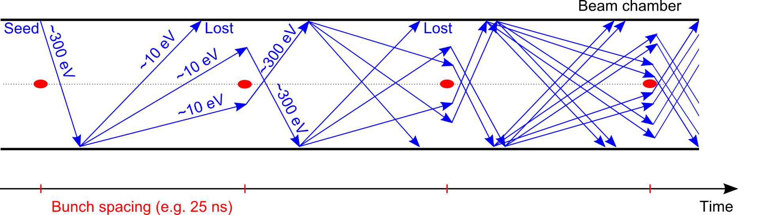

Electron clouds
Affects mainly machines operating with positively charged particles
    e⁻ is emitted (photoelectric effect)
    Secondary Electron Emission can drive an avalanche multiplication effect filling the beam chamber with an electron cloud
    Proton bunch
    Secondary Electron Emission
G. Iadarola
Bunches at the end of the train interact
with a (‘low density’) saturated e-cloud
Transverse instabilities
Transverse emittance blow-up
Energy loss -> Heat load on the cryogenic system

Slide 17
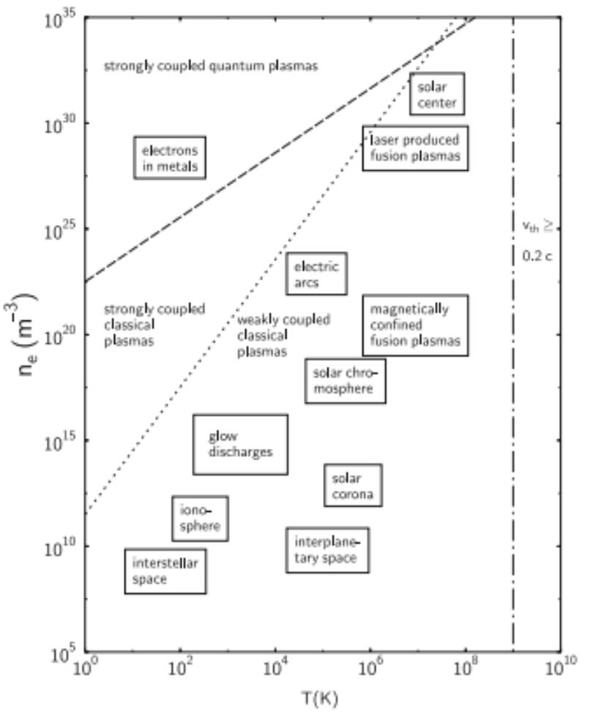


Remark: Plasma densities and temperatures
Electron clouds:
$$n_{e}≈{10}^{12}−{10}^{\begin{aligned}13 \\ \end{aligned} }m^{−3}$$
$T_{e}≈10−100$eV
lightning
Electron clouds

Slide 18


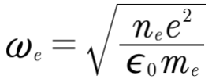
Electron cloud as a dielectric medium ?
Poisson equation
(electron plasma dielectric function)
(electron plasma frequency)
Unfortunatelly not: Requires „linear response“. A short LHC proton bunch
represents a strong perturbation for the „low density electron plasma“
and results in a (very) nonlinear response. Would work at higher electron densities.
See e.g. A. Al-Khateeb et al.,
Screening of the resistive-wall impedance by a cylindrical electron plasma
NJP (2008)

Slide 19
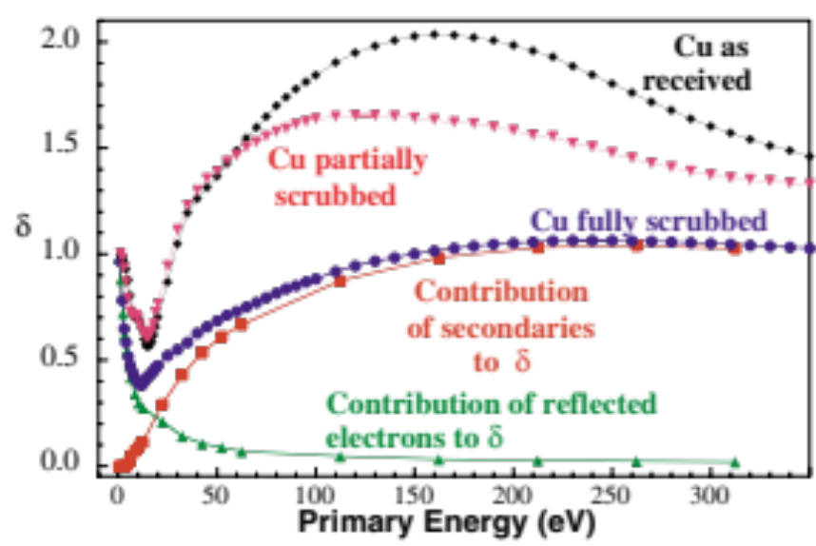

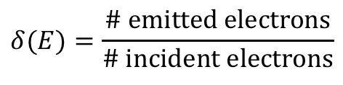

Secondary Emission Yield (SEY)
Measured total SEY from a Cu surface
as a function of the electron energy
(from R. Cimino at al, Phys. Rev. Lett. (2004))
Secondary Emission Yield (SEY)
$$δ(E)=\frac{\# emitted electrons}{\# incident electrons}$$
$$δ=δ_{el}+δ_{se}$$
el: Elastic scattered
se: Secondaries
Beam pipe
e-Multiplication
e-Capture
Short bunch
e-Energy gain
Beam induced scrubbing reduces
the SEY (but can take weeks).
reflected e

Slide 20
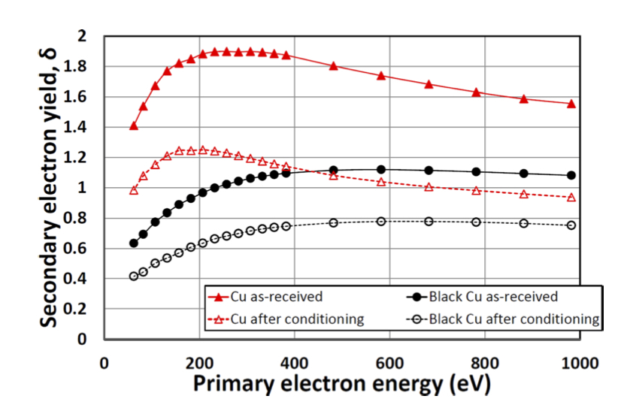
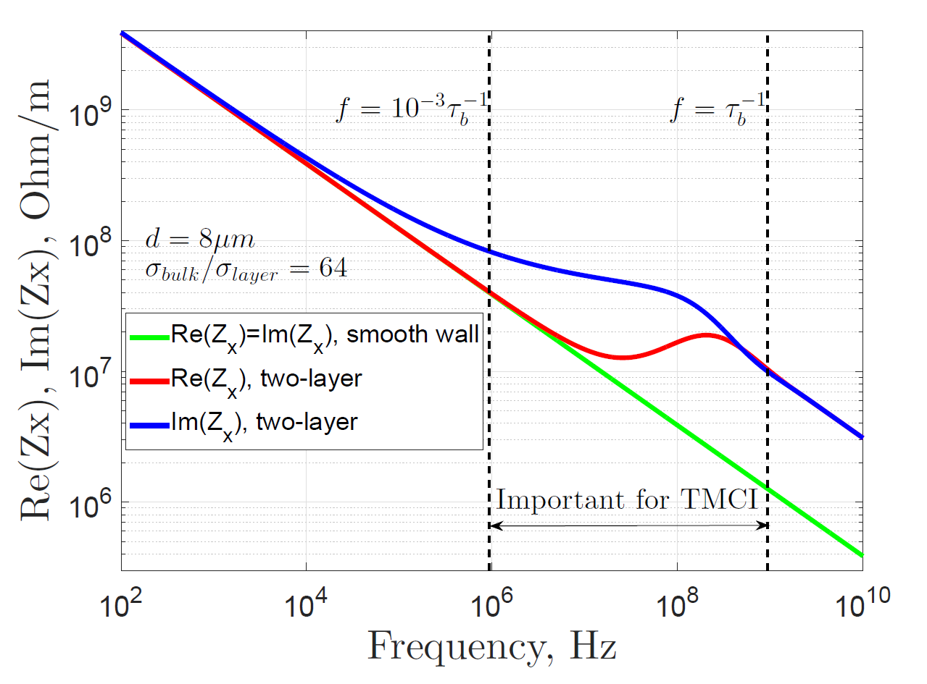
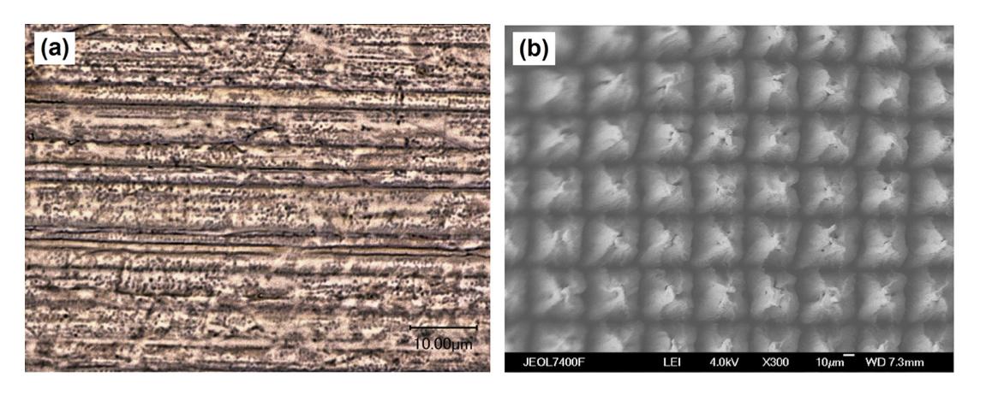

Coating and impedance
Coatings, like carbon and laser treatment, can reduce the SEY to values below 1.
Valizadeh et al., Appl. Phys. Lett. (2014)
Arsenyev, FFC week (2017)
Beam pipe + a thin resistive layer
Enlarged impedance at
$$δ_{skin}(ω)≈d_{layer}$$
Cu samples: (a) untreated and (b) laser treated.

Slide 21
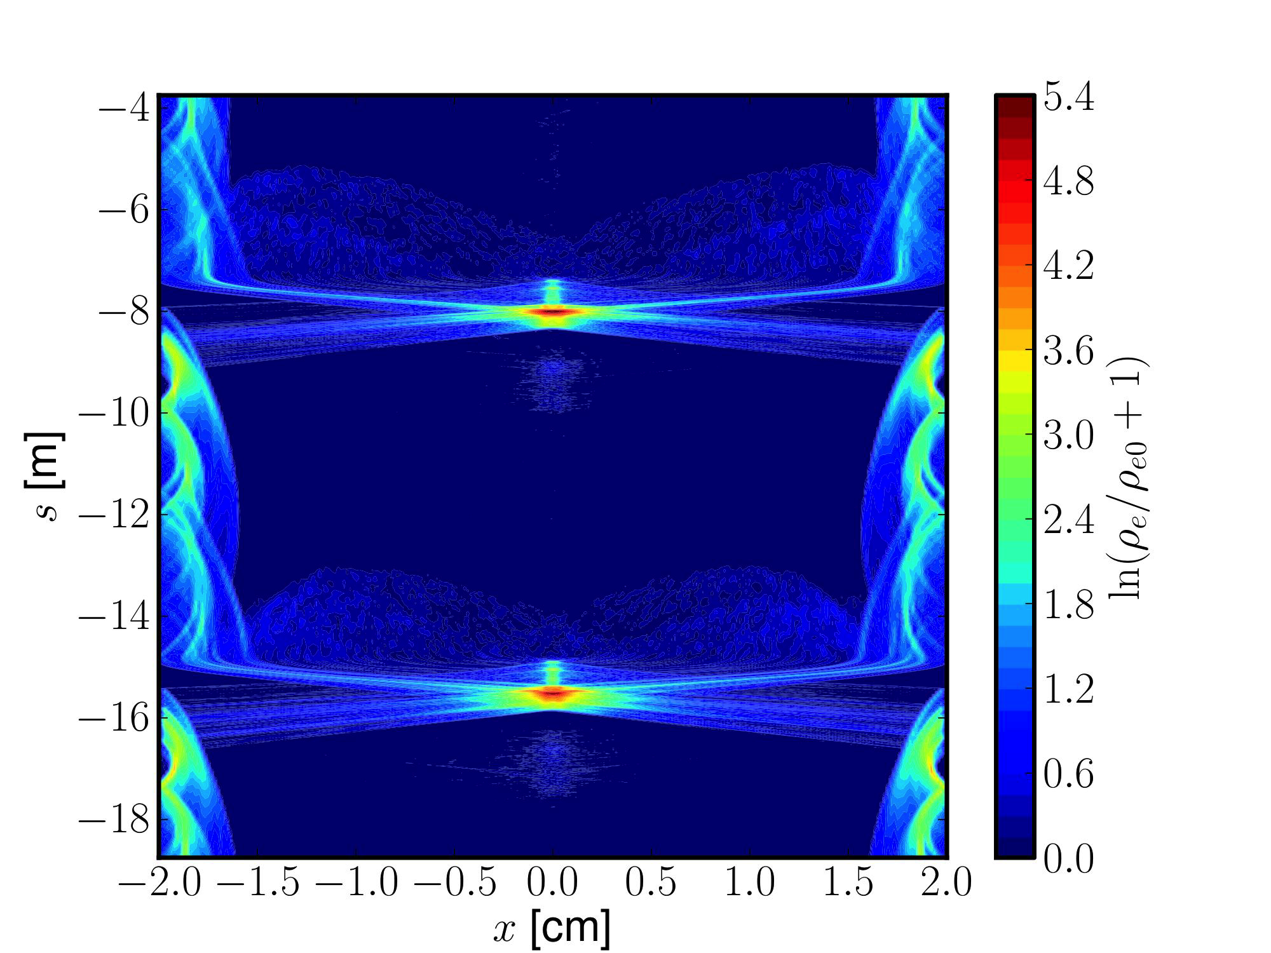




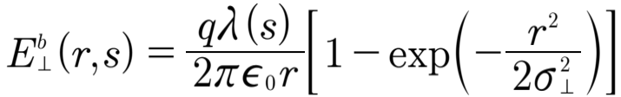
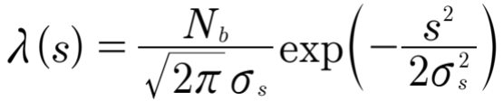




Electron cloud interaction with rigid bunches
Example result for
$$ρ_{e}\left(x,s\right)$$
Electron equation of motion:
Relativistic momenta:
Simulation codes for electron cloud interaction with bunch trains or long bunches: pyCloud, openecloud, ….
Space charge field (e-cloud):
Force on the bunch:
$${F\left(r\right)=qE}_{e}(r,s)$$
beam pipe
e-Multiplication (SEY model)
Electric field of the rigid bunch:
e-cloud
$$ρ_{e}(r,s)$$
$$ρ_{b}(r,s)$$
Short (< 10 ns) proton
bunch (N=10¹¹)
(Line density)
reflected e

Slide 22
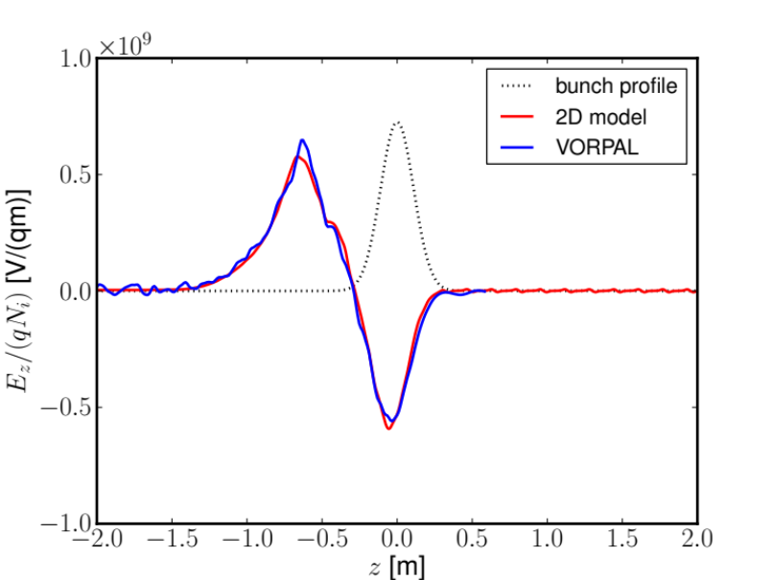
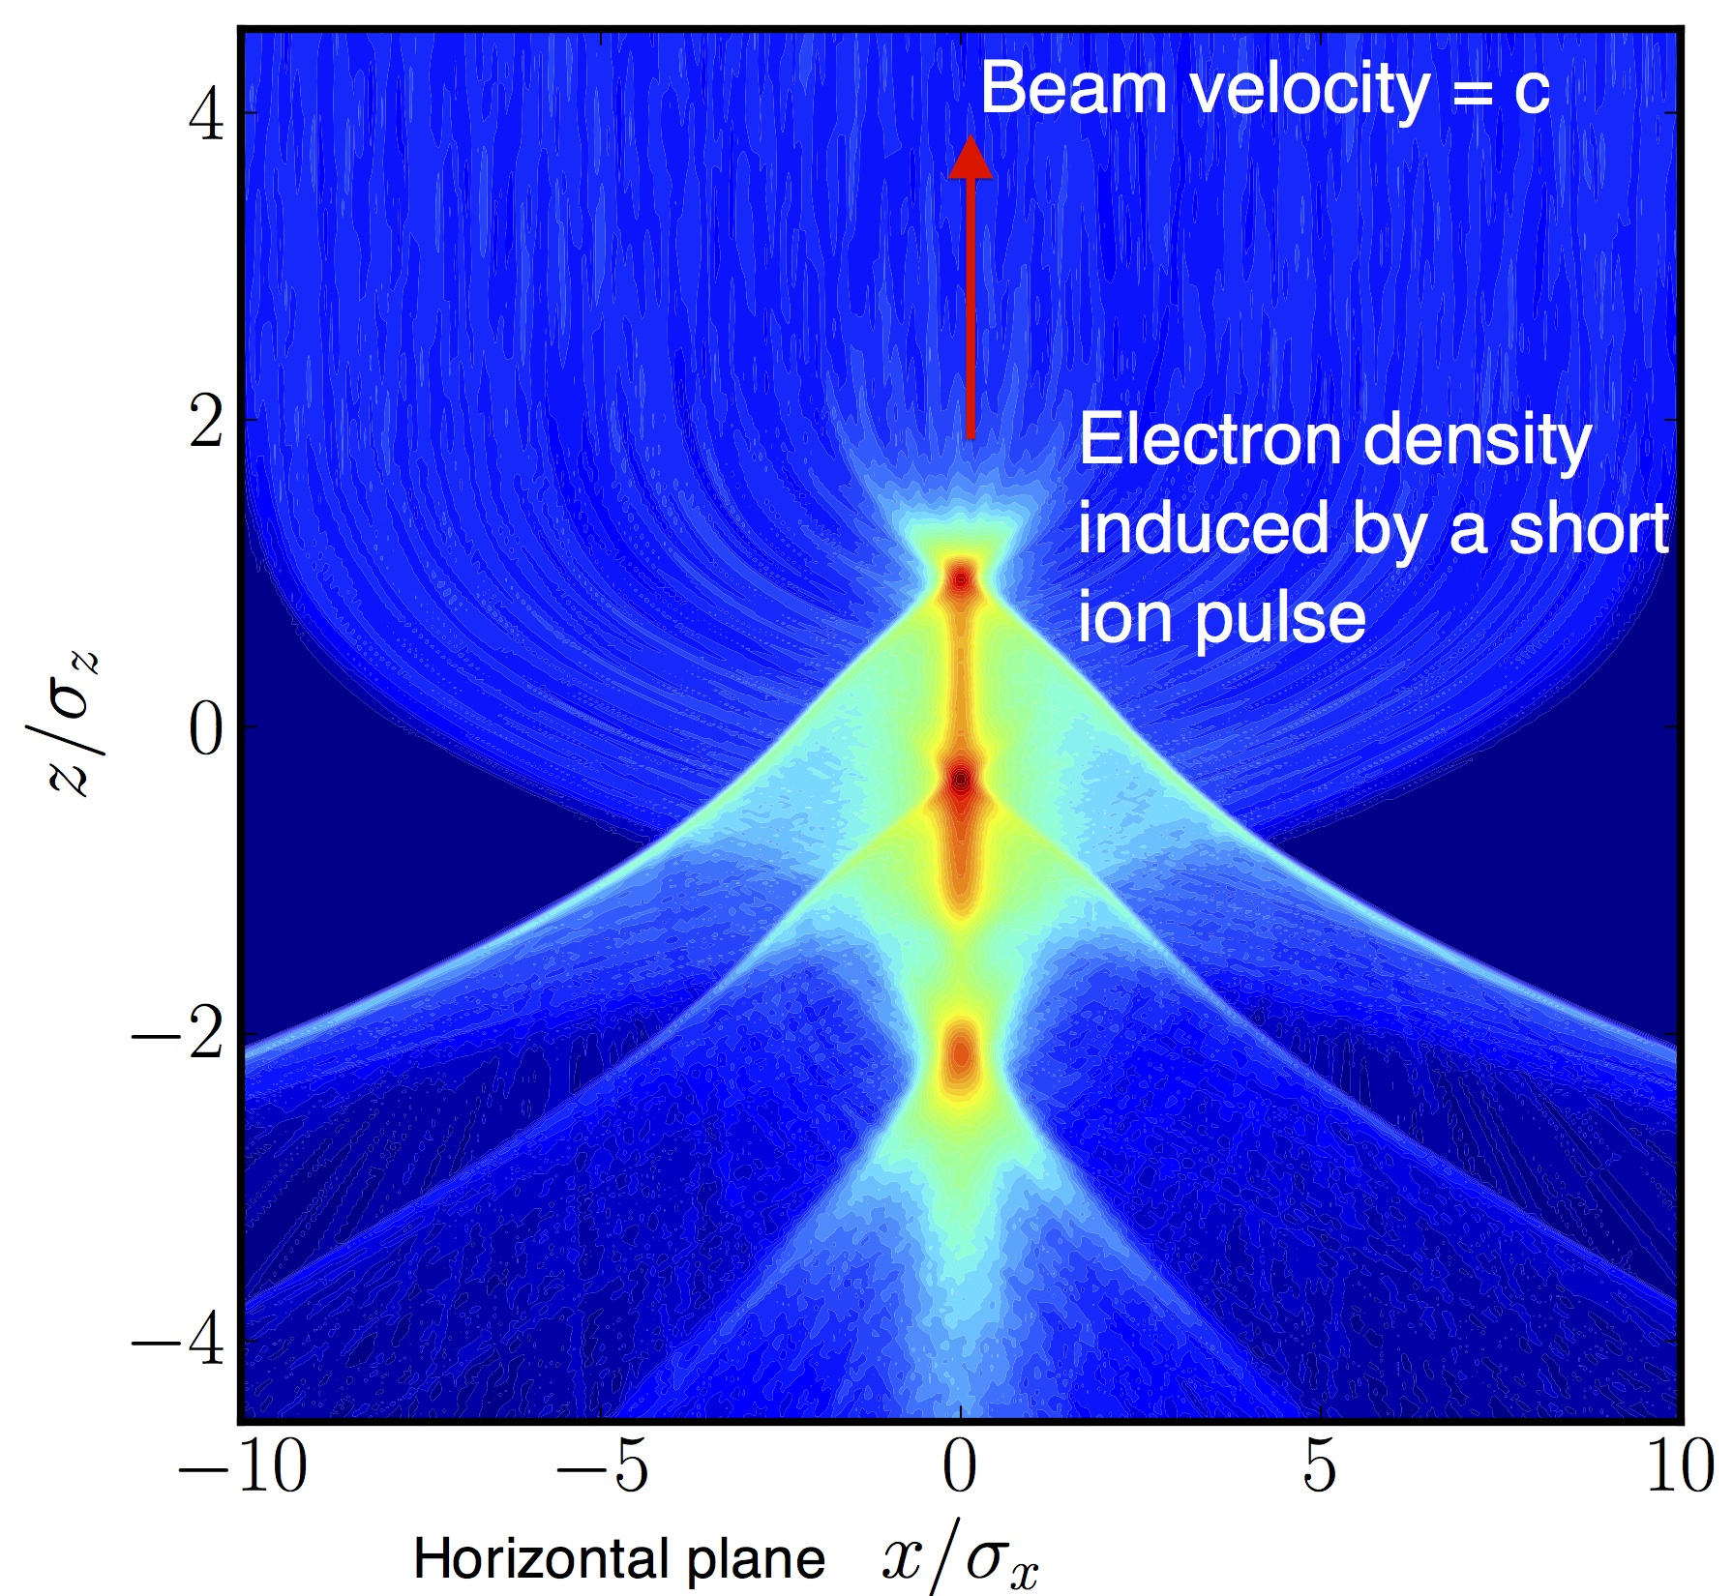
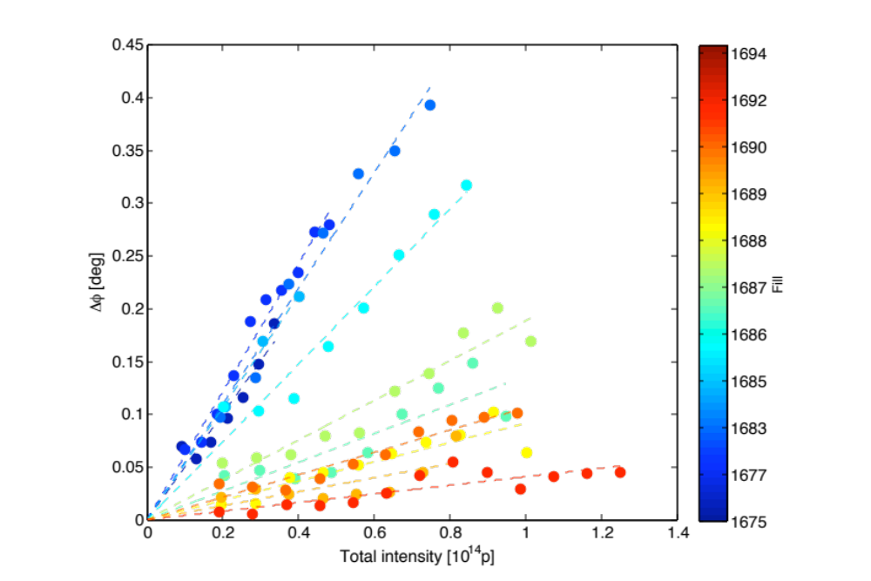

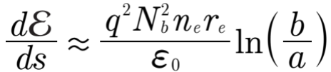

Longitudinal e-cloud wake field and energy loss
J. Esteban-Müller, E. Shaposhnikova
bunch energy
loss measured
in LHC during
scrubbing runs
Energy loss of a short bunch in an
(initially homogeneous) electron cloud:
rf phase shift vs. bunch intensity

Slide 23


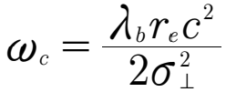
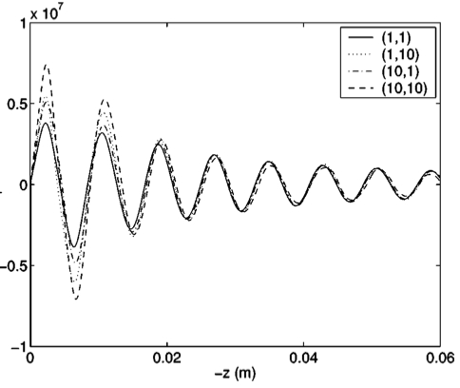
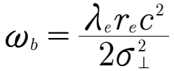


Transverse e-cloud wake function
Transverse wake function can be
approximated as a resonator:
one displaced
bunch slice
e⁻-cloud
resonant e-frequency:
coupling parameter:
$$W_{⊥}(z)$$
amplitude:
Obtain parameters by fit to simulations !
Remarks:
- Not a wake function, but a response function.
- More complicate in dipoles or quadrupoles.
Ohmi, Zimmermann, PRE (2001)

Slide 24

Summary and conclusions: Part I
Electromagnetic interaction with the accelerator environment is described through wake functions or impedances -> forces on the beam particles
Panofsky-Wenzel Theorem (PWT) links longitudinal and transverse forces.
Longitudinal wake function / impedance: Energy loss and heat load
Electron cloud buildup by multipacting can be suppressed by sufficiently long scrubbing or coatings, which increase the impedance at high frequencies.
The force on the beam particles can (in some cases) be described by electron cloud wake functions. The parameters for the wakes are obtained from fits to simulation results.
High beam energies:
$β=1,$ small beam sizes $σ∝γ^{−1/2}$, weak space charge (and image) effects.

