Slide 1


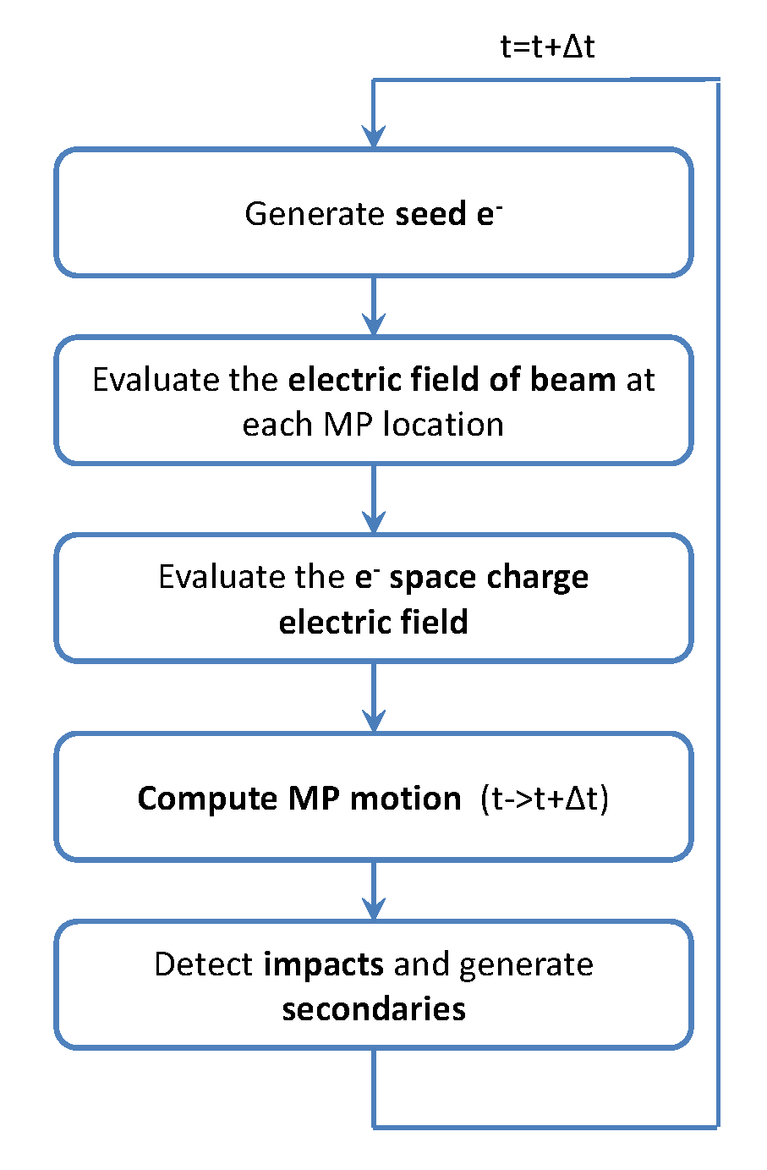
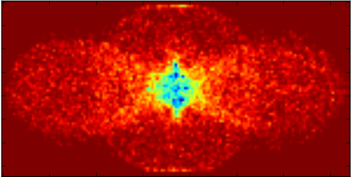
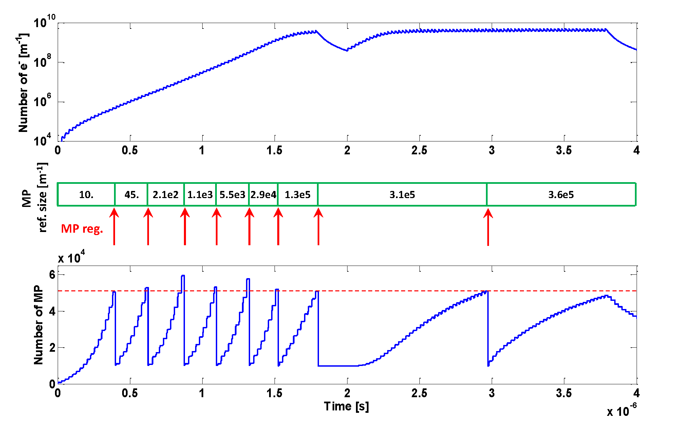
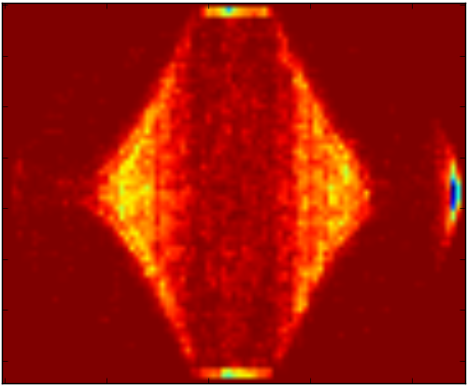
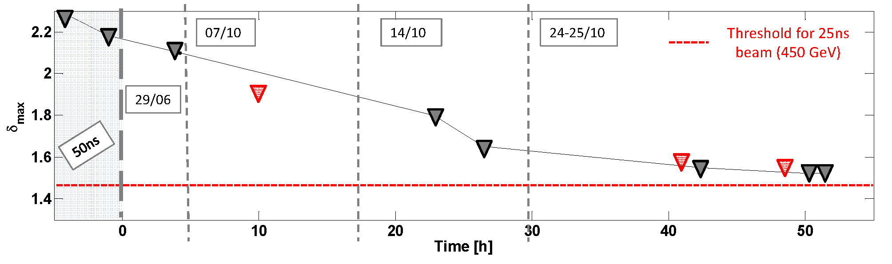
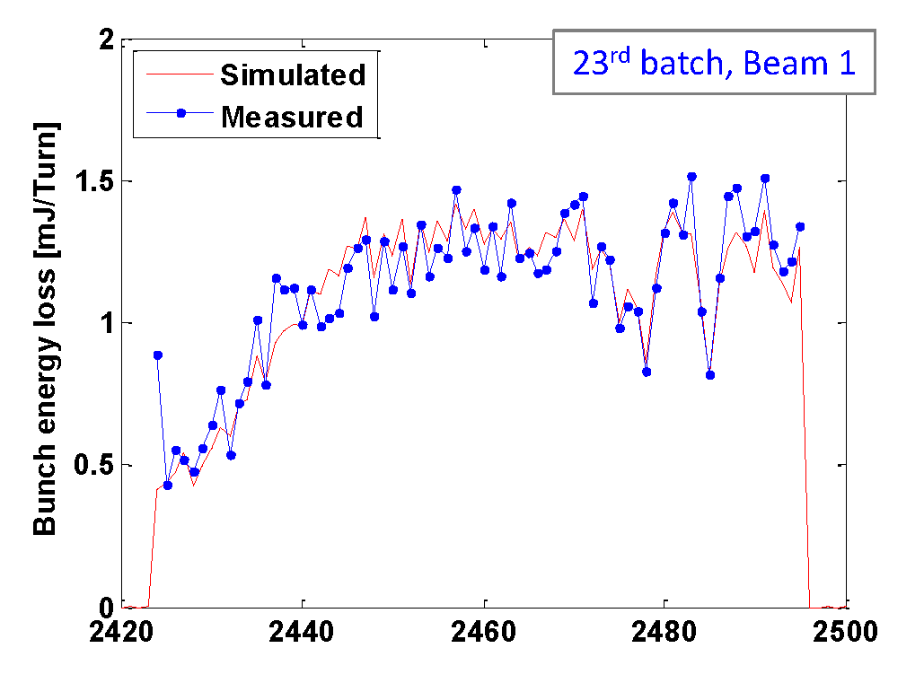
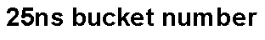
Improved electron cloud build-up simulations with PyECLOUD
G. Iadarola^{(1),(2)}, G. Rumolo⁽¹⁾
⁽¹⁾CERN, Geneva, Switzerland, ⁽²⁾Università di Napoli “Federico II”, Naples, Italy
Abstract
PyECLOUD is a newly developed code for the simulation of the electron cloud (EC) build-up in particle accelerators [1]. Almost entirely written in Python, it is mostly based on the physical models already used in the ECLOUD code [2] but, thanks to the implementation of new optimized algorithms, it exhibits a significantly improved performance in accuracy, speed, and usage flexibility. PyECLOUD simulations have been already broadly employed for benchmarking the EC observations in the Large Hadron Collider (LHC). Thanks to the new feature of running EC simulations with bunch-by-bunch length and intensity data from machine measurements, the “scrubbing” process of the LHC beam pipes could be reconstructed from heat load measurements in the cryogenic dipoles. In addition, PyECLOUD simulations also provide the estimation of the bunch-by-bunch energy loss, which can be compared with the measurements of the stable phase shift.
Simulation method
MP size management
Like ECLOUD, PyECLOUD is a 2D macroparticle (MP) code, where the electrons are grouped in MPs in order to achieve a reasonable computational burden. The code evaluates the forces acting on the MPs and computes their motion.
A proper model of the Secondary Emission Process is applied whenever a MP hits the camber’s wall, allowing the simulation of the electron multiplication.
In PyECLOUD, MP sizes are not enforced throughout the simulation but are determined by “decisions” taken during the execution. For this purpose a target MP size, dynamically adapted during the simulation, is employed to control the number of electrons per MP, allowing both an accurate description of the EC distribution and a computationally affordable number of MPs all along the simulated EC build-up.
Whenever the total number of MPs becomes too high, the reference MP size is changed and the entire MP set is regenerated by a routine designed to preserve the phase space distribution of the EC while reducing the total number of MPs.
Electron wave after a bunch passage
PS drift chamber (26GeV)
LHC dipole chamber (4TeV)
Simulation studies for the LHC
While the operation with 50ns bunch spacing can be presently considered EC free, several indications point out that a severe EC is still developing when 25ns bunch spacing is employed, with strong detrimental effects on the beam [3]. PyECLOUD simulations have been extensively used to analyze these observations and, in particular to estimate the Secondary Electron Yield (δ_{max}) of the beam screen of the superconducting magnets from the heat load measurements provided by the cryogenic system. Furthermore, the bunch-by-bunch energy loss due to the interaction of the beam with the EC, which is estimated using these simulations has been compared with measurements of stable phase shift provided by the RF system [4], with very encouraging results.
References
[1] G. Iadarola and G. Rumolo, “PyECLOUD and build-up simulations at CERN”, Proceedings of the ECLOUD12 workshop, 5-9 June 2012, La Biodola, Isola d’Elba, Italy
[2] G. Rumolo and F. Zimmermann, “Electron cloud simulations: beam instabilities and wakefields”, Phys. Rev. ST Accel. Beams 5, 121002 (2002)
[3] G. Iadarola and G. Rumolo, “Electron Cloud in the CERN accelerators (PS, SPS, LHC)”, Proceedings of the ECLOUD12 workshop, 5-9 June 2012, La Biodola, Isola d’Elba, Italy
[4] J. Esteban Muller et al., “Synchronous Phase Shift at LHC”, Proceedings of the ECLOUD12 workshop, 5-9 June 2012, La Biodola, Isola d'Elba, Italy

