Slide 1
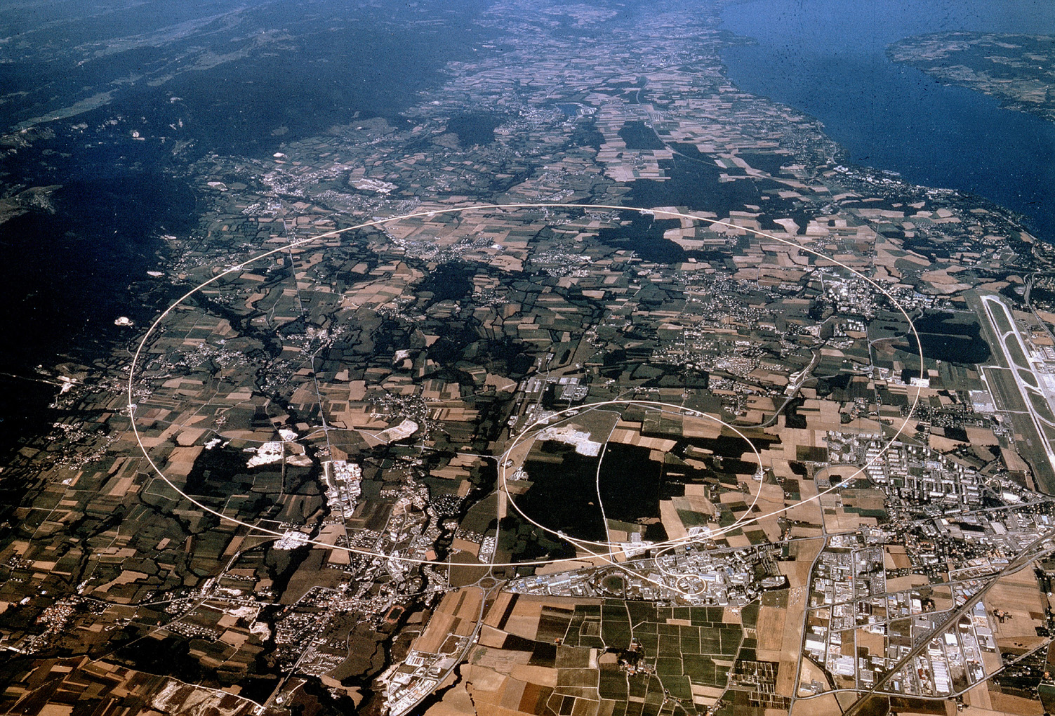

Accelerating Science and Innovation
The Large Hadron Collider LHC ˗̶
Shedding Light on the
EARLY Universe
R.-D. Heuer, CERN Chios, Greece, 28 September 2011
Notes:
1

Slide 2
Particle Physics at accelerators
Explore the innermost structure of matter :
• Which are the fundamental constituents of matter ?
• Which forces interact between them ?
Investigating the Structure of Matter
↓
Understanding the Early Universe

Slide 3
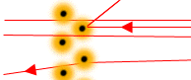

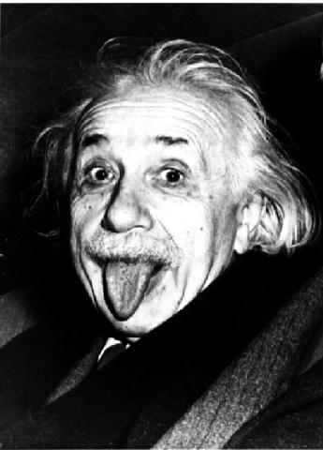
The role of accelerators
high energy:
Resolving the inner structure of matter: E = hc/λ
Production of new Particles : E = m c²
E=mc
2
high statistics (= high “luminosity”):
Precision measurements

Slide 4
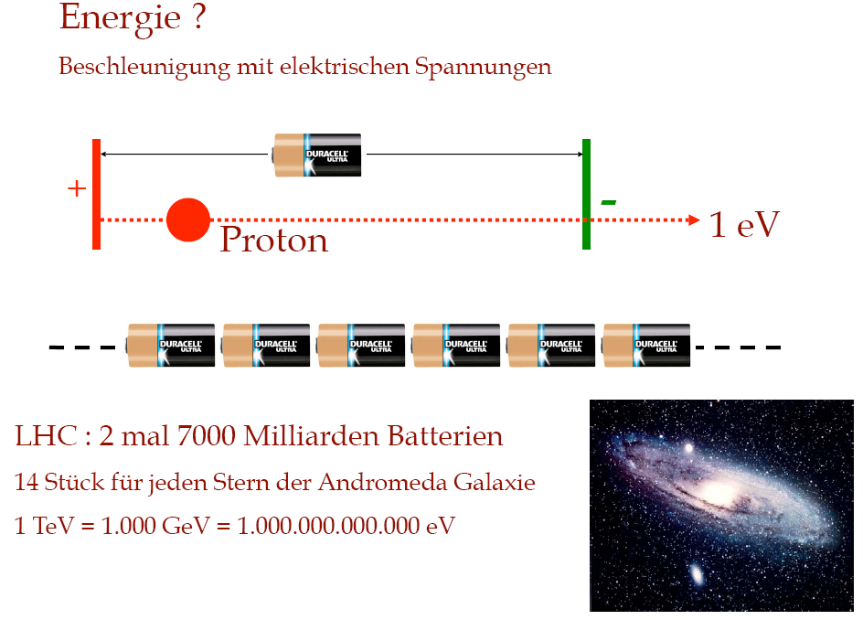
Energy ?
acceleration through electric voltage
1 TeV = 1.000 GeV = 1.000.000.000.000 eV
LHC energy: 2 x 7000 billion batteries
14 batteries per star in Andromeda galaxy

Slide 5
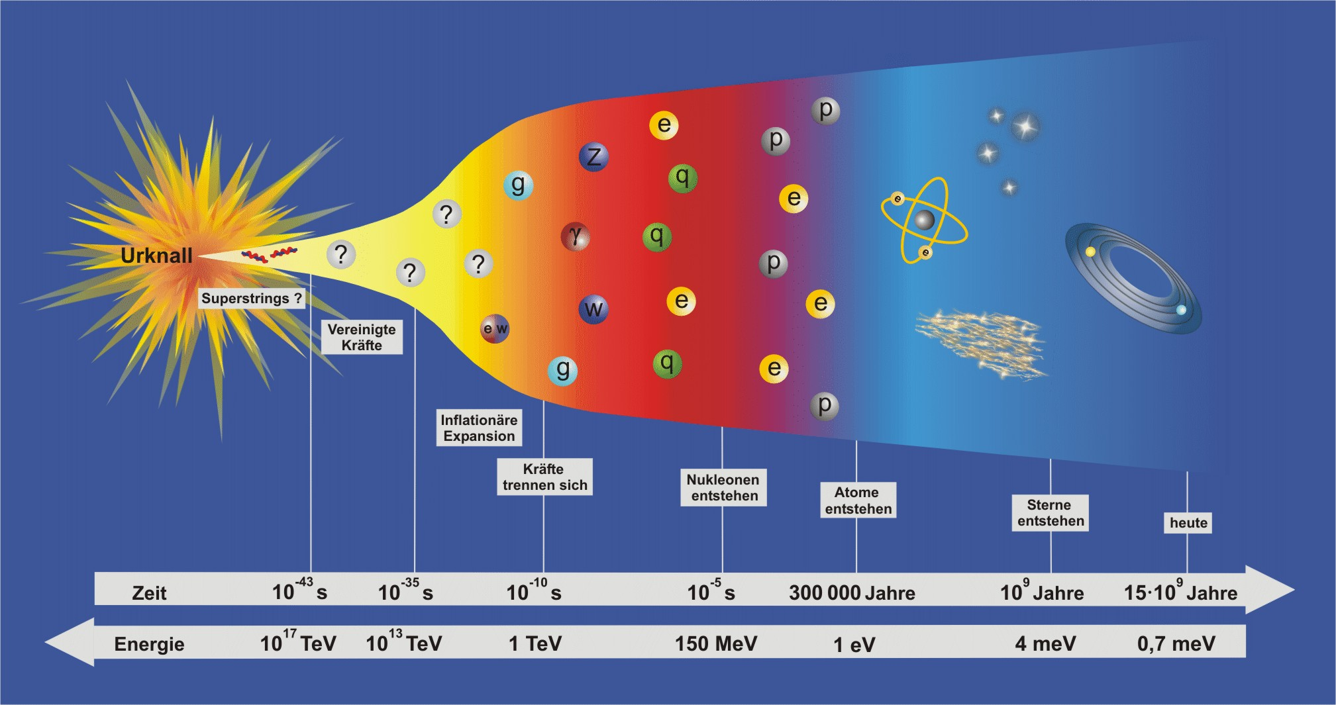
Vision
• Revolutionary advances in understanding the microcosm
• Connect microcosm with early Universe
Big Bang
terascale
Superstrings ?
Unified
Forces
Inflationary
Expansion
Separation
of Forces
Nucleon
Formation
Formation
of Atoms
Formation
of Stars
Today
Time 10⁻⁴³ s 10⁻³⁵ s 10⁻¹⁰ s 10⁻⁵ s 300 000 years 10⁹ years 15∙10⁹ years
Energy 10¹⁷ TeV 10¹³ TeV 1 TeV 150 MeV 1 eV 4 meV 0.7 meV
Particle Physics at the Energy Frontier with highest collision energies ever
will change our view of the universe

Slide 6
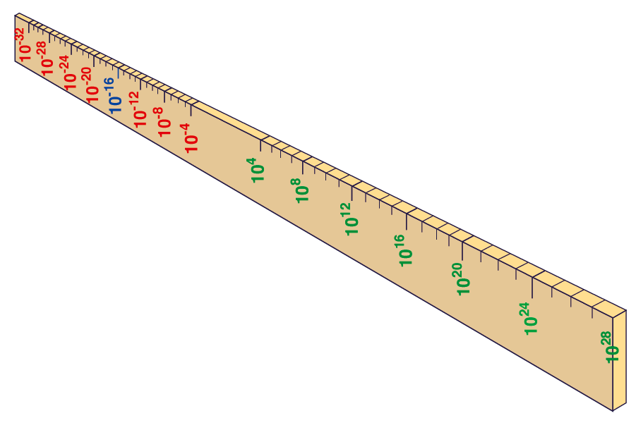
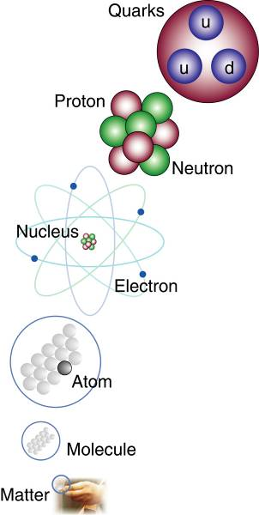
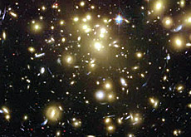
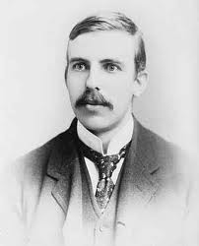
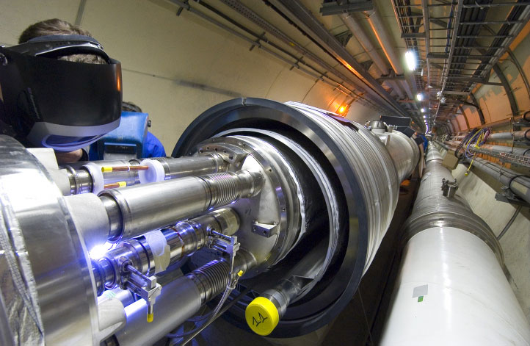
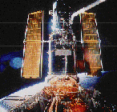
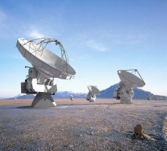
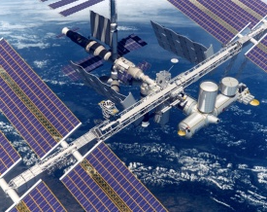
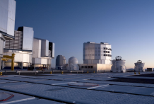
Big Bang
Proton
Atom
Radius of Earth
Earth to Sun
Radius of Galaxies
Universe
LHC
Super-Microscope
Hubble
ALMA
cm
Study physics laws of first moments after Big Bang
increasing Symbiosis between Particle Physics,
Astrophysics and Cosmology
AMS
VLT
Notes:
6
60 Grössenordnungen

Slide 7




matter particles
t
c
u
top
charm
up
d
s
down
strange
ν_{e}
b
.
ν
e-neutrino
e
.
μ
bottom
μ-neutrino
ν
electron
μ
.
τ
muon
τ-neutrino
τ
plus corresponding antiparticles
tau

Slide 8
Structure of Matter I
Matter (Stars <=> living organisms) consists of
3 families of Quarks and Leptons
Matter around us: only 1 of the 3 families
Matter at high energies:
‚democratic‘, all 3 families present
—> High Energy: Situation fraction of seconds after
the creation of the Universe
—> Study of Matter at High Energies
knowledge about Early Universe

Slide 9
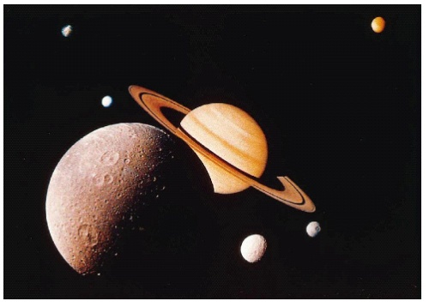

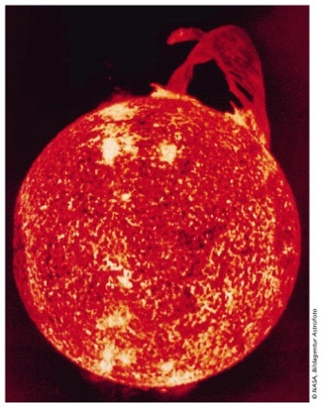

Forces
Gravitation
(acts on mass, energy)
Electromagnetic Force
(acts on el.charge)
Weak Force
(acts on leptons, quarks)
Strong Force
(acts on quarks)

Slide 10

Force Carriers = Gauge Bosons
Graviton
Photon
W ,Z
Gluon
+/-
0

Slide 11
Structure of Matter II
4 fundamental forces act between Matter Particles
through the exchange of Gauge Bosons
(Gluon, W und Z, Photon, Graviton)
Within our Energy regime:
resp. strengths of forces very different
At high Energies:
all forces of same strength → one force ?
—> High Energy: Situation fraction of seconds after
the creation of the Universe
—> Study of the Forces at High Energies
knowledge about Early Universe

Slide 12
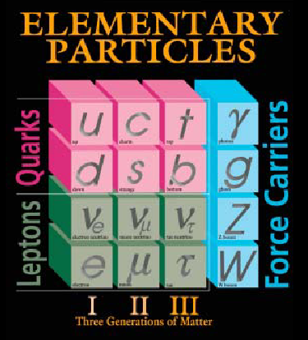
What have we learned the last 50 years or
The “Discovery” of the Standard Model
The physical world is
composed of
Quarks and Leptons
(Fermions)
interacting via force carriers
(Gauge Bosons)
Last entries: top-quark 1995
tau-neutrino 2000

Slide 13
Structure of Matter III
Standard Model of Particle Physics
Mathematical formalism describing all interactions
mediated through weak, electromagnetic and strong forces
Test of predictions with very high precision
experimental validation
down to ~10 ⁻¹⁸ m
or up to O(100 GeV)
Fantastic achievement . . .
however . . . one piece missing
within Standard Model

Slide 14
THE missing cornerstone of the Standard Model
What is the origin of mass of elementary particles?
Possible solution:
Mass = property of particles with energy E to move with
velocity v/c = (1-m²/E²)^{1/2} i.e. the higher the mass the lower
the velocity (at the same energy)
➔ introduction of a scalar field (Higgs-Field)
particles acquire mass through
interaction with this Higgs-Field
Self interaction of this field → Higgs-Particle
named after
Peter Higgs

Slide 15


Slide 16
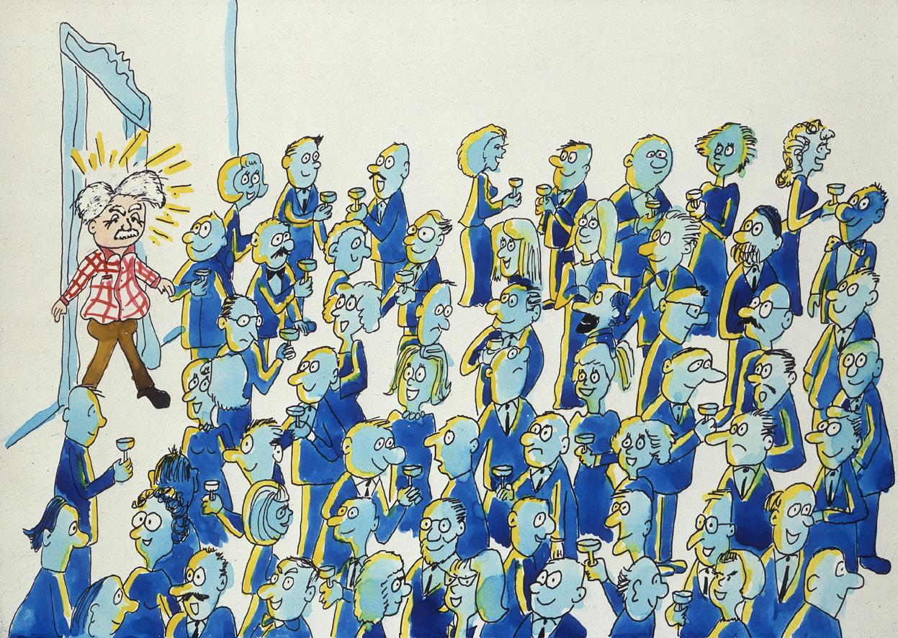

Slide 17


Slide 18


Slide 19


Slide 20
THE missing cornerstone of the Standard Model
What is the origin of mass of elementary particles?
Possible solution:
Mass = property of particles with energy E to move with
velocity v/c = (1-m²/E²)^{1/2}
➔ introduction of a scalar field (Higgs-Field)
particles acquire mass through
interaction with this Higgs-Field
Self interaction —> Higgs-Particle
Higgs-Particle = last missing cornerstone within SM
but:
Does the Higgs-Particle exist at all ??
named after
Peter Higgs

Slide 21
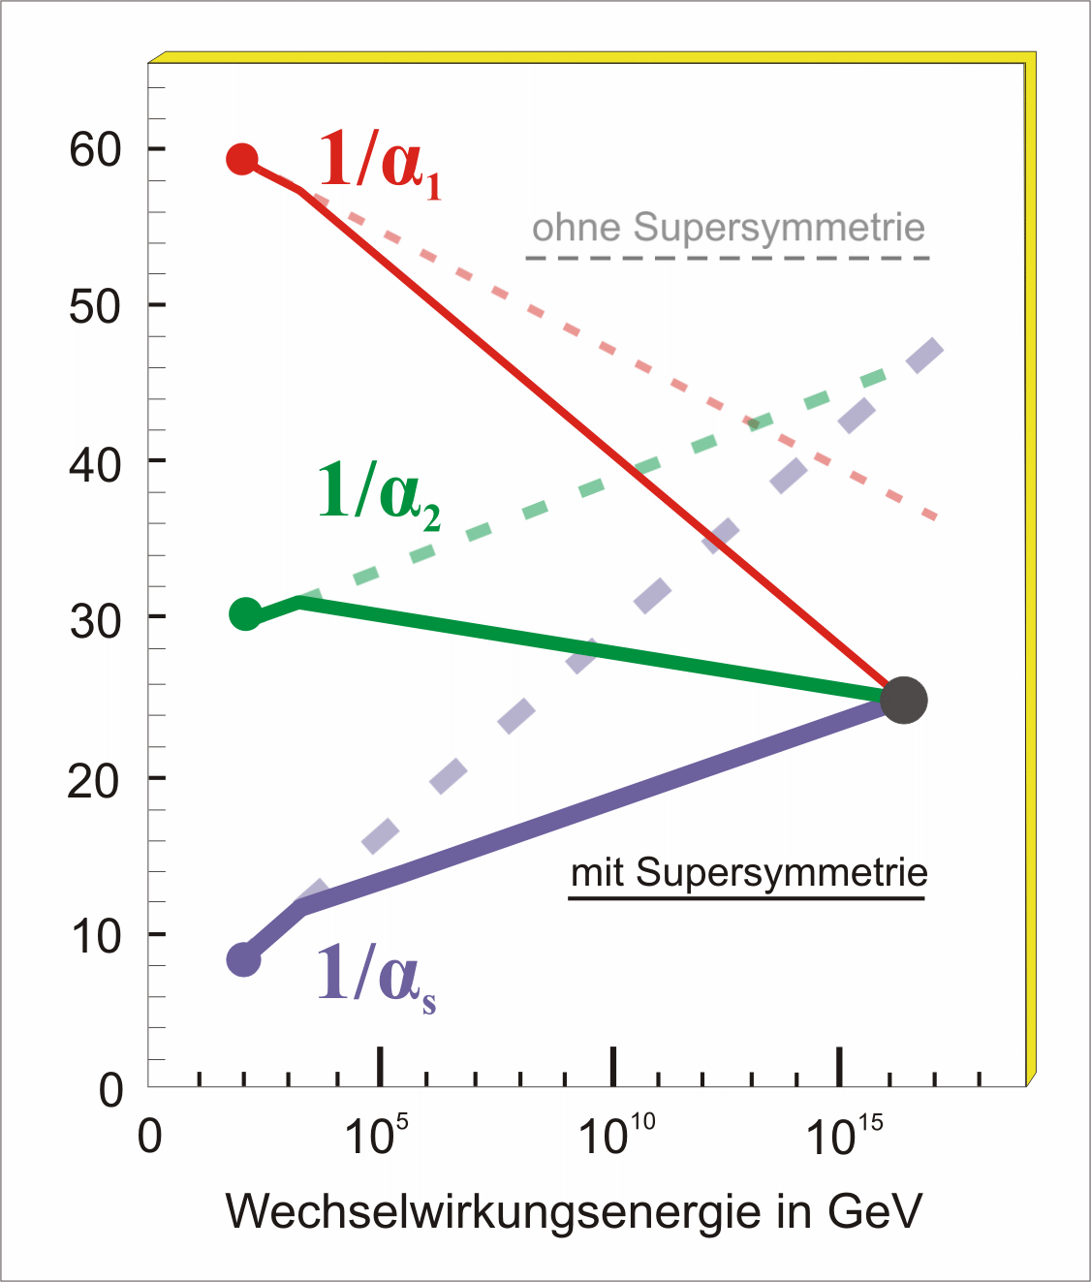
Key Questions of Particle Physics
origin of mass/matter or origin of electroweak symmetry breaking
unification of forces
fundamental symmetry of forces and matter
what happened to antimatter
number of space/time dimensions
what is dark matter
what is dark energy
with Supersymmetry
w/o Supersymmetry
Energy in GeV
The LHC will address most of these questions . . . .

Slide 22
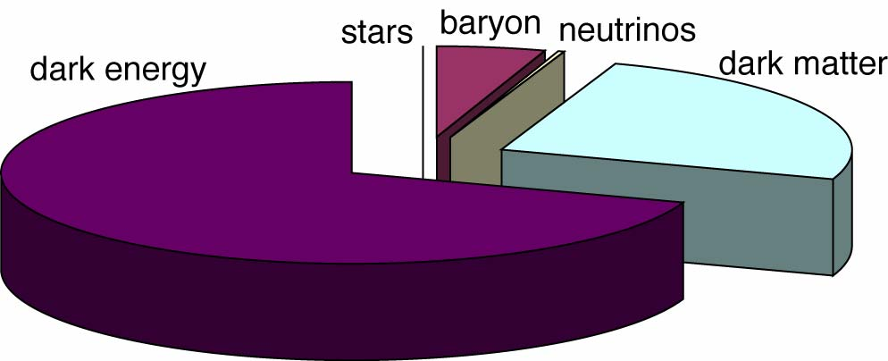


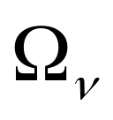


in particular......
Standard Model
THE ENERGY DENSITY BUDGET
BARYONS
COLD DARK MATTER
NEUTRINOS
DARK ENERGY
with the Large Hadron Collider
at the Terascale now entering the ’Dark Universe’

Slide 23
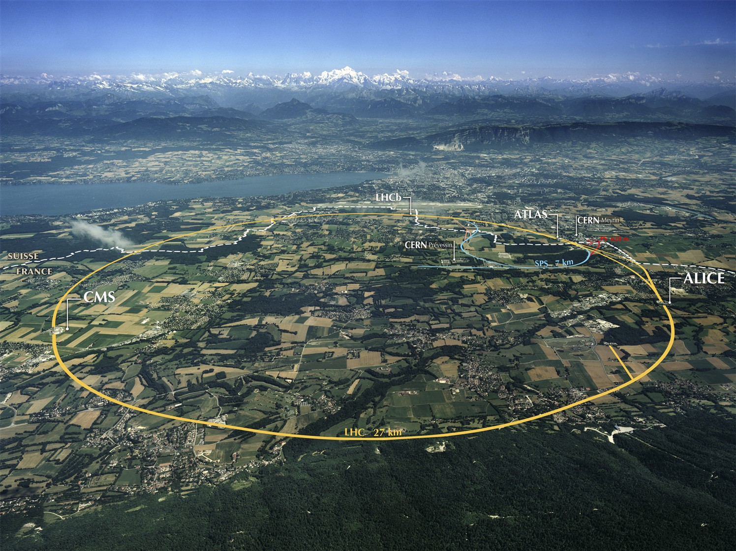

the Large Hadron Collider (LHC)
Largest scientific instrument
ever built, 27km of circumference
>10 000 people involved in its
design and construction
Collides protons to reproduce
conditions at the birth of the
Universe...
...40 million times a second
at Accelerating Science and Innovation
Notes:
23

Slide 24
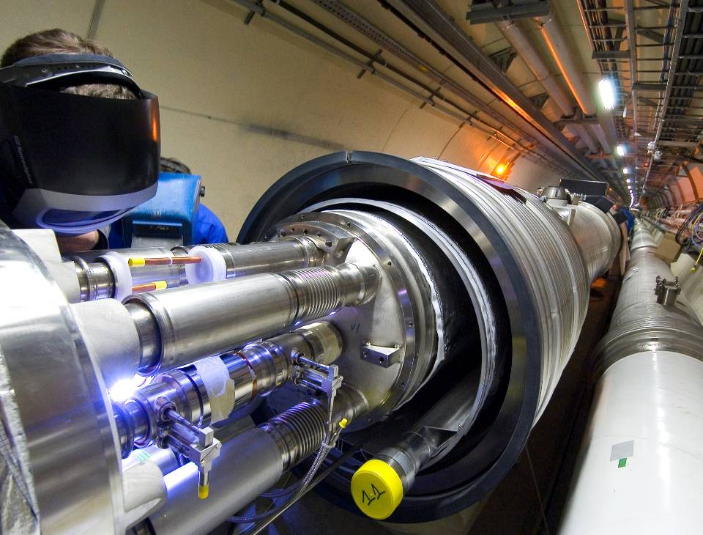
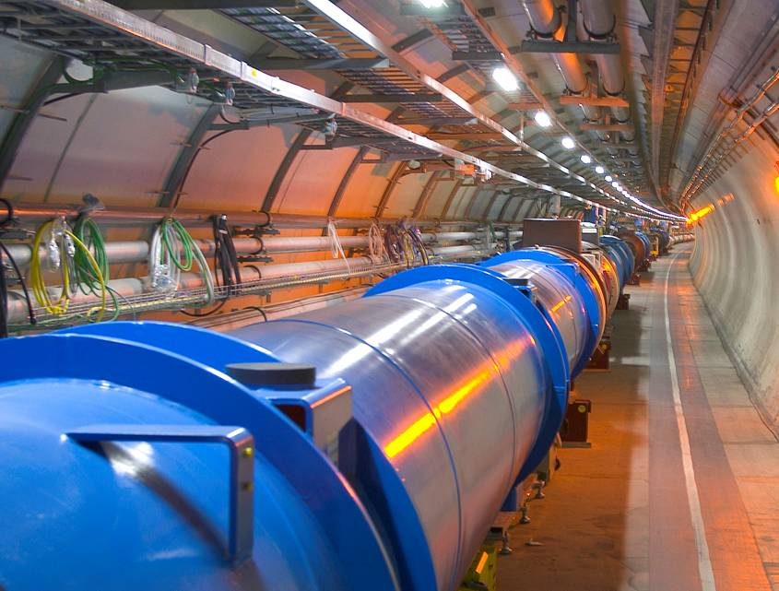
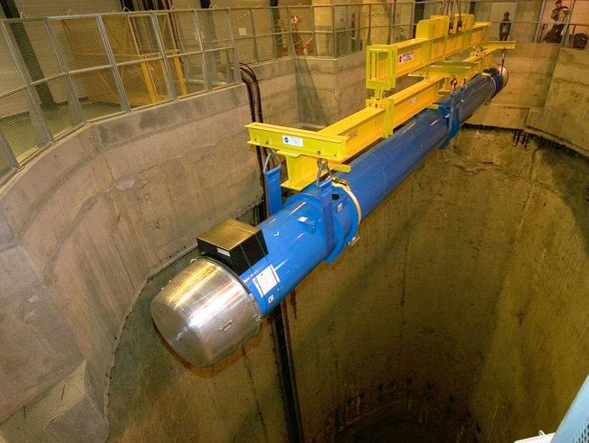
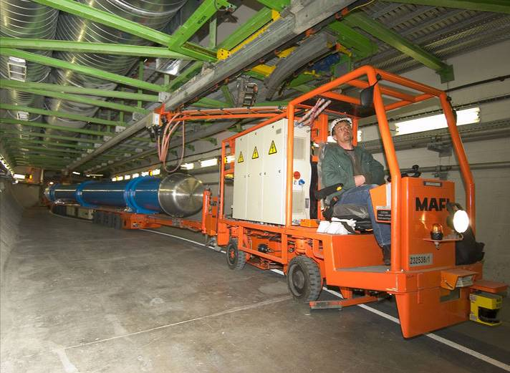
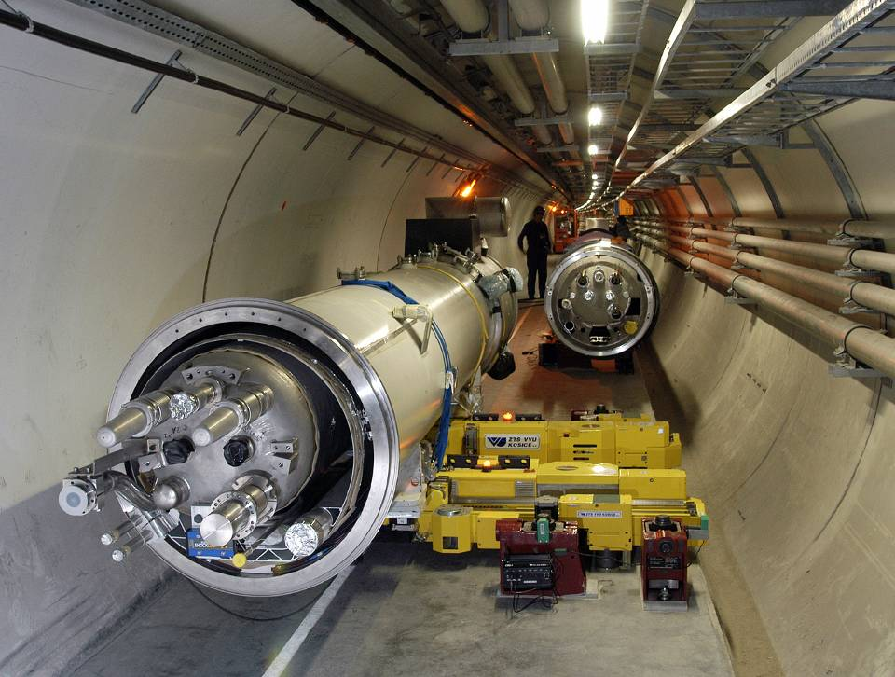
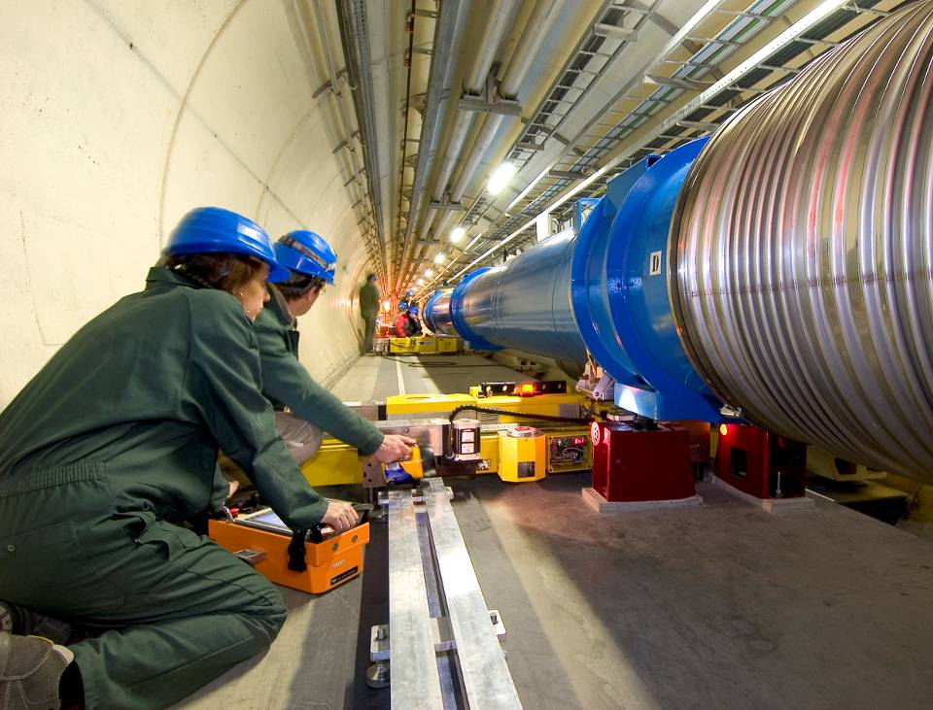

Slide 25
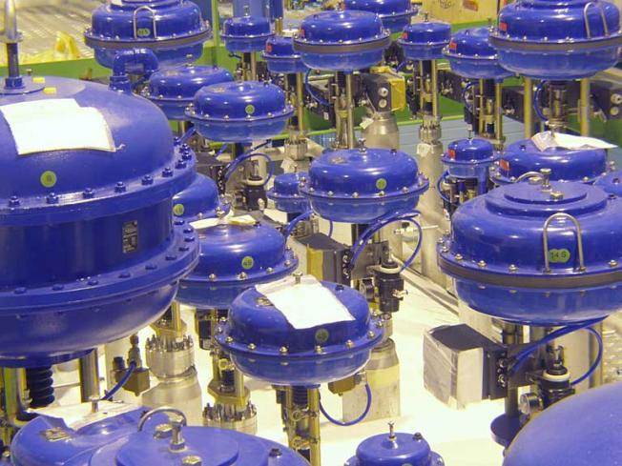
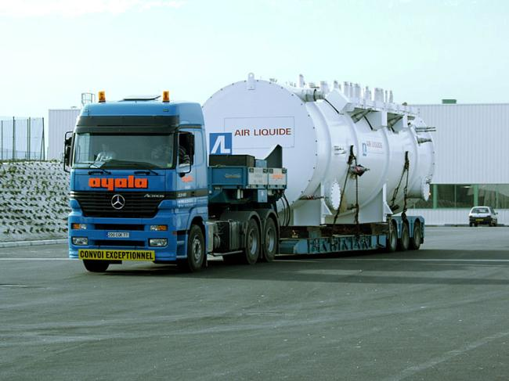
One of the coldest places in the Universe…
With a temperature of -271 C, or 1.9 K above absolute zero,
the LHC is colder than outer space.

Slide 26
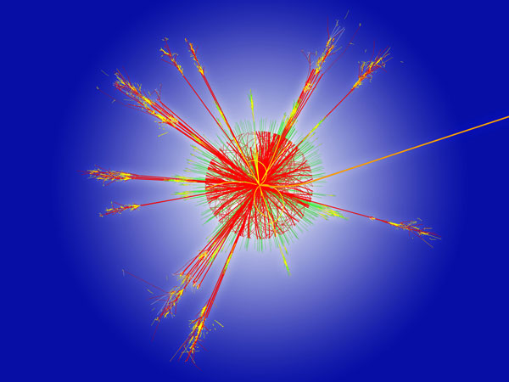
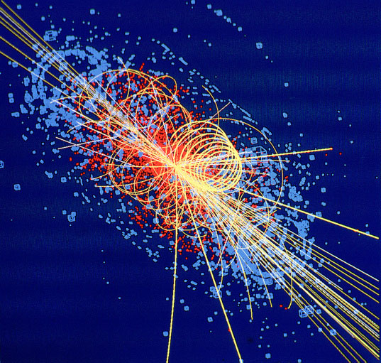
One of the hottest places in the galaxy…
The collision of two proton beams generates temperatures
1000 million times larger than those at the centre of the Sun,
but in a much more confined space.

Slide 27
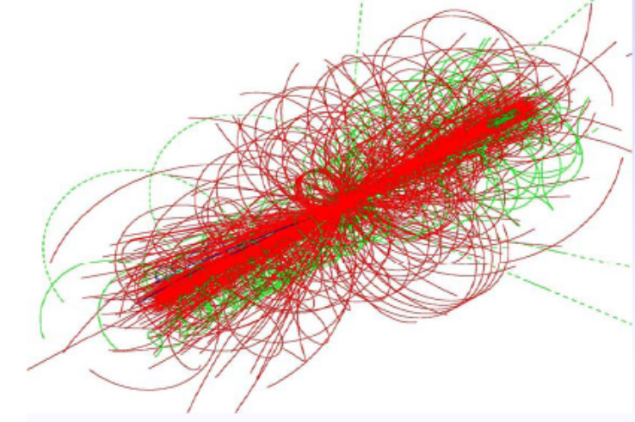
Proton-Proton Collisions at the LHC
2808 + 2808 proton bunches
separated by 7.5 m
→ collisions every 25 ns
= 40 MHz crossing rate
10¹¹ (=100 billion) protons per bunch
at 10^{34/}cm²/s
≈ 35 pp interactions per crossing
pile-up
→ ≈ 10⁹ pp interactions per second !!!
in each collision
≈ 1600 charged particles produced
enormous challenge for the detectors

Slide 28
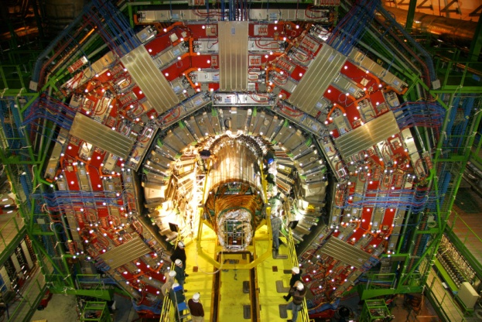
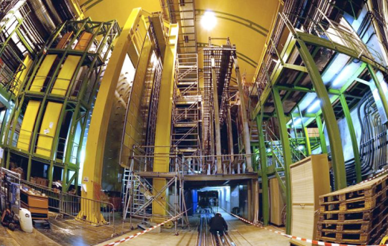
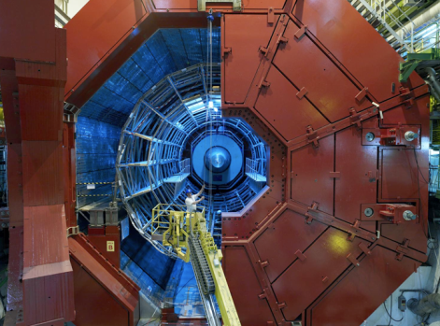
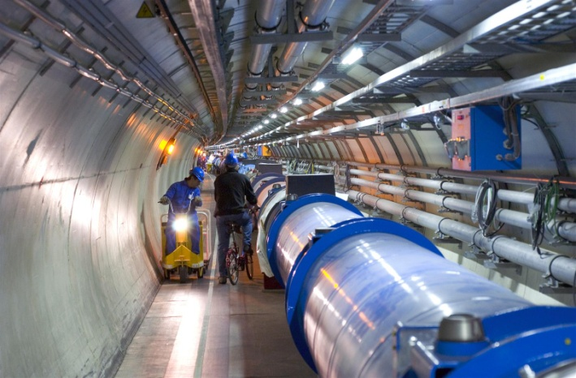
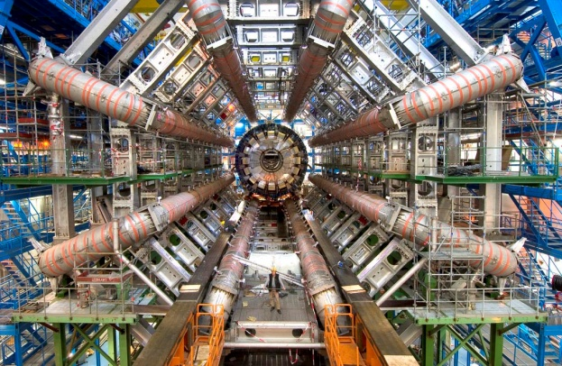
Enter a New Era in Fundamental Science
Start-up of the Large Hadron Collider (LHC), one of the largest and truly global scientific projects ever, is the most exciting turning point in particle physics.
CMS
LHCb
Exploration of a new energy frontier
Proton-proton collisions up to E = 14 TeV
(this year running at E = 7 TeV)
ALICE
LHC ring:
27 km circumference
ATLAS
Notes:
28

Slide 29
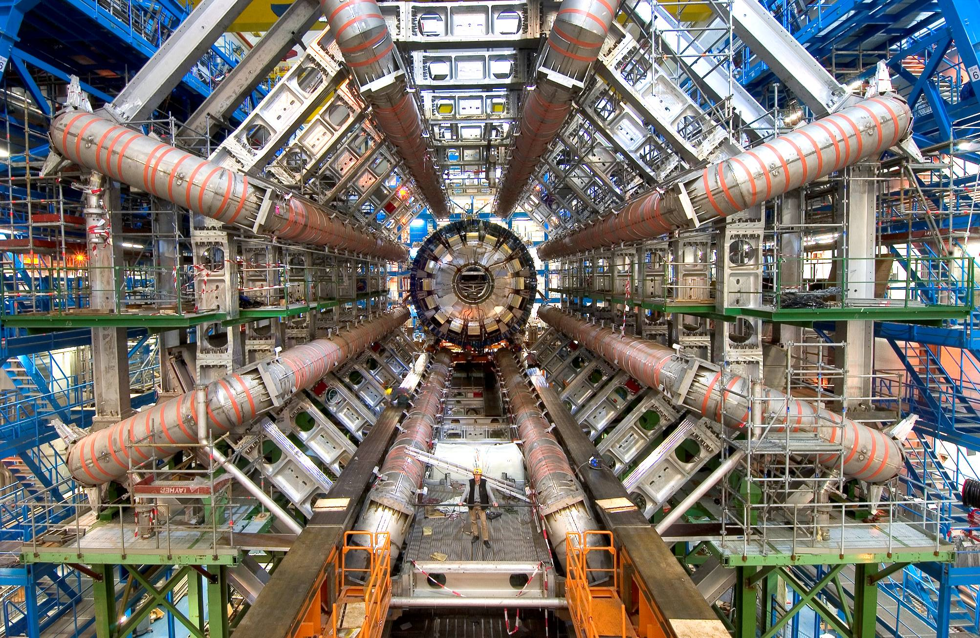
the largest and most complex detectors
Methodology
To select and record the signals from the 600 million proton collisions every second, huge detectors have been built to measure the particles traces to an extraordinary precision.

Slide 30
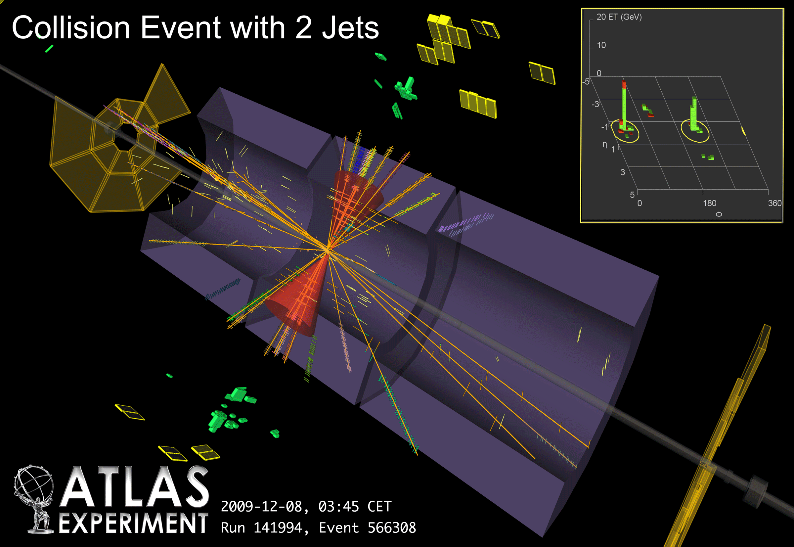
ATLAS through first data
Fabiola Gianotti
(on behalf of the ATLAS Collaboration)

Slide 31
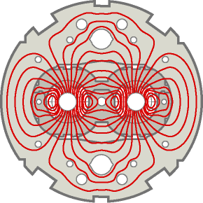
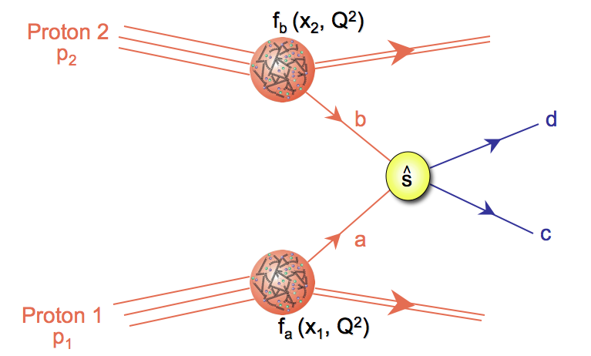
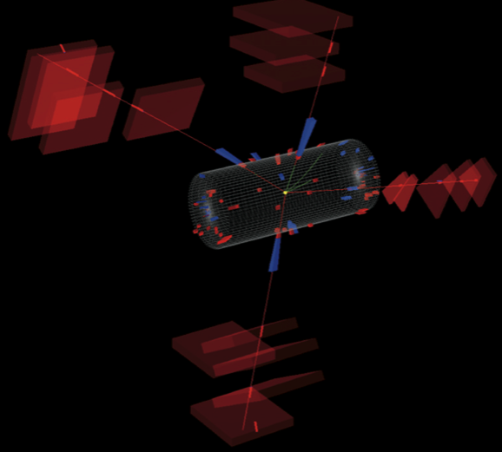
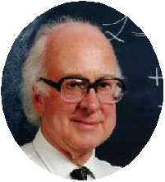
Example process at LHC
g
W/Z
m_{4μ}=201 GeV
g
W/Z
CMS

Slide 32
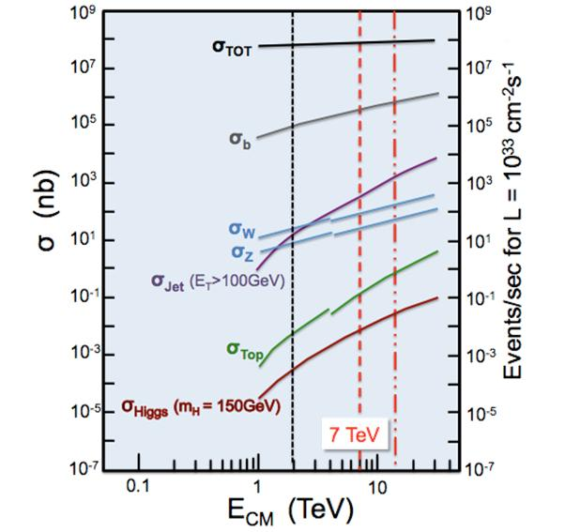
Cross Section („Production Rate“) of Various Processes
More than 10 orders of
magnitude difference between
total reaction rate
and
rate of new physics
select 1 out of much more than 10 billion . . .

Slide 33
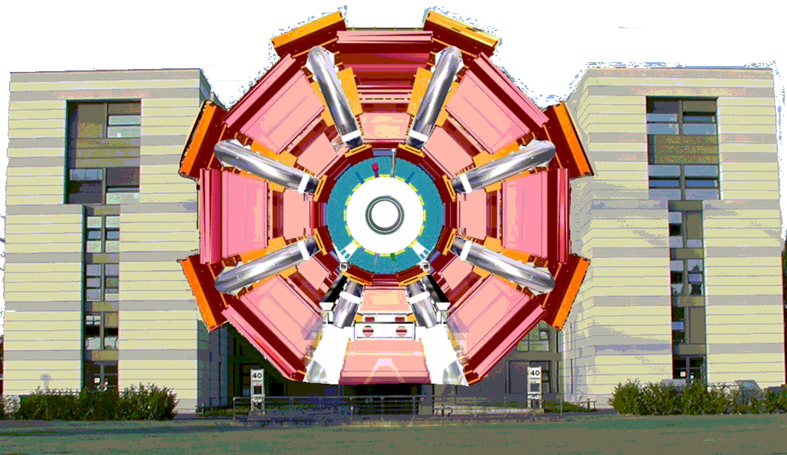
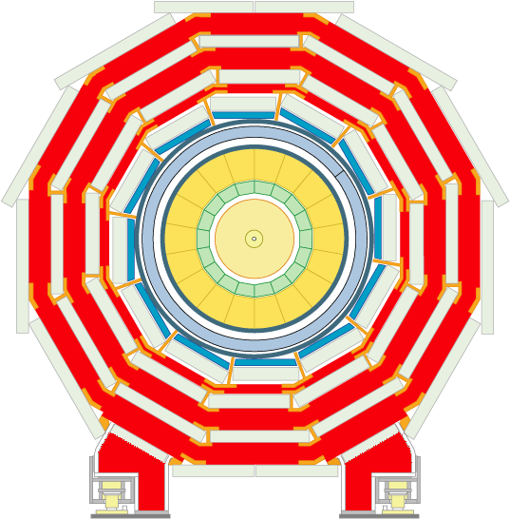
The LHC experiments: about 100 million “sensors” each
[think your 6MP digital camera...
...taking 40 million pictures a second]
ATLAS
CMS
five-story building

Slide 34

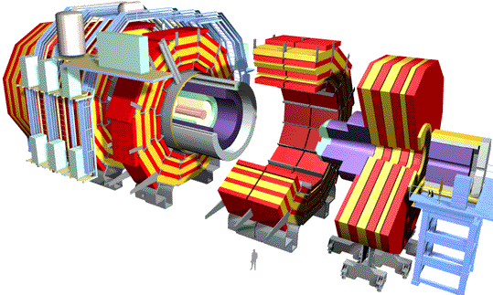
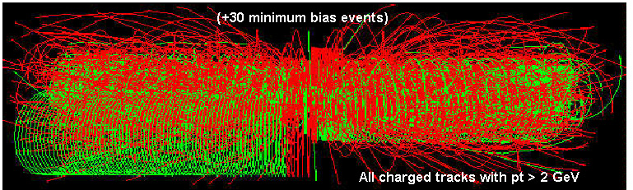
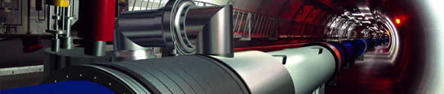
LHC DATA
Balloon
(30 km)
CD stack with
1 year LHC Data!
(~ 20 km)
online computers filter out from 40 MHz rate
a few hundred “good” events per sec.
these are recorded on disk and magnetic tape
at 100-1,000 MegaBytes/sec ~15 PetaBytes per year
for all four experiments
Mt. Blanc
(4.8 km)

Slide 35




Grid Computing and CERN
285 sites in 48 countries
~250k CPU cores
~100 PB disk
Large number of users
1M jobs/day
Astronomy & Astrophysics
Civil Protection
Computational Chemistry
Comp. Fluid Dynamics
Computer Science/Tools
Condensed Matter Physics
Earth Sciences
Finance
Fusion
High Energy Physics (WLCG)
Humanities
Life Sciences
Material Sciences
Social Sciences
EGEE-III INFSO-RI-222667

Slide 36



The New Territory
We are poised to tackle
some of the most profound questions in physics:
“Newton’s” unfinished business… what is mass?
Nature’s favouritism… why is there no more antimatter?
The secrets of the Big Bang… what was matter like within the first c moments of the Universe’s life?
Science’s little embarrassment… what is 96% of the Universe made of?

Slide 37
ready to enter the
Dark Universe

Slide 38

Dark Matter
Astronomers & astrophysicists over the next two decades using powerful new telescopes will tell us how dark matter has shaped the stars and galaxies we see in the night sky.
Only particle accelerators can produce dark matter in the laboratory and understand exactly what it is.
Composed of a single kind of particle
or
more rich and varied (as the visible world)?
LHC may be the perfect machine to study dark matter.

Slide 39




Beyond the Higgs Boson
Supersymmetry: A New Symmetry in Nature
Candidate Particles for Dark Matter
⇒ Produce Dark Matter in the lab
SUSY particle production at the LHC
Picture from Marusa Bradac

Slide 40


Looking for Dark Matter
χ⁰₁
No Supersymmetry yet! . . . But
potential for discovery of SUSY sizeable even at LHC start-up
Missing energy
taken away by dark matter particles

Slide 41
LHC results should allow,
together with dedicated dark matter searches,
first discoveries in the dark universe
around 73% of the Universe is in some mysterious “dark energy”. It is evenly spread.
Challenge:
get first hints about the world of dark energy in the laboratory

Slide 42
The Higgs is Different!
All the matter particles are spin-1/2 fermions.
All the force carriers are spin-1 bosons.
Higgs particles are spin-0 bosons (scalars).
The Higgs is neither matter nor force.
The Higgs is just different.
This would be the first fundamental scalar ever discovered.
The Higgs field is thought to fill the entire universe.
Could it give some handle of dark energy (scalar field)?
Many modern theories predict other scalar particles like the Higgs.
Why, after all, should the Higgs be the only one of its kind?
LHC can search for and study new scalars with precision.

Slide 43


Higgs-Boson at 7 TeV
g
W/Z
Not enough data yet
→ Interesting in 2011 and 2012!
H
g
W/Z
m_{4μ}=201 GeV
CMS

Slide 44
Higgs-Boson at 7 TeV
Excellent performance of
Collider, Experiments, Computing
end 2012 the question will be answered on the Higgs:
to be or not to be
m_{4μ}=201 GeV
CMS

Slide 45

In other words...
(G.Altarelli, LP09)

Slide 46
LHC results will allow
to study the Higgs mechanism in detail and
to reveal the character of the Higgs boson
This would be the first investigation
of a scalar field
This could be the very first step to
understanding Dark Energy

Slide 47
Past decades saw precision studies of 5 % of
our Universe → Discovery of the Standard Model
The LHC delivers data
We are just at the beginning of exploring
95 % of the Universe

Slide 48
Past decades saw precision studies of 5 % of
our Universe → Discovery of the Standard Model
The LHC delivers data
We are just at the beginning of exploring
95 % of the Universe
the future is bright in the Dark Universe

