Slide 1
FCC Injection
Group 9: Alejandro Sanz, Marco Garattini, Irina Tecker, Sergey Litvinov, Giovanni Franzini, Jingjing Zhang

Slide 2
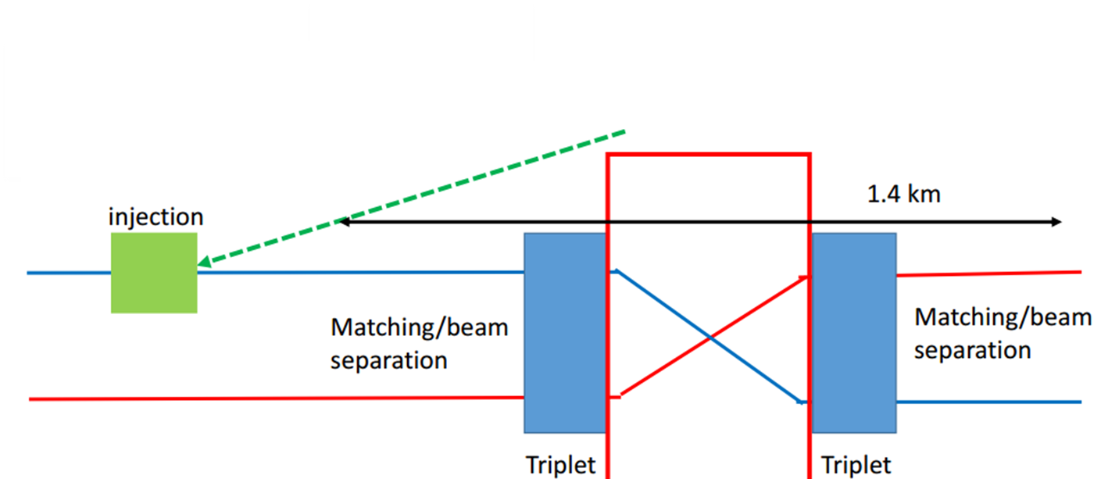
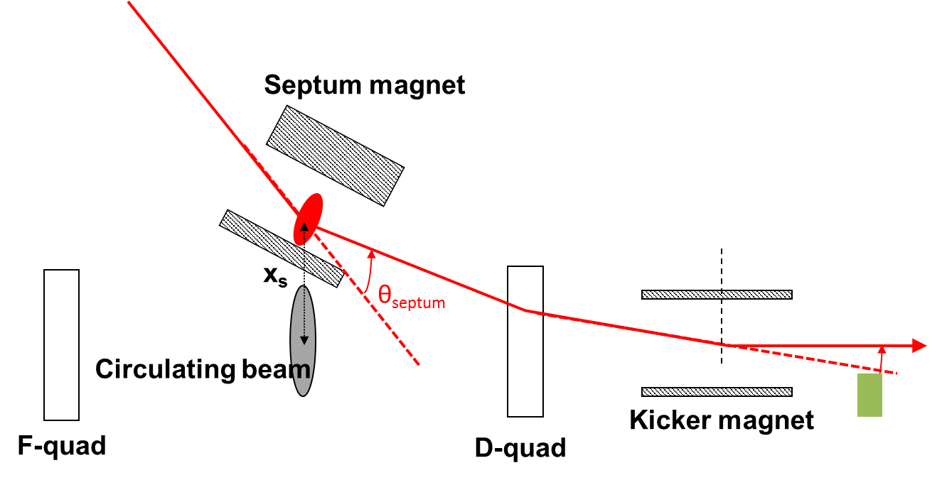
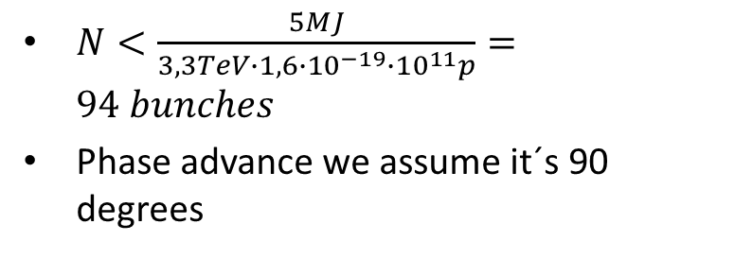
Injection layout
$N<\frac{5MJ}{3,3TeV∙1,6∙{10}^{−19}∙{10}^{11}p}=94 bunches$
Phase advance we assume it´s 90 degrees
Beams cross in the transfer line, not considering two plane injection

Slide 3
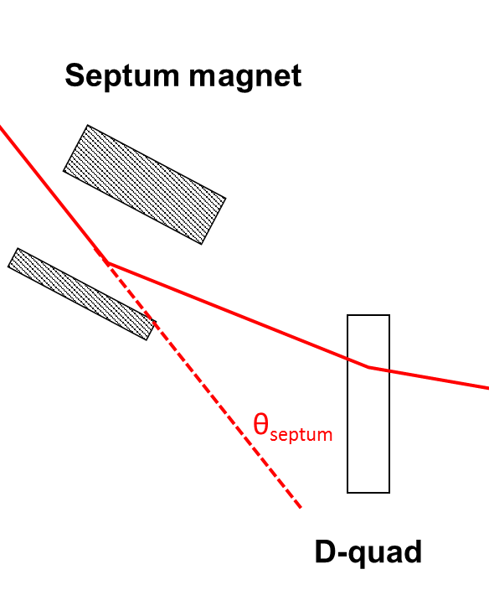
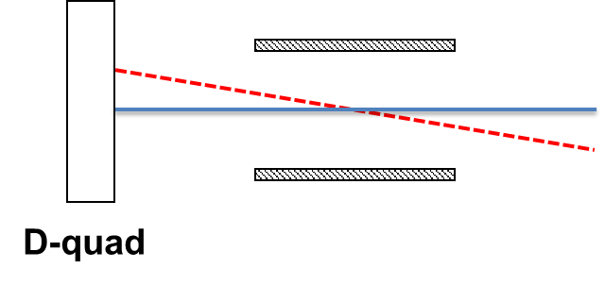

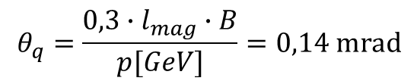
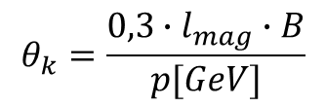
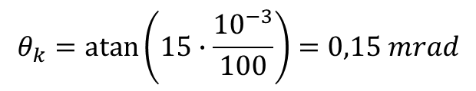

Kicker and Quadrupole
Length half cell of the FCC =100 m (baseline)
Transverse offset at the quadrupole = 15 mm
L_kicker = 10 m, 10 kickers of 1 m.
G_quad = 25T/m
B_quad= 25*15mm = 0.38T
L_quad =4m
L = 100(cell) + 215 +4 = 320 m
$$θ_{k}=\operatorname{atan}\left(15∙\frac{{10}^{−3}}{100}\right)=0,15 mrad$$
$$θ_{q}=\frac{0,3∙l_{mag}∙B}{p[GeV]}=0,14 mrad$$
$$θ_{k}=\frac{0,3∙l_{mag}∙B}{p[GeV]}$$
$tan⁡(0,14 mrad)=\frac{30 mm}{l_{q→s}}=$> $l_{q→s}$=214 m
$$B_{k}=0,165 T$$

Slide 4
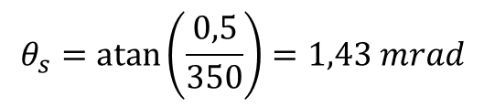

Magnetic septa, best septa
L(quad -> sept) = 700-320 =380 m, so we take 350 m before someone ocupies it. Injection first
B=1T. Simple, iron not saturated, we have margin for upgrades.
Injection bump? No, it would complicate our lives more than necessary and we have the physicists for that
$$θ_{s}=\operatorname{atan}\left(\frac{0,5}{350}\right)=1,43 mrad$$
$θ_{s}=\frac{0,3∙l_{septa}∙B}{p[GeV]}⇒l_{septa}$=15,4 m
5 magnets, ~3 m long. Easy handling

Slide 5

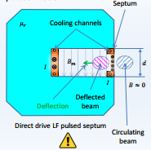
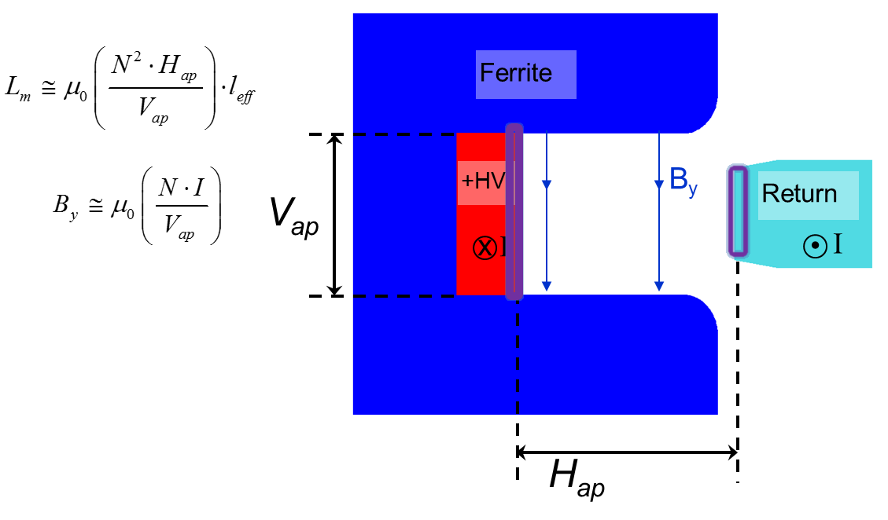

Kicker and septum details
flat-top : 94bunches*25ns+94*1ns = 2.4us
10 kickers, 1 m long, 1 turn.
Applying the two equations we get:
L = 1,26 uH
I = 6,5 kA
And a 20 kV PFN is not crazy, so with:
Same process as with the kicker:
I = 10 kA, 4 turns (These are slow and we know when we inject!!)
L = 20 uH
$U=L\frac{dI}{dt}⇒dt=0,8$us
Flat-top ripple 0.5% for kicker,
Field quality for septa and kickers :1%. We don´t want filamentation, emittance blow-up…
Post-injection pulse ripple: cause of oscillations, may turn into bigger hazards

Slide 6
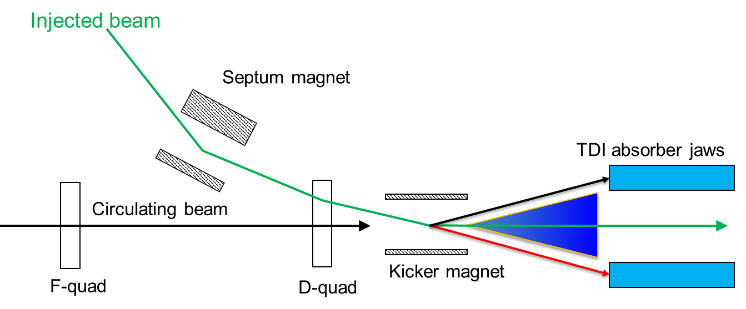
Protection
Absorbers, only shown in front of the kicker
Internal dump (not shown)
Shielding from experiment
(Radiation hard) electronics in separate gallery
Redundant magnets and hot spares
Underpaid students (not allowed to leave the tunnel)

Slide 7
Filling time
FCC ~ 3LHC in circumference (100 vs 27 km) Injection is instantaneous
LHC: 3 times rump up and down to fill → 3x(6 + 6) = 36 min/ring
LHC fill: 4 min/ring → 3 fills = 12min
36 +12 =48 min/ring of FCC → 96min
However, we can use both rings of LHC and fill 2 rings of FCC simultaneously
2 rings of LHC will take 8 min → 3 fills will take 24 min
36 + 24 = 60 min
Booster, PS and SPS negligible (seconds) compare to LHC/FCC, so not taken into account in this calculation
Other alternatives (maybe not very realistic solutions):
  faster LHC ramping (normal conducting, 1,7 TeV)
  reduce bunch spacing (more bunches in LHC every time)
  Reduce FCC circ., meaning we’ll need stronger magnets to reach the same energy
Using the SC SPS as injector
Ramp-up/down time = 6T/0.5 = 12s
Time to fill one ring of FCC about 8 min
Total filling time about 16 min

Slide 8
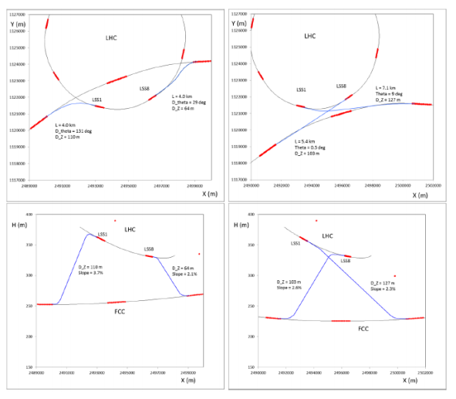
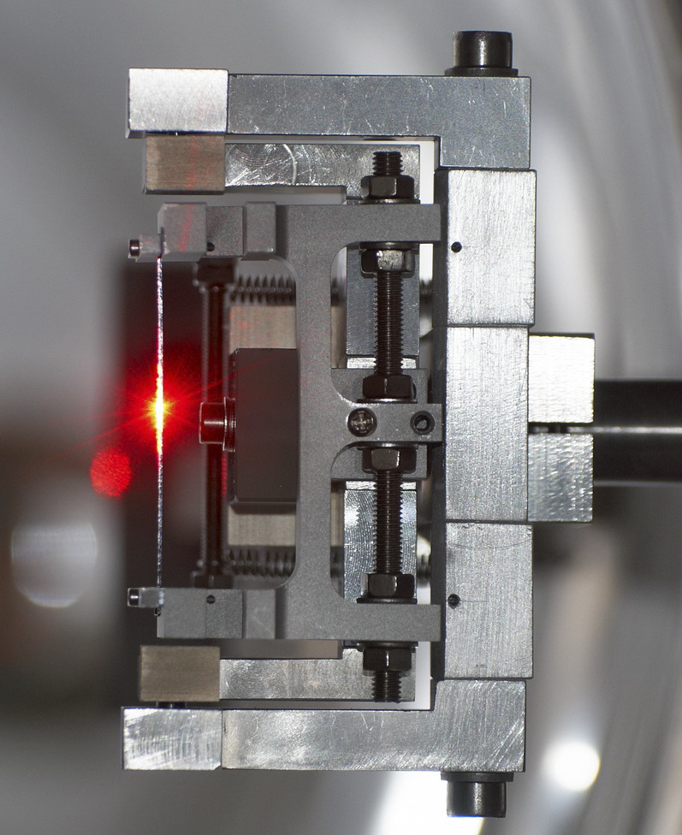
Alternative layouts
Layout could be further optimized
Maybe in the future: use bent crystals to steer the beam

