Slide 1
Injection system design for high-energy circular collider FCC-hh
Group 8
Agnieszka Chmielinska (CERN)
Gian Piero Di Giovanni (CERN)
Keith Furutani (Mayo Clinic Rochester)
Zahra Rezaei (Laboratoire de l'Accélérateur Linéaire)
Bo Wu (Chinese Academy of Sciences)
CAS, Erice, 18/03/2017
Case study C

Slide 2
Injection system design
FCC
Outer orbit injection
100 km
HEB
3.3 TeV
26.6 km
Inner orbit injection
Horizontal plane
Septum
Cryostats maximum
500 mm
TDI absorber jaws
Kicker
Circulating beam
FQ
DQ
Maximum 700 m
FQ
CAS, Erice, 18/03/2017
Case study C
Notes:
1.

Slide 3
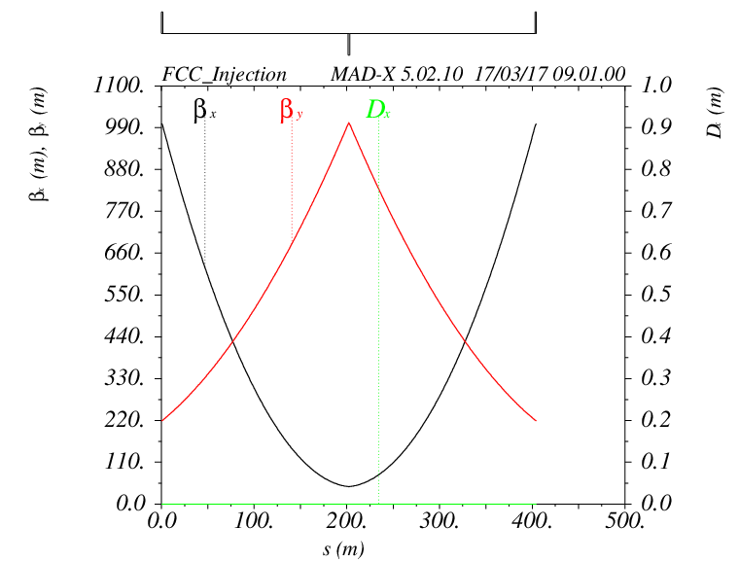
Lattice design
MADX
QF
Septum
QD
Kicker
QF
L_{cell} = 405 m
Δμ_{x}=90⁰
β_{x}= 611.1 m
β_{x}=60.9m
CAS, Erice, 18/03/2017
Case study C
Notes:
The beta function in horizontal direction was set to be 1000 m at the entracne and at the end of the cell.
To fulfill that we were varing quadrupols srength.
We chose to put the septum closeer to defocusing quadrupole, to minnimize the deflection angle of the kicker.
Knowing the position of the septum, we found position of the kicker to have phace advance of 90 degrees.

Slide 4
Injection system layout
$H/2=10σ_{x}$ + $x_{COD}\left(2mm\right)+x_{align} \left(1mm\right)+15.15mm=22mm$
Horizontal plane
Septum
550 mm
15.15 mm
Kicker
19.43 mm
Circulating beam
180 m
153 m
200 m
200 m
FQ
DQ
FQ
Element | FQ | Septum | DQ | Kicker
β_{x} (m) | 1000.3 | 60.9 | 46.0 | 611.1
X (±10σ_{x}) (mm) | 15.81 | 3.90 | 3.39 | 12.36
θ_{deflection} (mrad) | - | 2.864 | 0.095 | 0.101
L_{eff} (m) | 1.5 | 21 | 1.5 | 32
Magnetic Field | 34 T/m | 1.5 T | -42 T/m | 0.05 T
CAS, Erice, 18/03/2017
Case study C
Notes:
Beam size = 10 sigma = ten times the beam size
Epsilion=(epsilonN/beta y)
Sigma=sqrt(beta epsilon)
COD – closed orbit distortion

Slide 5
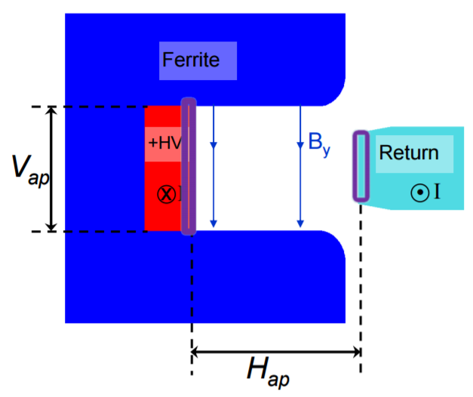
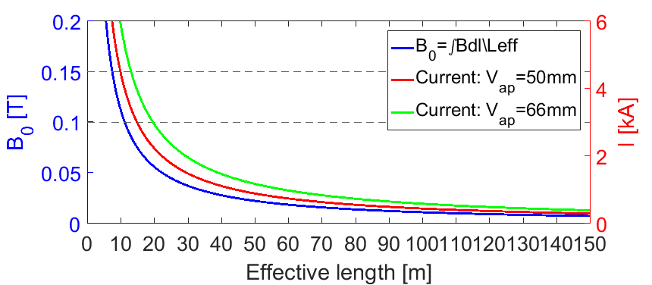


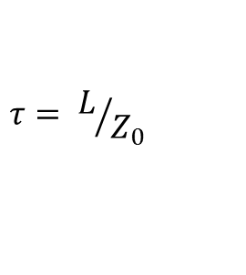




Kicker magnet
$L_{m/m}≅ u_{0}\frac{N^{2}H_{ap}}{V_{ap}}$
Assuming $H_{ap}$=$V_{ap}$: $L_{m/m}$=1.26E-06 H/m
$$τ= L/{Z_{0}}$$
Assuming $Z_{0}=5 Ω,τ=0.2 μs:$
$$L_{unit}=0.8 m$$
What should be the length of the entire magnet?
Including beam screen!
1
Assuming:
$$L_{eff}=32 m$$
40 magnets necessary.
$$I_{ }=2 kA$$
$$V=10 kV$$
CAS, Erice, 18/03/2017
Case study C

Slide 6
Bunches/Rise Time/Filling Pattern (I)
Maximum beam energy that can be transferred: 5 MJ
Maximum number of transferred bunches:
$$N_{b}=\frac{E_{trans}}{Intensity ∙E_{inj}}=\frac{5 x {10}^{6} J}{{10}^{11} protons ∙3.3{x10}^{12} eV ∙1.602 x {10}^{−19}eV/J}\sim 94$$
Planned to inject: 90 bunches
Flat-top time: t_{flattop} = 90 bunches * 25x10⁻⁹ s = 2.25 μs
For 100 Km collider and 25 ns buckets the ideal number of bunches is about 13342
  Assuming 80% filling factor we plan to inject 10674 bunches.
The desired rise time is about 280 ns:
  Number of empty bunches = 2668
  Planned injections is 10674/90 ~ 118 injections
  Assuming rise time and fall time to be identical and neglecting the abort gap
  This implies 12 bunches needed for rise/fall time so the injection scheme would be 12b + 90b + 12b …
  Number of injections is finally 117.

Slide 7
Bunches/Rise Time/Filling Pattern (II)
With 117 injections and assuming 3 mins to get the HEB filled and energy ramped
→ Assuming only 90 bunches in HEB at the time, it would take ~6 hrs to fill the FCC with
one beam.
How could this be speeded up?
→ Fill the HEB with multiple trains
  HEB can ideally accommodate 3562 bunches → At most 31 trains in 12b + 90b + 12b…
  In this configuration one can fill up the HEB and then inject in FCC (4 times).
→ Another approach could be by reducing the injection energy and allowing more
bunches in each train to be transferred.
  For instance we were provided with the option of 6.9 km ring at E_{inj}=1.3 TeV:
    Number of bunches that can be transferred is 240 (factor ~3 in time reduction).
    Assuming the same 80% filling factor:
      τ_{rise} = 758 ns and τ_{flattop} = 6.0 μs.
      Number of injections would be 44.
      Injection scheme would be 30b+ 240b +30b…
  For the same parameters, the effective length of the magnet would be 12.5 m …
  For higher rise time, the one module would be 3 m long.

Slide 8
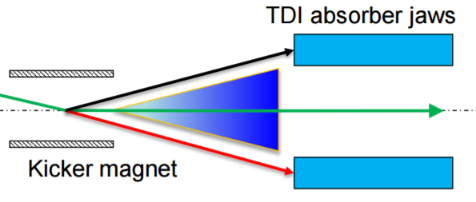
Hardware considerations
Flat top ripple: max. 1 % (minimized by optimizing electrical circuit of the magnet)
Post injection ripple: must be reduced to not perturbate circulating beam
Failure scenarios:
  → flashover (2.5 % deflection error)
  → wrong injected beam (TDI absorber)
Powering: independent for each kicker magnet
Important aspects:
  → screening of the ferrite to reduce heating and beam coupling impedance
  → beam screen made of low SEY material to reduce the electron cloud
  → high quality vacuum inside the kicker magnet
CAS, Erice, 18/03/2017
Case study C

Slide 9
  Thank you for your attention.

