Slide 1

FCC-hh injection group 7
Gigantic
Underground
INNer
Extremely
Small
Solenoid
HEB
Formally known as LHC
FCC

Slide 2
FCC-hh injection group 7
Gigantic
Underground
INNer
Extremely
Small
Solenoid
HEB
Formally known as LHC
In collaboration
with group 12
for beam dump studies
FCC

Slide 3
Injection Layout
Y
500 mm
Cryostat radius
X

Slide 4
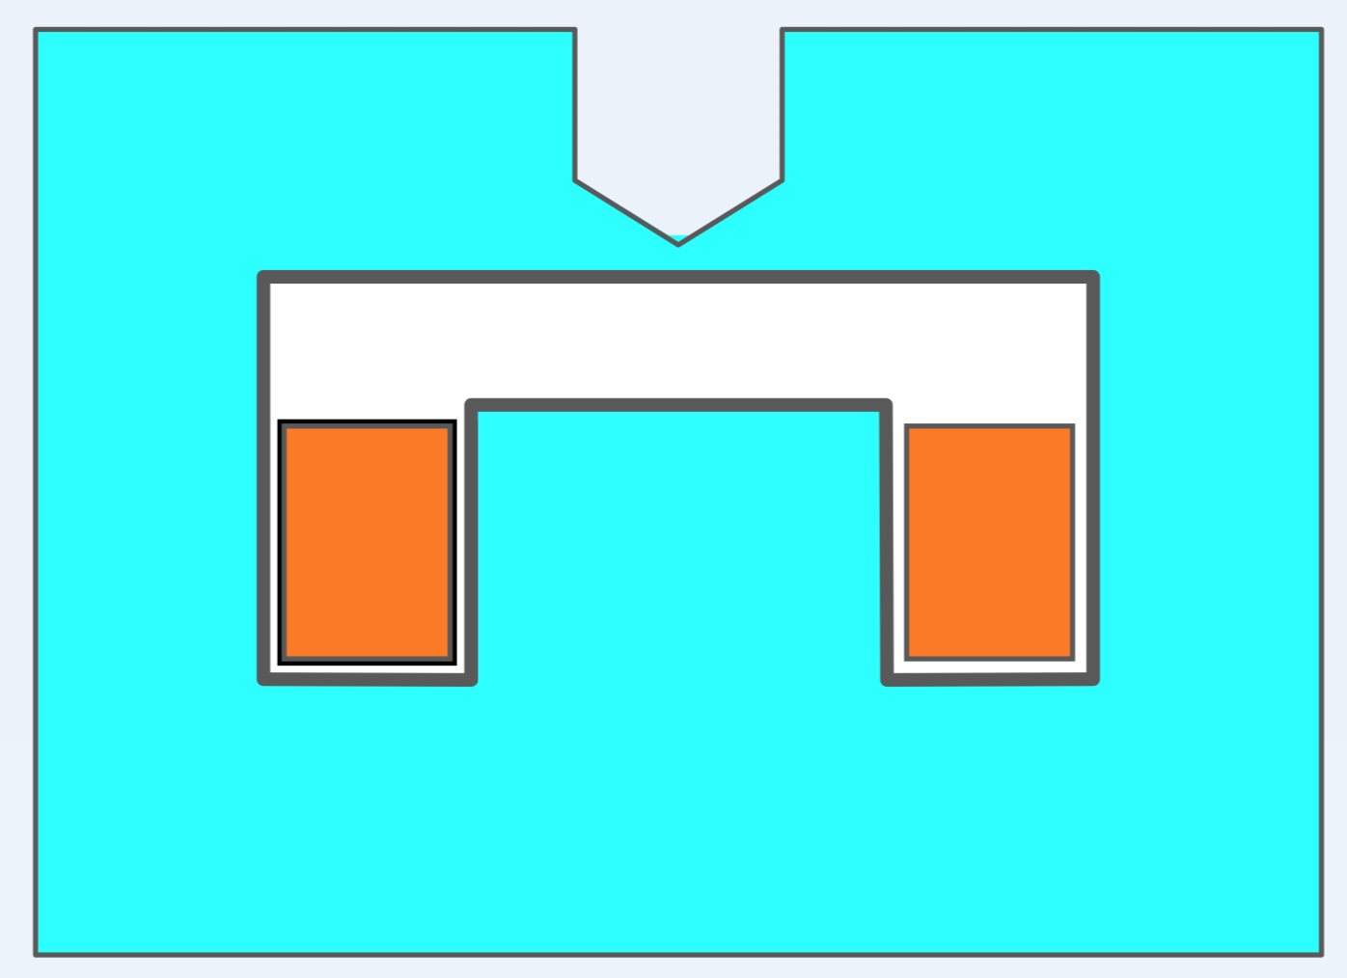
Injection Principle
- horizontal plane
Horizontal kick in septum
Radius of cryostat
+ Beam size circulating beam at septum
+ Beam size extracted beam at septum
+ margin
Y
500 mm
Cryostat radius
X
X
X

Slide 5
Injection Principle
- vertical plane
Vertical kicker
Beam size circulating beam at septum
+ Beam size extracted beam at septum
+ septum thickness
+ margin
Y
500 mm
Cryostat radius
X
X
Y

Slide 6
Injection Layout
Beta max
340 m
horizontal
510 mm
θ_{S =} 5 mrad
Beta min
Beta min
60 m
vertical
20 mm
θ_{K+Q} = 0.2 mrad
Beta max
Beta min
Beta max
Notes:
FoDo-Cell: 200 m + 90 deg phase advance ➔
Beta max = 340 m, Beta min = 60 m
Offset from septum (X_{Septum}) = 510 mm ➔ 5 mrad
Offset from kicker (X_{Kicker}) = 20 mm ➔ 0.2 mrad

Slide 7
Injection – longitudinal considerations
Assume we fill both HEB apertures, accelerate, then fill both FCC apertures
  3.5 T field ramp needed to accelerate from 0.45 to 3.5 TeV, so 117 s at 0.03 T/s
  Assume 3 minutes between cycles, then 4 HEB ramps take 22.6 minutes
Bunches/injection limited by 5 MJ beam energy limit
  Corresponds to ~90 bunches per filling batch from the HEB
Total number of bunches
  13’333 25 ns buckets in 100 km FCC. 80% fill means 10’666 bunches
  This implies 118 batches of 90 bunches
  Assuming HEB can provide 2x2808 25 ns bunches, means 4 HEB cycles needed
HEB
FCC

Slide 8
Hardware & Values
Septa
Kickers
 | Number of elements | B field per element | Ver. / hor. aperture | Magnetic length per element | inductance | Impedance transmission line | Rise time | Max. current | Max. voltage | Max dI/dt
kickers | 40 15 m total | 0.150 T | 55 mm / 55 mm | 375 mm | 471 nH | 1 ohm | 500 ns | 6500 A | 6500 V | 14kA/us
septa | 8 40 m total | 1,2 T | 100 mm / 100 mm | 5 m | 2,5 mH | 1 ohm | Pulse duration : 0,1 s | 4800 A | 540 V | 48 kA/s
Notes:
Kicker design
Assume 500 ns rise time
90 x 25 ns bunches imply a 2.25 us flat-top
Post-fill issues can be largely avoided by filling in the forward direction, just limited by the abort gap length (>2.5 us)
Using a Marx generator for powering should allow a repetition rate sufficient to inject all 118 batches in ~1 s
This fast kicker repetition implies that the overall FCC fill time is dominated by the LHC cycle time, so the use of a fast, low energy injector could be of interest

Slide 9
Failure scenarios
Interlock system!!
Septum fails
Kicker fails
crystal
~8 m
absorber
BLM
absorber
BLM
crystals
~8 m
Notes:
Usual failure scenarios for LHC injection
Kicker not firing, part-firing, asynchronous…
Neglect significant beam energy variations which will be filtered by the transfer line
Install injection protection device similar to LHC 90 degrees phase advance
Injected power is the same as the (5 MJ)
Will need to be 85% longer as shower depth maximum scales with log (E₀)
In addition as we only inject part of the circulating beam from the LHC, we need to consider:
Failure of the LHC extraction kicker to ‘switch off’ with possible 2808 bunches injected instead of 90
Will need to prevent this in the LHC, with redundancy on extraction kicker switches and possible other fast protection system
Crystals used to spread the beam for lower peak density on the absorber jaws

Slide 10
Failure scenarios
Interlock system!!
Septum fails
Kicker fails
~8 m
absorber
BLM
absorber
BLM
~8 m
Notes:
Usual failure scenarios for LHC injection
Kicker not firing, part-firing, asynchronous…
Neglect significant beam energy variations which will be filtered by the transfer line
Install injection protection device similar to LHC 90 degrees phase advance
Injected power is the same as the (5 MJ)
Will need to be 85% longer as shower depth maximum scales with log (E₀)
In addition as we only inject part of the circulating beam from the LHC, we need to consider:
Failure of the LHC extraction kicker to ‘switch off’ with possible 2808 bunches injected instead of 90
Will need to prevent this in the LHC, with redundancy on extraction kicker switches and possible other fast protection system
Crystals used to spread the beam for lower peak density on the absorber jaws

Slide 11
Failure scenarios
Interlock system!!
Septum fails
Kicker fails
crystal
~8 m
absorber
BLM
absorber
BLM
crystals
~8 m
Notes:
Usual failure scenarios for LHC injection
Kicker not firing, part-firing, asynchronous…
Neglect significant beam energy variations which will be filtered by the transfer line
Install injection protection device similar to LHC 90 degrees phase advance
Injected power is the same as the (5 MJ)
Will need to be 85% longer as shower depth maximum scales with log (E₀)
In addition as we only inject part of the circulating beam from the LHC, we need to consider:
Failure of the LHC extraction kicker to ‘switch off’ with possible 2808 bunches injected instead of 90
Will need to prevent this in the LHC, with redundancy on extraction kicker switches and possible other fast protection system
Crystals used to spread the beam for lower peak density on the absorber jaws

Slide 12

Thank you!
HEB
FCC

