Slide 1


Design a top‐up injection System for a light source
Group 5:
Miroslav Georgiev Atanasov CERN
Tomas Matlocha NPI of the CAS
Olha Kazinova Joint Institute for Nuclear Research
Roberto Formento Cavaier SUBATECH
Jean Francois Comblin CERN
Daniel Valuch CERN
18/03/2017, Erice

Slide 2
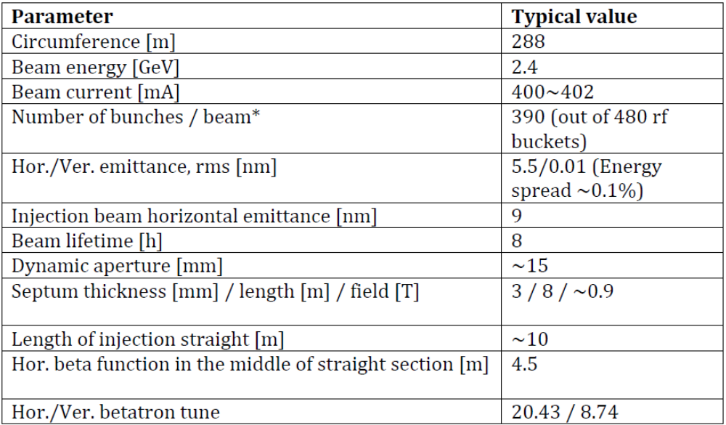
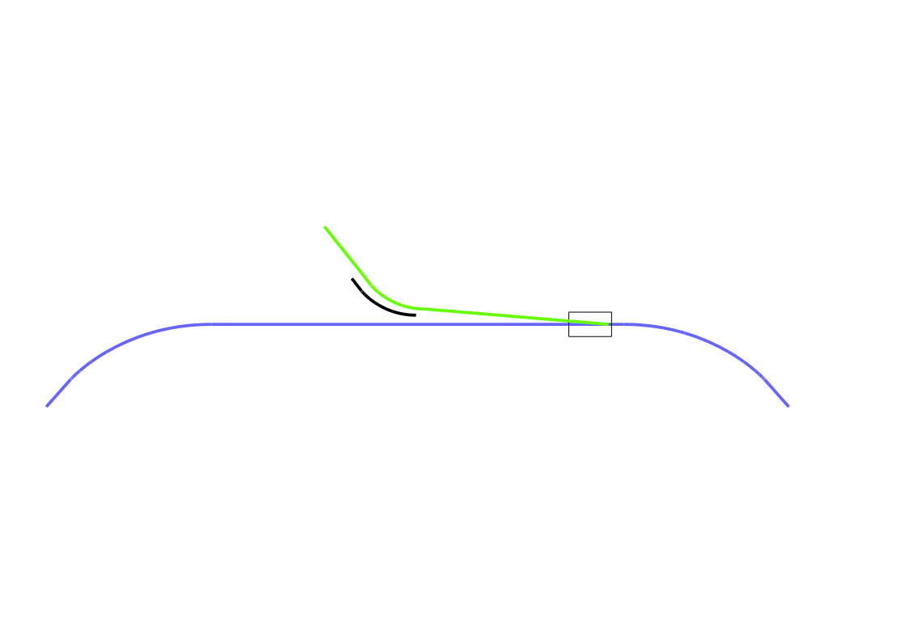
INTRODUCTION
INJECTED BEAM
KICKER
SEPTUM
STRAIGHT SECTION
ARC
CIRCULATING BEAM

Slide 3
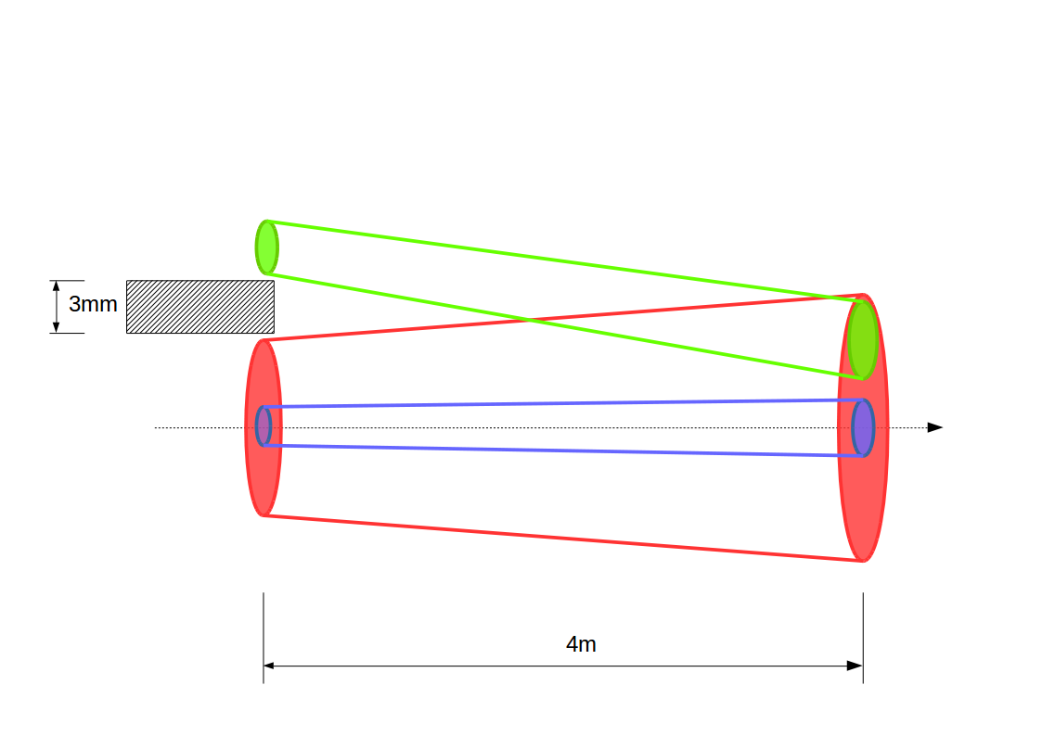
RESULTS
 | Septum | Kicker
Beta function (m) | 4.5 | 10.05
Beam size injected (mm) | 0.2 | 0.3
Beam size circulating (mm) | 0.15 | 0.235
Beam envelope injected (15σ*mm) | 3 | 4.5
Beam envelope circulating (15σ*mm) | 2.25 | 3.525
Dynamic aperture (mm) | 10 | 15
Injection offset (mm) | 9.5 | 5.25
Parameters | Values
Beam rigidity (Bρ) | 8.1 Tm
Septum deflection | ≈ 90 mrad
Kicker deflection | 1.062 mrad
Sextupole kicker length | 1 m
Magnetic field at injection point | 8.634 mT
Sextupole gradient | 626.5 T/m²
SEPTUM
SEXTUPOLE KICKER

Slide 4
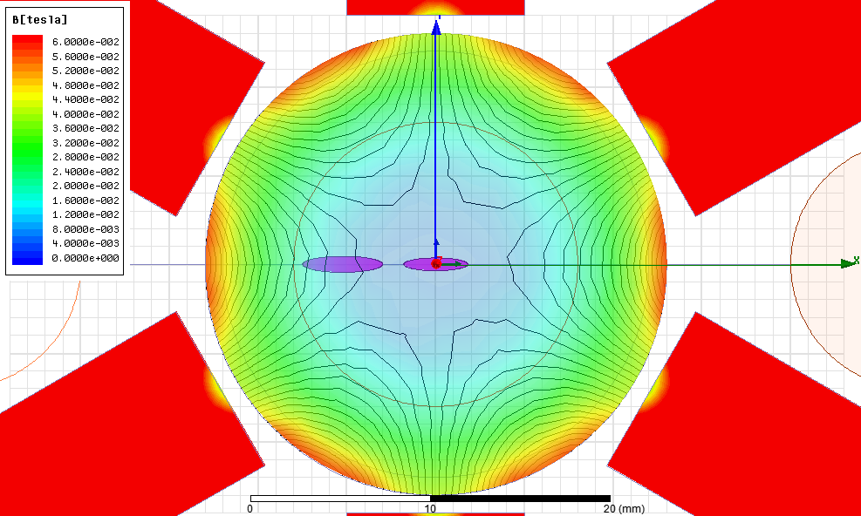
MAGNET DESIGN

Slide 5
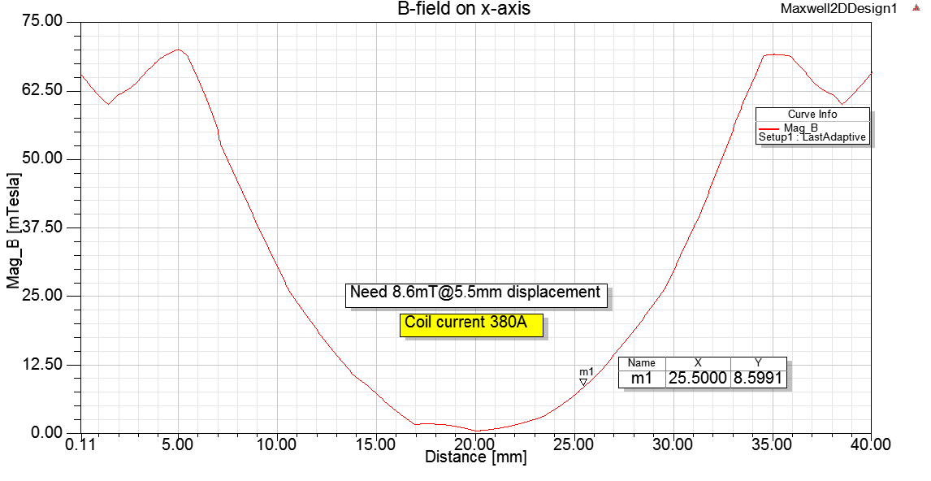
RESULTS
Injection Point

Slide 6
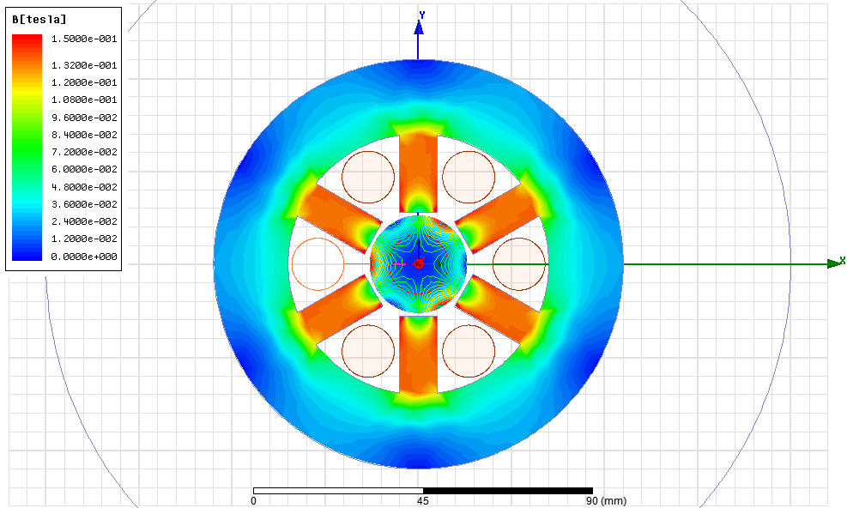
FINAL DESIGN

Slide 7

ACKNOWLEDGEMENTS
Masamitsu Aiba
Christoph Hessler
CO-DO lattice (Confusing-Deconfusing elements):
Bernhard
Holzer
Matthew
Fraser
THANK YOU FOR YOUR ATTENTION!

Slide 8
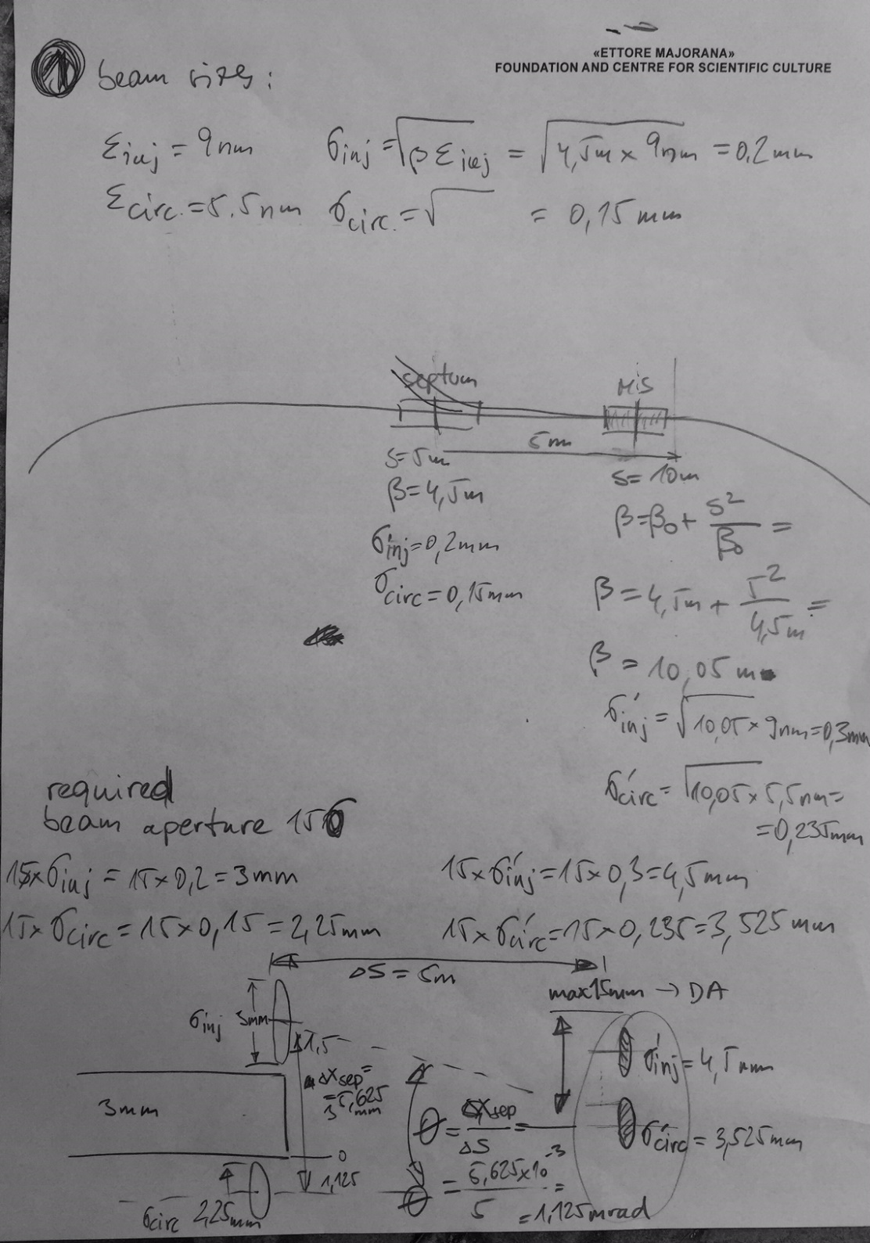

Slide 9
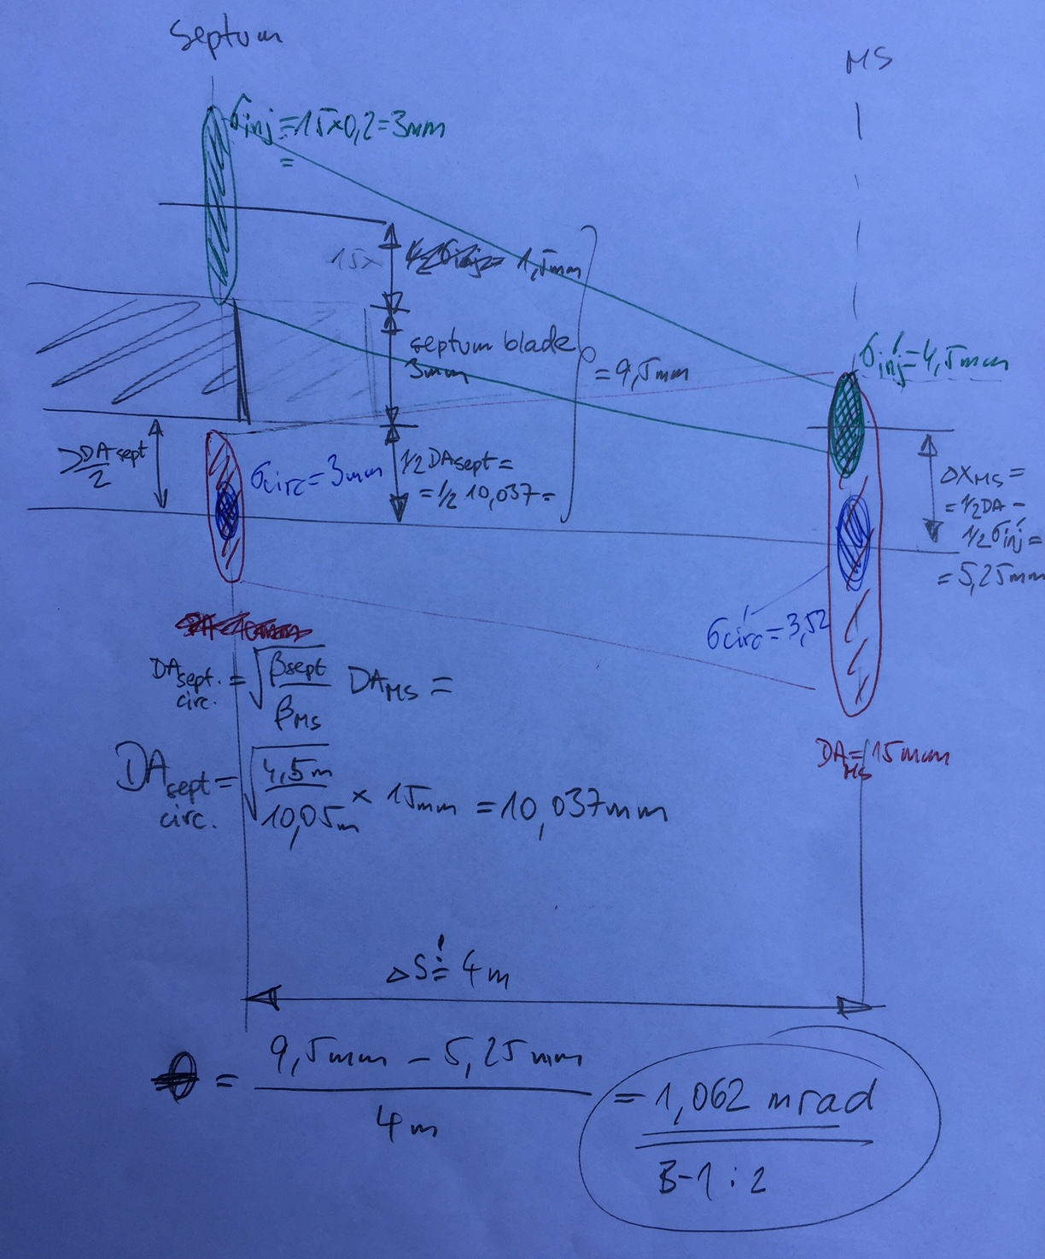

Slide 10
