Slide 1


Problems
Identify composition of residual gas spectra
What are the problems with those spectra

Slide 2
Problems
Case 1
First try…
whew, we got lost!
unbaked (18, 17, 16)
Fluorine! (19)
e.g. from Teflon
Perfluoroalkanes C_{n}F_{2n+2}?
hint for a
leak? (14)
no leak?
(28, 32, 40)
Trifluoromethane/Fluoroform?
CHF₃ (69, 51, 31, …)
Trifluoroacetic anhydride?
C₄F₆O₃ (69, 97, …)
C from
CO/CO₂?
(12)
Hydrocarbons?
Oil contamination?
Ar++?
H₂O isotope?
(20)
Neon?
(20, 22)
Ethane? (28, 27, 30, 26, 29)

Slide 3
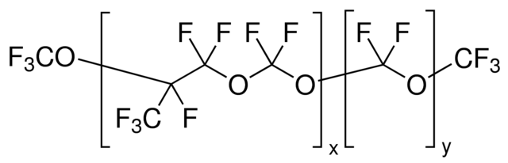
Problems
Case 1
… second try
C | 12
F | 19
O | 16
 | F |  | CF |  | CFO |  | CF2 |  | FO2 |  | CF3 |  | C2F3O |  | C2F4 |  | CF3O2 |  | C2F5 |  | C3F5 |  | C2F5O |  | C3F5O |  | C3F6 |  | C3F7 |  | C3F7O
 | 0 | 0 | 1 | 12 | 1 | 12 | 1 | 12 | 0 | 0 | 1 | 12 | 2 | 24 | 2 | 24 | 1 | 12 | 2 | 24 | 3 | 36 | 2 | 24 | 3 | 36 | 3 | 36 | 3 | 36 | 3 | 36
 | 1 | 19 | 1 | 19 | 1 | 19 | 2 | 38 | 1 | 19 | 3 | 57 | 3 | 57 | 4 | 76 | 3 | 57 | 5 | 95 | 5 | 95 | 5 | 95 | 5 | 95 | 6 | 114 | 7 | 133 | 7 | 133
 | 0 | 0 | 0 | 0 | 1 | 16 | 0 | 0 | 2 | 32 | 0 | 0 | 1 | 16 | 0 | 0 | 2 | 32 | 0 | 0 | 0 | 0 | 1 | 16 | 1 | 16 | 0 | 0 | 0 | 0 | 1 | 16
Mass |  | 19 |  | 31 |  | 47 |  | 50 |  | 51 |  | 69 |  | 97 |  | 100 |  | 101 |  | 119 |  | 131 |  | 135 |  | 147 |  | 150 |  | 169 |  | 185
At some point, it‘s necessary to:
● have a closer look on your vacuum system and procedures to find out where the conamination could come from
● find more detailed information about your „suspects“ in literature (or Google ☺)
51
69
→ In this case, one suspect could be „Fomblin“,
a lubricant used in vacuum pumps
19
http://www.sigmaaldrich.com/content/dam/sigma-aldrich/structure3/034/mfcd00163696.eps/_jcr_content/renditions/mfcd00163696-large.png
(http://www.sigmaaldrich.com/catalog/substance/fombliny123456999167911)
31
50
12
16
47
100
19
19
97
101
119
12
16
147
169
131
150
135
185

Slide 4
Problems
Case 2
baked, but rather badly
(18, 17, 16)
Residual gas spectrum on a small test setup
possibly an air leak (28, 32, 40, 14, 20)
low 32 because baked system
low 40? ca. 1 % of air, but peak 28 contains also CO
some additional contamination
(55, 52, 64, 56, 66, 37?, …)
?
 |  | m/z position of multiple ionisation
W | % | 2x | 3x | 4x | 5x | 6x | 7x | 8x
Iso. | ab.
182 | 26 | 91,0 | 60,7 | 45,5 | 36,4 | 30,3 | 26,0 | 22,8
183 | 14 | 91,5 | 61,0 | 45,8 | 36,6 | 30,5 | 26,1 | 22,9
184 | 31 | 92,0 | 61,3 | 46,0 | 36,8 | 30,7 | 26,3 | 23,0
186 | 28 | 93,0 | 62,0 | 46,5 | 37,2 | 31,0 | 26,6 | 23,3
W++++++++
W+++++++
W++++++
W+++++
W++++
W+++
W++
Multiple ionization of tungsten, sublimation of RGA filament (e.g. before burning through)

Slide 5
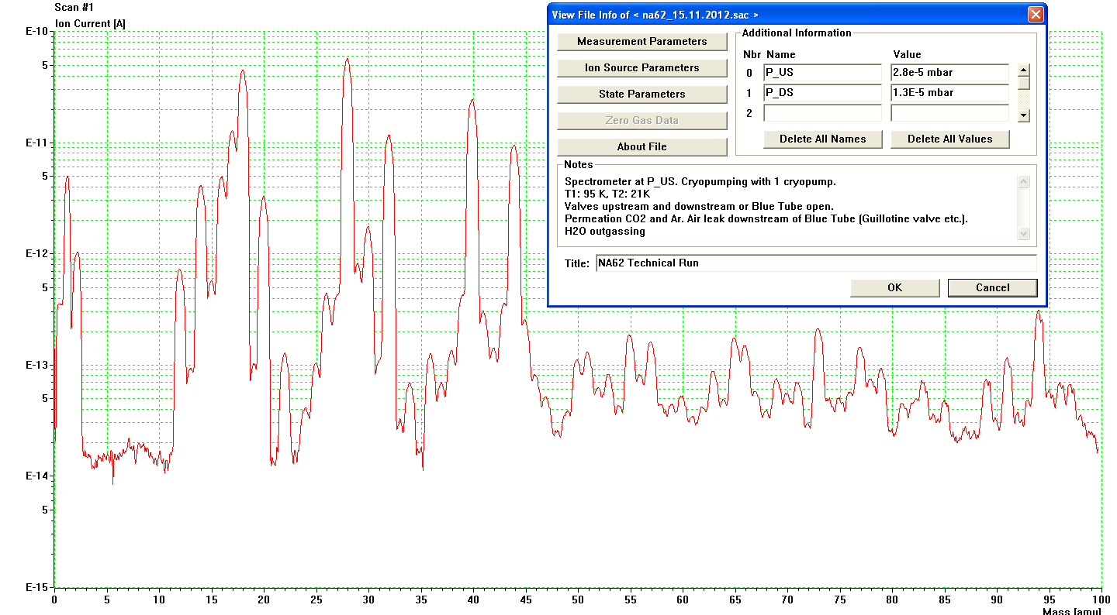
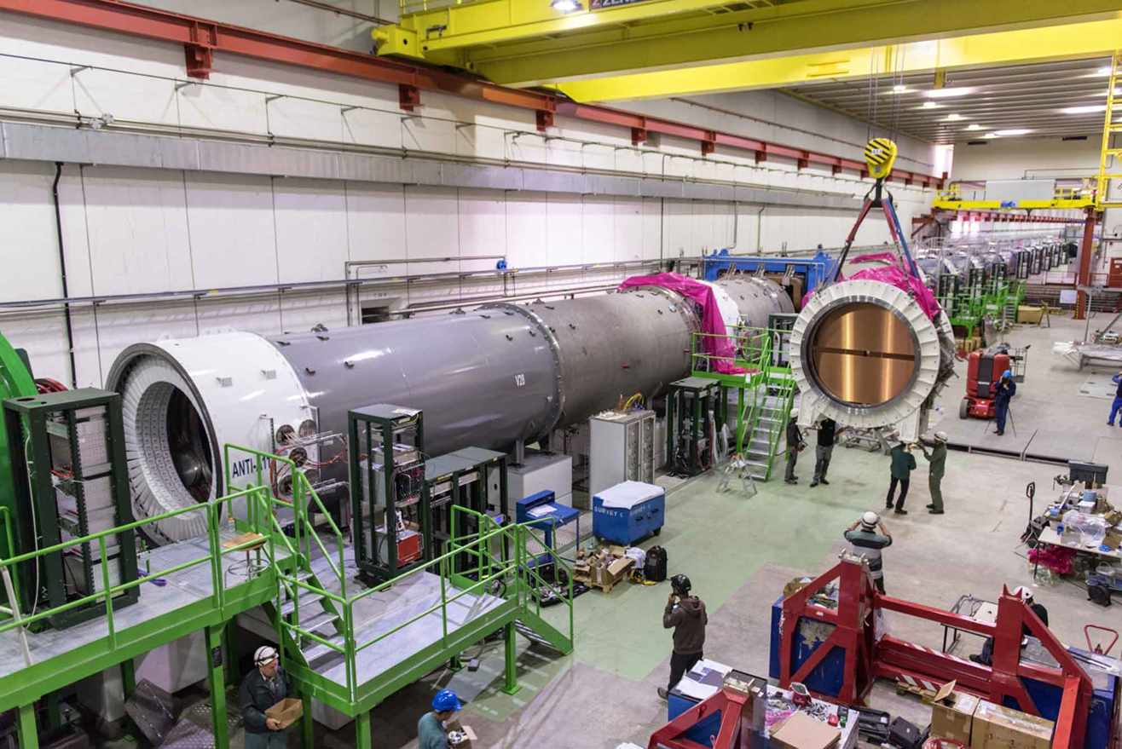
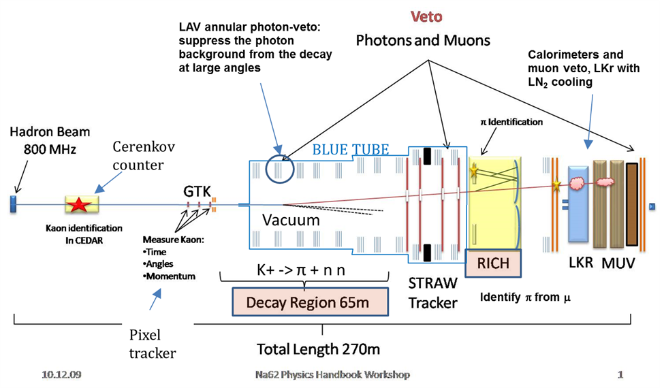
Problems
Measured Spectrum NA62 (16.11.2012)
Case 3
NA62 experiment at CERN
Residual gas spectrum in decay tube
Length > 100 m. Detectors inside vacuum
unbaked (18, 17, 16)
air leak
(28, 32, 40, 14, 20)
a rather dirty vacuum system
(Polymers?)
extremely high Ar-Peak (and CO₂-Peak)
Inside the vacuum system, there are very thin-walled Mylar tubes (Polyester) containing Ar and CO₂. These gasses are permeating through the Mylar walls into the vacuum system.

Slide 6
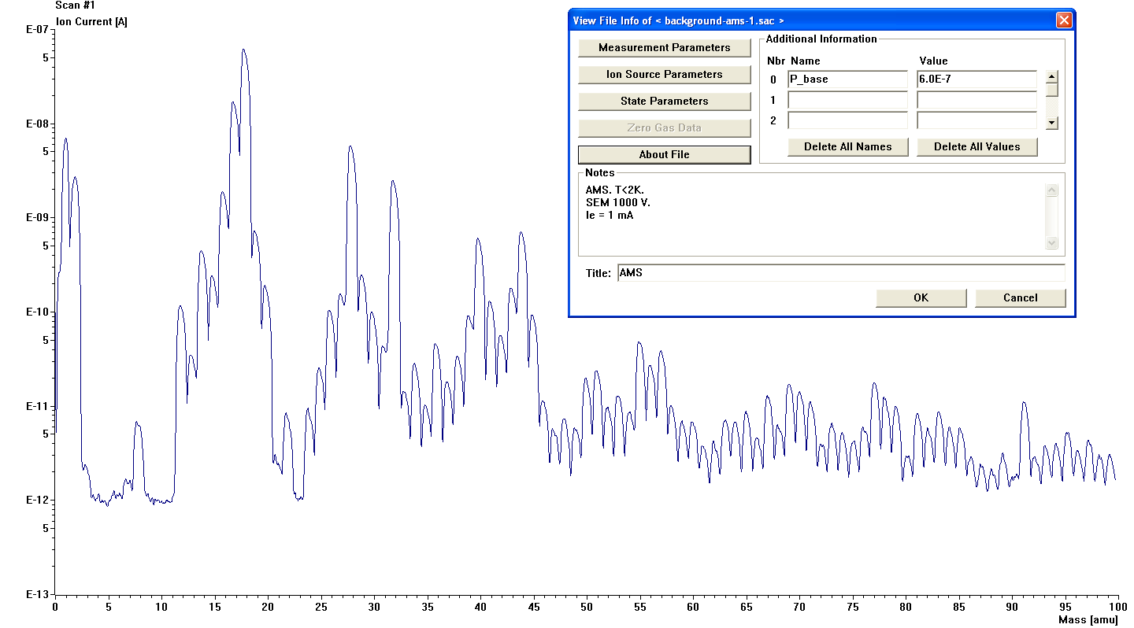
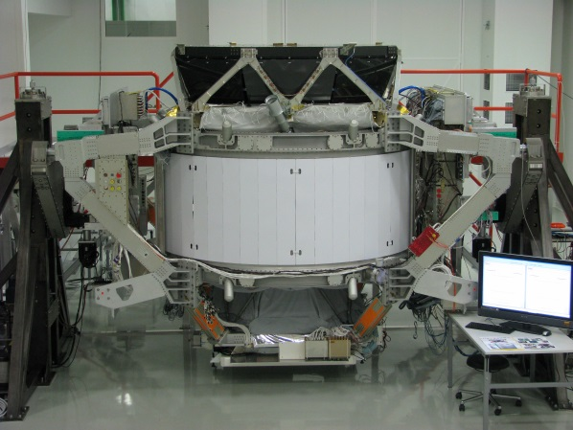
Problems
AMS background
Case 4
unbaked (18, 17, 16)
Tests after assembling at T < 2 K
Fluorine (19)
Alpha Magnetic Spectrometer
Designed by NASA
Tested at CERN
Sent to ISS
?
some contamination
or Polymeres
Air leak (28, 32, 40, 14, 20)
https://upload.wikimedia.org/wikipedia/commons/0/00/AMS01Geneva.jpg
(https://en.wikipedia.org/wiki/Alpha_Magnetic_Spectrometer)
This is a virtual leak (cannot be distingueshed by RGA) located in between the super-insulation layers
Generally: The system is cooled down to 2 K. We‘re blind on the cold part (cryo pumping), RGA shows only warm parts and transition area.

