Slide 1
Impedance and FCC-e⁻e⁺ of perfect flat surfaces with uniform resistance
Martin Duignan, Elisa Garcia-Tabares, Laura Grob, Xiuguang Jin, Anne-Laure Lamure, Mostafa Salahshoor, Roberto Salemme, Theo Sinkovits
Credit to Benoit Salvant and Sergio Calatroni.

Slide 2
Content
Impedance: bunch length, material resistance, and coating thickness.
One identified problem with FCC-ee and coatings.
Our task
Model inputs
Outputs
Summary
We do not intend to consider vacuum, e-cloud or desorption effects, but the coatings assessed play a significant role in reducing these problems, and their influence on impedance is critical!

Slide 3
Impact of frequency
The bunch length does not change the impedance itself, but changes the frequency range of interest. Bunch length in FCC-ee is very small (2.1 mm) and this leads to higher active frequencies.
Dependencies:
Frequency
Thickness (coating)
Material Resistance
Surface impedance is linked to longitudinal and transverse impedance.
If coating resistance is increased, real component shifts.

Slide 4
Impedance, FCC-ee & Coatings
Longitudinal Impedance
Real component leads to Power Loss
Real and Imaginary leads to longitudinal instabilities
Transverse Impedance
Leads to transverse instabilities.
Eleonora Belli presented findings in FCC week 2017 and concluded
For longitudinal impedance,
  1000 nm NEG leads to longitudinal instabilities.
  200 nm Amorphous Carbon and TiN do not.
  Amorphous Carbon and TiN (200 nm) and NEG (1000 nm) do not have a limitation for transverse impedance and instabilities
  but NEG (1 um) is identified as ‘dangerous’.

Slide 5

Impedance is like Shelob from Lord of the Rings.
She’s imaginary, and very real. If you try to pass a beam through her lair quietly and carefully your beam will get through.
If your beam moves with high frequency it will be slowed by her webs and she will paralyse and eat your beam!
Taken from http://deathbattlefanon.wikia.com/wiki/Shelob

Slide 6
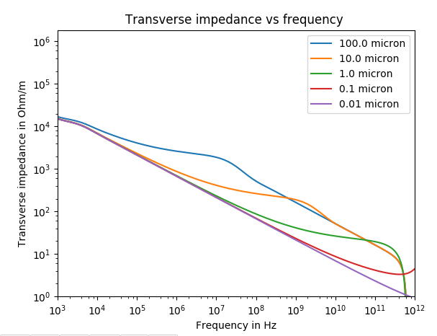
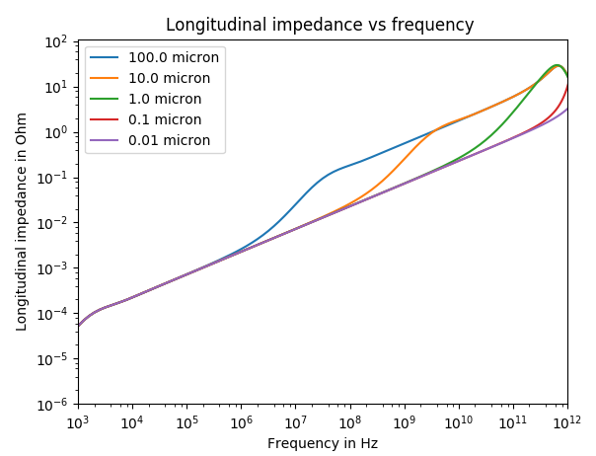

Impact of NEG thickness on Cu (for example)
Transverse impedance $∝Longitudinal Impedance/Frequency$
Thicker coatings increase impedance.

Slide 7
Task
Understand impedance limitations due to coatings in the FCC-ee design, by calculating longitudinal and transverse impedance with a Python code (Impedance Wake 2D by Nicolas Mounet)
What thickness of NEG will give the same impedance as 200 nm TiN and aC ?
What materials should be used to reduce power loss?

Slide 8
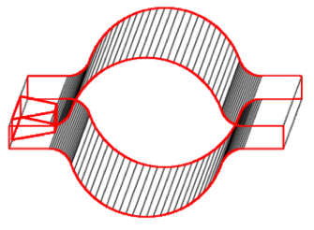
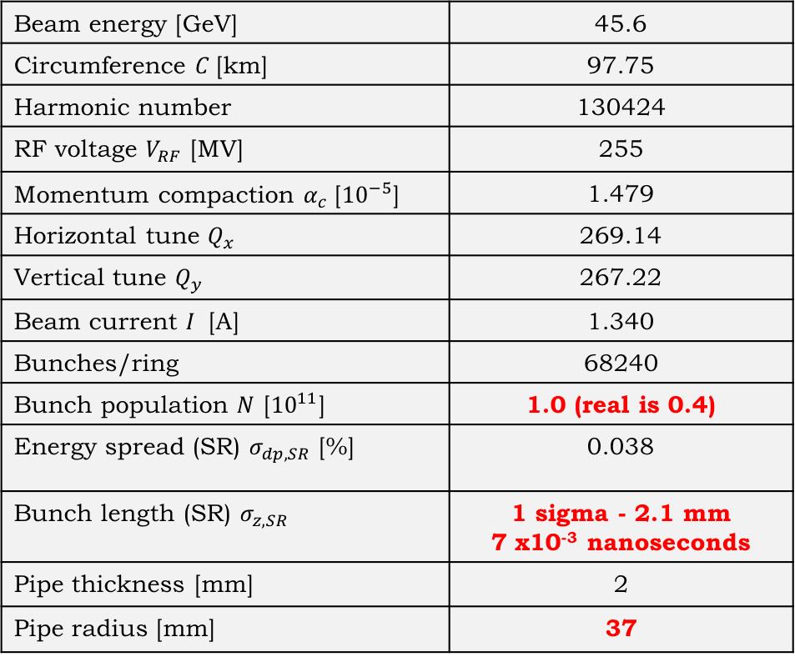
Input parameters
Beam energy [GeV] | 45.6
Circumference $C$[km] | 97.75
Harmonic number | 130424
RF voltage $V_{RF}$ [MV] | 255
Momentum compaction $α_{c}$[${10}^{−5}$] | 1.479
Horizontal tune $Q_{x}$ | 269.14
Vertical tune $Q_{y}$ | 267.22
Beam current $I$ [A] | 1.340
Bunches/ring | 68240
Bunch population $N$ [${10}^{11}$] | 1.0 (real is 0.4)
Energy spread (SR) $σ_{dp,SR}$ [%] | 0.038
Bunch length (SR) $σ_{z,SR}$ | 1 sigma - 2.1 mm 7 x10⁻³ nanoseconds
Pipe thickness [mm] | 2
Pipe radius [mm] | 37
Substrates | Resistivity [Ω.m]
Copper | 1.7 x10⁻⁸
Stainless steel | 1 x10⁻⁶
Aluminum | 4 x10⁻⁸
Coatings | Resistivity [Ω.m] | Thickness [nm] | Secondary Electron Yield
Amorphous carbon | 1 x10⁻⁴ | 400 | 1.0
Titanium | 5.6 x10⁻⁷ |  | -
Titanium + amorphous carbon |  | 300+50 | 1.0
NEG | 1 x10⁻⁶ | various | 1.8 (not active) 1.1-1.2 (active)
TiN | 5 x10⁻⁷ | 200 | 0.8 – 0.9
The code considers only a circular pipe cross-section.

Slide 9
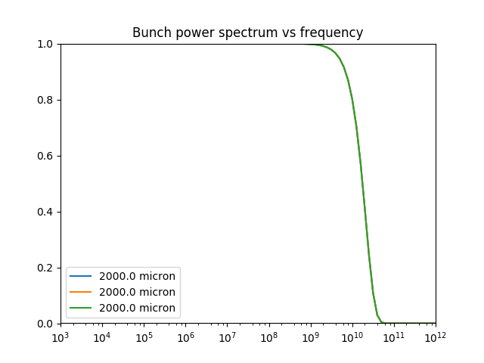
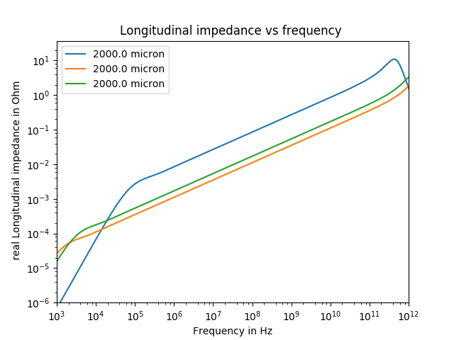
Active frequencies & Beam pipe impedance
Stainless Steel
Copper
Aluminium
Careful!
Go for copper!

Slide 10
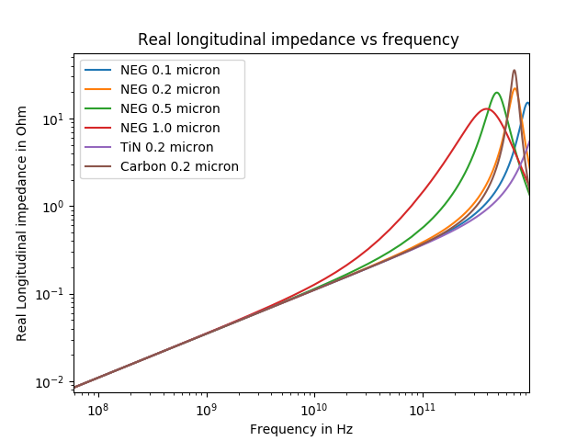
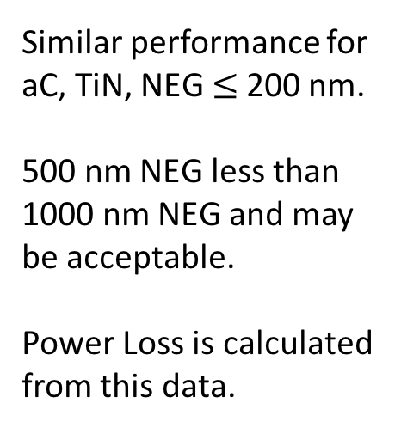
Cu with Coating?
Similar performance for aC, TiN, NEG $≤$200 nm.
500 nm NEG less than 1000 nm NEG and may be acceptable.
Power Loss is calculated from this data.

Slide 11
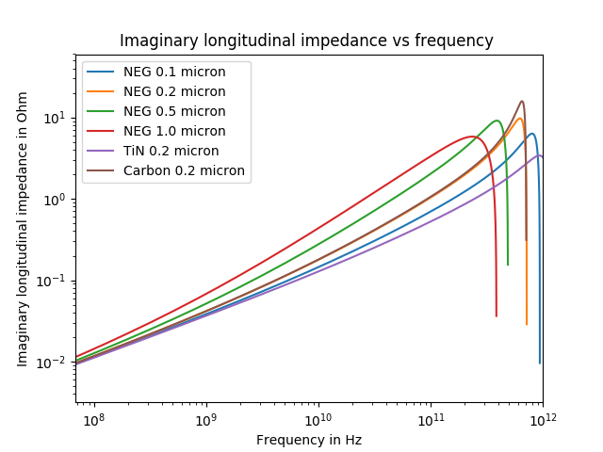
Longitudinal instabilities can develop over time due to this component.
Similar performance for aC, NEG at 200 nm thickness.
100 nm of NEG has better performance.
200 nm of TiV has the best performance. Due to lower resistance!
SuperKEKB (similar to FCC-ee) uses TiN…

Slide 12
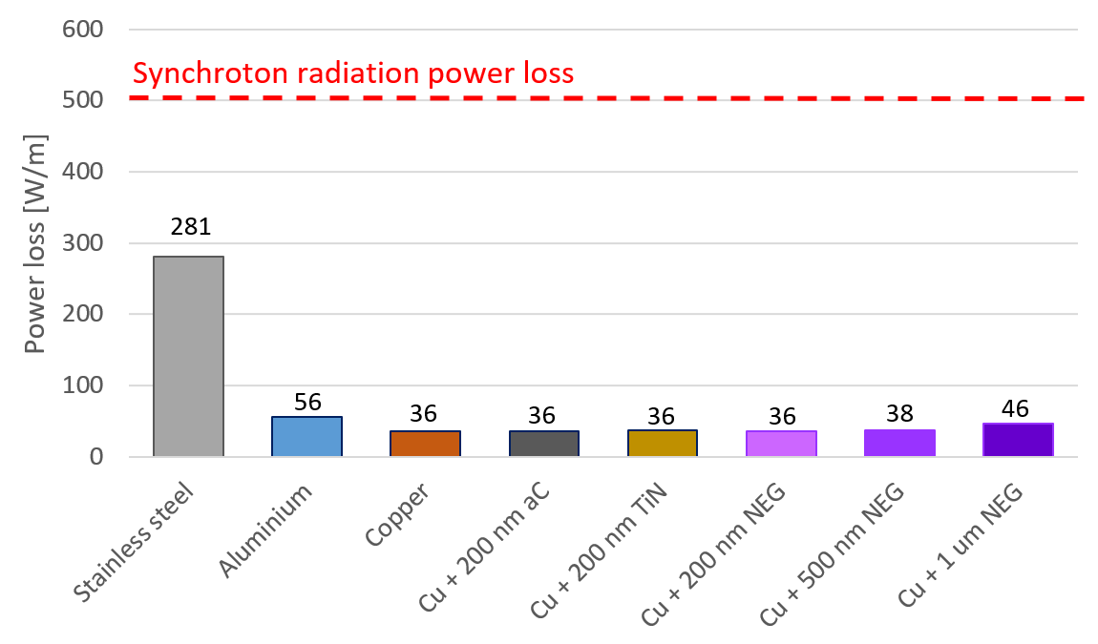
Power Losses [W/m]
Power losses are significant!

Slide 13
Summary
For a 2.1 mm bunch length:
Cu substrates are best to reduce power loss.
Power losses from impedance are non-negligible!
TiN on Cu is shown to have the lowest impedance.
aC and NEG (200 nm) have similar impedance.
Choose desirable secondary electron yield (TiN & aC), vacuum, outgassing or desorption characteristics to decide. NEG may only be used to reduce outgassing in this case.
* Perfect flat surfaces with uniform resistance.

Slide 14


Slide 15
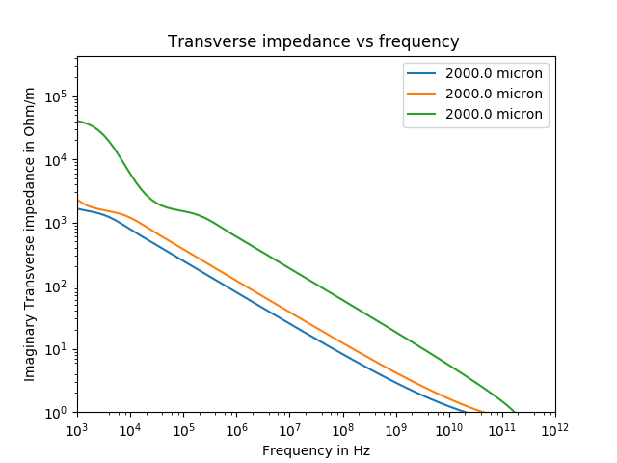
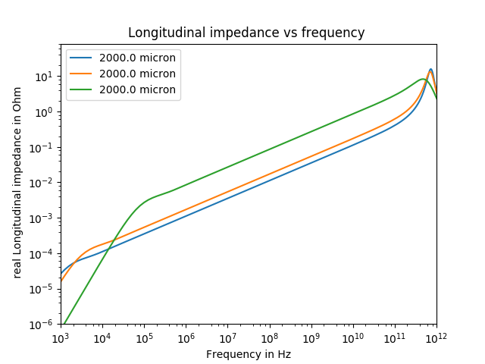
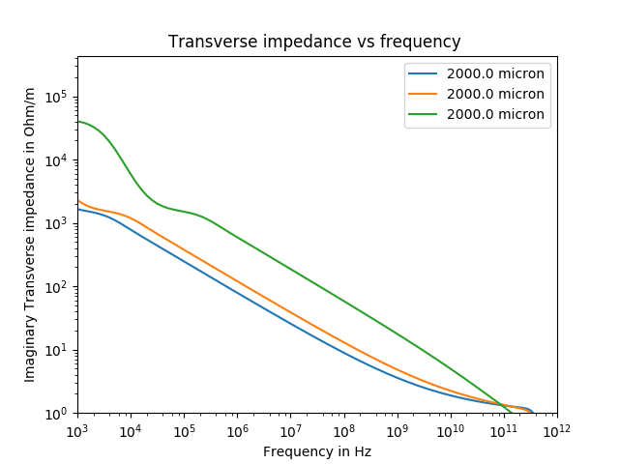
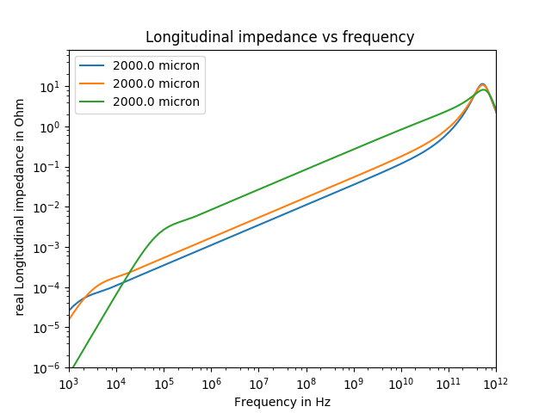
200 nm TiN
200 nm TiN
TiN on Copper
TiN on Aluminium
TiN on Stainless Steel
500 nm TiN
500 nm TiN

Slide 16
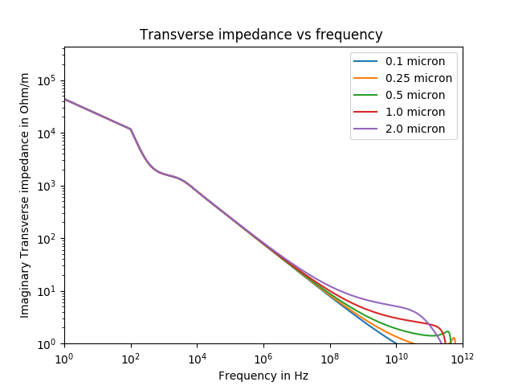
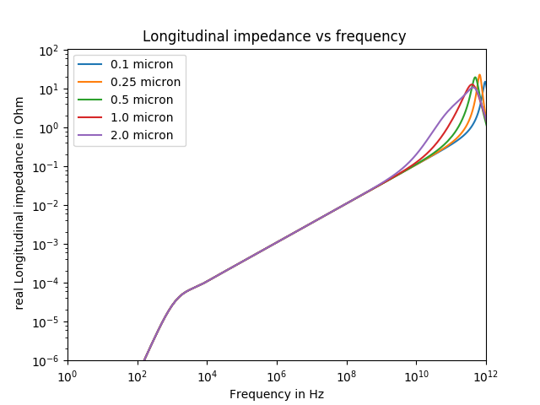
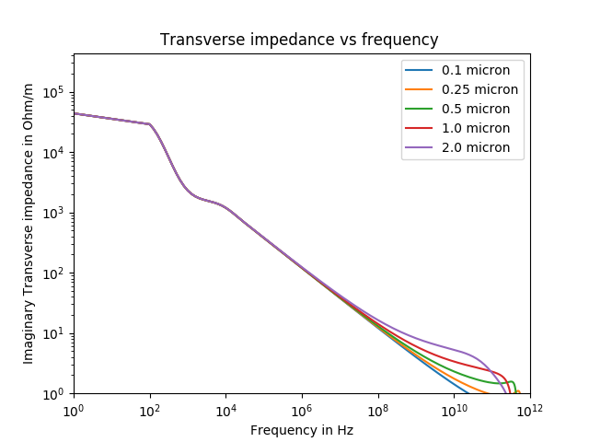

NEG on Copper
NEG on Aluminium

Slide 17
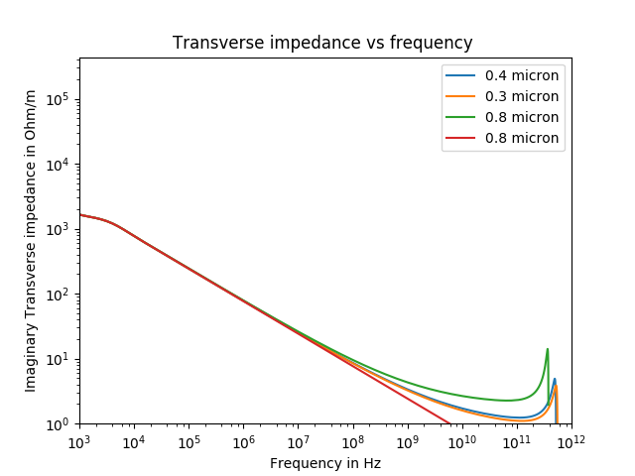
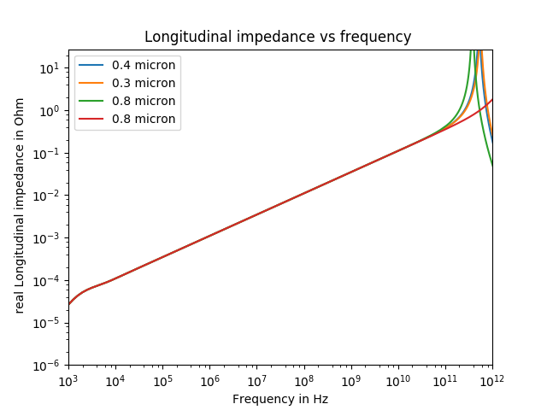
a-Carbon coating on Copper
400 nm
50 nm Ti + 300 nm carbon 800 nm
No coating

Slide 18
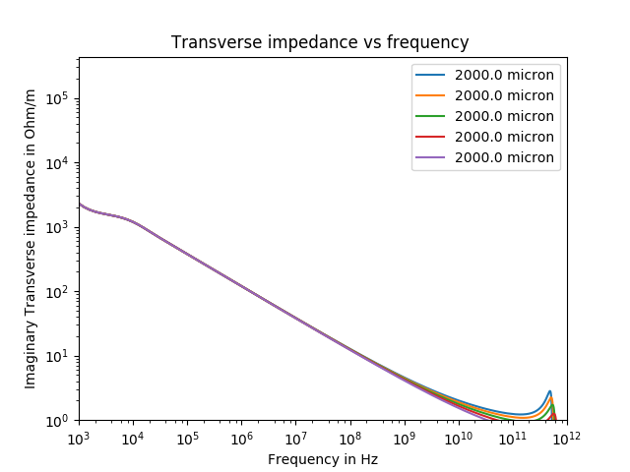
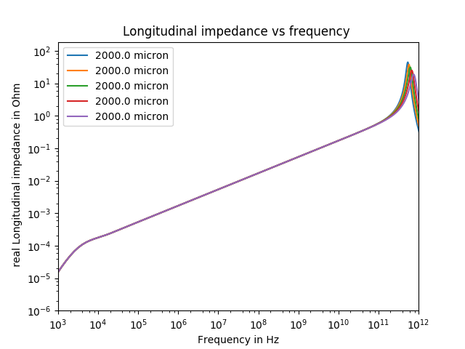
a-Carbon coating + 50 nm Titanium on Aluminium
300 nm a-C 250 nm a-C
200 nm a-C
150 nm a-C
100 nm a-C

