Slide 1
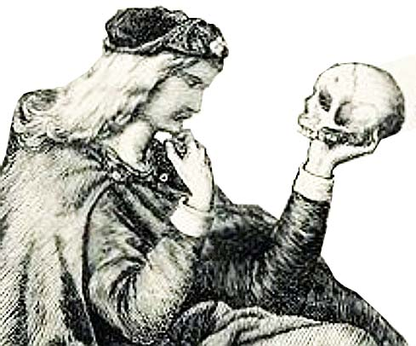
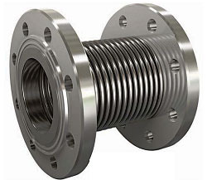
Bellow or not bellow?
CAS school SWEDEN 2017: VACUUM FOR PARTICULE ACCELERATORS
Impedance calculations tutorial assignment
Luca Rosario Buonocore – CERN
Shawn Carriere - Canadian Light Source
Gregory Cattenoz – CERN
Peng Li IMP - Chinese Academy of Sciences
Chiara Pasquino – CERN
Peter Reinhed - Stockholm University
Luca Rumiz ELETTRA - Sincrotrone Trieste S.C.p.A.

Slide 2

HOT POTATO
Consider two sets of 2 POTATOES tubes that need to be connected by a bellow (diameter of 7 mm and 18 mm).
Find for each case a suitable trade-off between mechanical and impedance constraints

Slide 3
Outline
Reference case:
  Continuous case
With 2 mm gap connection
Bellow connection:
  Convolution depth effect
  Bunch length effect
  Effect of the radius of the pipe

Slide 4


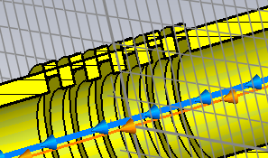
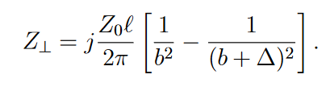

Impedance Gymnastics
Longitudinal Effective Impedance
Power Losses & Longitudinal Beam Instabilities
$$∆$$
b
Proportional to l*Δ/b if Δ<<b
Transverse effective impedance
Transverse Beam Instabilities
Proportional to l*Δ/b³ if Δ<<b

Slide 5
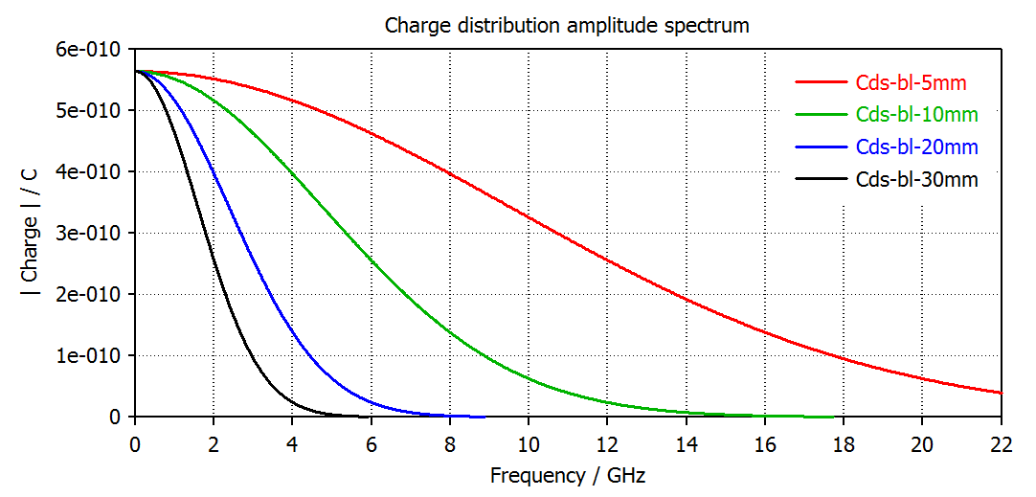
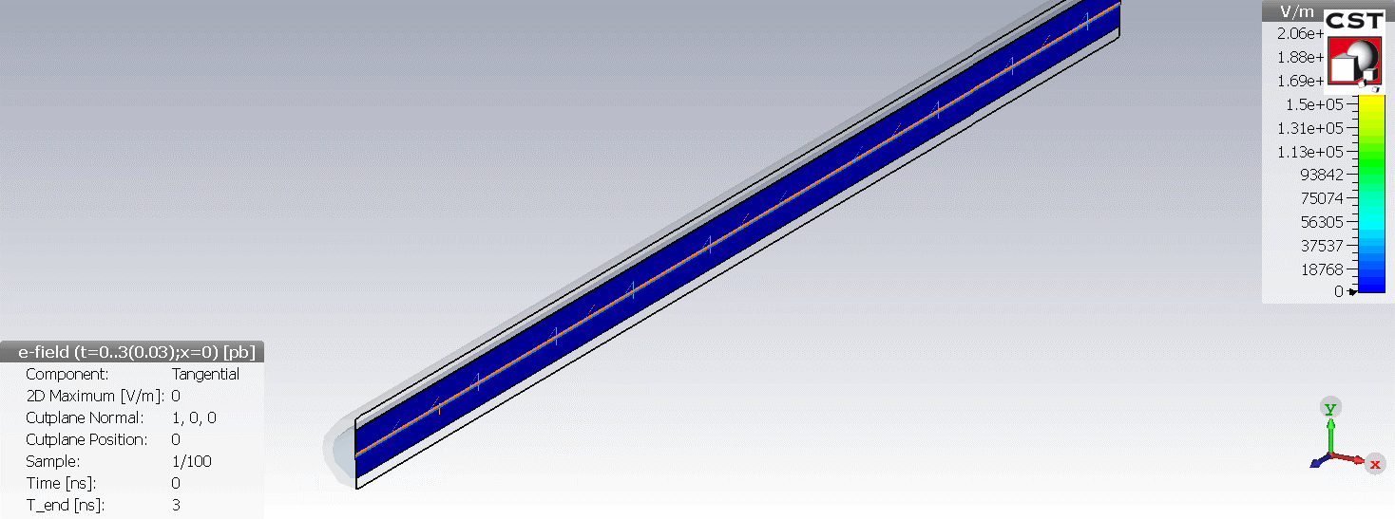
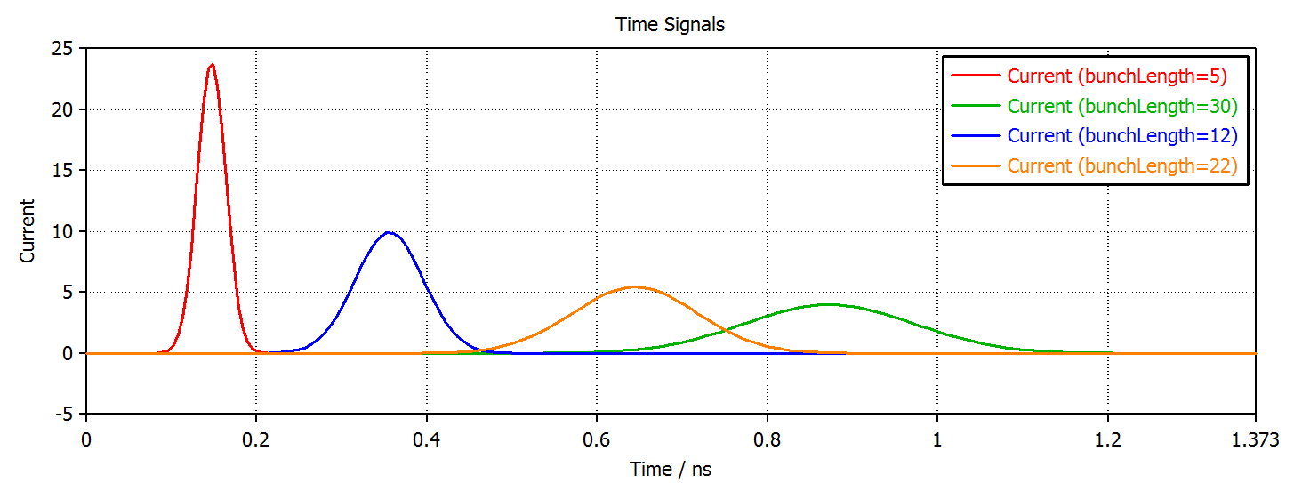

Reference case: continuous perfect conducting tube
Boundary conditions:
Centred beam → Longitudinal Impedance only;
Perfect Conducting;
Ф = 7 mm;
4σ longitudinal beam length
Notes:
1- beam charges over the frequencies → shorter bunch length have a broader spectrum → they will be more prone to instabilities as all cavities that couples with them up to 20 GHz could give issues. The longer the beam the shorter the frequency range. Still depending on the cavities in the accelerator ther could be some string coupling at low frequency that gives instabilities.
2- effect of the beam length__> time structure, are they really coming later in time? The interaction time of the bunch wrt to the cavity is longer for longer beams

Slide 6
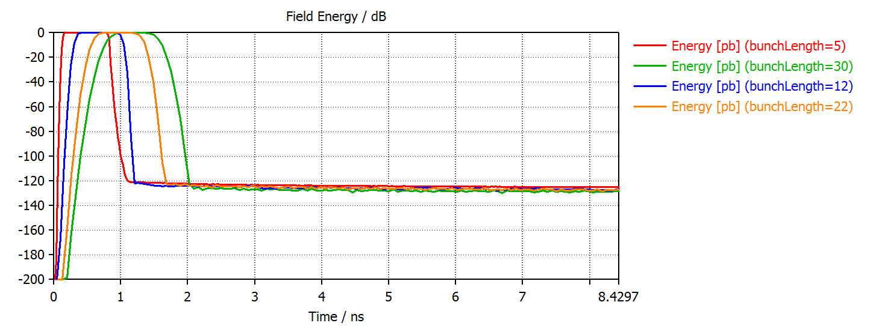
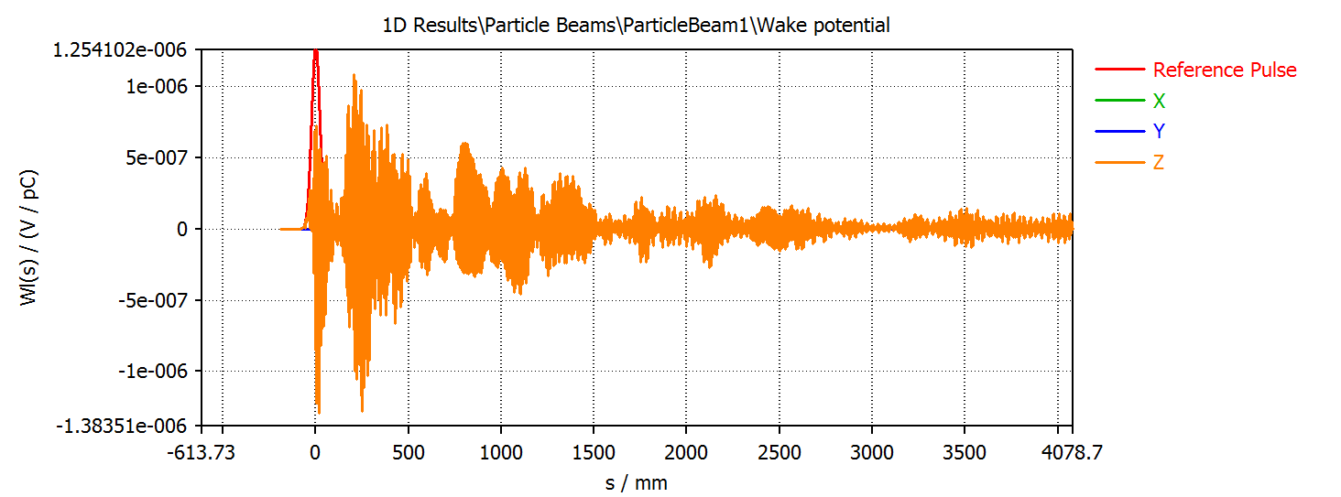
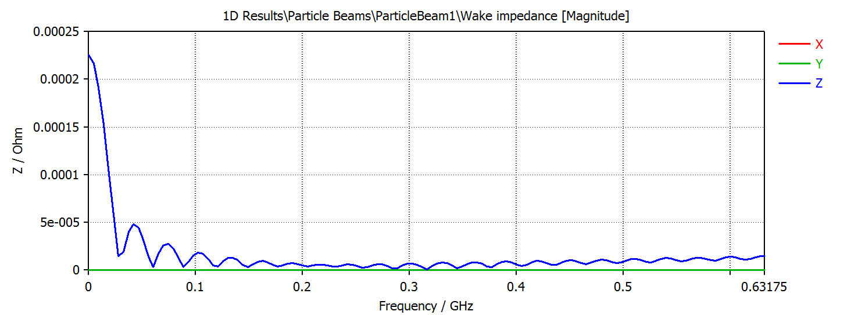
Reference case: continuous perfect conducting tube
Energy stored in the tube
Simulation Instabilities
Notes:
1- energy left in the structure for different bunch lengths→ in this case no interaction, so as expected the energy left in the acc structure is zero as the bunch leaves the structure. See effect of longer bunch length, longer interaction with the cavity.
2 – same problem from a different point of view -> spectrum of the frequency created by the beam in such a perfect structure → the decay of these frequency is short, basically no interaction32- Instabilitities of othe code → we expect nothing longitudinally wise, but still we have a finite system, the solution failes at the end of the tube

Slide 7
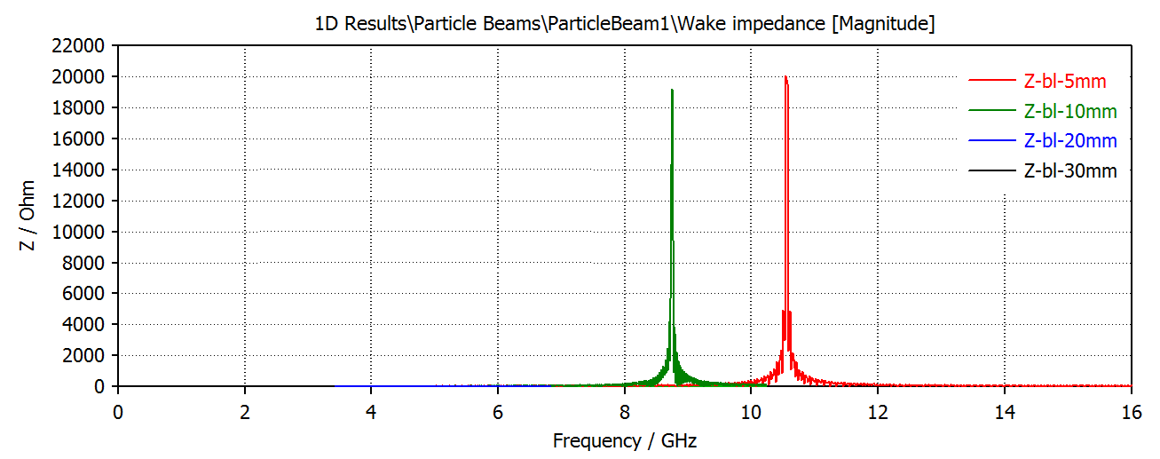
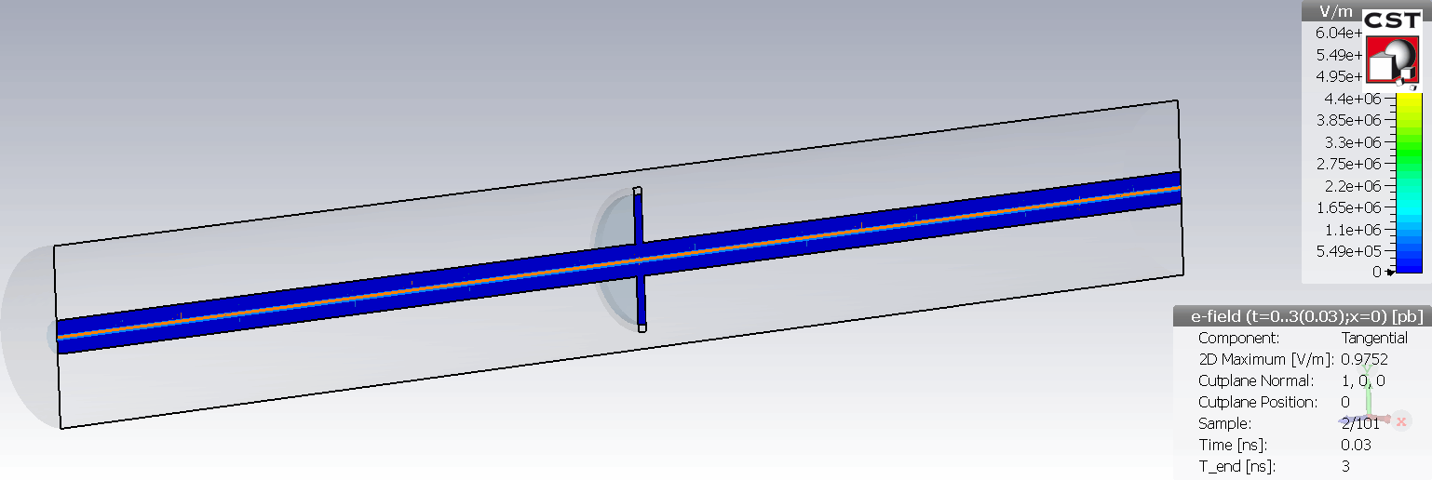
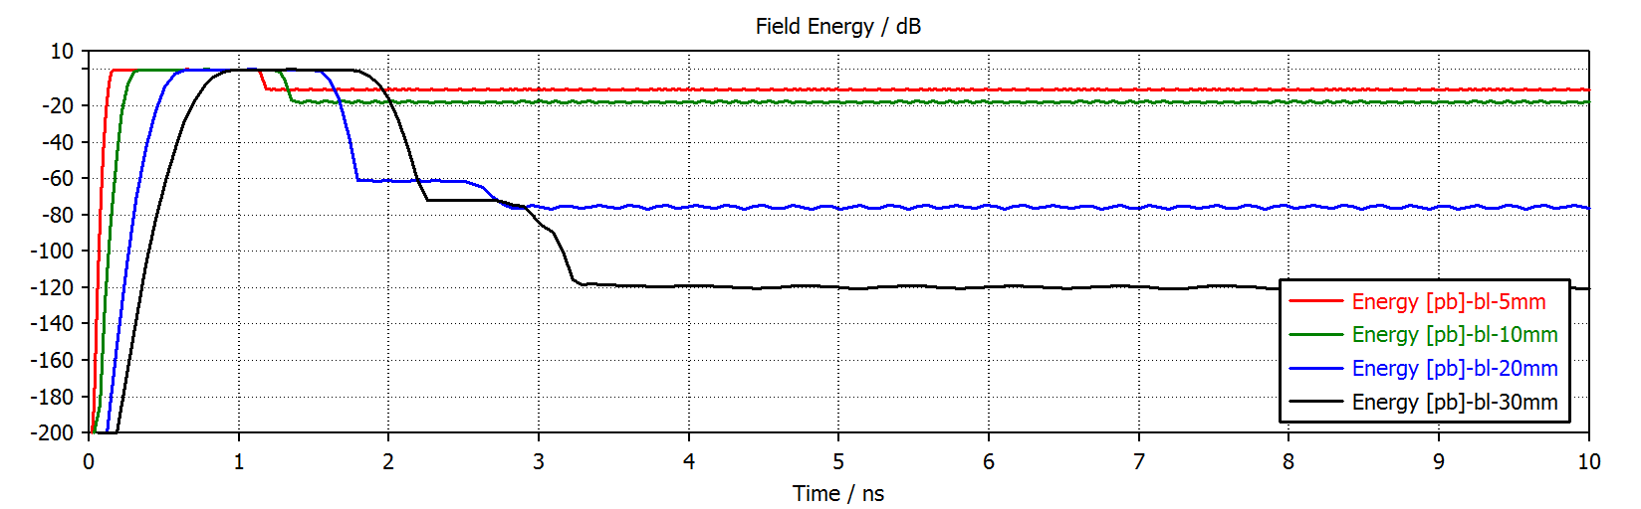
Case study : 2 mm cavity gap
Frequency shift → different cavity diameter.
Different stored energy → beam length.
Notes:
1 – we inserted a cavity of 2 mm → gasket gap→ we see frequencies appear! The same exercise have been done with different beam lengths__> the frequencies are peaked on the same frequency as the cavity geometrically is the same but the intensity is different.
2 – energy absorbed by the cavity differes with the bunch length: for shorter bunch lengths higher density of energy remains stored in the cavity even after the bunch leaves it;

Slide 8
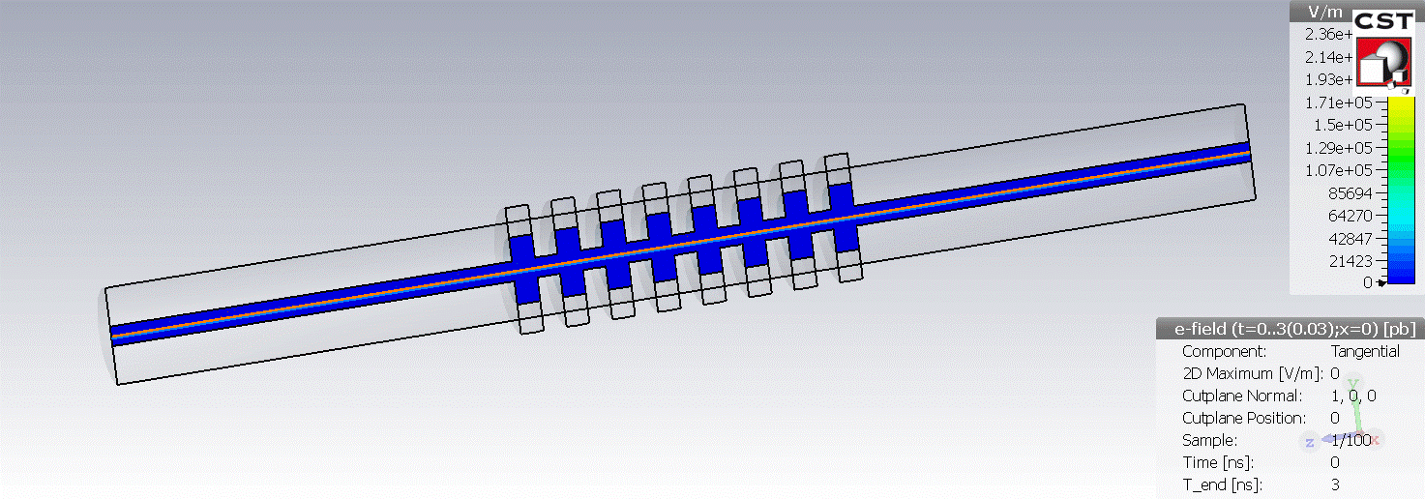
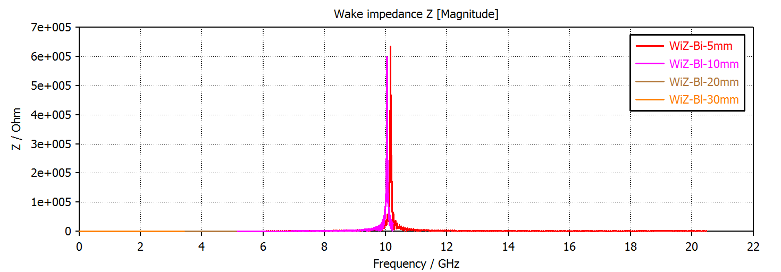
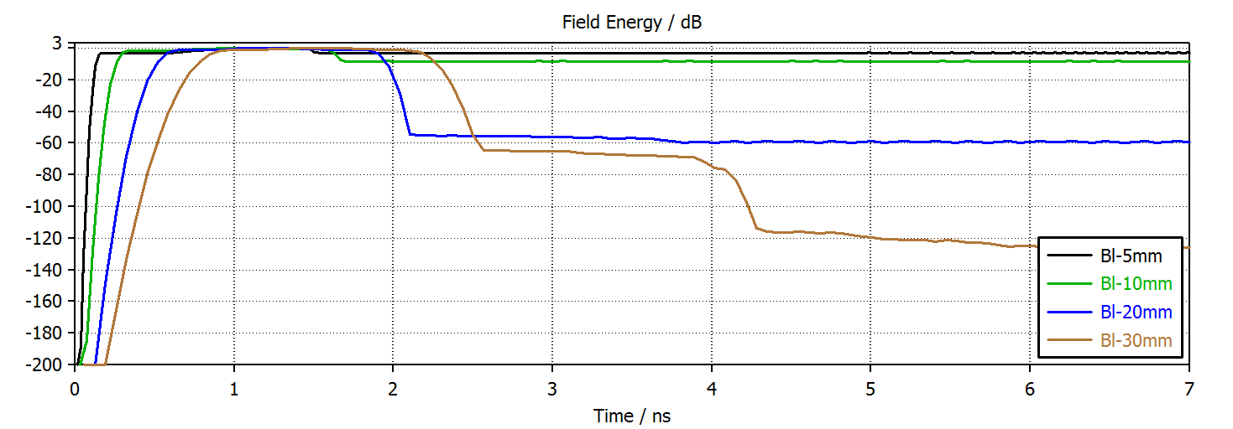
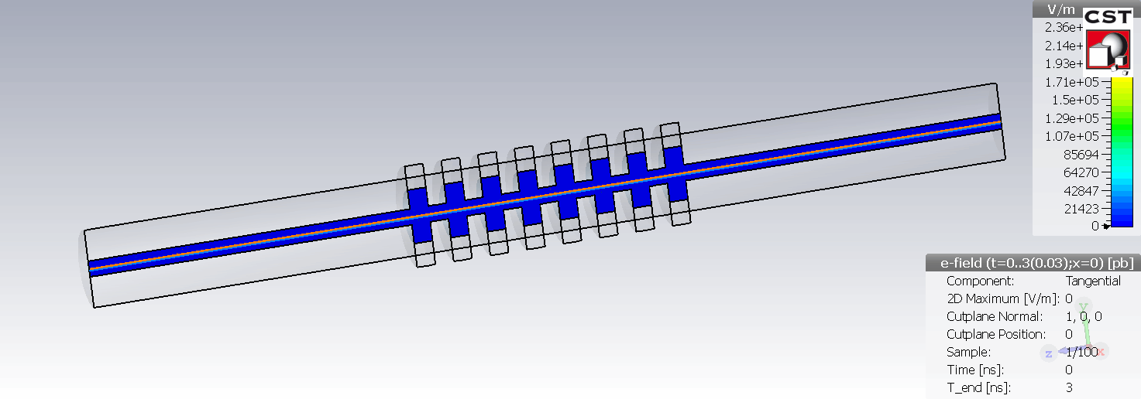
Case study : bellow, 8mm convolution depth
No shifts in Frequencies → constant geometry
Stored energy as function of the bunch length
Notes:
1 – same exercise but putting a bellow in between → frequencies are peaked around 10 Ghz, the energy dissipated in the cavity is higher then before with the same dependence on the beam.
2 – small change in the frequency range wrt to the bunch length → code instability, the cavity is the same.

Slide 9
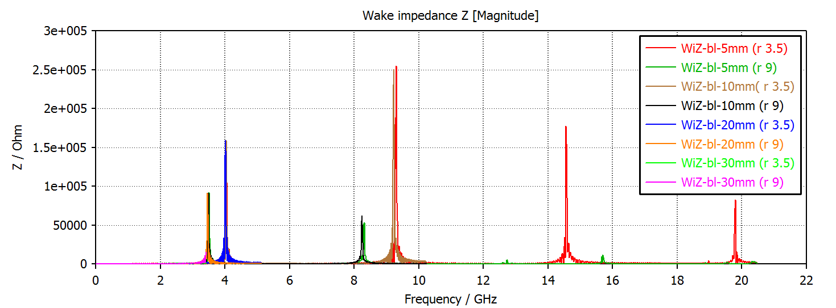
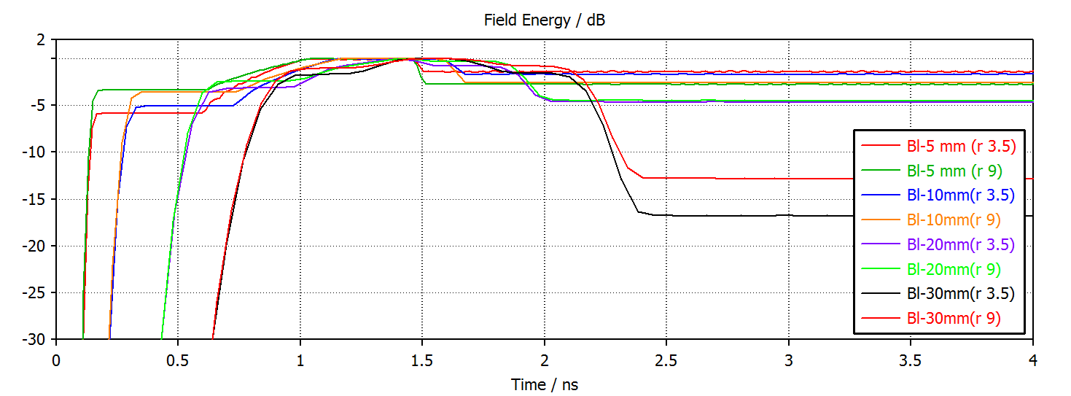
Case study : bellow, 25mm convolution depth
Frequency shift → different tube diameter;
Frequency spectrum → different bunch length;
Stored energy → dependence on the diameter for longer bunch lengths
Notes:
1- changing the convolution depths – changes the cavities, the peak frequency is shifted wrt to before and to a lower range. Shorter bunch length created higher order modes in higher frequency ranges.
2- slightly more energy is stored into the beam for this case;
3- we studied the effect of a different radius of the pipe--. The larger the better, less energy stays within the cavity, the difference becomes more clear with longer bunch lengths.

Slide 10
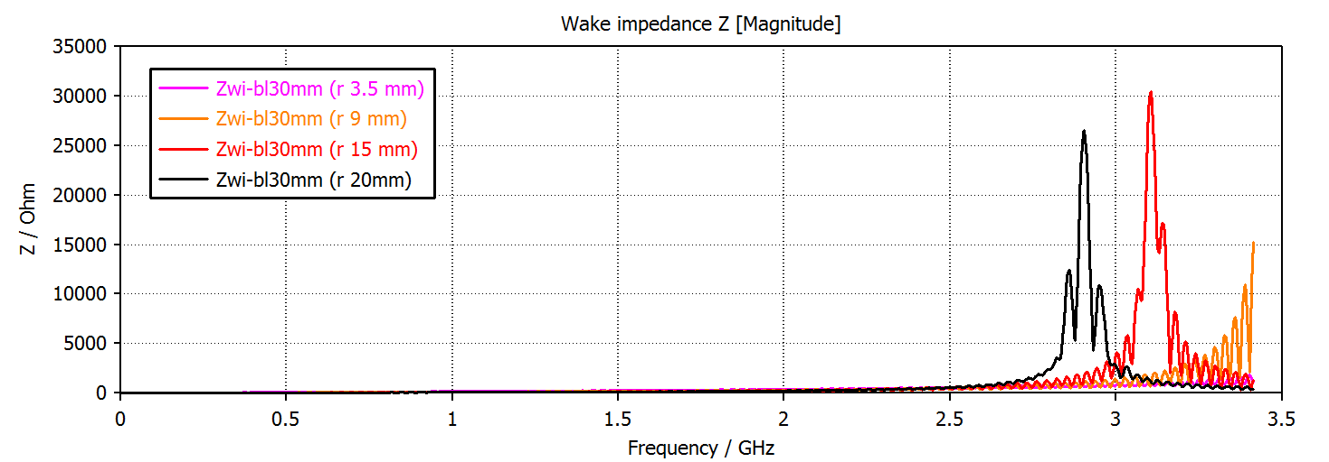
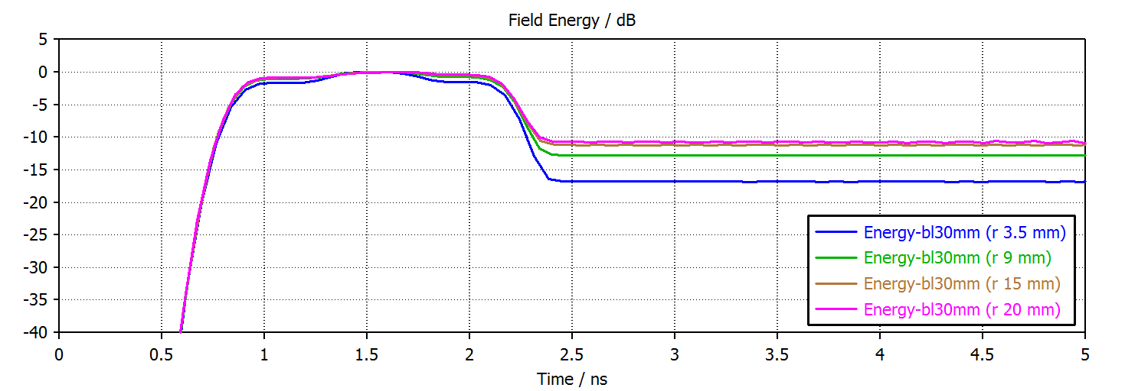
Case study : bellow, 25mm convolution depth
Stored energy → dependence on the diameter for longer bunch lengths;
Frequency spectrum for larger diameter → coupling with longer bunch length?
Notes:
1- changing the convolution depths – changes the cavities, the peak frequency is shifted wrt to before and to a lower range. Shorter bunch length created higher order modes in higher frequency ranges.
2- slightly more energy is stored into the beam for this case;
3- we studied the effect of a different radius of the pipe--. The larger the better, less energy stays within the cavity, the difference becomes more clear with longer bunch lengths.

Slide 11
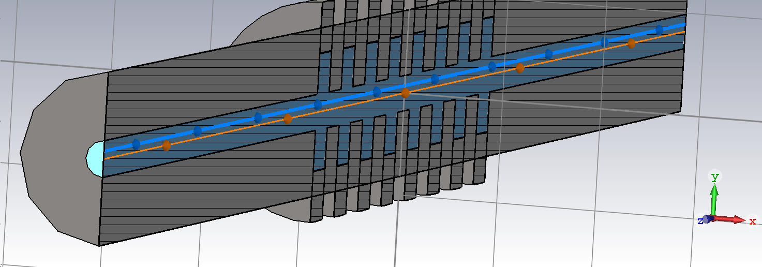
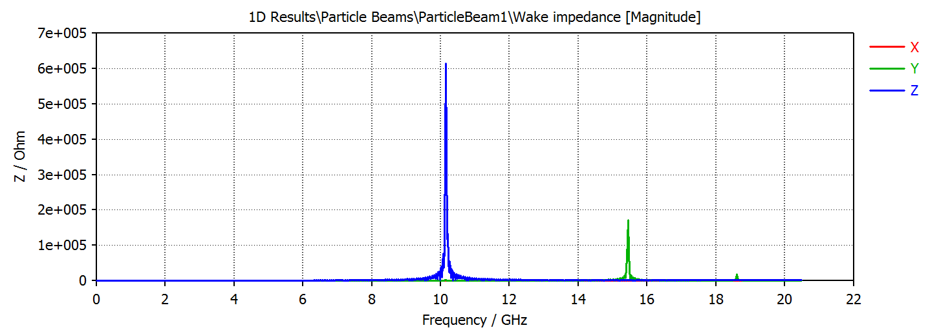
What about transverse Impedance?
Boundary conditions:
8mm convolution depth;
Ф = 7 mm;
y beam offset = 1.5 mm;
Off axes beam induces resonant frequencies that could induce beam instabilities.

Slide 12
Conclusions
Impedance gymnastics :
we played with the different parameters to understand the effect of cavities on the longitudinal stability of the beam;
A final optimal configuration depends on many factors:
  Beam characteristics;
  Geometry of the cavity;
  Mechanical feasibility of the configuration and ease in installation.

Slide 13
