Slide 1

Case Study - Group 2
FCC-ee Top-Up Injection
Dmitriy Berkaev (BINP SB RAS)
Johannes Bernhard (CERN)
Szymon Myalski (EBG MedAustron GmbH)
Shuang Ruan (Chinese Academy of Sciences)
Michaela Schaumann (CERN)
Christoph Wiesner (CERN)

Slide 2
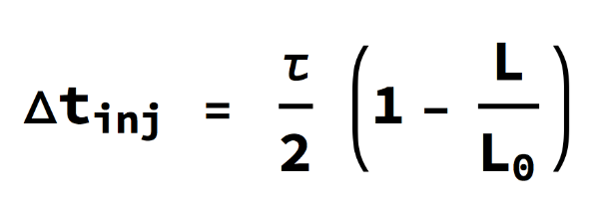
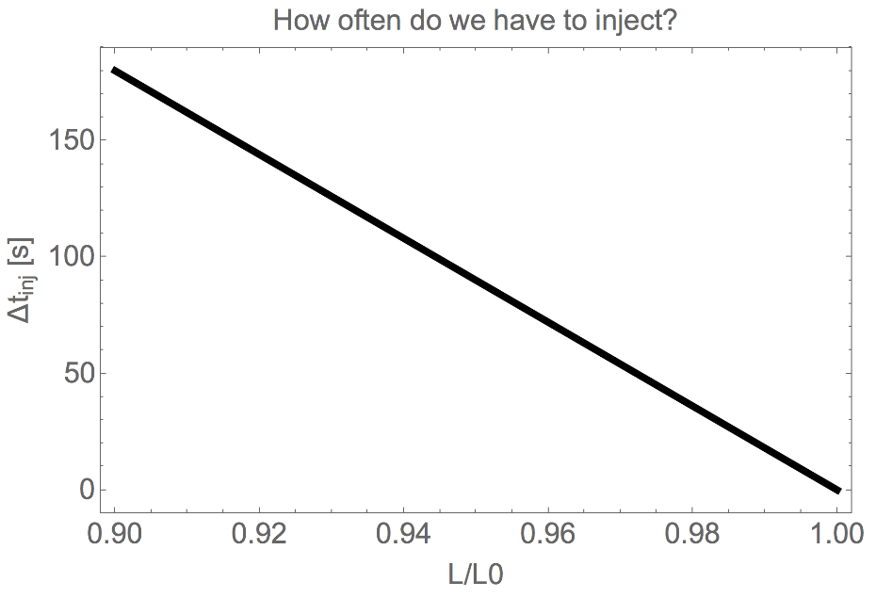
Luminosity and Injection Time
Lumi life time τ = 1 hour
Minimum Beam Length: 75 us
(for 2.5 ns bunch spacing)
Collider Parameters
Beam Energy (GeV) | 175 | 45.6
Number of bunches | 81 | 30 180
Rev. time | 334 us | 334 us
RF frequency | 400 MHz | 400 MHz
Harmonic number | 133 425 | 133 425
Design goal:
L/L0 = 99 %
Conclusion: Possibility of flexible filling/injection pattern
Conclusion: High top-up injection rate required
1

Slide 3
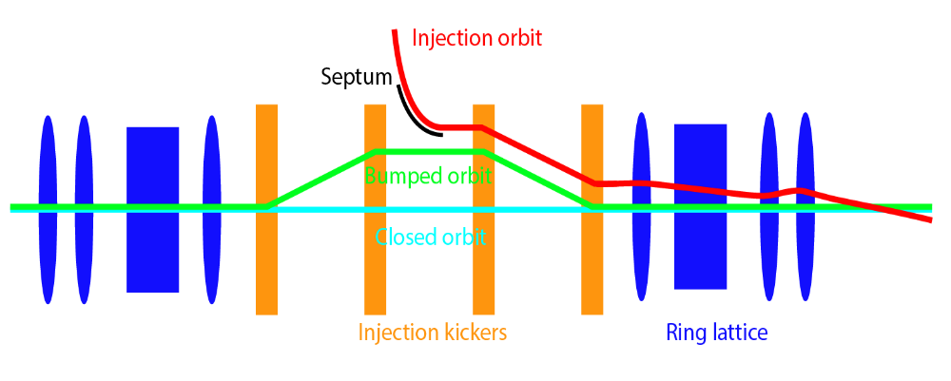
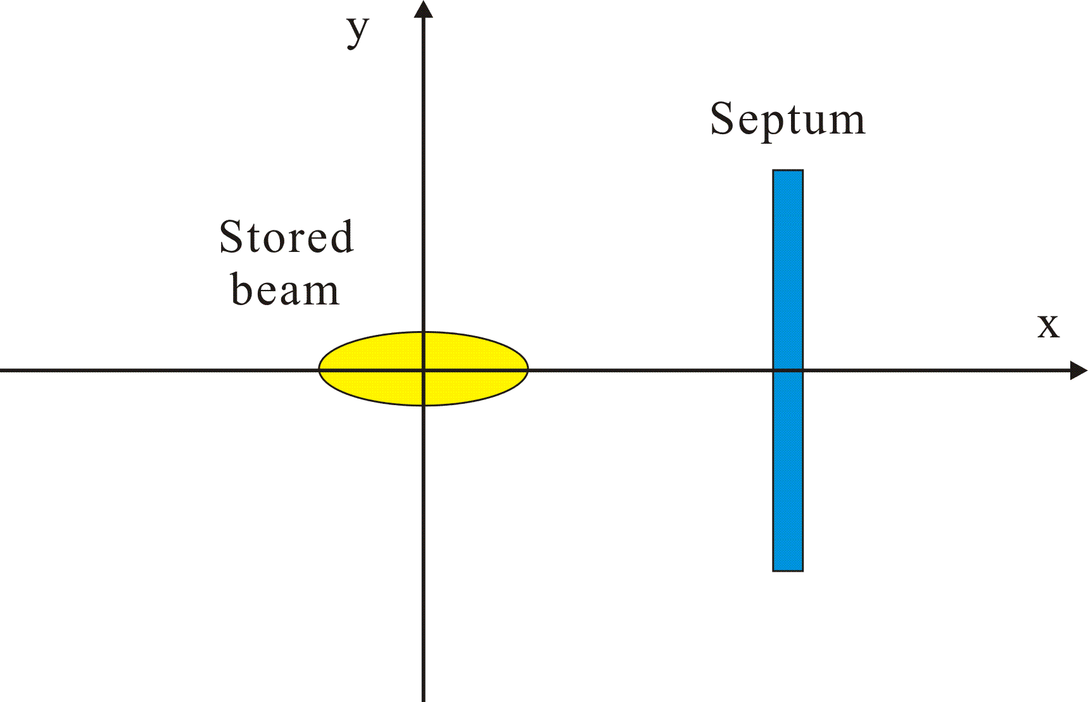
Injection Scheme
Conventional injection scheme based on static septum and dynamic bump
Challenges:
  Inject into small dynamic aperture
  Kicker stability
Drawing: M. Aiba, CAS’17
15σ
150 m
500 m
200 m
500 m
150 m
2

Slide 4
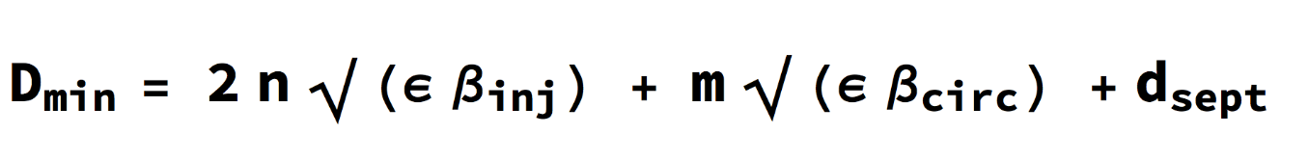
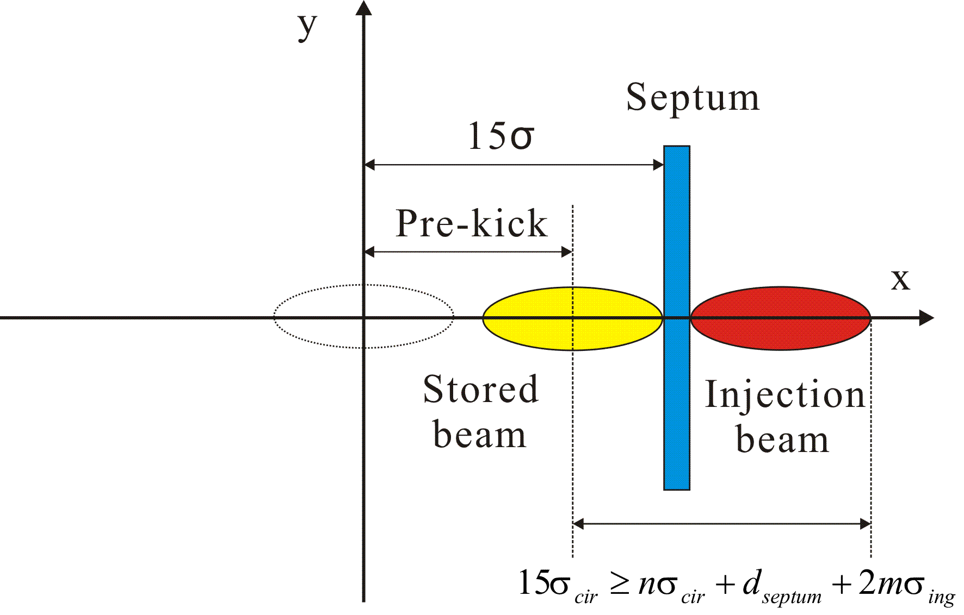
Injection Scheme
Conventional injection scheme based on static septum and dynamic bump
Required horizontal deflection:
Challenges:
  Inject into small dynamic aperture
  Kicker stability
< 15σ
Stored and injection beta funct.: β_{circ}, β_{inj}
d_{sept}: Septum thickness
n , m: Clearances in units of beam size
Drawing: M. Aiba, CAS’17
150 m
500 m
200 m
500 m
150 m
D
2

Slide 5
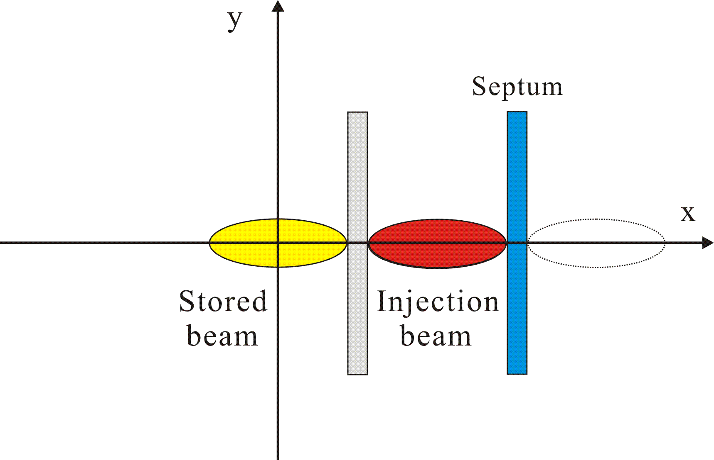
Injection Scheme
Conventional injection scheme based on static septum and dynamic bump
Required horizontal deflection:
Challenges:
  Inject into small dynamic aperture
  Kicker stability
< 15σ
Stored and injection beta funct.: β_{circ}, β_{inj}
d_{sept}: Septum thickness
n , m: Clearances in units of beam size
Drawing: M. Aiba, CAS’17
15σ
150 m
500 m
200 m
500 m
150 m
Use dispersion suppressor. Assuming zero dispersion in injection region.
No optic elements. (Defocusing quad. could be used to amplify kick).
D
2

Slide 6
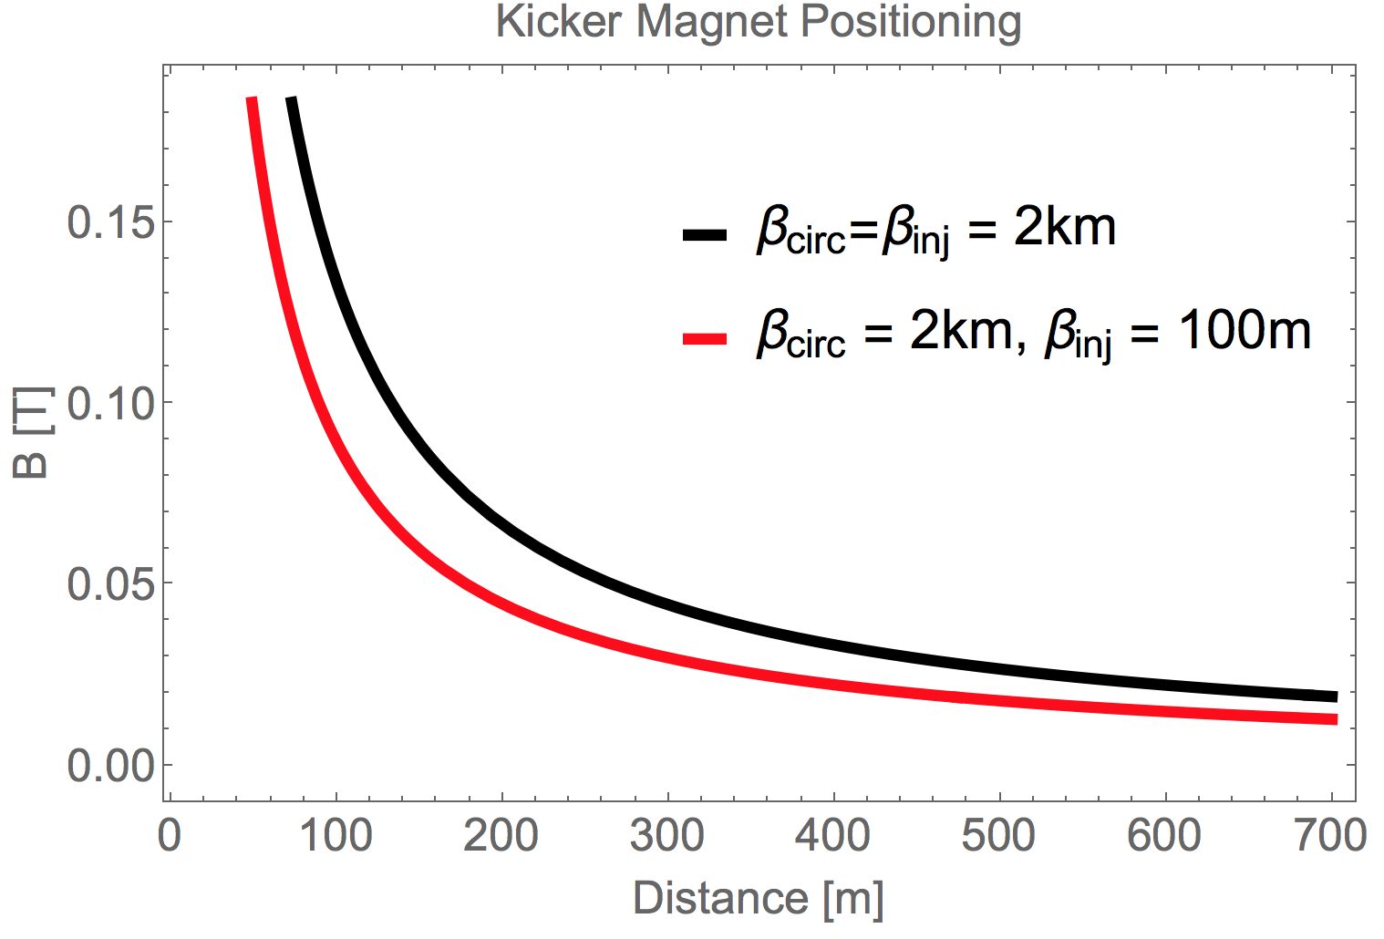
Optimizing Parameters
Matched injection preferable but not mandatory for lepton beam
Approach: Reduce β_{inj} and injection clearance n to be able to increase clearance m for stored beam (while staying inside dynamic aperture)
Example:
  n = 3
  m = 5
  β_{circ} = 2 km
  β_{inj} = 100 m
  d_{sept} = 5 mm
Kicker length = 1 m
Required kicker field: B = 18 mT
for kick angle α = 30 urad
D_{min}: required horiz. deflection
Stored and injection beta funct.: β_{circ}, β_{inj}
d_{sept}: Septum thickness
n , m: Clearances in units of beam size
3

Slide 7
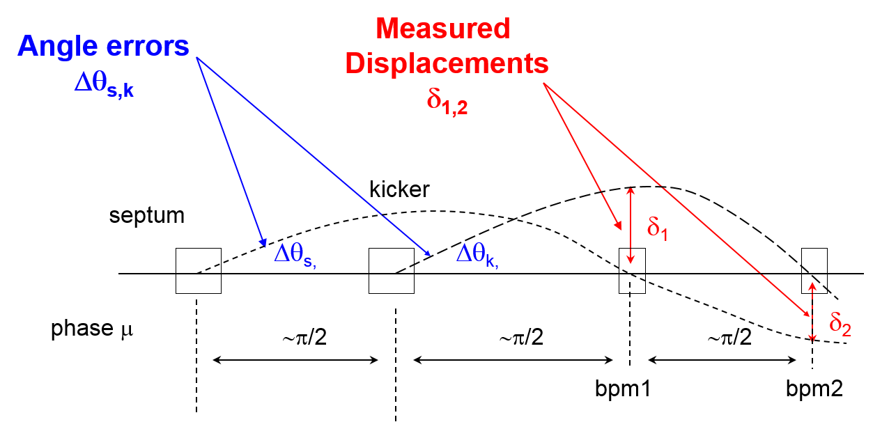
Kicker Error
Conclusion: Luminosity loss only relevant for very high repetition rate of top up injections.
However: Beam could become unstable (beam-beam effect…).
Kick angle θ_{k} = 50 µrad
β_{y}* = 1 mm
β_{x}* = 1 m
Worst case: 90º phase advance between kicker and IP
Luminosity change due to displacement during injection: ΔL/L = 1 - exp{-δ₁²/(2βε)}
Error Δθ_{k}/θ_{k} | Displacement vertical injection | Displacement horizontal injection | ΔL/L vertical injection | ΔL/L horizontal injection
1% | 0.7 µm (0.6 σ) | 22 µm (0.6 σ) | 17.5% | 17.5%
0.1% | 0.07 µm (0.06 σ) | 2.2 µm (0.06 σ) | 0.2% | 0.2%
Possible injection duty cycles:
Low rep. rate → 10 ms/18 s = 5.6e-4
High rep. rate → 10 ms/0.1 s = 0.1
4

Slide 8
Hardware: Kicker & Septum
Lambertson-Septum with 5 mm septum blade (vertical injection, horizontal bump).
Bump Kicker: Vertical gap size does not seem critical.
Fast Kicker:
  GTO Stack: long flat-top length (~100us), low flat-top stability
  Marx Generator: long flat-top length (>100us), high flat-top stability (< 1%) → Injection of long pulse trains possible
  Inductive Adder: short flat-top length (~ few us), very high flat-top stability (~0.02%, see CLIC-DR kicker), short rise and fall time (<100 ns) → Injection of short pulses with high repetition
To be confirmed.
5

Slide 9
Failure Scenarios
Assumption: Injected beam energy should be limited to 5 MJ
→ 5 (initial) injections required
not critical for top-up injected beam
Collider Parameters
Beam Energy (GeV) | 175 | 45.6
Number of bunches | 81 | 30180
Bunch Intensity | 1.7e11 | 1e11
Stored beam energy (MJ) | 0.4 | 22
Max # bunches / injection | 1048 | 6844
# of initial injection required | 1 | 5
Injected beam energy / top-up cycle (MJ) | 4e-3 | 0.22
Protection elements
Conclusion: Missing injection kicker seems less critical than erratic misfiring on stored beam (→ retriggering?).
6

Slide 10
Thank you for your attention!

Slide 11
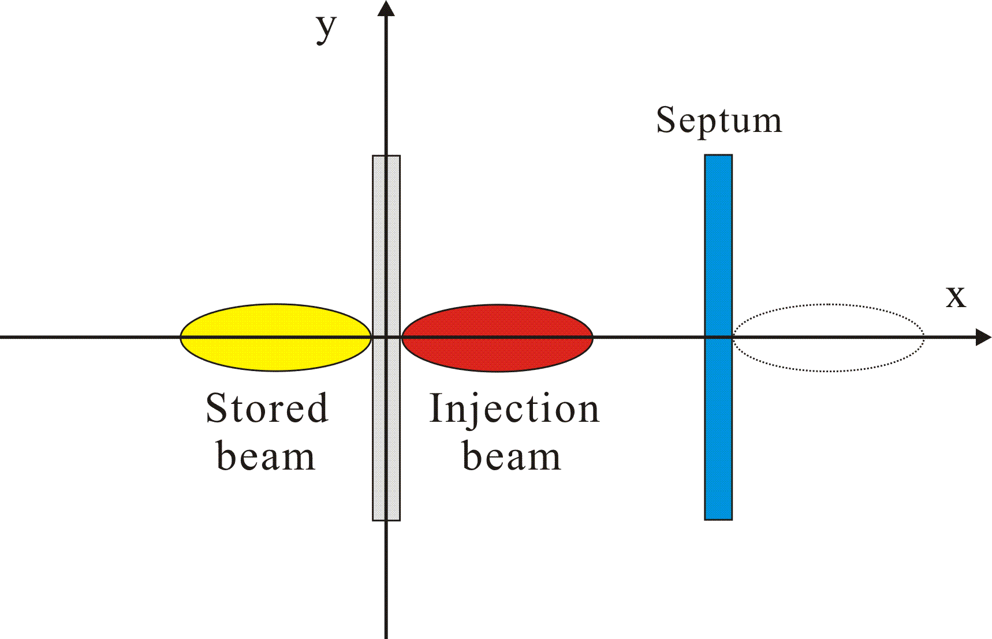
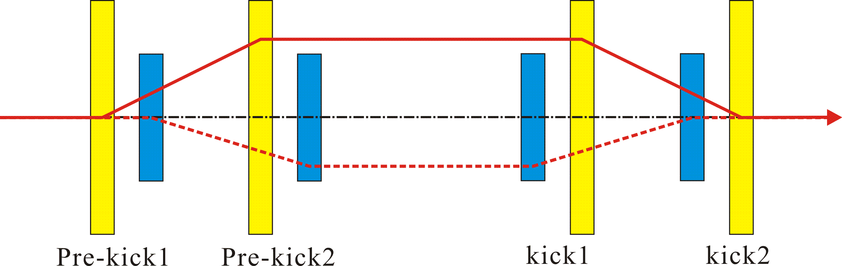
Gaining Dynamic Aperture?

Slide 12
