Slide 1
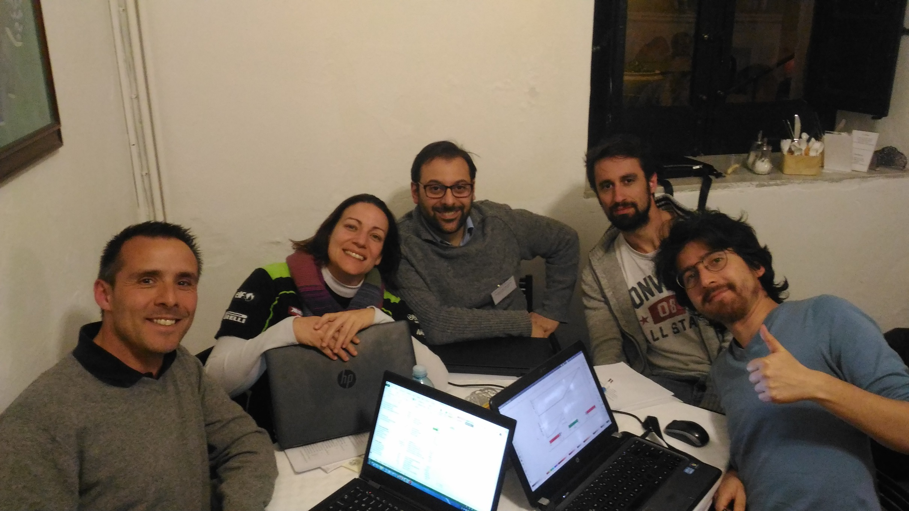
GROUP 12
CAS – Erice - March 2017
Andrea DE FRANCO
Vasilis VLACHODIMITROPOULOS
Greta GUIDOBONI
Jeremie BAUCHE
Oscar BLANCO

Slide 2
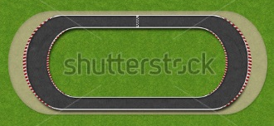

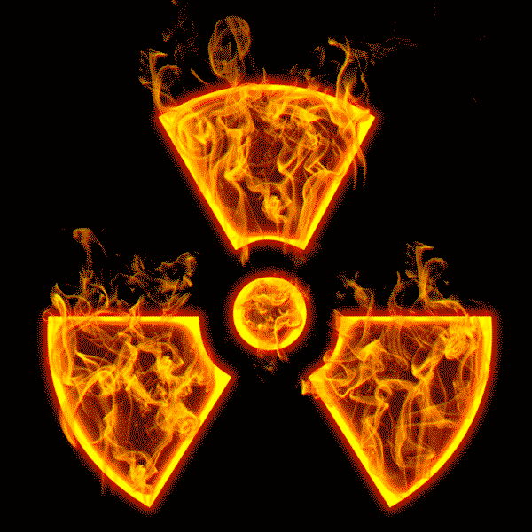
Fast-extraction hadrons from FCC
Design: only HORIZONTAL bending
Ring plane
Collision with the ring!

Slide 3
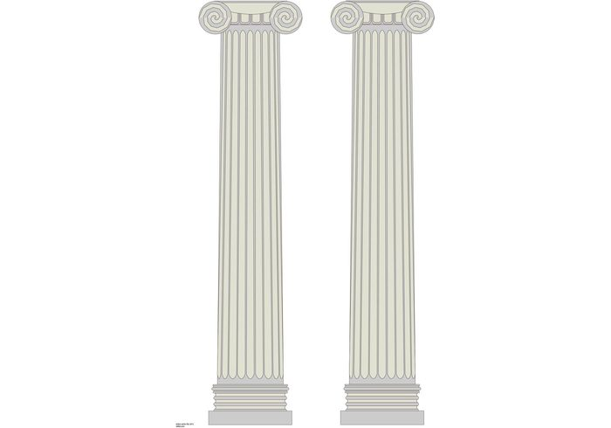

Fast-extraction hadrons from FCC
Design: only VERTICAL bending

Slide 4
Beam extremely rigid… old Greek wisdom theorem: → use magnetic fields!
Needs fast rising of field during empty buckets to jump out of ring to extraction channel
→ KICKERS!

Slide 5
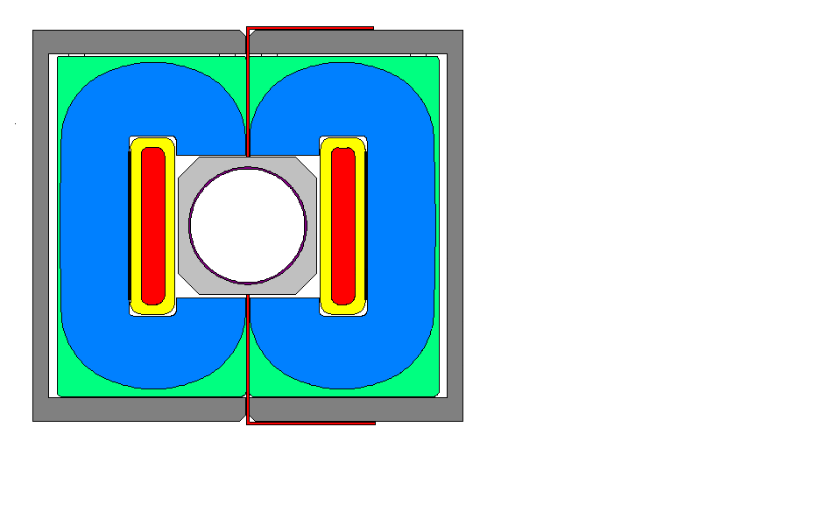
Option 1: only kickers (vertical or tilted)
Could work in terms of kick, but needs 1 km of the LSS to get the integrated field, assuming maximum flux density of 0.2 T in aperture
However, the straight circulating beam pipe needs to cross the magnet coil and yoke at some point… use empty section 500 m?
→ Magnet aperture would need to be enormous in many locations → circuit current and voltage issues
→ Circulating beam aperture not constant (Y chambers) →instabilities
→ [Tm] far more expensive compared to out of vacuum Lambertsum septa
Could work in terms of kick, but needs 1 km of the LSS to get the integrated field, assuming maximum flux density of 0.2 T in aperture
However, the straight circulating beam pipe needs to cross the magnet coil and yoke at some point…
☺
☹

Slide 6
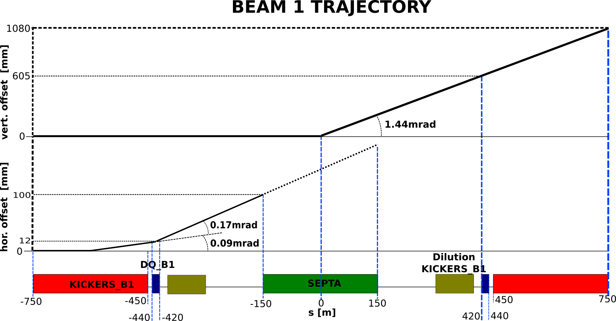
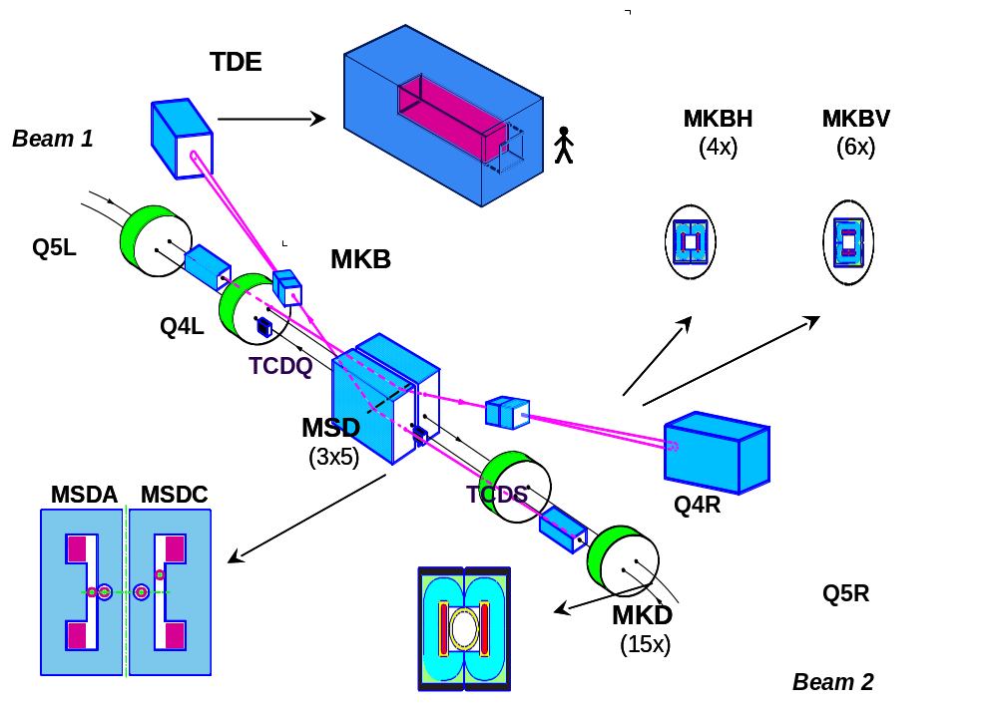
BEAM 2 TRAJECTORY:
SYMMETRIC W.R.T. SEPTA CENTRE
Option 2: kickers (H) + QD + septa (V)
Cristal
+
Collimator

Slide 7
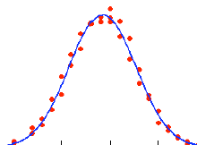
Apertures at 15 σ
Integration 2 beams
Vacuum chamber thicknesses to be considered
500 mm
50 mm

Slide 8
Some considerations
Aperture constraints driven by injection beam size (emittance scaling)
System availability across the full dynamic range from 7 TeV (assumed LHC as injector) to 50 TeV. Needs energy tracking system to correlate kicker voltage and septum magnet current
Field quality not relevant since the beam is dumped
Flat-top ripple or kickers: -/+ 2.5% of ripple → 3 mm deviation at septum entrance
Kicker rise time essentially driven by energy deposition in case of asynchronous beam dump
Each kicker has its own power supply, decrease sensitivity to erratic's
Simultaneous dumping for 2 beams

Slide 9
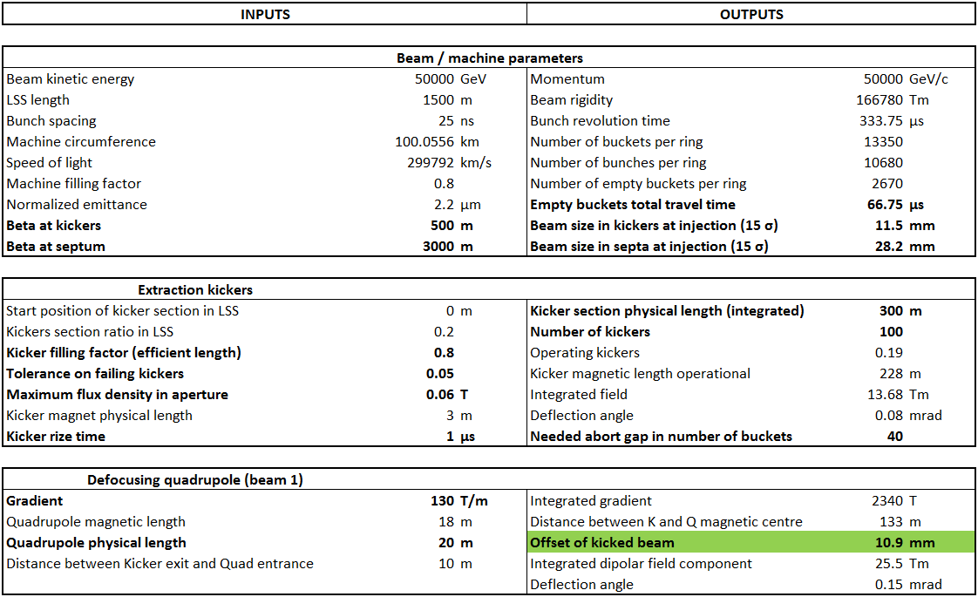

Slide 10
