Slide 1
Case Study D:
Design of a Fast Extraction System for FCC-hh
Group 11:
Luigi Salvatore Esposito (ADAM SA)
Carolina Belver-Aguilar (CERN)
Marc Delrieux (CERN)
Kajetan Fuchsberger (CERN)
Alexander Pryanichnikov (PTC LPI RAS)

Slide 2
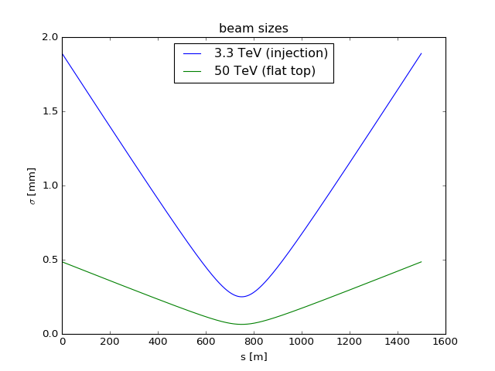
D.1. Overview and Extraction Scheme
LAYOUT FOR THE LHC DUMP: FAST SINGLE TURN EXTRACTION
      Horizontal kickers at the beginning, and vertical septa in the middle of the straight line of 1.5 km.
                Two focusing quadrupoles at the start and the end of the straight line.
                No defocusing quadrupole between the kickers and septa has been investigated.
                No (fast) bumps: increased failure probability.
QF
QF
H-Kicker
V-septum
𝜇 = 90 degree from kicker to septum

Slide 3
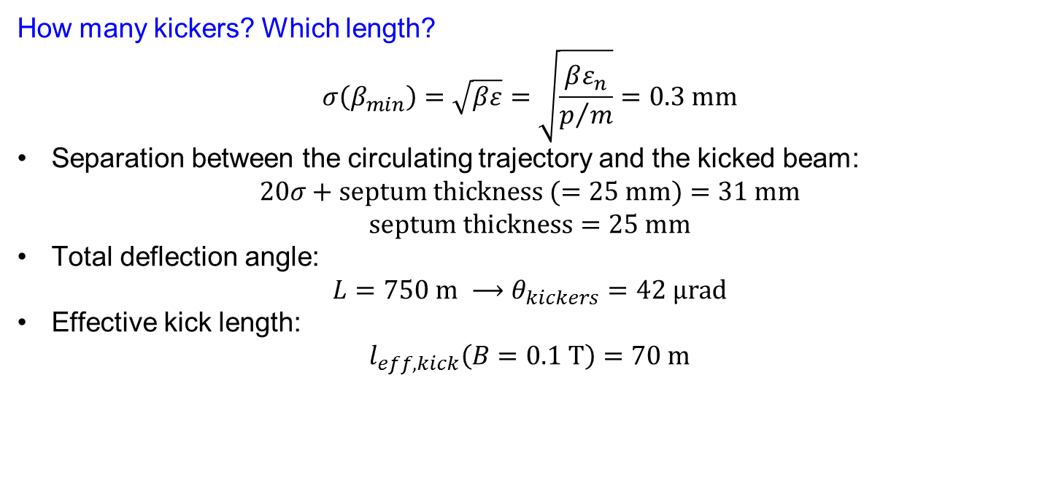

D.1. Overview and Extraction Scheme
KICKERS
How many kickers? Which length?
$$σ\left(β_{min}\right)=\sqrt{βε}=\sqrt{\frac{βε_{n}}{p/m}}=0.3 mm$$
Separation between the circulating trajectory and the kicked beam:
$$20σ+septum thickness (=25 mm)=31 mm$$
          $$septum thickness=25 mm$$
          Total deflection angle:
          $$L=750 m ⟶θ_{kickers}=42 μrad$$
          Effective kick length:
          $$l_{eff,kick}\left(B=0.1 T\right)=70 m$$
70 kickers of 1 m length each, spaced by 0.5 m
$$L_{tot,kickers}=105 m$$
Notes:
Considered at the worst case, i.e. at injection: E = 3.3 TeV
Maximum magnetic field to avoid saturation in the ferrite: B = 0.1 T

Slide 4
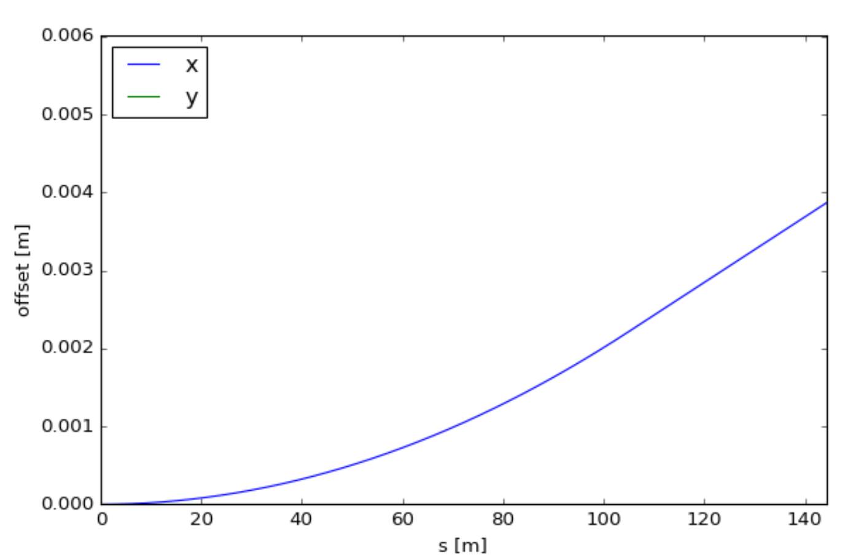


D.1. Overview and Extraction Scheme
What happens if one kicker fails?
$$0.6 μrad/kicker$$
Trajectory offset along the kicker
Offset of 0.45 mm (1.5σ) at the septum.
Horizontal deviation at the last kicker = 2.5 mm
What is the aperture at the last kicker?
$β$(last kicker)$=4 km→σ=1.63 mm$
$$20σ+hor.deviation=35.5 mm$$
Ok! Inside of the full aperture of 50 mm
Notes:
Considered at the worst case, i.e. at injection: E = 3.3 TeV
1.5 sigma too much? More segmentation of the kicker (put more kickers)
The aperture at the second quadrupole is the same as the aperture at the first kicker.

Slide 5




D.1. Overview and Extraction Scheme
SEPTA
How many septa? Which length?
To avoid the cryostat, the beam offset should be:
R_{cryos}+ 10σ = 500 mm + 25 mm = 525 mm
$$L=750 m→θ_{septa}=700 μrad$$
$$l_{eff,kick}\left(B=1 T\right)=117 m$$
24 septa of 5 m length each, spaced by 0.5 m
$$L_{tot,septa}=132 m$$
$$30 μrad/septum$$
Notes:
Considered at the worst case, i.e. at injection: E = 3.3 TeV
Septum thickness = 25 mm
Maximum magnetic field: B = 1 T

Slide 6
D.2. Hardware Considerations
REQUIREMENTS FOR KICKERS AND SEPTA
Dynamic operational range given by the energy range from 3.3 TeV (injection) to 50 TeV.
Kicker rise time = 2.5 µs (typical value for going from 0 to 0.1 T).
Abort gap = 3 µs (1% of the revolution time = 300 µs).
Flat-top ripple and septa field quality: as long as we keep the beam inside the aperture is ok.
So, what is important?
The synchronization and the triggering of the kickers, to be sure that the kick starts at the correct time, at the beginning of the abort gap.
Notes:
Arc filling factor = 0.8

Slide 7
D.2. Hardware Considerations
KICKERS AND SEPTA DESIGN
70 kickers with a length of 1 m each and a kicker spacing of 0.5 m, gives a total horizontal deflection of 42 µrad. One beam is extracted to inside the ring and the other beam is extracted outside the ring.
24 septa with a length of 5 m each and a septa spacing of 0.5 m, gives a total vertical deflection of 700 µrad. Both beams are extracted up of the ring.
The current/voltage generators for kickers and septa should track the beam energy at any time, to be ready to produce the magnetic field required to deflect the beam at the specified angle for any energy between 3.3 TeV and 50 TeV.
Notes:
Arc filling factor = 0.8

Slide 8
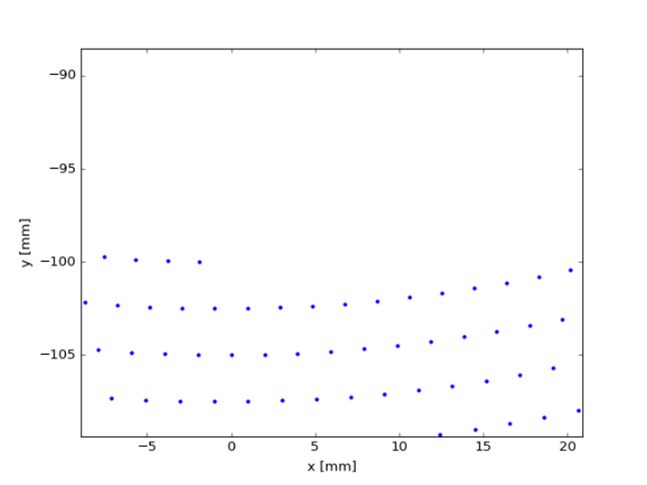
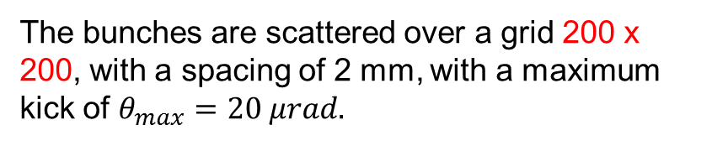


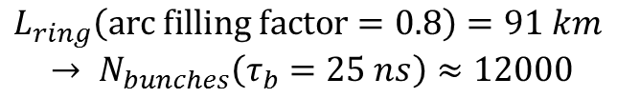

D.2. Hardware Considerations
DESIGN OF A DILUTION SYSTEM
$$ρ\left(B=16 T\right)=10 km$$
$$L_{ring}\left(arc filling factor=0.8\right)=91 km$$
$$→ N_{bunches}\left(τ_{b}=25 ns\right)≈12000$$
The bunches are scattered over a grid 200 x 200, with a spacing of 2 mm, with a maximum kick of $θ_{max}=20 μrad.$
$$Total strength needed=θ_{max}\frac{p}{c}≈3.4 T∙m$$
$$L_{tot}\left(B=0.1 T\right)≈34 m$$
34 dilution kickers of 1 m length each
Notes:
Arc filling factor = 0.8

Slide 9
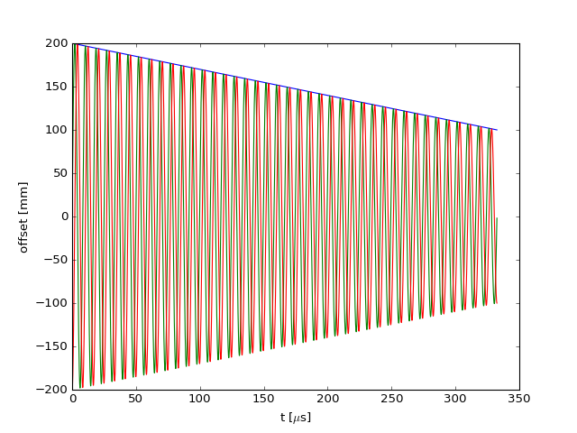
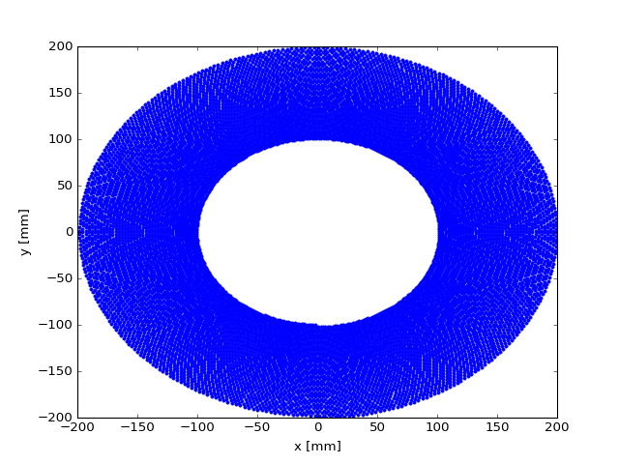
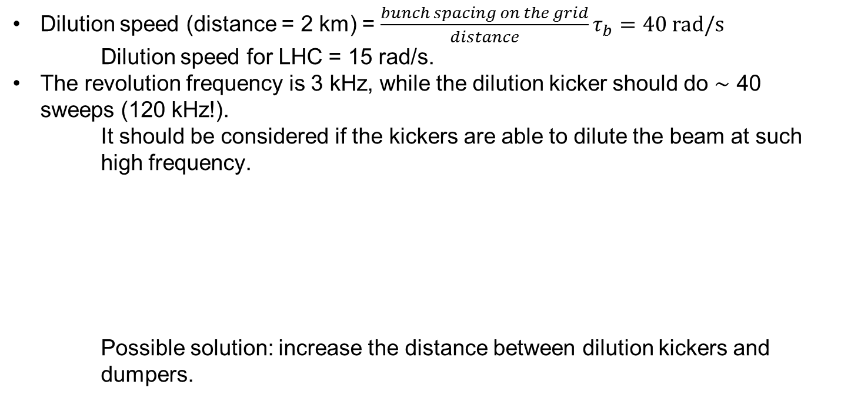
D.2. Hardware Considerations
DESIGN OF A DILUTION SYSTEM
Dilution speed (distance = 2 km) = $\frac{bunch spacing on the grid}{distance}τ_{b}=40 rad/s$
        Dilution speed for LHC = 15 rad/s.
        The revolution frequency is 3 kHz, while the dilution kicker should do $\sim$ 40 sweeps (120 kHz!).
          It should be considered if the kickers are able to dilute the beam at such high frequency.
          Possible solution: increase the distance between dilution kickers and dumpers.
Notes:
Arc filling factor = 0.8

