Slide 1
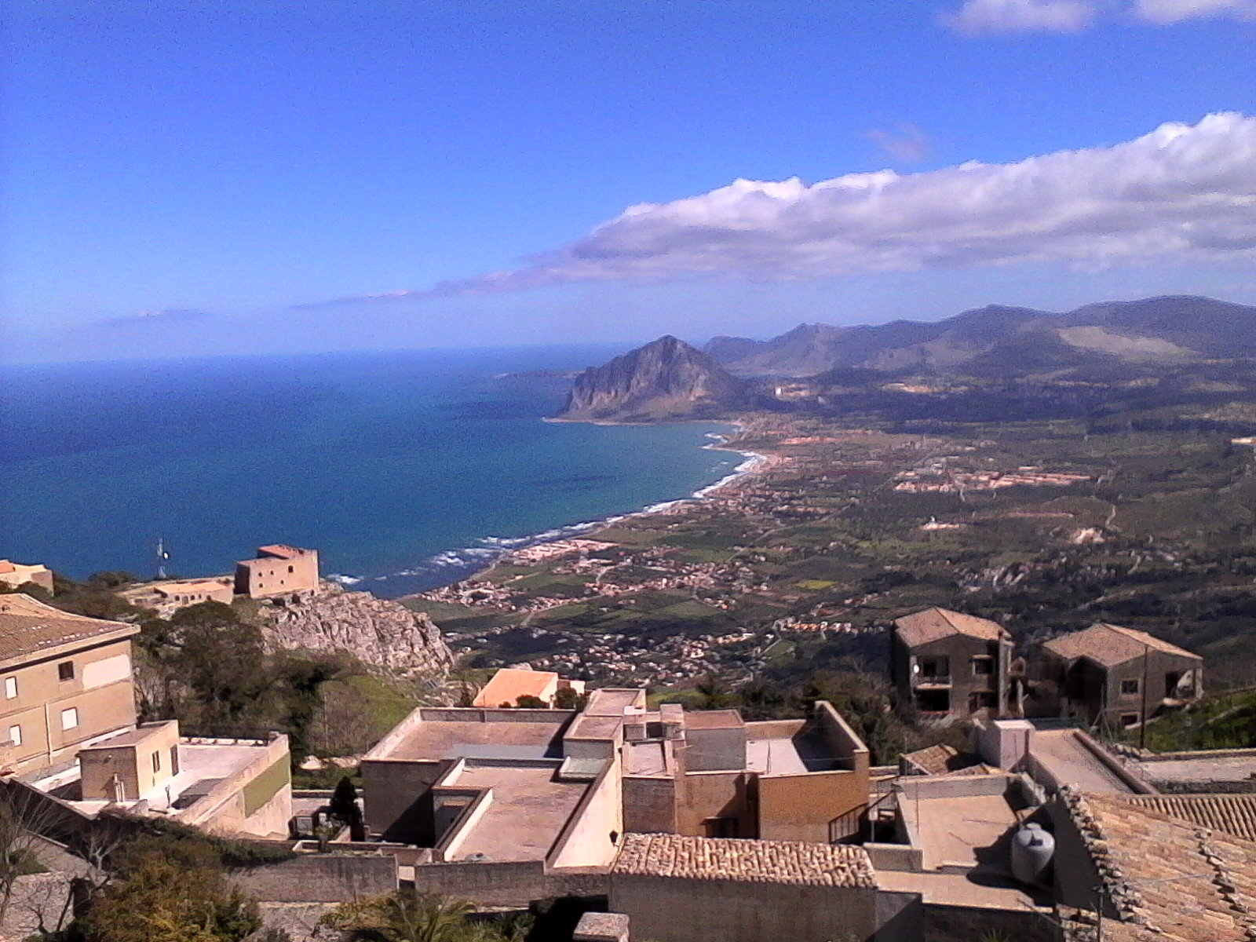

HINOMA injection system for fcc-ee
group 1-CASE STUDY A
Helen Barminova, Irina Avvakumova, Nicholas Evans,
Olaf Dressler, Mariusz Sapinski, Aurelio Berjillos

Slide 2
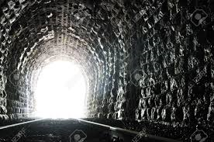
After 7 days of work we start seeing light at the end of the tunnel…
…but we remain vigilant, it could still be a train!

Slide 3
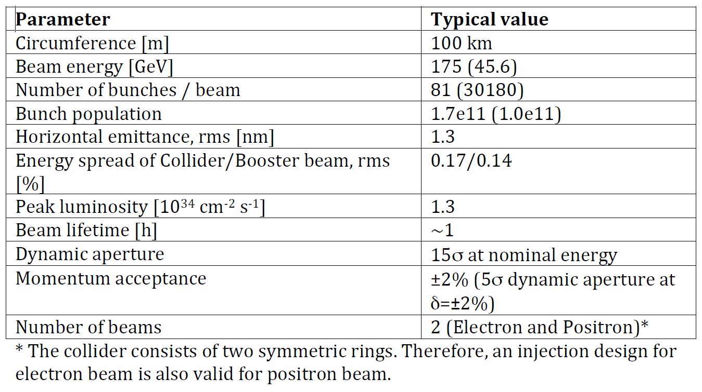

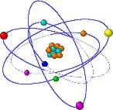
Global view
Δp/p <X
45,6 GeV
Operation mode
Circunference= 100Km
1,5 km Straight section
Dynamic acceptance
15σ
Beam lifetime 1h
Beam energy
175 GeV
Helen
Irina
Nicholas
Olaf
Mariusz
Aurelio
+
=
HINOMA??
Case A: Design a top‐up injection system for an high‐energy circular collider, e.g. FCC--‐ee

Slide 4
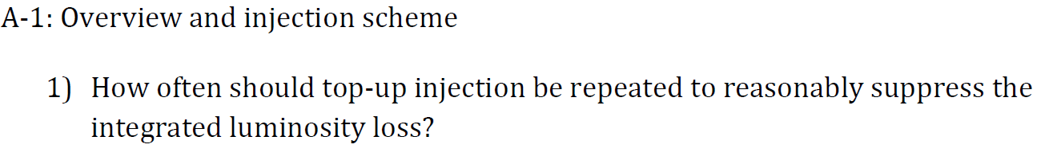
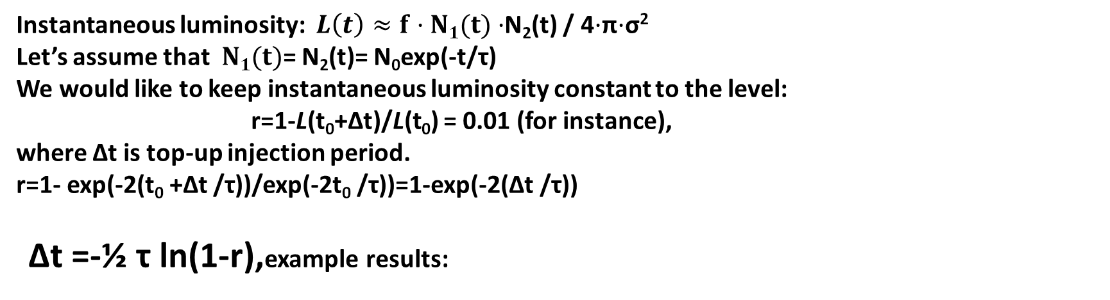
Intensity replenishment for Luminosity stabilization
Instantaneous luminosity: $L\left(t\right)≈f·N1(t)·$N₂(t) / 4$·$π$·$σ²
Let’s assume that $N1(t)$= N₂(t)= N₀exp(-t/τ)
We would like to keep instantaneous luminosity constant to the level:
r=1-L(t₀+∆t)/L(t₀) = 0.01 (for instance),
where ∆t is top-up injection period.
r=1- exp(-2(t₀ +∆t /τ))/exp(-2t₀ /τ))=1-exp(-2(∆t /τ))
∆t =-½ τ ln(1-r),example results:
r | ∆t
0.1% | 1.8 s
1% | 18 s
2% | 36 s
5% | 92 s

Slide 5
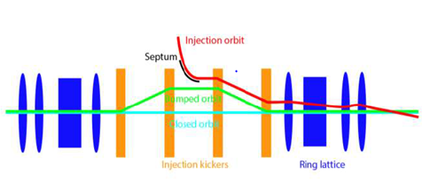
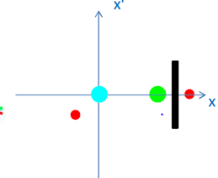
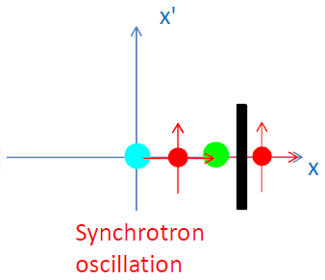
Conventional injection
OUR CASE
Transverse Separation
Longitudinal Separation

Slide 6
Optimum parameters jIn
CONSIDERATIONS
Momentum acceptance: ±2%
Energy spread: 0.14%
Luminosity constant r= 1% , Δt= 18 s
Injection energy= 178.855 GeV
Injected beam charge: 4.81897x10¹⁰

Slide 7
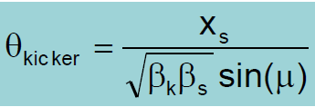
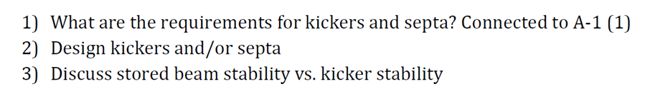
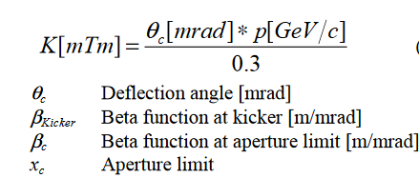
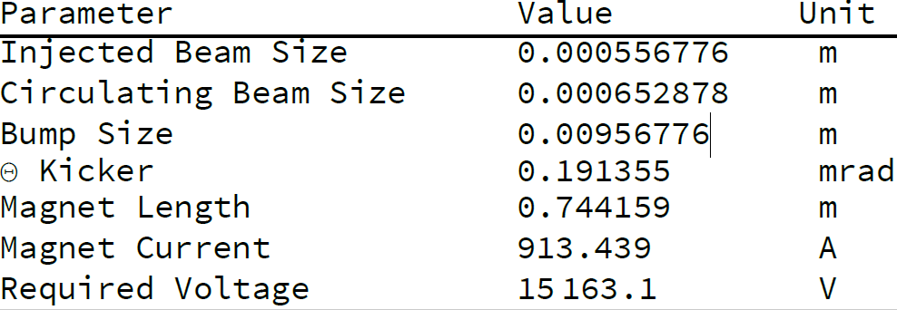

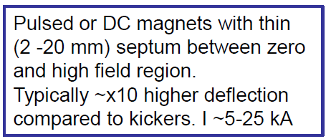
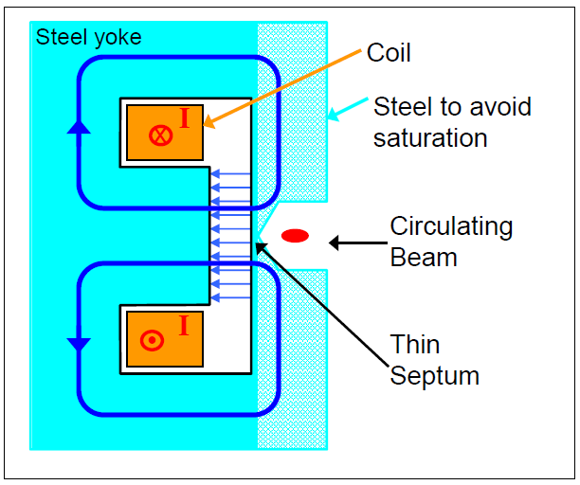
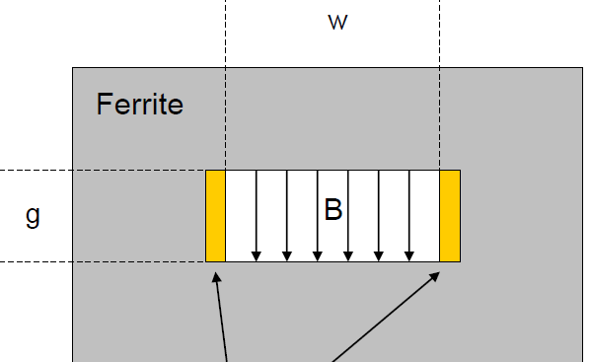
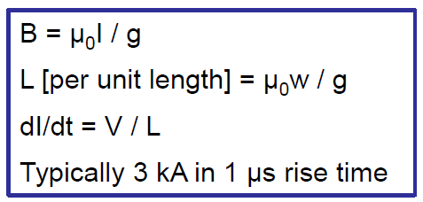
A-2: hardware considerations
Lambertson Septum Magnet
Window Frame Ferrite Kicker

Slide 8
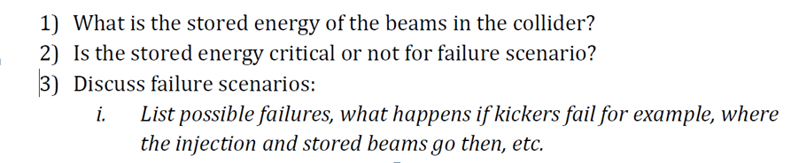
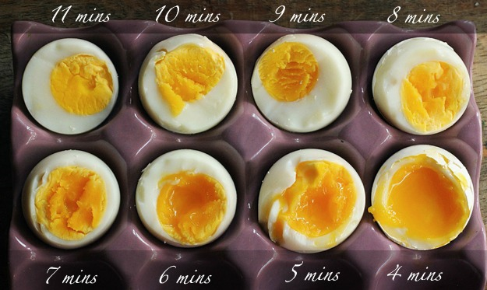
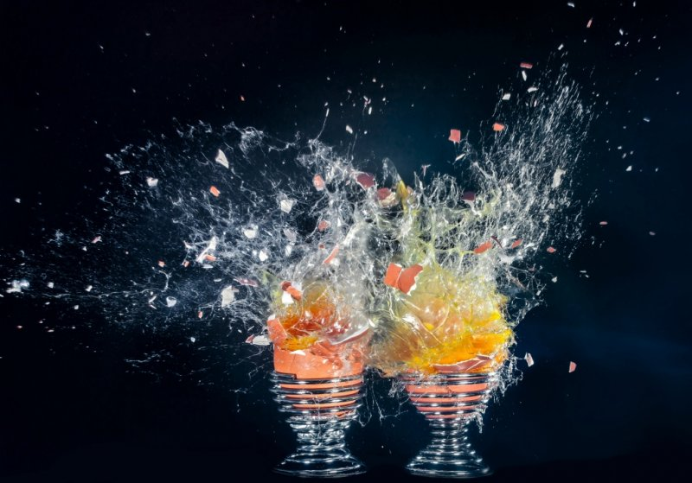
A-3:Failure scenario
Energy stored in a beam is: 390 kJ in 175 GeV collider case - enough to boil 2-6 eggs
2 MJ in 45.6 GeV collider case - enough to boil 10-30 eggs
(depending how you like your eggs)
However, if you try to boil eggs too fast:
LHC stored beam: 360 MJ/beam
2 MJ – can melt 2.8 kg of copper

Slide 9

Questions?

