Slide 1



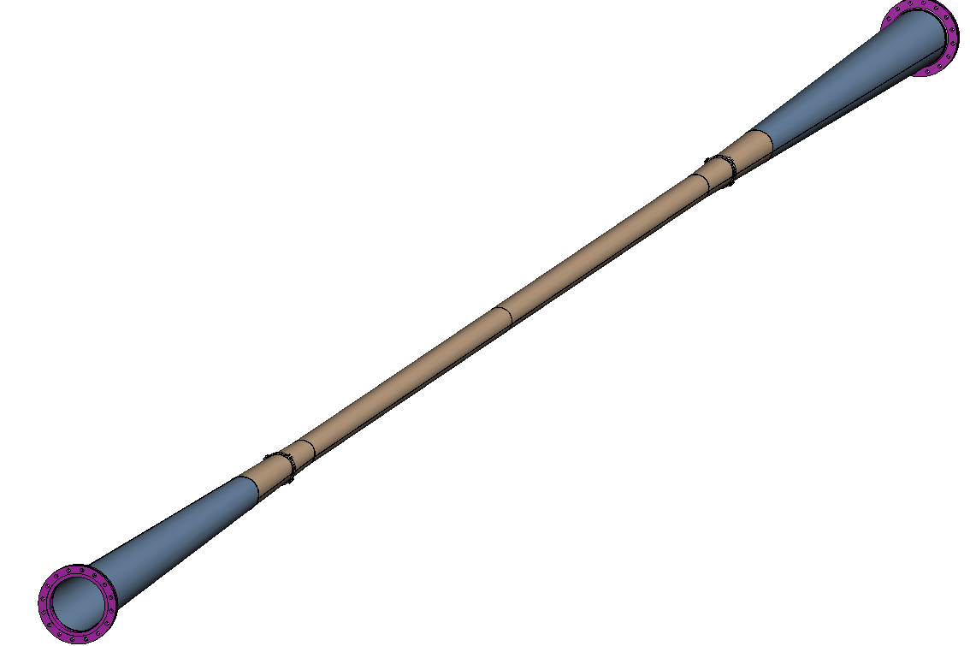
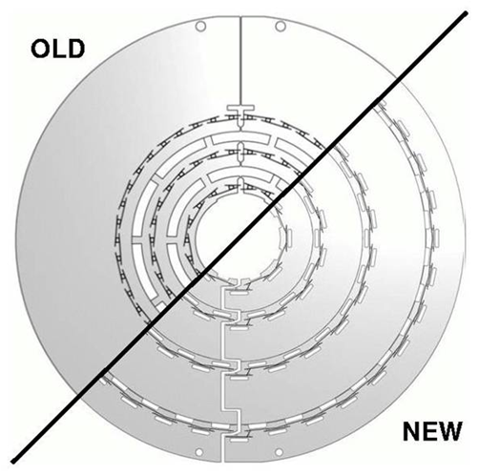
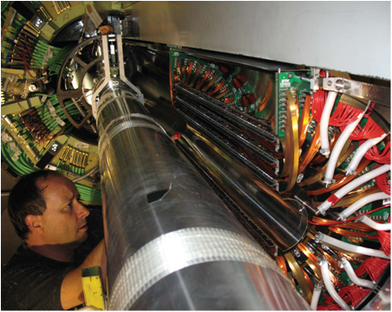
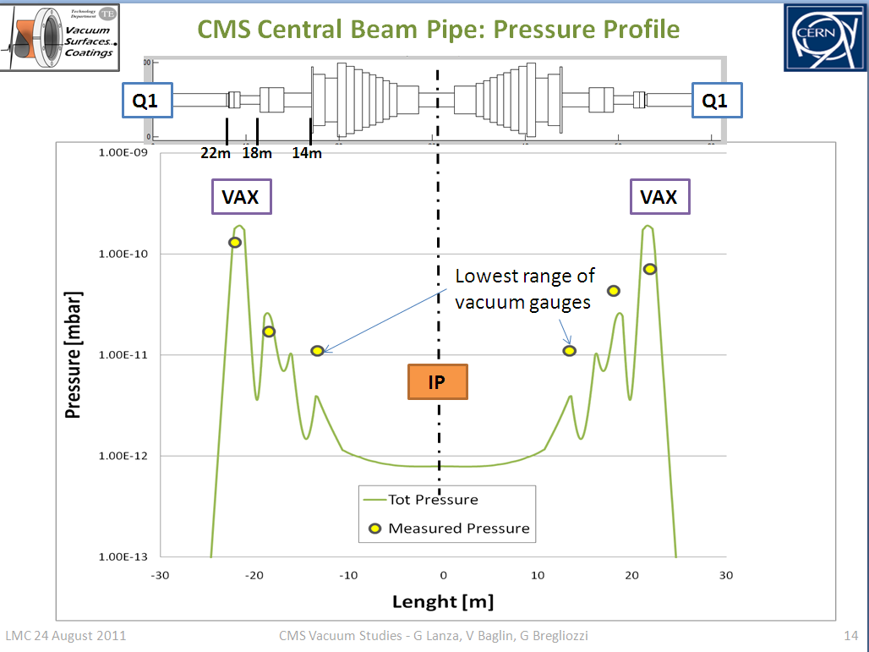
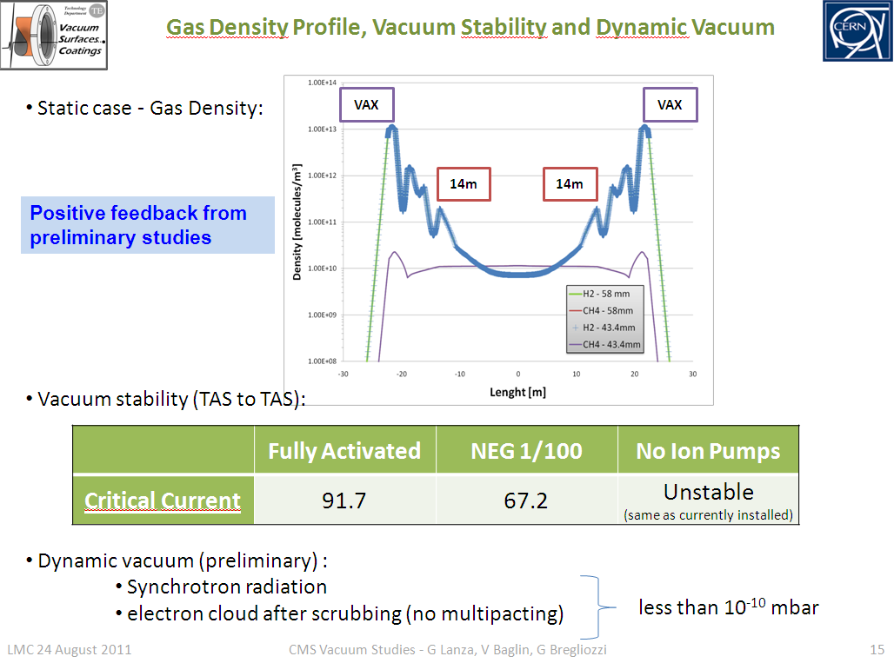
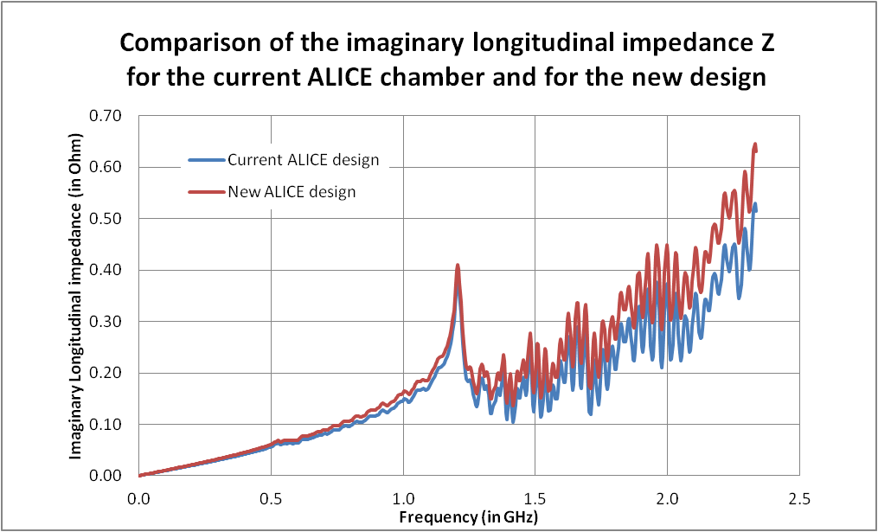
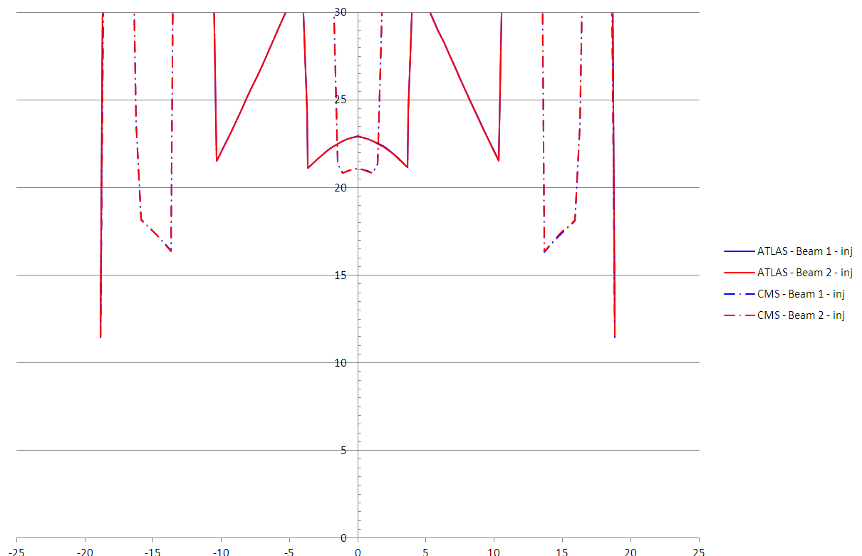



Considerations when introducing new
equipment into the LHC
M.Gallilee
CERN, CH-1211, Geneva 23, Switzerland
INTRODUCTION AND GOAL
This is a summary of the approval process required for the implementation of new vacuum chambers and equipment in the LHC. A rigorous approval process is required, with a final approval granted at the LHC Machine Committee (LMC). Reduction in diameter of the central vacuum chambers will allow for better Physics data and detector accuracy. The requested changes need a full machine study in order to ensure that they are compatible with both the current LHC and the future HL-LHC and that the most possible flexibility is given for future run conditions.
Pictures courtesy of ATLAS
EXAMPLES OF PAST STUDIES
Pictures courtesy of CMS
CMS reduction of central vacuum chamber inner diameter from 58 mm to 43.4 mm and ATLAS reduction from 58 mm to 47 mm inner diameter. Figures 1 and 2 show simplified diagrams of the changes.
Figure 2: New ATLAS Chamber—7.3 m in length, inner diameter 47 mm, 0.8 mm wall
Figure 1: New CMS Chamber—6.2 m in length, minimum inner diameter 43.4 mm, 0.8 mm wall
APPROVAL PROCESS
EXAMPLE OF CAVERN MOVEMENTS FOR STABILITY TOLERANCES
The approval process considers all areas where the new object may affect the performance of the machine.
The experimental caverns have been measured at regular intervals.
New Diameter Beam Pipe
Machine Protection
Background
Injection Optics & Beam Dump
Impedance Heating
Aperture approval with LMC
Collimation
E-Cloud
Positioning Tolerances
Dynamic Vacuum
Mechanical Tolerances
Aperture for n1 value
Stability Tolerances
(Sector layout now defined)
Static Vacuum
EXAMPLE OF VACUUM ANALYSIS
EXAMPLE OF IMPEDANCE CALCULATION
EXAMPLE OF APERTURE CALCULATION (N1 σ)
EXAMPLE OF TOLERANCES OLD AND NEW
More accurate tolerances have lead to an increase in the available physical aperture for the beam.
 | 2011 Design Value Tolerances
 | ATLAS CENTRAL CHAMBER | CMS CENTRAL CHAMBER
Composition of beampipe radius (mm)
Mechanical Construction and Assembly | 1.95 | 1.15
Installation Survey | 2.6 at 2 sigma (95.4%) | 1.6 at 2 sigma (95.4%)
Cavern Stability | 0.5/year | 0.5/year
Stability Margin | 0 | 2.3
Sum of Tolerances | 7.05 (for 5 years between alignments) | 6.55 (for 3 years between alignments)
Chamber Radius | 23.5 | 21.7
Aperture (Radius-Tolerance Sum) | 16.45 | 15.15
CONCLUSION
In conclusion it has been shown that the approval of a new LHC element is a non-trivial process and many items must be considered before the final go-ahead can be given for installation.
ACKNOWLEDGEMENTS
The author would like to thank the CERN LEB working group for the material which has been used to form the basis of this poster presentation.

