Slide 1
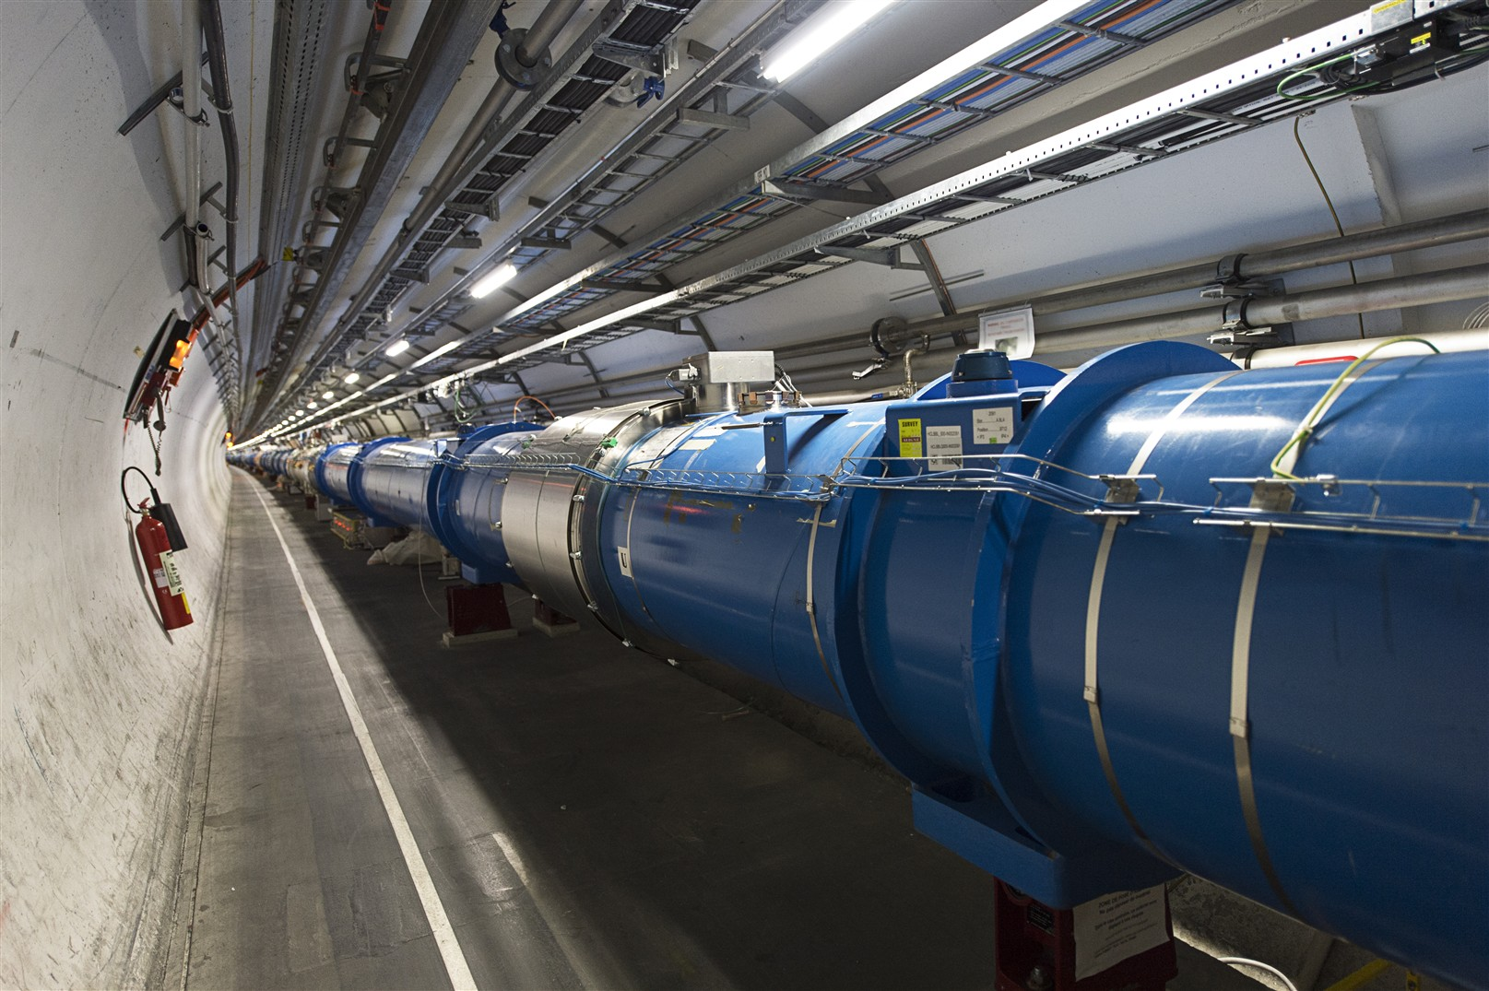



Electron cloud Effects
and Cures.
R. Cimino,
LNF INFN, Frascati, Italy & CERN, Geneva, CH.
partially founded by INFN-Gr.V nta-IMCA project.
CAS, Warsaw 6-10-2015
R. Cimino

Slide 2
Electron cloud in accelerators
Phenomenology:
What happens to the Vacuum beam pipe in presence of the beam? (LHC Example)
Numerical model
The Surface Science properties of relevance:
SEY (Secondary Electron Yield);
PY (Photo Yield);
R (photon Reflectivity)
Mitigation strategies
Conclusion
R. Cimino and T. Demma
“Electron cloud in Accelerators” Int. J. Mod. Phys. A 29 (2014) 1430023 (pag. 65).

Slide 3
Electron cloud in accelerators
Phenomenology:
What happens to the Vacuum beam pipe in presence of the beam? (LHC Example)
Numerical model
The Surface Science properties of relevance:
SEY (Secondary Electron Yield);
PY (Photo Yield);
R (photon Reflectivity)
Mitigation strategies
Conclusion
R. Cimino and T. Demma
“Electron cloud in Accelerators” Int. J. Mod. Phys. A 29 (2014) 1430023 (pag. 65).

Slide 4
But: Vacuum interact with the beam!
  Beam dynamic experts design a complex and high performing machine and than somebody will design a metallic shell around it: It is a technical issue!!! with:
  Pressure better than 10 ⁻⁹ mbar rapidly reached and stable
  Few pumps, no bake out (typically no space nor budget),
  Very low desorption yield
  High thermal conductivity
  High electrical conductivity
  No effect on the magnetic field!!
  Mechanically robust
  ….. And, of course, cheap!

Slide 5
One real example to see it:
5
8-10-2010
450 GeV – 150 ns bunch spacing: Merged vacuum @ LHC

Slide 6
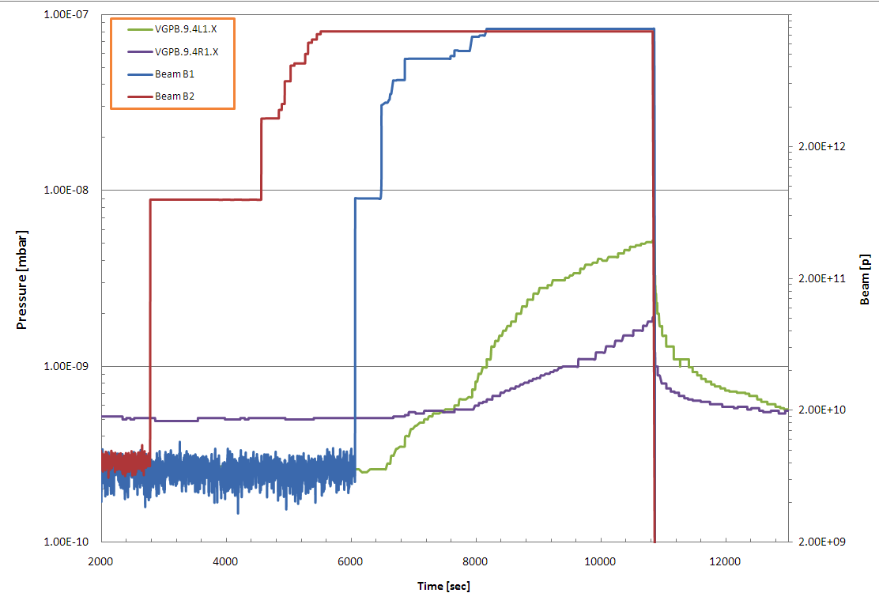
Exotic Vacuum behavior @ LHC:
6
Beam 2
Beam 1
Pressure Increase
No pressure Increase
450 GeV – 150 ns bunch spacing: Merged vacuum
8-10-2010

Slide 7
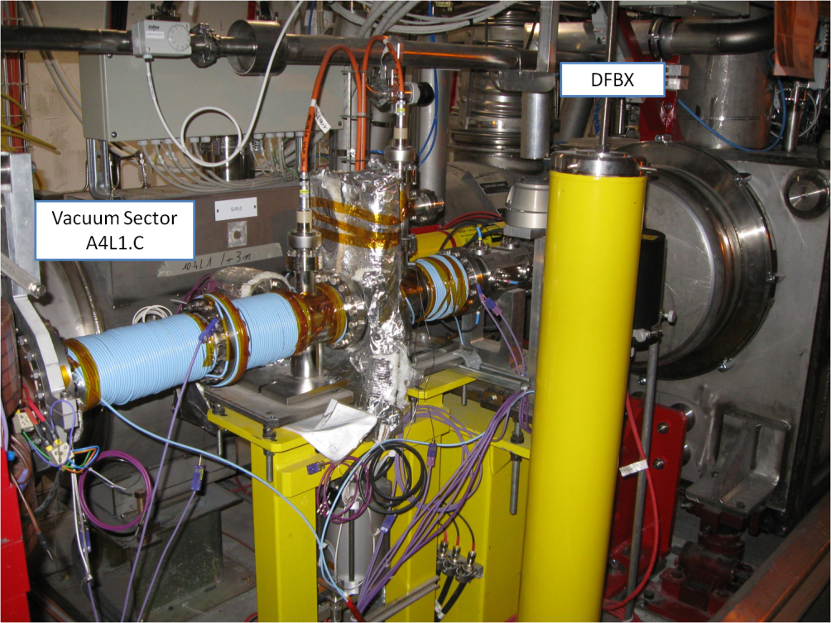
Easily solved: Installation of Solenoids

Slide 8
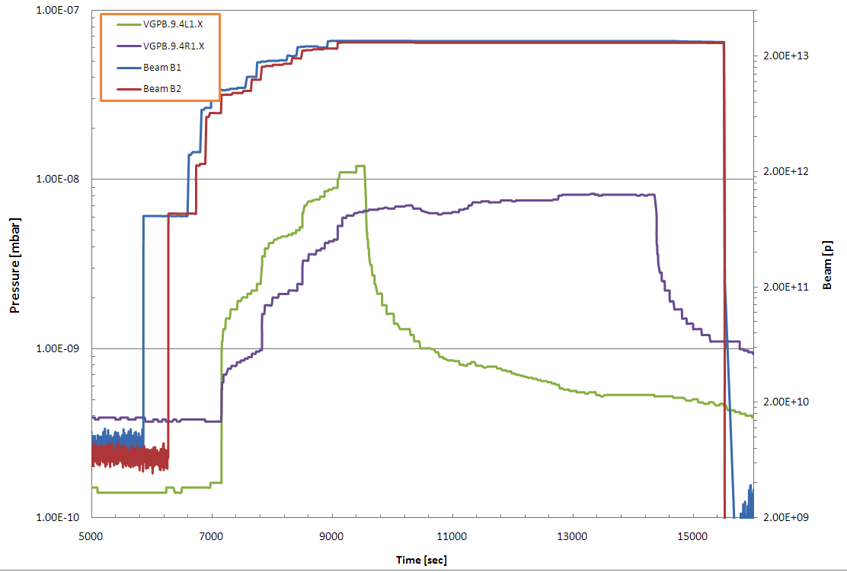
Solenoids have effect on pressure!!!
Solenoid ON
A4L1
Solenoid ON
A4R1
Beam Intensity
After 20 min
ΔP ≈7·10⁻¹⁰
After 20 min
ΔP ≈7·10⁻¹⁰
Remove multipacting
Still primary electrons

Slide 9
Solenoids have effect on pressure!!!
Evidence for:
e-Cloud
instabilities
Solenoid ON
A4L1
Solenoid ON
A4R1
Beam Intensity
After 20 min
ΔP ≈7·10⁻¹⁰
After 20 min
ΔP ≈7·10⁻¹⁰
Remove multipacting
Still primary electrons

Slide 10
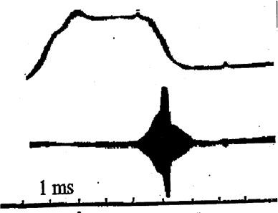
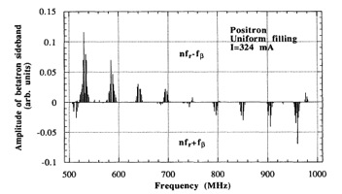
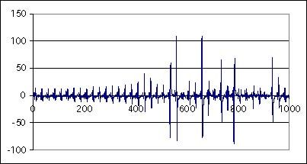
Electron-cloud history
G. Budker et al
1965 INP PSR Transverse instability & beam loss
1971 ISR e-p, 1977 Beam induced multipacting
1988 LANL PSR vertical instability &beam loss
1988 KEK PF multibunch instability
Since 1996 BEPC IHEP-KEK collaboration
1997 LHC crash program launched
1997 CESR “anomalous anti-damping” explained
1997/98 APS e⁻ cloud study start
Since 1998 SPS e⁻ cloud with LHC beam
2000 PS e⁻ cloud with LHC beam
Since 1999 e⁻ cloud at KEKB and PEP-II
Since October 2001 evidence for e⁻ cloud at RICH
Since december 2002 e⁻ cloud at TEVATRON
Etc etc…
KEK PF, 1988
M. Izawa, Y. Sato,
T. Toyomasu
K. Cornelis,
G. Arduini et al

Slide 11
Vacuum in new generation accelerators is much “more” than a technical issue!
Let us see what may cause such beam and/or pressure instabilities.
The case of the:
LHC arcs

Slide 12
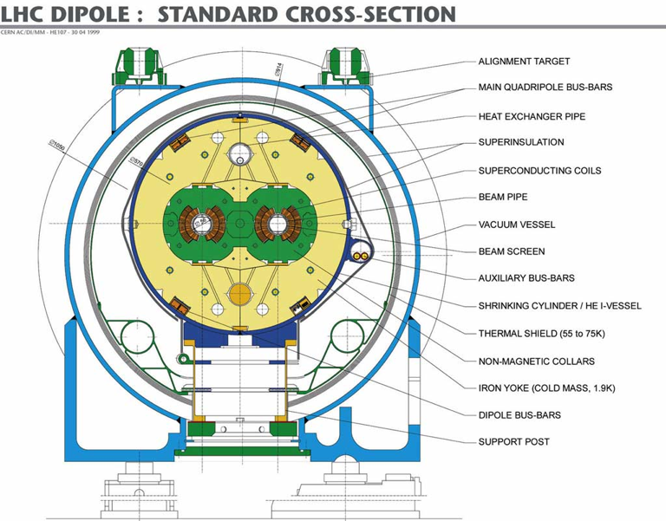
Static
Cold Bore @ 1.9 K
Extreme High Static Vacuum (<< 10⁻¹³ Torr)

Slide 13
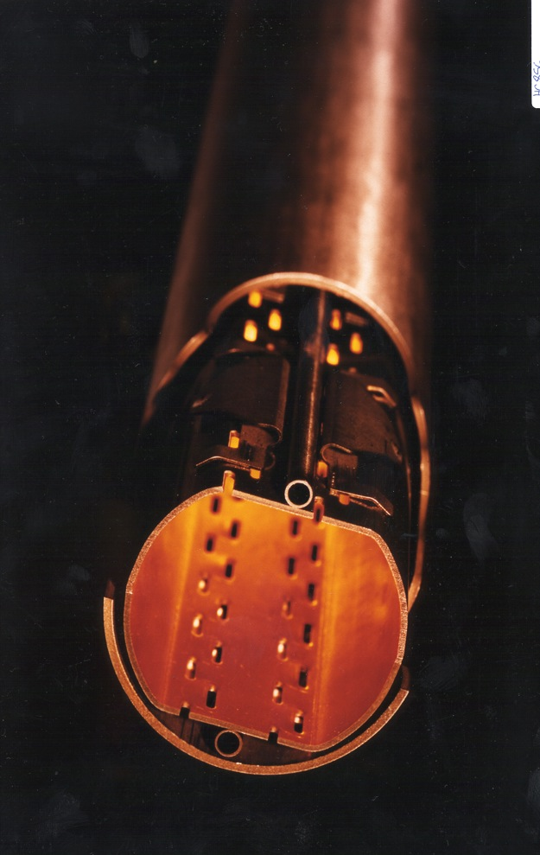
Static
Cold Bore @ 1.9 K
Need of a Beam Screen
@ 5K< T <20K
to reduce heat load (SR, Eddy current, Impedance, etc…) on Cold bore for thermal load issues
Radial Distance
T=0, without beam

Slide 14
Static
Cold Bore @ 1.9 K
Let us see what happens to the Beam screen Surface during operation
Radial Distance
T=0, without beam

Slide 15
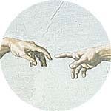
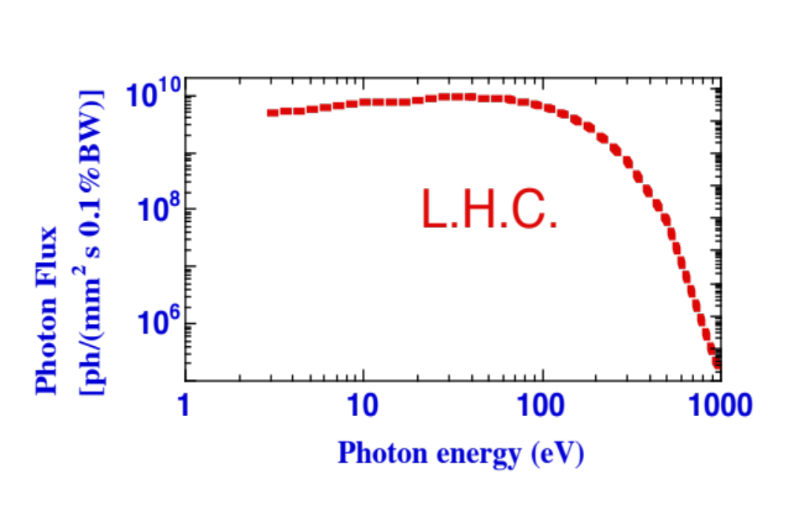
calculation
Synchrotron Radiation: E_{c} = 44 e V @ LHC
CB
BS
Radial Distance
+ +
+ + + +
+ + + + + +
+ + + +
+ +
p ⁺
E_{c}
Time = 0

Slide 16
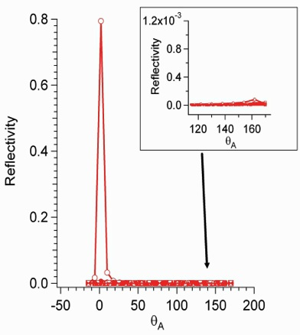
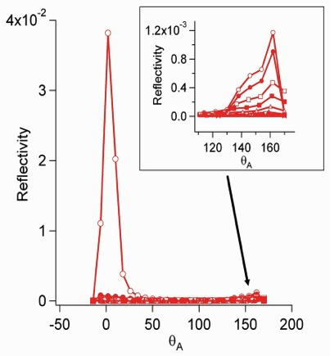
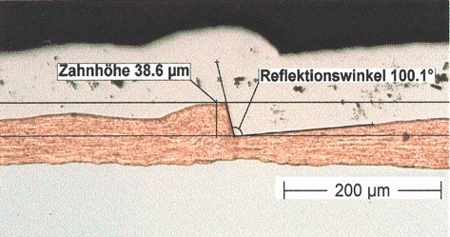
Photon reflectivity:
SR & Surface Science
CB
BS
Radial Distance
+ +
+ + + +
+ + + + + +
+ + + +
+ +
p ⁺
Flat Cu
Saw tooth
N. Mahne et al. App. Surf. Sci. 235, 221-226, (2004).
Time = 2 ns

Slide 17
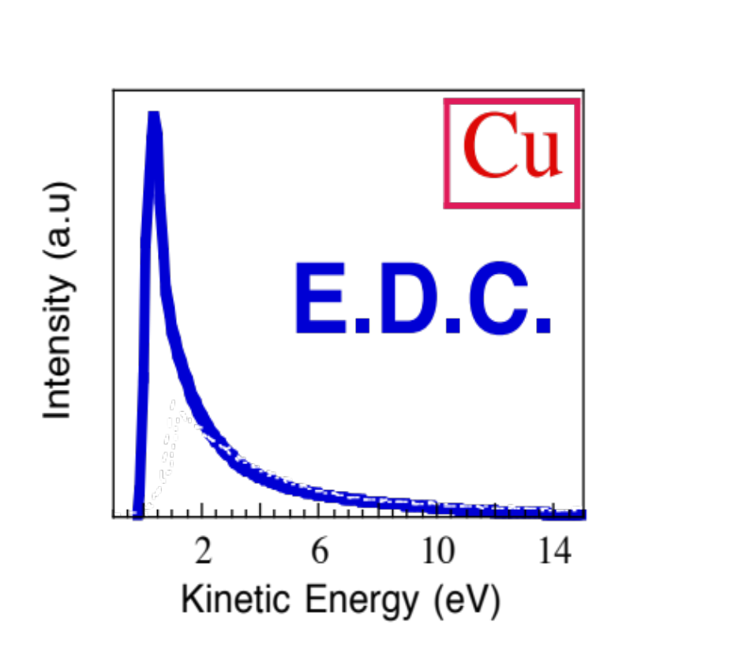
Photoemission:(vs. hν, Q, E,T, B)
SR & Surface Science
CB
BS
Radial Distance
+ +
+ + + +
+ + + + + +
+ + + +
+ +
p ⁺
    R. Cimino, V. Baglin, I. R. Collins. Phys.Rev. ST-AB 2 63201 (1999).
Time = 5 ns
Produced e⁻ (PY): very important for single beam instabilities (K.Ohmi and F. Zimmermann PRL 2000)

Slide 18
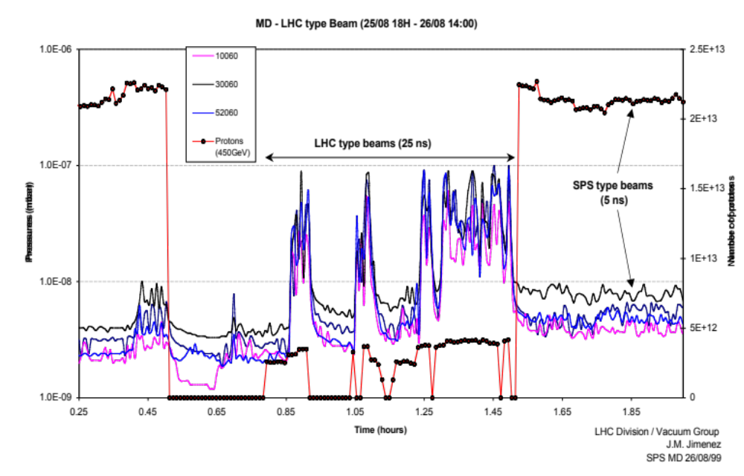
Observation
Even in absence of SR:
e⁻ from ionization of residual gas… etc
SPS
(M.Jimenez)
e⁻
Radial Distance
+ +
+ + + +
+ + + + + +
+ + + +
+ +
p ⁺
Time = 5 ns
Beam induced multipacting is observed in SPS where no e⁻ are photoemitted.

Slide 19
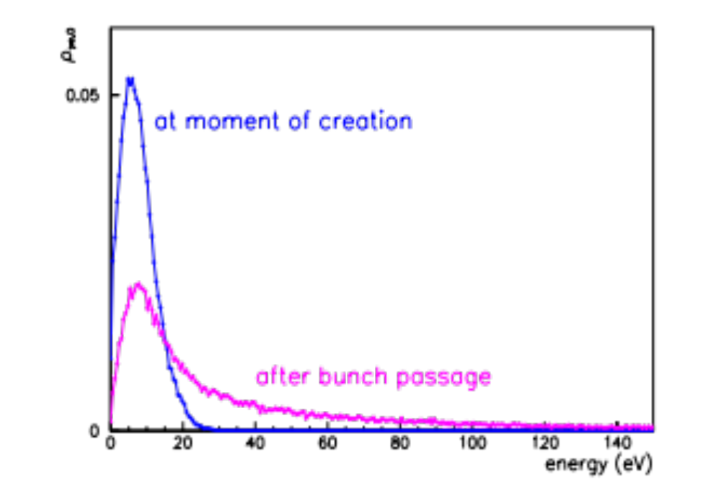
simulation
Beam induced el. acceleration
CB
BS
(F.Zimmermann)
At the moment of creation
Radial Distance
+ +
+ + + +
+ + + + + +
+ + + +
+ +
p ⁺
After acceleration
0
20
40
60
80
100
Energy (eV)
Time = 10 ns

Slide 20
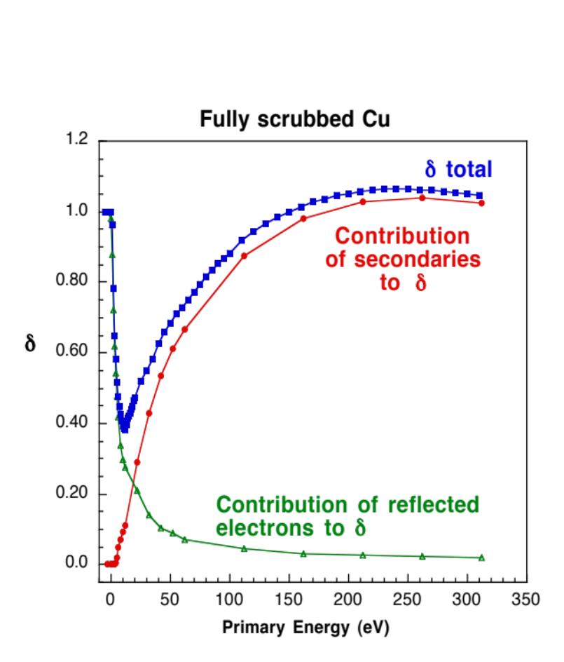
e⁻ induced e⁻ emission
Surface Science: SEY
CB
BS
Radial Distance
+ +
+ + + +
+ + + + + +
+ + + +
+ +
R. Cimino et al Phys. Rev. Lett. 93, 14801 (2004).
Time = 15 ns

Slide 21
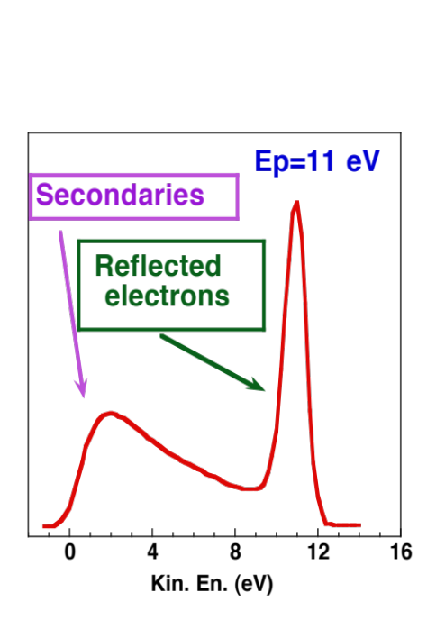
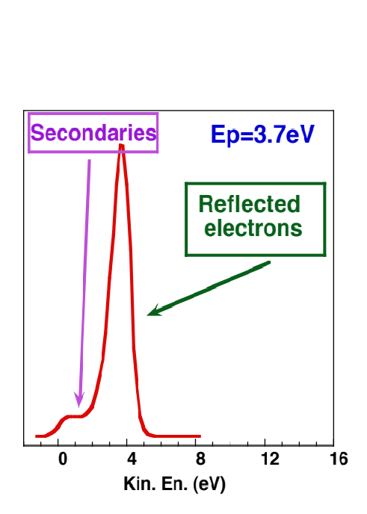
e⁻ induced e⁻ emission vs. E
Surface Science
CB
BS
Energy Distribution Curves as function of Ep
Radial Distance
+ +
+ + + +
+ + + + + +
+ + + +
+ +
R. Cimino et al Phys. Rev. Lett. 93, 14801 (2004).
Time = 20 ns

Slide 22
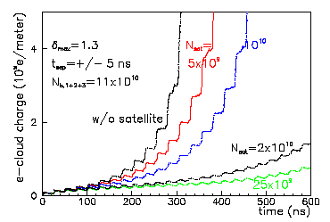
E- cloud simulation
e⁻ cloud Build-up
CB
BS
Radial Distance
+ +
+ + + +
+ + + + + +
+ + + +
+ +
+ +
+ + + +
+ + + + + +
+ + + +
+ +
P ⁺
P ⁺
(F. Zimmermann)
Time structure vs.
Simulations.
Time = 25 ns

Slide 23
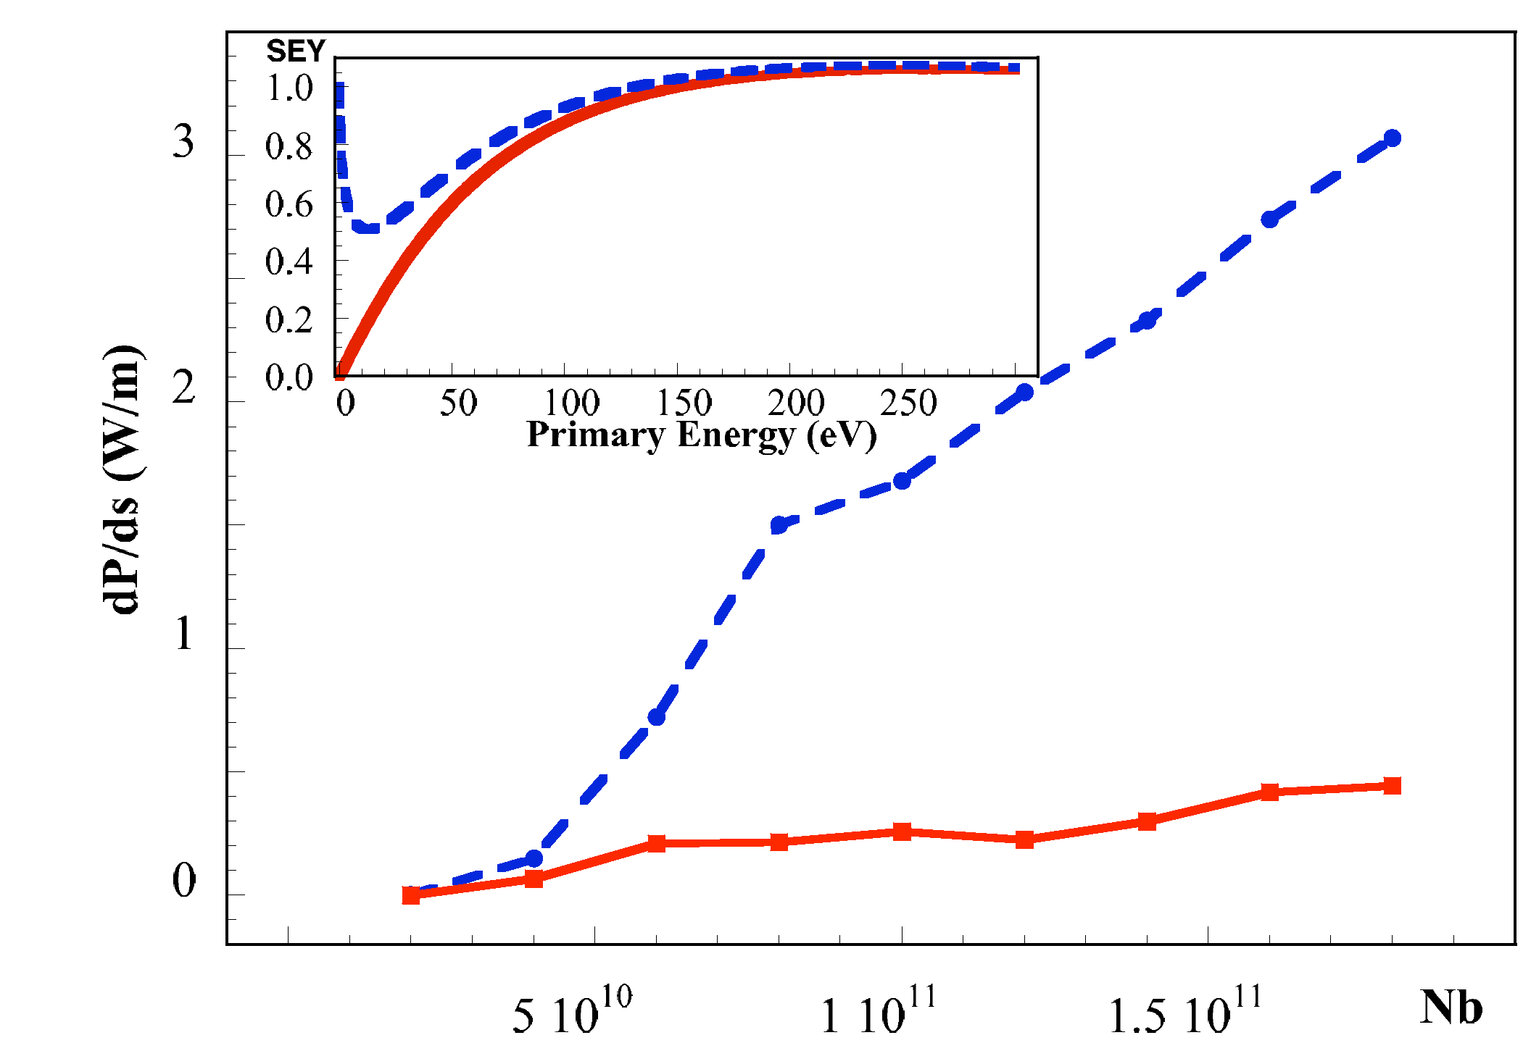
e⁻ induced heat load
Simulation
CB
BS
Radial Distance
+ +
+ + + +
+ + + + + +
+ + + +
+ +
+ +
+ + + +
+ + + + + +
+ + + +
+ +
p ⁺
p ⁺
R. Cimino et al Phys. Rev. Lett. 93, 14801 (2004).
Time = 25 ns
It causes Heat load!

Slide 24
ph. and/or e⁻ induced desorption
Surface Science and simulation
CB
BS
Radial Distance
Dynamic
pressure
increase !!!
+ +
+ + + +
+ + + + + +
+ + + +
+ +
+ +
+ + + +
+ + + + + +
+ + + +
+ +
p ⁺
p ⁺
Desorbed gas
Time = 25 ns
It is a beam/Vacuum issue!

Slide 25
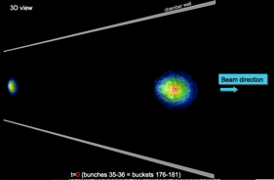
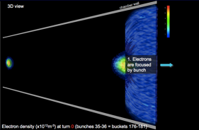
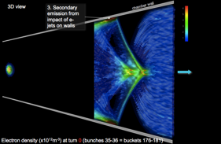
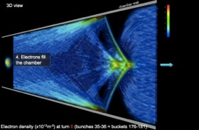
E- cloud simulation
Beam blow up
CB
BS
Radial Distance
+ +
+ + + +
+ + + + + +
+ + + +
+ +
+ +
+ + + +
+ + + + + +
+ + + +
+ +
+ +
+ + + +
+ + + + + +
+ + + +
+ +
+ +
+ + + +
+ + + + + +
+ + + +
+ +
+ +
+ + + +
+ + + + + +
+ + + +
+ +
+ +
+ + + +
+ + + + + +
+ + + +
+ +
+ +
+ + + +
+ + + + + +
+ + + +
+ +
+ +
+ + + +
+ + + + + +
+ + + +
+ +
+ +
+ + + +
+ + + + + +
+ + + +
+ +
P ⁺
P ⁺
Jean-Luc Vay
IPAC’2012
Time structure vs Simulations.
Time = 25 ns
It affects beam quality!

Slide 26
Electron cloud in accelerators
Phenomenology:
What happens to the Vacuum beam pipe in presence of the beam? (LHC Example)
Numerical model (G. Rumolo UPAS Lectures 2015)
The Surface Science properties of relevance:
SEY (Secondary Electron Yield);
PY (Photo Yield);
R (photon Reflectivity)
Mitigation strategies
Conclusion
R. Cimino and T. Demma
“Electron cloud in Accelerators” Int. J. Mod. Phys. A 29 (2014) 1430023 (pag. 65).

Slide 27
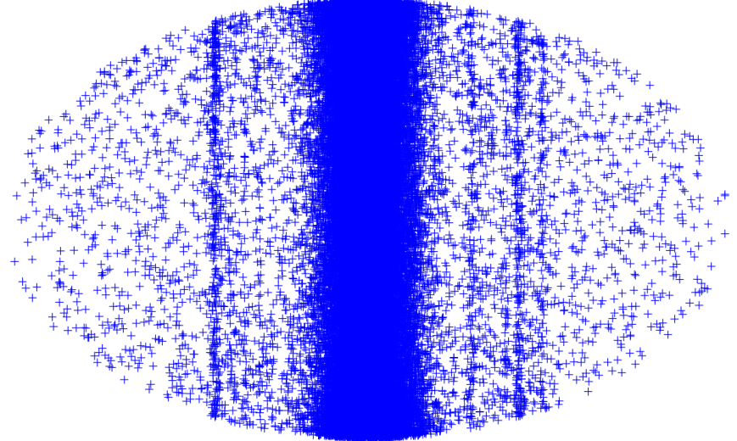
Numerical model of electron cloud effects
s
Multi-bunch beam
Primary and secondary electron production, chamber properties
Noise
Equations of motion of the beam particles
E-cloud build up
x
The instability problem
y
The build up problem
(see: G. Rumolo UPAS Lectures 2015)

Slide 28
Numerical model of electron cloud effects
Coupled bunch electron cloud instability naturally needs a self-consistent solution of the electron cloud problem
  A broad time scale to cover, currently working on the problem
For the moment we simulate the two branches separately (similar to what is done for impedances):
  Electron cloud build up
    Multi-bunch
    Usually single passage, single turn or just few turns
  Electron cloud instability
    Single bunch
    Multi-turn, or even multi-kick multi-turn
Build up simulation
Instability simulation
Information on how many electrons interact with a bunch:
central density
detailed distribution
ECLOUD, PyECLOUD, POSINST, CSEC, …
HEADTAIL, PyHEADTAIL, CMAD, PEHTS, …
(see: G. Rumolo UPAS Lectures 2015)

Slide 29
Numerical modeling: e⁻ cloud build up
t=t+Δt
Generate seed e⁻
Evaluate the electric field of beam at macroparticles’ location
Evaluate the e⁻ space charge
electric field
Move macroparticles (t → t+Δt)
Detect impacts and generate secondaries
(see: G. Rumolo UPAS Lectures 2015)

Slide 30
Numerical modeling: e⁻ cloud build up
t=t+Δt
Generate seed e⁻
Evaluate the electric field of beam at macroparticles’ location
  Evaluate the number of seed e⁻ to be generated during the current time step and generate macroparticles:
  Residual gas ionization and photoemission are implemented
  Theoretical/empirical models are used to determine macroparticle space and energy distributions
Evaluate the e⁻ space charge
electric field
Move macroparticles (t → t+Δt)
Detect impacts and generate secondaries

Slide 31
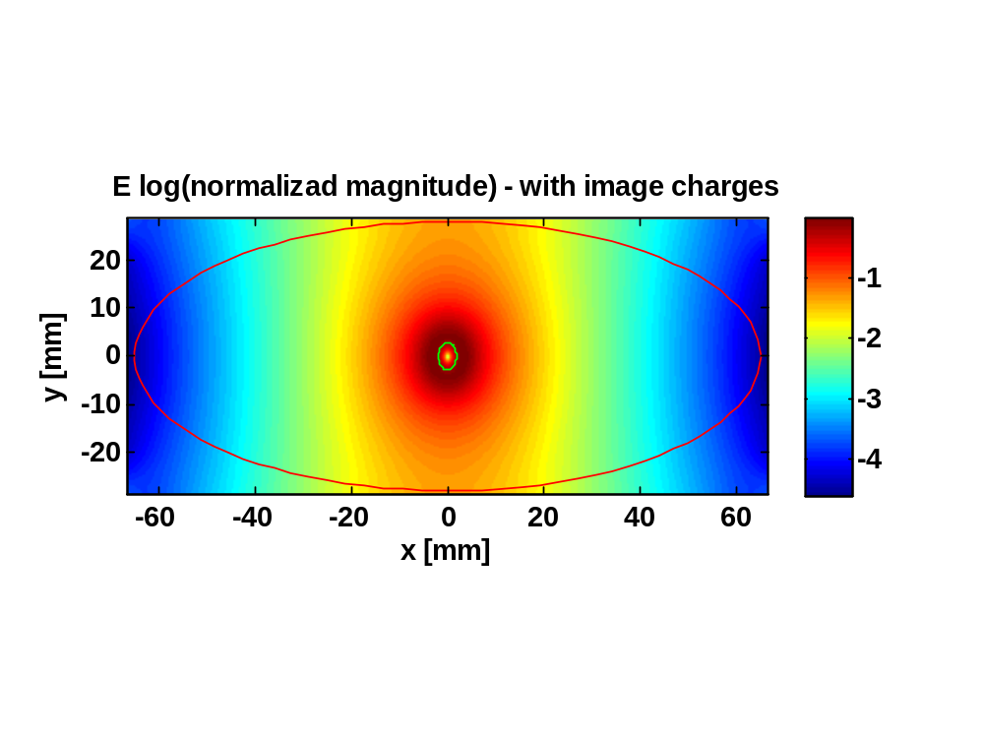
Numerical modeling: e⁻ cloud build up
t=t+Δt
Generate seed e⁻
Evaluate the electric field of beam at macroparticles’ location
  The field map for the relevant chamber geometry and beam shape is pre-computed on a suitable rectangular grid and loaded from file in the initialization stage
  When the field at a certain location is needed a linear (4 points) interpolation algorithm is employed
Evaluate the e⁻ space charge
electric field
Move macroparticles (t → t+Δt)
Detect impacts and generate secondaries

Slide 32
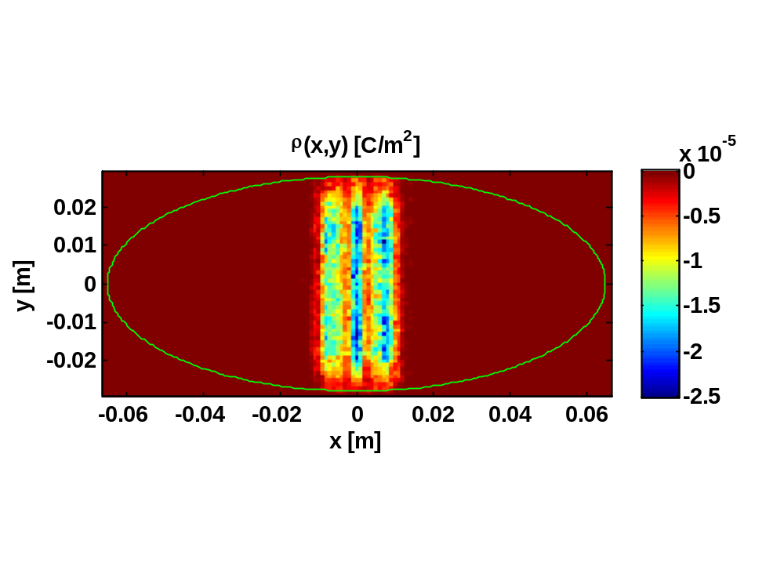
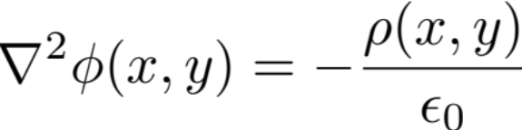


Numerical modeling: e⁻ cloud build up
t=t+Δt
Generate seed e⁻
Evaluate the electric field of beam at macroparticles’ location
  Use of PIC (Particle in Cell) algorithm for e⁻ space charge field: Poisson equation:
Evaluate the e⁻ space charge
electric field
with
on the boundary
Move macroparticles (t → t+Δt)
  The electric field, given by:
Detect impacts and generate secondaries
  is calculated on the grid points and interpolated at the macroparticles’ positions

Slide 33
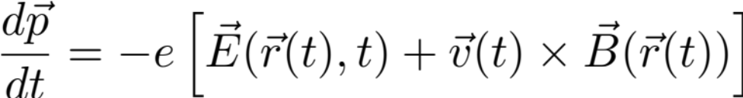
Numerical modeling: e⁻ cloud build up
t=t+Δt
Generate seed e⁻
Evaluate the electric field of beam at macroparticles’ location
  The equation of motion is integrated to update macroparticles’ position and momentum:
Evaluate the e⁻ space charge
electric field
Move macroparticles (t → t+Δt)
  Boris tracker is used for efficiently and accurately dealing with fast cyclotron motion and slow drift in presence of magnetic gradients
Detect impacts and generate secondaries

Slide 34
Numerical modeling: e⁻ cloud build up
t=t+Δt
Generate seed e⁻
Evaluate the electric field of beam at macroparticles’ location
  When a MP hits the wall the SEY model is employed to generate charge of emitted charge. Energy and angle also come from theoretical/experimental models.
  According to the number of emitted electrons, macroparticles can be simply rescaled or new are generated.
Evaluate the e⁻ space charge
electric field
Move macroparticles (t → t+Δt)
Detect impacts and generate secondaries

Slide 35
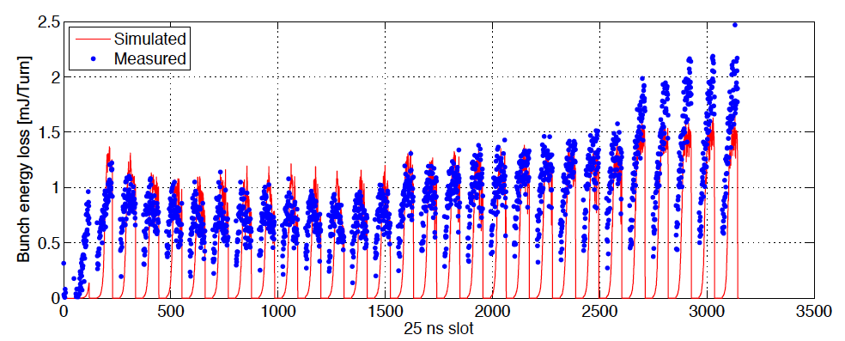
Numerical modeling: e⁻ cloud build up
Example: determine the bunch-by-bunch phase shift and compare it with machine measurements
(see: G. Rumolo UPAS Lectures 2015)

Slide 36
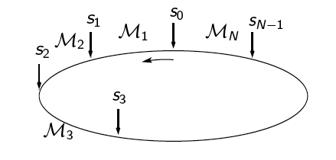
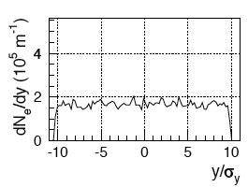
Numerical modeling: electron cloud instability
Electron Cloud (EC) interaction station
Beam made of macroparticles is transported from one EC interaction station to the next one
At EC interaction station, beam is sliced and slices interact sequentially with electron cloud, made of macroparticles
(see: G. Rumolo UPAS Lectures 2015)

Slide 37
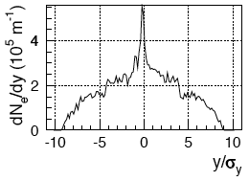
Numerical modeling: electron cloud instability
The effect of the electron cloud on the beam becomes visible only after many turns
The electron cloud is re-initialized at every EC interaction station
Slicing is renewed at every turn
The mutual force between beam and electrons is computed using the same module as for the build up and kicks are applied to both

Slide 38
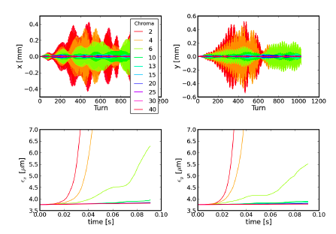
Numerical modeling: electron cloud instability
Sample result, LHC → Interaction of bunch with e-cloud causes coherent instability and emittance growth, cured by chromaticity

Slide 39
Electron cloud in accelerators
Phenomenology:
What happens to the Vacuum beam pipe in presence of the beam? (LHC Example)
Numerical model
The Surface Science properties of relevance:
SEY (Secondary Electron Yield);
PY (Photo Yield);
R (photon Reflectivity)
Mitigation strategies
Conclusion
R. Cimino and T. Demma
“Electron cloud in Accelerators” Int. J. Mod. Phys. A 29 (2014) 1430023 (pag. 65).

Slide 40
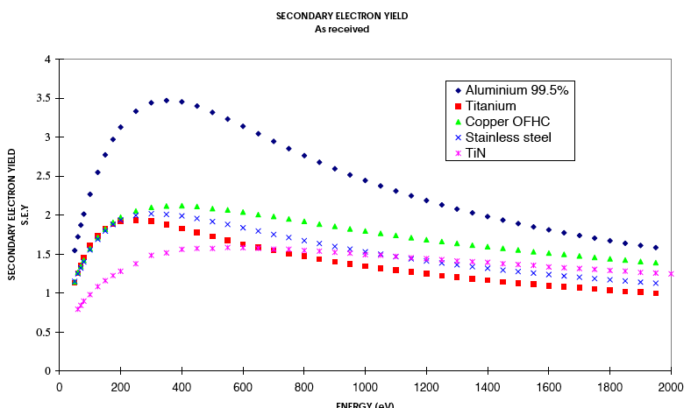
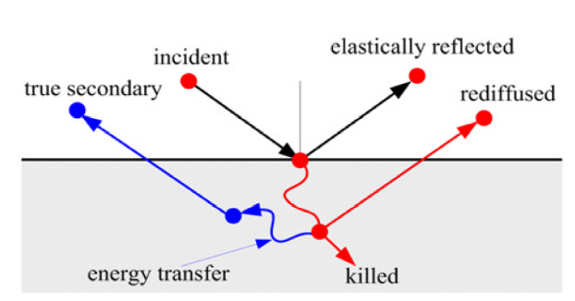
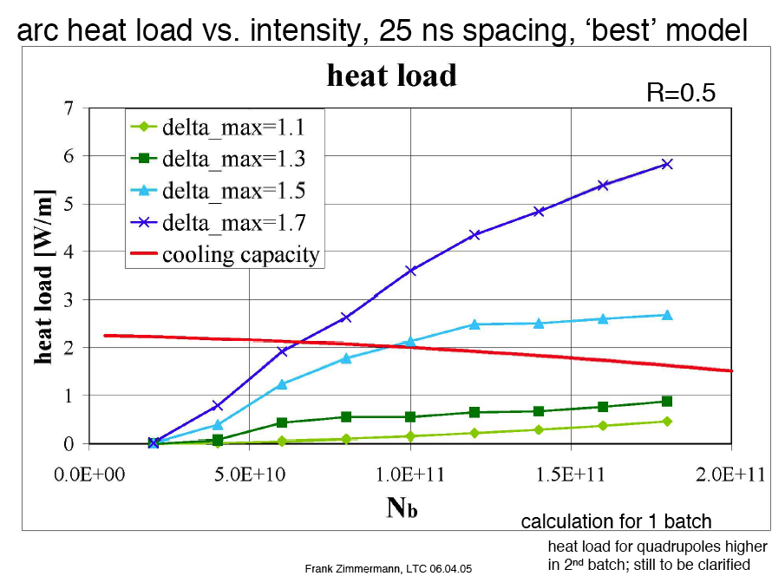
Secondary Electron Yield (SEY)
secondary electron emission
three-step process:
• production of SEs at a depth z
• transport of the SE toward the surface
• emission of SE across the surface barrier
It depend on the surface type and condition: has a big impact to simulations (see calculation for LHC).
See: R. Cimino and T. Demma, “Electron cloud in Accelerators”
Int. Jou. of Modern Physics A Vol. 29, 1430023 (2014).
40

Slide 41
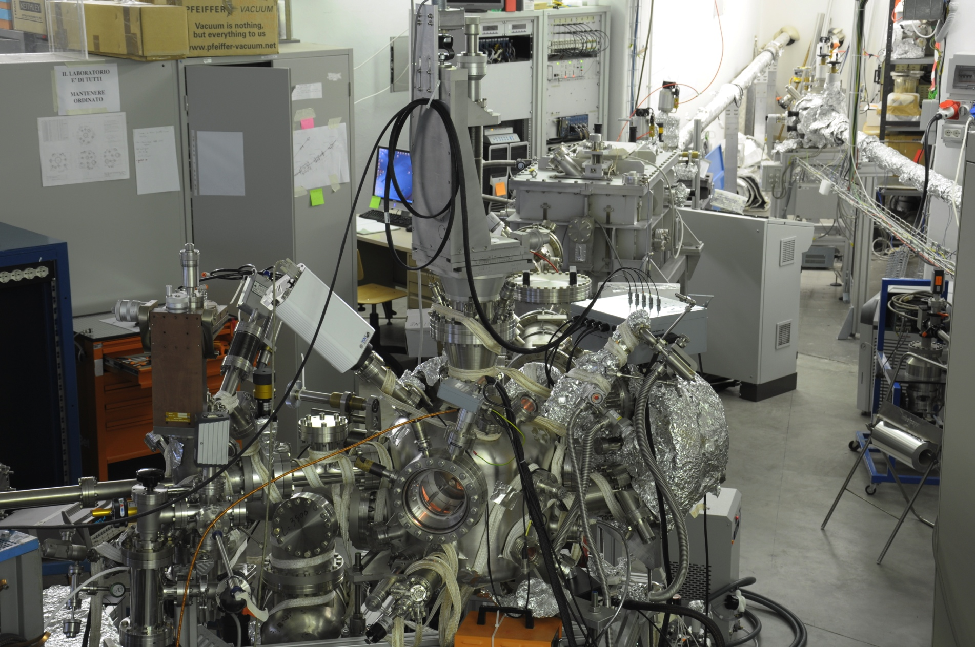
Need of “state of the art” Surface Science systems to study SEY
Manipulator
The XPS system
Farady Cup
Sample Prep.
Chamber for
reactions
Electron Analyser
LEED + e⁻ gun
e⁻ gun
X-ray Lamp
41

Slide 42
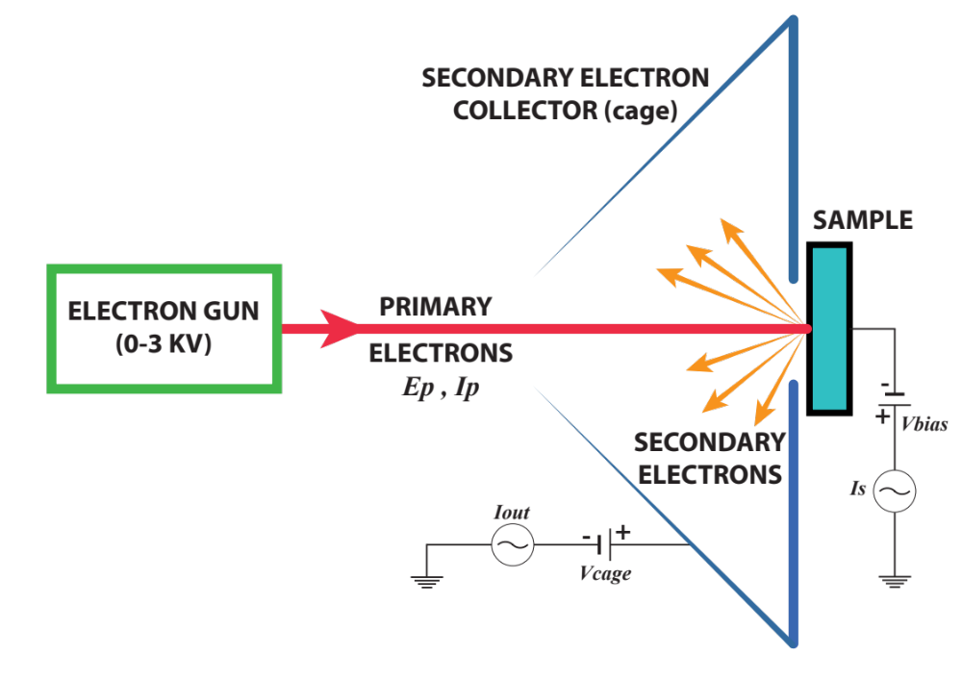
Measure of Secondary e⁻ Yield: 2 methods
SEY= δ=
=
Iout
Igun - Isample
Iin
Igun
42

Slide 43
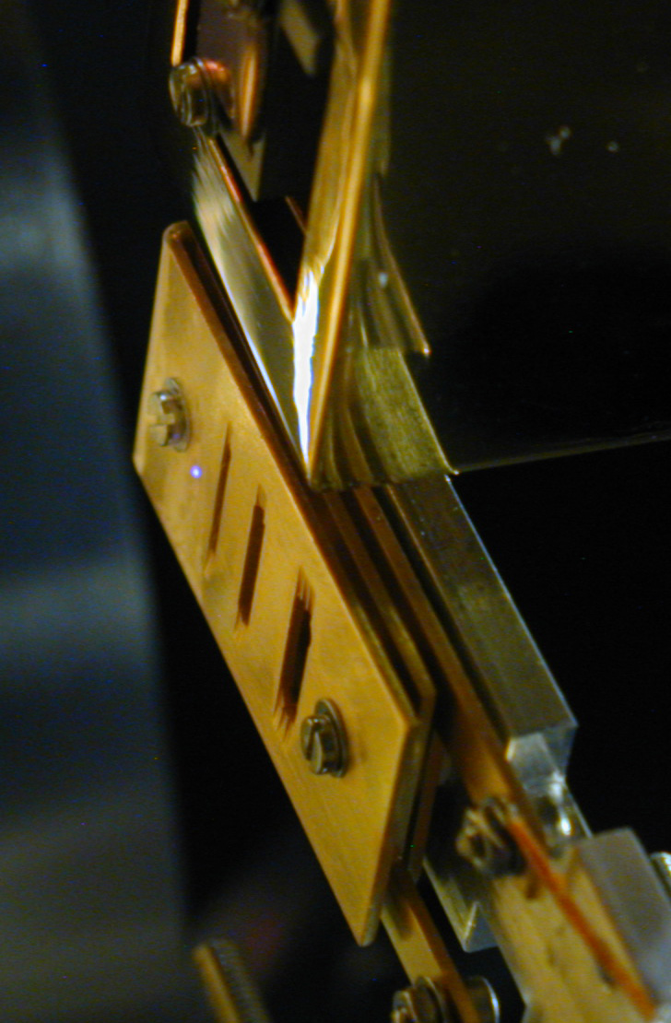
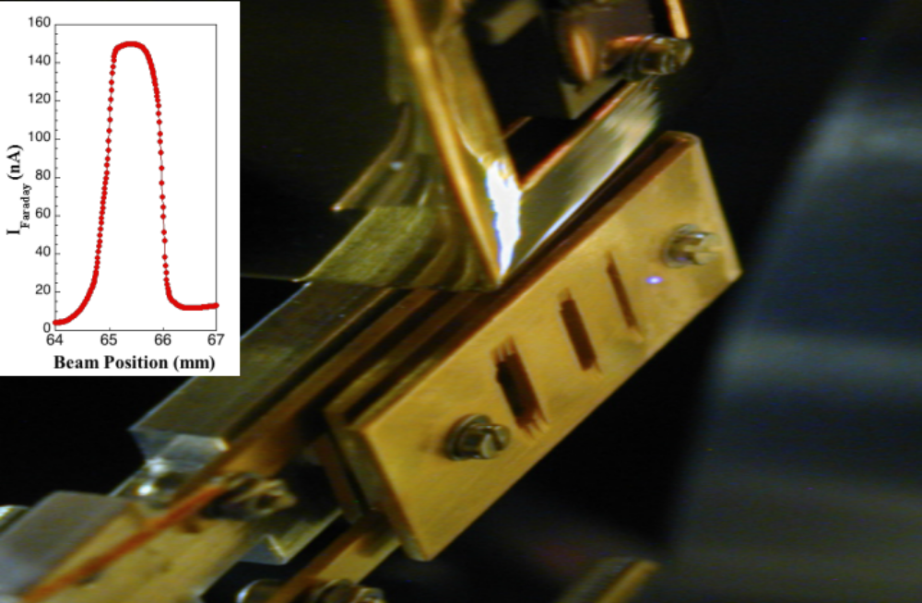
2nd method: Measure of Secondary e⁻ Yield
In a µ-metal chamber
sample manipulator (also at Low T)
Sample well insulated (to measure small current I_{s})
A Faraday cup.
A Low energy electron gun
Isample
1mm slot
e⁻ beam Stable between 30 - 500 eV
Currents from few nA to µA (20µC/h/mm² ⁻ 20mC/h/mm²)
Intense spot (φ < 0.5 mm) with low background
Igun
SEY= δ=
=
Iout
Igun - Isample
Iin
Igun
43

Slide 44
Measure of Secondary e⁻ Yield: 2 methods
SEY= δ=
=
Iout
Igun - Isample
Iin
Igun
I_{out} and I_{in} (N. Hilleret)
Advantages:
Simultaneously measure δ at each energy: very fast.
Effective also for “dispersive samples” (i.e. Sponges)
Disadvantages
Gun far from the sample
(difficult to control LE e⁻)
Big(er) spot and no LE-SEY
I_{Sample} and I_{in}
Advantages:
Gun close to sample.
Reduce noise for low current measurements (i.e. insulators)
LE-SEY accessible!?!
Disadvantages
Gun need to be very stable (takes time)
More work (2 separate runs)
44

Slide 45
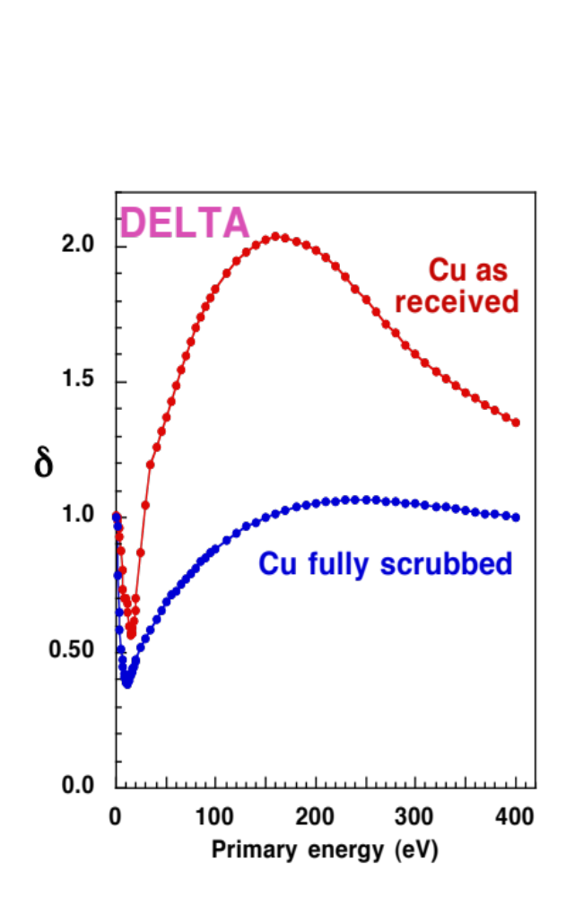
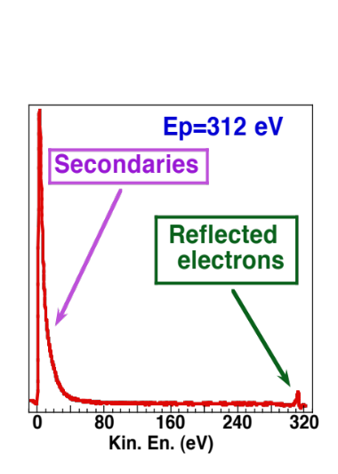
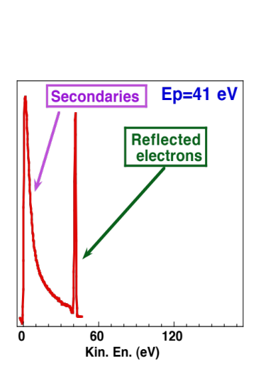
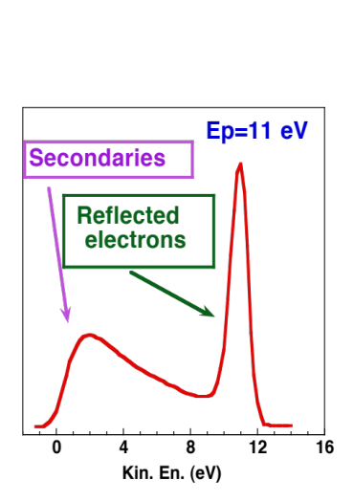
Measure of Secondary e⁻ Yield
=
SEY= δ
Igun - Isample
Igun
At each Primary energy we measure Igun (with the Faraday cup) and Isample.
Each point in d is the integral of the energy distribution of the emitted electrons
R. Cimino et al. Phys. Rev. Lett. 93, 14801 (2004).
45

Slide 46
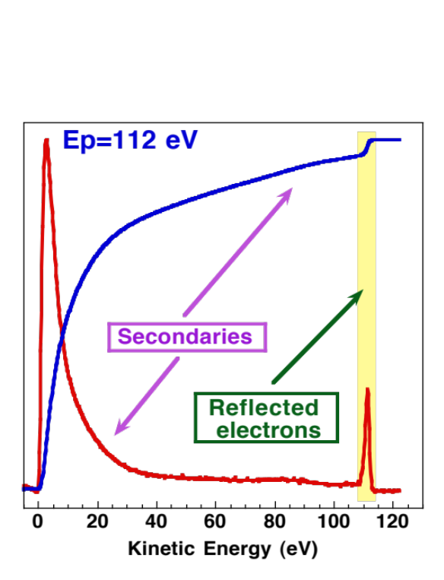
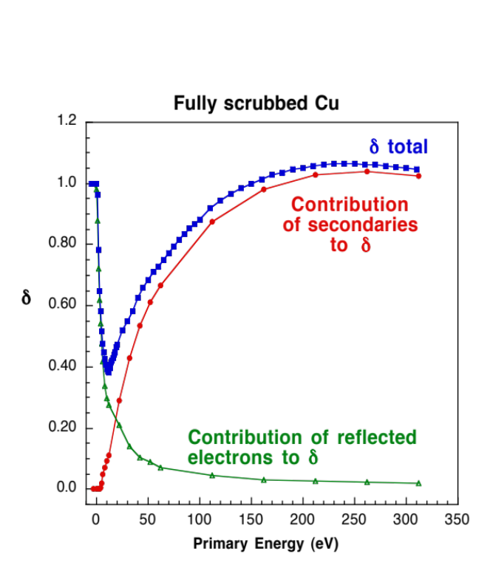
SEY of LHC Cu @ Low energy
Integrating the curves gives the Percentage of Secondaries and Reflected electrons
To separate “true secondaries from“re-diffused electrons is arbitrary and has not been considered in this analysis.
We observe that the contribution to  of the reflected electrons at very low primary energy is, in this material, very high.
R. Cimino et al. Phys. Rev. Lett. 93, 14801 (2004).

Slide 47
Recently A. N. Andronov, A. S. Smirnov, I. D. Kaganovich, E. A. Startsev, Y. Raitses, and V. I. Demidov, (in Proceedings of ECLOUD’12 (2013), CERN-2013-002, p. 161) questioned this result based on the fact that: Long (forgotten) history of secondary electron emission studies suggests otherwise.
Theoretical
  Quantum diffraction from potential barrier
Experimental
  Difficulties of measurements at low incident electron energy
  Previous careful measurements showing contrary observation
  Probe measurements in plasma will not work

Slide 48
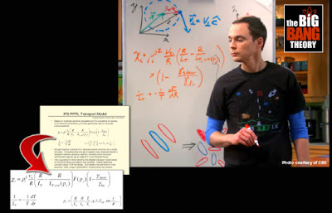
While I will leave the theoretical aspects to others….

Slide 49

  Previous careful measurements showing contrary observation
Total secondary electron yield of Cu as a function of incident electron energy. 1. from the letter for fully scrubbed Cu (T=10 K). 2. Experimental data for bulk Cu after heating in vacuum (room temperature).
1. R. Cimino, et al, Phys. Rev. Lett. 93, 014801 (2004).
2. I. M Bronshtein, B. S Fraiman. Secondary Electron Emission. Moscow, Russia: Atomizdat, p. 408 (1969).
Other measurements reported the reflection coefficient of about 7% for incident electron energy below few electron volts for most pure metals.
I.H. Khan, J. P. Hobson, and R.A. Armstrong, Phys. Rev. 129, 1513 (1963).
H. Heil, Phys. Rev. 164, 887, (1967).
Z. Yakubova and N. A. Gorbatyi, Russian Physics Journal, 13 1477 (1970).
From: A. N. Andronov, A. S. Smirnov, I. D. Kaganovich, E. A. Startsev, Y. Raitses, and V. I. Demidov, (in Proceedings of ECLOUD’12 (2013), CERN-2013-002, p. 161)

Slide 50


  Previous careful measurements showing contrary observation
Total secondary electron yield of Mo as a function of incident electron energy after degassing by prolong heating of target.
Total secondary electron yield of Ge.
I. M Bronshtein, B. S Fraiman. Secondary Electron Emission. Moscow, Russia: Atomizdat, p. 60 (1969).
From: A. N. Andronov, A. S. Smirnov, I. D. Kaganovich, E. A. Startsev, Y. Raitses, and V. I. Demidov, (in Proceedings of ECLOUD’12 (2013), CERN-2013-002, p. 161)

Slide 51
Thanks to this contribution we decided to address in details the capability of our setup to study LE-SEY.
Setting the energy scale.
Expected Setup limitations at Low energy
Study in identical conditions (same geometry etc.) atomically clean (XPS) Cu obtained by cycles of Ar⁺ sputtering of the “as received” Cu.
Compare it to “as received” Cu samples.
Warning: “As received” is NOT a well defined chemical state!

Slide 52
Setting the energy scale for metals
Vacuum
field free
region
At Sample
Surface
Gun
E
E_{k} + V_{lenses} = E_{g}
V_{lenses}
V_{bias}
E_{p} = E_{g} – V_{bias} - Δ_{W}
e⁻
e⁻
E_{k}
Δ_{W}
W_{G}
W_{S}
E_{F}
E_{F}
e⁻ Gun
Cathode
Metallic
Sample
R. Cimino et al. PR ST (2015)

Slide 53

Expected Setup limitations @ low energy
R. Cimino et al. PR ST (2015)

Slide 54

Clean (Ar⁺ Sputtered) Polycrystalline Cu
R. Cimino et al. PR ST (2015)

Slide 55

Clean (Ar⁺ Sputtered) Polycrystalline Cu
R. Cimino et al. PR ST (2015)

Slide 56

“As received” vs. Clean Cu
R. Cimino et al.
PR ST (2015)

Slide 57


“As received” vs. Clean Cu
R. Cimino et al.
PR ST (2015)

Slide 58

For the LHC: test HL simulations.
R. Cimino et al. PR ST (2015)

Slide 59

For the LHC: test HL simulations.
R= δ(0) = 0.8 in all cases
R. Cimino et al. PR ST (2015)

Slide 60

For the LHC: test HL simulations.
R. Cimino et al. PR ST (2015)

Slide 61
Electron cloud in accelerators
Phenomenology:
What happens to the Vacuum beam pipe in presence of the beam? (LHC Example)
Numerical model
The Surface Science properties of relevance:
SEY (Secondary Electron Yield);
PY (Photo Yield);
R (photon Reflectivity)
Mitigation strategies
Conclusion
R. Cimino and T. Demma
“Electron cloud in Accelerators” Int. J. Mod. Phys. A 29 (2014) 1430023 (pag. 65).

Slide 62
Why?
Not only to study the input parameters used in simulations of multipacting and e-cloud build-ups, related instabilities
But also to simulate and prevent single bunch instabilities just connected to the mere existence of a certain density of e⁻ in the accelerator chambers.
(K. Ohmi and F. Zimmermann PRL 2000)

Slide 63



Slide 64



Photon energy: 20-1600 eV
a low grating (150 l/mm)
is used for 20-150 eV
a high grating (1228.1 l/mm) is used for 130-1600 eV
Samples: aluminum, copper, and stainless steal
Spot size:
0.25 mm in vertical,
1.1 mm in horizontal
Optic beamline @ Bessy2

Slide 65



Reflectometer at BESSY II

Slide 66


Samples and Sample holder
During the preliminary beam period, we measured different samples:
- as example here we show CU from LHC beam screen
The samples are isolated from the sample holder by Kapton to also measure the photo yield.
120 mm
48 mm

Slide 67


Reflectivity from LHC Cu

Slide 68


Roughness produce scatter light

Slide 69

Photo Yield

Slide 70
Electron cloud in accelerators
Phenomenology:
What happens to the Vacuum beam pipe in presence of the beam? (LHC Example)
Numerical model
The Surface Science properties of relevance:
SEY (Secondary Electron Yield);
PY (Photo Yield);
R (photon Reflectivity)
Mitigation strategies
Conclusion
R. Cimino and T. Demma
“Electron cloud in Accelerators” Int. J. Mod. Phys. A 29 (2014) 1430023 (pag. 65).

Slide 71



Towards mitigation Strategies….
We measure and feed material parameters (R, PY, and SEY) into simulations.
Understand their profound nature to:
Optimize chemical (mechanical) process to reduce their detrimental influence on beam.
Search for new material / coatings with intrinsically “good” parameters.
XPS
SEY
SR Reflectivity and PY (@BESSY-II)

Slide 72
Most of the existing and planned accelerator machines base the reaching of their design parameters to the capability of obtaining walls with a SEY ~1.3 or below!
Mitigation Strategies
External solenoid field
Electrodes in the lattice
Surface Scrubbing
(or conditioning)
Intrinsically low
SEY material
Geometrical modifications

Slide 73
External solenoid field.
Not always possible…
Electrodes in the lattice.
If possible…
(Impedance, costs.)
Scrubbing
(or conditioning)
Efficiency
(time & final SEY)…
Intrinsically low
SEY material
Stability and material choice…
Geometrical modifications
Impedance. Space,
Machining costs.

Slide 74
External solenoid field.
Not always possible…
Electrodes in the lattice.
If possible…
(Impedance, costs.)
Scrubbing
(or conditioning)
Efficiency
(time & final SEY)…
Intrinsically low
SEY material
Stability and material choice…
Geometrical modifications
Impedance. Space,
Machining costs.

Slide 75


No field
60 Gauss solenoid field

Slide 76
External solenoid field.
Not always possible…
Electrodes in the lattice.
If possible…
(Impedance, costs.)
Scrubbing
(or conditioning)
Efficiency
(time & final SEY)…
Intrinsically low
SEY material
Stability and material choice…
Geometrical modifications
Impedance. Space,
Machining costs.

Slide 77

Electrodes at DAΦNE
D. Alesini et al. Phys. Rev. Lett. 110, 124801 ( 2013 )

Slide 78

Electrodes at DAΦNE
(a) Evolution of the averaged cloud density for different values of the electrode voltage. (b) e− cloud density at the end of the bunch train.
D. Alesini et al. Phys. Rev. Lett. 110, 124801 ( 2013 )

Slide 79
External solenoid field.
Not always possible…
Electrodes in the lattice.
If possible…
(Impedance, costs.)
Scrubbing
(or conditioning)
Efficiency
(time & final SEY)…
Intrinsically low
SEY material
Stability and material choice…
Geometrical modifications
Impedance. Space,
Machining costs.

Slide 80

The Beam “scrubbing” effect is the ability of a surface to reduce its SEY after e⁻ bombardment.
from LHC PR 472 (Aug. 2001):
“…Although the phenomenon of conditioning has been obtained reproducibly on many samples, the exact mechanism leading to this effect is not properly understood. This is of course not a comfortable situation as the LHC operation at nominal intensities relies on this effect…”
V. Baglin et al, LHC Project Report 472, CERN, 2001.

Slide 81

Beam scrubbing effect with photon
See: R. Cimino et al Phys. Rew. AB-ST 2 063201 (1999)
81

Slide 82


Study the Chemistry governing the SEY reduction (scrubbing) with X ray photoelectron spectroscopy
Atomically clean surface
SEY
secondary electrons
escape
depth
metal
the effective SEY of the metal is strongly modified by the surface contamination
“As received” surface
SEY
secondary electrons
escape
depth
metal
SEY is very Surface sensitive and XPS is a powerful tool to study its chemistry dependence

Slide 83





X-ray photoelectron spectroscopy
θ_{emiss}=0°
KE=hv-BE-φ
hv=400 eV
KE: kinetic energy
FWHM = 250 meV
φ: work function
BE: binding energy
hv=1253.6 eV
electron
analyzer
FWHM = 0.95 eV

Slide 84


XPS spectroscopy of technical samples
metal
M
binding energy (eV)

Slide 85

XPS spectroscopy of technical samples
oxygen
metal
M
M-O
binding energy (eV)

Slide 86

XPS spectroscopy of technical samples
hydrogen
oxygen
carbon
metal
C-C sp³
M
C-H
C1s
M-O
binding energy (eV)
binding energy (eV)

Slide 87

XPS spectroscopy of technical samples
hydrogen
oxygen
carbon
metal
C-C sp³
M
C-H
C1s
C-C sp²
M-O
binding energy (eV)
binding energy (eV)

Slide 88

XPS spectroscopy of technical samples
hydrogen
oxygen
carbon
metal
C-C sp³
M
C-H
C1s
C-O-C
C-C sp²
M-O
binding energy (eV)
binding energy (eV)

Slide 89

XPS spectroscopy of technical samples
hydrogen
oxygen
carbon
metal
C-C sp³
M
C-H
C1s
C-O-C
C-C sp²
M-O
C=O
binding energy (eV)
binding energy (eV)

Slide 90

XPS spectroscopy of technical samples
hydrogen
oxygen
carbon
metal
C-C sp³
C-H
C1s
M
C1s
C-O-C
C-C sp²
M-O
O-C=O
C=O
binding energy (eV)
binding energy (eV)

Slide 91


co-laminated Cu for LHC beam screen
Cu3p
O1s
C1s
Cu2p
Cu – ‘As received” technical surface
Understanding chemistry (XPS) and SEY

Slide 92



co-laminated Cu for LHC: fully scrubbed
R. Cimino et al. PRL
109 064801 (2012)
sp³
C-H
O-C=O
C-O
sp³
sp²
sp²
sp³
SEY and XPS are directly related

Slide 93


e⁻ beam induced surface reactions
R. Cimino et al. PRL (2012) & R. Larciprete PR ST (2013)
Cu-O dissociation
O₂
oxide reduction
CO
CO₂
reaction
sp³→sp² conversion
C-H dissociation
H₂
CO
sp³
sp²
O₂
C-O
dissociation
C
C
C film growth
C
O
H
Cu
the contribution of all electron-induced surface reaction reduces δ_{max} from 2.2 to 1.1

Slide 94
The chemical origin of the scrubbing is now clear: it is due to Electron induced surface graphitization!
It occurs (with small differences) for many technical surface like Cu, SS, TiN etc. (noticeably not for Al)
BUT: it is a phenomenon which intrinsically need energy to occur: do all electrons induce it?

Slide 95


Slide 96

co-laminated Cu for LHC beam screen
R. Cimino et al. PRL 109 064801 (2012)

Slide 97
co-laminated Cu for LHC beam screen
sp³
R. Cimino et al. PRL
109 064801 (2012)
C-H
O-C=O
C-O
sp³
sp²
sp²
sp³
sp²

Slide 98



optimize the “scrubbing” process @ LHC with beam parameters enhancing the presence, in the cloud, of higher energy el.
Give a more reliable estimate of the needed scrubbing time.
R. Cimino et al. PRL 109 064801 (2012)

Slide 99
External solenoid field.
Not always possible…
Electrodes in the lattice.
If possible…
(Impedance, costs.)
Scrubbing
(or conditioning)
Efficiency
(time & final SEY)…
Intrinsically low
SEY material
Stability and material choice…
Geometrical modifications
Impedance. Space,
Machining costs.

Slide 100


C films on polycristalline Cu
a-C films
magnetron sputtering @ RT
p(Ar)= 10⁻² mbar Δt = 2min
C film thickness 2-3 nm
R. Larciprete et al, App. Surf. Science 2015

Slide 101



C films on polycristalline Cu
R. Larciprete et al, App. Surf. Science 2015

Slide 102




C films on polycristalline Cu
2p-σ
2p-π
the graphitization of the C films corresponds to a lower SEY
R. Larciprete et al, App. Surf. Science 2015

Slide 103



a-C bases its stability on its low reactivity
If, on any surface, condensed gas is chemi or physi-sorbed the resulting SEY will be the one of the contaminant layer.
at LT: Kuzucan, et al JVSTA 30, 051401 (2012)
Kuzucan, et al JVSTA 30, 051401 (2012)

Slide 104

If annealing (@ ~ 200 °C) is possible: TiZrV
Scheuerlein et al. Appl. Surf. Sci. 172 (2001) 95-102
Kuzucan, et al JVSTA 30, 051401 (2012)
Activated NEG: it pumps, low SEY, stable: ideal mitigator

Slide 105
External solenoid field.
Not always possible…
Electrodes in the lattice.
If possible…
(Impedance, costs.)
Scrubbing
(or conditioning)
Efficiency
(time & final SEY)…
Intrinsically low
SEY material
Stability and material choice…
Geometrical modifications
Impedance. Space,
Machining costs.

Slide 106



Geometrical Mitigation:
dmax,< .8 …
Impedence?

Slide 107






Impedance enhancement factor
(Code : Finite Element Method, PAC07 THPAS067, L Wang)
The total impedance enhancement= η * percentage of grooved surface
p=1.25mm (period)
d=2.5mm (depth)
t=0.125mm (thickness)
p=1.25mm
d=2.5mm
t=0.25mm

Slide 108

Sponge materials:
R. Cimino, A. Romano, S. Petracca, I. Masullo, M. Taborelli etc: (IPAC 2014)

Slide 109

Sponge materials:
R. Cimino, A. Romano,S. Petracca, I. Masullo, M. Taborelli etc: IPAC 2014)

Slide 110

Sponge materials:
R. Cimino, A. Romano,S. Petracca, I. Masullo, M. Taborelli etc. (IPAC 2014)

Slide 111
Sponge materials:
R. Cimino, A. Romano,S. Petracca, I. Masullo, M. Taborelli etc. (IPAC 2014)
Impedance, vacuum behaviour, desorption properties
are still under study
but seems very promising.

Slide 112

Not only low SEY, PY and R

Slide 113
Conclusion
Electron-Cloud is and will be an important issue in circular accelerators in years to come!
Numerical simulations are able to predict observed effects.
Mitigation techniques are developing.
Synergic efforts, dedicated Surface, Material and Vacuum science laboratories are required to reach desired performances.

Slide 114








Acknowledgements
Davide Remo Grosso, INFN-LNF, Frascati (RM), Italy
Mario Commisso, INFN-LNF, Frascati (RM), Italy
Dafne-L and Dafne Accelerator group.
Roberto Flammini, CNR-IMIP, Montelibretti (RM), Italy
Rosanna Larciprete and Antonio Di Trolio,
CNR-ISC, Roma, Italy
Reiner Wanzenberg, Desy, Hamburg, Germany
V. Baglin, M. Jimenes, M. Taborelli, P, Chiggiato, G. Rumolo, G. Iadarola, etc… CERN, Geneva, Switzerland
Wolfram Fischer, Brookhaven Nat. Lab., USA
Franz Schäfers Institute for Nanometre Optics
and Technology (INT) Berlin

Slide 115

Acknowledgements
Davide Remo Grosso, INFN-LNF, Frascati (RM), Italy
Mario Commisso, INFN-LNF, Frascati (RM), Italy
Dafne-L and Dafne Accelerator group.
Roberto Flammini, CNR-IMIP, Montelibretti (RM), Italy
Rosanna Larciprete and Antonio Di Trolio,
CNR-ISC, Roma, Italy
Reiner Wanzenberg, Desy, Hamburg, Germany
V. Baglin, M. Jimenes, M. Taborelli, P, Chiggiato, G. Rumolo, G. Iadarola, etc… CERN, Geneva, Switzerland
Wolfram Fischer, Brookhaven Nat. Lab., USA
Franz Schäfers Institute for Nanometre Optics
and Technology (INT) Berlin

