Slide 1
High Brilliance Beam Diagnostics
A. Cianchi
University of Rome “Tor Vergata”
and INFN

Slide 2
Outline
Brightness and Brilliance
Fundamental parameters
Transverse and longitudinal measurements
Intercepting and non intercepting diagnostic

Slide 3
Some references
C. Lejeune and J. Aubert, “Emittance and Brightness, definitions and measurements”, Adv. Electron. Electron Phys.,Suppl. A 13, 159 (1980).
A. Wu Chao, M. Tigner “Handbook of Accelerator Physics and Engineering” World Scientific, pag 255
C. A. Brau “What Brightness means” in The Physics and Applications of High Brightness Electron Beam”, World Scientific, pag 20
M. Reiser, “Theory and design of charged particle beams”, Wiley-VCH, pag 61
Shyh-Yuan Lee, “Accelerator Physics”, World Scientific, pag 419
J. Clarke “The Science and Technology of Undulators and Wiggles” Oxford Science Publications, pag 73

Slide 4
Brightness and Brilliance
Several authors give different definitions
Brilliance is sometimes used, especially in Europe, instead of brightness
There is also confusion because the same words apply both to particle beams and photon beams
The best way is to look to units, which should be unambiguous

Slide 5
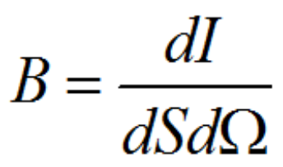
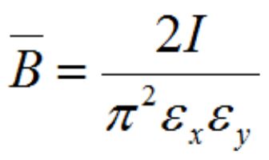
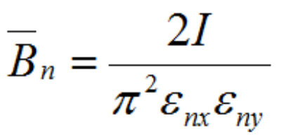
Definitions of Brightness
For particle distribution whose boundary in 4D trace space is defined by an hyperellipsoid
[A/(m-rad)²]
Normalized Brightness
From diagnostics point of view what does it mean high brightness?
Notes:
Microscopia elettronica, FEL, 6D brightness

Slide 6
But
Often the factor 2/π² is left out in literature
Often the RMS emittance is used in place of effective emittance and so there is another factor to take into the account
So it is important to agree on the brightness definition, but the difference can be also in numerical factors

Slide 7
Parameters to measure
High brightness can be achieved with small emittance, high current or both
Longitudinal and transverse parameters must be measured
High charge and small emittance -> high power density beam
Low charge, very short bunch length
We focus our attention on linac or transfer line where it is possible to use intercepting diagnostic
For some applications, it is needed to measure also the transverse parameters in different longitudinal positions (slice parameters)

Slide 8

Brilliance
Photons/ (s mm² mrad² 0.1% of bandwidth)
H. Wiedeman uses the name “spectral brightness” for photons
Report of the Working Group on Synchrotron Radiation Nomenclature – brightness, spectral brightness or brilliance?
The conclusion reached is that the term spectral brightness best describes this quantity. Brightness maintains the generally accepted concept of intensity per unit source size and divergence, while the adjective spectral conveys the scientific importance of the number of photons in a given bandwidth, particularly for experiments such as inelastic and/or nuclear resonant scattering.
J. Synchrotron Rad. (2005). 12, 385

Slide 9
Transverse parameters
The most important parameter is the emittance
To obtain high brightness beam it is of paramount importance to keep emittance growth under control
Different methods apply for beams with or without space charge contribution
Mainly the space charge is relevant at the exit of the RF GUN (few MeV)

Slide 10
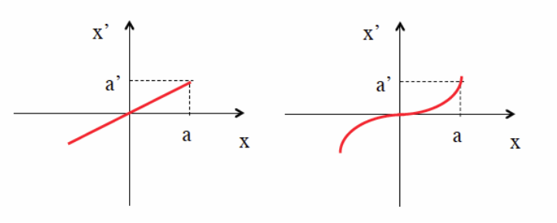

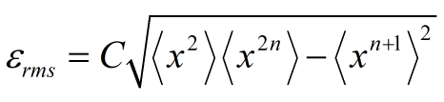
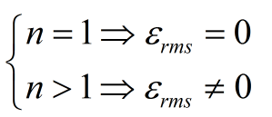
Importance of RMS emittance
Even when the phase-space area is zero, if the distribution lies on a curved line its rms emittance is not zero.
RMS emittance is not an invariant for Hamiltonian with non linear terms.

Slide 11
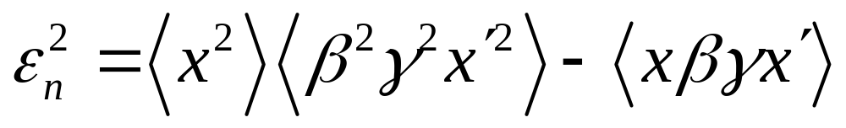
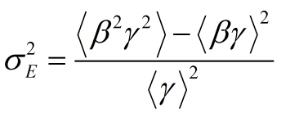
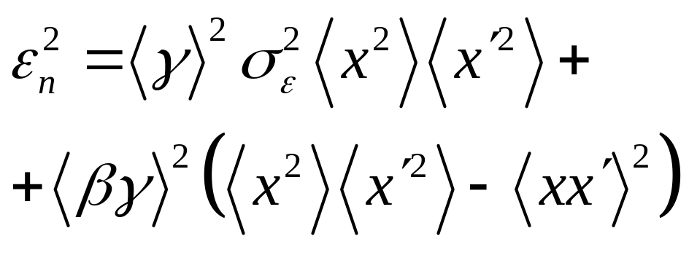
Geometrical vs Normalized
M. Migliorati et al, Physical Review Special Topics,Accelerators and Beams 16, 011302 (2013)
K. Floettmann, PRSTAB,6, 034202 (2003)
Notes:
Correlazione tra energia e posizione trasversa trascurabile

Slide 12


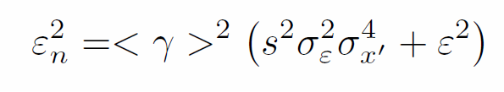
Fundamental issue
For the accelerator community the normalized emittance is one of the main parameter because is constant
For plasma accelerated beams, due to the large energy spread and huge angular divergence, it is not true anymore
Notes:
Beta=1 bene solo per gli elettroni, per particelle più pesanti è ancora peggio.
Si può mitigare tailoring plasma density at the exit…

Slide 13
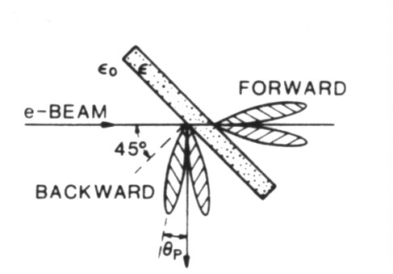

Intercepting devices
OTR monitors
  High energy (>tens of MeV), high charge (>hundreds of pC)
  No saturation
  Resolution limit closed to optical diffraction limit
  Surface effect
Scintillator (like YAG:CE)
  Large number of photons
  Resolution limited to grain dimension (few microns)
  Saturation depending of the doping level
  Bulk effect
  Thin crystal to prevent blurring effect
Wire scanner
  Multiple scattering reduced
  Higher beam power
  Multishot measurement
  1 D
  Complex hardware installation

Slide 14
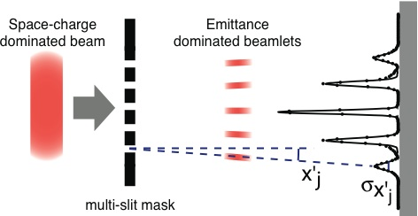

Space charge regime
To measure the emittance for a space charge dominated beam the used technique is the well known 1-D pepper-pot
The emittance can be reconstructed from the second momentum of the distribution
C. Lejeune and J. Aubert, Adv. Electron. Electron Phys. Suppl. A 13, 159 (1980)
Notes:
Non si può misurare l’energia nello stesso shot.

Slide 15
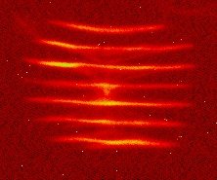
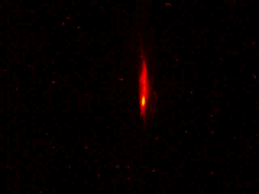
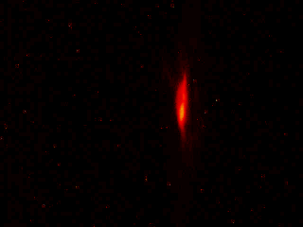
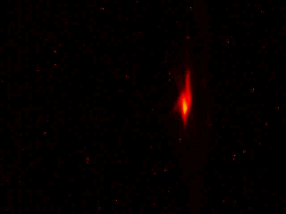
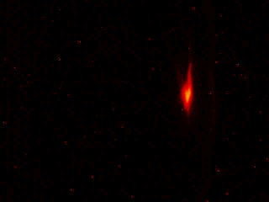
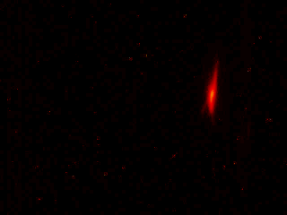
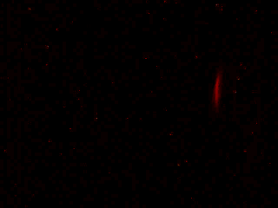
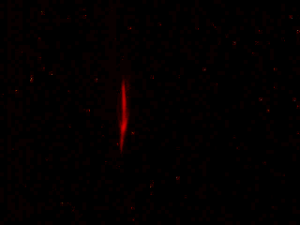
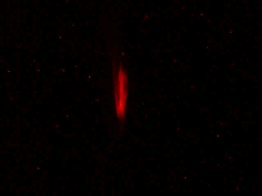
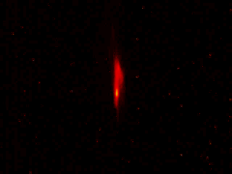
Examples

Slide 16

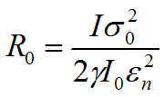

Design issue
The beamlets must be emittance dominated
Martin Reiser, Theory and Design of Charged Particle
Beams (Wiley, New York, 1994)
Assuming a round beam
d must be chosen to obtain R₀<<1, in order to have a emittance dominated beam

Slide 17
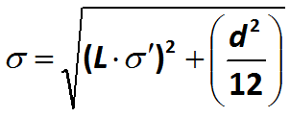


Design issues 2
The contribution of the slit width to the size of the beamlet profile should be negligible
The material thickness (usually tungsten) must be long enough to stop or heavily scatter beam at large angle (critical issue at high energy)
The angular acceptance of the slit cannot be smaller of the expected angular divergence of the beam

Slide 18
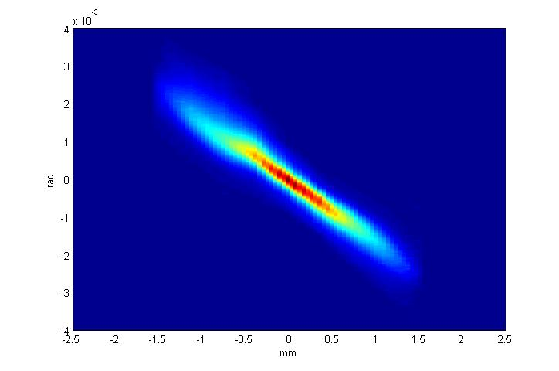
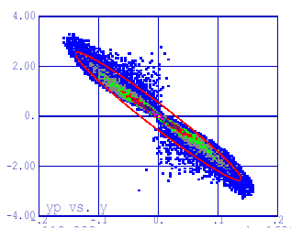
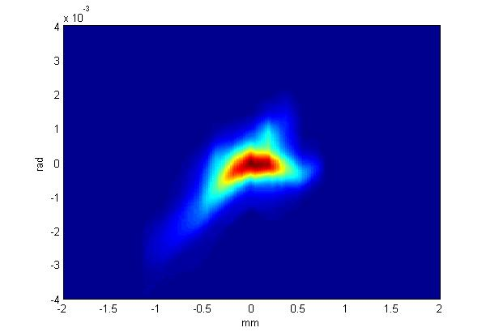
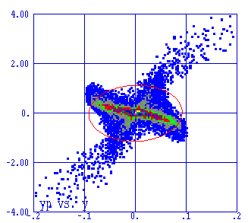
Phase space mapping

Slide 19
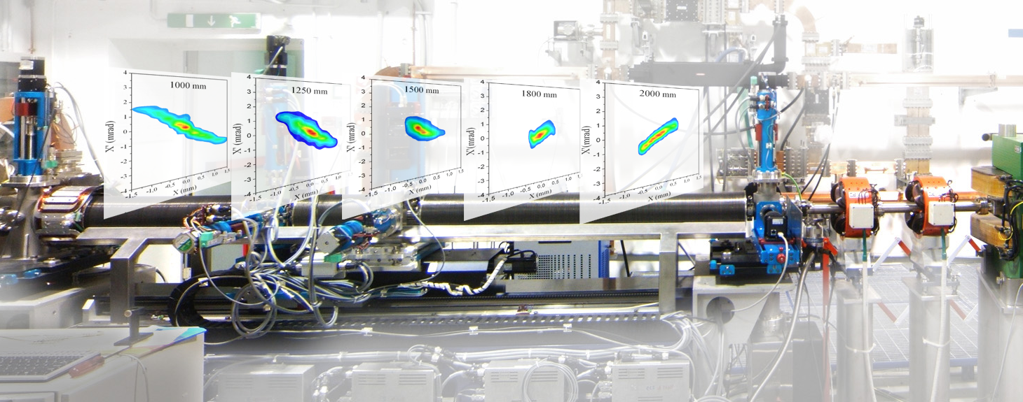
Phase space evolution
A. Cianchi et al., “High brightness electron beam emittance evolution measurements in an rf photoinjector”, Physical Review Special Topics Accelerator and Beams 11, 032801,2008

Slide 20
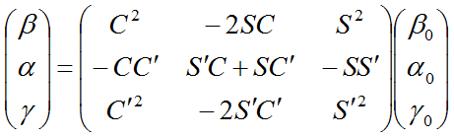

Emittance without space charge
The most used techniques for emittance measurements are quadrupole scan and multiple monitors
Notes:
21 minuti all’inizio della slide

Slide 21
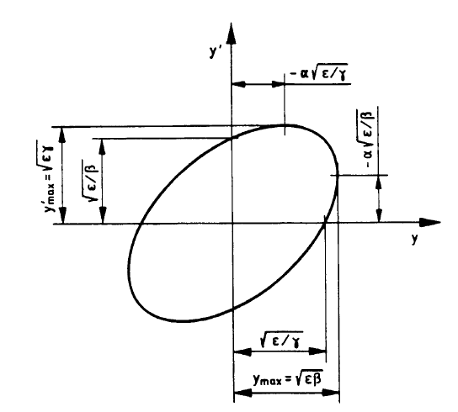
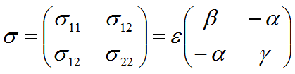


Beam Matrix

Slide 22

Multiple screens
There are 3 unknown quantities
σ_{i,11} is the RMS beam size
C_{i} and S_{i} are the element of the transport matrix
We need 3 measurements in 3 different positions to evaluate the emittance

Slide 23
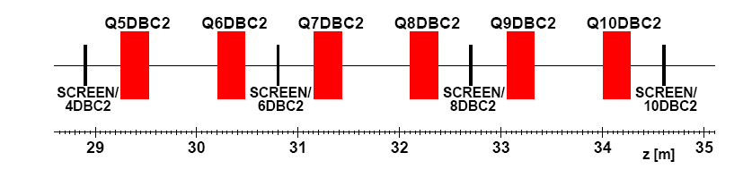
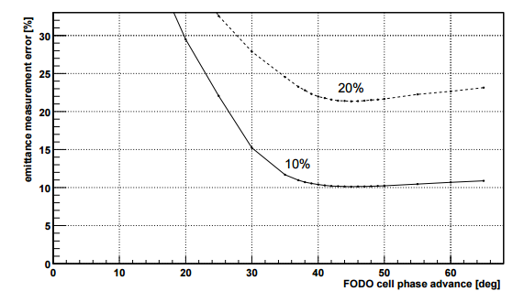
Example: FLASH@DESY
M. Minty, F. Zimmermann, “Measurement and control of charged particle beams”, Springer (2003)
DESY-Technical Note 03-03 , 2003 (21 pages) Monte Carlo simulation of emittance measurements at TTF2 P. Castro

Slide 24
Quadrupole scan
k₁
P₁
P₂
k₂
Beam
k₃
Quadrupole
Schermo
It is possible to measure in the same position changing the optical functions
The main difference respect to the multi screen measurements is in the beam trajectory control and in the number of measurements

Slide 25
Sources of errors
Usually the largest error is in the determination of the RMS beam size (Mini Workshop on "Characterization of High Brightness Beams“, Desy Zeuthen 2008, https://indico.desy.de/conferenceDisplay.py?confId=806)
Systematic error comes from the determination of the quadrupole strength, mainly for hysteresis. So a cycling procedure is required for accurate measurements
Thin lens model is not adequate
Energy
Large energy spread can gives chromatic effect
Assumption: transverse phase space distribution fills an ellipse
F. Loehl et al. “Physical Review Special Topics - Accelerators and Beams 9, 092802 (2006)

Slide 26
Phase space reconstruction
y
x
ρ
Tomography is related to the Radon theorem: a n-dimensional object can be reconstructed from a sufficient number of projection in (n-1) dimensional space

Slide 27







Tomography
Radon Transform
Fourier transform of the Radon transform
A. C. Kak and Malcolm Slaney, Principles of Computerized Tomographic Imaging, IEEE Press, 1988.
D. Stratakis et al, “Tomography as a diagnostic tool for phase space mapping of intense particle beam”, Physical Review Special Topics – Accelerator and Beams 9, 112801 (2006)

Slide 28
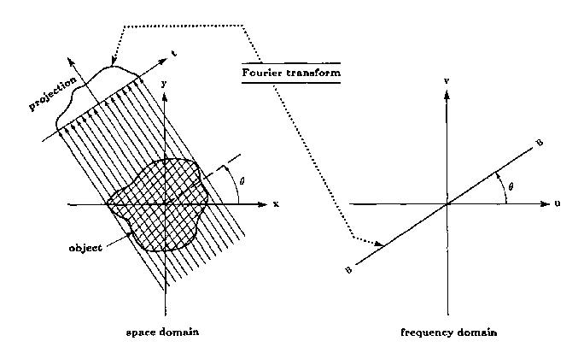
Fourier Slice theorem

Slide 29


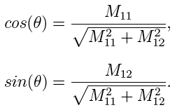

Tomography measurements
Scaling factor
Rotation angle
C can be easily obtained from beam spatial distribution
s can be calculated from the beam line optics
The accuracy of the result depends from the total angle of the rotation and from the number of the projections

Slide 30
Longitudinal parameters
Fundamental parameter for the brightness
Bunch lengths can be on ps (uncompressed) or sub-ps time scale, down to fs scale!
Several methods
  Streak Camera
  Coherent radiations
  RFD
  EOS
  Others?
T. Watanabe et al, “Overall comparison of subpicosecond electron beam diagnostics by the polychromator, the interferometer and the femtosecond streak camera”, Nuclear Instruments and Methods in Physics Research A 480 (2002) 315–327

Slide 31
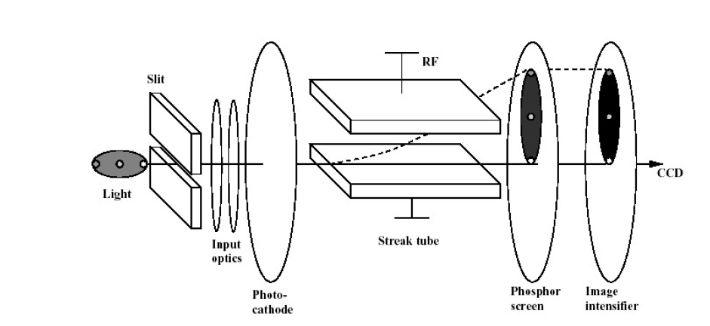
Streak camera
Expensive device
Resolution limited to 200-300 fs FWHM
It is better to place the device outside the beam tunnel so a light collection and transport line is needed
Reflective optics vs lens optics

Slide 32
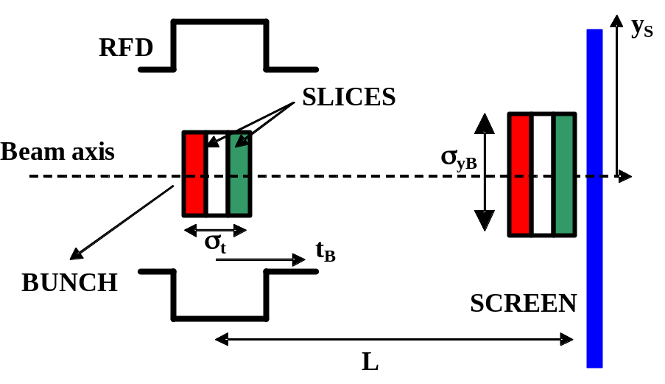
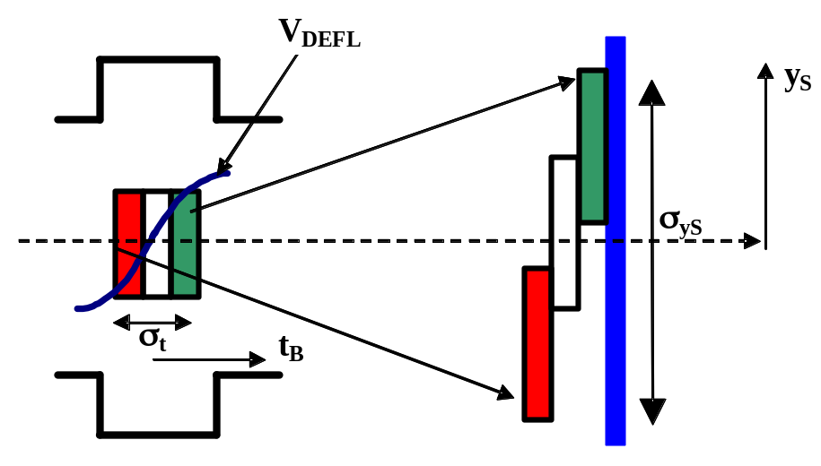
RF deflector
RFD OFF
The transverse voltage introduces a linear correlation between the longitudinal and the transverse coordinates of the bunch
Paul Emma, Josef Frisch, Patrick Krejcik, A Transverse RF Deflecting Structure for Bunch Length and Phase Space Diagnostics, LCLS-TN-00-12
Christopher Behrens, Measurement and Control of the Longitudinal Phase Space at High-Gain Free-Electron Lasers , FEL 2011, Shanghai

Slide 33






RFD

Slide 34
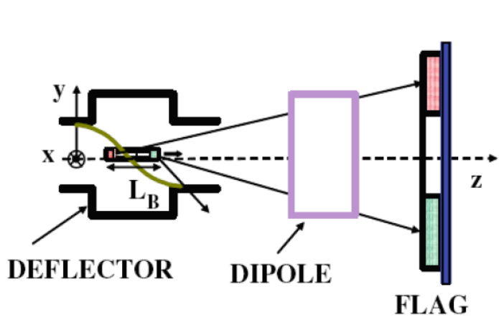
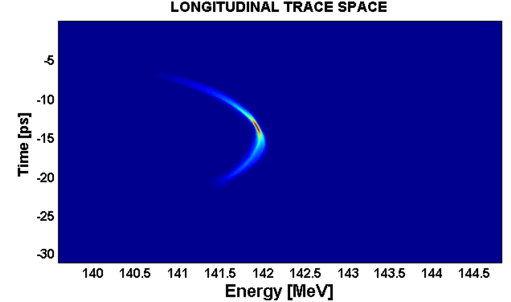
Longitudinal phase space
Using together a RFD with a dispersive element such as a dipole
Fast single shot measurement

Slide 35
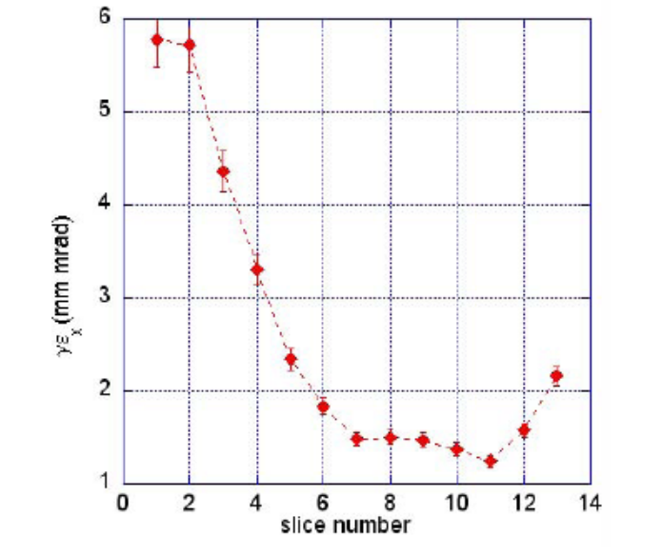
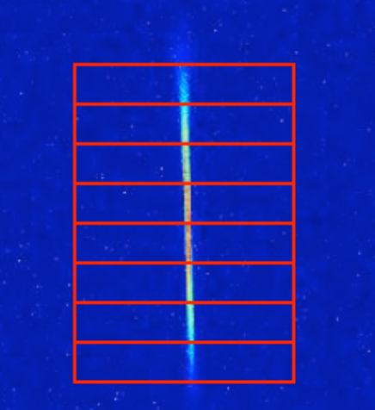
Slice parameters
Slice parameters are important for linac driving FEL machines
Emittance can be defined for every slice and measured
Also the slice energy spread can be measured with a dipole and a RFD

Slide 36
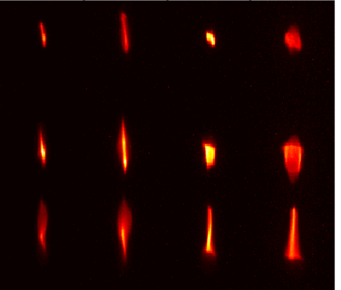
Quad scan comb-like beam
Time
Space

Slide 37
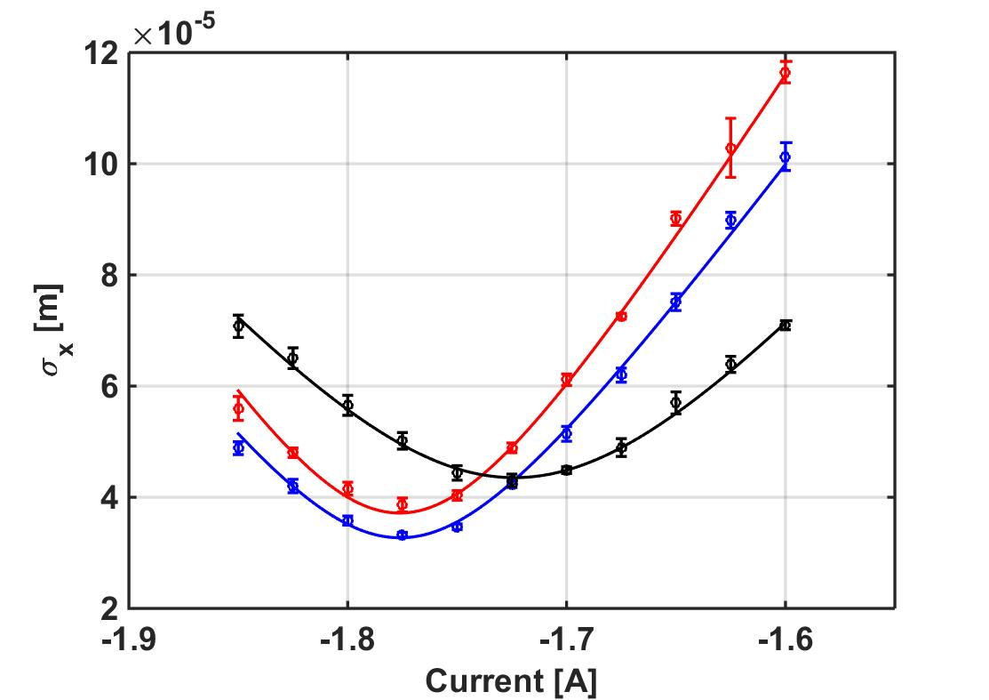
Results
Bunch | Emittance (mm-mrad)
Driver #1 | 1.38 (0.04)
Driver #2 | 1.61 (0.07)
Witness | 1.22 (0.06)
Driver #1
Witness
Driver #2
A. Cianchi et al. “Six-dimensional measurements of trains of high brightness electron bunches”, Physical Review Special Topics Accelerators and Beams 18, 082804 (2015)
Notes:
Misuri solo quella orizzontale

Slide 38
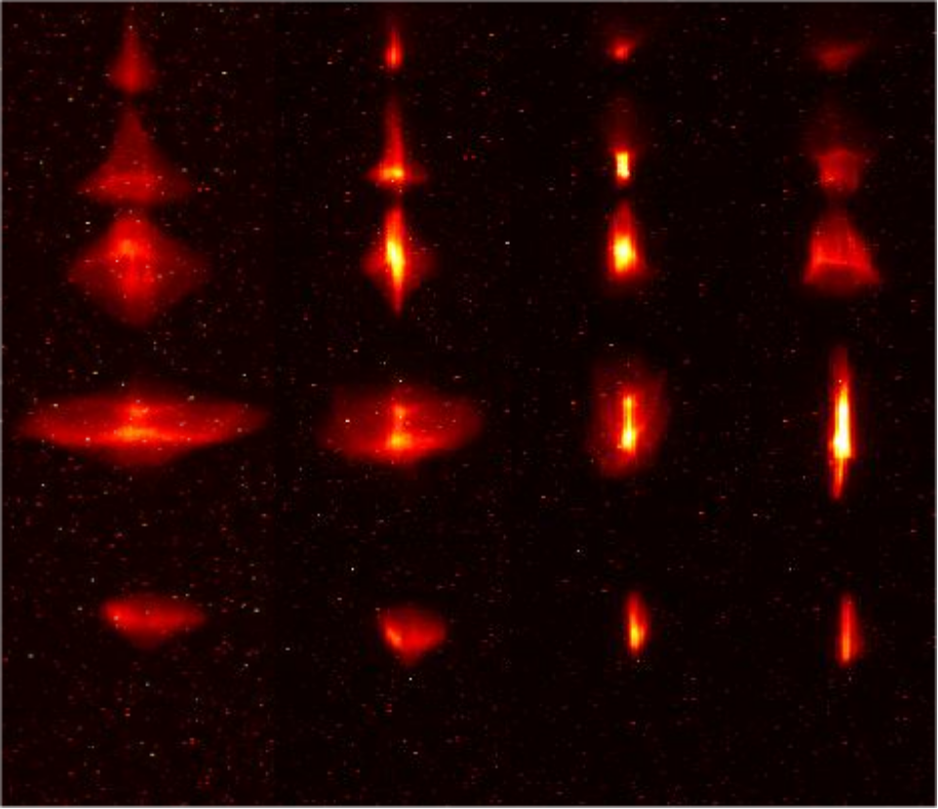
5 bunches
Time
Space

Slide 39
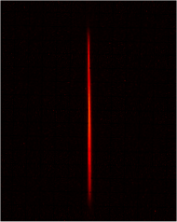
RFD summay
Self calibrating
Easy to implement
Single shot
Resolution down to fs
Intercepting device
As energy increases some parameter must be increased:
  Frequency
  Voltage or length
7 ps FWHM

Slide 40
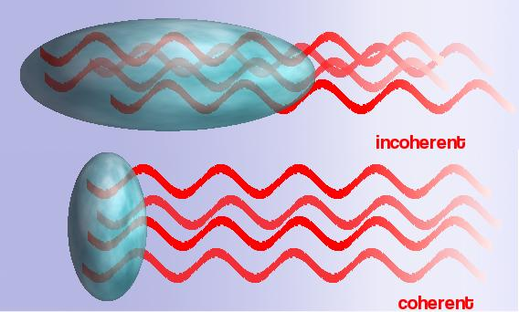
Coherent radiation
Any kind of radiation can be coherent and usable for beam diagnostics
  Transition radiation
  Diffraction radiation
  Synchrotron radiation
  Undulator radiation
  Smith-Purcell radiation
  Cherenkov radiation

Slide 41
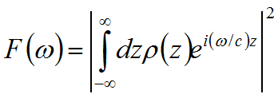

Power Spectrum
I_{tot}(ω)=I_{sp}(ω)[N+N*(N-1) F(ω)]
From the knowledge of the power spectrum is possible to retrieve the form factor
The charge distribution is obtained from the form factor via Fourier transform
The phase terms can be reconstructed with Kramers-Kronig analysis (see R. Lai, A.J. Sievers, NIM A 397 (1997) 221-231)

Slide 42


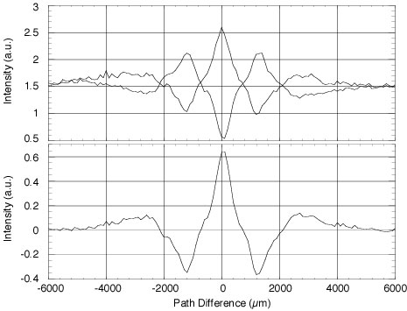
Martin-Puplett Interferometer
Roof mirror
Incident radiation with an arbitrary intensity distribution I(ω)
P
BS
Moveable
roof mirror
A
Golay cells or Pyroelectric detector

Slide 43
Experimental considerations
Spectrum cuts at low and high frequencies can affect the beam reconstruction
  Detectors
  Windows
  Transport line
  Finite target size
For this reason the approach is to test the power spectrum with the Fourier transform of a guess distribution
Coherent synchrotron radiation or diffraction radiation can be generated by totally not intercepting devices and so they are eligible for high brightness beams diagnostic
Multishots measurements. Single shot devices are still under developing

Slide 44


Single shot CTR measurements I
S. Wesch, B. Schmidt, C. Behrens, H. Delsim-Hashemi, P. Schmuser, A multi-channel THz and infrared spectrometer for femtosecond electron bunch diagnostics by single-shot spectroscopy of coherent radiation Nuclear Instruments and Methods in Physics Research A 665 (2011) 40–47
Pyro-electric line detector 30 channels @ room temperature no window, works in vacuum fast read out sensitivity
Notes:
blazed reflection grating Mid-infrared configuration5.1–43:5 mm Far-infrared configuration45.3–434:5 mm THz transport
Mr. Omid Zarini (Helmholtz-Zentrum Dresden-Rossendorf) down to 200 nm

Slide 45

Single shot CTR measurements II
T. J. Maxwell et al. "Coherent-radiation spectroscopy of few-femtosecond electron bunches using a middle-infrared prism spectrometer.“ Physical review letters 111.18 (2013)
KRS-5 (thallium bromoiodide) prism based spectrometer developed
Images OTR from foil onto 128 lead zirconate titanate pyroelectric elements with 100 μm spacing line array
Also double prism (ZnSe), S. Wunderlich et al., Proceedings of IBIC2014
Notes:
Tradeoff: lower spectral resolution and the
dispersion nonlinearity introduced by the prism material
properties. KRS-5 flat 0:8–40 rensponse but hygroscopic
Desy : double prism zinc selenide (ZnSe)

Slide 46
Electro Optical Sample (EOS)
Totally non intercepting device and not disturbing device
It is based on the change of the optical properties of a non linear crystal in the interaction with the Coulomb field of the moving charges
Several schemes has been proposed and tested
Very promising technique
I.Wilke et al., “single-Shot electron beam bunch length measurements” PRL, v.88, 12(2002)
G. Berden et al., “Electo-Optic Technique with improved time resolution for real time, non destructive, single shot measurements of femtosecond electron bunch profiles, PRL v93, 11 (2004)
B. Steffen, “Electro-optic time profile monitors for femtosecond electron bunches at the soft x-ray free-electron laser FLASH“, Phys. Rev. ST Accel. Beams 12, 032802 (2009)
Notes:
47 minuti

Slide 47






A bit of theory
Notes:
10^-12 m/V

Slide 48


Spectral decoding
Artifacts due to frequency mixing
Minimum resolution in the order
J.R. Fletcher, Opt. Express 10, 1425 (2002)

Slide 49

Temporal decoding
Resolution : duration of the gate beam, thickness of the SHG crystal
50 fs or slightly better
low efficiency SHG process, approx. 1mJ laser pulse energy necessary

Slide 50

Temporal cont.
The short gate pulse overlaps with different temporal slices of the EO pulse at different spatial positions of the BBO crystal. Thus the temporal modulation of the EO pulse is transferred to spatial distribution of the SHG light.

Slide 51


Spatial decoding

Slide 52

EOS setup
Notes:
Resolution limitation, DAST Crystal

Slide 53
Intercepting diagnostics
High charge or high repetition rate machines
Small beam dimension (between 50 μm down to tens of nm)
All the intercepting devices are damaged or destroyed from these kind of beams
No wire scanners, no OTR screens, no scintillators
There are good candidates for longitudinal diagnostic
It is difficult to replace intercepting devices for transverse dimensions
There are a lot of ideas in testing

Slide 54



Laser Wire
Rayleigh range of the laser beam : distance between the focus and the point where the laser spot-size has diverged to of its minimum value
Not intercepting device
Multi shot measurement (bunch to bunch position jitter, laser pointing jitter, uncertainty in the laser light distribution at IP)
Setup non easy
Resolution limited from the laser wavelength
Several effects to take into account
I. Agapov, G. A. Blair, M. Woodley, “Beam emittance measurement with laser wire scanners in the International Linear Collider beam delivery system”, Physical review special topics- accelerators and beams 10, 112801 (2007)

Slide 55


Laser interferometry
Tsumoru Shintake, “ Proposal of a nanometer beam size monitor for e⁺e⁻ linear collider”, Nuclear Instruments and methods in Physics Research A311 (1992) 453

Slide 56

Not intercepting multi shot
Steven J. Russell, Emittance measurements of the Sub-Picosecond Accelerator electron beam using beam position monitors, Review of Scientific Instruments 70, 2, February 1999
A. Jansson, “Noninvasive single-bunch matching and emittance monitor”, PRSTA-AB 5, 072803 (2002)
Special and customized electrodes are needed in order to maximize the quadrupole component
Very low signal to noise ratio, systematic error from beam position
Notes:
L.L. Gol’din. Investigation of Charged-Particle Beams by Means of Signal Electrodes. Instruments and Experimental Techniques, pages 780–784, 1966. Translated from Pribory i Tekhnika Eksperimenta, No. 4, pp. 18-21, July-August 1966.
S/N proportional to s^2/a^2 being s the beam sigma and a the pipe dimension!

Slide 57




ODRI
Cianchi, A., et al. "First non-intercepting emittance measurement by means of optical diffraction radiation interference." New Journal of Physics 16.11 (2014): 113029.
Size it will be on the Poster

Slide 58
Conclusions
High brightness beam demands particular diagnostic techniques in order to measure very small transverse emittance (<1 mm-mrad) and very short bunch length (< 1 ps)
Intercepting or not intercepting diagnostics are recommended in some cases
Some diagnostics are already state of the art
Some others are still developing
New ideas are daily tested, so if you want your part of glory start to think about today!

Slide 59
Finally it’s over
Thank you for your attention

