Slide 1
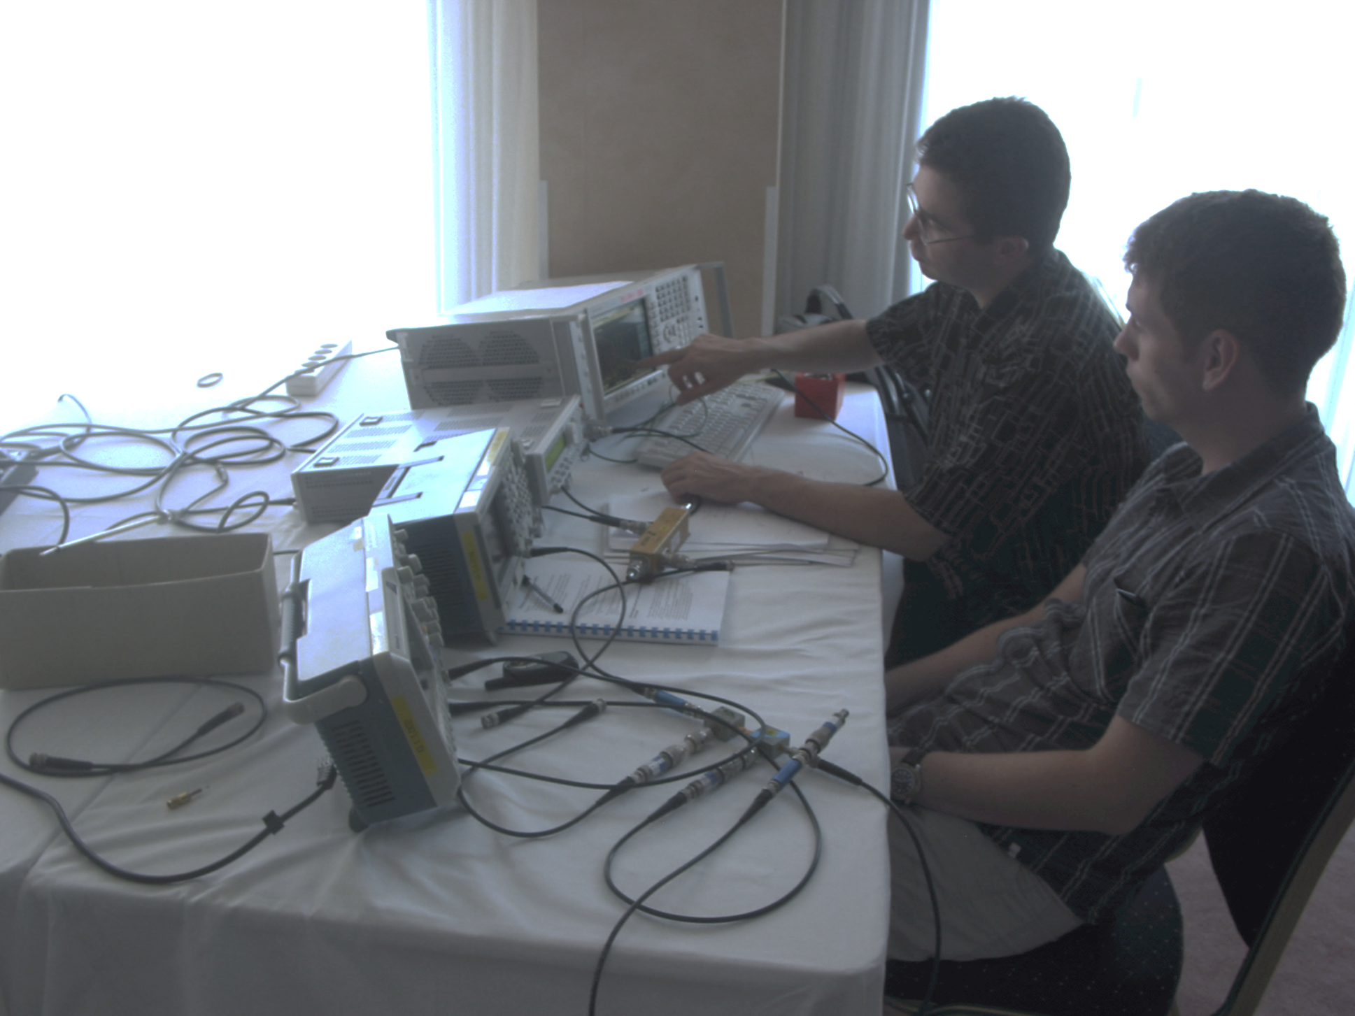

RF Measurement Concepts
Fritz Caspers, Piotr Kowina
Accelerator Physics (advanced level)
Trondheim, Norway, 19 - 29 August 2013

Slide 2
Contents
RF measurement methods – some history and overview
Superheterodyne Concept and its application
Voltage Standing Wave Ratio (VSWR)
Introduction to Scattering-parameters (S-parameters)
Properties of the S matrix of an N-port (N=1…4) and examples
Smith Chart and its applications
Appendices

Slide 3
Measurement methods - overview (1)
There are many ways to observe RF signals. Here we give a brief overview of the five main tools we have at hand
Oscilloscope: to observe signals in time domain
  periodic signals
  burst signal
  application: direct observation of signal from a pick-up, shape of common 230 V mains supply voltage, etc.
Spectrum analyzer: to observe signals in frequency domain
  sweeps through a given frequency range point by point
  application: observation of spectrum from the beam or of the spectrum emitted from an antenna, etc.
3

Slide 4
Measurement methods - overview (2)
Dynamic signal analyzer (FFT analyzer)
  Acquires signal in time domain by fast sampling
  Further numerical treatment in digital signal processors (DSPs)
  Spectrum calculated using Fast Fourier Transform (FFT)
  Combines features of a scope and a spectrum analyzer: signals can be looked at directly in time domain or in frequency domain
  Contrary to the SPA, also the spectrum of non-repetitive signals and transients can be observed
  Application: Observation of tune sidebands, transient behavior of a phase locked loop, etc.
Coaxial measurement line
  old fashion method – no more in use but good for understanding of concept
Network analyzer
  Excites a network (circuit, antenna, amplifier or similar) at a given CW frequency and measures response in magnitude and phase => determines S-parameters
  Covers a frequency range by measuring step-by-step at subsequent frequency points
  Application: characterization of passive and active components, time domain reflectometry by Fourier transforming reflection response, etc.
4

Slide 5
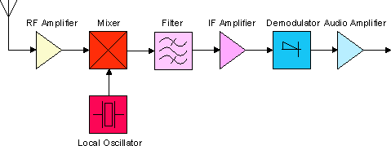
Superheterodyne Concept (1)
Design and its evolution
The diagram below shows the basic elements of a single conversion superhet receiver. The essential elements of a local oscillator and a mixer followed by a fixed-tuned filter and IF amplifier are common to all superhet circuits. [super ετερω δυναμισ] a mixture of latin and greek … it means: another force becomes superimposed.
The advantage to this method is that most of the radio's signal path has to be sensitive to only a narrow range of frequencies. Only the front end (the part before the frequency converter stage) needs to be sensitive to a wide frequency range. For example, the front end might need to be sensitive to 1–30 MHz, while the rest of the radio might need to be sensitive only to 455 kHz, a typical IF. Only one or two tuned stages need to be adjusted to track over the tuning range of the receiver; all the intermediate-frequency stages operate at a fixed frequency which need not be adjusted.
This type of configuration we find in any conventional (= not digital) AM or FM radio receiver.
en.wikipedia.org
5

Slide 6
Superheterodyne Concept (2)
IF
RF Amplifier = wideband front end amplification (RF = radio frequency)
The Mixer can be seen as an analog multiplier which multiplies the RF signal with the LO (local oscillator) signal.
The local oscillator has its name because it’s an oscillator situated in the receiver locally and not as far away as the radio transmitter to be received.
IF stands for intermediate frequency.
The demodulator can be an amplitude modulation (AM) demodulator (envelope detector) or a frequency modulation (FM) demodulator, implemented e.g. as a PLL (phase locked loop).
The tuning of a normal radio receiver is done by changing the frequency of the LO, not of the IF filter.
en.wikipedia.org
6

Slide 7
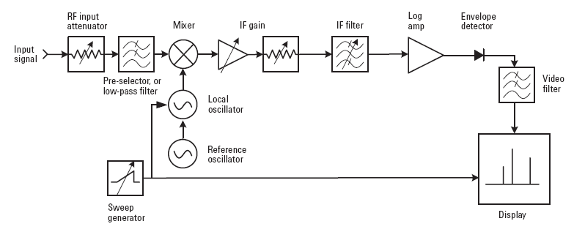
Example for Application of the Superheterodyne Concept in a Spectrum Analyzer
The center frequency is fixed, but the bandwidth of the
IF filter can be modified.
The video filter is a simple low-pass with variable bandwidth before the signal arrives to the vertical deflection plates of the cathode ray tube.
Agilent, ‘Spectrum Analyzer Basics,’
Application Note 150, page 10 f.
7

Slide 8
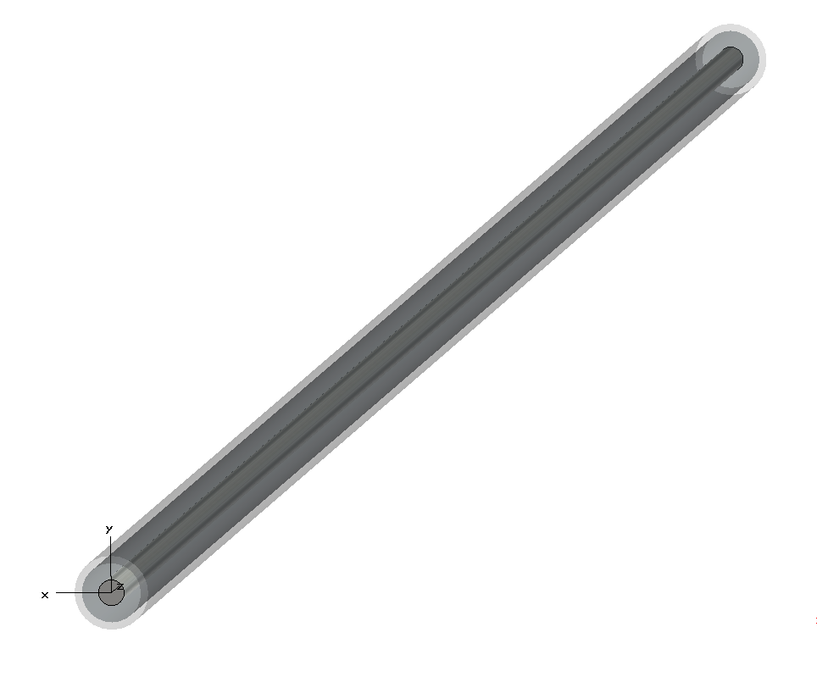
Another basic measurement example
30 cm long concentric cable with vacuum or air between conductors (e_{r}=1) and with characteristic impedance Z_{c}= 50 Ω.
An RF generator with 50 Ω source impedance Z_{G} is connected at one side of this line.
Other side terminated with load impedance:
Z_{L}=50 Ω; ∞Ω and 0 Ω
Oscilloscope with high impedance probe connected
at port 1
Z_{L}
Z_{in}>1MΩ
Scope
∼
Z_{G}=50Ω
8

Slide 9
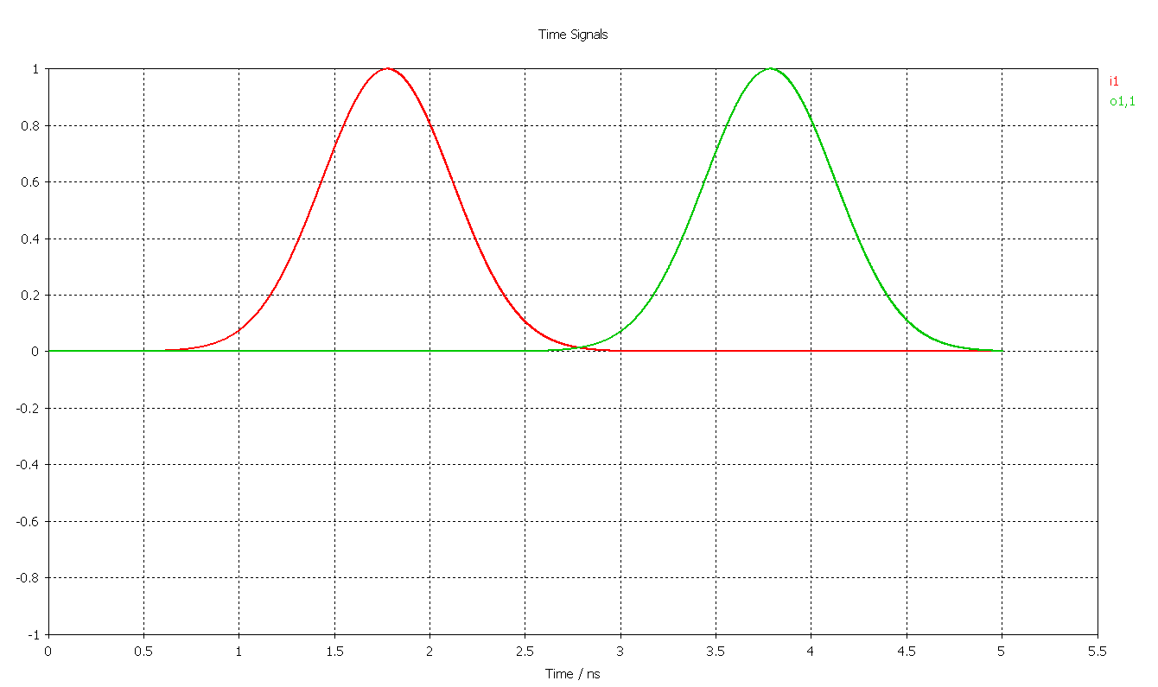
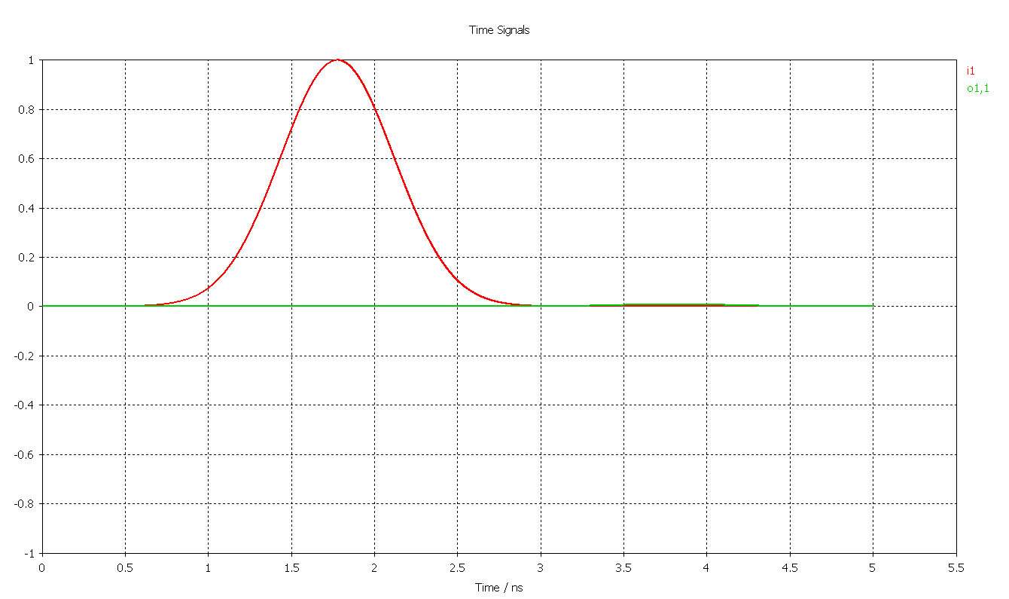
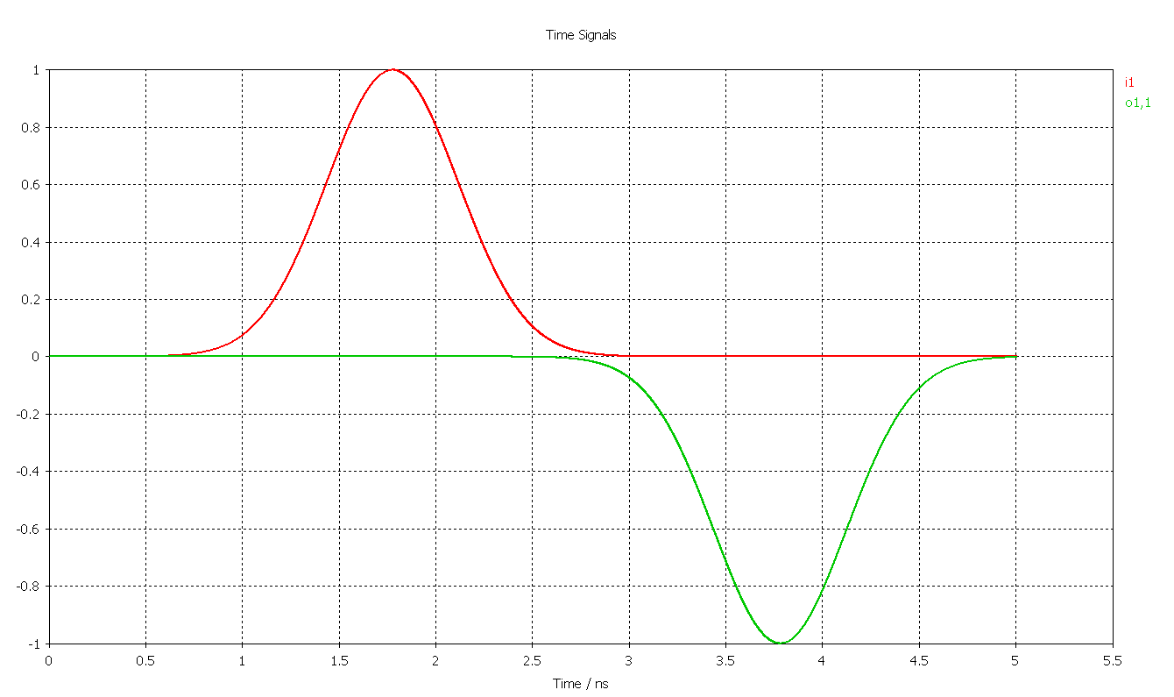
Measurements in time domain using Oscilloscope
2ns
Z_{in}=1MΩ
Z_{G}=50Ω
Z_{L}
∼
open: Z_{L}=∞Ω
total reflection; reflected signal in phase, delay 2x1 ns.
original signal
reflected signal
matched case: Z_{L}=Z_{G}
short: Z_{L}=0 Ω
no reflection
total reflection; reflected signal in contra phase
9

Slide 10
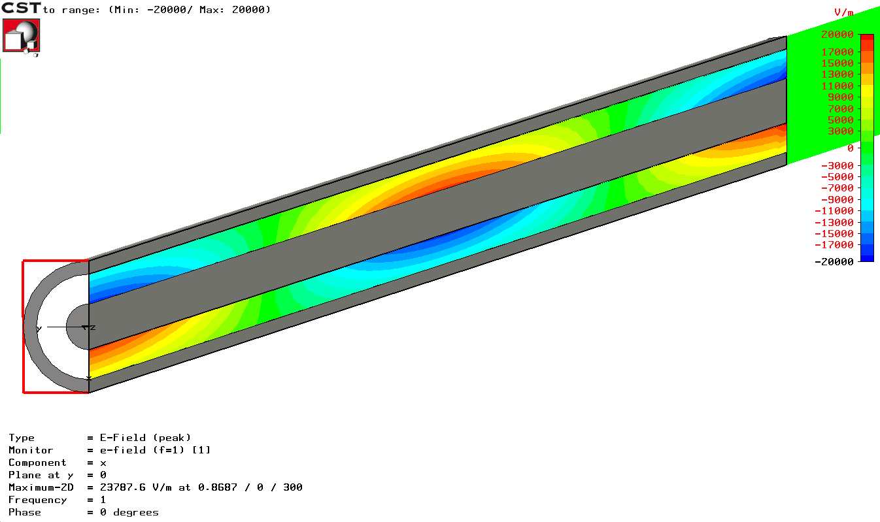
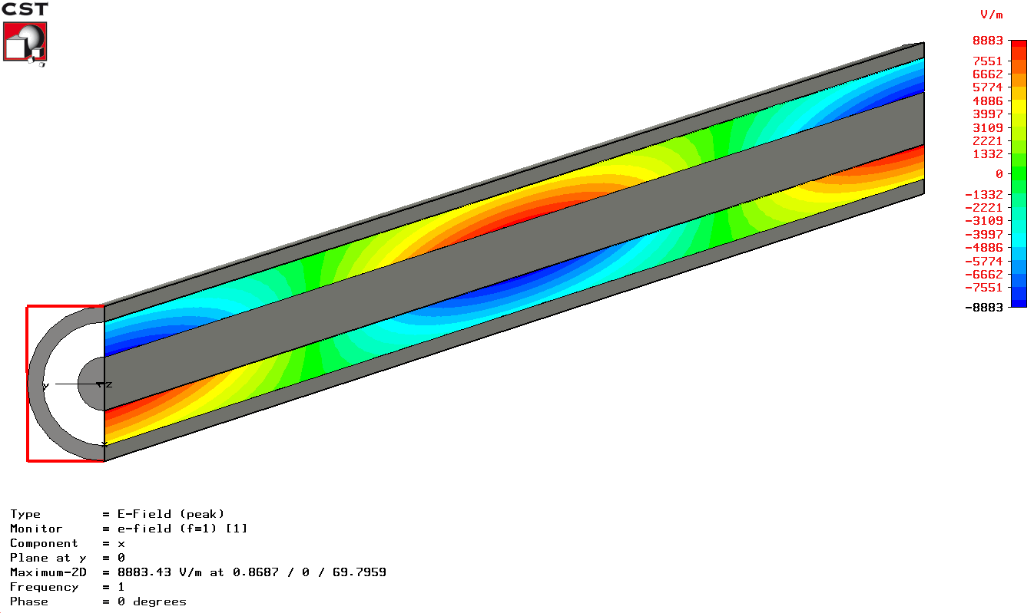
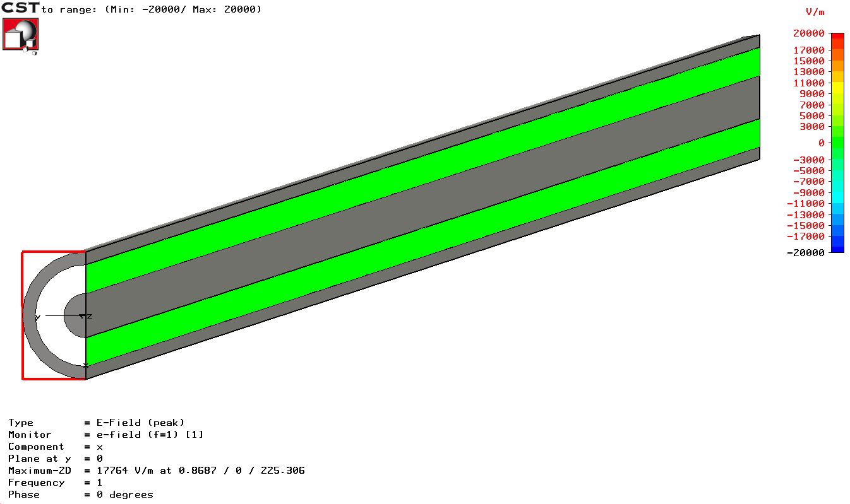
How good is actually our termination?
standing wave
matched case:
pure traveling wave
open
f=1 GHz
λ=30cm
f=0.25 GHz
λ/4=30cm
short
Caution: the colour coding corresponds to the radial electric field strength – these are not scalar equipotential lines which are anyway not defined for time dependent fields
f=1 GHz
λ=30cm
The patterns for the short and open case are equal; only the phase is opposite which correspond to different position of nodes.
In case of perfect matching: traveling wave only. Otherwise mixture of traveling and standing waves.
10

Slide 11
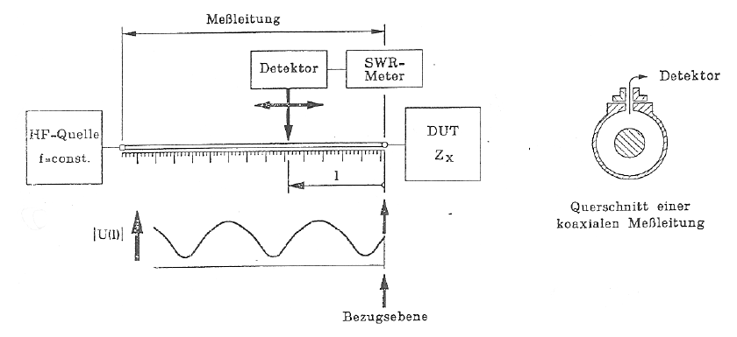
Voltage Standing Wave Ratio (1)
Origin of the term “VOLTAGE Standing Wave Ratio – VSWR”:
In the old days when there were no Vector Network Analyzers available, the reflection coefficient of some DUT (device under test) was determined with the coaxial measurement line.
Coaxial measurement line: coaxial line with a narrow slot (slit) in length direction. In this slit a small voltage probe connected to a crystal detector (detector diode) is moved along the line. By measuring the ratio between the maximum and the minimum voltage seen by the probe and the recording the position of the maxima and minima the reflection coefficient of the DUT at the end of the line can be determined.
Voltage probe weakly coupled to the radial electric field.
RF source
f=const.
Cross-section of the coaxial measurement line
11

Slide 12
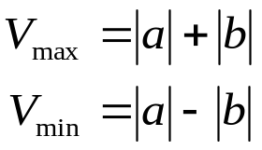
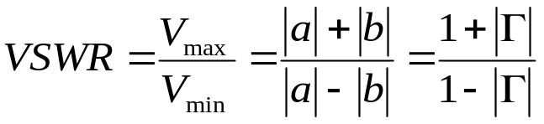
Voltage Standing Wave Ratio (2)
VOLTAGE DISTRIBUTION ON LOSSLESS TRANSMISSION LINES
For an ideally terminated line the magnitude of voltage and current are constant along the line, their phase vary linearly.
In presence of a notable load reflection the voltage and current distribution along a transmission line are no longer uniform but exhibit characteristic ripples. The phase pattern resembles more and more to a staircase rather than a ramp.
A frequently used term is the “Voltage Standing Wave Ratio VSWR” that gives the ratio between maximum and minimum voltage along the line. It is related to load reflection by the expression
Remember: the reflection coefficient Γ is defined via the ELECTRIC FIELD of the incident and reflected wave. This is historically related to the measurement method described here. We know that an open has a reflection coefficient of Γ=+1 and the short of Γ=-1. When referring to the magnetic field it would be just opposite.
12

Slide 13
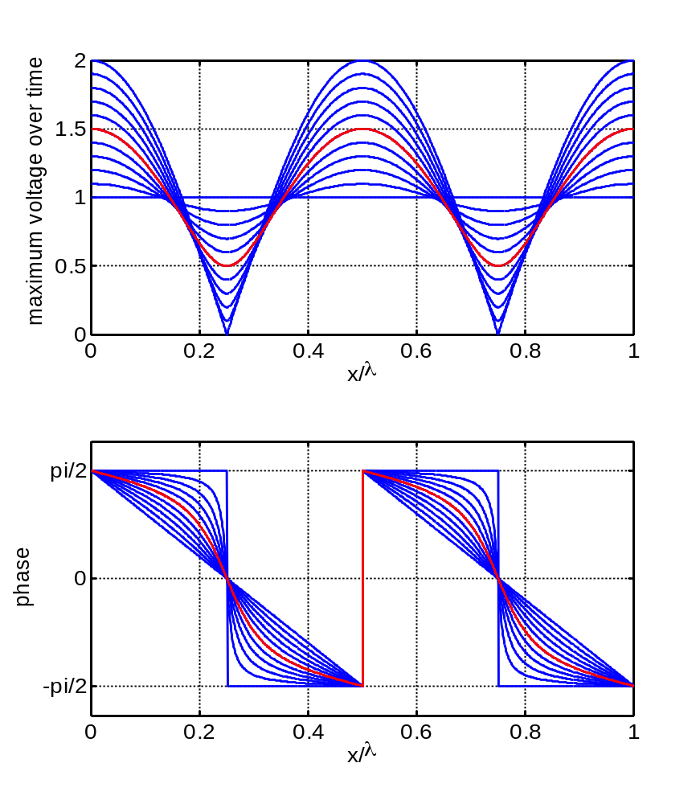


Voltage Standing Wave Ratio (3)
Γ | VSWR | Refl. Power |-Γ|²
0.0 | 1.00 | 1.00
0.1 | 1.22 | 0.99
0.2 | 1.50 | 0.96
0.3 | 1.87 | 0.91
0.4 | 2.33 | 0.84
0.5 | 3.00 | 0.75
0.6 | 4.00 | 0.64
0.7 | 5.67 | 0.51
0.8 | 9.00 | 0.36
0.9 | 19 | 0.19
1.0 | ∞ | 0.00
With a simple detector diode we cannot measure the phase, only the amplitude.
Why? – What would be required to measure the phase?
Answer: Because there is no reference. With a mixer which can be used as a phase detector when connected to a reference this would be possible.
13

Slide 14

S-parameters- introduction (1)
Look at the windows of this car:
  part of the light incident on the windows is reflected
  the rest is transmitted
The optical reflection and transmission coefficients characterize amounts of transmitted and reflected light.
Correspondingly: S-parameters characterize reflection and transmission of voltage waves through n-port electrical network
Caution: in the microwave world reflection coefficients are expressed in terms of voltage ratio whereas in optics in terms of power ratio.
14

Slide 15
S-parameters- introduction (2)
15
When the linear dimmensions of an object approche one tenth of the (free space) wavelength this circuit can not be modeled precisely anymore with the single lumped element.
Kurokawa in 1965 introduced „power waves” instead of voltage and current waves used so far K. Kurokawa, ‘Power Waves and the Scattering Matrix,’
IEEE Transactions on Microwave Theory and Techniques,
Vol. MTT-13, No. 2, March, 1965.
The essencial difference between power wave and current wave is a
normalisation to square root of characteristic impedance √Z_{c}
The abbreviation S has been derived from the word scattering.
Since S-parameters are defined based on traveling waves
-> the absolute value (modulus) does not vary along a lossless transmissions line
-> they can be measured on a DUT (Device Under Test) situated at some distance from an S-parameter measurement instrument (like Network Analyser)
How are the S-parameters defined?

Slide 16
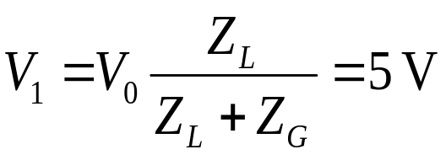

Simple example: a generator with a load
a₁
Z_{G} = 50Ω
1
I₁
V(t) = V₀sin(ωt)
V₀ = 10 V
~
b₁
V₁
Z_{L} = 50Ω
(load
impedance)
1’ reference plane
Voltage divider:
This is the matched case i.e. Z_{G} = Z_{L}.
-> forward traveling wave only, no reflected wave.
Amplitude of the forward traveling wave in this case is V₁=5V;
forward power =
Matching means maximum power transfer from a generator with given source impedance to an external load
16

Slide 17
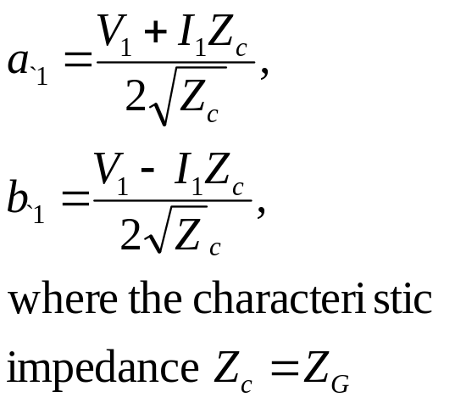
Power waves definition (1)
a₁
(*see Kurokawa paper):
Z_{G} = 50Ω
1
I₁
V(t) = V₀sin(ωt)
V₀ = 10 V
~
b₁
V₁
Z_{L} = 50Ω
(load
impedance)
1’ reference plane
Definition of power waves:
a₁ is the wave incident to the terminating one-port (Z_{L})
b₁ is the wave running out of the terminating one-port
a₁ has a peak amplitude of 5V / √50Ω; voltage wave would be just 5V.
What is the amplitude of b₁? Answer: b₁ = 0.
Dimension: [V/√Z], in contrast to voltage or current waves
Caution! US notation: power = |a|² whereas European notation (often): power = |a|²/2
17

Slide 18
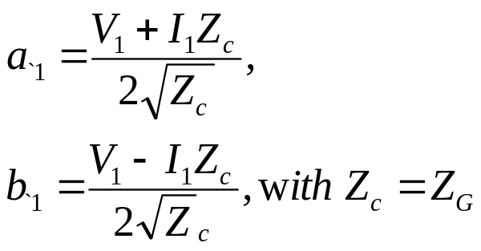
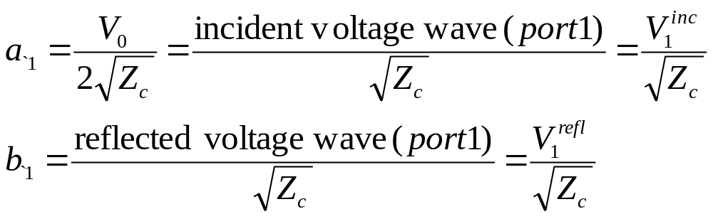
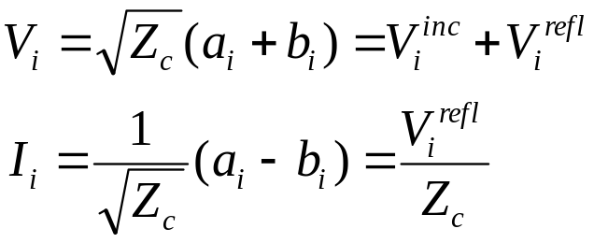
Power waves definition (2)
a₁
Z_{G} = 50Ω
1
I₁
V(t) = V₀sin(ωt)
V₀ = 10 V
~
b₁
V₁
Z_{L} = 50Ω
(load
impedance)
More practical method for determination: Assume that the generator is terminated with an external load equal to the generator impedance. Then we have the matched case and only a forward traveling wave (no reflection). Thus, the voltage on this external resistor is equal to the voltage of the outgoing wave.
Caution! US notation: power = |a|² whereas European notation (often): power = |a|²/2
18

Slide 19
Example: a 2-port (2)
a₁
a₂
Z_{G} = 50Ω
1
2
I₁
Z
I₂
V(t) = V₀sin(ωt)
V₀ = 10 V
~
b₁
b₂
V₁
V₂
Z_{L} = 50Ω
1’
2’
A 2-port or 4-pole is shown above between the generator with source impedance and the load
Strategy for practical solution: Determine currents and voltages at all ports (classical network calculation techniques) and from there determine a and b for each port.
Important for definition of a and b:
The wave “a_{n}” always travels towards an N-port, the wave “b_{n}” always travels away from an N-port.
19

Slide 20
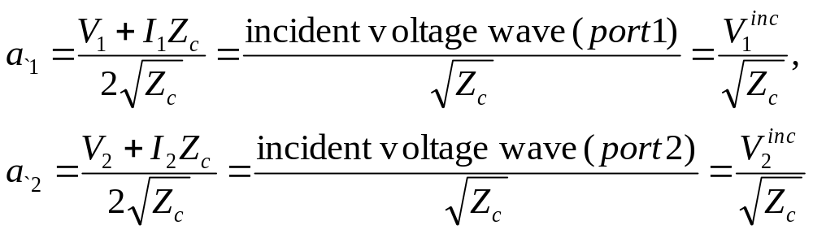
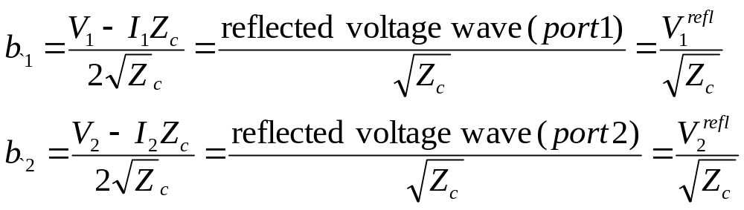
Example : a 2-port (2)
a₁
a₂
Z_{G} = 50Ω
1
2
I₁
Z
I₂
V(t) = V₀sin(ωt)
V₀ = 10 V
~
b₁
b₂
V₁
V₂
Z_{L} = 50Ω
1’
2’
independent variables a₁ and a₂ are normalized incident voltages waves:
Dependent variables b₁ and b₂ are normalized reflected voltages waves:
20

Slide 21
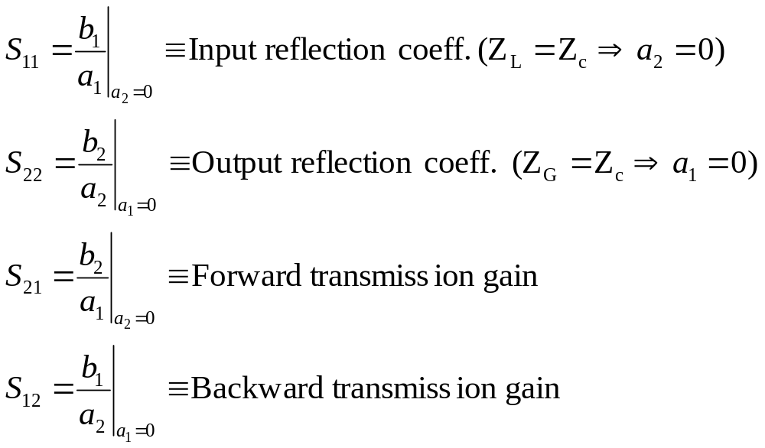
S-Parameters – definition (1)
The linear equations decribing two-port network are:
b₁=S₁₁a₁+S₁₂ a₂
b₂=S₂₂a₂+S₂₁ a₂
The S-parameters S₁₁ , S₂₂ , S₂₁ , S₁₂ are given by:
21

Slide 22
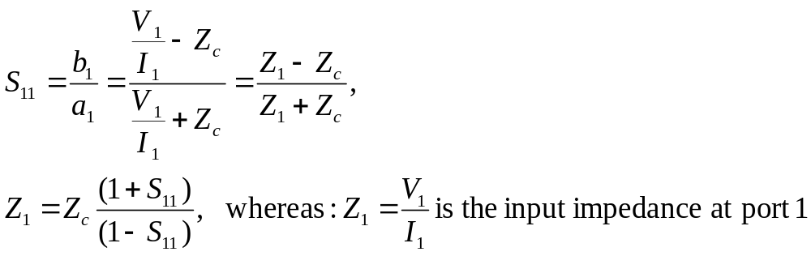
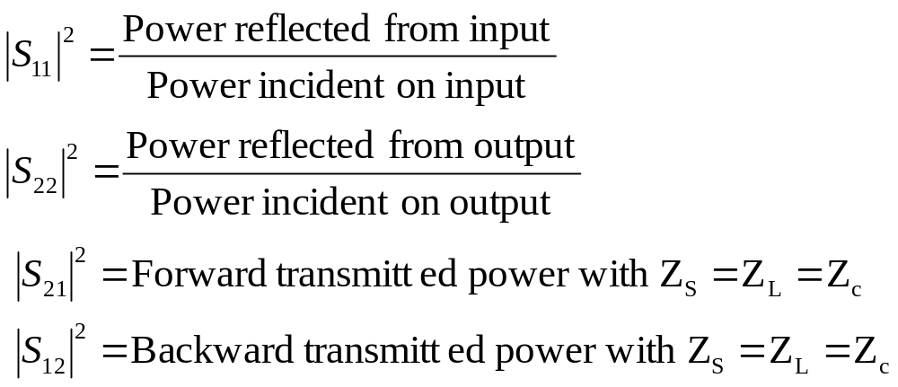
S-Parameters – definition (2)
Here the US notion is used, where power = |a|².
European notation (often): power = |a|²/2
These conventions have no impact on S parameters, only relevant for absolute power calculation
22

Slide 23
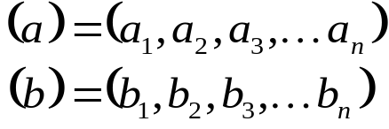
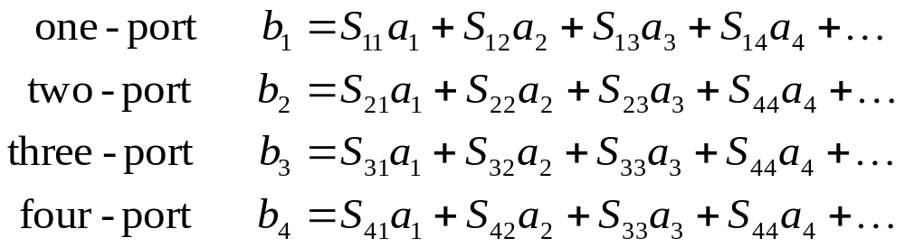
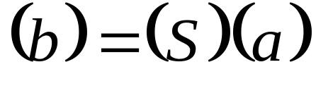
The Scattering-Matrix (1)
Waves traveling towards the n-port:
Waves traveling away from the n-port:
The relation between a_{i} and b_{i} (i = 1..n) can be written as a system of n linear equations (a_{i} = the independent variable, b_{i} = the dependent variable):
In compact matrix notation, these equations can also be written as:
23

Slide 24

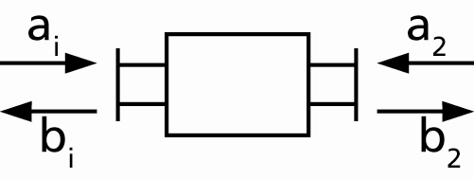
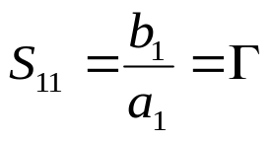
The Scattering Matrix (2)
The simplest form is a passive one-port (2-pole) with some reflection coefficient Γ.
With the reflection coefficient Γ it follows that
Reference plane
What is the difference between Γ and S11 or S22?
Γ is a general definition of some complex reflection coefficient.
On the contrary, for a proper S-parameter measurement all ports of the Device Under Test (DUT) including the generator port must be terminated with their characteristic impedance in order to assure that waves traveling away from the DUT (b_{n}-waves) are not reflected back and convert into
a_{n}-waves.
24

Slide 25
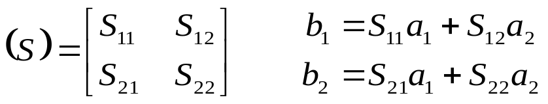
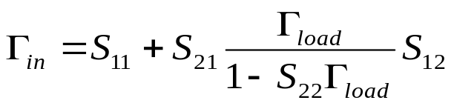
The Scattering Matrix (3)
Two-port (4-pole)
A non-matched load present at port 2 with reflection coefficient Γ_{load} transfers to the input port as
For a proper S-parameter measurement all ports of the Device Under Test (DUT) including the generator port must be terminated with their characteristic impedance in order to assure that waves traveling away from the DUT (b_{n}-waves) are not reflected back and convert into
a_{n}-waves.
25

Slide 26
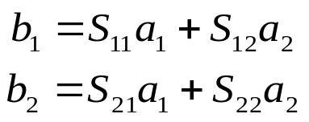
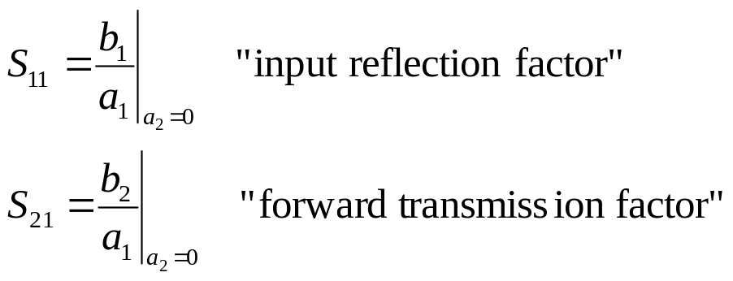
Evaluation of scattering parameters (1)
Basic relation:
Finding S₁₁, S₂₁: (“forward” parameters, assuming port 1 = input,
port 2 = output e.g. in a transistor)
- connect a generator at port 1 and inject a wave a₁ into it
- connect reflection-free terminating lead at port 2 to assure a₂ = 0
- calculate/measure
- wave b₁ (reflection at port 1, no transmission from port2)
- wave b₂ (reflection at port 2, no transmission from port1)
- evaluate
DUT = Device Under Test
Z_{g}=50Ω
DUT
2-port
Matched receiver or detector
4-port
proportional b₂
prop. a₁
Directional Coupler
proportional b₁
26

Slide 27
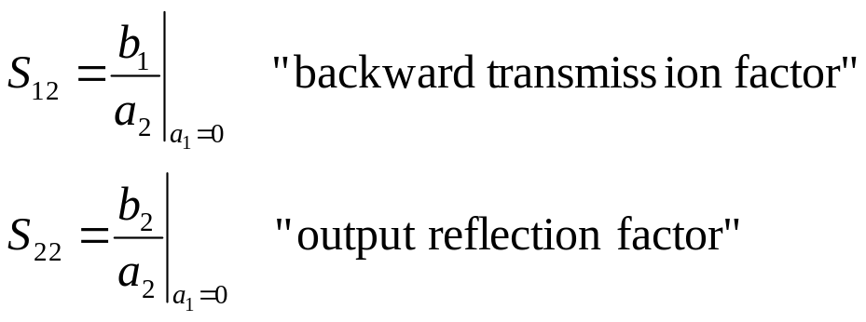
Evaluation of scattering parameters (2)
Finding S₁₂, S₂₂: (“backward” parameters)
- interchange generator and load
- proceed in analogy to the forward parameters, i.e.
inject wave a₂ and assure a₁ = 0
- evaluate
For a proper S-parameter measurement all ports of the Device Under Test (DUT) including the generator port must be terminated with their characteristic impedance in order to assure that waves traveling away from the DUT (b_{n}-waves) are not reflected back and convert into
a_{n}-waves.
27

Slide 28
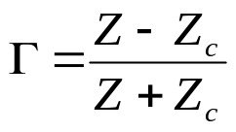
The Smith Chart (1)
The Smith Chart (in impedance coordinates) represents the complex Γ-plane within the unit circle. It is a conformal mapping of the complex Z-plane on the Γ-plane using the transformation:
Imag(Γ)
Imag(Ζ)
Real(Ζ)
Real(Γ)
→The real positive half plane of Z is thus
transformed into the interior of the unit circle!
28

Slide 29
The Smith Chart (2)
This is a “bilinear” transformation with the following properties:
generalized circles are transformed into generalized circles
  circle → circle
  straight line → circle
  circle → straight line
  straight line → straight line
angles are preserved locally
a straight line is nothing else than a circle with infinite radius
a circle is defined by 3 points
a straight line is defined by 2 points
29

Slide 30
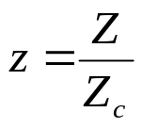
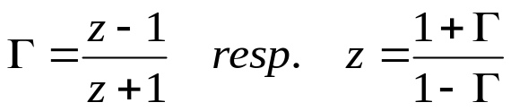
The Smith Chart (3)
Impedances Z are usually first normalized by
where Z₀ is some characteristic impedance (e.g. 50 Ohm). The general form of the transformation can then be written as
This mapping offers several practical advantages:
1. The diagram includes all “passive” impedances, i.e. those with positive real part, from zero to infinity in a handy format. Impedances with negative real part (“active device”, e.g. reflection amplifiers) would be outside the (normal) Smith chart.
2. The mapping converts impedances or admittances into reflection factors and vice-versa. This is particularly interesting for studies in the radiofrequency and microwave domain where electrical quantities are usually expressed in terms of “direct” or “forward” waves and “reflected” or “backward” waves. This replaces the notation in terms of currents and voltages used at lower frequencies. Also the reference plane can be moved very easily using the Smith chart.
30

Slide 31
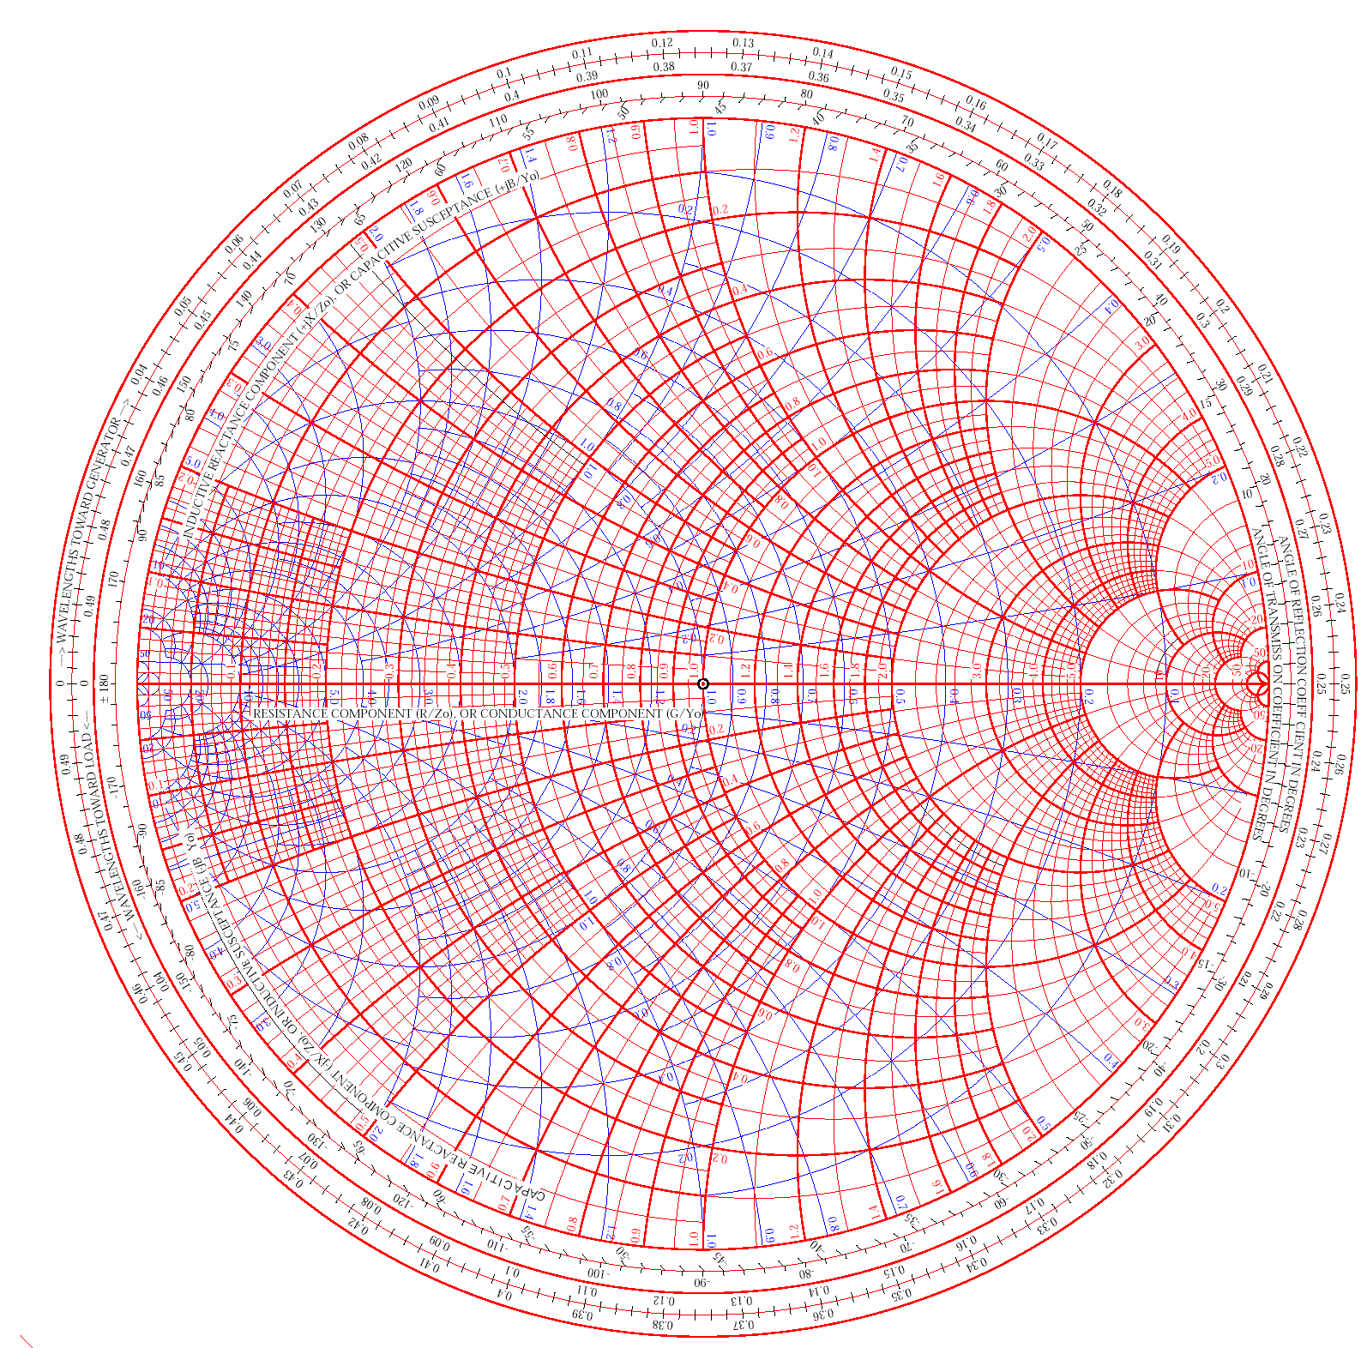

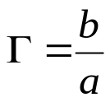
The Smith Chart (4)
The Smith Chart (Abaque Smith in French)
is the linear representation of the
complex reflection factor
This is the ratio between backward and forward wave
(implied forward wave a=1)
i.e. the ratio backward/forward wave.
The upper half of the Smith-Chart is “inductive”
= positive imaginary part of impedance, the lower
half is “capacitive” = negative imaginary part.
31

Slide 32
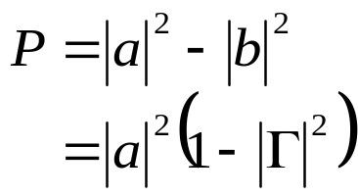





The Smith Chart (5)
3. The distance from the center of the diagram is directly proportional to the magnitude of the reflection factor. In particular, the perimeter of the diagram represents total reflection, |Γ|=1. This permits easy visualization matching performance.
(Power dissipated in the load) = (forward power) – (reflected power)
available source power
“(mismatch)” loss
32

Slide 33
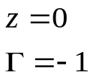

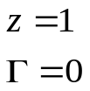
Important points
Im (Γ)
Short Circuit
Important Points:
Short Circuit
Γ = -1, z = 0
Open Circuit
Γ = 1, z → ∞
Matched Load
Γ = 0, z = 1
On circle Γ = 1
lossless element
Outside circle Γ = 1 active element, for instance tunnel diode reflection amplifier
Open Circuit
Re(Γ)
Matched Load
33

Slide 34
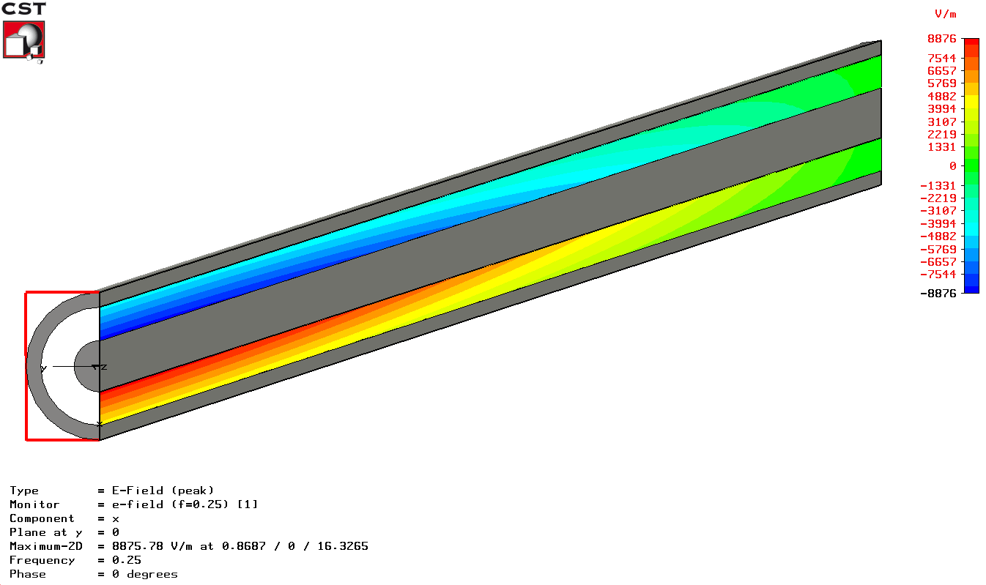
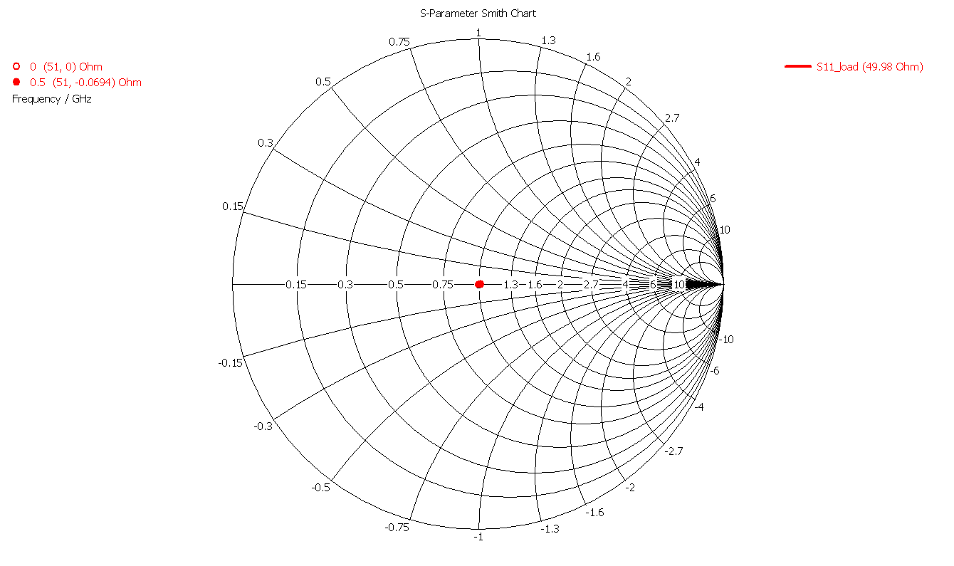
Coming back to our example
matched case:
pure traveling wave=> no reflection
Coax cable with vacuum or air with a lenght of 30 cm
f=0.25 GHz
λ/4=30cm
f=1 GHz
λ/4=7.5cm
Caution: on the printout this snap shot of the traveling wave appears as
a standing wave, however this is meant to be a traveling wave
34

Slide 35

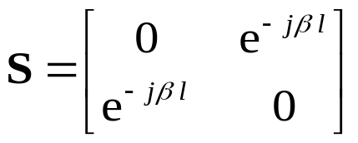



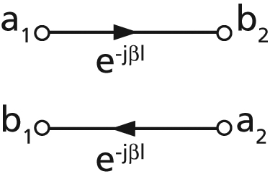

Impedance transformation by transmission lines
The S-matrix for an ideal, lossless transmission line of length l is given by
where
is the propagation coefficient with the wavelength λ (this refers to the wavelength on the line containing some dielectric).
N.B.: It is supposed that the reflection factors are evaluated with respect to the characteristic impedance Z_{c} of the line segment.
How to remember that when adding a section of
line we have to turn clockwise: assume we are at Γ= -1
(short circuit) and add a very short piece of coaxial cable.
Then we have made an inductance thus we are in the upper
half of the Smith-Chart.
35

Slide 36


λ/4 - Line transformations
Impedance z
A transmission line of length
transforms a load reflection Γ_{load} to its input as
This means that a normalized load impedance z is transformed into 1/z.
In particular, a short circuit at one end is transformed into an open circuit at the other. This is the principle of λ/4-resonators.
Impedance
1/z
when adding a transmission line
to some terminating impedance we move
clockwise through the Smith-Chart.
36

Slide 37
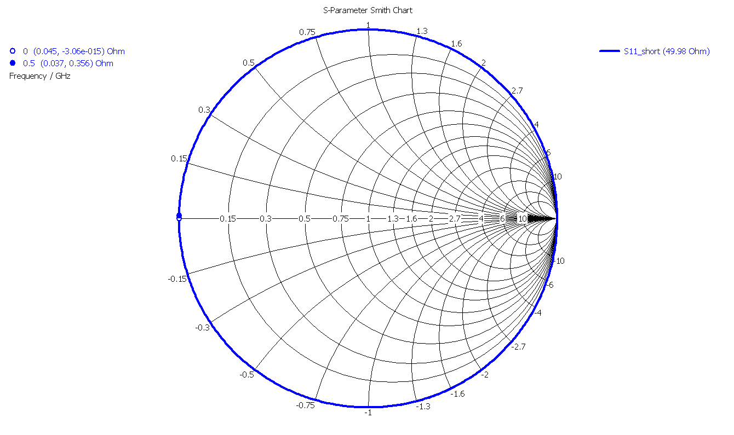
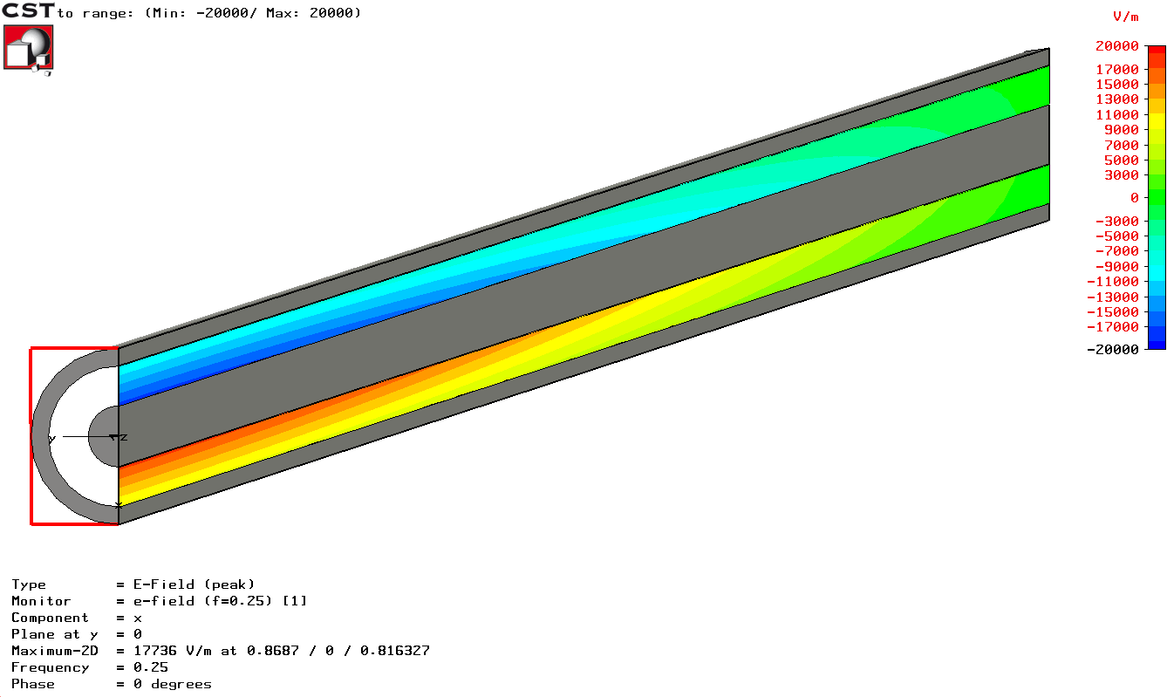
Again our example (shorted end )
short : standing wave
(on the printout you see only a snapshot of movie. It is meant however to be a standing wave.)
Coax cable with vacuum or air with a lenght of 30 cm
short
f=1 GHz
λ/4=7.5cm
f=1 GHz
f=0.25 GHz
f=0.25 GHz
λ/4=30cm
If lenght of the transmission line changes by λ/4 a short circuit at one side is transformed into an open circuit at the other side.
37

Slide 38
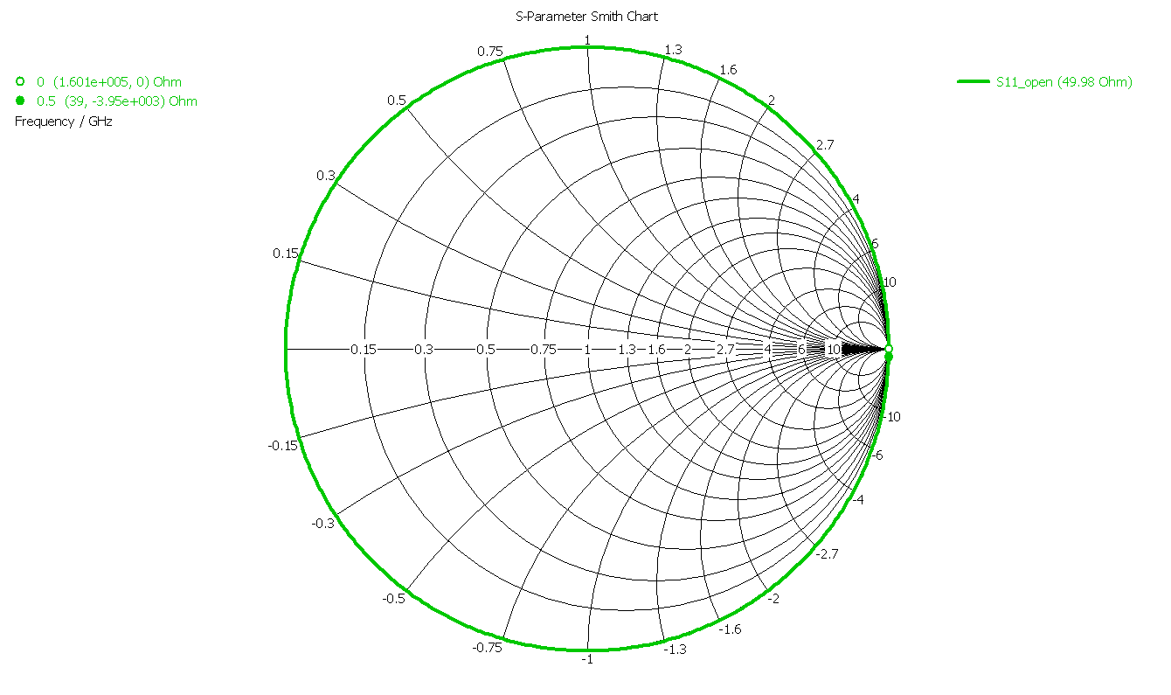
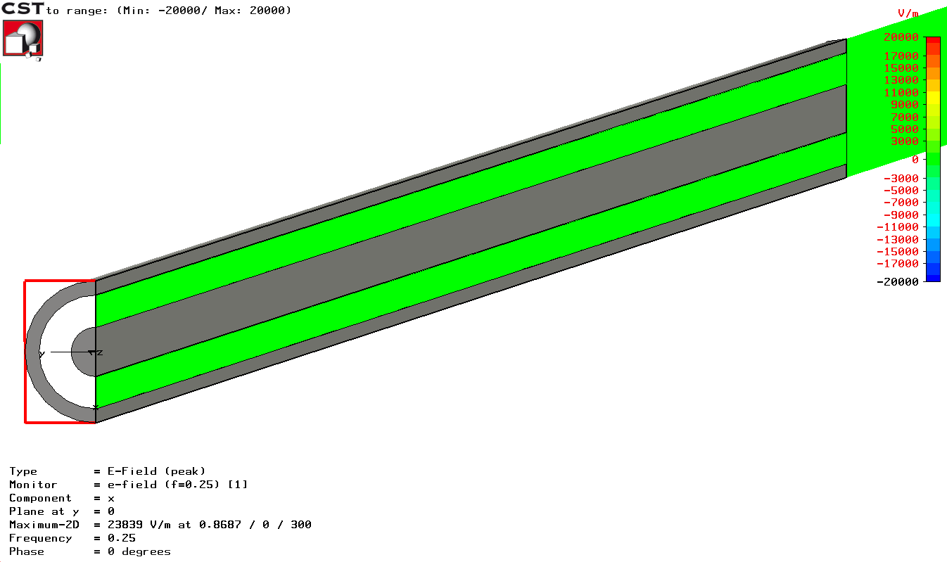
Again our example (open end)
open : standing wave
(on the printout you see only a snapshot of movie. It is meant however to be a standing wave.)
Coax cable with vacuum with a lenght of 30 cm
open
f=1 GHz
λ/4=7.5cm
f=0.25 GHz
f=1 GHz
f=0.25 GHz
λ/4=30cm
The patterns for the short and open terminated case appear similar; However, the phase is shifted which correspond to a different position of the nodes.
If the length of a transmission line changes by λ/4, an open become a short and vice versa!
38

Slide 39

What awaits you?
Photo from RF-Lab
CAS 2011, CHIOS
39

Slide 40
Measurements using Spectrum Analyzer and oscilloscope (1)
Measurements of several types of modulation (AM, FM, PM) in the time-domain and frequency-domain.
Superposition of AM and FM spectrum (unequal height side bands).
Concept of a spectrum analyzer: the superheterodyne method. Practice all the different settings (video bandwidth, resolution bandwidth etc.). Advantage of FFT spectrum analyzers.
Measurement of the RF characteristic of a microwave detector diode (output voltage versus input power... transition between regime output voltage proportional input power and output voltage proportional input voltage); i.e. transition between square low and linear region.
Concept of noise figure and noise temperature measurements, testing a noise diode, the basics of thermal noise.
Noise figure measurements on amplifiers and also attenuators.
The concept and meaning of ENR (excess noise ratio) numbers.
40

Slide 41
Measurements using Spectrum Analyzer and oscilloscope (2)
EMC measurements (e.g.: analyze your cell phone spectrum).
Noise temperature of the fluorescent tubes in the RF-lab using a satellite receiver.
Measurement of the IP3 (intermodulation point of third order) on some amplifiers (intermodulation tests).
Nonlinear distortion in general; Concept and application of vector spectrum analyzers, spectrogram mode (if available).
Invent and design your own experiment !
41

Slide 42
Measurements using Vector Network Analyzer (1)
N-port (N=1…4) S-parameter measurements on different reciprocal and non-reciprocal RF-components.
Calibration of the Vector Network Analyzer.
Navigation in The Smith Chart.
Application of the triple stub tuner for matching.
Time Domain Reflectomentry using synthetic pulse
→direct measurement of coaxial line characteristic impedance.
Measurements of the light velocity using a trombone (constant impedance adjustable coax line).
2-port measurements for active RF-components (amplifiers):
1 dB compression point (power sweep).
Concept of EMC measurements and some examples.
42

Slide 43
Measurements using Vector Network Analyzer (2)
Measurements of the characteristic cavity properties (Smith Chart analysis).
Cavity perturbation measurements (bead pull).
Beam coupling impedance measurements with the wire method (some examples).
Beam transfer impedance measurements with the wire (button PU, stripline PU.)
Self made RF-components: Calculate build and test your own attenuator in a SUCO box (and take it back home then).
Invent and design your own experiment!
43

Slide 44



Invent your own experiment!
or „Tabacco-box” cavity
Build e.g. Doppler traffic radar
(this really worked in practice during CAS 2011 RF-lab, CHIOS)
or test a resonator of any other type.
44

Slide 45




You will have enough time to think
and have a contact with hardware and your colleagues.
45

Slide 46

We hope you will have a lot of fun…
46

Slide 47


Appendix A: Definition of the Noise Figure
F is the Noise factor of the receiver
S_{i} is the available signal power at input
N_{i}=kT₀B is the available noise power at input
T₀ is the absolute temperature of the source resistance
N_{o} is the available noise power at the output , including amplified input noise
N_{r} is the noise added by receiver
G is the available receiver gain
B is the effective noise bandwidth of the receiver
If the noise factor is specified in a logarithmic unit, we use the term Noise Figure (NF)
47

Slide 48

Measurement of Noise Figure
(using a calibrated Noise Source)
48

Slide 49













Appendix B: Examples of 2-ports (1)
Line of Z=50Ω, length l=λ/4
Port 1:
Port 2:
Attenuator 3dB, i.e. half output power
backward
transmission
RF Transistor
forward
transmission
non-reciprocal since S₁₂ ≠ S₂₁!
=different transmission forwards and backwards
49

Slide 50


Examples of 2-ports (2)
Ideal Isolator
Port 1:
Port 2:
a₁
b₂
only forward
transmission
Faraday rotation isolator
Port 2
Port 1
Attenuation foils
The left waveguide uses a TE₁₀ mode (=vertically polarized H field). After transition to a circular waveguide,
the polarization of the mode is rotated counter clockwise by 45° by a ferrite. Then follows a transition to
another rectangular waveguide which is rotated by 45° such that the forward wave can pass unhindered.
However, a wave coming from the other side will have its polarization rotated by 45° clockwise as seen from the right hand side.
50

Slide 51







Looking through a 2-port (1)
In general:
were Γ_{in} is the reflection coefficient when looking through the 2-port and Γ_{load} is the load reflection coefficient.
The outer circle and the real axis in the simplified Smith diagram below are mapped to other circles and lines, as can be seen on the right.
Line λ/16:
0
1
2
1
∞
Attenuator 3dB:
1
2
0
1
∞
z = 0
z = ∞
z = 1 or
Z = 50 Ω
51

Slide 52



Looking through a 2-port (2)
1
If S is unitary
→ Lossless Two-Port
2
Lossless
Passive
Circuit
0
1
∞
Lossy
Passive
Circuit
1
Lossy Two-Port:
If
unconditionally stable
2
∞
1
0
1
Active Circuit:
If
potentially unstable
2
Active
Circuit
0
1
∞
52

Slide 53



Examples of 3-ports (1)
Port 1:
Port 2:
Resistive power divider
a₁
Z₀/3
Z₀/3
b₂
b₁
a₂
Z₀/3
a₃
b₃
Port 3:
3-port circulator
b₂
Port 2:
a₂
Port 1:
Port 3:
a₁
b₃
The ideal circulator is lossless, matched at all ports,
but not reciprocal. A signal entering the ideal circulator
at one port is transmitted exclusively to the next port in
the sense of the arrow.
b₁
a₃
53

Slide 54


Examples of 3-ports (2)
Practical implementations of circulators:
Port 3
Port 1
Port 2
Stripline circulator
Waveguide circulator
Port 3
ground plates
Port 1
ferrite disc
Port 2
A circulator contains a volume of ferrite. The magnetically polarized ferrite provides the
required non-reciprocal properties, thus power is only transmitted from port 1 to port 2,
from port 2 to port 3, and from port 3 to port 1.
54

Slide 55


Examples of 4-ports (1)
Ideal directional coupler
To characterize directional couplers, three important figures are used:
the coupling
the directivity
the isolation
Input
Through
a₁
b₃
b₂
b₄
Coupled
Isolated
55

Slide 56




Appendix C: T matrix
The T-parameter matrix is related to the incident and reflected normalised waves at each of the ports.
T-parameters may be used to determine the effect of a cascaded 2-port networks by simply multiplying the individual T-parameter matrices:
b₁
a₂
b₃
a₄
T⁽¹⁾
T⁽²⁾
S₁,T₁
a₁
b₂
a₃
b₄
T-parameters can be directly evaluated from the associated S-parameters and vice versa.
From S to T:
From T to S:
56

Slide 57





Appendix D: A Step in Characteristic Impedance (1)
Consider a connection of two coaxial cables, one with Z_{C,1} = 50 Ω characteristic impedance, the other with Z_{C,2} = 75 Ω characteristic impedance.
1
Connection between a 50 Ω and a 75 Ω cable. We assume an infinitely short cable length and just look at the junction.
2
Step 1: Calculate the reflection coefficient and keep in mind: all ports have to be terminated with their respective characteristic impedance, i.e. 75 Ω for port 2.
Thus, the voltage of the reflected wave at port 1 is 20% of the incident wave and the reflected power at port 1 (proportional Γ²) is 0.2² = 4%. As this junction is lossless, the transmitted power must be 96% (conservation of energy). From this we can deduce
b₂² = 0.96. But: how do we get the voltage of this outgoing wave?
57

Slide 58







Example: a Step in Characteristic Impedance (2)
Step 2: Remember, a and b are power-waves and defined as voltage of the forward- or backward traveling wave normalized to .
The tangential electric field in the dielectric in the 50 Ω and the 75 Ω line, respectively, must be continuous.
t = voltage transmission coefficient in this case.
This is counterintuitive, one might expect 1-Γ. Note that the voltage of the transmitted wave is higher than the voltage of the incident wave. But we have to normalize to to get the corresponding S-parameter. S₁₂ = S₂₁ via reciprocity! But S₁₁ ≠ S₂₂, i.e. the structure is NOT symmetric.
PE ε_{r} = 2.25
Air, ε_{r} = 1
58

Slide 59



Example: a Step in Characteristic Impedance (3)
Once we have determined the voltage transmission coefficient, we have to normalize to the ratio of the characteristic impedances, respectively. Thus we get for
We know from the previous calculation that the reflected power (proportional Γ²) is 4% of the incident power. Thus 96% of the power are transmitted.
Check done
To be compared with S11 = +0.2!
59

Slide 60
Example: a Step in Characteristic Impedance (4)
Visualization in the Smith chart:
As shown in the previous slides the voltage of the transmitted wave is
V_{t} = a + b with t = 1 + Γ
and subsequently the current is
I_{t} Z = a - b.
Remember: the reflection coefficient Γ is defined with respect to voltages. For currents the sign inverts. Thus a positive reflection coefficient in the normal definition leads to a subtraction of currents or is negative with respect to current.
V_{t}= a+b = 1.2
I_{t} Z = a-b
-b
b = +0.2
incident wave a = 1
Note: here Z_{load} is real
60

Slide 61
Example: a Step in Characteristic Impedance (5)
General case:
Thus we can read from the Smith chart immediately the amplitude and phase of voltage and current on the load (of course we can calculate it when using the complex voltage divider).
z = 1+j1.6
V₁= a+b
b
a = 1
a
-b
Z_{G} = 50Ω
I₁ Z = a-b
I₁
~
V₁
Z = 50+j80Ω
(load impedance)
b
61

Slide 62
Appendix E: Navigation in the Smith Chart (1)
in blue: Impedance plane (=Z)
in red: Admittance plane (=Y)
Series L
Shunt L
 | Up | Down
Red circles | Series L | Series C
Blue circles | Shunt L | Shunt C
Shunt C
Series C
62

Slide 63
Navigation in the Smith Chart (2)
G
R
Red arcs | Resistance R
Blue arcs | Conductance G
Con-centric circle | Transmission line going Toward load Toward generator
Toward load
Toward generator
63

Slide 64



Appendix F: The RF diode (1)
We are not discussing the generation of RF signals here, just the detection
Basic tool: fast RF* diode
(= Schottky diode)
In general, Schottky diodes are
fast but still have a voltage
dependent junction capacity
(metal – semi-conductor junction)
Equivalent circuit:
A typical RF detector diode
Try to guess from the type of the connector which side is the RF input and which is the output
Video output
*Please note, that in this lecture we will use RF for both the RF and micro wave (MW) range, since the borderline between RF and MW is not defined unambiguously
64

Slide 65



The RF diode (2)
Characteristics of a diode:
The current as a function of the voltage for a barrier diode can be described by the Richardson equation:
The RF diode is NOT an ideal commutator for small signals! We cannot apply big signals otherwise burnout
65

Slide 66

The RF diode (3)
This diagram depicts the so called square-law region where the output voltage (V_{Video}) is proportional to the input power
The transition between the linear region and the square-law region is typically between -10 and -20 dBm RF power (see diagram).
Since the input power is proportional to the square of the input voltage (V_{RF}²) and the output signal is proportional to the input power, this region is called square- law region.
Linear Region
In other words:
V_{Video} ~ V_{RF}²
-20 dBm = 0.01 mW
66

Slide 67

The RF diode (5)
Due to the square-law characteristic we arrive at the thermal noise region already for moderate power levels (-50 to -60 dBm) and hence the V_{Video} disappears in the thermal noise
This is described by the term
tangential signal sensitivity (TSS)
where the detected signal
(Observation BW, usually 10 MHz)
is 4 dB over the thermal noise floor
Output Voltage
4dB
Time
67

Slide 68
Appendix G: The RF mixer (1)
For the detection of very small RF signals we prefer a device that has a linear response over the full range (from 0 dBm ( = 1mW) down to thermal noise =
-174 dBm/Hz = 4·10⁻²¹ W/Hz)
This is the RF mixer which is using 1, 2 or 4 diodes in different configurations (see next slide)
Together with a so called LO (local oscillator) signal, the mixer works as a signal multiplier with a very high dynamic range since the output signal is always in the “linear range” provided, that the mixer is not in saturation with respect to the RF input signal (For the LO signal the mixer should always be in saturation!)
The RF mixer is essentially a multiplier implementing the function
f₁(t) · f₂(t) with f₁(t) = RF signal and f₂(t) = LO signal
Thus we obtain a response at the IF (intermediate frequency) port that is at the sum and difference frequency of the LO and RF signals
68

Slide 69



The RF mixer (2)
Examples of different mixer configurations
A typical coaxial mixer (SMA connector)
69

Slide 70

The RF mixer (3)
Response of a mixer in time and frequency domain:
Input signals here:
LO = 10 MHz
RF = 8 MHz
Mixing products at
2 and 18 MHz and
higher order terms at higher frequencies
70

Slide 71

The RF mixer (4)
Dynamic range and IP3 of an RF mixer
The abbreviation IP3 stands for the
third order intermodulation point
where the two lines shown in the
right diagram intersect. Two signals
(f₁,f₂ > f₁) which are closely spaced
by Δf in frequency are simultaneously
applied to the DUT. The intermodulation
products appear at + Δf above f₂
and at – Δf below f₁.
This intersection point is usually not
measured directly, but extrapolated
from measurement data at much
smaller power levels in order to
avoid overload and damage of the DUT.
71

