Slide 1
Case Study Summary
Very high level of talks, both in terms of content and presentation.
Perfect timing
Visible enthusiasm and sense of humor
Environmental mindset

Slide 2
The Referees
Many thanks to…
Werner Herr
John Galambos
Kai Wittenburg
…for helping us with the difficult task of selecting the winners.

Slide 3
The Categories
The five categories are
Best Overall Project
Most Innovative
Best Sales Pitch
Best Project Acronym
Most Entertaining Presentation

Slide 4
Most Entertaining Project
Daniel VALUCH, Jinhai LI, Aritz LEONARDO & Wolfgang KAUFMANN

Slide 5
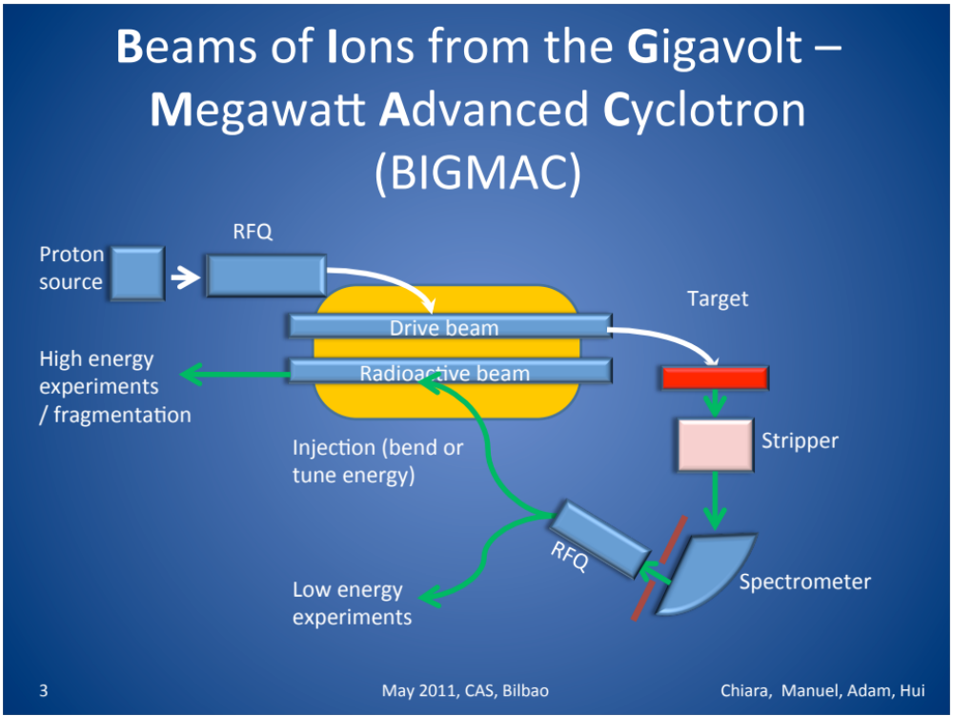
Best Project Acronym
Chiara BRACCO, Manuel GONZALEZ BERGES, Adam JEFF & Hui ZHANG

Slide 6
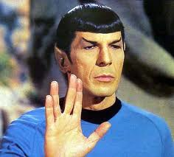
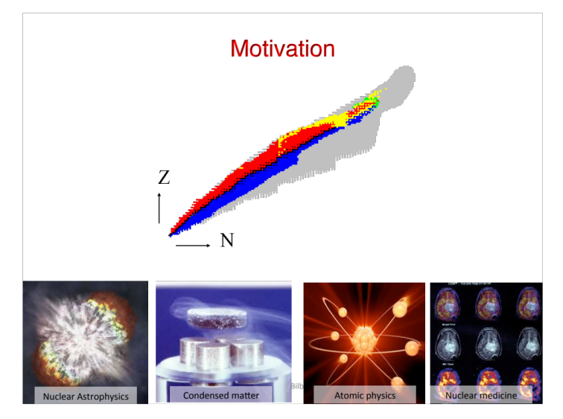
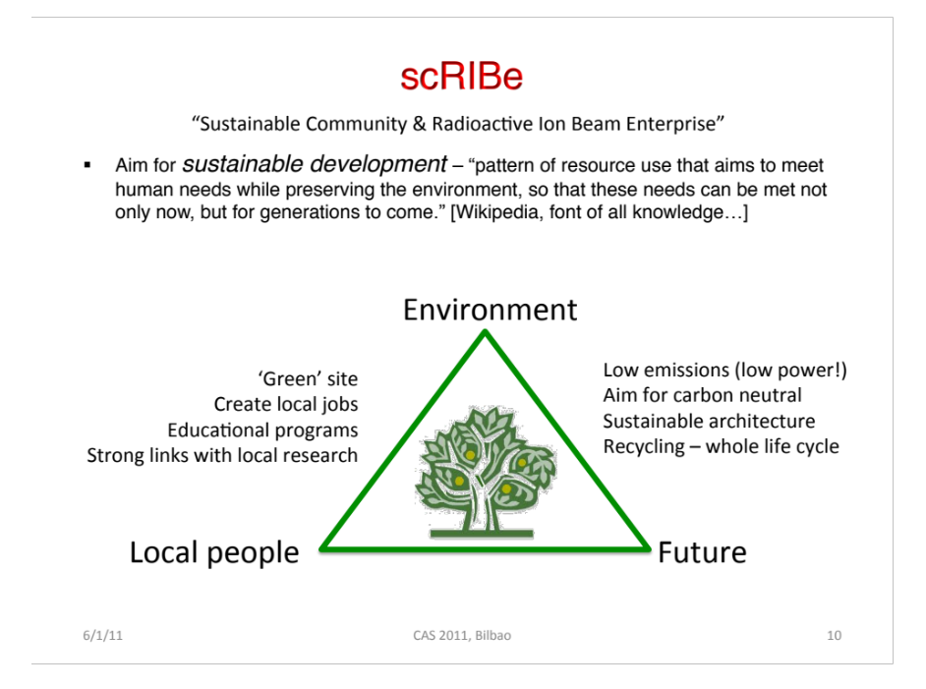
Best Sales Pitch
Edgar SARGSYAN, Federico RONCAROLO, Pierre-André DUPERREX & Suzie SHEEHY

Slide 7
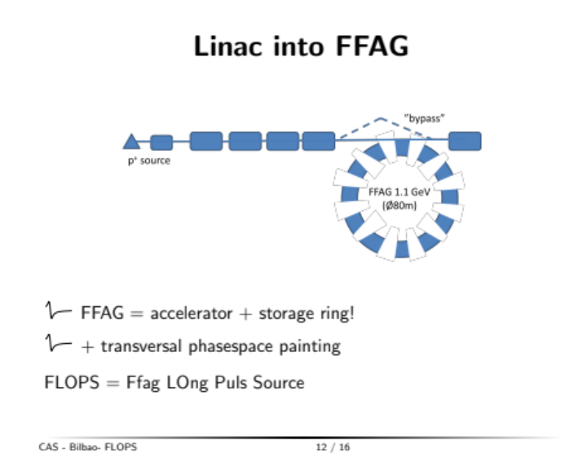
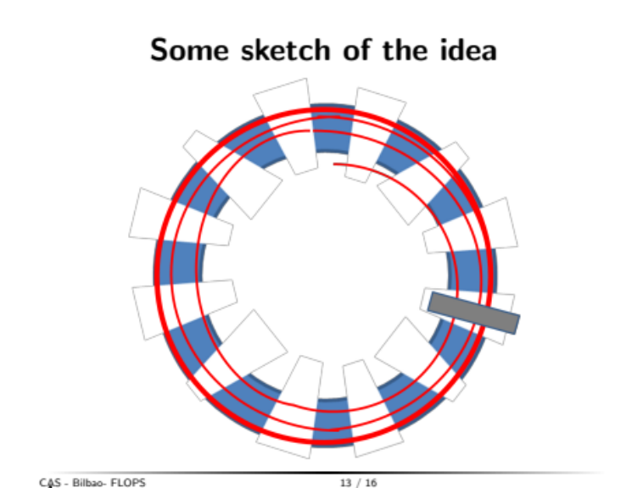
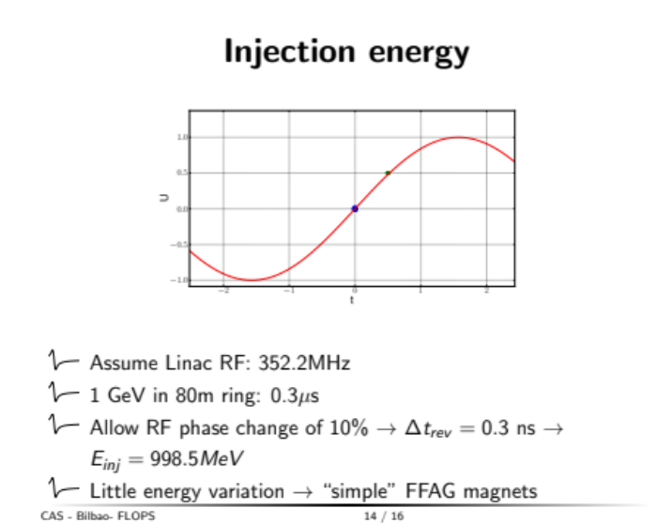
Most Innovative
Anirban BHATTACHARYYA, Ulrich DORDA, Roger BARLOW & Nikolaj ZANGENBERG

Slide 8
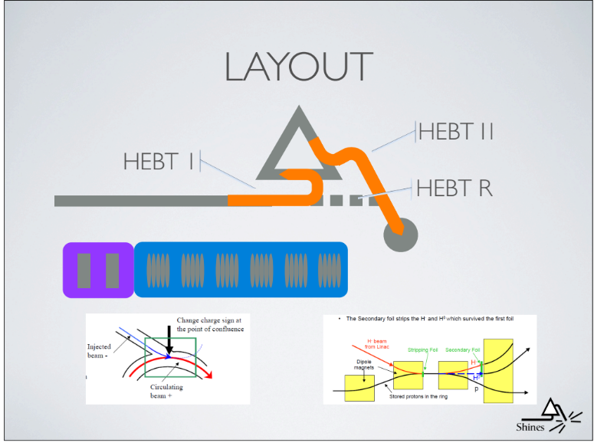
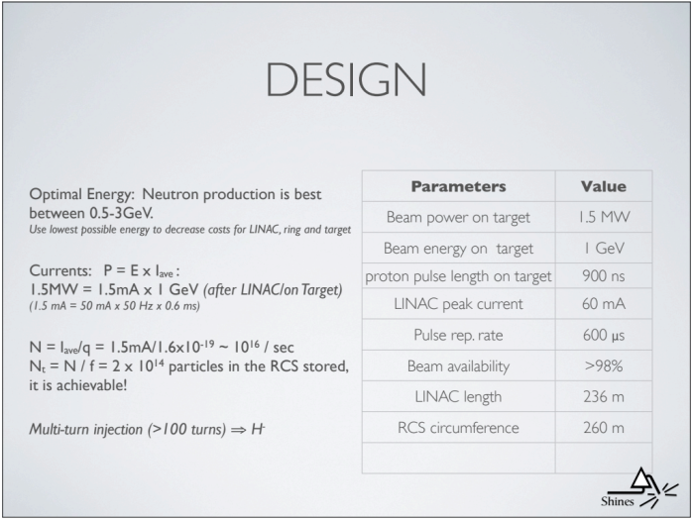

Best Overall Project
Cesare MAGLIONI, Mohammad ESHRAQI, Abel ROBIN & Josu EGUIA

Slide 9
Summary
Thank you all for an excellent job!!!

