Slide 1
Radioactive Ion Beams
CW
0.5 MW (for protons)
1 GeV (for protons)
p to U
May 2011, CAS, Bilbao
Chiara, Manuel, Adam, Hui

Slide 2
Contents
Frag vs ISOL
Overview & Layout
Components:
  Superconducting Drive beam cyclotron (RF,cryo,magnets)
  Target
  Stripping / cooling
  Spectrometer
  RFQ (-> possible exit to low-E experiment)
  Post-acceleration cyclotron
  Instrumentation
Conclusion
May 2011, CAS, Bilbao
Chiara, Manuel, Adam, Hui

Slide 3
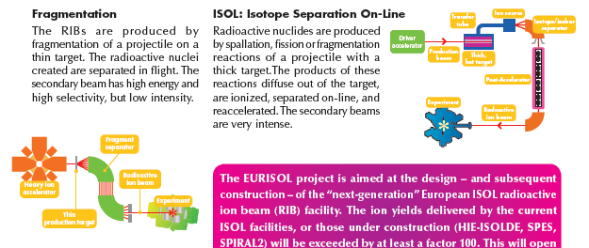
Fragmentation vs ISOL
ISOL:
Compact and flexible
Wide variety of users
Possible upgrade for fragmentation machine
ISOL
1
May 2011, CAS, Bilbao
Chiara, Manuel, Adam, Hui

Slide 4
Beams of Ions from the Gigavolt – Megawatt Advanced Cyclotron
Proton source
RFQ
Target
Stripper
Spectrometer
RFQ
Transfer line
Reduce costs by sharing magnetic field
Superconducting main+trim coils for power saving
2
May 2011, CAS, Bilbao
Chiara, Manuel, Adam, Hui

Slide 5
Beams of Ions from the Gigavolt – Megawatt Advanced Cyclotron
(BIGMAC)
RFQ
Proton source
Target
Drive beam
High energy experiments
/ fragmentation
Radioactive beam
Injection (bend or tune energy)
Stripper
RFQ
Low energy experiments
Spectrometer
3
May 2011, CAS, Bilbao
Chiara, Manuel, Adam, Hui

Slide 6
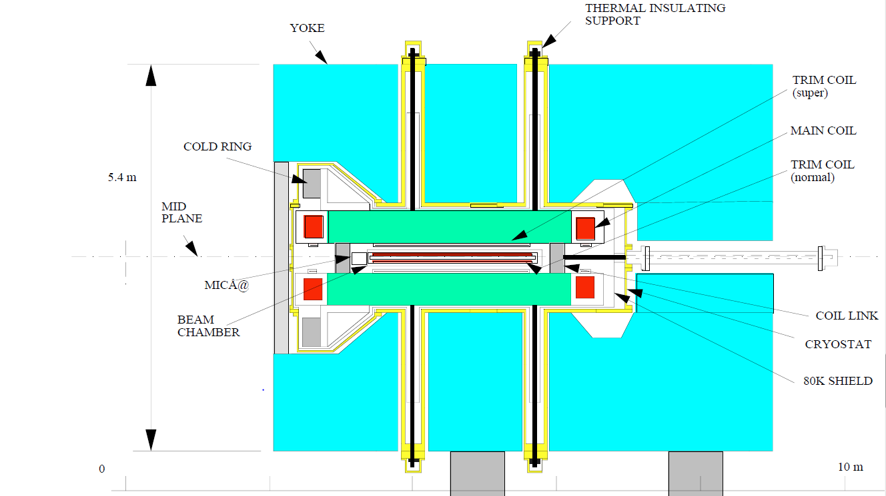
Sector magnets
Field strength 3T
Extraction radius 1.5m
Magnet radius 3m
Height 6m
Protons to 1 GeV
Radioactive ions to ~100 MeV / u
Based on RIKEN magnets
Adapted for dual beam chamber
4
May 2011, CAS, Bilbao
Chiara, Manuel, Adam, Hui

Slide 7
RF resonators
Independent systems for protons and RIs
100 MHz resonators for protons
Tunable 20-50 MHz for RI.
4 cavities for acceleration
1 for flat-topping (increase long. acceptance)
Independent powering (tetrodes)
5
May 2011, CAS, Bilbao
Chiara, Manuel, Adam, Hui

Slide 8
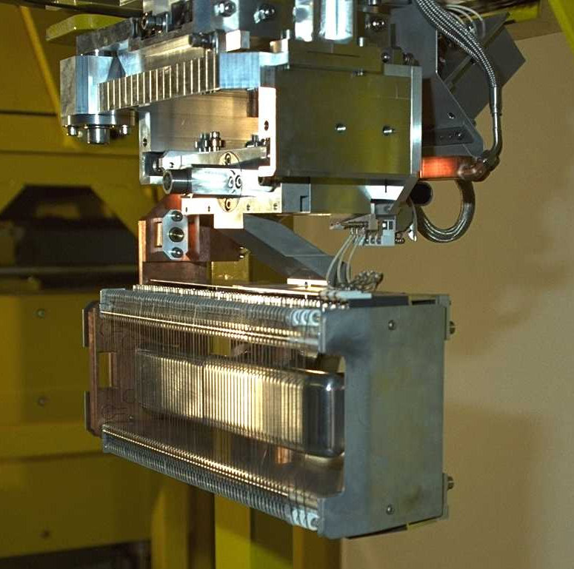
Extraction
Movable stretched-wire septum (up to 150 kV)
Beam channel 15 mm
Off-center injection for Betatron oscillations
Extraction loss 0.01%
6
May 2011, CAS, Bilbao
Chiara, Manuel, Adam, Hui

Slide 9
Target, stripping, separation
TARGET
Rotating target: different target materials, change target in case of damage
Remote handling
Helium gas cooling
STRIPPING
Foil stripper (rotating)
Laser stripping
SEPARATION
Dipole spectrometer
Beam dumps
Slit + collimators
7
May 2011, CAS, Bilbao
Chiara, Manuel, Adam, Hui

Slide 10
Instrumentation
collector
Drive beam:
  Current transformers
  Faraday cups (for commissioning)
  Feschenko monitor
  Beam loss monitors
  Wire scanner (low intensity only)
  Electron jet scanner
Transfer lines: BPMs, BLMs, residual gas ionisation PMT
RI beam: OTR screen (possible pepperpot)
Radiation monitors
p+
H0
e- gun
Scintillator
8
May 2011, CAS, Bilbao
Chiara, Manuel, Adam, Hui

Slide 11
Conclusion
Multipurpose
  Solid state physics & biology
  Medical isotope production
  Nucleosynthesis for astrophysics
Compact
Efficient
Low cost
i’m lovin’ it…
9
May 2011, CAS, Bilbao
Chiara, Manuel, Adam, Hui

