Slide 1
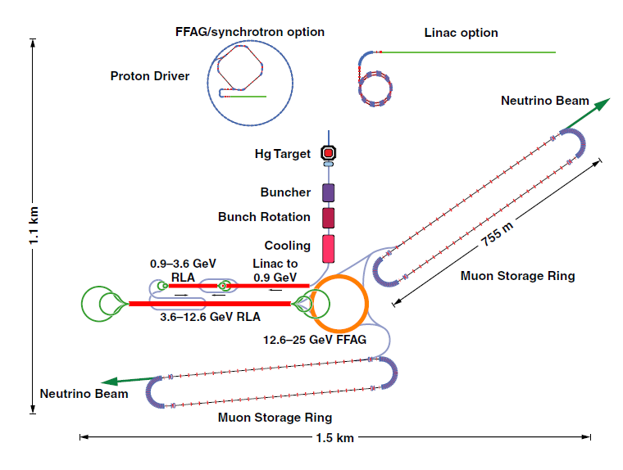
Neutrino Factory by
Zunbeltz, Davide, Margarita, Wolfgang
IDS proposal

Slide 2
Neutrino Factory - Our Specs
4 MW beam power
2 - 8 GeV kinetic energy
5 bunches of 3 ns length
50-60 Hz rep rate
Target

Slide 3
Neutrino Factory: ¿our? Approach
Compressor Ring
5 GeV
Accumulator Ring
H- Linac
Target
Laser assisted charge- exchange Injection
R. Garoby, E. Benedetto, M. Aiba, M. Meddahi
CERN, Geneva, Switzerland

Slide 4
5 GeV Linac as Proton Driver
352 MHz
704 MHz
H- Source
LEBT
RFQ
Chopper
DTL
PIMS (SC)
LowBeta (SC)
HighBeta (SC)
45 keV
3 MeV
3 MeV
80 MeV
160MeV
5GeV
Linac4/SPL…
H⁻ 50Hz Penning Source
Chopping at 3MeV
SC only after DTL -> save cost
Step in frequency after DTL -> reduce footprint

Slide 5
Linac Time Structure
20 ms
H⁻ Ion Source 50 Hz rep rate
480 µs
5 batches / accumulator turn
After
Chopper
…
Gaps of 60 ns (chopper)
Batch length: 140 ns
(50 linac bunches)
2400 batches (10¹⁴ protons) / pulse

Slide 6
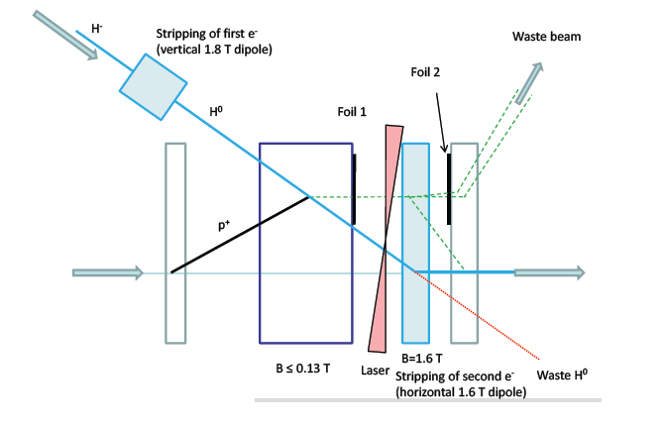
H⁻ – Injection
Laser assisted to avoid foil
Transverse painting to reduce SC effects

Slide 7
Accumulation and Compression
Injection into Acc-Ring (480 turns)
Accumulation: transverse x and y phase-space painting
No RF in Accumulator Ring (Isochronous)
Slippage Factor = 0
Compressor Ring
5 GeV
Accumulator Ring
(Circ: ~300 m )
H- Linac
Target

Slide 8
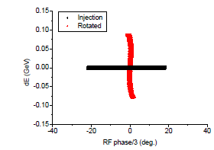
Bunch Compression
Required bunch length 3ns
Bunch rotation in two ways
  Fast bunch compression with voltage detuning
  Dephasing of the longitudinal bucket
  Consider ¼ of synchroton period
M. Aiba

Slide 9
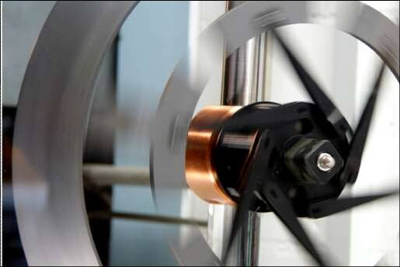
Extraction - Target
Fast extraction
Tungsten rotating wheel target
Compressor Ring
5 GeV
Acumulator Ring
H- Linac
Charge- Exchange Injection
Target

Slide 10
Conclusion
Linac length/energy
Laser assisted H- stripping to avoid foil damage
Accumulator + Compressor vs All-In-One
longitudinal requirements contradictory
Use multi turn injection to achieve required bunch current -power
Avoid ramping of circular machines

Slide 11
Green Field
Hot target cooling water flows through a generator providing part of the electricity needed by the accelerator facility

Slide 12
Green Field
Hot target cooling water flows through a generator providing part of the electricity needed by the accelerator facility
Locate neutrino factory next to nice mountains to provide nice skiing and hiking area for scientists…

Slide 13
Extra slides

Slide 14
Linac as proton driver
Parameters:
  Output Energy 5GeV
  70mA peak current
  35 % chopping factor
  2.4% duty cycle -> 480 us pulse length
  Num. particles per bunch 1.14 x10 ⁹
  Num. Bunches per pulse =50

