Slide 1
Design 4: ADS
Group 2
I. Bustinduy, J.-B. Lallement, M. Almalki,
H.D. Thomsen

Slide 2
High Level Parameters
20 MW = 1 GeV H⁺ x 20 mA
CW
Myrrha, Eurotrans, XADS

Slide 3
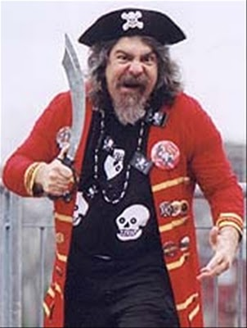
Demands
High-power baryonic beam for transmutation/power prod.
Reliable and available CW beam: avoid thermal stresses on the ADS beam window, target and sub-critical assembly
Target: Best left in steady state!
ADS application calls for
  Non-strained elements
  Redundancy
  Fault protection (accelerating and focusing elements)
The European Technical Working Group on ADS, ‘‘A European Roadmap for Developing Accelerator Driven Systems (ADS) for Nuclear Waste Incineration,’’ ENEA (2001), ISBN 88-8286-008-6.

Slide 4
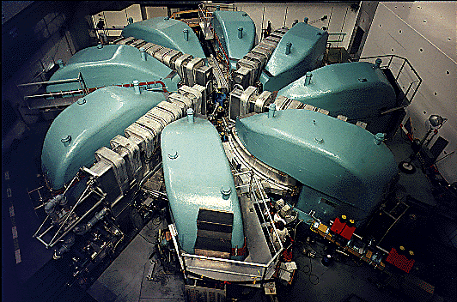
LINAC vs Ring
LINAC
Cyclotron
Large building cost but high running efficiency
Inherently long!
Beam extraction
Modular redundancy (fault-tolerance)
Energy & intensity
Low building cost.
Compact but dense!
Beam extraction
No intrinsic redundancy.
No feasible energy upgrade.
Relatively low currents

Slide 5
LINAC – NC & SC
352 MHz
704 MHz
5 cells/cav
7 cells/cav
H⁺
LEBT
RFQ
0.09
0.25
0.40
0.60
0.80
β_{g}
MEBT
HWR
Low β
HWR
High β
Elliptical
Low β
Elliptical
Med β
Elliptical
High β
HEBT
H⁺
LEBT
RFQ
3 MeV
10 MeV
50 MeV
150 MeV
450 MeV
1 GeV
W
45 keV
E_{a} = 5 MeV/m
E_{a} = 11 MeV/m
30 mA
20 mA
200 – 300 m
Reduce cell length & tolerances
~100 klystrons, diagnostics!

Slide 6
Source & LEBT
Double Front End (Parallel Redundancy!)
2 x H⁺ ECR source (hot stand-by spare)
Solenoids
H⁺
RFQ
3 MeV
45 keV
H⁺
RFQ

Slide 7
MEBT
3D Collimation: Remove Halo before SC!
Match to HWR
-90 deg
-90 deg
RFQ
HWR
Low β
20 mA
σ_{t} = 90 deg
losses in LEBT, RFQ = good transmission, iris = adjust currents + emmit. + halo
collimators
ACCT/DCCT
BPM

Slide 8
SC Half Wave Resonators (IFMIF)
DTL, CH, Spokes, QWR
HWR:
  Well-proven
  Flexible, can sustain alignment and field errors (IFMIF)
  β_{g}=0.09 (3.82MeV)
  β_{g}=0.25 (30.77MeV)
  Quadrupole focusing

Slide 9
Reliability – Serial Redundancy!
Local Compensation Method – SNS, Myrrha (& ESS?)
Lost beam ➔ quench/activation (hands-on!)
Single element failure: Online retuning of adjacent cavities and/or quads
  Few cavs / RF structure
  Some 30% safety margin
  Fast diagnostics and digital feedback (FPGA?) to LLRF
Failure

Slide 10

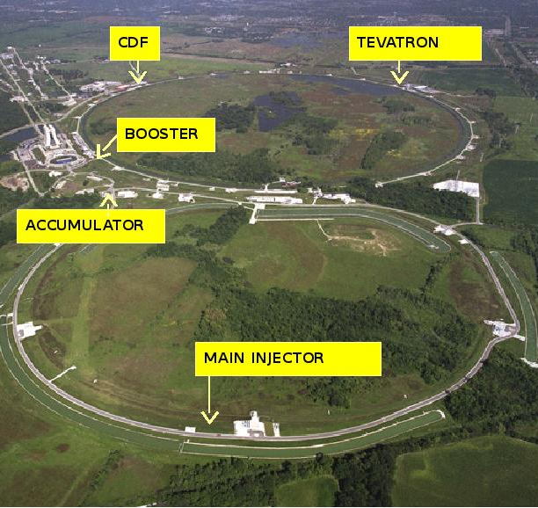
HEBT
Permanent Magnets?
  Compact
  Power consumption
  Reliable!
FNAL pbar Recycler Ring (brown- and blackouts)

Slide 11
LADSUCAS11
Linear ADS Facility Developed Only During CAS11
352 MHz
704 MHz
5 cells/cav
7 cells/cav
H⁺
LEBT
RFQ
0.09
0.25
0.40
0.60
0.80
β_{g}
MEBT
HWR
Low β
HWR
High β
Elliptical
Low β
Elliptical
Med β
Elliptical
High β
HEBT
H⁺
LEBT
RFQ
3 MeV
10 MeV
50 MeV
150 MeV
450 MeV
1 GeV
W
45 keV
E_{a} = 5 MeV/m
E_{a} = 11 MeV/m
30 mA
20 mA
200 – 300 m
Thanks for the attention!

Slide 12
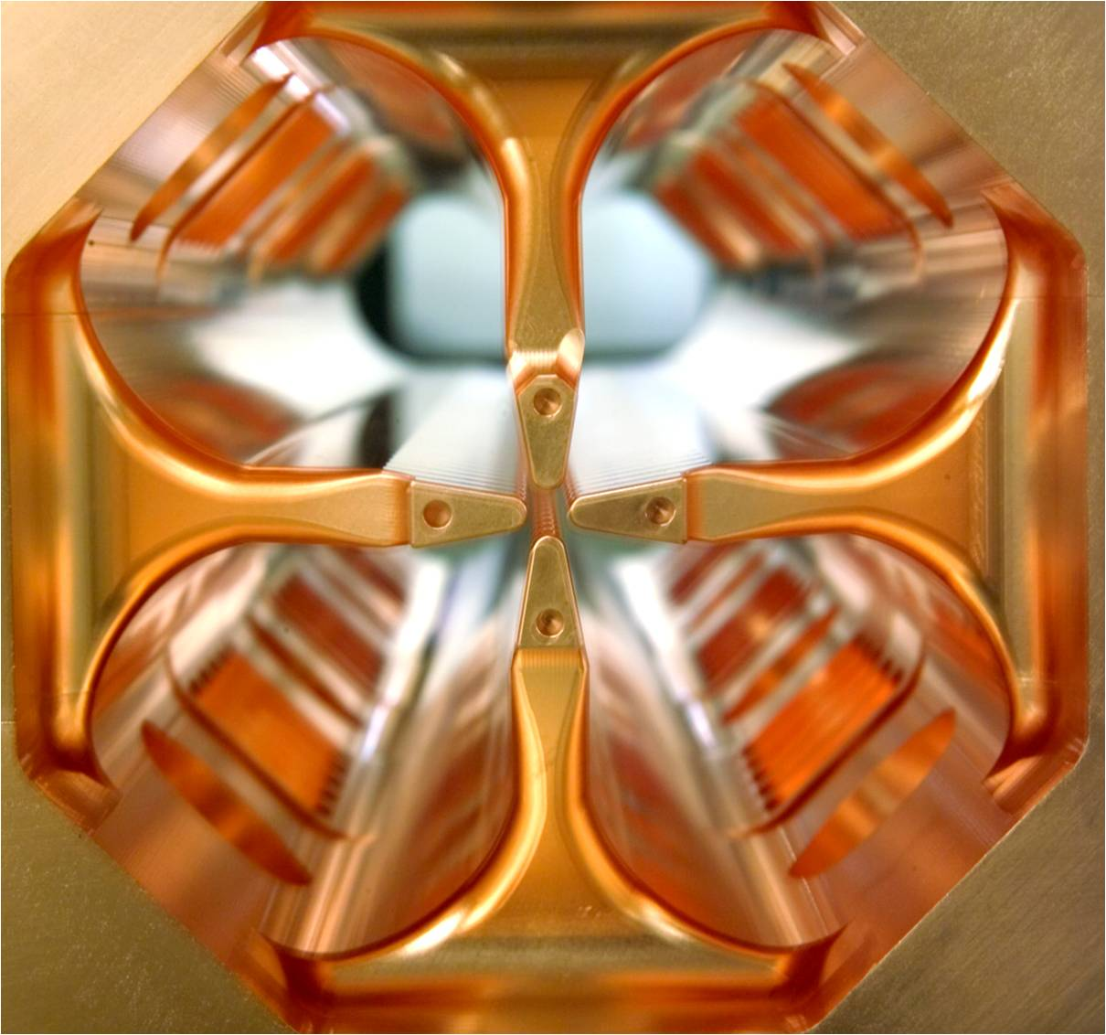
RFQ (linac4?)
4 vane structure
IPHI (CEA, CNRS, CERN)
  3 MeV, 100 mA, cw
  Fault tolerant design
Revised IPHI
  Lower power consumption
  Shorter (3 m)
  0.045 ➔ 3 MeV (hands-on maintenance!)

Slide 13
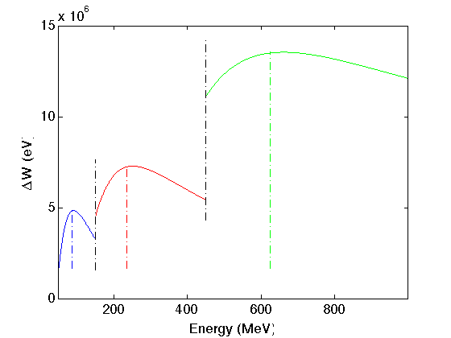
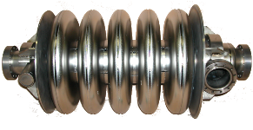
SC Elliptical Cavities (ESS, SPL)
Low β (0.4):
  5 cells / cav.
  50 ➔ 150MeV (~25 cav)
Med β (0.6):
  7 cells / cav.
  150 ➔ 450MeV (~46 cav)
High β (0.8):
  7 cells / cav.
  450 ➔ 1000 MeV (~42 cav)
Doublet focusing btw. cryostats
11 MeV/m (SPL: 19.3 MeV/m)
Room for cryostat, etc.

