Slide 1


CW neutron source
Benjamin Cheymol, Angel Jesus Romero Serrano, Jesus Alonso, Lali Tchelidze

Slide 2
CW Neutron Source
Pulse length: CW
Average beam power: ~ 1.5 MW
Beam energy: 0.5 – 4 GeV
Particle type: p or H⁻

Slide 3
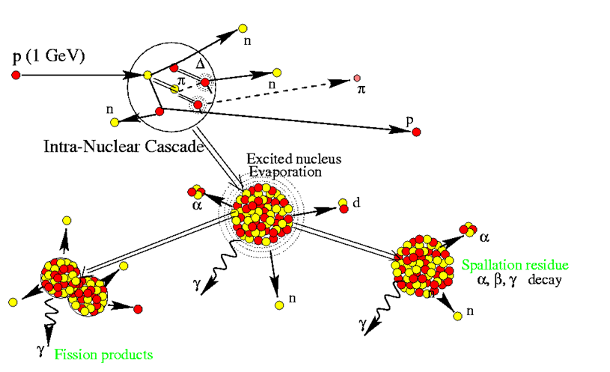
Spallation
For energies > 100 MeV, the neutron yield stays depends only on the beam power!

Slide 4
Linac vs Cyclotron
LINAC
protons
1 GeV
1.5 mA
Pros:
Low losses
Easy to upgrade
Cons:
long
Expensive
Cyclotron
protons
600 MeV
2.5 mA
Pros:
Vey compact
Relatively cheap
Cons:
Relatively high losses
Hard to upgrade

Slide 5
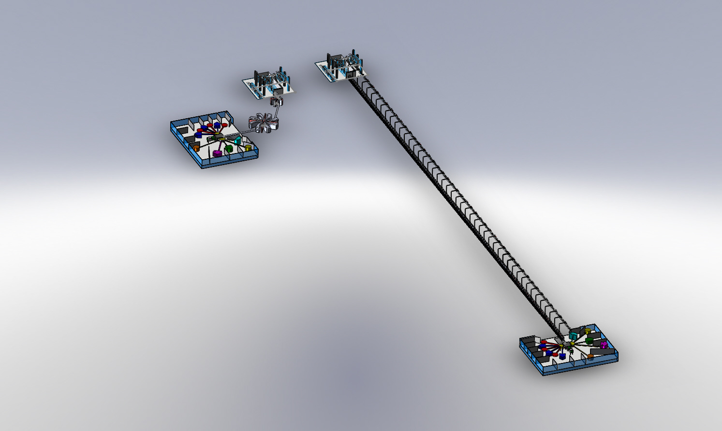
Linac vs Cyclotron
300 m – linac length
15 m – cyclotron diameter
Jesus Alonso

Slide 6
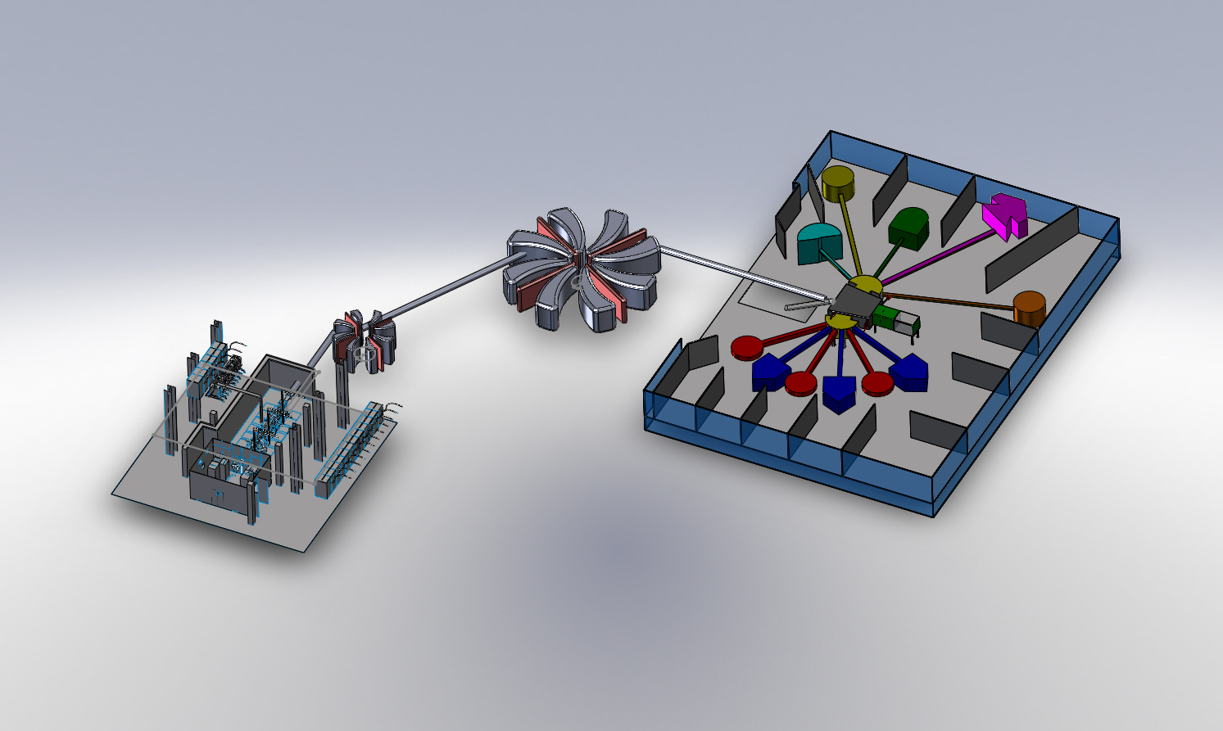
Cyclotron
ECR source + RFQ (Energy at the exit ~2.5MeV)
    Need 2.5 mA
First solenoid to accelerate the beam to 72 MeV
    4 sectors cyclotron
Second Solenoid up to 600 MeV
    8 sectors cyclotron
Jesus Alonso
Use the same RF frequency or all the different part (around 50 Mhz).
The RFQ will be a 4-rods RFQ.
The cyclotron frequency is much lower than the RF frequency.
injection on the nth harmonic
f_{RF}=n*f_{cyclotron}
The losses at the extraction of the cyclotrons must be controlled

