Slide 1
CASE STUDY 3
CW NEUTRON SOURCE
European Spallation Neutron Source ESNS
Ali Almomani, IAP- Frankfurt University
Anne I. S. Holm, Institute for Storage Ring Facilities, Aarhus University
Renaud Barillere, CERN
David Canoto, ESS-Bilbao
CAS – Bilbao
May 31, 2011

Slide 2
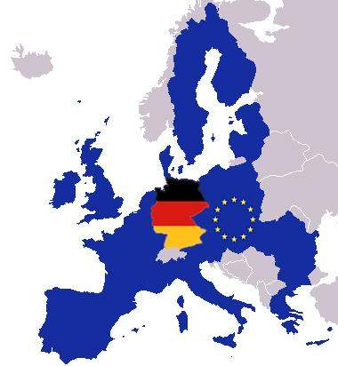
HOUSING COUNTRY -GERMANY

Slide 3
HIGHER ORDER PARAMETERS
Proton energy | 1 GeV
Beam intensity (CW) | 1.5 mA
Beam stability | energy ±1% intensity ±2%, size ±10%
Time structure | CW

Slide 4
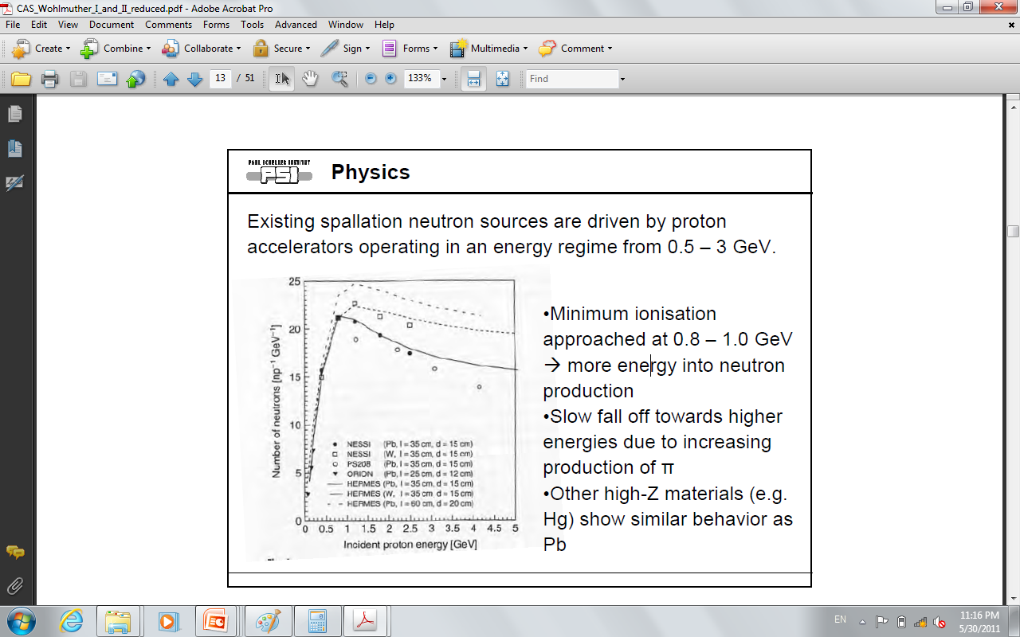
WHY 1 GeV?
CAS 2011, Wohlmuther

Slide 5
LINAC vs CYCLOTRON
LINAC | CYCLOTRON
Large space requirement (few hundred m long) but light | Compact but heavy
Expensive but low operation cost | Cheaper in construction
Less efficient power conversion | More efficient power conversion
Modularity provides redundancy | No intrinsic redundancy
Upgradable in energy | Difficult to upgrade in energy, NOT realistic
Straightforward beam extraction | Difficult extraction and related beam losses
Capable of high beam current (100 mA) | Modest beam current capability (5 mA)

Slide 6
PROJECT OVERVIEW
TS
HEBT
Proton SOURCE
LINAC

Slide 7
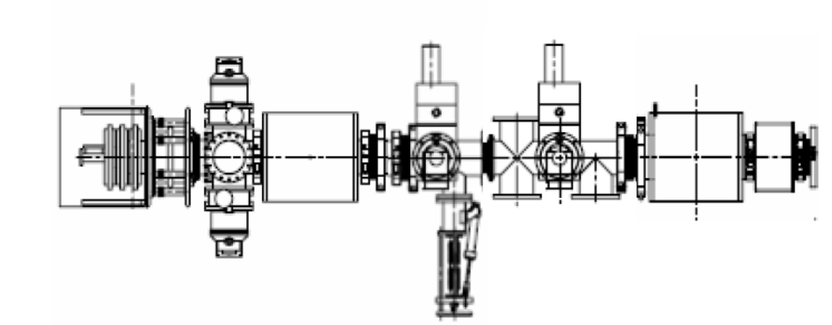
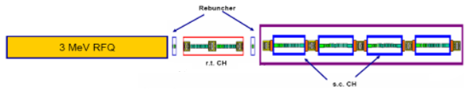
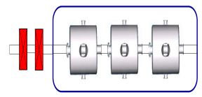
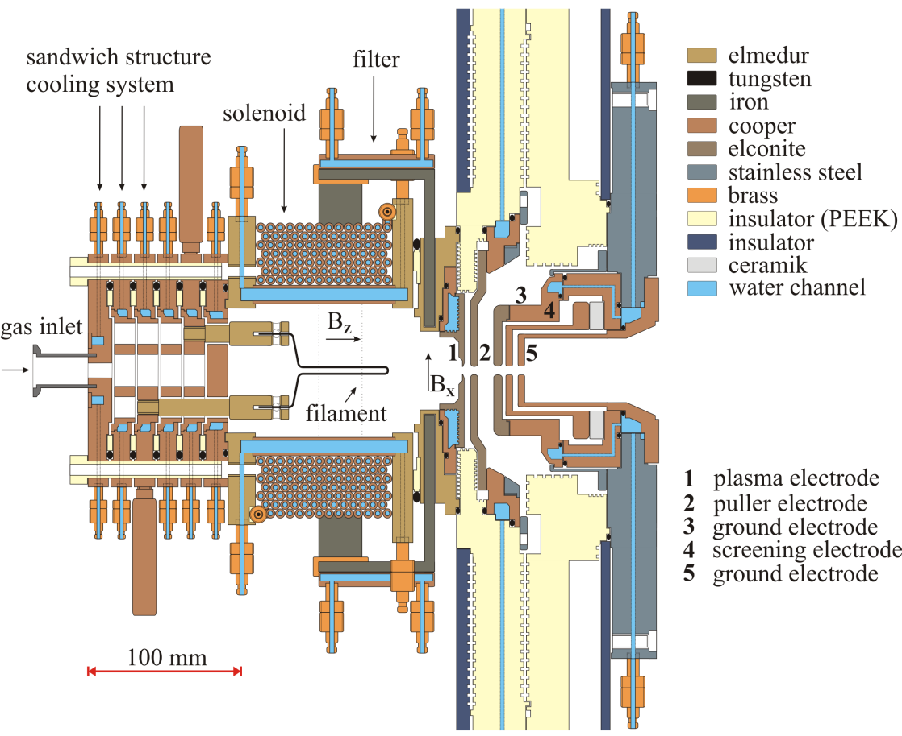
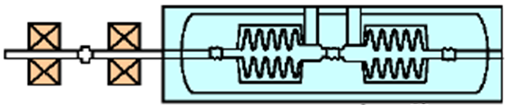
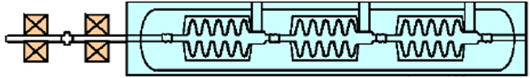
LINAC
Ion source
LEBT
MEBT
Spoke LINAC
352 MHz
Rebuncher
352 MHz
352 MHz
352 MHz
r.t CH
5 MeV
s.c CH
20 MeV
β = 0.35
Elliptical LINAC
704 MHz
704 MHz
704 MHz
352 MHz
352 MHz
352 MHz
200 MeV
β = 0.45
100 MeV
60 MeV
704 MHz
704 MHz
β = 0.65
600 MeV
HEBT
Spallation source
704 MHz
704 MHz
β = 0.85
1000 MeV
Thanks to IAP- Frankfurt University and MYRRAH

Slide 8
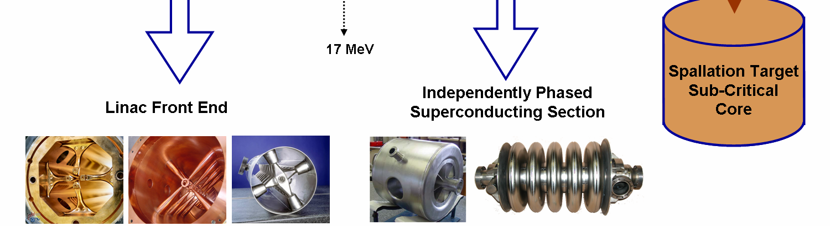
LINAC
Ion source
LEBT
MEBT
Spoke LINAC
352 MHz
Rebuncher
352 MHz
352 MHz
352 MHz
r.t CH
5 MeV
s.c CH
20 MeV
β = 0.35
Elliptical LINAC
704 MHz
704 MHz
704 MHz
352 MHz
352 MHz
352 MHz
200 MeV
β = 0.45
100 MeV
60 MeV
704 MHz
704 MHz
β = 0.60
β = 0.75
600 MeV
HEBT
Spallation source
704 MHz
704 MHz
β = 0.85
1000 MeV

Slide 9
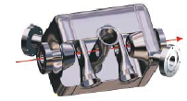
LINAC
Ion source
LEBT
MEBT
Spoke LINAC
352 MHz
Rebuncher
352 MHz
352 MHz
352 MHz
r.t CH
5 MeV
s.c CH
20 MeV
β = 0.35
Elliptical LINAC
704 MHz
704 MHz
704 MHz
352 MHz
352 MHz
352 MHz
200 MeV
β = 0.45
100 MeV
60 MeV
704 MHz
704 MHz
β = 0.65
600 MeV
HEBT
Spallation source
704 MHz
704 MHz
β = 0.85
1000 MeV

Slide 10
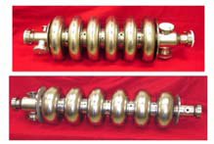
LINAC
Ion source
LEBT
MEBT
Spoke LINAC
352 MHz
Rebuncher
352 MHz
352 MHz
352 MHz
r.t CH
5 MeV
s.c CH
20 MeV
β = 0.35
Elliptical LINAC
704 MHz
704 MHz
704 MHz
352 MHz
352 MHz
352 MHz
200 MeV
β = 0.45
100 MeV
60 MeV
704 MHz
704 MHz
β = 0.65
β = 0.75
600 MeV
HEBT
Spallation source
704 MHz
704 MHz
β = 0.85
1000 MeV

Slide 11
HEBT to TARGET INTERFACE
Secondary shielding
Target monolith
Target
Proton beam window
Fixed collimators
Beam expansion system
Bending magnet
Combined beam dump/
Neutron beam catcher

Slide 12
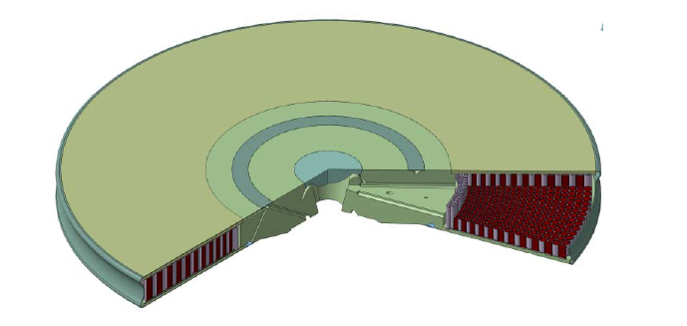
THE TARGET
Rotating disk, with (heavy)-water cooled tungsten rods
Cooling water in = 40 degrees

Slide 13
INVESTMENT BUDGET
2012 - 2025
Investment 1000 M€
Building
240 M€
Equipment
370 M€
Engineering
200 M€
Contingences
190 M€

Slide 14
FUNDS
Sources | Participation | Strategic aspect (motivation)
Germany | 40 % | Need to be hosting country Chances for EU support
Other EU countries (FR, GB, IT, SP, …) | 30 - 40 % | increase expertise / high level waste reduction / renaissance of nuclear program / participating in large research infrastructure
ROW countries (JP, KR,…) | 7 - 10 % | international scientific collaboration
EU grants (FP – SET-Plan) | 5 - … | EU-RTD (FP) / EU-TREN (SET-Plan)
Private sector | ? | energy players / technology providers financial agents / financial funds

Slide 15



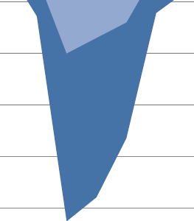

PROJECT PLAN
Phase I
2012 - 2014
Phase II
2015 - 2019
Phase III
2020 - 2025

Slide 16
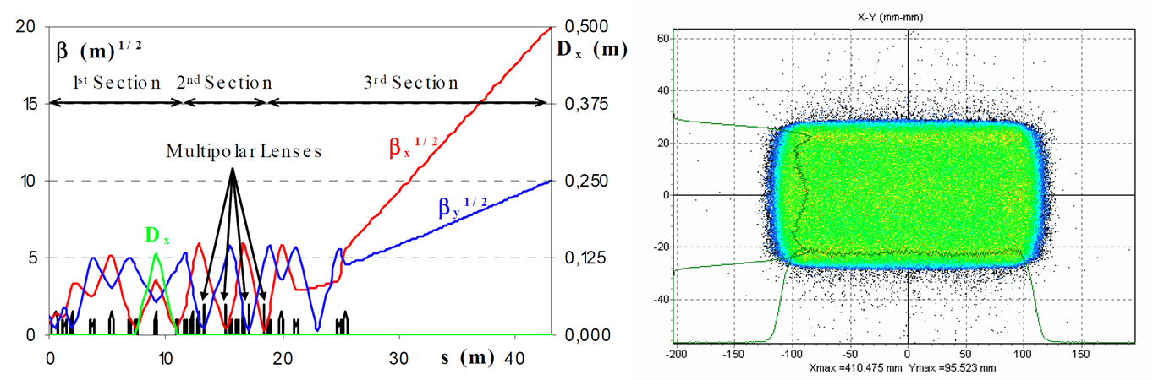
HEBT-S3 – BEAM EXPANSION
HEBT-S3 will utilise a combination of QPs and octupoles to produce a flat intensity distribution
Increase the lifetime of the target

Slide 17
HEBT
HEBT- S1:
Same focusing structure as linac (QPs) -> upgrade
HEBT-S2:
2 dipoles
QPs – focus and zero dispersion
HEBT-S3:
Beam expansion system
QPs and octupoles
TS
HEBT-S3
HEBT-S2
LINAC
HEBT-S1

Slide 18
MOTIVATION
Neutron sources are needed for several structure and dynamics studies like:
Condensed matter
Control of fission- based energy production
Materials test for fusion reactor
Tritium production.
• Irradiation Services – Medical RI

