Slide 1
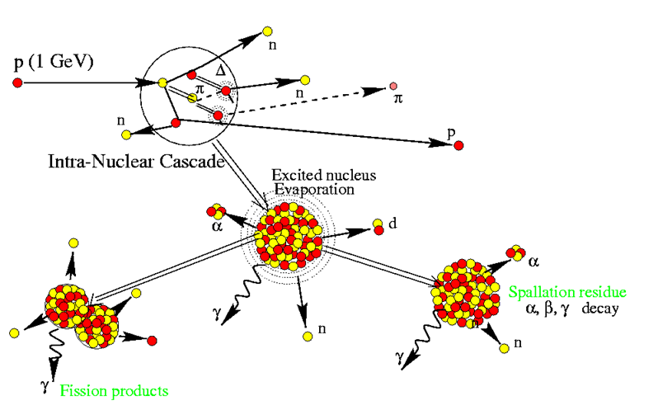
HiPoSpaNS
High Power Spallation Neutron Source
Tobias Bär,
Miriam Fitterer,
Fernando Mirapeix,
Robert Williamson

Slide 2
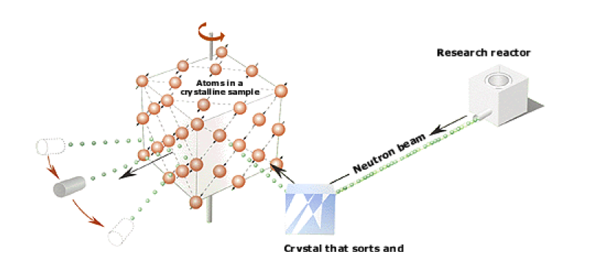
Why do we want a spallation neutron source?

Slide 3
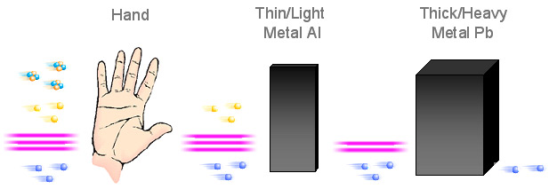
Neutrons penetrate deep into matter
Alpha
Beta
X-rays
Neutron

Slide 4
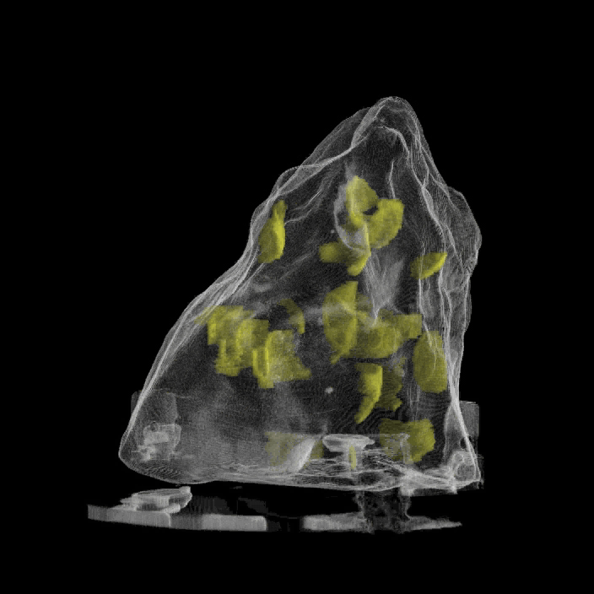
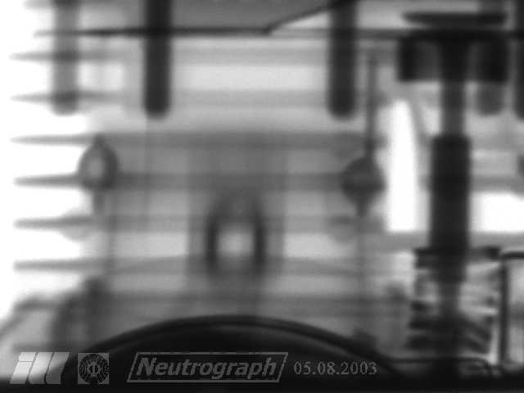
Neutrons “see” the world in a unique way

Slide 5
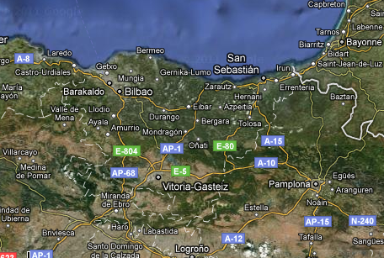
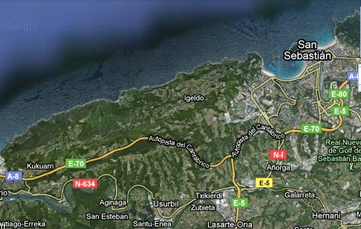
HiPoSpaNS Site
HiPoSpanNS site: about 10km west of San Sebastian (Spain)
HiPoSpaNS

Slide 6

Schematic Layout
Management and HR
Source, RFQ, Linac
Injection
Tetrode gallery
RF
Extraction
FIPPS Target &
Experimental Hall

Slide 7
Injector
H- Ion Source
LEBT
RFQ
MEBT
DTL
CCL
SCL
65 keV
3 MeV
50 MeV
200 MeV
400MeV
Penning type H- ion source, 1ms
3 solenoid LEBT
4-vane RFQ, 324 MHz
Fast chopper in MEBT
Frequency jump at CCL to 648 MHz
Superconducting linac to 400 MeV

Slide 8
Synchrotron
0.4 – 1.5 GeV RCS
700m, 3 superperiod doublet lattice
Sinusoidal B field (0.27 – 0.6T)
Ceramic vacuum chamber
RF frequency sweep
  Magnetic alloy loaded cavities
  (304 – 415 kHz, 608 – 830 kHz)
Gamma Transition 9.14
H- Charge exchange injection
  Carbon foil
  1.25 x 10¹⁴ protons over 670 µs (~200 turns)
Fast kicker extraction of 1µs pulse
RCS

Slide 9
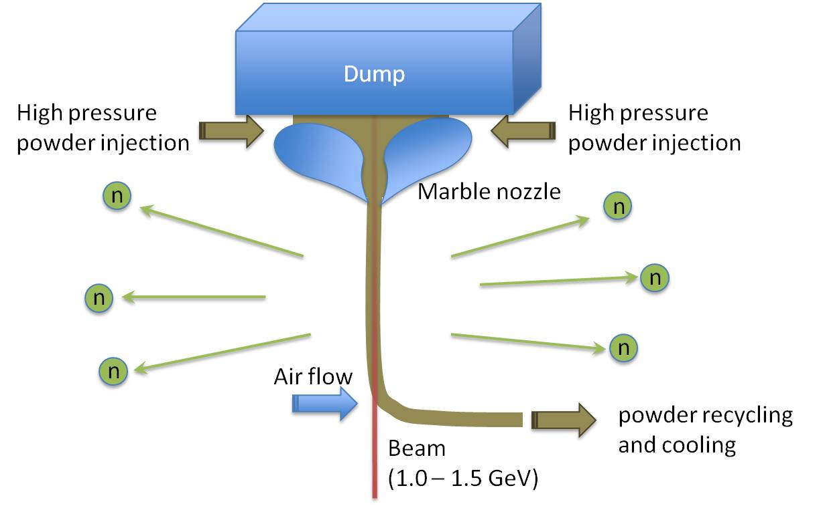
T-FIPPS Target
Tunable Fully Integrated Power Powder Stream Target

Slide 10
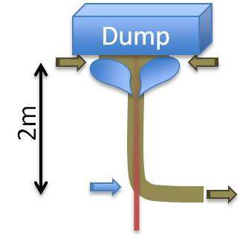
T-FIPPS Target Parameters
Powder material: W, Ni, Ti, (U)
Beam-Powder interaction length: 2m
(≈2.5 ∙ mean free path in W powder)
Jet velocity: 5m/s
Neutron flux: About 30n/p, -> 3∙10¹⁷ n/s

Slide 11
Summary
High power microscope for the future
Large neutron user community
A steal at only €1bn
Several upgrade paths
Investment for the future

