Slide 1
Medical applications
Caterina Biscari
Alba-CELLS

Slide 2
~30000 accelerators in the world

Slide 3
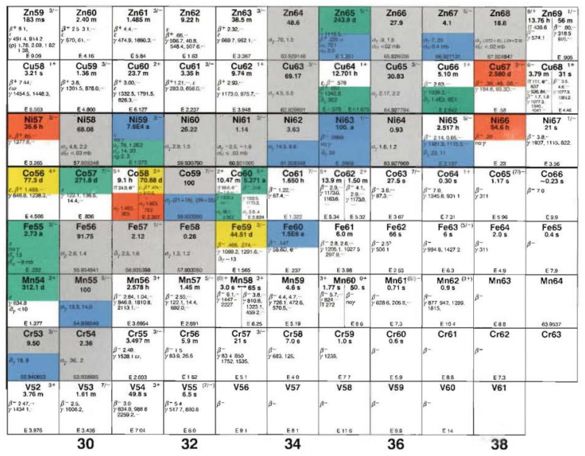
Isotope production
Isotope production for medical diagnoses purposes - First isotopes produced by Lawrence in his cyclotron in 1934
Since then both nuclear reactors and accelerators produce isotopes for an ever increasing demand
Accelerators are used to bombard production targets with beams of charged nuclei impinging on targets to produce a wide range range of isotopes
The range of particle energies and intensities vary between facilities -- 10 - 100 MeV for commercial cyclotrons dedicated for isotope production, with higher energies available at some research accelerators
See for example:
http://www.isotopes.gov/outreach/reports/Medical_Isotope_Production_Use.pdf

Slide 4
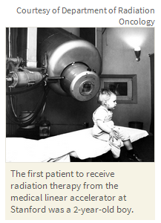
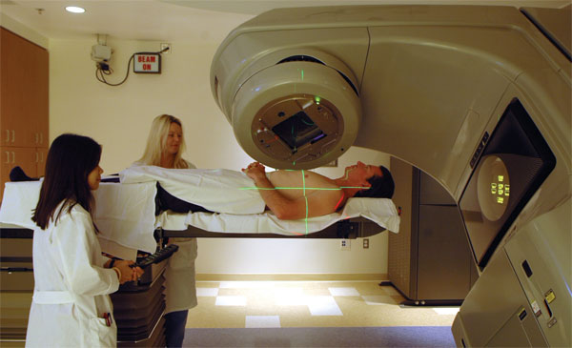
Cancer therapy: X-rays
1937: first X-rays irradiation from van de Graaff electrostatic machine
1956 : first patient treated with radiotherapy at Stanford – eye tumor
Since then 40 millions patients have been treated
Today 50% of cancer patients are X-ray treated (70% in industrialised countries), either alone or in combination with other techniques.
Electron Linacs (4 – 22 MeV) produce e- to be shot on a metallic target and produce X-rays
Commercially produced
Thousands of compact and fully reliable Linacs are daily treating patients
Control of radiation dose and radiation fields decrease collateral effects
IMRT = intensity modulated radiation therapy

Slide 5
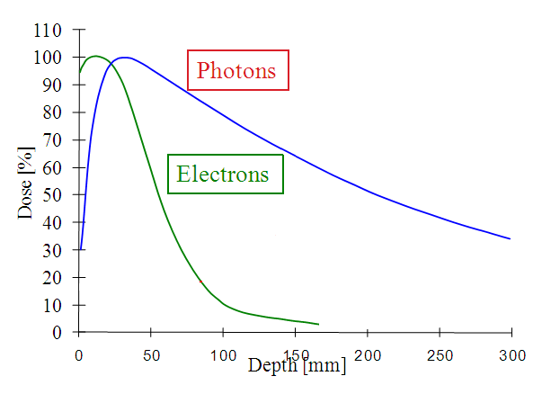
Radiotherapy
Radiotherapy uses electrons and photons to kill cancer cells damaging the DNA.
These particles loose energy at beam entrance and then exponentially.
The depth-dose deposition characteristics cause damage also to healthy tissues
Computer-aided treatment plans (IMRT) allows to reduce this counterpart

Slide 6
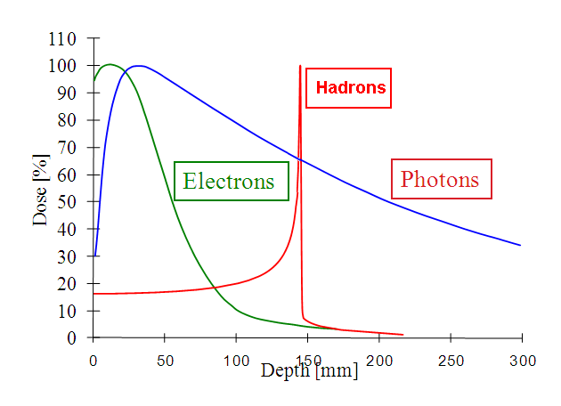
Radiotherapy and hadrontherapy
Hadrontherapy uses hadrons (protons and ions)
Particles at high energy deposit relatively little energy as they enter an absorbing material but tend to deposit extremely large amounts of energy in a very narrow peak, the Bragg peak, as they reach the end of their range: Very localized depth-dose deposition
The depth and magnitude of the Bragg peak is determined by the mass and charge, as well as the particle initial energy

Slide 7
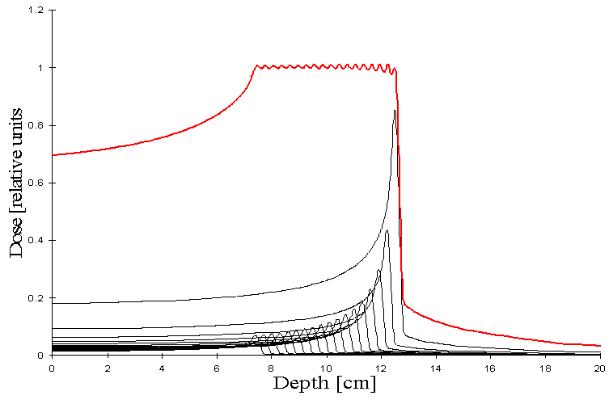
Hadrontherapy: Spread Out Bragg Peak
It is possible to localize longitudinally the irradiation only on the tumor target:
hadrontherapy is a high precision kind of radiotherapy.

Slide 8
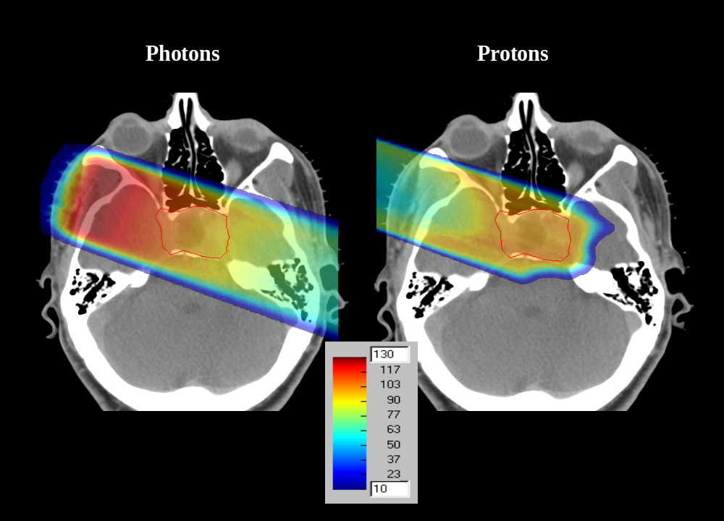
Macroscopic advantage of hadrons
X rays
protons
Rapid fall-off

Slide 9
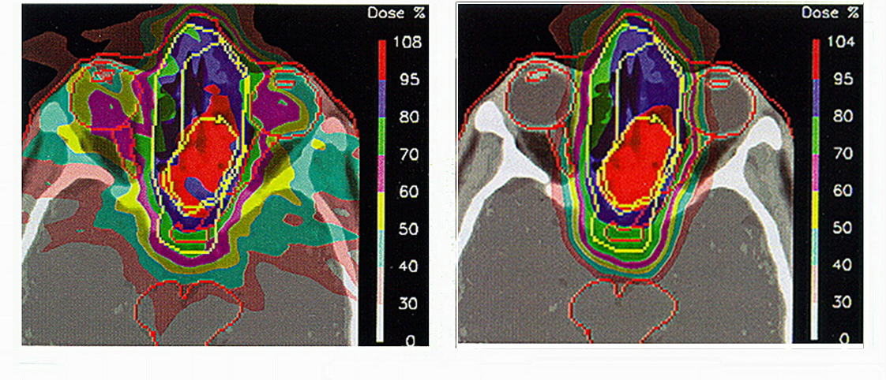
Better dose distribution
9 X beams 1 proton beam
tumor between eyes

Slide 10
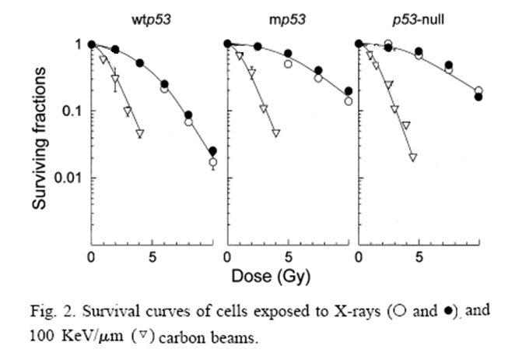
Cell survival
SF = exp[-(αD+βD²)]

Slide 11
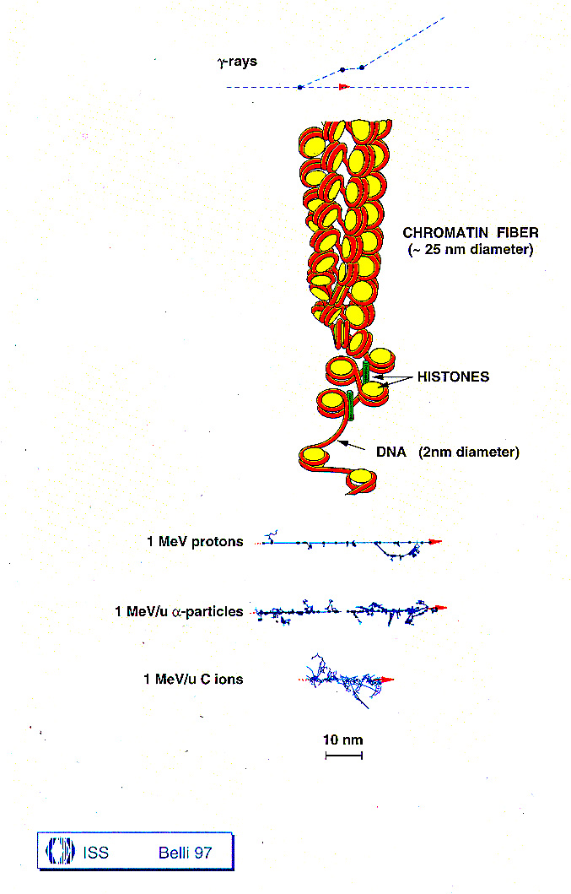
Ionization breaks chemical bonds
Free radicals creation (mainly hydroxyl radical, OH⁻, and superoxide, O₂⁻ . Poison for the cell!)
The target is DNA, ionization distribution is relevant

Slide 12
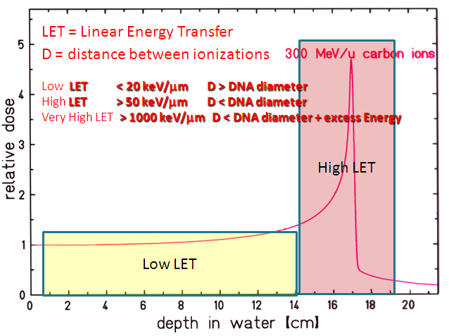
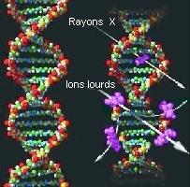
LET Linear Energy Transfer
Hadrontherapy biological basis
Carbon ions have higher LET than protons
Low LET
High LET
D = distance between ionizations
Energy deposition in matter
Low LET < 20 keV/mm D > DNA diameter
High LET > 50 keV/mm D < DNA diameter
Very High LET > 1000 keV/mm D < DNA diameter + excess Energy

Slide 13
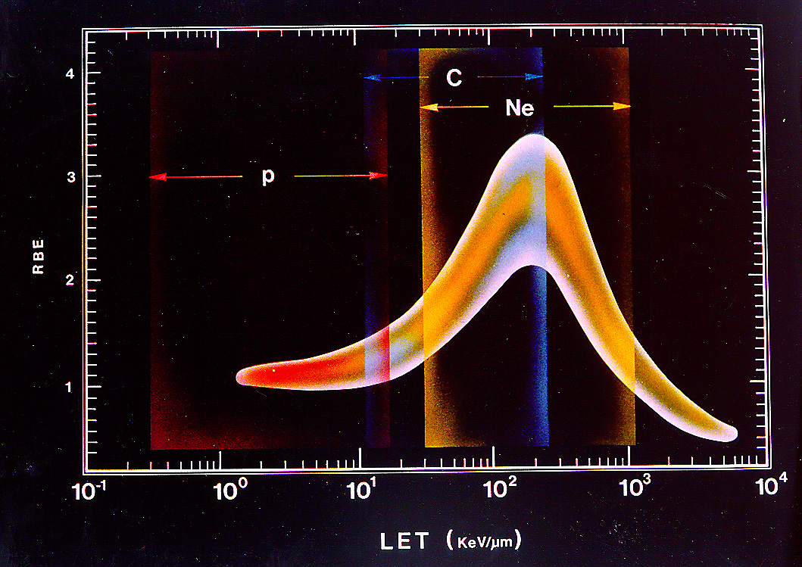
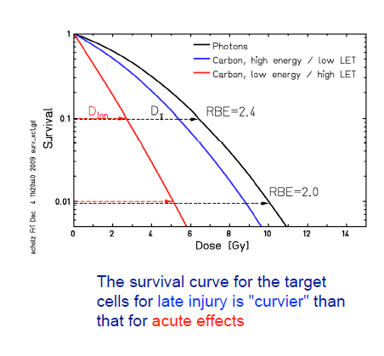
RBE : relative biological effectiveness
Qualitatively the energy deposited by carbon ions is more efficient, in terms of cell destruction, than the energy deposited by protons.
The higher efficiency in killing cells is expressed by the RBE, which is the ratio between the photon and the ion doses which are necessary for producing the same biological effect.
Carbon RBE > 3 in the Bragg peak region
>= 1 in the entry channel.

Slide 14
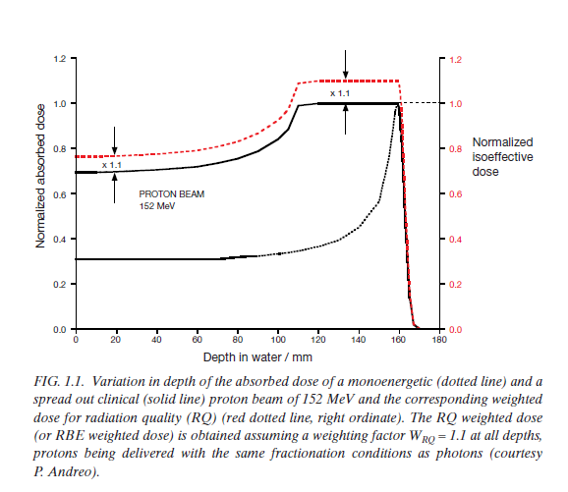
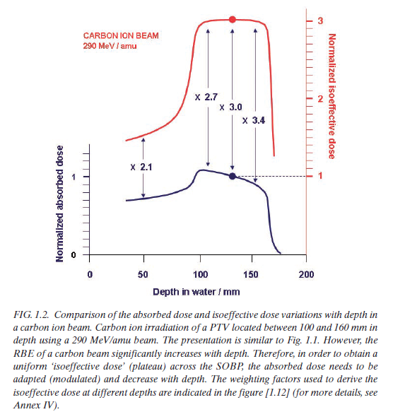
RBE varies with particle type and energy, dose, dose per fraction, degree of oxygenation, cell or tissue type, biological end point, etc
Protons
Carbon Ions

Slide 15
Accelerator design criteria
The kind of the accelerator depends mainly on:
The species to be accelerated
The radiation shaping and delivery method
particle | Penetration range | Energy range | Brho range
Proton | 30-300 mm | 60-250 MeV/u | 1.16-2.31 Tm
Carbon | 30-300 mm | 120-400 MeV/u | 3.18-6.34 Tm
Passive Scanning
Active Scanning

Slide 16
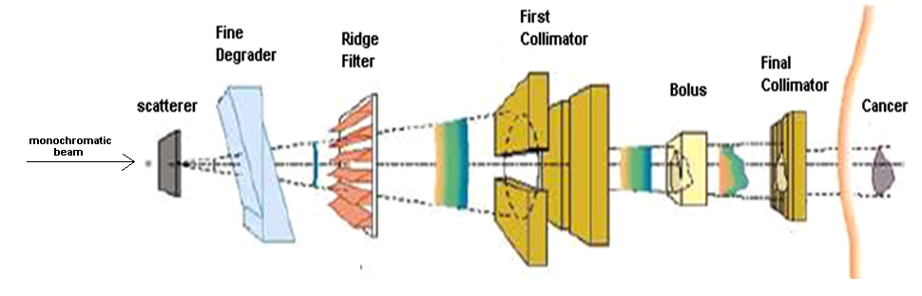
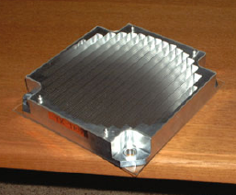

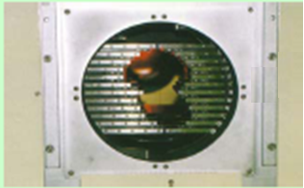
Passive Scanning
Passive scanning is based on putting several absorbers before the patient to change longitudinal and transverse characteristics
Ridge filter
Bolus
Multi-leaf final collimator

Slide 17
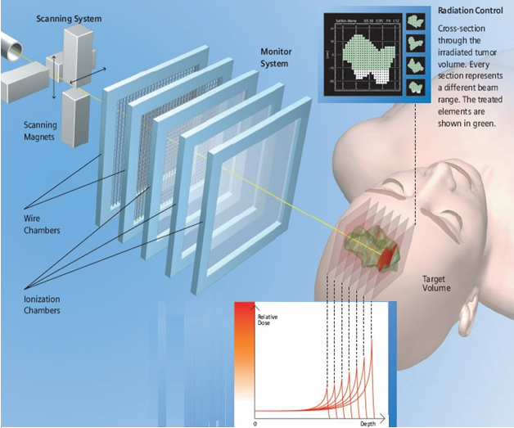
Active Scanning
Fast magnets paint the tumour transversally
Each voxel is irradiated during ~ 5 msec
A nozzle system controls the delivered dose
Several Bragg peaks from the accelerator paint the tumour longitudinally
First use in Japan (1980) and then regularly used at GSI, PSI, HIT, CNAO

Slide 18
Scanning beam

Slide 19
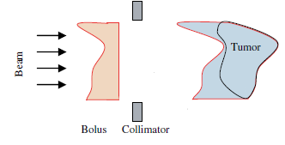
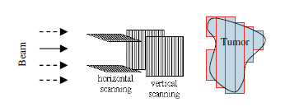

Active vs Passive
Passive system needs patient-specific hardware: Bolus, Multileaf collimator
There are errors on dose irradiation:
Bolus conforms the most distal surface
Absorbers Nuclear Fragmentation Tailing of Bragg Peak
Heavy ions need thicker absorbers greater energy and currents from the accelerator.
Active system needs a more challenging control of beam characterizations and of the
scanning magnets but allows a more precise dose irradiation of the tumor target

Slide 20
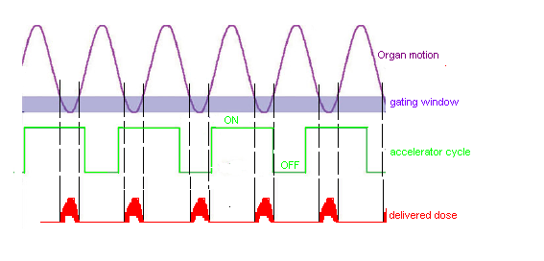
Moving organs
Active system is critical in the case of moving organs. R&D is in progress worldwide
about several techniques: Gating, repainting, beam tracking
Repainting consists in underdosing the tumour and increasing the treatment sessions
Gaiting consists in irradiating only at a specific position of the organ
Beam Tracking is an adjustment in real-time of treatment plan considering the
4D organ motion signal.

Slide 21
Types of accelerators
Three accelerators can provide clinical beam: LINAC, Cyclotrons, Synchrotrons.
The energy and the species of hadrontherapy make LINAC up to now not very practical and feasible
Nowadays Hadrontherapy centers are Cyclotrons and Synchrotrons
Cyclotrons | Synchrotrons
Compact (4 m diameter) | More complicated
cheaper | More expensive
DC beam | Pulsed beam
High current (hundreds nA) | Lower currents (tens nA)
BUT…

Slide 22
Types of accelerators
…BUT
Cyclotrons are easy for protons; only one CHALLENGING PROPOSAL exists for carbon
Cyclotron compactness is partially offset by the place required by the medical structure
Passive scanning is needed with cyclotrons because the energy from accelerator is fixed
while
Synchrotrons can accelerate protons and carbons.
A synchrotron designed for 300mm C6+ can accelerate 1<=Z<=6 and O up to 19 cm.
Synchrotron can perform active scanning.
Nowadays the best technological layout for a hadrontherapy center is a
Carbon Synchrotron equipped with active scanning.
A carbon synchrotron facility is made up of:
A low energy injector
A ring
The extraction lines

Slide 23
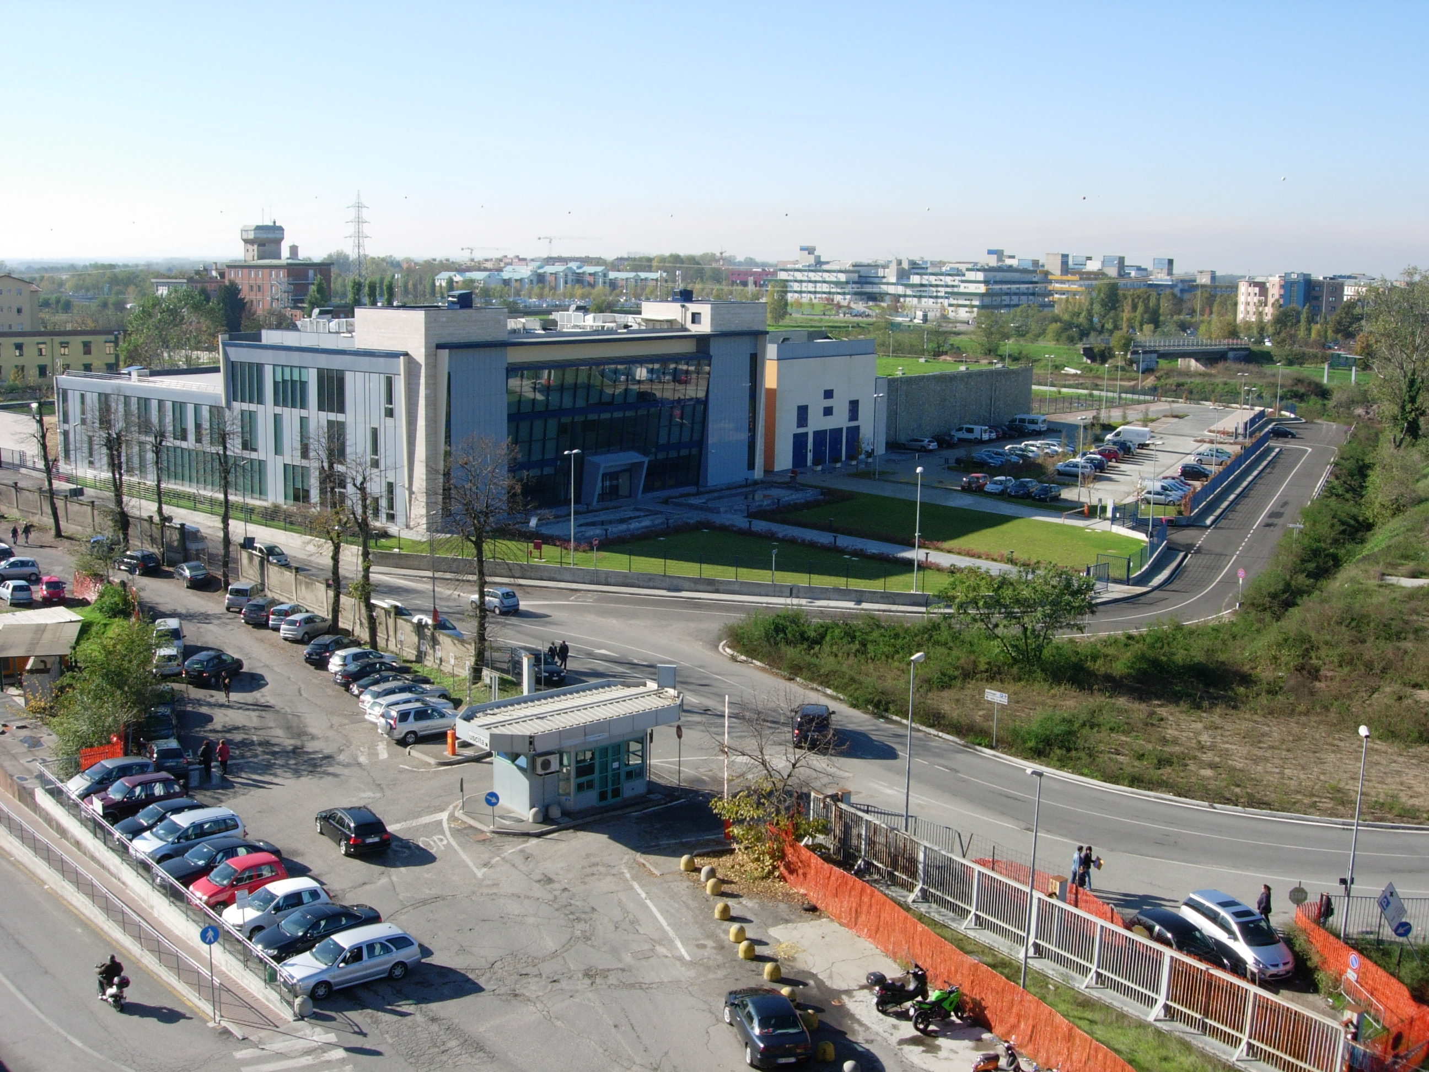
CNAO, Pavia
ITALY
Medical and Administrative buildings
Accelerator and treatment rooms

Slide 24
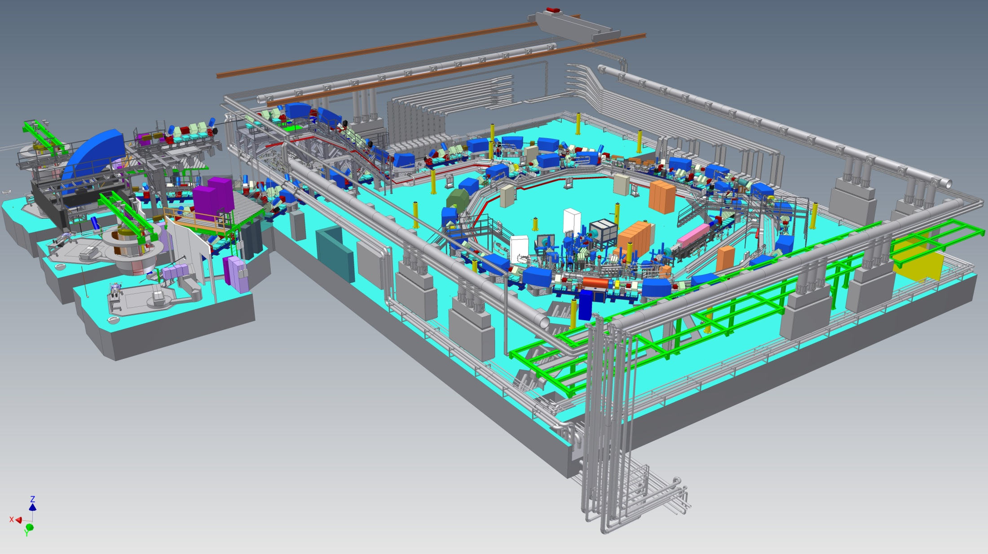
CNAO - Accelerator and Treatement Rooms
Davide Bianculli

Slide 25
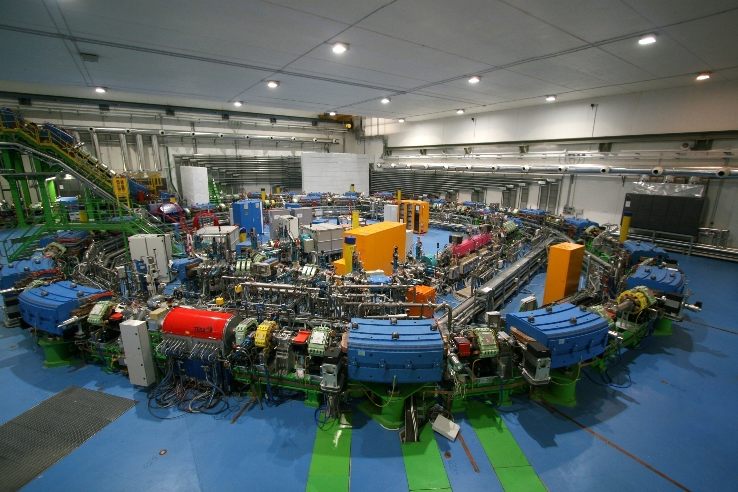
Synchrotron hall

Slide 26
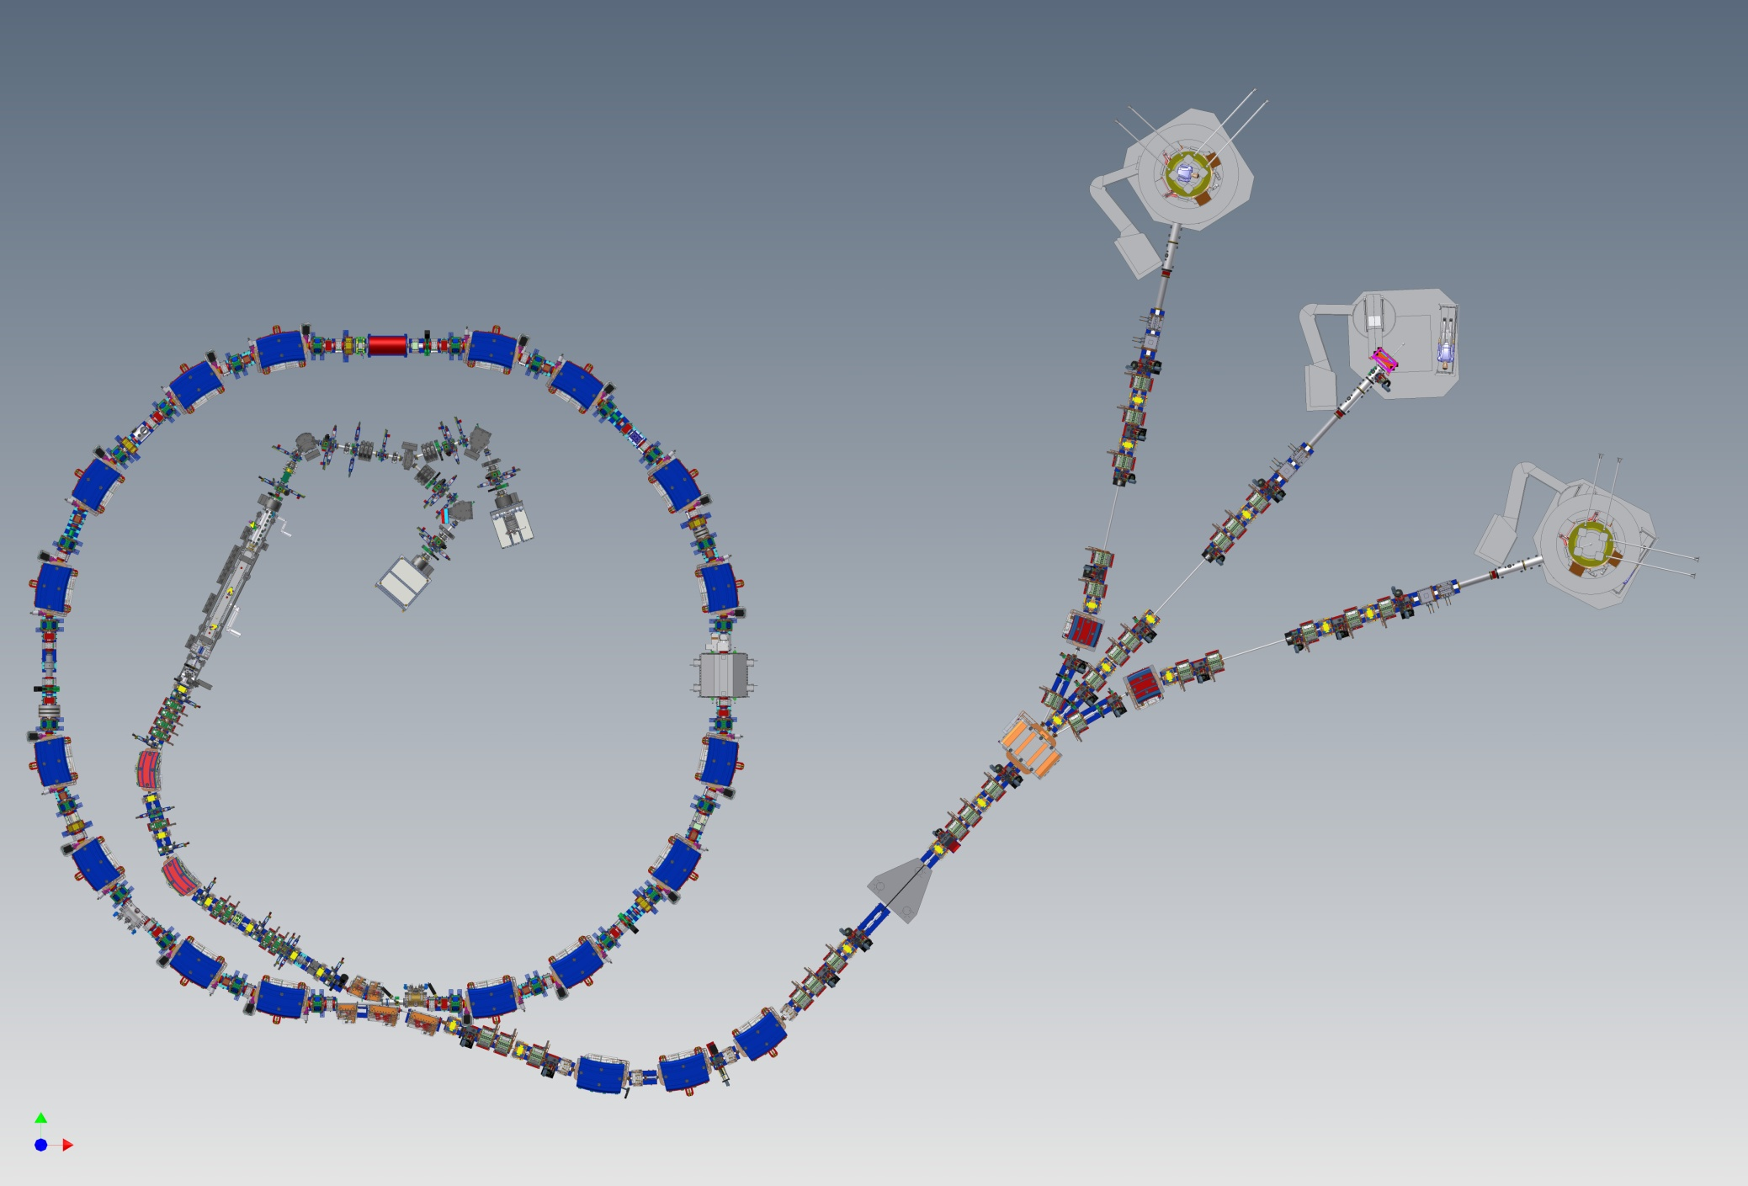
ACCELERATOR
3 Treatment
rooms
Synchrotron
P : 60 – 250 MeV
C6+ :120 - 400 MeV
protons
Carbon
ions
Injector

Slide 27
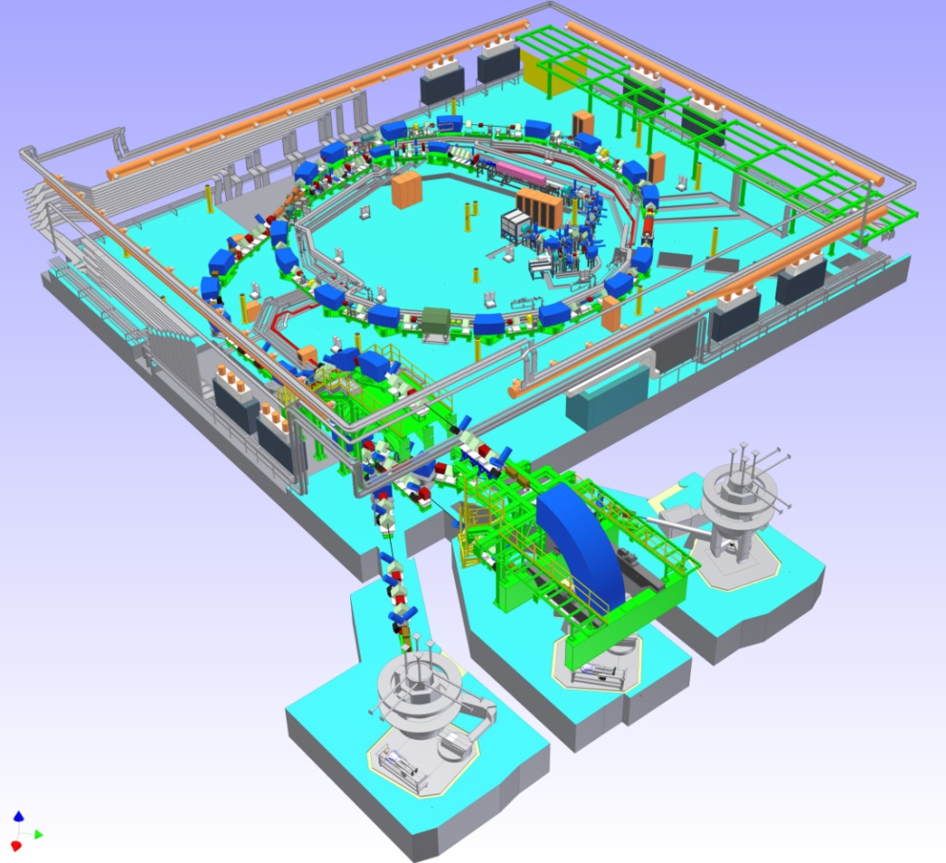
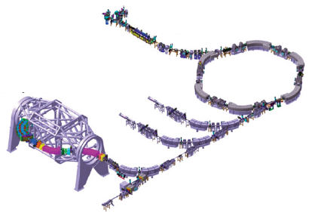
Synchrotron facility layout: Injector
The injector is placed outside the ring for easier maintenance or inside to save space
HIT (Heidelberg, Germany)
CNAO (Pavia, Italy)

Slide 28
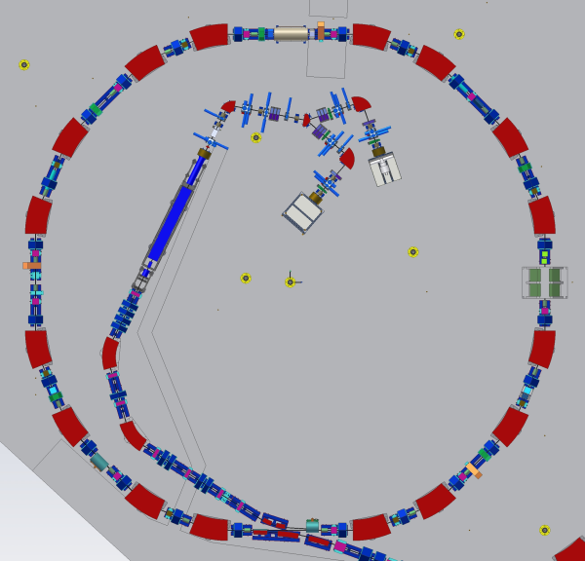
Synchrotron facility layout: Injector
An injector is made up of:
Two or three sources
A LEBT (Low Energy Beam Transfer line)
A low energy Linac
A MEBT (Medium Energy Beam Transfer line)
LEBT
Sources
LINAC
MEBT

Slide 29
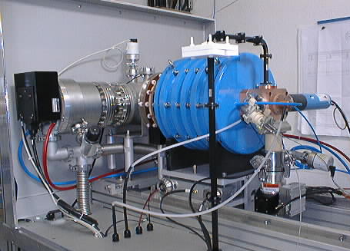
ION SOURCE
• Double wall, water cooled plasma chamber, 7 mm diameter aperture for beam extraction.
• Permanent magnets system providing the axial and radial confinement (axial field from 0.4 to 1.2 T, radial field 1.1 T)
• Copper made “magic cube” for microwave injection system = waveguide to coaxial converter with a tuner to minimize the reflected power.
• RF window for the junction between the magic cube at high vacuum and the waveguide at atmospheric pressure.
• A gas injection system.
• A DC bias system to add electrons to the plasma and decrease the plasma potential.
An RF generator of about 400 W at 14.5 GHz (the effective power used in operation is below 300W).
Flexible frequency variable travelling wave tubes amplifiers (TWTA) .
The type of ions sources are PIG, EBIS but, above all, ECR (Electron Cyclotron Resonance) Ion Sources
At CNAO 2 ECRs: Both can deliver H3+, C4+ and other species
Built by Pantecknic on INFN-LNS Design
Gas are ionized by RF power at electron cyclotron resonance frequency (10-18 GHz)
The magnetic trap for the electrons is obtained with a solenoid and an exapolar magnet

Slide 30
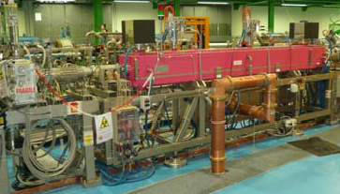
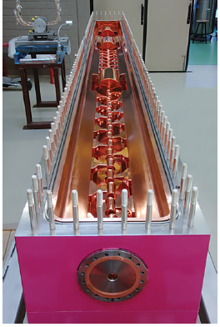
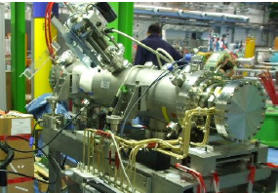
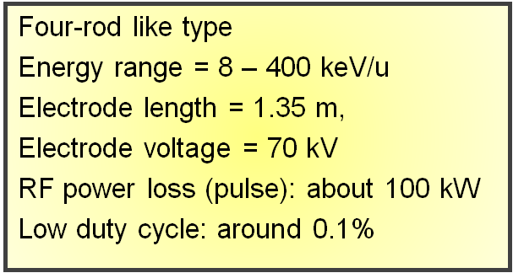
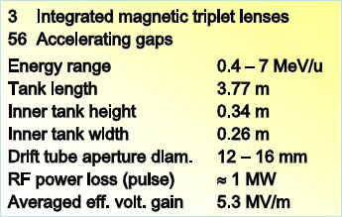
Linac
RFQ+IH
IH
RFQ
RFQ
0.008-0.4 MeV/u H³⁺
0.008-0.4 MeV/u C⁴⁺
IH
0.4-7 MeV/u H³⁺
0.4-7 MeV/u C⁴⁺

Slide 31
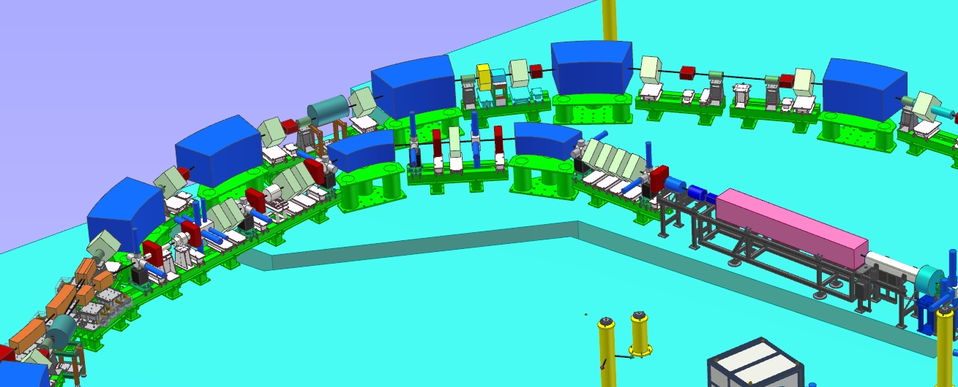
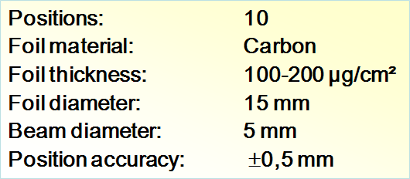
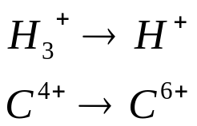
MEBT
Quadrupoles for matching in non dispersive zone
Dispersion bump
Debuncher to minimize the injected beam momentum spread
Stripping foil
Beams for
treatments
Same Bρ

Slide 32
Ring: Slow Extraction
Dose homogeneity : ± 2.5% a single turn extraction (<1 µsec) not possible
Unstable but controlled beam betatron oscillations: the motion amplitude grows until an electrostatic septum allows the extraction of the particle.
Extraction mechanism strongly influences the ring design
Optical layout must guarantee a machine tune near to an unstable value during the extraction.
The part of the beam with the resonance tune is extracted.
In the present facilities the unstable tune is chosen N/3. A sextupolar field feeds the resonance:
THIRD ORDER RESONANCE SLOW EXTRACTION MECHANISM

Slide 33
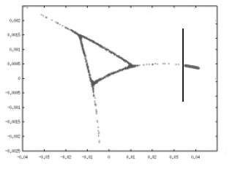
Ring: Slow Extraction
Horizontal Phase Space
at the resonant tune
Steinbach diagram
Electrostatic
Septum
X’
amplitude
Unstable
Region
Stable
Region
Stable
Region
X
Qres
Q, ∆p/p
Separatrix
Beam can be driven to the resonance condition by three methods:
amplitude selection
amplitude-momentum selection
RFKO
RF Knock-out

Slide 34
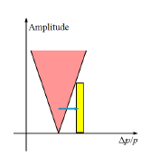
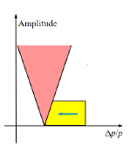
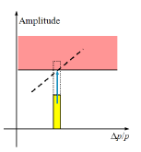
Ring: Slow Extraction
amplitude-momentum selection
RFKO
amplitude selection
Not constant optics
Narrow dp/p
Not constant position, size, energy of extracted beam
No more used
Constant optics
Large beam dp/p
Constant position, size, energy of extracted beam
Use of a betatron core
Constant optics
Constant position, size, energy of extracted beam
Use of a transverse RF exciter

Slide 35
Synchrotron facility layout: Ring
Broadband RF cavity
Air core quadrupole
16 resistive dipoles (1.5 T)
Betatron Core
24 m
Electrostatic
Septum

Slide 36
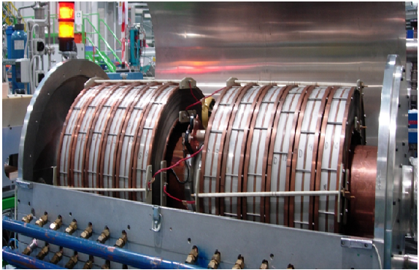
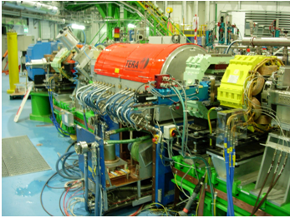
Ring : RF cavity
Acceleration is performed with a single RF cavity at harmonic 1 or 2 based on the principle of ferrite-loaded cavities and with tetrode or solid state technology for the amplifier. Nowadays ferrite often is replaced by amorphous alloy to reduce cavity length
Vitrovac amorphous alloy Fe-Co
Frequency Range | 0.4 MHz-3 MHz
Voltage Range | 50 V-10000 V
Vitrovac current | 0-10 A
Cavity length | 1.3 m
Q | 1-5
Rshunt | 900-500 ohm

Slide 37
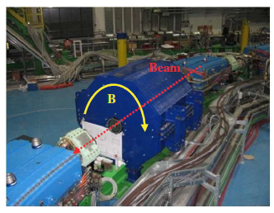
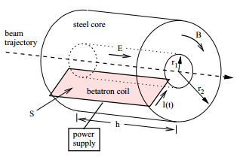
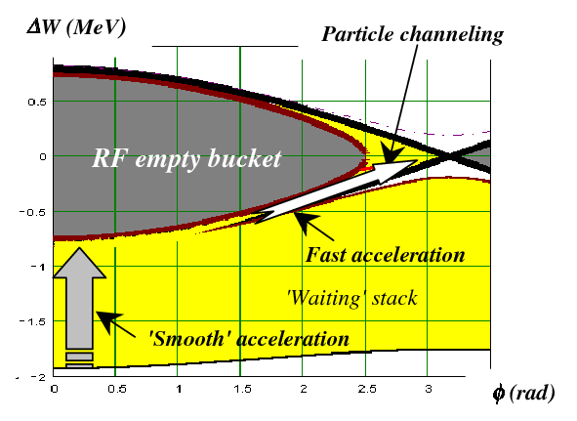
Ring: Betatron Core
High inductance device: the only active element during extraction. All the other elements, and thus also the lattice functions, are kept static, the RF voltage is switched off. Therefore, the energy of the extracted beam is kept constant, no RF structure can appear in the spill and sources of ripples are minimised.
To reduce ripple spill RF cavity is used with the technique of empty bucket channelling

Slide 38
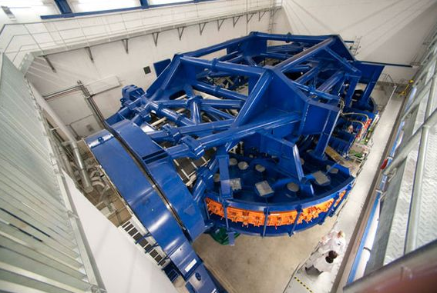
Extraction lines
The beam quality at all the energies (stable position, possibility to have round beams with more dimensions, RT control of the dose) constraints on magnetic lattices, power supplies, magnets, control system, Nozzle.
Irradiation from different directions is mandatory. It can be realized:
  Displacing the patient
  Several lines in the same room
  Gantry
Nowadays gantries for protons are present in most facilities.
A gantry for carbon is more challenging!
To date only HIT is equipped with a carbon ions gantry
(600 tons at 13 m against the standard 100 tons at 10 m)
First heavy ions gantry at Heidelberg

Slide 39
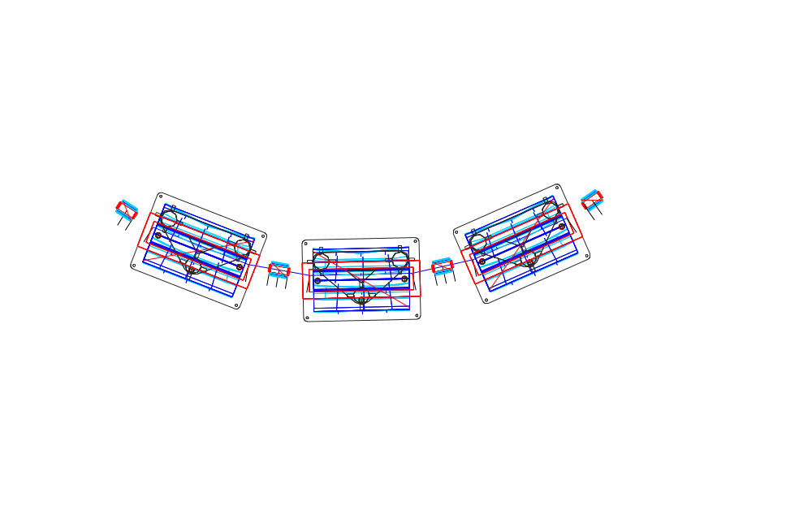



CNAO Extraction lines
CNAO lines: 3 treatment rooms: 2 with horizontal line and 1 with horizontal and vertical one. The beginning of the line has 4 fast magnets (100 microsec) to dump the beam for patient security.

Slide 40
Orders of magnitude
Dose uniformity required: ± 2.5%
Treatment session duration: 30 min
Irradiation duration: 3 min
Slice thickness: 2 – 4 mm
Spot size: 4 - 10 mm
Position precision: 0.1 mm
Energy precision: 10⁻⁴
Spot duration: 5 - 10 ms
Beam current: 0.1 - 1 nA
Measurement time: < 100 ms

Slide 41

Energy precision: 10⁻⁴
Energy measured with Bragg peak on water, feedback on position at BPM in high dispersion region – Precision much better than accelerator based measurements
Erminia Bressi, IPAC12

Slide 42
CNAO Design Parameters I
Protons (10¹⁰/spill)
 | LEBT (*) | MEBT | SYNC | HEBT
Energy [MeV/u] | 0.008 | 7 | 7-250 | 60-250
Imax [A] | 1.3×10⁻³ | 0.7×10⁻³ | 5×10⁻³ | 7×10⁻⁹
Imin [A] | 1.3×10⁻³ | 70×10⁻⁶ | 0.12×10⁻³ | 17×10⁻¹²
ε_{rms,geo} [π mm mrad] | 45 | 1.9 | 0.67-4.2 | 0.67-1.43(V)
ε_{90,geo} [π mm mrad] | 180 | 9.4 | 3.34-21.2 | 3.34-7.14 (V) 5.0 (H)
Magnetic rigidity [T m] | 0.013 (0.026) | 0.38 | 0.38-2.43 | 0.38-2.43
(Δp/p)_{tot} | ±1.0‰ | ±(1.2-2.2)‰ | ±(1.2-3.4)‰ | ±(0.4-0.6)‰
* (H₂⁺, H₃⁺)

Slide 43
CNAO Design Parameters II
Carbon (4·10⁸ C/spill)
 | LEBT (C⁴⁺) | MEBT | SYNC | HEBT
Energy [MeV/u] | 0.008 | 7 | 7-400 | 120-400
Imax [A] | 0.15×10⁻³ | 0.15×10⁻³ | 1.5×10⁻³ | 2×10⁻⁹
Imin [A] | 0.15×10⁻³ | 15×10⁻⁶ | 28×10⁻⁶ | 4×10⁻¹²
ε_{rms,geo} [π mm mrad] | 45 | 1.9 | 0.73-6.1 | 0.73-1.43(V)
ε_{90,geo} [π mm mrad] | 180 | 9.4 | 3.66-30.4 | 3.66-7.14 (V) 5.0 (H)
Magnetic rigidity [T m] | 0.039 | 0.76 | 0.76-6.34 | 3.25-6.34
(Δp/p)_{tot} | ±1.0‰ | ±(1.2-2.0)‰ | ±(1.2-2.9)‰ | ±(0.4-0.6)‰

Slide 44

High precision devices for patient positioning
The reference fractionation scheme consists of fractions of 2 Gy/d, five times per week, specified in the planning target volume (PTV).
(Treatment room #1 at CNAO)

Slide 45


3D Real-time IR Optical Tracking (OTS)
Real time reconstruction of spherical markers and surfaces
Sub-millimeter accuracy : peak 3D errors <0.5 mm
3D data flow @70 Hz
X-ray Patient Verification System (PVS)
2 X-ray tubes (deployable) ,
2 flat panels (deployable)
Supporting structure rotation: ±180°
Rotation and deployment accuracy: ± 0.15mm, ± 0.1°
Patient Positioning System (PPS)
Automatic couch or chair docking
Absolute accuracy: ≈ 0.3 mm
Markers, low density fixation materials

Slide 46
CNAO medical activity
1st patient protons: September 2011
1st patient Carbon Ions: September 2012
Three treatment rooms operational
62 Patients treated with protons
62 treated with Carbon ions
Cranium chordome and chondrosarcoma
Sacral chordome and chondrosarcoma
Intracranial meningioma
Salivary glands carcinoma
Trunk sarcoma
Prostate carcinoma
Aero-digestive mucosae melanoma

Slide 47

Hadrontherapy first proposed by R. Wilson in 1946
In 1954: 30 patients treated with protons at LBL (Lawrence Berkeley Laboratory)
In the next years other treatments in other research centers were performed
(Uppsala, Harvard, Dubna, St.Petersburg, Moscow, PSI, Chiba, Tsukuba)
In 1990 the first dedicated hospital facility has started treatments at Loma Linda (LLUMC)

Slide 48


First dedicated hospital center for proton therapy:
LLUMC (Lomalinda), USA
Proton synchrotron (70-250 MeV) equipped with a fixed beam room with two beam lines,
three rotating gantries and a research room with three beam lines.
To date over 15000 patients have been treated.

Slide 49
Hadrontherapy history: Rapid Growth doubled in last decade
Patients
.
Centres
.
80000
40
70000
35
60000
30
50000
.
25
.
40000
20
30000
.
15
20000
.
.
10
.
.
.
10000
.
.
.
5
.
.
0
1950
1960
1970
1980
1990
2000
2012

Slide 50

Hadrontherapy in the world
Uppsala , Sweden
Clatterbridge, England
Nice , France
Orsay, France
HZB(Berlin), Germany
RPTC(Munich),Germany
HIT(Heidelberg),Germany
PSI(Villigen),Switzerland
IFJ-PAN, Poland
LNS(Catania), Italy
CNAO (Pavia), Italy
ITEP(Moscow), Russia
St. Petersburg, Russia
Dubna, Russia
WPTC(Zibo),China
IMP(Langzhou), China
NCC, South Korea
TRIUMF(Vancouver),Canada
UCSF(California), USA
LLUMC(Lomalinda),USA
IUHealthPTC,(Bloomington),USA
NPTC(Boston),USA
MDACC(Houston),USA
UFPTI(Jacksonville),USA
Upenn(Philadelfia),USA
CDH(Warrenville),USA
HUPTI(Hampton),USA
Procure PTC(New Jersey),USA
Procure PTC(Oklahoma),USA
NCC (Kashiwa), Japan
PMRC (Tsukuba), Japan
WERC (Shizuoka), Japan
PATRO (Hyogo),Japan
HIMAC (Chiba),Japan
GHMC (Gunma),Japan
STPTC(Koriyama),Japan
Medipolis Medical Research Institute (Ibusuki), Japan
iThemba LABS, South Africa
~ 80000 patients (8000 with Carbon ions)

Slide 51
Hadrontherapy in the world: Cyclotrons
Uppsala , Sweden
Clatterbridge, England
Nice , France
Orsay, France
HZB(Berlin), Germany
RPTC(Munich),Germany
PSI(Villigen),Switzerland
IFJ-PAN, Poland
LNS(Catania), Italy
Dubna, Russia
WPTC(Zibo),China
NCC, South Korea
TRIUMF(Vancouver),Canada
UCSF(California), USA
IUHealthPTC,(Bloomington),USA
NPTC(Boston),USA
UFPTI(Jacksonville),USA
Upenn(Philadelfia),USA
CDH(Warrenville),USA
HUPTI(Hampton),USA
Procure PTC(New Jersey),USA
Procure PTC(Oklahoma),USA
NCC (Kashiwa), Japan
iThemba LABS, South Africa
24 cyclotron facilites

Slide 52
Hadrontherapy in the world: Synchrotrons
ITEP(Moscow), Russia
St. Petersburg, Russia
IMP(Langzhou), China
HIT(Heidelberg),Germany
CNAO (Pavia), Italy
PMRC (Tsukuba), Japan
WERC (Shizuoka), Japan
HIBMC (Hyogo),Japan
HIMAC (Chiba),Japan
GHMC (Gunma),Japan
STPTC(Koriyama),Japan
Medipolis Medical Research Institute (Ibusuki), Japan
LLUMC(Lomalinda),USA
MDACC (Houston),USA
14 synchrotron facilities

Slide 53
Hadrontherapy in the world: Carbon Synchrotrons
HIT(Heidelberg),Germany
CNAO (Pavia), Italy
PATRO (Hyogo),Japan
HIMAC (Chiba),Japan
GHMC (Gunma),Japan
IMP(Langzhou), China
6 carbon synchrotron facilities:
only HIT, CNAO and PATRO produce both clinical protons and carbon ions

Slide 54
Hadrontherapy in the world: New facilities (under construction or ready to start)
PSI(Villigen),Switzerland
PTC(Prague), Czech.Rep.
MedAustron
(Wiener Neustadt),Austria
ATREP(Trento),Italy
WPE(Essen),Germany
CMHPTC(Ruzomberok),
Slovak Rep.
CCSR(Bratislava),Slovak Rep.
Skandion Clinic(Uppsala),
Sweden
FudanUniversity(Shangai), China
HITFil(Lanzhou),China
Chang Gung Memorial Hospital(Taipei), Taiwan
PMHPTC(Protvino),Russia
SJFH(Beijing), China
Samsung Proton Center(Seoul), South Korea
MCLarenPTC(Michigan),USA
Northern Illinois PT Res.Institute, Chicago, USA
Barnes Jewish (St. Louis), USA
Scripps Proton Therapy Center(San Diego),USA
SCCA Proton Therapy,(Seattle)USA
USA, Europe, Asia: 12 proton cyclotrons; 2 proton-carbon synchrotrons;
2 proton synchrotrons; 1 carbon synchrotron; 1 proton synchro-cyclotron

Slide 55
Hadrontherapy business
The idea of hadrontherapy facilities has passed from the research field to the business field with several commercial firms:
IBA, Hitachi, Mitsubishi, Sumitomo, Varian, Still River, Optivus, Siemens
… Hadron therapy is the epitome of a multidisciplinary and transnational venture: its full development requires the competences of physicists, physicians, radiobiologists, engineers and IT experts, as well as collaboration between research and industrial partners.
The translational aspects are extremely relevant because the communities involved are traditionally separate and they have to learn to speak the same "language". Ions that are considered "light" by physicists, such as carbon, are "heavy" for radiobiologists – and this is just one of many examples (from Cern Courier, Nov 23, 2011)

Slide 56

Hadrontherapy future
Worldwide R&D for more compact and/or advanced accelerators:
FFAG: Fixed Field alternating Gradient: in the middle between a cyclotron and a synchrotron. DC beam with fast energy change! The radius change slightly because B changes with the radius. A fast energy change could be a good solution in treating moving organs
LIBO: Linac Booster Linac @ 3 GHz, 27MV/m for protons from 30 MeV to 250 MeV exploiting the standard 30 MeV cyclotrons for radioisotopes as injector.
Laser Plasma acceleration: heavy ions acceleration by high power lasers
DWA: dielectric wall induction linac: new dielectrics 100 MV/m (instead of 10) 250 MeV proton linac 3 m long

Slide 57
Ackwoledgements
To all CNAO Team, with whom I shared three years of work during the commissioning of the facility, to Marco Pullia and Erminia Bressi, for all the information and fruitful discussions, and specially to Luciano Falbo, from whom I have borrowed most of the slides (talk at HIAT2012, Chicago, http://www.phy.anl.gov/hiat12/Proceedings/papers/proceed.pdf, p. 156)

