Slide 1




The
CERN
Accelerator
School
High Gradient Wakefield Accelerator
11-22 March 2019 – Sesimbra, Portugal
Modeling & Simulations - Part 3
Parallel programming on
CPUs & GPUs - Outlook
Jean-Luc Vay & Rémi Lehe
Lawrence
Berkeley
National
Laboratory

Slide 2
Outline
Modern parallel architectures and why we need them.
Domain decomposition
Exchanging information and load balancing
  Between nodes (MPI)
  Within nodes (MPI, OpenMP)
  What about GPUs?
Dynamic load balancing
Parallelization of Quasistatic mode and boosted frame diags
Outlook
  Why so many PIC codes? Which one(s) to choose? Can we do better?
  Standardization of data I/O and input scripts.

Slide 3
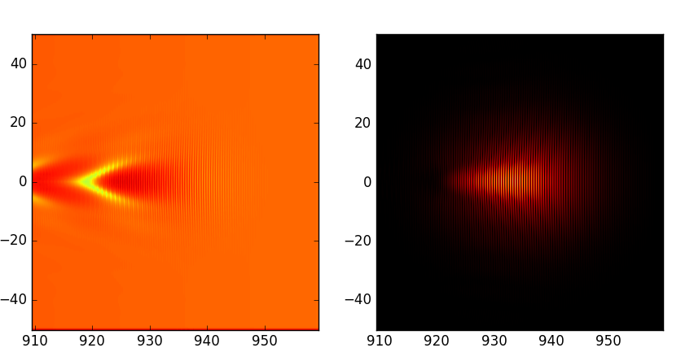
Why use parallel architectures?
Recent example: Laser-wakefield
simulation to interpret experiments at LBNL.
3D grid with 2500 x 200 x 200 grid points
0.2 billion macroparticles
140,000 timesteps (Courant limit!)
~60,000 hours on 1 core = 7 years!
=> Need either faster cores or more cores in parallel

Slide 4
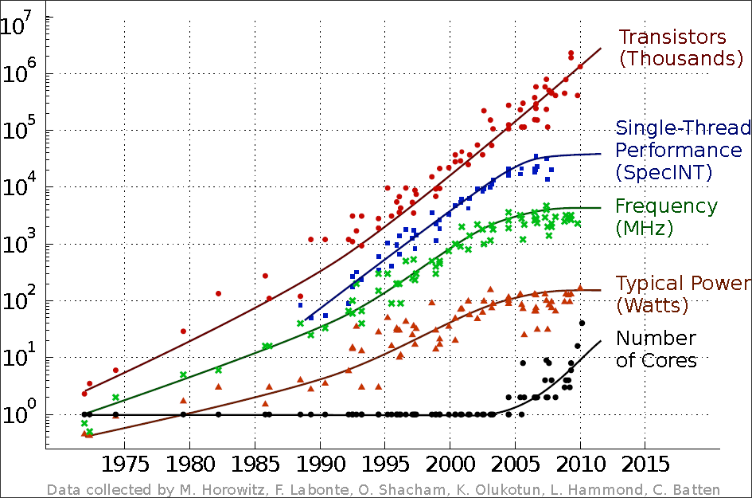
Why use parallel architectures?
History of CPU performance
Individual cores do not get faster.
➔ Need to use many cores in parallel.

Slide 5
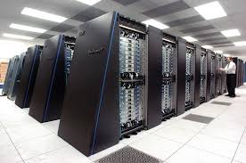

Parallel clusters aggregate many cores grouped in nodes
Contain 100,000s cores within 1000s-10,000s nodes
Multiple cores
Individual node
“Fast” network
communication

Slide 6
Leadership and Production Computing Facilities
Summit (USA):
Peak performance of 200.8 PFlop/s
4,608 Compute Nodes
2,397,824 Compute Cores
27,648 NVIDIA Volta V100 GPUs
Power: 9.8 MW
Sierra (USA):
Peak performance of 125.7 PFlop/s
4,320 Compute Nodes
1,572,480 Compute Cores
17,280 NVIDIA Volta V100 GPUs
Power: 7.4 MW
Sunway TaihuLight (China):
Peak performance of 125.4 PF
40,960 Compute Nodes
10,649,600 Compute Cores
Power: 15.4 MW
Source: https://www.top500.org/

Slide 7
Parallel clusters
Individual nodes have several cores (i.e. computing units):
“Traditional” CPUs: ~10-20 cores
Xeon Phi: 68 cores
GPUs: ~1000s (slow) cores
Cores within one node share memory
- How to use this architecture to make a PIC code faster?
- How to use the two levels of parallelism?
within one node and between nodes

Slide 8
Outline
Modern parallel architectures and why we need them.
Domain decomposition
Exchanging information and load balancing
  Between nodes (MPI)
  Within nodes (MPI, OpenMP)
  What about GPUs?
Dynamic load balancing
Parallelization of Quasistatic mode and boosted frame diags
Outlook
  Why so many PIC codes? Which one(s) to choose? Can we do better?
  Standardization of data I/O and input scripts.

Slide 9
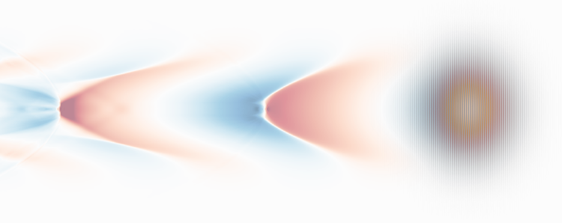
Traditional parallelization of PIC code: domain decomposition
Each node deals with a fixed chunk of the simulation box
(which includes fields on the grid + macroparticles)
The nodes are not independent:
They need to exchange information with other nodes via the network.
Domain-decomposition minimizes this:
communications only with a few neighbors
“Fast” network
communication

Slide 10
Particles are exchanged when crossing subdomains
Particle pusher: macroparticles may cross domain boundaries
After the particle pusher, the particle data needs to be communicated between subdomains.
Thanks to finite speed of light, with EM PIC, particles do not travel more than one cell in one time step
➔ exchange particles only with closest neighbors.

Slide 11
Field quantities need to be exchanged via ”guard cells”
Field update: each node needs values from neighboring nodes to calculate the spatial derivatives at the boundary
Field gathering/Current deposition: with wide shape factor, particles gather field values from other nodes and deposit some current/charge to other nodes
After the field update: communicate the new values of the fields at the border of the box.
After the current deposition: communicate the current that has been deposited into other nodes.

Slide 12
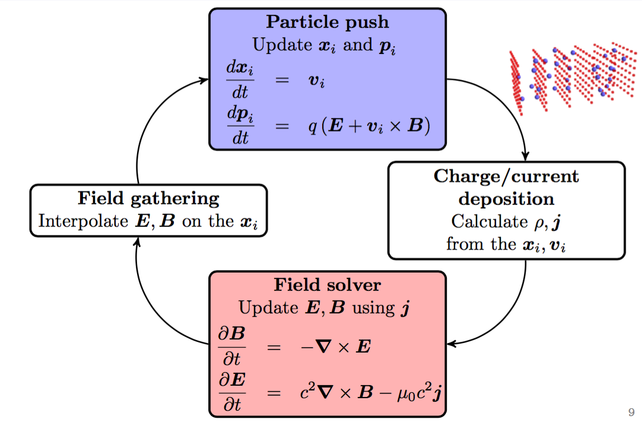
Sum up: the PIC loop
Communicate particles at the boundaries
between nodes
Communicate charge/current at the boundaries between nodes
Communicate E/B fields at the boundaries between nodes

Slide 13
Outline
Modern parallel architectures and why we need them.
Domain decomposition
Exchanging information and load balancing
  Between nodes (MPI)
  Within nodes (MPI, OpenMP)
  What about GPUs?
Dynamic load balancing
Parallelization of Quasistatic mode and boosted frame diags
Outlook
  Why so many PIC codes? Which one(s) to choose? Can we do better?
  Standardization of data I/O and input scripts.

Slide 14
Exchanging information: Message Passing Interface (MPI)
MPI: Message Passing Interface
Library that allows to send/receive information between processes:
- Each process has an id (or “rank”)
- Each process executes the same source code
- Call sending/receiving commands based on id
Proc. 0 sends message to proc. 1
Proc. 1 receives message from proc. 0
0
1
2
3
4
5
6
7
8

Slide 15
Contention can happen because of load imbalance
Example:
particle pusher,
schematic view
Push particle 1 | Push particle 1 | Push particle 1
Push particle 2 | Push particle 2 | Push particle 2
Push particle 3 | Exchange particles | Exchange particles
Push particle 4 | Wait | …
Push particle 5 | Wait
Push particle 6 | Wait
Exchange particles | Exchange particles
The simulation will always progress at the pace of the slowest node (the one doing the most work)
➔ Problematic when the particle distribution is very non-uniform

Slide 16
Parallelization between cores within one node can use MPI
Parallelization within one node can be done with MPI:
Divide each nodes’s sub-domain into smaller sub-domain.
Each core is tied to one of the smaller sub-domain.
 |  | core 1 | core 3
 |  | core 2 | core 4
The cores still exchange information via MPI send/receive, within one node.
(but in this case the information does not go through the network).

Slide 17
Load imbalance can slow down further with subdivisions
 |  | core 1 | core 3
 |  | core 2 | core 4
core1 | core2 | core3 | core4 | core1 | core2 | core3 | core4 | core1 | core2 | core3 | core4
push |  |  | push | push |  |  | push | push |  |  | push
 |  |  | push | Exchange particles |  |  |  | Exchange particles
 |  |  | push
 |  |  | push
 |  |  | push
Exchange particles |  |  |  | Exchange particles

Slide 18
Or can use “OpenMP” to fully take advantage of shared memory
OpenMP (Open Multi-Processing) uses shared memory on node
With OpenMP, cores are not tied to one subdomain
Cores can work on one subdomain and switch to the next subdomain until all are done.
Strategy: create more subdomains than cores: e.g. 4 cores/node but 14 subdomains or “tiles”)

Slide 19
Parallelization using “OpenMP” enables better load balancing
core1 | core2 | core3 | core4 | core1 | core2 | core3 | core4 | core1 | core2 | core3 | core4
push | push | push | push | push |  |  | push | push |  |  | push
 | push | push |  | Exchange particles |  |  |  | Exchange particles
Exchange particles |  |  |  | Exchange particles
Often, a hybrid MPI-OpenMP is optimal. Usually needs testing to determine.

Slide 20
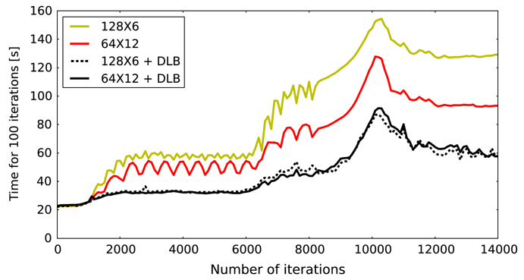
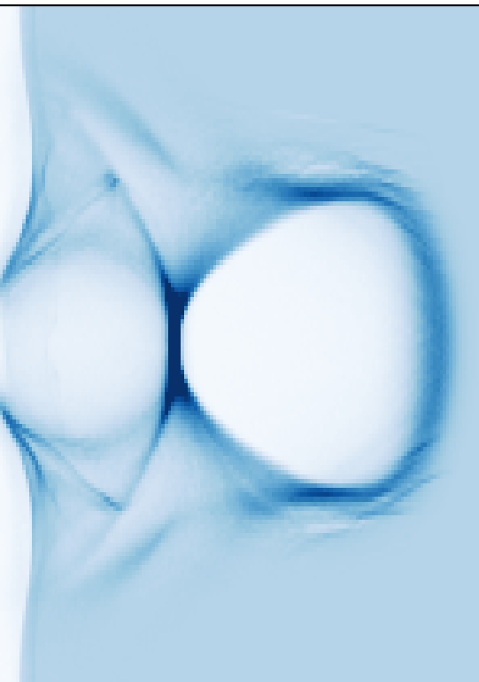
Example using 128 MPI subdomains with 6 OpenMP threads/MPI
128 MPI subdomains
Plasma electrons density
6 OpenMP threads / MPI
Subdomains with most work
slowest
other subdomains must wait!

Slide 21
Using 64 MPI subdomains with 12 OpenMP threads/MPI is faster
64 MPI subdomains
Plasma electrons density
12 OpenMP threads / MPI
Subdomains with most work
still slowest
other subdomains must wait, but less.

Slide 22
Shared memory comes at a price: race condition
The cores do not exchange information via MPI send/receive.
Instead they directly modify the value of the current in shared memory, without notifying the other cores.
Potentially, two cores could simultaneously try to modify the value of the current in a given cell (leads to inconsistencies).
This can be avoided with proper care (e.g. “atomic operations”).
Core 2 performs
current deposition
Core 3 performs
current deposition
Race condition!

Slide 23
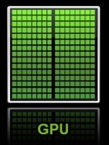
What about GPUs?
Conceptual similarities with OpenMP programming:
  Shared memory with load balancing by tiling, race conditions.
But also differences:
  ~1000s (slow) cores instead of tens of cores.
  Until recently, GPU programming involved mostly specific language (e.g. CUDA, OpenCL).
Common solutions are emerging for portable solutions:
  Using pragmas: e.g. OpenACC, OpenMP.
  Using libraries: e.g. Kokkos, Raja, Alpaka.

Slide 24
Outline
Modern parallel architectures and why we need them.
Domain decomposition
Exchanging information and load balancing
  Between nodes (MPI)
  Within nodes (MPI, OpenMP)
  What about GPUs?
Dynamic load balancing
Parallelization of Quasistatic mode and boosted frame diags
Outlook
  Why so many PIC codes? Which one(s) to choose? Can we do better?
  Standardization of data I/O and input scripts.

Slide 25
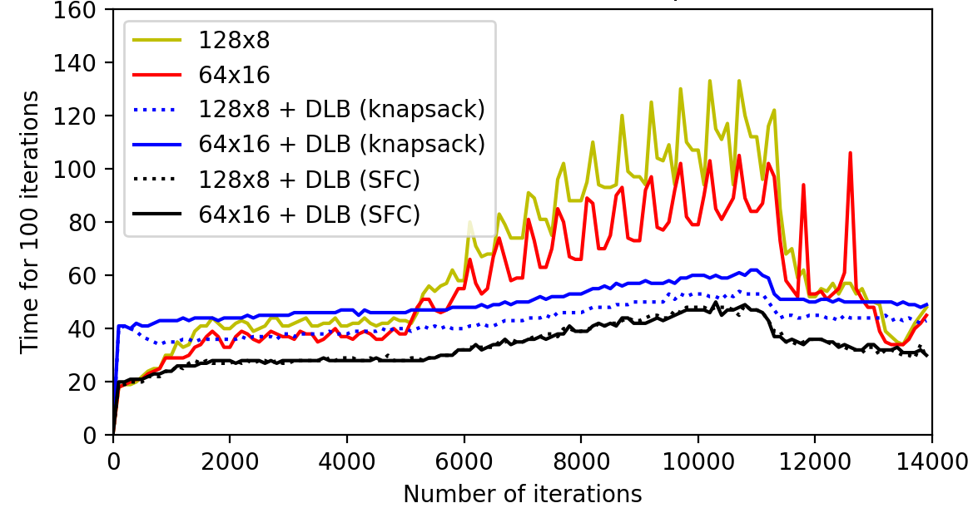
Dynamic load balancing enables better load distributions
Uses e.g. space-filling curve to distribute subdomains.
Simulation using Smilei¹
Plasma electrons density
Simulation using Warp-X²
Warp-X
¹J. Derouillat et al, Comput. Phys. Comm. 222, 351-373 (2018).
²J.-L. Vay et al, Proc. AAC 2018.

Slide 26
Outline
Modern parallel architectures and why we need them.
Domain decomposition
Exchanging information and load balancing
  Between nodes (MPI)
  Within nodes (MPI, OpenMP)
  What about GPUs?
Dynamic load balancing
Parallelization of Quasistatic mode and boosted frame diags
Outlook
  Why so many PIC codes? Which one(s) to choose? Can we do better?
  Standardization of data I/O and input scripts.

Slide 27
Quasistatic mode involves head-to-tail marching order
Implies pipelining algorithm for parallelization
Plasma column
Core # N-5 N-4 N-3 N-2 N-1 N
➔ also means that diagnostics need to reconstruct snapshots at a given time.

Slide 28
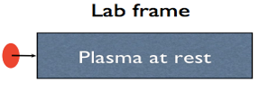
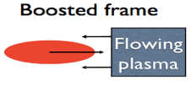
Boosted frame simulations do not need pipelining
Lorentz
Transform
λ
L
γ
λ’=λγ(1+β)
L’=L/γ
as it is a standard PIC simulations that can use standard domain decomposition.
But it also needs a reconstruction of the data in the laboratory frame.

Slide 29
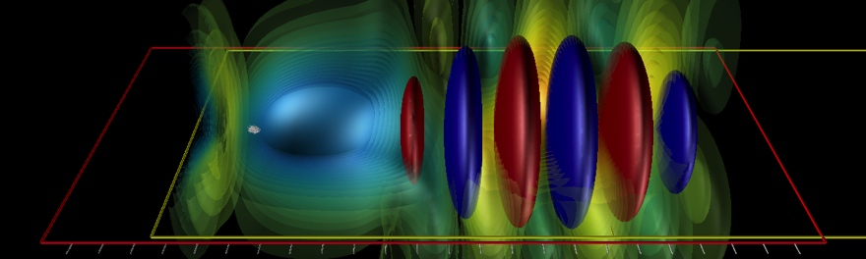
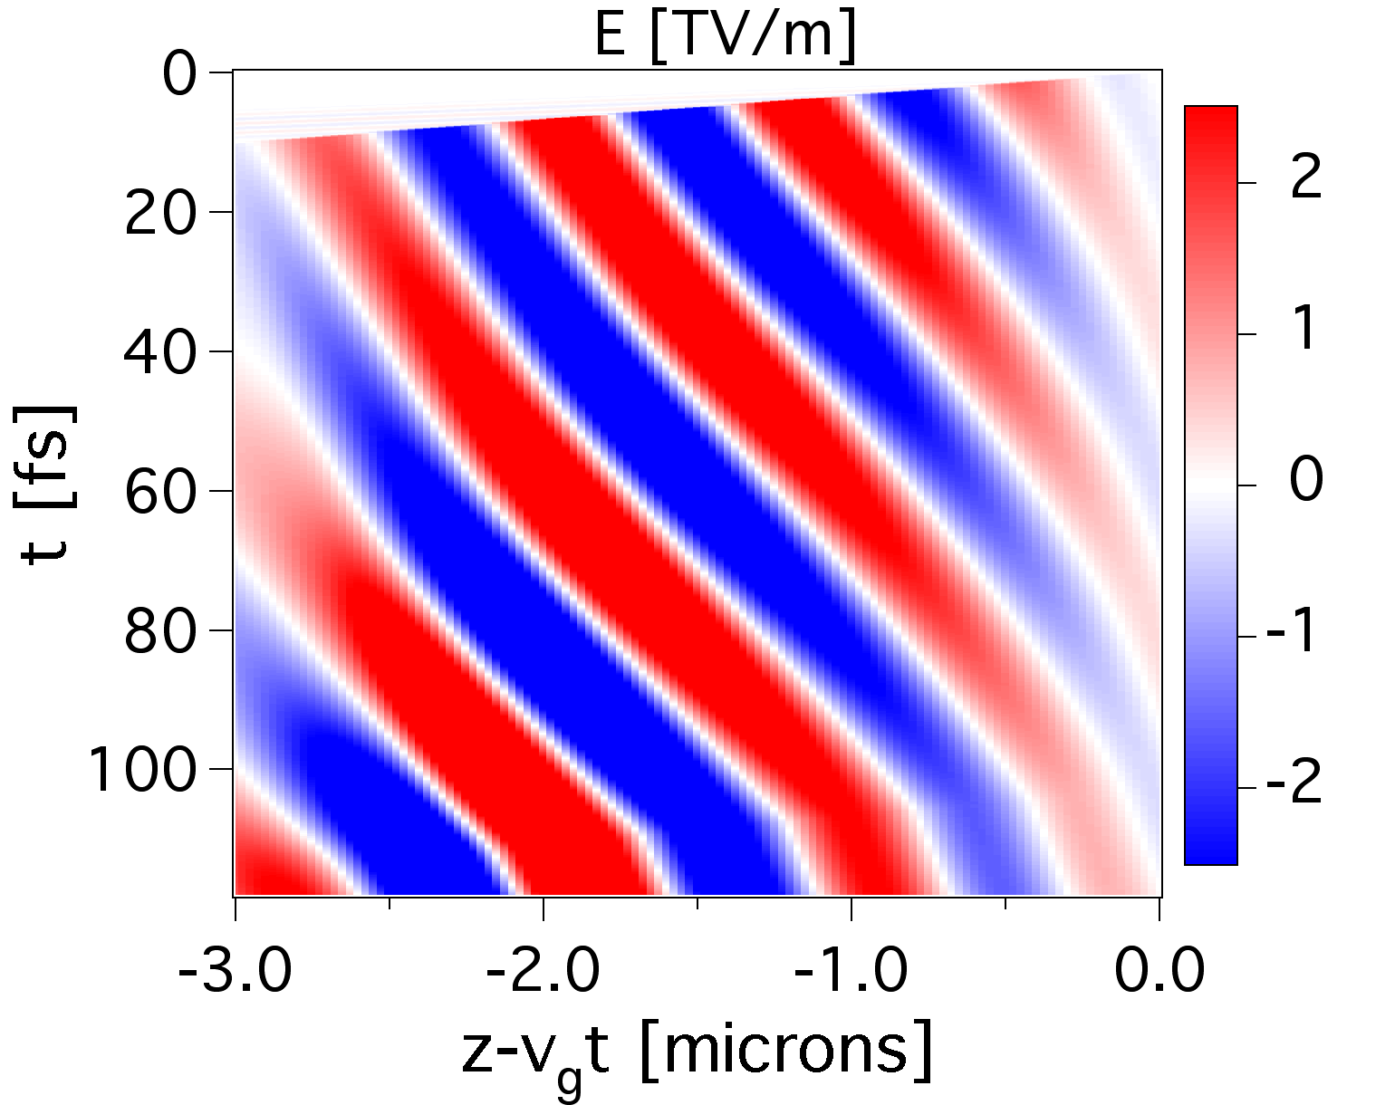
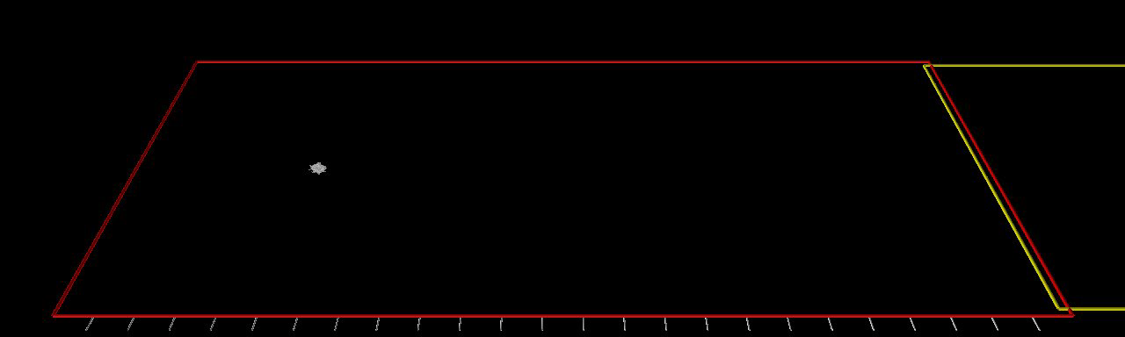
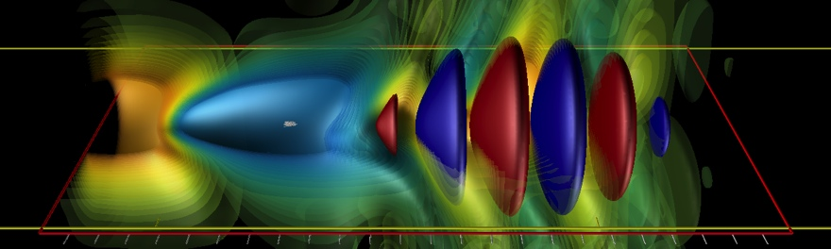
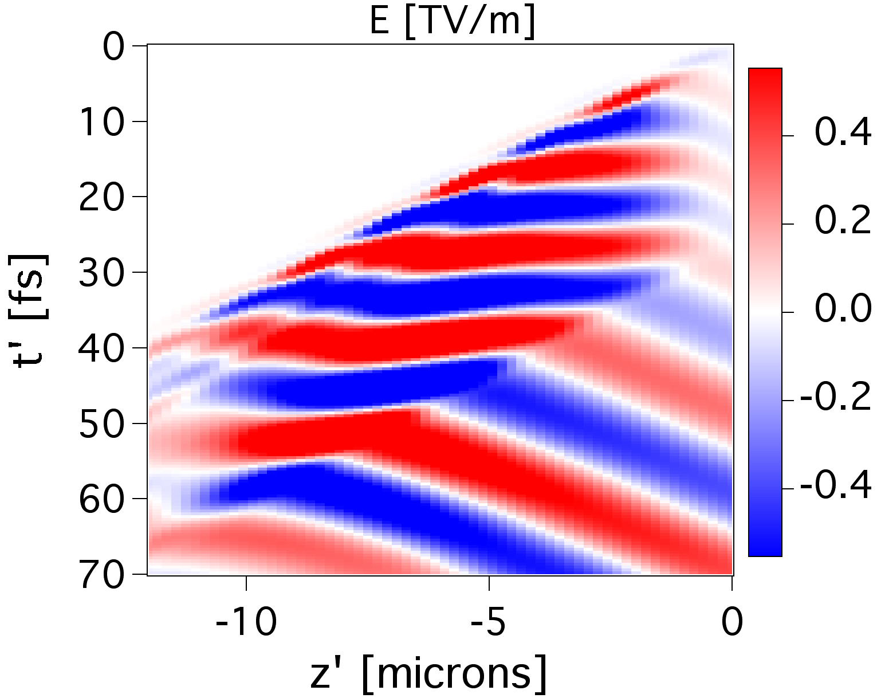
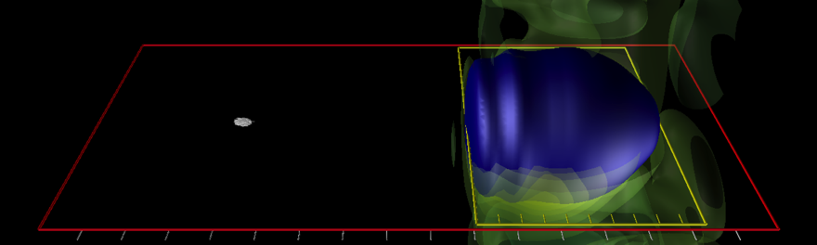
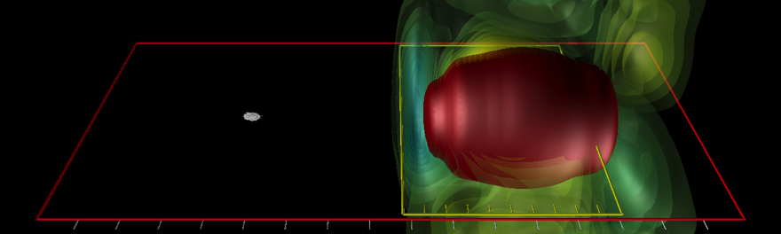
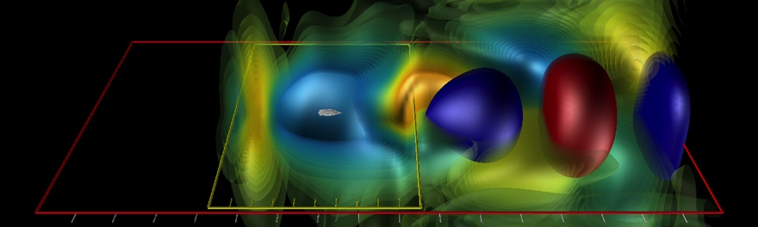
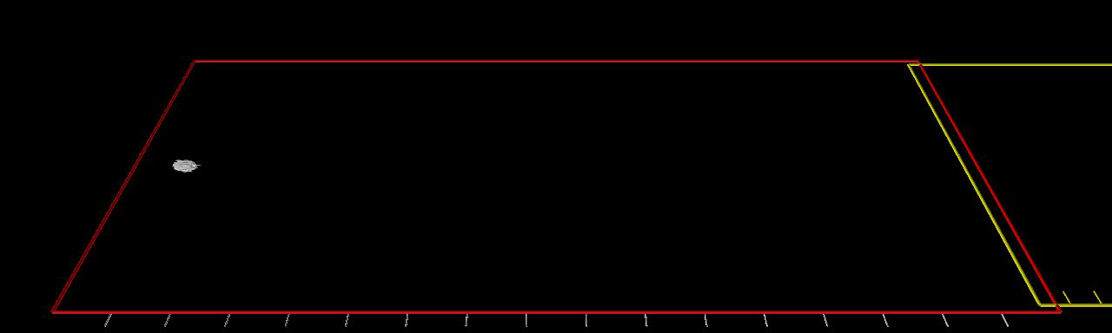
Laser field on axis
Time
Hyperbolic rotation from Lorentz Transformation converts laser…
…spatial oscillations into
time beating
Lab frame
Laser field on axis
Time
Wake frame

Slide 30
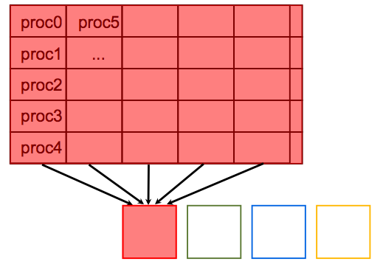
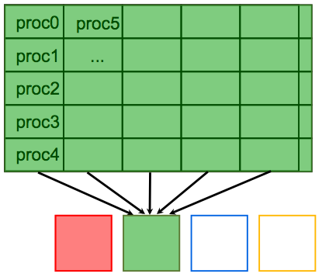
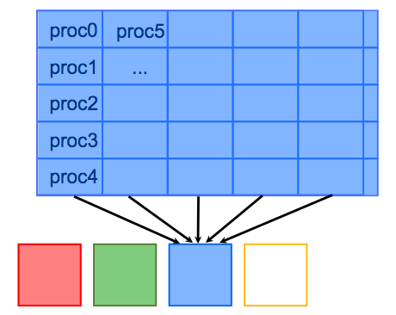
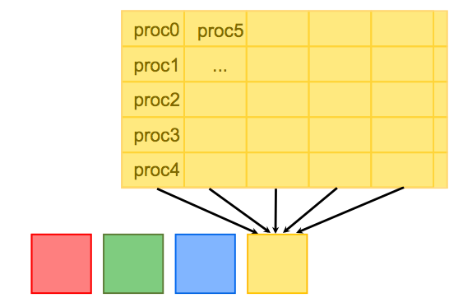
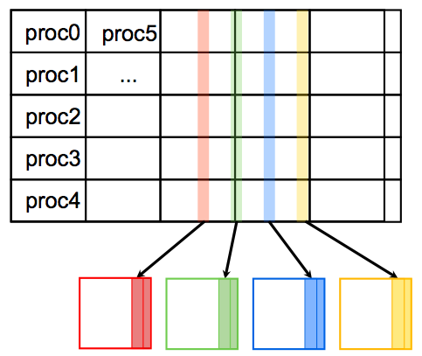
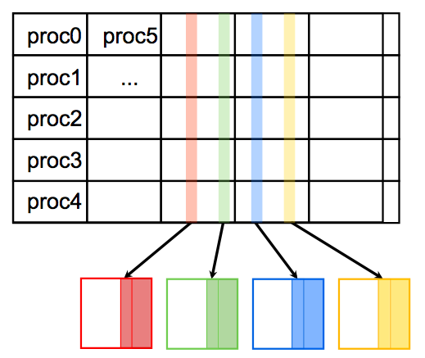
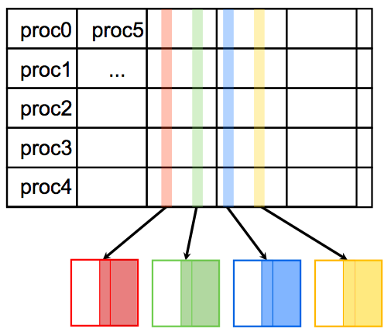
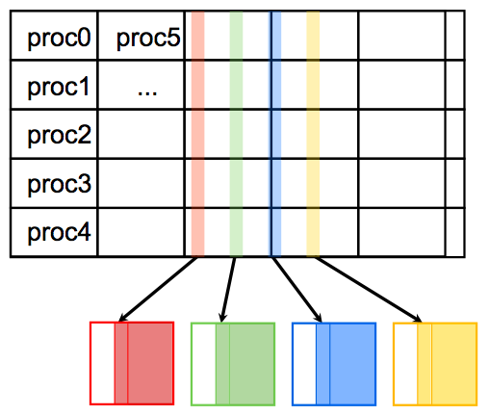
Similar to quasistatic data reconstruction + back Lorentz Tr. & interp.
Lab frame
t
t+nΔt
t+2nΔt
t+3nΔt
Simulation
Output
In lab.
t
t+nΔt
t+2nΔt
t+3nΔt
t
t+nΔt
t+2nΔt
t+3nΔt
t
t+nΔt
t+2nΔt
t+3nΔt
t
t+nΔt
t+2nΔt
t+3nΔt
Boosted frame
t’
t’+Δt’
t’+2Δt’
t’+3Δt’
Simulation
Output
In lab.
t
t+nΔt
t+2nΔt
t+3nΔt
t
t+nΔt
t+2nΔt
t+3nΔt
t
t+nΔt
t+2nΔt
t+3nΔt
t
t+nΔt
t+2nΔt
t+3nΔt

Slide 31
Outline
Modern parallel architectures and why we need them.
Domain decomposition
Exchanging information and load balancing
  Between nodes (MPI)
  Within nodes (MPI, OpenMP)
  What about GPUs?
Dynamic load balancing
Parallelization of Quasistatic mode and boosted frame diags
Outlook
  Why so many PIC codes? Which one(s) to choose? Can we do better?
  Standardization of data I/O and input scripts.

Slide 32
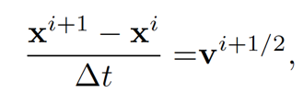
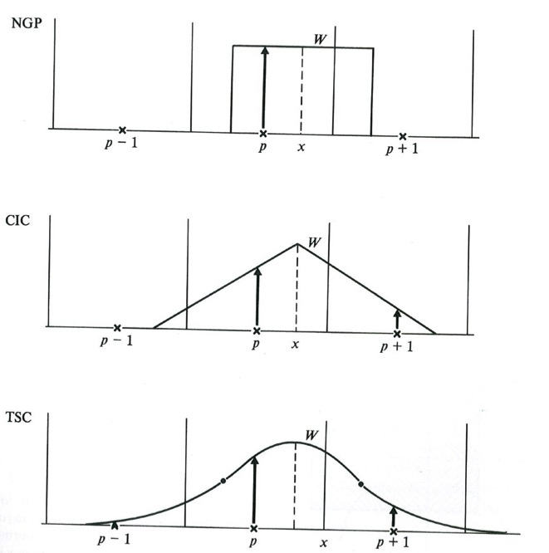
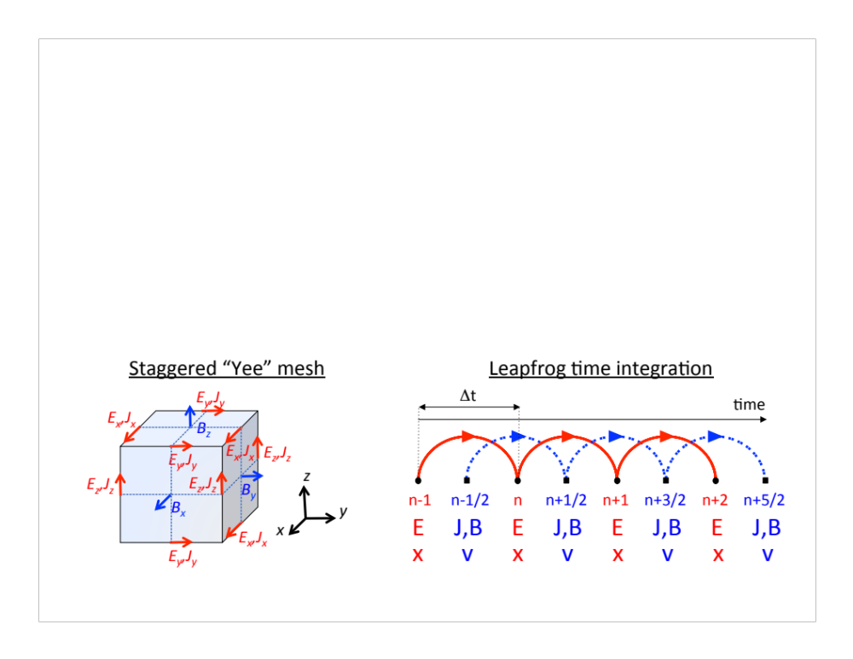
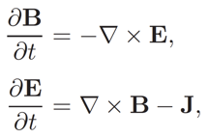
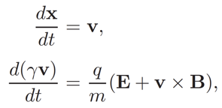
Implementing standard EM-PIC is fairly easy
Based on 2nd order centered “leapfrog” discretization
Interpolation between grids & particles based on splines
in time, e.g.
and space
Staggered “Yee” mesh
Courtesy: Hockney & Eastwood, “Computer Simulations using Particles”, IOP

Slide 33
Hence, many simulation codes exist to model plasma accelerators
List may not be complete…

Slide 34
Which one(s) to choose?
No easy answer.
In general, each developer (or team of developers) is spreading the word that their code(s) is(are) best for reason A, B, C...
However, just like with cars, whether a race car or a Sedan or an SUV is better depends on what you plan to do with it.

Slide 35
Can we do better as a community?
With cars, if you learn how to drive one of them, you (pretty much) know how to drive them all (even if using them optimally takes some practice).
With PIC codes, you have to learn how to write the input file and how to read and analyze the data files for each of them.
What is the difference? Car constructors follow standards.
➔ Can we define standards for PIC codes?

Slide 36


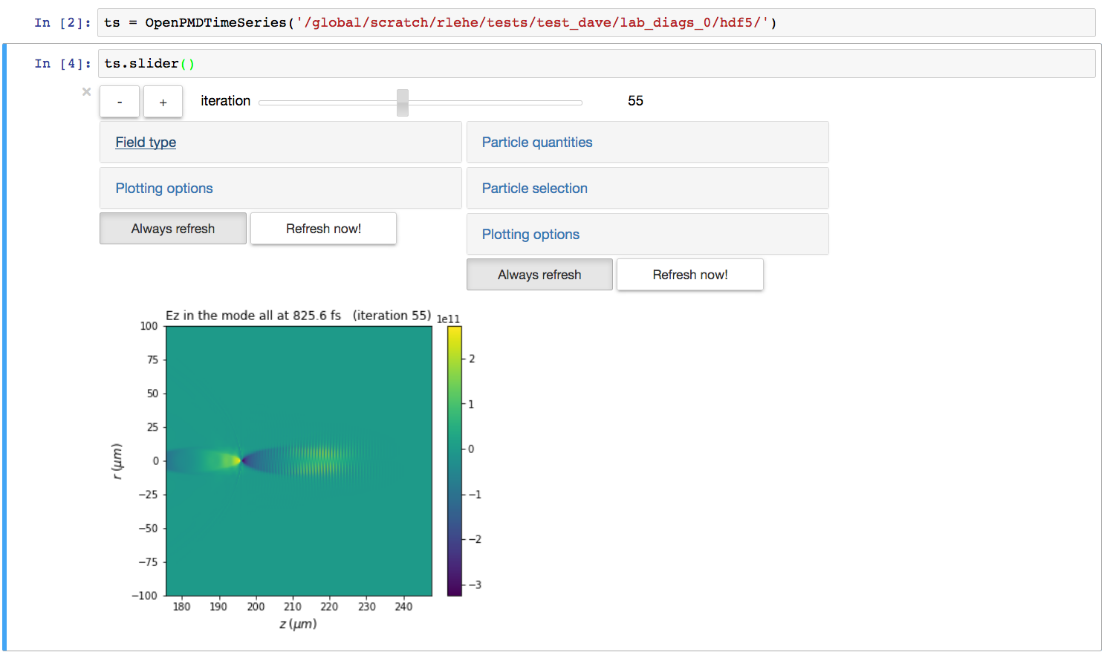
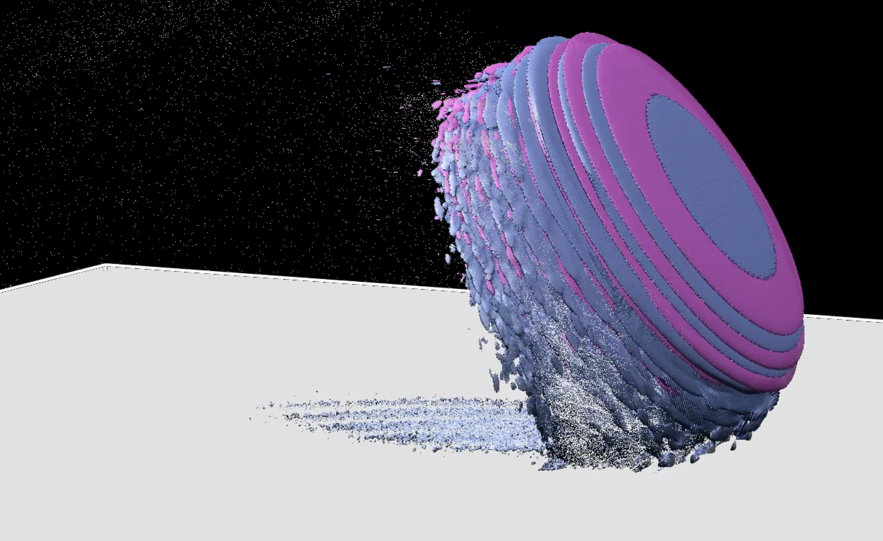
A common data standard for particles and fields is emerging
Initiated and led by Axel Huebl
(HZDR, Germany)
Tools for interactive analysis in Jupyter
Common output data standard
Adopted or being adopted by several PIC codes:
EPOCH, FBPIC, IMPACT, OPAL, OSIRIS, PIConGPU, Smilei, Synergia, QuickPIC, UPIC-EMMA, VLPL, Warp, WarpX.
Fully open-source
Hosted on Github: https://github.com/openPMD
C++, Fortran, Python reader/writer available.
OpenPMD-Notebook
Developed by R. Lehe
Plugins for visualization with Matplotlib, Visit, yt,…
3D viz with VisIt
Simulation by G. Blaclard

Slide 37
A collaboration is also ongoing on common standard for input files
Particle-In-Cell Modeling Interface (PICMI)
Developed within the Consortium of Advanced Modeling of Particle Accelerators in the USA
  LBNL, SLAC, FNAL, UCLA. (+LLNL via DOE Exascale Computing Project)
jointly with newly formed collaboration in Europe
  HZDR, CEA-Saclay, IST, PALS, GSI.
Goal: develop standardized ”language” for specifying
  Physics components: particle or laser beam, plasma distributions, …
  Numerical components: simulation grid, particle pusher, field solver, spline order…
  Simulation parameters: number of time steps, diagnostics, …
Supported language is Python ➔ each code converts input interface to PICMI or write an adapter.
Ideally, same simulation could be run using code A, B or C by changing only one line:
  E.g. ‘from A import PICMI’ for code A, ‘from B import PICMI’ with code B, etc.
Already working for lab frame LWFA/PWFA simulations with Warp & WarpX. More in development…

Slide 38
Conclusion
Parallel simulations are essential for the plasma acceleration community.
Programming of efficient parallel codes is increasingly complex, due to:
  Multilevel parallelisms.
  Load balancing among increasing number of cores.
There exist many codes in the community:
  Independent development and lack of standards is suboptimal.
  Standards for outputs and input files are emerging.

Slide 39
Thank you for your attention.
Questions?

Slide 40
Extras

Slide 41
OpenMP: example in Fortran
!!$OMP PARALLEL DO (Use OpenMP to do the loop in parallel)
DO it=1,ntiles (Loop over “tiles”)
…
… (Perform work on one “tile”)
ENDDO

Slide 42
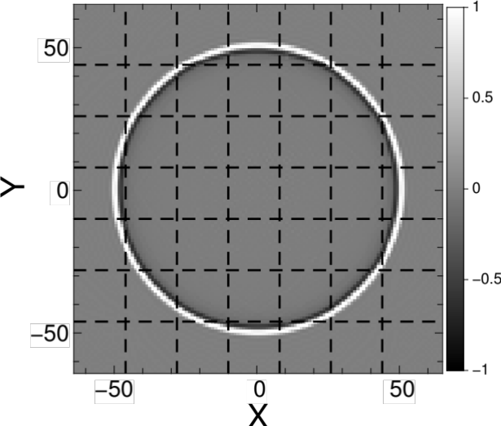
Spectral solvers involve global operations ➔ harder to scale to large # of cores
    Spectral Finite Difference (FDTD)
    global “costly” local “cheap”
    communications communications
    vs
    Harder to scale Easier to scale
○ | ○ | ○ | ○ | ○
○ | ○ | ○ | ○ | ○
○ | ○ | ○ | ○ | ○
○ | ○ | ○ | ○ | ○
○ | ○ | ○ | ○ | ○
○ | ○ | ○ | ○ | ○
○ | ○ | ○ | ○ | ○
○ | ○ | ○ | ○ | ○
○ | ○ | ○ | ○ | ○
○ | ○ | ○ | ○ | ○
Local FFT
Finite speed of light ➔ local FFTs ➔ spectral accuracy+FDTD scaling!
J.-L. Vay, I. Haber, B. Godfrey, J. Comput. Phys. 243, 260 (2013)
H. Vincenti, J.-L. Vay, Comput. Phys. Comm. 200, 147 (2016)
42
42

Slide 43
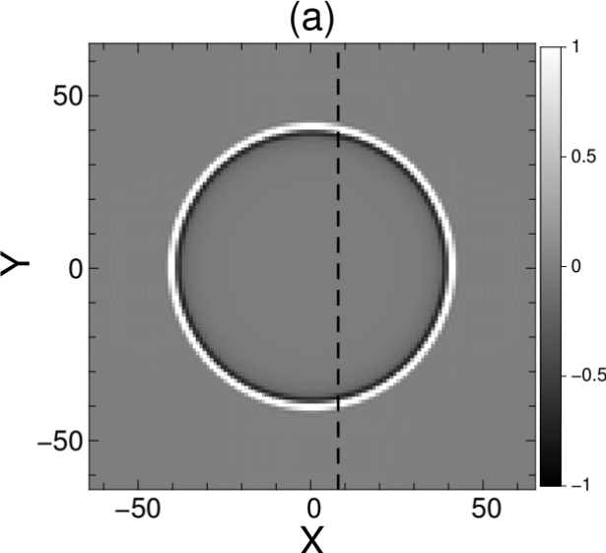
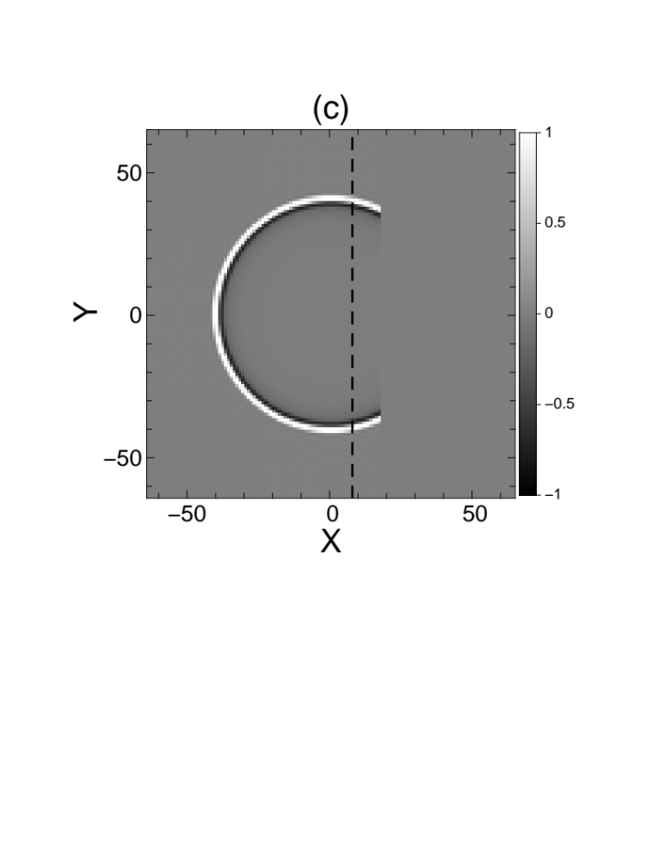
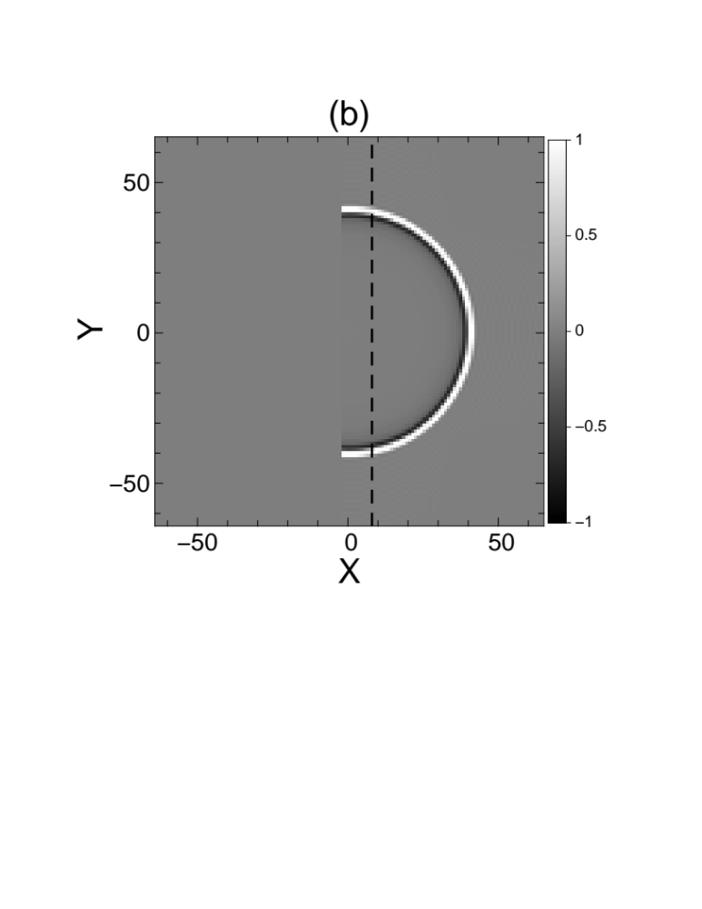


Local FFT example on single pulse – part 1
Example: unit pulse expansion at time T
Separate calculation in two domains
Global FFT
Local FFT
Local
FFT
guard regions
Advance to time T+DT
Copy unaffected data
Local FFT
Local
FFT
spurious signal limited to guard regions
*J.-L. Vay, I. Haber, B. Godfrey, J. Comput. Phys. 243, 260-268 (2013)
43

Slide 44
Local FFT example on single pulse – part 2
To affected areas
zero out remaining areas
Ready for next time step
Successfully tested on 7x7 domain
Local FFTs
Truncation errors have been studied and controlled at required level with finite-order stencil.
44

