Slide 1




The
CERN
Accelerator
School
High Gradient Wakefield Accelerator
11-22 March 2019 – Sesimbra, Portugal
Modeling & Simulations - Part 1
Particle-In-Cell method basics
and stability
Jean-Luc Vay
Lawrence
Berkeley
National
Laboratory

Slide 2
Outline
Intro
Pushing particles
Field solve (electrostatic)
Field solve (electromagnetic)
Interpolation between particles and fields
Stability, numerical heating, numerical dispersion, numerical Cherenkov instability
Conclusion

Slide 3
Modeling of a charged particle beams/plasmas - classification (1)
Plasma (neutral/non-neutral): collection of a large number of interacting charged particles.
  Interactions mathematically described by
    Lagrangian approach: sum from all singularities/particles forces
      instantaneous: Green functions
      with retardation: retarded Green functions
    Eulerian approach: fields
      instantaneous: Poisson/Ampère
      with retardation: Maxwell
  Particles mathematically described by
    Lagrangian approach: evolution of singularities/particles
      Klimontovitch eq. (+ shape factors)
    Eulerian approach: evolution of n-D fluid
      in phase-space (6-D):
        with collisions: Boltzmann/Fokker-Planck eq.
        no collisions: Vlasov eq.
      in real space (3-D): fluid/MHD eq.

Slide 4
Modeling of a charged particle beams/plasmas - classification (2)
In summary, the modeling of a plasma implies the modeling of
interacting
The numerical integration leads to further splitting
  Partial differential equations: finite-differences/volumes/elements, Monte-Carlo, semi-Lagrangian,…
  Time integration: explicit, implicit, Euler, Runge-Kuta, Leapfrog, …
  Direct interaction: direct summation, multipole expansion, tree-codes, …
  …
a collection of particles
fluid cells in phase-space
fluid cells in configuration space
or
v
or
y
x
x
directly
via a field
or
y
x

Slide 5
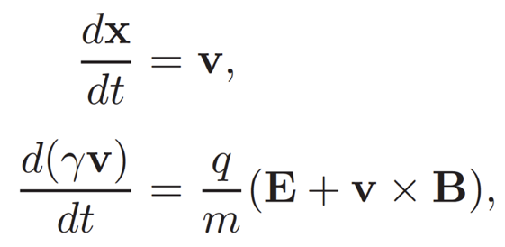
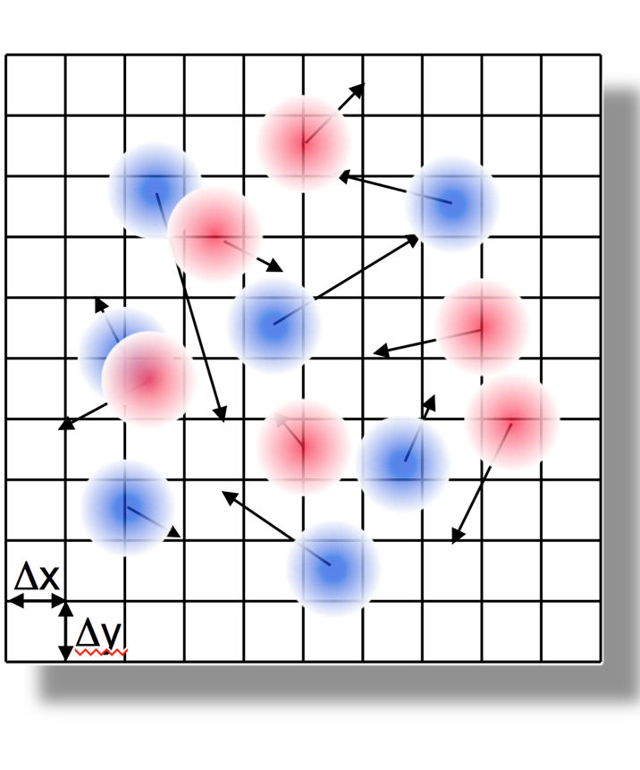

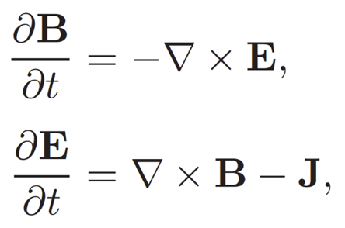
We concentrate on the widely used Particle-In-Cell method
Lagrangian macro-particles
Push particles
Newton-Lorentz
Gather forces
Δt
Deposit charge/current
Field solve
Eulerian fields on grids
(usually Cartesian)
Poisson/Maxwell
+ discretization of field and particles equations

Slide 6
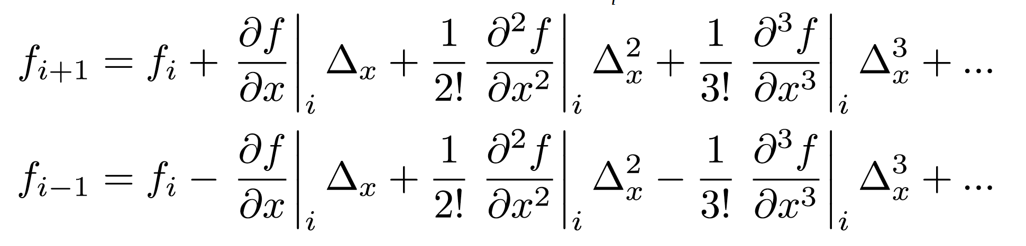
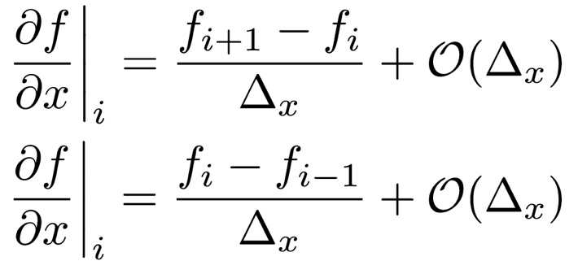
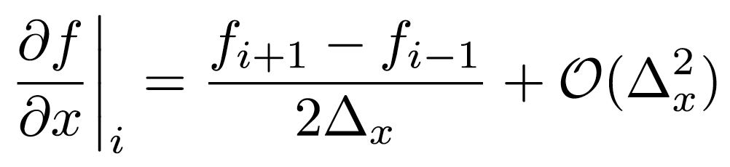
Discretization of differential operations
Δx
Assuming a uniform grid of cell size Δx,
and writing Taylor expansion of function f on grid, one cell forward and backward:
gives non-centered first-order finite-difference (FD) approximations of 1st order derivatives.
i-2
i-1
i
i+1
i+2
i+3
x
forward
backward
Subtracting forward and backward FD gives second order centered expression:

Slide 7
Outline
Intro
Pushing particles
Field solve (electrostatic)
Field solve (electromagnetic)
Interpolation between particles and fields
Stability, numerical heating, numerical dispersion, numerical Cherenkov instability
Summary

Slide 8
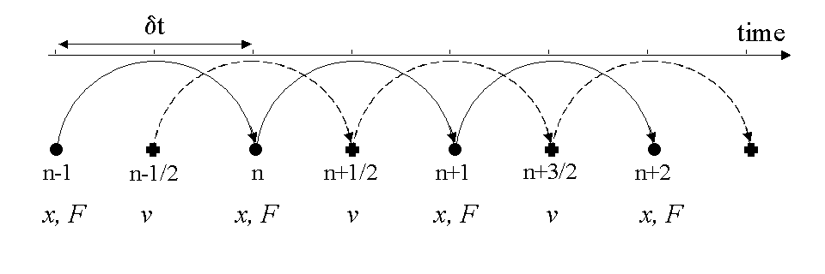
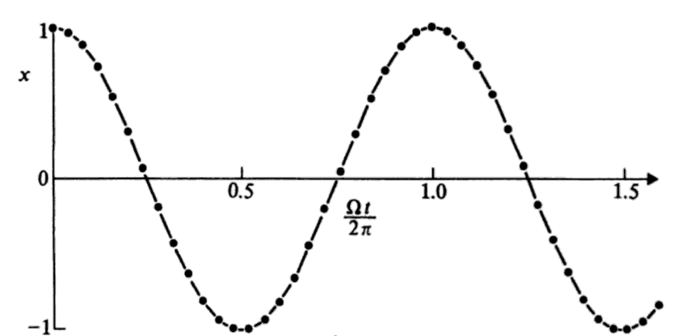

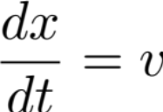
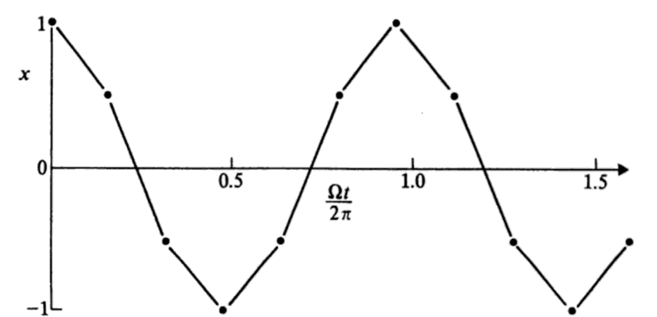

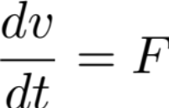
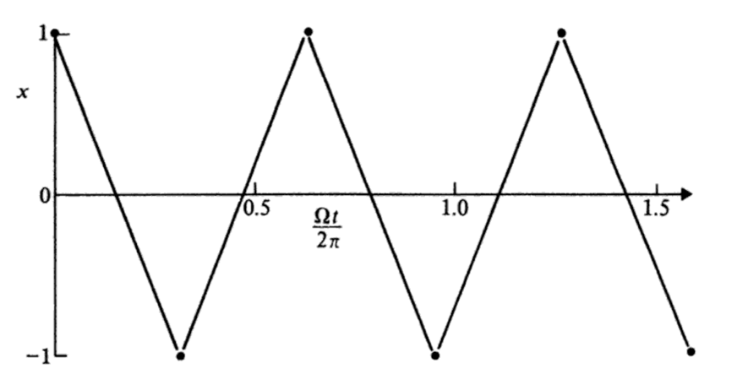

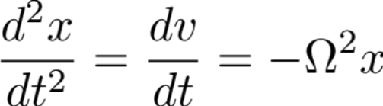
Application to particle pusher: leapfrog
Accuracy: error proportional to Δt²
Example: harmonic oscillator

Slide 9
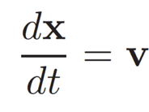
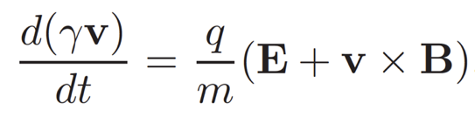
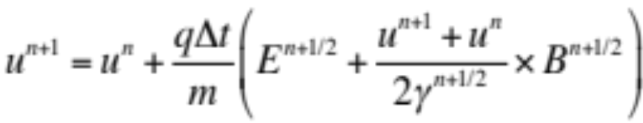

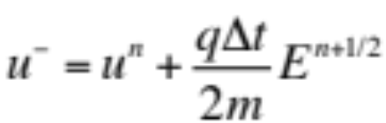
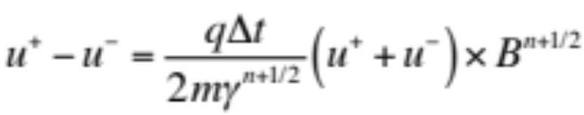
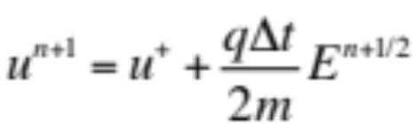
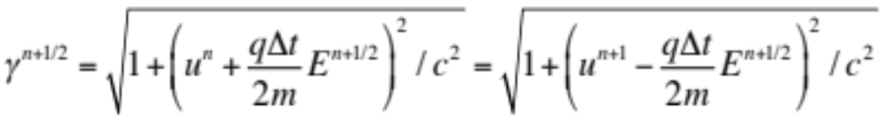
Integration of Newton-Lorentz: Leapfrog Boris pusher
Position update
For the velocity component, the Boris pusher writes
Note time-centering!
with
which decomposes into
one acceleration + one rotation + one acceleration
with

Slide 10
Outline
Intro
Pushing particles
Field solve (electrostatic)
Field solve (electromagnetic)
Interpolation between particles and fields
Stability, numerical heating, numerical Cherenkov instability
Summary

Slide 11







Electrostatic field solve (2-D example)
Δx
j+1
Φ
Φ
Φ
Δy
j
Φ
Φ
Φ
j-1
Φ
Φ
Φ
i-1
i
i+1
or
E_{x},E_{y}
E_{x},E_{y}
E_{x},E_{y}
E_{x}
E_{x}
Fields on “centered” or ”nodal” grid
E_{y}
E_{y}
E_{y}
Fields on “staggered” or ”Yee” grid
E_{x},E_{y}
E_{x},E_{y}
E_{x},E_{y}
E_{x}
E_{x}
E_{y}
E_{y}
E_{y}
E_{x},E_{y}
E_{x},E_{y}
E_{x},E_{y}
E_{x}
E_{x}

Slide 12
There are many ways to solve such a boundary value problem
Relaxation methods
Gauss-Seidel (GS)
successive overrelaxation (SOR)
alternating direction implicit (ADI)
Multigrid (MG)
…
Direct methods
Matrix
Thomas tridiagonal algorithm
sparse matrix methods (SM)
conjugate gradient algorithm (CGA))
Incomplete Choleski-conjugate gradient (ICCG)
…
Rapid elliptic (FFT)
cyclic reduction (CR)
Multiple Fourier transform (MFT)
Fourier analysis/cycling reduction (FACR)
convolution methods
…
Choice of the method depends on application and type of computer.
We will present only a subset that is versatile and popular in electrostatic PIC codes.

Slide 13
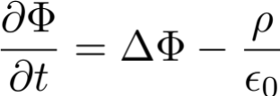
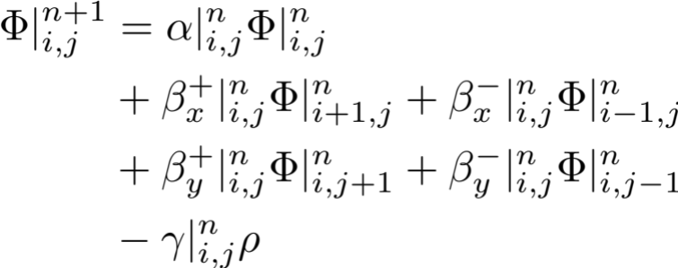
Electrostatic field solve – relaxation to solution
“Naïve” physicist view
Δx
Diffusion equation relaxes to
j+1
Φ
Φ
Φ
Δy
j
Φ
Φ
Φ
FD
j-1
Φ
Φ
Φ
More generally (assuming an explicit scheme where all the terms on the right-hand side are from the previous time step):
There exists many ways to re-interpret the procedure numerically and adapt to speedup convergence, varying coefficients, using implicit update, play with ordering of updates, etc.

Slide 14
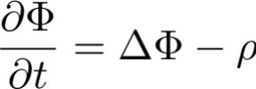

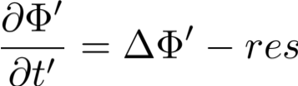

Electrostatic field solve – multigrid method
Standard relaxation methods have “slow convergence” due to locality of procedure.
The multigrid (MG) method enables much faster convergence by enabling multi-resolution solve.
Procedure:
Partial relaxation on fine grid
  Restrict residue to coarser grid
  Partial relaxation on coarser grid
    Repeat recursively up to coarsest grid
  Interpolate correction to finer grid
  Partial relaxation on coarser grid
    Repeat recursively up to finest grid
Repeat all until convergence
Courtesy: https://devblogs.nvidia.com/high-performance-geometric-multi-grid-gpu-acceleration

Slide 15
Outline
Intro
Pushing particles
Field solve (electrostatic)
Field solve (electromagnetic)
Interpolation between particles and fields
Stability, numerical heating, numerical dispersion, numerical Cherenkov instability
Summary

Slide 16
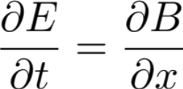
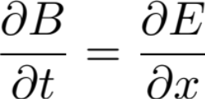
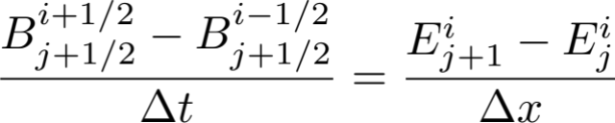
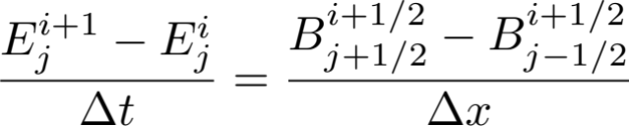
Leapfrog discretization of 1D Maxwell solver
o : E
+ : B
t
We consider 1d wave equation (natural units)
staggered on a regular space time grid using finite-difference time-domain (FDTD) centered scheme
o
δx
o
o
o
o
i+2
+
+
+
+
+
δt
i+1
o
o
o
o
o
+
+
+
+
+
i
o
o
o
o
o
+
+
+
+
+
i-1
o
o
o
o
o
+
+
+
+
+
i-2
o
o
o
o
o
j-2 j-1 j j+1 j+2 x
Notes:
%\frac{\partial E}{\partial t}=\frac{\partial B}{\partial x}
%
%\frac{\partial B}{\partial t}=\frac{\partial E}{\partial x}
%
%\frac{B^{i+1/2}_{j+1/2}-B^{i-1/2}_{j+1/2}}{\Delta t} = \frac{E^{i}_{j+1}-E^{i}_{j}}{\Delta x}
%
%\frac{E^{i+1}_{j}-E^{i}_{j}}{\Delta t} = \frac{B^{i+1/2}_{j+1/2}-B^{i+1/2}_{j-1/2}}{\Delta x}

Slide 17
Leapfrog discretization of 1D Maxwell solver
o : E
+ : B
t
We consider 1d wave equation (natural units)
staggered on a regular space time grid using finite-difference time-domain (FDTD) centered scheme
o
δx
o
o
o
o
i+2
+
+
+
+
+
δt
i+1
o
o
o
o
o
+
+
+
+
+
i
o
o
o
o
o
+
+
+
+
+
i-1
o
o
o
o
o
+
+
+
+
+
i-2
o
o
o
o
o
j-2 j-1 j j+1 j+2 x

Slide 18
Leapfrog discretization of 1D Maxwell solver
o : E
+ : B
t
We consider 1d wave equation (natural units)
staggered on a regular space time grid using finite-difference time-domain (FDTD) centered scheme
o
δx
o
o
o
o
i+2
+
+
+
+
+
δt
i+1
o
o
o
o
o
+
+
+
+
+
i
o
o
o
o
o
+
+
+
+
+
i-1
o
o
o
o
o
+
+
+
+
+
i-2
o
o
o
o
o
j-2 j-1 j j+1 j+2 x

Slide 19
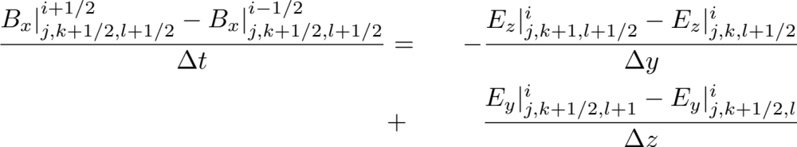
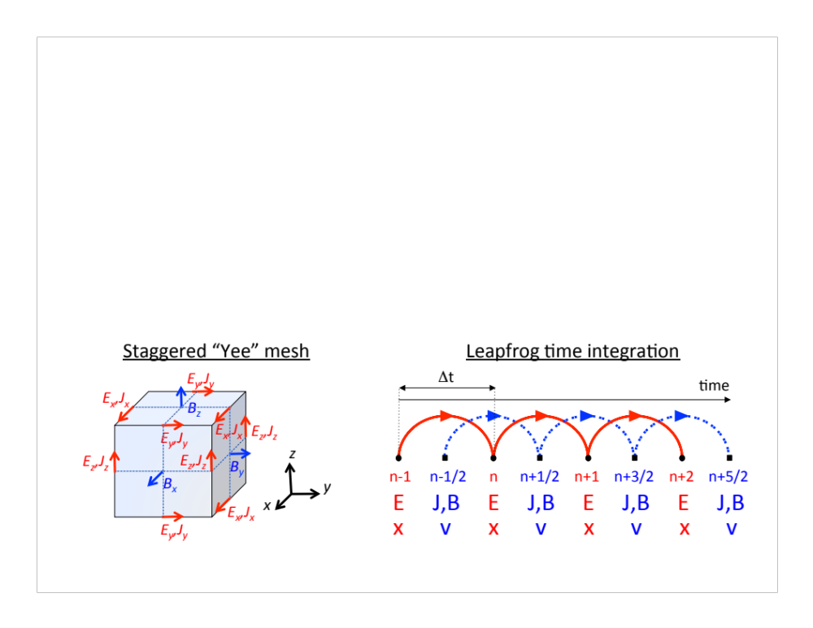
Maxwell’s equations in 3-D – e.g. equation on B_{x}
*K. Yee, Ieee Trans. Antennas & Propag. 14, 302 (1966).
Staggered ”Yee” grid*
Notes:
\frac{B_x|^{i+1/2}_{j,k+1/2,l+1/2}-B_x|^{i-1/2}_{j,k+1/2,l+1/2}}{\Delta t} & = & -\frac{E_z|^{i}_{j,k+1,l+1/2}-E_z|^{i}_{j,k,l+1/2}}{\Delta y} \\
& + &\frac{E_y|^{i}_{j,k+1/2,l+1}-E_y|^{i}_{j,k+1/2,l}}{\Delta z}

Slide 20
Outline
Intro
Pushing particles
Field solve (electrostatic)
Field solve (electromagnetic)
Interpolation between particles and fields
Stability, numerical heating, numerical dispersion, numerical Cherenkov instability
Summary

Slide 21
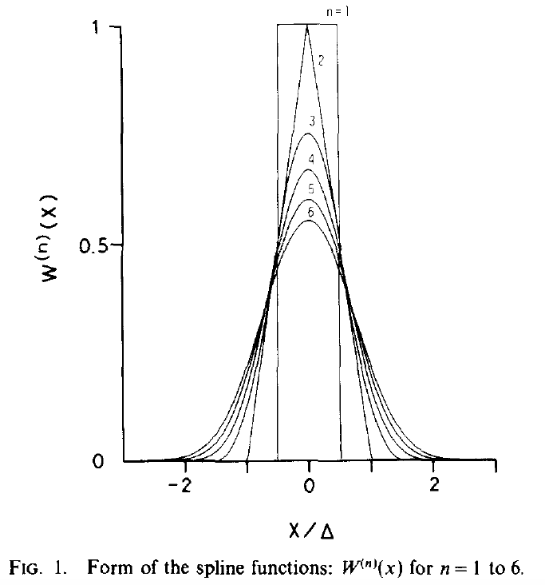
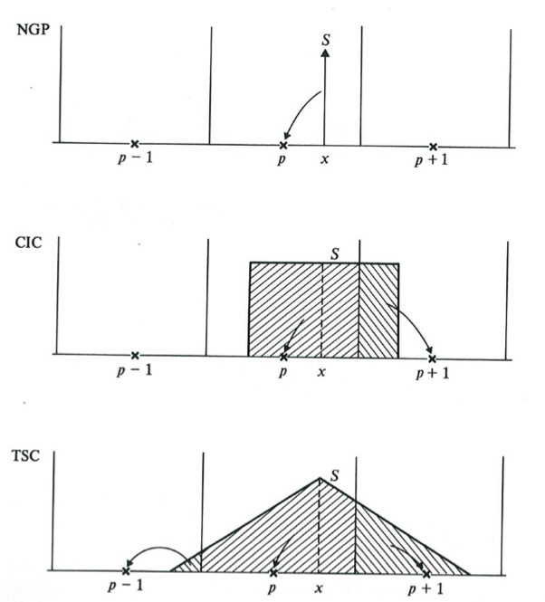
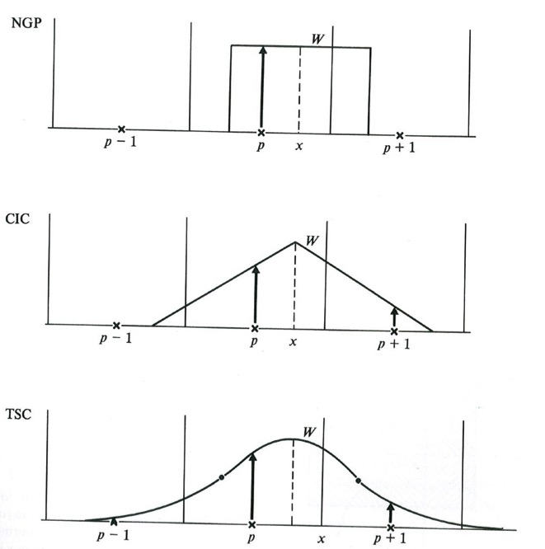
Splines are commonly used
order | Cloud shape
0 “NGP” | δ
1 “CIC” | Π
2 “TSC” | Π∗Π
3 “PQS” | Π∗Π∗Π
Assignment shape | Force
Π | Stepwise F
Π∗Π | Continuous piecewise F
Π∗Π∗Π | Continuous F+F’
Π∗Π∗Π∗Π | Continuous F+F’+F’’
Spline of order n is n times convolution of Π
Cloud shape interpretation
Assignment function shape interpretation
n⟶∞ ➔ W⟶Gaussian
# points = (order+1)^{dimension}
CIC is most common
Courtesy: Hockney & Eastwood, “Computer Simulations using Particles”, IOP

Slide 22
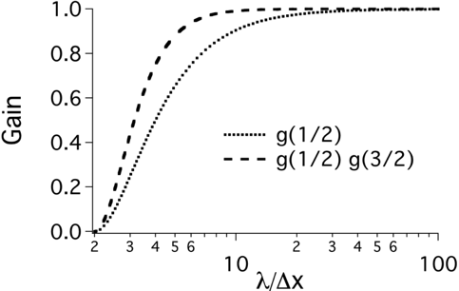
Digital filtering also commonly used
Bilinear filter + compensation routinely used
100% absorption at Nyquist freq.
1/4
1/2
1/4
Bilinear (B)
Bilinear (B) + compensation (C)
Bilinear
filter
Wider band filtering obtain via:
Wider (more points) filter.
Multiple passes of bilinear or wider filter.
Multiple passes of bilinear or wider filter with stride.

Slide 23
Most common options for field interpolations
“Energy-Conserving”
“Momentum-Conserving”
interpolates from staggered grid
one order down in // direction
first interpolate at grid nodes
same order in all directions
The conservation of energy or momentum is at the limit of infinitesimal time steps only.
Neither method is intrinsically superior to the other.
It can be useful to implement both methods and test whether one converges faster than the other for a given class of problems.
E_{x}
E_{x}
E_{x,y}
E_{x}
E_{x,y}
E_{x}
E_{x,y}
E_{y}
E_{y}
E_{y}
E_{y}
E_{y}
E_{y}
E_{x}
E_{x}
E_{x,y}
E_{x}
E_{x,y}
E_{x}
E_{x,y}
E_{y}
E_{x}
E_{y}
E_{y}
E_{y}
E_{y}
E_{y}
E_{x}
E_{x}
E_{x,y}
E_{x}
E_{x,y}
E_{x}
E_{x,y}
E_{x}
E_{x}
E_{x,y}
E_{x,y}
E_{x,y}
E_{y}
E_{y}
E_{y}
E_{x}
E_{x}
E_{x,y}
E_{x,y}
E_{x,y}
E_{y}
E_{y}
E_{y}
E_{y}
E_{x}
E_{x}
E_{x,y}
E_{x,y}
E_{x,y}

Slide 24
Outline
Intro
Pushing particles
Field solve (electrostatic)
Field solve (electromagnetic)
Interpolation between particles and fields
Stability, numerical heating, numerical dispersion, numerical Cherenkov instability
Summary

Slide 25
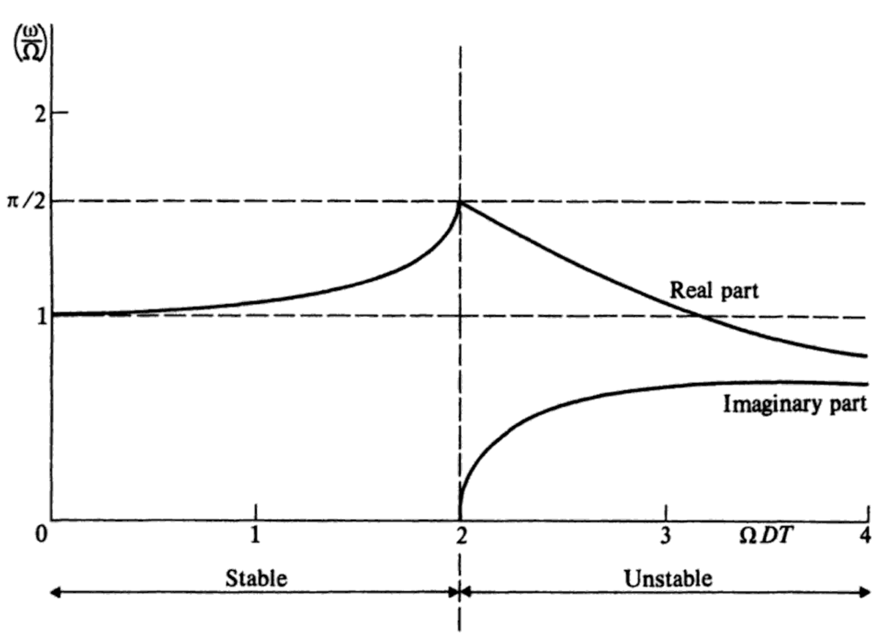
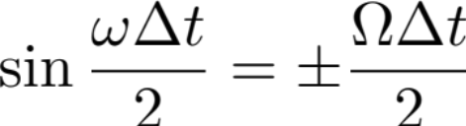


Stability analysis of the leapfrog particle pusher
Stability FD pusher: harmonic oscillator
➔ Unstable if
Hockney & Eastwood, “Computer simulation using particles”

Slide 26


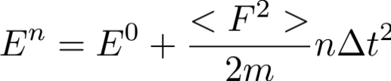
Energy considerations
Energy harmonic oscillator
Ω²x²
Δt=2.02/Ω
Finite-Difference discretization
if
Δt=2/Ω
Δt=1/Ω
x
Now assuming random force δF giving random velocity δv kick (due to field interpolations, etc):
Energy change 1 step:
Average energy change: ➔
i.e. energy grows with time unphysically.
This is known as “numerical heating” and is a very common limitation.
=
0

Slide 27
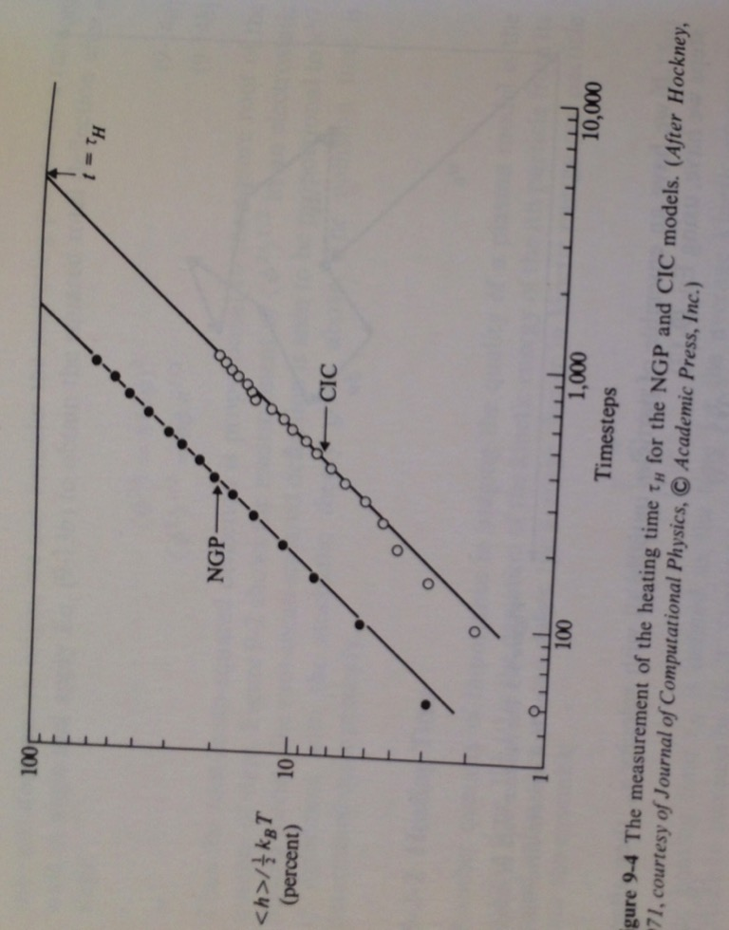
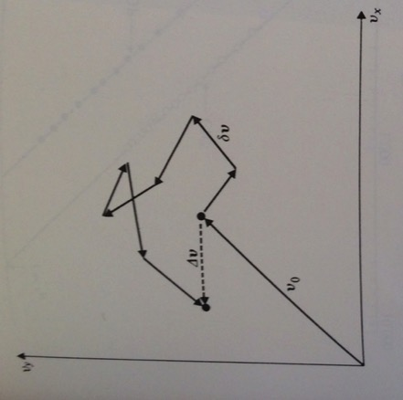
Aliasing is a source of numerical heating
Aliasing in PIC code
Numerical heating
Mode present in particles distribution
Random aliasing errors in velocity space
Mode as seen by the grid
Courtesy: Hockney & Eastwood, “Computer Simulations using Particles”, IOP

Slide 28
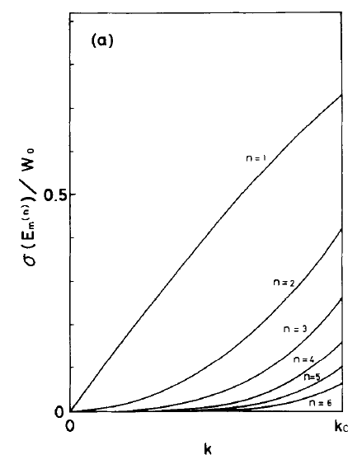
Best to combine splines & filtering to reduce aliasing errors
Aliasing error
Aliasing in PIC code
Mode present in particles distribution
no filter
with Gaussian filter
CIC
TSC
Mode as seen by the grid
PQS
Filter efficient at high k.
Spline efficient at low k.
Courtesy: H. Abe, J. Comput. Phys. 63, 247 (1985)

Slide 29
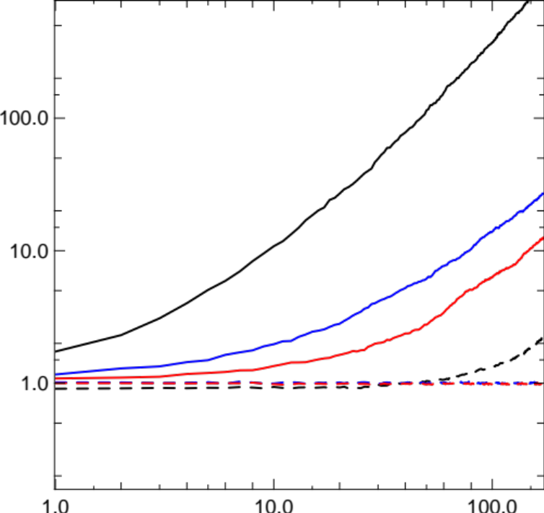
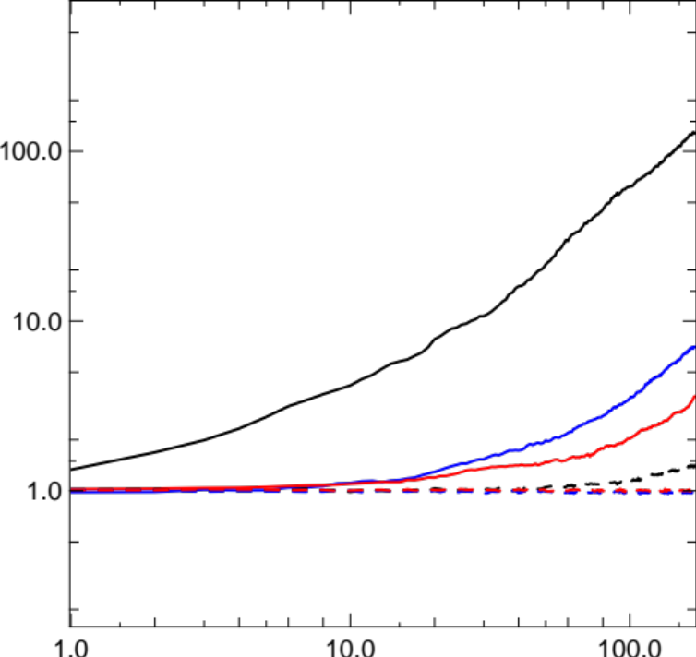
Example: test of energy conservation with a uniform warm plasma
1 pass bilinear filter
2 passes bilinear filter
Momentum cons.
Energy cons.
CIC
Energy (a.u.)
TSC
Energy (a.u.)
CIC
PQS
PQS
TSC
CIC
CIC
TSC
PQS
TSC
PQS
Time step
Time step

Slide 30
Outline
Intro
Pushing particles
Field solve (electrostatic)
Field solve (electromagnetic)
Interpolation between particles and fields
Stability, numerical heating, numerical dispersion, numerical Cherenkov instability
Summary

Slide 31

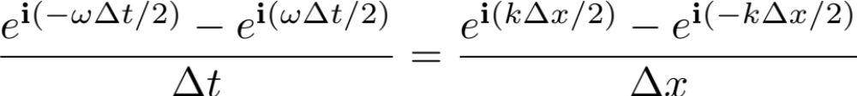
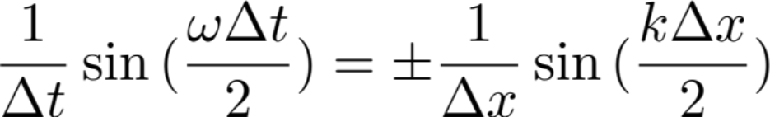
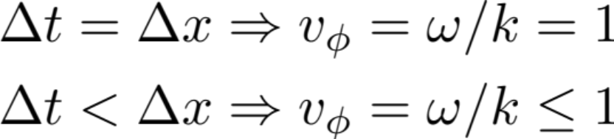
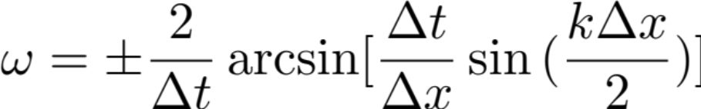
Dispersion relation 1D leapfrog Maxwell solver
Von Neumann analysis: assume solutions of the form
Numerical dispersion
Notes:
%E_0 e^{{\bf i}(kx-\omega t)}
%
%\frac{E_0 e^{{\bf i}(k j \Delta x-\omega (i+1) \Delta t)} - E_0 e^{{\bf i}(k j \Delta x-\omega i \Delta t)}}{\Delta t} = \frac{E_0 e^{{\bf i}(k (j+1/2) \Delta x-\omega (i+1/2) \Delta t)} - E_0 e^{{\bf i}(k (j-1/2) \Delta x-\omega (i+1/2) \Delta t)}}{\Delta x}
%
%\frac{e^{{\bf i}(-\omega \Delta t/2)} - e^{{\bf i}(\omega \Delta t/2)}}{\Delta t} = \frac{e^{{\bf i}(k \Delta x/2)} - e^{{\bf i}(-k \Delta x/2)}}{\Delta x}
%
%\frac{1}{\Delta t}\sin{(\frac{\omega \Delta t}{2})} = \pm \frac{1}{\Delta x}\sin{(\frac{k \Delta x}{2})}
%
%\omega = \pm \frac{2}{\Delta t} \arcsin[\frac{\Delta t}{\Delta x} \sin{(\frac{k \Delta x}{2})}]
%
%\Delta t = \Delta x \Rightarrow v_{\phi} = \omega/k = 1 \\
%\Delta t < \Delta x \Rightarrow v_{\phi} = \omega/k \leq 1

Slide 32
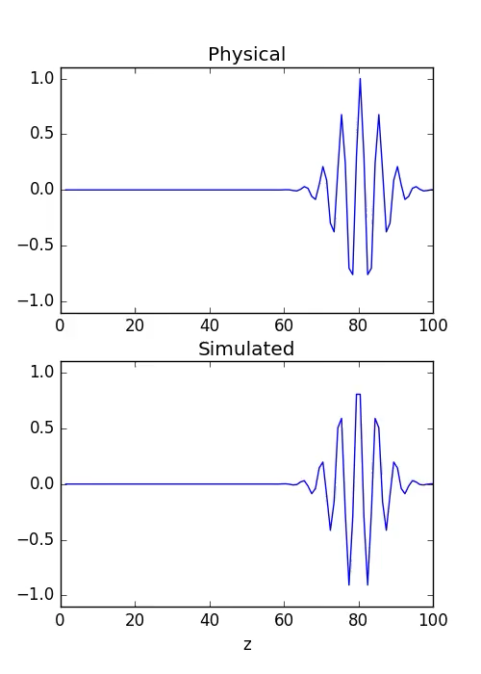
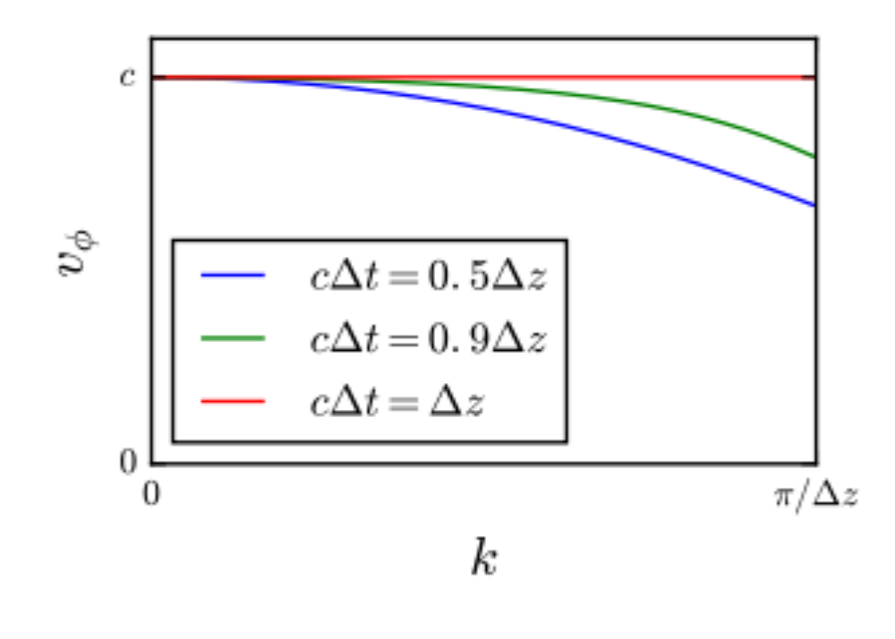
Δt<Δx: the shorter the wavelength, the slower…

Slide 33
Δt >Δx ➔ instability; Δt = Δx: Courant condition
For Δt>Δx, the solution is imaginary and the system is unstable (infinite growth).
The Courant (aka Courant–Friedrichs–Lewy or CFL) condition Δt>Δx is the maximum time step that can be used.
The smaller the grid cell size Δx, the smaller the time step Δt: this is a severe constraint of electromagnetic simulations.
CFL can be alleviated with implicit field solvers.

Slide 34
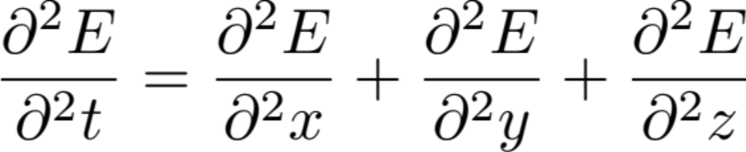
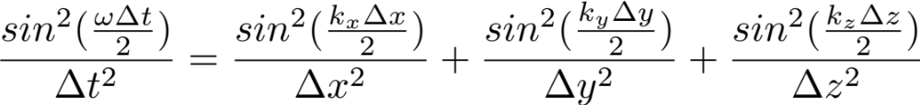

Dispersion relation and Courant condition in 3-D
Combine discrete Maxwell equations ➔ 3D full wave equation
➔ Discretization ➔ Von Neumann analysis ➔ Numerical dispersion relation
➔ Courant condition
Notes:
%\frac{\partial^2 E}{\partial^2 t}=\frac{\partial^2 E}{\partial^2 x}+\frac{\partial^2 E}{\partial^2 y}+\frac{\partial^2 E}{\partial^2 z}
%
%
%\frac{sin^2(\frac{\omega \Delta t}{2})}{\Delta t^2} = \frac{sin^2(\frac{k_x\Delta x}{2})}{\Delta x^2} + \frac{sin^2(\frac{k_y \Delta y}{2})}{\Delta y^2} + \frac{sin^2(\frac{k_z \Delta z}{2})}{\Delta z^2}

Slide 35


Example: expanding electromagnetic pulse
Physical
Simulated

Slide 36


Example: expanding electromagnetic pulse
Physical
Simulated
Numerical dispersion depends on time step, wavelength & angle.

Slide 37
Outline
Intro
Pushing particles
Field solve (electrostatic)
Field solve (electromagnetic)
Interpolation between particles and fields
Stability, numerical heating, numerical dispersion, numerical Cherenkov instability
Summary

Slide 38


Relativistic plasmas PIC subject to “numerical Cherenkov
B. B. Godfrey, “Numerical Cherenkov instabilities in electromagnetic particle codes”, J. Comput. Phys. 15 (1974)
Numerical dispersion leads to crossing of EM field and plasma modes -> instability.
Exact Maxwell
Standard PIC
38

Slide 39
Space/time discretization aliases ➔ more crossings in 2/3-D
Exact Maxwell
Standard PIC
light
light
ω
ω
k_{x}
k_{x}
plasma at β=0.99
k_{z}
plasma at β=0.99
k_{z}
39

Slide 40

Space/time discretization aliases ➔ more crossings in 2/3-D
Exact Maxwell
Standard PIC
aliases
aliases
light
light
ω
ω
k_{x}
k_{x}
plasma at β=0.99
k_{z}
plasma at β=0.99
k_{z}
Need to consider at least first aliases m_{x}={-3…+3} to study stability.
Analysis calls for full PIC numerical dispersion relation
40

Slide 41


Maps of unstable modes
Normal modes
at k_{x}=0.5π/Δx for cΔt=0.7Δz
Projection of normal
modes intersection
EM modes
Plasma modes
41

Slide 42






Numerical dispersion relation of full-PIC algorithm needed for theory
2-D relation
(Fourier space):
*B. B. Godfrey, J. L. Vay, I. Haber, J. Comp. Phys. 248 (2013)
42

Slide 43



Numerical dispersion relation of full-PIC algorithm needed for theory (II)
*B. B. Godfrey, J. L. Vay, I. Haber, J. Comp. Phys. 248 (2013)
43

Slide 44

Numerical dispersion relation of full-PIC algorithm needed for theory (III)
Then simplify and solve with Mathematica, Python or other…
*B. B. Godfrey, J. L. Vay, I. Haber, J. Comp. Phys. 248 (2013)
44

Slide 45


Growth rates from theory match computer simulations
Theory
Warp
k_{x}
k_{x}
k_{z}
k_{z}
Warp run uses uniform drifting plasma with periodic BC.
Yee finite difference, energy conserving gather (cΔt/Δx=0.7)
45

Slide 46


Stripes crossing at an angle growing with time are signature of NCI
Example from uniform plasma drifting at γ=100 with regard to computational grid.

Slide 47


High order splines and application of bilinear filter help reduce growth rate
Evolution of plasma electron total kinetic energy KE relative to initial energy KE₀.
Linear spline
Quadratic spline
Cubic spline
1-pass filter
4-pass filter
Time step
Time step

Slide 48
Outline
Intro
Pushing particles
Field solve (electrostatic)
Field solve (electromagnetic)
Interpolation between particles and fields
Stability, numerical heating, numerical dispersion, numerical Cherenkov instability
Conclusion

Slide 49
Conclusion
Second-order Finite-Difference PIC algorithm
  Leapfrog integrators for particles and fields
    have time step limit (Courant or CFL condition)
  Interpolation between fields and particles
    Splines for higher order deposition
    Layout on gathered fields on grid gives better momentum or energy conservation
Stability
  Aliasing ➔ random force kicks ➔ numerical heating
  Relativistic plasmas ➔ numerical Cherenkov instability
  High-order splines and filtering help

Slide 50
References
C. K. Birdsall and A. B. Langdon, Plasma Physics Via Computer Simulation (Adam-Hilger, 1991).
R. W. Hockney and J. W. Eastwood, Computer simulation using particles (Taylor & Francis,1988).

