Slide 1
CAS – Introduction to Accelerator Physics
Collective effects
Part III: Wake fields and impedances – instabilities

Slide 2
In the last lecture, we discussed indirect space charge and showed that this can lead to both incoherent as well as coherent tune shifts. We then moved on to a more general treatment of electromagnetic fields in simple structures where we were able to identify yet another type of induced fields originating from the electromagnetic properties of the surrounding material – the wall wake.
We looked at more general examples of induced fields in complex structures and then introduced the concept of the wake function.
Next we will look at some different wake fields and study more the effect of wake fields and impedances an the machine and on the beam.
Part 3: Wake fields and impedances – impacts
  Longitudinal and transverse wake fields and impedances
  Panofsky-Wenzel theorem
  Examples of analytically expressible wake functions and impedances
  Impact of wake fields and impedance on the accelerator environment
  Description of a coherent beam instability and the instability loop

Slide 3
We have already seen how we can simplify our handling of induced electromagnetic fields within complex structures by means of the wake function. The wake function is the electromagnetic response of a structure and is an intrinsic property of any such structure.
We will now look how we handle longitudinal and transverse wake fields in practice and what are some of the fundamental properties. We will also introduce the impedance.
Part 3: Wake fields and impedances – impacts
  Longitudinal and transverse wake fields and impedances
  Panofsky-Wenzel theorem
  Examples of analytically expressible wake functions and impedances
  Impact of wake fields and impedance on the accelerator environment
  Description of a coherent beam instability and the instability loop

Slide 4
Wake function – general definition
How can we treat these phenomena effectively in our models?
The rigid beam approximation
The impulse approximation
We will use a little trick: we consider two point particles – one source, one probe
The forces will be a function of the locations of both the source and the probe particles:
L
Source, q₁
Witness, q₂
Δx₁ (or Δy₁)
2b
z
Δx₂ (or Δy₂)
Wake force measured by the witness particle
Note that:

Slide 5
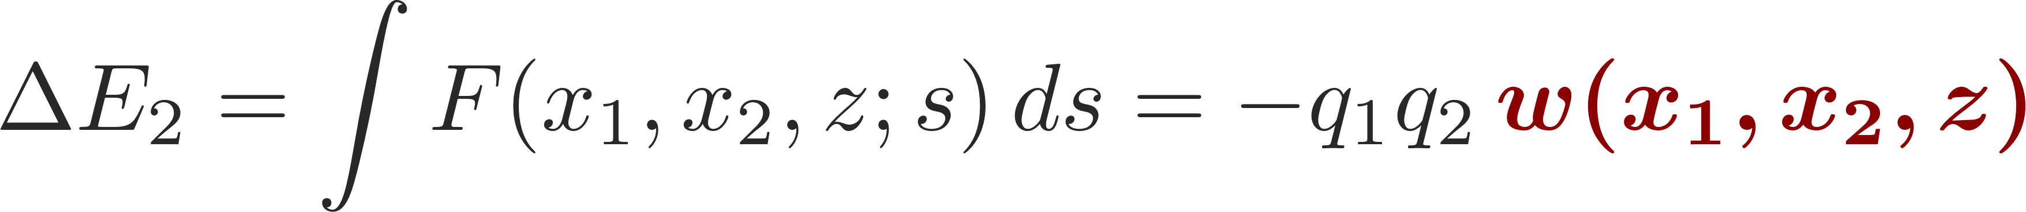
Wake function – general definition
L
Source, q₁
Witness, q₂
Δx₁ (or Δy₁)
2b
z
Δx₂ (or Δy₂)
Note that:
We define the wake function as the integrated force on the witness particle (associated to a change in energy):
Let’s focus on the horizontal plane. In general, for two point-like particles, we have

Slide 6
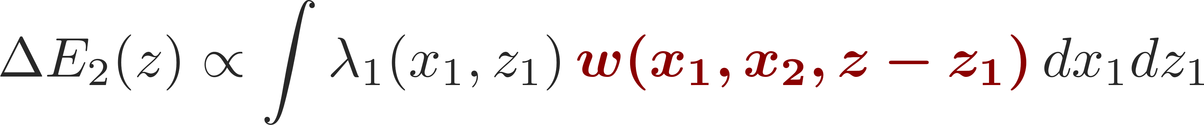
Wake potential for a distribution of particles
L
Source, q₁
Witness, q₂
Δx₁ (or Δy₁)
2b
Δx₂ (or Δy₂)
z
z₁
We define the wake function as the integrated force on the witness particle (associated to a change in energy):
For an extended particle distribution this becomes (superposition of all source terms)
  Forces become dependent on the particle distribution function

Slide 7
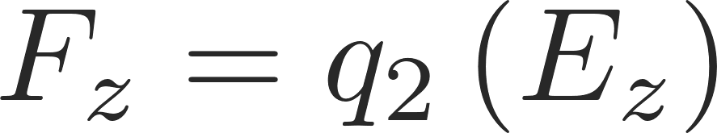
Longitudinal wake function
L
Source, q₁
Witness, q₂
Δx₁ (or Δy₁)
2b
z
Δx₂ (or Δy₂)
Note that:
Longitudinal wake fields
Zeroth order with source and test centred
usually dominant
Higher order terms
Usually negligible for small offsets

Slide 8
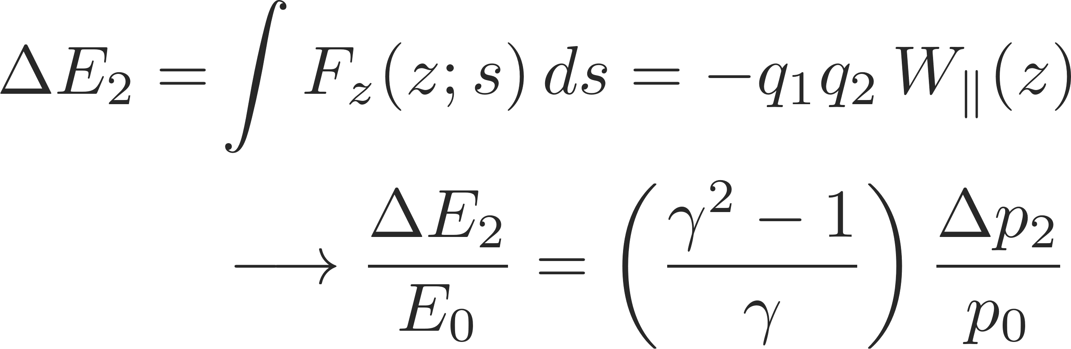
Longitudinal wake function
L
Source, q₁
Witness, q₂
Δx₁ (or Δy₁)
2b
z
Δx₂ (or Δy₂)
Note that:
Longitudinal wake fields
Energy kick of the witness particle from longitudinal wakes

Slide 9
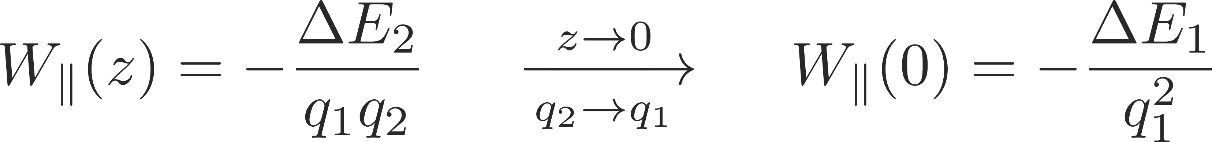
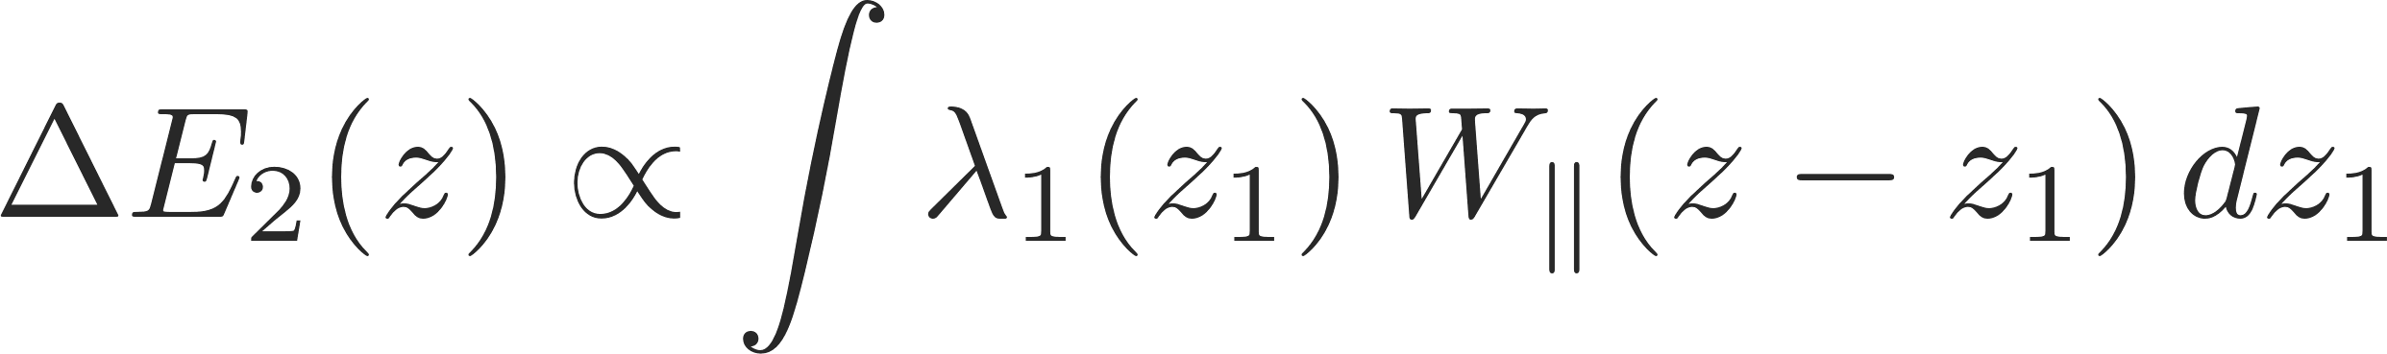
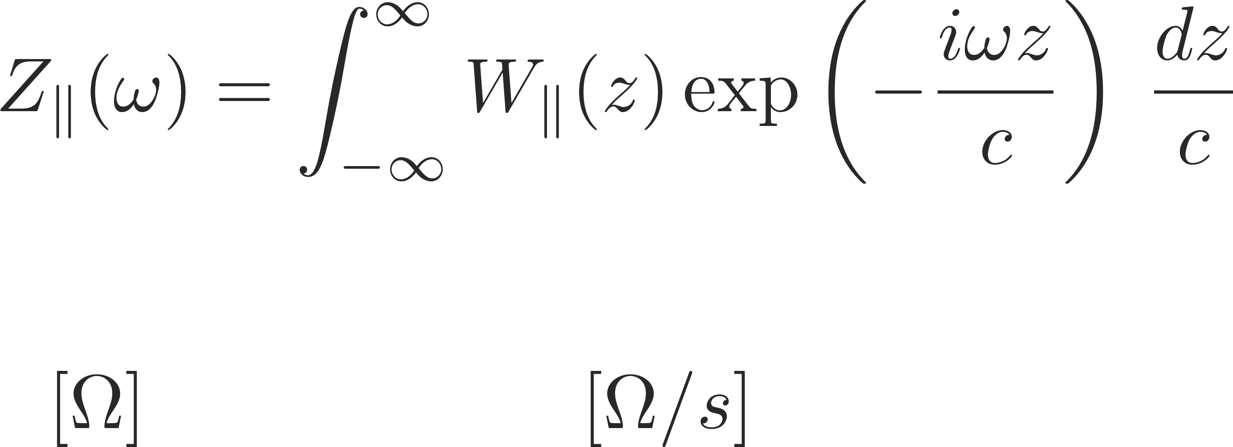
Longitudinal wake function
  The value of the wake function in z=0 is related to the energy lost by the source particle in the creation of the wake
  The wake function of an accelerator component is basically its Green function in time domain (i.e., its response to a pulse excitation)
    Very useful for macroparticle models and simulations, because it can be used to describe the driving terms in the single particle equations of motion!
  We can also describe it as a transfer function in frequency domain
    This is the definition of transverse beam coupling impedance of the element under study

Slide 10
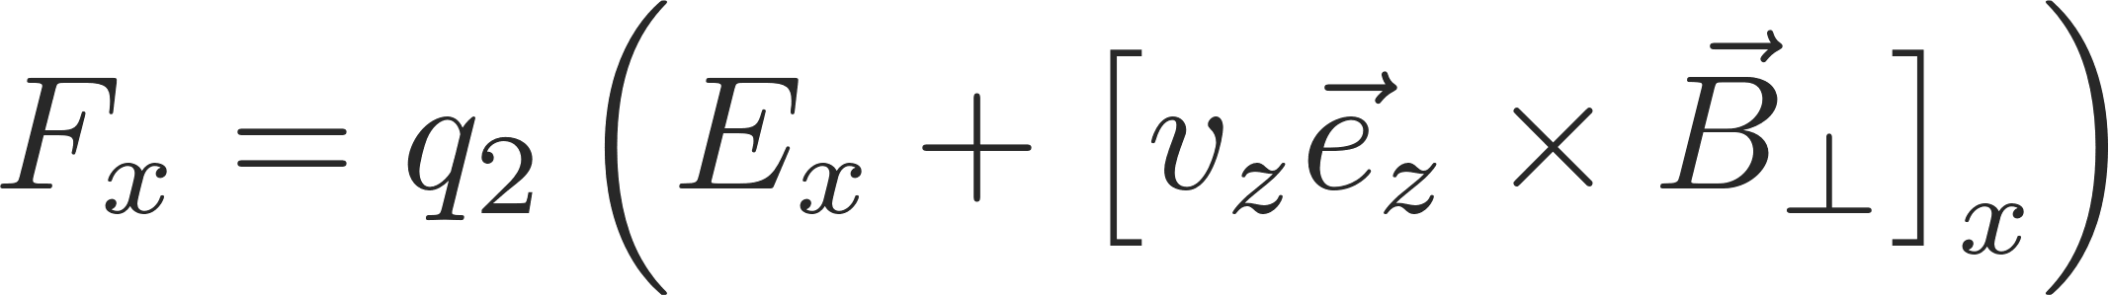
Transverse wake functions
L
Source, q₁
Witness, q₂
Δx₁ (or Δy₁)
2b
z
Δx₂ (or Δy₂)
Note that:
Transverse wake fields

Slide 11
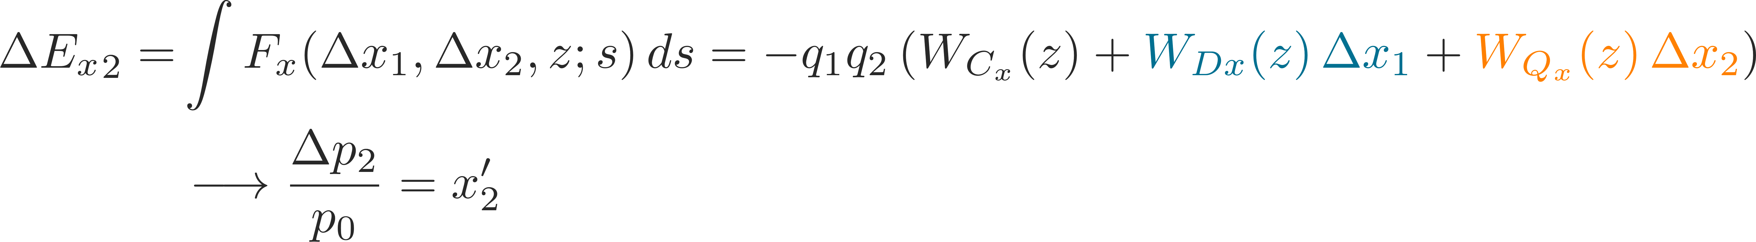
Transverse wake functions
L
Source, q₁
Witness, q₂
Δx₁ (or Δy₁)
2b
z
Δx₂ (or Δy₂)
Note that:
Transverse wake fields
First order expansion in transverse coordinates of source and witness particles
Transverse deflecting kick of the witness particle from transverse wakes

Slide 12
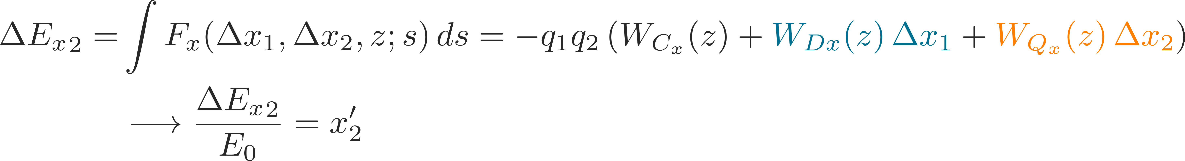
Transverse wake functions
L
Source, q₁
Witness, q₂
Δx₁ (or Δy₁)
2b
z
Δx₂ (or Δy₂)
Note that:
Transverse wake fields
First order expansion in transverse coordinates of source and witness particles
Transverse deflecting kick of the witness particle from transverse wakes

Slide 13
Transverse wake functions
L
Source, q₁
Witness, q₂
Δx₁ (or Δy₁)
2b
z
Δx₂ (or Δy₂)
Note that:
Transverse wake fields
Zeroth order for
asymmetric structures
→ Orbit offset
Dipole wakes –
depends on source particle
→ Orbit offset
Quadrupole wakes –
depends on witness particle
→ Detuning

Slide 14
Transverse wake functions
L
Source, q₁
Witness, q₂
  We have truncated to the first order, thus neglecting
    First order coupling terms between x and y planes
    All higher order terms in the wake expansion (including mixed higher order terms with products of the dipolar/quadrupolar offsets)
Δx₁ (or Δy₁)
2b
z
Δx₂ (or Δy₂)
Note that:
Transverse wake fields
Zeroth order for
asymmetric structures
→ Orbit offset
Dipole wakes –
depends on source particle
→ Orbit offset
Quadrupole wakes –
depends on witness particle
→ Detuning

Slide 15
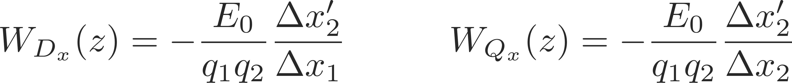
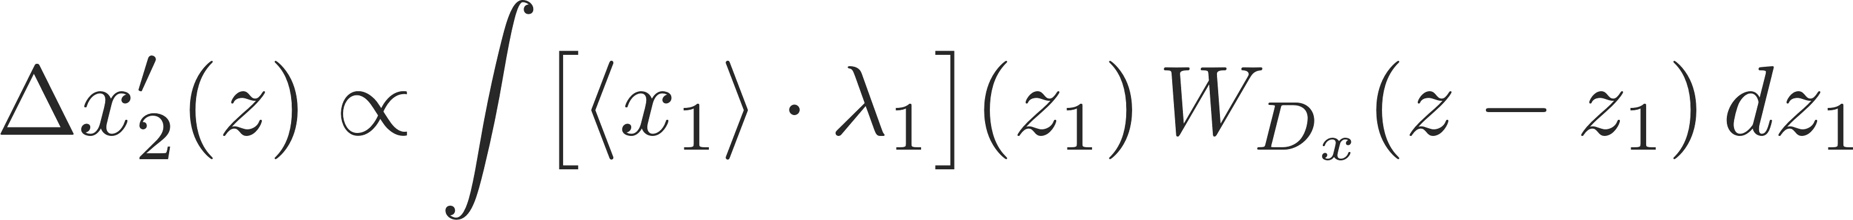
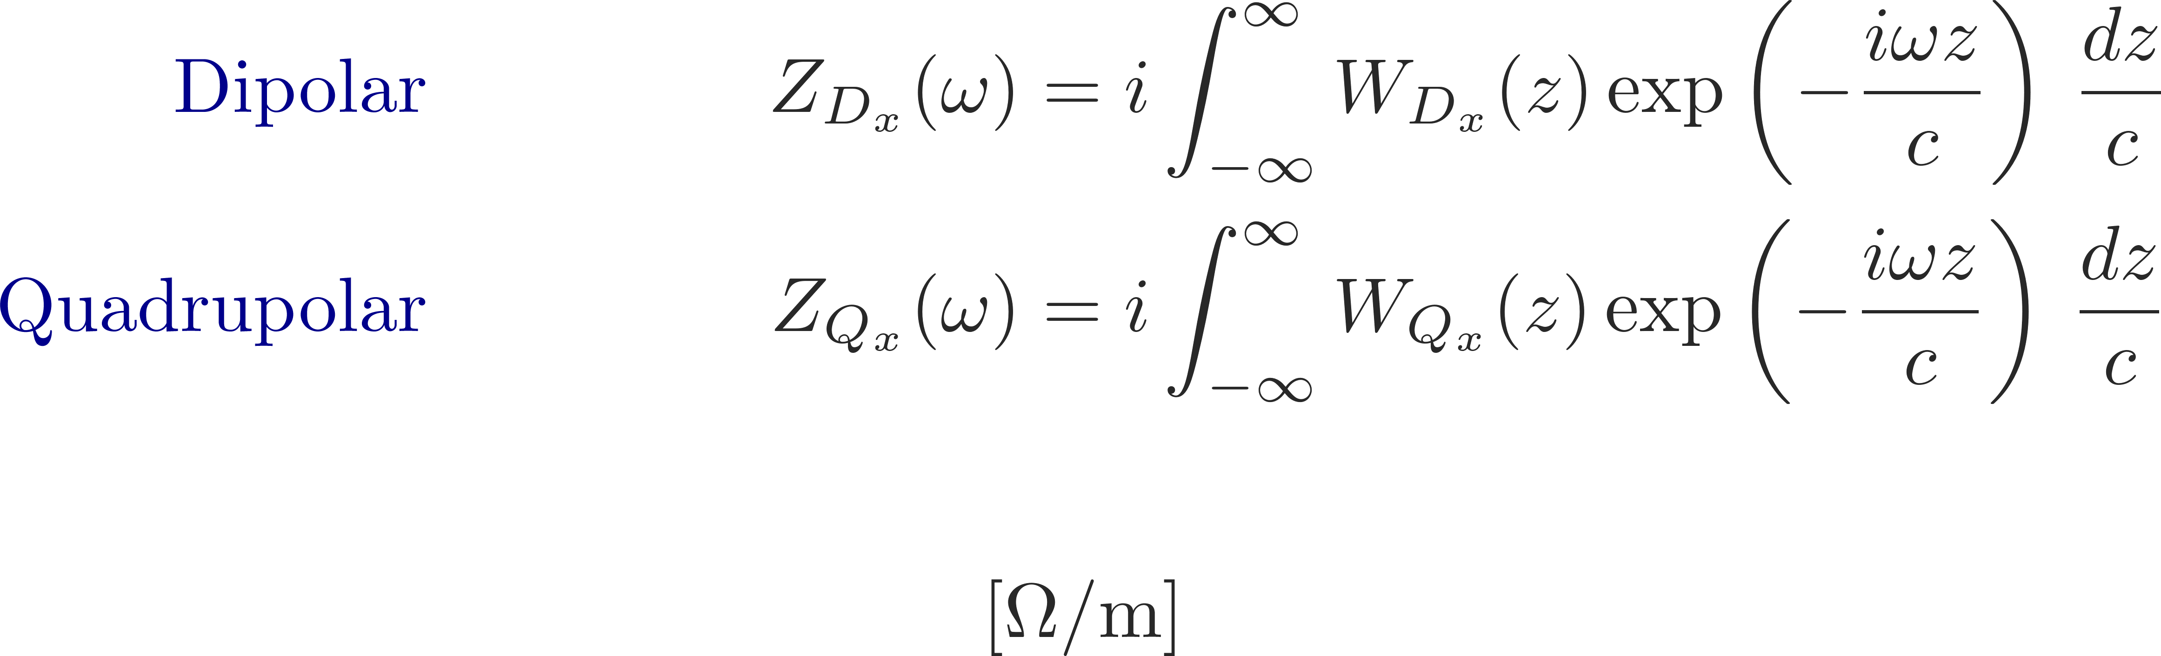
Transverse impedance
  The wake function of an accelerator component is basically its Green function in time domain (i.e., its response to a pulse excitation):
    Very useful for macroparticle models and simulations, because it can be used to describe the driving terms in the single particle equations of motion!
  We can also describe it as a transfer function in frequency domain
    This is the definition of transverse beam coupling impedance of the element under study

Slide 16
We have used the concept of wake fields in the longitudinal and the transverse planes, respectively. We have found that we usually do a decomposition of the wake function to obtain only the leading orders, namely, constant, dipolar and quadrupolar wake fields. We have also introduced the impedance of the frequency domain representation of the wake function.
We will now study some more properties of wake fields and show some typical examples of wake fields and impedances for which an analytical expression exists.
Part 3: Wake fields and impedances – impacts
  Longitudinal and transverse wake fields and impedances
  Panofsky-Wenzel theorem
  Examples of analytically expressible wake functions and impedances
  Impact of wake fields and impedance on the accelerator environment
  Description of a coherent beam instability and the instability loop

Slide 17
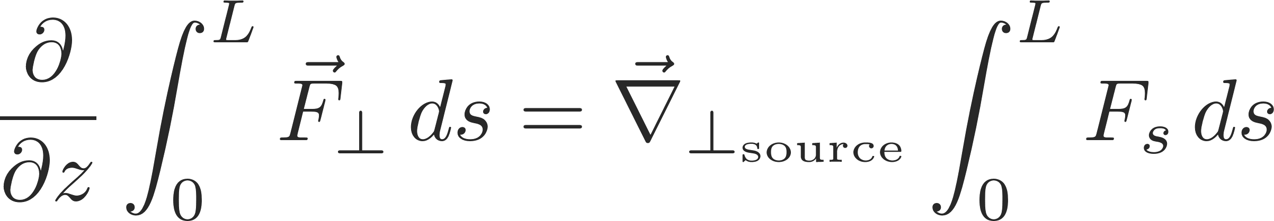
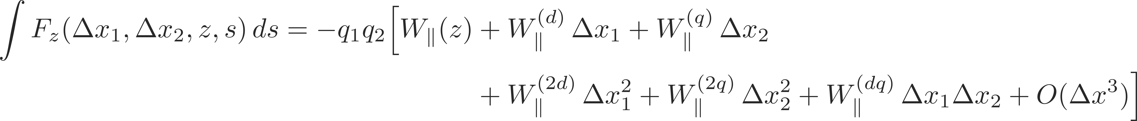
Panofsky-Wenzel Theorem
Longitudinal and transverse wake fields and impedances are tightly related via Maxwell’s equations by means of the Panofsky-Wenzel theorem, which states that:
Remembering that:

Slide 18
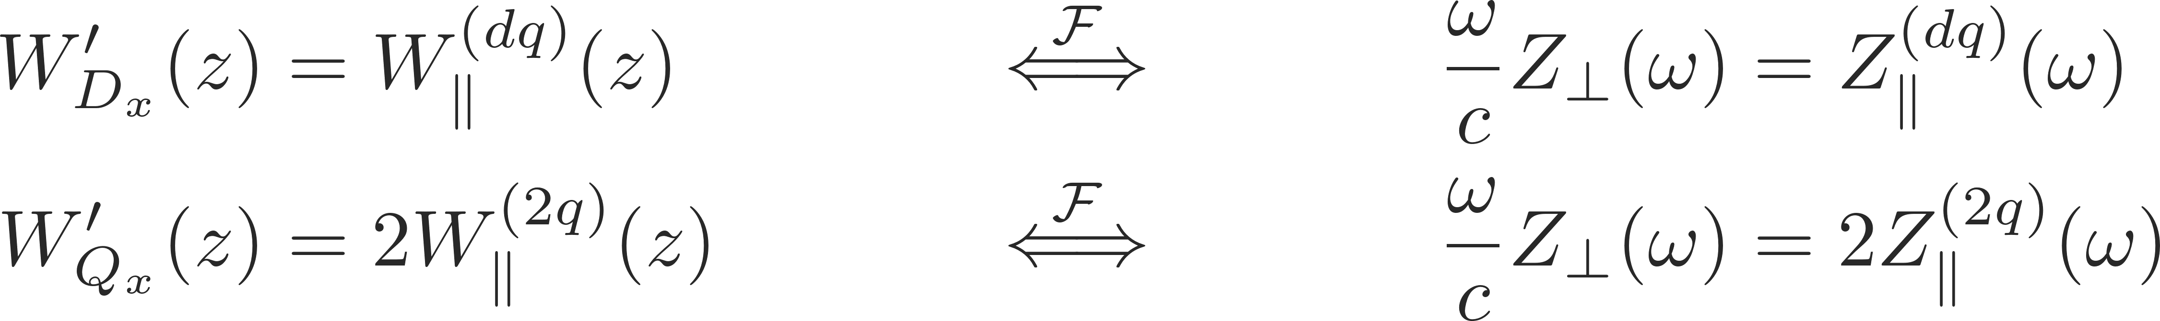
Panofsky-Wenzel Theorem
Longitudinal and transverse wake fields and impedances are tightly related via Maxwell’s equations by means of the Panofsky-Wenzel theorem, which states that:
Remembering that:
It follows for the longitudinal and transverse wake fields and impedances that:
The longitudinal and transverse wake functions are not independent, although in general no relation can be established between W||(z) and W_{Dx, Dy}(z), which are the main wakes in the longitudinal and transverse planes, respectively.

Slide 19
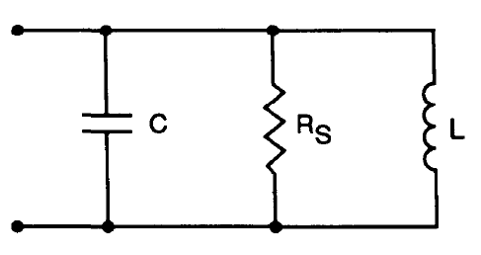
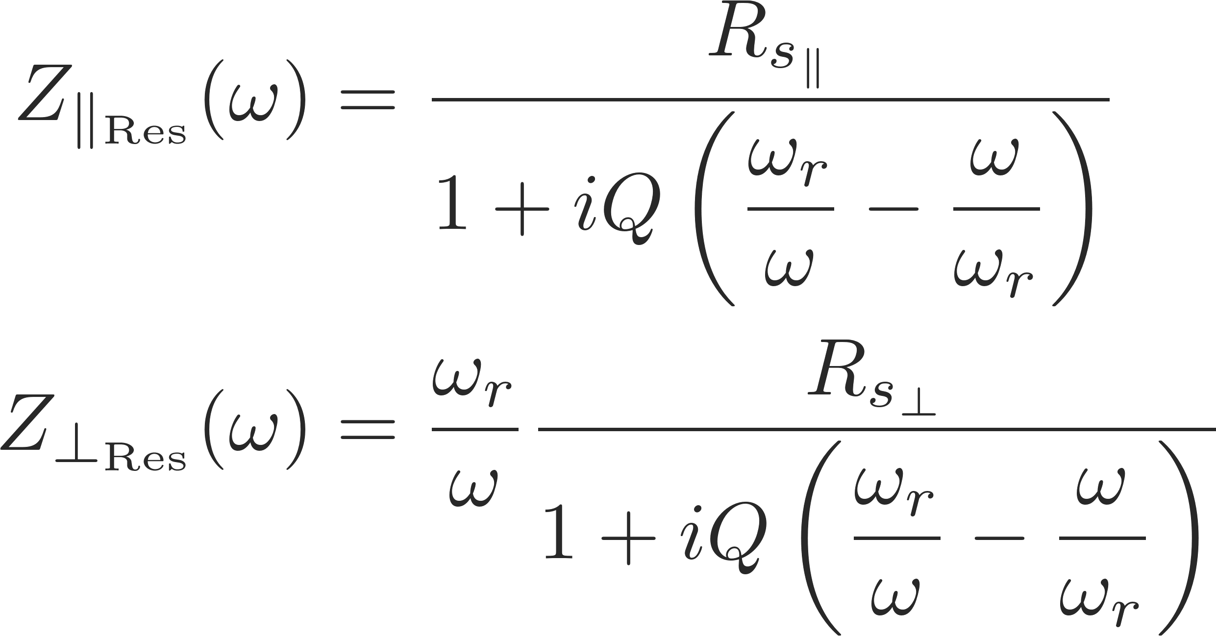
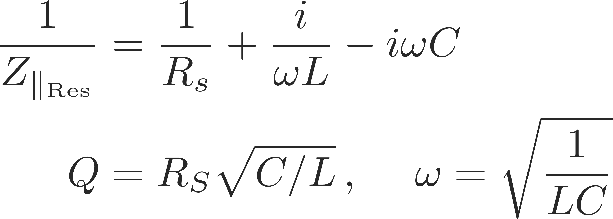
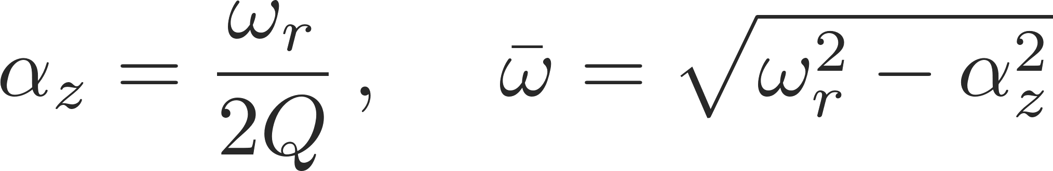
Examples: resonator wakes
Wakefields and/or impedances can be computed by using Maxwell’s equations to compute the impulse response for a given structure either in time domain or in frequency domain, respectively.
Some examples of impedances computed in the ultra-relativistic limit are:
  Resonator impedance

Slide 20
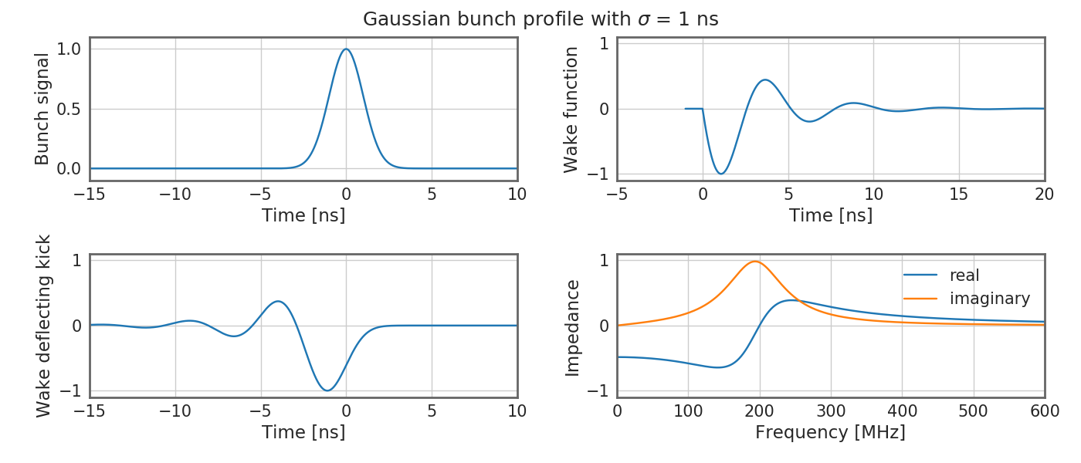
Examples: broadband resonator
Wakefields and/or impedances can be computed by using Maxwell’s equations to compute the impulse response for a given structure either in time domain or in frequency domain respectively.
Some examples of impedances computed in the ultra-relativistic limit are:
  Resonator impedance

Slide 21
Examples: broadband resonator
Wakefields and/or impedances can be computed by using Maxwell’s equations to compute the impulse response for a given structure either in time domain or in frequency domain respectively.
Some examples of impedances computed in the ultra-relativistic limit are:
  Resonator impedance
  Broadband resonator wake:
    Fast decaying fields – short range, mostly single bunch effect. Whether centroid or intra-bunch motion is excited is determined by the resonator frequency and bunch length.

Slide 22
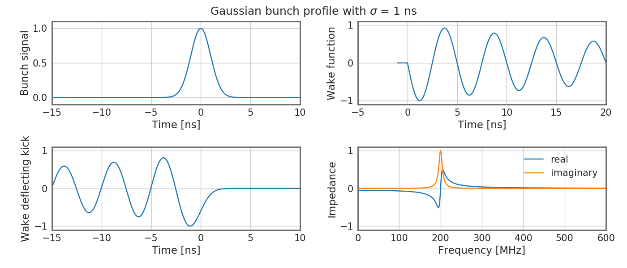
Examples: narrowband resonator
Wakefields and/or impedances can be computed by using Maxwell’s equations to compute the impulse response for a given structure either in time domain or in frequency domain respectively.
Some examples of impedances computed in the ultra-relativistic limit are:
  Resonator impedance

Slide 23
Examples: narrowband resonator
Wakefields and/or impedances can be computed by using Maxwell’s equations to compute the impulse response for a given structure either in time domain or in frequency domain respectively.
Some examples of impedances computed in the ultra-relativistic limit are:
  Resonator impedance
  Broadband resonator wake:
    Slowly decaying fields – long range, coupled bunch effect. Whether coupled centroid or intra-bunch motion is excited is determined by the resonator frequency, bunch spacing and bunch length.

Slide 24
We have briefly discussed the Panofsky-Wenzel theorem and looked at analytical expressions for the resistive wall and resonator impedances. We have seen the different between short range and long range wake fields and understood how these can lead to single or coupled bunch instabilities.
Before actually looking at the impact of wake fields and impedances on the beam, we will now first study their impact on the environment – in particular, beam induced heating which can be dangerous and even destructive for poorly designed machine elements.
Part 3: Wake fields and impedances – impacts
  Longitudinal and transverse wake fields and impedances
  Panofsky-Wenzel theorem
  Examples of analytically expressible wake functions and impedances
  Impact of wake fields and impedance on the accelerator environment
  Description of a coherent beam instability and the instability loop

Slide 25
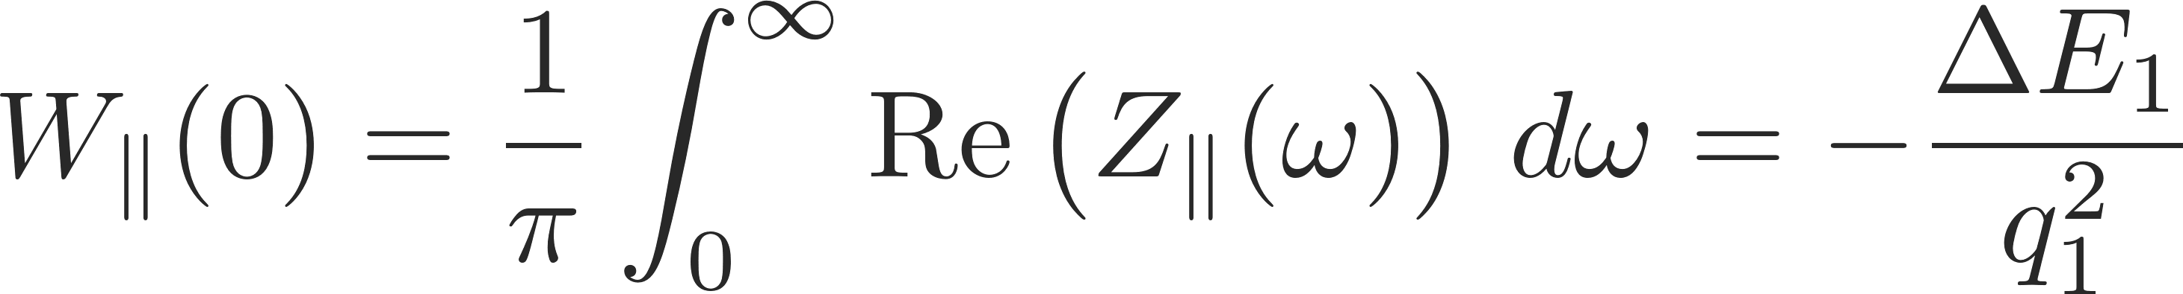
The energy balance
What happens to the energy lost by the source?
  In the global energy balance, the energy lost by the source splits into:
    Electromagnetic energy of the modes that remain trapped in the object
      Partly dissipated on lossy walls or into purposely designed inserts or HOM absorbers
      Partly transferred to following particles (or the same particle over successive turns), possibly feeding into an instability!
    Electromagnetic energy of modes that propagate down the beam chamber (above cut-off), eventually lost on surrounding lossy materials

Slide 26
The energy balance
What happens to the energy lost by the source?
  The energy loss of a particle bunch
    causes beam induced heating of the machine elements (damage, outgassing)
    feeds into both longitudinal and transverse instabilities through the associated EM fields
    is compensated by the RF system determining a stable phase shift
  In the global energy balance, the energy lost by the source splits into:
    Electromagnetic energy of the modes that remain trapped in the object
      Partly dissipated on lossy walls or into purposely designed inserts or HOM absorbers
      Partly transferred to following particles (or the same particle over successive turns), possibly feeding into an instability!
    Electromagnetic energy of modes that propagate down the beam chamber (above cut-off), eventually lost on surrounding lossy materials

Slide 27
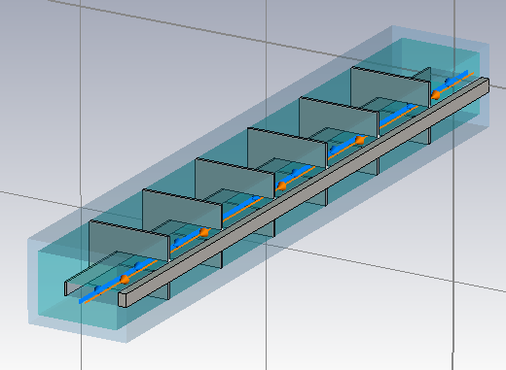
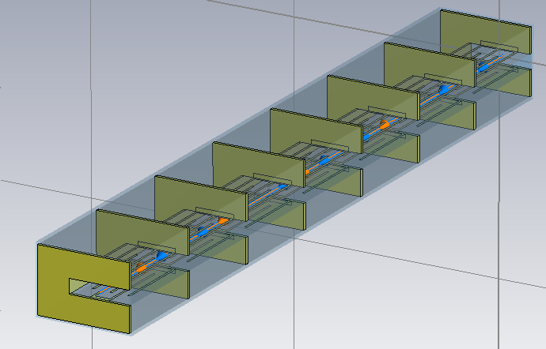
Examples: SPS kickers
Two types of SPS extraction kickers (MKE):
  Original design: several modules separated by conductor stripes (segmentation) with bare ferrite blocks, fed by an inner and an outer conductor
  New design: like original, but modules have ‘serigraphed’ ferrite blocks (i.e. with patterns of silver paste screen printed on the ferrite surface exposed to the beam)
Original kicker Serigraphed kicker

Slide 28
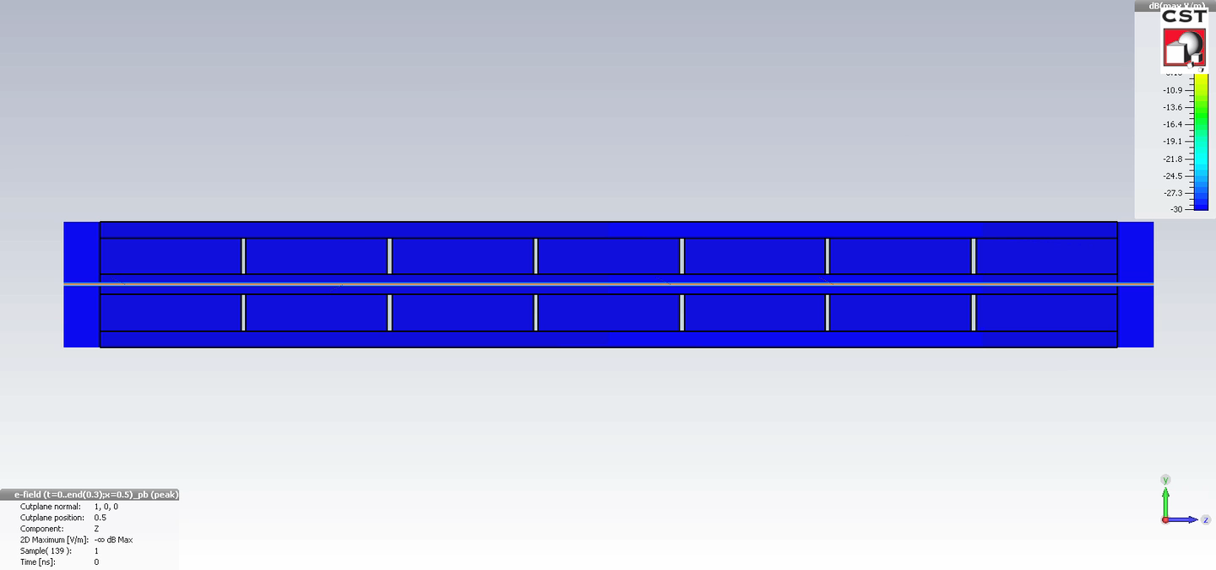
Examples: ferrite kicker – simple model
  Original kicker without serigraphy, typical broad-band behaviour, here some ringing is due to the longitudinal segmentation

Slide 29
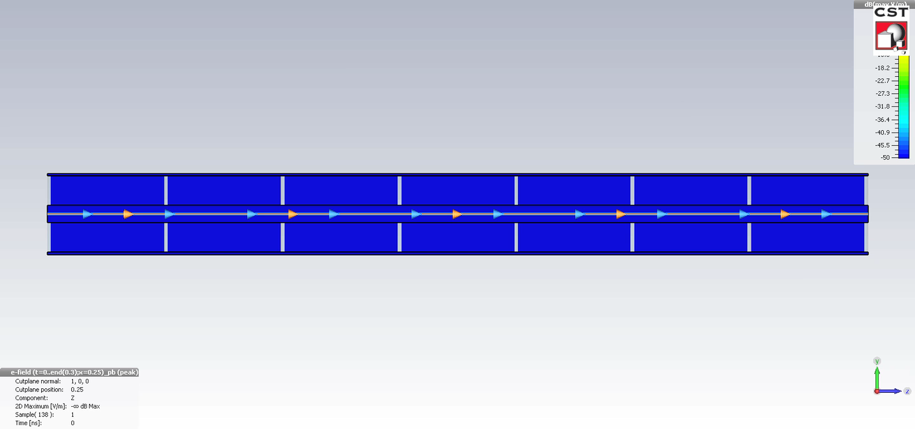
Examples: serigraphed kicker – simple model
  Serigraphed kicker exhibits strong ringing due to the EM trapping along the serigraphy fingers

Slide 30
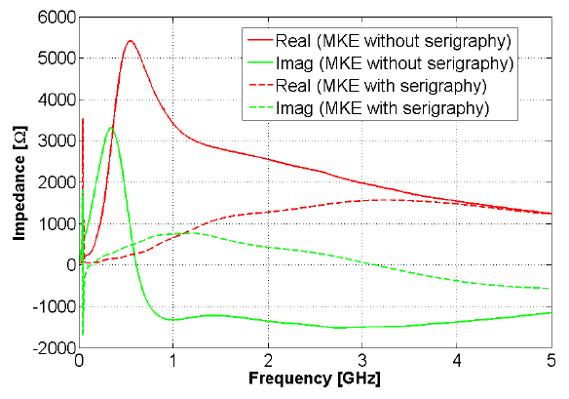
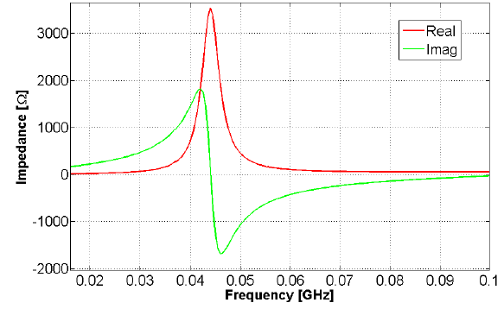
Examples: Serigraphy impact
Solid lines – no serigraphy /
Dashed lines – serigraphy
Serigraphy:
Reduces the broad-band contribution
Introduces resonance peak around 44 MHz
Less overall heating of device

Slide 31
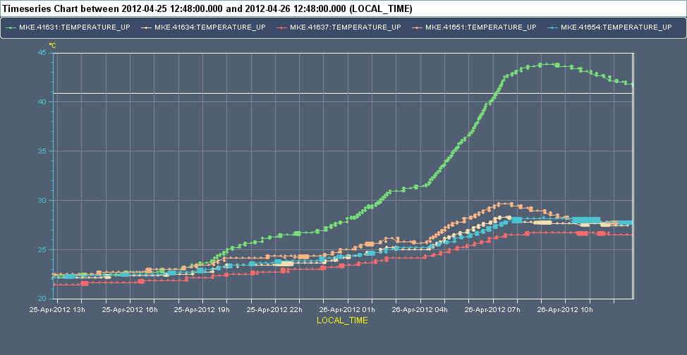



Examples: Serigraphy impact
~ 17h run with 25 ns beams at 26 GeV after technical stop

Slide 32
How are wakes and impedances computed?
Analytical or semi-analytical approach, when geometry is simple (or simplified)
  Solve Maxwell’s equations with the correct source terms, geometries and boundary conditions up to an advanced stage (e.g. resistive wall for axisymmetric chambers)
  Find closed expressions or execute the last steps numerically to derive wakes and impedances
Numerical approach
  Different codes have been developed over the years to solve numerically Maxwell’s equations in arbitrarily complicated structures
  Examples are CST Studio Suite (Particle Studio, Microwave Studio), ABCI, GdFidL, HFSS, ECHO2(3)D. Exhaustive list can be found from the program of the ICFA mini-Workshop on “Electromagnetic wake fields and impedances in particle accelerators”, Erice, Sicily, 23-28 April, 2014
Bench measurements based on transmission/reflection measurements with stretched wires
  Seldom used independently to assess impedances, usefulness mainly lies in that they can be used for validating 3D EM models for simulations

Slide 33
We have seen how the impedance of a device can have an impact on the machine environment and cause, for example, beam induced heating. This can lead to outgassing or damage of a device. Therefore, devices need to be carefully designed in order to minimize their impedance.
Impedances also have a direct impact on a passing beam. This can lead to impedance induced beam instabilities. We will now first understand the basic concept and mechanism of beam instabilities.
Part 3: Wake fields and impedances – impacts
  Longitudinal and transverse wake fields and impedances
  Panofsky-Wenzel theorem
  Examples of analytically expressible wake functions and impedances
  Impact of wake fields and impedance on the accelerator environment
  Description of a coherent beam instability and the instability loop

Slide 34
Why worry about beam instabilities?
Why study beam instabilities?
  The onset of a beam instability usually determines the maximum beam intensity that a machine can store/accelerate (performance limitation)
  Understanding the type of instability limiting the performance, and its underlying mechanism, is essential because it:
    Allows identifying the source and possible measures to mitigate/suppress the effect
    Allows dimensioning an active feedback system to prevent the instability

Slide 35

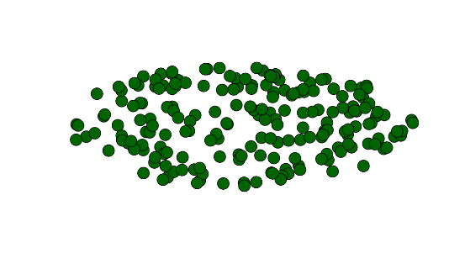
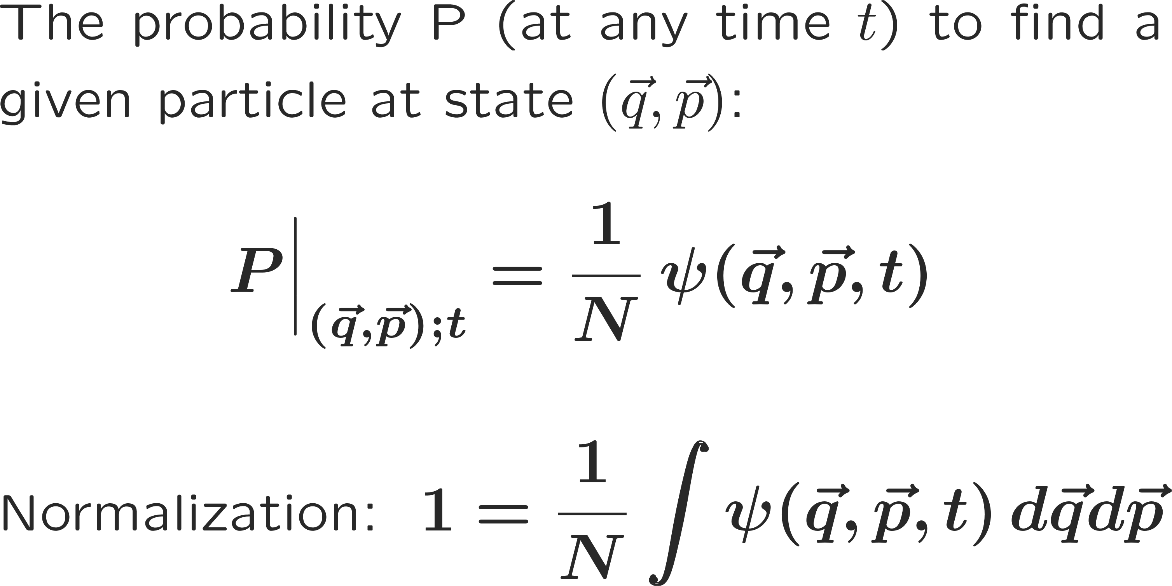


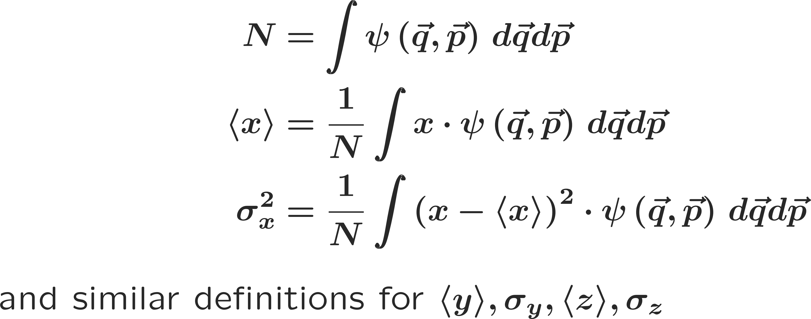
What is a beam instability?
A beam becomes unstable when a moment of its distribution exhibits an exponential growth (e.g. mean positions, standard deviations, etc.), resulting into beam loss or emittance growth!

Slide 36
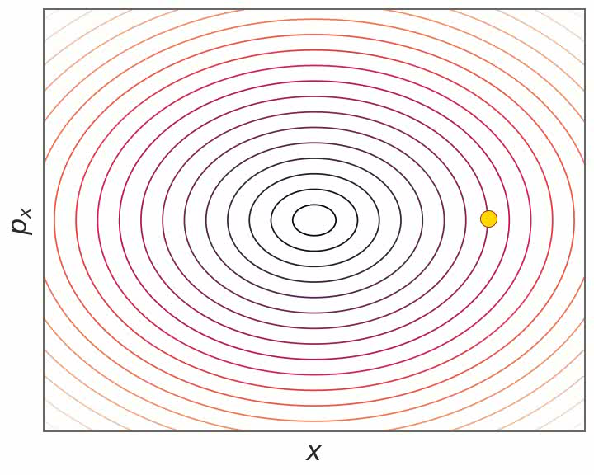
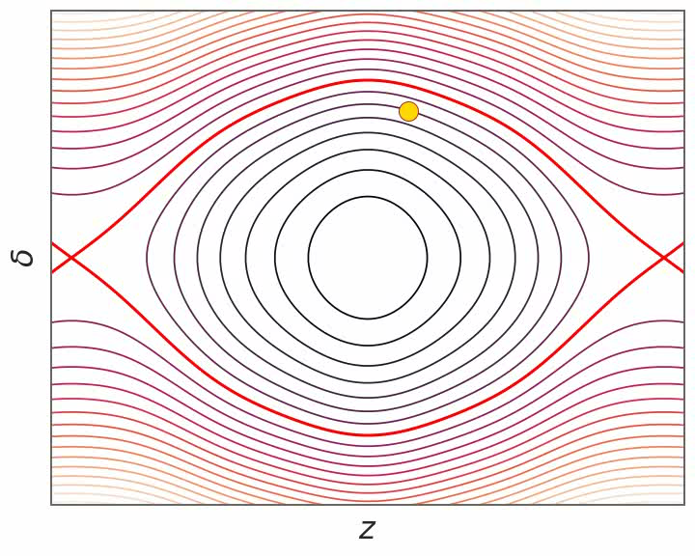
Examples: broadband resonator
Wakefields and/or impedances can be computed by using Maxwell’s equations to compute the impulse response for a given structure either in time domain or in frequency domain respectively.
Some examples of impedances computed in the ultra-relativistic limit are:
  Resonator impedance
  If betatron and synchrotron motion and wakefields manage to synchronize such that they get into resonance, a distinct bunch oscillation pattern will be excited – a so called bunch mode. The coherent bunch/beam signal will grow exponentially.
  This can be either a single bunch mode…

Slide 37
Examples: narrowband resonator
Wakefields and/or impedances can be computed by using Maxwell’s equations to compute the impulse response for a given structure either in time domain or in frequency domain respectively.
Some examples of impedances computed in the ultra-relativistic limit are:
  Resonator impedance
  If betatron and synchrotron motion and wakefields manage to synchronize such that they get into resonance, a distinct bunch oscillation pattern will be excited – a so called bunch mode. The coherent bunch/beam signal will grow exponentially.
  This can be either a single bunch mode…
  … or a coupled bunch mode

Slide 38
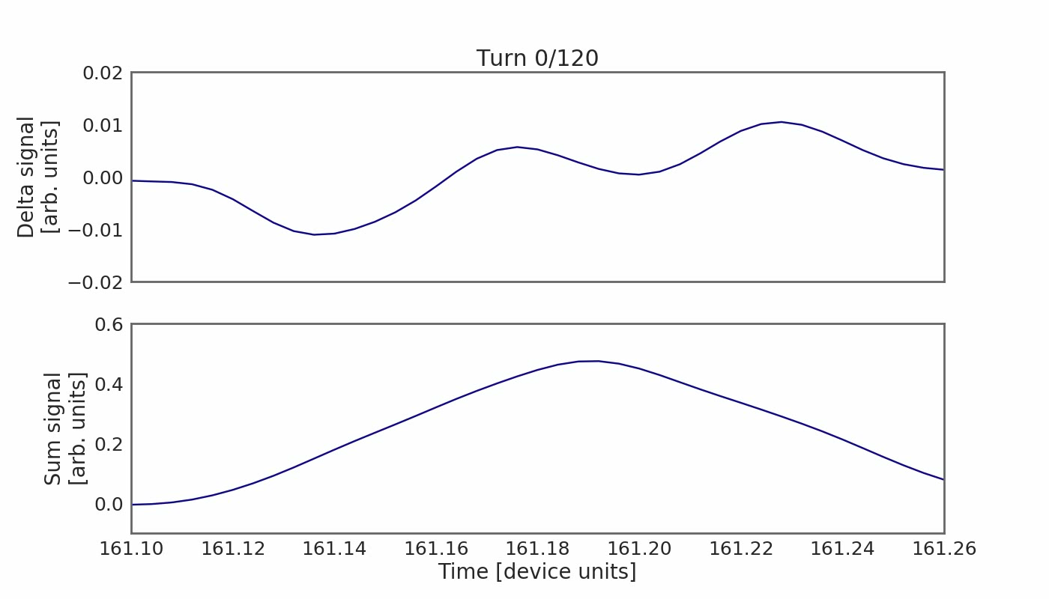
Examples: narrowband resonator
Wakefields and/or impedances can be computed by using Maxwell’s equations to compute the impulse response for a given structure either in time domain or in frequency domain respectively.
Some examples of impedances computed in the ultra-relativistic limit are:
  Resonator impedance
  If betatron and synchrotron motion and wakefields manage to synchronize such that they get into resonance, a distinct bunch oscillation pattern will be excited – a so called bunch mode. The coherent bunch/beam signal will grow exponentially.
  This can be either a single bunch mode…
  … or a coupled bunch mode

Slide 39
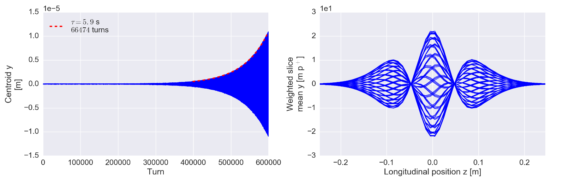
What is a beam instability?
A beam becomes unstable when a moment of its distribution exhibits an exponential growth (e.g. mean positions, standard deviations, etc.), resulting into beam loss or emittance growth!

Slide 40
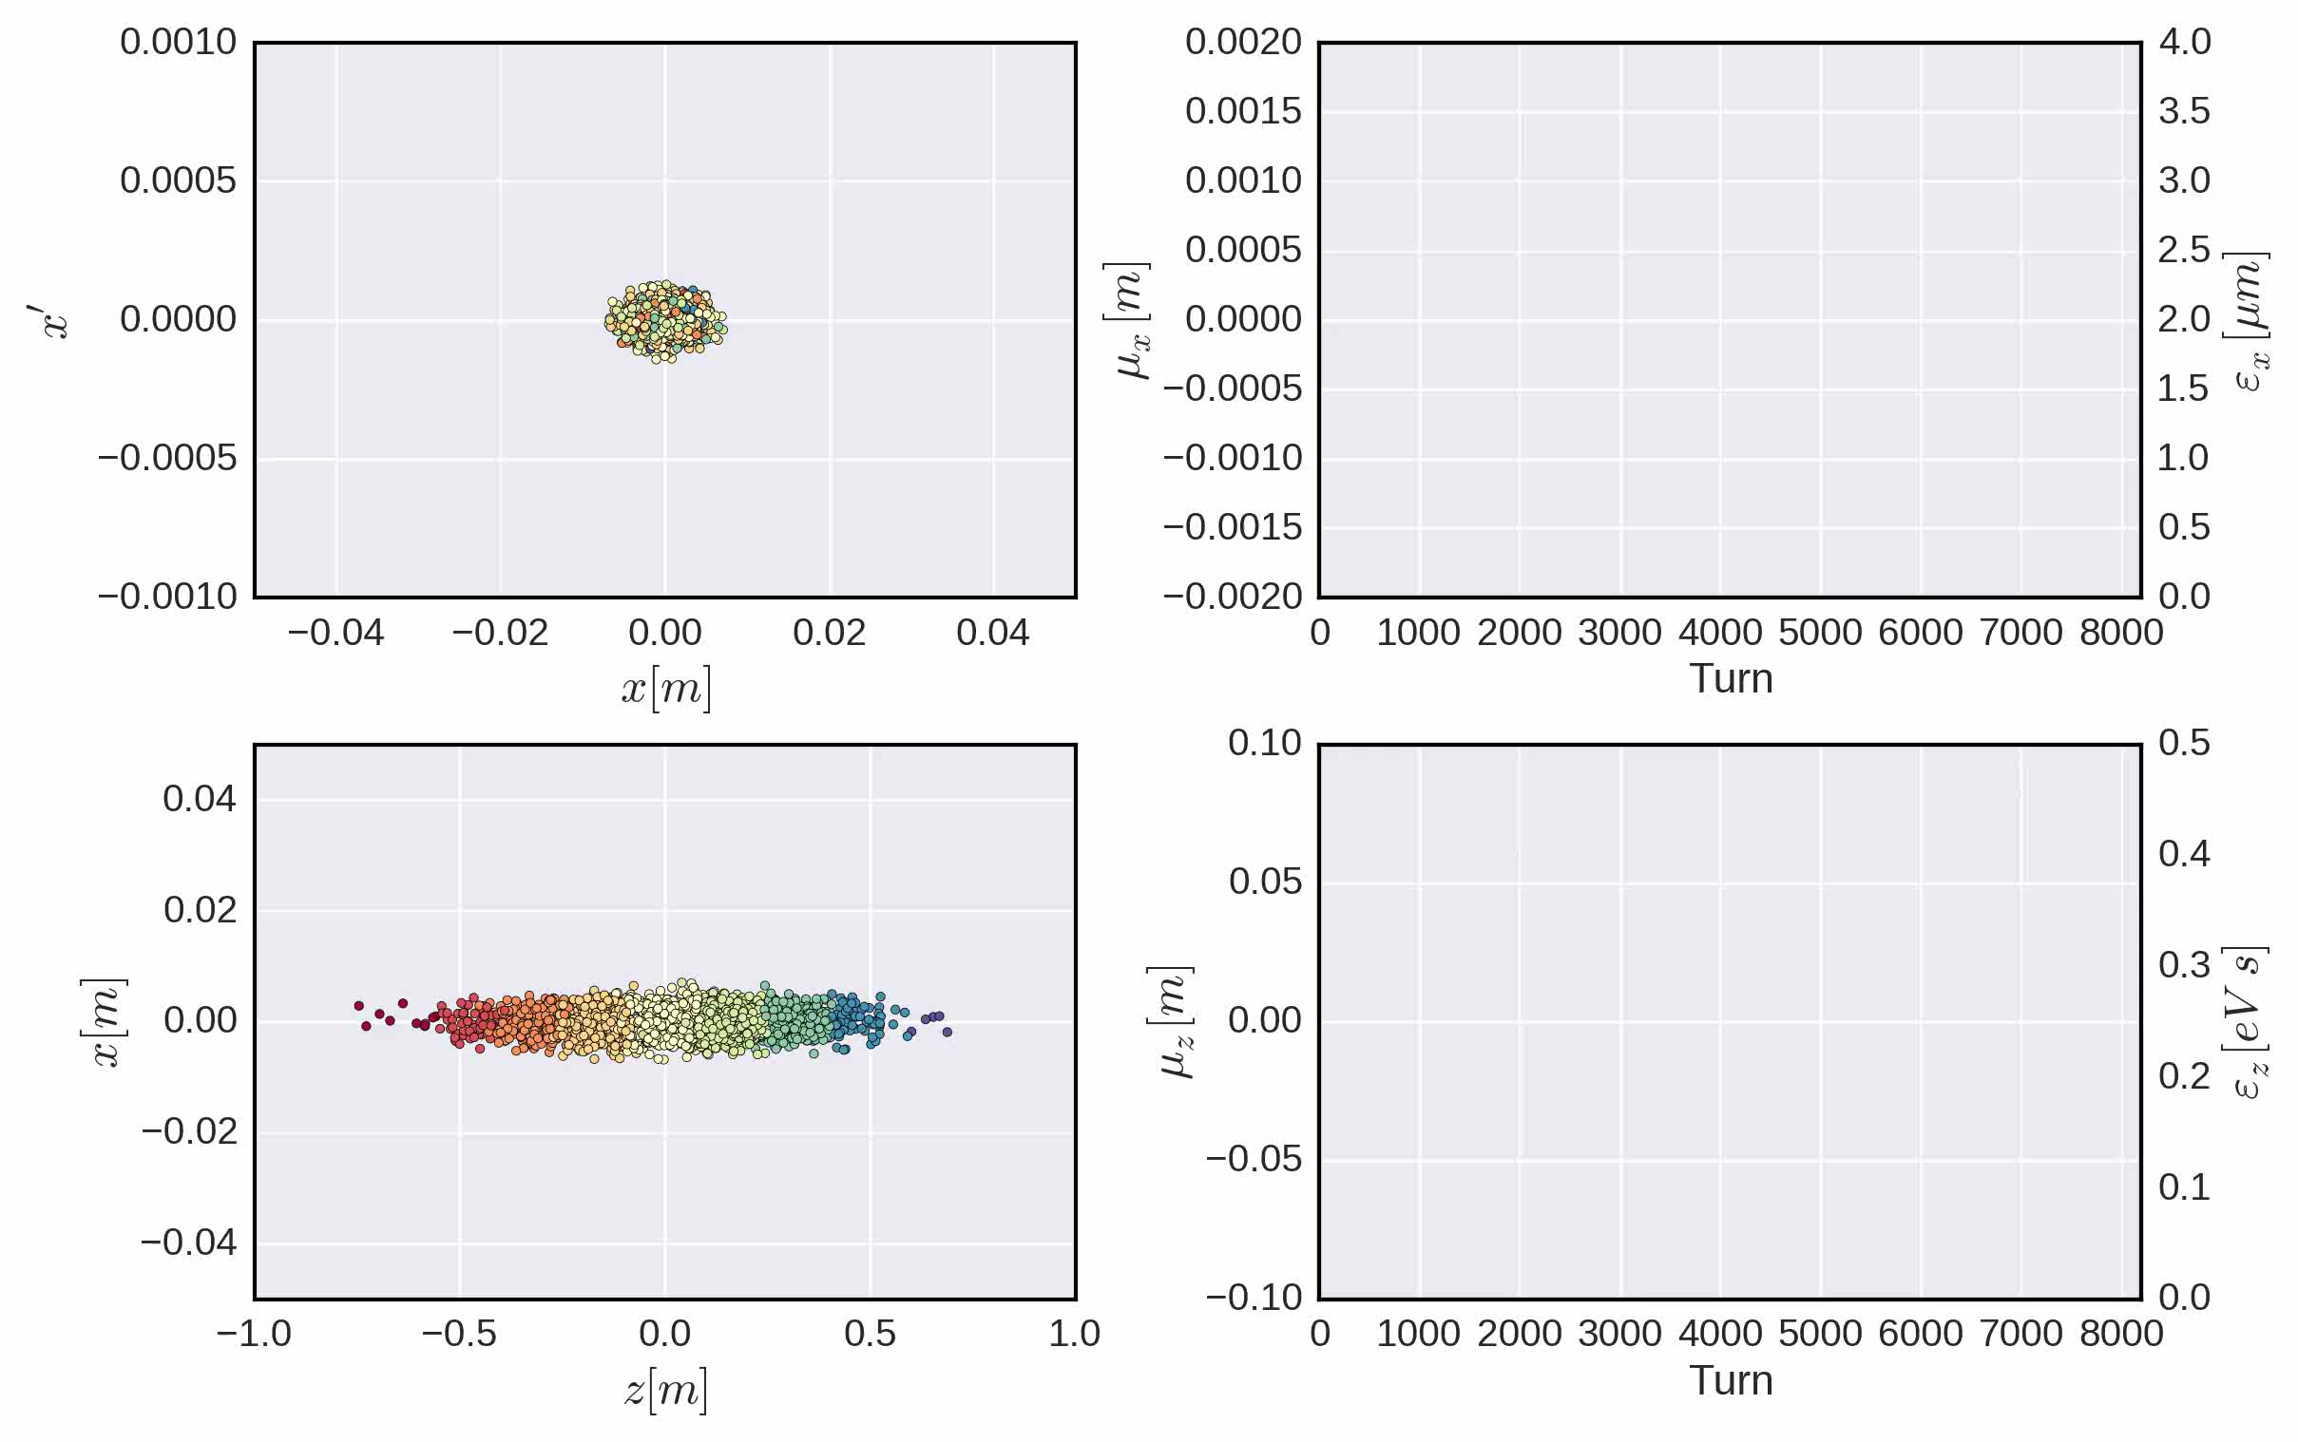
What is a beam instability?
A beam becomes unstable when a moment of its distribution exhibits an exponential growth (e.g. mean positions, standard deviations, etc.), resulting into beam loss or emittance growth!

Slide 41
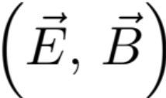
The instability loop
Multi-bunch beam
s
Equations of motion of the beam particles
Interaction with the external environment
Additional electromagnetic field acting on the beam, besides RF and external magnetic fields

Slide 42
The instability loop
Multi-bunch beam
s
Equations of motion of the beam particles
Interaction with the external environment
Additional electromagnetic field acting on the beam, besides RF and external magnetic fields
When the loop closes, either the beam will find a new stable equilibrium configuration …

Slide 43
The instability loop
Multi-bunch beam
s
Equations of motion of the beam particles
Interaction with the external environment
Additional electromagnetic field acting on the beam, besides RF and external magnetic fields
… or it might develop an instability along the bunch train …

Slide 44
The instability loop
Multi-bunch beam
s
Equations of motion of the beam particles
Interaction with the external environment
Additional electromagnetic field acting on the beam, besides RF and external magnetic fields
… or also an instability affecting different bunches independently of each other

Slide 45
The instability loop – knobs to preserve beam stability…
Act on the right side of the loop
→ Minimise the creation of EM fields potentially detrimental to the beam
Multi-bunch beam
s
Equations of motion of the beam particles
Interaction with the external environment
This will translate eventually into reducing/controlling/optimising the impedance of the single components of an accelerator ring
Additional electromagnetic field acting on the beam, besides RF and external magnetic fields

Slide 46
The instability loop – knobs to preserve beam stability…
Act on the left side of the loop
→ Introduce stabilising terms in the equations of motion
Multi-bunch beam
s
Equations of motion of the beam particles
Interaction with the external environment
This will translate eventually adding cooling/damping terms or nonlinear driving terms that can provide stabilisation of the system
Additional electromagnetic field acting on the beam, besides RF and external magnetic fields

Slide 47
The instability loop – knobs to preserve beam stability…
Multi-bunch beam
s
… or we actively create another loop in which we first detect a selected moment of the beam distribution and we then kick the particles accordingly to cancel deviations from the desired steady state
Equations of motion of the beam particles
Interaction with the external environment
Additional electromagnetic field acting on the beam, besides RF and external magnetic fields
Kick beam particles
Detect
moments

Slide 48
We have seen some examples of analytically expressible wake fields and impedances, namely resonator and resistive wall wakes. We have learned that impedances can have a detrimental impact on both the machine environment as well as the beam itself. In the first case, impedances can lead to beam induced heating, in the latter to coherent beam instabilities.
A careful design of machine elements to minimize the impedance is therefore necessary.
After having introduced the instability loop, in the next lecture we will be looking more in detail at examples of different types of instabilities.
Part 3: Wake fields and impedances – impacts
  Longitudinal and transverse wake fields and impedances
  Panofsky-Wenzel theorem
  Examples of analytically expressible wake functions and impedances
  Impact of wake fields and impedance on the accelerator environment
  Description of a coherent beam instability and the instability loop

Slide 49

End part 3

Slide 51
Backup slides

Slide 52
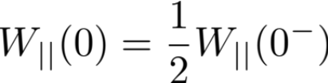
Longitudinal wake function
  The value of the wake function in z=0 is related to the energy lost by the source particle in the creation of the wake
  W||(0)>0 since ΔE₁<0
  W||(z) is discontinuous in z=0 and it vanishes for all z>0 because of the ultra-relativistic approximation
W||(z)
Beam loading theorem
z

Slide 53
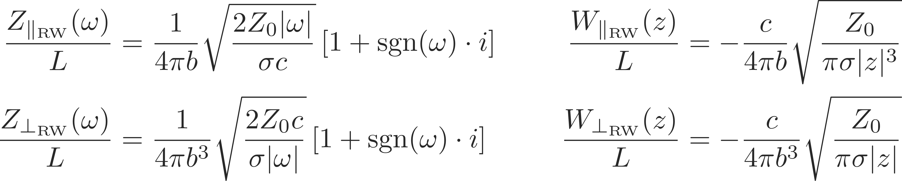
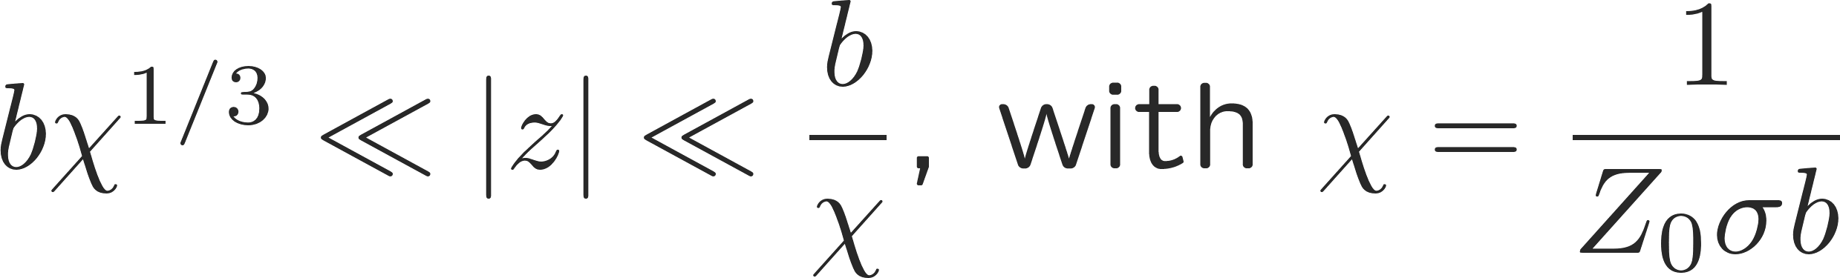
Examples: resistive wall wakes
Wakefields and/or impedances can be computed by using Maxwell’s equations to compute the impulse response for a given structure either in time domain or in frequency domain, respectively.
Some examples of impedances computed in the ultra-relativistic limit are:
  Resistive wall impedance

Slide 54
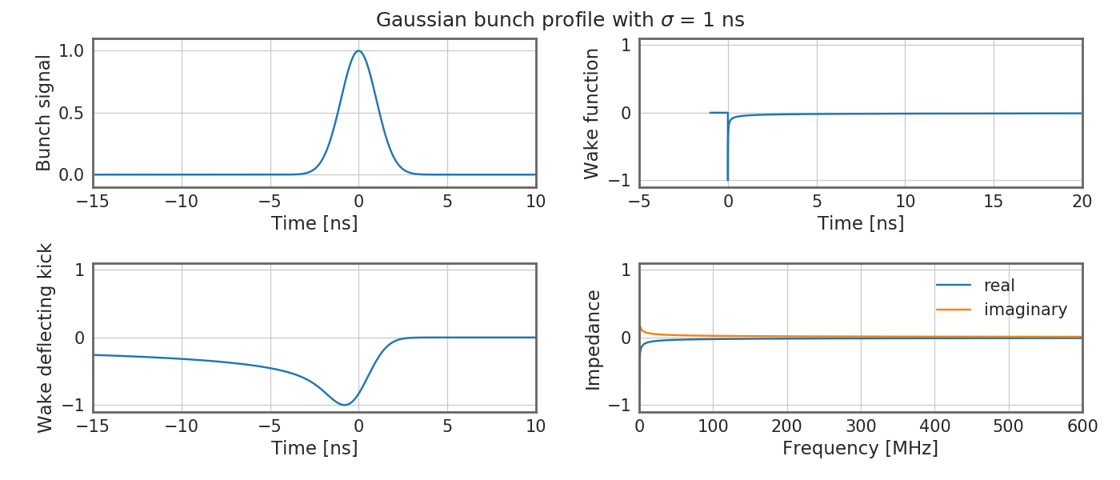
Examples: resistive wall wakes
Wakefields and/or impedances can be computed by using Maxwell’s equations to compute the impulse response for a given structure either in time domain or in frequency domain respectively.
Some examples of impedances computed in the ultra-relativistic limit are:
  Resistive wall impedance

Slide 55
Examples: resistive wall wakes
Wakefields and/or impedances can be computed by using Maxwell’s equations to compute the impulse response for a given structure either in time domain or in frequency domain respectively.
Some examples of impedances computed in the ultra-relativistic limit are:
  Resistive wall impedance
  Resistive wall wakes:
    Slow decay of low frequency fields → long range, coupled bunch effect.

Slide 56
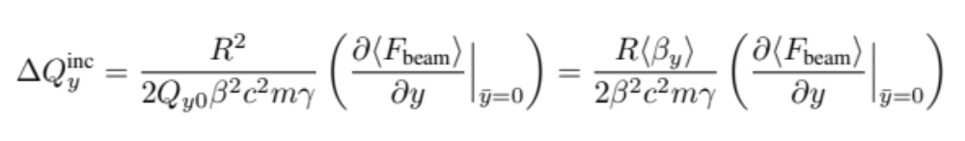
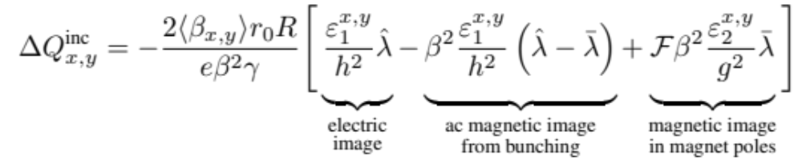
Indirect space charge: incoherent tune shift
We found the expression for the coherent tune shift as function of the beam force as
  In the second step the tune shift is written in terms of the average beta function instead of the betatron tune (as given by the smooth approximation) – like this we can refine our model and account for different geometries around the machine
Collecting all contributions to the incoherent incoherent tune shift we find for the general case of bunched beams
  For coasting beams the peak line density is equal to the average line density
  The F factor corresponds to the ratio of the circumference surrounded by ferromagnetic material

Slide 57
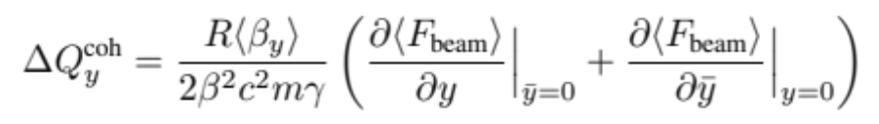
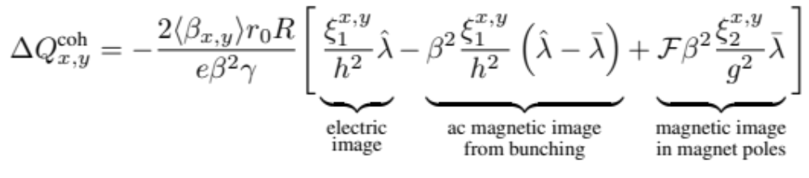
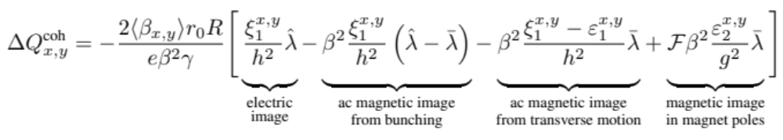
Indirect space charge: coherent tune shift
The general expression of the coherent tune shift is obtained as
Here we need to consider two cases
  Betatron oscillations are of such low frequency that the induced magnetic field can penetrate through the vacuum chamber
  Magnetic fields from both betatron oscillations and longitudinal bunching cannot penetrate the vacuum chamber

Slide 58
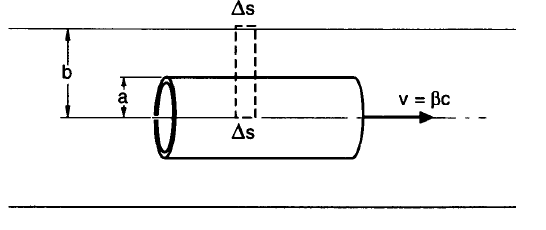
Longitudinal space charge
Longitudinal (direct) space charge can be also computed analytically (via Maxwell’s equations) for cylindrically symmetric bunches of a given transverse density profile n(r):
Note about this formula
  For r=b the longitudinal electrical field vanishes as it should (perfect conducting pipe)
  It diverges for b → ∞ because the analysis breaks down if the bunch length ≤ b/γ

Slide 59
Longitudinal space charge
It has the following interesting dependencies:
It decreases with energy like 1/γ2 and vanishes in the ultra-relativistic limit
It is proportional to the opposite of the derivative of the line density –λ’. This can be understood intuitively because it must be directed from a region with higher charge density to a region with lower charge density (i.e. it pushes with the opposite of the gradient of the line charge)
Longitudinal (direct) space charge can be also computed analytically (via Maxwell’s equations) for cylindrically symmetric bunches of a given transverse density profile n(r):
Note about this formula
  For r=b the longitudinal electrical field vanishes as it should (perfect conducting pipe)
  It diverges for b → ∞ because the analysis breaks down if the bunch length ≤ b/γ
Space charge would then spread out charge bumps. However, remember that only below transition energy, accelerated particles go faster and space charge has this smoothing action. Above transition, accelerated particles take a longer time to go around the accelerator and density peaks can be enhanced. This is the origin of the so-called negative mass instability. Momentum spread (unbunched beams) or synchrotron motion (bunched beams) can usually stabilize this effect.

Slide 60
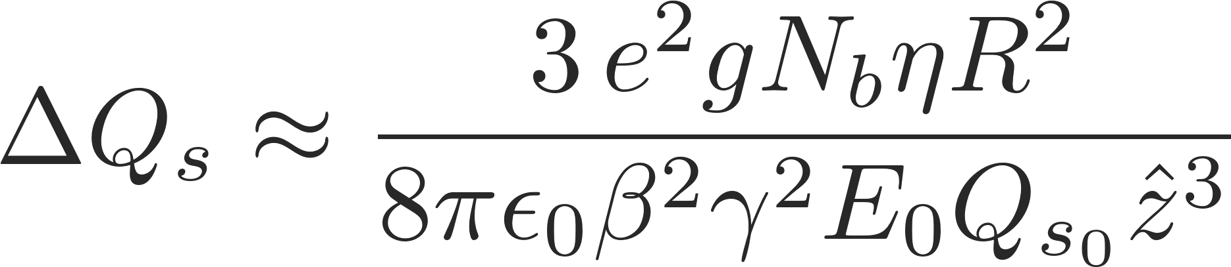

Longitudinal space charge: synchrotron tune shift
Similarly to the transverse plane, longitudinal space charge also leads to a synchrotron tune shift which is proportional to number of particles in the bunch N_{b} (linear)
… example of synchrotron tune shift due to space charge in the radial center of a transverse parabolic bunch
The longitudinal space charge force changes sign when crossing transition:
Quadrupolar oscillations are excited due to the sudden mismatch of the beam distribution at transition
This effect gets stronger with increasing space charge force
To avoid the mismatch, a jump of the RF voltage needs to be programmed similar to the phase jump

