Slide 1
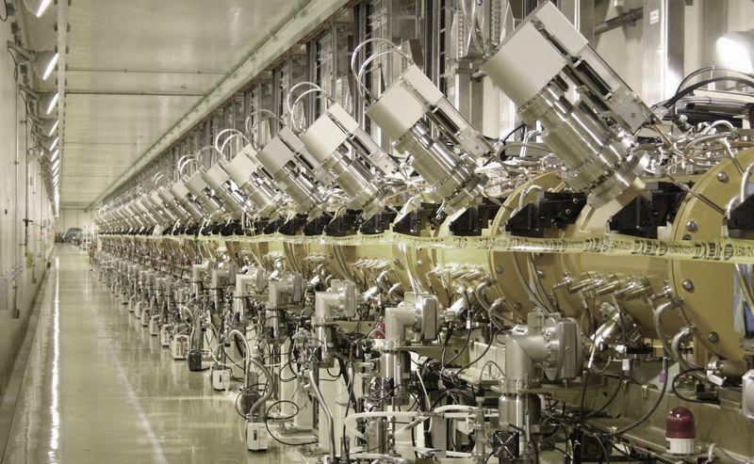
Linear Accelerators
Maurizio Vretenar, CERN
Advanced Accelerator Physics Course
Trondheim 2013

Slide 2
Outline
These 2 lectures:
recall the basic concepts introduced at the Introductory CAS course following an alternative more rigorous approach
again, common treatment for electron and proton linacs (main concepts with little mathematics)
go more deeply into 2 specific topics: applications of linacs, RFQs and small accelerators
Lecture 1:
Main concepts, building blocks, synchronicity
Periodic accelerating structures
Applications of linacs
Lecture 2:
Beam dynamics fundamentals
Linac architecture
The Radio Frequency Quadrupole

Slide 3

1. Introduction: main concepts, building blocks, synchronicity

Slide 4
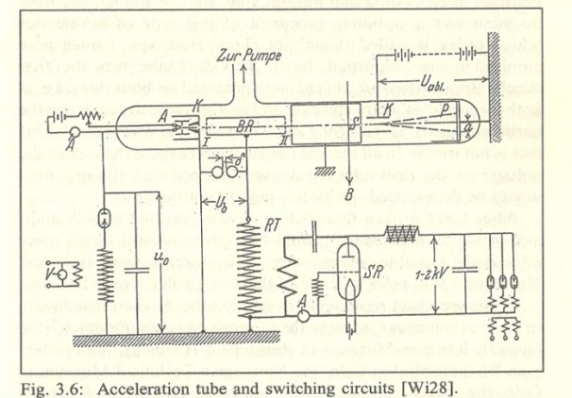
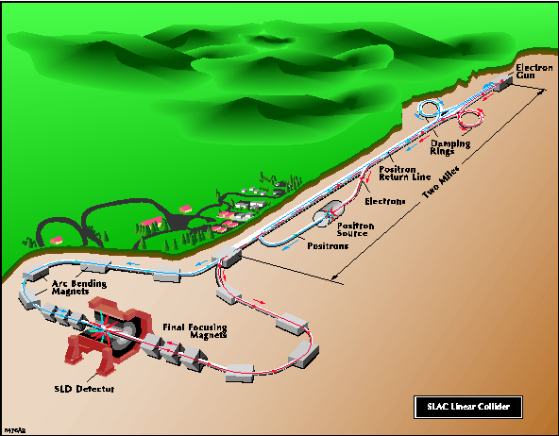
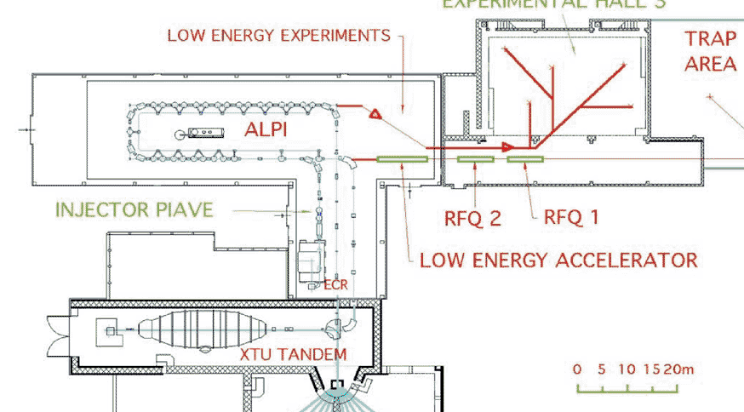
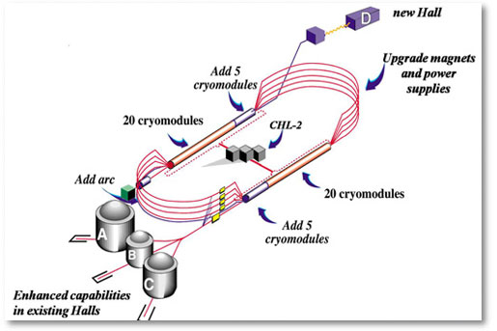
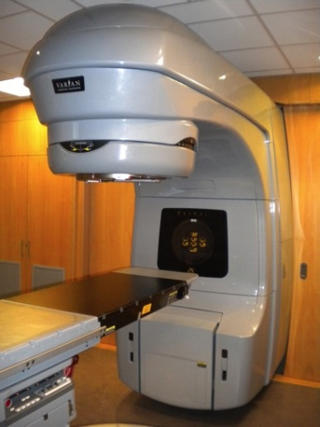
Variety of linacs
The first and the smallest: Rolf Widerøe thesis (1923)
The largest: Stanford Linear Collider (2 miles = 3.2 km) (but CLIC design goes to 48.3 km !)
One of the less linear: ALPI at LNL (Italy)
A limit case, multi-pass linacs: CEBAF at JLAB
The most common: medical electron linac (more than 7’000 in operation around the world!)
Notes:
What these machines have in common and why do we need linear accelerators

Slide 5
Why Linear Accelerators
Linacs:
Particles go only once through the accelerating structure
 | LINACS
 | Low Energy | High Energy
Protons, Ions | Injectors to synchrotrons, stand alone applications synchronous with the RF fields in the range where velocity increases with energy. Protons : β = v/c =0.51 at 150 MeV, 0.95 at 2 GeV. | Higher beam intensity (increased luminosity or production of secondary beams) higher cost/MeV than synchrotron but: - high average beam current (high repetition rate, less resonances, easier beam loss) - higher accumulated intensity in the synchrotron for a higher energy linac.
Electrons | Conventional e- linac simple and compact | Linear colliders do not lose energy because of synchrotron radiation – only option for high energy!
« traditional » linac range
« new » linac range

Slide 6
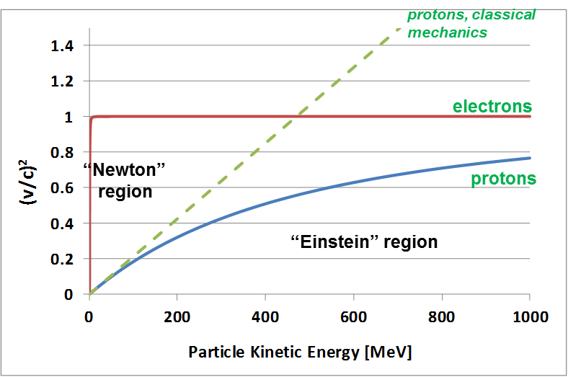
Linacs as «Newton» accelerators
In linear accelerators the beam crosses only once the accelerating structures. Protons, ions: used in the region where the velocity of the particle beam increases with energy
Electrons: used at all energies.
The periodicity of the RF structure must match the particle velocity → development of a complete panoply of structures (NC and SC) with different features.
Protons and ions:
at the beginning of the acceleration, beta (=v/c) is rapidly increasing, but after few hundred MeV’s (protons) relativity prevails over classical mechanics (β~1) and particle velocity tends to saturate at the speed of light.
The region of increasing β is the region of linear accelerators.
The region of nearly constant β is the region of synchrotrons.
Electrons:
Velocity=c above few keV
Notes:
Curve on beta square

Slide 7
Basic linear accelerator structure
RF cavity
Focusing magnet
B-field
DC
particle
injector
bunching
section
?
E-field
d
Protons: energy ~100 keV
β= v/c ~ 0.015
Accelerating gap: E = E₀ cos (ωt + φ)
en. gain ΔW = eV₀Tcosφ
Acceleration → the beam has to pass in each cavity on a phase φ near the crest of the wave
The beam must to be bunched at frequency ω
distance between cavities and phase of each cavity must be correlated
Phase change from cavity i to i+1 is
For the beam to be synchronous with the RF wave (“ride on the crest”) phase must be related to distance by the relation:
… and on top of acceleration, we need to introduce in our “linac” some focusing elements
… and on top of that, we will couple a number of gaps in an “accelerating structure”
Notes:
How must be spaced the gaps? How should they be connected to the source of the wave? How many quadrupoles should we have?
Idea by 2 norwegians: Wideroe for the gap and the RF, Bill Hansen for the cavity

Slide 8
Accelerating structure architecture
When β increases during acceleration, either the phase difference between cavities Δφ must decrease or their distance d must increase.
d = const.
φ variable
d
Individual cavities – distance between cavities constant, each cavity fed by an individual RF source, phase of each cavity adjusted to keep synchronism, used for linacs required to operate with different ions or at different energies. Flexible but expensive!
Better, but 2 problems:
create a “coupling”;
create a mechanical and RF structure with increasing cell length.
φ = const.
d variable
d ∝ βλ
Coupled cell cavities - a single RF source feeds a large number of cells (up to ~100!) - the phase between adjacent cells is defined by the coupling and the distance between cells increases to keep synchronism . Once the geometry is defined, it can accelerate only one type of ion for a given energy range. Effective but not flexible.
Notes:
How must be spaced the gaps? How should they be connected to the source of the wave? How many quadrupoles should we have?

Slide 9
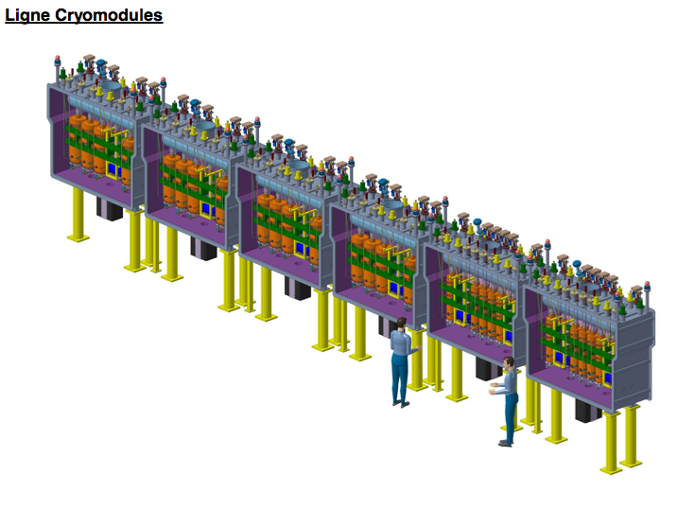
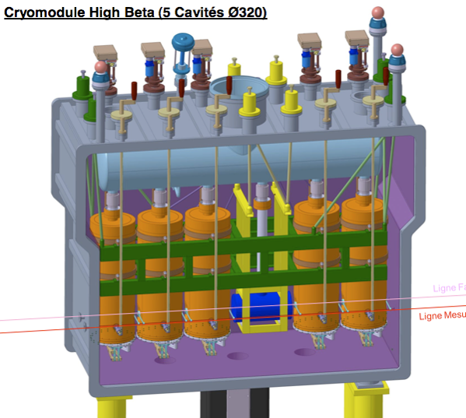
Case 1: a single-cavity linac
The goal is flexibility: acceleration of different ions (e/m) at different energies
→ need to change phase relation for each ion-energy
RF cavity
focusing solenoid
HIE-ISOLDE linac
(to be built at CERN - superconducting)
Post-accelerator of radioactive ions
2 sections of identical equally spaced cavities
Quarter-wave RF cavities, 2 gaps
12 + 20 cavities with individual RF amplifiers, 8 focusing solenoids
Energy 1.2 → 10 MeV/u, accelerates different A/m
beam

Slide 10
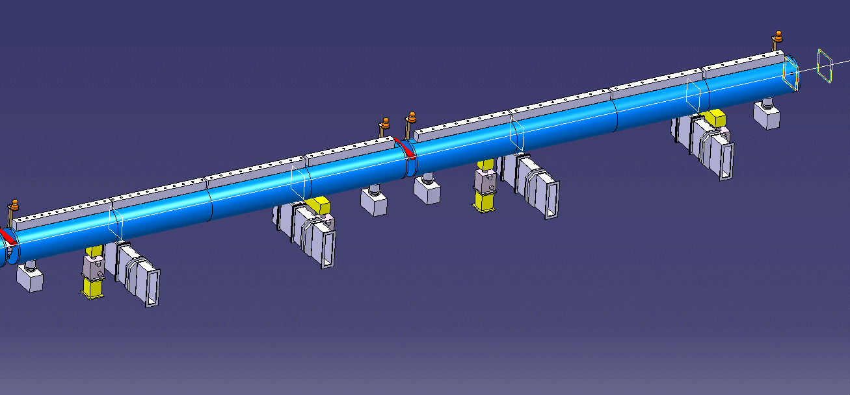
Case 2 : a Drift Tube Linac
d
10 MeV,
β = 0.145
50 MeV,
β = 0.31
Tank 2 and 3 of the new Linac4 at CERN:
57 coupled accelerating gaps
Frequency 352.2 MHz, λ = 85 cm
Cell length (d=βλ) from 12.3 cm to 26.4 cm (factor 2 !).

Slide 11
Intermediate cases
But:
Between these 2 “extremes” there are many “intermediate” cases, because:
  Single-gap cavities are expensive (both cavity and RF source!).
  Structures with each cell matched to the beta profile are mechanically complicated and expensive.
→ as soon as the increase of beta with energy becomes small (Δβ/ΔW) we can accept a small error and:
Use multi-gap cavities with constant distance between gaps.
Use series of identical cavities (standardised design and construction).
11

Slide 12
Synchronism condition in a multi-cell cavity
The distance between accelerating gaps is proportional to particle velocity
Example: a linac superconducting 4-cell accelerating structure
Synchronism condition bw. particle and wave
t (travel between centers of cells) = T/2
d=distance between centres of consecutive cells
“phase slippage”
The synchronism condition is valid only for one β : if β changes (acceleration!) in a cavity made of identical cells only the central cell will be synchronous, and in the other cells the beam will have a phase error.
= phase error on a gap for a particle with β+Δβ crossing a cell designed for β
High and unacceptable for low energy, becomes lower and acceptable for high β

Slide 13
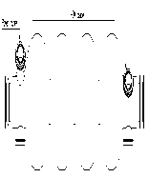
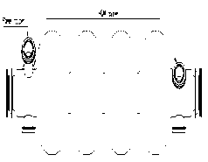
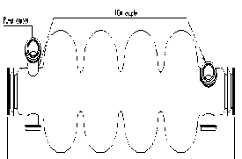
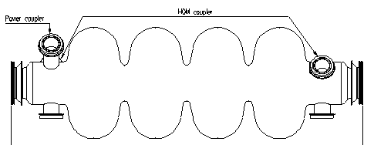
Sections of identical cavities: a superconducting linac (medium β)
The same superconducting cavity design can be used for different proton velocities. The linac has different sections, each made of cavities with cell length matched to the average beta in that section. At “medium energy” (>150 MeV) we are not obliged to dimension every cell or every cavity for the particular particle beta at that position, and we can accept a slight “asynchronicity” → phase slippage + reduction in acceleration efficiency from the optimum one.
β=0.52
β=0.7
β=0.8
β=1
CERN (old) SPL design, SC linac 120 - 2200 MeV, 680 m length, 230 cavities
Notes:
Cell length has to be matched to the increasing particle velocity

Slide 14
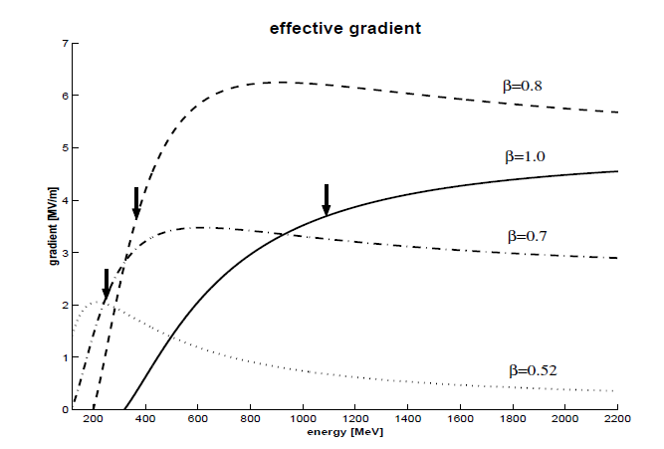
Effects of phase slippage
When sequences of cells are not matched to the particle beta → phase slippage
The effective gradient seen by the particle is lower.
The phase of the bunch centre moves away from the synchronous phase → can go (more) into the non-linear region, with possible longitudinal emittance growth and beam loss.
Very large at small energy (γ~1) becomes negligible at high energy (~2.5 °/m for γ~1.5, W=500 MeV).
Curves of effective gradient (gradient seen by the beam for a constant gradient in the cavity) for the previous case (4 sections of beta 0.52, 0.7, 0.8 and 1.0).

Slide 15
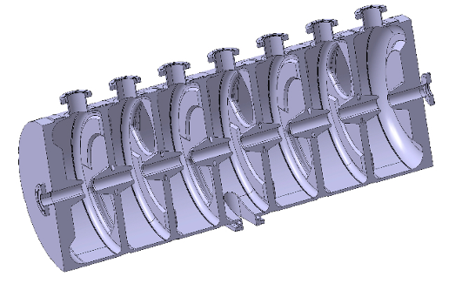
Multi-gap coupled-cell cavities (for protons and ions)
Between the 2 extreme cases (array of independently phased single-gap cavities / single long chain of coupled cells with lengths matching the particle beta) there can be a large number of variations (number of gaps per cavity, length of the cavity, type of coupling) each optimized for a certain range of energy and type of particle.
The goal of this lecture is to provide the background to understand the main features of these different structures…
DTL
SCL
CH
CCDTL
PIMS
Notes:
Dialogues between specialists…

Slide 16
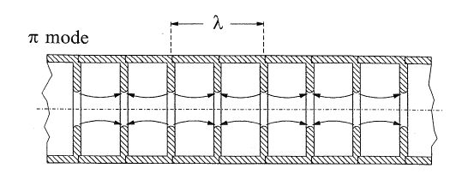
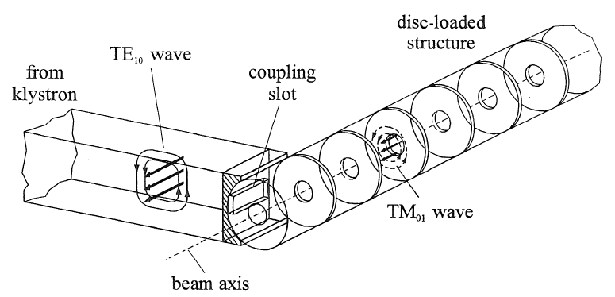
Electron linacs
In an electron linac velocity is ~ constant. To use the fundamental accelerating mode cell length must be d = βλ / 2.
the linac structure will be made of a sequence of identical cells. Because of the limits of the RF source, the cells will be grouped in cavities operating in travelling wave mode.
Pictures from K. Wille, The Physics of Particle Accelerators

Slide 17
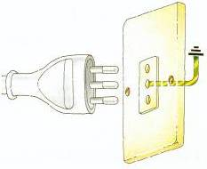
(Proton) linac building blocks
HV AC/DC power converter
AC to DC conversion efficiency ~90%
Main oscillator
RF feedback
system
DC to RF conversion efficiency ~50%
High power RF amplifier (tube or klystron)
RF to beam voltage conversion efficiency = SHUNT IMPEDANCE
ZT² ~ 20 - 60 MΩ/m
DC
particle
injector
buncher
ion beam, energy W
magnet
powering
system
vacuum
system
water
cooling
system
LINAC STRUCTURE
accelerating gaps + focusing magnets
designed for a given ion, energy range, energy gain

Slide 18
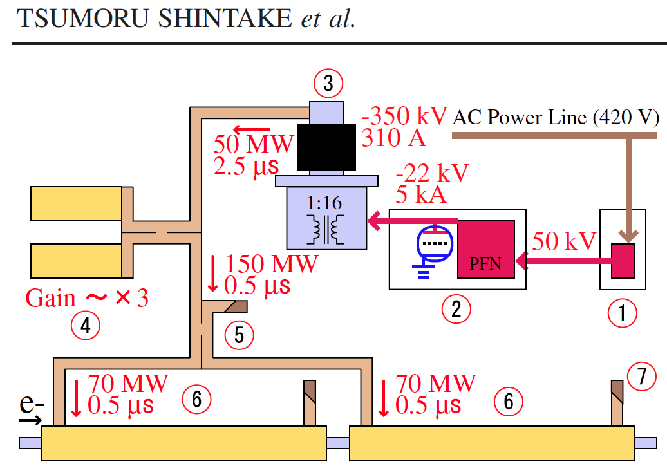
(Electron) linac building blocks

Slide 19
Conclusions – part 1
What did we learn?
A linac is composed of an array of accelerating gaps, interlaced with focusing magnets (quadrupoles or solenoids), following an ion source with a DC extraction and a bunching section.
When beam velocity is increasing with energy (“Newton” regime), we have to match to the velocity (or to the relativistic β) either the phase difference or the distance between two subsequent gaps.
We have to compromise between synchronicity (distance between gaps matched to the increasing particle velocity) and simplicity (number of gaps on the same RF source, sequences of identical cavities). At low energies we have to follow closely the synchronicity law, whereas at high energies we have a certain freedom in the number of identical cells/identical cavities.
Proton and electron linacs have similar architectures; proton linacs usually operate in standing wave mode, and electron linacs in traveling wave mode.

Slide 20

2 –Accelerating Structures

Slide 21
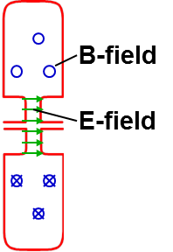

Coupling accelerating cells
1. Magnetic coupling:
open “slots” in regions of high magnetic field → B-field can couple from one cell to the next
2. Electric coupling:
enlarge the beam aperture → E-field can couple from one cell to the next
How can we couple together a chain of n accelerating cavities ?
The effect of the coupling is that the cells no longer resonate independently, but will have common resonances with well defined field patterns.

Slide 22
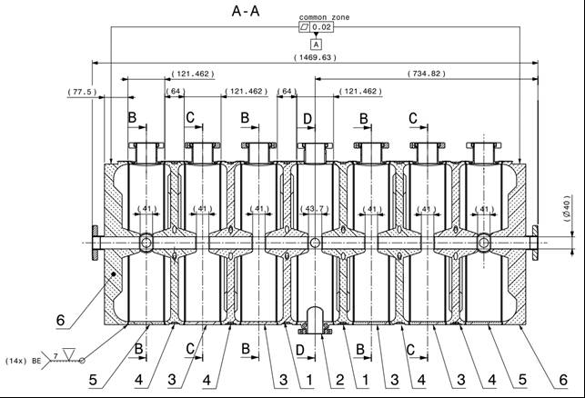
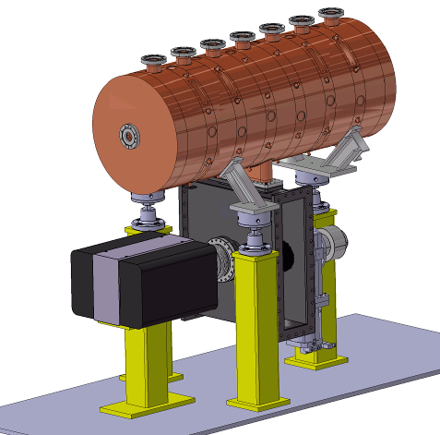
A 7-cell magnetically-coupled structure: the PIMS
PIMS = Pi-Mode Structure, will be used in Linac4 at CERN to accelerate protons from 100 to 160 MeV
RF input
This structure is composed of 7 accelerating cells,
magnetically coupled.
The cells in a cavity have the same length, but
they are longer from one cavity to the next, to
follow the increase in beam velocity.

Slide 23
Linac cavities as chains of coupled resonators
What is the relative phase and amplitude between cells in a chain of coupled cavities?
A linear chain of accelerating cells can be represented as a chain of resonant circuits magnetically coupled.
Individual cavity resonating at ω₀ → frequenci(es) of the coupled system ?
Resonant circuit equation for circuit i (R≅0, M=k√L²):
M
R
M
L
L
L
I_{i}
L
C
Dividing both terms by 2jωL:
General response term, ∝ (stored energy)^{1/2,}
can be voltage, E-field, B-field, etc.
Contribution from adjacent oscillators
General resonance term

Slide 24
The Coupled-system Matrix
A chain of N+1 resonators is described by a (N+1)x(N+1) matrix:
or
This matrix equation has solutions only if
Eigenvalue problem!
System of order (N+1) in ω → only N+1 frequencies will be solution of the problem (“eigenvalues”, corresponding to the resonances) → a system of N coupled oscillators has N resonance frequencies → an individual resonance opens up into a band of frequencies.
At each frequency ω_{i} will correspond a set of relative amplitudes in the different cells (X₀, X₂, …, X_{N}): the “eigenmodes” or “modes”.

Slide 25
Modes in a linear chain of oscillators
We can find an analytical expression for eigenvalues (frequencies) and eigenvectors (modes):
the index q defines the number of the solution → is the “mode index”
Frequencies of the coupled system :
Each mode is characterized by a phase πq/N. Frequency vs. phase of each mode can be plotted as a “dispersion curve” ω=f(φ):
each mode is a point on a sinusoidal curve.
modes are equally spaced in phase.
ω₀/√1-k
ω₀
ω₀/√1+k
0
π/2
π
The “eigenvectors = relative amplitude of the field in the cells are:
STANDING WAVE MODES, defined by a phase πq/N corresponding to the phase shift between an oscillator and the next one → πq/N=Φ is the phase difference between adjacent cells that we have introduces in the 1st part of the lecture.

Slide 26
Example: Acceleration on the normal modes of a 7-cell structure
0
ω = ω₀/√1+k
0 (or 2π) mode, acceleration if d = βλ
Intermediate modes
π/2
ω = ω₀
π/2 mode, acceleration if d = βλ/4
…
π
ω = ω₀/√1-k
π mode, acceleration if d = βλ/2,
Note: Field always maximum in first and last cell!

Slide 27
Practical linac accelerating structures
Note: our equations depend only on the cell frequency ω, not on the cell length d !!!
→ As soon as we keep the frequency of each cell constant, we can change the cell length following any acceleration (β) profile!
Example:
The Drift Tube Linac (DTL)
Chain of many (up to 100!) accelerating cells operating in the 0 mode. The ultimate coupling slot: no wall between the cells!
Each cell has a different length, but the cell frequency remains constant → “the EM fields don’t see that the cell length is changing!”
d↑ → (L ↑ , C↓) → LC ~ const → ω ~ const

Slide 28
The DTL
Standing wave linac structure for protons and ions, β=0.1-0.5, f=20-400 MHz
Drift tubes are suspended by stems (no net RF current on stem)
Coupling between cells is maximum (no slot, fully open !)
The 0-mode allows a long enough cell (d=βλ) to house focusing quadrupoles inside the drift tubes!
E-field
B-field

Slide 29
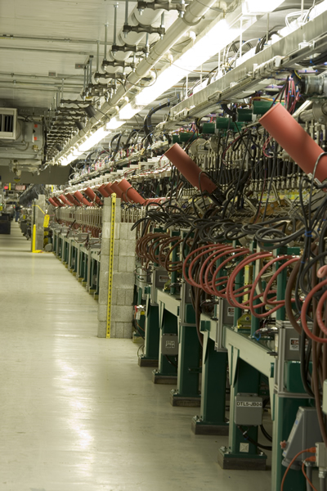
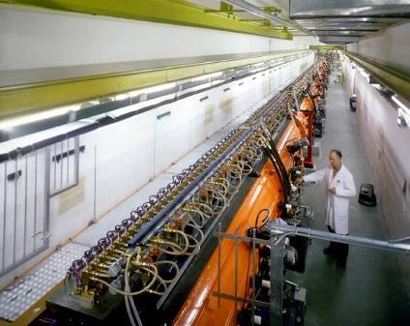
Examples of DTL
Top; CERN Linac2 Drift Tube Linac: 1978, 202.5 MHz, 3 tanks, final energy 50 MeV, tank diameter 1 meter.
Left: The Drift Tube Linac of the SNS at Oak Ridge (USA): 402.5 MHz, 6 tanks, final energy 87 MeV.

Slide 30
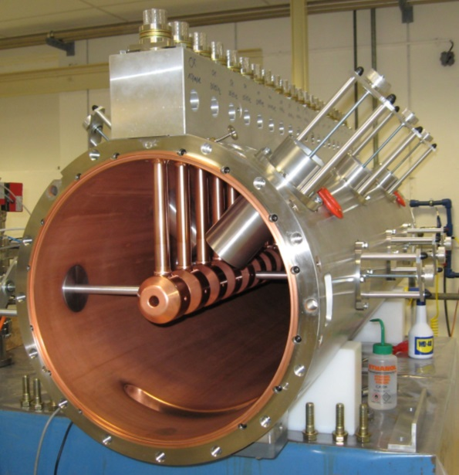
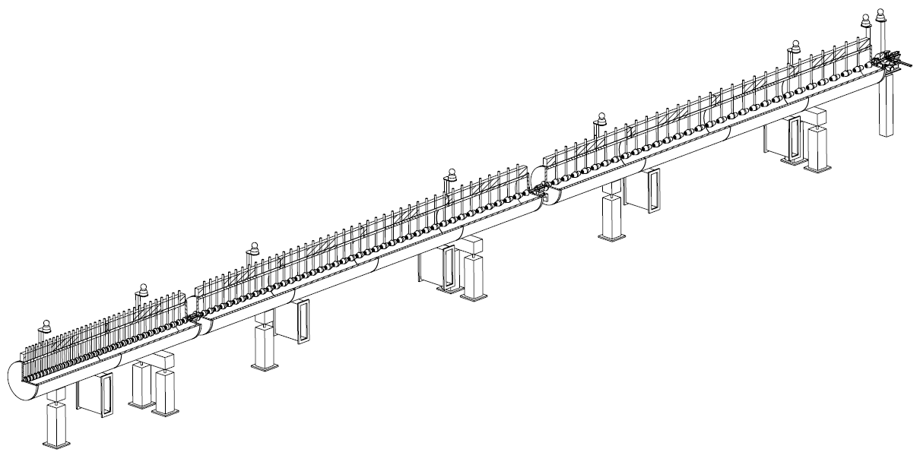
The Linac4 DTL
DTL tank 1 fully equipped: focusing by small permanent quadrupoles inside drift tubes.
352 MHz frequency
Tank diameter 500mm
3 resonators (tanks)
Length 19 m
120 Drift Tubes
Energy 3 MeV to 50 MeV
Beta 0.08 to 0.31 → cell length (βλ) 68mm to 264mm
→ factor 3.9 increase in cell length
beam

Slide 31
Stabilization of long chains: the π/2 mode
Long chains of linac cells can be operated in the π/2 mode, which is intrinsically insensitive to mechanical errors = differences in the cell frequencies.
In presence of errors, the E-field will have components from the adjacent modes, with amplitude proportional to the error and to the mode separation.
Perturbing mode
Perturbing mode
Operating mode
→ Contribution from adjacent modes proportional to with the sign !!!
The perturbation will add a component ΔE/(f²-f_{o}²) for each of the nearest modes.
Contributions from equally spaced modes in the dispersion curve will cancel each other !!

Slide 32
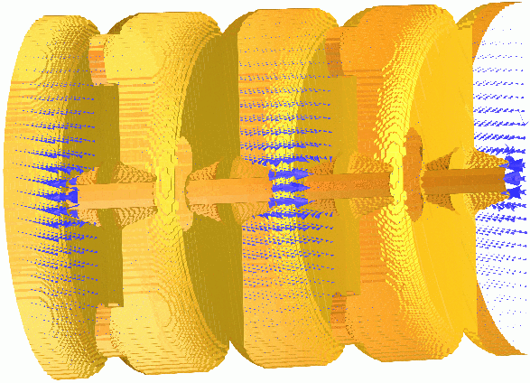
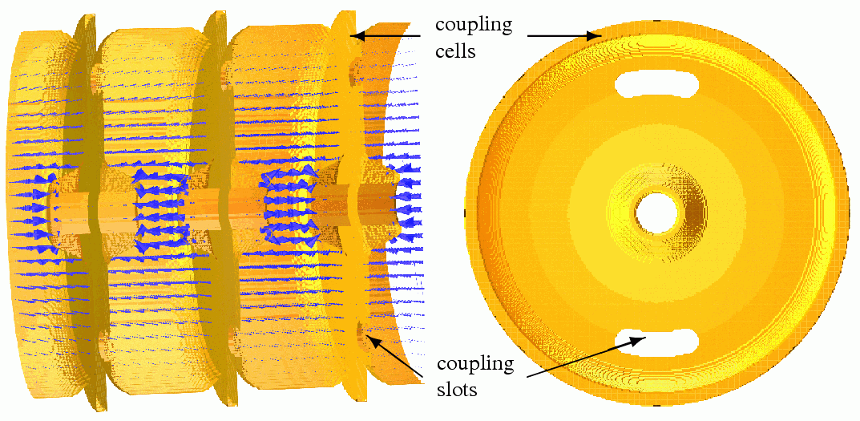
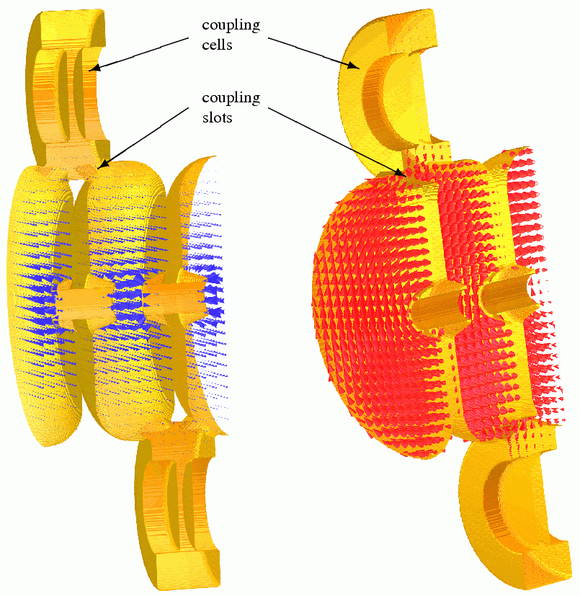
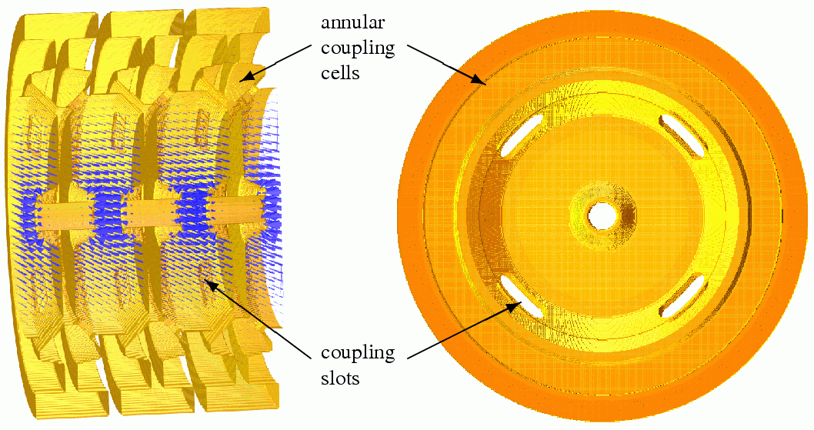
π/2-mode in a coupled-cell structure
Examples of π/2 structures
On axis Coupled Structure (OCS)
Annular ring Coupled Structure (ACS)
Side Coupled Structure (SCS)

Slide 33
The normal conducting zoo
For normal-conducting, the goal is designing high-efficiency structures with a large number of cells (higher power RF sources are less expensive).
Two important trends:
Use π/2 modes for stability of long chains of resonators → CCDTL (Cell-Coupled Drift Tube Linac), SCL (Side Coupled Linac), ACS (Annular Coupled Structure),....
Use alternative modes: H-mode structures (TE band) → Interdigital IH, CH
DTL
SCL
CH
33
CCDTL
PIMS
Notes:
Help you to find your way inside the zoo…

Slide 34
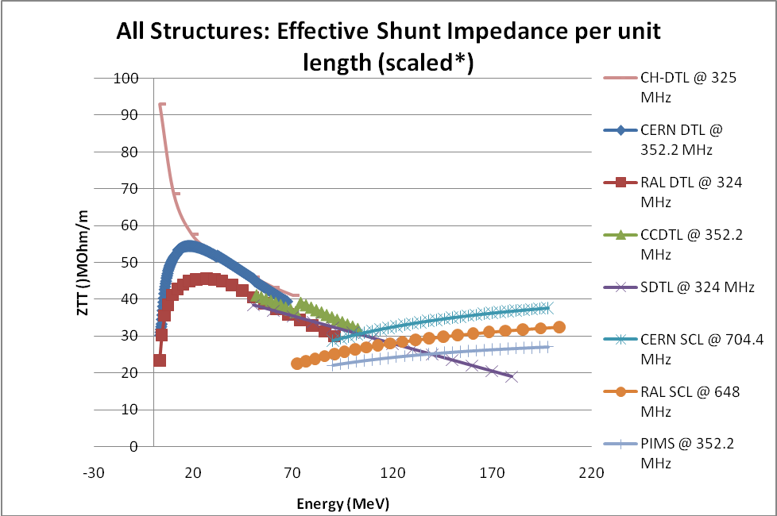
Shunt impedance
How to choose the best linac structure?
Main figure of merit is the power efficiency = shunt impedance
Ratio between energy gain (square) and power dissipation, is a measure of the energy efficiency of a structure.
Depends on the beta, on the energy and on the mode of operation.
But the choice of the best accelerating structure for a certain energy range depends as well on beam dynamics and on construction cost.
Comparison of shunt-impedances for different low-beta structures done in 2005-08 by the “HIPPI” EU-funded Activity.
In general terms, a DTL-like structure is preferred at low-energy, and π-mode structures at high-energy.
CH is excellent at very low energies (ions).

Slide 35
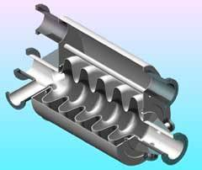
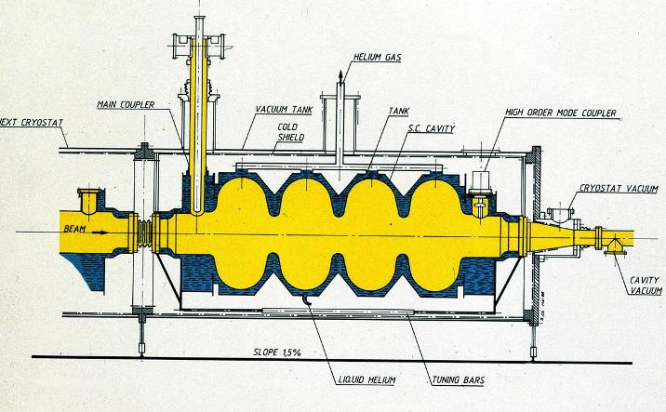
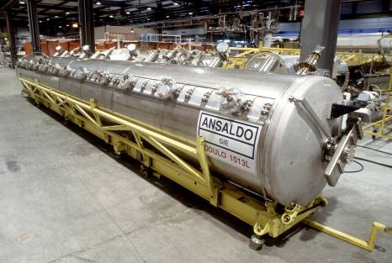
Multi-gap Superconducting linac structures (elliptical)
Standing wave structures for particles at β>0.5-0.7, widely used for protons (SNS, etc.) and electrons (ILC, etc.) f=350-700 MHz (protons), f=350 MHz – 3 GHz (electrons)
Chain of cells electrically coupled, large apertures (ZT² not a concern).
Operating in π-mode, cell length βλ/2
Input coupler placed at one end.

Slide 36
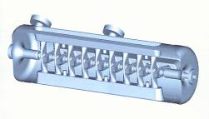
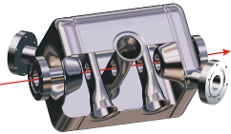
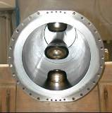

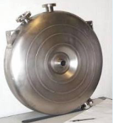
The superconducting zoo
Spoke (low beta)
[FZJ, Orsay]
CH (low/medium beta)
[IAP-FU]
QWR (low beta)
[LNL, etc.]
10 gaps
2 gaps
4 gaps
Re-entrant
[LNL]
HWR (low beta)
[FZJ, LNL, Orsay]
4 to 7 gaps
2 gaps
1 gap
Superconducting structure for linacs can have a small number of gaps → used for low and medium beta.
Elliptical structures with more gaps (4 to 7) are used for medium and high beta.
Elliptical cavities [CEA, INFN-MI, CERN, …]

Slide 37
Traveling wave accelerating structures (electrons)
What happens if we have an infinite chain of oscillators?
becomes (N→∞)
becomes (N→∞)
ω₀/√1-k
All modes in the dispersion curve are allowed, the original frequency degenerates into a continuous band.
The field is the same in each cell, there are no more standing wave modes → only “traveling wave modes”, if we excite the EM field at one end of the structure it will propagate towards the other end.
ω₀
ω₀/√1+k
0
π/2
π
But: our dispersion curve remains valid, and defines the velocity of propagation of the travelling wave, v_{φ} = ωd/Φ
For acceleration, the wave must propagate at v_{φ} = c
→ for each frequency ω and cell length d we can find a phase Φ where the
apparent velocity of the wave v_{φ} is equal to c

Slide 38
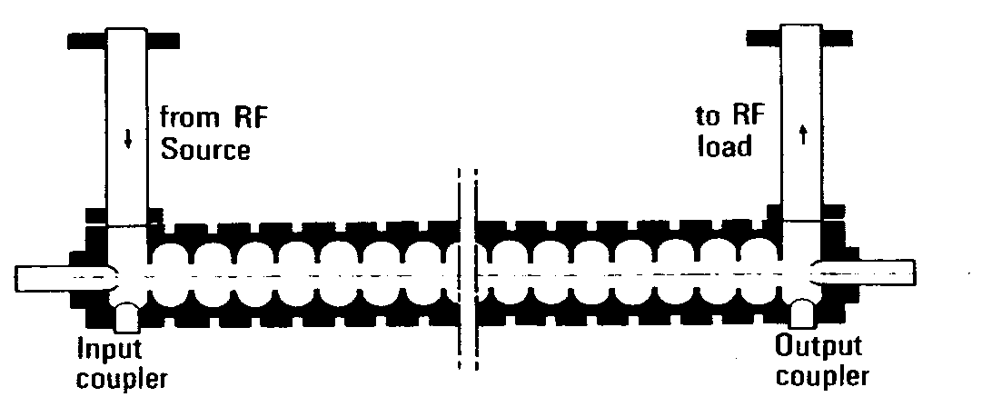
Traveling wave accelerating structures
How to “simulate” an infinite chain of resonators? Instead of a singe input, exciting a standing wave mode, use an input + an output for the RF wave at both ends of the structure.
beam
“Disc-loaded waveguide” or chain of electrically coupled cells characterized by a continuous band of frequencies. In the chain is excited a “traveling wave mode” that has a propagation velocity v_{ph} = ω/k given by the dispersion relation.
For a given frequency ω, v_{ph} = c and the structure can be used for particles traveling at β=1 The “traveling wave” structure is the standard linac for electrons from β~1.
Can not be used for protons at v<c:
1. constant cell length does not allow synchronism 2. structures are long, without space for transverse focusing

Slide 39
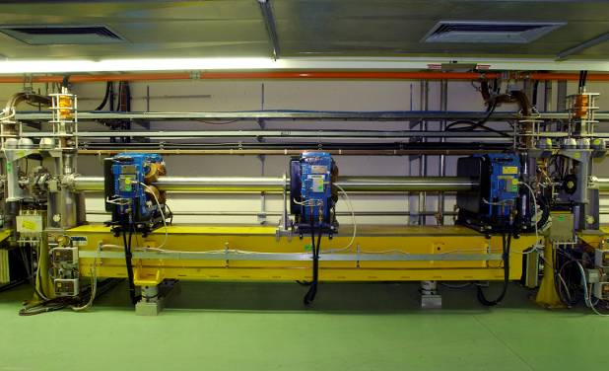
Example: the 3 GHz electron linac
A 3 GHz LIL accelerating structure used for CTF3. It is 4.5 meters long and provides an energy gain of 45 MeV. One can see 3 quadrupoles around the RF structure.

Slide 40
Conclusions – part 2
What did we learn?
Coupling together accelerating cells (via the magnetic or electric field) is a way to fix their phase relation.
A chain of N coupled resonators will always have N modes of oscillation. Each mode will have a resonance frequency and a field pattern with a corresponding phase shift from cell to cell.
Choosing the excitation frequency, we can decide in which mode to operate the structure, and we can select a mode with a phase advance between cells suitable for acceleration. If we change the length of a cell without changing its frequency, we can follow the increase the particle velocity.
Practical linac structures operate either on mode 0 (DTL), less efficient but leaving space for internal focusing elements, or on mode π, standard for multi-cell cavities. More exotic modes (π/2, TE) are used in special cases.
Electron linacs operate with long chains of identical cells excited by a traveling wave, propagating at the (constant) velocity of the beam.

Slide 41

3. Applications of linacs beyond nuclear and particle physics: materials and life science, energy, medicine, industry

Slide 42
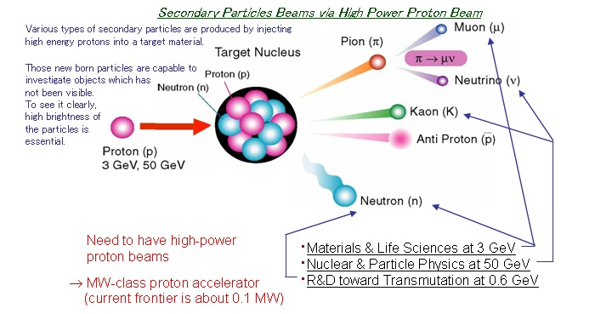
Linacs as powerful sources of secondary particle beams
Proton linacs can operate at high repetition frequencies with long pulses and currents up to 100 mA → can accelerate large average currents to energies above spallation threshold (about 1 GeV) and produce intense beams of secondary particles on a target (neutrons, pions, etc.)
Above a threshold, the amount of secondary particles is proportional to beam power (P=W x I)
. Energy production (Accelerator Driven Systems), > 2 GeV
. Radiactive Ion Beams (ISOL), > 1 GeV
(scheme courtesy of JPARC)

Slide 43
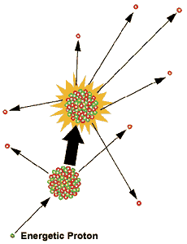

Neutron scattering:
Spallation Neutron Sources
Neutrons are ideal probes to map the molecular and magnetic structure and behavior of materials (high-temperature superconductors, polymers, metals), and biological samples → Application to fundamental physics, structural biology and biotechnology, magnetism and superconductivity, chemical and engineering materials, nanotechnology, complex fluids, ...
Traditionally, neutrons were produced by nuclear reactors; nowadays, are used linear accelerators at energy ≥ 1 GeV
2 linac-based facilities operational (SNS at Oak Ridge – USA and J-PARC at Tokai – Japan) and a third starting construction (European Spallation Source at Lund – Sweden).

Slide 44
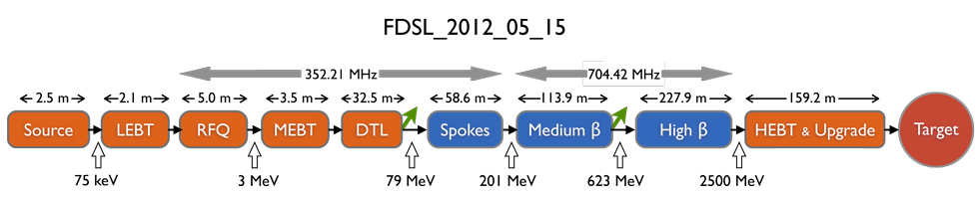
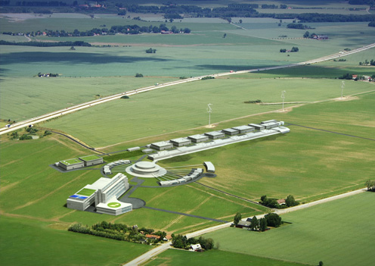
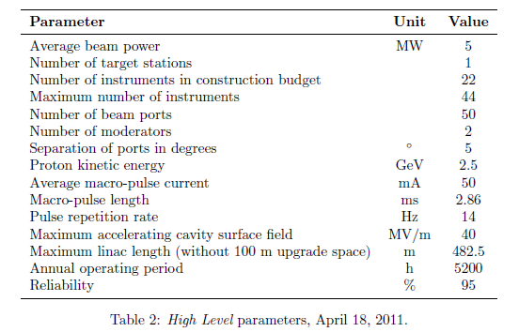
The ESS linac

Slide 45
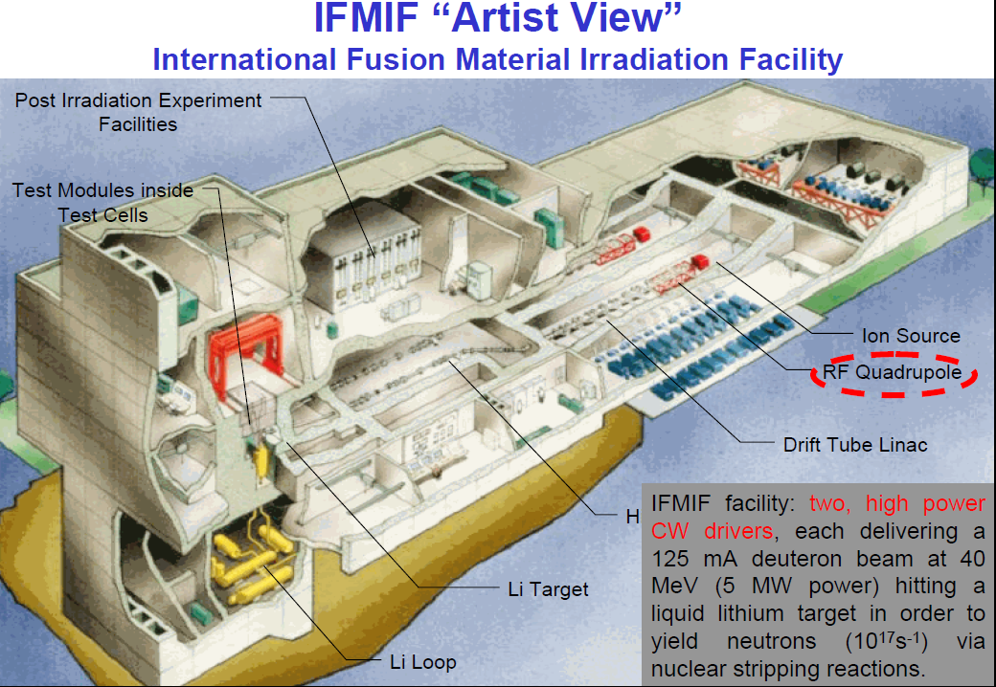
Material testing under intense neutron flux: IFMIF
Test under strong neutron fluxes of materials to be used in ITER

Slide 46
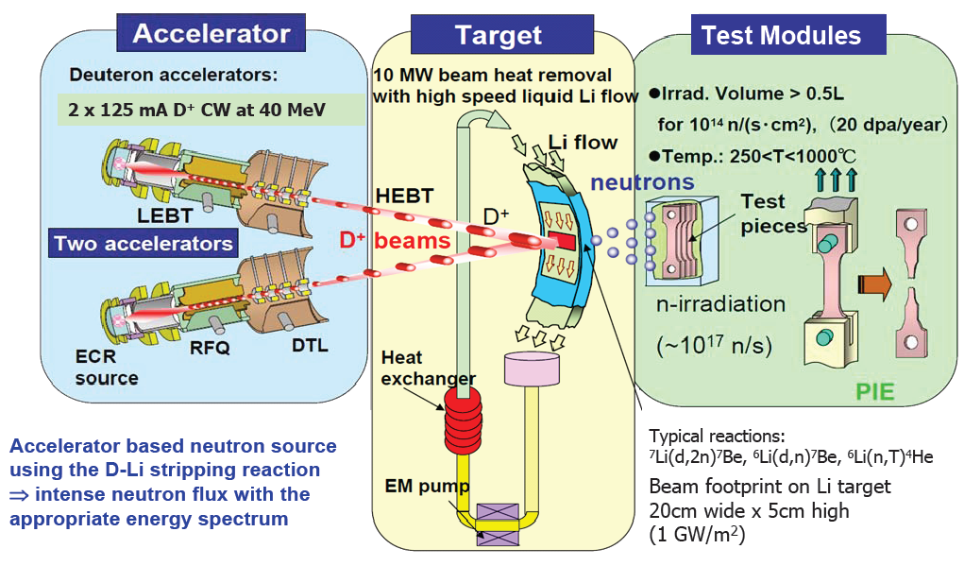
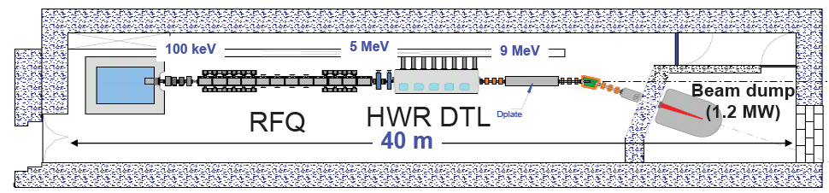
IFMIF principles
IFMIF-EVEDA in construction (CEA, INFN, CIEMAT, JAEA):
9 MeV 125 mA CW deuteron linac (9-m RFQ + SC cavities)

Slide 47
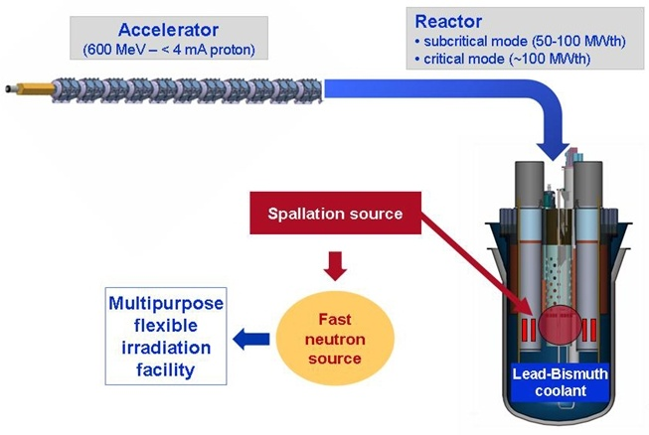
Accelerator Driven Systems
A linac coupled to a spallation source provides the missing neutrons to maintain the reaction in a subcritical reactor.
Use of alternative fuel cycles (thorium), no safety concerns (subcritical).
Can be coupled with a transmutation facility, the accelerator can process long-life nuclear waste and transform it into shorter lifetime waste.
The MYRRHA Project (Multi-purpose hYbrid Research Reactor for High-tech Applications) based at Mol (BE) is the European way to an ADS demonstrator: in the ESFRI list, partly supported by EU and by the Belgian government, looking for other international partners.
ADS demonstrator + fast neutron irradiation facility

Slide 48
Advantages of ADS
Advantages/disadvantages of accelerator driven systems as compared to conventional reactors:
Pros | Cons
Safety: subcritical reaction, allows for immediate switch-off | High reliability (→cost) required for the accelerator, to protect structures from thermal shocks
Possibility to operate below criticality opens the way to new reactor concepts | Reduction in net plant power efficiency due to power consumption of accelerator
Simple reactor control by modulating accelerator current | Increased complexity (and cost)

Slide 49
Industrial applications of linacs
 | Goal | Examples | Accelerator
Material processing (electrons) | Improve polymer resins inducing cross-linking of polymer chains → higher stress resistance | Heat-shrinkable films for food packaging, tires and cable insul. Gemstone irradiation | Electrons, 100 keV-10 MeV
Sterilization | Kill microroganisms | Sterilization of medical products Food processing (public acceptance!) | Electrons, ~10 MeV
Wastewater treatment | Distruction of organic compounds | Russia, Korea, USA, Brazil | Electrons, ~10 MeV
Non-destructive testing | Detect discontinuities in a material (cracks, etc.) | Inspection of pipelines, ships, bridges, etc. (depth + variable energy) | Electrons for X-rays, 1-15 MeV, portable (9 GHz)
Cargo inspection | Screening of trucks or containers for illegal objects | Many ports, customs, etc. | Electrons for X-rays, 3-6 MeV
Ion implantation | Alter near-surface properties of semiconductors (doping) | Semiconductor industry (arsenic, boron, indium, phosphorus,…) | Ions, from low to high energy (5 MeV)
PET isotope production | Production of radiotracers for Positron Emission Tomography | Linacs are smaller and have less res. activation than cyclotrons | Protons, 7 MeV
Neutron testing | Neutron generation for non-destructive inspection | Inspection of materials, cargo, etc. | Protons, 1-10 MeV
More than 20’000 industrial linacs in operation in the world.
A large fraction is made of small electrostatic machines for ion implantation (10’000 units).

Slide 50


Radiotherapy with linear accelerators
Courtesy of Elekta
electrons
X
Linac for electrons
@3 GHz
5-20 MeV
(usually short side-coupled structures)
X
20 000 patients per year every 10 million inhabitants
  >7000 electron linacs in the world for radiotherapy
50

Slide 51




Compact proton linacs for hadrontherapy
LIGHT (Linac for Image Guided Hadron Therapy) project developed by the ADAM company. Collaboration with CERN (related to TERA).
230 MeV energy in 20 m
Recently built and successfully tested a prototype unit (2 modules).
Modular, compact, variable energy.
Conventional proton linac as injector.

Slide 52
Linear Accelerators – part 2
Beam dynamics fundamentals
Linac architecture
The Radio Frequency Quadrupole

Slide 53

4 – Fundamentals of linac beam dynamics

Slide 54
Introduction
A linear accelerator requires an accurate beam optics design, in order to:
Minimize emittance growth (remember Liouville: emittance can only increase!);
Minimize beam loss, to: a) avoid activation of the accelerator (of the linac and of the following machine!) and b) reduce the requirements on the ion source.
Note that the operating regimes in linacs can be very different, between
μa peak currents for heavy ion linacs (~ 10⁵ particles / bunch)
mA peak currents for proton linacs (~ 10⁸ particles / bunch)
100’s mA peak currents for high-power proton linacs (~ 10¹¹ particles / bunch)
A’s peak currents for electron linacs

Slide 55
Longitudinal dynamics
Ions are accelerated around a (negative = linac definition) synchronous phase.
Particles around the synchronous one perform oscillations in the longitudinal phase space.
Frequency of small oscillations:
Tends to zero for relativistic particles γ>>1.
Note phase damping of oscillations:
At relativistic velocities phase oscillations stop, and the beam is compressed in phase around the initial phase. The crest of the wave can be used for acceleration.
Notes:
This happens for every value of phi

Slide 56
Longitudinal dynamics - electrons
Electrons at v=c remain at the injection phase.
Electrons at v<c injected into a TW structure designed for v=c will move from injection phase ϕ₀ to an asymptotic phase ϕ, which depends only on gradient and β₀ at injection.
The beam can be injected with an offset in phase, to reach the crest of the wave at β=1
Capture condition, relating E₀ and β₀ :
Example: λ=10cm → W_{in}=150 keV for E₀=8 MV/m.
In high current linacs, a bunching and pre-acceleration sections up to 4-10 MeV prepares the injection in the TW structure (that occurs already on the crest)
Notes:
Again obtained solving the equation of motion dp/dt=eEcos(phi(z,t)).

Slide 57
Transverse dynamics - Space charge
Large numbers of particles per bunch ( ~10¹⁰ ).
Coulomb repulsion between particles (space charge) plays an important role and is the main limitation to the maximum current in a linac.
But space charge forces ~ 1/γ² disappear at relativistic velocity
Force on a particle inside a long bunch with density n(r) traveling at velocity v:
B
E
Notes:
Gauss law

Slide 58
Transverse dynamics - RF defocusing
RF defocusing experienced by particles crossing a gap on a longitudinally stable phase. Increasing field means that the defocusing effect going out of the gap is stronger than the focusing effect going in.
In the rest frame of the particle, only electrostatic forces → no stable points (maximum or minimum) → radial defocusing.
Lorentz transformation and calculation of radial momentum impulse per period (from electric and magnetic field contribution in the laboratory frame):
Bunch position at max E(t)
Transverse defocusing ~ 1/γ² disappears at relativistic velocity (transverse magnetic force cancels the transverse RF electric force).
Notes:
Particles experience a higher field in the 2nd half of a gap. Defocusing forces (2nd half of gap) are stronger than focusing forces (1st half).

Slide 59
Transverse beam equilibrium in linacs
The equilibrium between external focusing force and internal defocusing forces defines the frequency of beam oscillations.
Oscillations are characterized in terms of phase advance per focusing period σ_{t} or phase advance per unit length k_{t}.
Ph. advance = Ext. quad focusing - RF defocusing - space charge
q=charge
G=quad gradient
l=length foc. element
f=bunch form factor
r₀=bunch radius
λ=wavelength
…
Approximate expression valid for:
F0D0 lattice, smooth focusing approximation, space charge of a uniform 3D ellipsoidal bunch.
A “low-energy” linac is dominated by space charge and RF defocusing forces !!
Phase advance per period must stay in reasonable limits (30-80 deg), phase advance per unit length must be continuous (smooth variations) → at low β, we need a strong focusing term to compensate for the defocusing, but the limited space limits the achievable G and l → needs to use short focusing periods N βλ.
Note that the RF defocusing term ∝f sets a higher limit to the basic linac frequency (whereas for shunt impedance considerations we should aim to the highest possible frequency, Z ∝√f) .
59

Slide 60

Phase advance – an example
Beam optics of the Linac4 Drift Tube Linac (DTL): 3 to 50 MeV, 19 m, 108 focusing quadrupoles (permanent magnets).
Oscillations of the beam envelope (coordinates of the outermost particle) along the DTL (x, y, phase)
Corresponding phase advance per period
Design prescriptions:
Tranverse phase advance at zero current always less than 90°.
Smooth variation of the phase advance.
Avoid resonnances (see next slide).

Slide 61
Instabilities in linacs – the Hoffman plot
The “tune diagram” of a linac
Ratio between transverse phase advance and zero current phase advance (a measure of space charge)
Plot courtesy of J.B. Lallement / CERN
Ratio between longitudinal and transverse phase advance
Linac4 DTL: the operating point(s) for all possible current levels are far from the resonances between transverse and longitudinal oscillations which are enhanced by space charge.
Effect of the resonances: emittance exchange, transverse emittance growth, migration of particles into the beam halo → particularly dangerous for high intensity machines (beam loss).

Slide 62
Focusing periods
Focusing usually provided by quadrupoles.
Need to keep the phase advance in the good range, with an approximately constant phase advance per unit length → The length of the focusing periods has to change along the linac, going gradually from short periods in the initial part (to compensate for high space charge and RF defocusing) to longer periods at high energy.
For Protons (high beam current and high space charge), distance between two quadrupoles (=1/2 of a FODO focusing period):
- βλ in the DTL, from ~70mm (3 MeV, 352 MHz) to ~250mm (40 MeV),
- can be increased to 4-10βλ at higher energy (>40 MeV).
- longer focusing periods require special dynamics (example: the IH linac).
For Electrons (no space charge, no RF defocusing):
focusing periods up to several meters, depending on the required beam conditions. Focusing is mainly required to control the emittance.
Notes:
Beta 7% at 3 MeV

Slide 63
Conclusions – part 3
What did we learn?
Transverse beam dynamics in linacs is dominated by space charge and RF defocusing forces.
In order to keep the transverse phase advance within reasonable limits, focusing has to be strong (large focusing gradients, short focusing periods) at low energy, and can then be relaxed at higher energy.
A usual linac is made of a sequence of structures, matched to the beam velocity, and where the length of the focusing period increases with energy.
The very low energy section remains a special problem → next lecture

Slide 64

5. Linac architecture

Slide 65

Architecture: cell length, focusing period
EXAMPLE: the Linac4 project at CERN. H-, 160 MeV energy, 352 MHz.
A 3 MeV injector + 22 multi-cell standing wave accelerating structures of 3 types
DTL, 3-50 MeV: every cell is different, focusing quadrupoles in each drift tube, 0-mode
CCDTL, 50-100 MeV: sequences of 2 identical cells, quadrupoles every 3 cells, 0 and π/2 mode
PIMS, 100-160 MeV: sequences of 7 identical cells, quadrupoles every 7 cells, π/2 mode
Two basic principles to remember:
1. As beta increases, phase error between cells of identical length becomes small → we can have short sequences of identical cells (lower construction costs).
2. As beta increases, the distance between focusing elements can increase.
Injector
Notes:
Forget about the acronyms, important are 2 elements

Slide 66
Linac architecture: the frequency
approximate scaling laws for linear accelerators:
RF defocusing (ion linacs) ~ frequency
Cell length (=βλ/2) ~ (frequency)⁻¹
Peak electric field ~ (frequency)^{1/2}
Shunt impedance (power efficiency) ~ (frequency)^{1/2}
Accelerating structure dimensions ~ (frequency)⁻¹
Machining tolerances ~ (frequency)⁻¹
Higher frequencies are economically convenient (shorter, less RF power, higher gradients possible) but the limitation comes from mechanical precision required in construction (tight tolerances are expensive!) and beam dynamics for ion linacs.
The main limitation to the initial frequency (RFQ) comes from RF defocusing (~ 1/(λβ²γ²) – 402 MHz is the maximum achievable so far for currents in the range of tens of mA’s.
High-energy linacs have one or more frequency jumps (start 200-400 MHz, first jump to 400-800 MHz, possible a 3rd jump to 600-1200 MHz): compromise between focusing, cost and size.

Slide 67
Linac architecture: superconductivity
Advantages of Superconductivity:
- Much smaller RF system (only beam power) → prefer low current/long pulse
Larger aperture (lower beam loss).
Lower operating costs (electricity consumption).
Higher gradients (thanks to cleaning procedures)
Disadvantages of Superconductivity:
- Need cryogenic system (in pulsed machines, size dominated by static loss → prefer low repetition frequency or CW to minimize filling time/beam time).
In proton linacs, need cold/warm transitions to accommodate quadrupoles → becomes more expensive at low energy (short focusing periods).
Individual gradients difficult to predict (large spread) → for protons, need large safety margin in gradient at low energy.
Conclusions:
1. Superconductivity gives a large advantage in cost at high energy (protons)/ high duty cycle.
2. At low proton energy / low duty cycle superconducting sections are more expensive.

Slide 68


Electron linac architecture
courtesy of R. Muñoz, ALBA-CELLS
EXAMPLE:
injector linac of the ALBA Synchrotron Light Facility (Barcelona):
100 MeV electron linac supplied by Thales in 2008. Produces a beam up to 4 nC/bunch in either single or multi-bunch mode at repetition rate up to 5 Hz. Normalized beam emittance below 30 π mm mrad.
Injector + sequence of identical multi-cell traveling wave accelerating structures.

Slide 69
Conclusions – part 4
What did we learn?
A proton linac is made of different sections optimized for a particular range of beta. Each section is characterized by its RF frequency, by the periodicity of the RF structure and by the focusing distance. The frequency of the first section (RFQ) is limited by beam dynamics (RF defocusing). In the following sections, the frequency can be increased (by multiples of the basic frequency), to gain in efficiency.
Superconductivity gives a clear advantage in cost to linacs operating at high duty cycle.
An electron linac is made of an injector where the beam is generated, bunched and brought to the speed of light (usually by a standing-wave buncher), followed by a sequence of identical traveling-wave structures.

Slide 70

6. The Radio-Frequency Quadrupole

Slide 71
Low-energy acceleration of protons and ions
Low energy →
for protons,
between ~ 50 keV (source extraction) and ~ 3 MeV (limit for an effective use of the DTL) → range β = 0.01 – 0.10
Why it is a problem?
We have seen that at low energy we need strong focusing (strong space charge!), but the short cell length (~βλ) limits the length of quadrupoles, for ex. βλ(1MeV,352MHz) = 3.9cm
in this region the beam needs to be bunched → standard bunching systems are quite ineffective (~50% beam loss…).
At low energy, the usual accelerating structures have low efficiency (low shunt impedance).
The classical solution:
Increase as much as possible the extraction voltage from the source → huge HV installations, up to the maximum of some 800 kV.
Add a bunching section (1 or 2 cavities) after the source extraction.
Start the first accelerating structure (usually a Drift Tube Linac) from the minimum possible energy.

Slide 72




The classical solution: HV column + LEBT + bunching
5.6m
Double harmonic buncher (200-400 MHz)
DTL
W
φ
Principle of single-harmonic bunching
Useful beam (inside DTL acceptance)
Drawbacks:
Large and expensive HV column
Reliability (800 kV…)
Bunching efficiency (~50%)
Long line with inefficient magnetic focusing (∝ β)
Difficult DTL at low energy (short tubes and quads)
Large emittances for high currents

Slide 73


RFQ compared to the old pre-injectors
The old pre-injector at CERN (1976):
Source+ Cockroft Walton +line+bunching
The new RFQ2 pre-injector at CERN (1993):
Source+LEBT+RFQ
3.2m

Slide 74
New ideas – an history of the RFQ
The driving force for the development of something new for the low-energy section was the research in URSS and USA on high-current proton accelerators. The idea is to break the limitation to current coming from space charge in the beam transport and from bunching losses.
1960’s: Early works of I. Kapchinski at ITEP (Moscow): idea to use at low energy an electric quadrupole focusing channel, excited at RF frequency, and modulated to add a longitudinal field component providing adiabatic bunching and acceleration.
1969: an RF resonator is designed around Kapchinski’s electrodes by V. Tepliakov (IHEP). First paper on the RFQ by Kapchinski and Teplyakov (in Russian). First experimental RFQ in Russia (1974).
1977: the idea arrives at Los Alamos (USA), introduced by a Czech refugee.
1977-1980: the Los Alamos team is enthusiastic about the idea (for their Fusion Material Irradiation), makes some improvements to the original Kapchinski structure and develops a new resonator design. The first complete RFQ is built at Los Alamos and successfully operated (for a few hours…) in 1980.
1980’s: the RFQ principle spreads around the world, more RFQs are built in the USA and in Europe (1st CERN RFQ: 1984). Long and difficult learning curve (RFQs are not simple devices…).
1985-1995 : reliable RFQ designs exist and progressively replace the old pre-injectors in most accelerator laboratories (CERN: 1993). Different design and applications are proposed all over the world.
1995-now : new RFQs are designed and built for extreme applications, like very high intensity (CW, high current). Start to design compact RFQs.

Slide 75


The 4-vane RFQ
The RFQ will result in cylinder containing the 4 vanes, which are connected (large RF currents!) to the cylinder along their length.
A critical feature of this type of RFQs are the end cells:
The magnetic field flowing longitudinally in the 4 “quadrants” has to close its path and pass from one quadrant to the next via some openings at the end of the vanes, tuned at the RFQ frequency!
Field excitation via a loop or an iris in one (or more) quadrants
B-field

Slide 76


The Radio Frequency Quadrupole (RFQ)
RFQ = Electric quadrupole focusing channel + bunching + acceleration
~1-3m
New and performing accelerator.
Compact and critical structure, where beam dynamics, RF and mechanical aspects are closely interconnected.

Slide 77



The basic RFQ principle
1. Four electrodes (called vanes) between which we excite an RF Quadrupole mode → Electric focusing channel, alternating gradient with the period of the RF. Note that electric focusing does not depend on the velocity (ideal at low β!)
+
−
−
2. The vanes have a longitudinal modulation with period = βλ → this creates a longitudinal component of the electric field. The modulation corresponds exactly to a series of RF gaps and can provide acceleration.
+
−
+
Opposite vanes (180º)
Adjacent vanes (90º)

Slide 78








Bunching and acceleration
3. The modulation period (distance between maxima) can be slightly adjusted to change the phase of the beam inside the RFQ cells, and the amplitude of the modulation can be changed to change the accelerating gradient → we can start at -90º phase (linac) with some bunching cells, progressively bunch the beam (adiabatic bunching channel), and only in the last cells switch on the acceleration.
☞ An RFQ has 3 basic functions:
Adiabatically bunching of the beam.
Focusing, on electric quadrupole.
Accelerating.
Longitudinal beam profile of a proton beam along the CERN RFQ2: from a continuous beam to a bunched accelerated beam in 300 cells.

Slide 79


Peeping into an RFQ…
Looking from the RF port into the new CERN RFQ (Linac4, 2011)

Slide 80
RFQ beam dynamics
An RFQ is made of a sequence of cells (length βλ → in 1 m we can have > 100 cells) where the beam dynamics designer can vary 3 parameters for each cell:
Aperture a (defines the focusing strength)
Modulation factor m (defines the longitudinal component)
The beam phase φ, phase difference between bunch center and RF wave (defines the bunching and/or accelerating action).
+ 1 more parameter that is common to all cells or can be changed only smoothly: the RF voltage V.
a = minimum aperture
m = modulation factor (ratio bw. max and min aperture)
cell length/βλ = changing the length of the cell with respect to the optimum length for a given beta will change the RF phase seen by the beam.
Notes:
I find a solution, and I build the electrodes that generate this solution

Slide 81
The Kapchinski potential
In order to define the 3-dimensional shape of the RFQ electrodes, Kapchinski introduced an analytical expression for the fields in an RFQ channel :
The region between the vanes is small w.r.t. the wavelength → static approximation, we can use the formulae for static fields.
The potential in the intervane region is then a solution of the Laplace equation, which in cylindrical coordinates can be solved by a series of Bessel functions.
Kapchinski’s idea: of all the terms in the series, take only the 2 that are interesting for us (the transverse quadrupole term + a longitudinal focusing and accelerating term) and try to build some electrodes that give only those 2 terms.
k=2π/βλ
Transverse quadrupole term
“Longitudinal” term
→ an RFQ cell is defined by the 2 parameters, A₀ and A₁₀ (plus the phase)
→ the 3 dimensional profile of an RFQ electrode must correspond to an
equipotential surface of V(r,theta,z)
81

Slide 82

RFQ beam dynamics - 2
→ The electrodes have to follow equipotential surfaces of this equation
The equipotential surfaces giving the 2-term RFQ potential are hyperbolic surfaces with a longitudinal sinusoidal modulation.
→ The vanes in the 1st generation of RFQs were perfect truncated hyperbolae.
V=voltage applied between 2 adjacent vanes
The constants A₀, A₁₀ depend on the geometry, and can be related to the modulation factors and to the intervane voltage V:
But truncated hyperbolic surfaces are difficult to machine, while modern field calculation codes allow to use vane profiles that cannot be analyzed analytically.
→ after the first generation of RFQs, the designers are now using simplified vane profiles with constant curvature radius or simplified surfaces → introduction of multipoles, can be calculated and kept within acceptable limits.

Slide 83
Parameters of the RFQ
Transverse
focusing coefficient
limited by sparking
Transverse field distortion due to modulation (=1 for un-modulated electrodes)
Longitudinal bunching and accelerating field
Accelerating efficiency : fraction of the field deviated in the longitudinal direction
(=0 for un-modulated electrodes)
cell length
Transverse focusing B is the external focusing contribution to phase advance (see linac lecture)

Slide 84

Example of an RFQ Beam Dynamics design
The new CERN Linac4 RFQ:
352 MHz, 45 keV to 3 MeV, 303 cells, 3 m length, 70 mA beam current
Beam transmission 95 % (calculated)
The first ~200 cells are used for adiabatic bunching of the beam: the synchronous phase is slowly increased from -90 to -20 deg → bunching with low beam loss!

Slide 85
RFQ sections

Slide 86


The RFQ resonator
Problem:
How to produce on the electrodes the quadrupole RF field?
2 main families of resonators: 4-vane and 4-rod structures
plus some more exotic options
(split-ring, double-H, etc.)
Remark:
what is the ideal frequency for an RFQ?
Cell length βλ/2 at injection should be mechanically achievable, of the order of few mm.
For heavy ions,
β~10⁻⁴ – 10⁻³
corresponding to
f~ 10 – 100 MHz
For protons,
β~10⁻² makes higher frequencies possible, but beam dynamics (focusing ~f⁻²) and technology limit to
f ~ 200 – 400 MHz

Slide 87



The “4-vane” RFQ
B-field
Basic idea:
An empty cylindrical cavity can be excited on different modes.
Some of these modes have only transverse electric field (the TE modes), and in particular going up in frequency one can find a “quadrupole” mode, the TE210.
The introduction of 4 electrodes (the vanes) can then “load” the TE210 mode, with 2 effects:
  Concentrate the electric field on the axis, increasing the efficiency.
  Lower the frequency of the TE210 mode, separating it from the other modes of the cylinder.
Unfortunately, the dipole mode TE110 is lowered as well, and remains as a perturbing mode in this type of RFQs.
E-field

Slide 88



The 4-rod RFQ
An alternative solution is to machine the modulation not on the tip of an electrode, but on a set of rods (machining on a lathe, old design) or on some small “vanelets”.
The 4 electrodes are then brought to the correct quadrupole potential by an arrangement of quarter-wavelength transmission lines. The set-up is then inserted into a cylindrical tank.
Cost-effective solution, becomes critical at high frequencies → dimensions become small and current densities go up.
Power densities are higher than in the 4-vane → more problems for high power applications.
Commonly used for heavy ions and protons at low frequency – low duty cycle (f <200 MHz). Under development versions for high duty
+
-
<λ/4

Slide 89


Mechanical aspects – tolerances
Two main mechanical problems:
1. The need to achieve the tight tolerances in vane machining and positioning required by beam dynamics and RF.
RF and beam dynamics both require tight tolerances in the position of the electrodes (Linac4 RFQ: <30 μm).
RF: presence of dipole and/or longitudinal components.
Beam dynamics: introduction of multipoles (Linac4 RFQ average aperture r₀ = 3.3 mm, 1% of aperture is ~30 μm). Minimum aperture a = 1.8 mm !!
Machining of a vane for the new CERN RFQ (linac4)

Slide 90


Mechanical aspects – joining RFQ parts
2. The need to assemble a LEGO®8 of several components (tanks, vanes or rods, supports, etc.) that have to fit together keeping the tolerances and providing a good quality RF contact (large currents flowing!).
4-vane, high frequency: furnace brazing of 4 copper elements
4-vane, low frequency: EB welding or bolting of copper or copper plated elements
SPIRAL2, CEA-CNRS, France
RFQ1 and RFQ2, CERN
TRASCO, LNL, Italy
IPHI, CEA-CNRS, France

Slide 91

RFQ – thermal aspects
High (beam) power RFQs need to dissipate large amounts of RF power in small volumes (vanes are “thin” to maximize shunt impedance).
Thermal deformations can lead to large voltage variations and to beam loss.
Need to carefully design and dimension the cooling channels to keep High (beam) power RFQs need to dissipate large amounts of RF power in small volumes (vanes are “thin” to maximize shunt impedance).
Thermal deformations can lead to large voltage variations and to beam loss.
Example: thermal study of the TRASCO RFQ (CW, 352 MHz, 1 kW/cm) – courtesy of LNL, Legnaro

Slide 92


The 1st 4-vane RFQ
Proof of Principle (POP) RFQ, Los Alamos
1980 – the 1st vane-type RFQ
100 KeV - 650 KeV, 30 mA , 425 MHz

Slide 93

Examples of RFQs – 1
“Star Wars” RFQ (now de-classified), 1983, LANL
2 MeV, 100 mA, ~5% duty, H-minus, 425 MHz
Cu plated carbon steel vanes and cavity, manifold coupled
Demonstrated very small emittance H-minus beams

Slide 94

Examples of RFQs - 2
“BEAR” RFQ (beam experiment aboard a rocket)(partly classified) 1989
30 KeV – 1 MeV, 20 mA, <1% duty H-minus
425 MHz, solid-state RF system
Cu plated Al quadrants, joined by electroforming, 55 kg
Operated in sub-orbital flight with a “neutral” beam, LANL

Slide 95



Examples of RFQs - 3
High frequency (352 MHz), high duty cycle (CW)
for ADS studies and other applications.
2 RFQs in construction in Europe:
TRASCO@LegnaroINFN
IPHI@Saclay.CEA

Slide 96

Examples of RFQ - 4
Superconducting RFQs:
Only one operating Superconducting RFQs built so far in the world (INFN Legnaro, Italy).
The modulation is extremely difficult to realise in Nb → a superconducting RFQ is limited to few cells at low frequency → heavy ions.
LNL superconducting RFQ: 2 separate structures, 1.4 m and 0.8 m, 41 and 13 cells
On proton RFQs with high intensity, the unavoidable beam loss during the bunching process would be very dangerous for a superconducting structure.
Al prototype and the final installation of the superconducting RFQ at LNL, Italy

Slide 97




Examples of RFQ - 5
Medium frequency (176 MHz), high duty cycle (CW),
4-rod design
for high-intensity deuteron and proton acceleration.
The SARAF RFQ, built by NTG for the Soreq Nuclear Research Center in Israel.

Slide 98



Examples of RFQs - 6
The CERN Linac4 RFQ
Delivered its first beam in March 2013
45 keV – 3 MeV, 3 m
80 mA H-, max. 10% duty cycle

Slide 99
Low-energy proton linacs
DTL, 3 MeV to 80 MeV, high current, high (>200 MHz) frequency
Interdigital structures (IH, CH) 3 MeV to 80 MeV, low current, lower (>350 MHz) frequency
Ion source
Low Energy Beam Transport (LEBT), 2 solenoid or electrostatic
RFQ, 1 MeV to 5 MeV depending on application
Medium Energy Beam Transport (MEBT), match to following structure with space for diagnostics etc.
HV extraction, 20-100 kV
Pulsed beam (1-100 Hz)
10 MeV in 5 – 10 meters
future challenge: go to 10 MeV in 3 – 4 meters for a Compact Proton Linac for Medical and Industrial Applications

Slide 100

Linac Bibliography
1. Reference Books:
T. Wangler, Principles of RF Linear Accelerators (Wiley, New York, 1998).
P. Lapostolle, A. Septier (editors), Linear Accelerators (Amsterdam, North Holland, 1970).
I.M. Kapchinskii, Theory of resonance linear accelerators (Harwood, Chur, 1985).
K. Wille, The physics of particle accelerators (Oxford Press, Oxford, 2001).
2. General Introductions to linear accelerators
M. Puglisi, The Linear Accelerator, in E. Persico, E. Ferrari, S.E. Segré, Principles of Particle Accelerators (W.A. Benjamin, New York, 1968).
P. Lapostolle, Proton Linear Accelerators: A theoretical and Historical Introduction, LA-11601-MS, 1989.
P. Lapostolle, M. Weiss, Formulae and Procedures useful for the Design of Linear Accelerators, CERN- PS-2000-001 (DR), 2000.
P. Lapostolle, R. Jameson, Linear Accelerators, in Encyclopaedia of Applied Physics (VCH Publishers, New York, 1991).
3. CAS Schools
S. Turner (ed.), CAS School: Cyclotrons, Linacs and their applications, CERN 96-02 (1996).
M. Weiss, Introduction to RF Linear Accelerators, in CAS School: Fifth General Accelerator Physics Course, CERN-94-01 (1994), p. 913.
N. Pichoff, Introduction to RF Linear Accelerators, in CAS School: Basic Course on General Accelerator Physics, CERN-2005-04 (2005).
M. Vretenar, Differences between electron and ion linacs, in CAS School: Small Accelerators, CERN- 2006-012.
M. Vretenar, Low-beta Structures, in CAS RF School, Ebeltoft 2010 (in publication).

