Slide 1
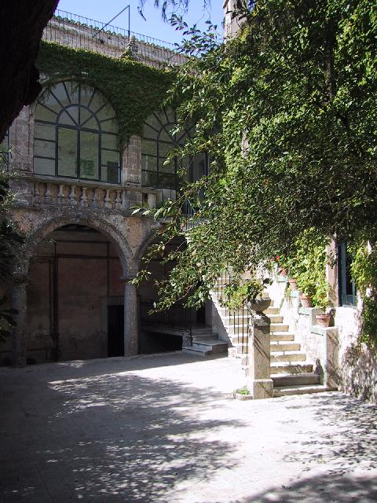
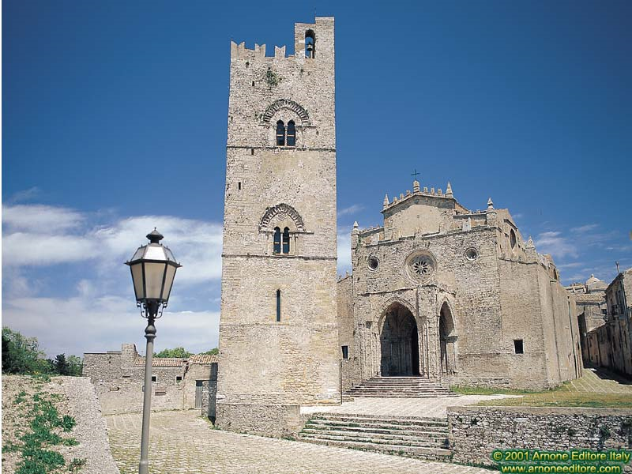
Manufacturing and Testing based on LHC SC magnet production
Lucio Rossi
CERN
Erice
4 May 2013
CERN
Accelerator
School

Slide 2
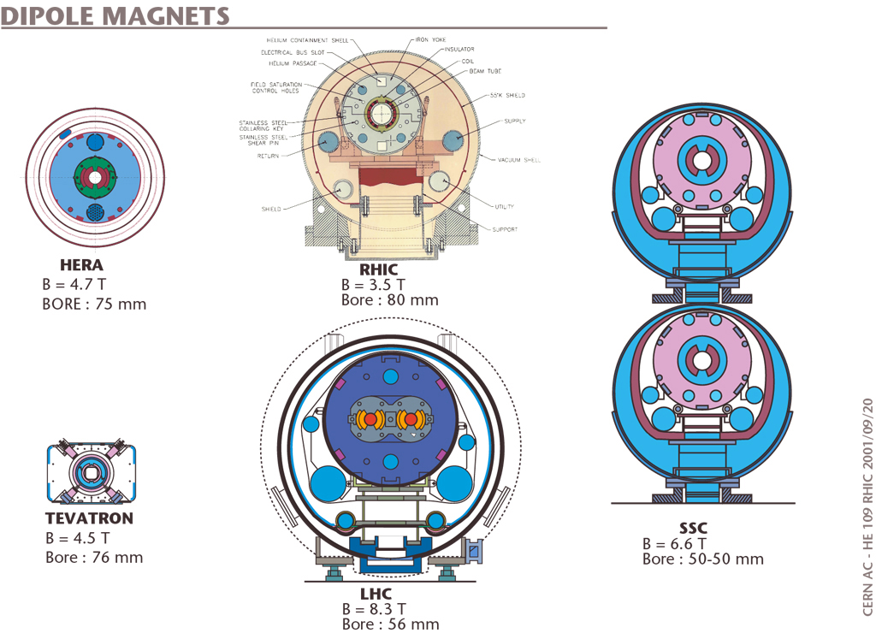
Many projects, different approaches
Various large projects, different approach

Slide 3
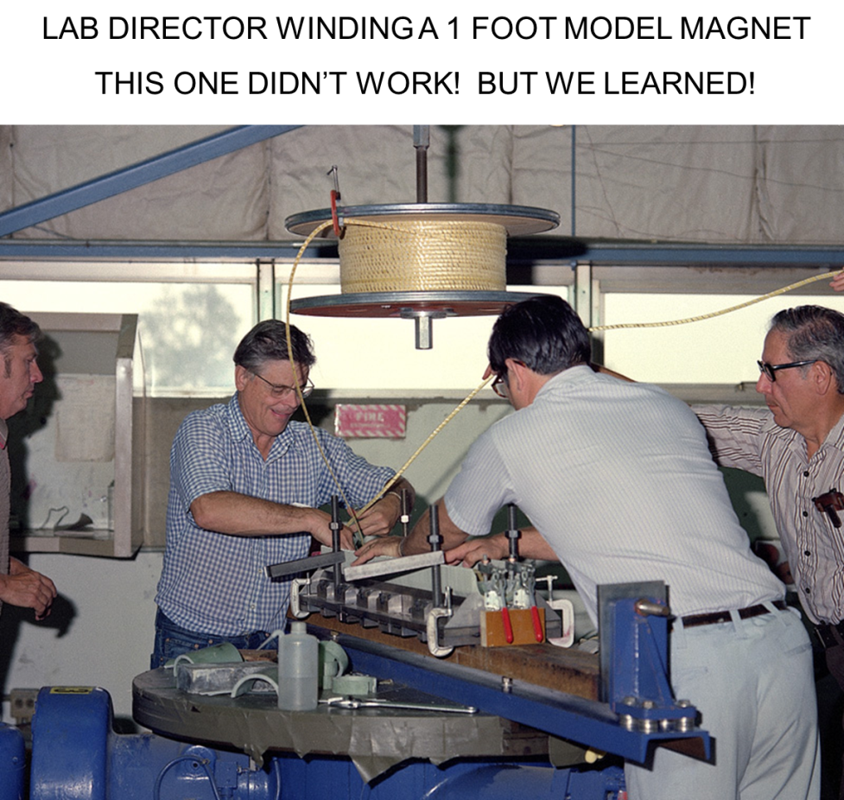
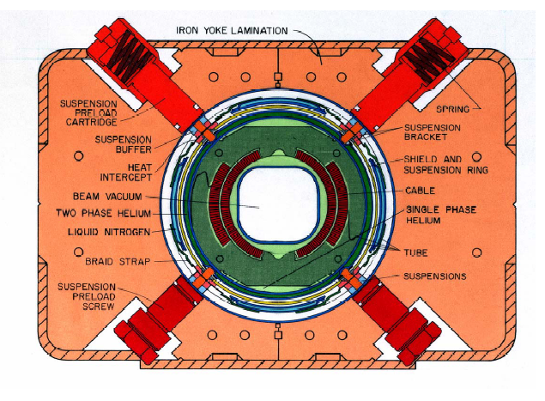
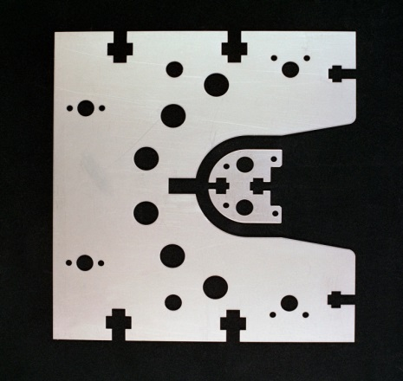
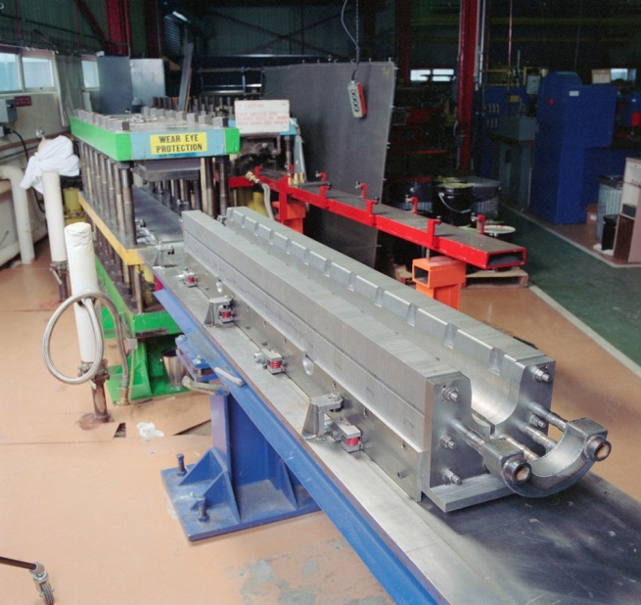
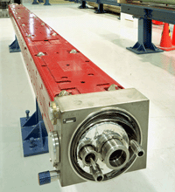
Tevatron (FNAL): all-in-house
(pioneer)
All done in the lab: R&D, tooling, prototyping, series construction and testing

Slide 4
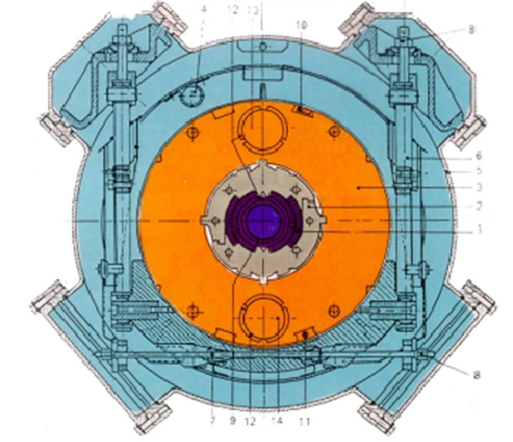
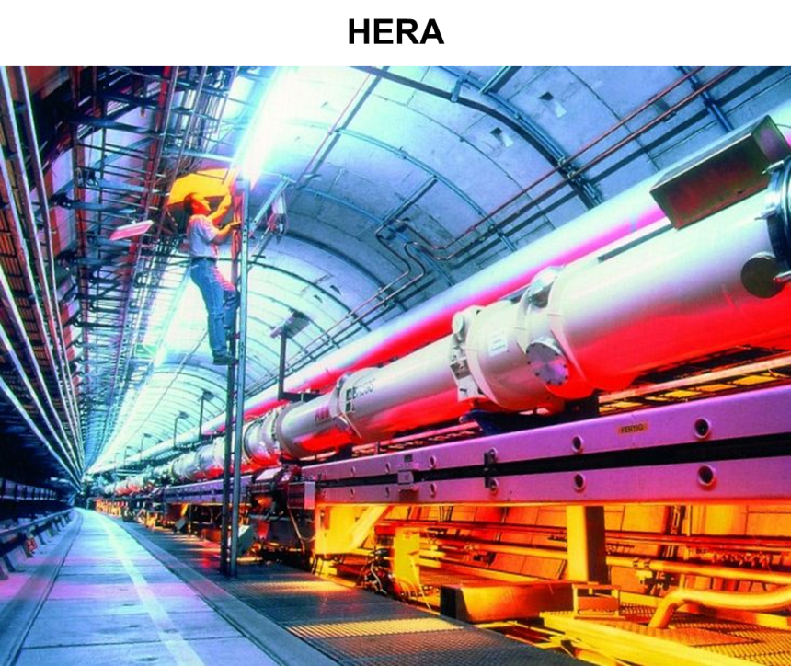
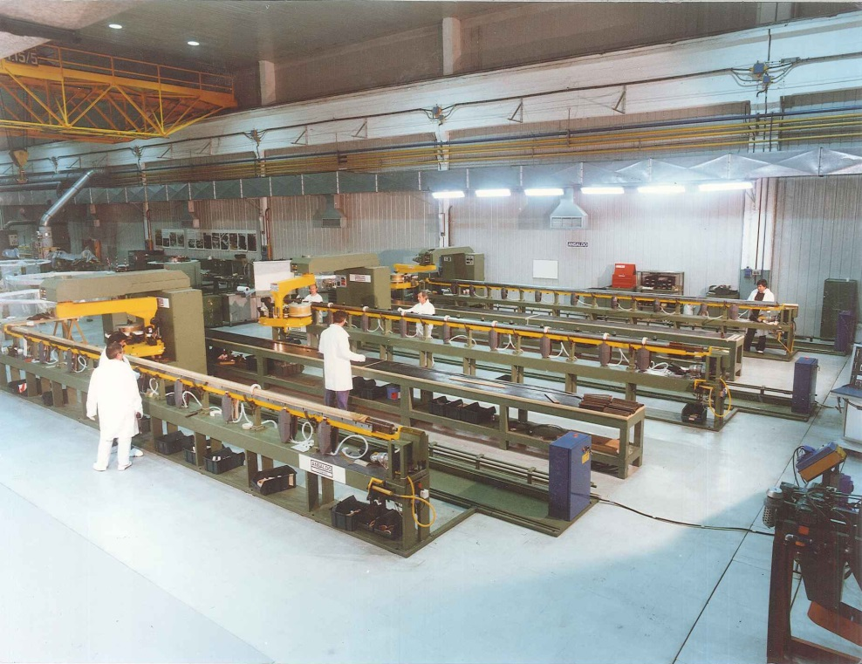
HERA (Desy) : industry based
  416 5.1 T dipoles, 75 mm aperture, 8.8 m long.
  Cold iron collared coil. Free standing Aluminum collars. Following BNL Isabelle and CERN P0
Designed and short prototypes in the laboratory, manufactured all by industry, coil cold test Industry opening the way for RHIC and LHC

Slide 5
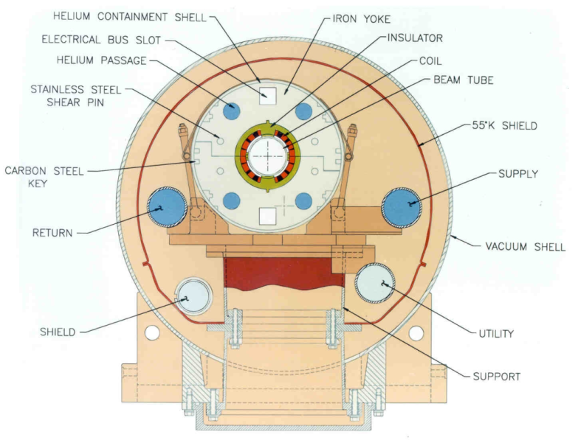
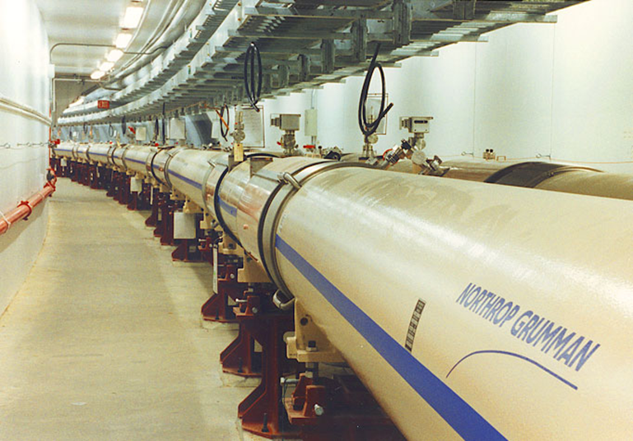
RHIC (BNL): Industry as assembler saving money by keeping responsibility
On the ashes of the 200 M$ spent for Isabelle BNL re-built its future.
Approved during SSC, it was low field-low cost machine for heavy ions (100 GeV p equivalent)
On the ashes of the 200 M$ spent for Isabelle (mainly in civil engineering , i.e. tunnel!), BNL re-built its future.
Approved during SSC, it was low field-low cost machine for heavy ions (100 GeV p equivalent)
3.5 T field
Low cost was really a challenge
Plastic collar (spacer)
Yoke as collars
Field careful design and correction/trim
Perfection in SC and its measurements
Field measurements to steer production

Slide 6
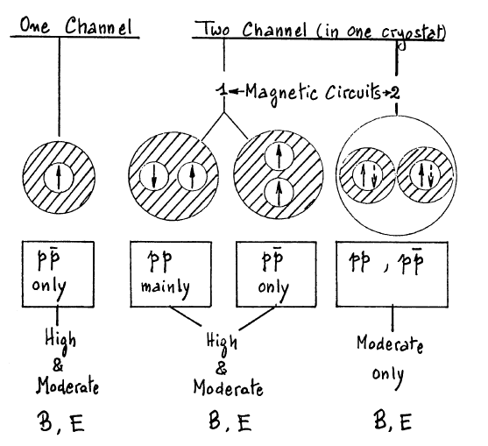
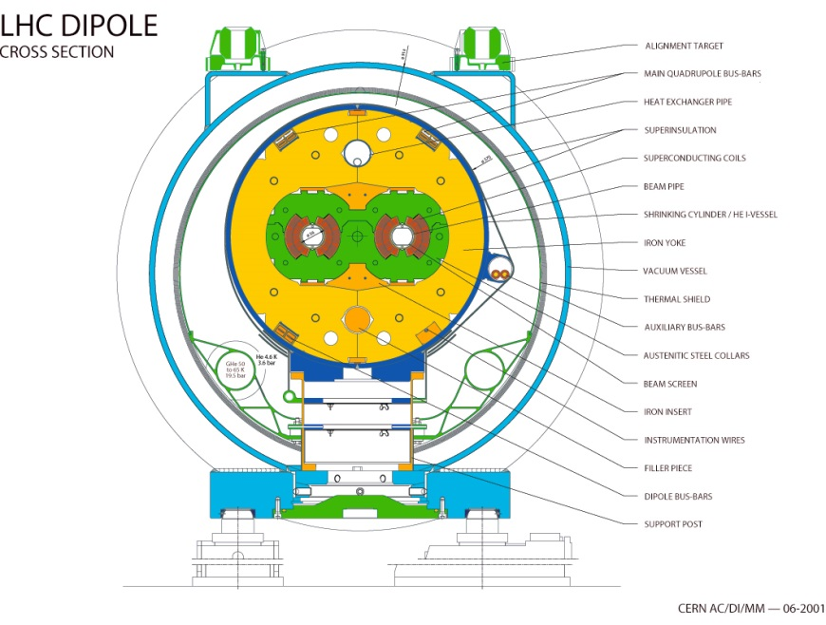
LHC: a long history
1995
I generation
III generation
II generation
1999 - final
1990
1995

Slide 7
LHC
R&D started in Industry!
  CERN busy with LEP200
  First short magnet models (full cross section – 1 m long) all in Industry
    Nb-Ti based on previous project, assessed technology
    Nb3Sn was an innovation just on going on small size solenoid and on a few experimental large coils for fusion
  CERN lab for 1 m operative from about 1991-92
  CERN facility for long magnets (not coils) in 1994/97
  CERN Magnet Facility completed now, in 2013!

Slide 8
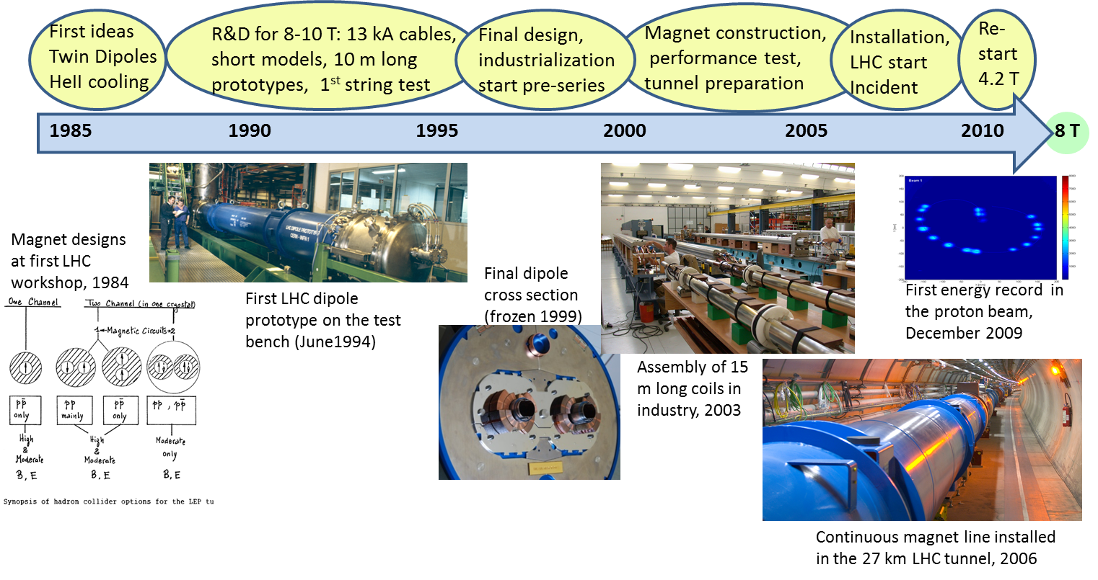
LHC Magnet timeline

Slide 9
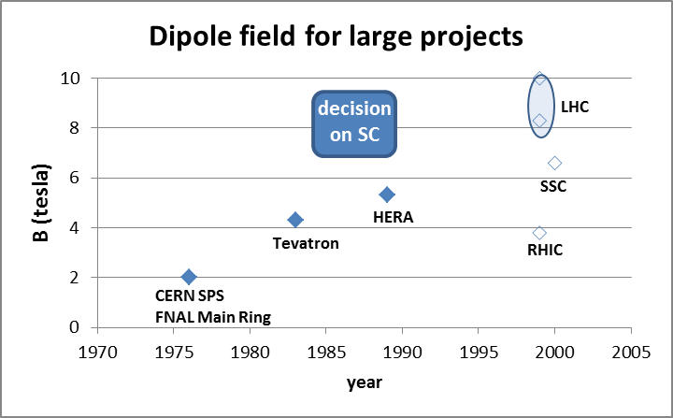
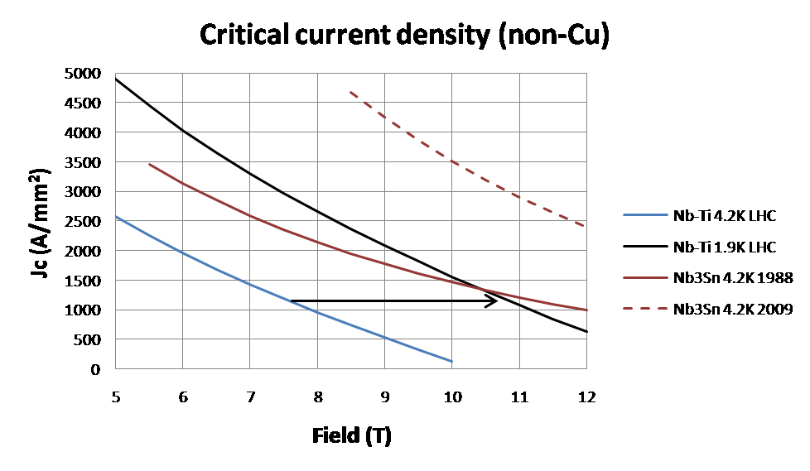
Basic choices -1
Highest field: 8-10 T
  Nb-Ti @ 1.8 K
  Nb₃Sn@ 4.4 K
  Gain in Jc not large
Not an obvious choice in 1985-86
HEII decision very courageous: only one plant, concentrated (Tore Supra)
10 T was too ambitious, could have cost the project see next

Slide 10
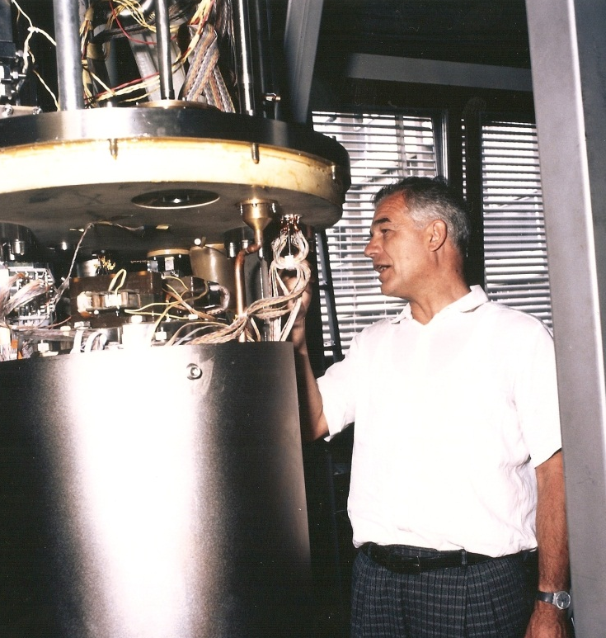
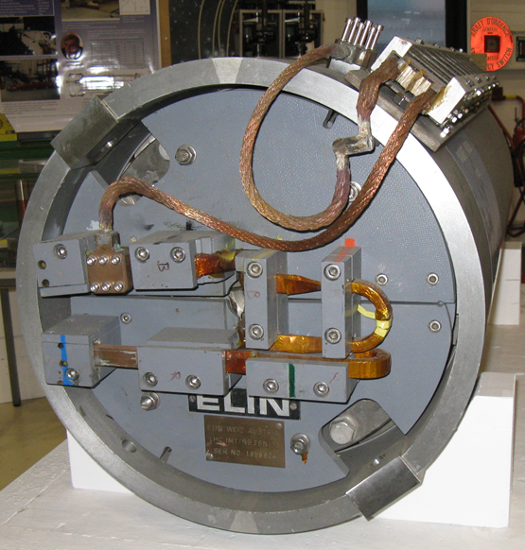
Two routes : Nb-Ti and Nb₃Sn
High field dipole in Nb-Ti (HERA strands). CERN (Perin &Leroy) Ansaldo (Spigo)
8. 55 T first quench, reached 9.3 T at 1.6 K in 1987
Nb₃Sn CERN-Elin dipole (Asner-Wenger & Zerobin)
Reached 9.7 T in 1989: Previously a coil in mirror configursation broke first the 10 T barrier
Decision by 1998: Nb-Ti with HeII

Slide 11
First generation model & prototypes
Development picked up by SSC
(86 km ring in texas halted in 1993)
Issue tackled by CERN program
Fine filament Nb-Ti with high Jc
Nb barrier
Polyimmide insulation
Development of special steel
Analysis systems
10 T range TWIN dipole model
Concept of long 2-in-1 cold mass with HEII cryostat
Putting together the two concepts and make a first long prototypes
Test procedures and tooling as well as components situable for mass production

Slide 12
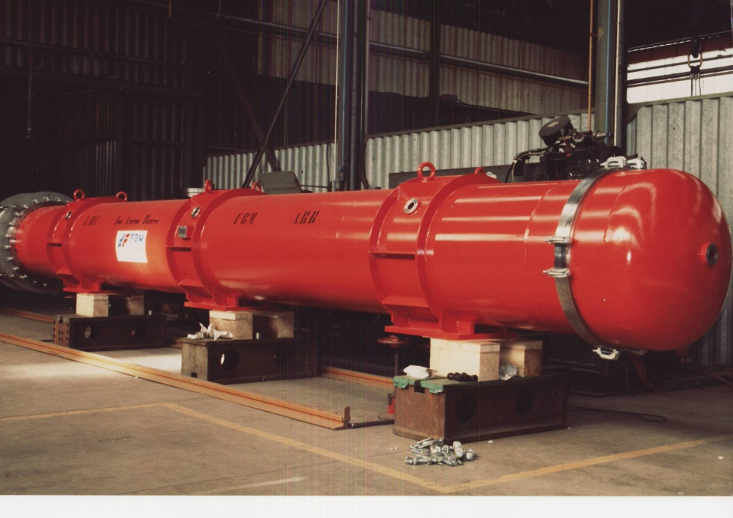
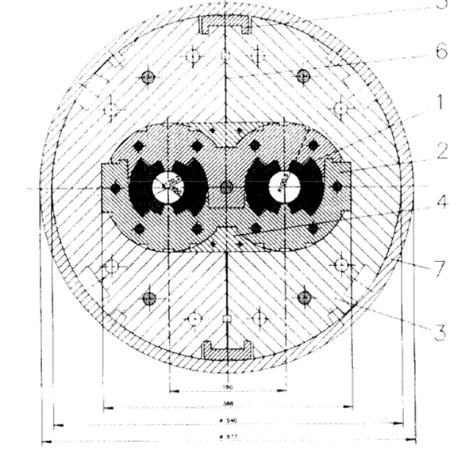
TAP proto and MTA models successful
Work on high field concept (R. Perin, D. Leroy, M. Bona)
Test rapidly the 2-1 concept on long magnet and HE II cryostat
Develop large cable size with small filam. and properties
Test appropriate coil-collar design
Test 2-1 final structure
All in 1 m long models
4 model orders in Industry!
Use of HERA coils from Industry at end of HERA dipole production
TAP prototype all in Industry (Ph.Lebrun, J. Vlogaert)
∅ 50 mm
Al collar
17 mm cable

Slide 13
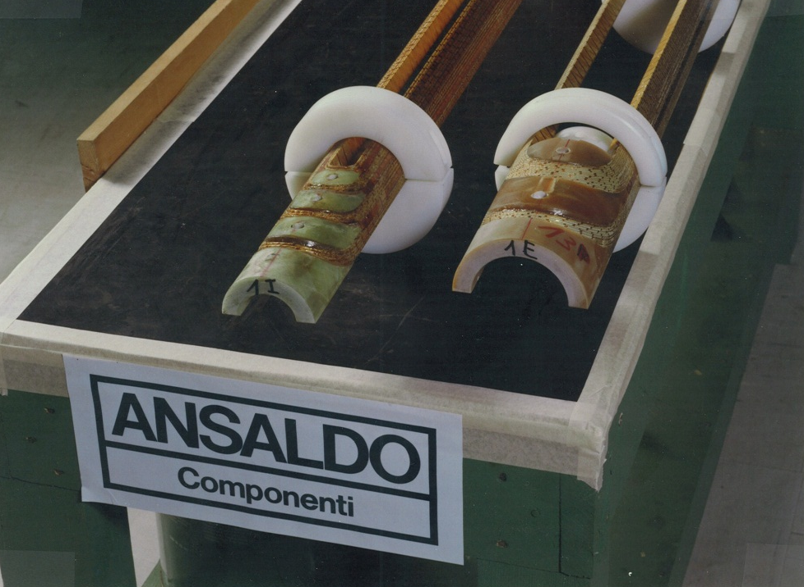
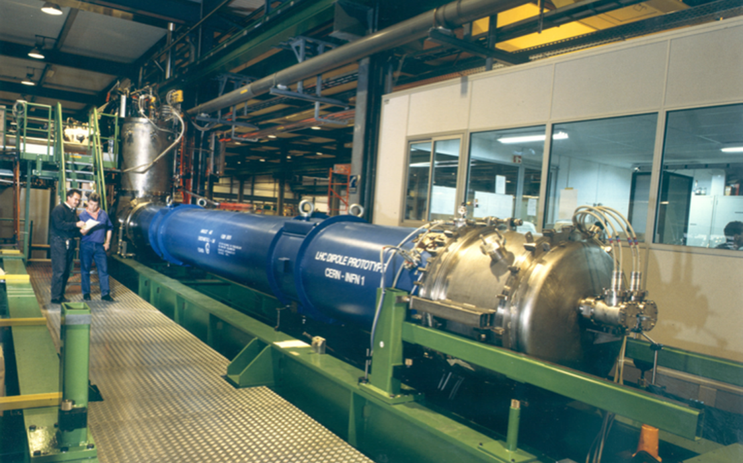
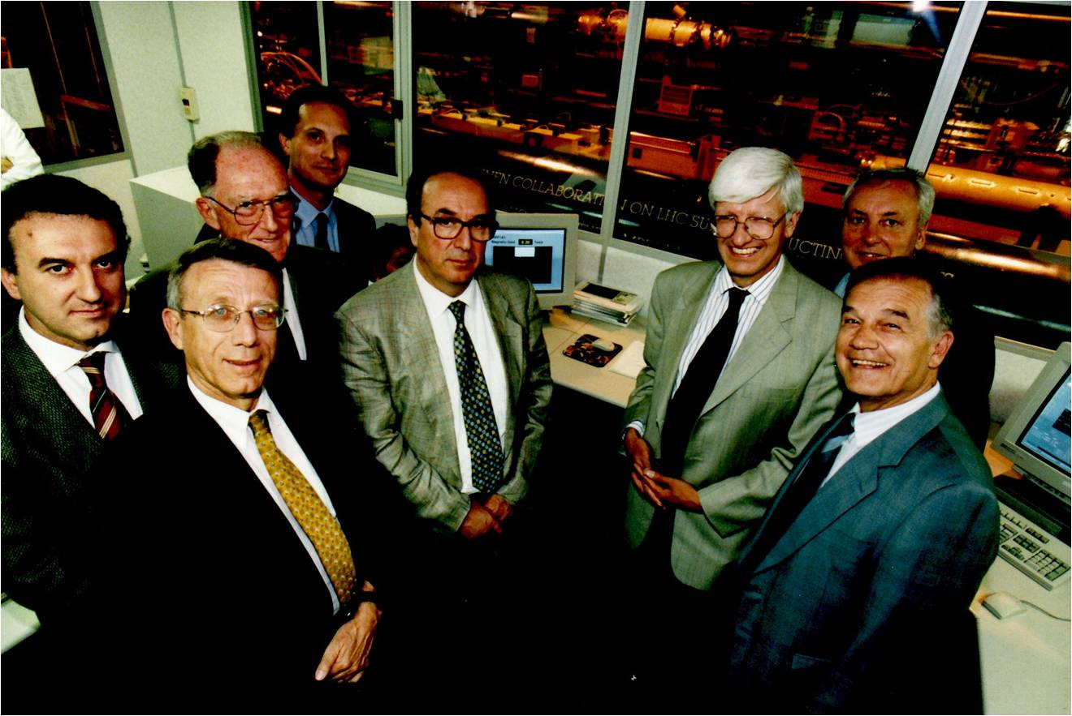
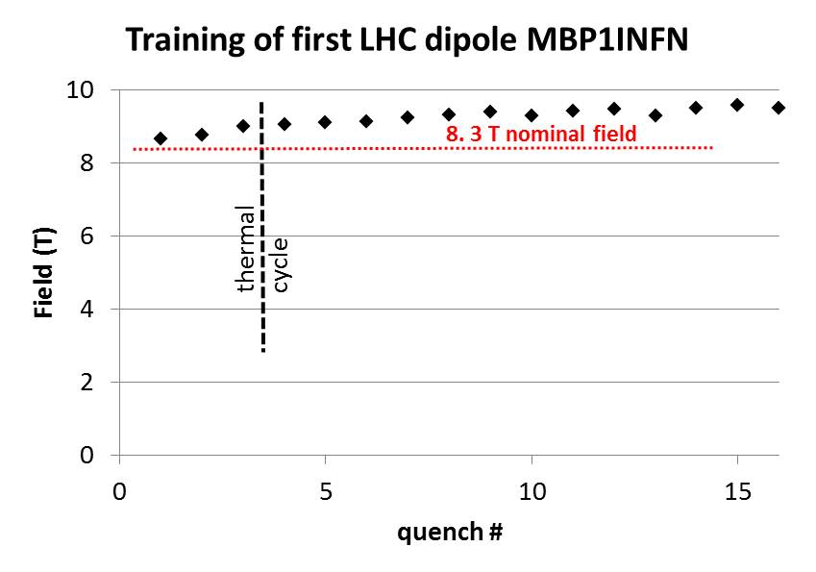
Putting all together 1989-94
First LHC prototypes (CERN-INFN)
First LHC coils arriving!
SSC stop on October 21, 1993
Cost was escalating to 14 B$ (from 4.4 B$ intial).
Spent 2 B$ for civil and tech.
Test INFN-1: June 1994: incredibly good!
String1 : 3 dipoles 1 Quads by end of year
Approval by Council of LHC : December 1994

Slide 14
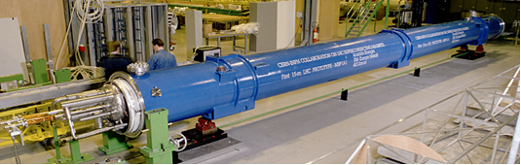
But the design kept changing…
The results of the MTA# short model were good but short of the 10 T flag value: more around 8.5 T and then to 9.5 T with many quenches.
Decision to increase aperture from 50 to 56 mm at detriment of superconductor thickness.
Redesign to «improve» and to lower cost
First 15 m long prototype of LHC dipole

Slide 15
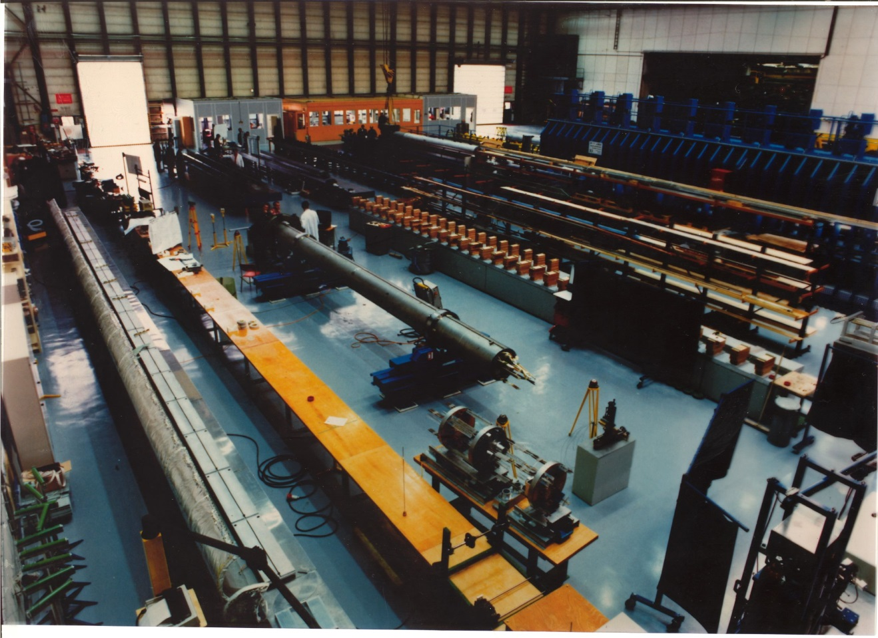
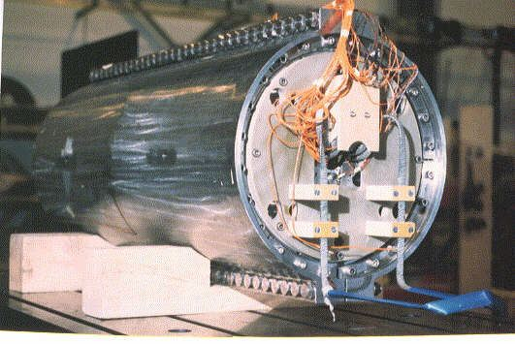
CERN increase internal R&D
Then CERN took over with the short model lab and the MAF (1994-1999);

Slide 16
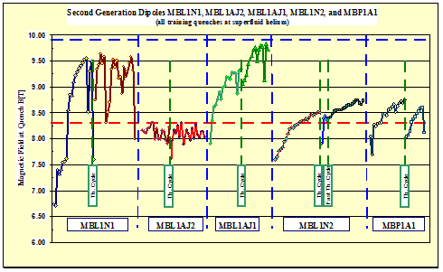
Results form the II generation
(training, de-training, memory, degradation)

Slide 17
But meanwhile the production was under preparation
Change in design (cross section), again
Change in material for collars : Austenitic steel to replace Aluminum alloy.
⇒ No redesign of cross section, just more margin
Keep three companies to preserve
  Competition for the main tender
  Time plan
  Acceptable level of risk

Slide 18
Further step toward CERN ownership
In 1998 tender for 3/8 of the dipole was launched, Generation III (final) was just proved in short model
Too high prices: if extrapolated 300-600 MCHF overcost (only dipole assembly)
The companies were required a responsibility in performance not substantiated by prototype results
Go for only tooling and 30x3 dipoles (preseries for each manufacturers), assigned June 1999.

Slide 19
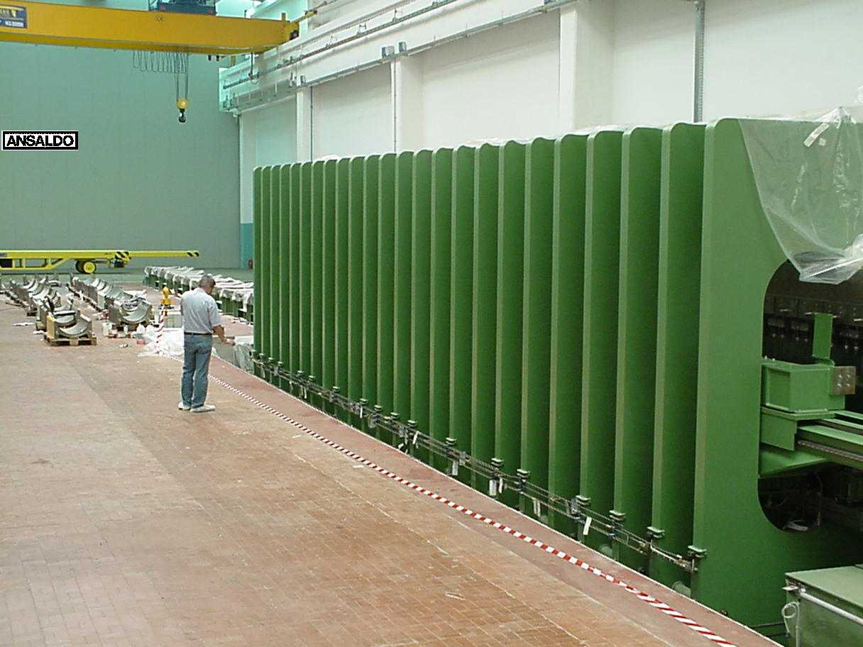
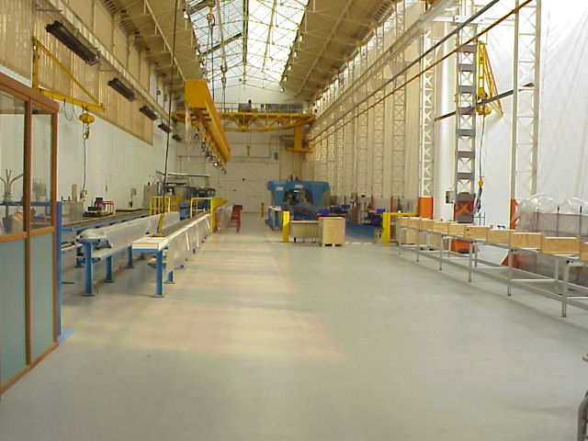
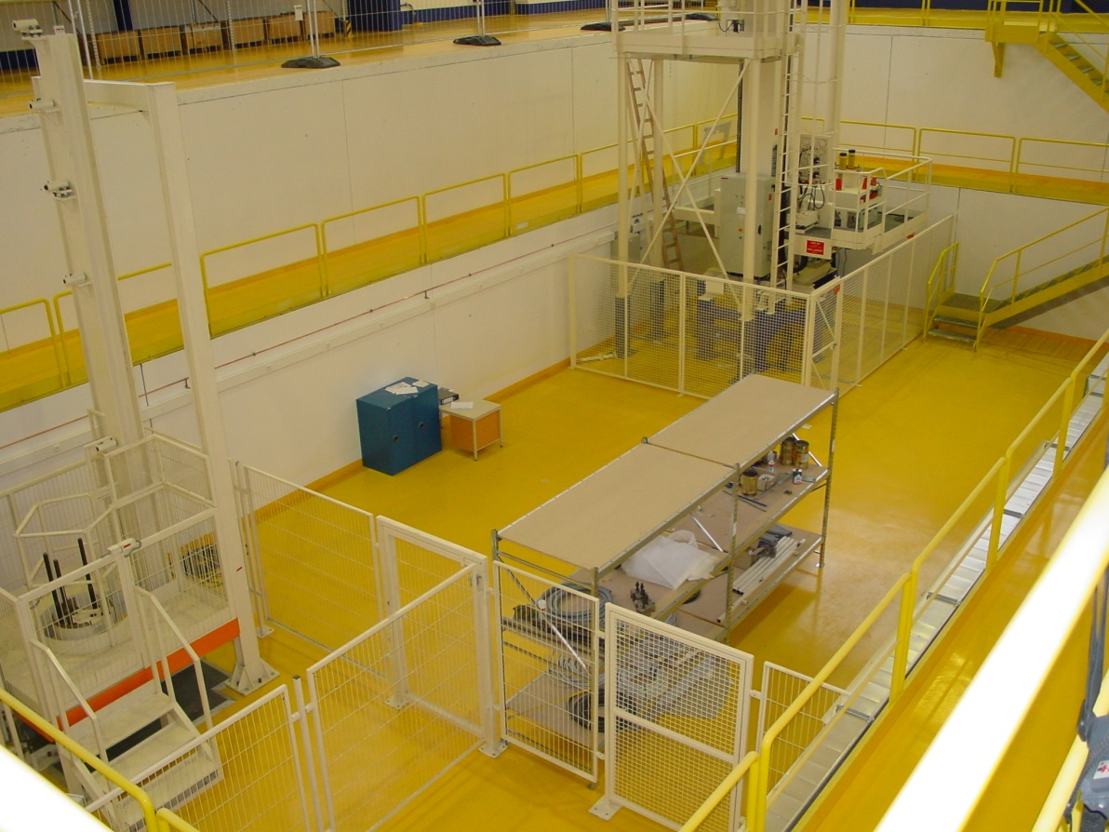
Prototyping phase - III
Overlap with starting industrial production and CERN final R&D (1999-2001): very dangerous!
Transfer of the production to Industry (2002-06)
For quadrupoles: CEA prototypes till 2000 - Industry from 2001
Situation at the end of 2001 !

Slide 20
Long prototyping phase
Industry was ready to produce since the beginning of 1990s, results were good but not consolidated.
cold mass assembly was not optimized yet for mass production; many changes (cable, coil length, long route to st.steel collars, CM welding, curvature…)
Procurements of the components (Superconducting Cables, Collars, etc…) were already on the critical path

Slide 21
Products of main magnets in 10 years prototyping phase
5 MB first generation (String1); all Industry
2 MQ first generation; CEA
5 MB second generation; 4 long CC in Industry + CM at CERN-MAF and 1 full proto Industry;
27 Single and 11 Twin Short models
6 MB third generation (CC in Industry+CM MAF)
3 MQ of second generation; CEA
7 MB pre-series; CC in Industry + CM MAF
From 1997
50 M€/1200 M€ tot
5 years/10 years tot

Slide 22
Construction Strategy
Cost reduction - I
Mixing of industrial construction and R&D and prototyping ⇒ no good
Keep all possible industry in the business from early stage ⇒ good but expensive and resource demanding; rewarding for tendering and after
Procurements of all main components by CERN; this for schedule and for cost reduction; but also flexibility, uniformity (and quality); disadvantage: CERN responsible for everything

Slide 23
Construction Strategy
Cost reduction - II
Set up of particular technologies at CERN and procurement of related tooling
  Coil dimension measurements and analysis
  Collaring press
  Magnetic measurements and analysis
  CM final assembly - Welding technique and welding press
  CM curvature and measurements (Laser tracker)
  MTF (electronic traveller, a very useful tooling for QA and long term documentation) and EDMS data flow management
The final tender was 60 MCHF overcost (wrt to very low price estimate of 1993): success!

Slide 24
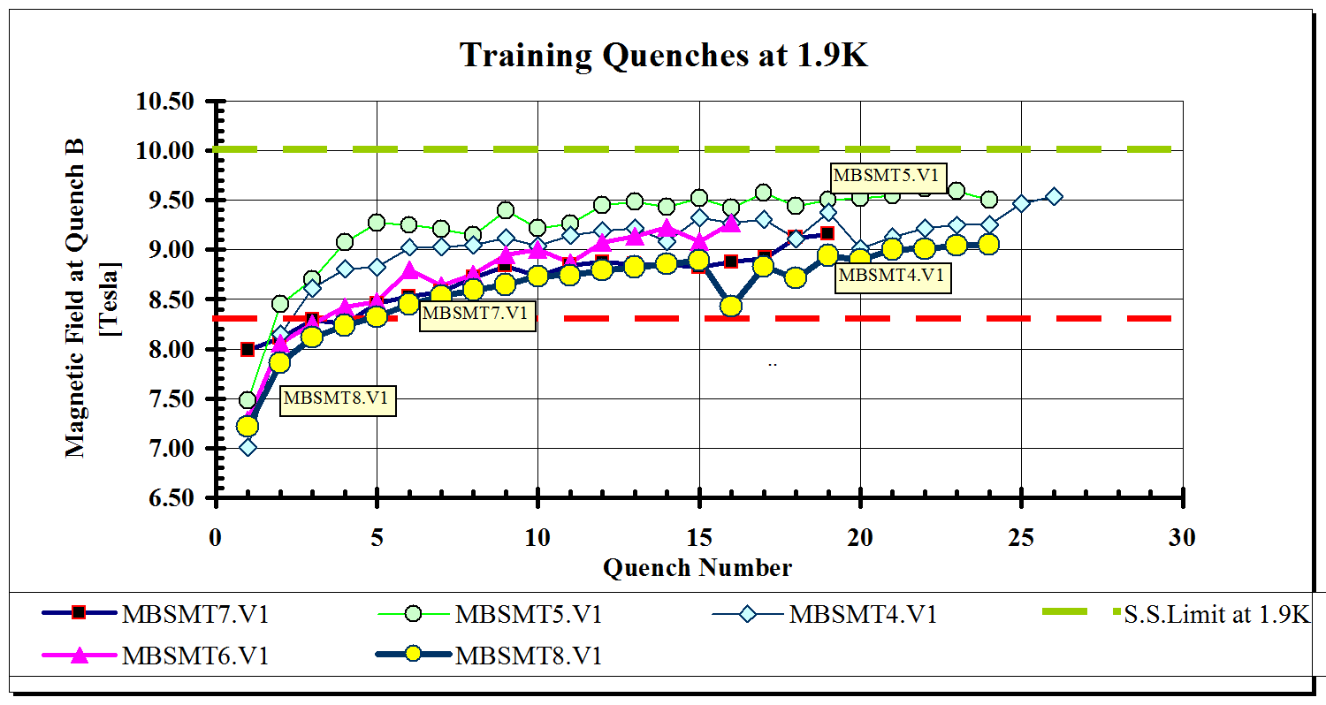
Meanwhile results were stabilizing on 1 m long models

Slide 25
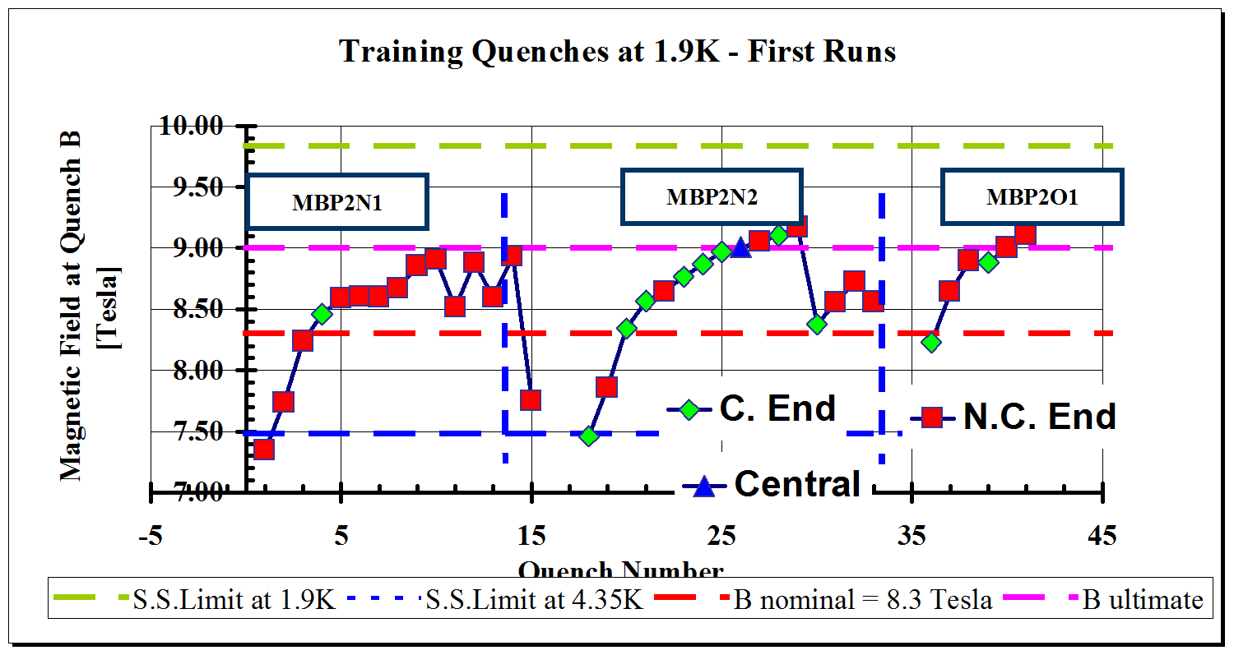
… as well as on prototype
Operational field of 8.3 T, ultimate 9 T

Slide 26
CERN supply
Basic decision around 1996-98
CERN would have supplied
  SC Cable: big tender in 1999.
  All main components: end 1997 all iron for yoke lamination purchesed for all project (70 MCHF!) 1 week after the project approval
  All main tools
  Qualify (by CERN) suppliers of sensitive components of collared coils even in case of procurement by magnet manufacturers

Slide 27
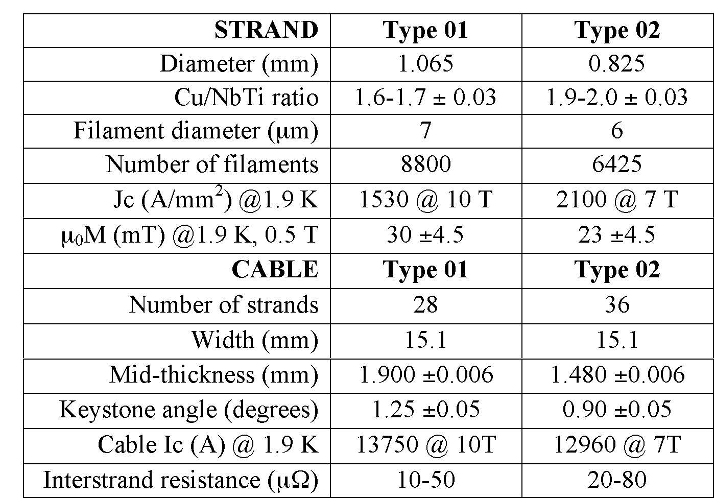
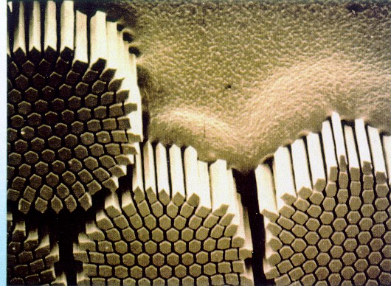
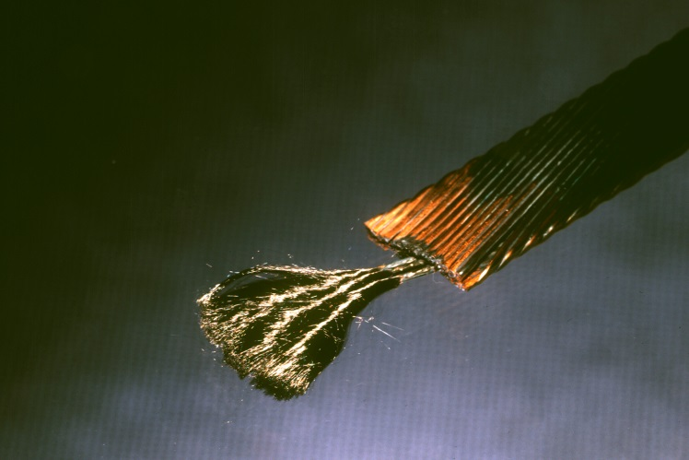
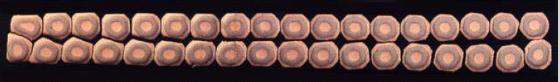
The LHC superconductor
7000 km of Cu/Nb-Ti cable

Slide 28
Critical Current of LHC inner cable

Slide 29
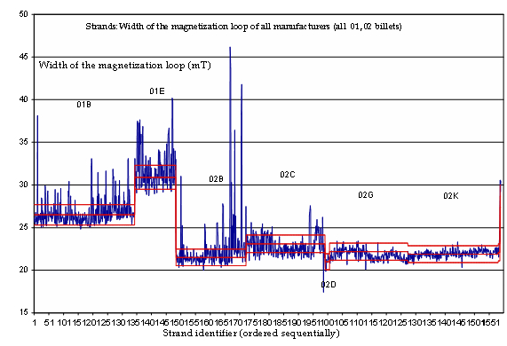
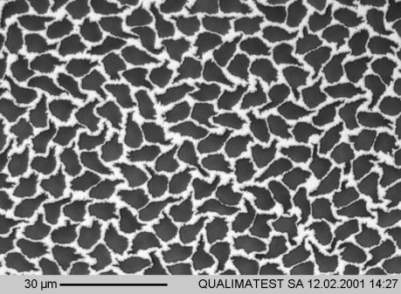
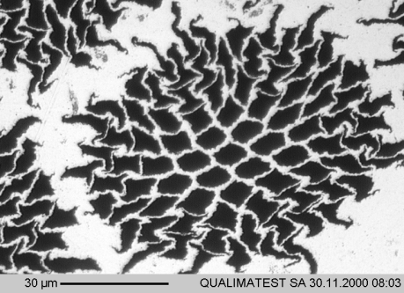
Magnetization for LHC NbTi
Rejection of conductor (few)
Limit in the dynamic range of the magnets
Cable 01B

Slide 30
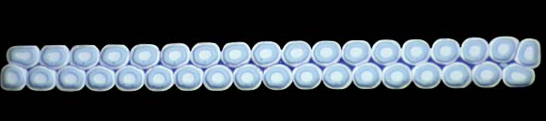
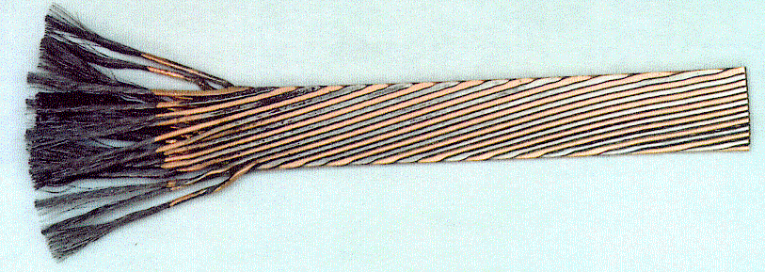
Rutherford cables
Needs for 10-20 kA cable for protection
Needs very high packing factor: 90% !!
Needs a system simple that keep strands
resistive contact R_{c} at cross-over point
The strand are fully transposed
BUT field changes over a period !
Ends problems
Junctions
BICC
⊗ dB/dt
induced eddy currents in the loop I ∝ -dB/dt and I ∝ 1/R_{c}
superconducting path in the strands

Slide 31
Controlling the contact resistance
CERN has developed the controlled oxidation method
Value too low gives field errors
Too high may give instability

Slide 32
Number of tests in 2003 at CERN

Slide 33
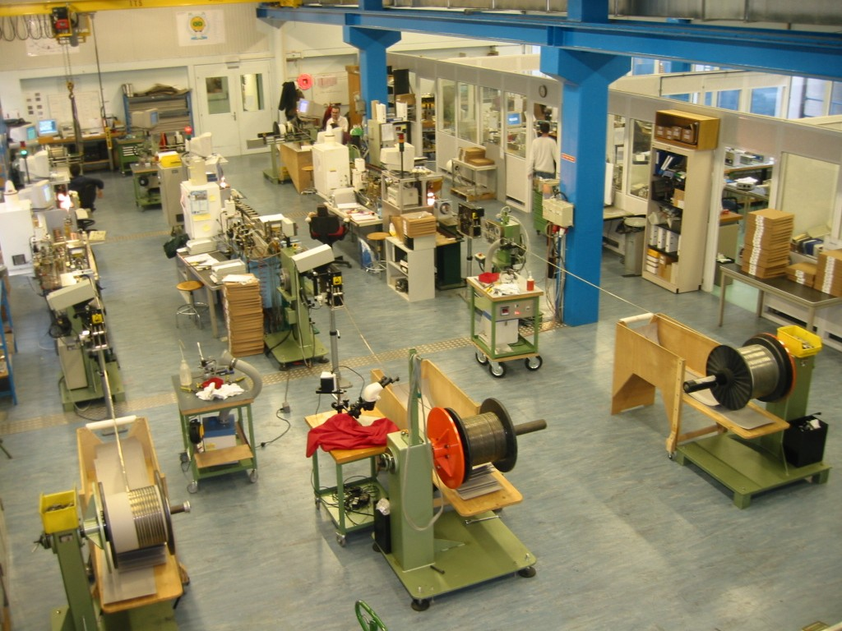
QA: Laboratory Equipment
( 300 K tests)

Slide 34
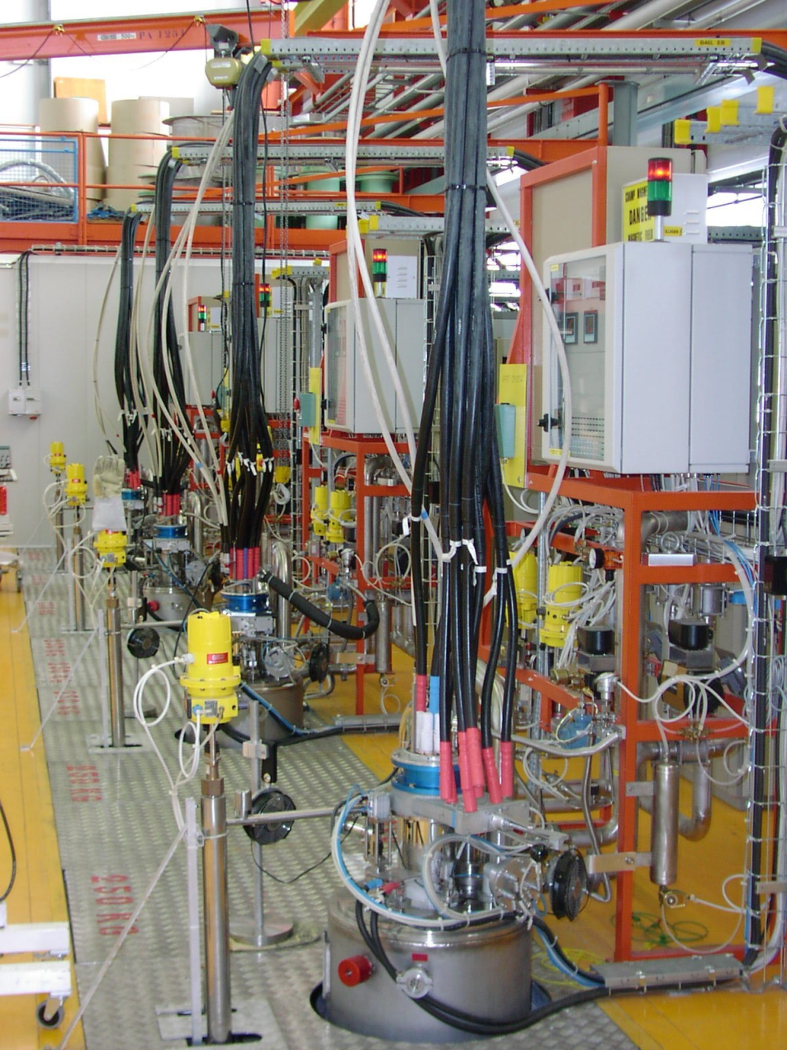
QA: Laboratory Equipment

Slide 35
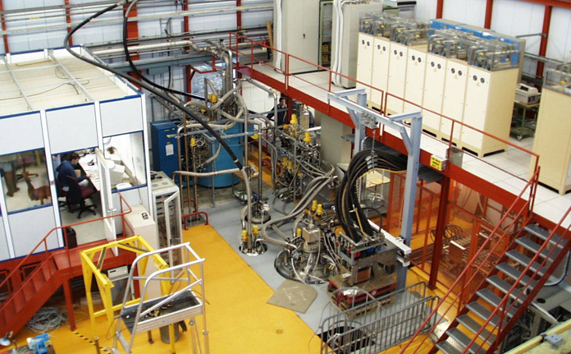
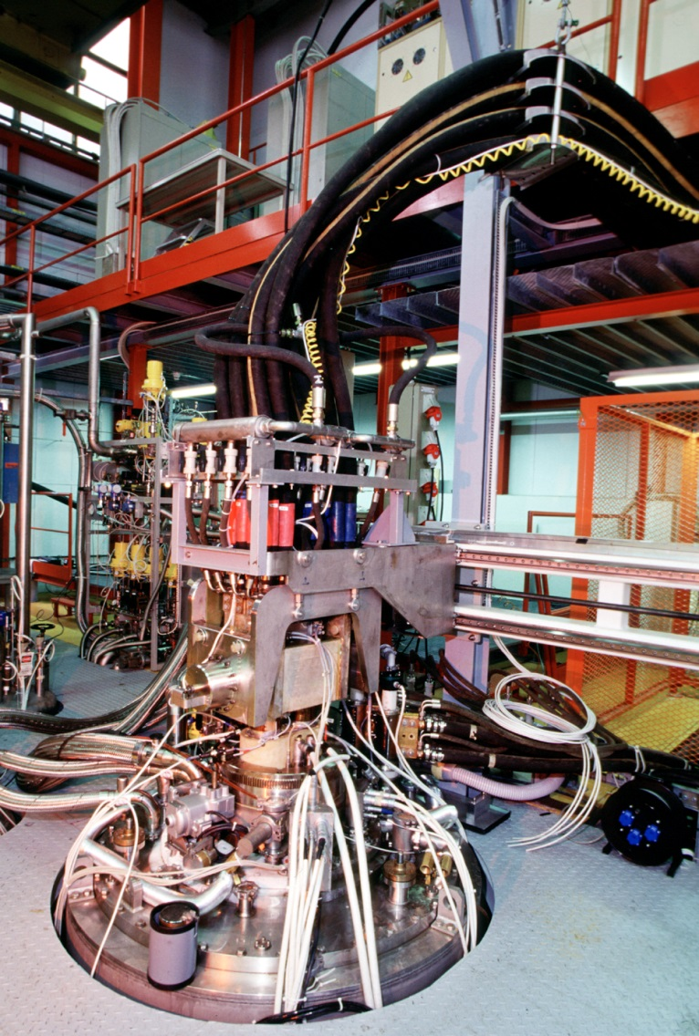
QA : Cable Ic measurements on thousands samples (BNL, CERN)

Slide 36
Cable for main dipoles : delivery striving to keep 3-4 months margins
International permanent review
Multiple suppliers helped: however only a few were really critical for the project

Slide 37
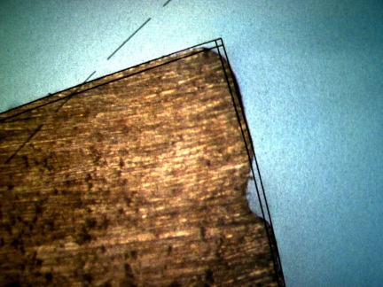
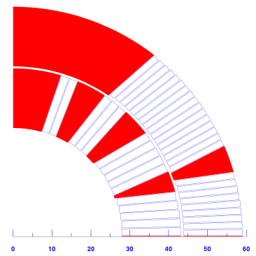



Dipole cross section: cable and copper wedges
±30 µm
Cu wedges
Dipole X-Section
Rutherford cable
Mid-thickness ±6 µm
Key-stone angle ±0.05 deg
Width 0/+80 µm

Slide 38
Insulation and heat removal
Much QA to meke sure that the tapes bond but glue do not block channels!
And to assure gluing in any conditions
1st Layer with overlap (to provide enough surface current path: 200V/cm &
to avoid punch through)
2nd Layer with or w/out spacing and glue on 1 or 2 sides
This translate in about 10 W/m of heat tr. from coil to the bath

Slide 39

Operating point and stability
Jc (A/mm2)
Quench Energy (μJ)
I / Ic
Field (T)

Slide 40


Coils - Winding
Accurate positioning
⇒for quench
⇒for field accuracy
Winding
Curing at 185 °C
3-D: ends. Quasi-impregnation
Shim
0
200

Slide 41


Critical Process
Winding-Curing-Coil
30 µm

Slide 42





Dipole cross section :
Collars
Collars and collaring are the main controllers of the final coil shape Fine blanking of special austenitic strips (μ_{r}<1.005).
Collaring press
> 20 MN/m
700 mm wide
450 mm high
Beam accuracy 20 μm

Slide 43
Steering the production through Field quality
AT-MAS
To get it right we need model that predict position and deformation at the level of 10-20 μm!

Slide 44
QA: Magnetic measurements
Introduced first to steer the FQ toward beam dynamics targets.
E. Todesco,
C. Vollinger
It has also helped to detect a number of defects.
It has also been used to detect subtle electrical shorts

Slide 45





Magnetic Measurements in Industry as ultimate QA
Time lag from construction to cold test
Intercept constructive defects at early stage

Slide 46



Dipole X-sect: regular yoke laminations
One supplier for the steel 45,000 tons (change properties, strikes..)
Two supplier of lamination
precise vertical gap
Sampling! Each lot has been mesured
Temperature probe

Slide 47


Dip X-sect
Shrinking
Cylinder
Outer Yoke
Iron Yoke
Force
Packing rods
Austenitic Steel
Collars
Inclined
Force
Collar/Yoke
Coils
Forces
Iron
Insert
15 m long (14.3 L_{m}), coil aperture 56 mm, and curved (sag is 9 mm)
Correctors are fixed on magnet CM end
Collaring rods
Ft=340 tonnes
Notes:
47

Slide 48


Dipole X-sect: Shrinking cylinder and support
Two half shells, welded on the magnet
One supplier
Many difficulties
Curvature released from ± 1 to ± 2.5 mm:
Solution: pairing
Precise support

Slide 49



3D
Inner layer lyre side
End Spacers: critical for Quench

Slide 50

Dipole -end part end plate

Slide 51

Dipole-end part Bus Bars postioning and connection

Slide 52

Dipole -end part
Shrinking cyilinder

Slide 53


Dipole -end part
Cu HXT

Slide 54

Dipole -end part
Corrector Magnets
From various suppliers
Assembly in CMAs is purely mechanical
(tolerances of B axis wrt mech. frame given by supplier

Slide 55

Dipole -end part
Cold foot, Bellows and N-line

Slide 56



Snapshot at Industry:
Superconducting poles

Slide 57

Snapshot at Industry:
Aperture assembly

Slide 58

Snapshot at Industry: collaring process

Slide 59

Snapshot at Industry:
The Welding Press
3 welding presses, 12 MN/m, aperture (mm) : 2000W x 1500H, 15 m long, beam accuracy 50 mm !!
equipped with new welding technique (STT) for the route pass
With calibrated curved half shells, and proper shaping under press the geometry is obtained in one go
35 km of longitudinal wledin in LHC: not one leak!

Slide 60





Snapshot at Industry:
Cold Mass
Laser Tracking measurements

Slide 61

Snapshot at Industry:
Cold Mass waiting

Slide 62

Snapshot at Industry: delivery to CERN

Slide 63






Snapshot at Industry:
MAIN Quadrupole

Slide 64

More than 6000 of various corrector magnets
MCDO
Decapole
Octupole
Magnets
MCS
Sextupole Magnets
MO
Octupole
Magnets
MQSXA
Quadrupole
Octupole
Sextupole
Magnets

Slide 65
The way to control production
Have clear what you want to buy and pay for
  B field/volume/homo
  Or Assembly on your design/tool/components
  Something in between
Tech. Specs,
definition of the ITP (Inspection & Test plan): the final step is test, even for turn-key
Follow up visually!
Audit: very good to find out reality and to avoid drift…

Slide 66
2. QA/QC structure, documentation and organization :
QA audit
 | ☺ | 😐 | ☹
Jeumont |  |  | Very good system in place, but structure not correctly sized (missing staff)
Alstom |  | System correctly sized and in place, documentation very good and normally correctly filled.
Ansaldo |  | System correctly sized and in place, documentation very good and normally correctly filled.
BNN | System correctly sized and in place, documentation very good and correctly filled.

Slide 67
5. Specific WEAK points at each site:
QA audit
 | ☹ | ☹ | 😐
Jeumont | Missing QA staff and night shift supervision Assembly Reports to be ameliorate (missing data) | -Tooling industrialization - Tooling traceability - Missing buffer of poles that impacts on QA rules | - Clean area preservation - Some QA doc to be improved (CoC to Alstom etc.)
Alstom | - QA rules sometimes not correctly followed (signatures on MFD) | - PV→ NCR - Tooling traceability - Minor tools maintenance | - Cleaning condition during ground insulation forming
Ansaldo | Official Responsibility of operators not clear QA rules (MFD sign.) | Tooling traceability - Components Incoming Inspection and Storing | - Some manufacturing procedures to be updated - Curing Press alarm
BNN |  | - QA rules (MFD signatures for shim approval) | - Rejected end spacers identification

Slide 68

LHC dipole complex structure
Concept applies for small cosntruction, too

Slide 69


The cold bore tube to welding flare fillet weld
The requirements
He II
Insulation vacuum
Beam vacuum
Ins. vacuum
He II
Ins. vacuum

Slide 70


Inspection at CERN – First case discovered in SMI2
1137
  Delivery: 9.07.04
  Cryostating: 12.07.04
  Cold tests finished: 24.07.04
  Storage: 11.08.04
Storage after cold tests: from 11.08.04 to 25.11.04, i.e. > 3 months
NCR opened, see LHC-MB-QN-CR-1137-SMI2-AGR-01, EDMS 532734
After verification at the CMA, we discovered that they were not using the backing gas, thus violating the approved WPS and WPAR (about 150 cold masses affected)
3 days

Slide 71


Visual defects observed in the Main Quadrupoles
Also pointed out during the Quality Audit in April 2005, see Audit Report AT-MAS/MM 7683
We also discovered that the CMA was using a high speed machining grade (higher S content) for the welding flare made out of AISI 304L

Slide 72

MTF
All relevant data were uploaded into the Manufacturing and Test Folder (MTF), an electronic data management system designed and implemented for the purpose at CERN
In total, 3383 non-conformities affecting 1274 cold masses were reported for the 3 CMAs

Slide 73

Superconducting LHC dipoles: the long route
1988-98 short models and six prototypes for each of the three generation design were built by industry/CERN
1999: 3x30 pre-series magnets were ordered from three firms.
Three contracts for the fabrication of 1146 (+30 spares) magnets have been signed March 2002 – End Nov 2006

Slide 74
Integrated supply chain management
CERN took care of most components
and of tooling for construction and measurements
Benefits
Technical homogeneity
We know what went inside and how was measured
Quality assurance
Economy of scale
Security of supply
Balanced industrial return
Risks & drawbacks
Responsibility interface
Additional workload
Liability for delays (just in time!). In one case we had to pay 5-10 MCHF extra!
Transport, storage & logistics: we have moved 120,000 tonnes around Europe (5 TIRs a day for 5 years)

Slide 75


LHC components
& industrial products
Industrial production
Art!
Courtesy of Ph. Lebrun

Slide 76



90 main supply contracts worldwide
Europe in details

Slide 77

Personnel training in Coil production
Courtesy of Jeumont, France

Slide 78

Log Linear model learning curves: FIrm 3
Fit: Crawford model
Collared Coil production: 800-1000h
Cold Mass Production: 500-1000h

Slide 79

Dashboard: simple methods are very useful!
Rebaseline

Slide 80


Slide 81






LHC Superconducting Magnet Test Facility
Facility was completed and fully operational in May 2004: too late!
Testing is part of construction!

Slide 82

LHC Superconducting Magnet Test Facility
The test facility consists of 12 fully equipped test benches arranged in 6 clusters which can run independently
All test benches are capable to operate, both at 1.9 K and 4.5K
Cryo-magnets can be equipped with anticryostats & shafts for:
  Magnetic Measurements
  Quench Localisation
Over 3 years operated round the clock for 11 month per year

Slide 83
Criteria for acceptance of the
Quench Performance
First training
  8.3 T (nominal, 86% of load line margin) ≤ 2 quench
  9 T (ultimate, 93% of load line margin) in ≤ 7 que.
Second training (first dipoles and then only the bad ones)
  No quench for nominal
  3 quenches for ultimate
Bonus (1%) for magnets going to 9 T with ≤ 3 q.
MORE THAN HALF WERE BONUS !

Slide 84


Backlog and revision of criteria

Slide 85
Dipole performance today
Only 2.5% rejected
Half for quench half for electrical NCs (QH)
Except 1, all repaired successfully

Slide 86
Quadrupole even safer
Summary of quench performance for 306 arc SSS tested (08-08-06)
180
170
160
150
In average each SSS
140
needs 0.61 quench to
130
reach the nominal
120
(excluding SSS277)
110
100
90
Number of SSS
80
70
60
50
40
SSS277
30
20
10
0
No quench
to nominal
One quench
to nominal
Two quenches
to nominal
Three and more
quenches to nominal
Nominal
not reached

Slide 87
















Magnet work flow at CERN before beam test
6 superconducting bus bars 13 kA for B, QD, QF quadrupole
20 superconducting bus bars 600 A for corrector magnets (minimise dipole field harmonics)
Arrival CM
Reception
Cryostat
Cold test
To be connected:
Beam tubes
Pipes for helium
Cryostat
Thermal shields
Vacuum vessel
Superconducting
cables
Reception
Cryostat
Cold test
Arrival CM
Beam screen
Store
4 areas
Extra-work
(30% dip)
Stripping
Fiducials
Beam screen
Store
4 areas
Extra-work
(30% dip)
Stripping
Fiducials
13 kA Protection diode
Store
limited number
Tunnel
Alignment
Connections
Store
limited number
Tunnel
Alignment
Connections
1st dipole lowered : 7th March 2005
Beam test
Hardware Commissioning
Beam test
Hardware Commissioning
42 sc bus bars 600 A for corrector magnets (chromaticity, tune, etc….)
+ 12 sc bus bars for 6 kA (special quadrupoles)
December 2007
Start January 2007

Slide 88


Drawback as opportunity: delays in installation allowed sorting!

Slide 89


Troubles found in Commisioning-1
Symmetric quenches: when detected, after a quench at 6.5 T, it was decided to limit field until new QDS was installed
Inductive voltage differences
Diode box act as sink for all metallic pieces

Slide 90



Problems in commissioning – 3: bus bars shorts
On the left side of the interconnection QBBI.A21R7, at around 1.3 m there is a dipole magnet and the bus bar lyra.
Fault localization

Slide 91
Quench performance in the tunnel
We pushed magnets to high field in only one sector: symmetric quenches a
In a sector we had the time to push to 11200 or 7.7 T (95% of nominal field )
above 7. 4 T we found unexpected training, i.e. lack of memory.
Mainly one family of magnets, that were the best at acceptance test to 9 T !!
LHC to its nominal we need 3-4 months of dedicated time; Restart at 6.5/ev
Analysis by E. Todesco

Slide 92



Electric splices (13 kA) in the magnet interconnection

Slide 93

Failure: 260 nΩ instead of < 1 nΩ run away at 8900 A on 19 Sept 2008
QA did not intercept this: actually critical steps were removed to comply to time schedule; toling that could detect this were ready at end production
Cryogenic measurements carried out in stready state at 7 kA were overlooked
QPS was absolutely inadequate (now 10,000 better).
System was not analyses despite international reviewed and ealry warning in the proper body

Slide 94
Protection scheme
Switch to activate R2
Switch to activate R1
Dumping resitor R2
Dumping resitor R1
Protection scheme of the LHC magnets. Magnet coils are series connected and by-passed in case of voltage raise ba a by-pass diode. The path of the current is shown for the case of one quench (dipole 4 in the picture) after about 1 s, when all curent has abandoned the quenched coil. The current is passing through the dump resistor , however in the whole circuit it is still very near to its initial value. Decay time of the circuit is 104 s, the Bus bars have quench integral >> a single magnet.

Slide 95


Electrical arc between C24 and Q24
V lines
M3 line

Slide 96


Collateral damage: magnet displacements
QQBI.27R3

Slide 97


Collateral damage: magnet displacements
QQBI.27R3
N line
QQBI.27R3
V2 line

Slide 98


Collateral damage: magnet displacements
QBQI.27R3
Bellows torn open
QBBI.B31R3
Extension by 73 mm

Slide 99

Collateral damage: ground supports

Slide 100
Beam vacuum contamination all along 3 km!!

Slide 101



We have plenty like this : so run at limted current (60%)
LHC stop 2 years to consolidate
Defective interconnetion-bus bar transition
γ-ray picture (left) and scheme (right)
Interconnection joint
Bus bar from magnet
Interconnection joint
Bus bar from magnet
Sc cables from left side magnet
Sn-Ag filler
Sc cable from right side magnet
QQBI.A23R3-M3-lyra-QRL
Gaps with lack of Sn-Ag filler
This was clear only 5 months after the incident !

Slide 102
Conclusion & Lesson learnt
LHC had a technical failure in a relatively low tech part
All high tech parts
  SC cable with all properties constraints
  SC Magnets
  HTS current leads
  1.9 HEII cryogenics
  SCRF from LEP technology
Have worked successfully.
Especially the SC part went really on time and on budget which is a success of applied superconductivity and shows its industrial maturity.
The failure was primarily due to a mistake, but:
It has evidenced deficiencies in :
  Basic design of IC splice
  Lack of robustness of manufacturing process wrt series production
  Diagnostics (QPS)
The lessons for me are:
  In SC devices, everything has to do with superconductivity! We should inject more science in the engineering
  Scientists should work more with system engineer. Lack of integration (and adequate risk analysis) may cause large damage to SC part.

Slide 103


Even at 60% energy LHC and SC have done the job: Higgs boson got!

Slide 104

With the new SC magents and SC (crab) cavities for Hilumi and HiEnergy LHC, superconductivity may reveal…
A SuperWorld ahead of us !

