Slide 1
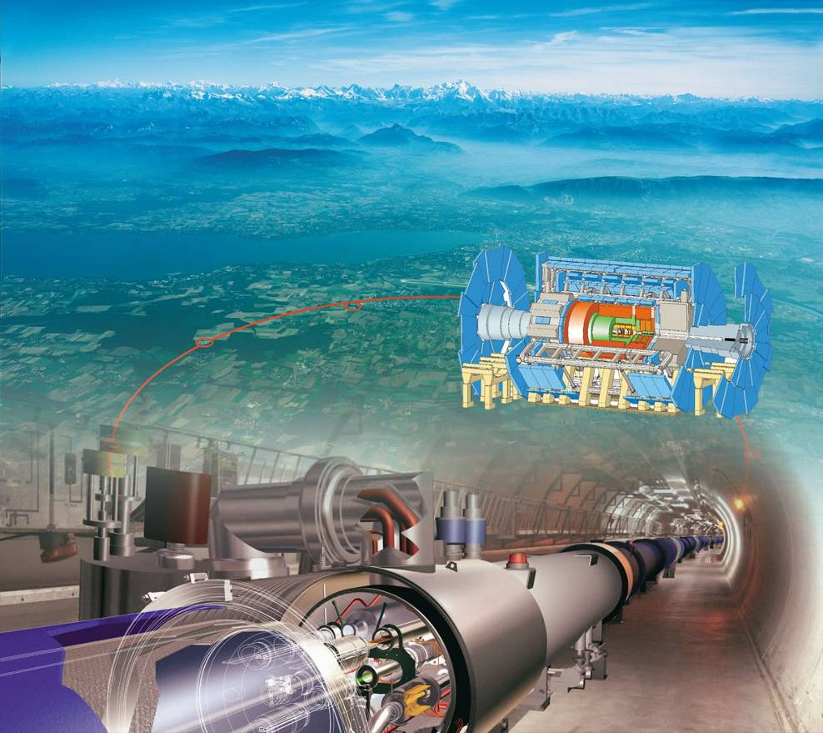

Slide 2

Superconducting Magnets
Quench Propagation and Protection
Herman ten Kate
CERN Accelerator School on Superconductivity for Accelerators, Erice 2013

Slide 3
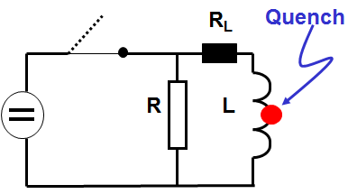
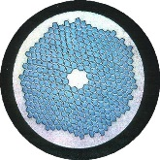
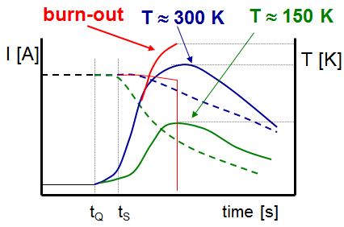
Quench Protection, what for?
  Superconducting coil running at 2 or 4 K, what can go wrong ?
  Assume coil in a circuit with power supply, switch and resistor as usual.
  Quench, transition to normal state in a hot spot larger than the MPZ.
  → ρJ² heating in the matrix and stabilizing material > temperature raise quickly.
  Now a resistor is needed to bring the current down.
  When not done fast enough, or too late, the temperature will go too high, the coil is damaged or dies….
  How to control this process ?

Slide 4
Content
Why does a magnet quench
Stored energy and enthalpy
Adiabatic heating of coil windings
Controlling the decay times
Normal zone propagation
Safe hot spot temperatures
Protection schemes
Quench detection
Case ATLAS 1.5 GJ Toroids
String of magnets
Case high field accelerator magnet
Conclusion

Slide 5
Definition
Quench in a superconductor:
A sudden, unexpected and unrecoverable transition to the normal state of the superconductor in the device (magnet, bus bar, current lead, transport cable, generator, motor etc.),
which enforces the conversion of the stored energy into mostly heat, which can lead to destruction of the device when not properly controlled.
Quench protection:
The art of preventing damage of any kind to the device (magnet) or its services after a quench.

Slide 6
1. Why does a magnet quench ?
Note! A quench, though not wished to occur, is part of “normal operation” of a magnet and has to be explicitly designed for, also for safety.
Internal to the magnet:
  Lack of stability (design mistake), transients, training phenomena like wire movement, resin cracking, shearing on coil windings.
  Accidents, design or manufacturing flaws, helium leaks in cooling pipes, connections, leaks in vacuum parts.
Failing or not appropriately designed magnet services:
  Control system down, false triggering of quench detection system, power cuts, loss of cryogen, refrigerator down.
External to the magnet:
  Radiation, damaged cryo-lines or vacuum lines, sensors, valves, flow meters, bus bars; earth quake; sabotage.
Solution?
  You do not want to lose your magnet, so quench protection is mandatory!

Slide 7

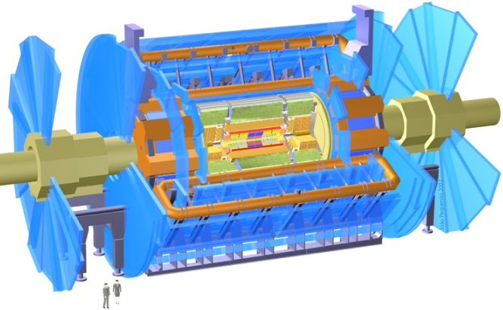
Destructive power of an uncontrolled quench
LHC dipole of 15m and 8.35T stores 8 MJ, which corresponds to melting 1.5L of copper, enough to evaporate 10cm of coil !
And we have seen in Sep 2008 what a few magnet quenches can do!
http://www.youtube.com/watch?v=1R7KsfosV-o&feature=player_detailpage
ATLAS detector toroid stores 1.6 GJ, good for 600L of melted copper, or equivalent to the collision energy of 100 trucks of 40 tons with speed of 100 km/h!
To be safe with equipment and personnel,
Quench Protection has to cover all possible quenches in the entire electrical circuit from + to – terminal on the cryostat (current leads & bus connections & coil)
Damage at an LHC interconnect

Slide 8
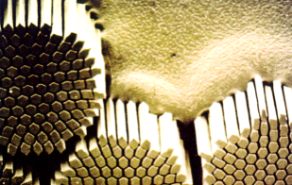

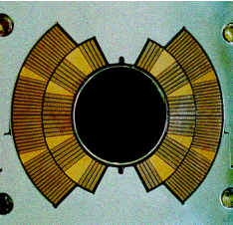
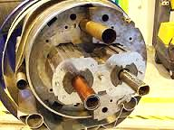
2. Stored energy to dump
  The energy stored in a magnet with current I is
  E_{L} = ½ LI² = 1/2µ_{o} ∫ B²dV [J],
  the energy density being ½ BH or B²/2μ_{o.}
  After a quench (superconductor in normal state), the current is forced to flow in the low-resistive section of the conductor, the matrix in the wire.
  This energy could be absorbed by the enthalpy of the magnet coil windings m up to a safe peak temperature T_{m}
  E_{L}/m = _{o} ∫ ^{Tm} C_{p}(T) dT = H(T_{m}) – H(T_{o}= 2 or 4K)
    ≈ H(T_{m}) since C_{p}(4.2) is negligibly small.
  Note: m = mass of coil windings, NOT the mass of the entire cold mass, since the heat production is in the windings only, other material (collars, casings, yoke) are thermally speaking too far away.

Slide 9
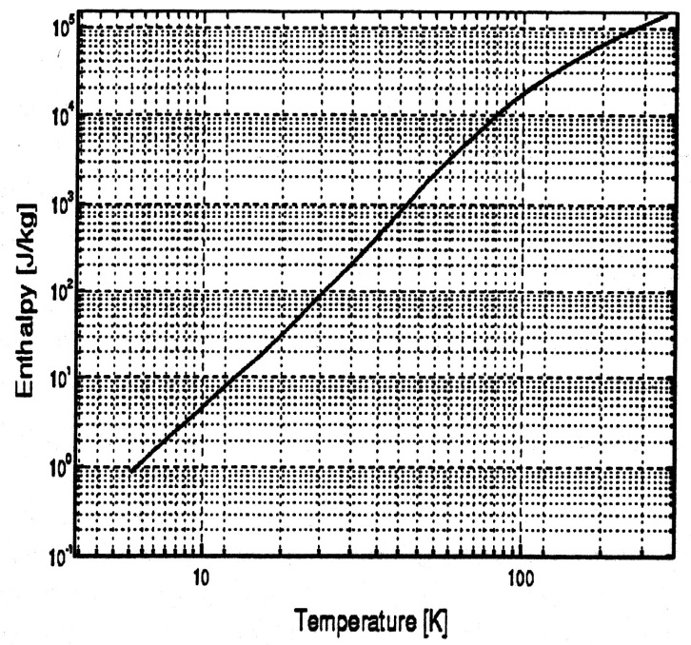
Stored energy to dump
  How much can the enthalpy take?
  For 150 K we can absorb ~20 kJ/kg,
  for 300 K we find ~60 kJ/kg.
  Usual values for E_{L}/m in low and medium field magnets is in the range 1-20 kJ/kg, so no problem, provided the heat can be absorbed uniformly across the coil windings!
  So, next problem is how to achieve a uniform heating across a magnet of 10-20 meters when the quench starts in a spot of ~1 mm (wire level stability) to ~500 mm (cable level stability).
  Can a single hot spot that expands do this? Obviously not, have to do more....

Slide 10
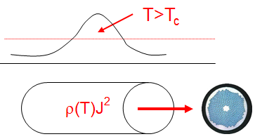
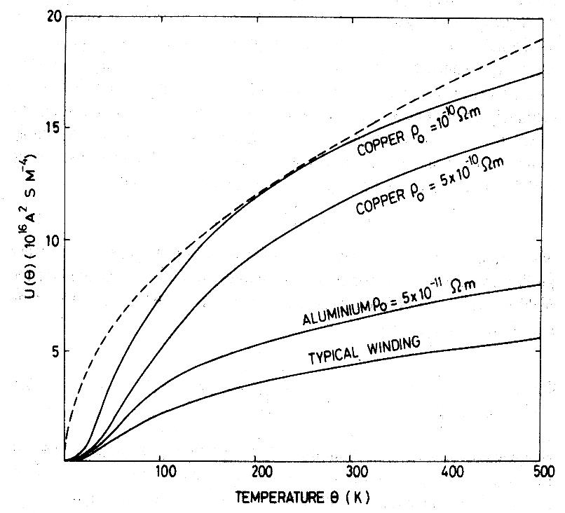
3. Adiabatic heating of the conductor
Temperature of the conductor
  Heating in the normal zone ρJ² is taken up by enthalpy
  ρ(T) J²(t) dt = c(T) dT
  _{o} ∫ ^{t} J²(t) dt =₄ ∫^{T}c(T)/ρ(T) dT = constant = F(T_{m})
  F is the Load Integral, used to assess transient thermal loads in fuses, diodes, transistors, etc.
  F is a constant and can be calculated for NbTi, Cu, resin and any mixture as a typical winding assuming for ρ(T) the copper/matrix value and for c(T) the mean specific heat of copper + superconductor c_{av}(T), justified since the filaments are fine and thermally accessible.
  Typical values for F(T_{m}) for a winding is 2-3x10¹⁶ at 150 K and ~4-5x10¹⁶ at 300 K depending on conductor and winding pack composition.

Slide 11
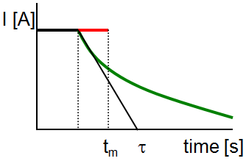
Adiabatic hot spot temperature
  Again:
  _{o} ∫ ^{t} J²(t) dt = ₄ ∫ ^{T}c_{av}(T)/ρ_{Cu}(T) dT = constant = F(T_{m})
  Simple solutions for J(t) exist for constant or
  exponentially decaying current
Constant current: I_{o}² t_{m} = F(T_{m}) → t_{m} < F/I_{o}²
Exponential decay: I_{o}² τ/2 = F(T_{m}) → τ < 2.F/I_{o}²
Example:
  NbTi/Cu and CuNi matrix conductors with J = 500 A/mm²
  F(300) ∝ 1/ρ
  F(300) for Cu is ∼1.3 10¹⁷ and ∼1.4 10¹⁶ for CuNi (or pure NbTi)
  Maximum τ in NbTi/Cu before reaching 300 K is a ~1 second
  Maximum τ in NbTi or NbTi/CuNi is few ms, so very little time to react and the conductor will burn out when used at high current density !

Slide 12
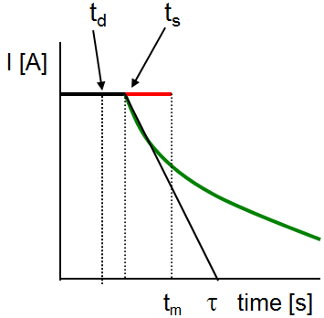
4. Controlling dumping time constant
  We need time to properly respond to a quench at t=0.
  Time t_{d} is required for detection, to verify and then
  to take action at time t_{s}.
  The time t_{d} must be short but safe (filtering noise).
  Obviously t_{d} is much shorter than the dump characteristic time τ, τ >> t_{d}.
Solution in low-current density (detector) magnets:
  τ < 2.F/J² given F, we can only reduce J in the conductor matrix/stabilizer, add Cu or Al & buy time! then t_{d} (~1 second) << τ (minutes).
  In the sec-min range, heat conduction plays a role, which greatly helps.
  If J permits, this strategy should be followed.
  Note: Large detector magnets like ATLAS, or fusion magnets are single and require maximum safety! Dipoles/Quads are many, can be replaced!

Slide 13
High-J accelerator magnets
  τ < 2F/J² given F, we can reduce J in the conductor matrix/stabilizer as far as possible, however, restrained by the high field requirement and cost.
  t_{d} (1-10 ms) << τ (100-500 ms).
  Very close to the limit, heat conduction cannot be fully exploited.
  1-10 ms detection time is very demanding for the Q- detectors, filtering is hard, risk of spurious quenches.
  Looks solved for NbTi in LHC, but is a real problem for future compact 12-15 T magnets, especially when built in 10-15 m length (nobody has done this so far!).
  Urgent need for a long study model to exercise quench protection in long (>>1m) high-field accelerator magnets.

Slide 14
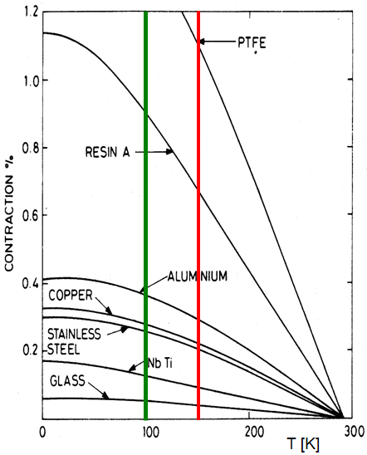
5. Safe hot spot temperature
Criterion for hot spot temperature
  Beyond 900 K Al structures start to collapse.
  Beyond 650 K we start to lose pinning, so J_{c}.
  Even 300 K is too high, as it endangers the windings.
  Severe thermal shock due to differential thermal contractions will occur.
  This may cause resin cracking and de-bonding, and thus training or degradation.
  A “safe” hot spot temperature is 100-150 K!
  Usually 100 K is taken nominally and a peak of 200-300 K for exceptional cases (failing protection systems for example).
300 K may be acceptable for an R&D magnet, but is not an acceptable design value for series production of long magnets with accelerator quality meant to be installed in a system!

Slide 15
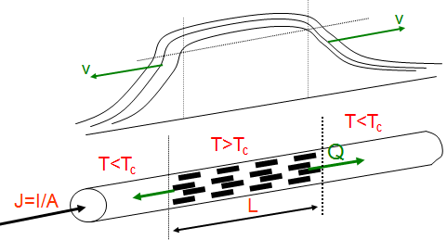
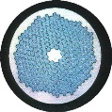
6. Normal zone propagation in 1-d
Let’s check how fast normal zones expand in a wire and transversally
  Consider the 1-d heat balance equation in z:
  P.A + ∂/∂z{λ(T).∂T/∂z}.A = A.c(T).∂T/∂t + h.p.(T_{c}-T_{o}), where P(T) is the
  heat production in the zone P(T)=ρ.η².J².(T-T_{cs})/(1-η).(T_{c}-T_{cs}) [W/m³],
  A= area, p= perimeter, λ, h and c thermal conductivity, heat transfer
  coefficient and specific heat.
  For simplicity P, λ and c are
  taken at the average
  temperature (T_{cs}+T_{c})/2.
  A traveling wave solution
  is found with
  constant velocity v.

Slide 16
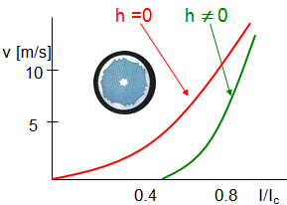
Normal zone propagation in 1-d
  A solution is found in terms of a running wave with constant velocity v
Adiabatic conditions (h=0)
  v_{z} = J/c [ρ.λ/(T_{cs}/2+T_{c}/2-T_{o})]^{1/2} [m/s], so v ∝ J and 1/c as expected
  This velocity is valid in normal size conductors in fully impregnated coil windings where the heat transfer is negligible.
  Normal velocities at operating conditions are in the range 10-30 m/s
With some cooling, (h≠0), a correction factor applies
  v_{z} = v_{z}(h=0) x (1-2y)/(1-y)^{-1/2}
  with y = h.p.(T-To)/ρ.J².A
  Essentially, for h ≠ 0, the velocity is
  significantly reduced,
  in particular for a low I/I_{c}, as expected.

Slide 17
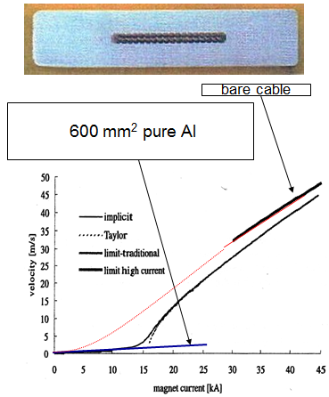
Example ATLAS conductor, not standard 1-d
2-d Heat diffusion in Al & cooling
  Large dimensions require to include heat and magnetic field diffusion !
  ATLAS Barrel Toroid conductor
  40 strands Rutherford cable (60 mm²) inside an Al stabilizer of 57x12mm²
  I_{c}=65 kA at 5 T
  What is the effective J=I/A in this case?
  At low current: dominated by Al
  At high current: dominated by cable (almost adiabatic, even inside the Al)
  A good example of non-uniform
  conditions requiring a detailed analysis,
  Thus, be careful with using simple formulae

Slide 18
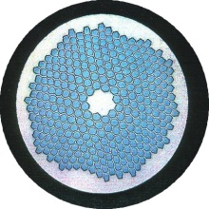
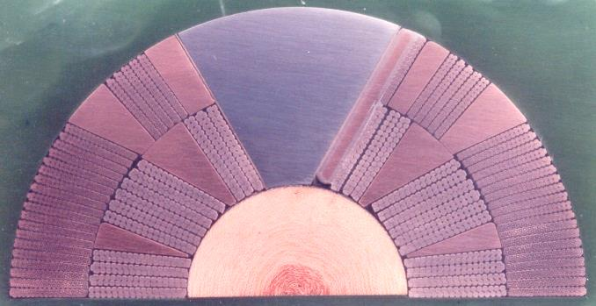
Normal zone propagation in coil windings
Propagation along the conductor
  As before v// = J/c.{ ρ.λ / (T_{cs}/2+T_{c}/2-T_{o}) }^{1/2}
Transverse direction
  Heating through many layers of insulation
  dominating the velocity in transverse direction
  v⊥ = v// { λ⊥ / λ// }^{1/2} ≈ v// /70 to v// /20
  “Normal” values are in the range:
  v// = 10-20 m/s and v⊥= 10-100 mm/s.
Resistance increase in the coil caused by:
  v// and v⊥ and growing ρ(T)J² since temperature will rapidly increase
  The total effective coil resistance is found by integration over the affected volume in 3 directions, is complicated in the case of non-solenoidal shapes or in the case of thermally decoupled coil segments

Slide 19
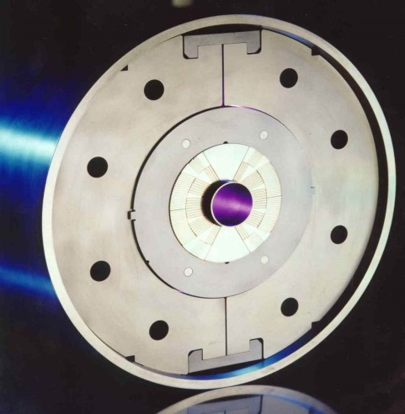
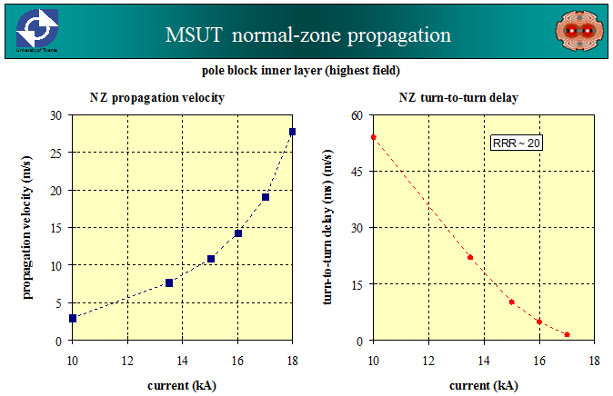
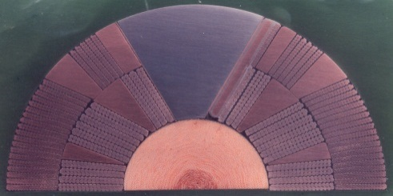
Example: propagation in 11T- Dipole Magnet (1995)
Features: 11.3 T/18.6 kA at 4.4 K, 50 mm bore, 1 m long, 130 MPa,
192 filaments, 33 PIT strands R-cable, fully impregnated.
nz-propagation velocities were measured and are according the adiabatic case: ~ 28 m/s in strands and ~ 1 ms turn-to-turn, as expected

Slide 20
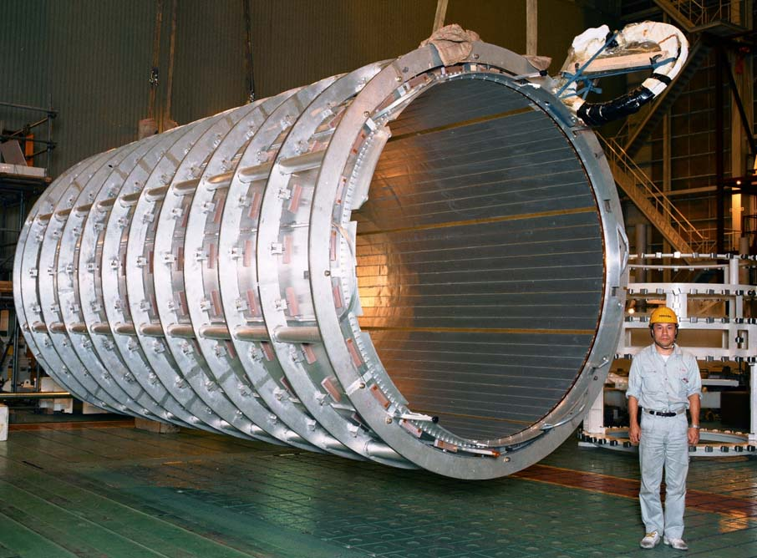
Acceleration of propagation
Two methods
  Faster resistance growth, by accelerated propagation, by introducing additional normal zones, either by switching on heaters to provoke additional normal zones, or by making thermal short cuts.
Heaters
  Extra heaters are positioned on the windings surface, multiple normal zones are created.
Thermal short cuts (example ATLAS Solenoid)
  Pure Al strips are glued onto the windings
  in the bore in axial direction
  Normal zone propagates from one end to
  the other end through only 2 insulation
  layers, rather than through hundreds…….
  Another advantage: the method is
  passive, not requiring detection.

Slide 21
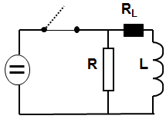
7. Protection schemes
Reduction of time constant
  Maximum τ < 2 F(T_{max})/J² (adiabatic)
  Two resistances can be distinguished:
  External resistor R and
  Internal resistance of coil after quench R_{L}
  “Time constant like” τ = L/”R”
  can be dominated by R, R_{L} or (R+R_{L}).
External dump resistor R_{L}<<R
  When a quench is detected, the switch is opened and the current forced to flow through the resistor R.
  R is such that the time constant is in the seconds to minutes range.
Internal dump, use of coil resistance R_{L}>>R
  Internal resistance is maximized by artificially heating the coils, multiple normal zones are introduced.
  The time constant is controlled by velocity of normal zone propagation and number of normal zones propagating at the same time.

Slide 22
Voltage on external dump resistor
  Here the energy is dissipated in the external resistor R by opening the switch.
  R must be relatively high to meet the required time constant.
  Peak voltage is V=I x R is often many kV.
  Requires high-voltage (10-50 kV) design with risks of electrical breakdowns.
  This method is used only when fast recovery is required (a tokomak fusion reactor for utility use cannot interrupt service for many days).
R L

Slide 23
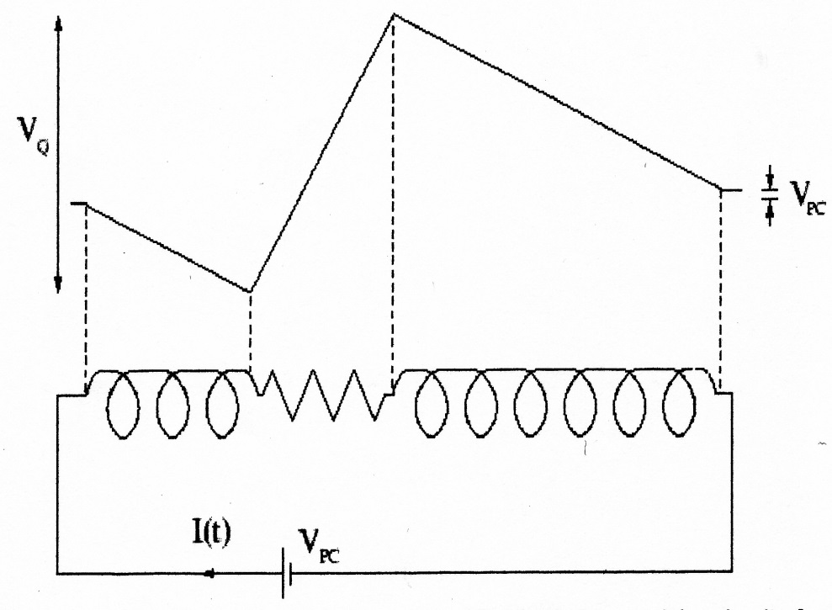
Voltage internal dump
  The voltage V(t) across the magnet is
    V(t) = I(t) R(t) + L(I) dI(t)/dt - ∑ M_{i}dI/dt –U_{PC.}
  Assuming L constant, M negligible and U_{PC} small (few volts),
  we find for the voltage across the zone:
  V_{Q}(t)= I(t) R(t).(1 - L_{Q}(t)/L)
  The internal voltage peaks across
  the normal zone, can be reduced
  by maximizing the L_{Q},
  so by spreading the quench.
  The voltage V_{Q} is internal,
  and divided across many turns,
  so normally not a problem.

Slide 24
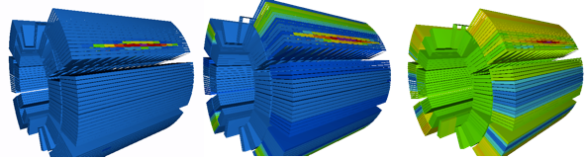
Quench simulation software
  Analytical methods are not that accurate, but still mandatory to use for a first order approach, for predesign.
  Also numerical programs exist using simplified models to simulate quench propagation, calculating coil resistance growth and using circuit analysis to calculate run down time, temperatures and voltages, like : QUENCH (Wilson), QUENCHPRO(Bauer), QLASA (INFN).
  Modern general commercial FEM codes like OPERA-3D, ANSYS and COMSOL can do quench analysis very well.
  E-circuits simulation code like PSPICE has circuit elements for superconducting-to-normal transitions.
  In a few labs there are dedicated codes for accelerator magnet design including quench evolution like ROXIE at CERN:

Slide 25
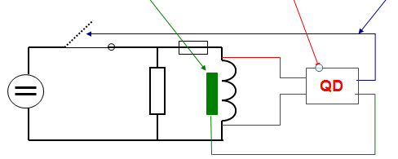
8. Magnet Safety System
Quench detection circuit
  The magnet safety system comprises the quench detectors, logics for opening switches and to supply current to the quench heaters.
  The system must be extremely reliable and power secured.
  The motto is : “keep it simple”, meaning robust and straight forward detection circuits, simple electronics, hardwired and 3-5 times redundant.
  First the quench, a normal zone, must be detected, then switches have to be opened and quench heaters activated.

Slide 26
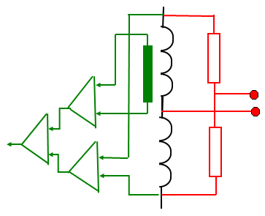
Quench detection in magnets
Bridge method
  Detects the resistance in any branch of the coils, very robust, simple and proven.
  3 sets of bridges, asymmetrically connected to see symmetric quenches.
  Commonly used for large magnets.
Voltage across coil
  Voltage across coil compensated for the inductive component. Requires differential amplifiers, more complicated, more electronics.
Other methods
  Temperature, pressure gages, pick-up coils, strain sensor, etc.
  Many proposed, but mostly not used.

Slide 27
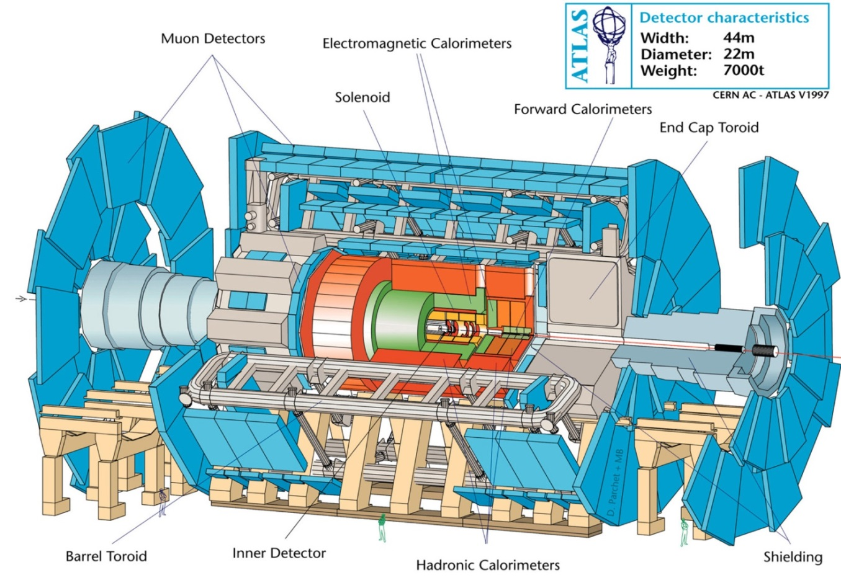

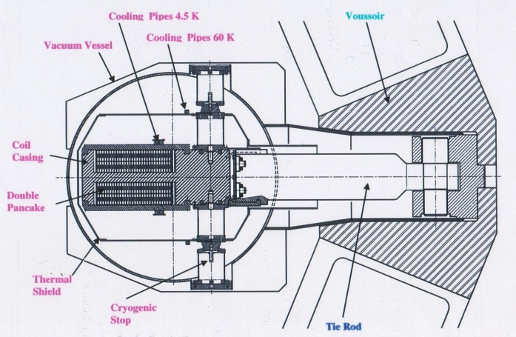
9. Example ATLAS Toroids
Toroids quench detection
  1.5 GJ energy, 20 kA current, 4 T peak field, 3 kJ/kg stored
  3 toroids, each comprising 8 flat coils, thermally not connected
  22 m diameter
  5 m x 26 m long coils
  Largest toroid ever built.

Slide 28

Example ATLAS Toroids
  All toroids 3 x 8 = 24 coils are connected in series.
  The energy is dumped in the 3 toroid cold masses, voltage limited to 40V.
  Quench detection by 3 bridges + 3 differential units per toroid so 6 fold redundancy, heaters are fired introducing 4 normal zones in every coil, expected maximum hot spot temperature ~100K.
  Threshold 0.3 V
  Low pass filter 1 s
  Fast dump in
  about 80 s.

Slide 29
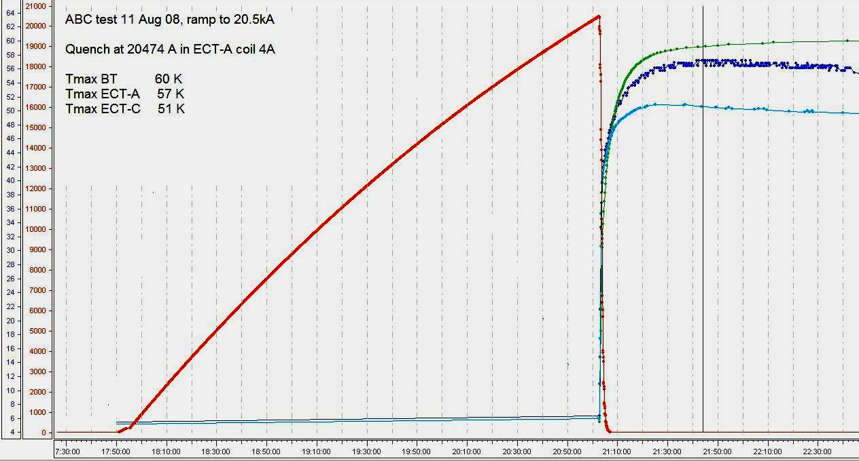

Example ATLAS Toroids
Toroid Fast Dump test result
  Provoked Quenches at 20.5 kA, heaters fired, quench spread
  ~ 60 K cold mass temperature at 20.5 kA, recovery in about 80 hours
  ~ 90 K hot spot in the conductor, perfectly safe quench behavior

Slide 30
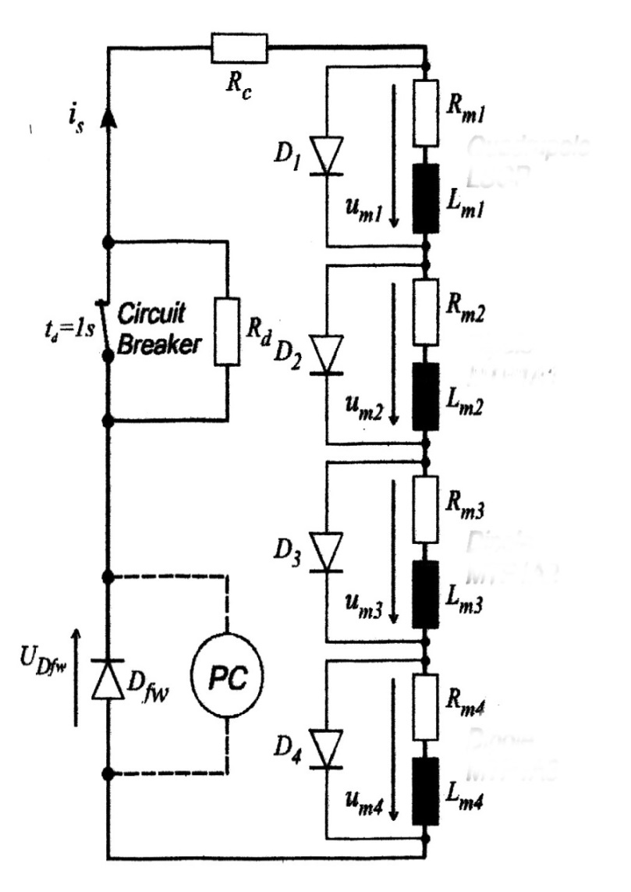
10. String of Magnets: independently together
  A string of magnets can be protected (voltage limit across each magnet) by bridging each magnet with a diode/resistor.
  After a quench the string current can bypass the quenched magnet, so decoupling the magnet energy from the string energy, decoupling the magnet run-down time from the string run-down time.
  Each magnet has a quench detector, and a quench heater system to provoke internal resistance to distribute the energy, required in high field dipole operating at 80-90% of I_{c}
  To avoid many current feed throughs (He consumption!) diodes are cold on the magnets.
  A complete accelerator ring can be split in for example 4, 8 or 16 strings depending on size.

Slide 31
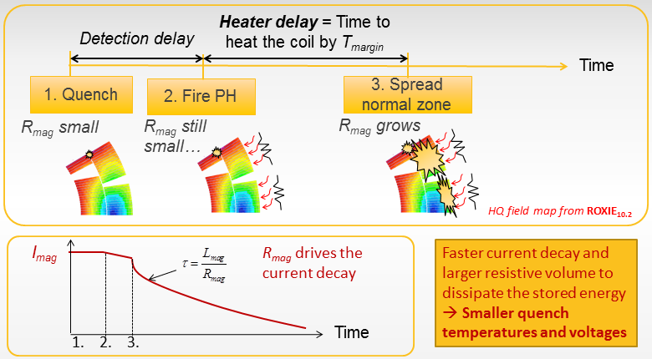
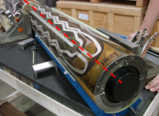

Case of the single high-field magnet
Given the high energy density, high J and minimum coil thickness/mass,
the coil must be switched to normal state in typically 30-50 ms in order not to overheat the coils on quench.
How to do this?
Minimize detection time ($\sim$10 ms), heater delay time (5-10ms) and put many heaters to get a uniform heating of the coil in many places (10-30ms).

Slide 32
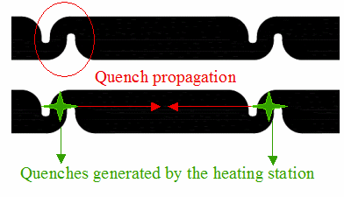
Acceleration by multiple normal zones
How to bring a 15 m long D or Q magnet
to normal state within 10 ms?
Cable-to-cable propagation is marginal,
only the adjacent cables are reachable within few ms.
Layer-to-layer is too slow: we need transverse line heaters
on both layers (or a heavy heating system in-between the two layers).
Heating system with spot-like “heating stations” is
not good enough for 5-10 ms and T_{max}<150K.
Need line-heating of short sections on all cables, in both layers.
Bottom line: rely on longitudinal propagation only
=> Initiate multiple normal zones in all cables periodically.

Slide 33

Exercise: How many heaters and power for 10 ms?
Heater layouts introducing hot spots in all cables at the same time
Example:
Switch 15 m magnet to normal state in 10 ms with 15 m/s normal zone velocity
15 m with15 m/s => 1 s, need 50 hot line heaters in 15 m, 3 per meter.
Heating power:
1 ring type heater element sized ~ 20 cm x 0.5 cm,
when using 25 W/cm² one needs 250 W/heater, 750 W/m for 1 layer
with heaters in 2 layers, 1.5 kW/m, ~ 25 kW per single bore magnet of 15 m!
with 2 fold redundancy and 2 apertures: ~ 100 kW per magnet.
Perhaps at some 50% less when relying on a cable turn-to-turn propagation.
Doable! Such systems must be optimized for layout and tried on long magnets.

Slide 34
12. Conclusion
Quench protection requirements of magnets must be respected from the beginning, otherwise magnets will degrade or die…….
For low voltage, diode-shorted magnets the protection is based on normal zone propagation velocity. In compact high-field accelerator magnets we find 10-30 m/s, by far not enough to warrant hot spot temperatures below 150 K, which should still be the driving criterion.
Essentially for driving a coil normal in 10-20 ms range, following a quench, all turns in the coil must be heated at intervals of some 10 cm and in all layers; or even better, instantly go normal across the entire coil.
Faster and more robust heating systems must be developed.
Quench propagation studies on real long high-field magnets 13-20T are necessary to assess the various options and test new ideas.
“Simple, robust and redundant”, the way to success in quench protection.

