Slide 1
(Practical) limitations & Possible solutions
How achieving best SRF performances
C. Z. ANTOINE,
CEA, Irfu, SACM, Centre d'Etudes de Saclay, 91191 Gif-sur-Yvette Cedex, France

Slide 2
Outlook
First part: Niobium
Field emission & cleanliness
What kind of Nb ?
Surface and damage layer
Surface and roughness
Surface and baking effect
Second part: after Niobium
Ultimate limits : recall
Past trials
New thin film techniques
Multilayers
Recent exp. results
Conclusion
27/04/2013
Claire Antoine CAS Erice
| PAGE 2

Slide 3
First part: niobium

Slide 4
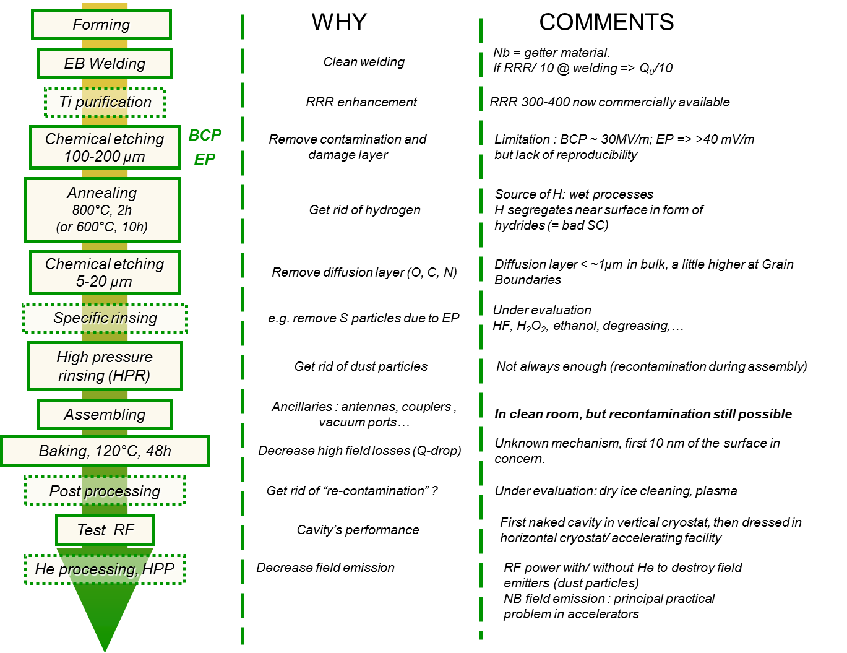
Cavities’ fabrication scheme
27/04/2013
Claire Antoine CAS Erice
| PAGE 4

Slide 5
Cavities’ fabrication scheme vs surface and material properties
Mechanical properties, grain size, strain hardening…
Purity issues
Surface composition and surface morphology
Surface composition
Surface cleanliness
Surface composition
Surface cleanliness
27/04/2013
Claire Antoine CAS Erice
| PAGE 5

Slide 6
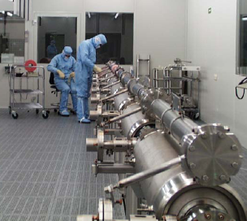
Niobium cavities
Typical performances
(CEA/Saclay- CARE-SRF project Cavity ):
40-45 MV/m !
Niobium: bulk, electropolished and baked
Practical issues
- we do not know the exact origin of the limitation: classical theory (BCS) is not enough to fully predict RF observations,
- reproducibility not good
RF superconductivity: a surface phenomenon
λ_{L} = field penetration depth
= where thermal dissipation occurs
R&D activities :
- surface , solid state physics; connection with cavities’ behavior
Nb : ~ 50 nm
…and cleanroom assembled
Notes:
Les limites en SRf ce sont celles-ci : aujourd’hui, on est capable d’obtenir ~45 MV/m, mais uniquement avec du niobium massif, électropoli et étuvé. Toutes les tentatives pour dépasser ces performances par exemple en utilisant d’autres supraconducteurs ont échoué.
En fait on ne connait pas bien la raison de ces limites, et on manque de reproductibilité d’une cavité à l’autre.
La supraconductivité RF est limitée par les dissipations thermiques qui ont lieu dans la profondeur de pénétration du champ -50 nm pour le Nb.
Mon activité principale en R&D se situe là : essayer de comprendre la physique de cette surface et l’origine des limitations, et voir si on peut les dépasser.

Slide 7
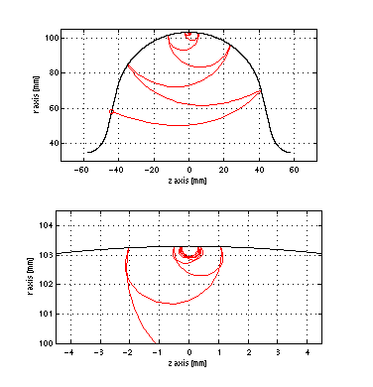

Note : I won’t talk about Multipactor…
Due to resonant electron emission (secondary emission)
It is influenced by adsorbed layers…
But the main ways to overcome it is:
  changing the cavity’s geometry…
  RF processing
http://www.rni.helsinki.fi/research/em/EM_multipacting.html
8/04/2013
Claire Antoine ESS tutorial
| PAGE 7

Slide 8
Field emission & cleanliness

Slide 9
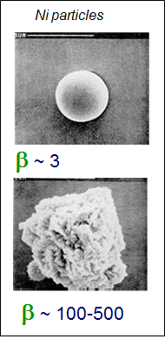
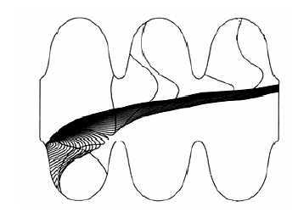
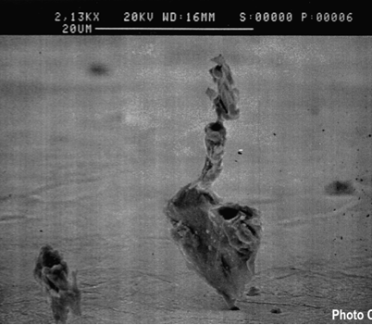
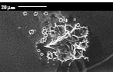

Why do we need a clean room ?
  Emitting sites = dusts, scratches near irises (high E field)
  Dust particles gather and weld together and to surface
  Local enhancement of E => βE
  e- from emitting site may disrupt the beam

Slide 10
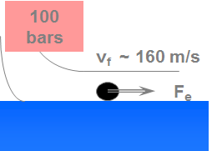
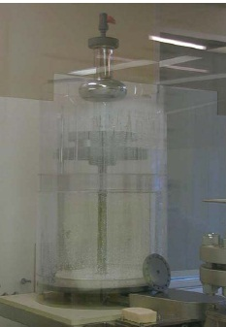
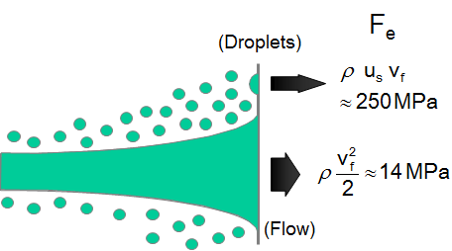
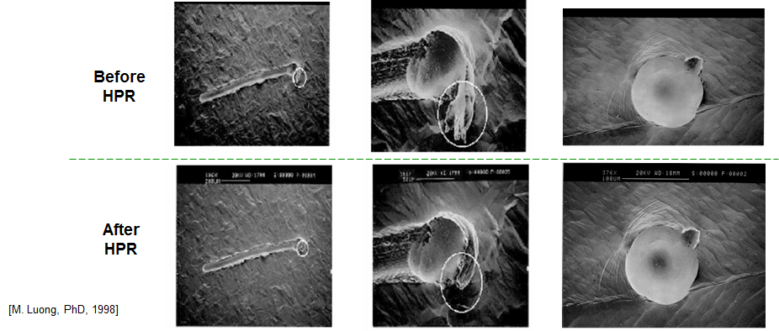
High pressure rinsing (HPR)
ultra pure H₂O, ultra filtered, 80-100 bars
Particles are displaced when F_{e} > F_{ad}
  NB :
      Similar action : dry ice processing (developed @ DESY)
      Surface microhardness ↑ (=> density of dislocations ↑)
See also [C. Reece 2008]
https://indico.desy.de/getFile.py/access?sessionId=5&resId=0&materialId=3&confId=401
[M. Luong, PhD, 1998]
Notes:
HPR is due to mechanical effect of the droplets
F_{e} is high enough to deform Nb (σ_{l Nb} ~ 150-200 MPa)
post contamination after HPR is still possible
HPR is not very efficient on S particles after EP (S embedded in organic material ?)

Slide 11
What kind of Niobium ?

Slide 12
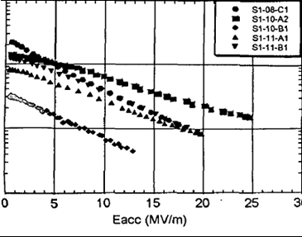

Why bulk niobium ?
  Bulk Niobium:
      grains ∅>~ 50 µm to mms, good crystallographic quality
  Niobium ~1-5 µm/Copper :
      ∅ <~ 100 nm, many crystallographic defects, grain boundaries…
      sometimes better low field performance (thermal configuration and/or cost)
  It is changing !!!: New emerging thin films techniques (see part 2)
Typical sputtered Nb cavities
1.5 GHz
Typical Good bulk Nb cavity
1.3 GHz

Slide 13
Why high RRR ?
Surface resistance:
2,5
1,66
T (K)
1,3 GHz
1MV/m
4,5 K
Bulk Nb
Nb/Cu
residual
(l ∝ RRR)
(K⁻¹)
High RRR not required for superconductivity
=> thermal stabilization in case of defects

Slide 14
Surface state/
(electro-) chemical treatments

Slide 15


Why Surface polishing?
  Raw material:
Surface : scratches, contamination, dust particles
Damage layer: (rolling, forming, machinnig) ⇒ broken, smached grains, residual strain
  After fabrication: need to remove 150-200µm on cavity’s surface
      Chemical polishing ~ 1 µm/min
      Electropolishing ~ 0.3 µm/min
  Basically
      you oxidize Nb⁰
      you dissolve it with HF

Slide 16
Short comment on surface processing (BCP vs EP) -1
1) BCP (Buffered Chemical Polishing):
  Composition
  ~ 2 vol. of H₃PO₄ (buffer, very viscous)
  ~1 vol. of HNO₃ (oxidant, transforms Nb⁰ into Nb⁵⁺)
  ~ 1 vol. of HF (complexant of Nb⁵⁺ , dissolves the oxide layer formed by HNO₃ into NbF₅)
    Variation of composition allows to adjust the etching rate
  Pros
  Easy to handle, middle stirring is necessary
  Fast etching rate
  Very reproducible
  Cons
  It is not “polishing”, it is “etching” : all crystalline defects are preferentially attacked (etching pits, etching figures)
  Grains with various orientation are not etched at the same rate => roughness !
  Except a few cases, E_{acc}^{ma}x~ 25-30 MV/m
  Caution :
  Don’t process at T higher than 25° C
  Risk of runaway
27/04/2013
Claire Antoine CAS Erice
| PAGE 16

Slide 17
Short comment on surface processing (BCP vs EP) -2
http://ilc-dms.fnal.gov/Members/tajima/References/Antoine_EP_tutorial_01JUN2006.ppt/file_view
2) EP (Electropolishing):
  Composition
  ~ 9 vol. of H₂SO₄ (buffer, very viscous)
  ~ 1 vol. of HF (complexant of Nb⁵⁺ , dissolves the oxide layer formed due to the high potential applied to Nb⁰)
    Variation of composition allows to adjust the etching rate
  Pros (when idealistic conditions, i.e. viscous layer present)
  It is really “polishing”, no sensitive to crystallographic defects. => smooth surface
  Should not be sensitive to the cathode-anode distance => same etching rate everywhere
  Gives (but not always!) the best ever E_{acc}^{max}~ 45 MV/m (TESLA shape => ~180mT)
  Cons
  Idealistic conditions are not possible to reach in most of our processing conditions
  Very sensitive to stirring condition, temperature, aging of the mixture
  Not very reproducible
  Safety issues (acid mixture sensitive to water, H₂ evolution…)
  Caution :
  If T ↑ : etching rate ↑ but pitting risk ↑, H loading ↑, HF evolution ↑
  If V ↑ : etching rate ↑ but pitting risk ↑, S generation ↑, sensitivity to Cathode/Anode distance ↑
27/04/2013
Claire Antoine CAS Erice
| PAGE 17

Slide 18
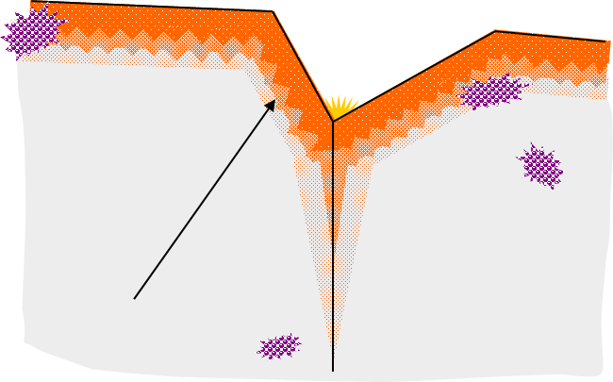
Surface State after polishing
  Real Niobium is far from ideal “textbook” superconductor
  Surface
      oxide, contamination, dust particles
      roughness
  Oxide
      thickness~ 5nm, depends on orientation and previous process
      mainly Nb₂O_{5-x}, with ppb impurities content (PO_{x}, SO_{x}…)
      one layer NbO @ interface
      decompose into suboxides upon baking (UHV)
  First 10 nm of Nb
      distorted (lattice mismatch)
      a lot of interstitial atoms. Mainly H, O (At% to 10s of At%), also F, C, P… i.e. surface segregation & chem residue
      higher imp. content for EP (O, C) !
  Within λ (36 nm for Nb):
Inclusions
Chemical
residues
Native oxide : Nb₂O₅
5-10 nm
Interstitial oxygens : thickness concentration profile ?
Interface : suboxids + interstitials : some monolayers
Grain boundaries

Slide 19
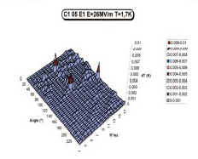
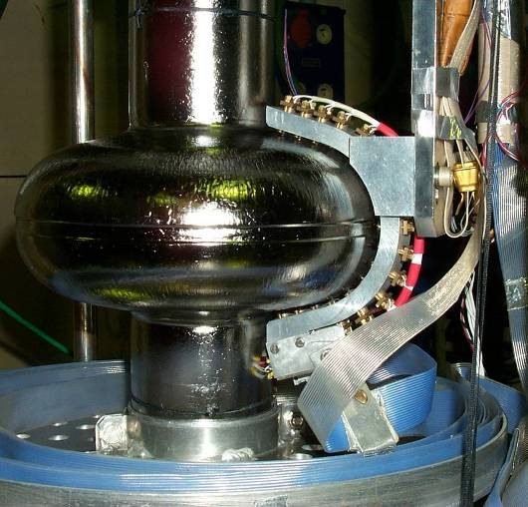
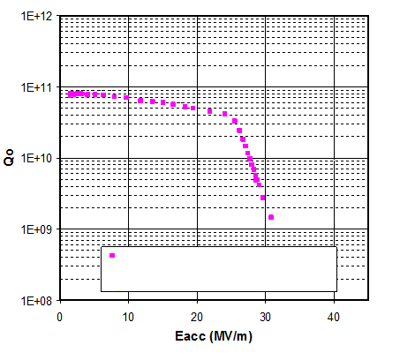
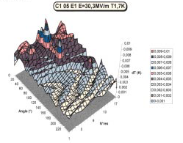
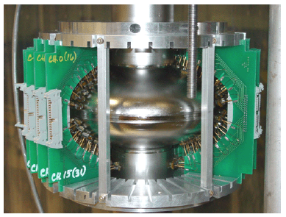
T-Maps & Hot spots
  Hot spots are observed in cavities at high field
Saclay’s ↑, Cornell’s↓
Electropolished cavity
Notes:
Modifier, montrer que ça commence à chauffer au même champ, mais que hot spot chauffe +

Slide 20
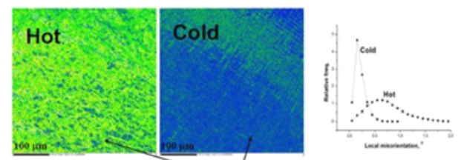
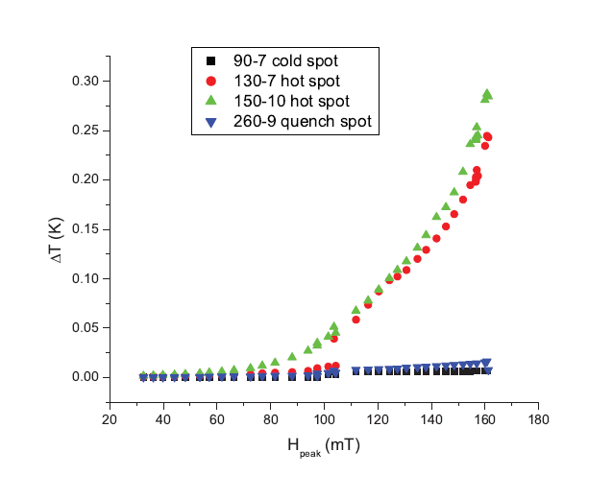
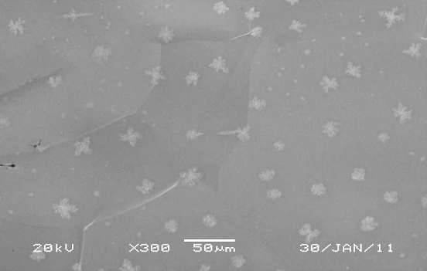
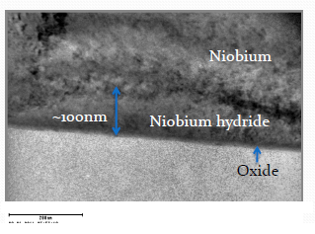
Hot spots
  Hot spots in cavities are correlated with :
      Early vortex penetration (see [Grasselino] and [Ciovati])
      High misorientation (i.e. high density of dislocation)
      High density of hydrides precipitates (Cotrell clouds)
      Onset of heating ~ same as cold spots, heats faster
  Hydrides
      SC, low H_{C1}
      Symptom or reason for early vortex penetration ?
[Courtesy :A. Romanenko, Cornell /FNAL]
Notes:
Modifier, montrer que ça commence à chauffer au même champ, mais que hot spot chauffe +

Slide 21
Surface state and
Damage

Slide 22
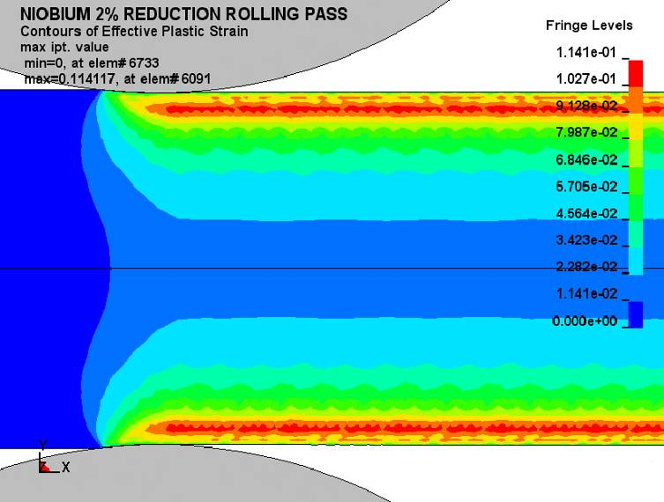
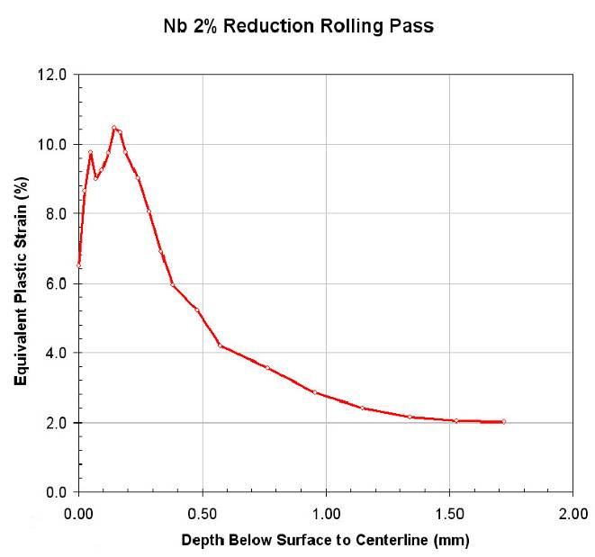
Why Surface polishing?
=>Damage layer
After rolling sheets undergo a skin pass for planarity
  Damage layer = deformed grains + high density of dislocations + (foreign atoms)
  Rolling leaves a damage layer ~2-300 µm with a texture resistant to recrystallization, i.e. same order of magnitude than the necessary etching of material.
  Further damage (dislocations !) probably brought by deep drawing and thermal strain during welding
  Interesting trails :
      look at remaining stress after forming/welding,
      chemical mechanical polishing
Finite element simulation of 2% reduction of 3.5 mm sheet with 1 cm diameter rolls (Courtesy Non-Linear Engineering, L.L.C.). Stress is concentrated in the near-surface region (~300 µm). Localized strain exceeds the average by a factor of 5
[R. Crook et al, Black Laboratory]

Slide 23
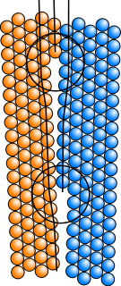
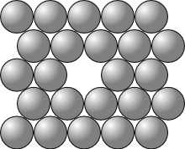
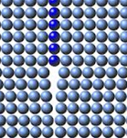
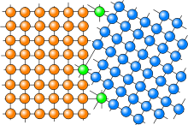
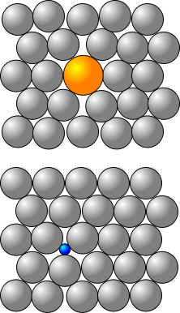
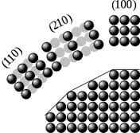
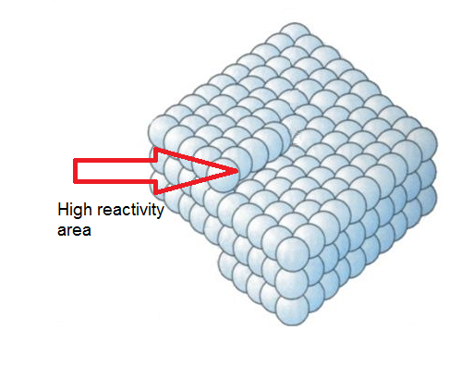
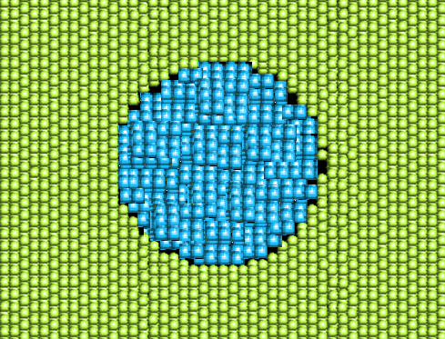
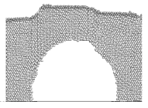
Examples of Crystalline defects
2D :
Punctual:
1D:
Surfaces, interfaces
Vacancy
Edge dislocation
Substitutional atom
3D :
Screw dislocation
Surface faceting
Interstitial atom
Inclusions
Voids

Slide 24
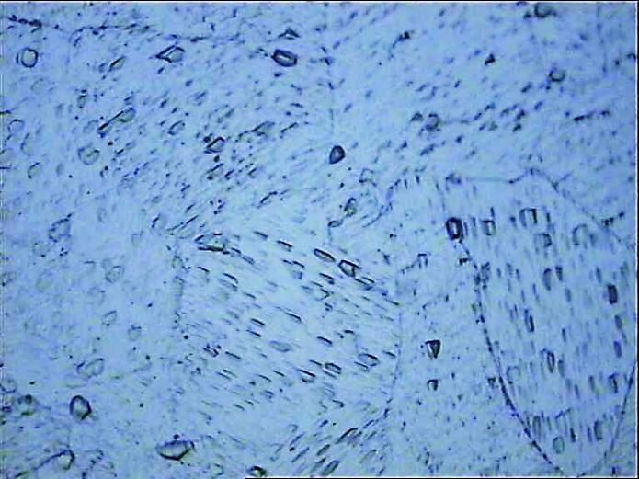
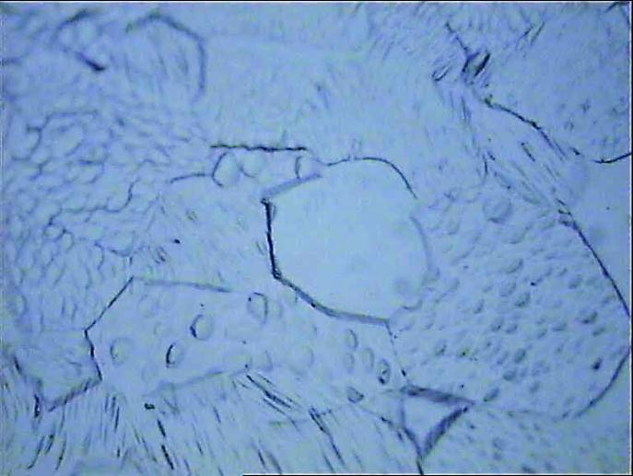
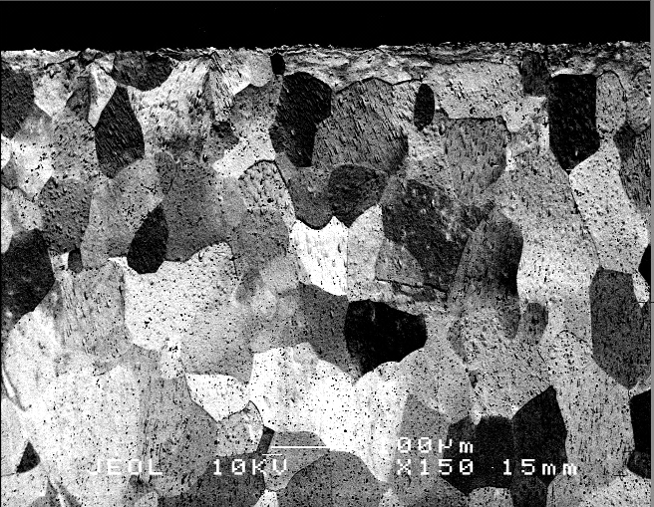
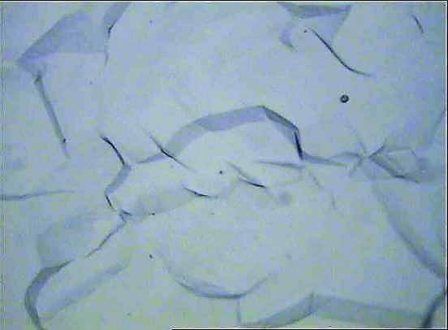
Etching figures & damage
  Typical etching figures (dislocations emerging at the surface)
  As received Nb Sheet,
  optical microscope, w. surface etching →
SEM, cross section, transverse to rolling direction ↓
  Existence of etching figures provide a coarse but very quick estimation of the presence of remaining stress inside the material
Depth (µm)
Silver epoxy
Distorted grains
(mottled contrast)
100
Etch pits
200
300
optical microscope, surface etching on low damage Nb surface →
S
Cross-section, ST plane
T

Slide 25
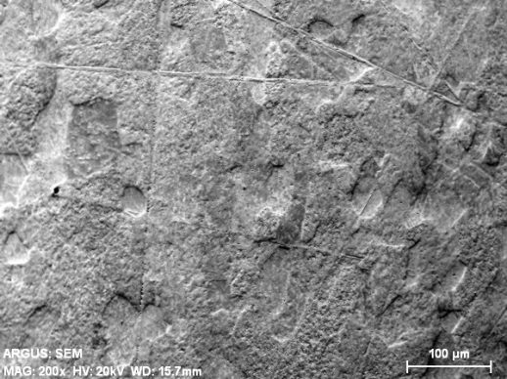
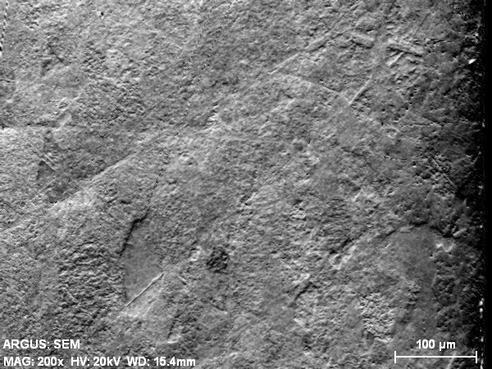
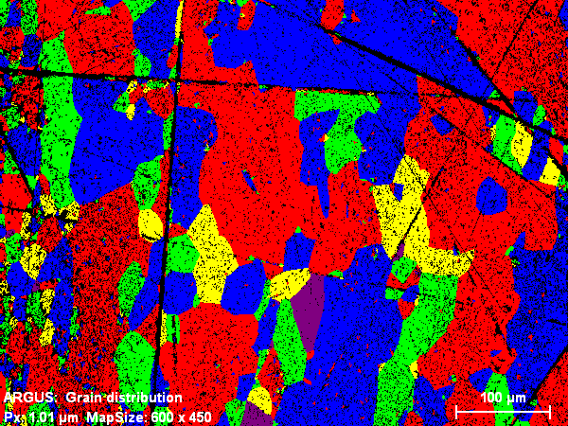
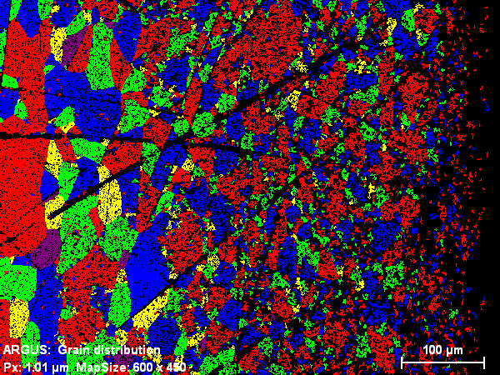
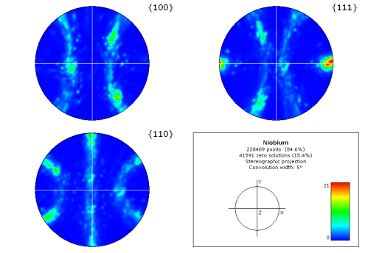
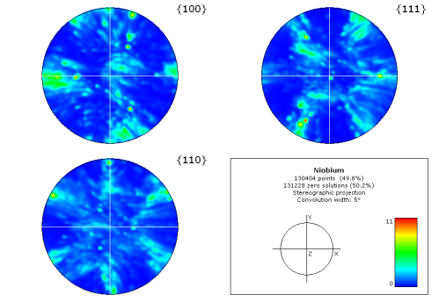
Damage layer seen by e⁻ diffraction
Analysis of a cut of Nb Sheet (MC polishing)
Bulk
SEM
Surface
EBSD (O.I.)
Surface: Grains are small, distorted,
A lot of large, dark spot close to the surface : grain are so distorted => cannot refract e- any more
Bulk : Grains are large, slightly elongated,
NB small dark spot uniformly distributed source = MC polishing damage (<<100 nm)
Pole figures
Surface: blurred pole figure :
many distortions, different orientations, several textures
Bulk : clear and clean cubic pole figure :
Sheet is textured as expected for rolled material
Notes:
Electron diffraction : typically first 100 nm=> need to polish the surface
Bulk is as expected for rolled material

Slide 26
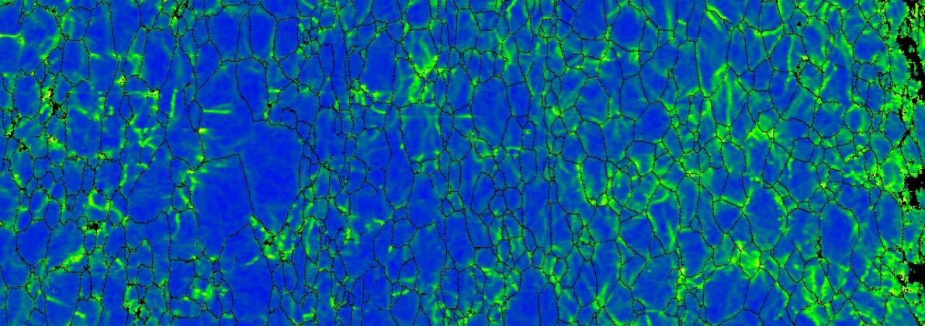
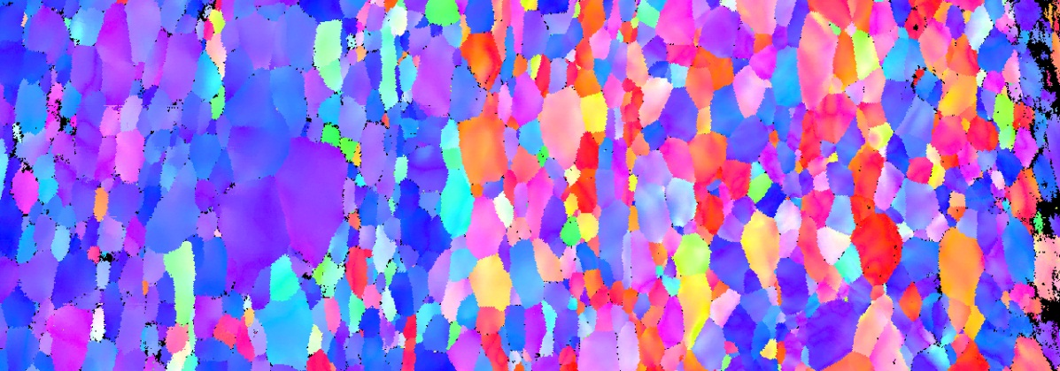
e⁻ diffraction after Deep drawing :
Half cell cutout
(just after deep drawing, before welding)
1500
1000
500
300
100
equator
μm from surface
~ 5 mm
cavity
interior
surface
Local Average Misorientation
1 μm spatial
resolution
Inverse Pole Figure
(poles normal to cavity surface)
[R. Crook et al, Black Laboratory]

Slide 27
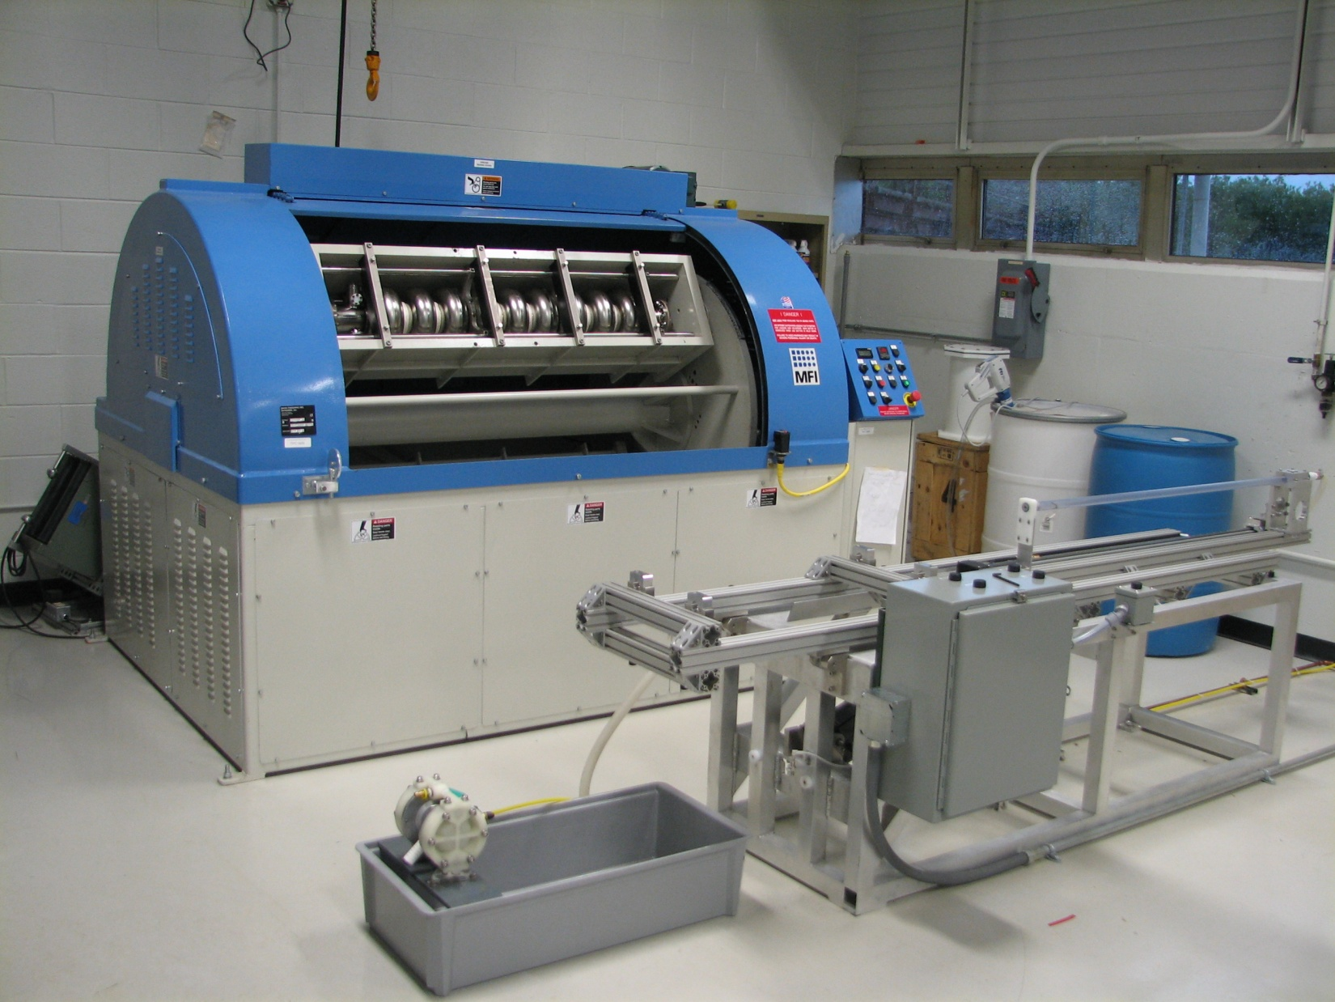
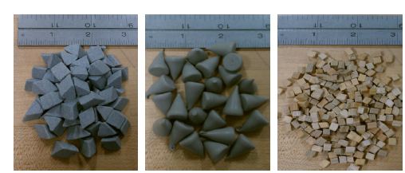
Centrifugal barrel polishing
Developed @ FNAL
[Cooper - SRF 2011]
Individual Barrels rotate 115 RPM in opposite direction to main shaft
Notes:
État de l’art : développé @FNAl, ∃ maintenant à Cornell, JLAB , Desy, RRCAT (Indes), en cours de développement à IHEP –Chine, et de transfert de recette de polissage à KEK. En gros tout le monde sauf la France !!!

Slide 28
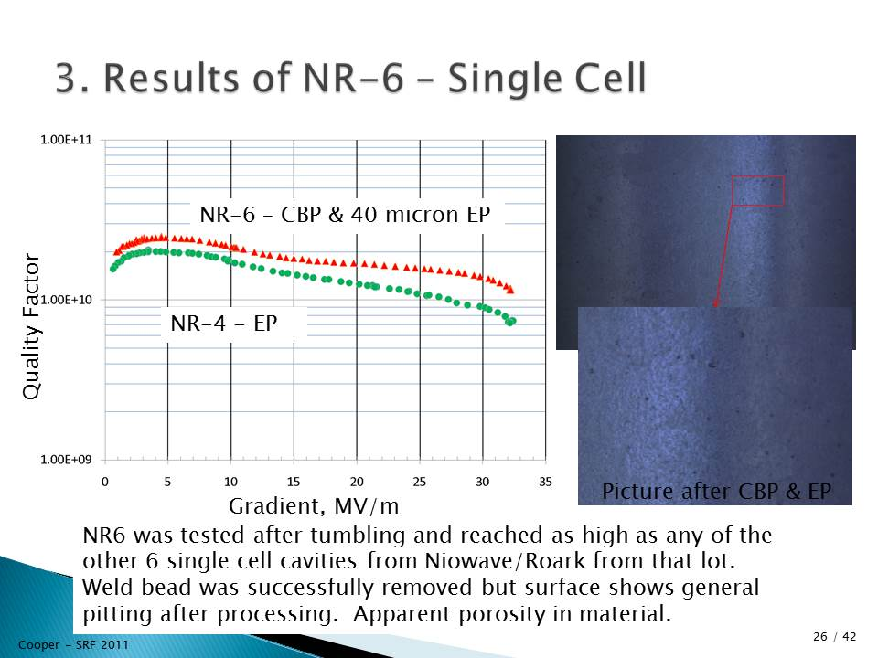
Recent results on cavities without long chem. Etching/EP

Slide 29
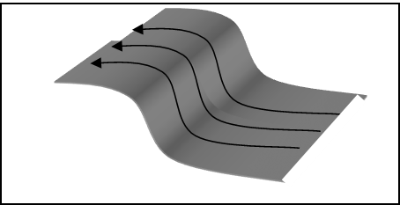
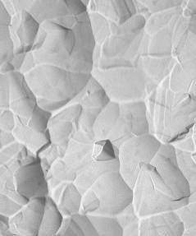


Chemical Etching vs Electropolishing :
Surface morphology effect on Quench
Grains do no etch @ the same rate => relief
~ 20 µm
Curvature of magnetic field lines => local ↑ of H⊥
  Local ↑of the magnetic field => local normal state transition => Quench ?
  Quench location:
  Roughness (e.g. Rq) is not sufficient to evaluate field enhancement behavior
superfluid He Temperature maps
Same height distribution, ≠ RF behavior
Notes:
Relief => augmentation local du champ magnétique => transition (magnétique) localisée, en particulier les « nez de marche » au bord des grains

Slide 30







Morphology effect: field enhancement
[A. Polyanskii et al, FNAL/FSU]
H ⊥ surface: notch has small impact on flux distribution even at higher T
Single crystal with notch on the surface :
H // surface
H
H=40 mT T=7K
H=80 mT T=7K
0.5 mm
H
T=5.6K
H
No MO contrast at the groove, when in-plane field parallel to groove
MO contrast is double at the groove, when in-plane field perpendicular to groove
27/04/2013
Claire Antoine CAS Erice
| PAGE 30

Slide 31





Replica @ the quench site – 2D simple model
→ 550 µm x ↑ 15 µm
Normal cond. zone
H/<H>
x (mm)
Size of the defect ~
→ 550 µm x ↑ 15 µm
  Thermal behavior :
  Edges thermally stabilized until T~ 5.35 K and W ~142mW
  T<9.2 K but H> Hc
  When W ~143 mW => Quench !
P (W)
Dissipated power (Rs ~ 2mΩ)
H/H_{c}
27/04/2013
Claire Antoine CAS Erice
| PAGE 31
Notes:
Relief => augmentation local du champ magnétique => transition (magnétique) localisée, en particulier les « nez de marche » au bord des grains

Slide 32


A topological useful tool : conformational equivalent ellipsoids
  Can model 1! step or give a medium value / 1 surface.
      Surface characterization
      Access to 3D model
  Ellipsoid demagnetization factor easy to calculate

Slide 33
Conformal equivalent ellipsoids and demagnetization factor
c
2a
Weld →
m=c/a
Parameter | Small grain material | Annealed, away from the weld | Thermally affected zone@ weld | Mean value for EP material | Defect, close to weld* C~ 50µm 2A~200µm
 | BCP : chemical etching |  |  | Electropolishing
Φ grains | 70 µm | 1-2 mm | 0,5-1 cm | 1 mm => 1 cm | -
Ra | 1-2 µm | 4-8 µm | 40-80 µm | ~ 1 µm | -
C/A | ~ 0.085 | ~ 0.024 | ~ 0.099 | ~ 0.005 | ~ 0.5
β=1/(D) | 1.065 | 1.028 | 1.4 | 1,018 | 1.9 !!! *
FNAL cavity
quench @ ~15 MV/m
Chemical etching
=> premature quench @ weld

Slide 34
Surface state and roughness

Slide 35



Other 3D modeling of holes and pits
  Pit in a cavity :
[SHEMELIN , Cornell, 2008]
  Same defect, 3D modeling
[INSEPOV, NOREM, ANL 2011]
β ~ 1.6
http://flash.desy.de/sites2009/site_vuvfel/content/e403/e1644/e2271/e2272/infoboxContent2358/TTC-Report2008-07.pdf

Slide 36

Morphology : Conclusion
  This effect is important on macroscopic defects
  Welding defects
  Thermally affected zone
  Large grains cavities
Modeling, RF + thermal => quench
  Prevention:
  => Electropolishing, CBP …
  Or … Avoid welding !
        Hydroforming
        Monocrystalline cavities (no large grain !)
[W. Singer, DESY]

Slide 37
Surface state and baking

Slide 38

Why baking ?
  Baking: shifts high field dissipation to higher field
      Discovered at Saclay in 1998 (B. Visentin)
      Low temperature treatment : 110-120°C, 48 H : few changes expected
      Dramatic effect on performances
      Still resists full explanation
EP
EP+ baking
NB. Hot spots ≠ quench !

Slide 39

Dislocations and Baking
[A. Romanenko, PhD, Cornell , 2009]
Local misorientation shifts in cavity samples due to mild baking. Measurements of misorientation distribution are performed on the same sample before and after baking. (courtesy of A. Romanenko)
  Misorientation reduced upon baking, except for small grain, BCP
  BCPied cavities show no improvement upon baking

Slide 40


Baking and SC gap
bulk Nb (UH Vann. >2200°C) = reference →
↑. Nb low Z conductance
(measurement deep, past the oxide layer)
Nb high Z conductance
(oxide-SC interface included in the measurement)
→
  Bulk : BCS behavior
  Δ ~ Nb bulk : 1.55 meV
  Behavior ≠ BCS @ interface

Slide 41

High field dissipations:
PCT Results 2
@ interface :
  Broadened conductance => Mechanism = Cooper pair breaking
  Fit = Shiba => quasiparticles inelastic scattering / impurities
  Baking : ↓ inelastic scattering part of the signal
  Same results air/vacuum => interface !
[T. Proslier et al,IIT, ANL, 2007]
BCS
Exp
0.1
Norm. Conductance
_ Before baking
_ After baking
0.5
Shiba*
0
0 0.5 1 1.5 2 2.5
Voltage (mV)
high Z (w. oxide)
NB baking in air !
* H.Shiba Prog.Theo.Phys. 50, 50 (1973);

Slide 42


Baking & vortex penetration ( by µSR)
[Grasselino, FNAL, 2012-13]
  Polarized muons implanted in Nb (~300µm deep)
      µ tend to go into interstitial sites
      Spin precession sensitive to mean local magnetic field
      Meissner state: fraction without local field (a₀)is high
      Vortex penetration: fraction without local field ↓↓
  Onset of vortex penetration increases w. baking !
      NB perpendicular field but same trend as cavities (// field) !
      Influence of morphologic defects ? (=>⊥ field component?)

Slide 43
Niobium at the end…

Slide 44

surface defects and Quench
(What happens if we do not work correctly…)
[H. Safa, 1995]
http://accelconf.web.cern.ch/accelconf/SRF95/papers/srf95c10.pdf
    Quench field < 15-20 MV/m:
    Defect ~ 50-100 µm
    You can see it with the eye !

Slide 45




Quench without defect ?
(What happens if we do work correctly…)
Cavity 1DE3 :
EP @ Saclay
T- map @ DESY
Film : curtesy
A. Gössel +
D. Reschke
(DESY, 2008)
Notes:
Enchainement à revoir
Avant : quench toujours sur un seul défaut localisé, qqs 10 µm
par exemple :
inclusion = défaut chimique, augmente localement Rs
marche sur un joint de grain = défaut morphologique, augmente localement le champ H
Ici presque toute la surface est équiprobable => ce n’est plus 1 défaut localisé, c’est le matériau
Le Nb… Si on passait à autre chose ?

Slide 46
Second part: after niobium

Slide 47

Other superconductors ?
Nb₃Sn
Nb films: sputtered; energetic condensation
Multilayer SIS for preventing flux entry (NbN, MgB₂)

Slide 48

SRF limits
  What is the critical field in RF ?:
Pb
Nb
2.5
Normal state
2.0
1.5
Mixed state
1.0
Superheated state
Meissner state
0.5
  Superheating field ?
      normal zone nucleation ~10⁻⁶ s
      RF ~10⁻⁹ s *
  BUT
      1! vortex penetration ~10⁻¹³ s **
Type I
Type II
0
0.4
0.6
1.2
1.6
2.0
GL parameter κ (= λ/ξ)
H_{SH} ~1,2.H_{C} pour κ ~1
H_{SH} ~0,75.H_{C} pour κ>>1
* H. Padamsee, J. Knobloch, and T. Hays, "RF superconductivity for accelerators". 1998: J. Willey & son.
** Gurevich, Brandt, Smethna…
Notes:
Rbcs vient du modèle à 2 fluides, mais n’est pas équivalent aux calculs de dissipation dues aux vortex

Slide 49
SRF limitations in (brief) summary
Superheating field vs Vortex nucleation
Nb~ 55 MV/m
Nb₃Sn ~ 95 MV/m
Nb<50 MV/m
+ magn. screening
  Approx. for the superheating model valid principally
      close toT_{C}
      “perfect material” (few surface defects)
      and/or short pulses
  In real life :
      early/fast penetration of vortex possible @ surface defects
      penetration of vortex seem faster @ low temperature (why !? λ small ?)
    Nb : the best because of its high H_{C1} ?
      Either we are able to produce 0 defect surfaces,
      Either we screen the surface ….
  More theoretical and exp. work needed
Notes:
“rf pair breaking” induces non linear corrections which increase when T decreases : at high field : quadratic variation of R_{BCS} w. field and Tp° . Correction due to clean/dirty limits not done yet
Note : RF H_{C1} should be > to DC H_{C1} (Gurevich dixit). If you keep below H_{C1}
If you keep below H_{C1} : no need to draw hypothesis on the origin/ prediction of H_{SH} (∃ a controversy between Cornell’s theoretician Sethna and Gurevich on the topic)
If you measure DC or low frequency H_{C1} you have some safety margin concerning RF H_{C1}

Slide 50
Thin films

Slide 51
Thin films
  Nb : λ~50 nm => only a few 100s nm of SC necessary (the remaining thickness= mechanical support) => Make thin films !
  Advantages
    Thermal stability (substrate cavity = copper)
    Cost
    Innovative materials
    Optimization of R_{BCS} possible
  Disadvantages
    Fabrication and surface preparation (at least) as difficult as for bulk
    Steep Q₀ reduction by increase of RF field (sputtered niobium films)
    Deposition of innovative materials is very difficult

Slide 52
Thin films
Films: Many techniques, not possible mention all
There are two categories of films
  Films which are intrinsically films
    Thin, small grains, under stress
    Problems: defects & microstructure, impurities, surface state
    Examples: magnetron sputtered films on oxidized copper
  The general trend is to move towards films which are bulk-like
    Dense, large grain material
    Examples:
      high-energy deposition techniques
      annealed films
      Nb Cu-clad cavities (hydroformed cavities from bimetallic Nb (2.5 mm), Cu (0.5-1 mm) tube)

Slide 53



Sputtered Nb films
The only Nb films deployed in accelerators were made by magnetron or diode sputtering (CERN).
Reached relatively low surface fields => E_{acc} ~5 MV/m.
An exponential slope in R_{s} and Q₀
1.5 GHz Nb/Cu cavities, sputtered w/ Kr @ 1.7 K (Q₀=295/R_{s})
Standard films
-V
Bulk Nb
RRR_{max} =28
Nb films – sputtered
1.5 GHz Nb/Cu
LEP II
350MHz Nb/Cu (4.2K)
Oxide-free films
RRR_{max}= 40
CERN 2000
Nb films grown at low energy (Ions Energy <10eV) appear very susceptible to early flux entry, which yields Q slope for applications
  New approach: High Power Pulsed Magnetron Sputtering HPPMS (Ionized sputtered material)

Slide 54


Coaxial Energetic Deposition (CED)
Substrate | RRR
Single crystal insulator
MgO (100) | 176
MgO (110) | 424
MgO (111) | 197
a-Al₂O₃ | 488
c-Al₂O₃ | 247
Cu large grains | 289
Record | 585
Cathodic arc plasma.
Ions Energy 60-120 eV
Arc source is scalable for large scale cavity coatings
UHV and clean walls important
Ch. Reece; JLab
Nb films grown by Jlab and AASC Almeda Applied Science Corporation. Balk like RRR values
Coaxial Energetic Deposition (CEDTM)

Slide 55
Sputtered films :
Structure zone model (from A. Anders)

Slide 56


Nb₃Sn failure : due to vortices ?
H_{P} Nb₃Sn 0.03T (H°_{C1}=0.05 T)
H_{P} Nb 0.12 T (H°_{C1}=0.17 T)
Nb₃Sn
Nb
1.5 GHz Nb₃Sn cavity (Wuppertal, 1985)
1.3 GHz Nb cavity (Saclay, 1999)
    Nb : the best because of its high H_{C1} ?
    Nevertheless it is interesting to master Nb₃Sn for SRF applications => on going activities @ Cornell, (re-) starting @ CERN
Notes:
Modifier pour montrer prédiction superheating

Slide 57
multilayers

Slide 58
Multilayers
Overcoming niobium limits (A.Gurevich, 2006) :
  Keep niobium but shield its surface from RF field to prevent vortex penetration
  Use nanometric films (w. d < λ) of higher Tc SC : => H_{C1} enhancement
  Example :
  NbN , ξ = 5 nm, λ = 200 nm
  H_{C1} = 0,02 T
  20 nm film => H’_{C1} = 4,2 T
(similar improvement expected with MgB₂ or Nb₃Sn)
x 200
Nb
I-S-I-S-
H_{applied}
      high H_{C1} => no transition, no vortex in the layer
      applied field is damped by each layer
      insulating layer prevents Josephson coupling between layers
      applied field, i.e. accelerating field can be increased without high field dissipation
      thin film w. high T_{C} => low R_{BCS} => higher Q₀
H_{Nb}
Cavity's internal surface →
Outside wall
←
Notes:
C’est encore A. Gurevich propose en 2006 de garder le Nb, mais d’augmenter artificiellement sa barrière de surface avec des films supra très minces.
En effet lorsque l’épaisseur est inférieure à la profondeur de pénétration, on augmente artificiellement le champ de première pénétration et la barrière de surface qui préviennent la pénétration des lignes de champ dans le supra.
Par exemple ici pour 20 nm de NbN on multiplie le HC1 par 200. De plus NbN a un Tc plus élevé que le Nb et donc une résistance de surface ~10 fois moindre et donc dissipe moins
If H_{c1}(d) >Hc^{Nb}, field onset of vortex penetration is limited by the depairing current in the last layer (>~Hc )

Slide 59
Multilayers’ H_{C1}
Accelerator cavities' operating range
~ 25 nm NbN
x 4
14 nm insulator
(MgO)
500 nm Nb “bulk”
ML4
Tc = 15,1K
Monocrystalline sapphire
~ 25 nm NbN
~ 15 nm insulator (MgO)
250 nm Nb “bulk”
SL
Tc = 16.37 K
Monocrystalline sapphire
~ 15 nm insulator (MgO)
250 nm Nb “bulk”
Monocrystalline sapphire
R
Tc = 8.9 K
ML sample : 250 nm Nb + (14 nm MgO + 25 nm NbN) x 4
Multilayer tested for the first time B_{C1} > 55 mT @ 8K !
Notes:
Comments : still some technical problems of thermal contact between sample and set up + thermal regulation not precise below 5 K

Slide 60
MgB₂-MgO Multilayer Films
MgB₂
MgO
MgB₂
MgO
MgB₂
Sapphire
Alternating MgB₂-insulator structures have been fabricated on sapphire substrate:
40 nm MgO as insulating layer, sputtered.
MgB₂ deposited by HPCVD ex situ. 150, 100, and 75 nm in thickness.
T_{c} near 40 K for 100 and 150 nm films. Lower for 75 nm film.
Multilayer films with thin MgB₂ layers show higher H_{C1} than the 300 nm film even though the total thickness are the same.
[Teng, Xi – Temple University]
Notes:
In fabricating multilayer films. We use sapphire substrate and MgO as our insulator material. The MgO insulating layer is deposited using RF magnetron sputtering with an MgO target. Then the film will be transferred back to the HPCVD chamber to deposit a layer of MgB2 on top of it. Each insulator layer is with 40nm thickness. The penetration depth for MgB2 still have some contraversary. So we choose to compare 4 series of multilayer samples. 300nm single layer which is regarded as bulk materials, 150nm single layer and bilayer, 100nm single layer and trilayer, 75nm single layer and quandrolayer. The idea is to test whether thin films will really have enhanced Hc1, and if we deposit multilayer of thin films, will it still have enhanced hc1. R-T curves for those samples are plotted on the right. All samples are with good Tc and residual resistivity ratio, except for 75nm series.

Slide 61

Other results
[Lukaszew, 2012]
*
~30(*) or 50 nm (**) NbN
~ 15 nm insulator (MgO)
600(*) / 250(**) nm Nb “bulk like”
MgO (100) substrate
**
  Compare with what is expected for
  bulk Nb : ~1300 Oe @ 4.5 K !
Notes:
lukasiev

Slide 62
Conclusions and perspectives
  Superconducting cavities are dominated by their surface quality (Niobium AND other SC !)
  Niobium is close to its ultimate limits
  H_{SH} difficult to reach in real “accelerating cavities” (low T, large scale cavity fabrication, surface defects,…)
  ML structures seem to be a promising way to go beyond Nb for accelerator cavities
  Renewed activity on bulk-like Nb films (cost issues) and high H_{SH} SC e.g. Nb₃Sn or NbN (higher performances)
  Look for higher Q₀, not only E_{acc} !
  WE ARE ON THE EVE OF A TECHNOLOGICAL REVOLUTION FOR SRF CAVITIES !

Slide 63

ADVERTIZING

Slide 64

ADVERTIZING
EUCARD-CERN Monographs
Volume # 12

Slide 65
DSM
Irfu
SACM
LIDC2
Thank you for your attention
  Commissariat à l’énergie atomique et aux énergies alternatives
Centre de Saclay | 91191 Gif-sur-Yvette Cedex
T. +33 (0)1 69 08 73 28| F. +33 (0)1 69 08 64 42
  Etablissement public à caractère industriel et commercial | RCS Paris B 775 685 019

