Slide 1
CAS – Introduction to Accelerator Physics
Collective effects
Part IV: Coherent beam instabilities

Slide 2
In the last lecture, we have seen some examples of analytically expressible wake fields and impedances, namely resonator and resistive wall wakes and impedances. We have learned that impedances can have a detrimental impact on both the machine environment (beam induces heating) as well as the beam itself (coherent beam instabilities).
A careful design of machine elements to minimize the impedance is therefore necessary.
We have also discussed the mechanism of coherent instabilities on the instability loop. In this lecture, we will be looking at examples of different types of instabilities and some of their phenomenology.
Part IV: Coherent beam instabilities
  Examples of coherent beam instabilities at CERN
  Slow headtail instability at finite chromaticity
  Fast headtail or transverse mode coupling instability
  Longitudinal instabilities

Slide 3
In the last lecture, we have seen some examples of analytically expressible wake fields and impedances, namely resonator and resistive wall wakes and impedances. We have learned that impedances can have a detrimental impact on both the machine environment (beam induces heating) as well as the beam itself (coherent beam instabilities).
A careful design of machine elements to minimize the impedance is therefore necessary.
We have also discussed the mechanism of coherent instabilities on the instability loop. In this lecture, we will be looking at examples of different types of instabilities and some of their phenomenology.
Part IV: Coherent beam instabilities
  Examples of coherent beam instabilities at CERN
  Slow headtail instability at finite chromaticity
  Fast headtail or transverse mode coupling instability
  Longitudinal instabilities

Slide 4
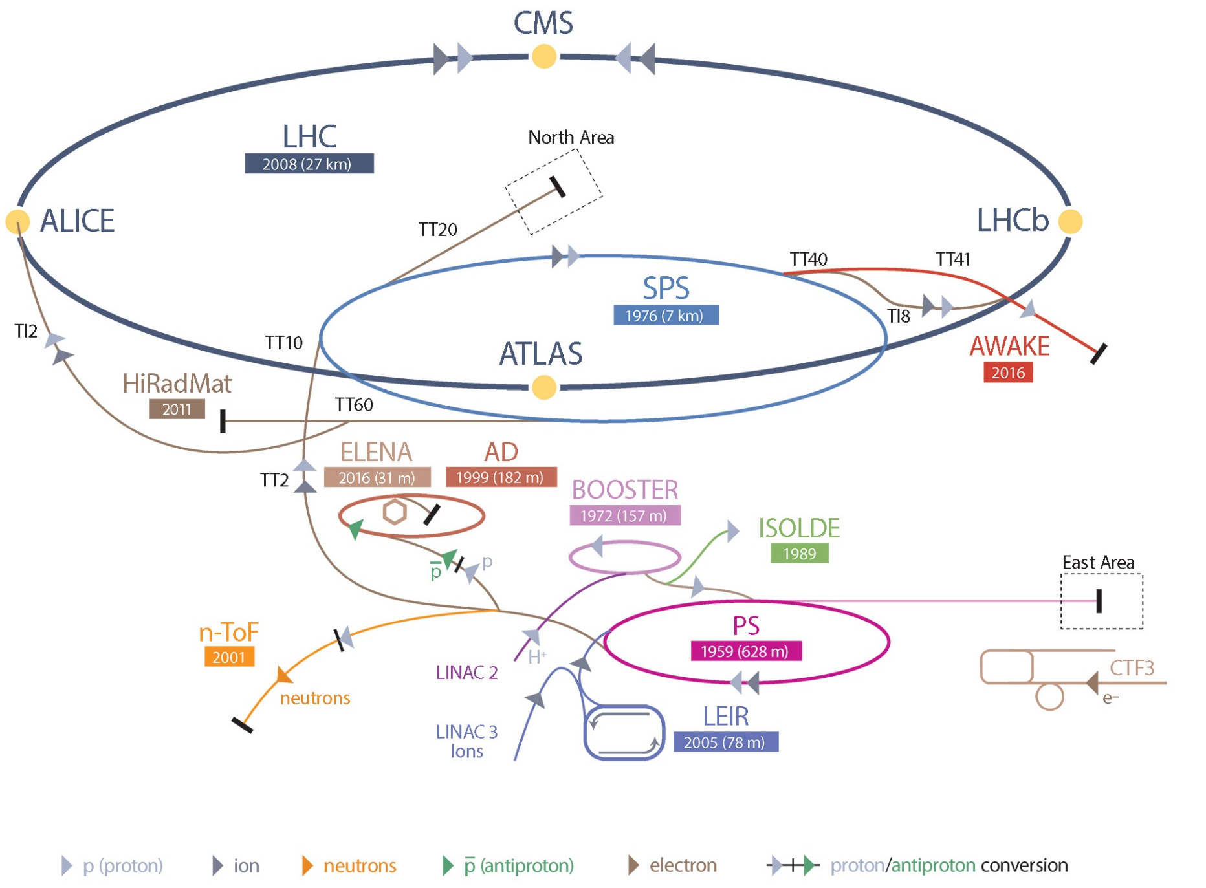
The CERN accelerator complex

Slide 5
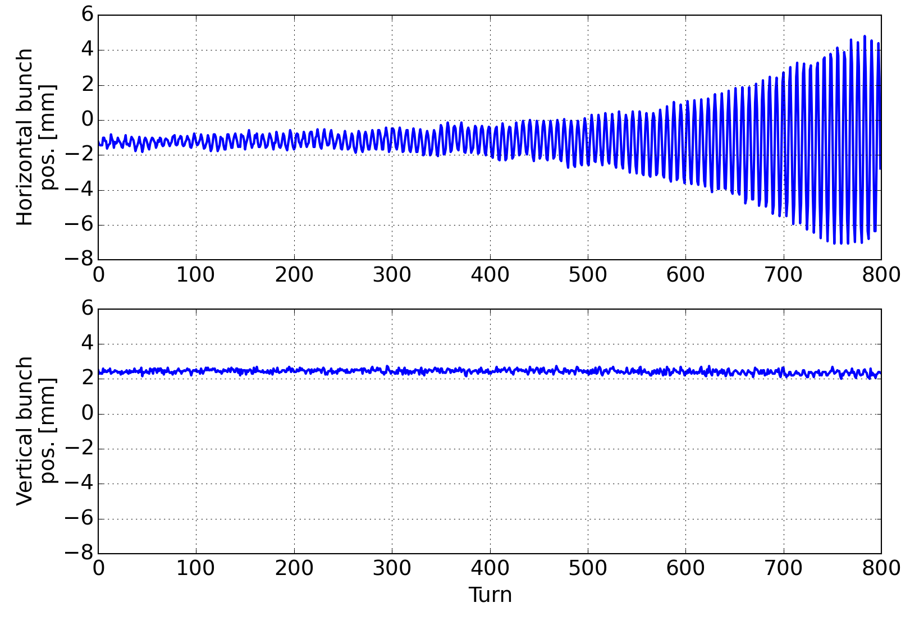
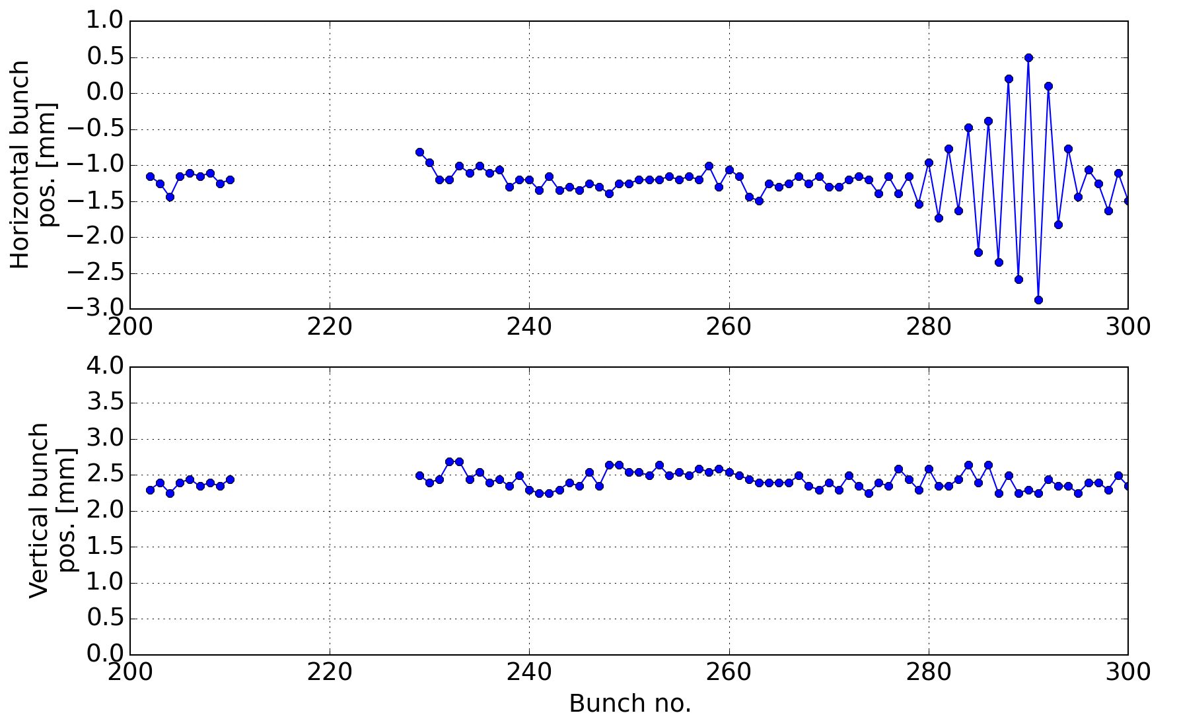
Example: coupled bunch instability
Coupled bunch instabilities vs. single bunch instabilities
  Depends on: long range vs. short range wakefields
  Mitigated by: transverse damper systems and Landau damping
Horizontal cent. [mm] Vertical cent. [mm]
Horizontal coupled bunch instability observed during the 2015 scrubbing run in the SPS.
The transverse damper was set up to damp low frequency oscillations. It would not reach up to 20MHz. It would turn off, once a certain oscillation amplitude was exceeded, as a safety measure.

Slide 6
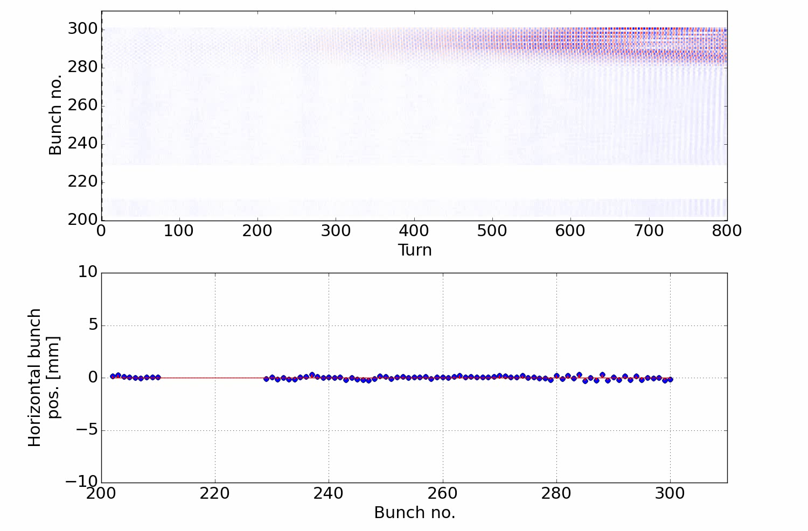
Example: coupled bunch instability
Coupled bunch instabilities vs. single bunch instabilities
  Depends on: long range vs. short range wakefields
  Mitigated by: transverse damper systems and Landau damping
Transverse damper deactivates
Horizontal cent. [mm] Vertical cent. [mm]
Horizontal coupled bunch instability observed during the 2015 scrubbing run in the SPS.
The transverse damper was set up to damp low frequency oscillations. It would not reach up to 20MHz. It would turn off, once a certain oscillation amplitude was exceeded, as a safety measure.

Slide 7
Example: coupled bunch instability
Coupled bunch instabilities vs. single bunch instabilities
  Depends on: long range vs. short range wakefields
  Mitigated by: transverse damper systems and Landau damping
As a consequence, bunches blow up and intensity or even the full beam are lost during the cycle.
During some adjustments in 2017 the bandwidth of the transverse damper up to 20MHz could be fully exploited, successfully suppressing this instability.
Instead, a new type of instability emerged…
Horizontal cent. [mm] Vertical cent. [mm]
Horizontal coupled bunch instability observed during the 2015 scrubbing run in the SPS.
The transverse damper was set up to damp low frequency oscillations. It would not reach up to 20MHz. It would turn off, once a certain oscillation amplitude was exceeded, as a safety measure.

Slide 8
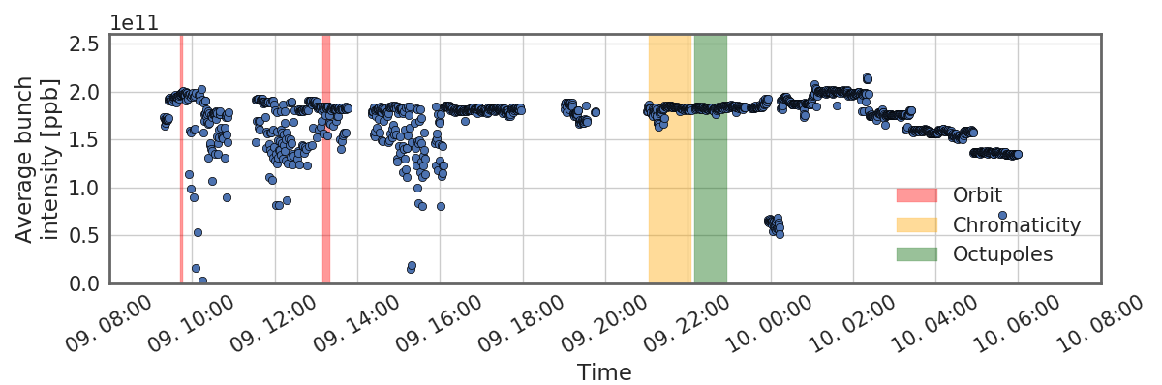
Example: single bunch instabilities
Pure centroid vs. intra-bunch motion (slow headtail instability)
  Relation between bunch length and impedance spectrum
Investigation beam stability and incoherent losses as a function of chromaticity for high intensity beams.
BCMS beam – 4 x 48 bunches
The horizontal coupled bunch instability at 20 MHz did no longer appear with the transverse damper now having been fine adjusted resulting in finite gain at these frequencies.

Slide 9
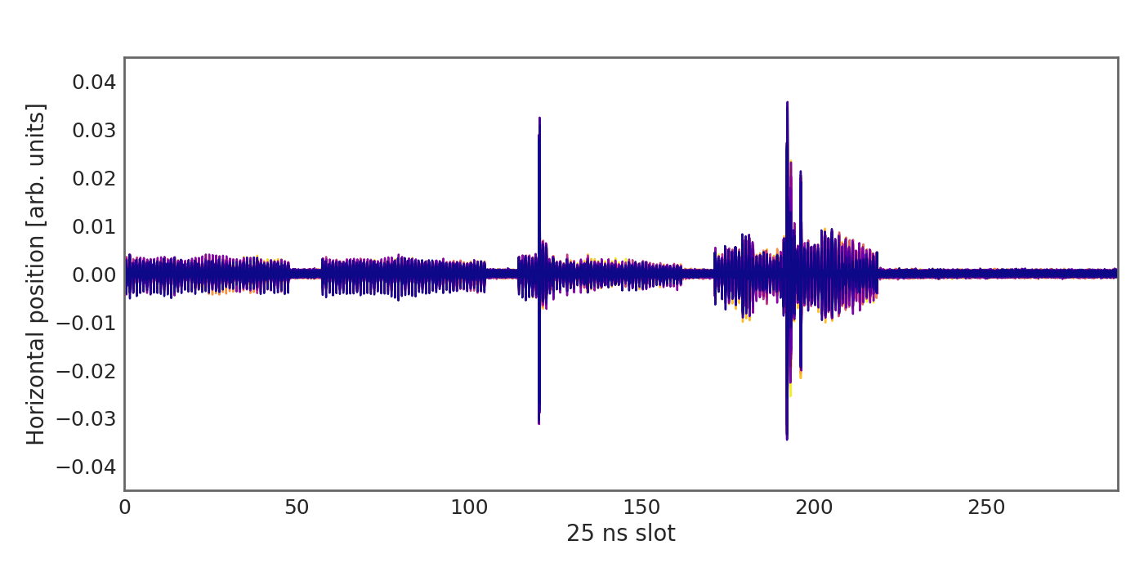
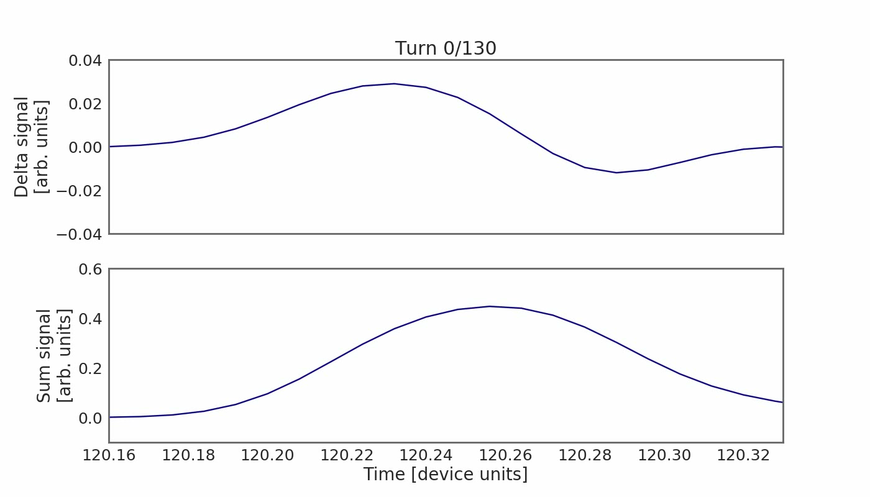
Example: single bunch instabilities
Pure centroid vs. intra-bunch motion (slow headtail instability)
  Relation between bunch length and impedance spectrum
Investigation beam stability and incoherent losses as a function of chromaticity for high intensity beams.
BCMS beam – 4 x 48 bunches
Setting the chromaticity to 0.2 (normalized units) yielded instabilities that were not mitigated by the transverse damper.

Slide 10
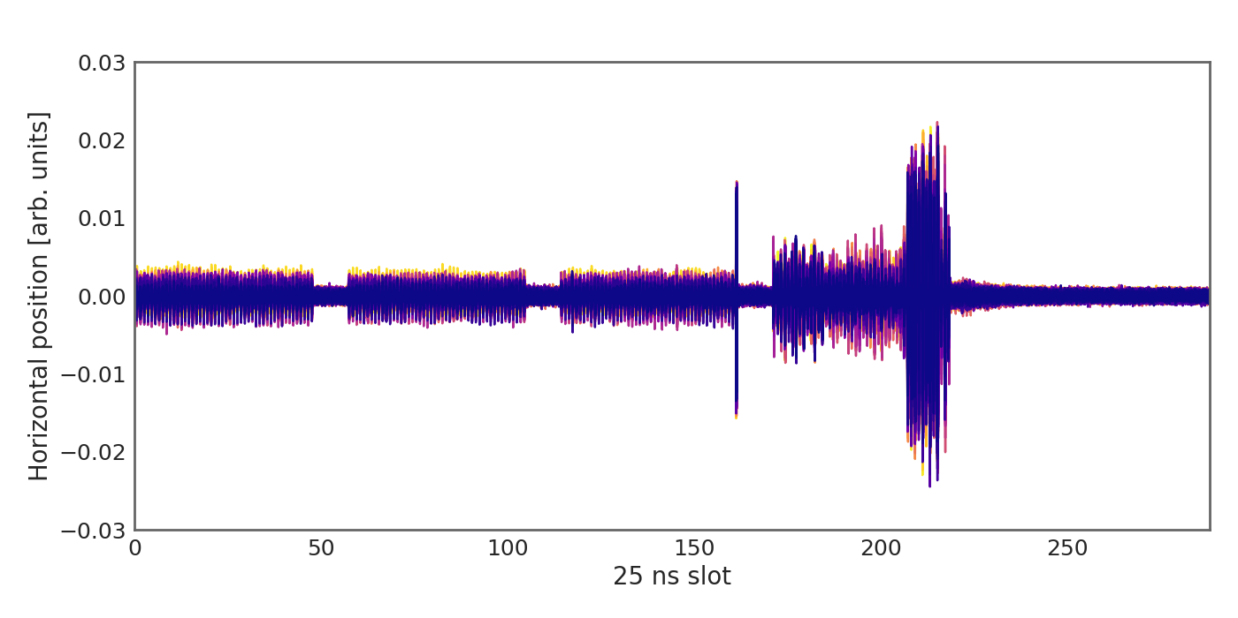
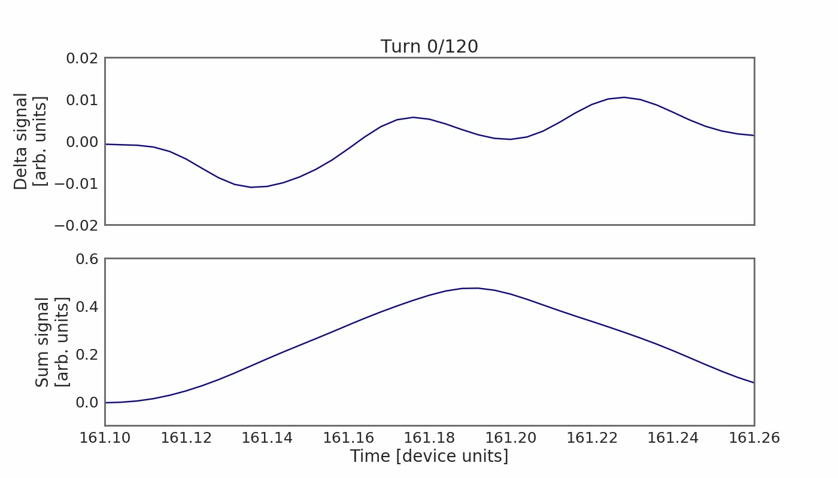
Example: single bunch instabilities
Pure centroid vs. intra-bunch motion (slow headtail instability)
  Relation between bunch length and impedance spectrum
Investigation beam stability and incoherent losses as a function of chromaticity for high intensity beams.
BCMS beam – 4 x 48 bunches
Setting the chromaticity to 0.4 (normalized units) yielded instabilities that were not mitigated by the transverse damper.

Slide 11
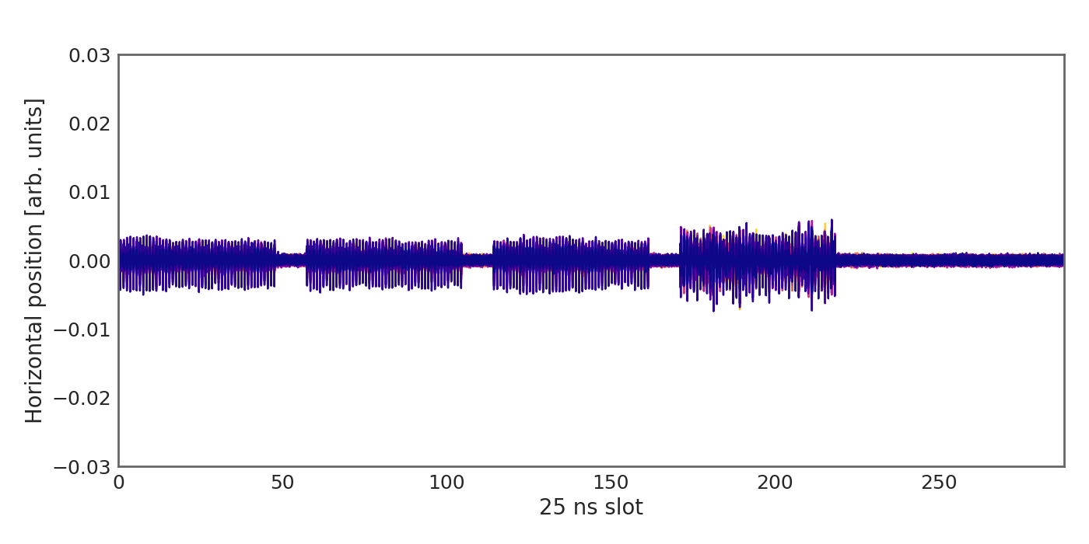
Example: single bunch instabilities
Pure centroid vs. intra-bunch motion (slow headtail instability)
  Relation between bunch length and impedance spectrum
Investigation beam stability and incoherent losses as a function of chromaticity for high intensity beams.
BCMS beam – 4 x 48 bunches
Setting the chromaticity to 0.6 (normalized units) the instabilities were suppressed.

Slide 12
We have seen some examples of coherent beam instabilities observed in recent years at the CERN Super Proton Synchrotron (SPS). We were able to observe a coupled bunch instability and have seen that these types of instabilities can be mitigated by a transverse feedback system.
We have then seen another type of instability arising at finite chromaticities. This instability features higher frequency intra-bunch motion and is therefore called a (slow) headtail instability.
We will now have a brief look at a more formal description of this type of instability.
Part IV: Coherent beam instabilities
  Examples of coherent beam instabilities at CERN
  Slow headtail instability at finite chromaticity
  Fast headtail or transverse mode coupling instability
  Longitudinal instabilities

Slide 13
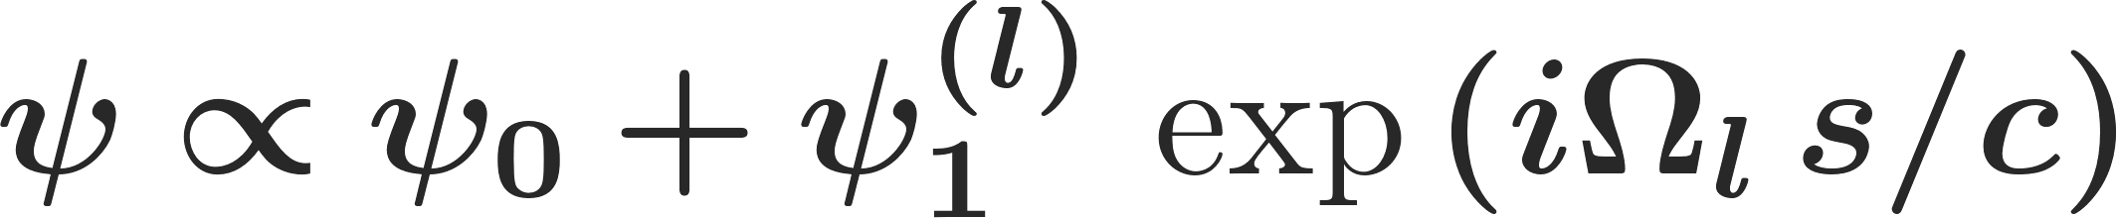
Headtail modes
Headtail instabilities can be derived from the Vlasov equation in the presence of impedances. They evolve as eigenmodes of the coupled accelerator-beam system. The eigenvalue of these modes is the complex tune Ω – this number fully characterizes a mode and thus an instability:
Single particle probability
density function
Stationary solution
Perturbation mode
Eigenfrequency
From solving Vlasov equation
* F. Sacherer: Methods for computing bunched-beam instabilities, CERN-SI-BR-72-5. - 1972. - 41 p.

Slide 14
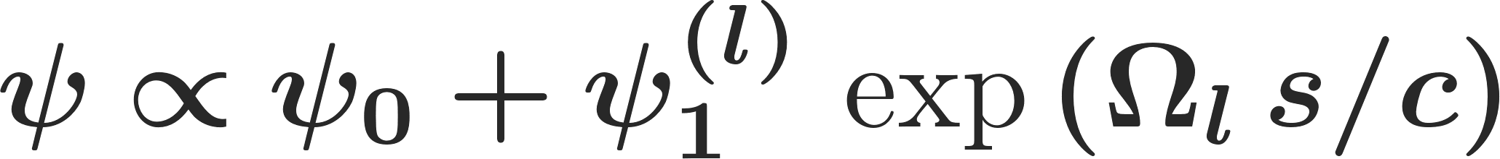
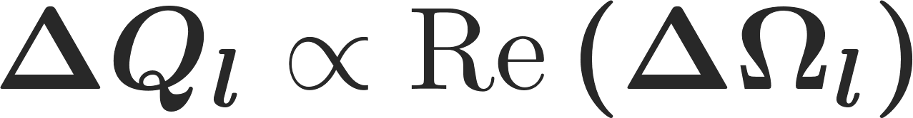
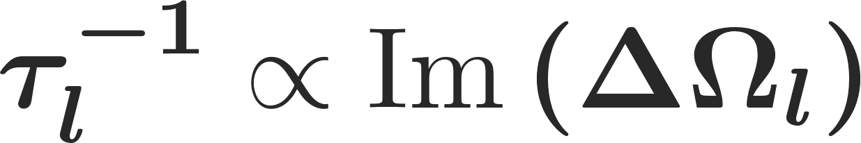
Headtail modes
Headtail instabilities can be derived from the Vlasov equation in the presence of impedances. They evolve as eigenmodes of the coupled accelerator-beam system. The eigenvalue of these modes is the complex tune Ω – this number fully characterizes a mode and thus an instability:
Ultimately, we express the characteristics of a given perturbation mode via its complex tune shift
The real part of this number gives the coherent tune shift of the respective unperturbed mode
The imaginary part gives the growth rate of the perturbation mode
Single particle probability
density function
Stationary solution
Perturbation mode
Eigenfrequency
From solving Vlasov equation
* F. Sacherer: Methods for computing bunched-beam instabilities, CERN-SI-BR-72-5. - 1972. - 41 p.

Slide 15
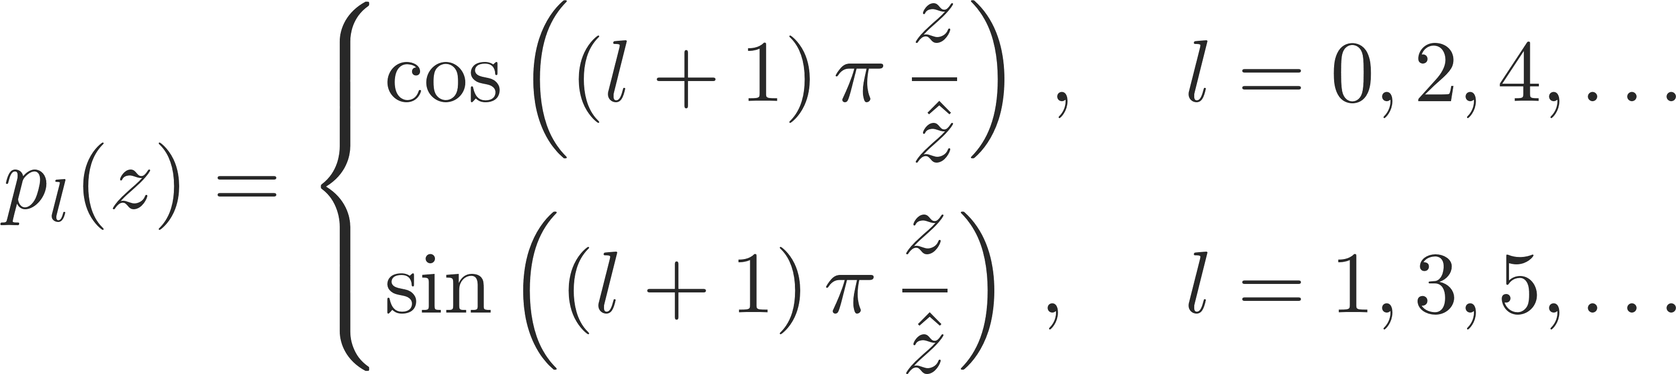
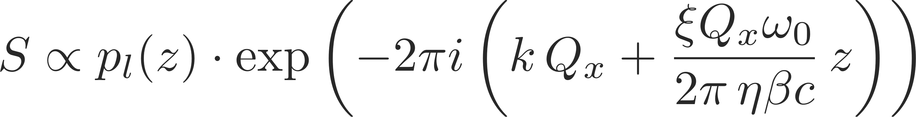
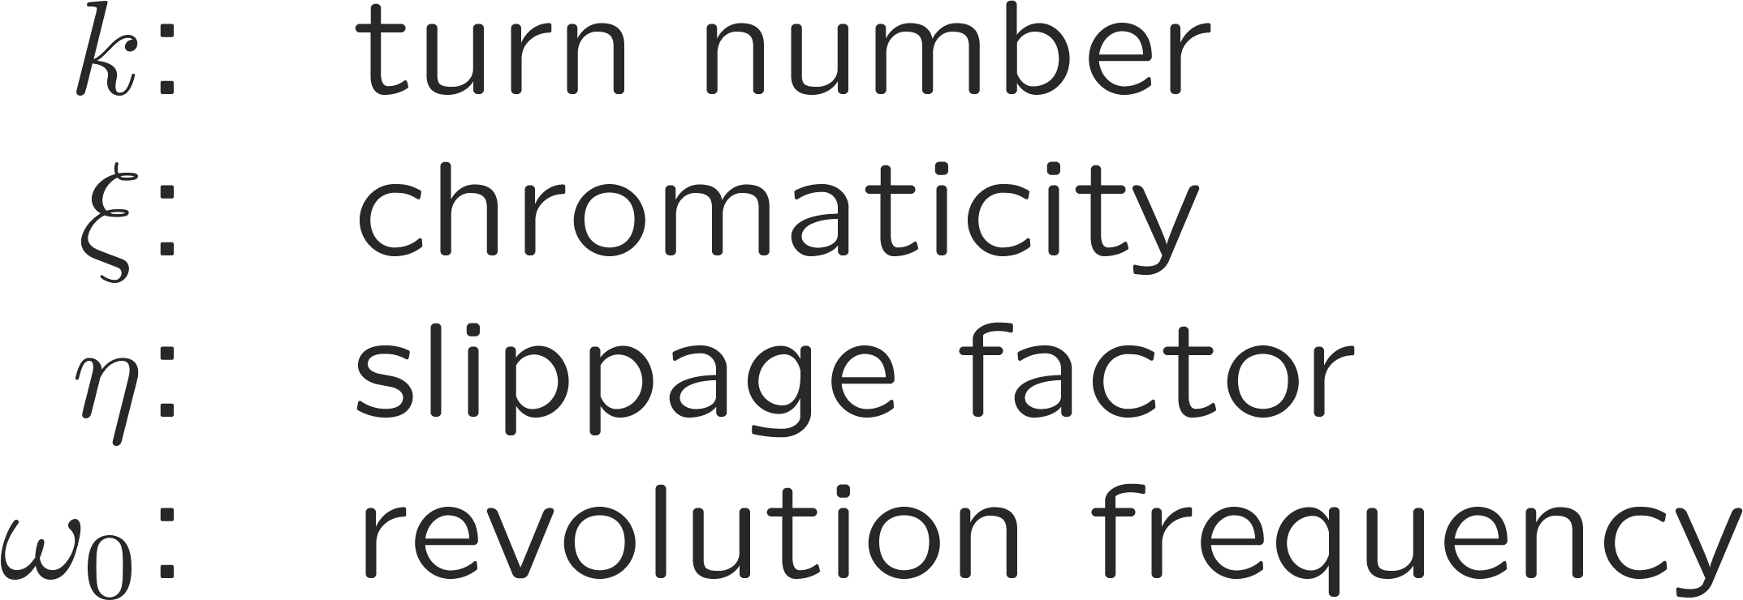
Headtail modes
Writing down the full Vlasov equation with the beam coupling impedance and finding a solution in terms of eigenmodes and eigenfrequencies is non-trivial.
In 1972, Frank Sacherer wrote down an approximate solution for the headtail modes, which very well matched observations in the CERN Proton Synchrotron (PS) (*):
Thus, Sacherer found that the observed signal at a (wideband) pickup for a given mode l can be described as:
* F. Sacherer: Methods for computing bunched-beam instabilities, CERN-SI-BR-72-5. - 1972. - 41 p.

Slide 16
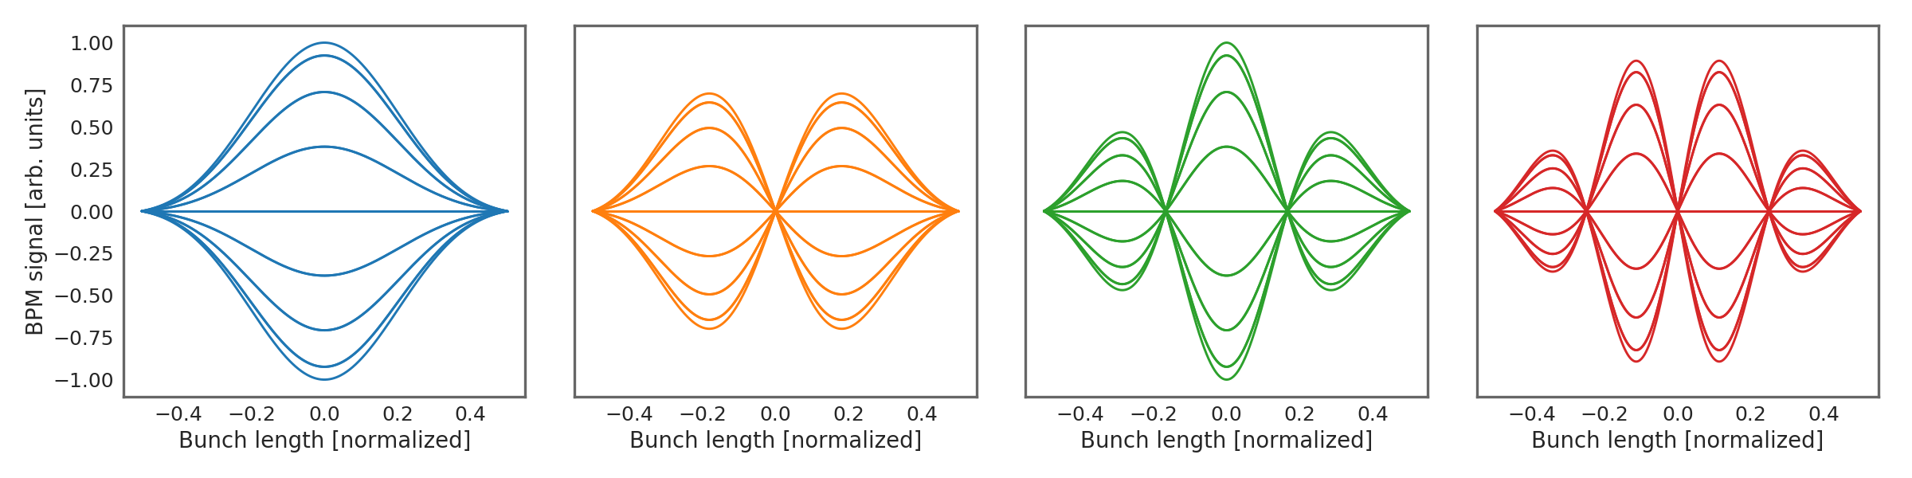
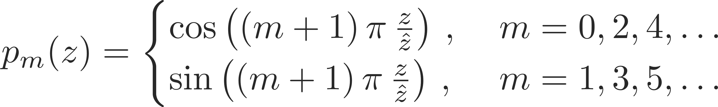
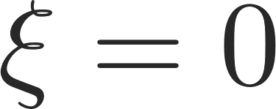
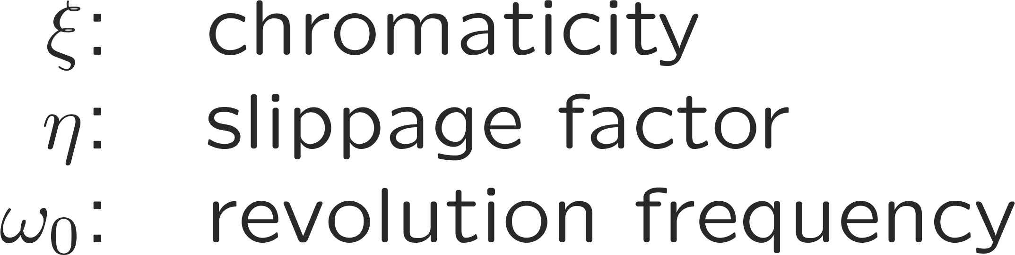
Headtail modes
In a certain abstraction, we can think of a bunch as a quasi one dimensional line element (string) of finite length.
Writing down and solving the Vlasov equation one finds that, with certain approximations*, this string has a set of eigenmodes of oscillation, each featuring a distinct oscillation pattern. These are called the Sacherer modes given as:
Each of these modes is characterized by its unique radial mode number m. Each mode features a distinct pattern when observed as a signal detected at a pickup:
It is to be noted, that these bunch modes are always latently present, but not usually excited.
It requires an impedance as source of energy together with chromaticity to generate a synchronization of the bunch motion with the wake fields kicks in order to drive a given bunch mode into resonance.
* F. Sacherer: Methods for computing bunched-beam instabilities, CERN-SI-INT-BR-72-5. - 1972. - 44 p.

Slide 17
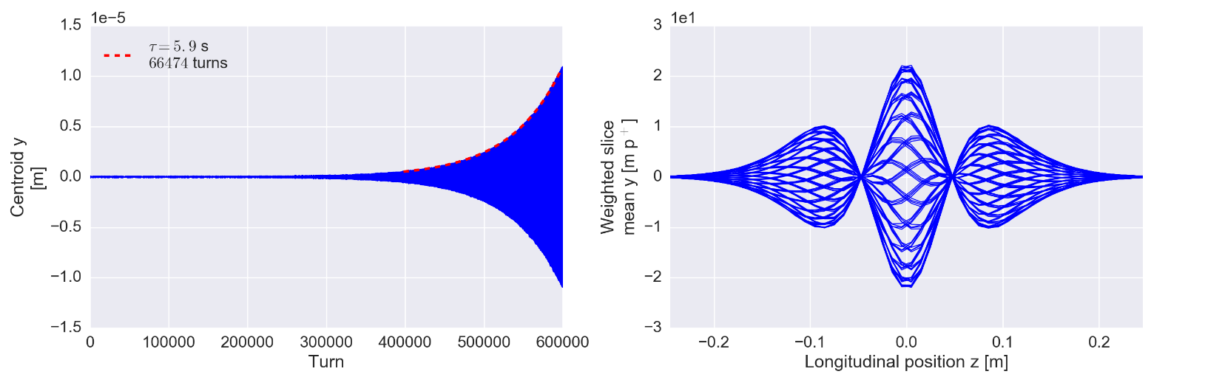

Headtail modes
In a certain abstraction, we can think of a bunch as a quasi one dimensional line element (string) of finite length.
Writing down and solving the Vlasov equation one finds that, with certain approximations*, this string has a set of eigenmodes of oscillation, each featuring a distinct oscillation pattern. These are called the Sacherer modes given as:
Each of these modes is characterized by its unique radial mode number m. Each mode features a distinct pattern when observed as a signal detected at a pickup:
It is to be noted, that these bunch modes are always latently present, but not usually excited.
It requires an impedance as source of energy together with chromaticity to generate a synchronization of the bunch motion with the wake fields kicks in order to drive a given bunch mode into resonance.
* F. Sacherer: Methods for computing bunched-beam instabilities, CERN-SI-INT-BR-72-5. - 1972. - 44 p.

Slide 18
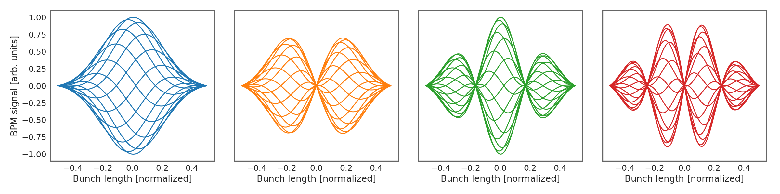
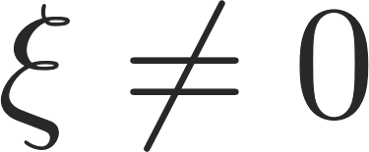
Headtail modes
In a certain abstraction, we can think of a bunch as a quasi one dimensional line element (string) of finite length.
Writing down and solving the Vlasov equation one finds that, with certain approximations*, this string has a set of eigenmodes of oscillation, each featuring a distinct oscillation pattern. These are called the Sacherer modes given as:
Each of these modes is characterized by its unique radial mode number m. Each mode features a distinct pattern when observed as a signal detected at a pickup:
It is to be noted, that these bunch modes are always latently present, but not usually excited.
It requires an impedance as source of energy together with chromaticity to generate a synchronization of the bunch motion with the wake fields kicks in order to drive a given bunch mode into resonance.
* F. Sacherer: Methods for computing bunched-beam instabilities, CERN-SI-INT-BR-72-5. - 1972. - 44 p.

Slide 19
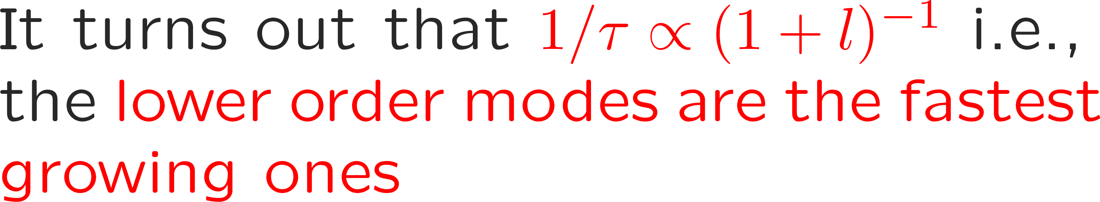
Headtail modes
In a certain abstraction, we can think of a bunch as a quasi one dimensional line element (string) of finite length.
Writing down and solving the Vlasov equation one finds that, with certain approximations*, this string has a set of eigenmodes of oscillation, each featuring a distinct oscillation pattern. These are called the Sacherer modes given as:
Each of these modes is characterized by its unique radial mode number m. Each mode features a distinct pattern when observed as a signal detected at a pickup:
It is to be noted, that these bunch modes are always latently present, but not usually excited.
It requires an impedance as source of energy together with chromaticity to generate a synchronization of the bunch motion with the wake fields kicks in order to drive a given bunch mode into resonance.
 | Below transition | Above transition
Chromaticity negative | l = 0 stable; l > 0 unstable | l = 0 unstable; l > 0 stable
Chromaticity positive | l = 0 unstable; l > 0 stable | l = 0 stable; l > 0 unstable
* F. Sacherer: Methods for computing bunched-beam instabilities, CERN-SI-INT-BR-72-5. - 1972. - 44 p.

Slide 20
Headtail modes
In a certain abstraction, we can think of a bunch as a quasi one dimensional line element (string) of finite length.
Writing down and solving the Vlasov equation one finds that, with certain approximations*, this string has a set of eigenmodes of oscillation, each featuring a distinct oscillation pattern. These are called the Sacherer modes given as:
Each of these modes is characterized by its unique radial mode number m. Each mode features a distinct pattern when observed as a signal detected at a pickup:
It is to be noted, that these bunch modes are always latently present, but not usually excited.
It requires an impedance as source of energy together with chromaticity to generate a synchronization of the bunch motion with the wake fields kicks in order to drive a given bunch mode into resonance.
 | Below transition | Above transition
Chromaticity negative | l = 0 stable; l > 0 unstable | l = 0 unstable; l > 0 stable
Chromaticity positive | l = 0 unstable; l > 0 stable | l = 0 stable; l > 0 unstable
* F. Sacherer: Methods for computing bunched-beam instabilities, CERN-SI-INT-BR-72-5. - 1972. - 44 p.

Slide 21
We have seen how we can describe headtail modes as Sacherer’s sinusoidal modes. We have learned that it requires impedances and chromaticity for these modes to actually be resonantly excited via a synchronization between the transverse and longitudinal particle motion and the wake field kicks.
We have also seen how we usually operate machines in certain chromaticity regimes, depending on the state of transition, in order to suppress the mode 0.
Another very violent type of instability is the transverse mode coupling instability (TMCI) which occurs also for vanishing chromaticity and provides a hard limit on the intensity reach of many machines.
Part IV: Coherent beam instabilities
  Examples of coherent beam instabilities at CERN
  Slow headtail instability at finite chromaticity
  Fast headtail or transverse mode coupling instability
  Longitudinal instabilities

Slide 22
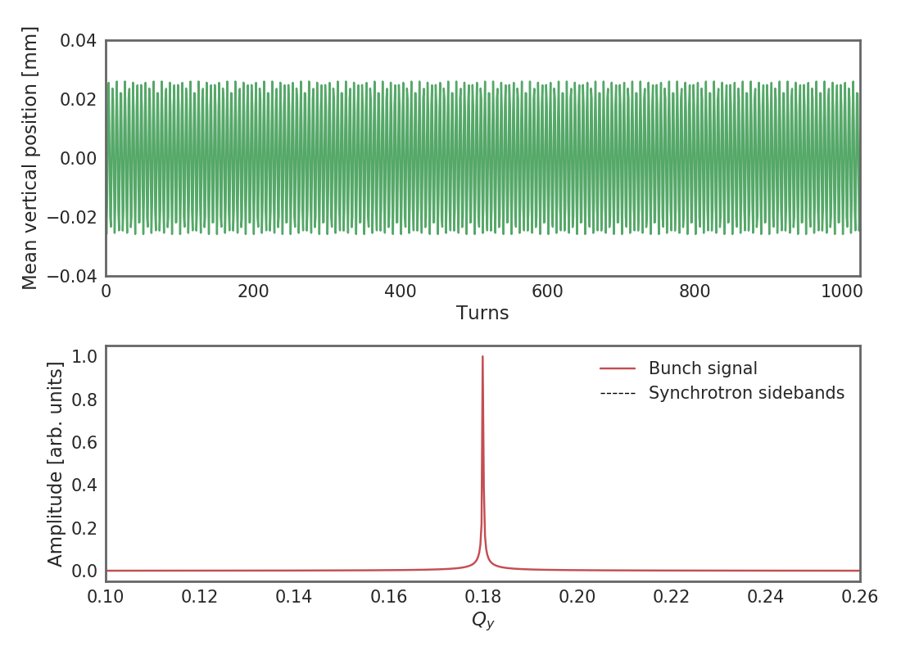
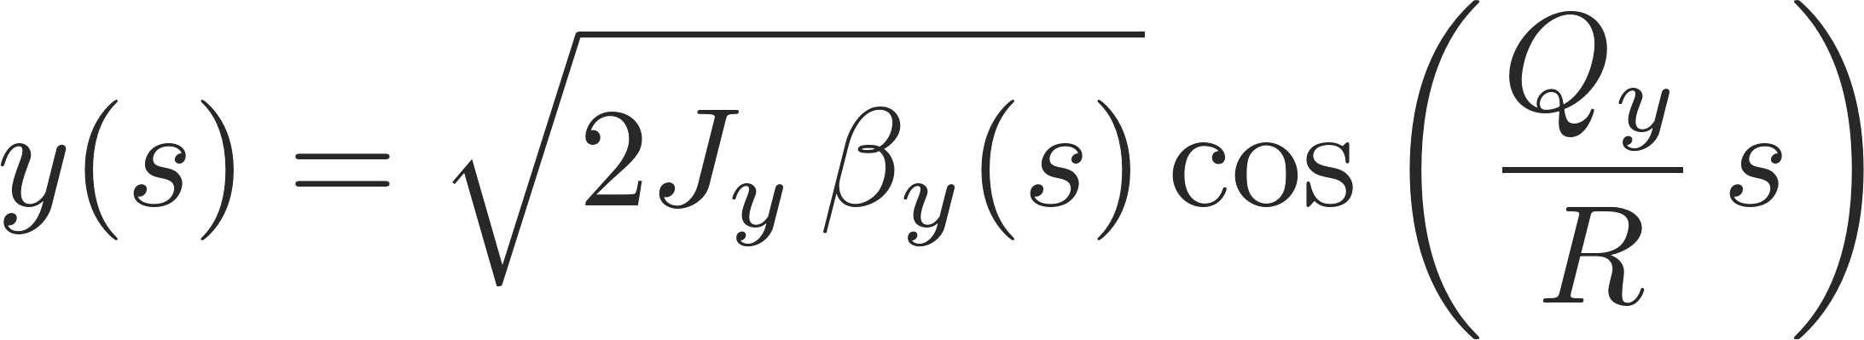
Azimuthal bunch modes
The pure betatron motion follows from Hill’s equation to
A spectral analysis of the betatron motion yield a single distinct line at the betatron tune

Slide 23
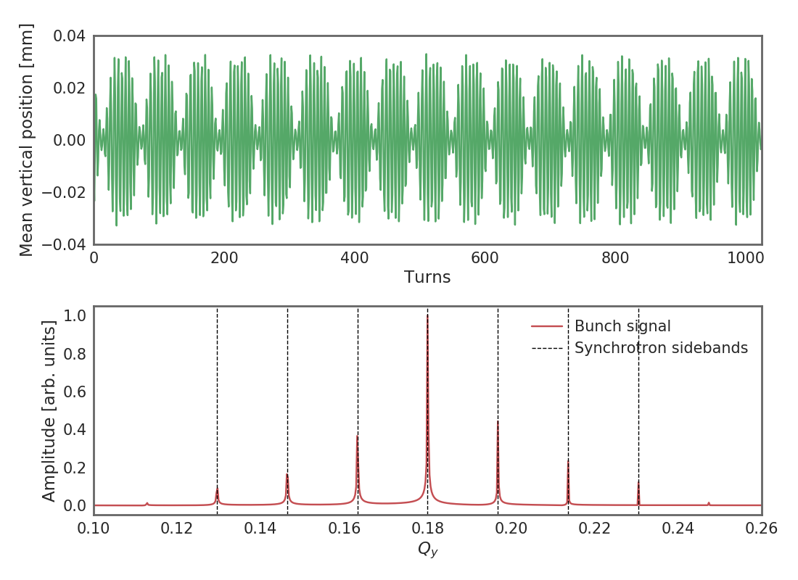

Azimuthal bunch modes
The pure betatron motion follows from Hill’s equation to
A spectral analysis of the betatron motion yield a single distinct line at the betatron tune
Any coupling of the transverse to the longitudinal motion, such in the case of wake fields for example, leads to a modulation of the betatron motion with the synchrotron motion.
Synchrotron sidebands develop in the betatron spectrum – we call each sideband an azimuthal mode of order l.

Slide 24

Azimuthal bunch modes
The pure betatron motion follows from Hill’s equation to
A spectral analysis of the betatron motion yield a single distinct line at the betatron tune
Any coupling of the transverse to the longitudinal motion, such in the case of wake fields for example, leads to a modulation of the betatron motion with the synchrotron motion.
Synchrotron sidebands develop in the betatron spectrum – we call each sideband an azimuthal mode of order l.
Impedances generate a complex tune shift ΔQ_{l} for every mode
The real part of this shift indicates the shifting of the corresponding mode
The imaginary part of this shift indicates the growth rate of the corresponding mode

Slide 25
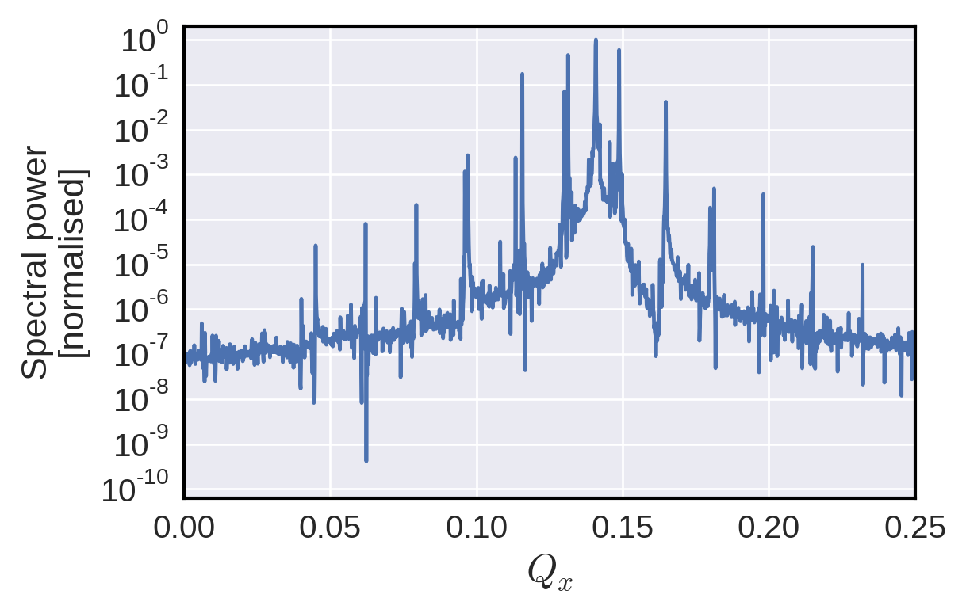
Transverse mode coupling instability (TMCI)
At zero chromaticity, all headtail modes are usually symmetrically at the same time damped and excited. None of the modes begins to grow and the beam is inherently stable.

Slide 26
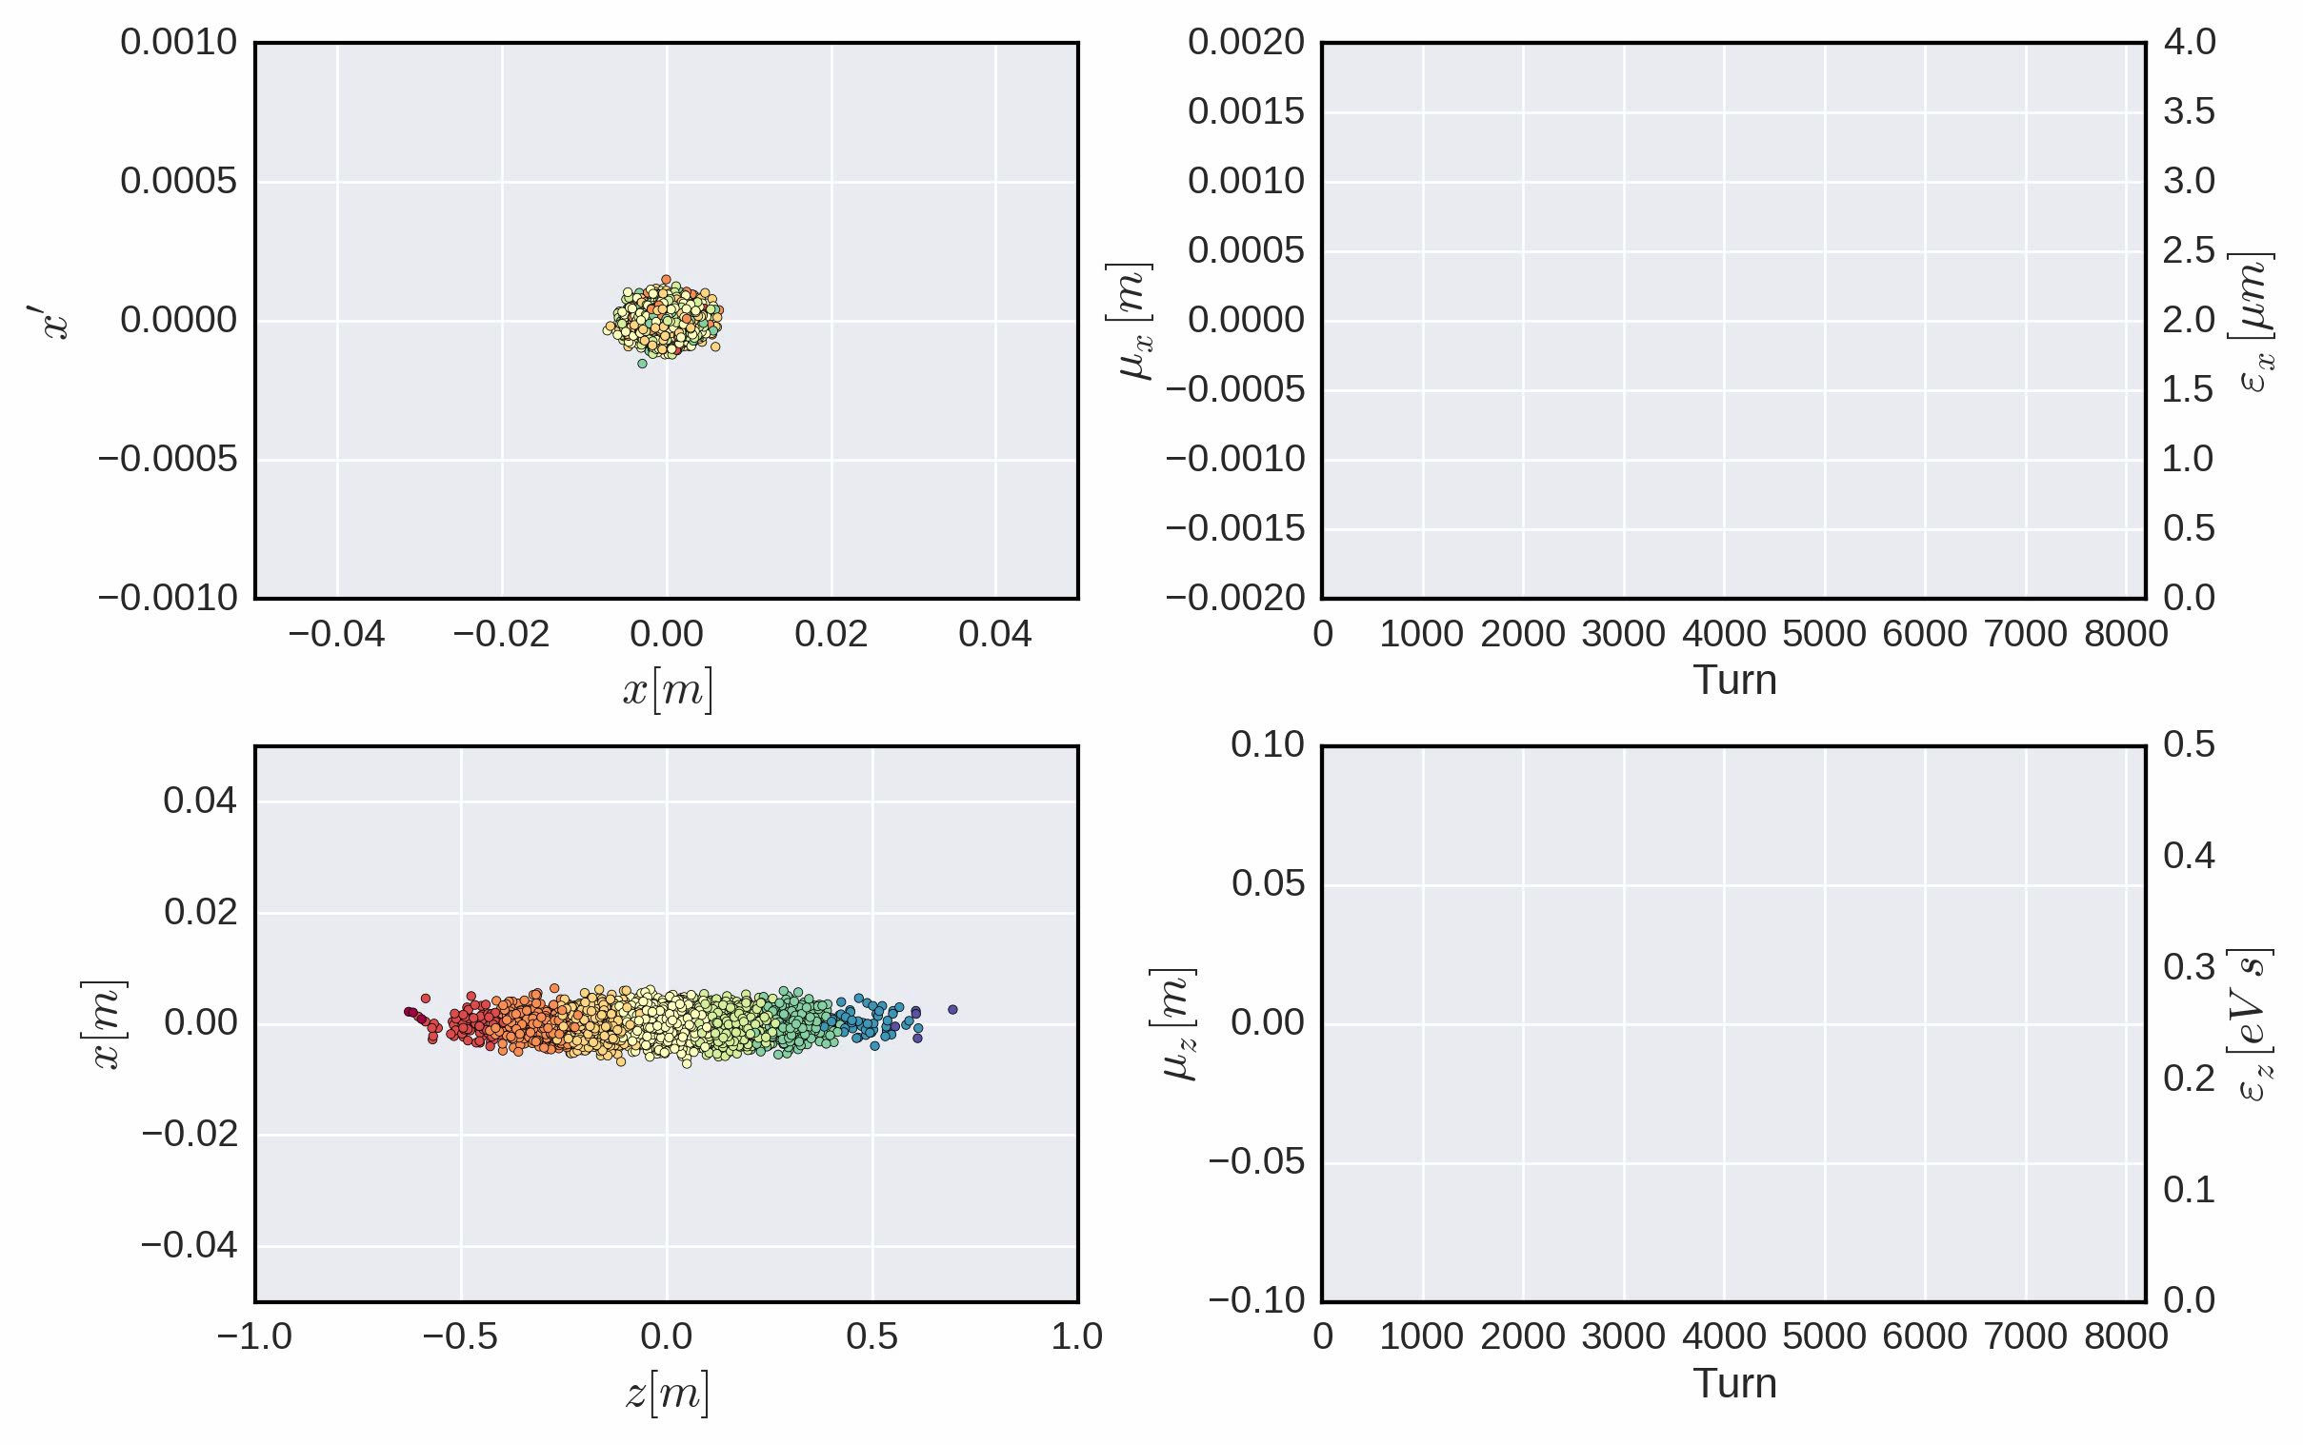
Transverse mode coupling instability (TMCI)
At zero chromaticity, all headtail modes are usually symmetrically at the same time damped and excited. None of the modes begins to grow and the beam is inherently stable.

Slide 27
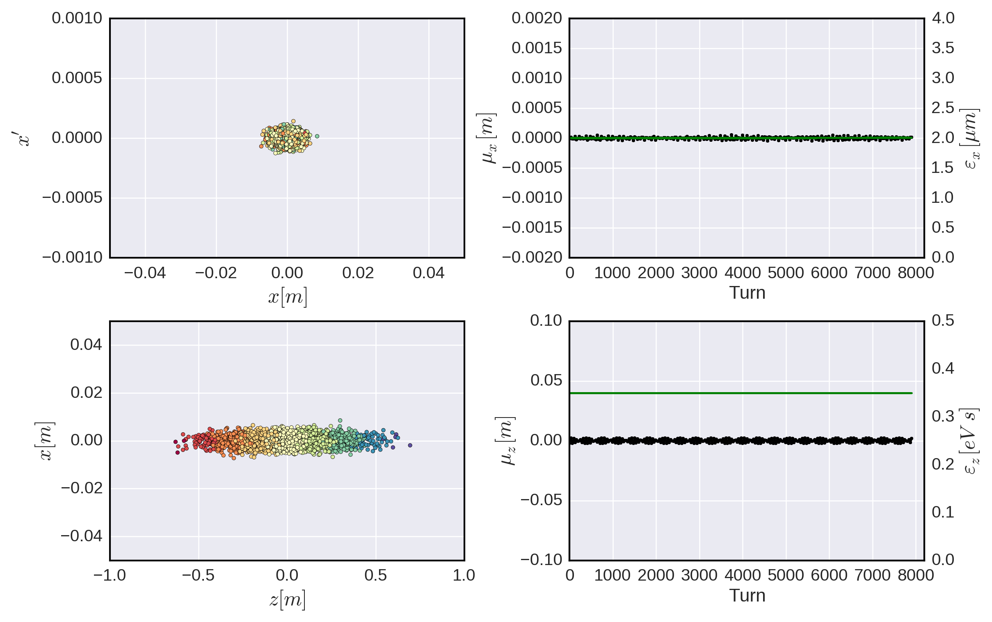
Transverse mode coupling instability (TMCI)
At zero chromaticity, all headtail modes are usually symmetrically at the same time damped and excited. None of the modes begins to grow and the beam is inherently stable.
As the bunch intensity grows tunes will shift further…
Azimuthal mode lines can shift in opposite directions…
Mode A
Mode B

Slide 28
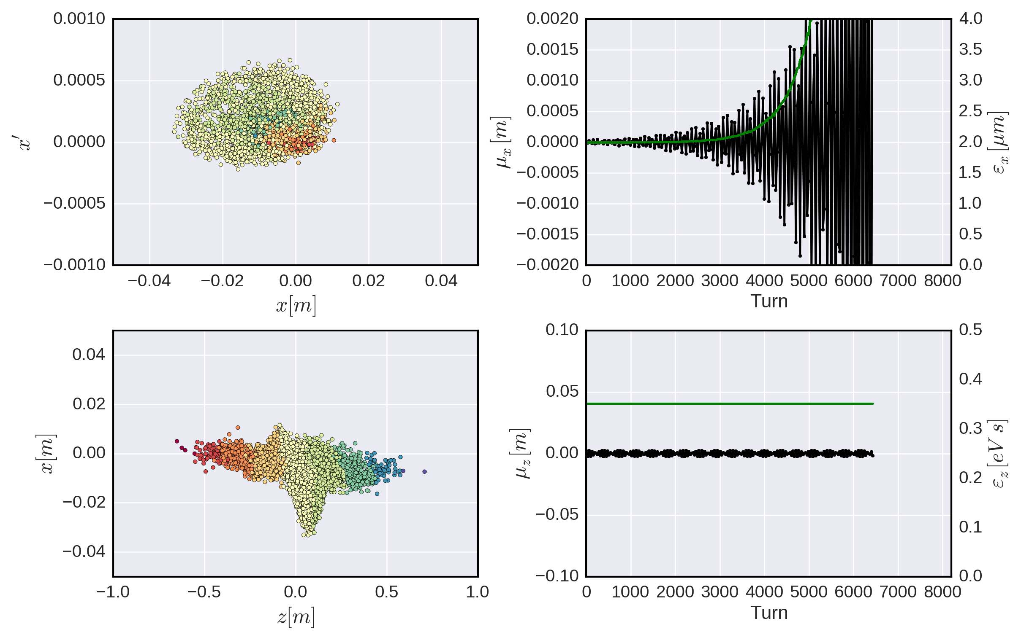
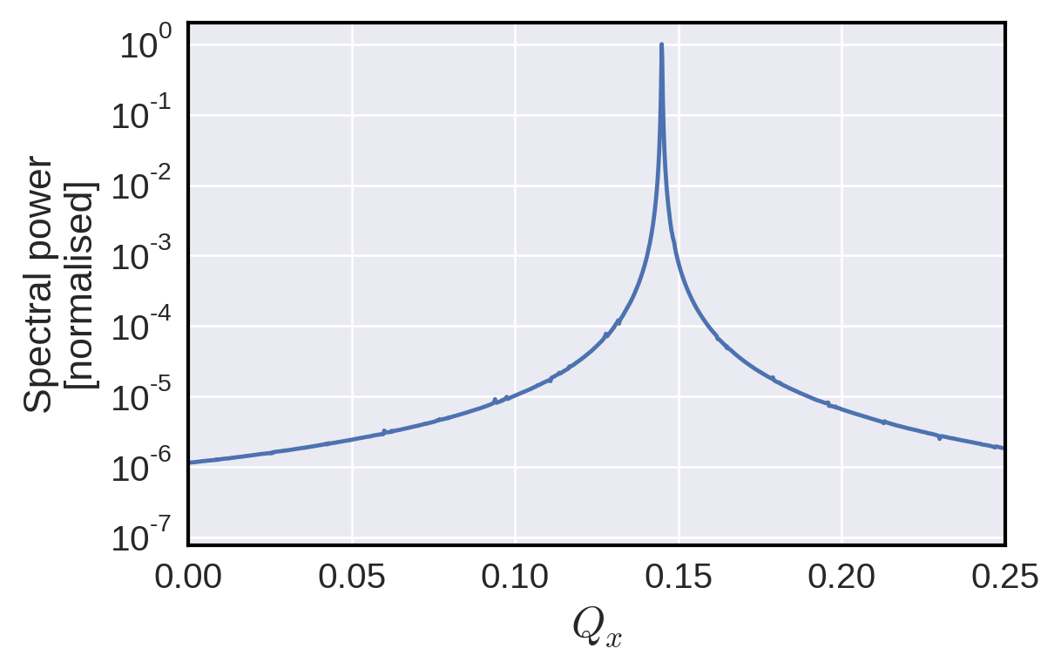
Transverse mode coupling instability (TMCI)
At zero chromaticity, all headtail modes are usually symmetrically at the same time damped and excited. None of the modes begins to grow and the beam is inherently stable.
As the bunch intensity grows tunes will shift further…
Azimuthal mode lines can shift in opposite directions…
Until they couple and generate the highly violent transverse mode coupling instability
Mode A
Mode A
Mode B
Mode B

Slide 29
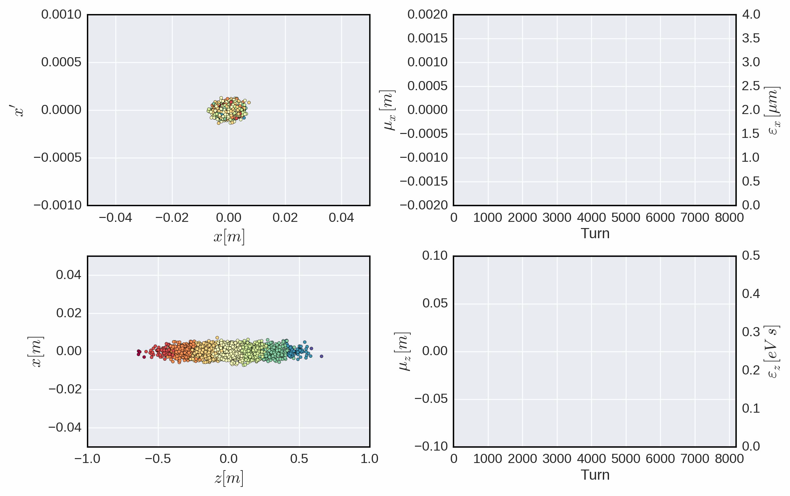
Transverse mode coupling instability (TMCI)
At zero chromaticity, all headtail modes are usually symmetrically at the same time damped and excited. None of the modes begins to grow and the beam is inherently stable.
As the bunch intensity grows tunes will shift further…
Azimuthal mode lines can shift in opposite directions…
Until they couple and generate the highly violent transverse mode coupling instability
Mode A
Mode A
Mode B
Mode B
The TMCI threshold is often a hard limit on the reachable intensity in many machines.

Slide 30
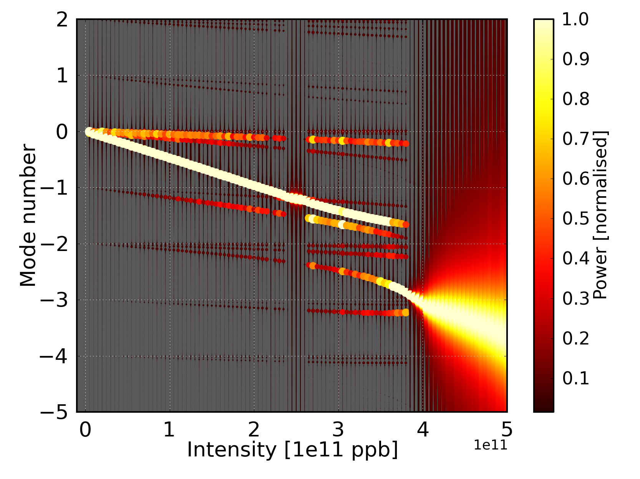
Transverse mode coupling instability in the SPS
TMCI in the SPS (modeled using a broadband resonator impedance at around 1.3GHz)
Fast TMCI regime
Slow TMCI regime
Mitigation of TMCI is usually done already at the design stage by maintaining a strict impedance budget.
H. Bartosik

Slide 31
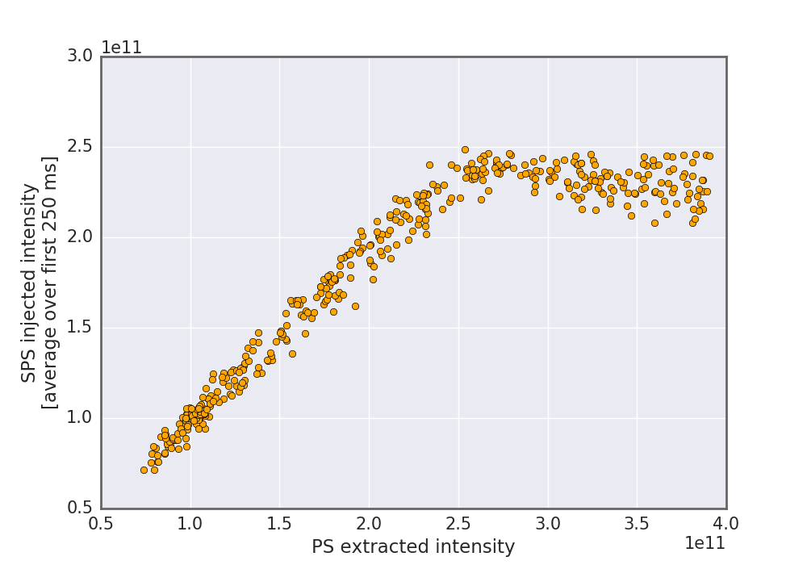
An intensity scan in the SPS from 2017
Intensity scans clearly reveal an intensity limitation at around 2.4e11 ppb
This limit manifests itself via a strong instability accompanied by very fast losses. This is the transverse mode coupling instability (TMCI).

Slide 32
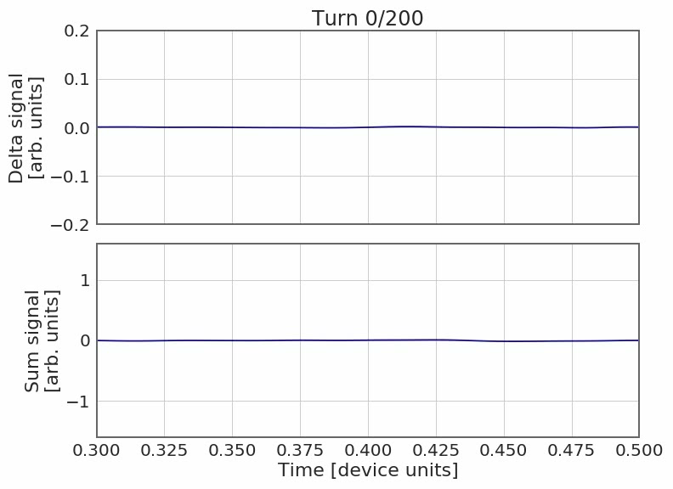
An intensity scan in the SPS from 2017
Intensity scans clearly reveal an intensity limitation at around 2.4e11 ppb
This limit manifests itself via a strong instability accompanied by very fast losses. This is the transverse mode coupling instability (TMCI).

Slide 33
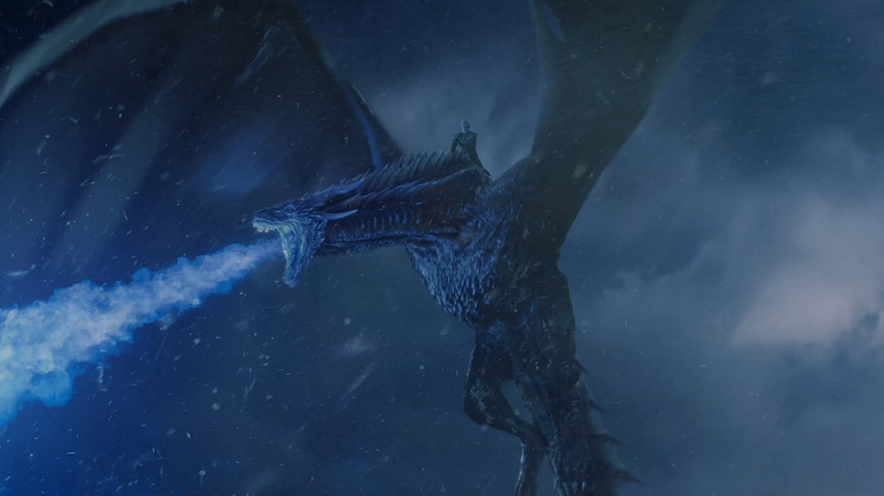
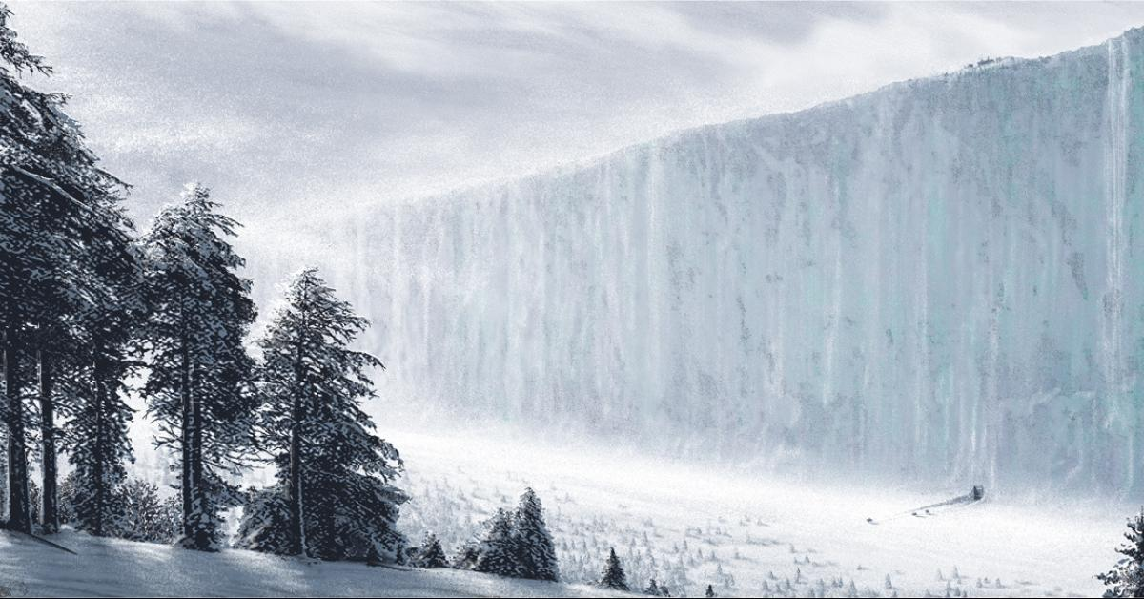
TMCI threshold
Intensity scans clearly reveal an intensity limitation at around 2.4e11 ppb
This limit manifests itself via a strong instability accompanied by very fast losses. This is the transverse mode coupling instability (TMCI).
The LHC Injectors Upgrade will require a total injected intensity of 2.6e11 ppb in the future!
Is this excluded?
Are there any means to breach the wall…?!

Slide 34
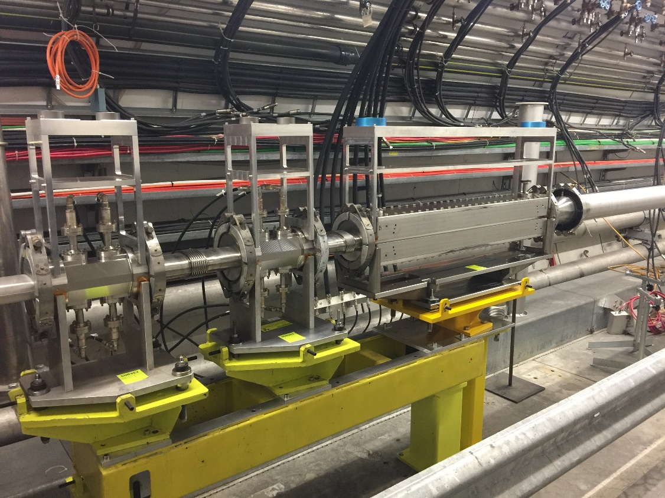
TMCI threshold
The TMCI threshold in the SPS for Q22 at a voltage of 2.7 MV and a long. Emittance around 0.3 eVs is at 2.4e11 ppb!
LIU requires an injected intensity of 2.6e11 ppb.
Does this mean Q22 is excluded as potential alternative for LIU?
Are there any means to breach the wall…?!

Slide 35
Wideband feedback systems
Simulations show that a wideband feedback system in principle can mitigate both TMCI and e-cloud driven instabilities.

Slide 36
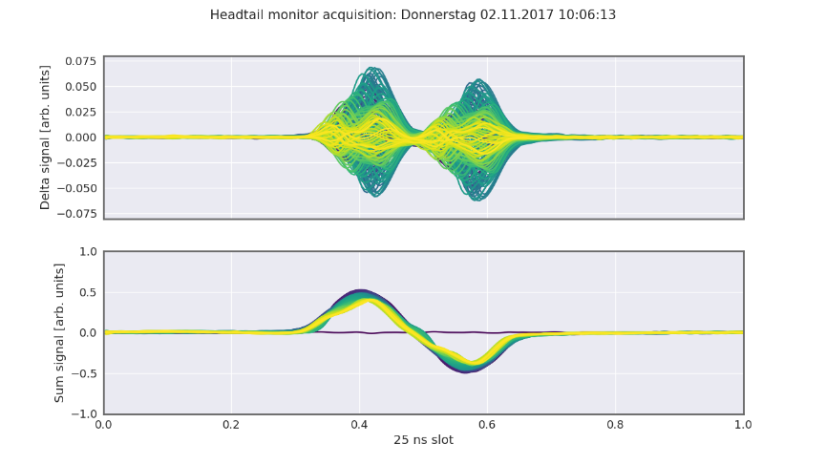
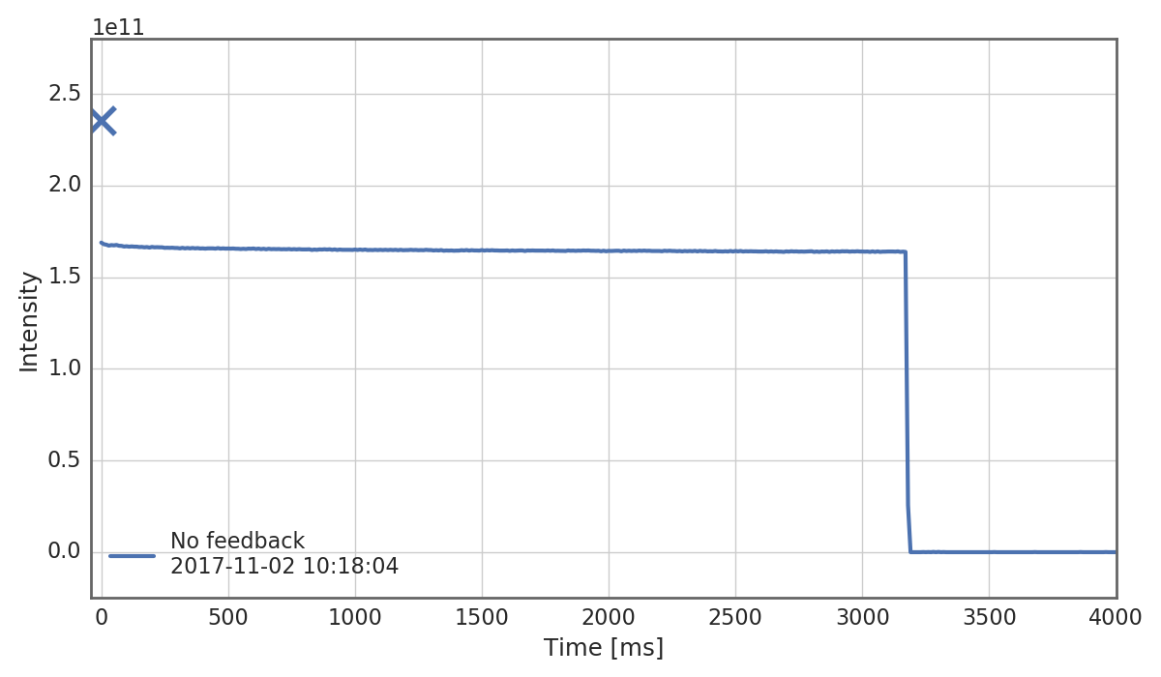
Intensity scan
First test… looking at the BCT, a constant signal is observed all along the cycle.
To be noted that we are injecting high intensity beams (~2.5e11 ppb) → TMCI induced losses occur before the first BCT sampling point!
A look into the HEADTAIL monitor just after injection reveals the TMCI.

Slide 37
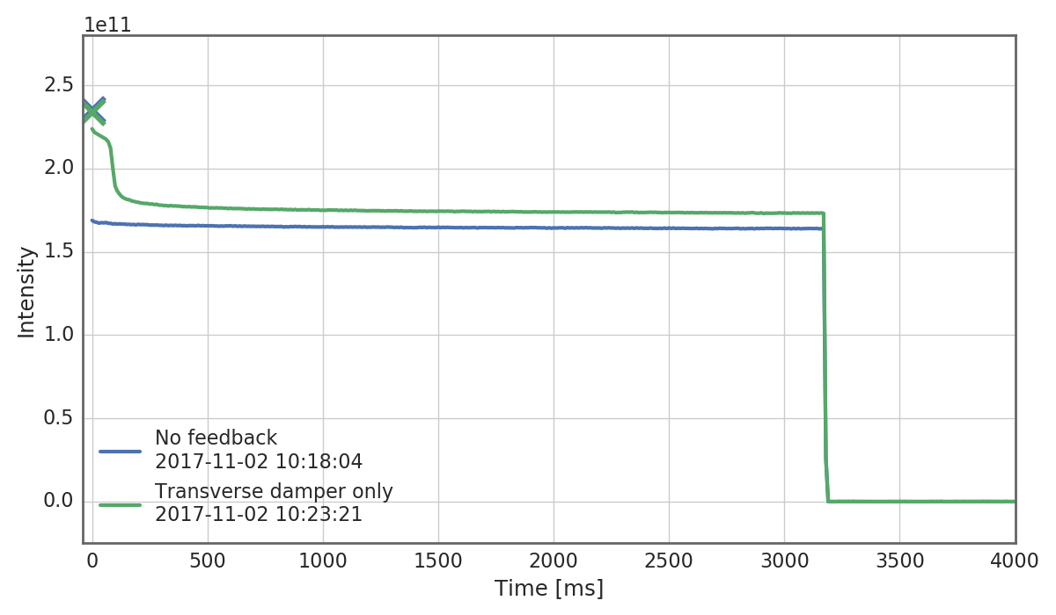
Intensity scan
The standard transverse damper was set up and put into operation in an attempt to mitigate the instability.
The fast growth was reduced but could not be stopped. The losses are ultimately comparable to running without the transverse damper.
This is expected due to the bandwidth limitations of the transverse damper… the high frequency content of the instability remains unaffected.

Slide 38
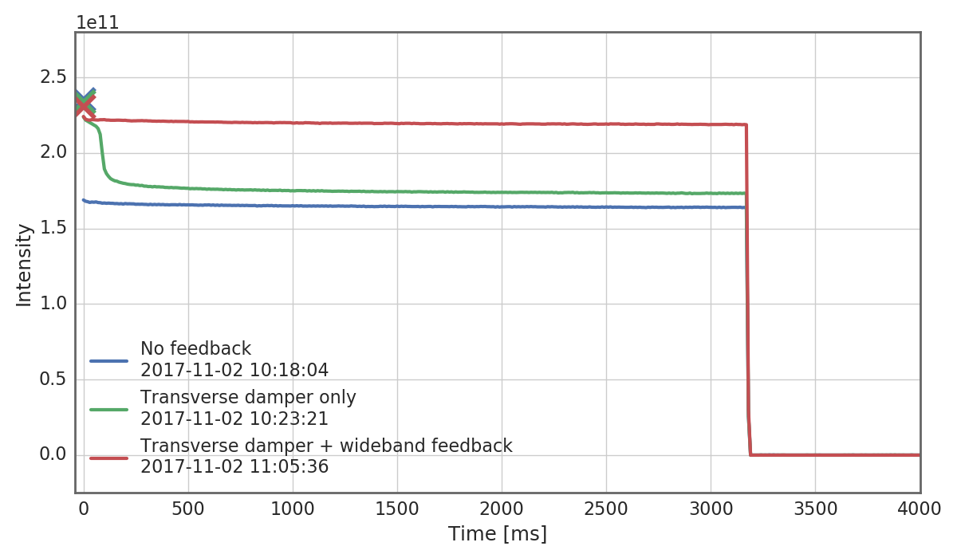
Intensity scan
Finally, the wideband feedback system was time aligned, configured and activated by closing the loop over the observed instability.
The transverse damper was kept active to control the large amplitude low frequency motion to prevent saturation of the ADCs which would otherwise render the wideband feedback system ineffective.
With the two systems active, the losses are significantly reduced and comparable to what is observed in absence of TMCI.

Slide 39
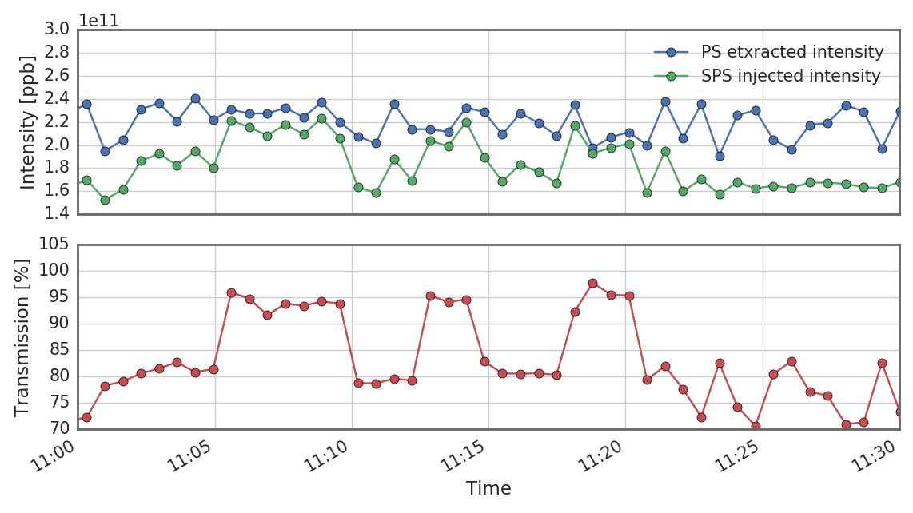
Intensity scan
The wideband feedback loop was closed and opened several times over a period of half an hour to ensure reproducibility of both the TMCI and the stabilization of the latter.

Slide 40
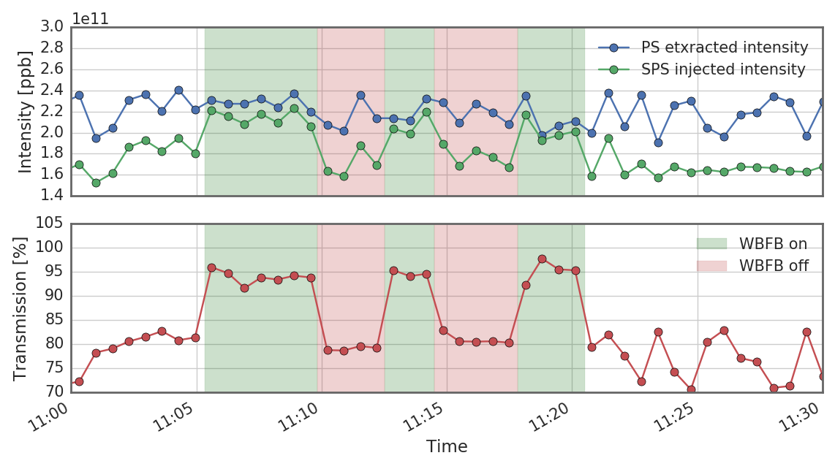
Intensity scan
The wideband feedback loop was closed and opened several times over a period of half an hour to ensure reproducibility of both the TMCI and the stabilization of the latter.
There is a clear correlation between transmission and open/closed loop configuration.

Slide 41
We seen another type of particularly violent instability – the fast headtail instability. This occurs at zero chromaticity of the intensity is high enough, such that different sidebands in the bunch spectrum couple. For this reason, it is also called the transverse mode coupling instability (TMCI). As opposed to the slow headtail instabilities, TMCI has a distinct intensity threshold.
TMCI usually poses a hard limit on the machines reachable intensity and is usually avoided during the design phase of the machine. Recent developments of wideband feedback systems indicate, however, that these limits could probably also be breached by means of active mitigation.
Part IV: Coherent beam instabilities
  Examples of coherent beam instabilities at CERN
  Slow headtail instability at finite chromaticity
  Fast headtail or transverse mode coupling instability
  Longitudinal instabilities

Slide 42
Longitudinal instabilities
  For the case of longitudinal wake fields, two regimes can be found:
    Regime of potential well distortion (i.e. perturbations to equilibrium solutions are damped)
    Stable phase shift
    Synchrotron frequency shift
    Different matching (→ bunch lengthening for lepton machines)
  Regime of longitudinal instability (i.e. perturbations to equilibrium solutions grow exponentially):
    Dipole mode instabilities
    Coupled bunch instabilities
    Microwave instability (longitudinal mode coupling)

Slide 43
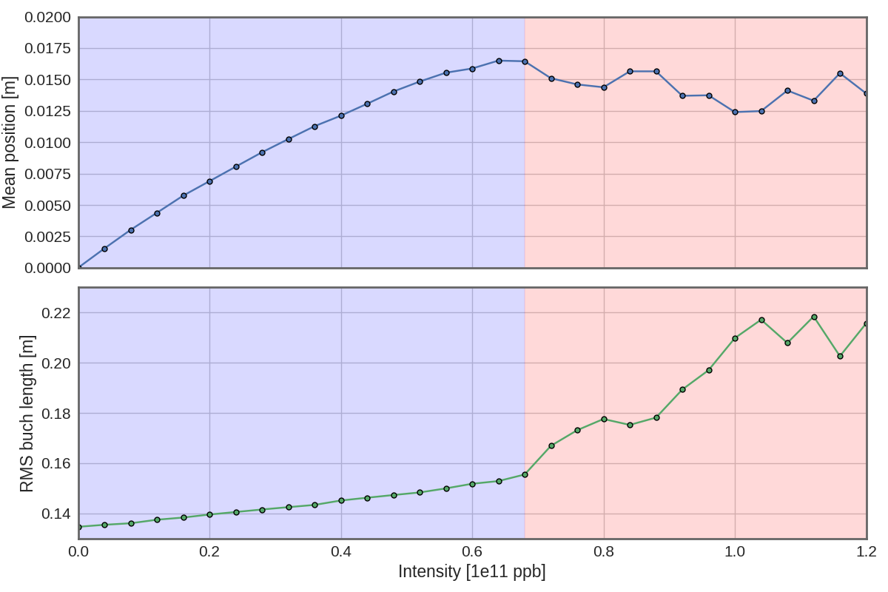
Example: bunch lengthening and MW instability
Examples of numerical simulations – SPS bunch with single broad-band resonator wake:
Initializing a matched bunch at low intensity, two regimes are found:
Bunch lengthening/emittance blow up regime with roughly linear increase of the synchronous phase and bunch length with intensity
Unstable regime (turbulent bunch lengthening)
Below MWI threshold
Above MWI threshold

Slide 44
Example: bunch lengthening and MW instability
Below MWI threshold
Above MWI threshold

Slide 45
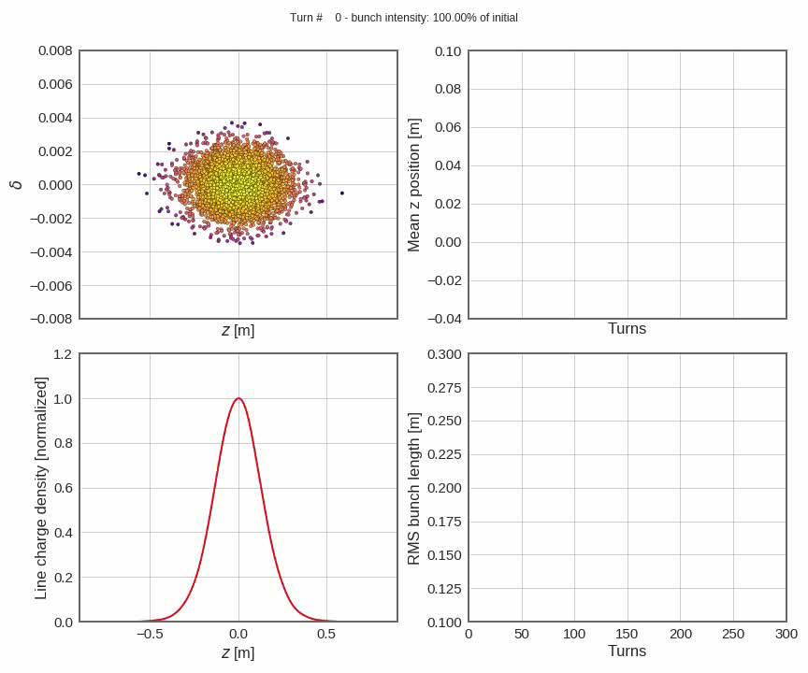
Example: bunch lengthening and MW instability
Below MWI threshold
Below MWI threshold
Above MWI threshold

Slide 46

Example: bunch lengthening and MW instability
Above MWI threshold
Below MWI threshold

Slide 47
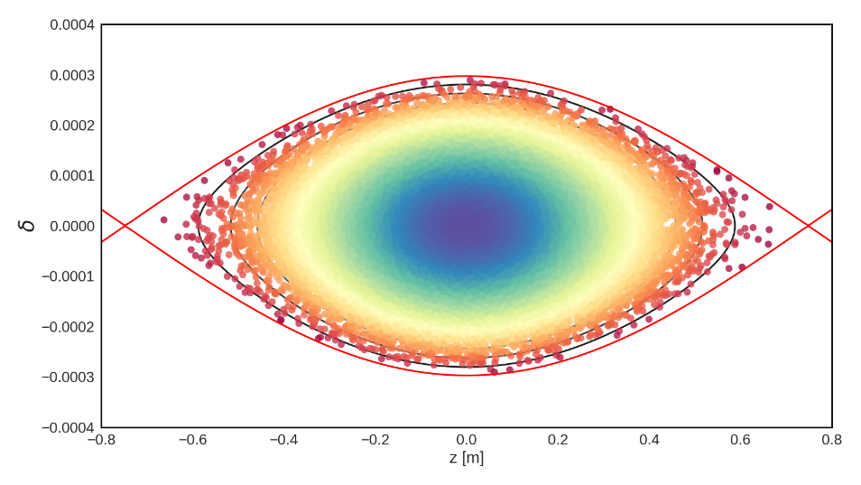
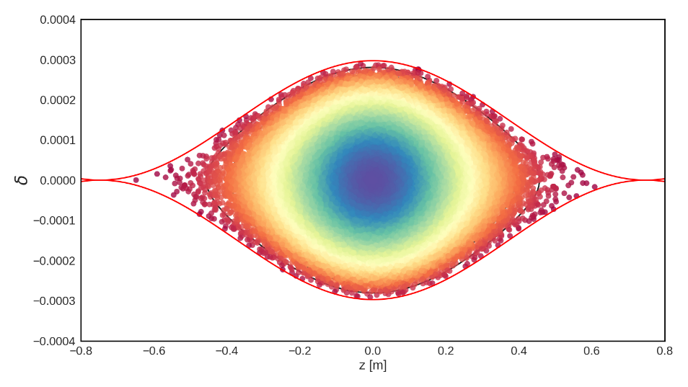




Other types of longitudinal instabilities
Other types of longitudinal instabilities:
  Coupled bunch instabilities
  Negative mass instability
  Robinson instability
Mitigation:
  Longitudinal feedbacks
  Enhancing the tune spread
Like in the transverse plane, on can introduce a synchrotron tune spread to introduce Landau damping. This is done using higher harmonic cavities.

Slide 48
Closing remarks
In the last four lectures we have briefly touched the topic of collective effects in accelerator physics and beam dynamics. We have treated most items phenomenologically to gain an intuitive understanding of the involved mechanisms.
By now we should be able to identify the main differences between the dynamics of single particles vs. multi-particle systems.
We understand the features of collective effects such as space charge and how instead of being constant forces, instead, they depend on the particle distribution function itself.
We know how we can use the concept of wake fields and impedances to model the impact of more complex elements.
And we know how to identify an instability, with a rough overview over the different type of instabilities typically observed in synchrotrons along with possible mitigations.
More complex analysis involve the Vlasov formalism to analytically model simplified cases or full macroparticle models to simulate the beam dynamics of collective effects.

Slide 49

End part IV

