Slide 1
CAS – Introduction to Accelerator Physics
Collective effects
Part II: Space charge – wake fields and impedances

Slide 2
In the last lecture, we have learned about the dynamics and the representation of multiparticle systems. We have seen how we differentiate between incoherent and coherent motion. Linked to this, we looked at the phenomenon of filamentation with decoherence and emittance blow-up.
We also discussed a first collective effect – direct space charge. We saw that direct space charge leads to an incoherent tune shift and the characteristic tune footprint.
We will now look into some of the mitigation methods for direct space charge and then discuss some of the effects of indirect space charge. We will then move to studying the concept of wake fields and impedances.
Part 2: Direct- and indirect space charge, wake fields and impedances
  Direct space charge – mitigation techniques
  Indirect space charge
  From indirect space charge to (resistive) wall wakes
  Concept of wake fields

Slide 3
Direct space charge effects have the undesired property of generating incoherent tune spreads which can be a problem for dynamic aperture and emittance preservation.
We will look at a few of the different techniques used for the mitigation of direct space charge effects.
Part 2: Direct- and indirect space charge, wake fields and impedances
  Direct space charge – mitigation techniques
  Indirect space charge
  From indirect space charge to (resistive) wall wakes
  Concept of wake fields

Slide 4
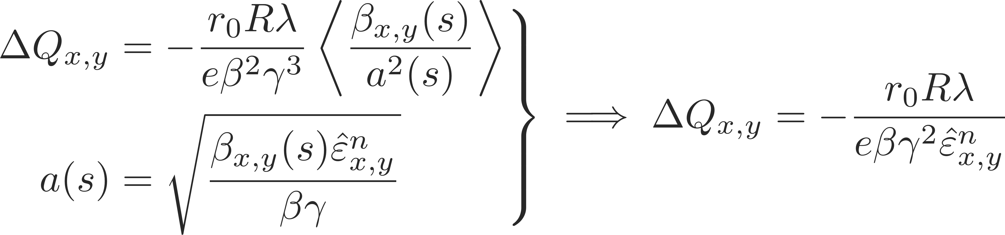
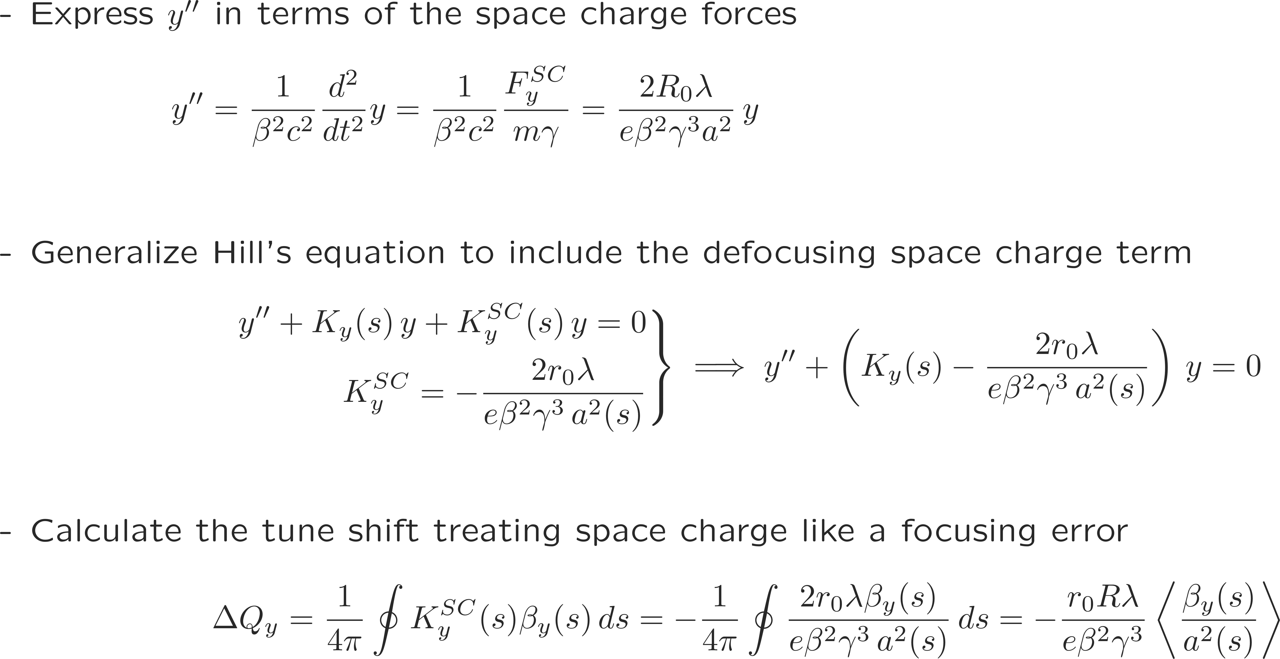
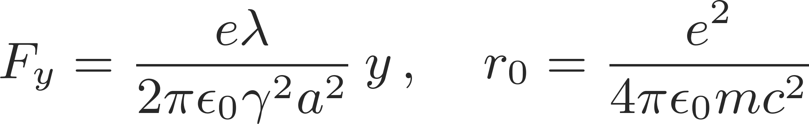
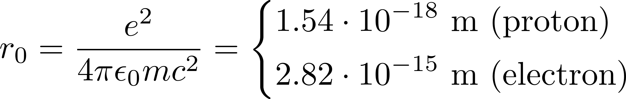

Direct space charge tune shift
After some reshuffling we notice some of the fundamental properties of the direct space charge tune shift:
is negative, because space charge transversely always defocuses
is proportional to the line density and thus to the number of particles in the beam
decreases with energy like $1/(βγ^{2})$ (when expressed in terms of normalized emittance) and therefore vanishes in the ultra-relativistic limit
does not depend on the local beta functions or beam sizes but is inversely proportional to the normalized emittance (here the emittance includes all particles!)
The direct space charge force for a beam with uniform charge distribution is linear in x and y
→ results in a direct space charge tune shift
We derive the general expression for the space charge induced tune shift in the vertical plane
Linear force Classical particle radius
Generalized Hill’s equation

Slide 5
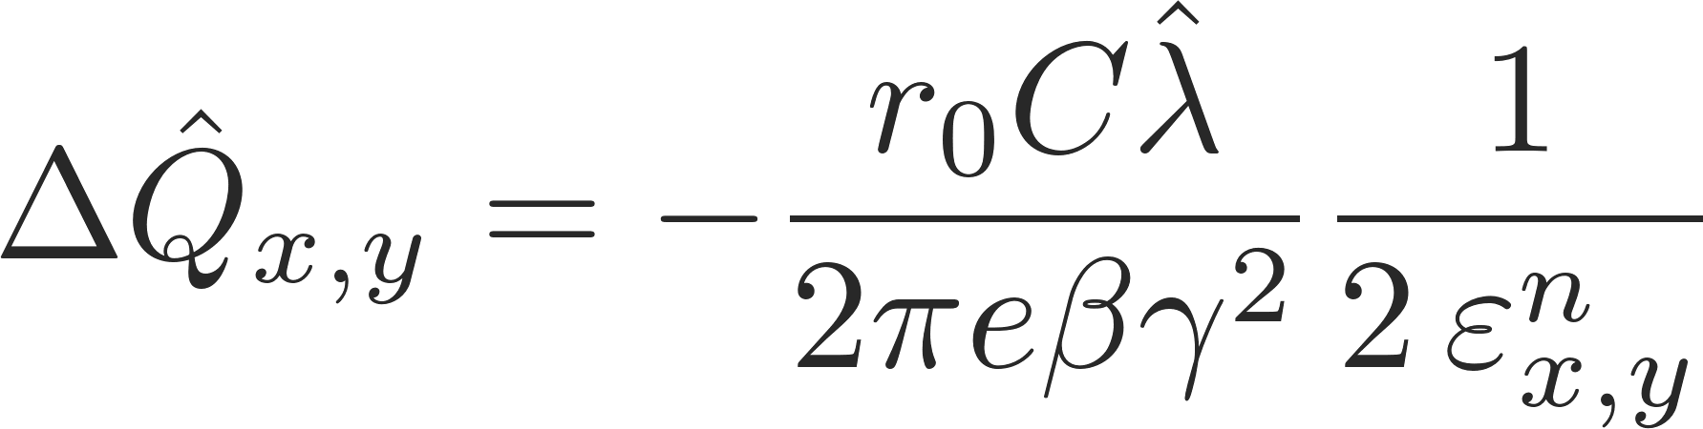
Mitigation techniques
Maximum tune shift (circular Gaussian)
Decrease the peak line density by
  maximizing the bunch length
  flattening the bunch profile with a specially configured (double harmonic) RF system

Slide 6
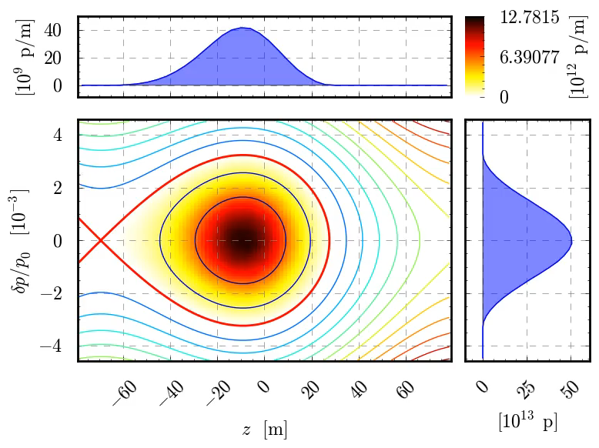
Mitigation techniques
Maximum tune shift (circular Gaussian)
Decrease the peak line density by
  maximizing the bunch length
  flattening the bunch profile with a specially configured (double harmonic) RF system
  using bunch distributions with small peak density (e.g. parabolic instead of Gaussian)
  reducing the central density of the particle distribution (e.g. “hollow bunches”)

Slide 7
Mitigation techniques
Maximum tune shift (circular Gaussian)
Decrease the peak line density by
  maximizing the bunch length
  flattening the bunch profile with a specially configured (double harmonic) RF system
  using bunch distributions with small peak density (e.g. parabolic instead of Gaussian)
  reducing the central density of the particle distribution (e.g. “hollow bunches”)
Increase the beam energy by
  accelerating the beam as quickly as possible
  increasing the injection energy (usually requires an upgrade of the pre-injector)

Slide 8
Mitigation techniques
Maximum tune shift (circular Gaussian)
Decrease the peak line density by
  maximizing the bunch length
  flattening the bunch profile with a double harmonic RF system
  using bunch distributions with small peak density (e.g. parabolic instead of Gaussian)
  reducing the central density of the particle distribution (e.g. “hollow bunches”)
Increase the beam energy by
  accelerating the beam as quickly as possible
  increasing the injection energy (usually requires an upgrade of the pre-injector)
Minimize the machine circumference
  when designing/building a new accelerator since the space charge detuning is an integrated effect

Slide 9
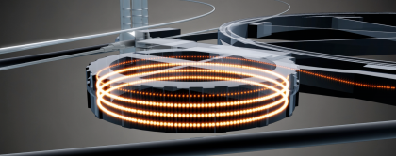
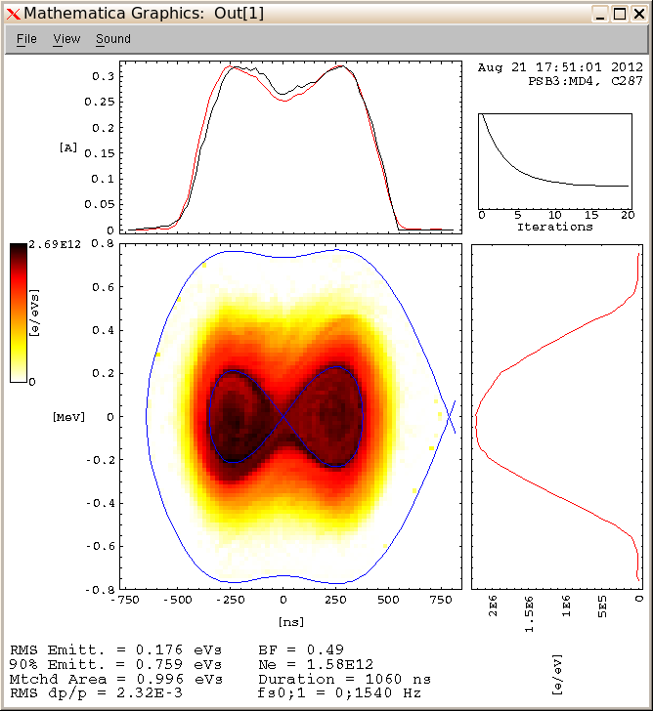
Direct space charge in the CERN PSB
An accelerator that is particularly subject to space charge effects and makes use of several mitigation schemes at the same time is the CERN PS Booster:
The PSB accelerates bright beams from 50 MeV to 1.4 GeV over 530 ms
Instead of one large ring is it made up of 4 smaller rings to reduce the integrated effect
Space charge is important, especially in first part of the cycle – bunch is flattened through a second harmonic RF system
A future upgrade (LIU) foresees to increase the injection energy from 50MeV to 160MeV
Injection@50MeV Extraction@1.4GeV
(275 ms) (850 ms)
β
9

Slide 10
Direct space charge leads to a purely incoherent tune shift and a tune spread leading to the characteristic tune footprint with its typical necktie shape for bunched beams. Direct space charge does not lead to any coherent tune shifts (on the centroid motion).
We will now look at the effect of indirect space charge. We will briefly look at the different sources of indirect space charge, that it can lead to both incoherent as well as coherent tuneshifts and how these tune shifts are usually parameterized using the Laslett coefficients.
Part 2: Direct- and indirect space charge, wake fields and impedances
  Direct space charge – mitigation techniques
  Indirect space charge
  From indirect space charge to (resistive) wall wakes
  Concept of wake fields
  Longitudinal and transverse wake fields and impedances

Slide 11
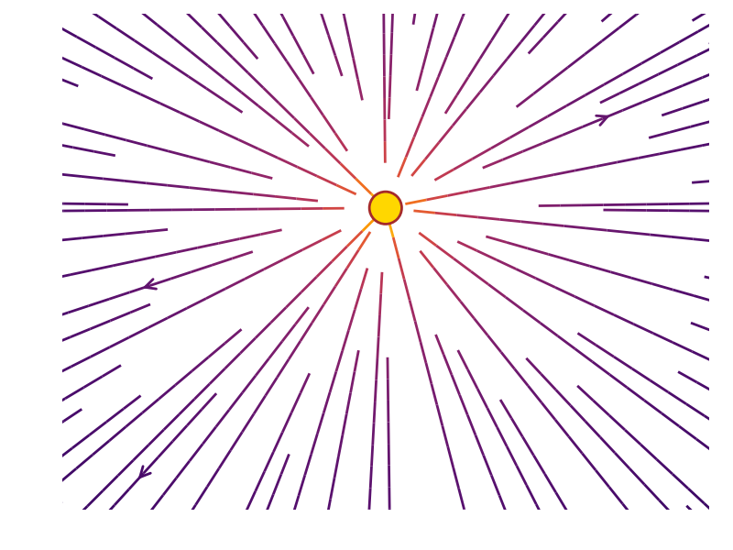
Direct vs. indirect space charge
Direct space charge – central force
The space symmetry endowed by free space eliminates any impact on the centroid motion
→ Exclusively incoherent tune shifts
Tune footprint - necktie
Q_{y}
Q_{x}

Slide 12
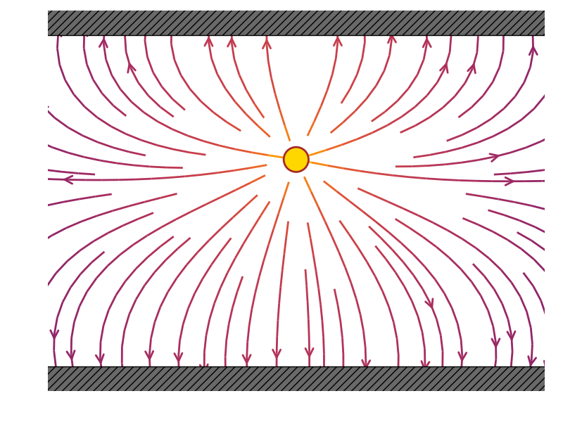
Direct vs. indirect space charge
Direct space charge – central force
The space symmetry endowed by free space eliminates any impact on the centroid motion
Indirect space charge – image charge forces
The free space symmetry is broken by the geometrical arrangement of the conducting parallel plates; this gives a net impact on the centroid motion
→ Exclusively incoherent tune shifts → Both incoherent and coherent tune shifts

Slide 13
Direct vs. indirect space charge
Electro- and magneto-static forces can be computed with the method of image charges:
We iteratively add charges to satisfy the boundary conditions. The resulting sum of fields converges to the final net field.
Indirect space charge – image charge forces
The free space symmetry is broken by the geometrical arrangement of the conducting parallel plates; this gives a net impact on the centroid motion
→ Exclusively incoherent tune shifts → Both incoherent and coherent tune shifts
y, y << h

Slide 14
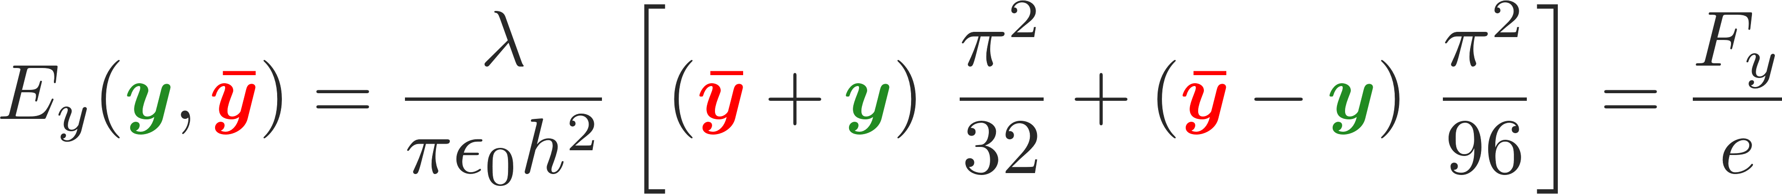
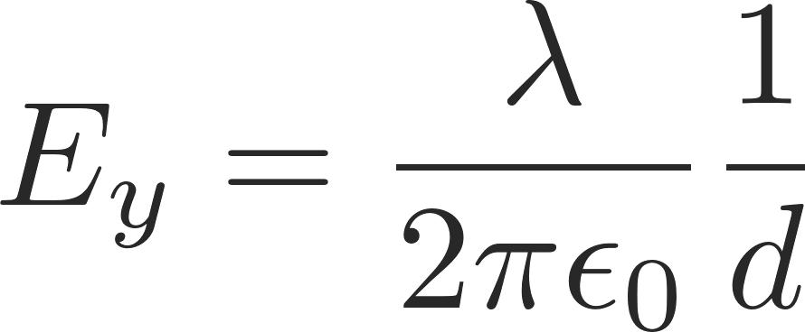
Direct vs. indirect space charge
Electro- and magneto-static forces can be computed with the method of image charges:
We iteratively add charges to satisfy the boundary conditions. The resulting sum of fields converges to the final net field.
We consider the beam as line charge density λ with infinite length
The electric field at distance d is given by Gauss’ law
A flat vacuum chamber can be approximated by two perfect conducting parallel plates placed at vertical positions +h and –h
Let the beam centroid be displaced vertically by y̅
The witness particle is at y
The boundary condition at the two perfect conducting plates is satisfied by superposing an infinite number of image line charges with alternating signs as shown in the sketch
The resulting electric field as a function of beam and witness particle offsets can be computed as
y, y << h

Slide 15
Image charge forces
Static electric fields vanish inside a conductor for any finite conductivity, while static magnetic fields pass through (unless in case of very high permeability)
This is no longer true for time varying fields, which can penetrate into the material in a region δ_{w} called skin depth
The skin depth depends on the material properties and on frequency. Fields pass through the conductor wall if the skin depth is larger than the wall thickness Δ_{w}. This happens at low frequencies. At higher frequencies, for a good conductor δ_{w} << Δ_{w} and both electric and magnetic fields vanish in the wall
We have seen how electric image charge force are induced by electrostatic fields in the presence of (perfectly) conducting boundaries
Similarly, there are also magnetics image current forces – here we need to differentiate between AC and DC forces

Slide 16
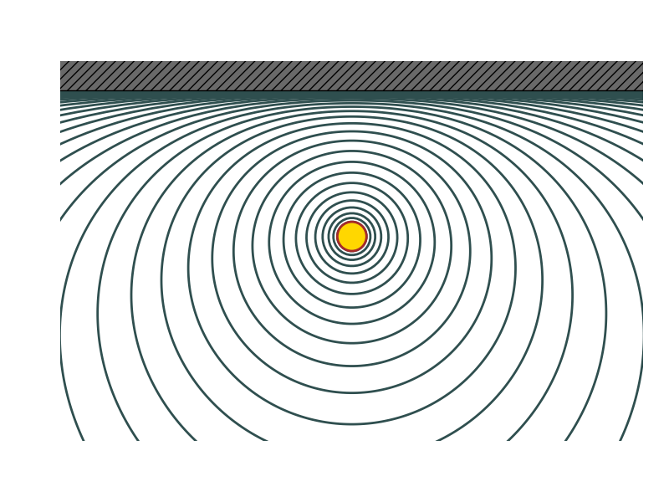
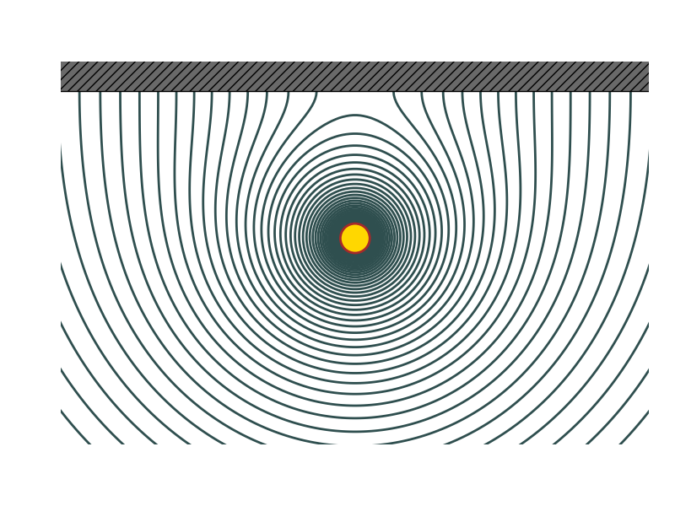
Image current forces
conductor
Static electric fields vanish inside a conductor for any finite conductivity, while static magnetic fields pass through (unless in case of very high permeability)
This is no longer true for time varying fields, which can penetrate into the material in a region δ_{w} called skin depth
The skin depth depends on the material properties and on frequency. Fields pass through the conductor wall if the skin depth is larger than the wall thickness Δ_{w}. This happens at low frequencies. At higher frequencies, for a good conductor δ_{w} << Δ_{w} and both electric and magnetic fields vanish in the wall
If the skin depth is very small (rapidly varying fields), magnetic fields do not penetrate and the field lines are tangent to the surface.
At low frequencies magnetic fields penetrate and pass through the vacuum chamber, they can interact with bodies behind the chamber
Ferromagnetic material
conductor

Slide 17
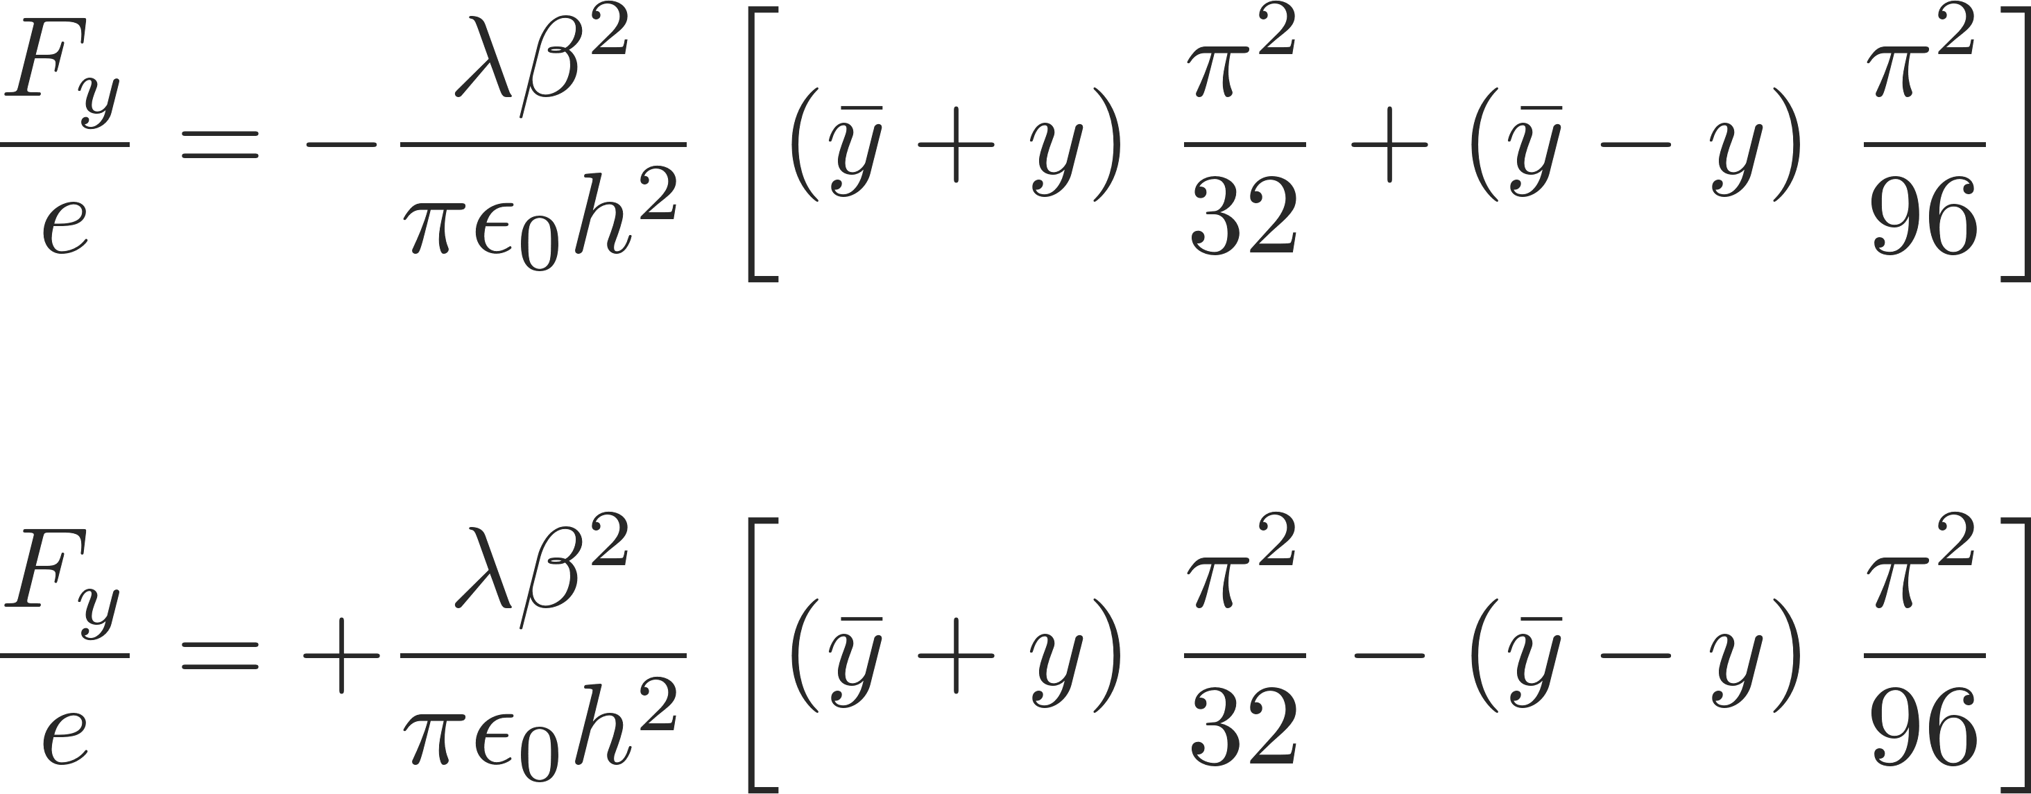
Image current forces
In a very similar fashion as done for the electrostatic case we can also here deploy the method of image currents to solve for the magnetostatic fields and forces
We obtain forces of the form
conductor
Static electric fields vanish inside a conductor for any finite conductivity, while static magnetic fields pass through (unless in case of very high permeability)
This is no longer true for time varying fields, which can penetrate into the material in a region δw called skin depth
The skin depth depends on the material properties and on frequency. Fields pass through the conductor wall if the skin depth is larger than the wall thickness Δw. This happens at low frequencies. At higher frequencies, for a good conductor δw<< Δw and both electric and magnetic fields vanish in the wall
If the skin depth is very small (rapidly varying fields), magnetic fields do not penetrate and the field lines are tangent to the surface.
At low frequencies magnetic fields penetrate and pass through the vacuum chamber, they can interact with bodies behind the chamber
Ferromagnetic material
conductor

Slide 18
Tune shifts and Laslett coefficients
These electric image charge and magnetic ac and dc image current forces have the general similar form
These forces can lead to both incoherent as well as coherent tune shifts – from the forces, the tune shifts can be computed. In fact, it turns out that the tune shifts can be parameterized via the Laslett coefficients. For example, for electric image charge forces between two perfectly conducting parallel plates, the incoherent and coherent tune shifts can be expressed as:
The Laslett coefficients can be evaluated for different geometries and are classified in incoherent and coherent tune shifts for electric, magnetic ac and magnetic dc image charges and currents.

Slide 19
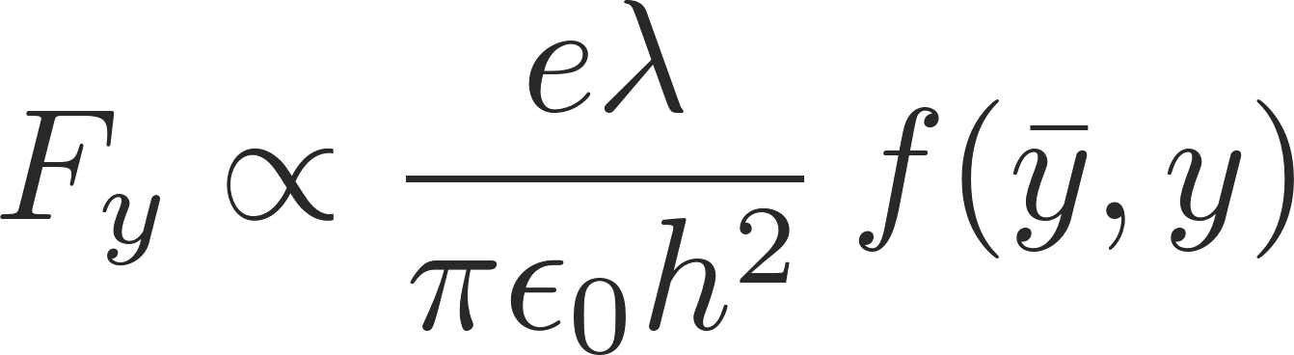
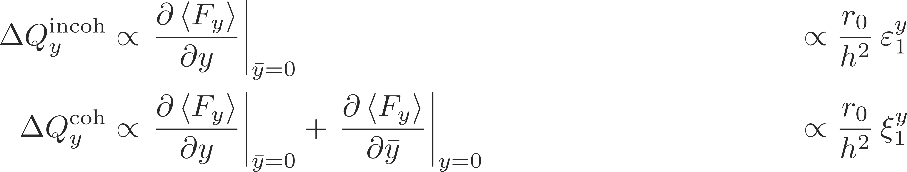
Tune shifts and Laslett coefficients
These electric image charge and magnetic ac and dc image current forces have the general similar form
These forces can lead to both incoherent as well as coherent tune shifts – from the forces, the tune shifts can be computed. In fact, it turns out that the tune shifts can be parameterized via the Laslett coefficients. For example, for electric image charge forces between two perfectly conducting parallel plates, the incoherent and coherent tune shifts can be expressed as:
Note: they are always defined with respect to the vertical half gap h or g
Assuming parallel plates for the ferro-magnetic boundary for all geometries …
* L. J. Laslett, LBL Document PUB-616, 1987, vol III
The Laslett coefficients can be evaluated for different geometries and are classified in incoherent and coherent tune shifts for electric, magnetic ac and magnetic dc image charges and currents.

Slide 20
Example: PS injection oscillations
The observed intra-bunch motion was reproduced with an amazing precision with multi-particle simulations (HEADTAIL code) including the indirect space charge effect taking
measurement
simulation
A. Huschauer et. al

Slide 21
Example: PS injection oscillations
The observed intra-bunch motion was reproduced with an amazing precision with multi-particle simulations (HEADTAIL code) including the indirect space charge effect taking
It was understood from simulations that the observed intra-bunch motion was induced by the beam injected off-center in combination with the indirect space charge effect, which causes a tune shift along the bunch proportional to the local charge density
measurement
simulation
A. Huschauer et. al

Slide 22
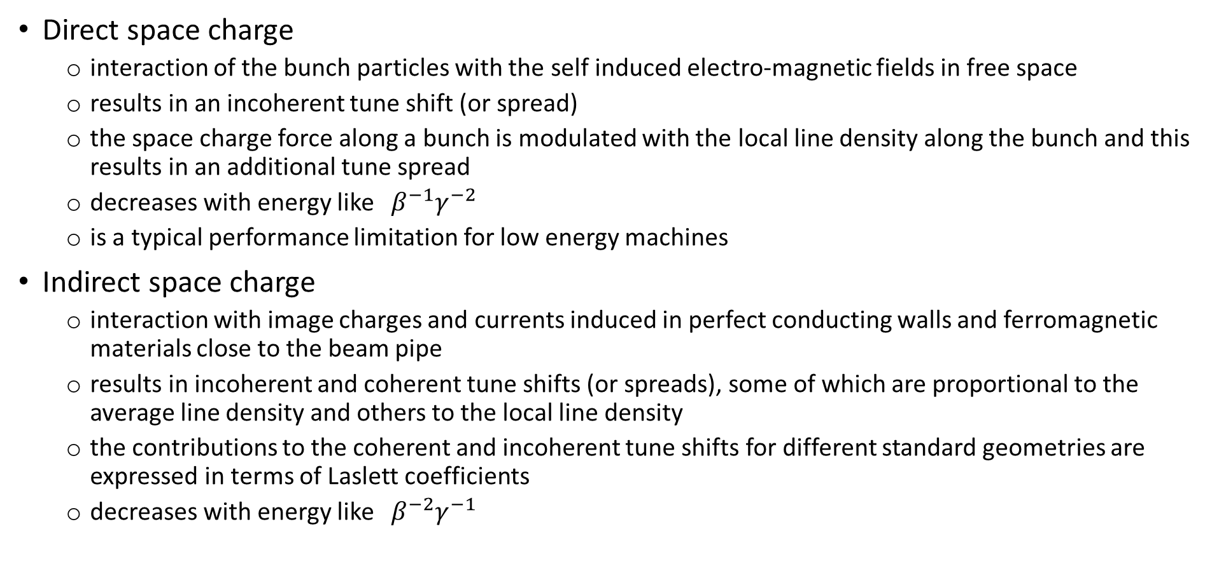
Remarks
Direct space charge
  interaction of the bunch particles with the self induced electro-magnetic fields in free space
  results in an incoherent tune shift (or spread)
  the space charge force along a bunch is modulated with the local line density along the bunch and this results in an additional tune spread
  decreases with energy like ${ β}^{−1}γ^{−2}$
  is a typical performance limitation for low energy machines
Indirect space charge
  interaction with image charges and currents induced in perfect conducting walls and ferromagnetic materials close to the beam pipe
  results in incoherent and coherent tune shifts (or spreads), some of which are proportional to the average line density and others to the local line density
  the contributions to the coherent and incoherent tune shifts for different standard geometries are expressed in terms of Laslett coefficients
  decreases with energy like ${ β}^{−2}γ^{−1}$

Slide 23
So far, we have introduced direct and indirect space charge as collective effects. The corresponding forces were not externally given but dependent on the actual particle distribution within the beam (remember, we looked at single particles as well as uniform and Gaussian distributions). The forces led to incoherent and coherent tune shifts.
We will now go a step further and investigate more complicated structures. We will try to find a smart way to deal with these structures. In the course of this, we will generalize and extend the direct and indirect space charge effects towards the concept of wake fields and impedances.
Part 2: Direct- and indirect space charge, wake fields and impedances
  Direct space charge – mitigation techniques
  Indirect space charge
  From indirect space charge to (resistive) wall wakes
  Concept of wake fields

Slide 24
Electromagnetic fields of different sources
Direct space charge
  Free space: probe particles are effected directly by the source particles via the Lorentz force.
Indirect space charge/resistive wall wake
  Smooth boundaries: probe particles are effected by the source particles’ induced image charges and currents.
Resonator wake fields
  Discontinuities in boundaries: fields are excited by the source particles’ distribution and can keep ringing, thus effecting trailing probe particles
Probe
Source
From (in-)direct space charge to resistive walls…

Slide 25
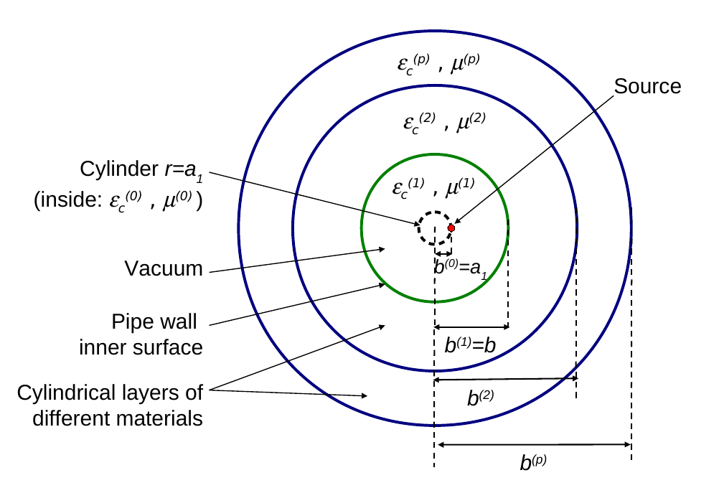
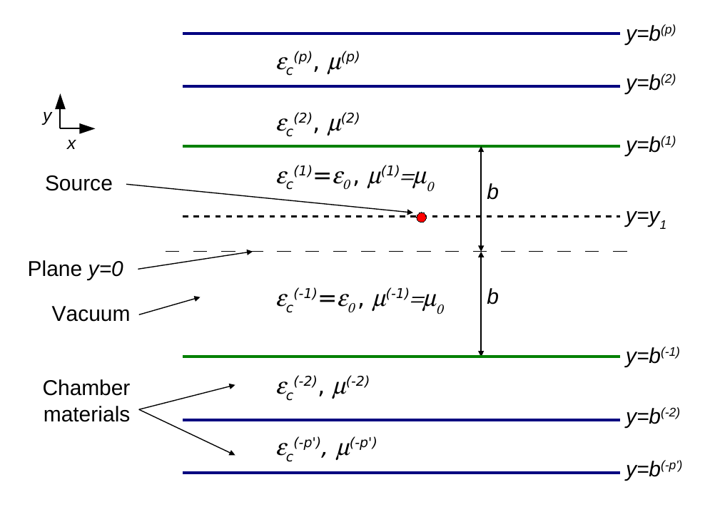
From (in-)direct space charge to resistive wall
We consider a smooth multilayer structure, longitudinally translation invariant and transversely bounded.
We consider a charged point particle traveling through the smooth multilayered structure.
The induced electromagnetic fields can be computed for certain geometries by means of Maxwell’s equations (longitudinal and transverse electromagnetic fields) with field matching at the boundaries. Two examples of such geometries are shown below.
Cylindrical Flat

Slide 26
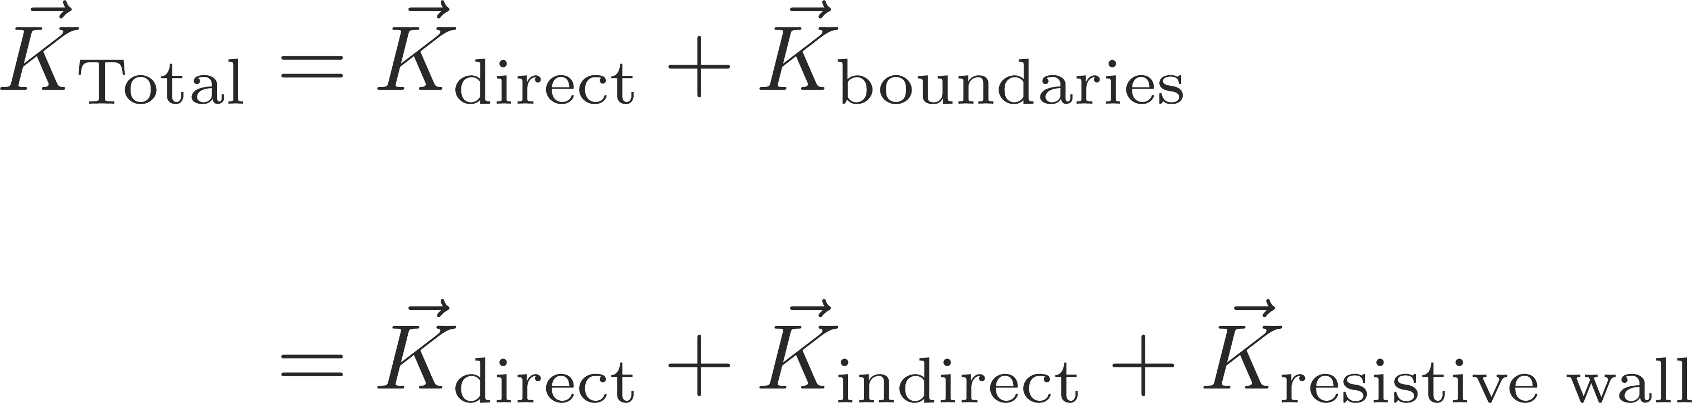


From (in-)direct space charge to resistive wall
We consider a smooth multilayer structure, longitudinally translation invariant and transversely bounded.
We consider a charged point particle traveling through the smooth multilayered structure.
The induced electromagnetic fields can be computed for certain geometries by means of Maxwell’s equations (longitudinal and transverse electromagnetic fields) with field matching at the boundaries. Two examples of such geometries are shown below.
It turns out, that the resulting electromagnetic fields can be decomposed into 3 components:

Slide 27
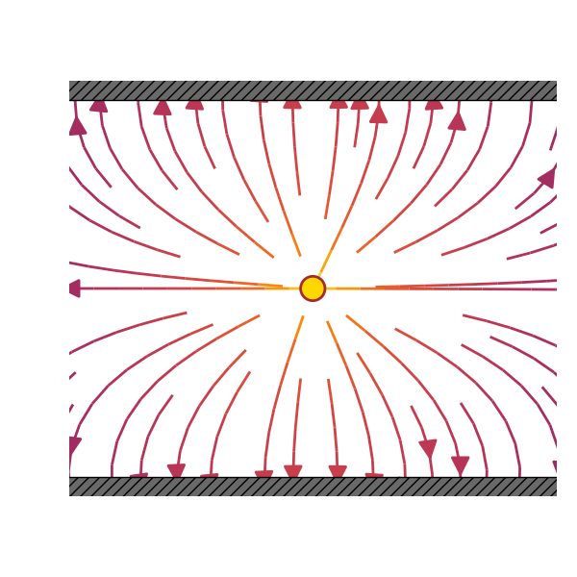
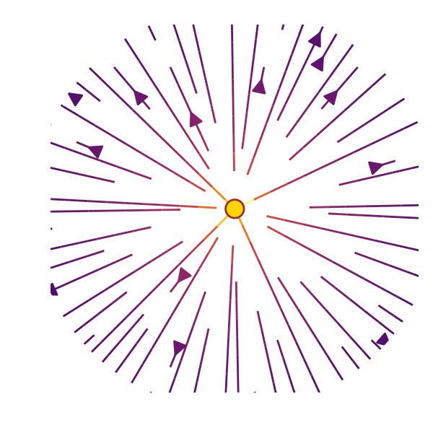
From (in-)direct space charge to resistive wall
We consider a smooth multilayer structure, longitudinally translation invariant and transversely bounded.
We consider a charged point particle traveling through the smooth multilayered structure.
The induced electromagnetic fields can be computed for certain geometries by means of Maxwell’s equations (longitudinal and transverse electromagnetic fields) with field matching at the boundaries. Two examples of such geometries are shown below.
It turns out, that the resulting electromagnetic fields can be decomposed into 3 components:
A component which is independent of the surrounding boundaries → direct space charge
A component which is independent of the surrounding material properties and purely depended on the surrounding geometry → indirect space charge
A component which is dependent on the surrounding material’s electromagnetic properties → resistive wall

Slide 28
Electromagnetic fields in different types of structures
Direct space charge
  Free space: probe particles are effected directly by the source particles via the Lorentz force.
Indirect space charge/resistive wall wake
  Smooth boundaries: probe particles are effected by the source particles’ induced image charges and currents.
Resonator wake fields
  Discontinuities in boundaries: fields are excited by the source particles’ distribution and can keep ringing, thus effecting trailing probe particles
Probe
Source

Slide 29
Electromagnetic fields in different types of structures
Direct space charge
  Free space: probe particles are effected directly by the source particles via the Lorentz force.
Indirect space charge/resistive wall wake
  Smooth boundaries: probe particles are effected by the source particles’ induced image charges and currents.
Resonator wake fields
  Discontinuities in boundaries: fields are excited by the source particles’ distribution and can keep ringing, thus effecting trailing probe particles
Probe
Source
For more complicated geometries the (semi-) analytic methods no longer work. One must rely on computational methods to evaluate the induced electromagnetic fields (FDTD, FEM etc.).
Some examples:
…

Slide 30
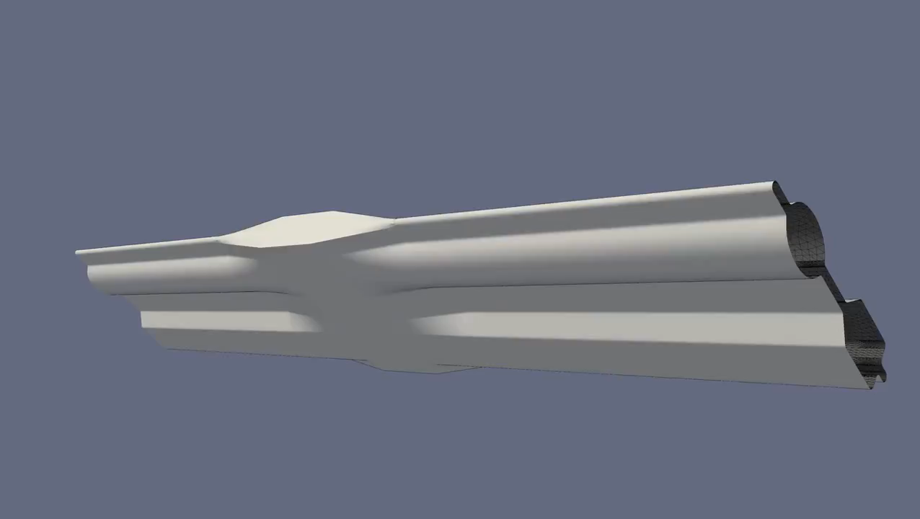
Electromagnetic fields in complex structures
For more complicated geometries the (semi-) analytic methods no longer work. One must rely on computational methods to evaluate the induced electromagnetic fields (FDTD, FEM etc.).
Some examples:
ERL vacuum chamber

Slide 31
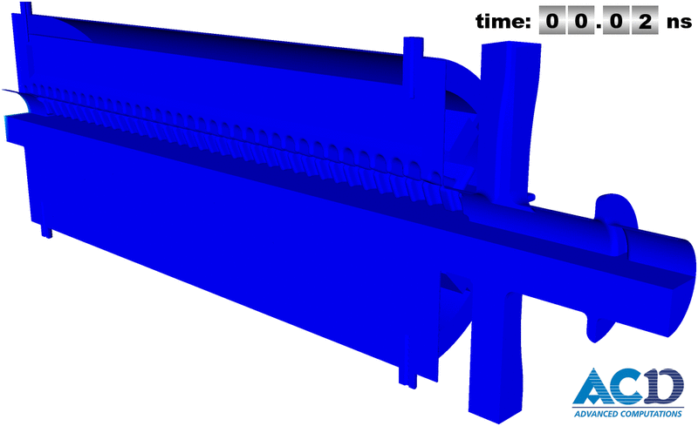
Electromagnetic fields in complex structures
For more complicated geometries the (semi-) analytic methods no longer work. One must rely on computational methods to evaluate the induced electromagnetic fields (FDTD, FEM etc.).
Some examples:
CLIC PETS

Slide 32
Electromagnetic fields in complex structures
For more complicated geometries the (semi-) analytic methods no longer work. One must rely on computational methods to evaluate the induced electromagnetic fields (FDTD, FEM etc.).
In principle, we need to solve the full set of Maxwell’s equations at every time step to obtain the electromagnetic fields at every location within the structure in order to evaluate to forces at the probe particle’s locations. This becomes very tedious and virtually impossible for a 27km ring such as the LHC.
How can we treat these phenomena more effectively in our models?
We normally use a set of assumptions to simplify the problem:
Rigid beam approximation: the beam traverses the discontinuity of the vacuum chamber rigidly
Impulse approximation: what the beam really cares about is the integrated impulse as it completes the traversal of the discontinuity

Slide 33
We have shown on the example of multilayer structures that one can in principle solve Maxwell’s equations to obtain the induced electromagnetic fields by a given charge distribution. We saw that it is possible to decompose these fields. We were able to identify the part that is dependent on the electromagnetic properties of the surrounding material as the wall wake which already led to the idea of wake fields.
We have seen examples of induced electromagnetic fields within complex structures. We will now look at how we can deal with these types of fields more practically by introducing the concept of wake fields.
Part 2: Direct- and indirect space charge, wake fields and impedances
  Direct space charge – mitigation techniques
  Indirect space charge
  From indirect space charge to (resistive) wall wakes
  Concept of wake fields

Slide 34
Wake function – general definition
How can we treat these phenomena effectively in our models?
We will use a little trick: we consider two point particles – one source, one probe
The forces will be a function of the locations of both the source and the probe particles:
L
Source, q₁
Witness, q₂
Δx₁ (or Δy₁)
2b
z
Δx₂ (or Δy₂)
Wake force measured by the witness particle
Note that:

Slide 35
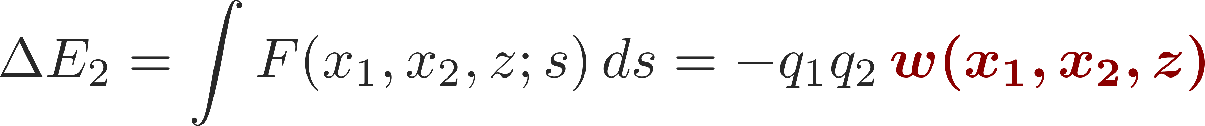
Wake function – general definition
L
Source, q₁
Witness, q₂
Δx₁ (or Δy₁)
2b
z
Δx₂ (or Δy₂)
Note that:
We define the wake function as the integrated force on the witness particle (associated to a change in energy):
Let’s focus on the horizontal plane. In general, for two point-like particles, we have

Slide 36
Wake function – general definition
L
Source, q₁
Witness, q₂
w is proportional to the integrated forces felt by the witness particle:
It is a function of the transverse offsets and the longitudinal separation of the source and the witness particles.
It is typically expanded in the transverse offsets of source and witness particles. This then yields the different types of wake fields (dipole, quadrupole, coupling wakes).
Δx₁ (or Δy₁)
2b
z
Δx₂ (or Δy₂)
Note that:
We define the wake function as the integrated force on the witness particle (associated to a change in energy):
Let’s focus on the horizontal plane. In general, for two point-like particles, we have

Slide 37
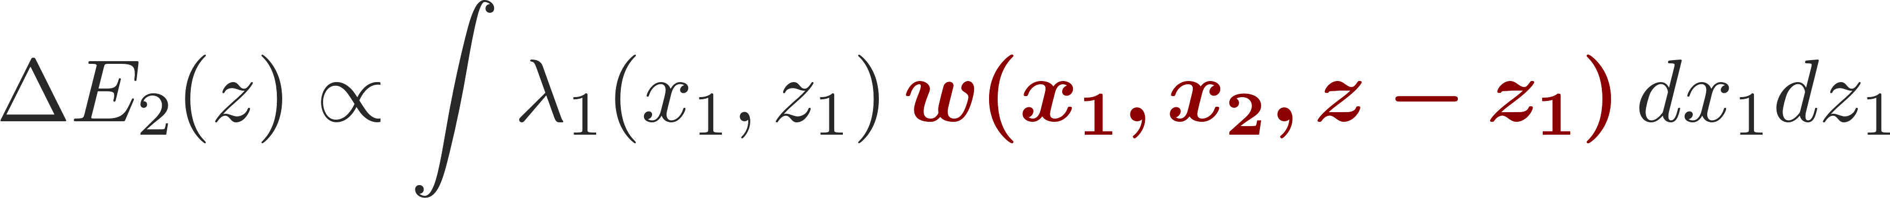
Wake potential for a distribution of particles
L
Source, q₁
Witness, q₂
Δx₁ (or Δy₁)
2b
Δx₂ (or Δy₂)
z
z₁
We define the wake function as the integrated force on the witness particle (associated to a change in energy):
For an extended particle distribution this becomes (superposition of all source terms)
  Forces become dependent on the particle distribution function

Slide 38
In this lecture we discussed indirect space charge and showed that this can lead to both incoherent as well as coherent tune shifts. We then moved on the a more general treatment of electromagnetic fields in simple structures where we were able to identify yet another type of induced fields originating from the electromagnetic properties of the surrounding material – the wall wake.
We looked at more general examples of induced fields in complex structures and then introduced the concept of the wake function.
Next we will look at some different wake fields and study more the effect of wake fields and impedances an the machine and on the beam.
Part 2: Direct- and indirect space charge, wake fields and impedances
  Direct space charge – mitigation techniques
  Indirect space charge
  From indirect space charge to (resistive) wall wakes
  Concept of wake fields

Slide 39

End part 2

Slide 41
We have seen how we can deal with the induced electromagnetic fields within complex structures by means of the wake function. The wake function is the electromagnetic response of a structure and is an intrinsic property of any such structure.
We will now look how we handle longitudinal and transverse wake fields in practice and what are some of the fundamental properties. We will also introduce the impedance.
Part 2: Direct- and indirect space charge, wake fields and impedances
  Direct space charge – mitigation techniques
  Indirect space charge
  From indirect space charge to (resistive) wall wakes
  Concept of wake fields
  Longitudinal and transverse wake fields and impedances

Slide 42
Backup

Slide 43
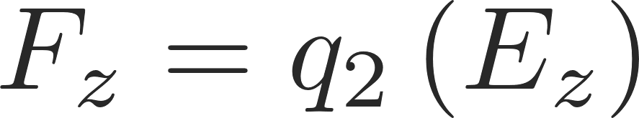
Longitudinal wake function
L
Source, q₁
Witness, q₂
Δx₁ (or Δy₁)
2b
z
Δx₂ (or Δy₂)
Note that:
Longitudinal wake fields
Zeroth order with source and test centred
usually dominant
Higher order terms
Usually negligible for small offsets

Slide 44
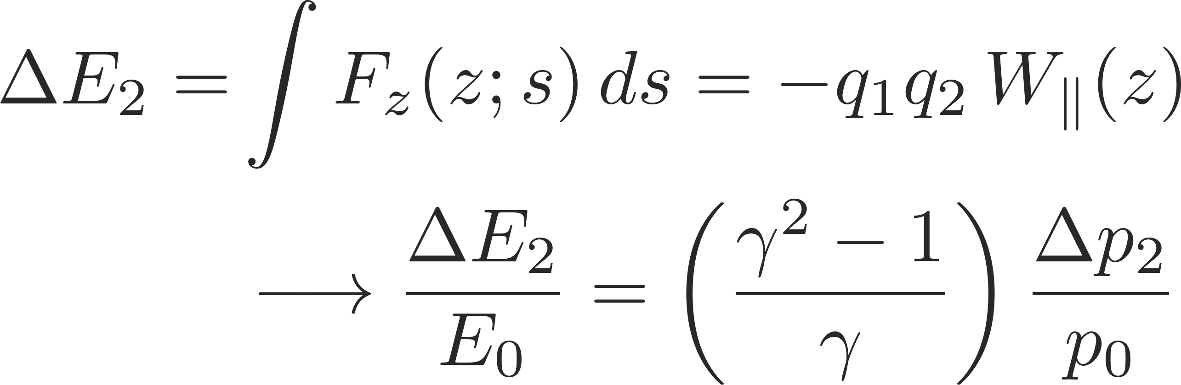
Longitudinal wake function
L
Source, q₁
Witness, q₂
Δx₁ (or Δy₁)
2b
z
Δx₂ (or Δy₂)
Note that:
Longitudinal wake fields
Energy kick of the witness particle from longitudinal wakes

Slide 45
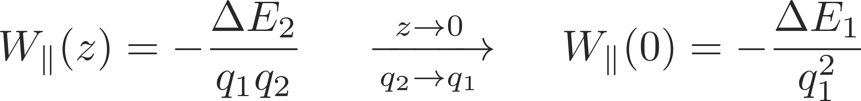
Longitudinal wake function
  The value of the wake function in z=0 is related to the energy lost by the source particle in the creation of the wake
  W||(0)>0 since ΔE₁<0
  W||(z) is discontinuous in z=0 and it vanishes for all z>0 because of the ultra-relativistic approximation
W||(z)
Beam loading theorem
z

Slide 46
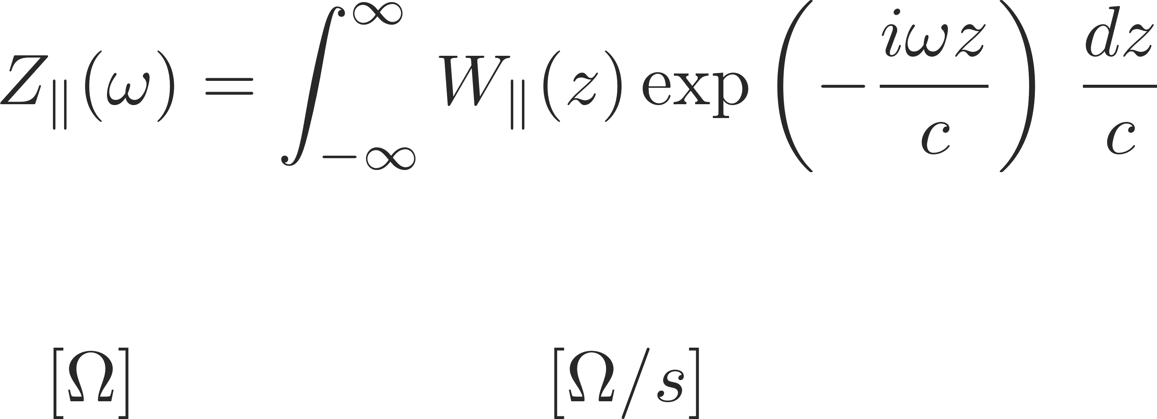
Longitudinal wake function
  The wake function of an accelerator component is basically its Green function in time domain (i.e., its response to a pulse excitation)
    Very useful for macroparticle models and simulations, because it can be used to describe the driving terms in the single particle equations of motion!
  We can also describe it as a transfer function in frequency domain
    This is the definition of longitudinal beam coupling impedance of the element under study

Slide 47
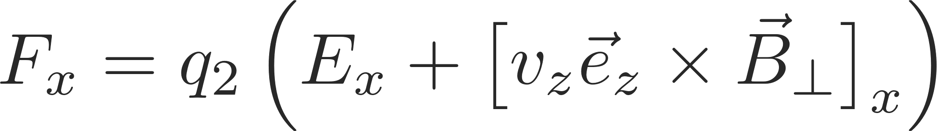
Transverse wake functions
L
Source, q₁
Witness, q₂
Δx₁ (or Δy₁)
2b
z
Δx₂ (or Δy₂)
Note that:
Transverse wake fields

Slide 48
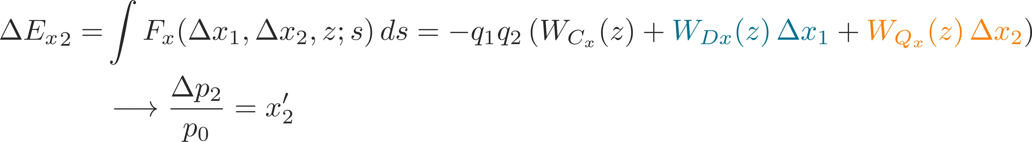
Transverse wake functions
L
Source, q₁
Witness, q₂
Δx₁ (or Δy₁)
2b
z
Δx₂ (or Δy₂)
Note that:
Transverse wake fields
First order expansion in transverse coordinates of source and witness particles
Transverse deflecting kick of the witness particle from transverse wakes

Slide 49
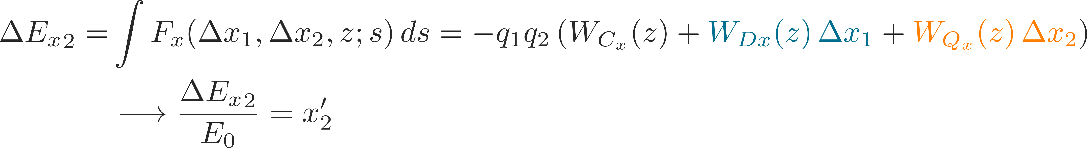
Transverse wake functions
L
Source, q₁
Witness, q₂
Δx₁ (or Δy₁)
2b
z
Δx₂ (or Δy₂)
Note that:
Transverse wake fields
First order expansion in transverse coordinates of source and witness particles
Transverse deflecting kick of the witness particle from transverse wakes

Slide 50
Transverse wake functions
L
Source, q₁
Witness, q₂
Δx₁ (or Δy₁)
2b
z
Δx₂ (or Δy₂)
Note that:
Transverse wake fields
Zeroth order for
asymmetric structures
→ Orbit offset
Dipole wakes –
depends on source particle
→ Orbit offset
Quadrupole wakes –
depends on witness particle
→ Detuning

Slide 51
Transverse wake functions
L
Source, q₁
Witness, q₂
  We have truncated to the first order, thus neglecting
    First order coupling terms between x and y planes
    All higher order terms in the wake expansion (including mixed higher order terms with products of the dipolar/quadrupolar offsets)
Δx₁ (or Δy₁)
2b
z
Δx₂ (or Δy₂)
Note that:
Transverse wake fields
Zeroth order for
asymmetric structures
→ Orbit offset
Dipole wakes –
depends on source particle
→ Orbit offset
Quadrupole wakes –
depends on witness particle
→ Detuning

Slide 52
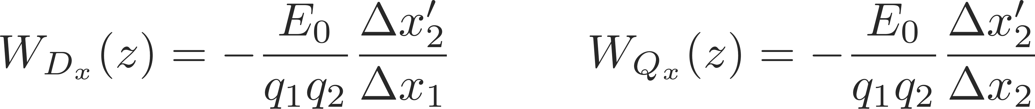
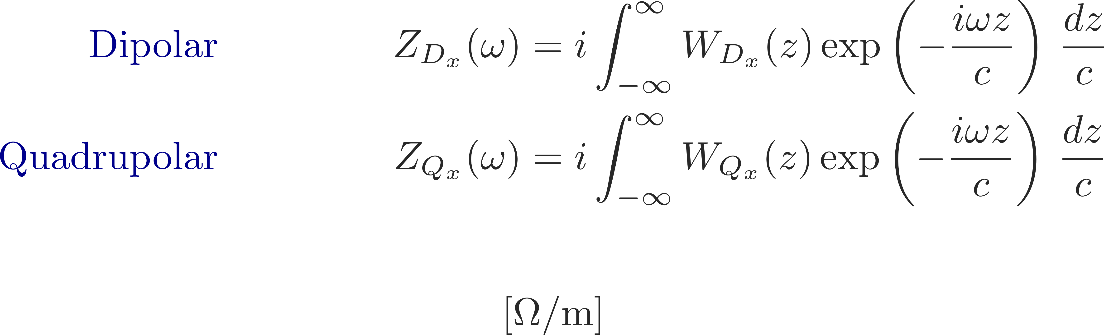
Transverse impedance
  The wake function of an accelerator component is basically its Green function in time domain (i.e., its response to a pulse excitation)
    Very useful for macroparticle models and simulations, because it can be used to describe the driving terms in the single particle equations of motion!
  We can also describe it as a transfer function in frequency domain
    This is the definition of transverse beam coupling impedance of the element under study

Slide 53
Wake function – general definition
How can we treat these phenomena effectively in our models?
We will use a little trick: we consider two point particles – one source, one probe
The forces will be a function of the locations of both the source and the probe particles:
L
Source, q₁
Witness, q₂
Δx₁ (or Δy₁)
2b
z
Δx₂ (or Δy₂)
Because of translational invariance in z, the forces can only depend on the relative longitudinal distance between source and witness particles

